Slide 1
GLOBE Website Challenge

Slide 2
Visualization Challenge
What school reported the coldest solar noon temperature in Poland on 2/16/2014? What was the temperature?

Slide 3
Visualization Challenge
What school reported the coldest solar noon temperature in Poland on 2/16/2014? What was the temperature?
If you did solar noon dailies - Gymnasium No 1, daily average -1C, minimum daily, -5C
If you did minimum - Gimnazium por. J.Czumy in Celestynów -6C

Slide 4
Visualization Challenge
What school reported the coldest solar noon temperature in Poland on 2/16/2014? What was the temperature?
If you did solar noon dailies - Gymnasium No 1, daily average -1C, minimum daily, -5C
If you did minimum - Gimnazium por. J.Czumy in Celestynów -6C
What was the temperature for the one school which reported data in Argentina on that date?

Slide 5
Visualization Challenge
What school reported the coldest solar noon temperature in Poland on 2/16/2014? What was the temperature?
If you did solar noon dailies - Gymnasium No 1, daily average -1C, minimum daily, -5C
If you did minimum - Gimnazium por. J.Czumy in Celestynów -6C
What was the temperature for the one school which reported data in Argentina on that date?
21.7 C

Slide 6
Visualization Challenge
What school reported the coldest solar noon temperature in Poland on 2/16/2014? What was the temperature?
If you did solar noon dailies - Gymnasium No 1, daily average -1C, minimum daily, -5C
If you did minimum - Gimnazium por. J.Czumy in Celestynów -6C
What was the temperature for the one school which reported data in Argentina on that date?
21.7 C
Make a chart showing the Solar Noon Temperature Dailies for 1 year with data from the school in Poland and the school in Argentina.
What do you see happening?
Why does it happen
Try checking and un-checking the “Auto Y-Axis” button to see what happens

Slide 7
Visualization Challenge
What school reported the coldest solar noon temperature in Poland on 2/16/2014? What was the temperature?
If you did solar noon dailies - Gymnasium No 1, daily average -1C, minimum daily, -5C
If you did minimum - Gimnazium por. J.Czumy in Celestynów -6C
What was the temperature for the one school which reported data in Argentina on that date?
21.7 C
Make a chart showing the Solar Noon Temperature Dailies for 1 year with data from the school in Poland and the school in Argentina.
What do you see happening?
Why does it happen
Try checking and un-checking the “Auto Y-Axis” button to see what happens
The temperature cycles are shifted relative to each other…because they are in the north/south latitudes

Slide 8
ADAT Challenge
How many sites measured Soil Moisture (SMAP Block Pattern) during the Northern Hemisphere Fall and Winter periods (2015-09-01 to 2016-02-29)

Slide 9
ADAT Challenge
How many sites measured Soil Moisture (SMAP Block Pattern) during the Northern Hemisphere Fall and Winter periods (2015-09-01 to 2016-02-29) – 89 Sites

Slide 10
ADAT Challenge
How many sites measured Soil Moisture (SMAP Block Pattern) during the Northern Hemisphere Fall and Winter periods (2015-09-01 to 2016-02-29) – 89 Sites
How many data points were taken?

Slide 11
ADAT Challenge
How many sites measured Soil Moisture (SMAP Block Pattern) during the Northern Hemisphere Fall and Winter periods (2015-09-01 to 2016-02-29) – 89 Sites
How many data points were taken? – 1298

Slide 12
ADAT Challenge
How many sites measured Soil Moisture (SMAP Block Pattern) during the Northern Hemisphere Fall and Winter periods (2015-09-01 to 2016-02-29) – 89 Sites
How many data points were taken? – 1298
Which school and site had the highest gravimetric soil moisture (g/g), when was it measured, and what was the value?

Slide 13
ADAT Challenge
How many sites measured Soil Moisture (SMAP Block Pattern) during the Northern Hemisphere Fall and Winter periods (2015-09-01 to 2016-02-29) – 89 Sites
How many data points were taken? – 1298
Which school and site had the highest gravimetric soil moisture (g/g), when was it measured, and what was the value? - Srednja skola Vela Luka, 1/15/2016, 0.85 g/g (column g)

Slide 14
Navigation Challenge
How many GLOBE Schools in India?
What is the URL a teacher goes to to join GLOBE?
What is the URL for where I post bugs and questions about the site?
How many workshops are currently scheduled in Prague?
How many Learning Activities are associated with the Aerosol protocol
Who posted to the scientists blog on 5/4/16?
How many schools received the Atmosphere Science Honor Roll in March, 2016?

Slide 15
Navigation Challenge - Hints
Community Map
1406 (7/13/2016)
Join
http://www.globe.gov/join/become-a-globe-teacher or /create-a-globe-teacher-account
Support
http://www.globe.gov/support/feedback-forum
Get Trained
1
Teacher’s Guide
5 – or maybe 6 if you include the introduction
Scientists Network
Julie Malmberg
GLOBE Data
105

Slide 16
Collaboration Search
Find someone in another country who has done a protocol you are interested in within the last year.
Find their MyPage
Request to be their friend

Slide 17
Project Collaborator
Cheat sheet help
Find Someone to Collaborate With | Select Community->Find a Project Collaborator from the top Menu. Use the form to find someone who is in a particular country and using the same protocols as you. Select “Add as Friend” and they will receive an email from you.

Slide 18
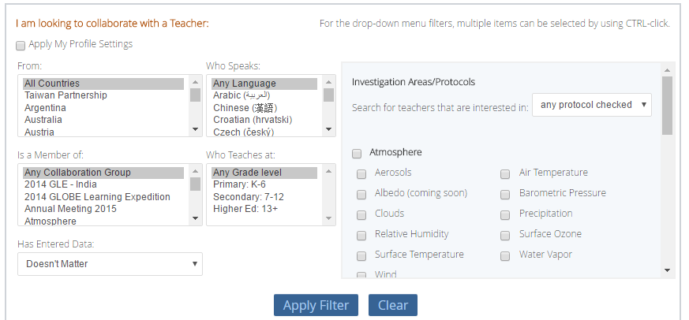
Project Collaborator

Slide 19
Posting to a Forum
Go to the Atmosphere forum, join the community and post a comment about doing one of the protocols (clouds, aerosol, ozone etc)

Slide 20
Posting to a Forum
Cheat sheet help
Post to a Forum | Go to the forum you are interested in and click “Post a new Thread”, or click “Reply” to an existing thread. You can also “subscribe” to the forum to receive email anytime someone posts to the forum. . Communities are listed under Community->GLOBE Communities

Slide 21
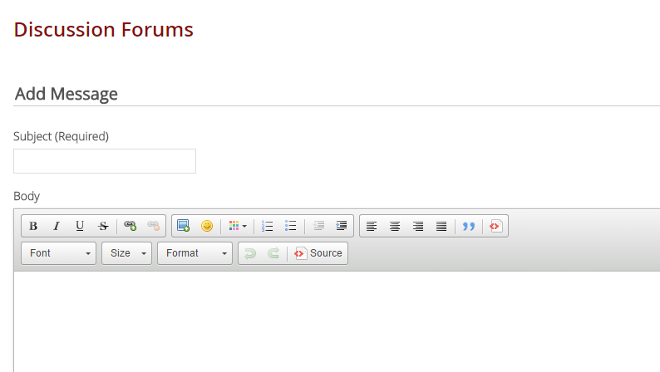
Posting to a Forum

Slide 22
Uploading a Document
Go to the Atmosphere community, join the community and upload a document to the Member Documents folder

Slide 23
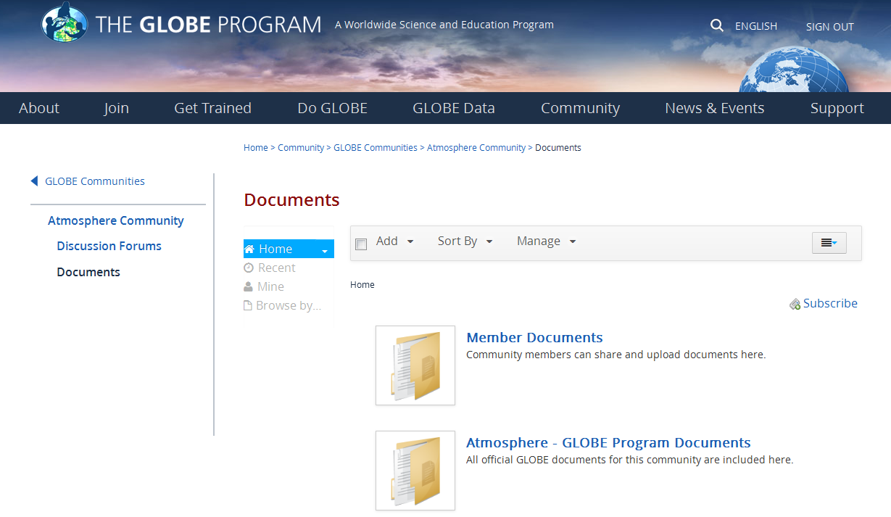
Uploading a Document

Slide 24
Uploading a Document
Cheat sheet help
Upload a Document to a community | Go to the community you’d like to upload the document to. (Community->GLOBE Communities lists all communities). Most Communities have a Documents page – click on it in the left hand nav. Most communities have a “Member Documents” Folder – click on it. Select “Add” from the menu and create a folder, or add a document. Select Browse to find the document, add meta data an “Publish”. There is a document link created which you can link to if desired.
Upload a Document to your MyPage | Select Your Name->MyPage. Select Manage->Content. Select Documents and Media from the left side menu. This is your personal library. Click Add to add documents/images. Once you upload the document, select Details and Get URL to find the URL to the image you just uploaded.

Slide 25
CC/Partner Topics

Slide 26
Create a Workshop
Setup a workshop with your choice of protocols in your choice of location. Do not set it to “active”
Find the friendly URL for the workshop
Make sure you know where to “View Roster” and how to change user’s status

Slide 27
Create a Workshop
Cheat sheet help
Create Workshops | Go to Manage-> Workshop Administration. Select “Create New Workshop”
If you follow these steps – your teachers will be able to interact with GLOBE flawlessly!
1) Create the Workshop
2) Assign the trainers for the workshop
3) Make the workshop Active
4) Accept people into the workshop
5) Change people’s status as they complete the workshop

Slide 28
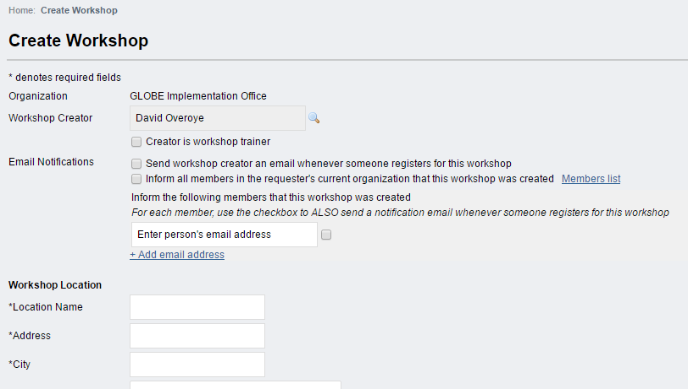

Slide 29
Update your MyPage
Update information about yourself
Update the number of students you teach
Update which protocols you use

Slide 30
Update Your MyPage
Cheat sheet help
Change the content on their MyPage | Click on the first link on the drop down arrow on the top right of the page (Goto->MyPage). Look for and click on the small pencil icon in the middle column of the page. You will see a form which you can input information into.
Input the number of students they directly support (for GLOBE metrics) | Click on “Go to” and select “MyPage”. On the right side of the page, select the “Edit” button next to “Number of my students using GLOBE this year”.
Input which protocols and learning activities they use (for GLOBE metrics, and to let other teachers know what is useful) | Click on Your Name and select “MPage”. On the right side of the page, select the Tab “Protocols and Activities Used”. Click on “Edit” to select which you use.

Slide 31
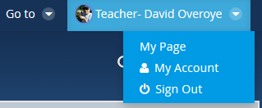
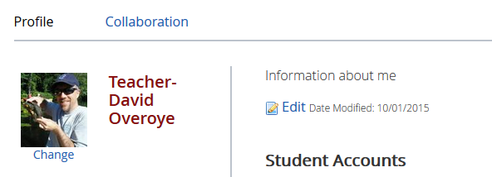
Updating your MyPage

Slide 32
Adding News/Events
Go to your partner/Country page and add a news article about your being here

Slide 33
Add News/Events to your partner/country page
Cheat sheet help
Post a News or Event Article on their page | Select Goto>Partner page name. Select Manage->Site Administration->Content from the drop down menu on the top right. Select CMS News or CMS Events from the left hand navigation. Click Add News or Add Events. Enter required fields and click “Publish”.

Slide 34
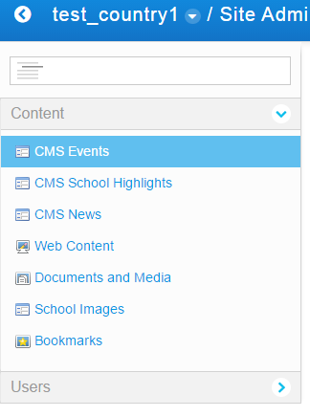
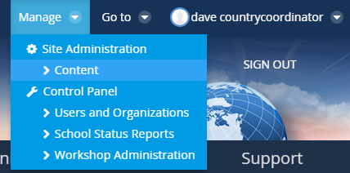
Adding News and Events
From your country/partner page, select Manage and go to Content
This is only available when you are on your country (or school) pages
On the left menu you will see options to Add News (CMS News), Add Events, (CMS Events) and upload Documents and Media
Documents and Media can be linked to from your web content, news or event

Slide 35
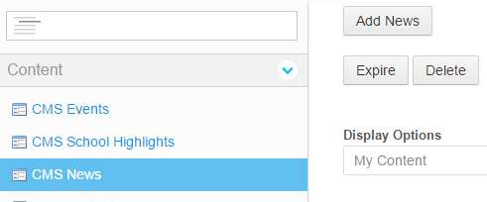
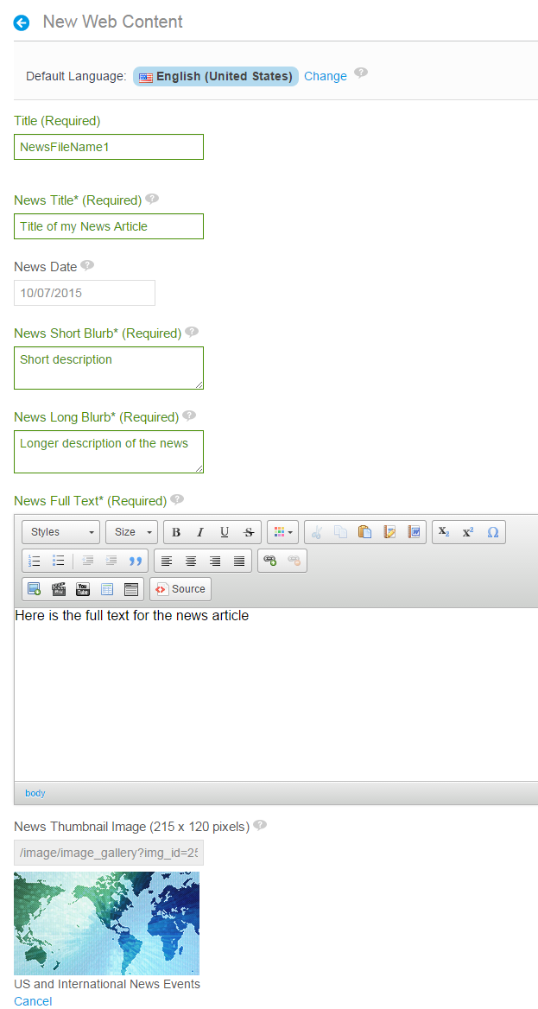
Example – Add News
Select CMS News, and “Add News”
Fill in required fields
Filename (Title)
News Title
Short and Long descriptions
Full text (Content)
Optional metadata
Upload images/videos
Click Save and Publish, or schedule the article to be live on specific dates
News will appear on your country/partner page
You can go back and edit or add translations

Slide 36
Questions

