Slide 1
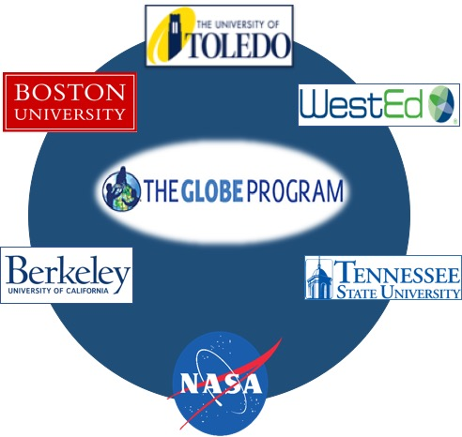
Mission Earth: Fusing GLOBE with NASA Assets to Build Systemic Innovation in STEM Education
Kevin Czajkowski
The University of Toledo

Slide 2
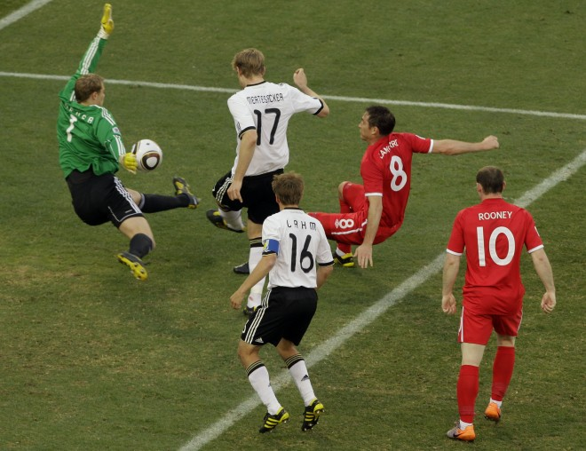
Play the Game: Do Science
Notes:
Improve STEM Instruction by creating developmentally appropriate vertically-integrated K-12 materials and activities which link NASA and GLOBE learning materials, supported by high quality professional development and ongoing support, engaging teachers from all grades (elementary, middle and high school) to work together in both program implementation and continuous improvement.
Increase and Sustain Youth and Public Engagement in STEM through project activities and engagement of citizen scientists through GLOBE’s new citizen science initiative.
Enhance STEM Experience for Undergraduate Students, through service learning for pre-service teachers and engineering challenges.
Better Serve Groups Historically Underrepresented in STEM through serving high-need school districts (Providence, RI, Toledo, OH, Nashville, TN, Oakland, CA) and engagement of Historically Black Colleges and Universities, Tennessee State University.

Slide 3
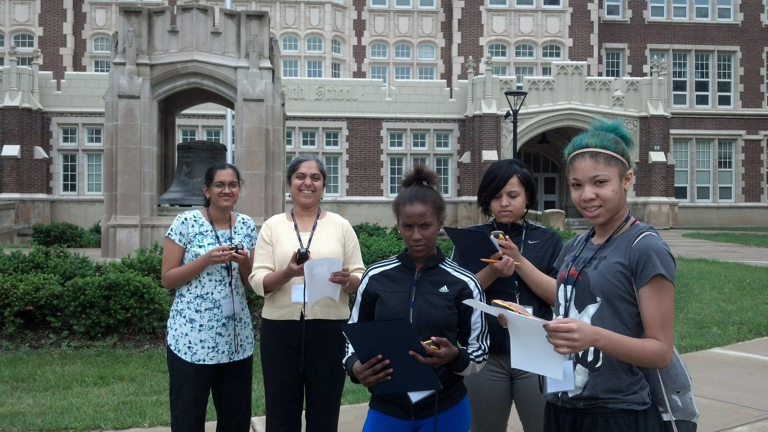
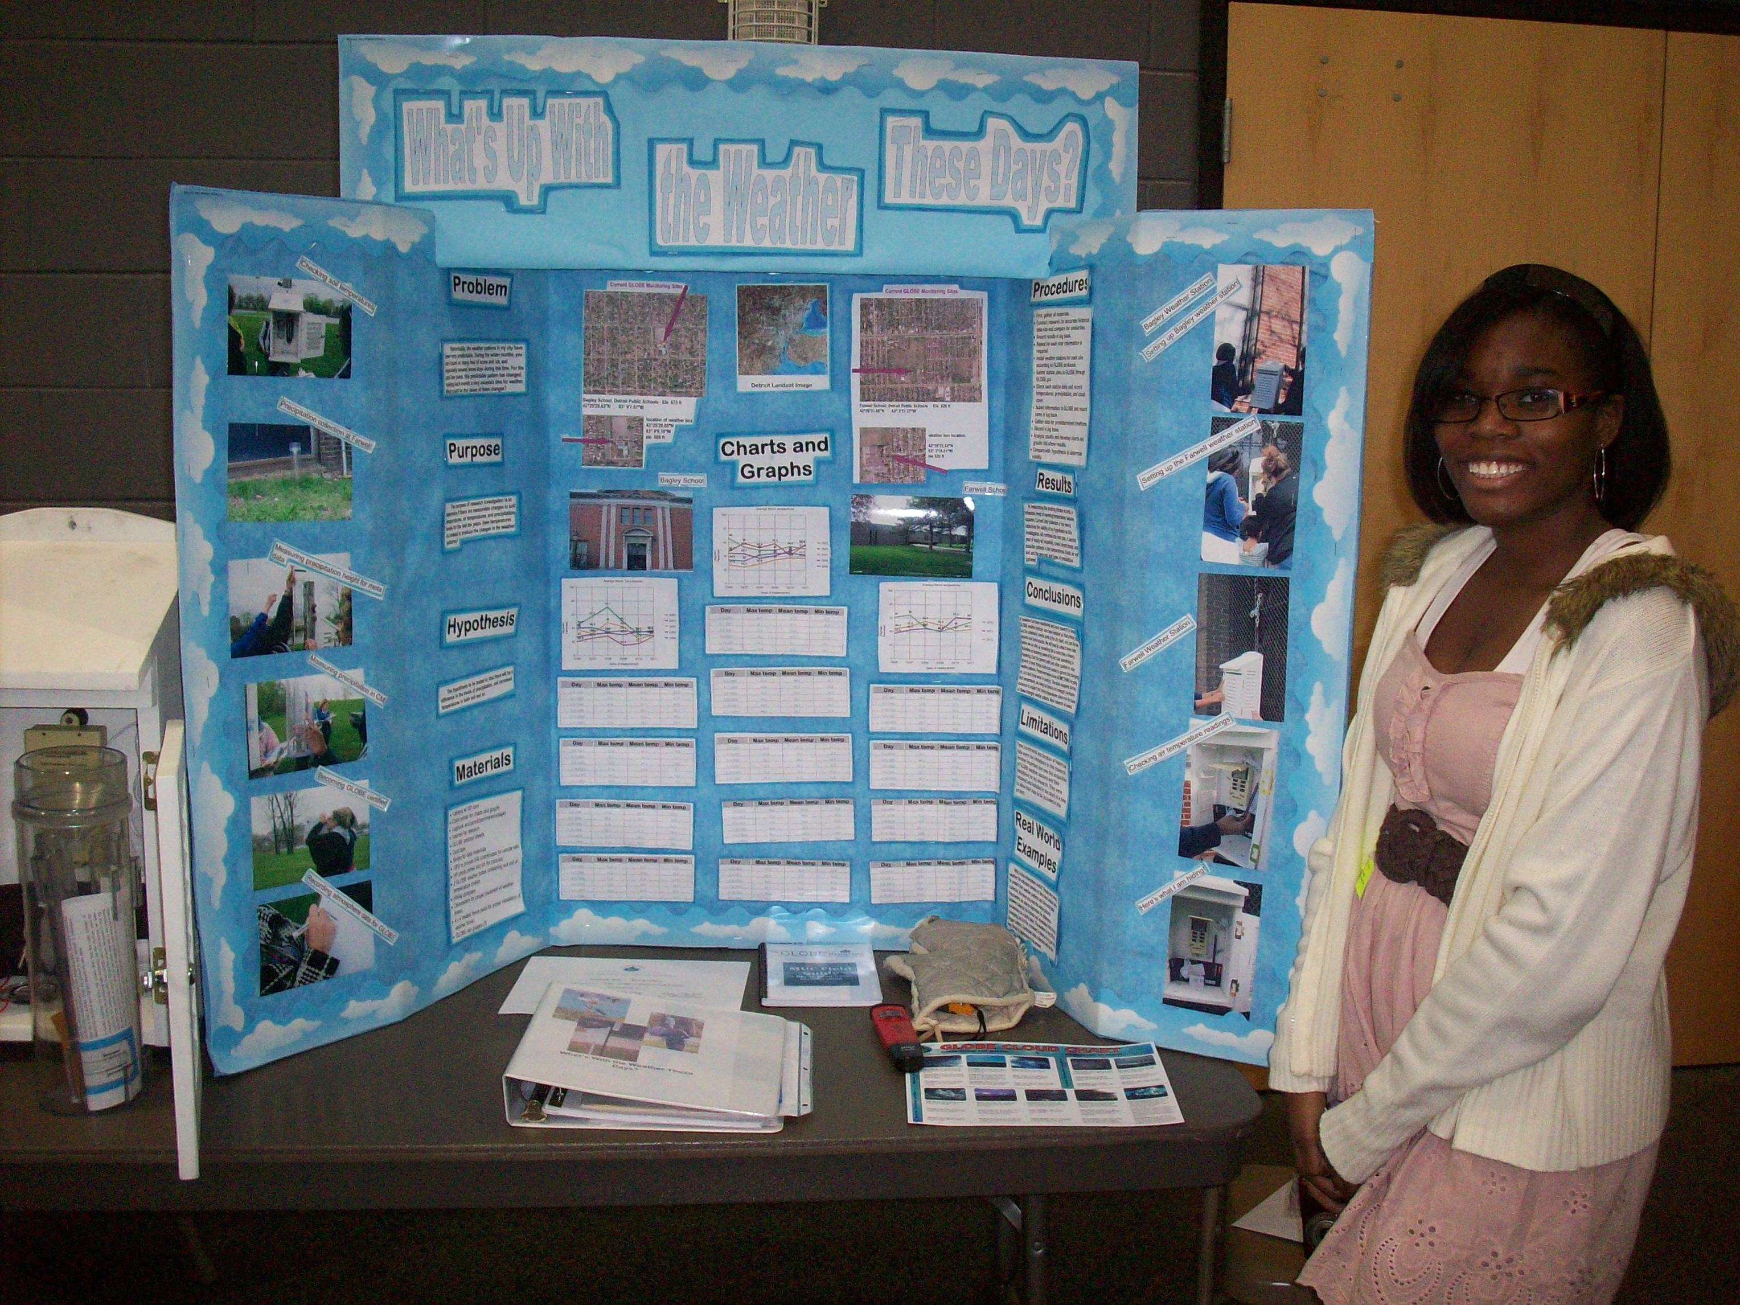
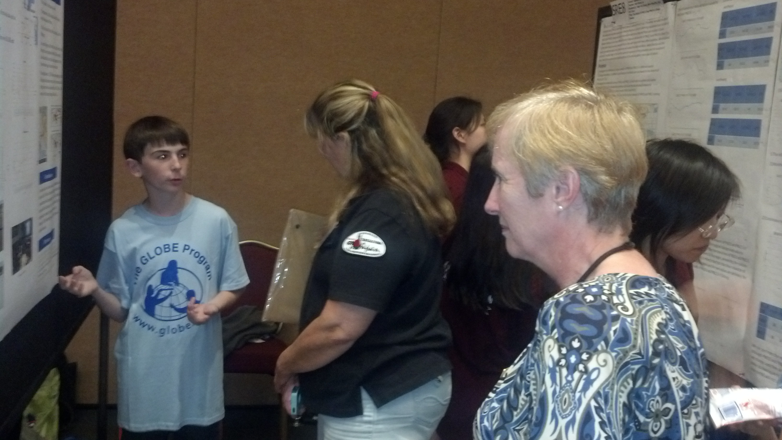
Do GLOBE
Notes:
Improve STEM Instruction by creating developmentally appropriate vertically-integrated K-12 materials and activities which link NASA and GLOBE learning materials, supported by high quality professional development and ongoing support, engaging teachers from all grades (elementary, middle and high school) to work together in both program implementation and continuous improvement.
Increase and Sustain Youth and Public Engagement in STEM through project activities and engagement of citizen scientists through GLOBE’s new citizen science initiative.
Enhance STEM Experience for Undergraduate Students, through service learning for pre-service teachers and engineering challenges.
Better Serve Groups Historically Underrepresented in STEM through serving high-need school districts (Providence, RI, Toledo, OH, Nashville, TN, Oakland, CA) and engagement of Historically Black Colleges and Universities, Tennessee State University.

Slide 4
Middle School
Elementary School
Engineering Challenge
Career/Technical
Education
High School
Pre-service Ed
Underrepresented
Groups
Career/Technical
Education
High School
My NASA Data
Missions, etc.

Slide 5
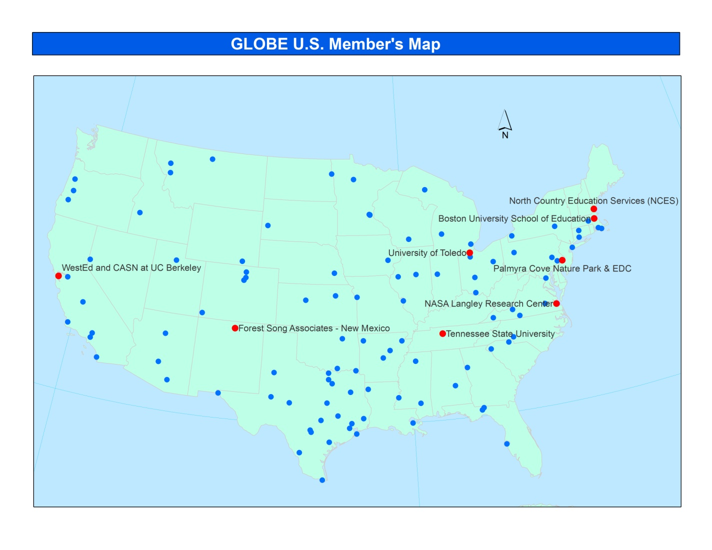
GLOBE Partnership
Red indicates Partners in MISSION EARTH

Slide 6
Mission Earth Supports the Following GLOBE Strategic Priorities
Improve student understanding of environmental and Earth system science across the curriculum
Contribute to scientific understanding of Earth as a system
Build and sustain a global community of students, teachers, scientists, and citizens
Engage the next generation of scientists and global citizens in activities to benefit the environment
Notes:
Improve STEM Instruction by creating developmentally appropriate vertically-integrated K-12 materials and activities which link NASA and GLOBE learning materials, supported by high quality professional development and ongoing support, engaging teachers from all grades (elementary, middle and high school) to work together in both program implementation and continuous improvement.
Increase and Sustain Youth and Public Engagement in STEM through project activities and engagement of citizen scientists through GLOBE’s new citizen science initiative.
Enhance STEM Experience for Undergraduate Students, through service learning for pre-service teachers and engineering challenges.
Better Serve Groups Historically Underrepresented in STEM through serving high-need school districts (Providence, RI, Toledo, OH, Nashville, TN, Oakland, CA) and engagement of Historically Black Colleges and Universities, Tennessee State University.

Slide 7
MISSION EARTH’s Goals
Provide K-12 professional development (PD) and year-long as well as multi-year support for teachers with scaling through Train-the-Trainer models
Develop vertically-integrated activities and materials to support program implementation
Enhance STEM Experience for Undergraduate Students
Engage the public by supporting and enhancing GLOBE, MY NASA DATA and S’COOL citizen science initiatives.
Disseminate through NSTA and GLOBE
Notes:
Specifically, MISSION EARTH will;
Develop vertically-integrated activities and materials to support program implementation
Gather community through an annual meeting/conference to share best practices
Develop, implement, evaluate and refine NASA-infused GLOBE activities, drawing on the expertise of both partners and teacher teams.
Provide K-12 professional development (PD) and year-long as well as multi-year support for teachers with scaling through Train-the-Trainer models
Recruit high-need schools to participate, targeting multiple teachers from one school/district at elementary, middle and high school levels.
Provide PD and develop a professional learning community (PLC) of teachers, scientists and engineers and science educators; host online meetings, follow-up telecons and annual conferences.
Provide support to pilot schools and elicit feedback for further development
Train and support lead teachers as future GLOBE trainers employing Train-the-Trainer approach.
Engage district and state education agencies as appropriate to leverage existing PD structures for replication and sustainability.
Enhance STEM Experience for Undergraduate Students
Facilitate pre-service teachers and STEM undergraduates to mentor K-12 students in service learning projects.
Engage undergraduate students in engineering design challenges of observing instrumentation.
Engage the public by supporting and enhancing GLOBE, MY NASA DATA and S’cool citizen science initiatives.
Disseminate the program widely through the National Science Teachers Association and the GLOBE Partner Network, the National Career Academy Coalition (for the high school component), and other relevant networks.

Slide 8
MISSION EARTH’s Activities
Develop curricular materials to support a vertically integrated K-12 learning progression - infuse NASA and GLOBE assets/activities
Develop models of educational professional development (EPD) that result in teachers’ use of NASA/GLOBE learning and teaching assets - esp. in high need districts.
Develop learning communities in schools to support the use of NASA/GLOBE learning and teaching assets.
Focus on El Nino or hydrology
Notes:
Specifically, MISSION EARTH will;
Develop vertically-integrated activities and materials to support program implementation
Gather community through an annual meeting/conference to share best practices
Develop, implement, evaluate and refine NASA-infused GLOBE activities, drawing on the expertise of both partners and teacher teams.
Provide K-12 professional development (PD) and year-long as well as multi-year support for teachers with scaling through Train-the-Trainer models
Recruit high-need schools to participate, targeting multiple teachers from one school/district at elementary, middle and high school levels.
Provide PD and develop a professional learning community (PLC) of teachers, scientists and engineers and science educators; host online meetings, follow-up telecons and annual conferences.
Provide support to pilot schools and elicit feedback for further development
Train and support lead teachers as future GLOBE trainers employing Train-the-Trainer approach.
Engage district and state education agencies as appropriate to leverage existing PD structures for replication and sustainability.
Enhance STEM Experience for Undergraduate Students
Facilitate pre-service teachers and STEM undergraduates to mentor K-12 students in service learning projects.
Engage undergraduate students in engineering design challenges of observing instrumentation.
Engage the public by supporting and enhancing GLOBE, MY NASA DATA and S’cool citizen science initiatives.
Disseminate the program widely through the National Science Teachers Association and the GLOBE Partner Network, the National Career Academy Coalition (for the high school component), and other relevant networks.

Slide 9
MISSION EARTH’s Activities cont.
Support STEM career development through linkages to real world application through Career/Technical Education.
Collaborate and build capacity with district and state agencies, including train-the-trainer approaches.
Infuse Teacher Preparation (pre-service) with NASA/GLOBE learning and teaching assets.

Slide 10
Nektaria Adaktilou is leading…
EVALUATION
EVALUATION
EVALUATION
EVALUATION
EVALUATION
EVALUATION
EVALUATION

Slide 11
How can you get involved? We will be hosting webinars on various topics
Topics:
Geospatial Technologies (GPS, GIS, remote sensing)
Using ArcGIS with GLOBE Data
Setting up your school site
Protocols: Atmosphere and Hydrology
Links to NASA – eg. My NASA Data
Working with underrepresented groups
Notes:
Webinars:
Geospatial Technologies
Using ARC GIS with GLOBE Data
Remote Sensing
Using Google Earth with GLOBE
How to do GLOBE in your Classroom
How to set up you site at school
How to do a scavenger hunt at your school
How to do a GLOBE Science Fair
Protocols: Atmosphere and Hydrology

Slide 12
How can you get involved? (con’t)
Participation in field campaigns
Development of student projects
Sharing experiences
Webinar – sharing of pre-service experiences
August 9, 2016 12:30 pm EDT (16:30 UTC)
Let me know if you are interested in attending

Slide 13
How can you get involved? Advisory Committee
10 members – meet once a year
help direct the project and connect the project to other initiatives that will promote successful scaling and sustainability.
Members will come from: key stakeholders groups, groups underrepresented in STEM, and eventually, STEM employers
There are still a couple places left to be filled on the Advisory Committee. If you are interested in joining, please let us know. We will will review those who are interested and may choose new members from the group.
Notes:
Provides guidance throughout the project, including monitoring the vertical integration.
Help direct the project and connect the project to other initiatives that will promote successful scaling and sustainability
Advisors have been identified for their content knowledge, experiences and understanding of target audiences, their vision, and their connections with other initiatives.

Slide 14
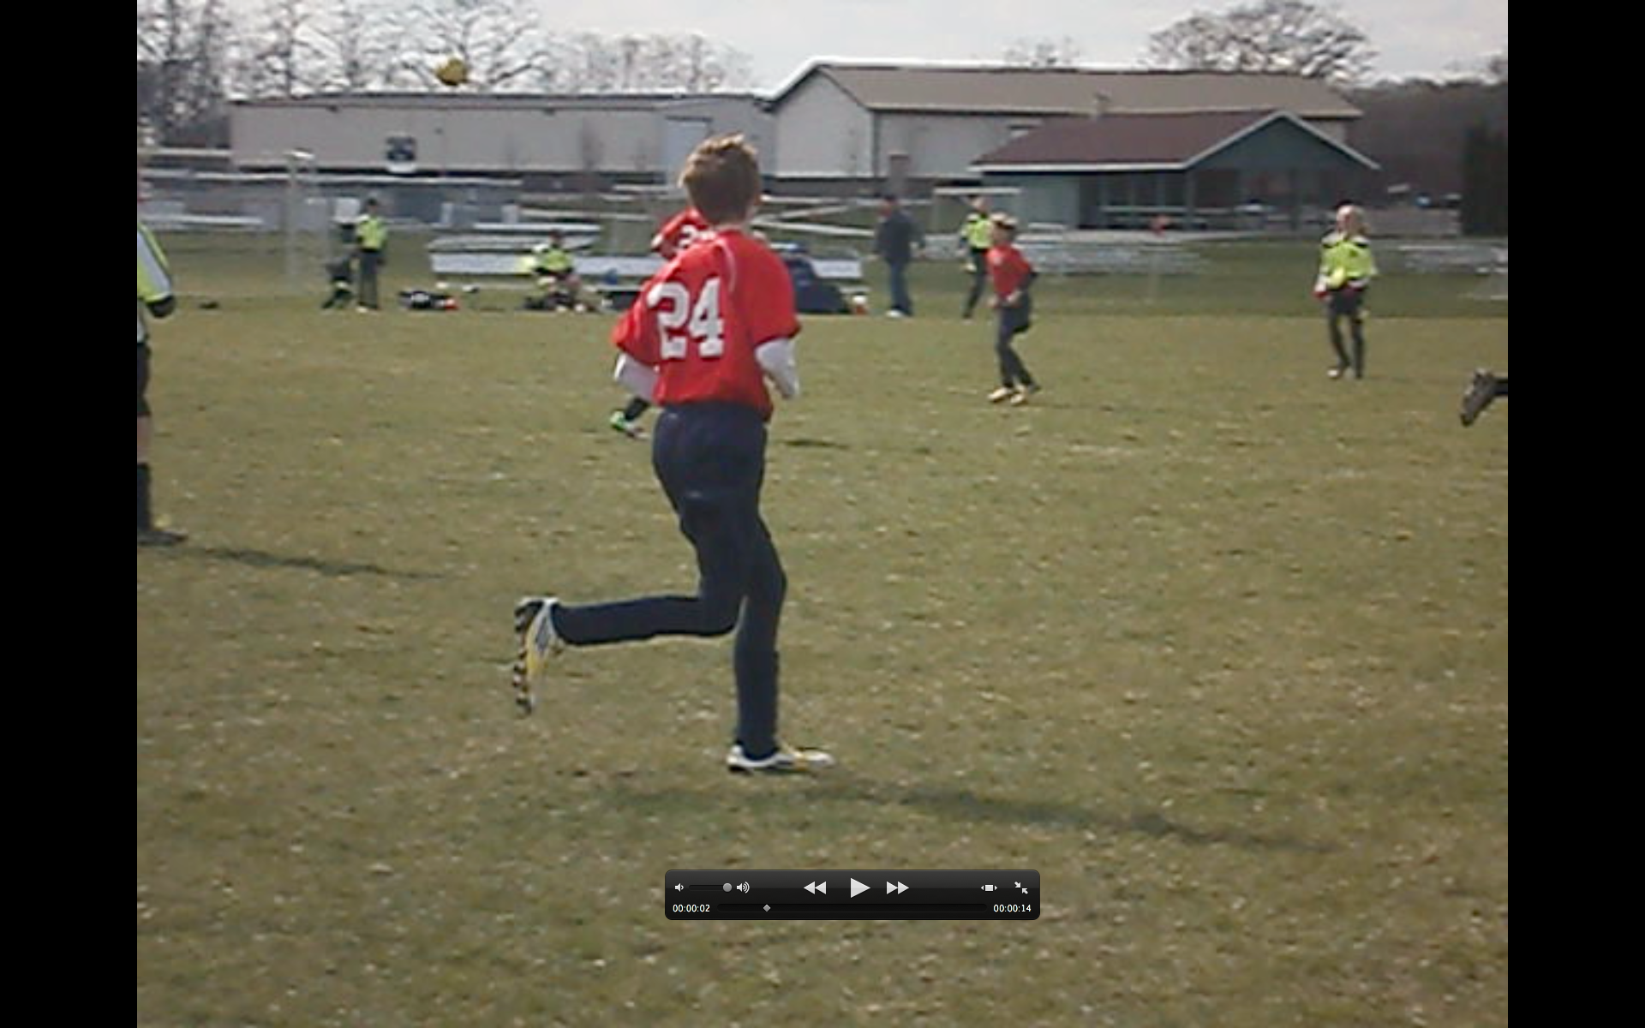
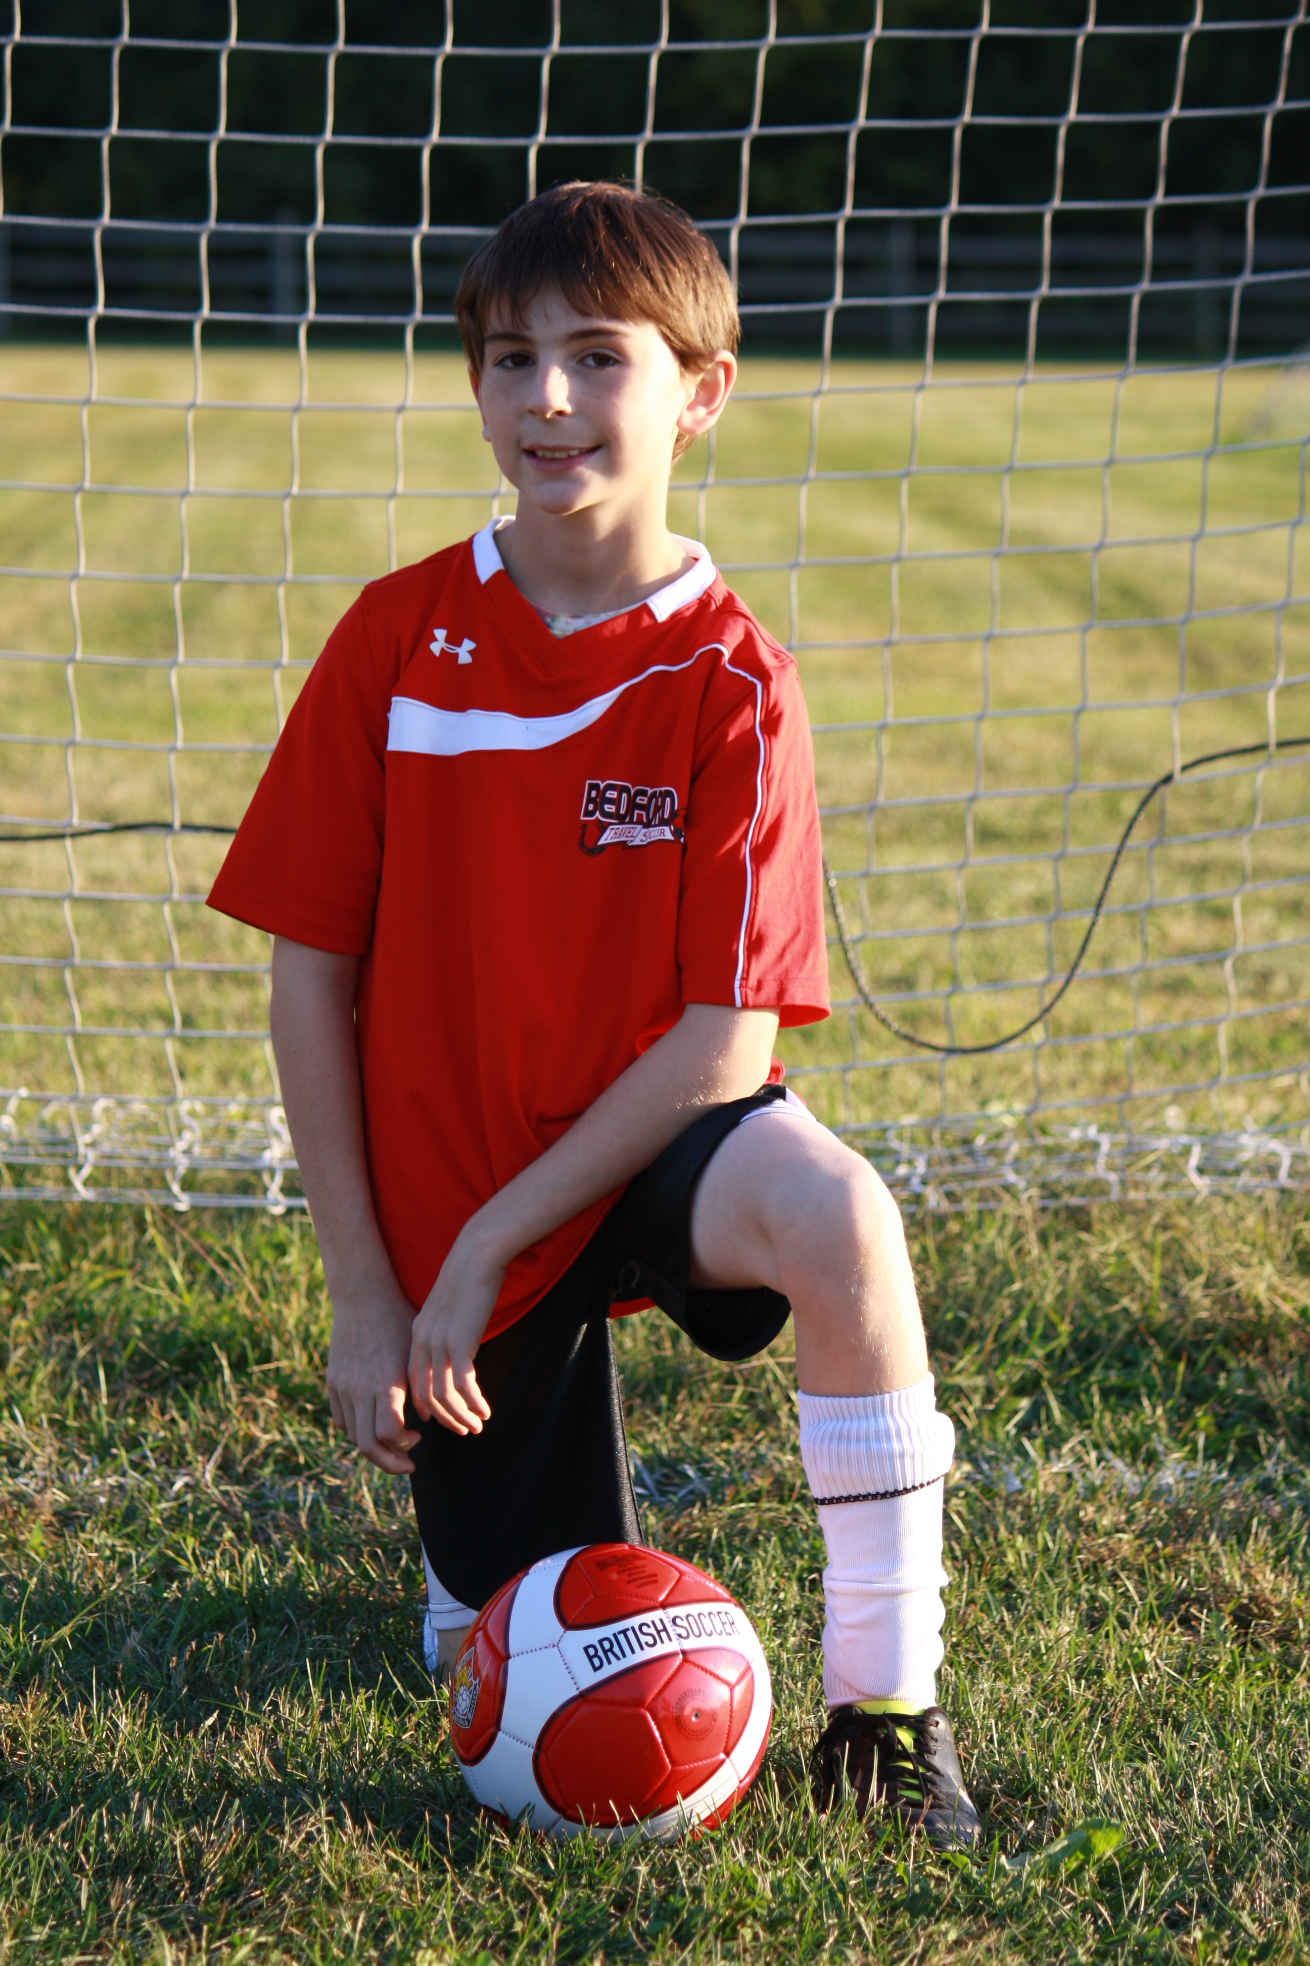
Thank you!
Kevin Czajkowski
GLOBE Scientist
The University of Toledo
Kevin.czajkowski@utoledo.edu

