Slide 1
NASA Goddard Space Flight Center m GLOBE m Pilot Training Program
Todd Toth
July 20, 2016

Slide 2
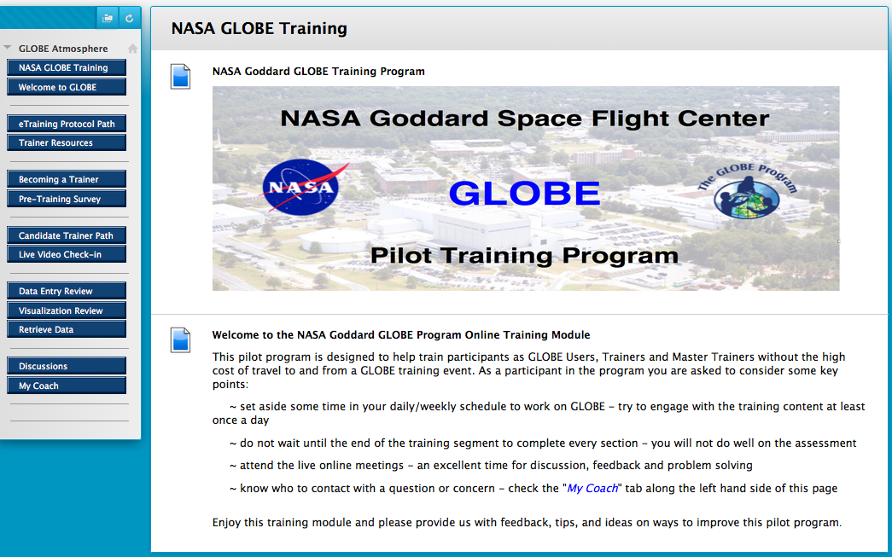

Slide 3
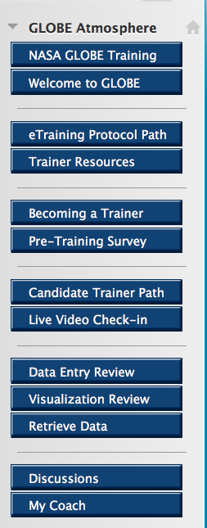
Menu bar – on each page
All steps included in our program – from setting up an account, using GLOBE website, eTraining, becoming a trainer and Master Trainer.
Support via “My Coach” tab
Individual / Group discussions – via video chats and discussion posts
How to prepare for a GLOBE training event – before, during and after.
Video taping a GLOBE training event
Evaluation / submission of paperwork to GLOBE (GIO)

Slide 7
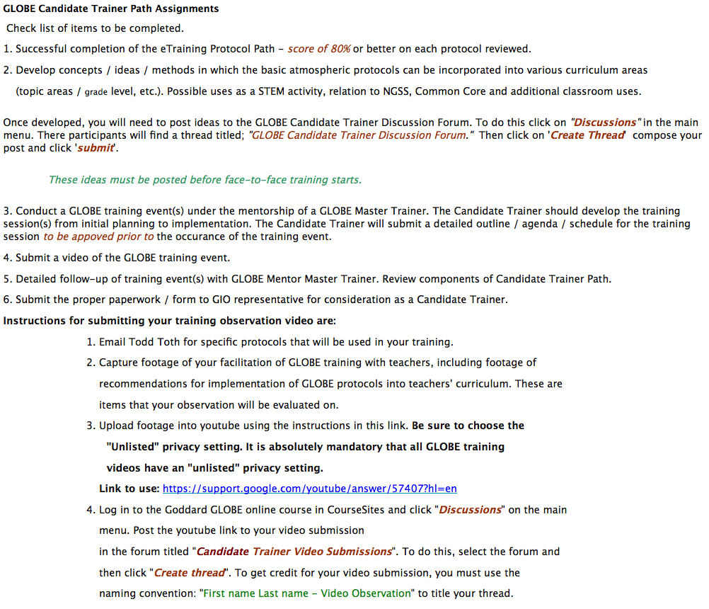

Slide 8
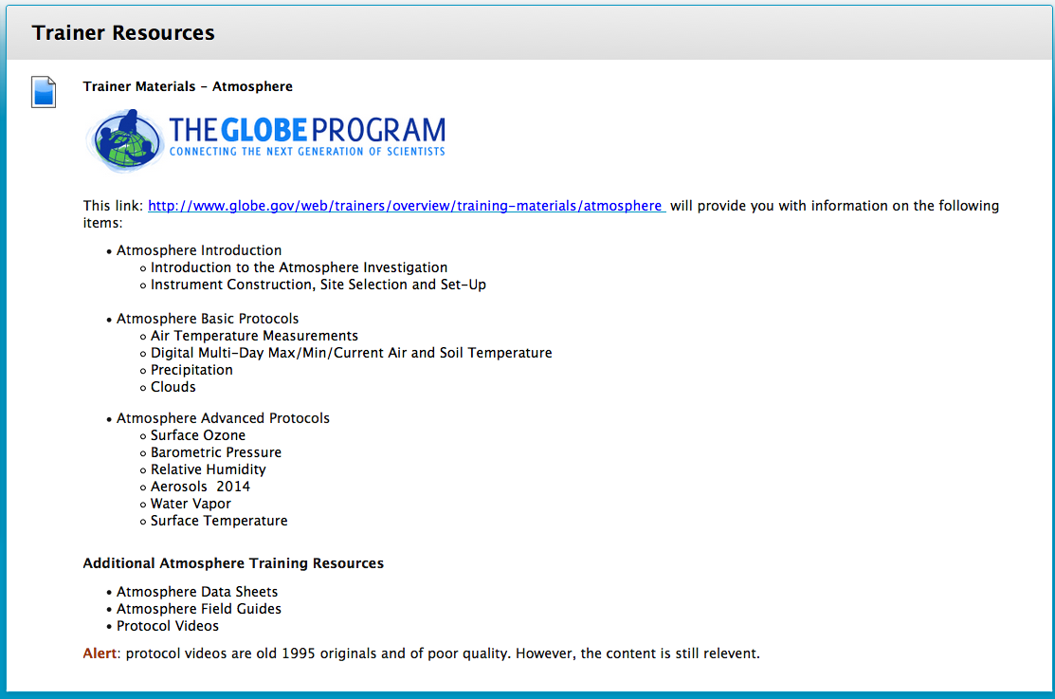

Slide 9
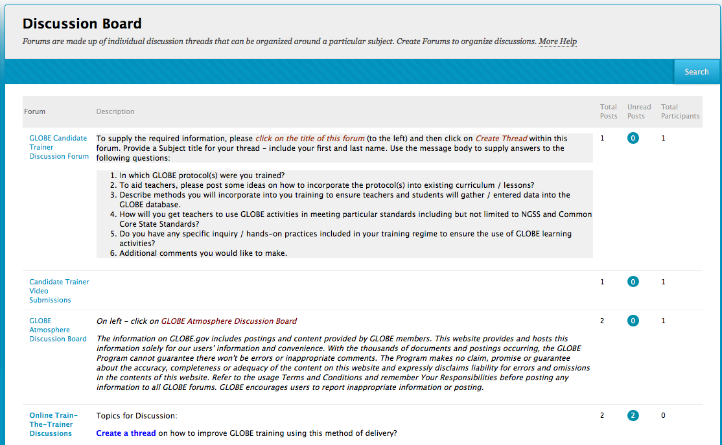

Slide 11
Thank you
Todd Toth
todd.e.toth@nasa.gov

