Slide 1
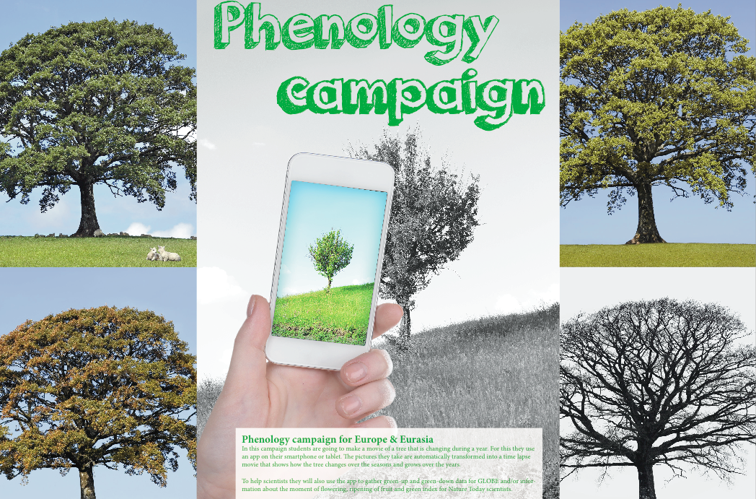
Phenology app
www.globe.gov/web/european-phenology-campaign

Slide 2
Agenda
Phenology app
GLOBE phenology green up and down
Phenology campaign (for Europe)
How can you join?

Slide 3
What is a time lapse movie?

Slide 4
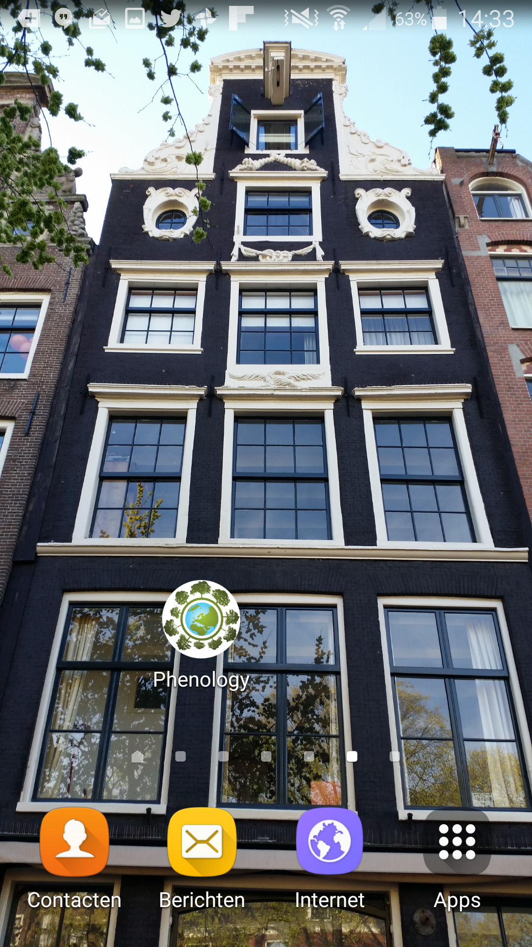
Download app from:
www.globe.gov/web/european-phenology-campaign

Slide 5
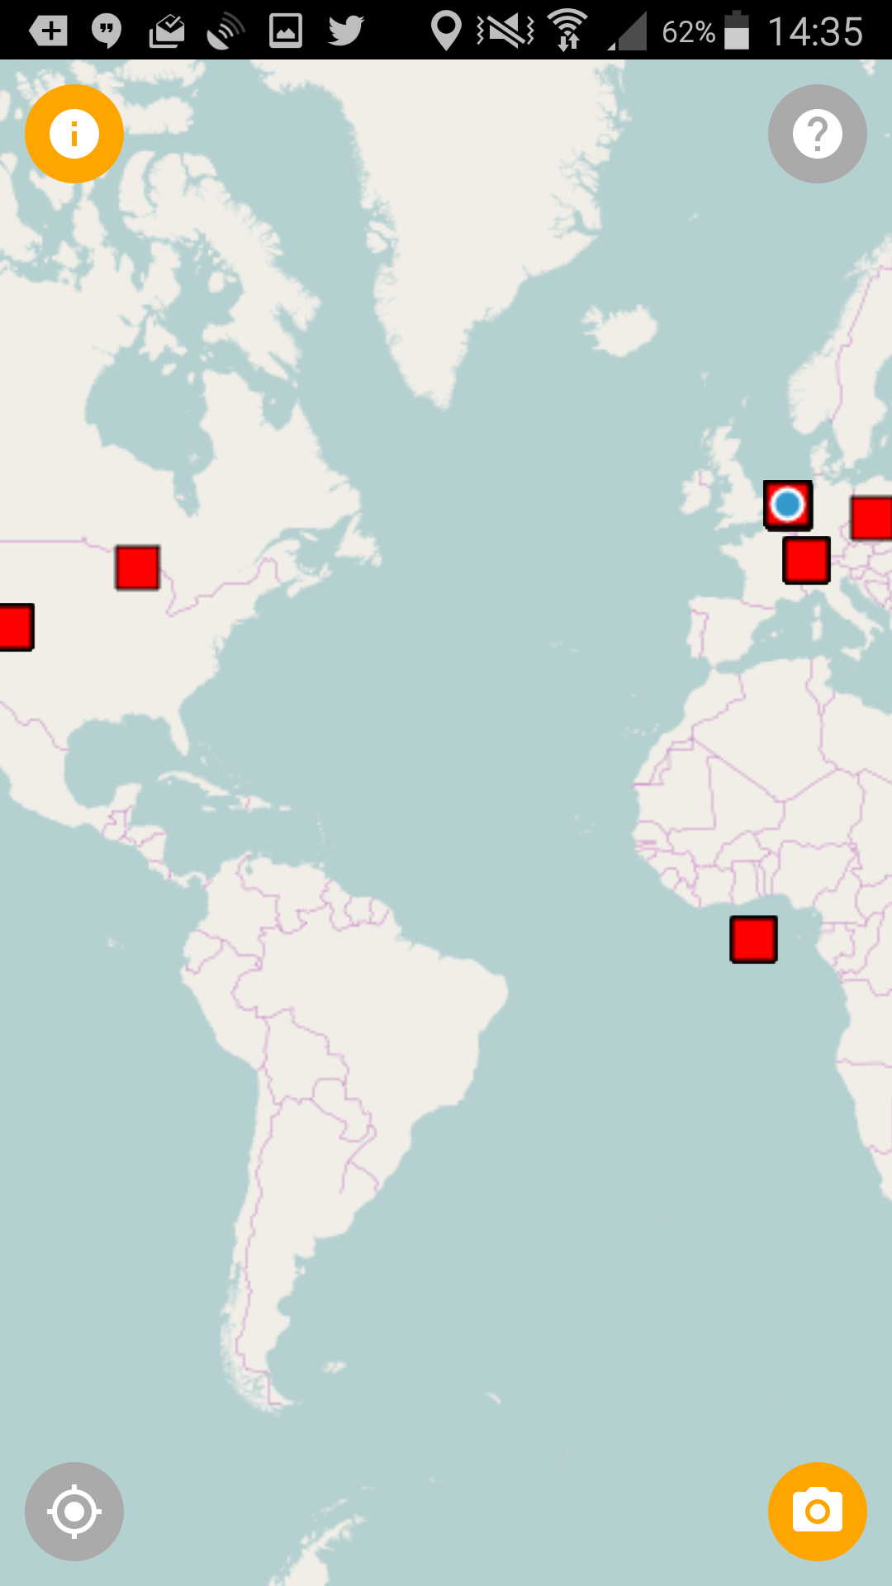
Map with picture locations
With the app you can start as many picture locations as you wish. In this way you can:
Follow several trees of the same species to compare them What could make the difference in moment of green-up?
Follow several species
Follow several zoom levels of one tree:
Landscape
Entire tree
One or more of the twigs you are investigating for GLOBE

Slide 6
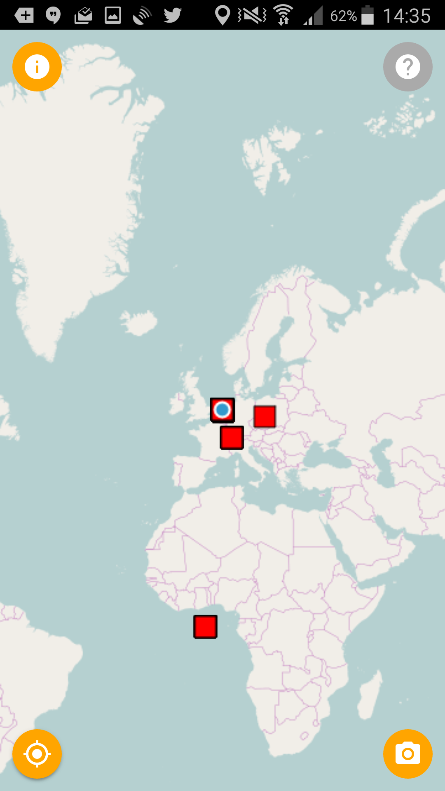
Auto-center on my location / tracking
(bottom left button)

Slide 7
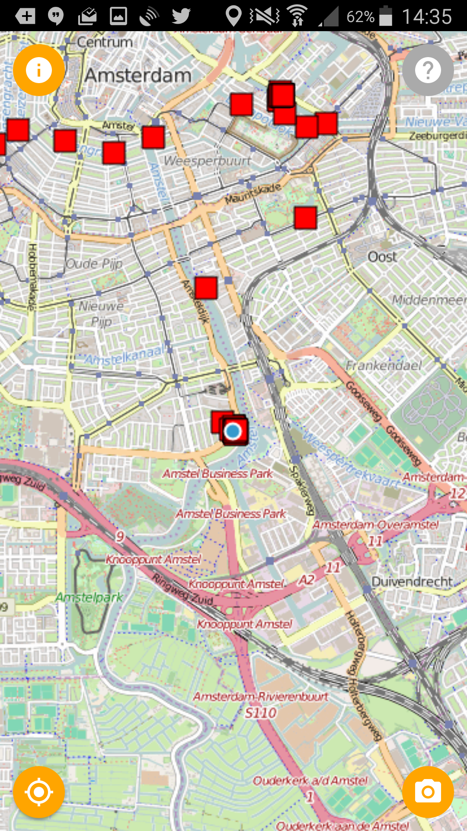
Zoom in

Slide 8
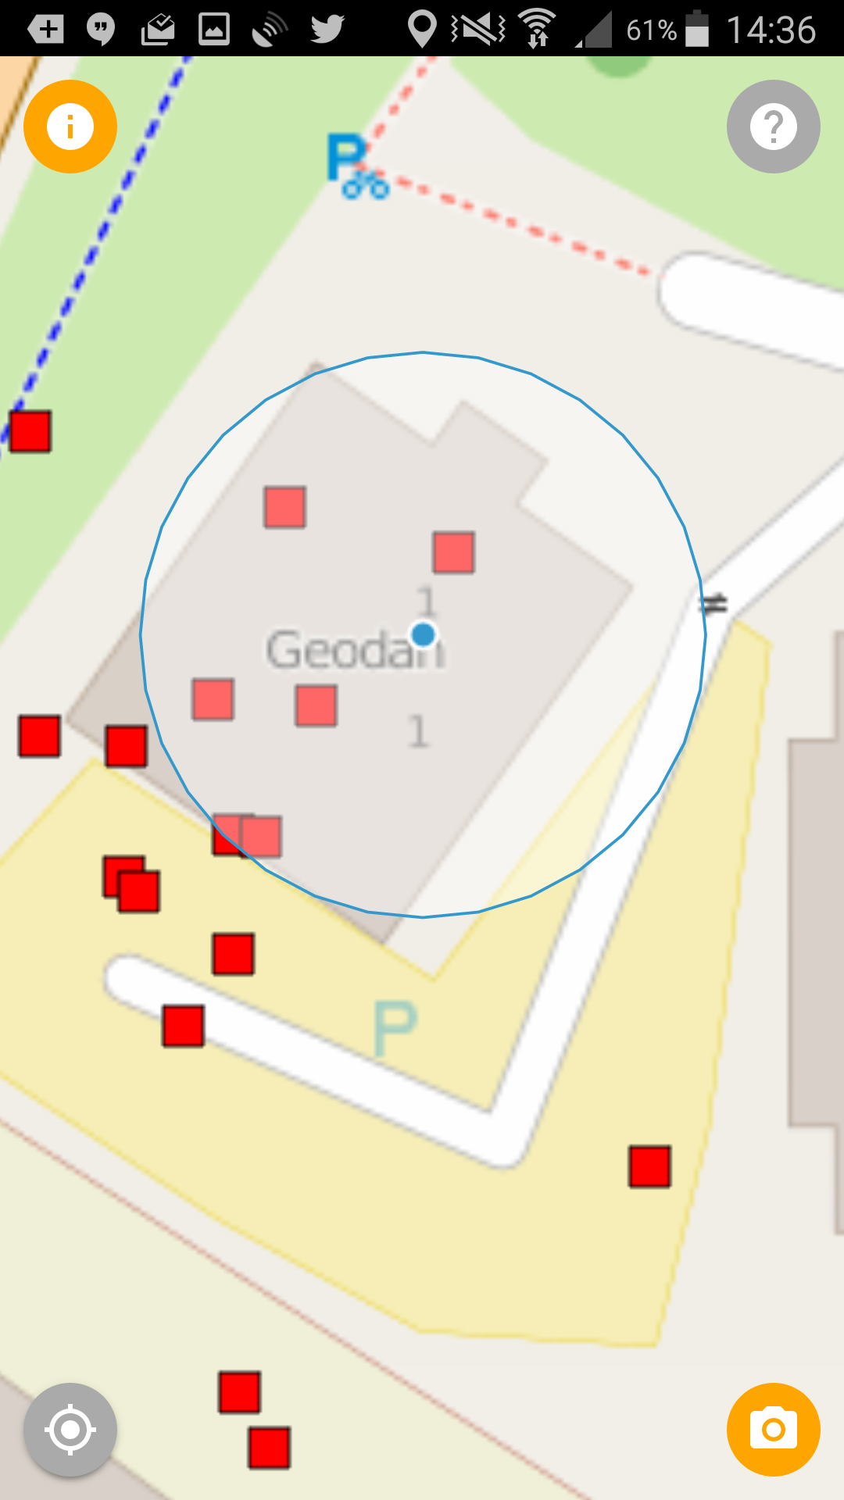
Detailed zoom

Slide 9
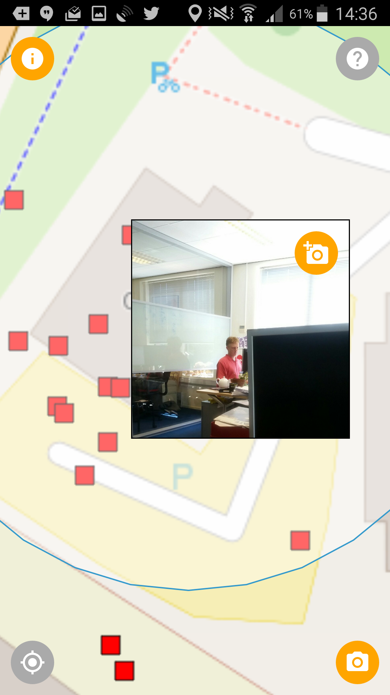
Click/Touch photo location
Photo displayed

Slide 10
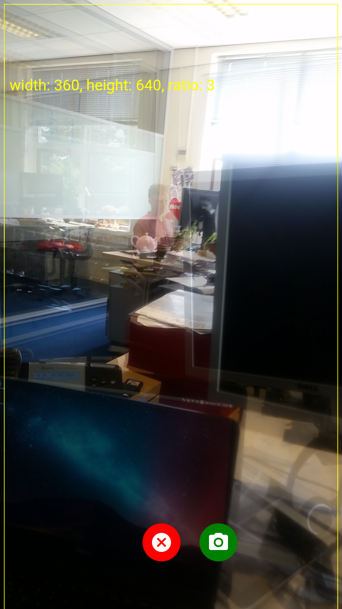
Add picture to existing picture
Show camera preview on top of picture
'Onion Skinning'

Slide 11
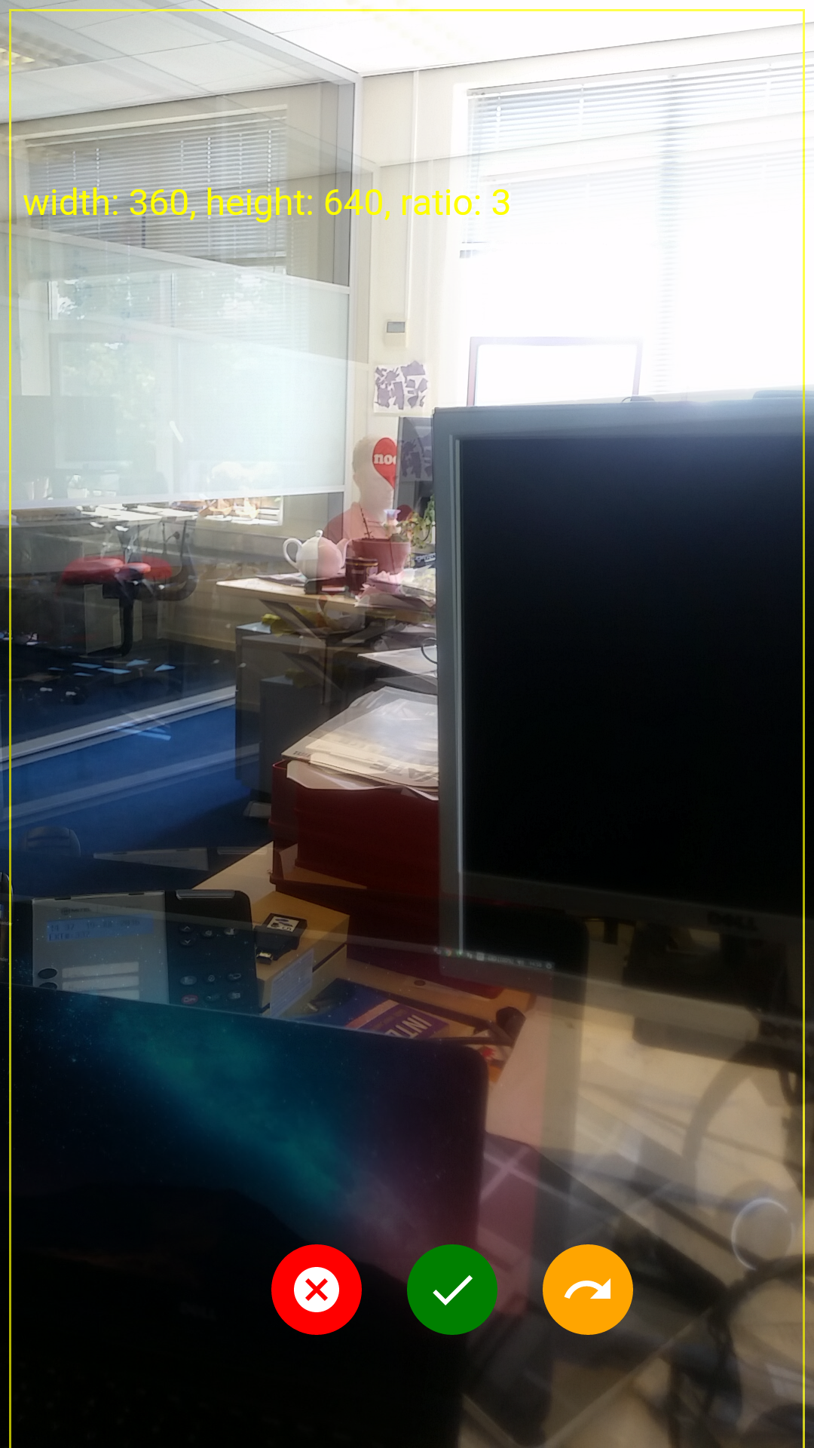
Picture taken
Cancel, Upload or Redo?

Slide 12
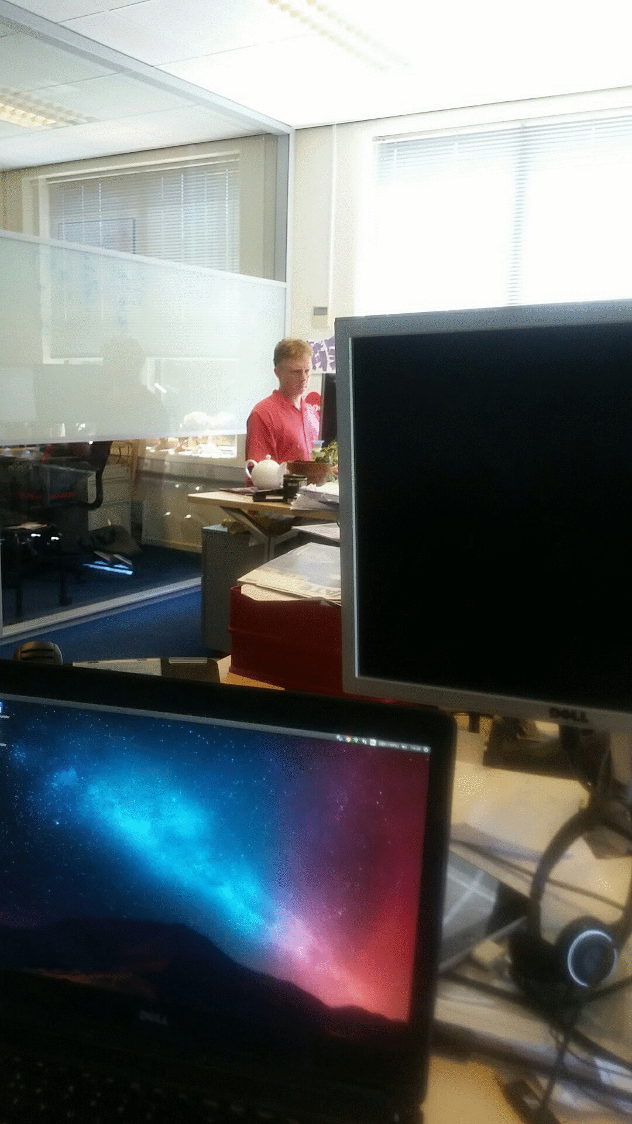
New (office) animation generated

Slide 13
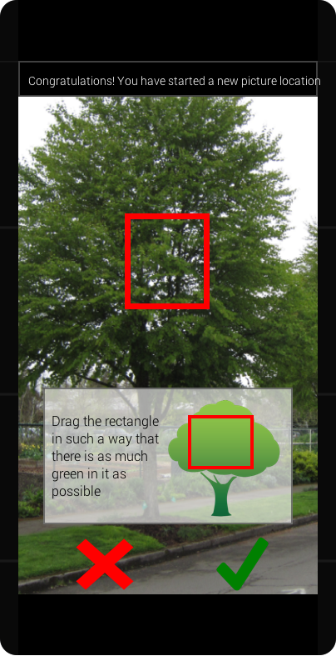
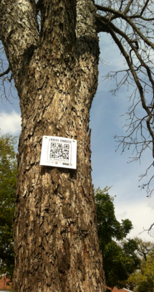
Optional features
?

Slide 14
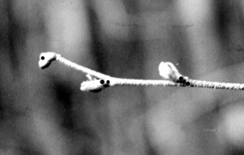
GLOBE protocols: Green-up
Determine whether there are more than one green down cycles
Select a healthy and relatively large branch
south side of the plant in the Northern Hemisphere
north side of the plant in the Southern Hemisphere
Mark the branch with flagging tape (beginning at least two weeks prior to the anticipated start of green-up)
Label 4 buds closest to the end of branch
Examine each bud and record (at least twice a week,):
“dormant” if the bud is unchanged.
“swelling” if the bud is getting bigger.
“budburst” the first day you see the green tips of leaves.
“lost” if something happens to the bud and you cannot continue observations.
After each budburst measure the length of the leaf or leaves.

Slide 15
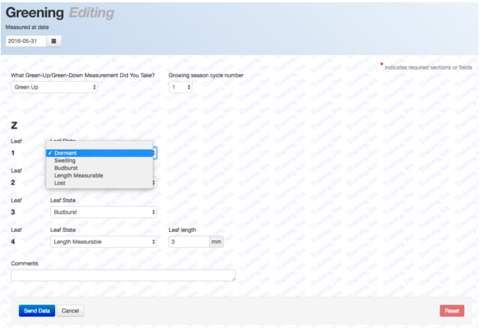
Data entry Green up

Slide 16
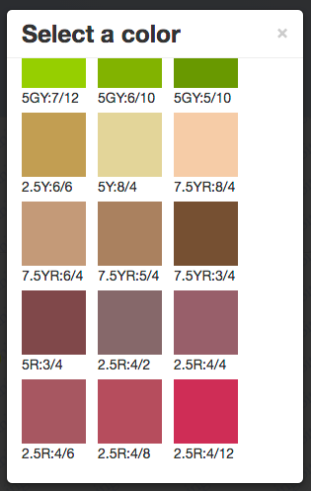
GLOBE protocol: Green down
Find a tree and determine species
Tag a branch with flagging tape
Determine whether there are more than one green down cycles
Label the 4 leafs at the end of the branch with 1,2,3 or 4 dots
Check the colour of the leafs at least twice a week until they have fallen of
Start at least 2 weeks prior to the expected start of green down
Use the GLOBE Plant Color Guide to estimate the dominant color of each leaf

Slide 17
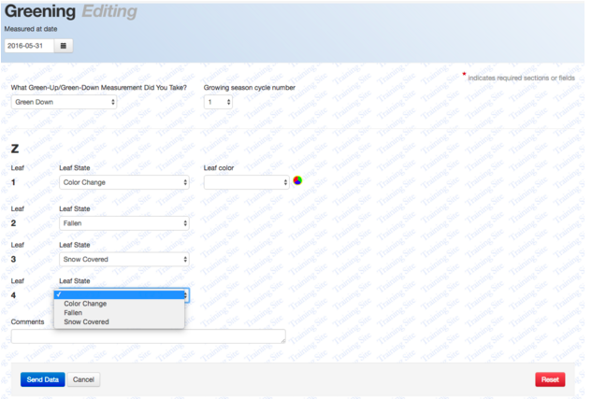
Data entry Green down

Slide 18
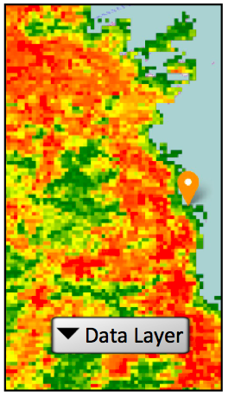
Visualization
GLOBE
Graphs and maps with at least the 6 species of the European campaign
2. Nature Today
movies of individual trees on map
Slide through time comparing satellite data with the greening of trees
Link to show your tree on school page or social media

Slide 19
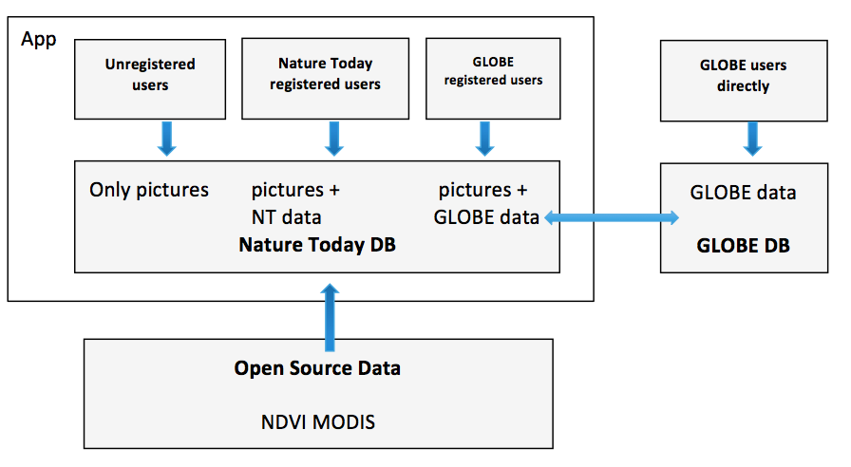
Data connections

Slide 20
On the school (1)
Pick one or more (of the 6) species and consider:
Can it be found in your area;
When are the phenology events (flowering, leaf unfolding, etc.) to be expected
Identify different individuals of the chosen species in your area.
Make sure that they are in a location that you see (almost) every day.
Try to pick individuals in different habitats in order to find out what influences the phenology events. Think about:
Shade/sun
Dry/wet
In the city / out of the city
Temperature
Soil type

Slide 21
On the school (2)
Make sure to take a first picture when the tree is still completely bare.
As soon as you see that the tree is starting to green-up:
Take follow up pictures at least every 2 days (or as often as you can. The more pictures the better your video will be)
Enter the green up information by following the GLOBE green up protocols
When the tree is completely green you don’t need to take so many pictures anymore. Once a week would be nice, but less is also ok. Remember: more pictures is a better movie! You also don’t need to add GLOBE data.
As soon as the tree is starting to green down:
Start to take pictures at least every 2 days
Follow the GLOBE green down protocols
When the tree is completely bare again, you don’t need to take so many pictures anymore. Again, once a week would be nice, but less is ok. When it is snowing or there is another event that looks pretty, take pictures every day again.

Slide 22
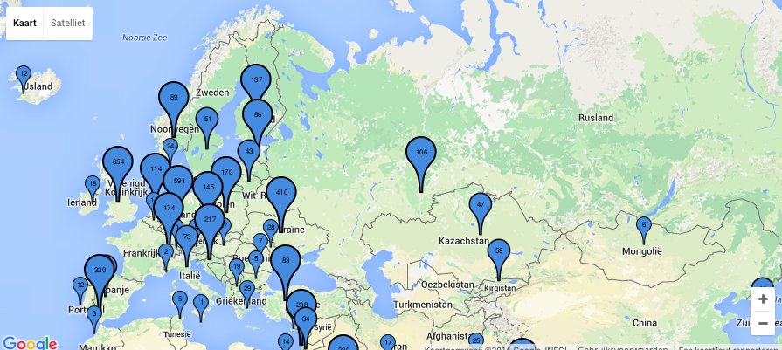
European campaign
Investigate 6 species with a Europe wide distribution

Slide 23
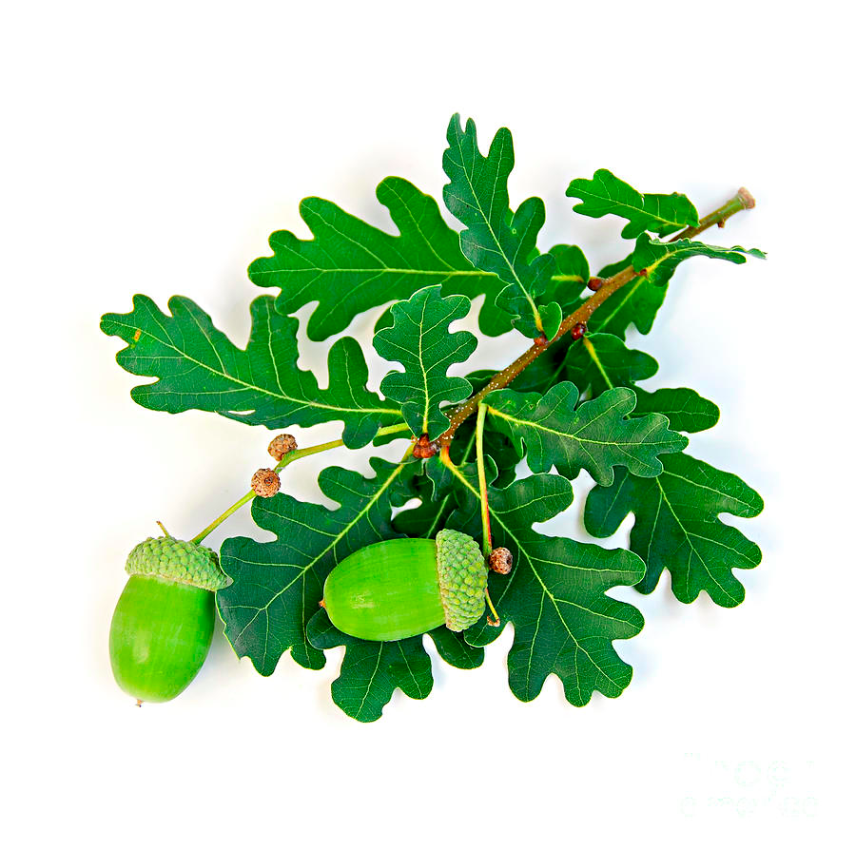
Oak (Quercus robur)

Slide 24
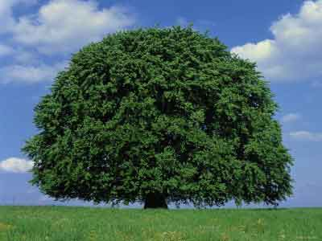
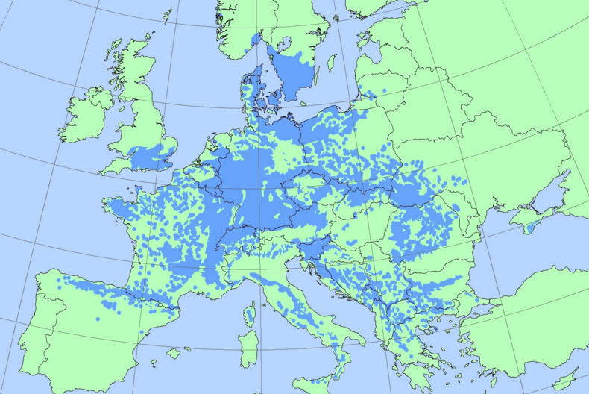
Beech (Fagus sylvatica)

Slide 25
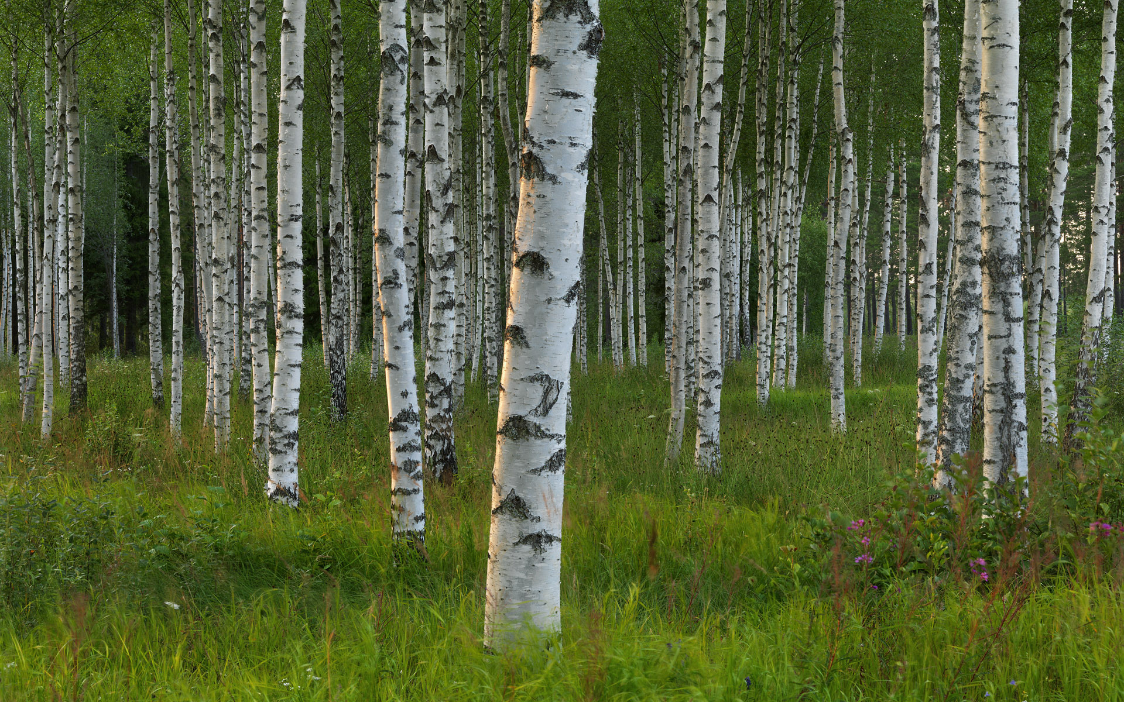
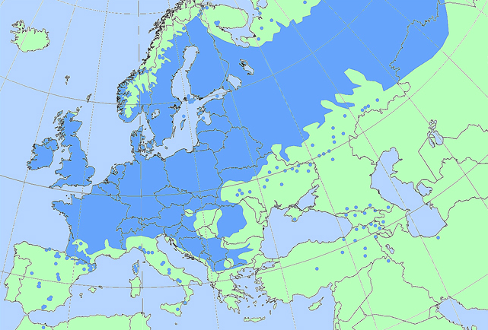
Birch (Betula pendula)

Slide 26
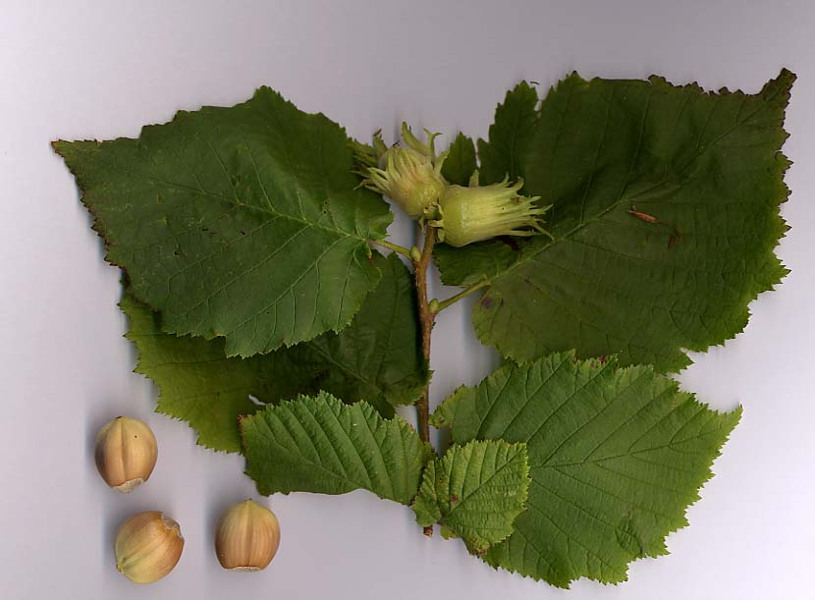
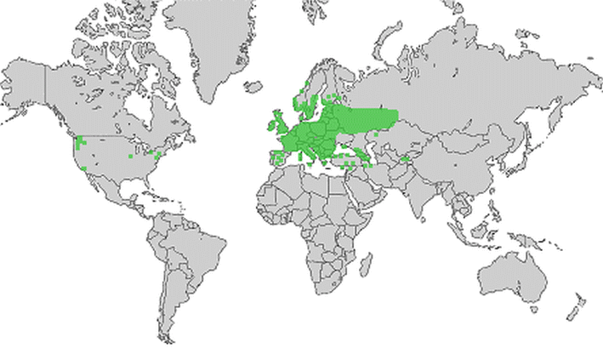
Hazel (Corylus avellana)

Slide 27
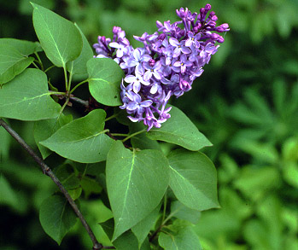
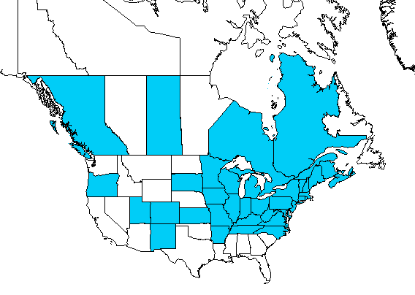
Lilac (Syringa vulgaris)

Slide 28
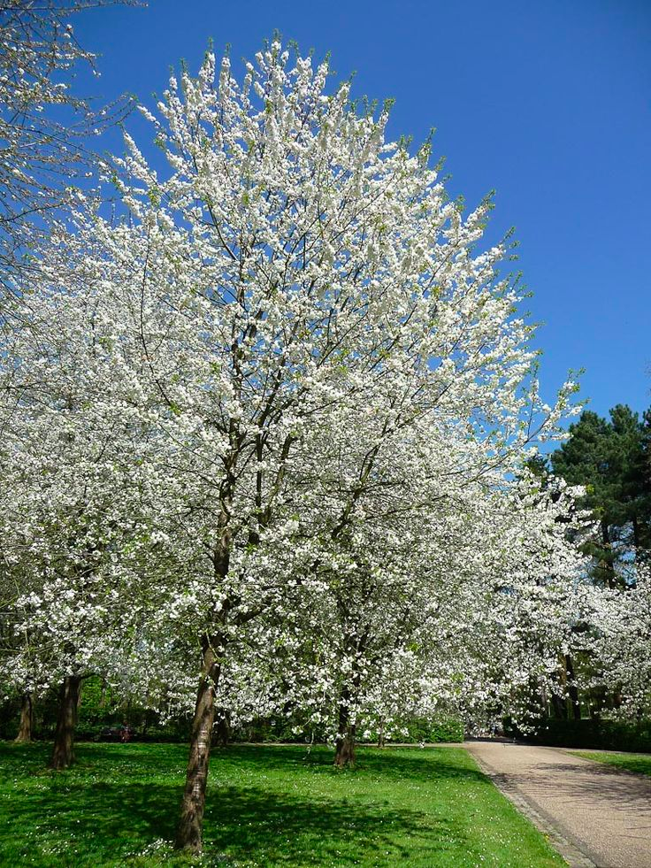
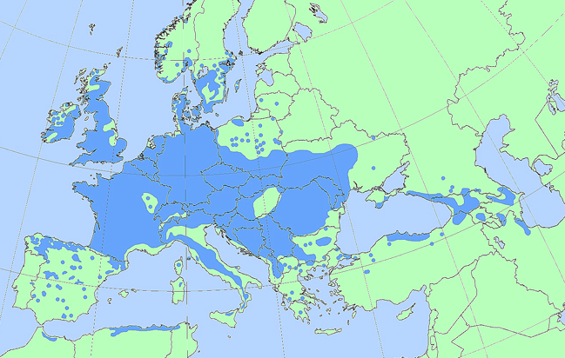
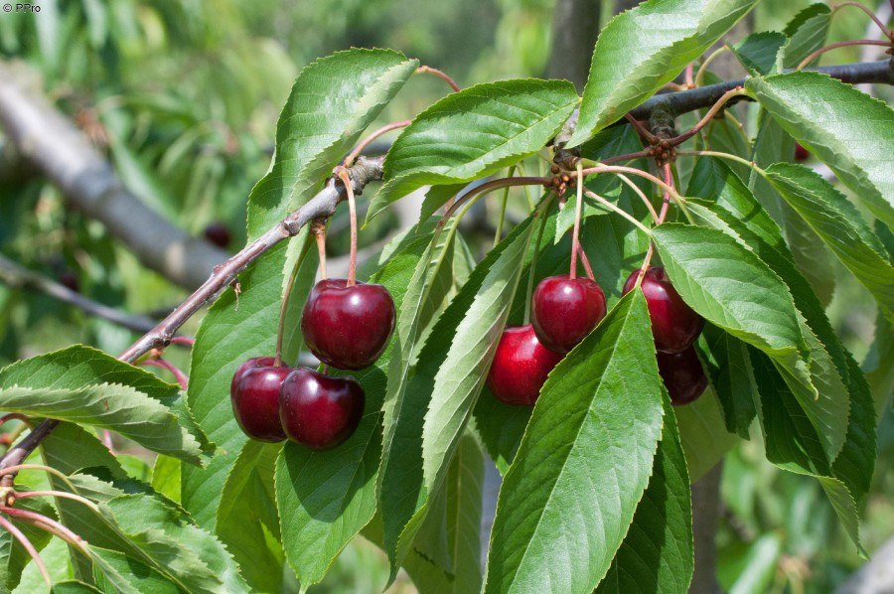
Wild cherry (Prunus avium)

Slide 29
Partners
EU (MYGEOSS)| funding building app
Ministry of environment | funding learning materials & outreach
GLOBE Europe & Eurasia board | organisation and outreach
Wageningen University | science
Leiden University | strategy app development
Geodan | development app
GLOBE | connection to database (API) and visualisation
GLOBE Netherlands foundation | coordination

Slide 30
Outreach

Slide 31
Planning
July 2016: first beta app version ready, presentation Colorado
September 2016: announce campaign to schools (in Europe & Eurasia)
September 2016: training of teachers and trainers in Cologne
November 2016: EU meeting in Sint Petersburg (Russia)
December 2016: app in Play/Appstore and learning materials ready in English
Spring 2017: official start

Slide 32
How will we facilitate you?
App (with translation module)
Learning materials in English that you can translate
Training during meeting in Cologne
Webpage with results and newsletters

Slide 33
How to join?
Go to www.globe.gov/web/european-phenology-campaign
Sign in to your account and click on
Help us (let us know using the ‘participation form’:
Scientist: train teachers, give feedback on results, use data
Teacher: give feedback on learning materials
CC: communicate the campaign to your teachers and train them
Everyone: help us test the app. Send us your e-mail so we can send you link to the latest updates

Slide 34
Discussion
Can you use the app in your country?
If you’re a teacher:
How can you integrate it into your teaching practice?
Whom of your colleagues at school would like to join?
Would you like to collaborate with another school? How?
What do you need from us? How can we help you to make this a success?
If you’re a cc or other:
Do you wish to set up a campaign in your country? How? When?
How do you want to communicate this to your schools?
What knowledge or partners do you need (for example collaboration with university, research institute….)?
What do you think could be improved in the app?
What do you need from us? How can we help you to make this a success?

Slide 35
www.globe.gov/web/european-phenology-campaign
Please let us know if you want to join and send us feedback!

Slide 36
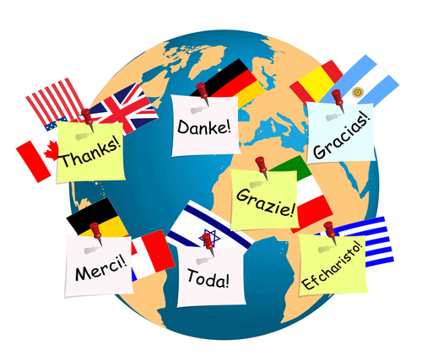
Matthijs Begheyn
matthijs@globenederland.nl

