Slide 1
Looking Ahead 2016-2017 Ming-Ying Wei Tony Murphy David Overoye

Slide 2
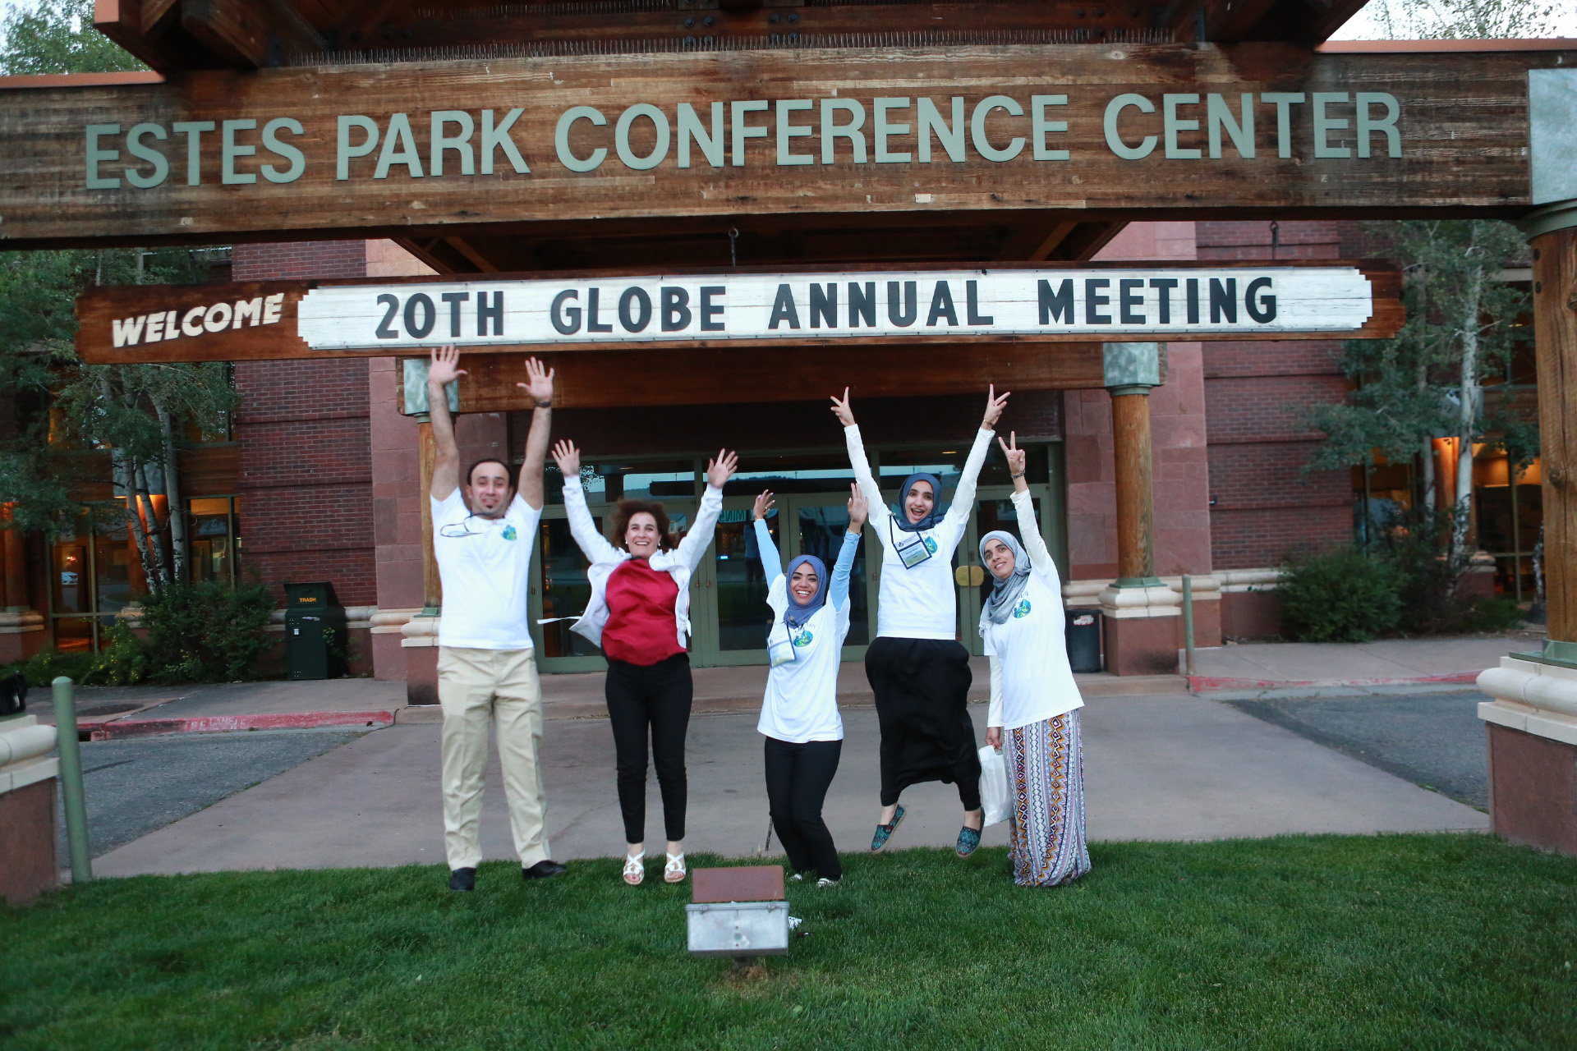

Slide 3
Technology – Goals for 2016/2017

Slide 4
Leverage Citizen Science work - Simplify while doing meaningful science
For Citizen Science, we create sites automatically
We make good use of mobile technology to simplify data input
We’re focused on simplifying the access to data
We’re focused on quick and interesting feedback
Adding more protocols to Citizen Science GLOBE Observer app
Mosquitos
Adopt a pixel [land cover]

Slide 5
Data Access
Open up access to the GLOBE database of observations
Documented API for putting data in to GLOBE
Other apps, sensors
Student apps
Documented API for taking data out of GLOBE
Other visualizations and sharing
Integrate across tools
After you submit data
See a chart of data for the last 30 days
See a list of other schools who’ve also submitted the same protocol data
See how close you are to honor roll status

Slide 6
Collaboration
Focus on who is doing the work actively
How can we better recognize those who are active
How can we better connect those who are interested and active

Slide 7
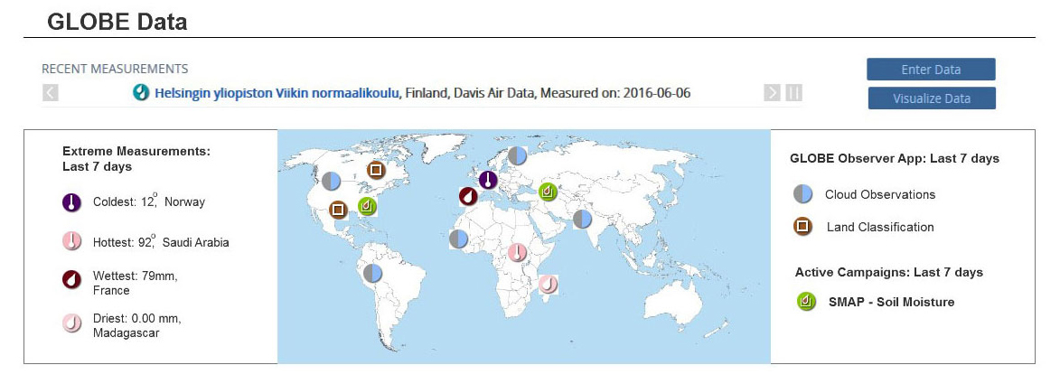
Redesign of the home page

Slide 8
Science and Analysis
New and improved Protocols
Lilacs
Aerosols
Frost Tube
In Review – Hydrocolor, Fire fuel and othes
Enhancing visualization and data retrieval

Slide 9
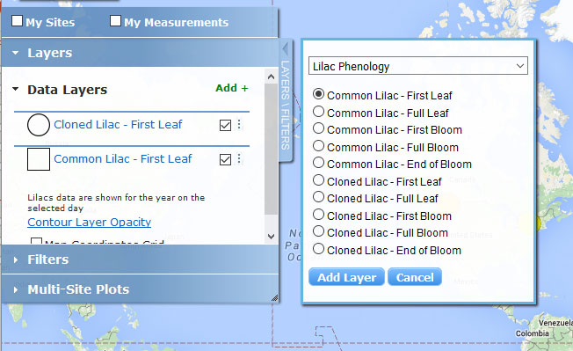
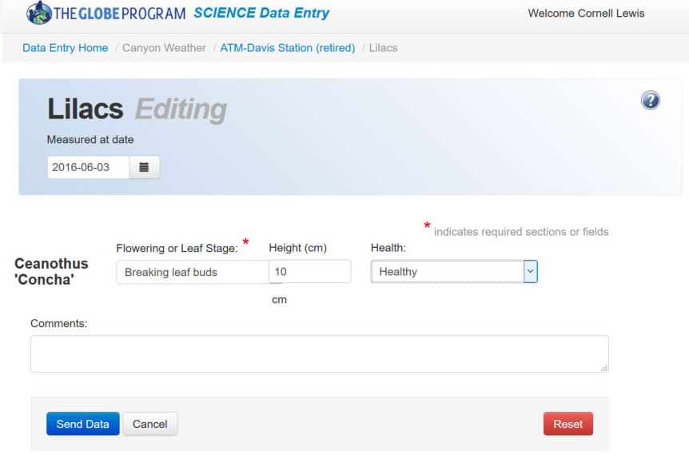
Protocol: Lilacs Phenology (early August)
Data Entry
Visualization

Slide 10
Major upgrade to Aerosols Protocol Interface
Modify interface to more closely match how you collect data
Won’t require you to enter wavelengths over and over!
Trial 1 UTC Time (24 hr)
Manual Input with seconds
(UTC)
Channel Wavelength nm AOT Reading
619
Prepopulate
wavelengths
Channel Wavelength nm AOT Reading
540
Channel Wavelength nm AOT Reading
465
Trial 2 UTC Time (24 hr)
(UTC)
Channel Wavelength nm AOT Reading
619
Channel Wavelength nm AOT Reading
540
Channel Wavelength nm AOT Reading
465

Slide 11
New Visualization Capabilities
Save visualization/ADAT filters to reuse and share
View Summary Data Layers – to view specific monthly climate values
View data over time animation
Additional languages to be translated

Slide 12
Technology
Data Entry App V 1.2 – multiligual, Site Creation
Look to Leverage Advances built for GLOBE Observer

Slide 13
Demos - GLOBE Observer

Slide 14
Thank you
You provide us the input, direction and corrections to continue to improve GLOBE to make it a world class environment to do science

Slide 15
Citizen Science
GLOBE Observer starting with clouds Next measurements Mosquitos Early 2017
Adopt-a-Pixel Summer 2017
“Campaigns”
Clarify campaigns, challenges, partner/mission collaborations, etc.

Slide 16
eTraining
feedback about system
process
Slides: common errors
translation of slides
eTraining: Videos Possible process:
Call for application HS or alumni or pre-service Select protocols that they are good at Create a short video on the protocol
Plan for a professional shoot

Slide 17
New GLOBE Learning Activities
9 activities
Mixture of middle and high school activities
Using GLOBE data sets
Regions represented in the activities
Additional new Learning Activities:
Pilot program:
Development of contemporary activities
Aligned with NGSS
Associated professional development with the activities

Slide 18
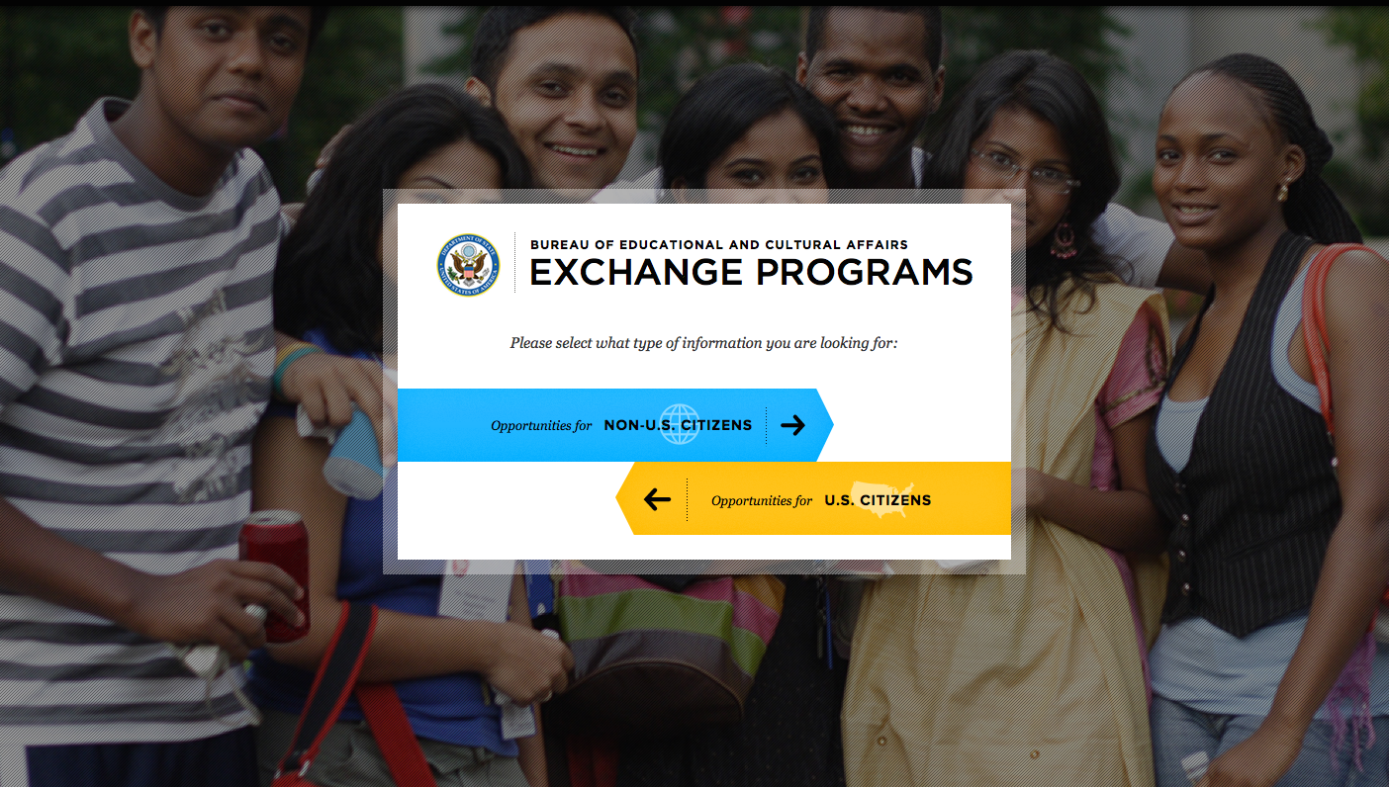
Dept of State Teacher Exchange
https://exchanges.state.gov

Slide 19
International Virtual Science Fair
3 April 2017 Reports Due
15 May 2017 Scores and badges announced
Some restructuring of the categories
addition of undergraduate section

Slide 20
US Funding Opportunities
NSF Solicitation
A number of proposals being submitted
An additional ‘bootcamp’ may be possible
NASA Funded Education Projects
Elena Sparrow: Climate Change
Kevin Czajkowski: Articulation of materials
David Bydlowski: Aerokats and Rovers
NOAA funding
Peter Schmidt
Other US Partners BWET

Slide 21
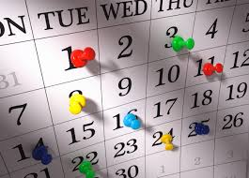
Calendar
Getting a calendar on the site

Slide 22
Ongoing Work
Working Groups
Continue to meet throughout the year
If you have any ideas or thoughts, connect with them
http://www.globe.gov/globe-community/globe-working-groups
GISN
Encourage scientists and STEM professionals to join
http://www.globe.gov/web/globe-international-stem-network

Slide 23
Ongoing Work
Information Packets
http://www.globe.gov/support/media/one-pagers
Templates
http://www.globe.gov/news-events/globe-stars
News Items
Send to communications@globe.gov

Slide 24
Ongoing Work
Regional Meetings
Country and regional hosted GLOBE camps;
student research exhibitions
Country and regional science campaigns

Slide 25
Ongoing Work
Annual Meeting
Presentations from this meeting
http://www.globe.gov/news-events/meetings_symposia/annual-meetings/20th-annual-meeting
In US, in July
Exact location TBD

Slide 26
