Slide 1
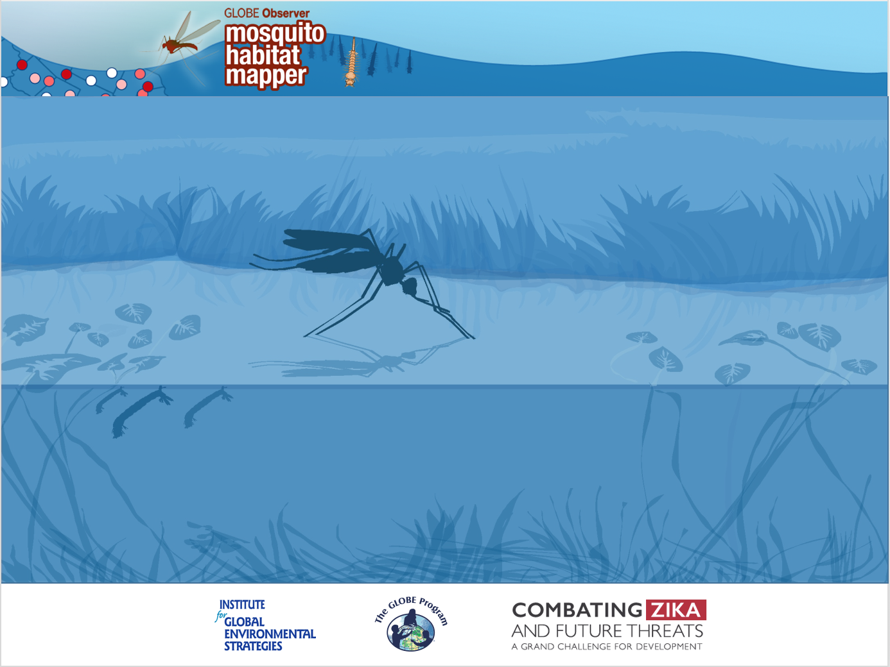
Tutorial
Mosquito Habitat Mapper

Slide 2
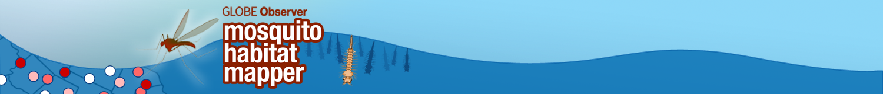
Overview
This presentation:
Provides background information to prepare citizen scientists to use the GLOBE Observer Mosquito Habitat Mapper
Provides the step by step instructions for obtaining
a mosquito sample for analysis

Slide 3
Overview
Learning Objectives
After reviewing these slides, you will be able to:
Recognize potential mosquito breeding sites
Sample water for mosquito larvae
Identify mosquito larvae and differentiate between Aedes, Anopheles, and Culex larva.
Understand the importance of removing extraneous containers with standing water from around your neighborhood and community

Slide 4
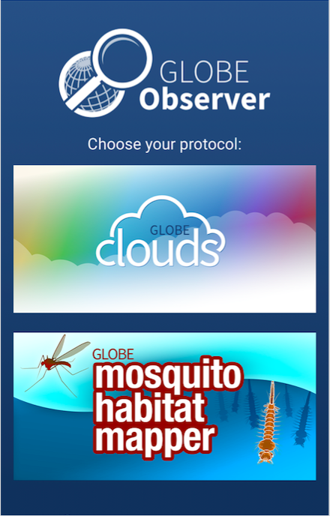
GLOBE Observer is an international network of citizen scientists and scientists working together to learn more about our global environment, including our changing climate and its impacts.
Mosquito Habitat Mapper

Slide 5
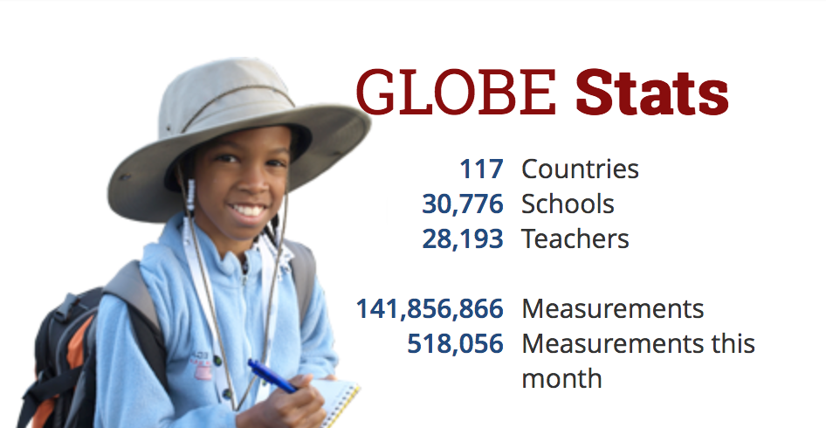
GLOBE Observer is part of The GLOBE Program. Data collected by citizen scientists through GLOBE Observer encourages student research, strengthens science education, and supports the work of scientists.

Slide 6
The goals of the MHM app are to SEE increased mosquito awareness and decreased mosquito-borne disease risk through:
Scientific data collection and analysis: Identifying locations of mosquito taxa of interest to participants, communities, public health authorities
Empowerment: Actively reducing mosquito risk- by dumping containers and monitoring environment
Education: Learning opportunistic breeding habits used by Aedes aegypti/albopictus in human built environments and about vector borne disease risk communities

Slide 7
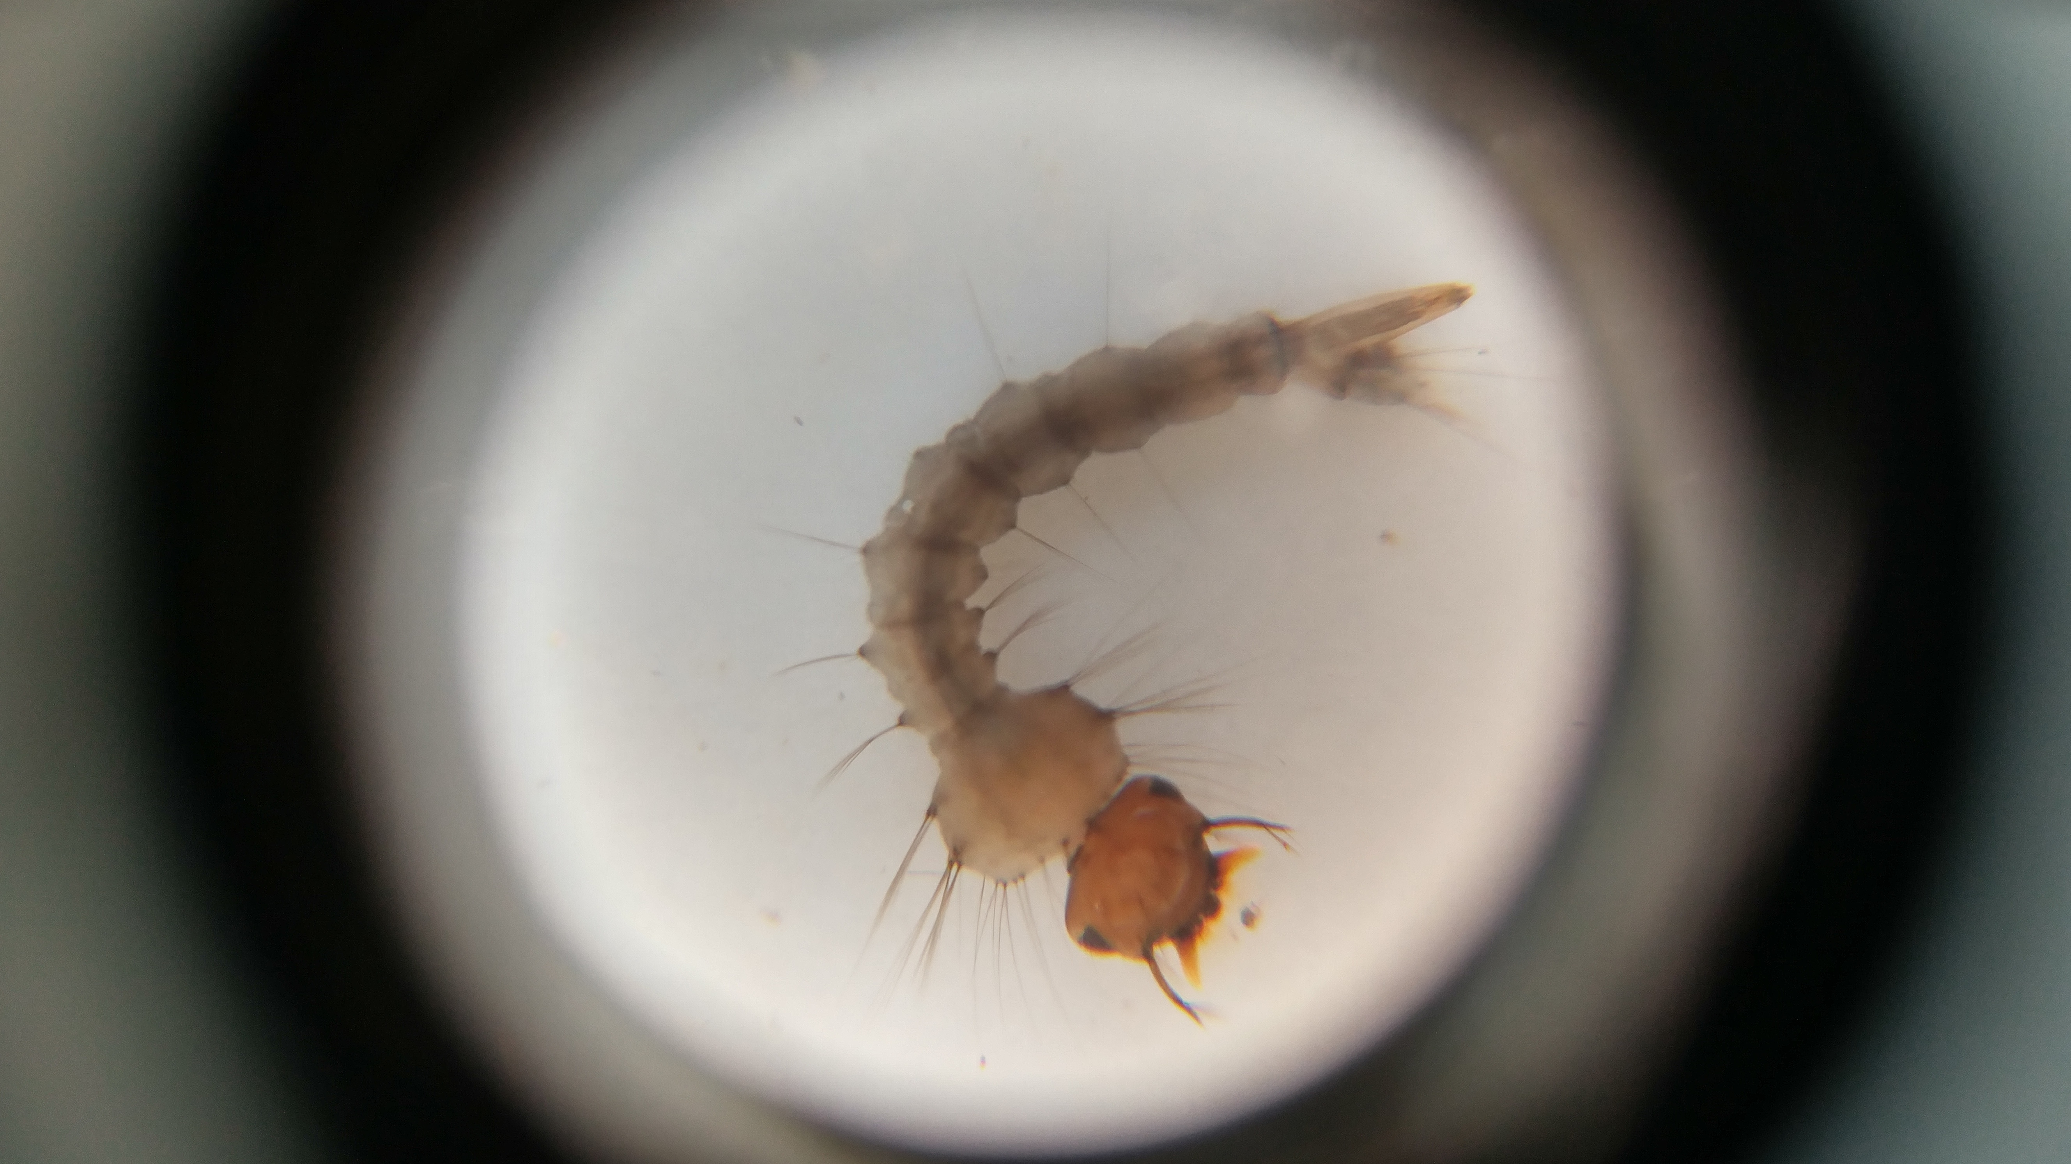
Our investigation focuses on mosquito larvae- an immature developmental stage that lives in water, doesn’t bite and doesn’t pose a health hazard to humans!

Slide 8
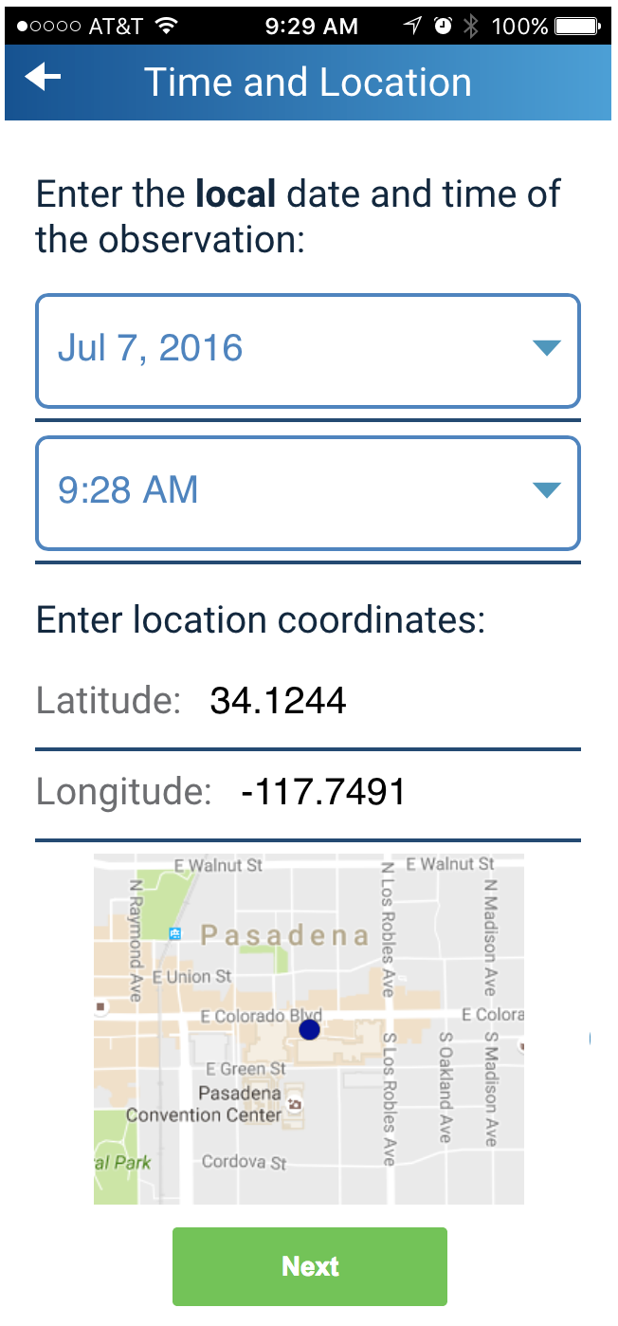
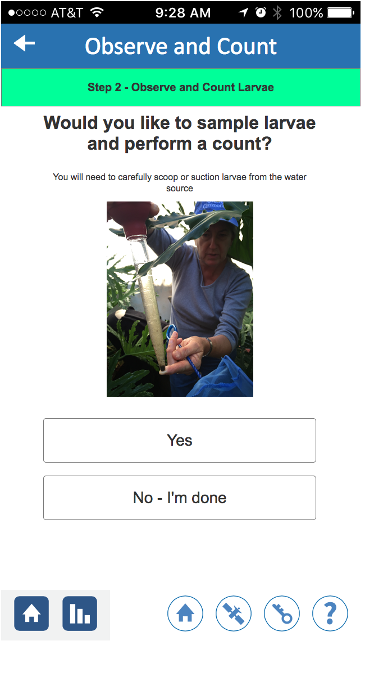
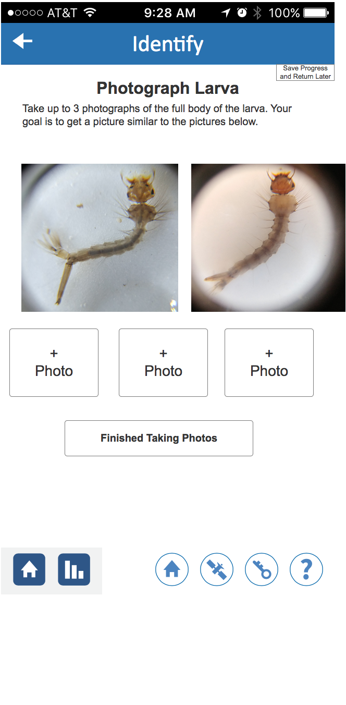
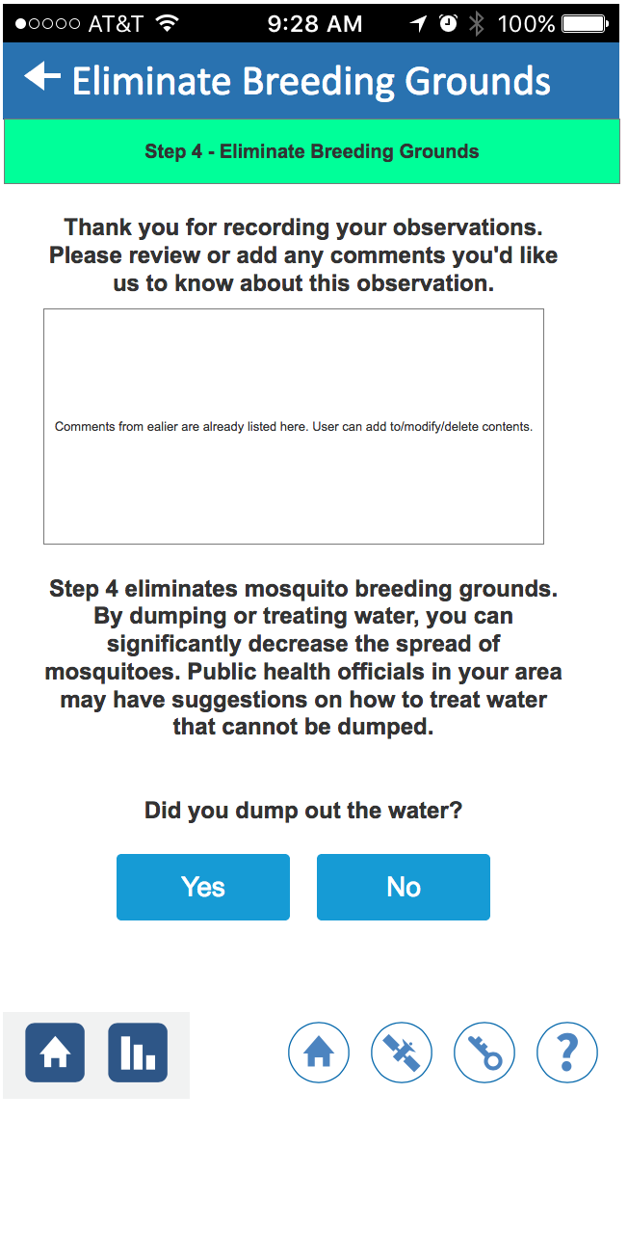
The Mosquito Habitat Mapper supports you through 4 data collection steps:
Locate Sample/Count Identify Decommission
1 2 3 4

Slide 9
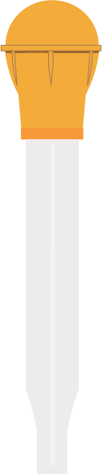
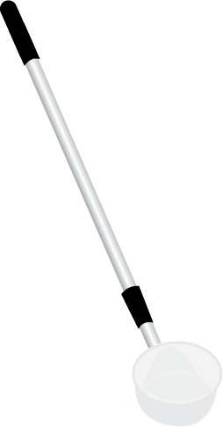
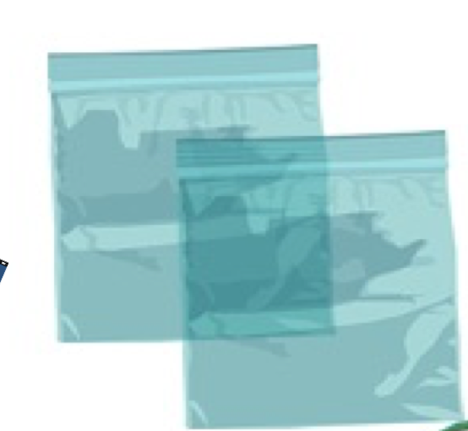

Equipment Needed for habitat mapping and sampling:
GO Mosquito Habitat Mapper on a mobile device (e.g., phone or tablet) for recording and submitting data.
Mosquito dipper, ladle, cup or bulb syringe (or a net, bucket, and wash bottle) for sampling. (Contact your local mosquito control authority for any recommendations)
Plastic bag and marker for saving or transporting water samples with larvae and labeling the bag.

Slide 10
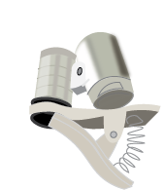
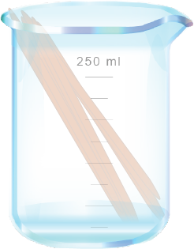
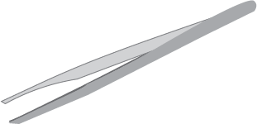


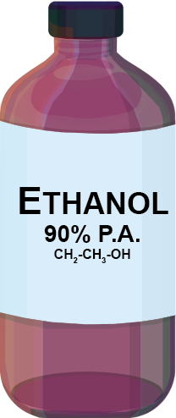
Equipment needed for Identification
Macro lens attachment for mobile device (35x) or microscope. (Some features can be seen with a good magnifying glass.)
Toothpicks, tweezers or forceps to move larvae for viewing
White plastic or paper plate
Paper towels
Ethanol for euthanizing specimens or preserving samples (optional)
Plastic or glass vials for specimen storage (optional)

Slide 11
Citizen Scientist Safety
Note: most mosquitoes do not transmit pathogens to humans or cause disease.
Protect against mosquito bites:
Wear long sleeves, pants, socks and shoes.
Apply an effective insect repellent to exposed skin.
Protect from polluted or unsafe water:
Wear gloves and/or goggles.
Avoid sampling on private property:
Sample in your own yard or in public areas. Do not take samples on
private property unless you have obtained permission.
✔Recommended: goggles and gloves for safety

Slide 12
Data Collection using the GO
Mosquito Habitat Mapper

Slide 13
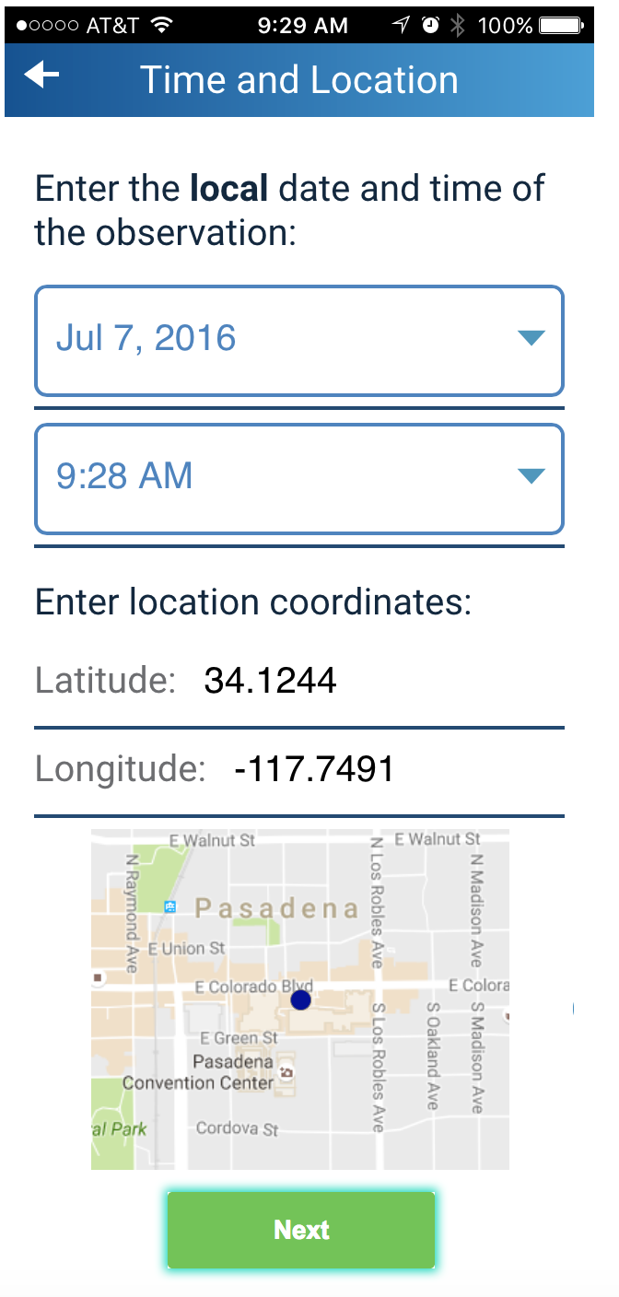
Step 1. Locate Breeding Sites
Open GLOBE Observer Mosquito Habitat Mapper.
The app will automatically download the date, time and the latitude / longitude of your location.
You will be able to verify the location by the map that is provided.
Note: You can use the app whether or not there is Wi-Fi at your sampling location. All recorded data will automatically be sent when Wi-Fi becomes available!

Slide 14
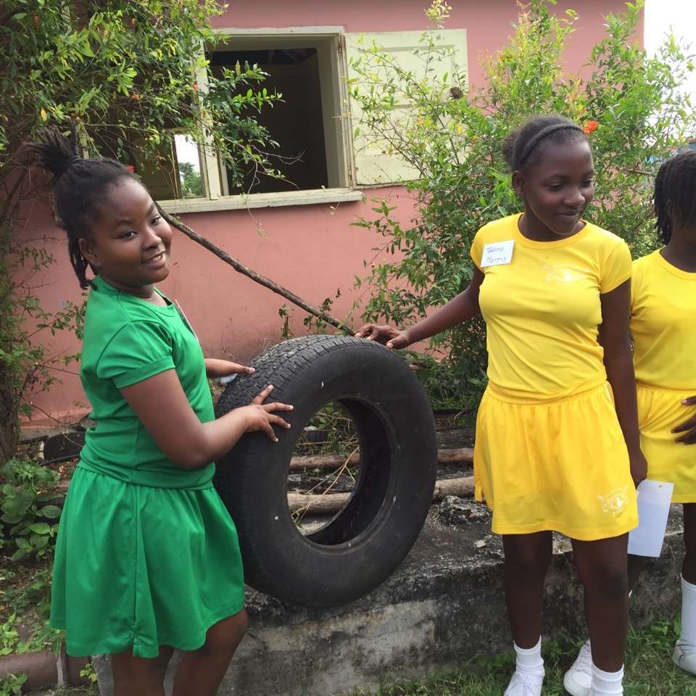
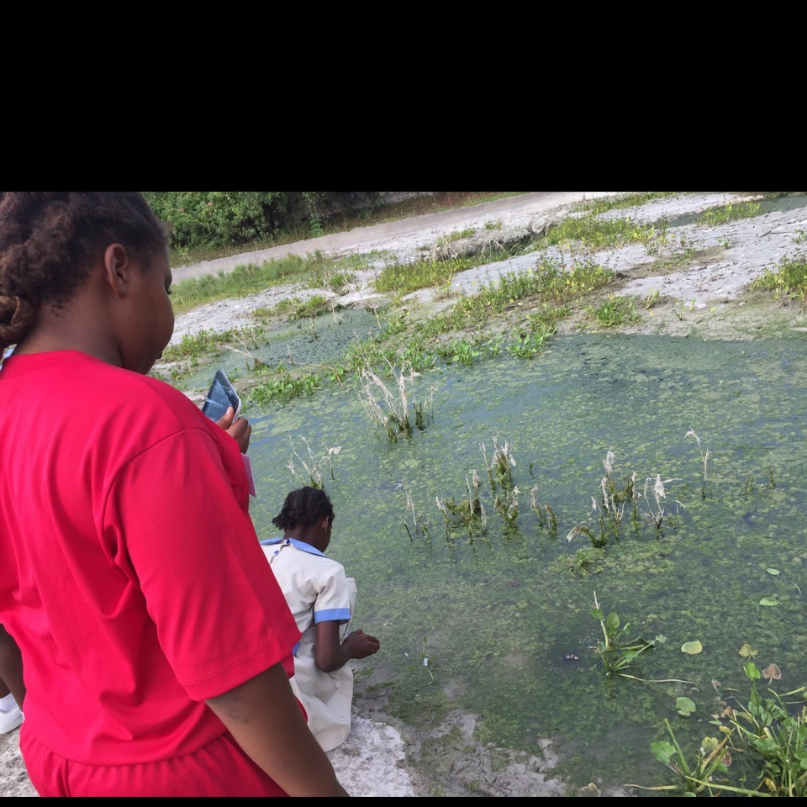
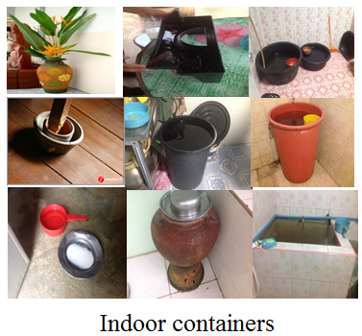
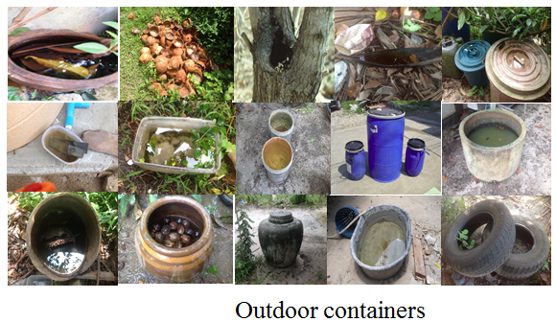
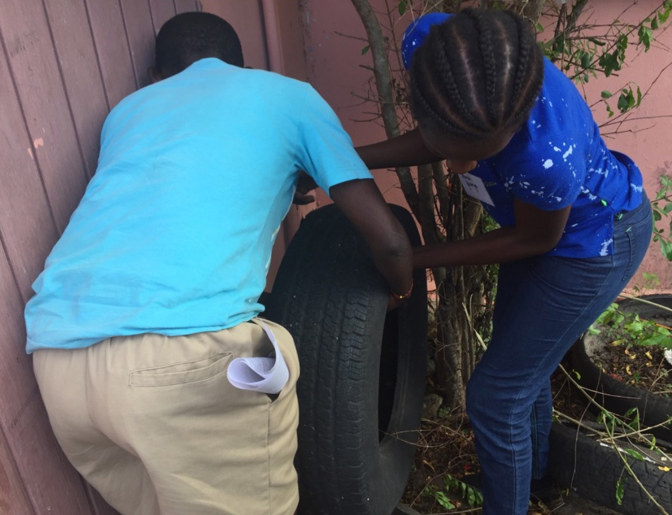
Locate sources
Locate sources of standing water. Check the surface of the water for mosquito larvae.

Slide 15
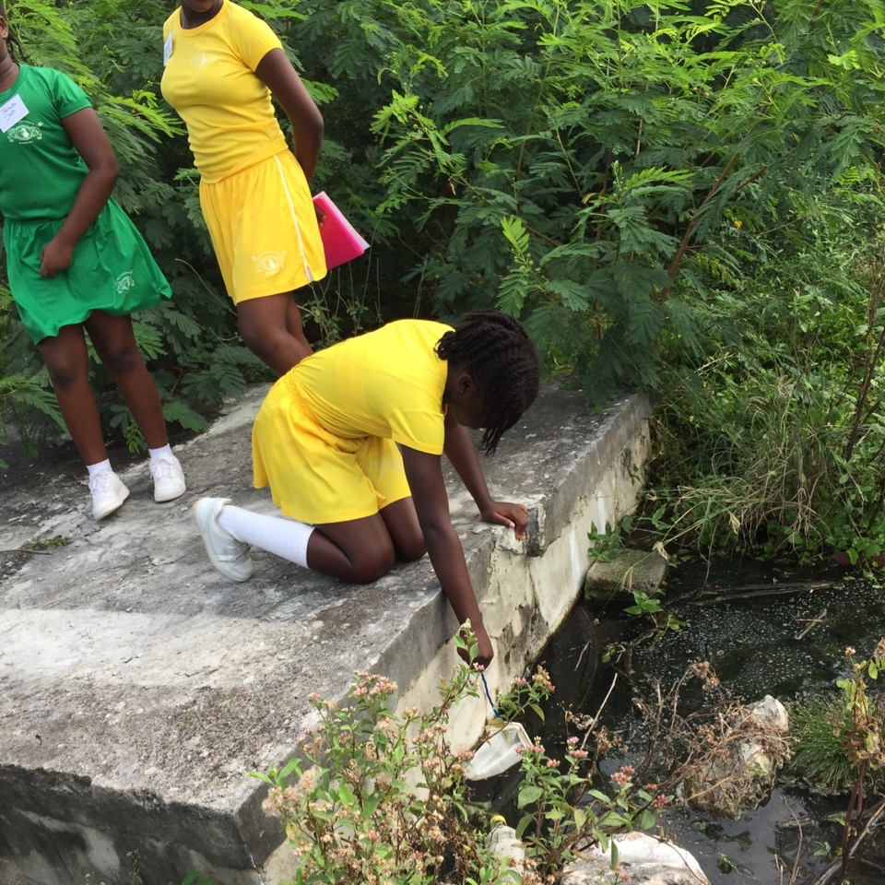
Step 2: Sample and Count
Use your sampling tool (whether a cup, syringe, dipper, net/wash bottle) to obtain a water sample containing larvae.
Protocols for gathering samples vary according to the tool used. Use the one that works best for your situation.

Slide 16
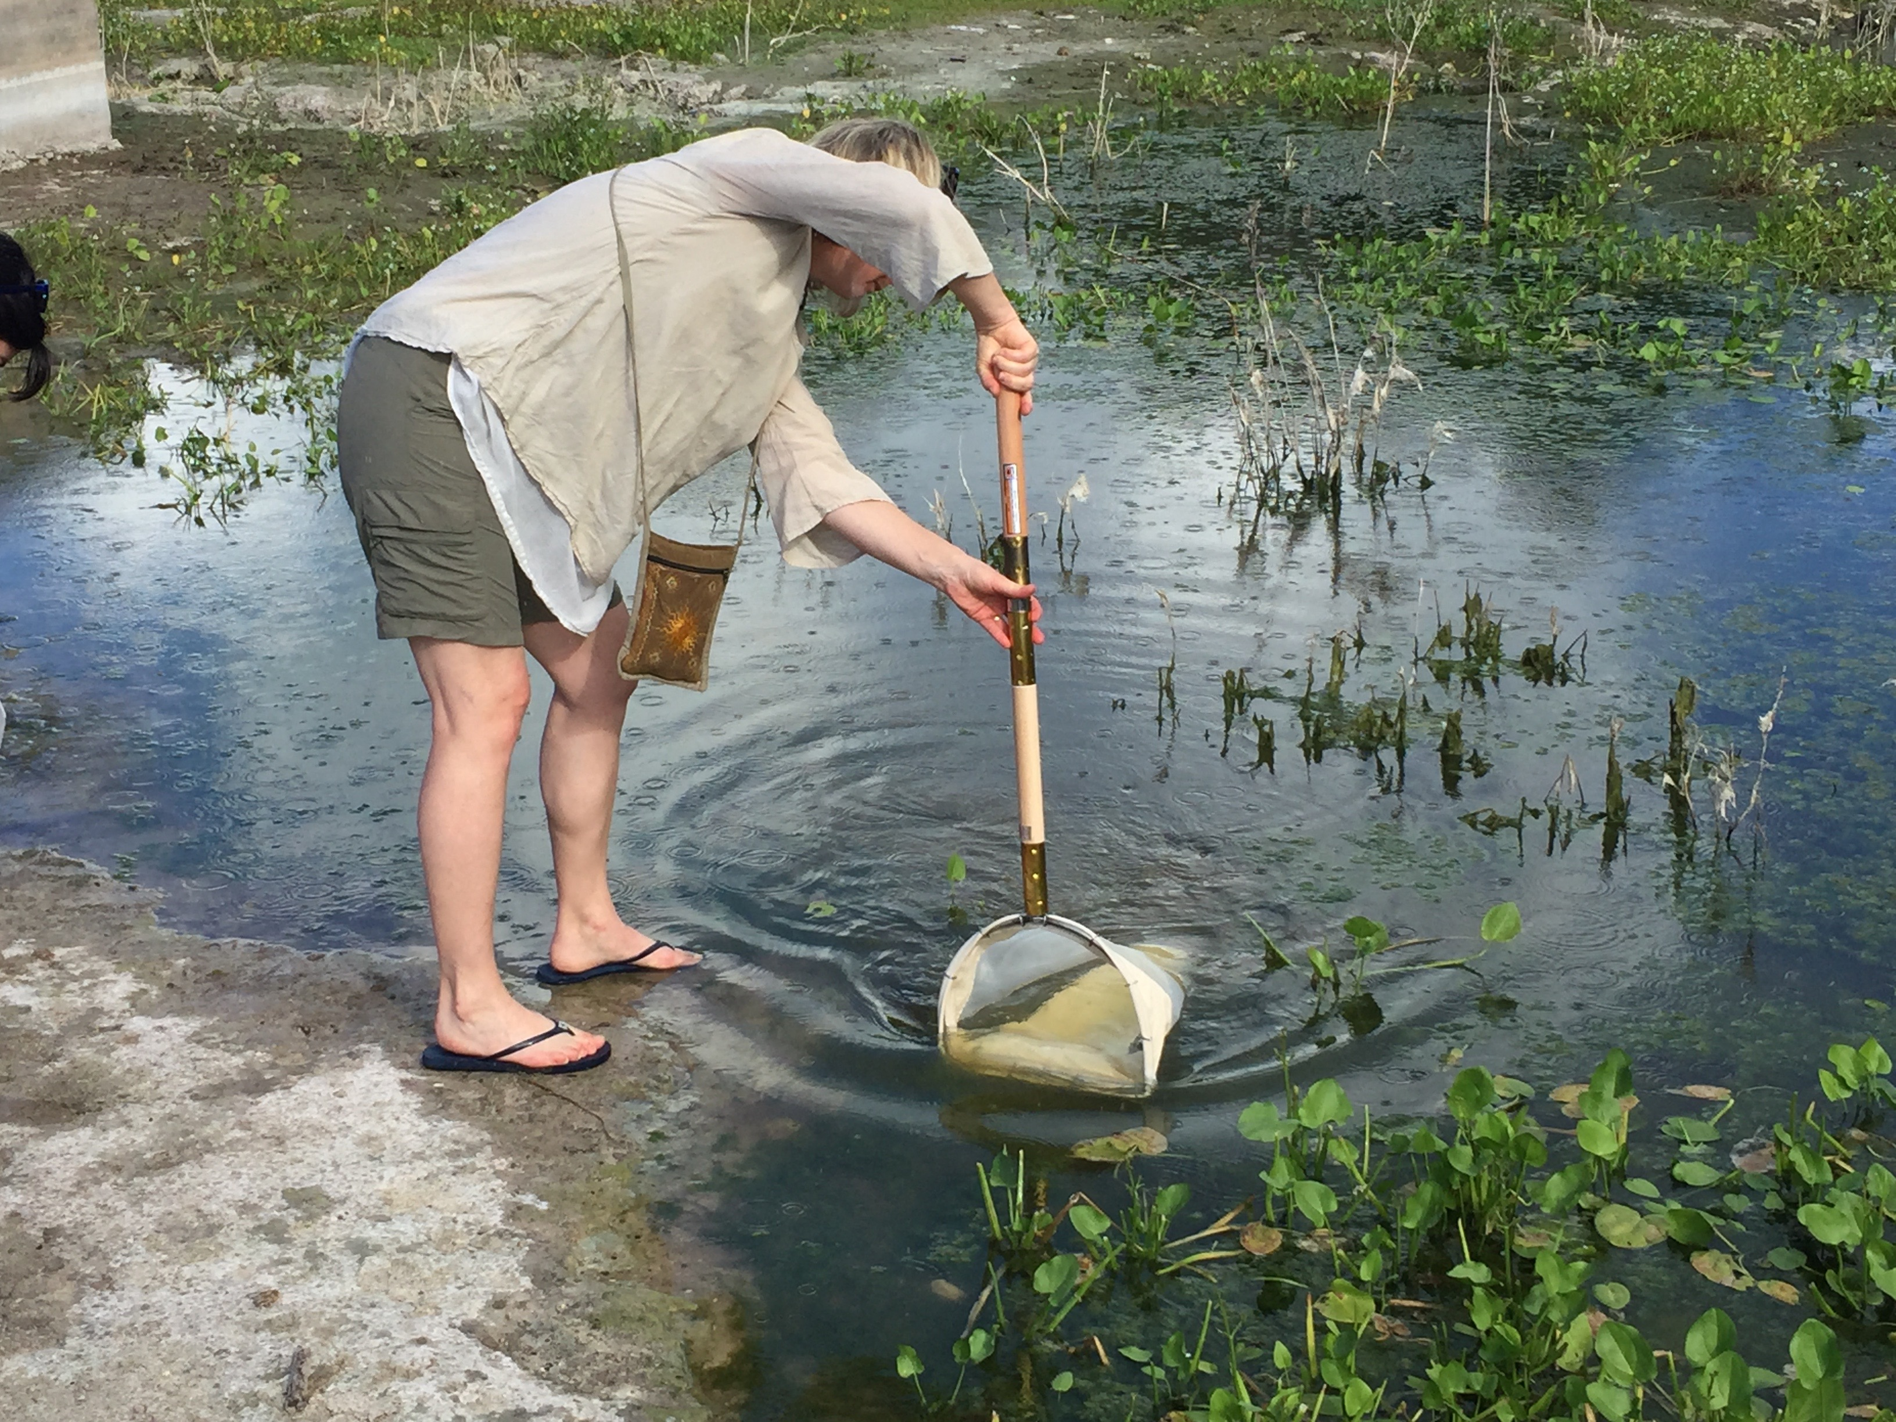
Importance of taking multiple dips
But no matter which tools you use, GLOBE recommends sampling each source 5 times. Because the larvae are not evenly distributed on the surface, so you may need several dips to obtain a sample with larvae in it.
Wait a couple minutes between each dip. Why? When you disturb the surface of the water, the larvae will swim below for safety. However, they will soon return to the surface because they have to breathe.
Technique for using a net or a
mosquito dipper in a small pond

Slide 17
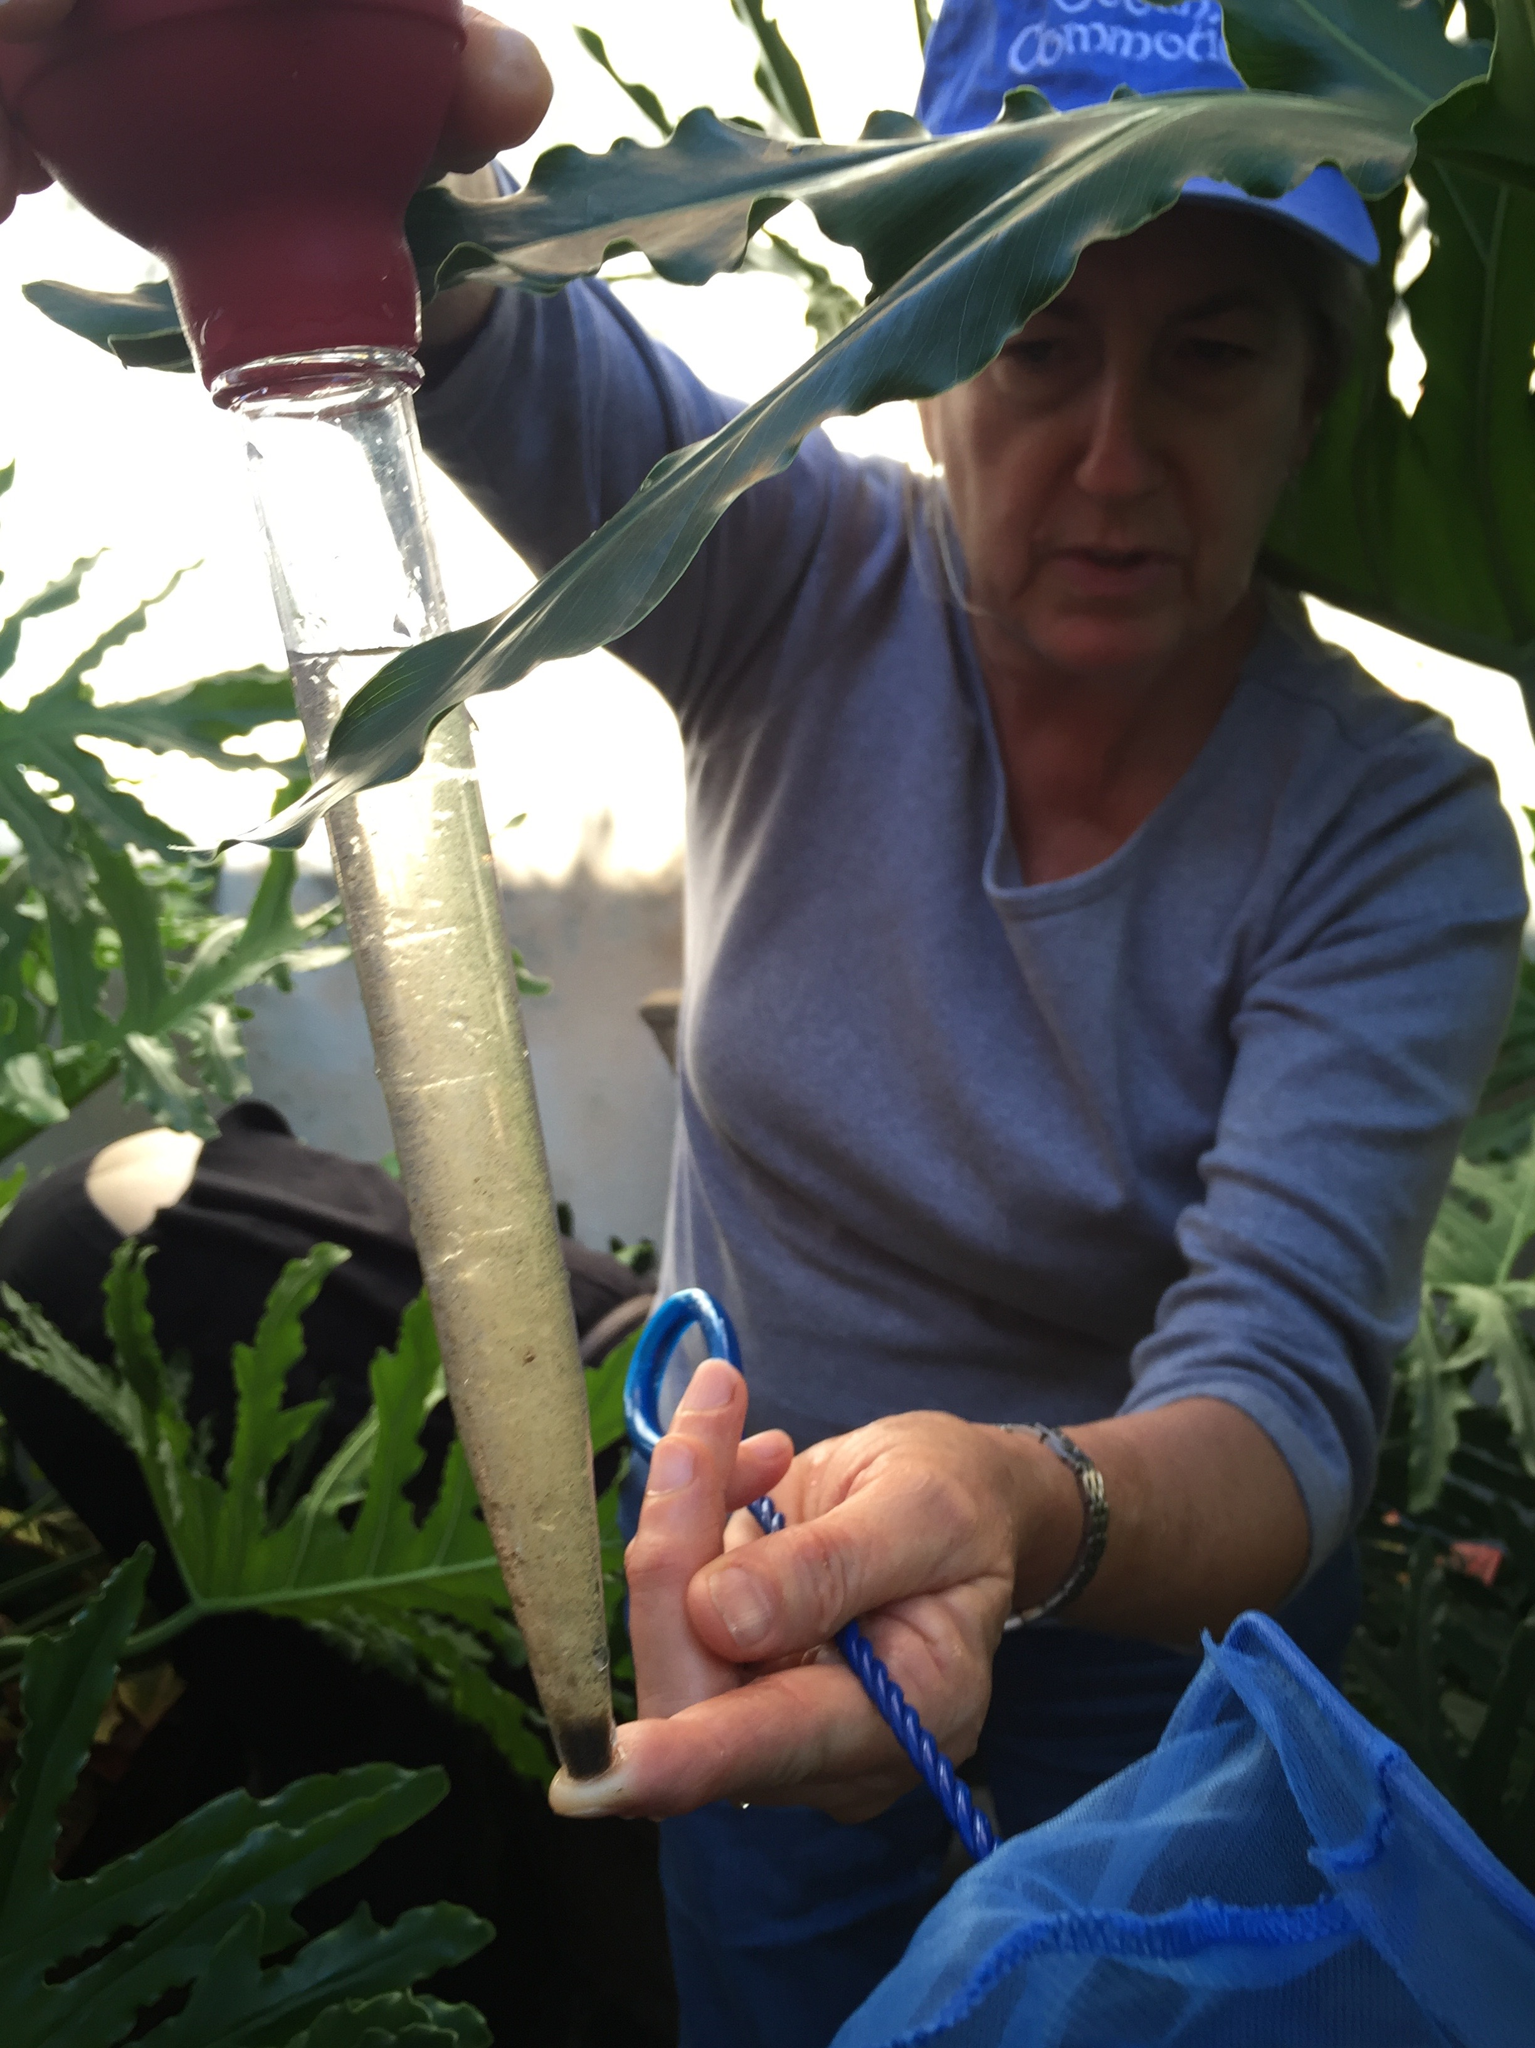
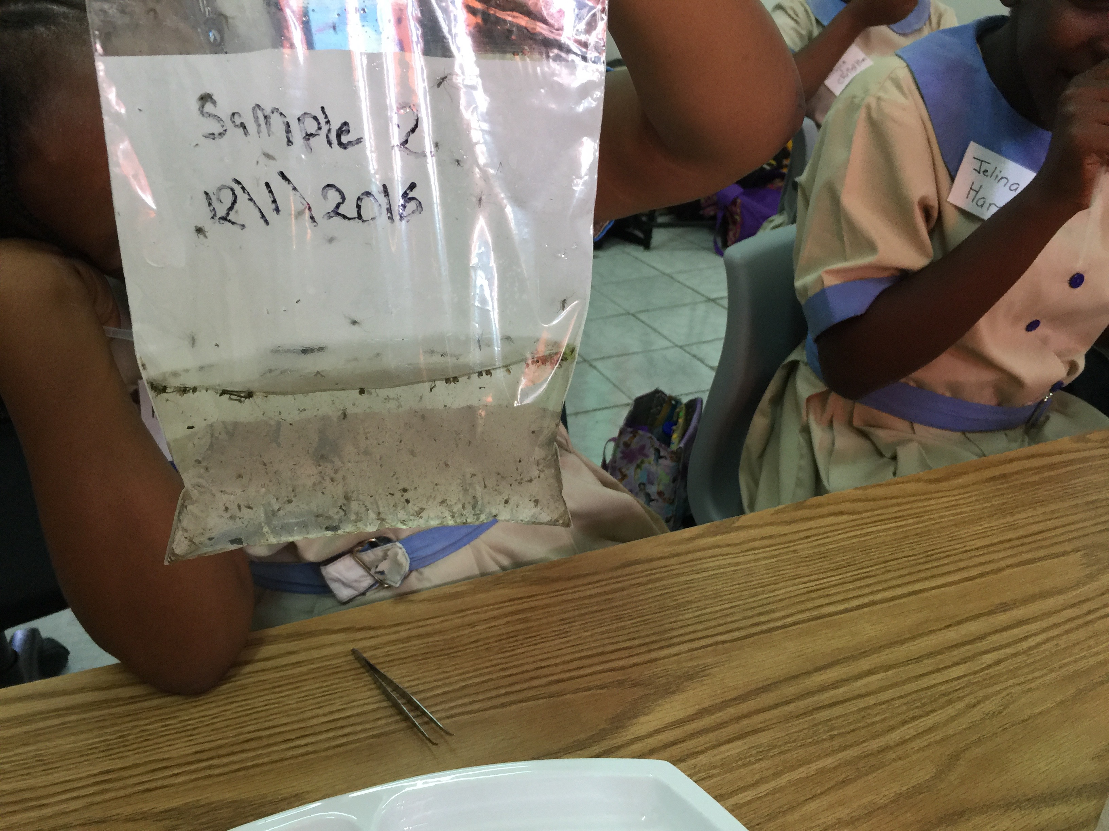
Sampling Method 1: Bulb Syringe
This method is appropriate for all environments and sampling sites.
Steps: 1.Press and collapse bulb. 2. Place syringe tip near the top of the water surface. 3. Release bulb so bulb inflates and water enters the syringe. 4.Transfer sample to plastic bag by holding tip and then releasing the sample into the bag.

Slide 18
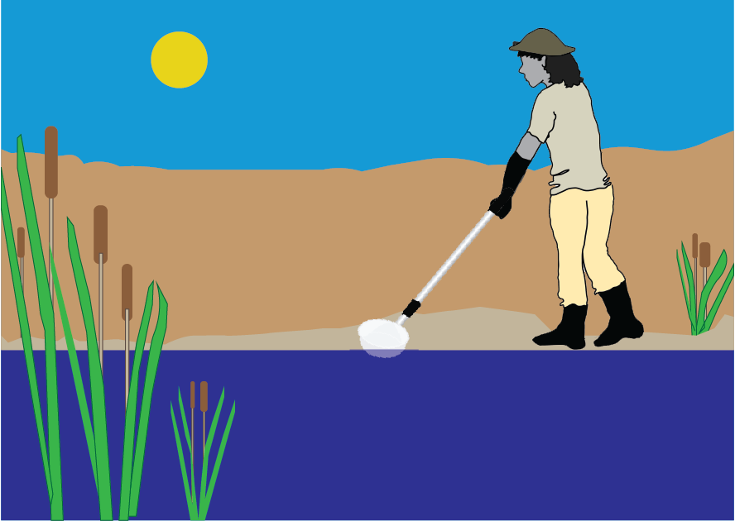
Sampling Method 2: Dipper
You can use a mosquito dipper, a soup ladle, or even a plastic cup when sampling either a container or a non-container site.
Steps:
Skim the upper most surface of the water with the dipper at an acute angle with respect to the water surface.
Transfer your sample to a sample bag. (You can put all your samples in the same bag.)

Slide 19
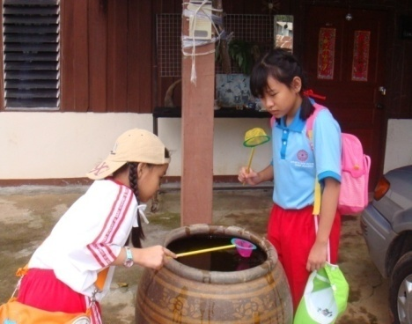
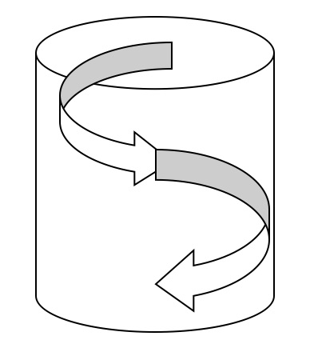
Sampling Method 3: Net sample from large container
Large water containers are those that hold 500 L or more of water. Examples include large water jars, water pools, and cement tanks.
Steps:
1. Dip the net in at the surface of the water.
2. Start at the top of the container by swirling the net around the edge. 3. Continue to the bottom in a swirling motion- sampling all edges of the container.

Slide 20
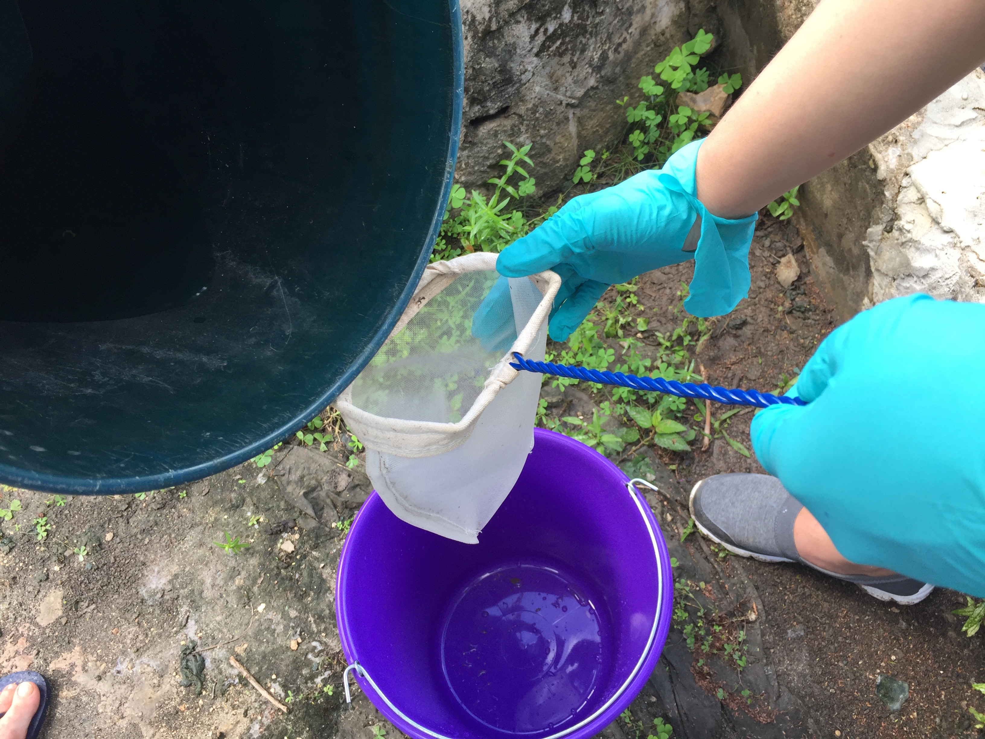
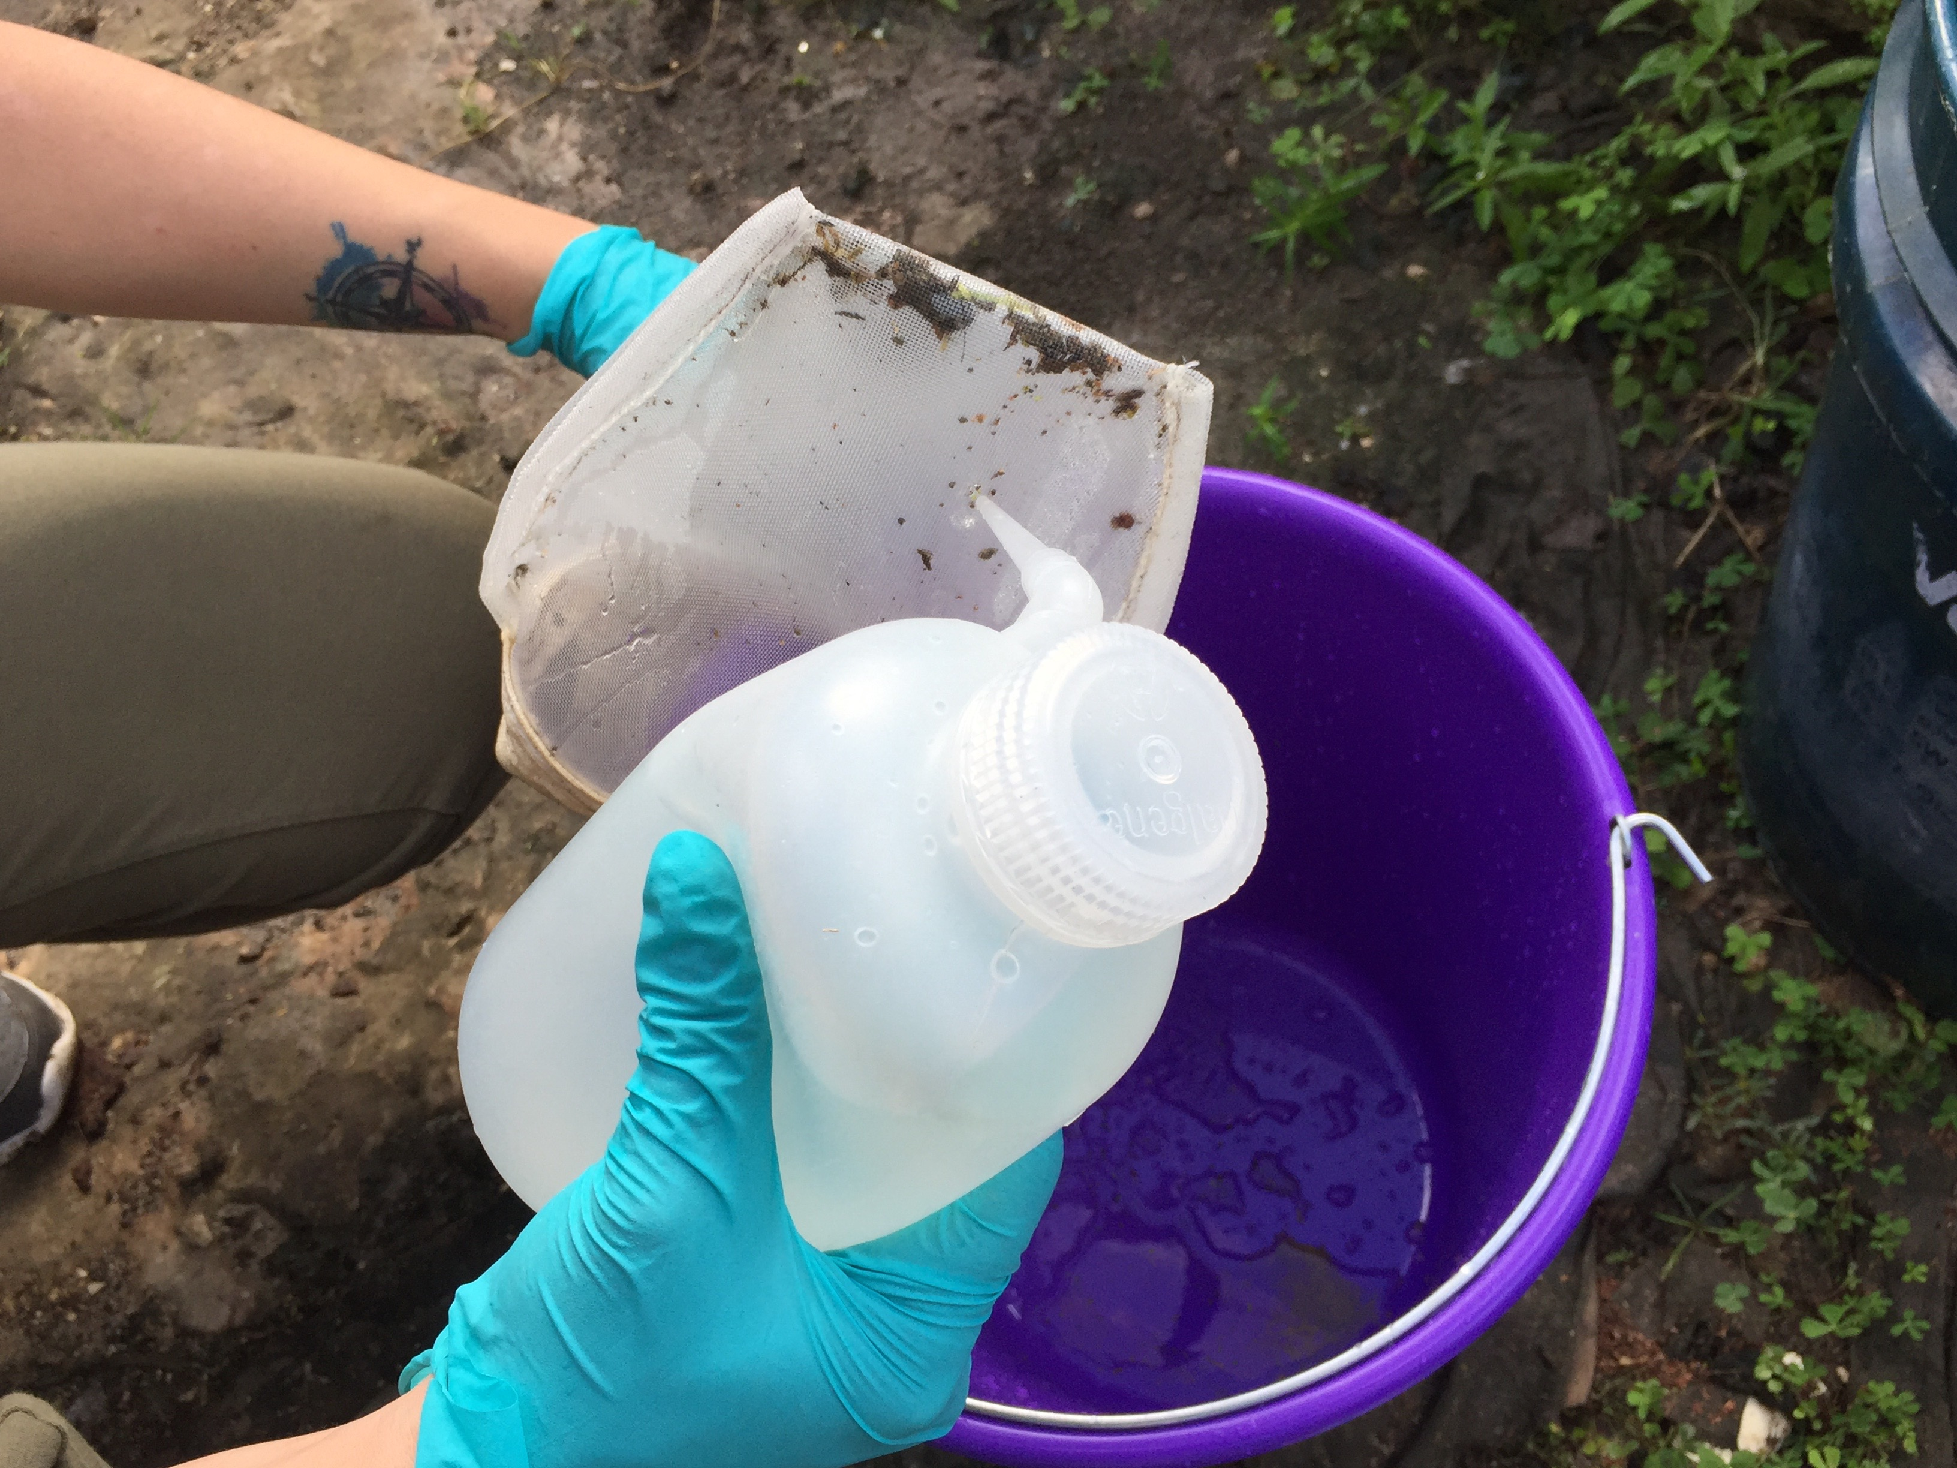
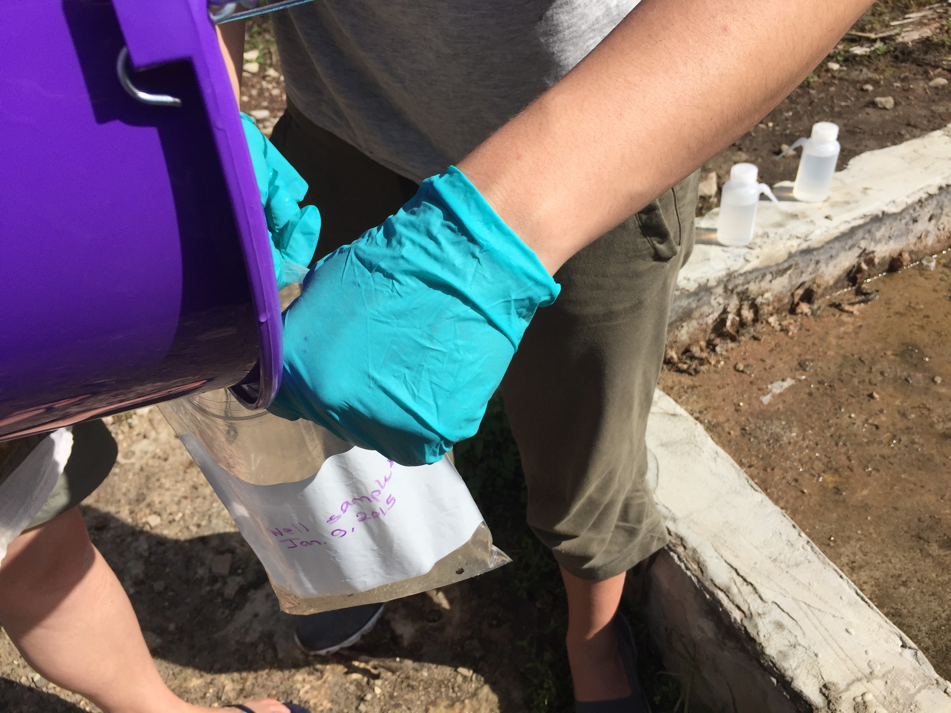
Sampling Method 4. Net sample from small container
Steps:
1.Pour water from the container holding the sample througha collection net into a separate bucket.
2. Use a squirt bottle filled with water to wash any trapped debris into the bucket.
3. Pour sample from bucket into a plastic bag(s).

Slide 21
Handling Samples
You may want to take your sample inside to identify your specimen
Leave air in bags so that larvae can breathe.
Keep bags cool and in the shade (overheating will kill larvae).
Identify the larvae soon after collection. If left overnight, any pupae in the sample may become adult flying mosquitoes.
If you find adult mosquitoes in your sample bag, shake the bag to drown the adult mosquitoes and dispose of the sample by pouring all contents on the ground.

Slide 22
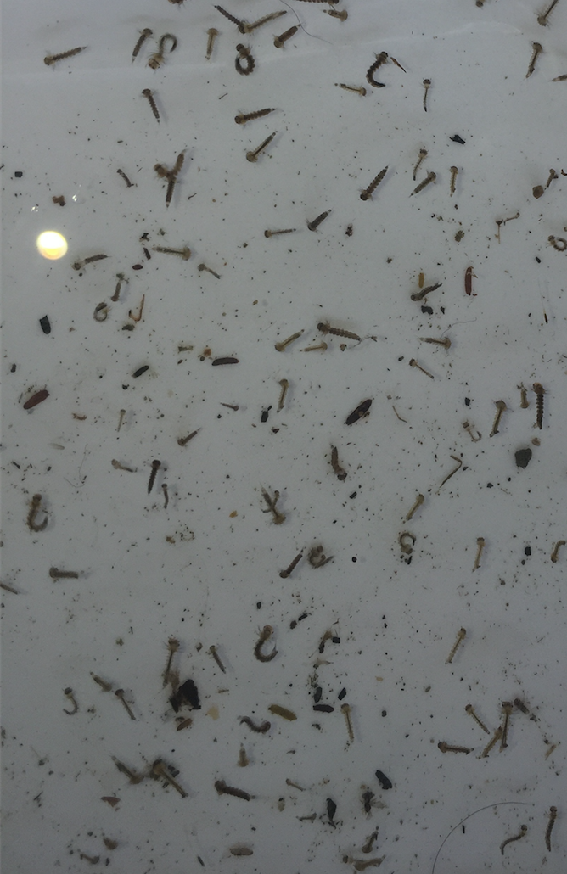
Step 2: Sample and Count
Count the number of larvae in your sample. You can provide an exact number or an estimate.
For example, in the sample to the right, the larvae count is estimated to be 75-100.
Using this same sample photo, it is important to note that not all of the larvae look the same. Why do you think they are different?

Slide 23
(Answer)
This sample has larvae from different stages of development.
We will show you what we mean in the next few slides.

Slide 24
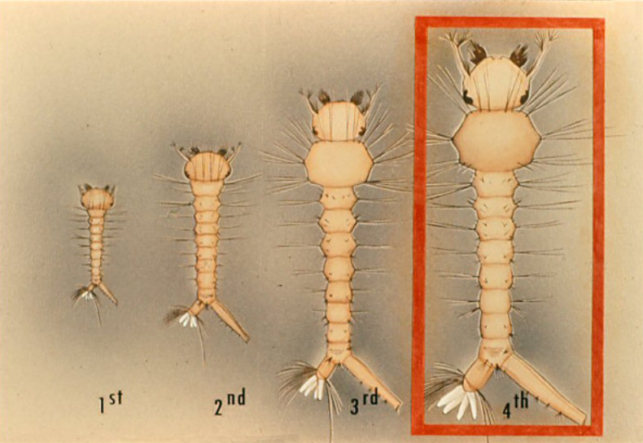
After hatching from its egg, the larva is in its first instar (stage between molts). It eventually outgrows its exoskeleton and molts (loses its outer covering) to become a second instar. It does this two more times to reach the fourth instar. The fourth instar is the larval stage that is most visible, reaching a length of one-half inch.

Slide 25
The features used to identify your specimen are seen on the
4th instar larva- so look for the biggest larvae in your sample.
If you can’t distinguish any features, it is possible that the larvae are still in an earlier instar stages. If that is the case, you can count your larvae, but you will not be able to identify features.

Slide 26
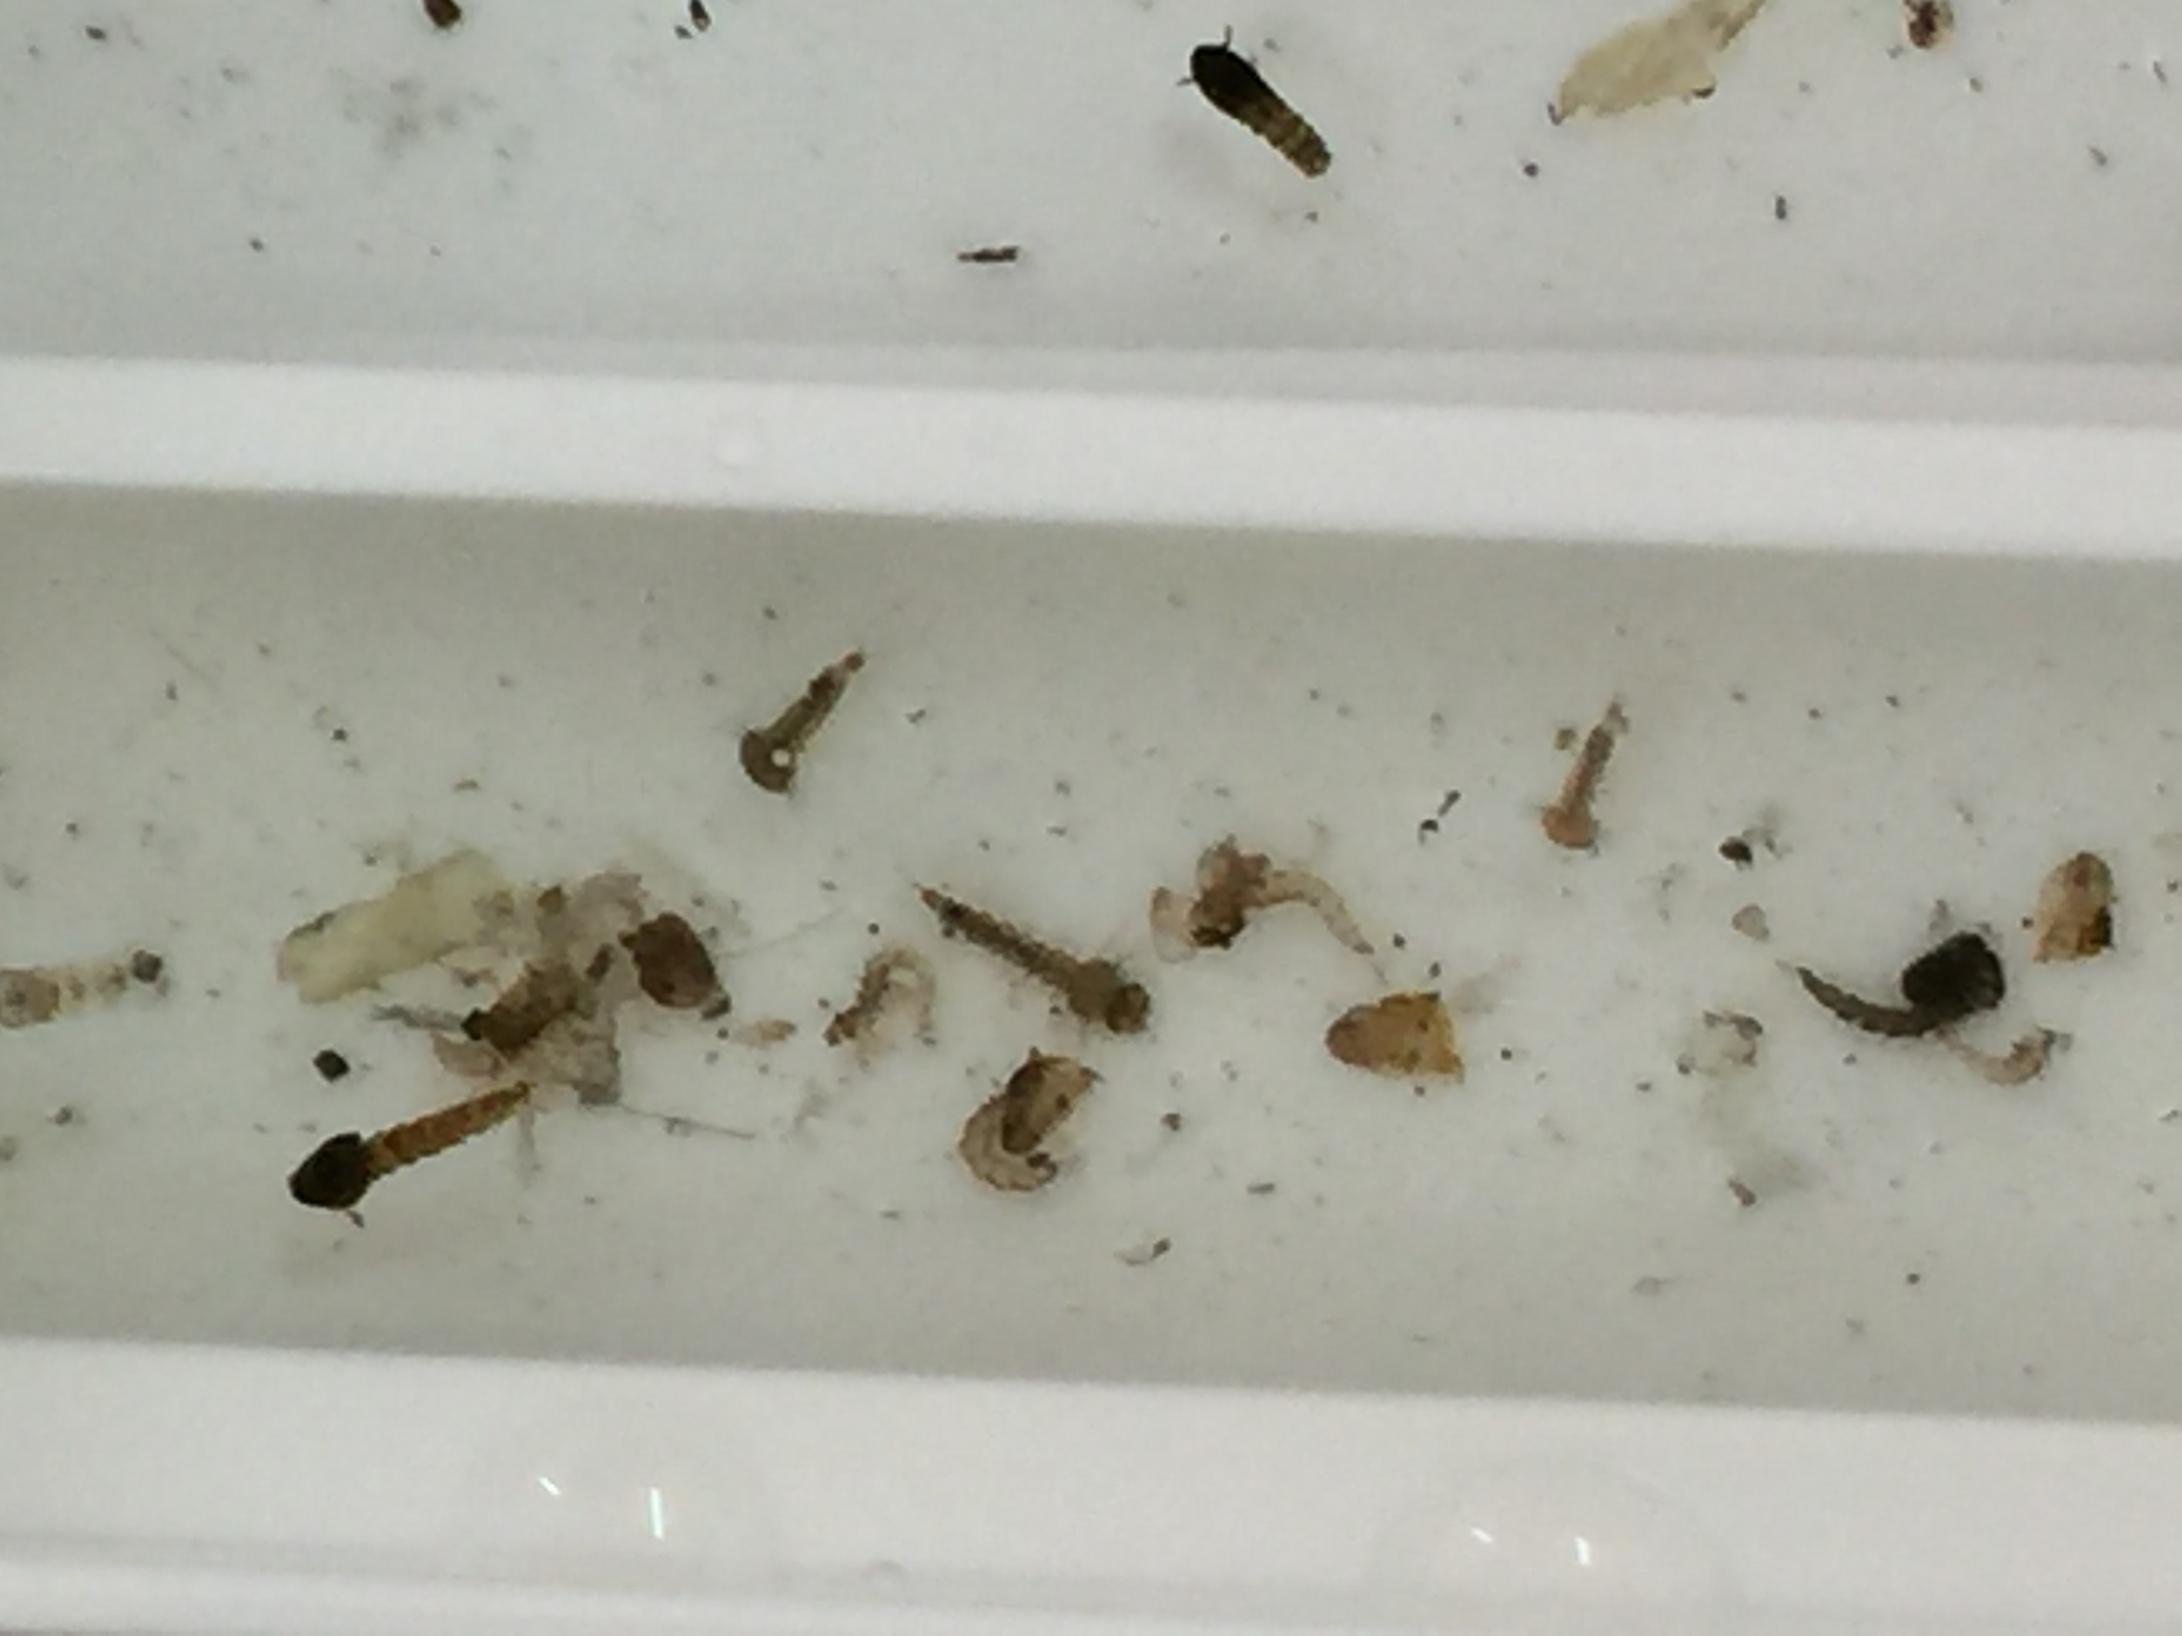
The 4th instar will molt to become a pupa, another stage in the lifecycle of a mosquito. Pupa are distinguished by their appearance- they look like a comma. You may find pupae in your sample.
pupa

Slide 27
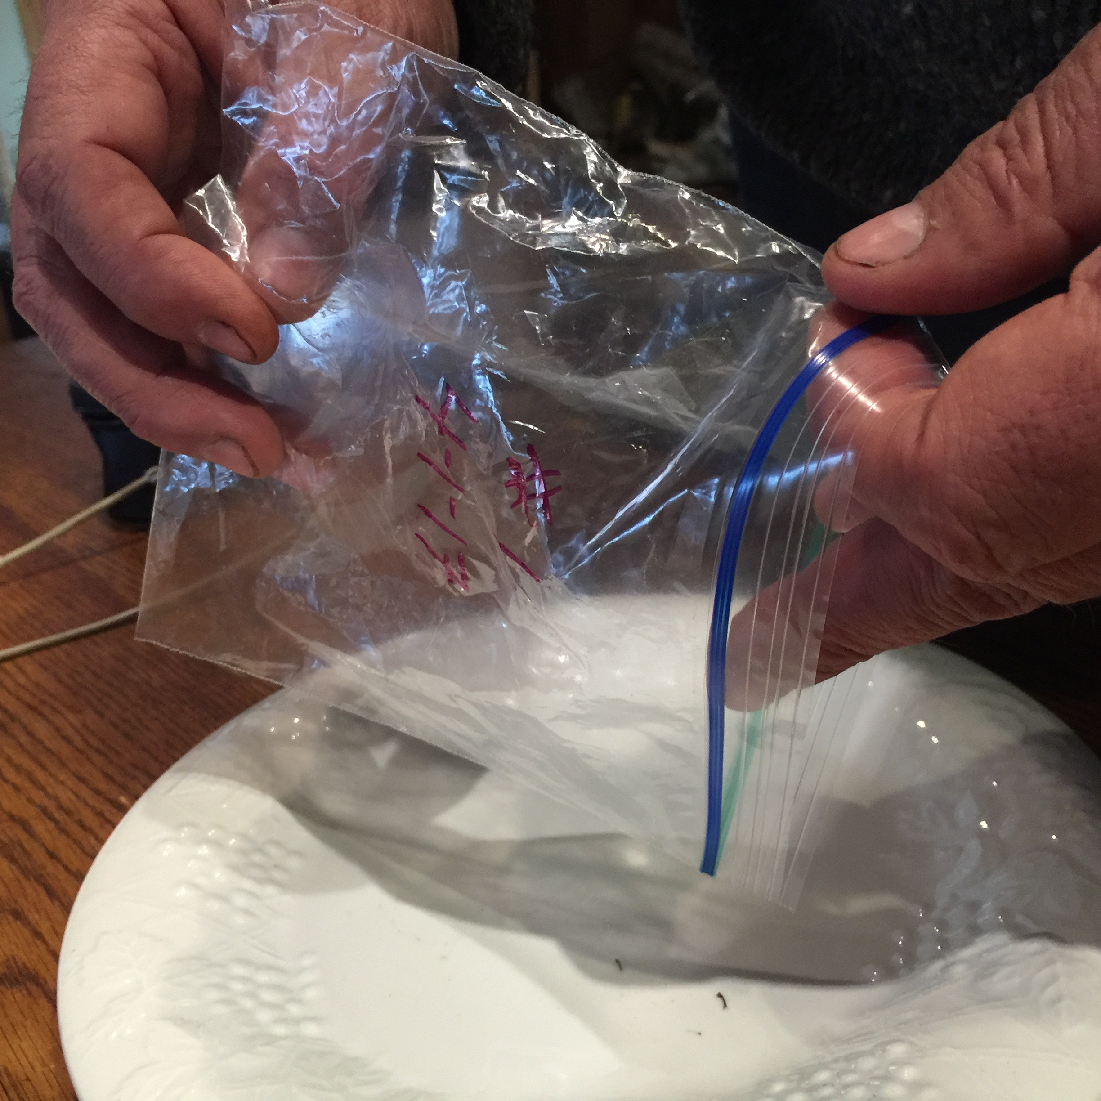
Step 3. Photograph and Identify-1
In order to examine and photograph the larvae, they must be removed from the bag.
To begin:
Pour part of the sample containing larvae onto a white tray or plate.

Slide 28
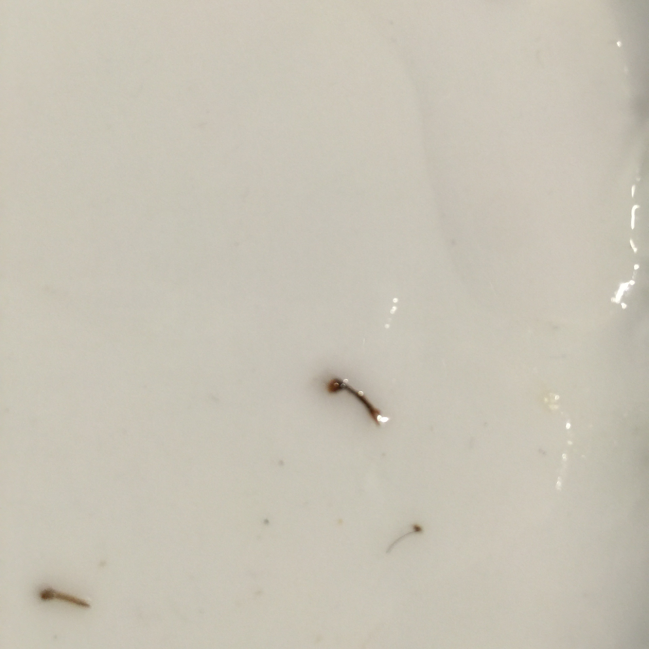
Photograph and Identify-2
Use a dropper or spoon to isolate one larva.
Make sure each larva is suspended in a small drop of water.

Slide 29
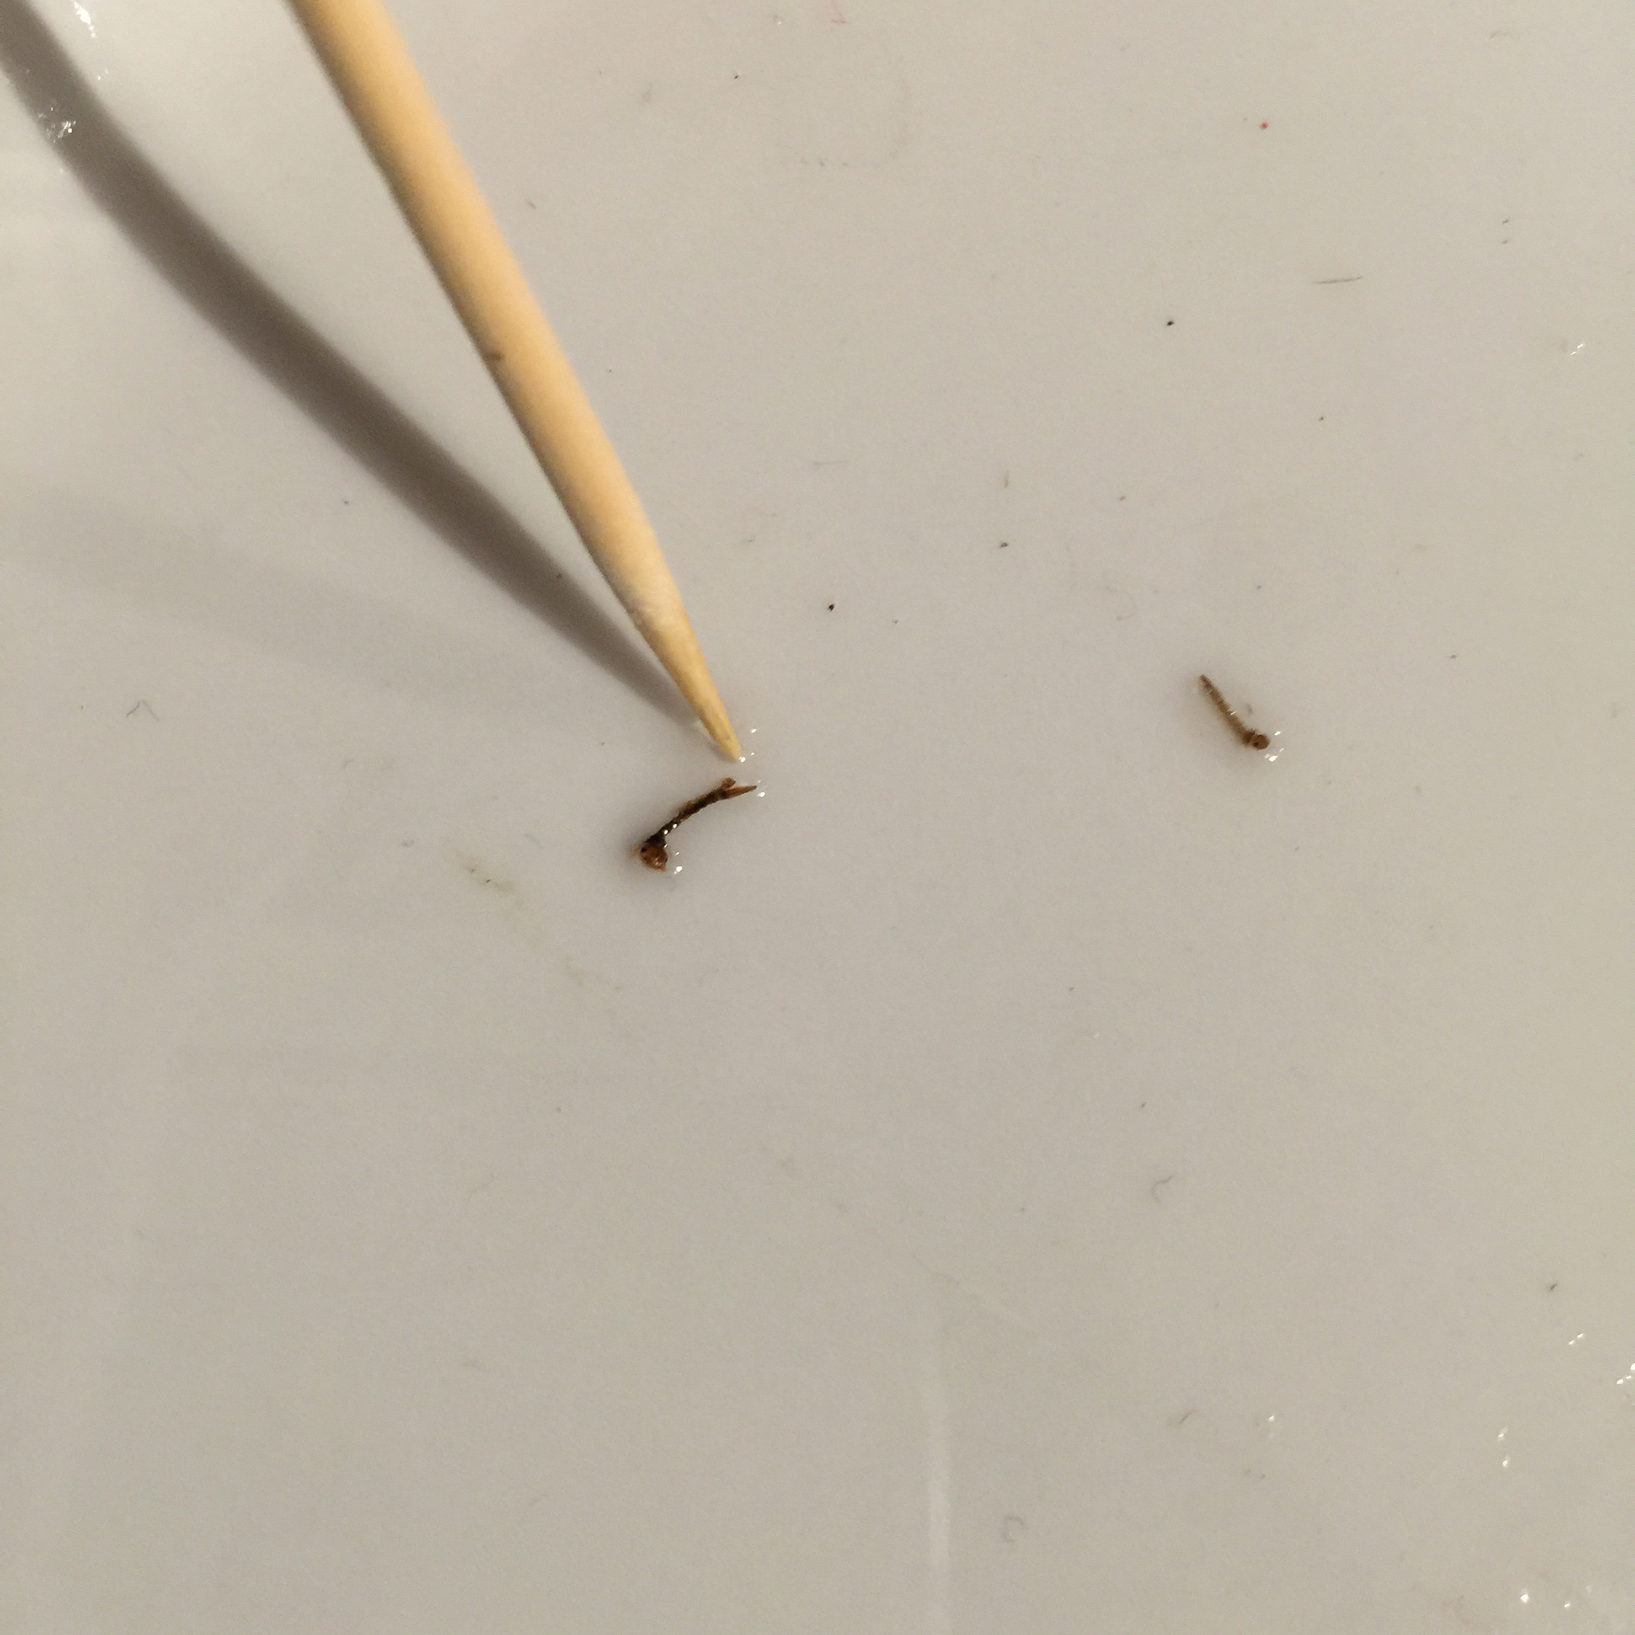
Photograph and Identify-3
It is important that the drop of water just covers the larva. Too much water will allow the larva can swim- making it difficult to examine and photograph.
You can remove most of the water by blotting it up using the corner of a paper towel.
If the larva is still moving too fast to see, you can euthanize it with a drop of alcohol.

Slide 30
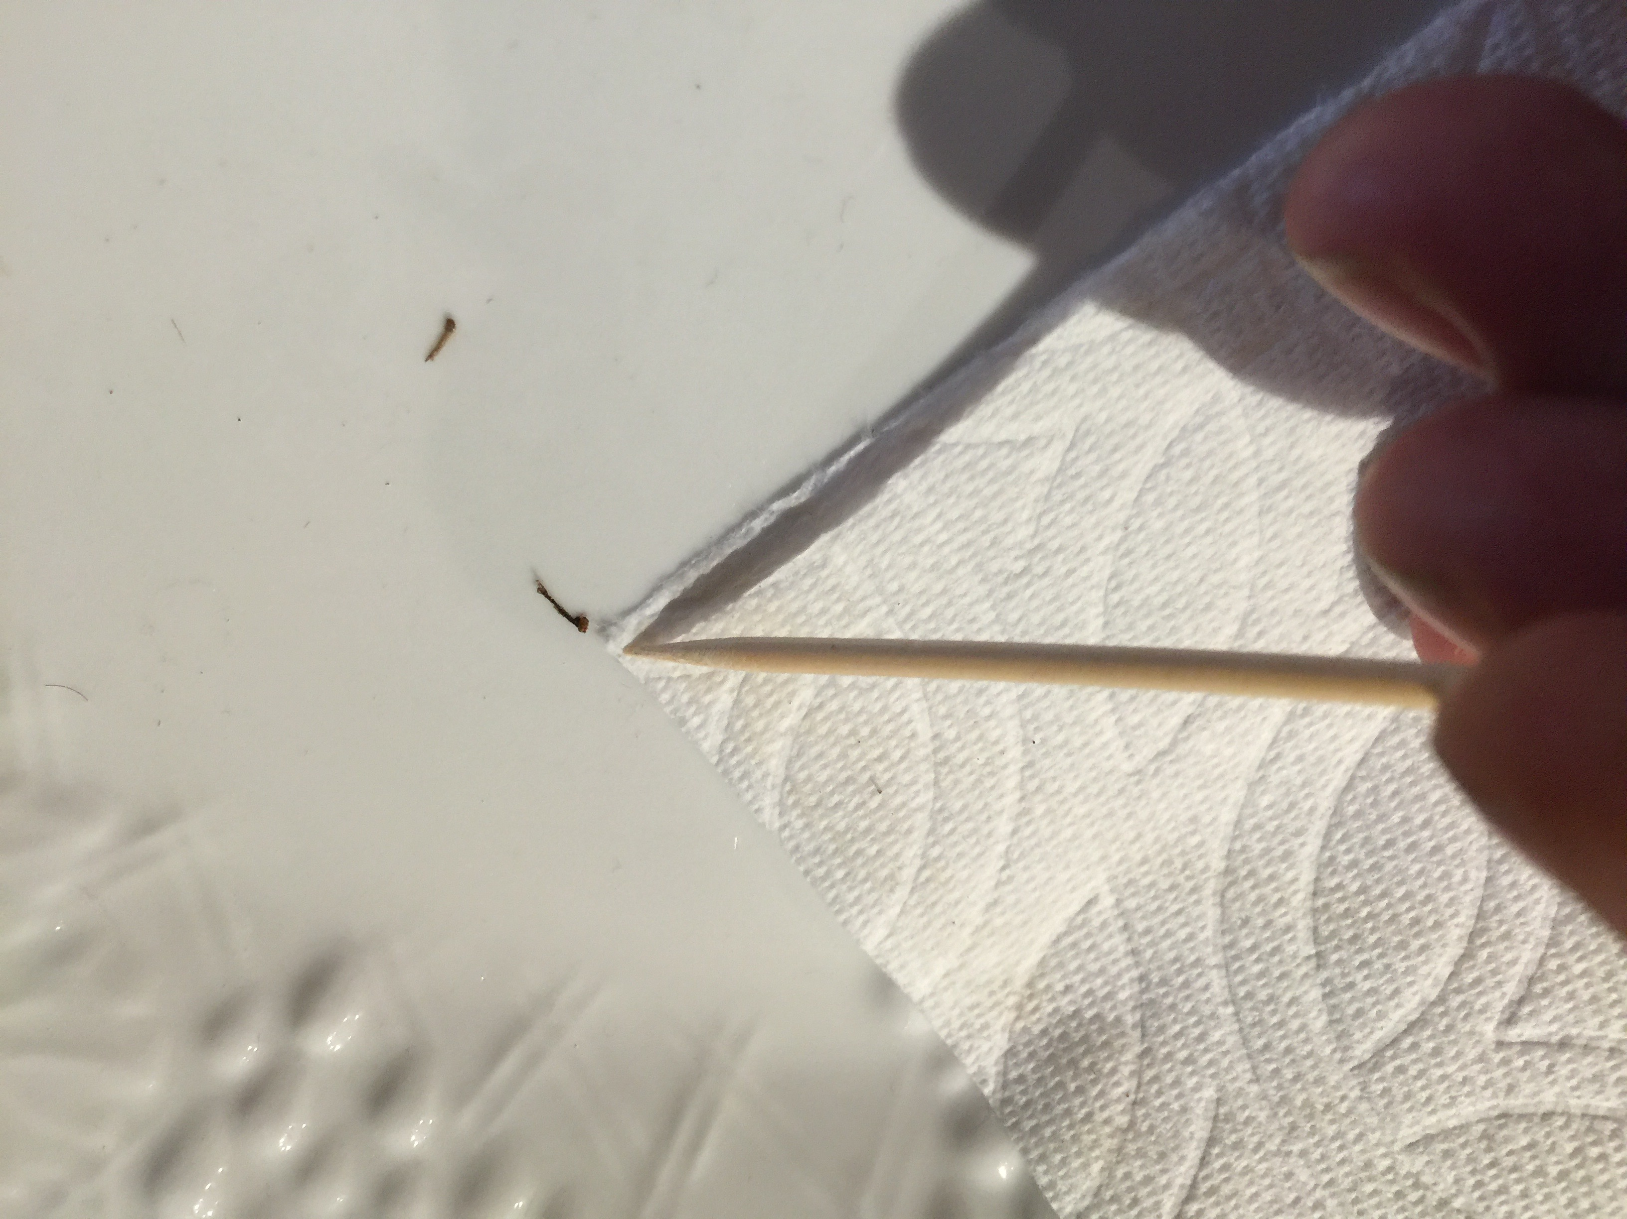
Photograph and Identify-4
Use a probe or toothpick to position the larvae so you can see the diagnostic features.

Slide 31
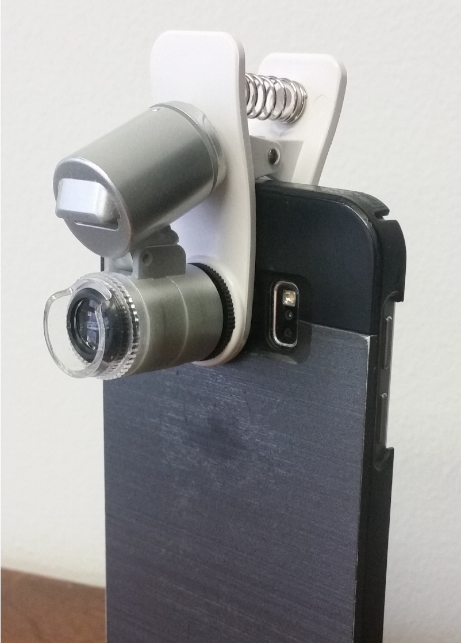
Photograph and Identify-5
Attach a macro lens to a mobile device so that you can take a picture and upload it to the app.

Slide 32
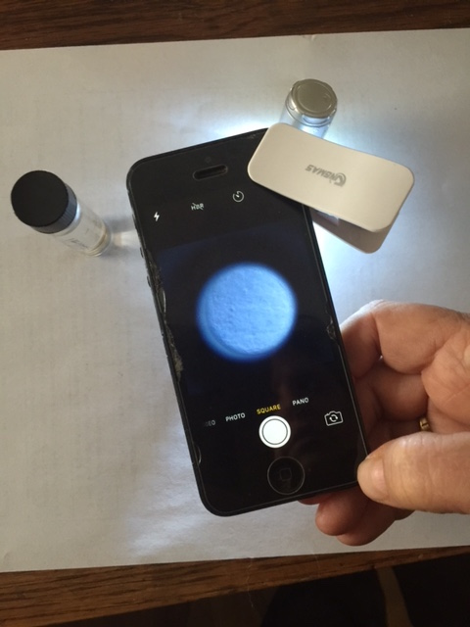
Photograph and Identify-6
Clip the macro lens over the lens of the camera and line it up so that you see a perfect circle of light on your phone screen.

Slide 33
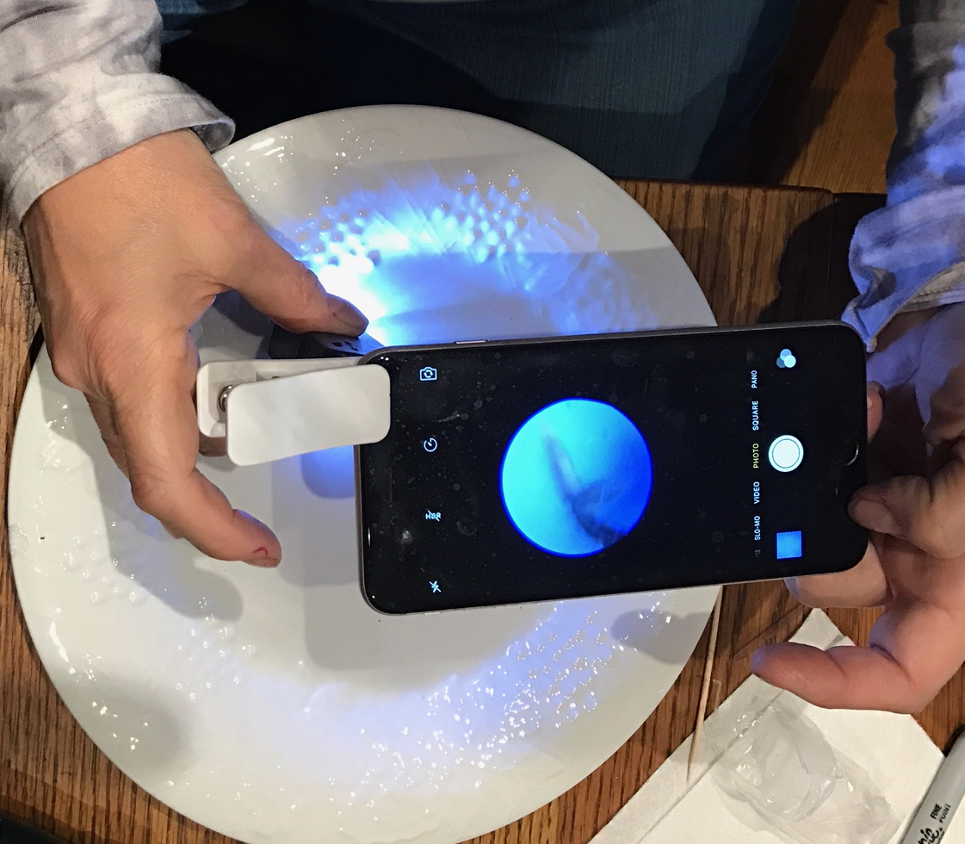
Photograph and Identify-7
Line up the lens so that the specimen is in the circle of light on the viewer.

Slide 34
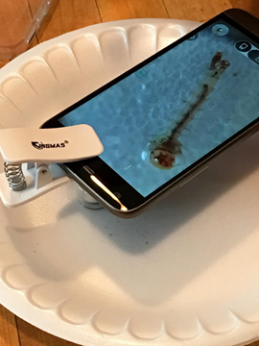
Photograph and Identify-8
Note that many clip-on devices have a clear collar on them at the end of the lens. You can rest the collar of the lens on your plate.
The collar helps you find the focal length that is ideal for looking at your specimen.

Slide 35
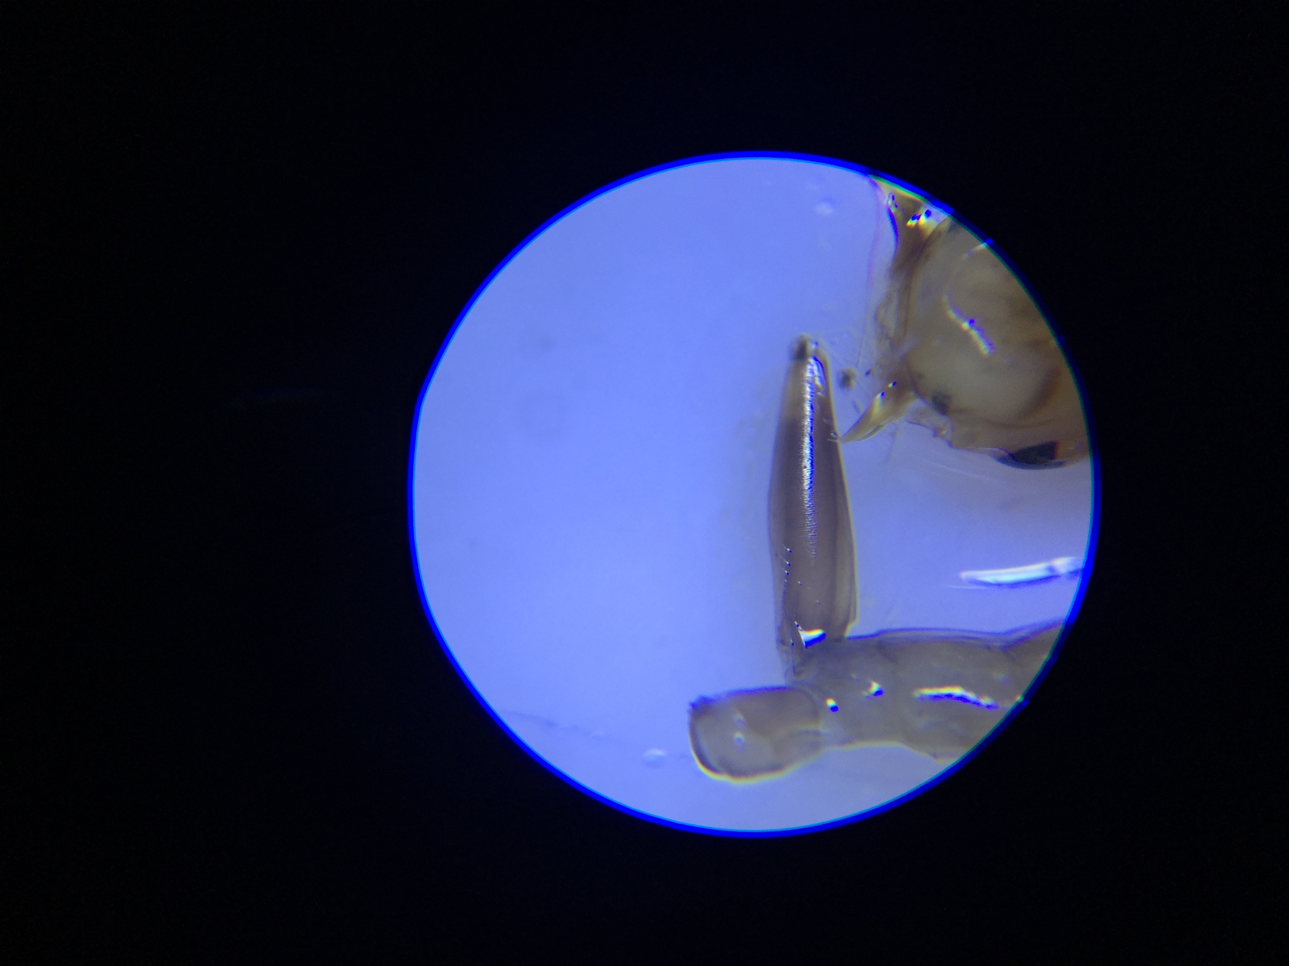
Photograph and Identify-9
Once you have a mosquito larva in view, closely examine the diagnostic features.
Now you are ready to identify your specimen. Use the MHM app or a local mosquito larva key to determine the types of mosquitoes in your sample.
Submit photograph and identification to MHM, following instructions in the app.

Slide 36
Photograph and Identify-9
If the larvae you found are “other,” it is probable you have found one of the many mosquitoes that play an important role in the ecosystem. These mosquitoes are occasionally referred to as “nuisance” species, with respect to humans, but they also serve as food for other organisms and as pollinators for plants.

Slide 37
Step 4: Decommission the breeding site
Where possible, decommission (eliminate) container breeding sites by:
Tipping the container and tossing the water
Covering the container
If you locate a breeding site that you can’t or shouldn’t decommission by yourself, contact a public health official.
Don’t worry about removing a breeding site from use unless it is a natural or artificial container. Birds, frogs and other living things will thank you!

Slide 38
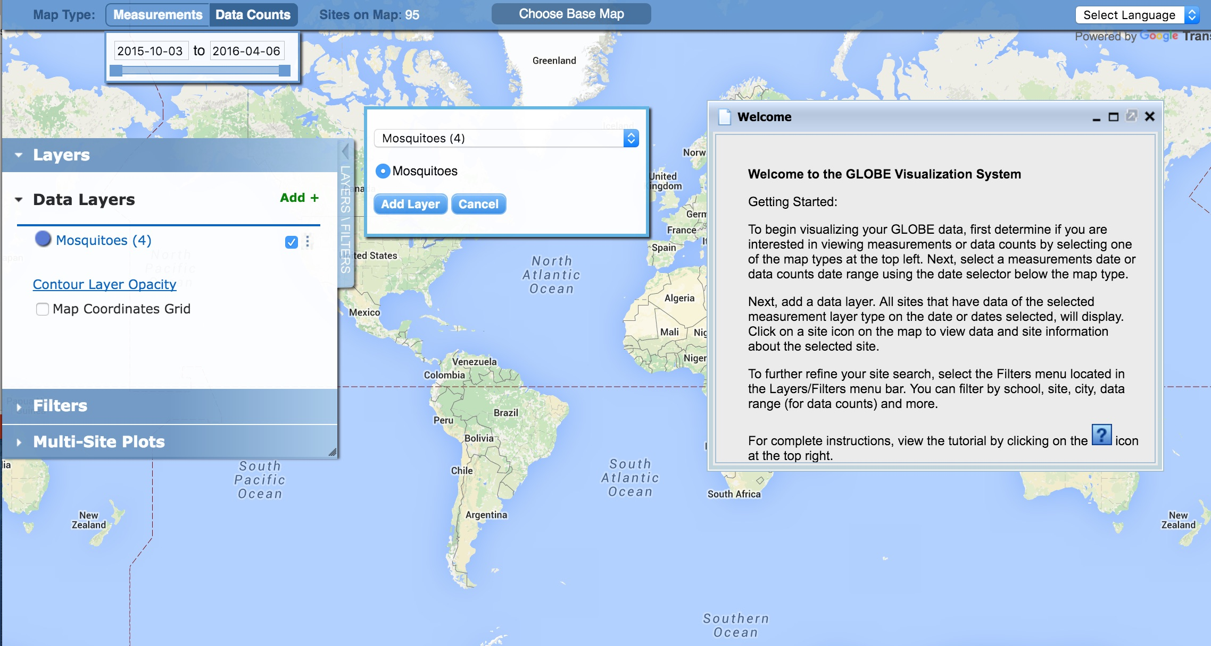
Visualize and Retrieve Data-1
GLOBE provides the ability to view and interact with data measured across the world. Use our visualization tool to map, graph, filter and export data that have been measured across GLOBE protocols since 1995. The Mosquito Protocol is new- so we look forward to seeing your data!
Link to step-by-step tutorial on using the GLOBE Data Visualization Tool

Slide 39
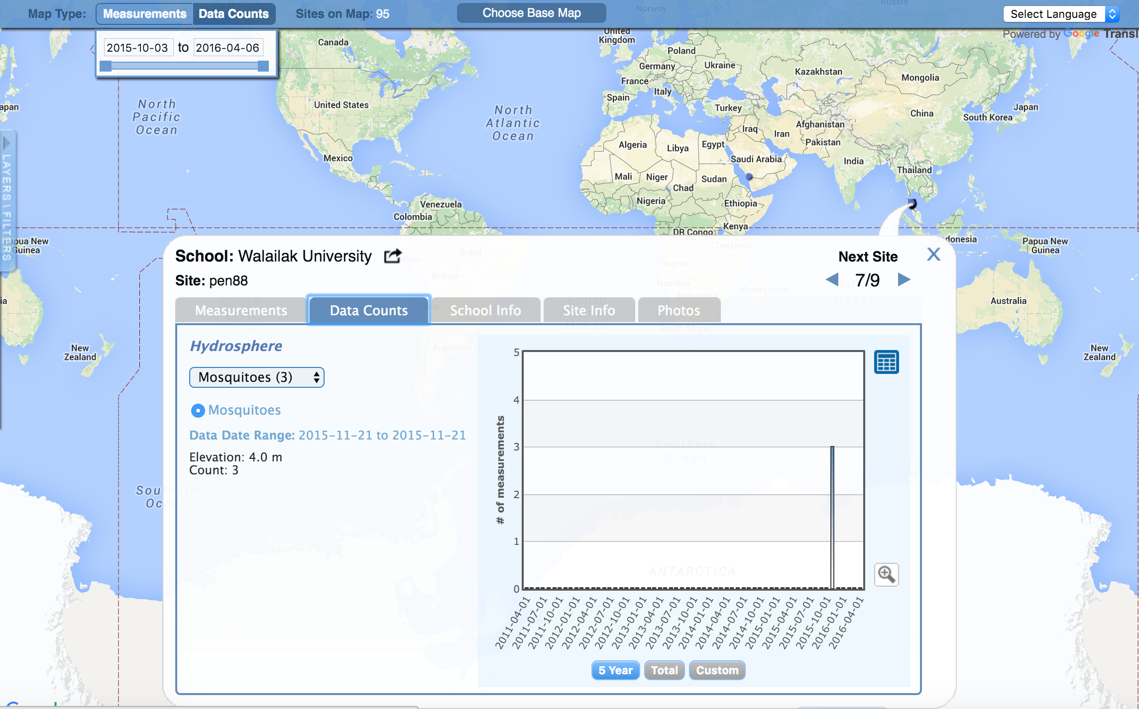
Visualize and Retrieve Data-2
Select the date for which you need pH data, add layer and you can see where data is available.

Slide 40
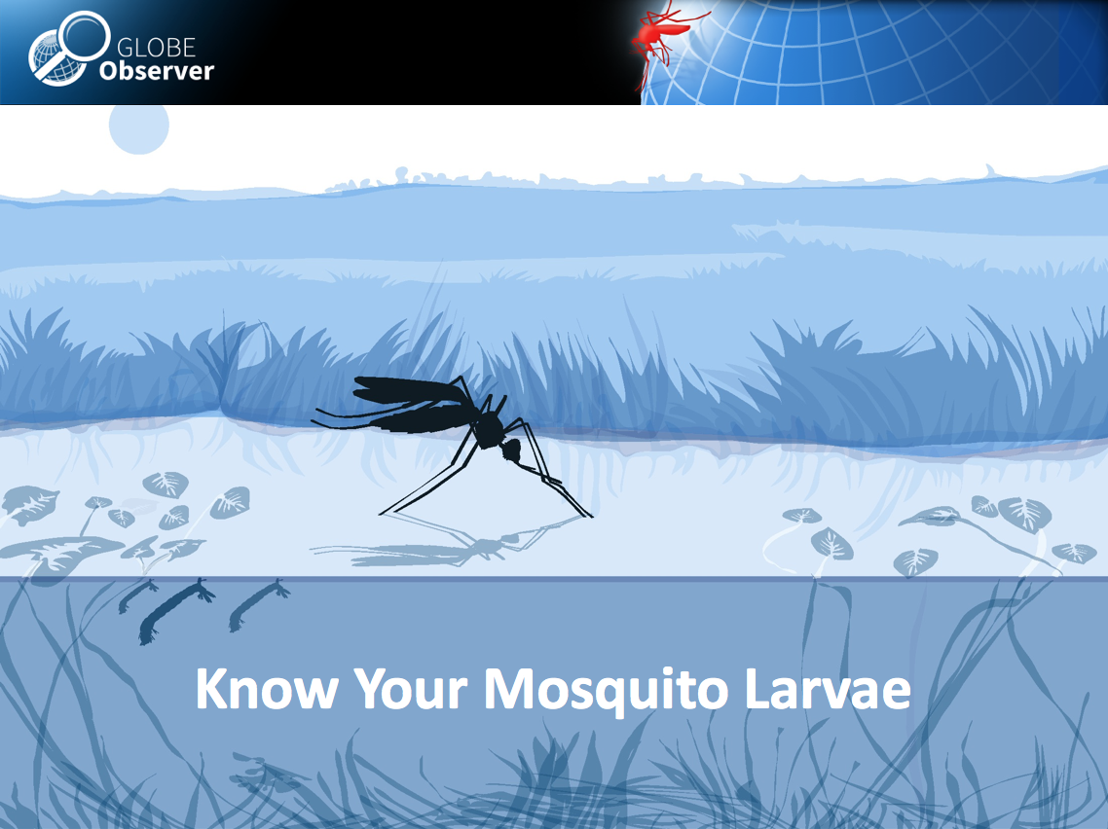
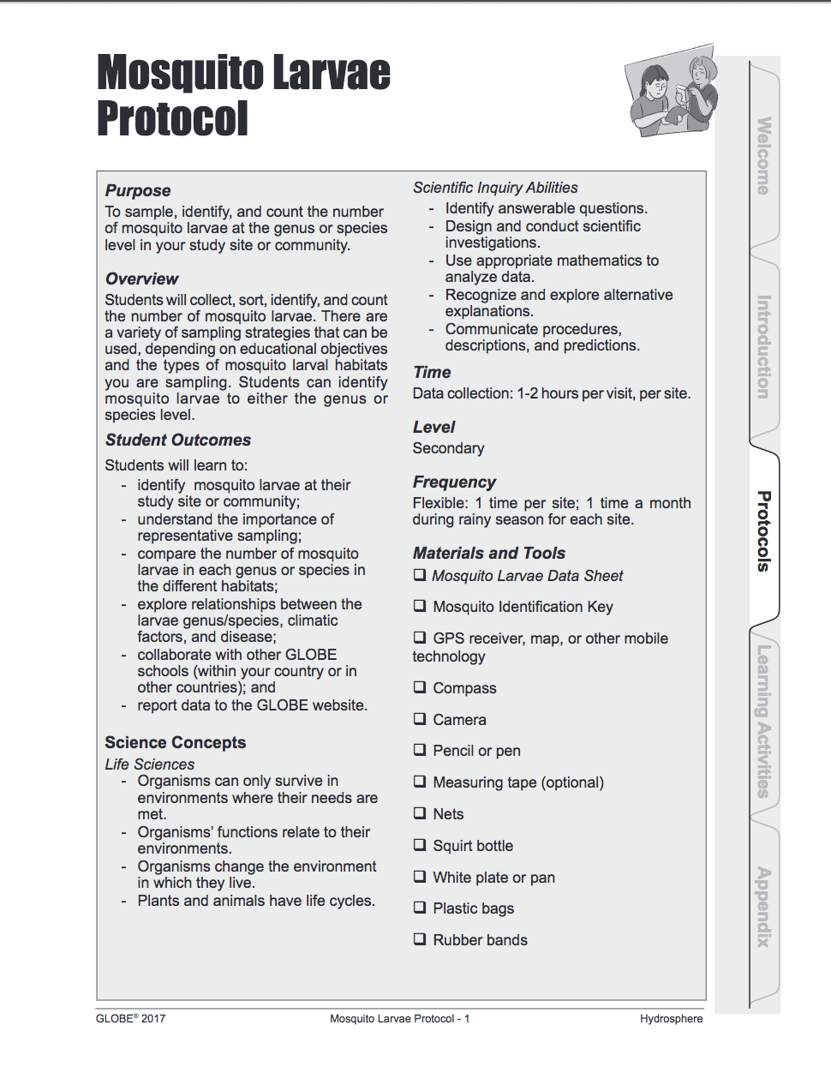
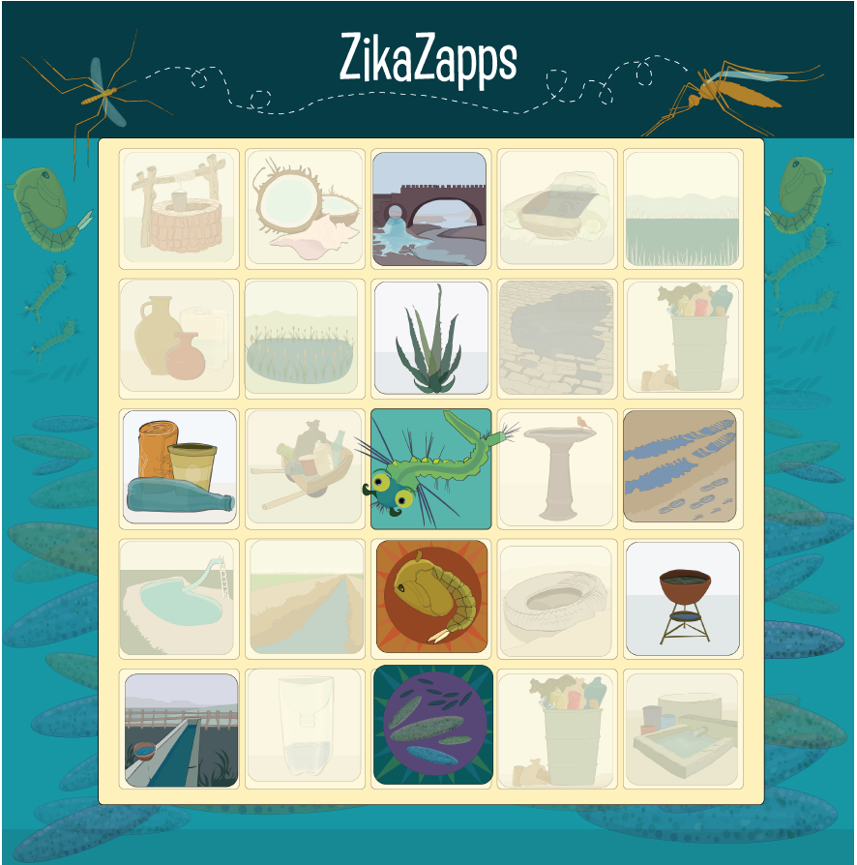
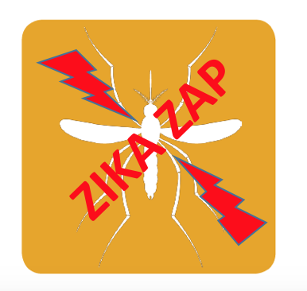


Additional educational materials for formal and informal education contexts
Educational Training Games
Resources Protocols

Slide 41
Frequently Asked Questions (FAQs)
What is the mosquito life cycle? It is variable, based on species and environmental conditions- so this is approximate!
Adult → eggs (2 -3 days) → larvae (4 -5 days) → pupae (1- 2 days) →Adult
How do you differentiate between the Anopheles, Aedes or Culex larvae (identify with unaided eyes)?
We can see the characteristics of mosquito larvae: In the water, Anopheles larvae cling parallel with the water surface. On the other hand, Aedes and Culex larvae cling at an angle of 45° with the side of the container. Aedes larvae have shorter siphons, Culex larvae tend to have have longer siphons. However, there are 3,500 species of mosquitoes, so you should consult a key for your area to be sure.
What do adult mosquitoes feed on?
Adult mosquitoes feed on any sugar source, including flowers, fruit, nectar and other insects. Some mosquitoes are important pollinators, like bees!
At what time of the year are greater percentages of mosquito larvae found?
Most often they are found in the rainy season or shortly after the end of the rainy season.

Slide 42
Frequently Asked Questions (FAQs-2)
When should I use the GLOBE Observer App or the GLOBE Data Entry App to enter my data?
If you are going to also conduct water quality measurements at the same time or return to the same study site periodically, you will want to follow the GLOBE Mosquito Larva Protocol and GLOBE Data Entry App. This will allow you to look at mosquito density and population change in conjunction with other environmental variables at your GLOBE Hydrosphere study site.
The GLOBE Observer Mosquito Habitat Mapper is designed to support identification of breeding sites around your neighborhood and school, especially those that are in containers. Where possible you will be removing the opportunistic breeding site from use by dumping the container and removing trash. This reduces risk of disease in communities. For some sites, you may be returning to the site- such as a water storage container or drain- but these sites do not need to be identified as GLOBE Hydrosphere study sites.

Slide 43


Acknowledgements
The GLOBE Observer Mosquito Habitat Mapper is a NASA-sponsored project that is the result of the combined efforts of an extended team that includes the Institute for Global Environmental Strategies (IGES); NASA Goddard Space Flight Center, Langley Research Center, and Jet Propulsion Laboratory; Space Science Applications, Inc. (SSAI); the GLOBE Implementation Office (GIO), GLOBE DIS and Brooklyn College.
The Mosquito Challenge Community Campaign (MCCC) is focused on demonstrating the usefulness of citizen science data collected using the GO Mosquito Habitat Mapper for combating Zika in Brazil and Peru. MCCC is led by IGES in partnership with the University Corporation for Atmospheric Research (UCAR), and leverages the NASA App, and the GLOBE Program networks of scientists, teachers, students, and citizen scientists. The MCCC project is made possible through the generous support of the Combating Zika and Future Threats Grand Challenge through the United States Agency for International Development (USAID).
This presentation was prepared by the Institute for Global Environmental Strategies (IGES) and does not necessarily reflect the views of the NASA or USAID.
Educators: If you modify these slides for your own use, please retain this last slide and put your name and contact information below, thank you!
For more information, contact the MCCC PI, Dr. Russanne Low, IGES, rusty_low@strategies.org. www.globe.gov

