Slide 1
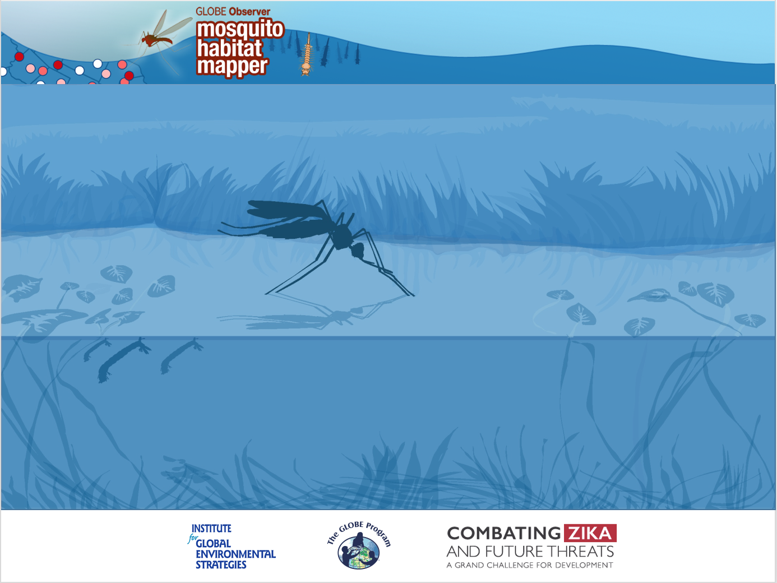
Mosquitoes as Vectors of Human Disease: Aedes, Anopheles and Culex

Slide 2
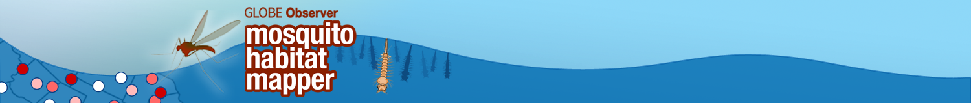
What do you know about mosquitoes?
Where do they breed?
Why are some mosquitoes dangerous to humans?
How can you protect yourself and your community?

Slide 3
Mosquitoes are responsible for more human deaths than any other kind of animal.
Every year, more than a billion people worldwide (roughly one in every seven people) become ill and half a million die as a result of mosquito bites.
This presentation will introduce you to some of the most serious mosquito vectors of human disease. They fall into one of three genera:
Anopheles
Aedes
Culex

Slide 4
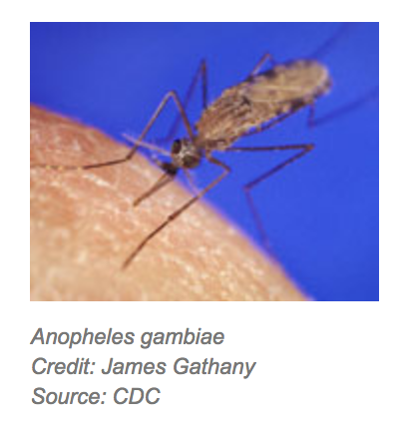
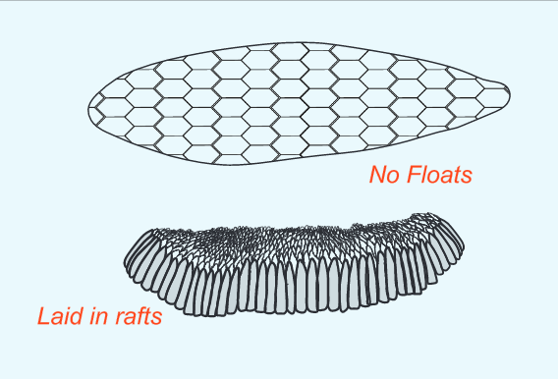
Genus Anopheles
Anopheles mosquito larvae are found in a wide variety of habitats. Many species of Anopheles prefer open-water pools with little vegetation, but others have adapted to different habitats.
Anopheles species lay individual eggs, supported by floats, on the water surface or on moist soil immediately adjacent to fluctuating water bodies.
Notes:
Eggs image: Jenn Glaser, for the GLOBE Program

Slide 5
Anopheles as a human disease vector
Malaria is a disease caused by parasites that are transmitted to humans by the Anopheles mosquito. Malaria causes more deaths per year than any other mosquito-transmitted disease.
The female Anopheles requires a blood meal to produce her eggs.
When female mosquitoes bite an infected person the parasite is transmitted to the mosquito. The parasite enters the mosquito gut and eventually moves to her salivary glands. The mosquito injects the parasite along with her saliva at a subsequent feeding.
Not all Anopheles mosquitoes transmit malaria.
You can find out which species are important vectors for disease transmission in your region.

Slide 6
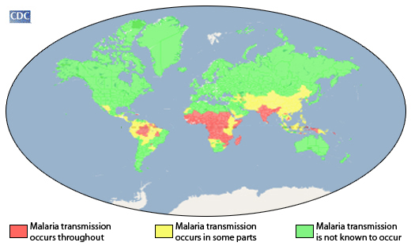
Malaria (Anopheles mosquito)
Number of cases per year: 214 million.
Prevention: Anti-malaria medication, netting and screens, bug repellent, long clothing, and eliminating breeding sites.
Notes:
Eggs image: Jenn Glaser, for the GLOBE Program

Slide 7
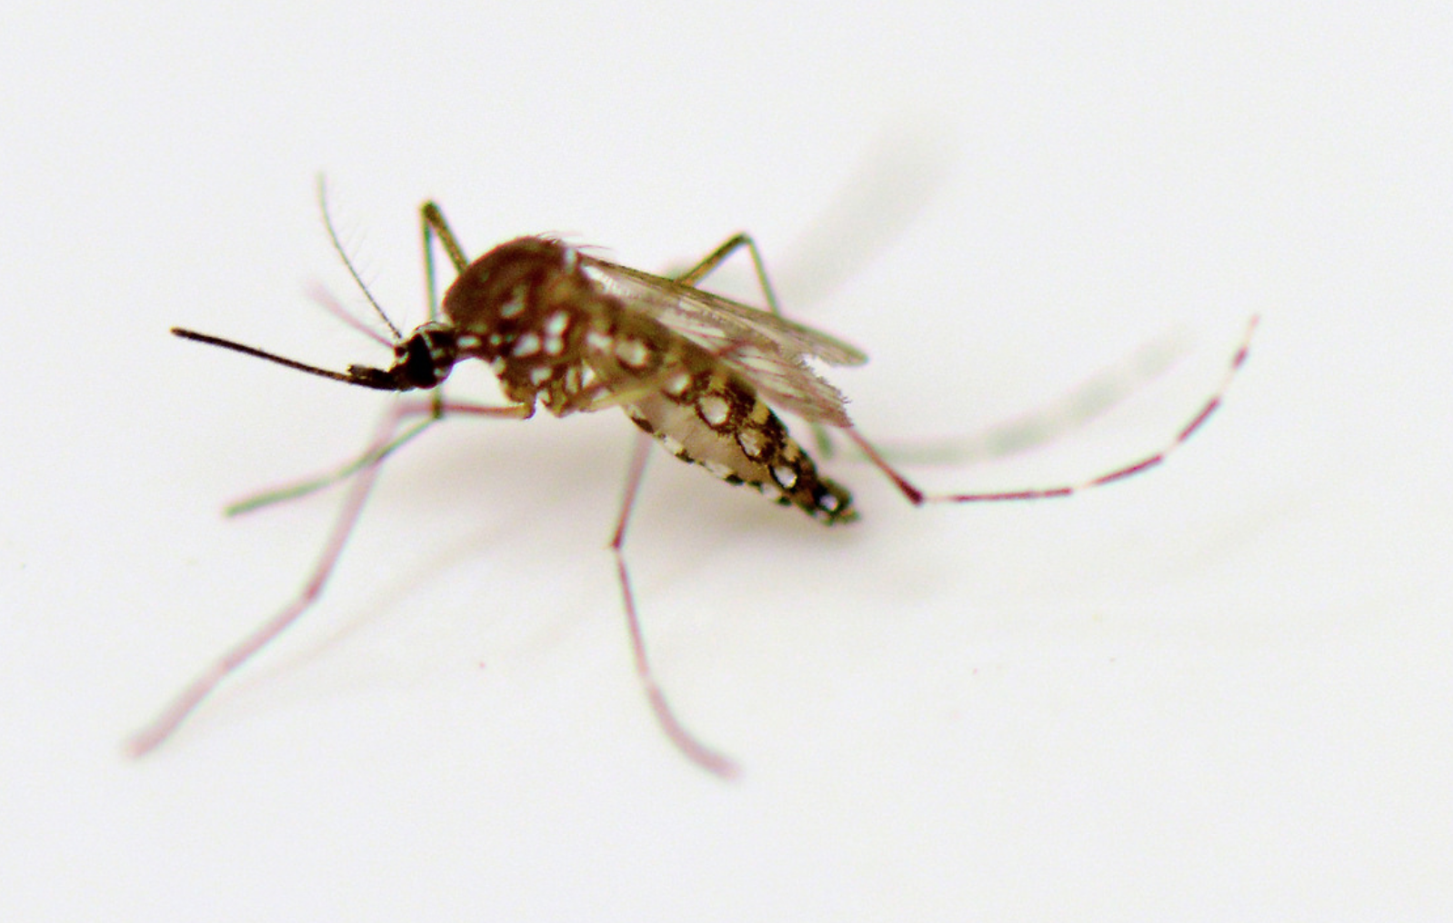
Anopheles in Central and South America
Common species include:
Anopheles darlingi
Anopheles marajoara
Anopheles albimanus
Anopheles pseudopunctipennis
Anopheles aquasalis
Anopheles albitarsis
Anopheles braziliensis
To determine if the Anopheles mosquito you identify using the GLOBE Observer Mosquito Habitat Mapper is a potential disease vector, consult a local mosquito key.

Slide 8
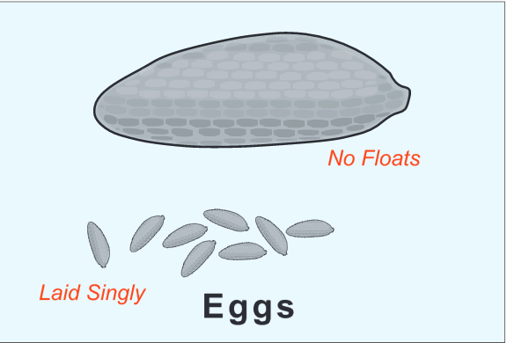
Genus Aedes
Aedes aegypti and Aedes albopictus are container breeding mosquitoes. They lay eggs in artificial containers that contain water. The females lay the eggs just above the water level. When the water level rises, it moistens the eggs, and they then begin to develop. Aedes aegypti strongly prefer artificial containers. Aedes albopictus will use both artificial and natural containers.
Other Aedes mosquitoes breed in floodplains after rain events, in irrigation ditches, in woodland pools, brackish swamps and salt marshes.
Notes:
Adult Mosquito Photo Credit: Dean Calma / IAEA
Eggs: Jenn Glaser for GLOBE

Slide 9
Aedes as a human disease vector
Aedes aegypti and Aedes albopictus are species that potentially transmit pathogens to humans that can cause the following diseases:
Yellow fever
Dengue fever
Zika virus
Chikungunya
Lymphatic filariasis

Slide 10
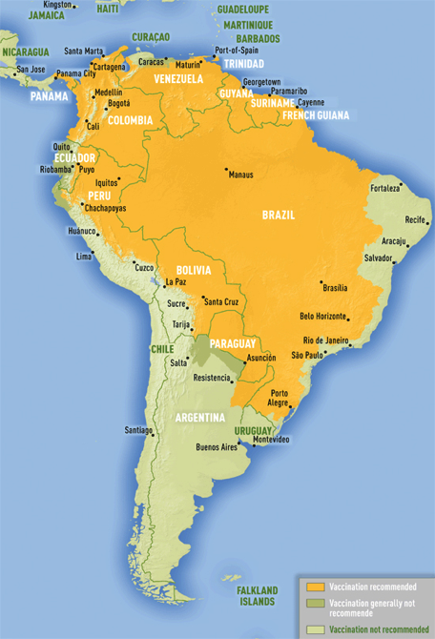
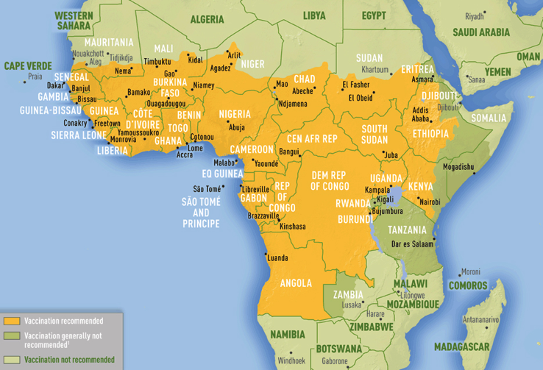
Yellow fever
(Aedes aegypti/ Aedes albopictus mosquito)
Symptoms: fever, headache (mild) to organ failure (severe)
Prevention: Vaccination, repellants, long clothing, , netting and screens, eliminating breeding sites.

Slide 11
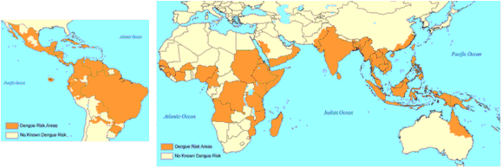
Dengue
(Aedes aegypti/ Aedes albopictus mosquito)
40% of the world’s populations lives in areas where there is a risk of dengue transmission.
Number of cases per year: ~400 million (CDC).
Symptoms: fever, headache, joint pain, rash… can be fatal
Prevention: Repellants, long clothing, netting and screens, eliminating breeding sites. (No vaccine)

Slide 12
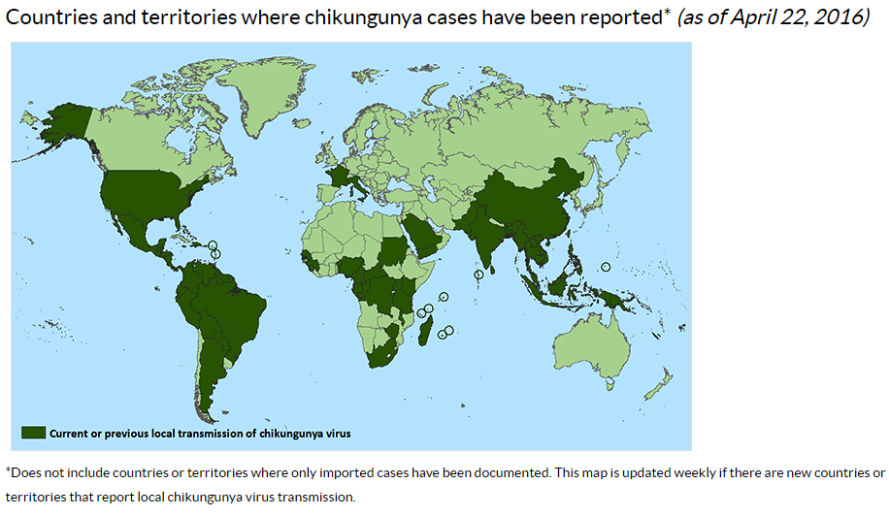
Chikungunya
(Aedes aegypti/ Aedes albopictus mosquito)
Symptoms: fever and rash – similar to dengue and Zika.
Prevention: Repellant, long clothing, netting and screens, eliminating breeding sites.
Map: CDC, USA

Slide 13
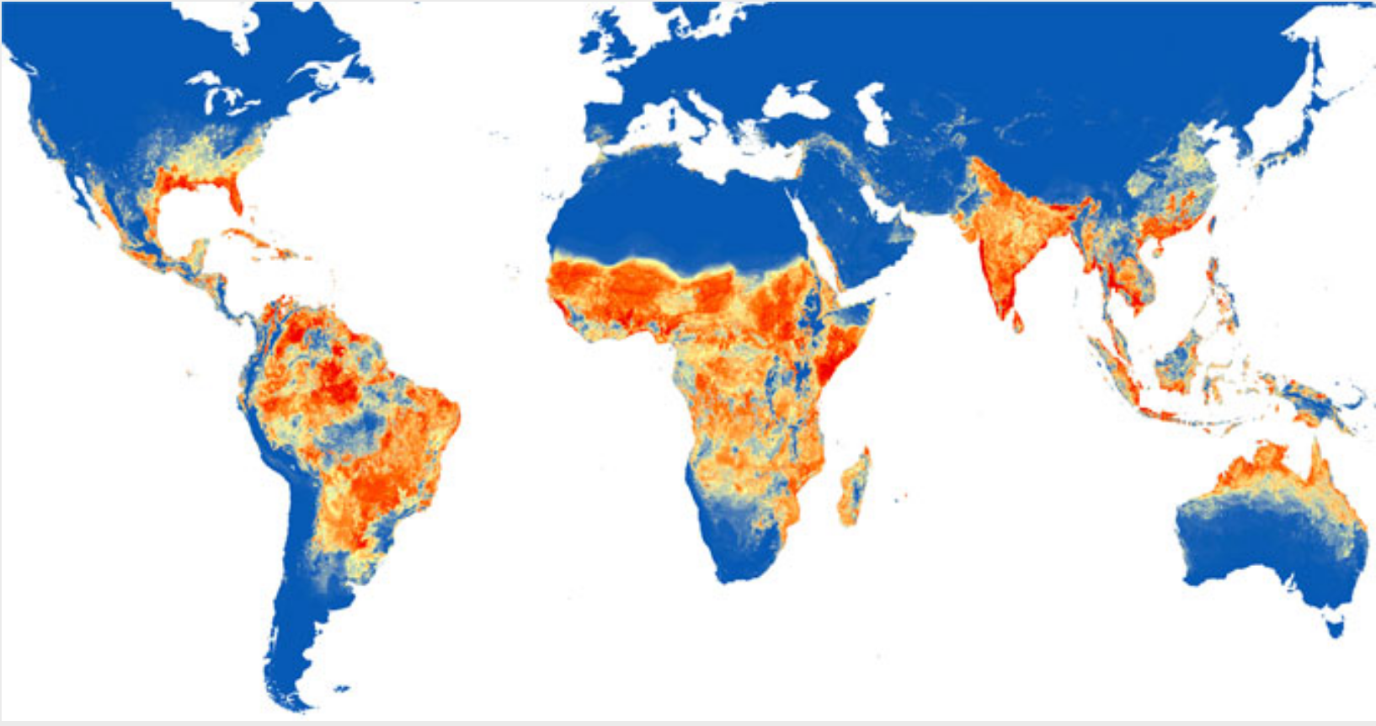
Zika
(Aedes aegypti/ Aedes albopictus mosquito)
Symptoms: fever, rash, headache, joint/muscle pain.
Prevention: Repellant, long clothing, netting and screens, eliminating breeding sites.
Global map of the predicted distribution of Ae. aegypti. The map depicts the probability of occurrence (from 0 blue to 1 red).
DOI.org.

Slide 14
Zika
(Aedes aegypti/ Aedes albopictus mosquito)
Connections to Climate Change
In 2013, Zika arrived in South America for the first time. People there had no prior exposure or immunity to the virus.
Two years later, El Niño brought wetter, warmer weather- and with it, more mosquitoes (and more Zika). (Mosquitoes thrive when the conditions are warm and there is access to standing water.)
Zika is a disease of great concern because of the risk of birth defects when mothers are infected.
Podcast here: https://www.yaleclimateconnections.org/2017/06/zikas-link-to-climate-change/

Slide 15
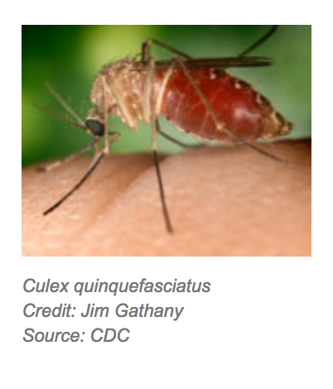
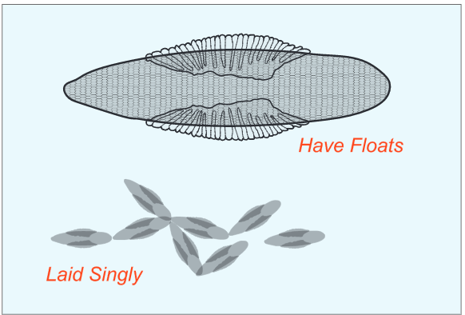
Genus Culex
Culex mosquitoes breed in
  stagnant water: places such as rainwater barrels, drainage systems, septic tanks, and containers (tires, buckets and rain barrels).
  open habitats: surface water habitats that become stagnant and enriched with organic matter (swamps, marshes, bogs, rice fields, pastures).
They prefer to lay eggs in rainwater barrels, storm drains, septic tanks.
Eggs are laid in rafts that float on the water surface
Notes:
Egg image: Jenn Glaser, for GLOBE

Slide 16
Culex as a human disease vector
Some species of the genus Culex carry viruses or other pathogens. A number of viruses are transmitted by the mosquito to animals and livestock. There are also some viruses that can be transmitted to humans.
Diseases include a number of encephalitis viruses that are found around the world, as well as West Nile virus.
Some species of Culex can also transmit filarial worms- a type of nematode. Adult female mosquitoes acquire the worm larvae. The larvae mature and migrate to the proboscis of the mosquito; they enter the bite puncture or the intact skin of a person bitten by the mosquito. Filariasis causes swelling in the lymph glands in humans.

Slide 17
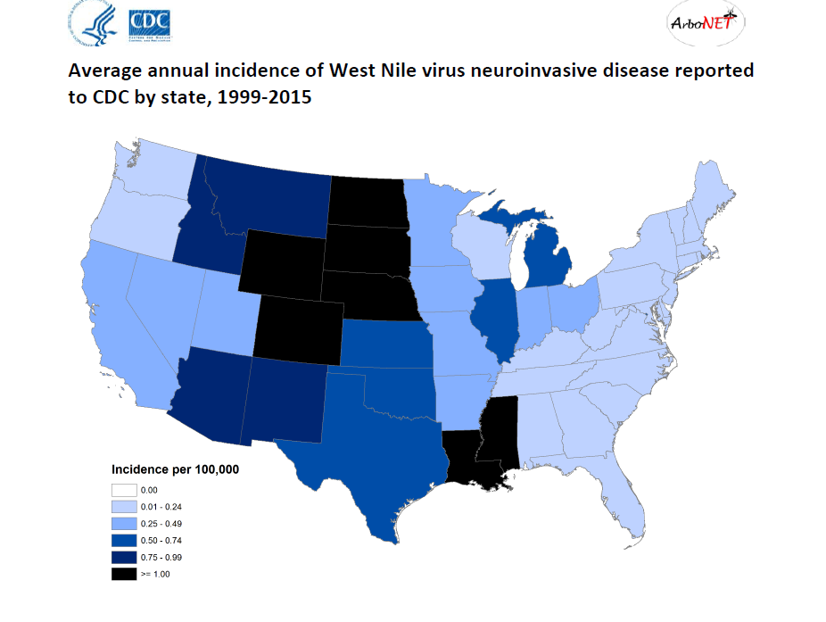
West Nile virus (Culex mosquito)
Symptoms: none in most people; 1 in 5 get fever, headache; <1% get encephalitis/meningitis.
Prevention: Repellant, long clothing, netting and screens, eliminating breeding sites.
Map: CDC, USA

Slide 18
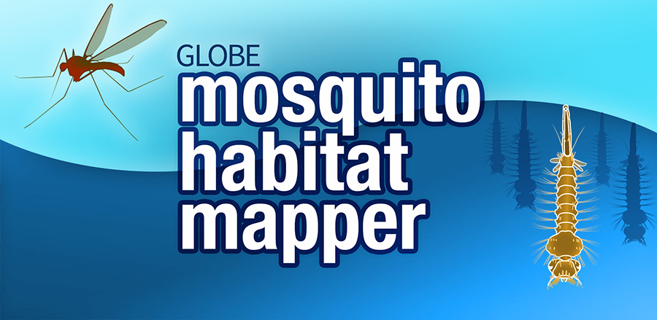
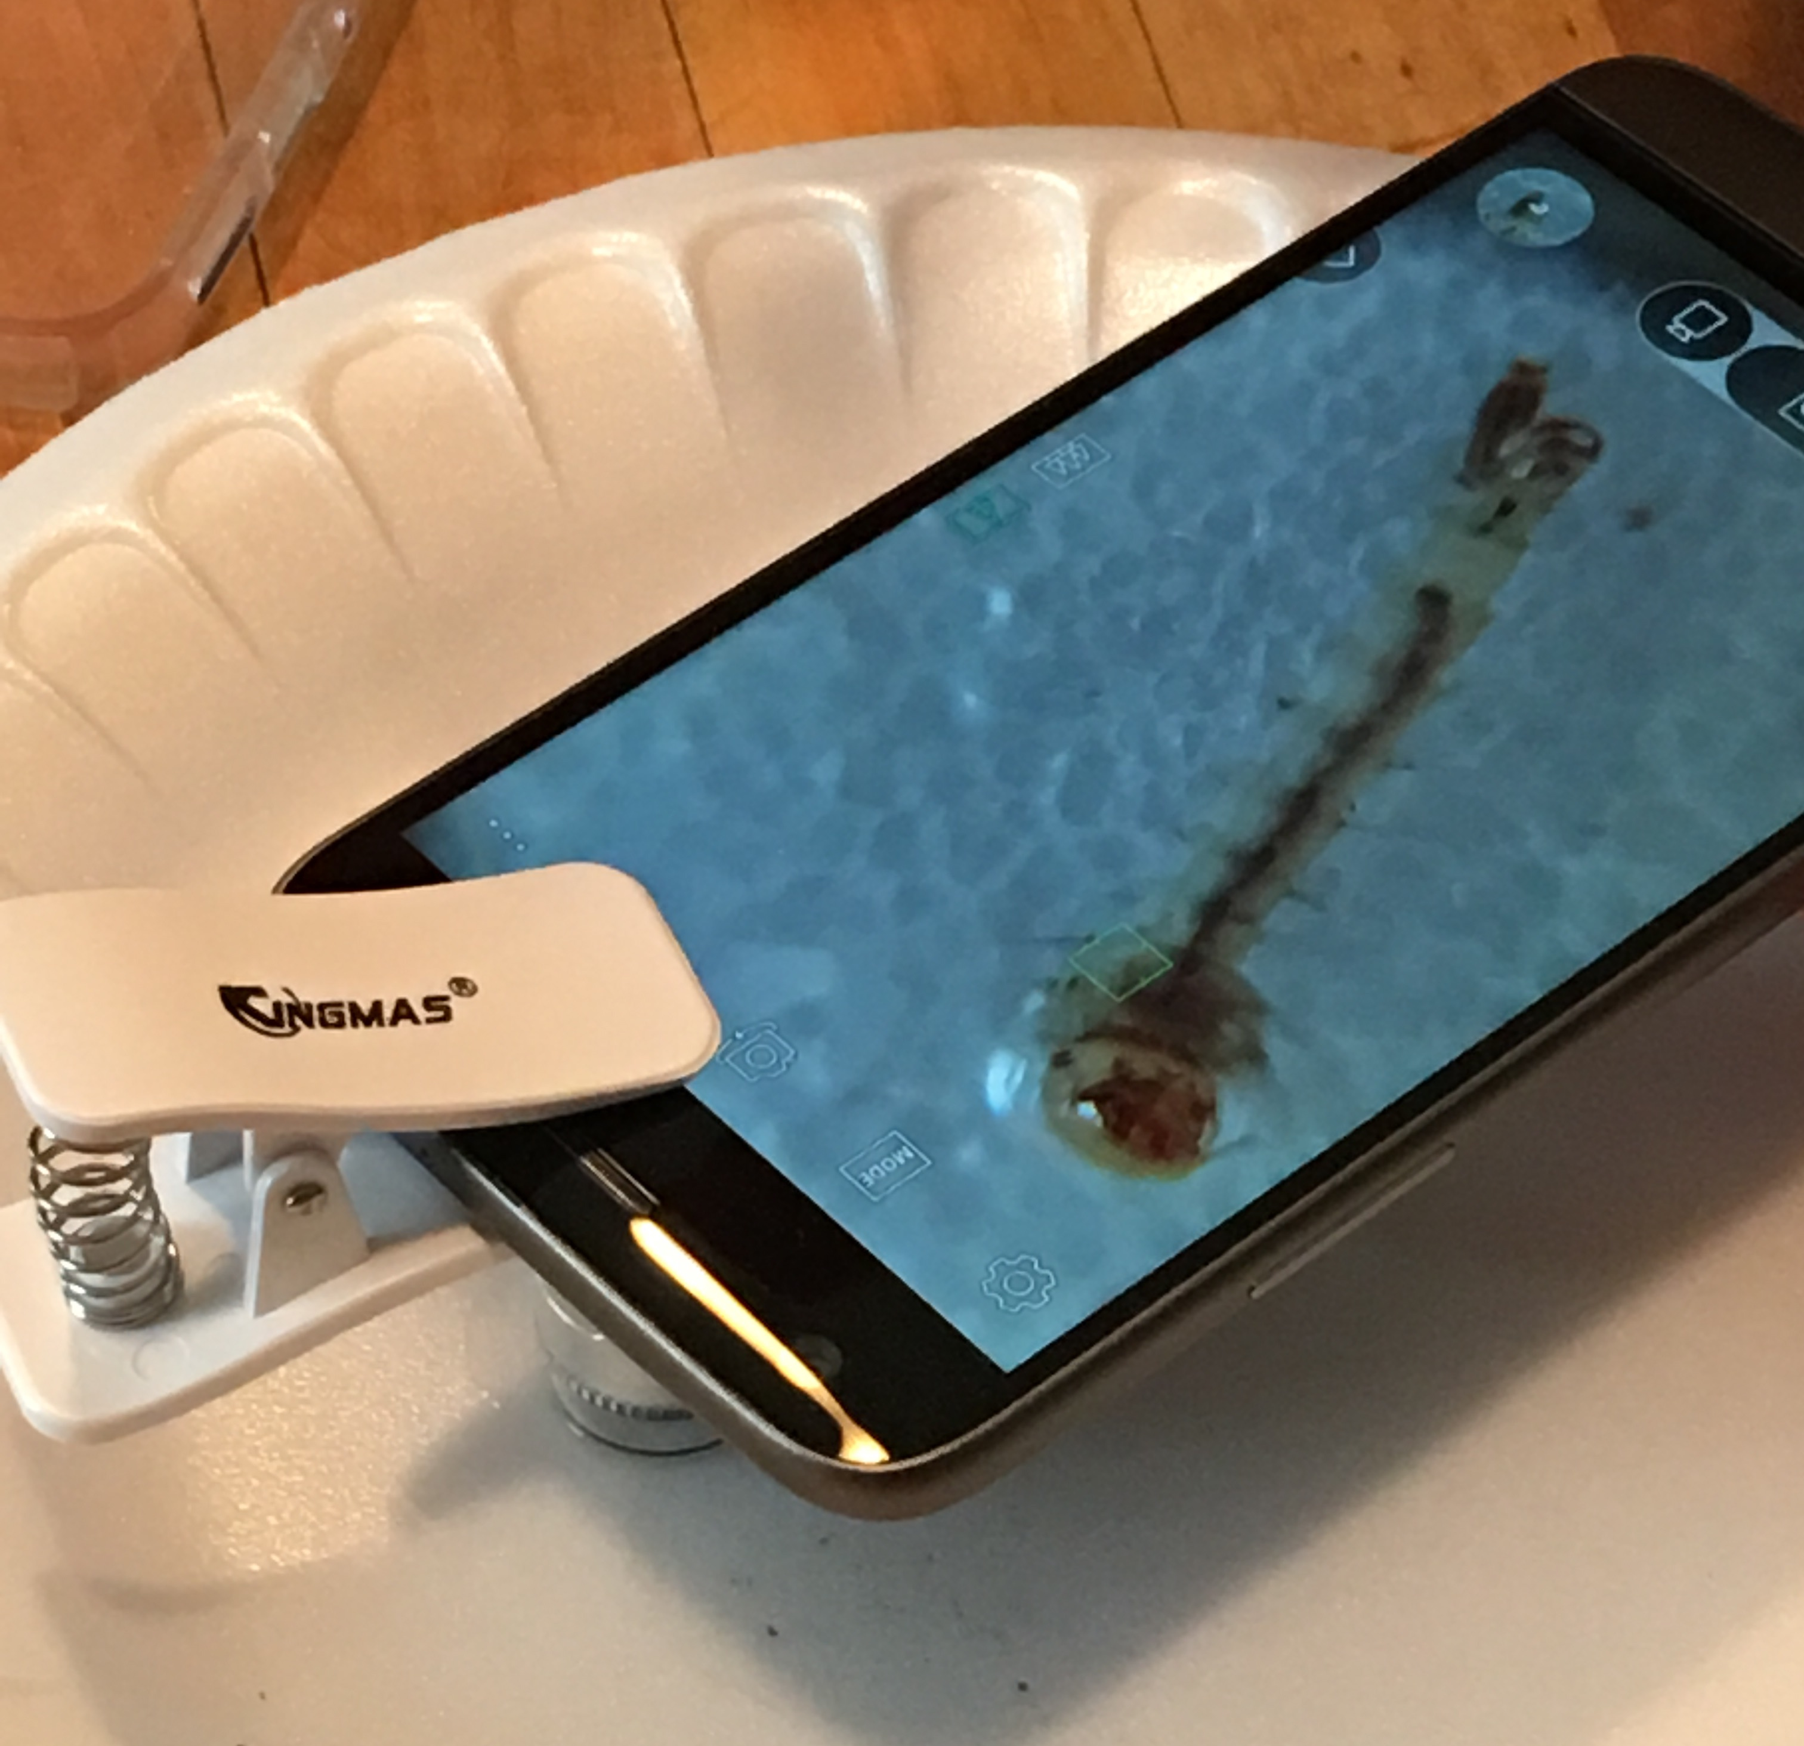
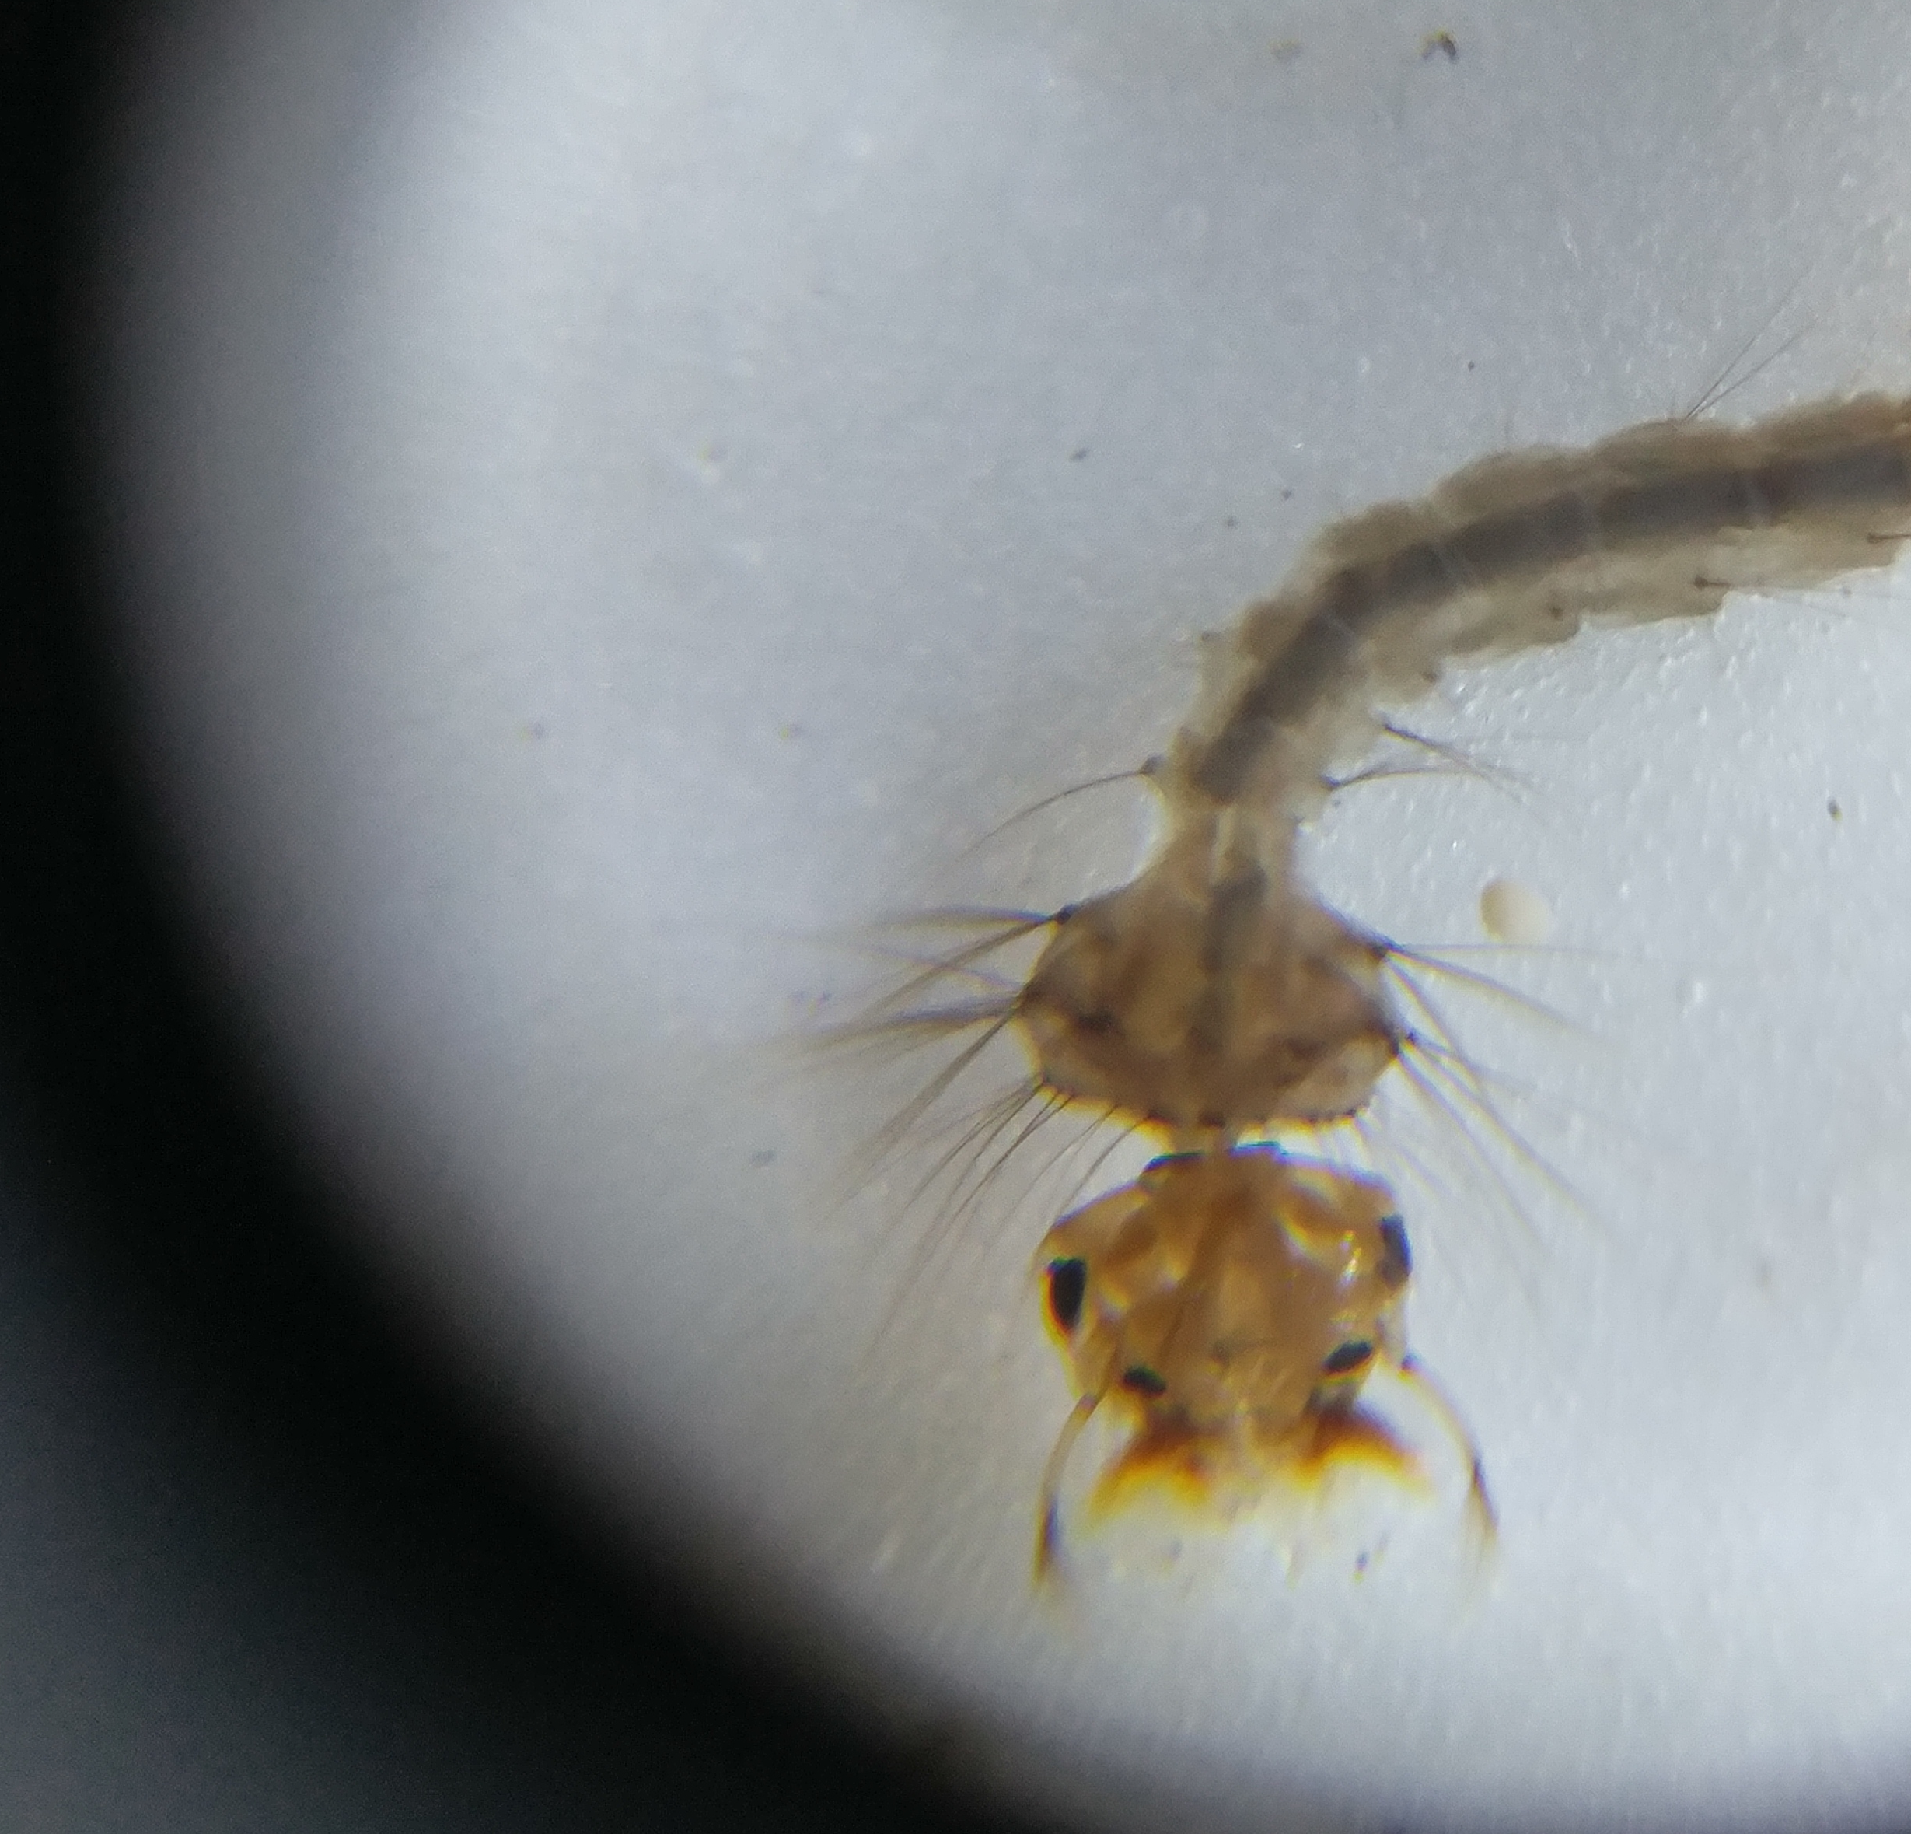
Use the GLOBE Observer Mosquito Habitat Mapper to determine if you have found a potentially dangerous mosquito, or one of the approximately 3,500 other non-disease carrying species.
Remember that mosquitoes play important roles in our ecosystems as pollinators and as food for frogs, fish and other animals.
GLOBE Observer Mosquito Habitat Mapper

Slide 19
You will not be able to determine if a mosquito is carrying a disease, only if it is a type of mosquito that can potentially carry disease.
Your data can be used by public health partners to determine if disease is being transmitted by the mosquitoes in your community.
Knowing where the mosquitoes are located is important for public health authorities, who take action to reduce the risk of disease in your community.

Slide 20
Decommissioning breeding sites by dumping water from containers and picking up trash will help reduce the population of mosquitoes in your community.
Reduce the risk of mosquito borne disease in yourself and your community!
Eliminate places where mosquitoes breed.
Wear mosquito repellent.

Slide 21


Acknowledgements
The GLOBE Observer Mosquito Habitat Mapper is a NASA-sponsored project that is the result of the combined efforts of an extended team that includes the Institute for Global Environmental Strategies (IGES); NASA Goddard Space Flight Center, Langley Research Center, and Jet Propulsion Laboratory; Space Science Applications, Inc. (SSAI); the GLOBE Implementation Office (GIO), GLOBE DIS and Brooklyn College.
The Mosquito Challenge Community Campaign (MCCC) is focused on demonstrating the usefulness of citizen science data collected using the GO Mosquito Habitat Mapper for combating Zika in Brazil and Peru. MCCC is led by IGES in partnership with the University Corporation for Atmospheric Research (UCAR), and leverages the NASA App, and the GLOBE Program networks of scientists, teachers, students, and citizen scientists. The MCCC project is made possible through the generous support of the Combating Zika and Future Threats Grand Challenge through the United States Agency for International Development (USAID).
This presentation was prepared by the Institute for Global Environmental Strategies (IGES) and does not necessarily reflect the views of the NASA or USAID. For more information, contact the MCCC PI, Dr. Russanne Low, IGES at:
Rusty_low@strategies.org
www.globe.gov
Educators: did you modify this file for your class? Put your name here!

