Slide 1

Data Literacy
DAVID BYDLOWSKI and Lisa Ogiemwonyi
WAYNE RESA / NASA’s AREN Project
bydlowd@resa.net and ogiemwl@resa.net
March 7, 2025 – MSTA – 9:30 am

Slide 2
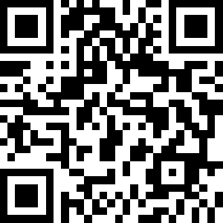
AREN Project and
Today’s Presentation
https://www.globe.gov/web/aren-project

Slide 3
Workshop Goals
Participants will be able to:
1. Learn how to use “My NASA Data.”
2. Learn how to use the “My NASA Data” Literacy Cubes.
3. Learn a differentiation skill for data analysis.

Slide 4
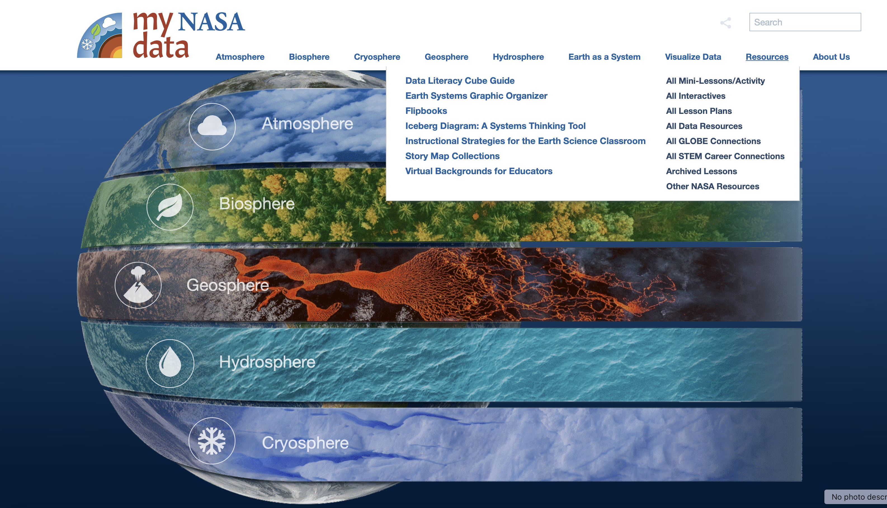
My NASA Data – Supports the integration of Authentic Earth Data in your Instruction
My NASA Data Website
Resources
Data Literacy Cube Guide
https://mynasadata.larc.nasa.gov

Slide 5
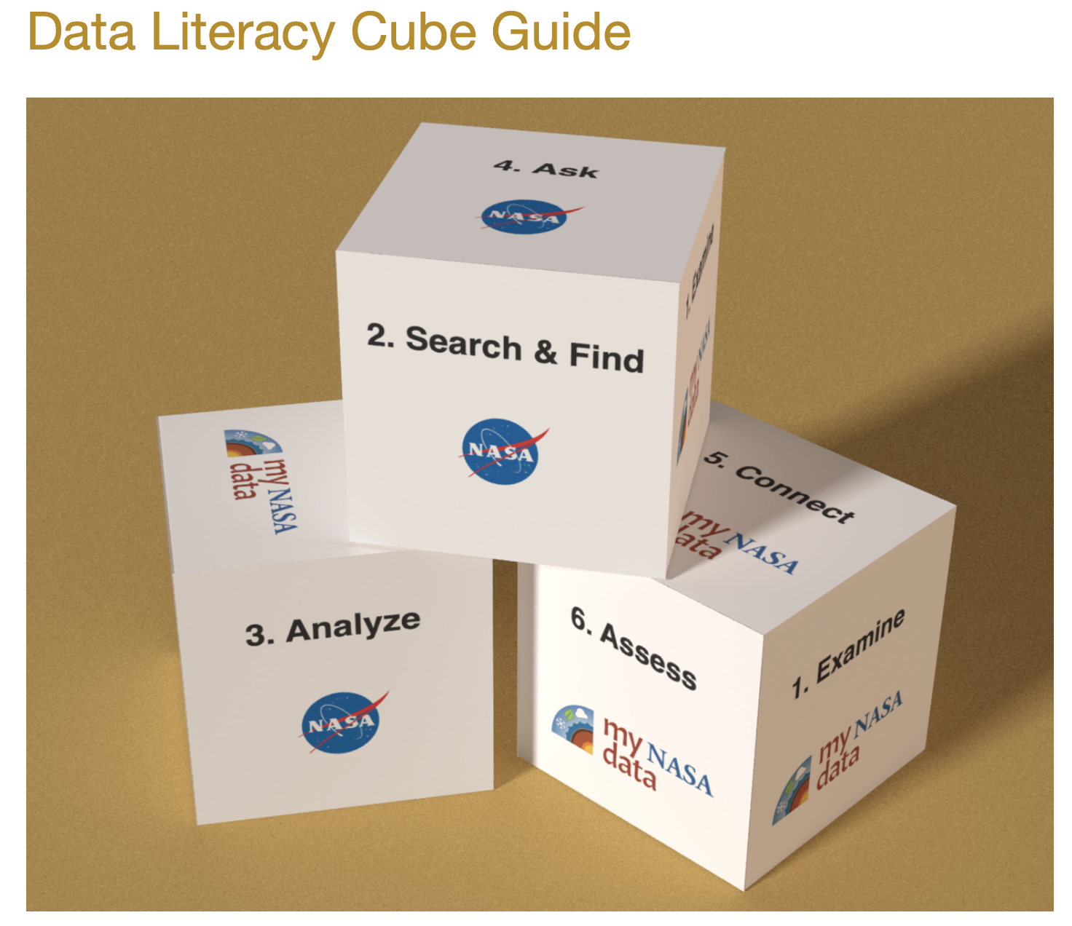
Data Literacy Cubes
https://mynasadata.larc.nasa.gov/data-literacy-cubes-graphs-maps-and-data-tables

Slide 6
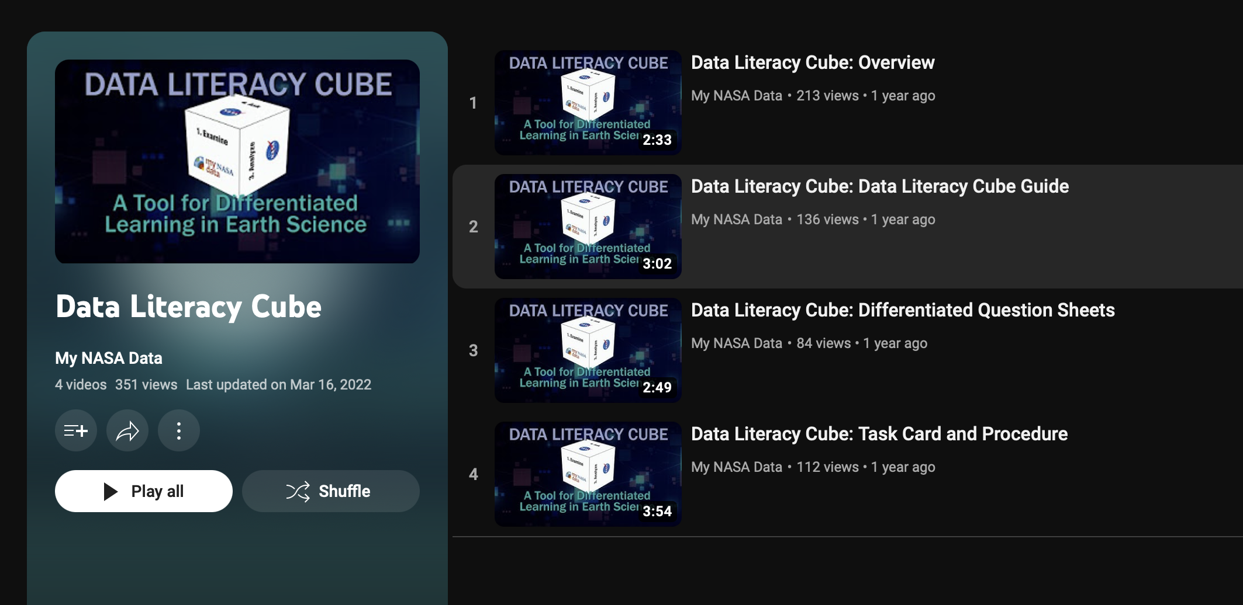
Using Data Literacy Cubes
Video Series as a Workshop Follow-up
https://www.youtube.com/playlist?list=PLQVWjfOruX-w6kNAk_Ii-PrCLayJ17aUN

Slide 7
Using Data Literacy Cubes
Read the “About this Resource”
Review Icons – Maps, Line Graphs, Data Tables
Cube Template – Page 5
Task Card – Page 6
Question Sheets – Everything after page 6

Slide 8
Question Sheets
Differentiated – Page 2
Key Words
Note Differentiated Levels on Sheet
Steps for Use – Page 4

Slide 9

Mini Lesson / Activity
Tropical Cyclone Counts Histogram

Slide 10
Form a Group of 4
Select Histogram or Map
Select Question Sheet
Do the Procedure
Report Out

Slide 11
Workshop Goals
Participants will be able to:
1. Learn how to use “My NASA Data.”
2. Learn how to use the “My NASA Data” Literacy Cubes.
3. Learn a differentiation skill for data analysis.

Slide 12
Data Literacy
DAVID BYDLOWSKI and Lisa Ogiemwonyi
WAYNE RESA / NASA’s AREN Project
bydlowd@resa.net and ogiemwl@resa.net
March 7, 2025 – MSTA – 9:30 am

