Slide 1
Forces of Flight
DAVID BYDLOWSKI and Lisa Ogiemwonyi
WAYNE RESA / NASA’s AREN Project
bydlowd@resa.net and ogiemwl@resa.net
March 7, 2025 – MSTA – 11:00 am

Slide 2
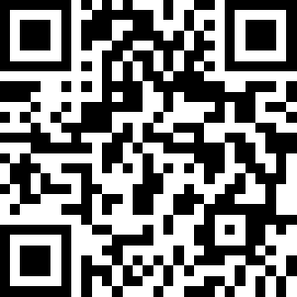
AREN Project and Today’s Presentation
https://www.globe.gov/web/aren-project

Slide 3
Workshop Goals
Participants will be able to:
Know the four forces of flight.
Apply the four forces of flight within the state standards on Forces and Interactions.
Apply the forces of flight to different examples.

Slide 4
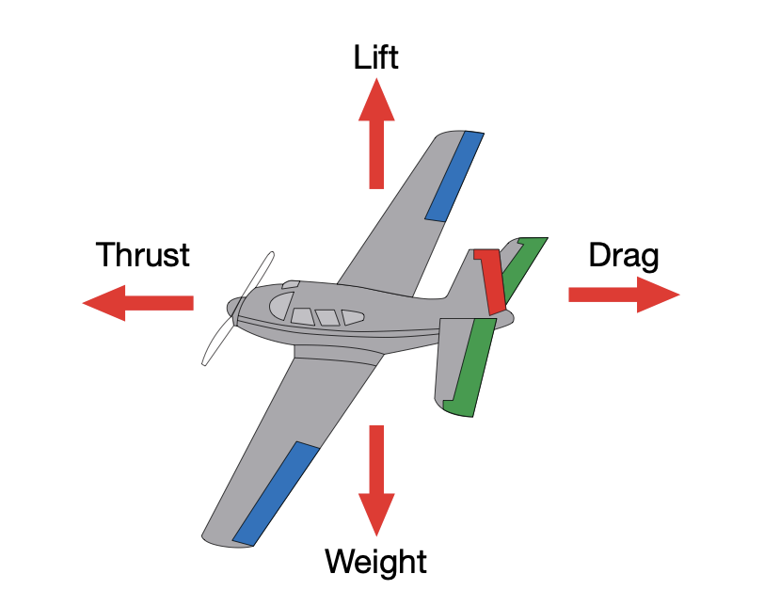
Four Forces of Flight
https://www1.grc.nasa.gov/beginners-guide-to-aeronautics/four-forces-on-an-airplane/

Slide 5
Alignment to the Disciplinary Core Ideas
Kindergarten https://www.nextgenscience.org/dci-arrangement/k-ps2-motion-and-stability-forces-and-interactions
Third Grade https://www.nextgenscience.org/dci-arrangement/3-ps2-motion-and-stability-forces-and-interactions
Fifth Grade https://www.nextgenscience.org/dci-arrangement/5-ps2-motion-and-stability-forces-and-interactions
Middle School https://www.nextgenscience.org/dci-arrangement/ms-ps2-motion-and-stability-forces-and-interactions
High School https://www.nextgenscience.org/dci-arrangement/hs-ps2-motion-and-stability-forces-and-interactions

Slide 6
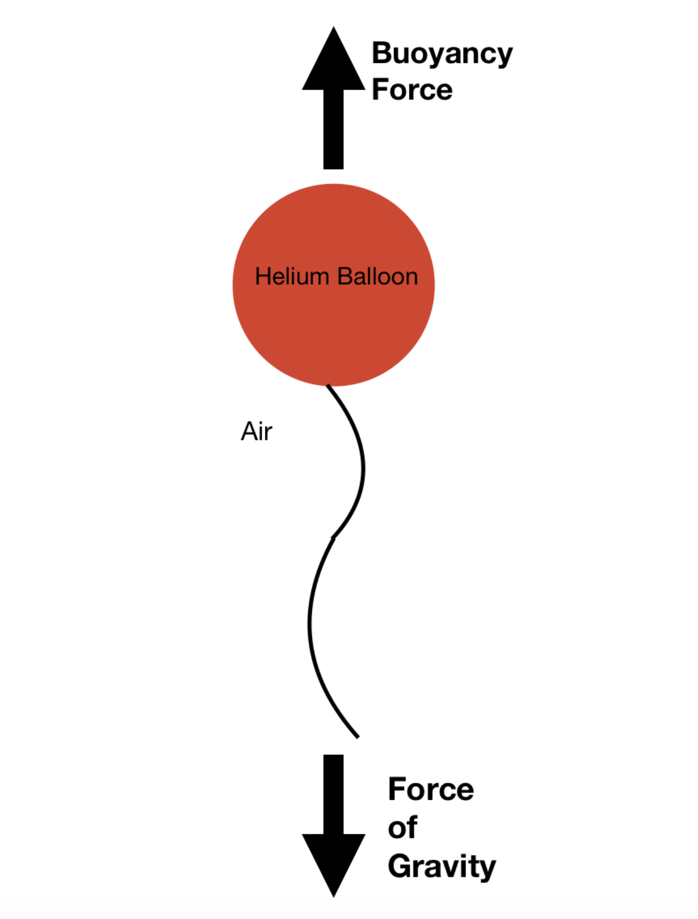
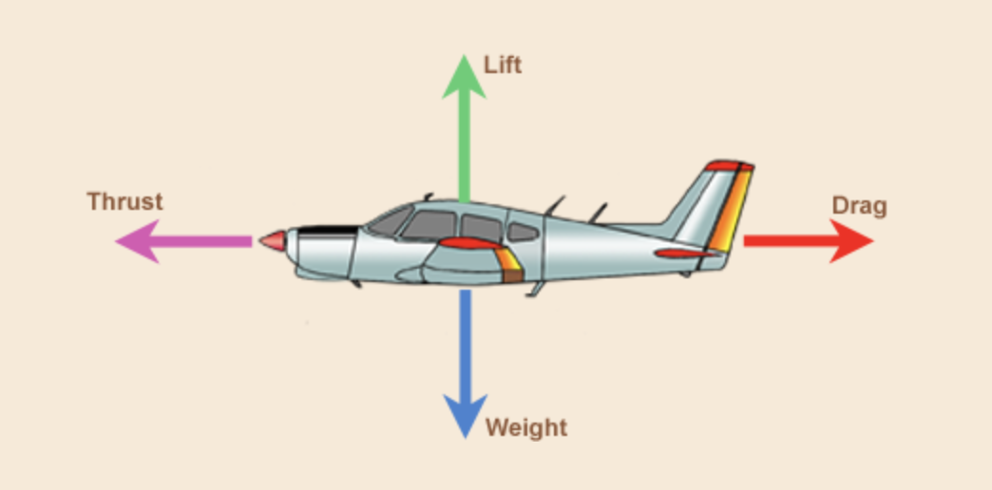
Flight – Action of flying through the atmosphere without touching a surface. Two types:
Buoyancy
Aerodynamic

Slide 7
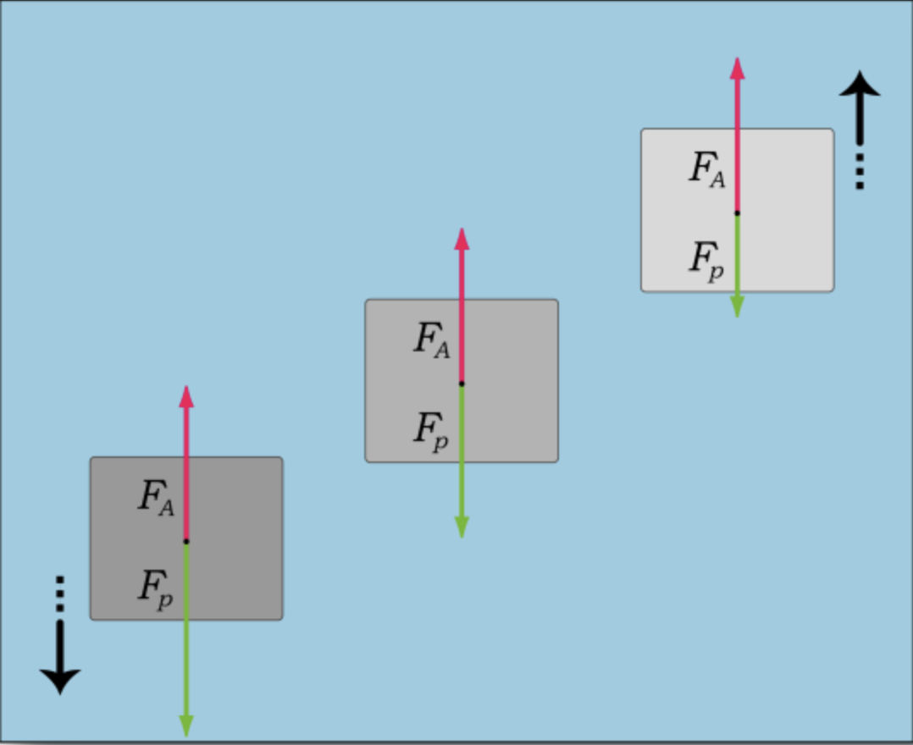
Neutral Buoyancy Challenge
Mission: Create a neutrally-balanced balloon that will float without touching the ground, ceiling, or any other object.

Slide 8
Today’s Challenges:
1. 10 Seconds
2. 30 Seconds
3. The Longest Time

Slide 9
Steps to Success -- Must Use the Words: Bouyancy and Gravity
Form a Team of 4
Briefing – Discuss the Mission
Logistics – Get Supplies (clear tape, masking tape, paper, ribbon, string, paper clips, additional approved materials)
Building – Time Limit
Launch – 10 Second Countdown
Testing/Flight – Team Member Keeps Time
Analysis – Discussion of Success/Failure
Conclusion – Clean Up, Return Supplies

Slide 10
Today’s Challenges:
1. 10 Seconds
2. 30 Seconds
3. The Longest Time

Slide 11
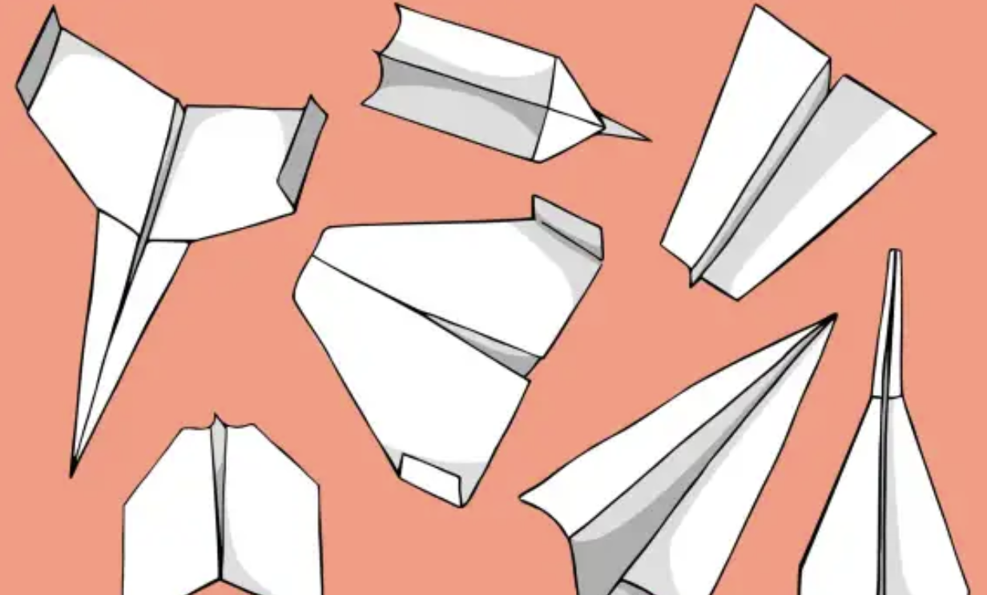
Aerodynamic Flight Challenge
https://www.sciencefriday.com/educational-resources/paper-airplane-flight-challenge/

Slide 12
Today’s Challenges:
Greatest Distance I
Greatest Distance II

Slide 13
Steps to Success – Must use the words for the: 4 Forces of Flight
Form a Team of 4
Briefing – Discuss the Mission
Logistics – Get Supplies (paper)
Building – Time Limit
Launch – 10 Second Countdown
Testing/Flight – Team Member Records Distance
Analysis – Discussion of Success/Failure
Conclusion – Clean Up, Return Supplies

Slide 14
Today’s Challenges:
Greatest Distance I
Greatest Distance II

Slide 15
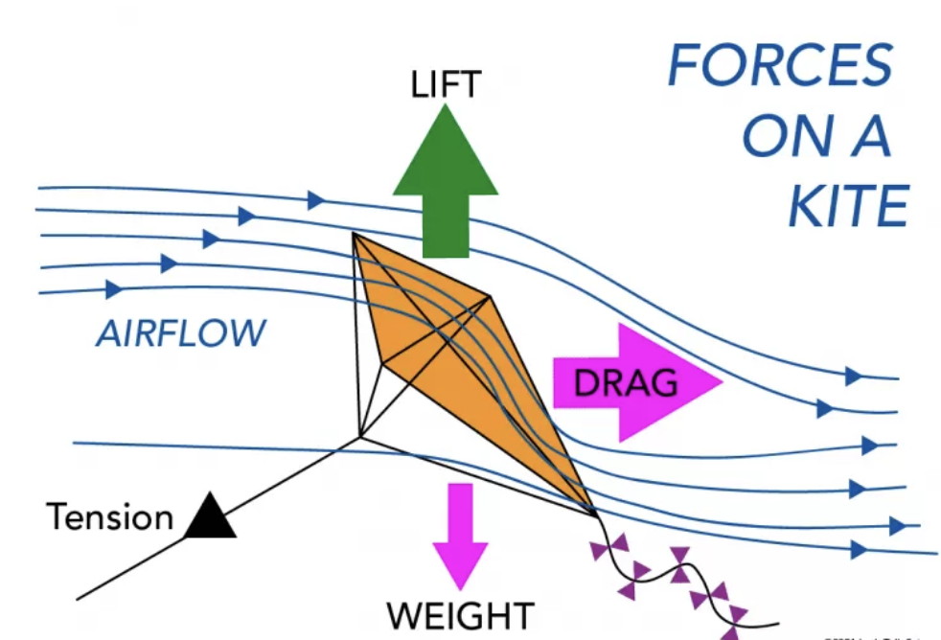
Kites – What force is missing? Explain!

Slide 16
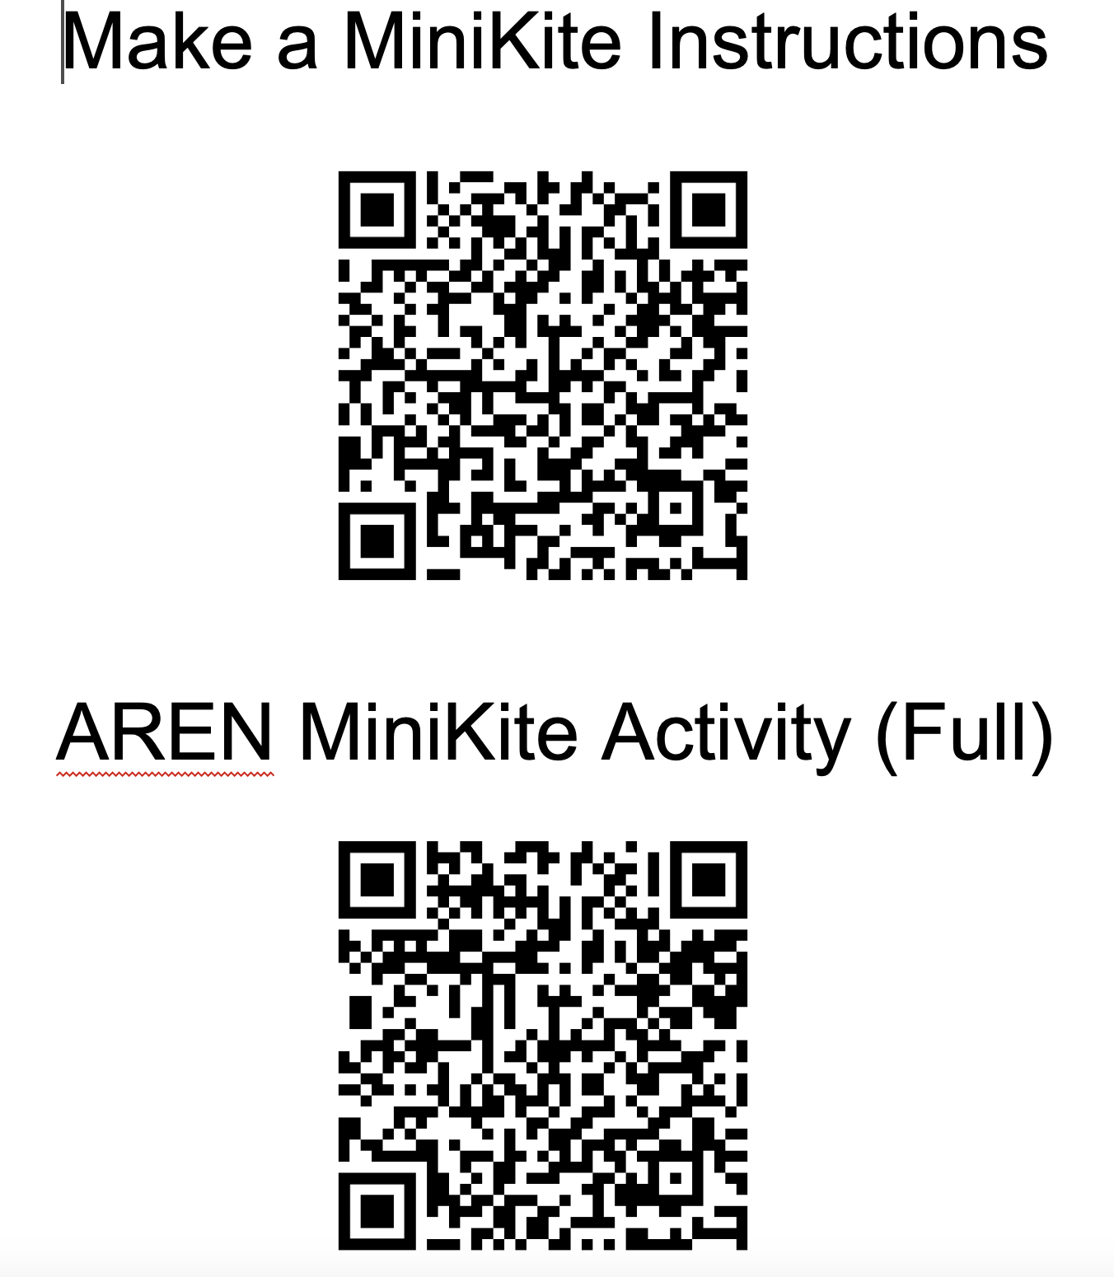

Slide 17
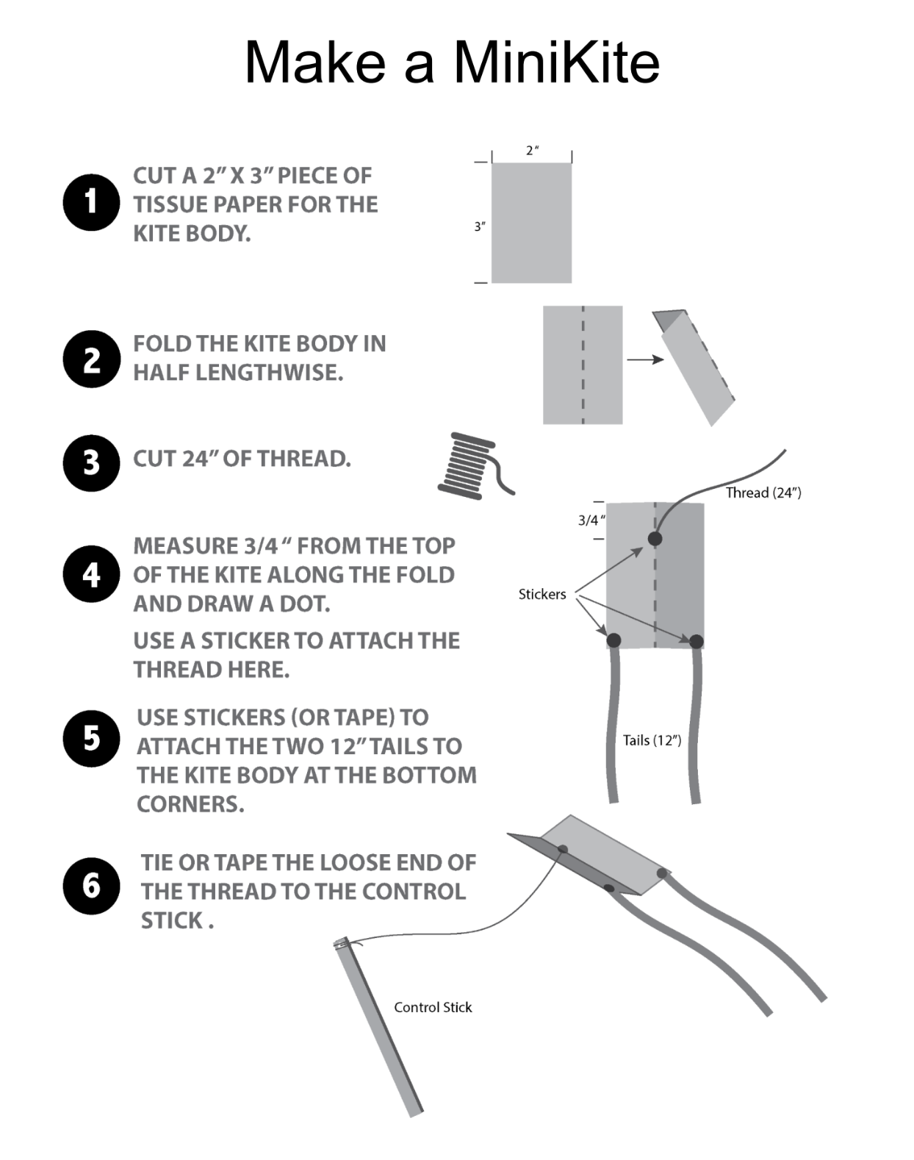

Slide 18
Workshop Goals
Participants will be able to:
Know the four forces of flight.
Apply the four forces of flight within the state standards on Forces and Interactions.
Apply the forces of flight to different examples.

Slide 19
Forces of Flight
DAVID BYDLOWSKI and Lisa Ogiemwonyi
WAYNE RESA / NASA’s AREN Project
bydlowd@resa.net and ogiemwl@resa.net
March 7, 2025 – MSTA – 11:00 am

