Slide 1
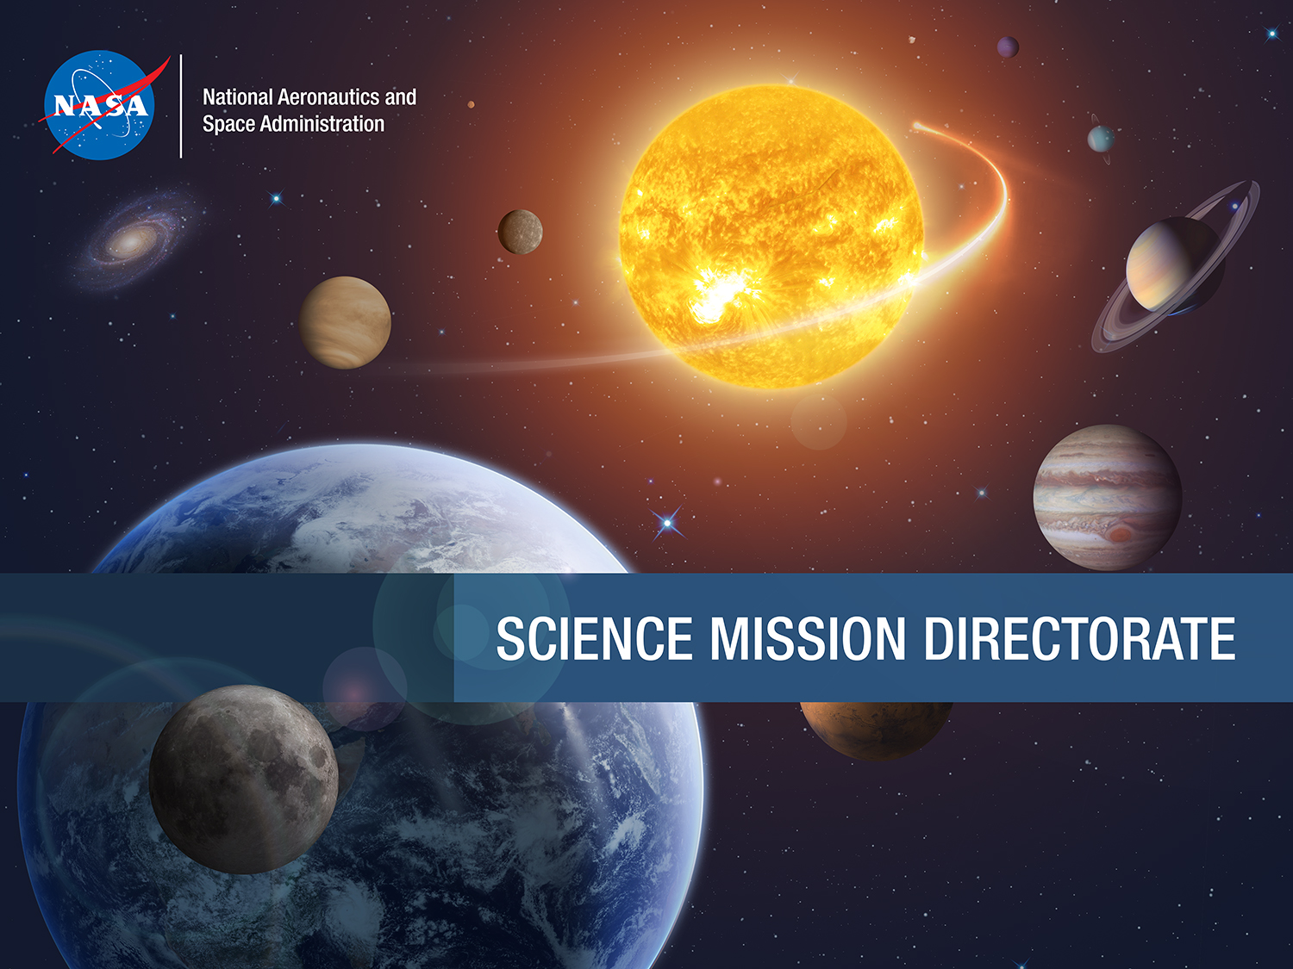
David Bydlowski
AREN Project at the NSTA Conference in St. Louis, MO
April / May, 2019

Slide 2
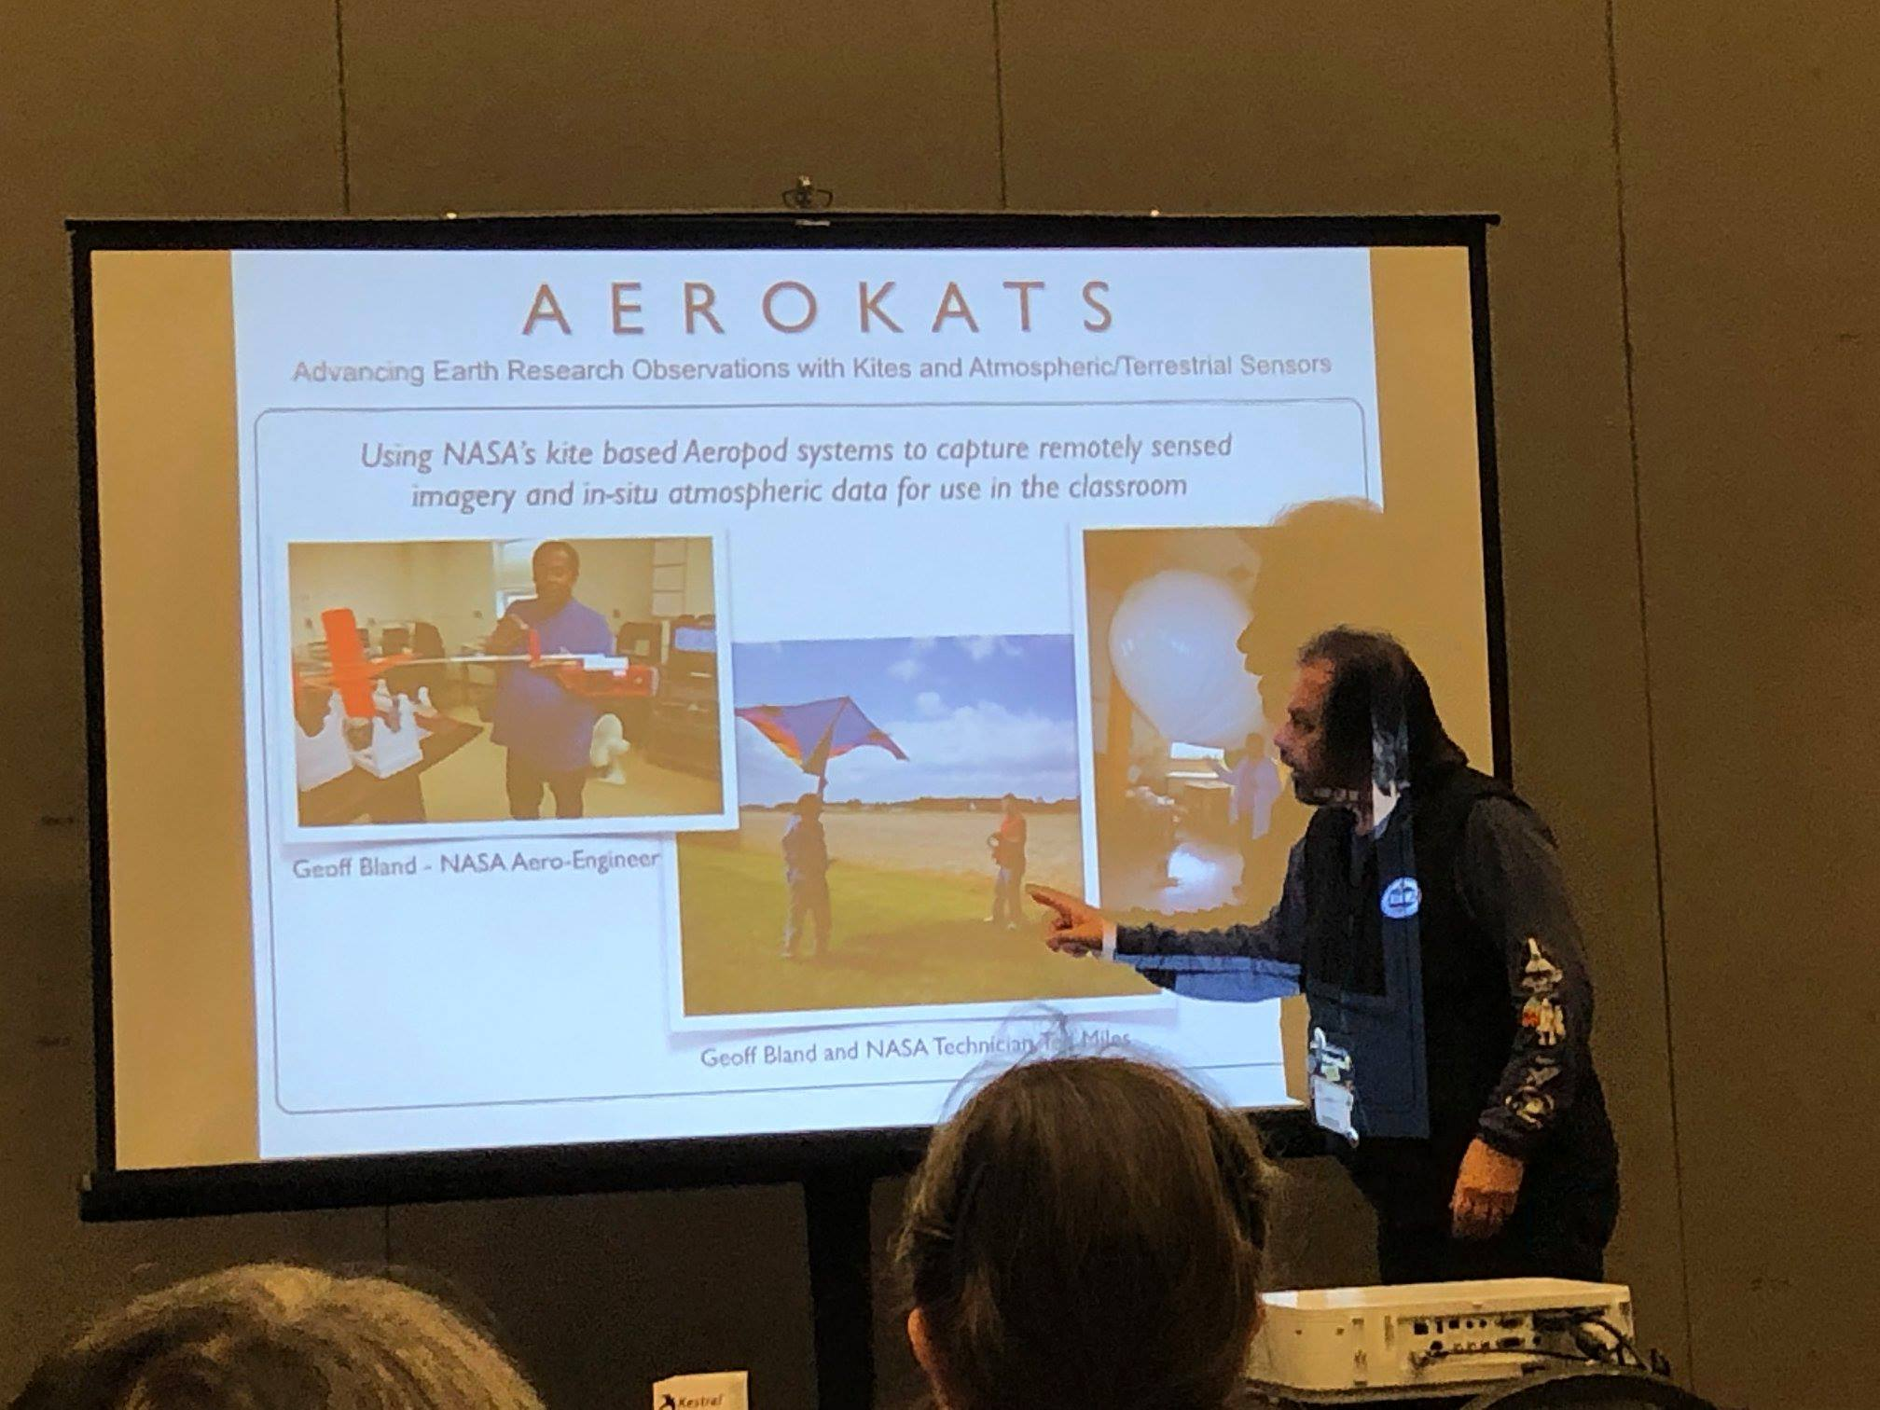
AREN Presents at NSTA
David Bydlowski, PI for the AREN Project, presented two sessions at the National Science Teachers Association Conference in St. Louis, MO, during April, 2019:
#GettingScienceDone -- Using CoCoRaHS and the GLOBE Observer apps as starting points for students to collect data on precipitation, clouds, mosquitoes, and other citizen science projects.
Aerial Exploration of Environmental Study Sites Using Kites, Cameras and Other Sensors -- A look at environmental study sites from 150 meters above ground level.
Participant highlights Included:
Representation from over 20 US states
Building of their own “table-top” kites to simulate kite flying, while indoors.
Conducting a cloud observation study.

