Slide 1
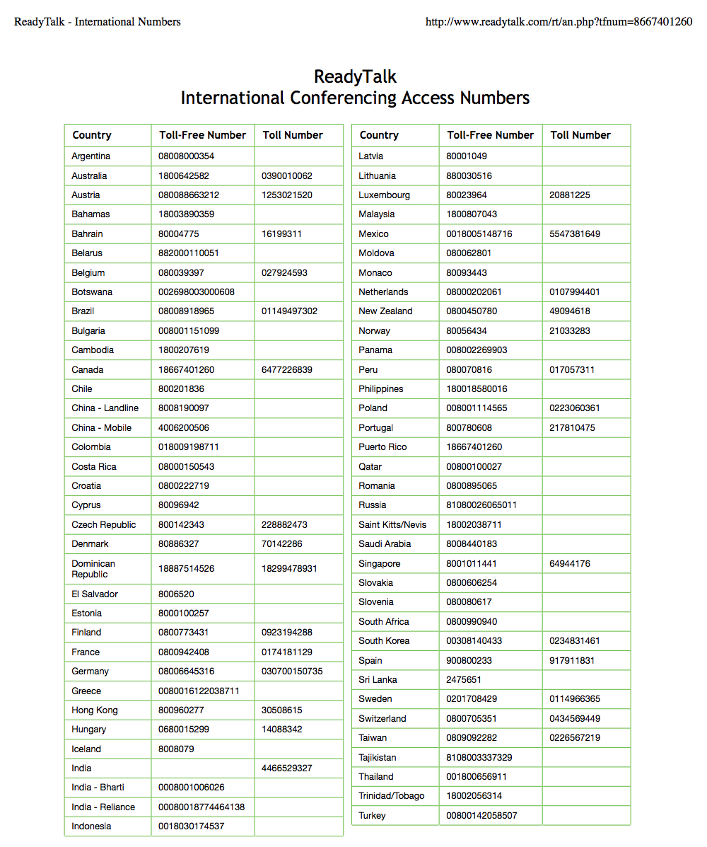
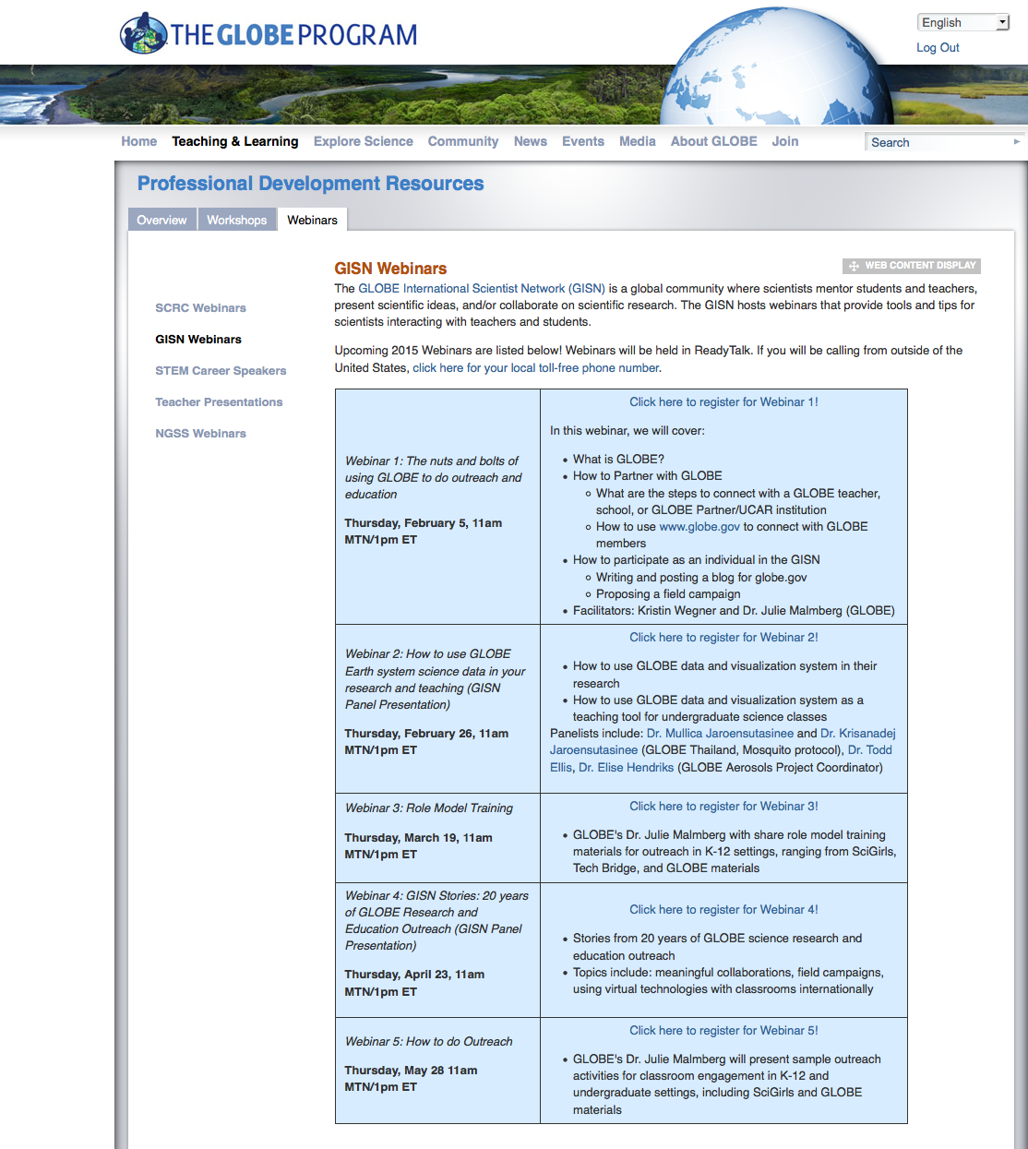
Webinar Logistics
http://go.usa.gov/S98Q
Click here for the international conference access number

Slide 2
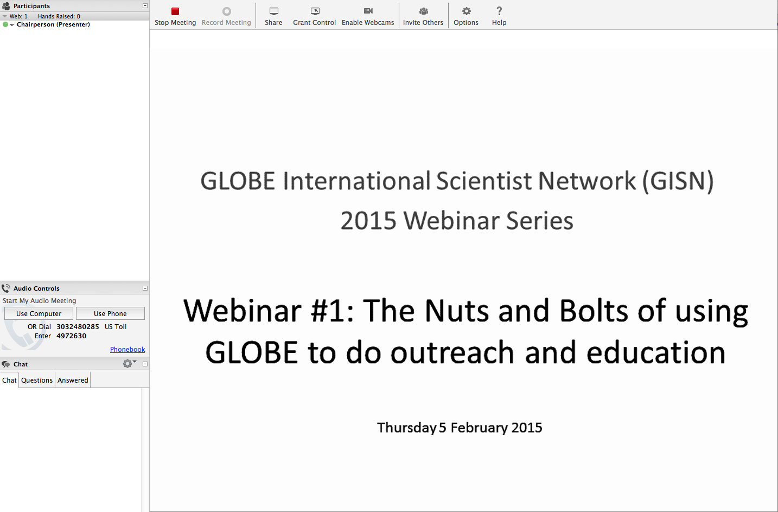
Webinar Logistics
Raise your hand if you have any technology problems
Type questions and comments in the chat space here

Slide 3


Webinar #3: Role Model Training
GLOBE International Scientist Network (GISN)
2015 Webinar Series
Thursday, 19 March 2015
Notes:
Welcome to the first webinar in the 2015 GISN Webinar Series! Today’s GISN webinar is called “The Nuts and Bolts of using GLOBE to do outreach and education.” In this webinar, we will focus on the logistics of the GISN on globe.gov, as well as share some of the tools and capabilities that you have as a GISN member.

Slide 4
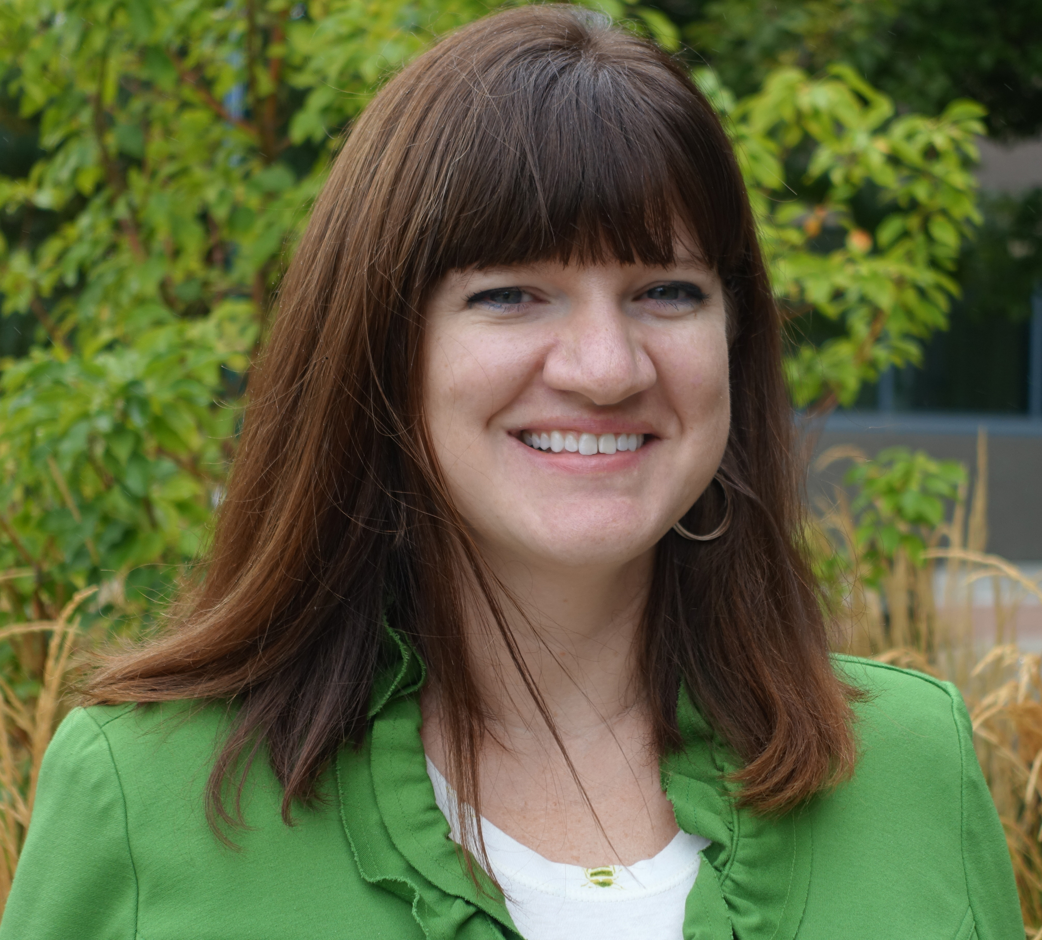
Presenter
Dr. Julie Malmberg
GLOBE Implementation Office
Science Education and Outreach
SciGirls Trainer
TechBridge Role Model Trainer

Slide 5
Who are you?
  Who are you? Let us know in the chat window. (I’ll read answers aloud).
  Name
  Location
  Organization

Slide 6
Introduction (1)
Julie Malmberg, PhD
BS and MS in Atmospheric Sciences from University of Illinois at Urbana-Champaign
  Focused on 850mb 0˚C isotherm to forecast freezing rain events
  Later studies focused on Atmospheric Sciences and Education
PhD in Geography from the University of Colorado at Boulder
  Dissertation Title: Social, Demographic, and Environmental Influences on Perceptions and Memories of Weather, Climate, and Climate Change
Notes:
I’m going to introduce myself two times – take note!
Studied biometeorology at CU

Slide 7
Introduction (1), Cont.
Work History
  The GLOBE Program, 2011 – current
  American Public University Systems, 2010 – current
  University of Colorado at Boulder, 2005 – 2011
  National American University, 2003 – 2011
  Western Water Assessment – NOAA, 2007-2009
  National Weather Service, 2000 – 2003
  University of Illinois at Urbana-Champaign, 1999 - 2003

Slide 8
Introduction (2)

Slide 9


How it began…
Grew up in Illinois
Always liked math and science
  AP Chemistry Teacher: Dr. Jackson
Loved watching severe weather
Truman State University, Kirksville, MO
  Undeclared (chemistry, music, elementary education, math, literature, etc…)
Two events
  Tornado hit Alton, IL (June 14, 1998)
  The Handy Weather Answer Book
Transferred to the University of Illinois at Urbana-Champaign
Notes:
Meteorologist meant being on TV, did NOT want to do that, talked to guidance counselor and she told me the same thing

Slide 10
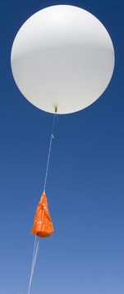
Education and Career History
BS in Atmospheric Sciences – University of Illinois at Urbana-Champaign (2001)
  Volunteered at the National Weather Service – Lincoln, IL
  Graded papers for Intro to Atmospheric Sciences and Severe & Unusual Weather
MS in Atmospheric Sciences – University of Illinois at Urbana-Champaign (2003)
  SCEP at National Weather Service – Lincoln, IL
  TA for Intro to Atmospheric Sciences
  Research focus changed! Freezing Rain → Atmospheric Sciences and Education

Slide 11

Education and Career History
Started working for an online university in 2003
  Taught meteorology, ecology, and math courses
  All online – unique ways to teach about sciences
PhD in Geography – University of Colorado-Boulder (2014)
  Wanted to study weather and climate PLUS people (biometeorology) → memories and perceptions of weather, climate, and climate change
  Taught many courses (Climate & Vegetation, World Regional Geography, Hydrology. Mountain Geography)
  Lead Graduate Teaching Assistant
  Research Assistant for Western Water Assessment (CIRES/NOAA)
Biometeorology noun | bio·me·te·o·rol·o·gy
: a science that deals with the relationship between living things and atmospheric phenomena

Slide 12

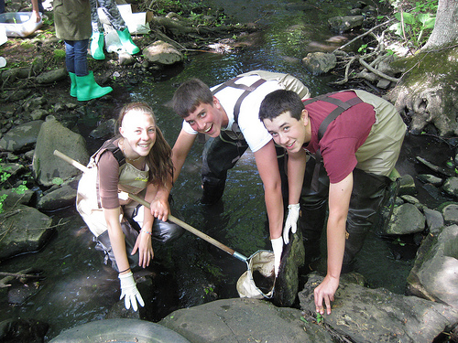
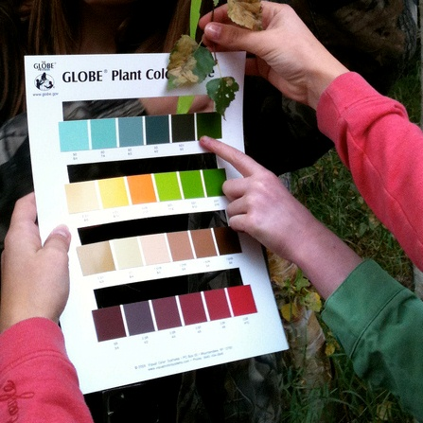
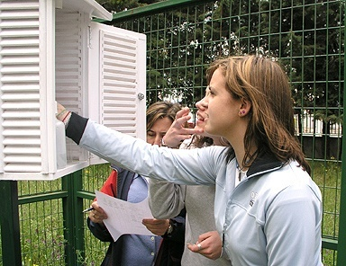
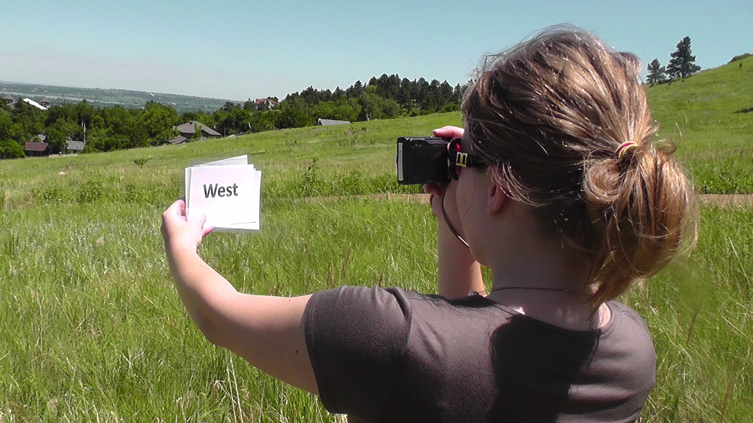
Current Job
Education, Outreach, Technology Specialist
The GLOBE Program
  Global Learning and Observations to Benefit the Environment
  www.globe.gov
  Worldwide (110+ countries), K-20
  Science and education
Notes:
Atmosphere
Hydrology
Soils
Earth as a System and Phenology
Land Cover and Biology

Slide 13
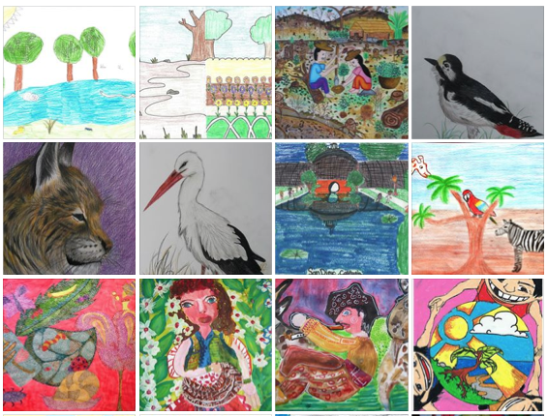
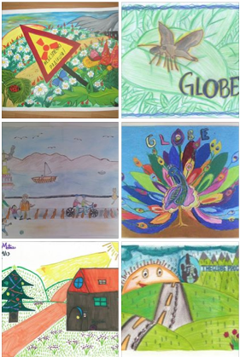
Current Job - Tasks
Work with students, teachers, scientists to promote science in (or out of!) the classroom
Competitions and events
Work with NASA Education and Public Outreach
Project management, web page design, blog writing, education standards, publications, grants, mentoring students, professional development, SciGirls, …
Notes:
Work with students, teachers, scientists to promote science in (or out of!) the classroom
Focus on underrepresented populations in the sciences
Competitions and events
Student art competitions
Educator Fellowship
GLOBE Learning Expeditions
Virtual Student Conferences and Student Research Exhibitions
Work with NASA Education and Public Outreach
Earth observing satellite missions
Project management, web page design, blog writing, education standards, publications, grants, mentoring students, professional development, SciGirls

Slide 14

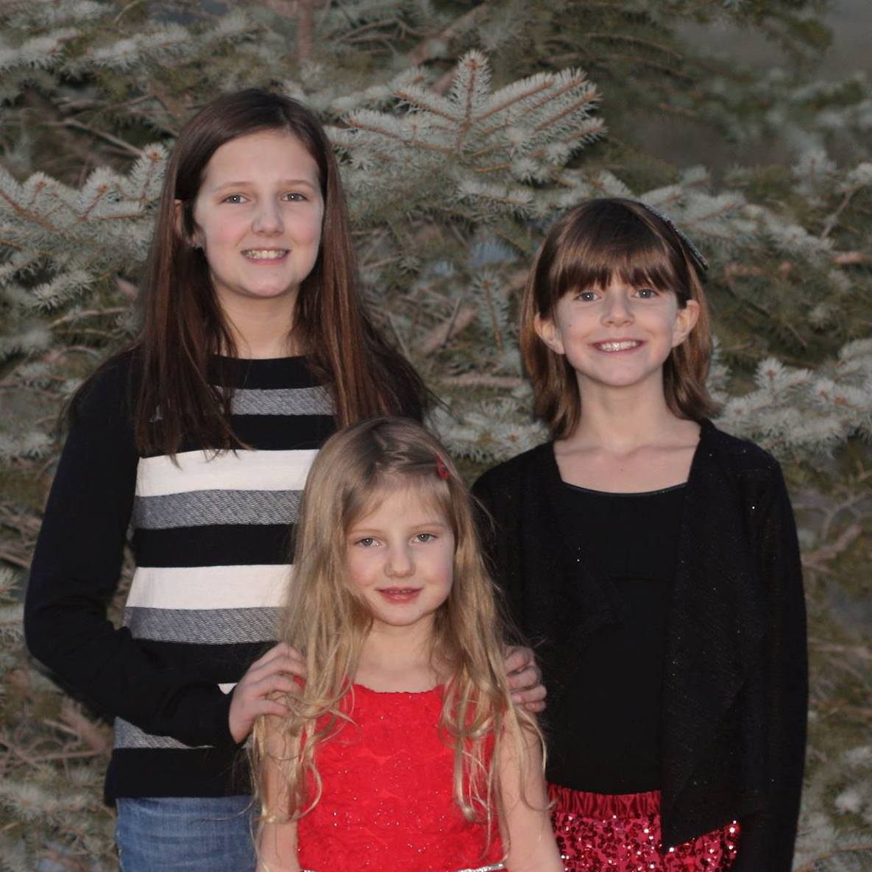
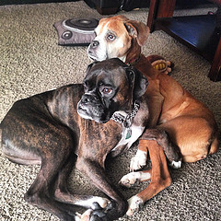

Outside of Work
Family
Hobbies: traveling, reading, snowshoeing
Girl Scout leader, classroom volunteer, science fair judge

Slide 15
Poll
From the perspective of a student, which do you prefer? Say why in the chat box.
  Introduction 1
  Introduction 2

Slide 16


Role Model Training
Overview
  What is a role model?
  Why do role models matter?
  Role model strategies

Slide 17
Role Model Training
Overview
  What is a role model?
  Why do role models matter?
  Role model strategies

Slide 18
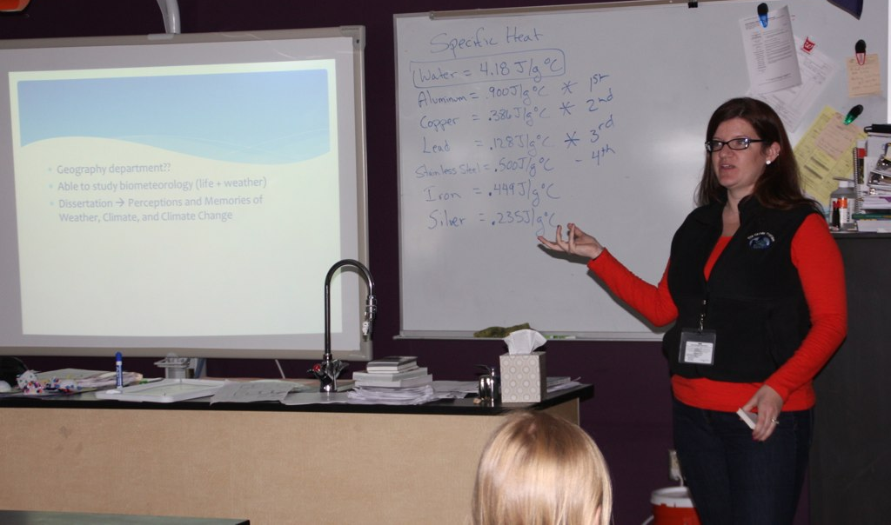
What is a role model?
Reflect on a role model in your life
  List a few of his or her traits in the chat window (I’ll read them aloud)

Slide 19

What is a role model?
A role model is someone whose own passion and enthusiasm help motivate others and inspire them to see possibilities for the future.
-Techbridge, 2013
(EU Women, 2012)

Slide 20
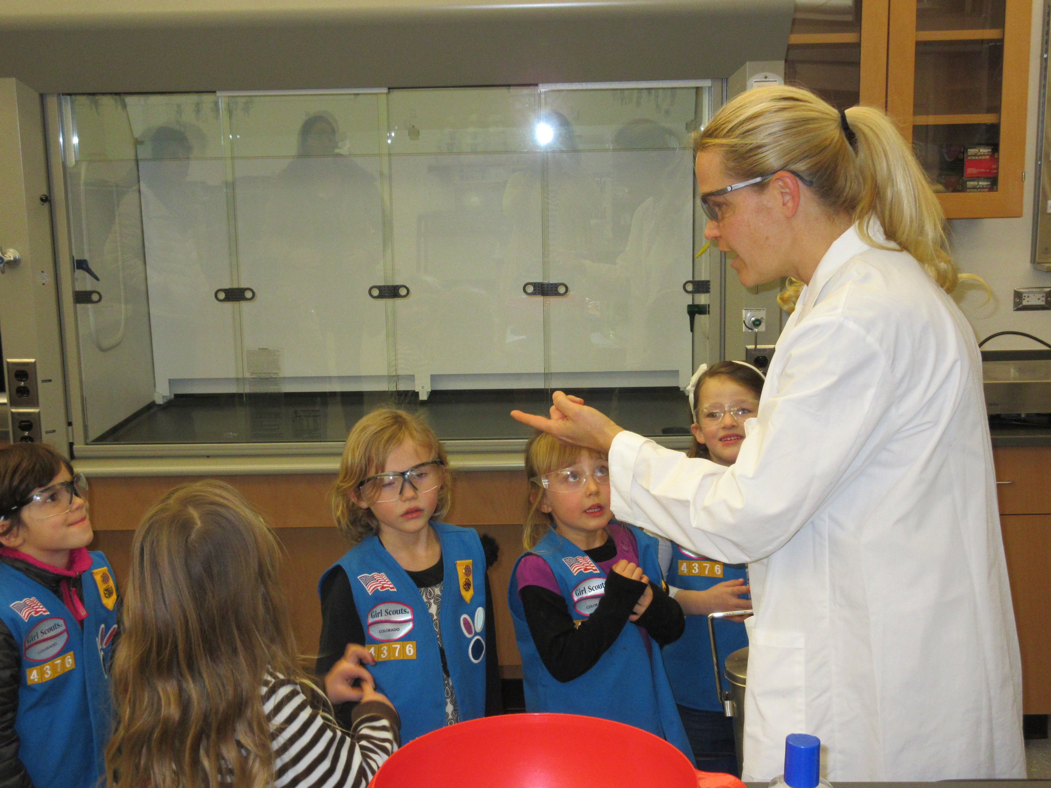
What is a role model?
Personal connection to a field
Increase interest and participation in STEM careers

Slide 21
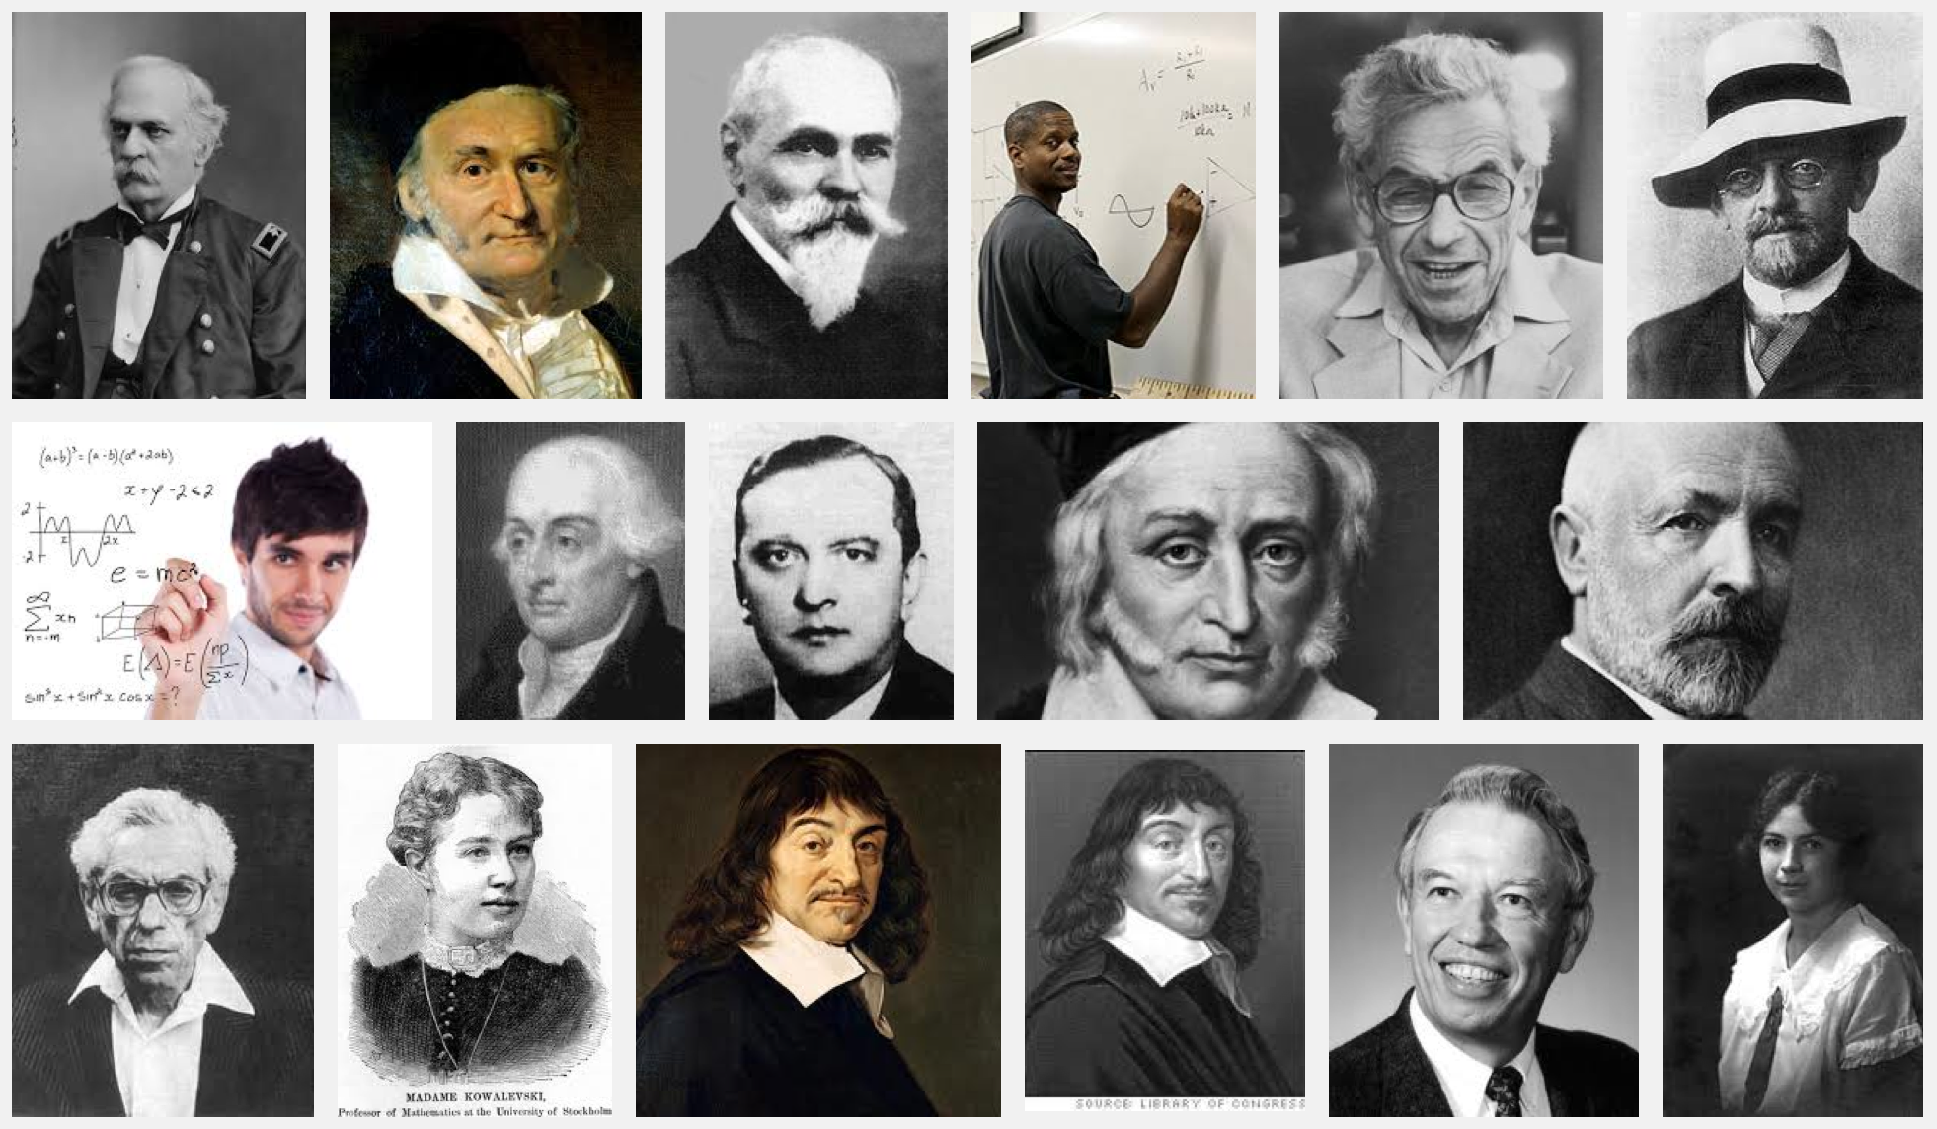
What is a role model?
Dispel myths and negative stereotypes

Slide 22
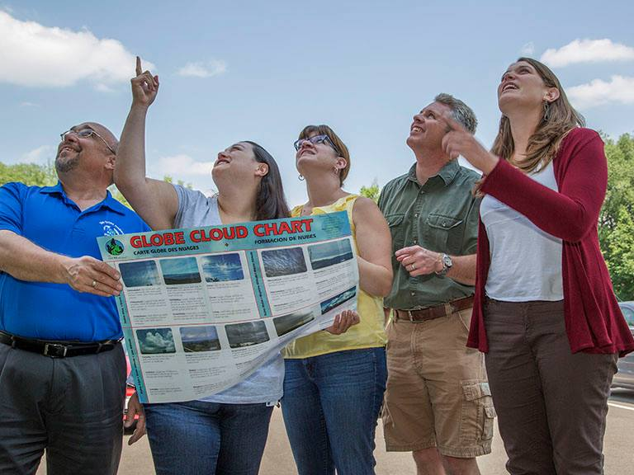
Role Model Training
Overview
  What is a role model?
  Why do role models matter?
  Role model strategies

Slide 23
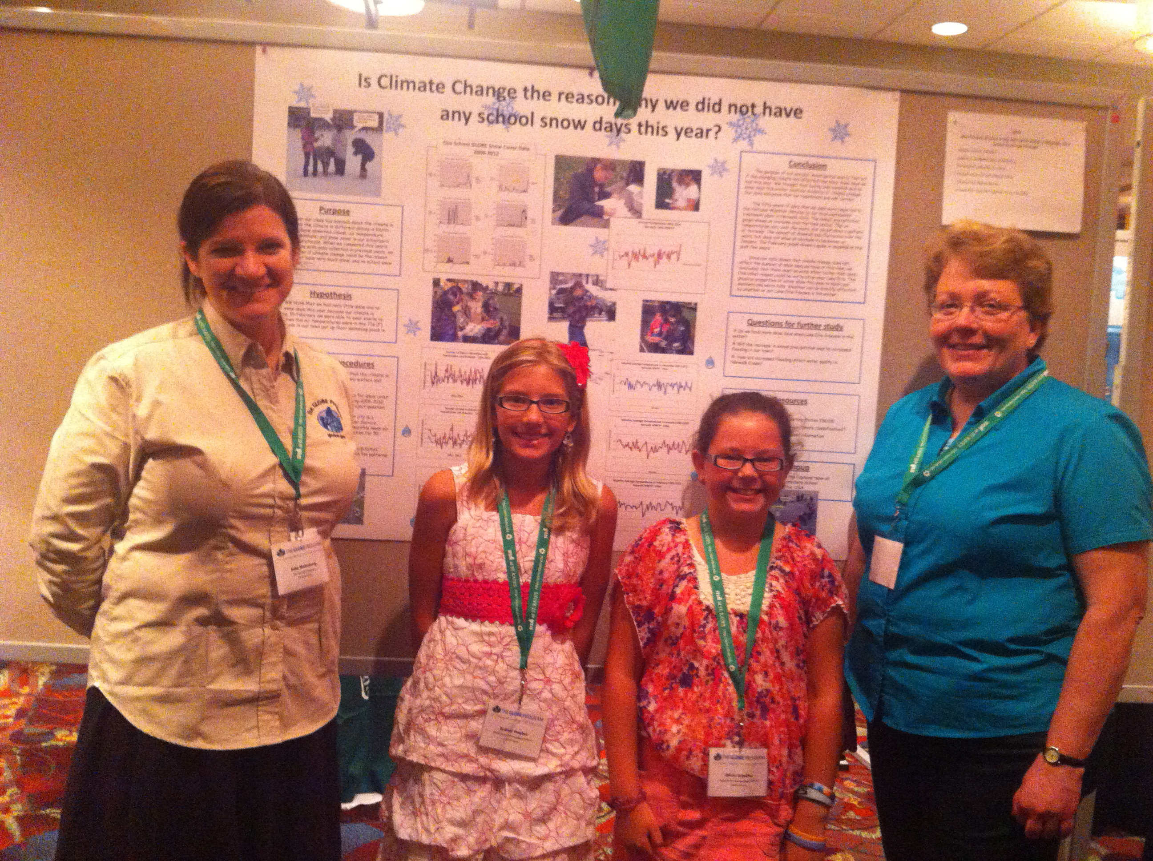
Why do role models matter?
Inspire the next generation
Seeing someone who looks like them (particularly important for girls and minorities)

Slide 24
Why do role models matter?
Non-stereotypical role models → higher belief in success (Cheryan et al., 2011)
Role model influence more important than self-efficacy in career choice (Quimby and De Santis, 2011)
Students’ perceptions of STEM positively influenced by role models – including fixing misconceptions (Scherz and Oren, 2006)

Slide 25
Role Model Training
Overview
  What is a role model?
  Why do role models matter?
  Role model strategies

Slide 26
Role Model Strategies
Make personal connections to dispel stereotypes.
Use positive messaging to show how STEM makes the world a better place.
Share your passion.
Make it hands-on and keep it interactive.

Slide 27

Role Model Strategies
Foster a growth mindset and promote perseverance.
Show the way: offer resources and academic guidance for right here, right now.
Follow-up and invite feedback.
SciGirls: Role Model Strategies, 2013

Slide 28
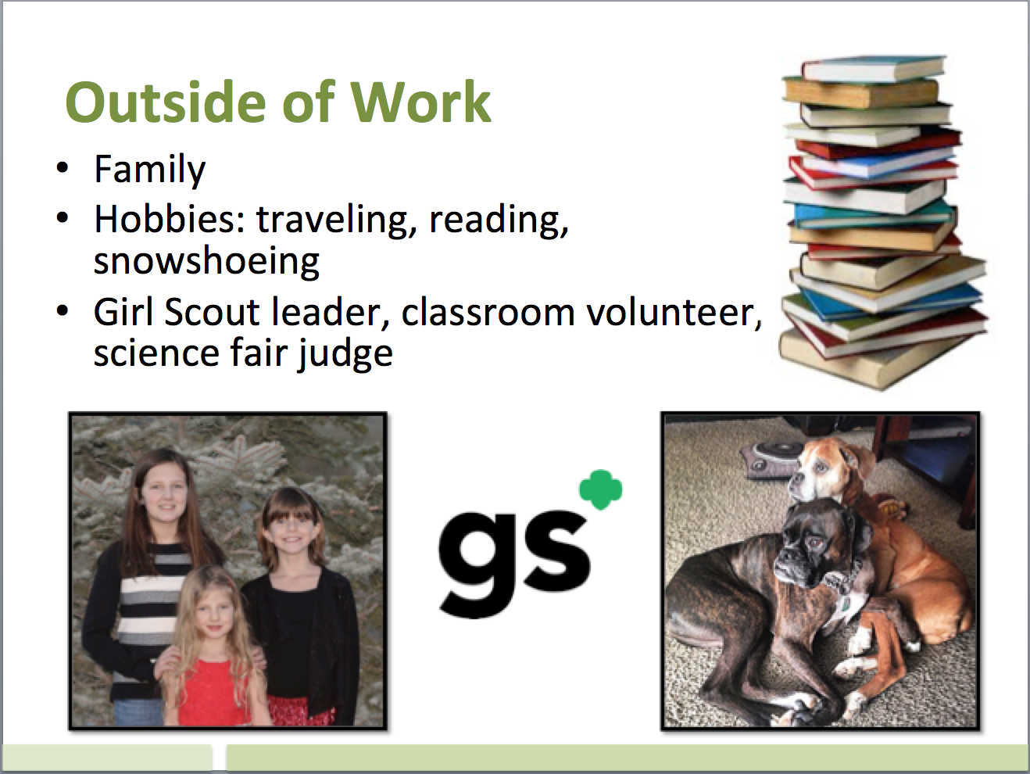
Role Model Strategies
Make personal connections to dispel stereotypes.
  Share personal stories
  Share photos
  Talk about family and
  friends
  Share your journey

Slide 29
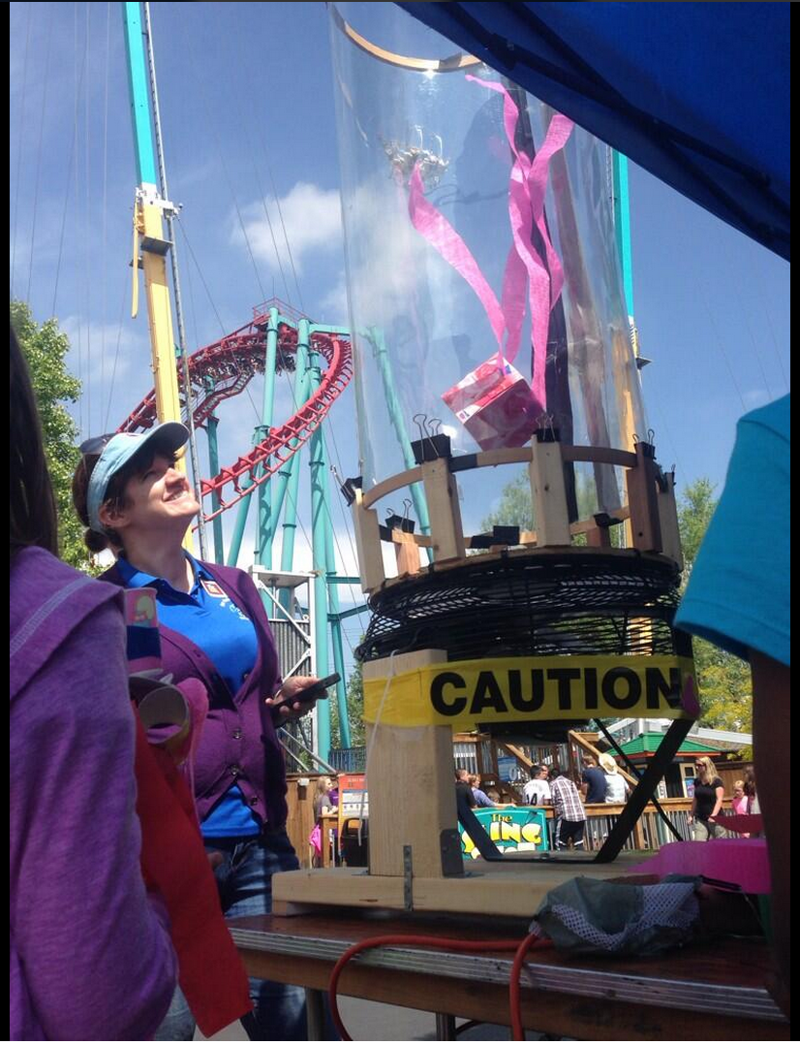
Role Model Strategies
Use positive messaging to show how STEM makes the world a better place.
  Describe how your career
  improves the world
  Communicate the creative and
  collaborative nature of your work

Slide 30
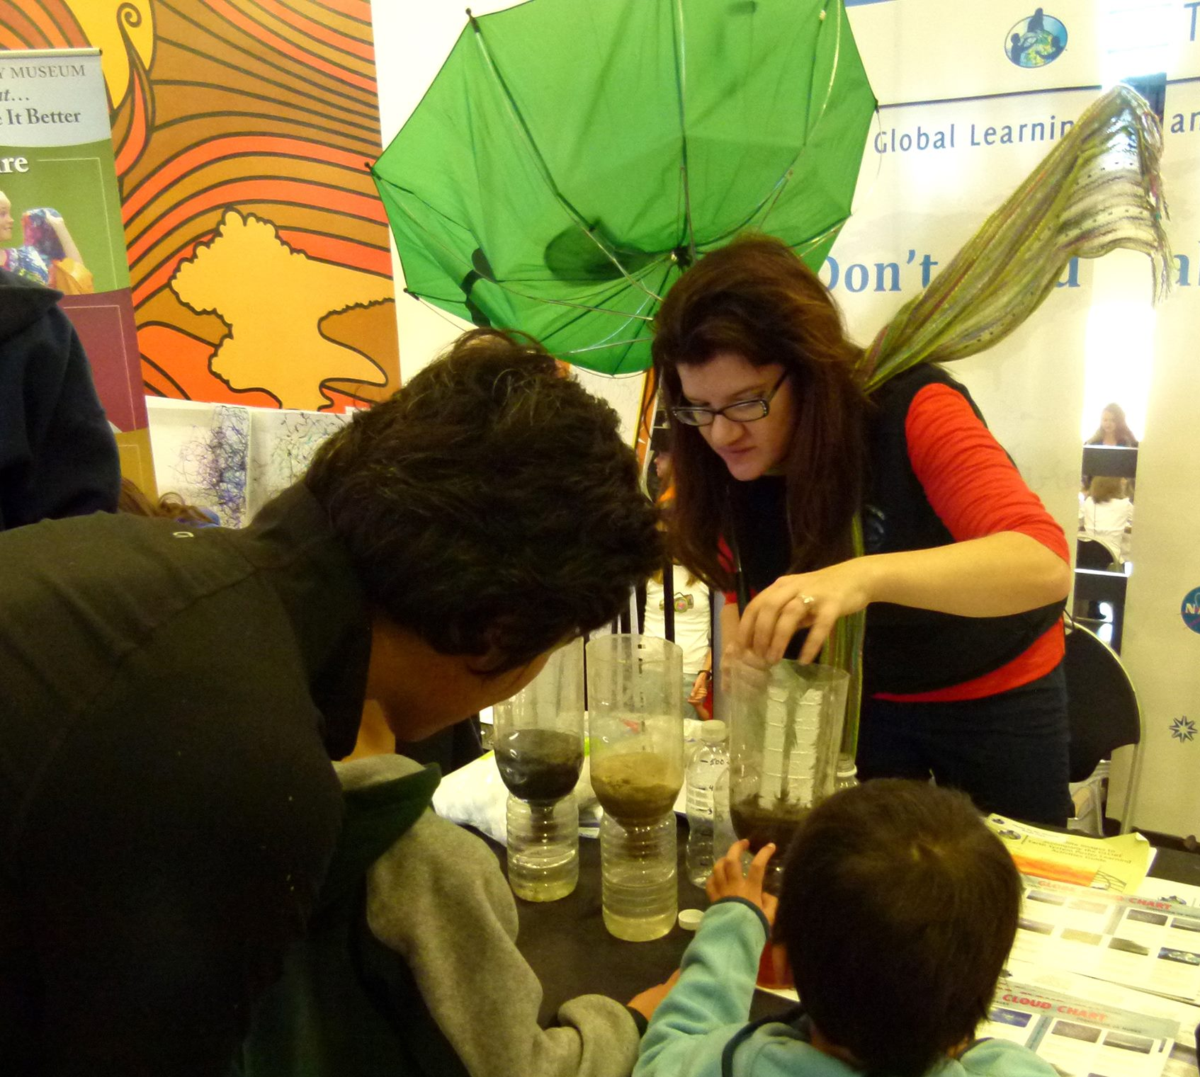
Role Model Strategies
Share your passion.
  Recall what first inspired you in STEM.
  Describe how your job is rewarding both personally and professionally.
  Talk about what the future holds for you and your career.

Slide 31
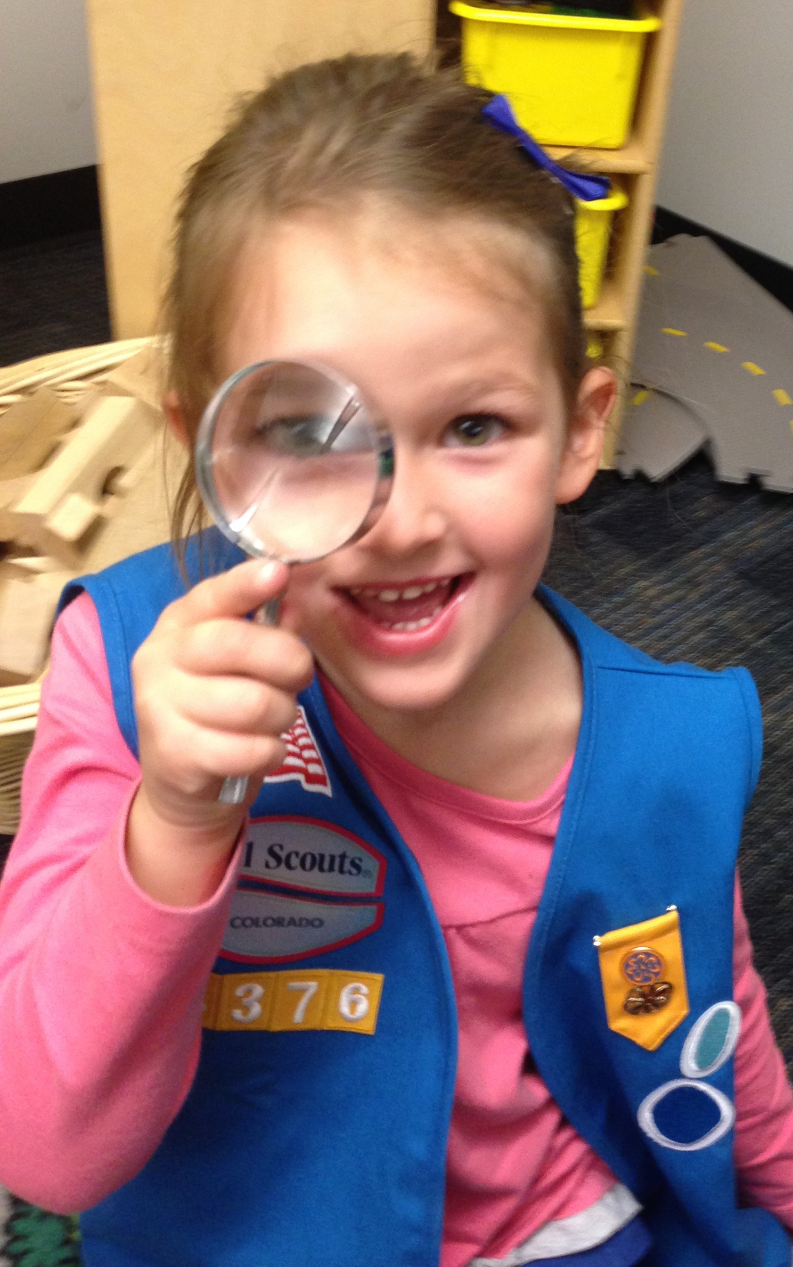
Role Model Strategies
Make it hands-on and keep it interactive.
  Start with an icebreaker
  Introduce a collaborative activity that gives a snapshot of your work
  Encourage participation with open ended questions.
Notes:
Start by finding out what the group knows, encourage girls to make predictions, invite discussion throughout your visit

Slide 32
Role Model Strategies
Foster a growth mindset and promote perseverance
  Share a story of facing a challenge, failing, and the lesson(s) you learned.
  Constructive feedback can motivate girls and help them persist.
Notes:
Keeping a positive attitude about failure – emphasize that in real life, setbacks are opportunities for learning

Slide 33
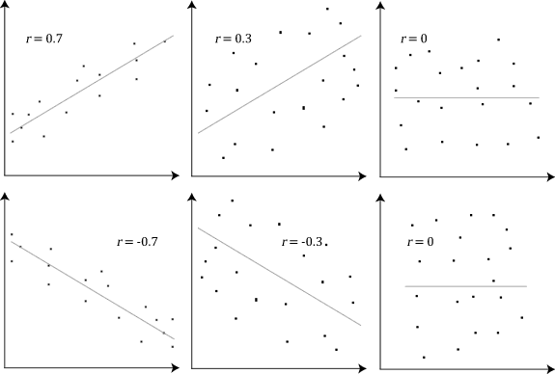

Role Model Strategies
Foster a growth mindset and promote perseverance.
Notes:
Keeping a positive attitude about failure – emphasize that in real life, setbacks are opportunities for learning

Slide 34






Role Model Strategies
Show the way: offer resources and academic guidance for right here, right now.
  Share ideas for resources that could help girls prepare for STEM fields.
  Share resources for navigating STEM careers.
Notes:
Keeping a positive attitude about failure – emphasize that in real life, setbacks are opportunities for learning

Slide 35
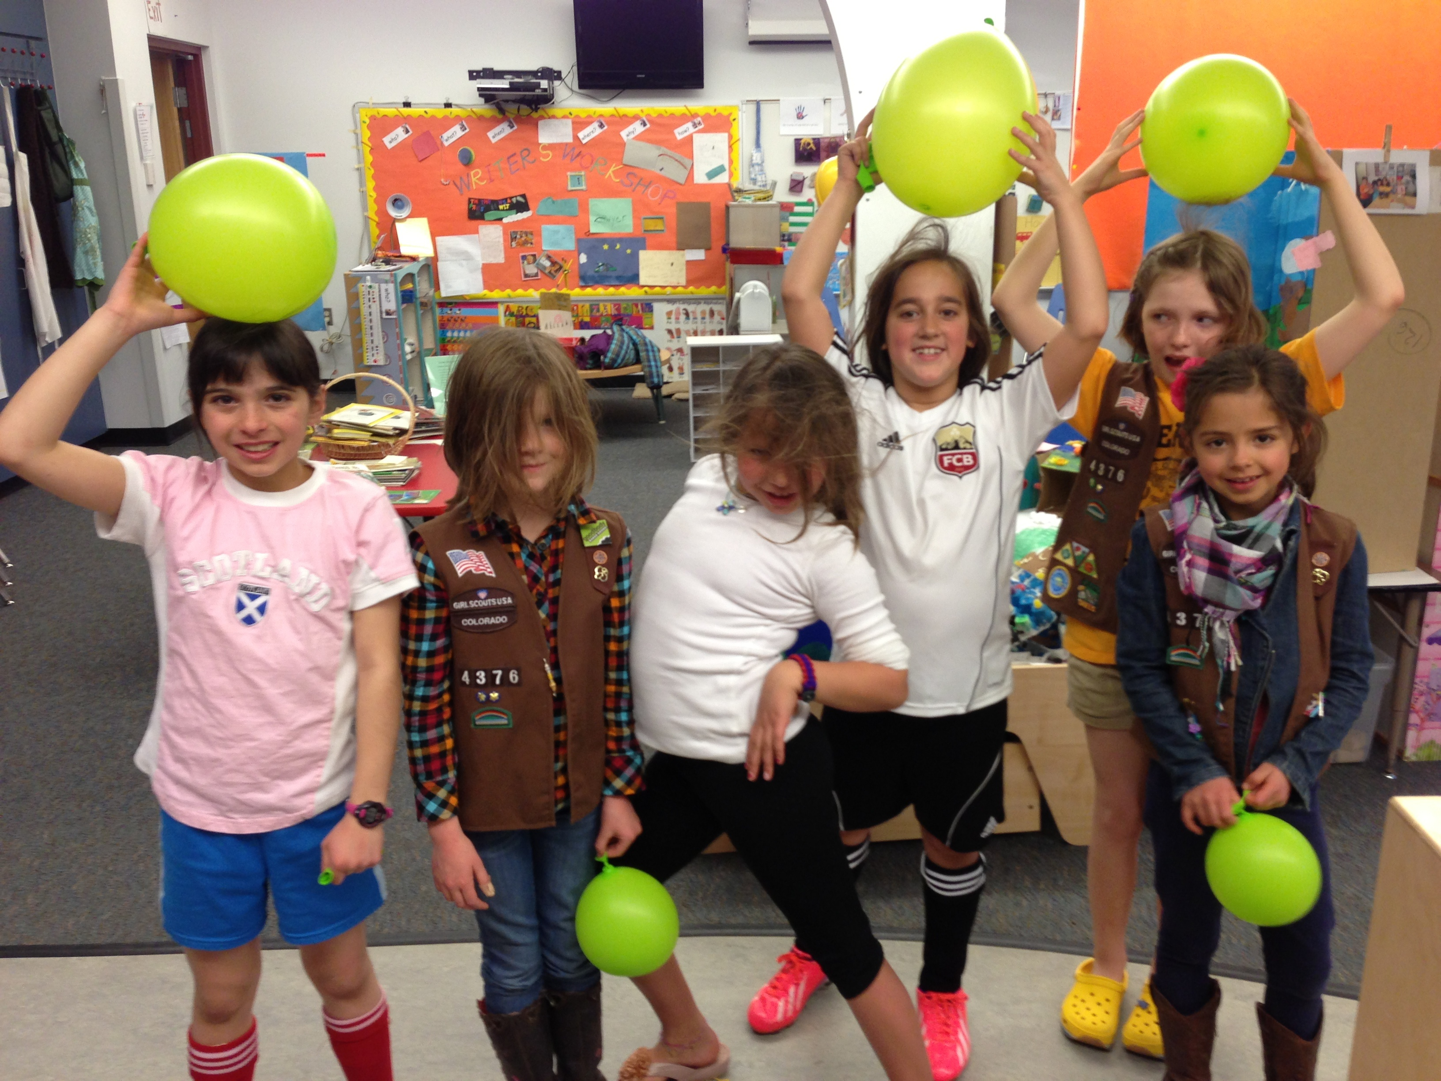
Role Model Strategies
Follow-up and invite feedback.
  Ask girls for their input.
  Schedule a call with the organizers of the event.
Notes:
Keeping a positive attitude about failure – emphasize that in real life, setbacks are opportunities for learning

Slide 36
Role Model Strategies
Bonus – Celebrate!
  Share the experiences with coworkers. Colleagues might want to get involved.
  Thank you card or photo on your desk.
  Talk to managers or supervisors about the experience – let them know the value of outreach
Notes:
Keeping a positive attitude about failure – emphasize that in real life, setbacks are opportunities for learning

Slide 37
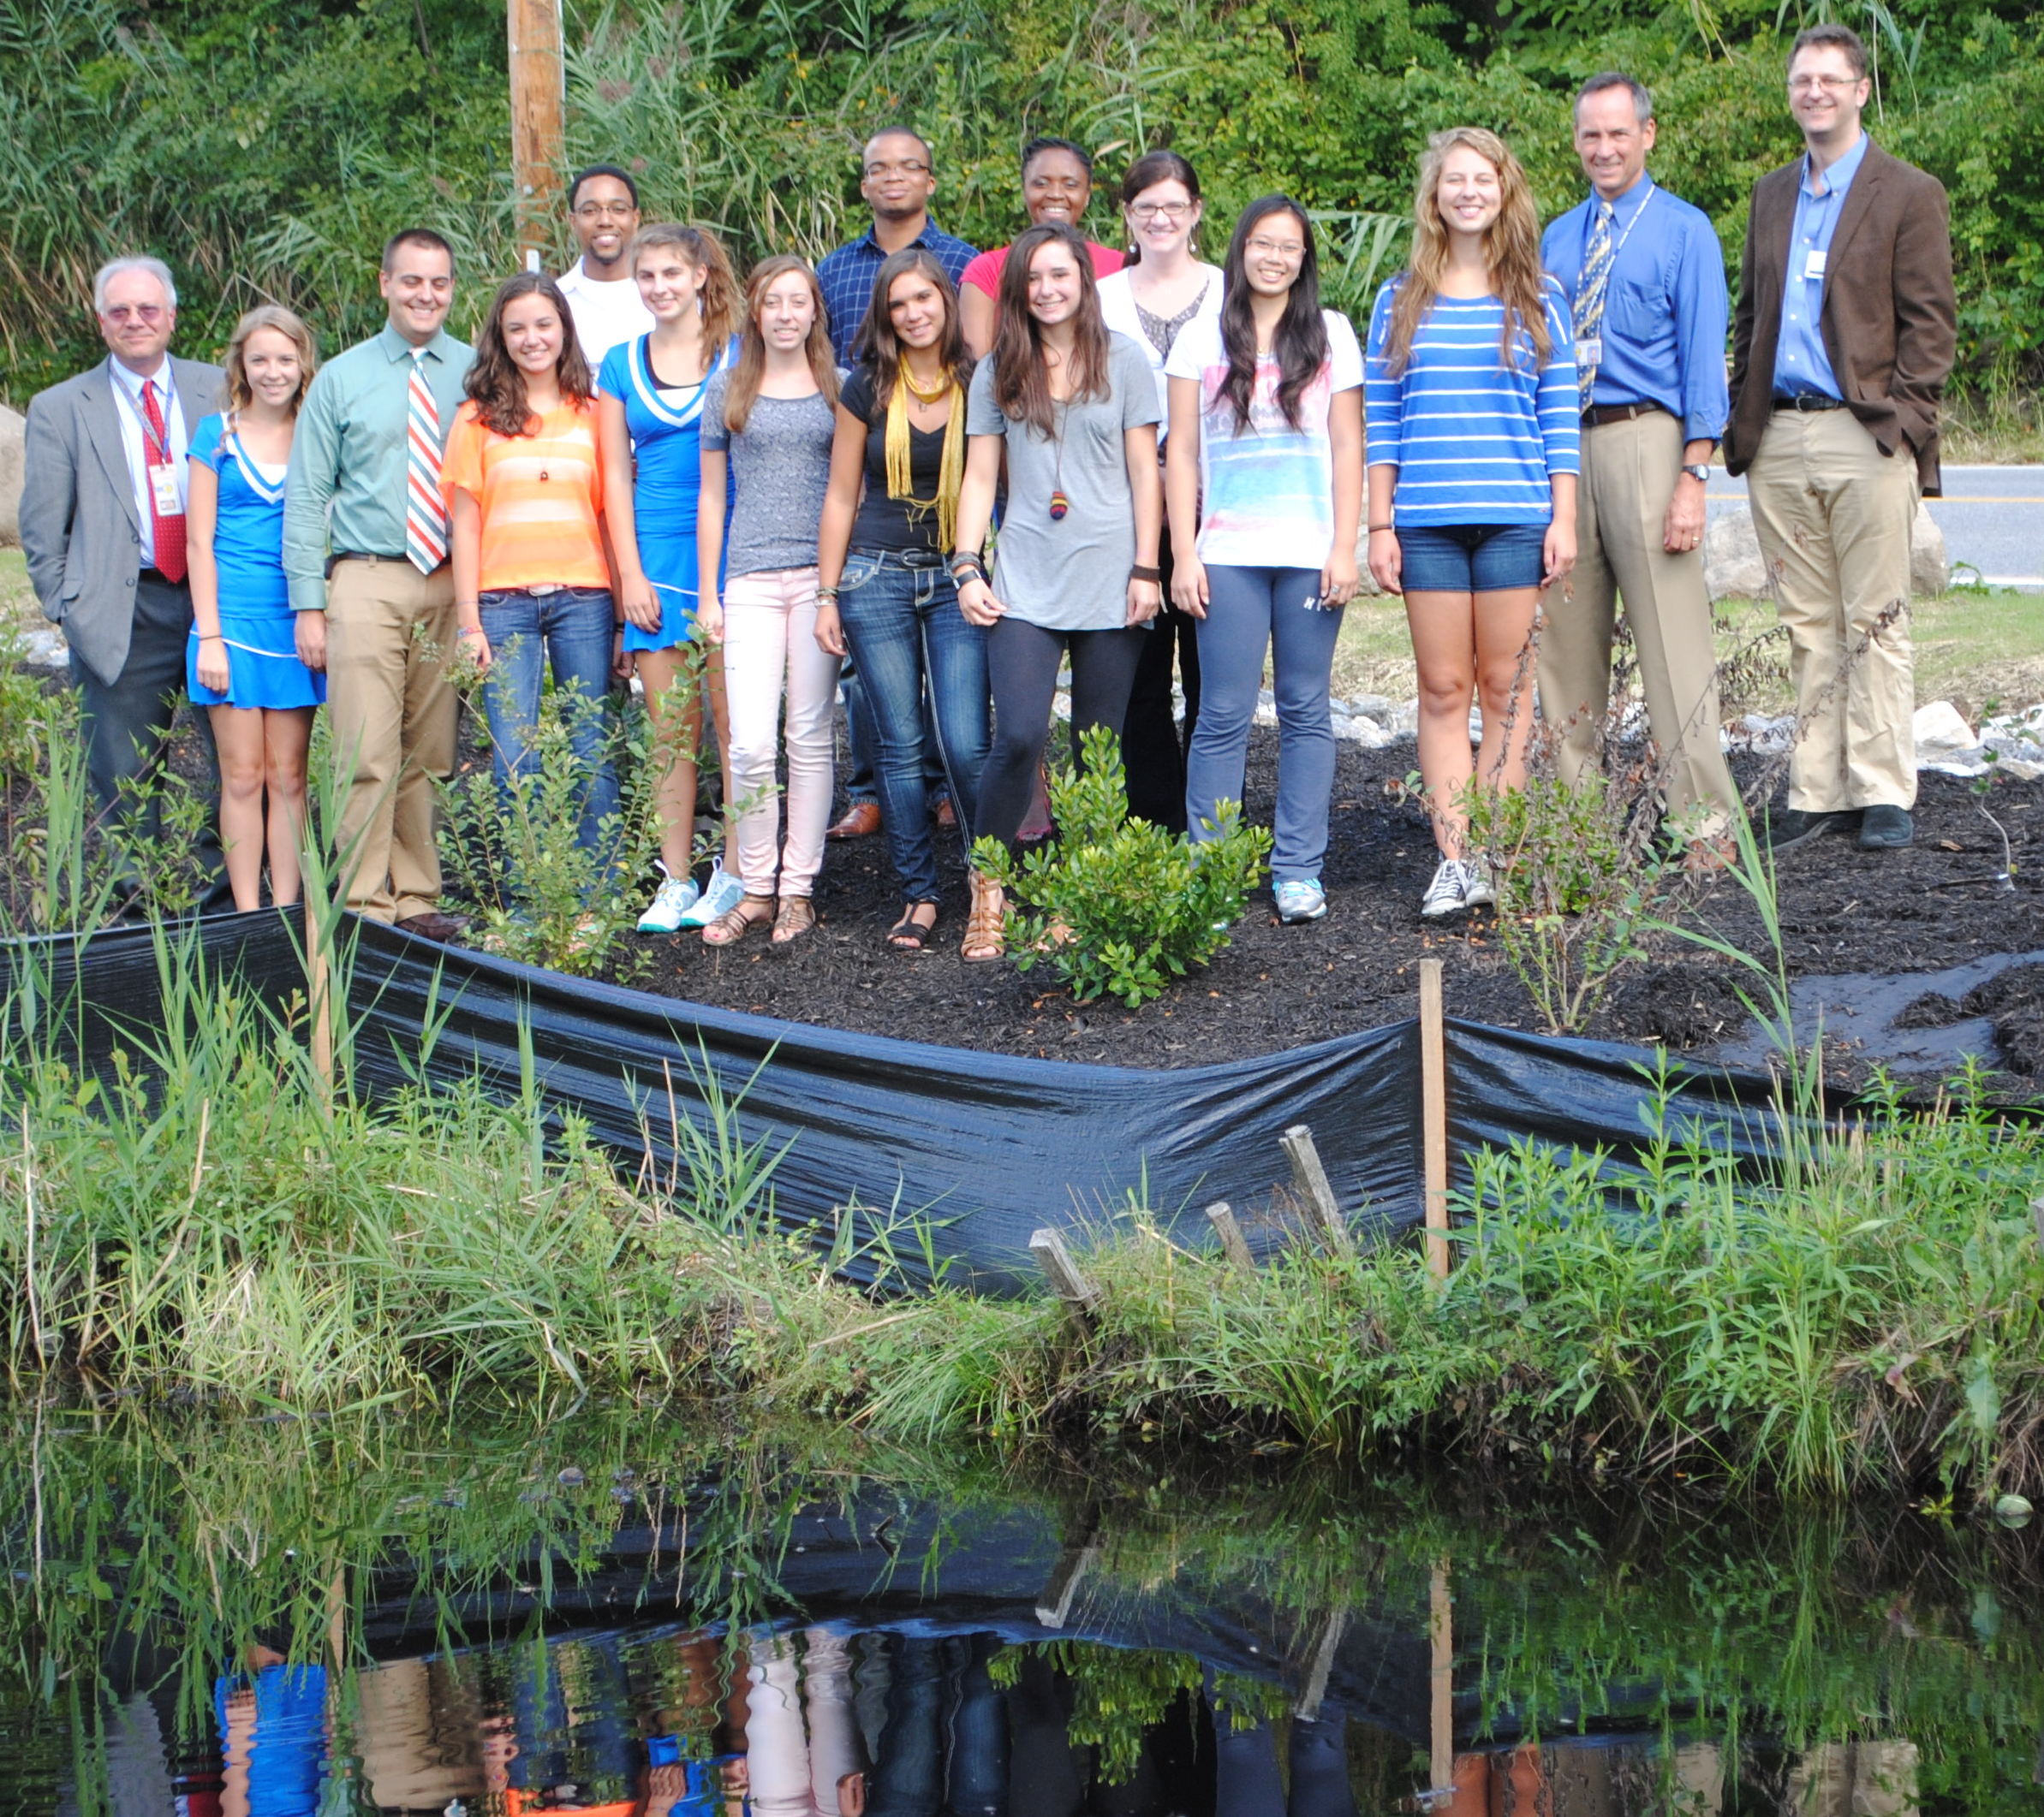
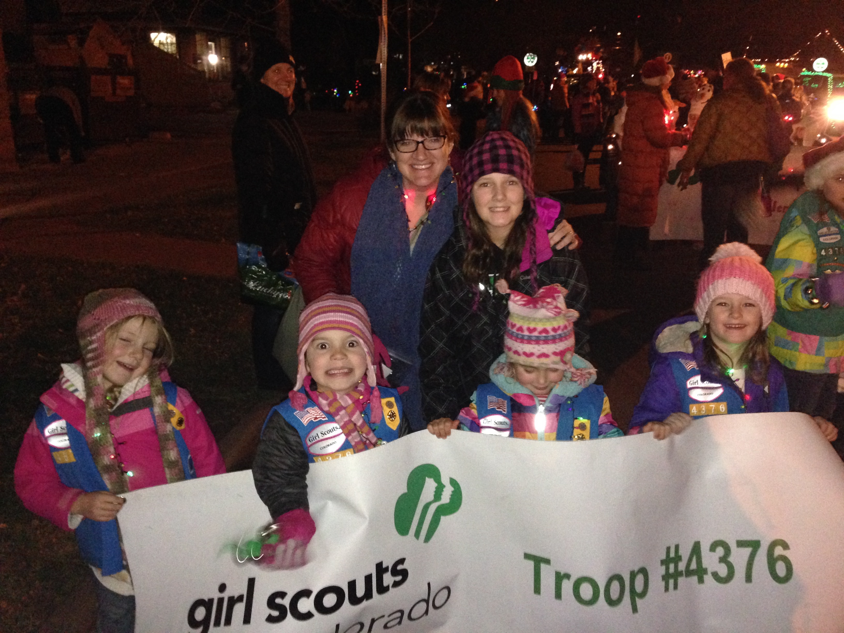
Role Model Strategies
Bonus – Celebrate!
Notes:
Keeping a positive attitude about failure – emphasize that in real life, setbacks are opportunities for learning

Slide 38
Role Model Strategies
Suggestions for role model events
  Invite students to lab or workplace
  Visit GLOBE schools
    In person
    Virtual – Skype, Google Hangouts
  Visit after school clubs (Girl Scouts, Boy Scouts, Science clubs, Destination Imagination, etc)
  One-on-one mentorships (GISN, FabFems, Million Women Mentors, REUs)
Notes:
Keeping a positive attitude about failure – emphasize that in real life, setbacks are opportunities for learning

Slide 39
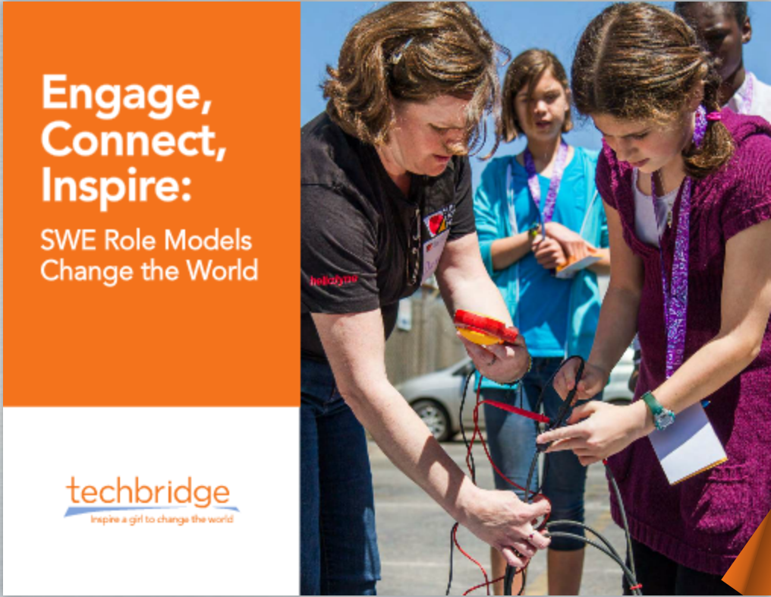
Role Model Strategies
Planning an event
  Step 1: Setting Themes and Goals
  Step 2: Icebreakers and Introductions
  Step 3: Leading Hands-on Activities
  Step 4: Reflection
Techbridge Engage, Connect, Inspire: SWE Role Models Change the World, 2013
Notes:
Keeping a positive attitude about failure – emphasize that in real life, setbacks are opportunities for learning

Slide 40
Role Model Strategies
Planning an event
  Step 1: Setting Themes and Goals
    Responsibilities and expectations for the event
    Time with group
    What hands-on activities
    Objectives of activities
    Materials and supplies

Slide 41
Role Model Strategies
Planning an event
  Step 1: Setting Themes and Goals
    Personal connections and take aways
      What drew you to the field?
      What factors did you consider when choosing this type of work?
      What surprised you about the career path?
      What obstacles did you encounter and how did you overcome them?
      What do you find inspiring in your work?

Slide 42
Role Model Strategies
Planning an event
  Step 1: Setting Themes and Goals
    Personal connections and take aways
      Possible provide a role model bio card prior to the event or at the start of the event

Slide 43
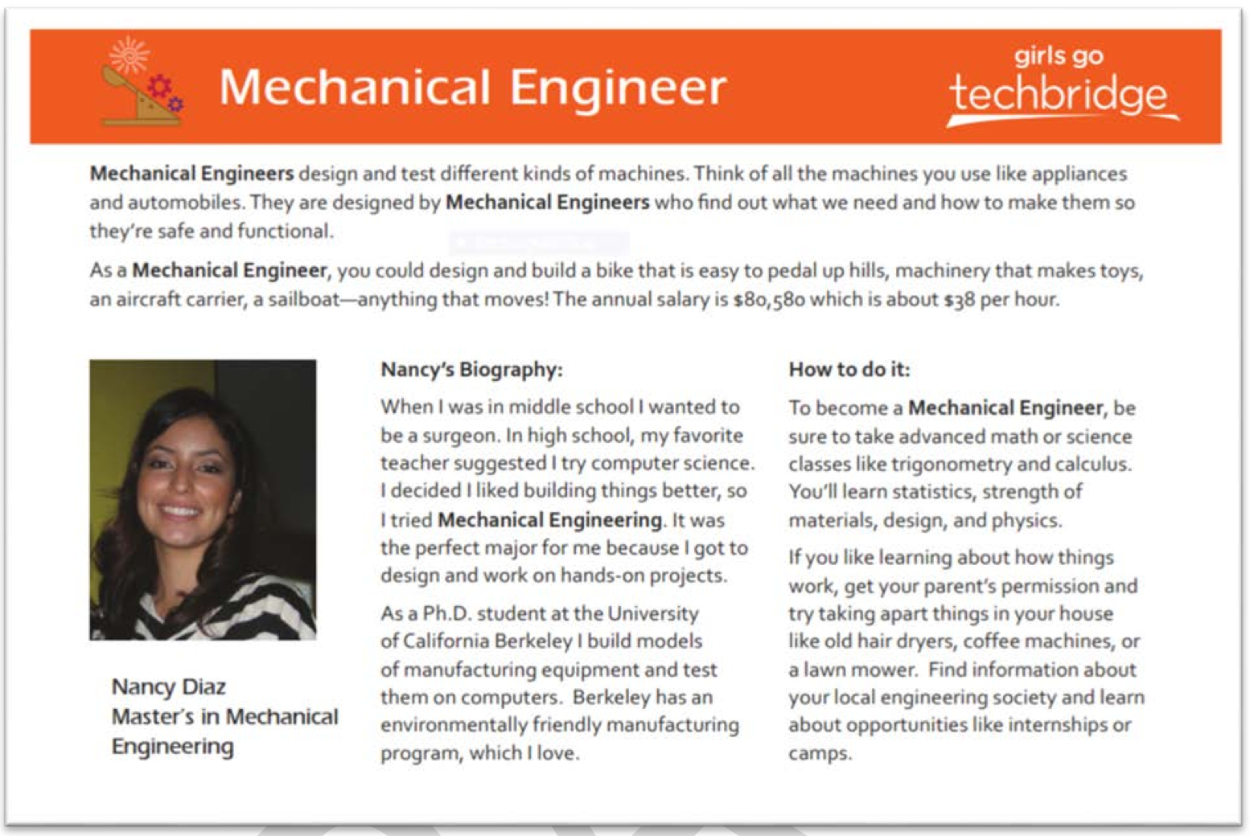
Role Model Strategies
Planning an event
  Step 1: Setting Themes and Goals
    Personal connections and take aways
      Possible provide a role model bio card prior to the event or at the start of the event

Slide 44
Role Model Strategies
Planning an event
  Step 1: Setting Themes and Goals
    Personal connections and take aways
      Possible provide a role model bio card prior to the event or at the start of the event
      Positive messaging about STEM professions
      Connecting to careers
        Keep issues local (home, school, community) for younger audiences!

Slide 45
Role Model Strategies
Planning an event
  Step 1: Setting Themes and Goals
    Personal connections and take aways
      Inspire curiosity through inquiry practices
        Make predictions
        Record observations and data
        Recorded evidence → new ideas
        Apply to other situations
        Probing questions

Slide 46
Role Model Strategies
Planning an event
  Step 2: Icebreakers and Introductions
    Icebreakers:
      Make students feel more comfortable with one another and with you!
      Introduce new scientific topics, vocabulary, careers
      Gauge level of background knowledge on topic
        STEM Career Charades: Put students in groups, give each group a specific STEM career (e.g., meteorologist, marine biologist), have the students act out the career, other students guess
Notes:
Keeping a positive attitude about failure – emphasize that in real life, setbacks are opportunities for learning

Slide 47
Role Model Strategies
Planning an event
  Step 2: Icebreakers and Introductions
    Introductions
      What you like to do for fun
      Where you went to college and what the experience was like
      Why and when you chose your career
      What you like about your career
      What struggles you face and what you learned from them
    Move around the space, make eye contact, ask questions, allow time for questions
    Bring props!
Notes:
Keeping a positive attitude about failure – emphasize that in real life, setbacks are opportunities for learning

Slide 48
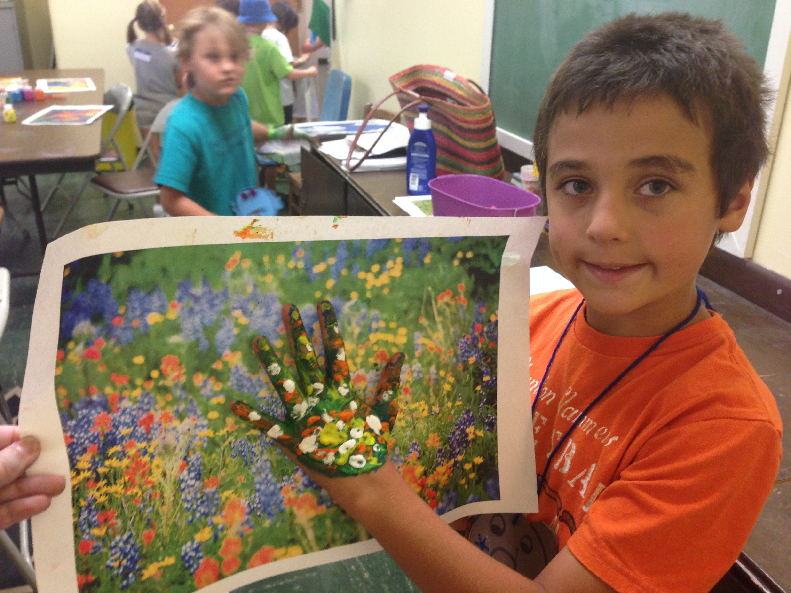
Role Model Strategies
Planning an event
  Step 3: Leading Hands-on Activities
Notes:
Keeping a positive attitude about failure – emphasize that in real life, setbacks are opportunities for learning

Slide 49
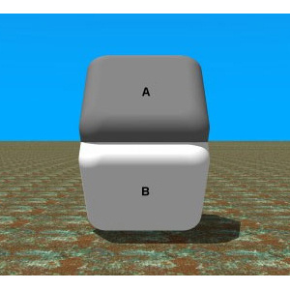
Role Model Strategies
Colors of the squares?
A) A is darker
B) B is darker
C) They are the same
Type your answer in the chat window!

Slide 50
Role Model Strategies
Colors of the squares?
A) A is darker
B) B is darker
C) They are the same
Did your answer change?

Slide 51
Role Model Strategies
Demographics, environmental or social factors influencing perception
Actual weather and climate
Notes:
Put your finger over the center to see that they are the same color!

Slide 52
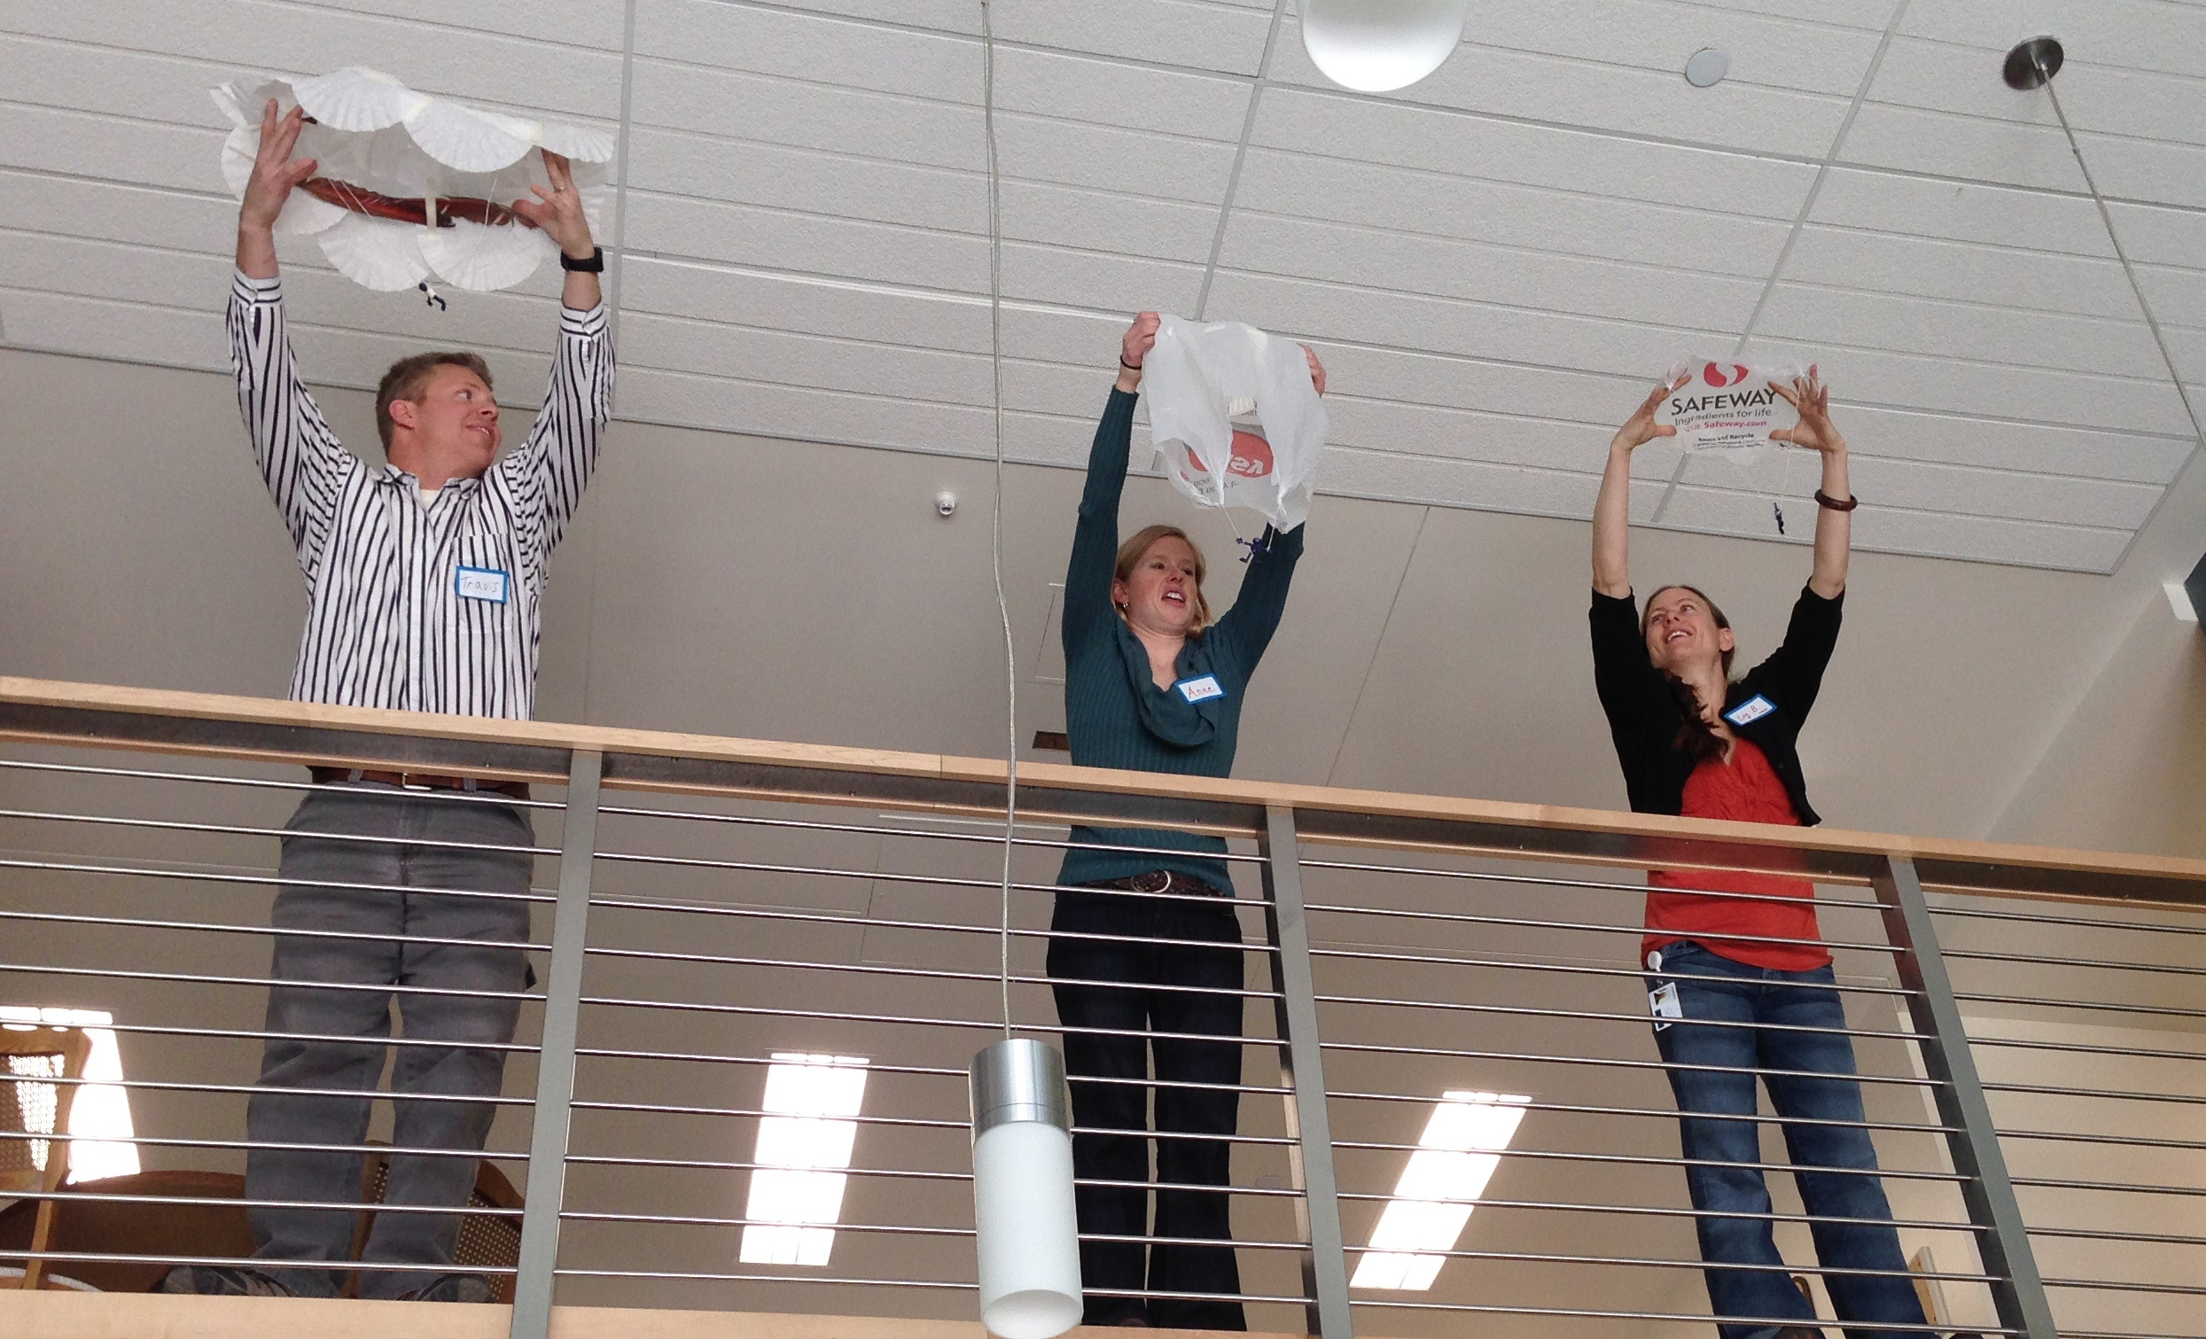
Role Model Strategies
Planning an event
  Step 3: Leading Hands-on Activities
    Age of group
    Don’t get too complex
    Practice!
    Avoid technobabble –
    define key terms
Notes:
Keeping a positive attitude about failure – emphasize that in real life, setbacks are opportunities for learning

Slide 53
Role Model Strategies
Planning an event
  Step 3: Leading Hands-on Activities
    Who? What? When? Where? Why?
      Tell me how you came up with this design?
      Why did you choose to incorporate this particular element?
      What changes would you recommend to…?
      What would happen if…?
      What do you see as other possible outcomes?
      What are the applications for this?
Notes:
Keeping a positive attitude about failure – emphasize that in real life, setbacks are opportunities for learning

Slide 54
Role Model Strategies
Planning an event
  Step 3: Leading Hands-on Activities
    Feedback
      Be positive and specific
      Provide feedback throughout the activity
      Provide some time for self reflection
      Feedback that implies control (hard worker vs. smart)
I really like how you… This is really interesting because…
I saw you using a lot of The strengths of this are…
effort when…

Slide 55
Role Model Strategies
Planning an event
  Step 4: Reflection
    Not just a fun project or craft!
    Relate the activity to your career
    Provide “restatements”
    Ask open-ended questions

Slide 56
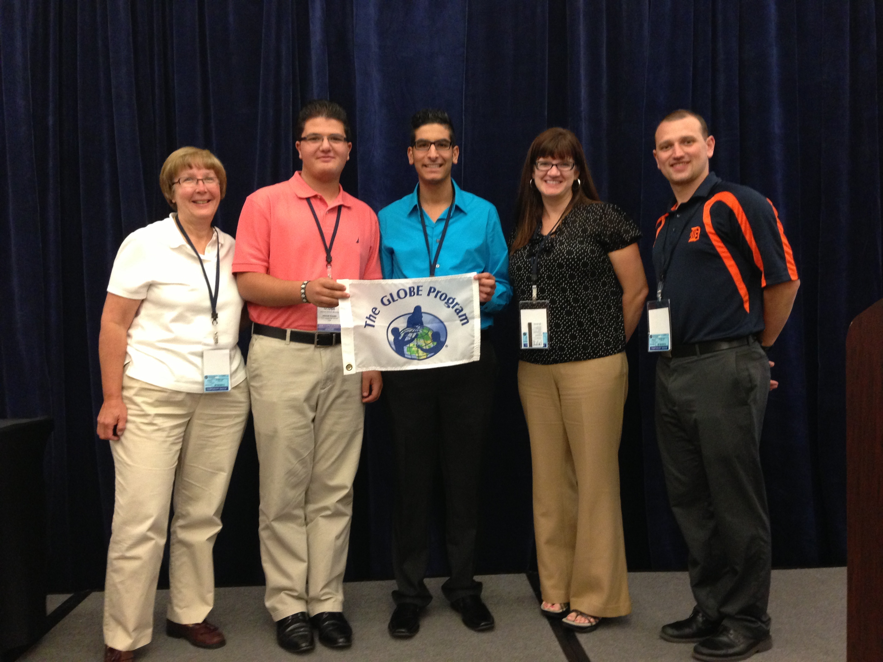
Role Model Training
Wrap up question (Raise hand to talk or type in the chat window)
  How do you see using this information?
Any other questions
or comments?

Slide 57
Role Model Training
Resources:
  SciGirls: http://scigirlsconnect.org/
  Techbridge: http://techbridgegirls.org/
  GLOBE activities in investigation areas: http://www.globe.gov/explore-science/globe-investigations
  Click2Science: http://www.click2sciencepd.org/

Slide 58
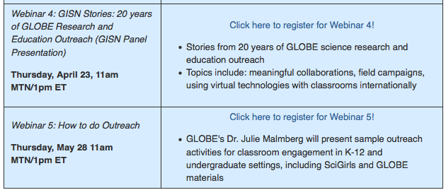
Upcoming Webinars
Register now for the other webinars in this series!!
http://www.globe.gov/teaching-and-learning/professional-development-resources/webinars/gisn-webinars
or
http://go.usa.gov/S98Q
Notes:
We invite you to register for the other webinars in this series. Webinar 2 and 4 will have panel presentations by GLOBE community members, Webinar 3 and 5, presented by Julie Malmberg, will go deeper into the GISN, including role model training and how to do outreach.

Slide 59
Thank you for attending!
Contact information:
Julie Malmberg: malmberg@ucar.edu
Questions: help@globe.gov

