Slide 1
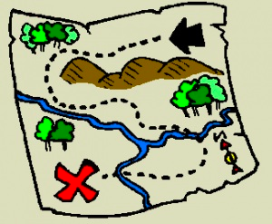
A Virtual Treasure Hunt to Find the Spot that X Marks!
A latitude longitude treasure hunt
image credit: wikiclipart.com - https://wikiclipart.com/treasure-map-clipart_17146/

Slide 2
Lines of Latitude
90ºN
45ºN
EQUATOR
0º
45ºS
90ºS
Notes:
This is an editable grid if you would like to add more numbers to the grid. All of the numbers are simple text boxes, so they can be copied and moved around to edit the grid.

Slide 3
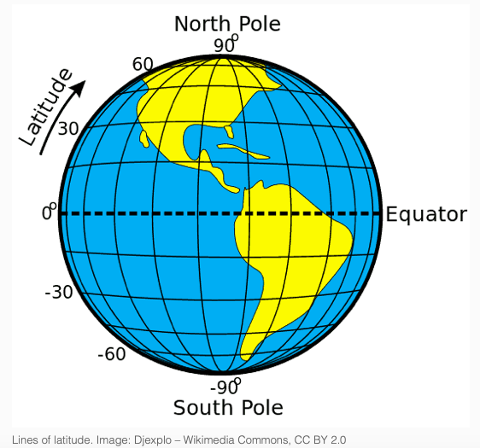
Northern Hemisphere
Southern Hemisphere

Slide 4
Lines of Longitude
MERIDIAN
180º
90ºW
0º
90ºE
180º
Notes:
This is an editable grid if you would like to add more numbers to the grid. All of the numbers are simple text boxes, so they can be copied and moved around to edit the grid.

Slide 5
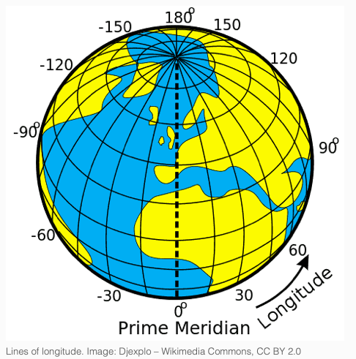
Western Hemisphere
Eastern Hemisphere

Slide 6
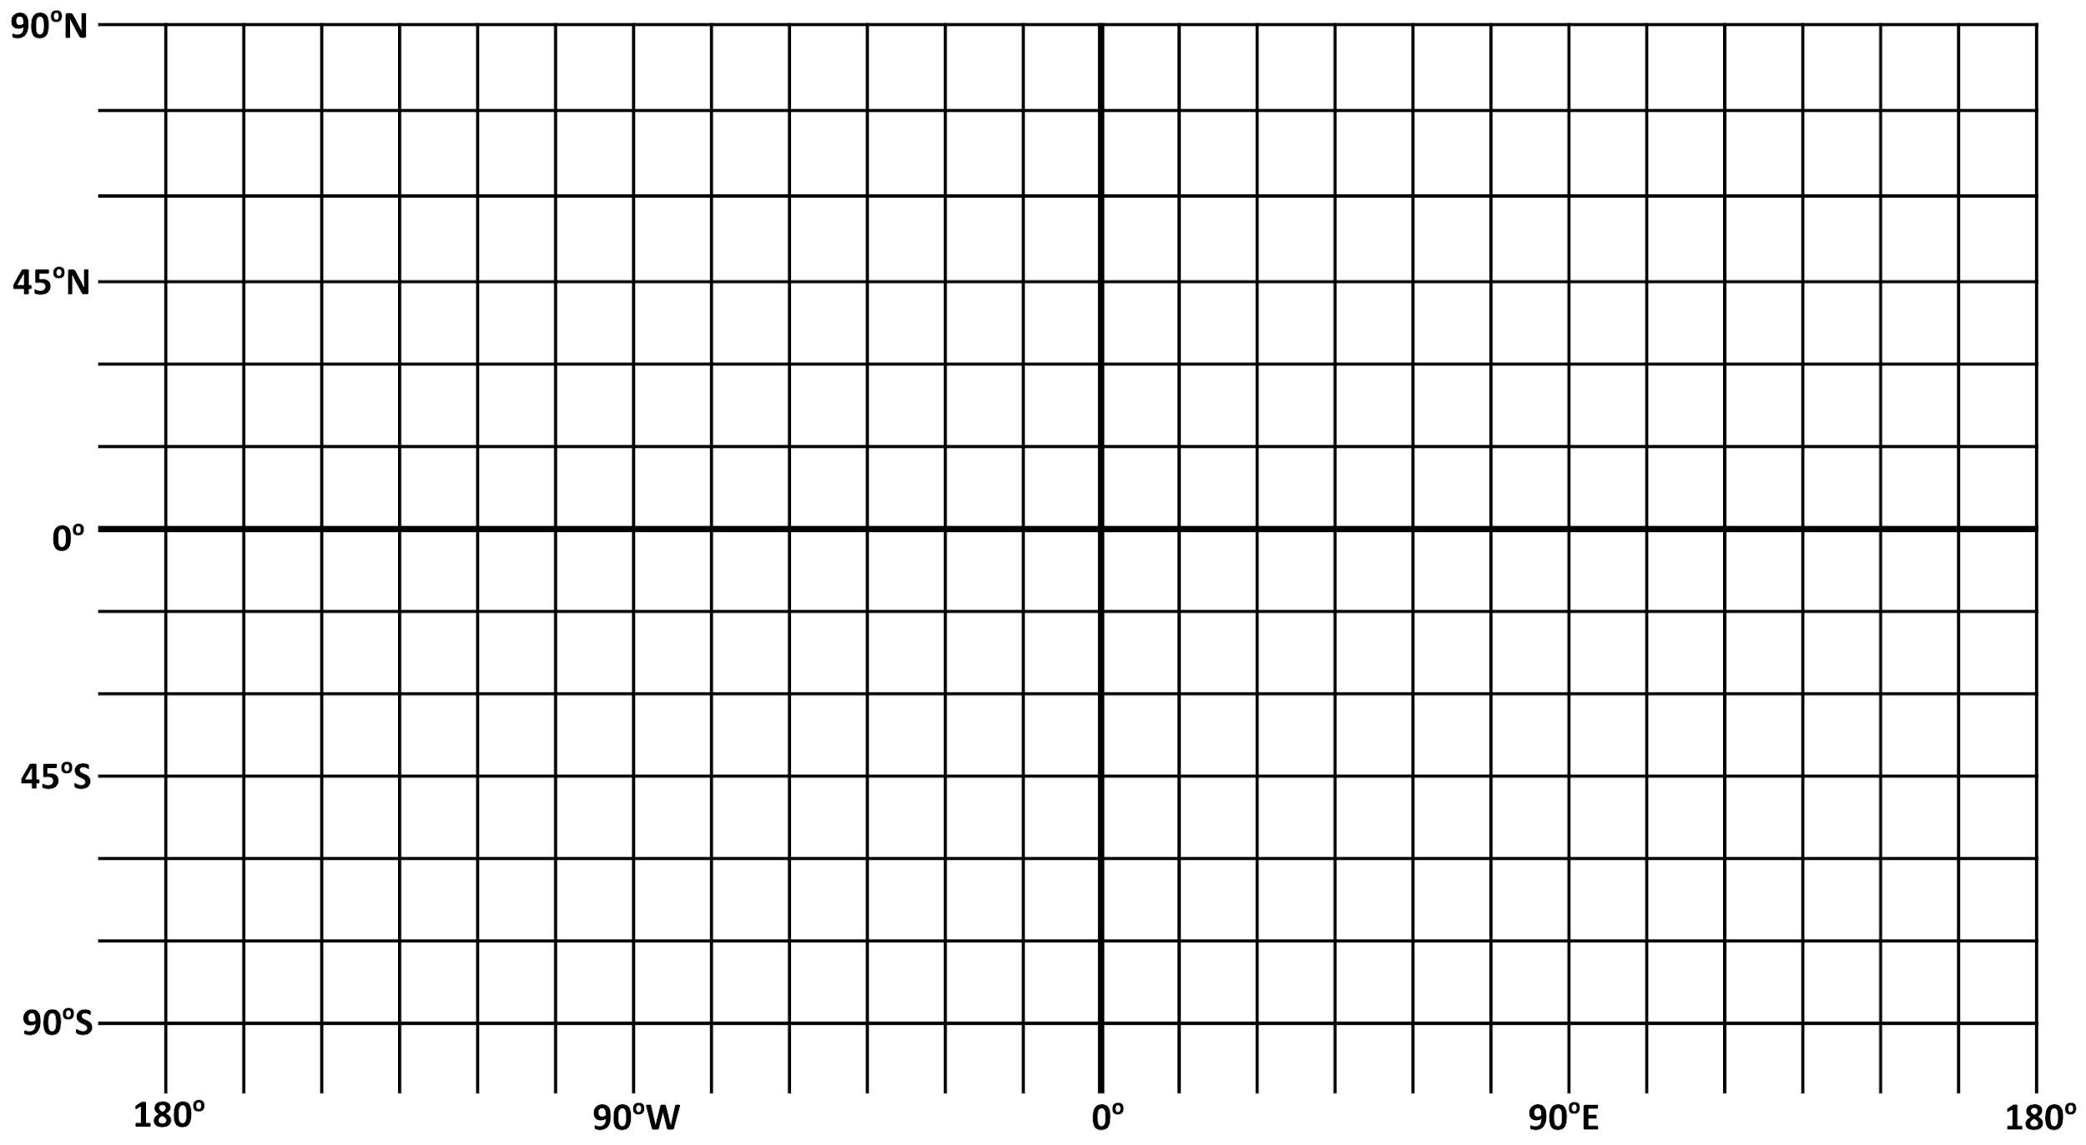
Lines of Latitude and Longitude can overlay each other as a grid
MERIDIAN
EQUATOR

Slide 7
Latitude and Longitude lines together in a grid are called Coordinates

Slide 8

Coordinate Choices
The numerical values for latitude and longitude can occur in a number of different units or formats:
  Degrees, minutes, and seconds (DMS) : 40° 26′ 46″ N and 79° 58′ 56″ W
  Degrees decimal minutes (DDM): 40° 26.767′ N 79° 58.933′ W
  Decimal degrees (DD): 40.446° N 79.982° W

Slide 9
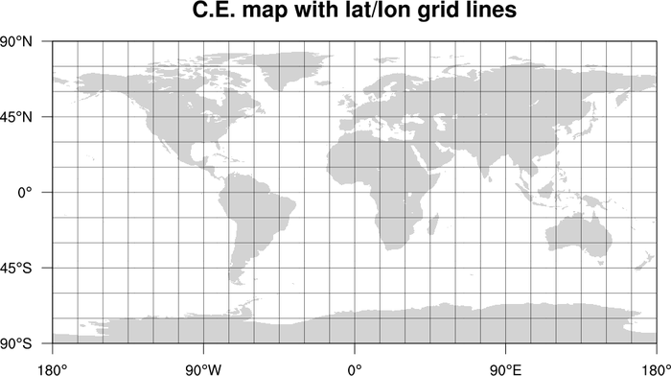
Coordinates in a map can help us determine specific locations
image credit: https://www.ncl.ucar.edu/Applications/mapgrid.shtml

Slide 10

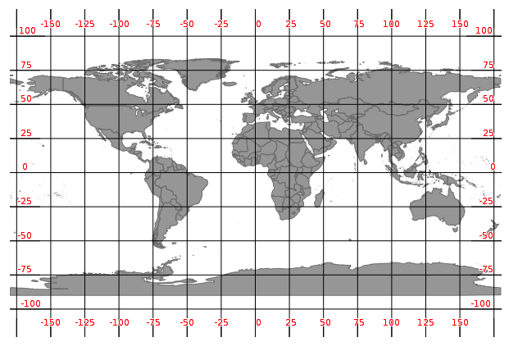
What are the Coordinates of “X”
“X” is located in what hemispheres?
Western (W) Hemisphere
Northern (N) Hemisphere
X
-125 W and 25 N

Slide 11
ACTIVITY: Practice Coordinates of “X”
“X” is located in what hemispheres?

Slide 12
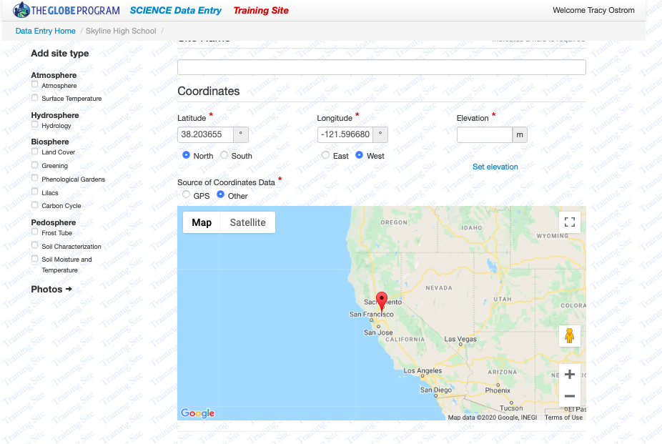
GLOBE Site Setup Application
Name study site
Zoom in on study site location
Align red marker to (exact) location
GLOBE uses degrees decimals
Add elevation in meters (R)
Click sphere (L)

Slide 13
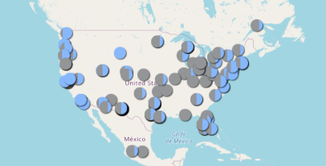
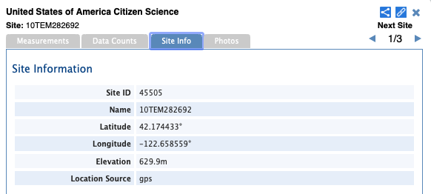
ACTIVITY: Find the coordinates and map them
STEP 1:
STEP 3:
Go to GLOBE.GOV
Click GLOBE DATA
Click DATA VISUALIZATION
Click ENTER VISUALIZATION SYSTEM
Click on any cloud coverage symbol (a window pops up in the middle of the screen)
Click on Site Info
Write down the latitude/longitude of that location (site)
Pick any other cloud coverage symbol and repeat 2 more times
Place all 3 sites on the degree decimal grid based on the site’s latitude and longitude
Put an “X” marking the spot of each site
STEP 2:
CLICK LAYERS (L)
Click ATMOSPHERE
Click CLOUDS
Click CLOUD COVER
Click SUBMIT(green)

Slide 14
One form of spatial skill is being able to use latitude and longitude coordinates to locate a study site
Notes:
Note to Teacher: This is to familiarize students with any map with latitude and longitude coordinates including those on the NASA Earth System Data Explorer (MyNASAData) and to show them that, just like rulers not all Lat Long grids are marked out the same (this one only goes to 80º Lat), but 1º is always 1º (like 1cm is always 1cm even if my ruler doesn’t mark every cm on it).

Slide 15
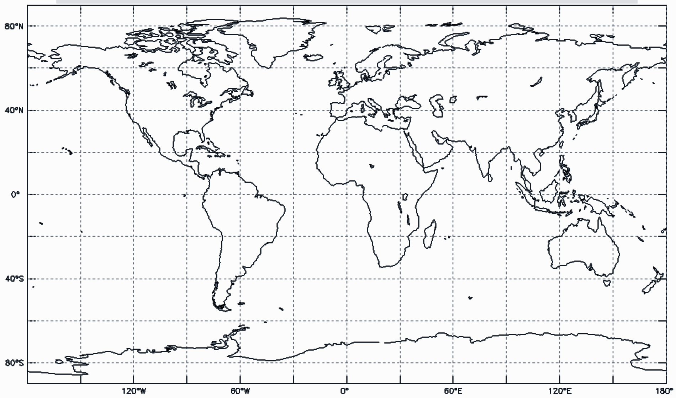
MyNASAData: NASA Earth System Data Explorer has maps you can interact with
Notes:
Note to Teacher: This is to familiarize students with the NASA Earth System Data Explorer and to show them that, just like rulers not all Lat Long grids are marked out the same (this one only goes to 80º Lat), but 1º is always 1º (like 1cm is always 1cm even if my ruler doesn’t mark every cm on it).

Slide 16
Visit btc.montana.edu for some engaging mapping activities
Potato World: http://btc.montana.edu/ceres/Worlds/Landform/potato.htm
Mapping New Worlds: http://btc.montana.edu/ceres/Worlds/Landform/application.htm
All Activities: http://btc.montana.edu/ceres/Worlds/Landform/planettrek.htm

Slide 17

Credit Kathleen Johnson, 2020 (kjohns12@bu.edu). Developed for Boston University GLOBE Mission Earth.

