Slide 1

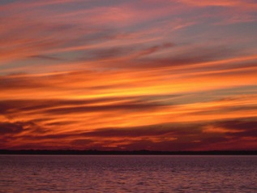
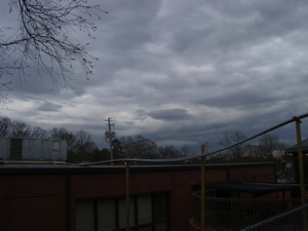
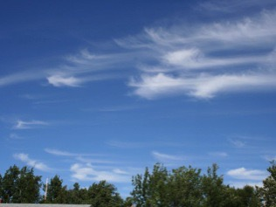
GLOBE
Cloud
Protocols
“We seek to remind people that clouds are expressions of the atmosphere’s moods, and can be read like those of a person’s countenance.”
– From the Manifesto of the Cloud Appreciation Society

Slide 2
Why Observe Clouds?
It’s fun!
It’s science!
Clouds are highly variable in space and time, so observations and photos from people in many places, especially when timed to a satellite overpass, provide useful “ground truth” information.

Slide 3
What do you need to start?
Instrument | Your eyes
Helpful References | GLOBE cloud chart and contrail ID chart (English/French/Spanish) (Russian/Chinese/Arabic)
When | Good: Any time Better: Within one hour of local solar noon Best: Within +/- 15 minutes of a satellite overpass (times available in app)
Where | A good observation site (See next slides)

Slide 4
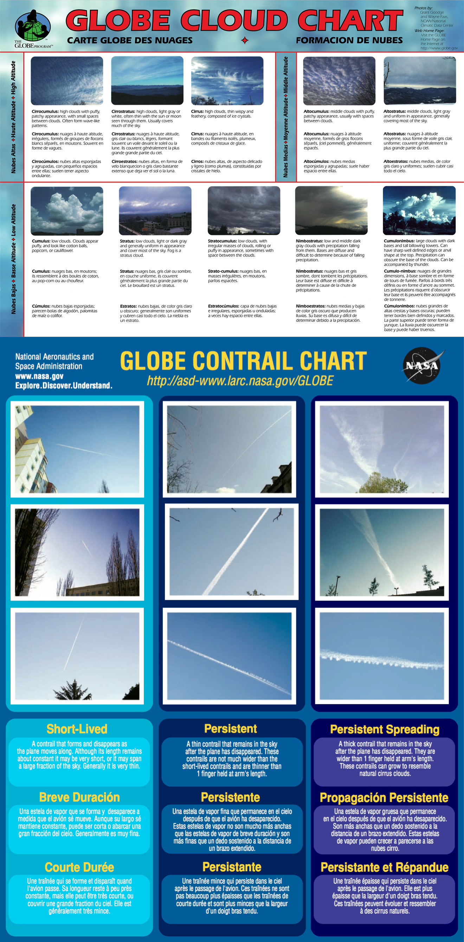

Slide 5
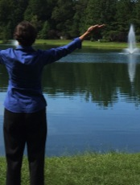
What makes a good observation site?
Obstacle test:
Below hands extended at about head-top level
Good observation site
Good:
14°

Slide 6

What makes a good observation site?
Obstacles present:
Minimize as much as possible
Document (with photos) and proceed
Okay:
14°

Slide 7
What makes a good observation site?
Obstacles present:
Sky really not visible
Not a good site
Bad:
14°

Slide 8

How to Observe Introduction
NEVER look directly at the Sun!
Look at the sky above 14º in every direction.
Cloud identification is an art; you will get better with practice.
The most important step is the first and easiest:
Is the Sky Clear?
If yes:
1) Report
2) Take Photos (optional)
and you are DONE!

Slide 9










How to Observe:
Obscuration
If over 1/4 of the sky is obscured:
1) Record and report the reason
2) Take photos (optional)
and you are DONE!
Blowing Snow
Heavy Snow
Heavy Rain
Fog
Spray
Volcanic Ash
Smoke
Dust
Sand
Haze

Slide 10
If Clouds are Present
The app walks you through the steps:
  Cloud fraction
  Cloud type
    Including contrails and contrail fraction
  Taking Photo
The following pages explain these steps.

Slide 11

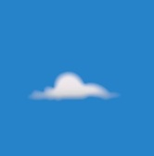




How to Observe: Cloud Fraction
Divide the sky in four quadrants (North, South, East, West) and estimate cloud cover in each first. Then take the average to get the whole sky value.
What Percent of the Sky is Covered by Clouds?
No Clouds 0%
Clear
0 - 10%
Isolated
10 - 25%
Scattered
25 - 50%
Broken
50 - 90%
Overcast
>90%

Slide 12
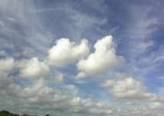
How to Observe:
Cloud Fraction
Observing hint: If directly overhead there is a pattern of cloud cover with puffs or rolls of cloud separated by clear areas, it is reasonable to infer that pattern continues and the cloud cover is not 100% toward the horizon.

Slide 13
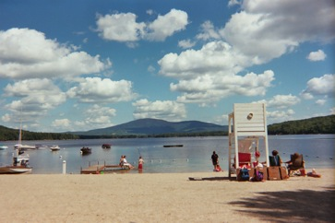
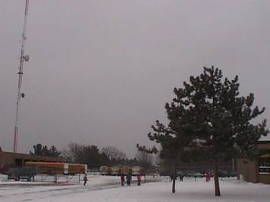
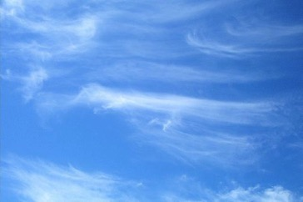
How to Observe:
Cloud Type
Factor 1: Cloud Shape
The three main
cloud shapes are:
Cumulus
(Puffy)
Stratus
(Layered)
Cirrus
(Wispy)
Images: NASA

Slide 14
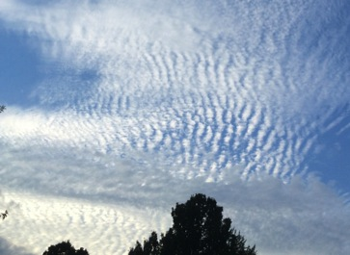
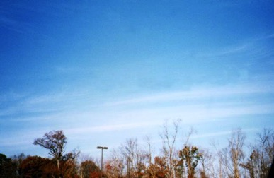
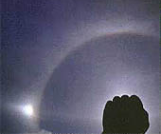
How to Observe:
Cloud Type
Factor 2: Cloud Height
High Clouds: Base > 6 Km
Composed of ice crystals, which gives them a delicate appearance. Generally, the Sun can be seen through high clouds and ice particles in cirrostratus scatter sunlight to form a bright ring, called a halo, around it.
Cirrus
Cirrocumulus
NEVER look directly at the Sun!
Cirrostratus
With Halo
Images: NASA

Slide 15
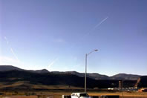
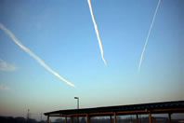
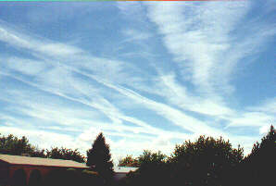
How to Observe:
Contrail Type
If contrails are present,
Count the number of each type:
Images:
GLOBE
Short-lived
Contrails that form short line segments that fade out as the distance from the airplane that created them increases.
Persistent
Non-spreading
Persistent
Spreading
Remain long after the airplane has left the area. They form long, generally straight, lines of ~constant width across the sky. These contrails are no wider than an index finger held at arm’s length.
Remain long after the airplane has left the area. They form long streaks that have widened with time since the plane passed. These contrails are wider than an index finger held at arm’s length.

Slide 16
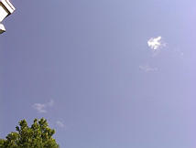
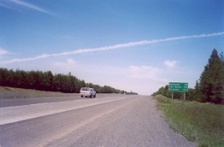
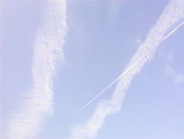
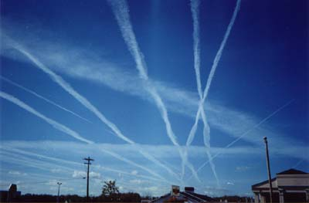
How to Observe:
Contrail Type
If contrails are present:
Estimate the total cover of contrails
The quadrant technique is also useful here
One single persistent contrail crossing the sky covers less than 1% of the sky. Therefore, counting contrails can also be helpful.
Contrail Cover Categories
No Contrails – 0%
0–10%
Images:
GLOBE
10–25%
25–50%
>50%

Slide 17
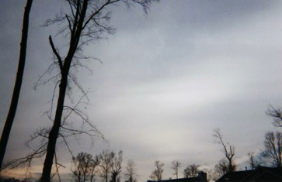
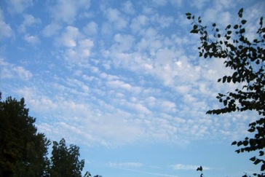
How to Observe:
Cloud Type
Factor 2: Cloud Height
Middle Clouds: Base 2–6 Km
Always begin with the prefix alto- and are predominantly comprised of water droplets; may contain some ice. Sometimes the sun can be seen through these clouds, but without a ring.
Altostratus
Altocumulus
Images: NASA

Slide 18
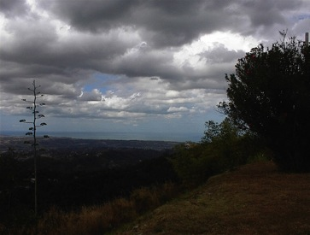
How to Observe:
Cloud Type
Factor 2: Cloud Height
Low Clouds: Base < 2 Km
Closest to the observer, and often appear to be quite large compared to higher clouds. They may be much darker and grayer than high or middle clouds.
Stratus
Stratocumulus
Cumulus
Images: NASA

Slide 19
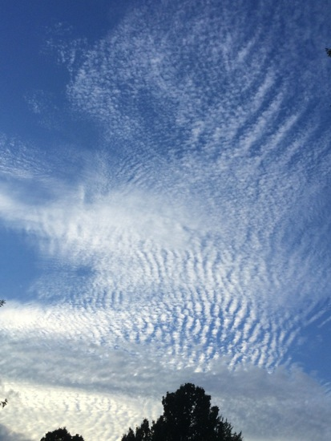
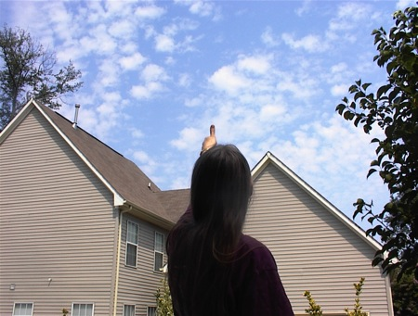
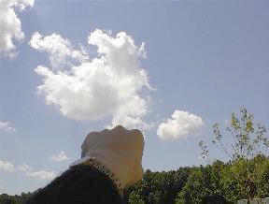
Observing Hints:
Puffy Clouds
Hint: For cumulus (puffy) clouds, use fist/thumb/pinky finger rule to estimate cloud height.
High Clouds
(cirrocumulus)
Appear comparable in size to pinky finger held at arm’s length
Mid-level Clouds
(altocumulus)
Low Clouds
(cumulus)
Appear comparable in size to thumb held at arm’s length
Appear comparable in size to fist held at arm’s length
Images: NASA

Slide 20
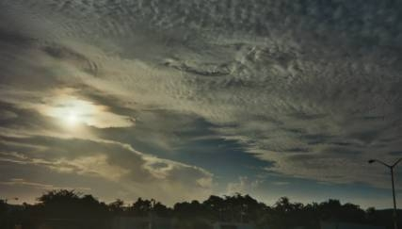
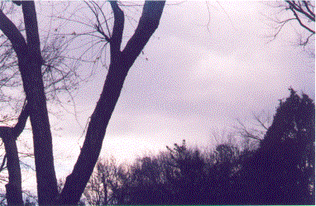
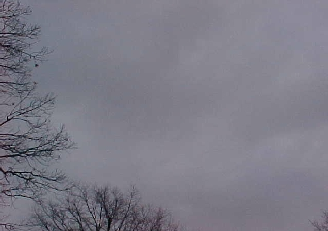
Observing Hints: Layered Clouds
Hint: For stratus (layered) clouds, look for clues near the Sun.
NEVER look directly at the Sun!
Cirrostratus
The only cloud type which can produce a halo around the Sun or moon. The halo will have all the rainbow colors in it.
Altostratus
Stratus
Produces a thinly veiled Sun or moon, and will often be darker in appearance, a medium gray color.
Usually very gray and often very low to the ground. The Sun is not visible.
Images: NASA

Slide 21
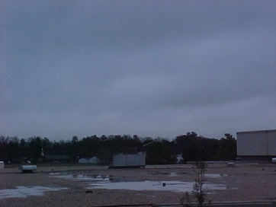
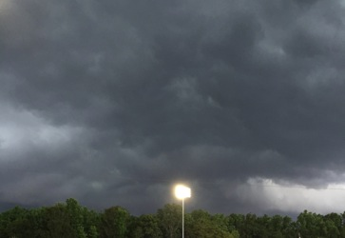
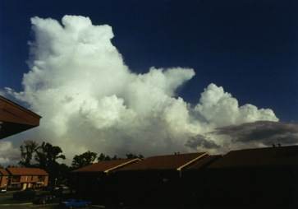
How to Observe:
Cloud Type
Factor 3: Precipitation
Clouds with Precipitation
Nimbostratus
Cumulonimbus
Seen from below
Seen from a distance
Images: NASA
Nimbus means cloud in Latin

Slide 22
You are ready to observe!
Download the app:
For iOS via the App Store
For Android via Google Play

