Slide 1
Clouds Protocol Featuring Satellite Comparison
Read the module content and take the test that follows to earn the GLOBE Atmosphere: Clouds certificate.

Slide 2
Clouds and Satellite Comparison
“We seek to remind people that clouds are expressions of the atmosphere’s moods, and can be read like those of a person’s countenance.”
Manifesto of the Cloud Appreciation Society
https://cloudappreciationsociety.org/manifesto/

Slide 3
Overview
This module…
Provides a step by step introduction to the protocol method
Reviews the selection of a GLOBE Atmosphere site
Explains how to make a cloud observation and report it to GLOBE
Introduces satellite comparison data

Slide 4
Learning Objectives
After completing this module, you will be able to:
Explain what clouds are and how they form
Explain why clouds are an important element of the Earth system
Explain why cloud observations are important for understanding our changing Earth System
Identify a clouds study site and take observations of the sky
Upload data to the GLOBE database
Compare corresponding satellite data to ground cloud reports
Visualize data using GLOBE’s Visualization System
Develop ideas for questions and investigations you can address using cloud observations and incorporate satellite data when applicable
Estimated time to complete module: 2 hours

Slide 5
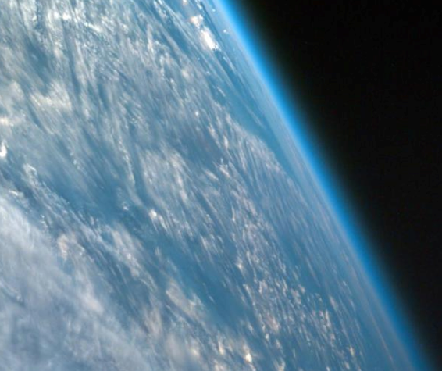
The Atmosphere
The Earth's atmosphere is an extremely thin sheet of air extending from the surface of the Earth to the edge of space. The Earth is a sphere with a roughly 13,000 km diameter; the thickness of the atmosphere is about 100 km.
In this picture, taken from a spacecraft orbiting at 300 km above the surface, we can see the atmosphere as the thin blue band between the surface and the blackness of space. If the Earth were the size of a basketball, the thickness of the atmosphere could be modeled by a thin sheet of plastic wrapped around the ball!

Slide 6
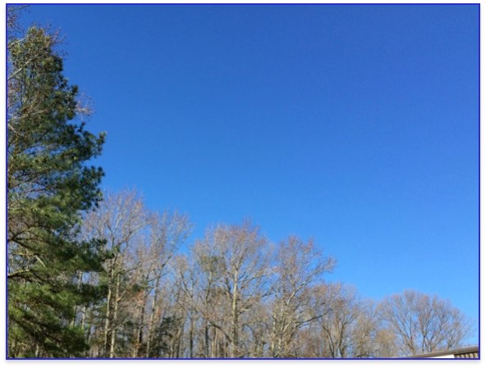
Where Do Clouds Come From?
Water in the atmosphere exists in three main phases (solid, liquid, and gas). It changes phase depending on temperature and pressure. Like most other gases that make up the atmosphere, water vapor is invisible to the human eye.
Unlike most other gases in our atmosphere, under the right conditions water vapor can change from a gas into solid particles or liquid drops.
Though we cannot see it, there is still water (vapor) present in a clear blue sky.

Slide 7
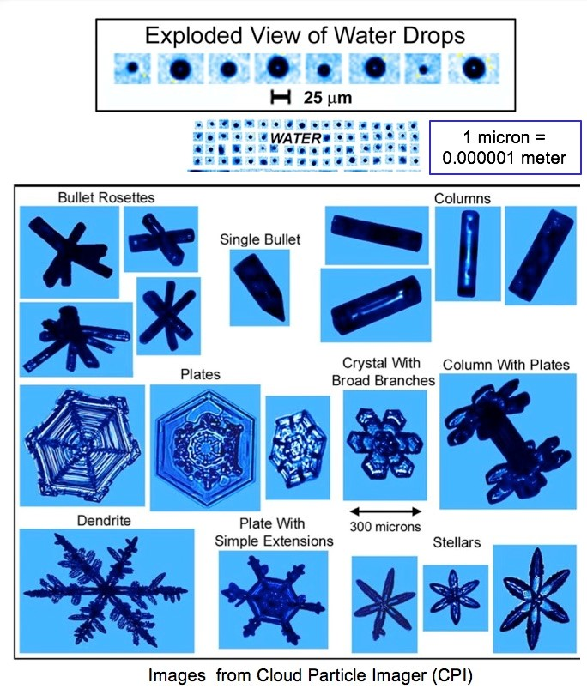
How do Clouds Form?
If temperatures are above freezing, water vapor will condense onto small particles (dust, smoke, salt, etc.) in our atmosphere, as water droplets. The small particles are known as cloud condensation nuclei (CNN). Without them clouds would not form above -40°C.
If temperatures are below freezing, as they are at high altitudes, tiny ice crystals will mostly form instead.

Slide 8
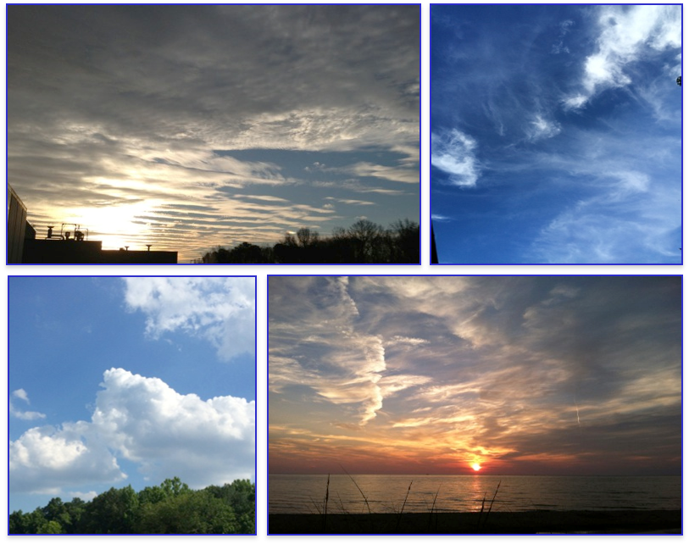
What are Clouds?
When a large number of water drops or ice crystals are present, and they scatter enough light for us to see them, they form visible clouds.
At any given time, over half of Earth’s surface is covered by clouds.

Slide 9
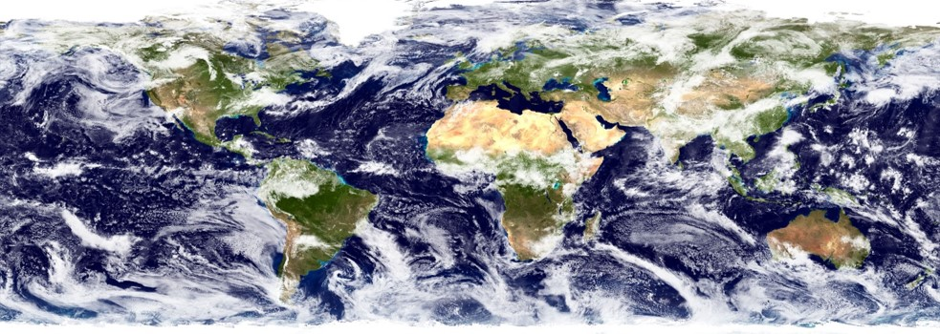
Why Collect Cloud Data?
One of the most interesting features of Earth, as seen from space, is the ever-changing distribution of clouds. They are as natural as anything we encounter in our daily lives. As they float above us, we hardly give their presence a second thought. And yet, clouds have an enormous influence on Earth’s energy balance, climate, and weather.
Even small changes in the abundance, location, or cloud type can impact Earth’s climate and weather. This is why collecting data on clouds is important.

Slide 10
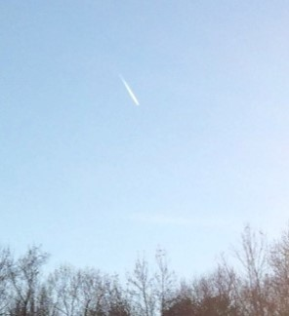
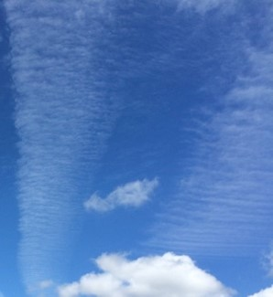
Clouds and Weather
Clouds can help us predict weather. Clouds can also tell us something about air temperature, water, and wind up in the sky. During the day a cloudy sky will make the temperature cooler. At night a clear sky will make temperatures cooler. Clouds also bring us rain.
Dry air aloft
Moist air aloft, wind perpendicular to contrail

Slide 11
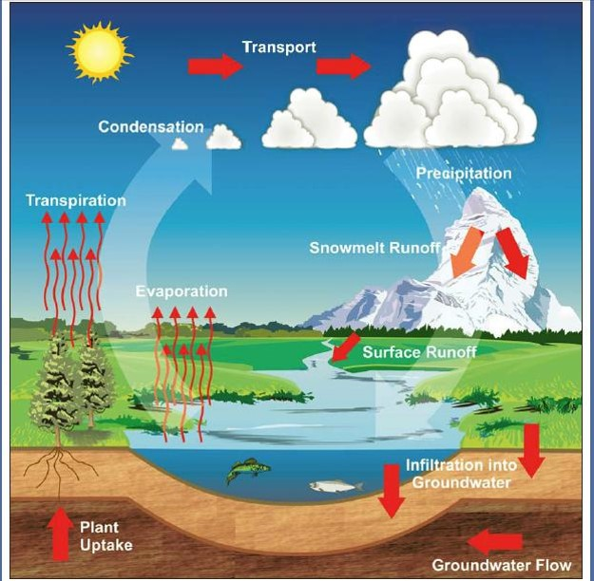
Role of Clouds in the Water Cycle
The water on Earth is always on the move, changing from liquid to vapor and back to liquid and snow and ice near the poles and mountains. The process is called the water cycle, or hydrologic cycle.
Clouds are a key element of our Earth’s hydrologic cycle, bringing water from the air to the ground and from one region of the globe to another.

Slide 12
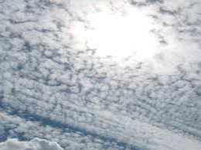
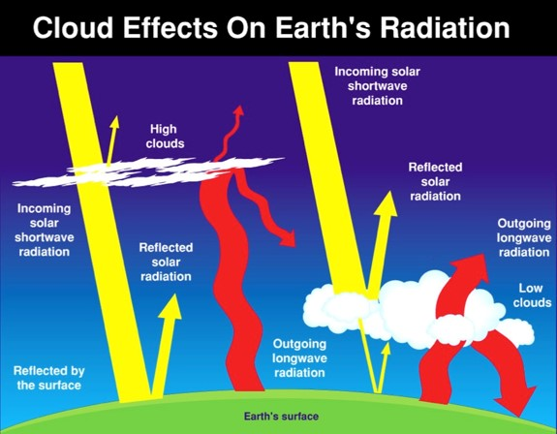
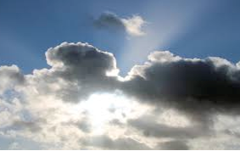
Clouds and Earth’s Energy Budget
Clouds also affect how much sunlight is reaching the ground and how much heat is escaping back to space. Understanding the clouds helps us better understand climate.
Clouds are the key regulator of the planet’s average temperature. Some clouds contribute to cooling because they reflect some of the Sun’s energy – called solar energy or shortwave radiation – back to space. Other clouds contribute to warming because they trap some of the energy emitted by Earth’s surface and lower atmosphere – called thermal energy or longwave radiation.

Slide 13
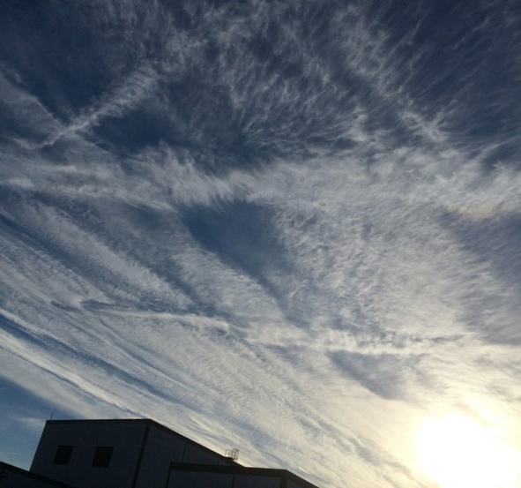
Importance of Contrail Data
Contrails, or condensation trails, are the linear clouds formed when a jet aircraft passes through a portion of the atmosphere having the right moisture and temperature conditions. The relationship between contrails and clouds is a current investigation area for scientists.

Slide 14
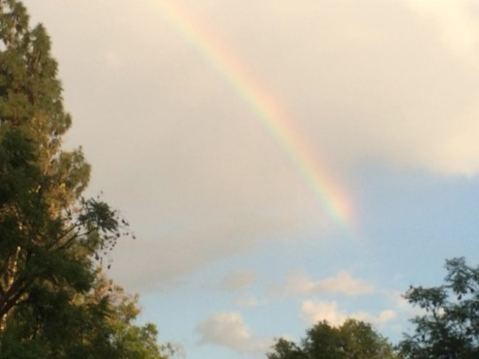
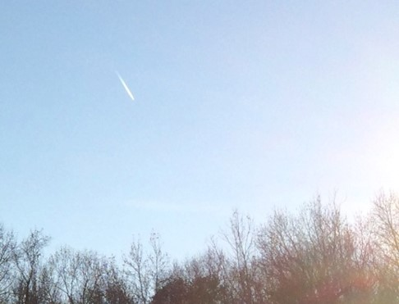
Your Measurements Can Help Scientists
Understand how cloud climatology may be changing
Human observers can identify qualitative aspects (e.g. cloud type clues) that automated sensors cannot.
Provide ground-based data on contrails
Human observers can see small features (e.g. short-lived contrails) that are not visible from satellites.

Slide 15
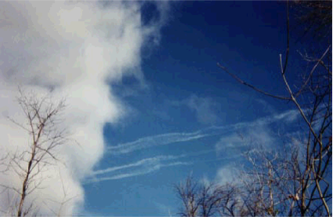
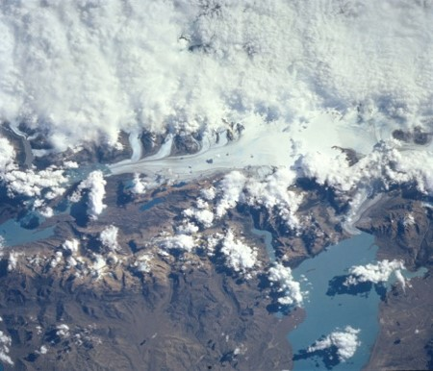
Your Measurements Can Help Scientists
Verify and improve automated remote sensing.
Improve interpretation of satellite observations of Earth’s energy balance.
From the bottom: Blue sky provides great contrast
From the top: Varied surface confounds detection
Hint: Observations timed to coincide with satellite imagery provide useful comparisons, for scientists, and for you!

Slide 16
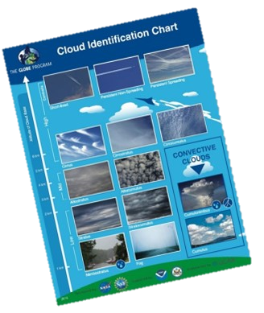
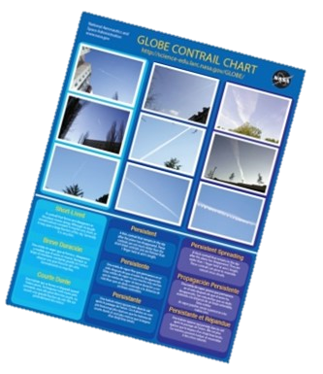
Equipment and Documents Needed 1
Instrument | You are the instrument (eyes)
References | GLOBE cloud chart and contrail ID chart (English/French/Spanish) (Russian/Chinese/Arabic)
When | Good: Any time Better: Within one hour of local solar noon Best: Corresponding to satellite observation (within +/- 15 minutes of orbiting satellites)
Where | A good observation site (See the Documenting Your Atmosphere Study Site Field Guide)

Slide 17
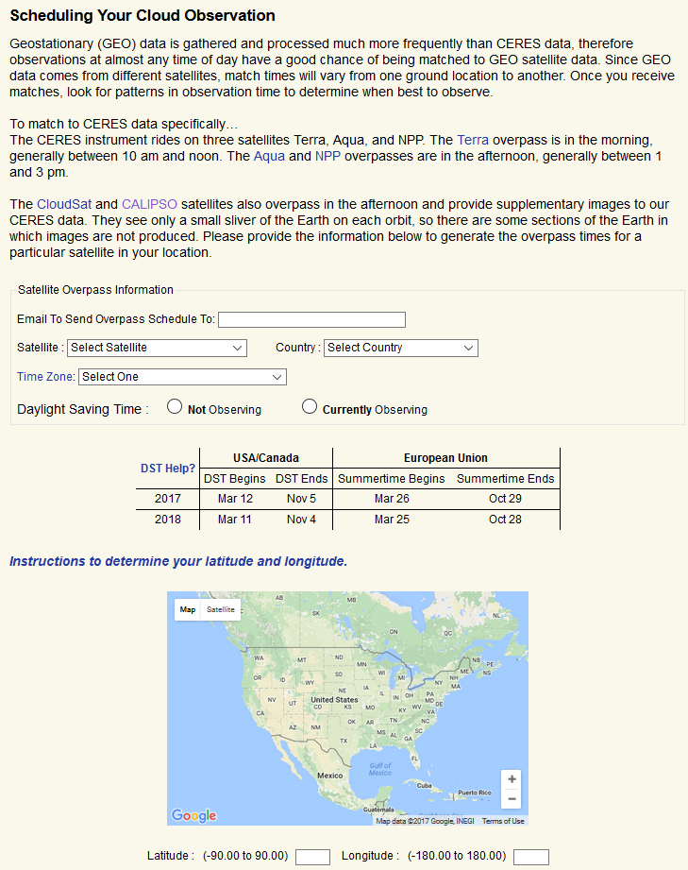
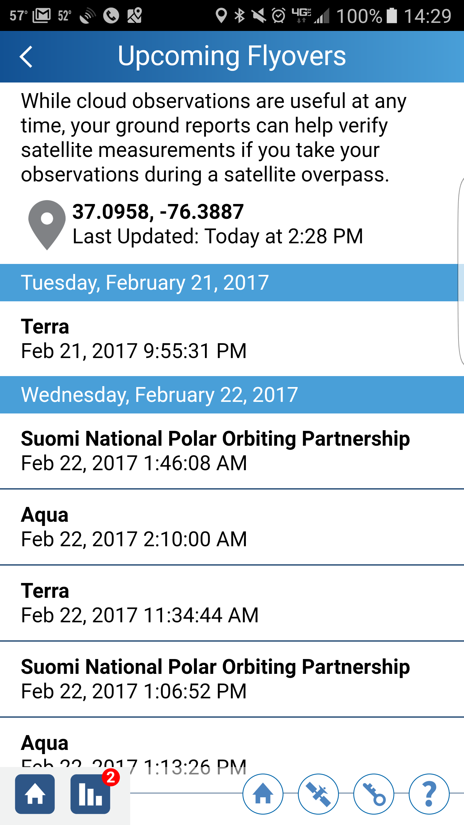
Equipment and Documents Needed 2
Align your ground report to corresponding satellite data by accessing satellite overpass times on the NASA Cloud Satellite Portal or the free NASA GLOBE Observer App.
The GLOBE Cloud protocol includes satellite comparison support. Access satellite overpass times for your observation site by entering your credentials. An overpass schedule will be available on the website and emailed to your inbox.
From the home screen of the GLOBE Clouds app, select the orange button titled “Check Satellite Flyovers”.
Note: Geostationary (GEO) satellites are focused over one section of the Earth’s surface, scanning a designated area, and GEO data is processed more frequently than CERES. That is why observations at almost any time of day have a good chance of being matched. For those reasons, GEO satellites are not included on overpass schedules.

Slide 18
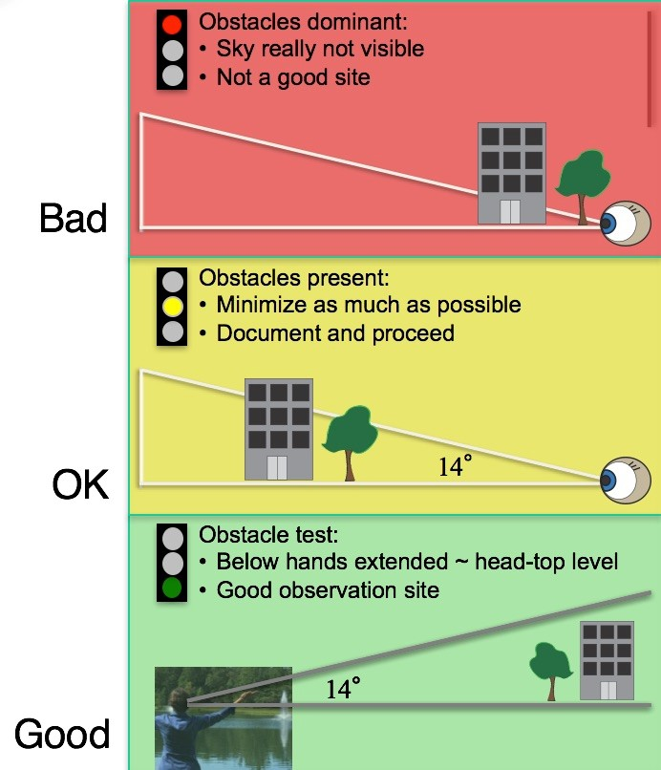
Site Selection What Makes a Good Site?
Observe from location that provides the most unobstructed view of the sky.
Best to observe from a consistent location each time.
Reminder: Define a new site within your GLOBE profile (online or on the mobile apps) if you are in a different location.

Slide 19
How to Observe: Introduction
Look at the sky in every direction above 14°.
This is a good observation to do with a small group (each can take a quarter of the sky) although individuals can do it also.
Cloud identification is an art; you will get better with practice.
The most important step is the first and easiest: observing “What is in Your Sky”
No Observable Clouds
Observable Clouds
Or the view of your sky and clouds is obscured
NEVER look at directly at the Sun!
This photo shows observers estimating 14 degrees above the horizon by placing their hands in a “V” at about head height. The area between their hands, above them, is their observation area.

Slide 20
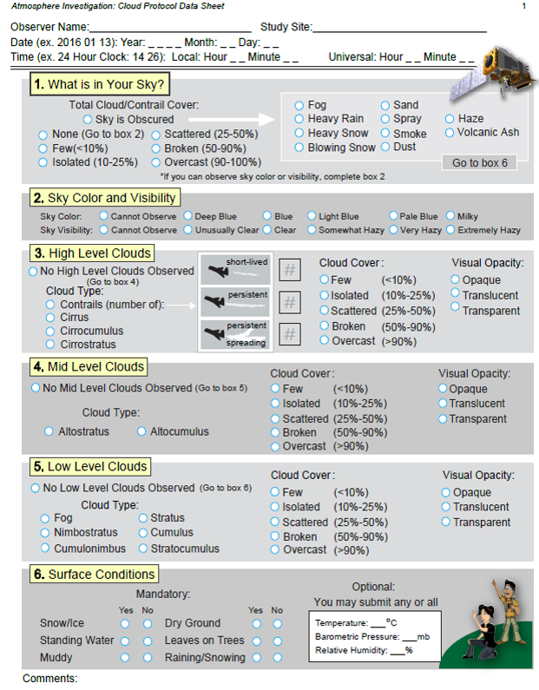
How to Observe: The Data Sheet
Walk through the GLOBE Cloud Data Sheet:
Record date, time, and location.
Observe total sky conditions, if applicable.
On high, mid, and low levels define cloud type, cloud cover, and cloud visual opacity.
Conclude your report with surface condition observations.
Cloud Data Sheet

Slide 21
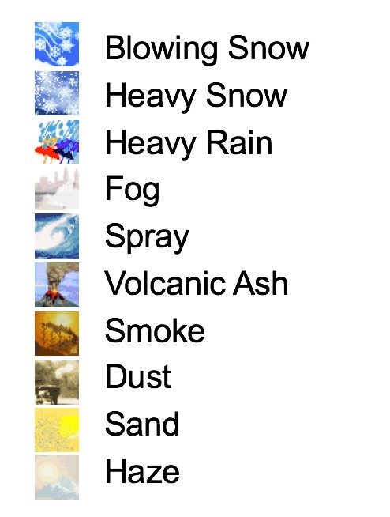
How to Observe: Obscuration
Identify an obscuration if you can not see the sky.
If more than 1/4th of the sky is obscured by one of these options, record and report the reason on the data sheet.
Note: If your sky is blocked by buildings or trees, do not record it as an obscuration, please look for a more open observation site.

Slide 22
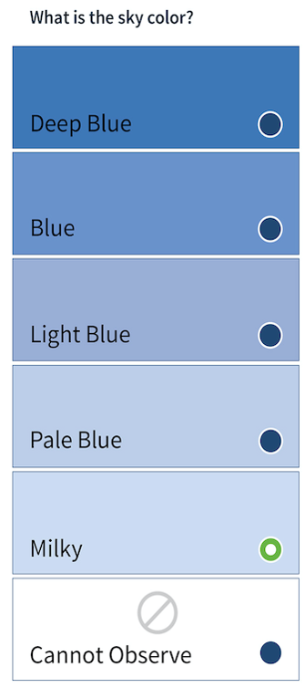
How to Observe: Sky Color
Sky color is an indication of the amount of aerosols in the atmosphere. Aerosols tend to scatter all wavelengths of light, making the sky look more white. Deep blue suggests very few aerosols. A milky sky suggests there are lots of aerosols.
Goal: to observe the bluest part of the sky.
Note: Sky color can only be observed from a clear section of sky, with no clouds in view.
Tips:
Turn your back to the Sun.
Look at the sky halfway between the horizon and straight up (45°).
Pick the shade that most closely matches your sky.
You want to match the color of the sky, not the clouds, so if it’s too cloudy you may not to be able to observe sky color.

Slide 23
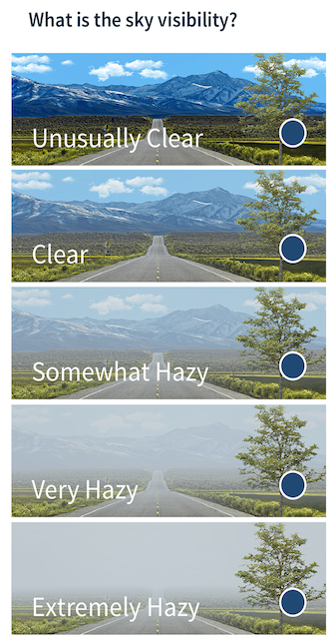
How to Observe: Sky Visibility
Sky visibility is an indication of the amount of the aerosols close to the surface of the ground. The more aerosols there are, the hazier it will appear.
Look at a landmark in the distance.
Try to use the same landmark every time.
Tip: It can be helpful to take a picture of your sky day-to-day to notice the difference between visibility observations. In addition, the clearest sky for your area will be seen just after a front or a storm moves through your area.

Slide 24
How to Observe: Sky Conditions
Tip:
Here’s a good reminder for the difference between observing sky color and sky visibility, and where to look as you observe each.

Slide 25
How to Observe: Cloud Details at Each Height
At each level (high, mid, and low) observers will identify the following:
Cloud Type(s)
Cloud Cover
Cloud Visual Opacity
Contrails are reported in the high cloud section.

Slide 26
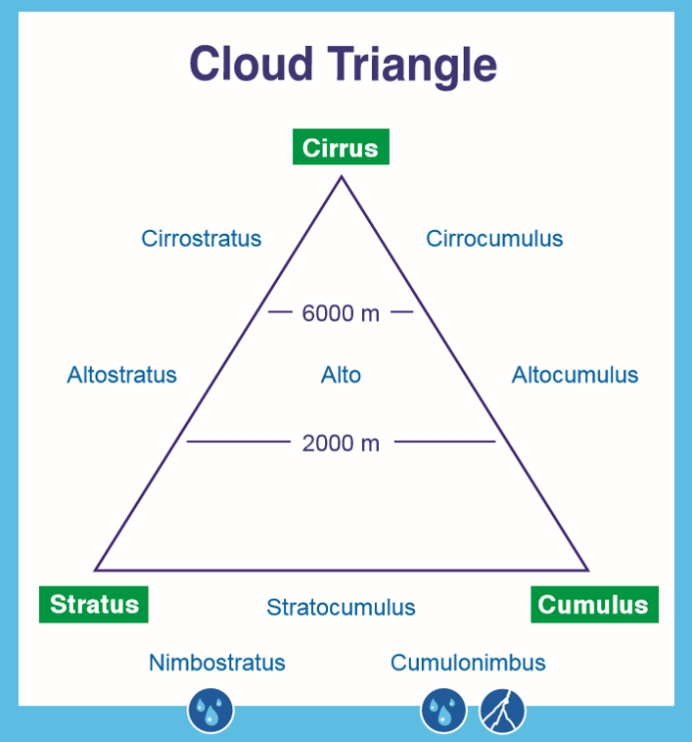
How to Observe: Cloud Type
Clouds can be defined according to:
Their shape
The cloud base altitude
Whether they are producing precipitation
The Cloud Triangle is a useful memory device.

Slide 27
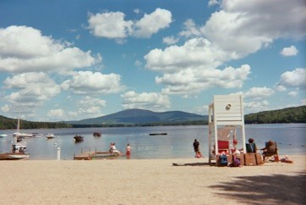
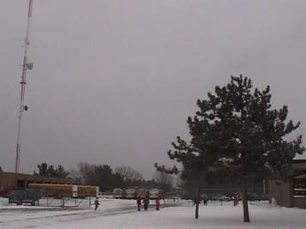
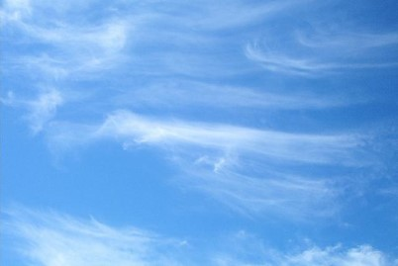
How to Observe: Cloud Type by Shape
3 main cloud shapes are:
Cumulus (Puffy): Made of water, cumulus clouds can be associated with fair weather. They are usually not very tall and they are separated from each other with lots of blue sky in between.
Stratus (Layered): Made of water. These clouds can be found from Earth’s surface to 2,000 m high. When you see the Sun’s disk through them, the edges look sharp.
Cirrus (Wispy): Made of ice crystals and are considered “high clouds”, forming above 5,000m. They generally indicate fair to pleasant weather. The reason for the long tail is primarily due to high speed winds at high altitudes.

Slide 28
How to Observe: Cloud Cover
You will estimate the total cloud cover of the whole sky and at each level (high, mid, and low levels).
It may be helpful to divide the sky in 4 quadrants (North, South, East, and West) and estimate cloud cover in each, then take the average to get the whole sky value.
Tip:
Observe the sky overhead, excluding the horizon. This can be done by:
observing above 14°,
or holding your arms out in a “V”, hands even with the height of the top of your head, and observing between your hands,
or holding your fist out at arm’s length, even with the horizon; putting your second fist on top of the other; observing the sky from above the top of your second fist.
No Clouds (0%)
Few
(0-10%)
Isolated
(10-25%)
Scattered
(25-50%)
Broken
(50-90%)
Overcast
(>90%)

Slide 29
How to Observe: Visual Opacity
Tip:
If your shadow is well defined, a lot of sunlight is getting through the cloud above you, so the cloud’s visual opacity would be transparent. As your shadow becomes more fuzzy, the cloud would be considered more opaque.
Transparent: Thin clouds through which light passes easily, and through which you can even see blue sky. Note the milky bluish-whitish appearance.
Translucent: Medium-thickness clouds that let some sunlight through. There may be some milky bluish-white near the edges, and a very little bit of gray; but these clouds are mostly a bright white.
Opaque: Thick clouds which do not allow light to pass directly, although light can diffuse through them. Clouds look gray. When these clouds are in from of the Sun, it is impossible to tell where the Sun is.
Transparent
Translucent
Opaque

Slide 30
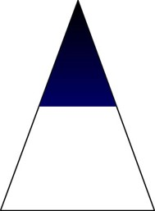
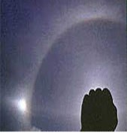
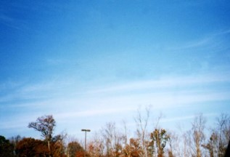
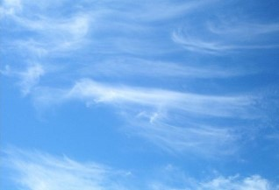
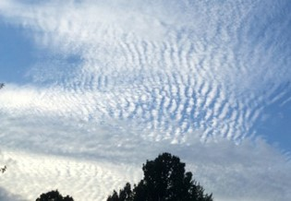
How to Observe: High Level Clouds
NEVER look directly at the Sun!
High Clouds are those whose base is 5,000m to 13,000m. Types include cirrus, cirrocumulus, and cirrostratus. The clouds can be either ice or water droplets, but are more often ice crystals. Water clouds tend to have definite edges, while ice clouds are more wispy. Persistent contrails (airplane trails of moisture that don’t just disappear as the airplane passes) are high clouds as well.
Cirrostratus with Halo
Cirrostratus
Cirrus
Cirrocumulus

Slide 31
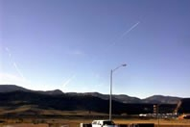
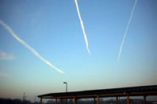
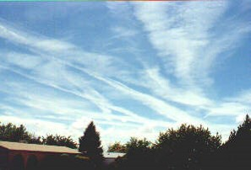
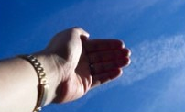
How to Observe: Contrails
Count the number of each type; remember to report 0 if no clouds are present
Short-Lived:
Contrails that form short line segments that fade out as the distance from the airplane that created them increases.
Persistent Non-Spreading: Remain long after the airplane has left the area. They form long, generally straight lines of constant width across the sky. These contrails are no wider than your index finger, held at arm’s length.
Persistent Spreading: Remain long after the airplane has left the area. They form long streaks that have widened with time since the plane passed. These contrails are wider than your index finger held at arm’s length.

Slide 32
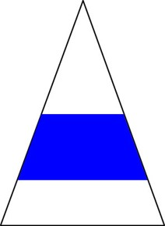
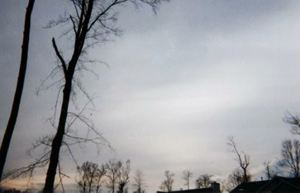
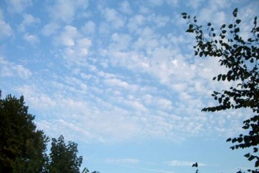
How to Observe: Mid-Level Clouds
Altostratus
Altocumulus
These are generally clouds whose base is between 2,000 and 7,000m altitude. Cloud types are altostratus or altocumulus, and are generally but not always water clouds, depending on the atmosphere’s temperature and other conditions at the cloud altitude.

Slide 33
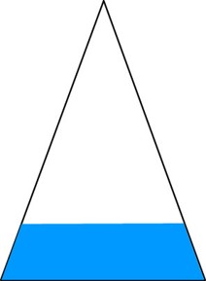
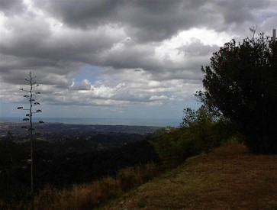
How to Observe: Low Level Clouds
Stratus
Stratocumulus
Cumulus
These are generally clouds made of water droplets whose base is below 2,000m altitude. Low cloud types include stratocumulus, cumulus, stratus, cumulonimbus, and nimbostratus. Fog can also be put in this class because it is a ground-level stratus cloud. The tops of cumulonimbus clouds can be high enough to form ice crystals.

Slide 34
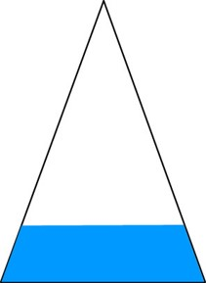
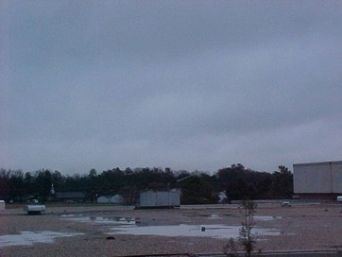
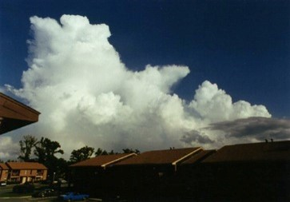
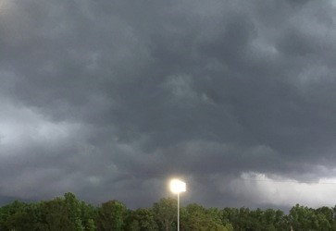
How to Observe: Low Level Precipitating Clouds
From afar
From below
Nimbostratus
Cumulonimbus
Clouds that precipitate have names with nimbo prefix/suffix. Precipitation can be in any form such as rain, snow, hail, etc. Cumulonimbus clouds are known as thunderstorm clouds and are sometimes called anvil clouds because of their shape. Nimbostratus clouds often bring steady, ongoing precipitation.

Slide 35
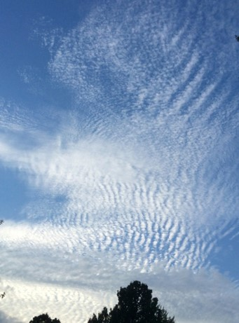
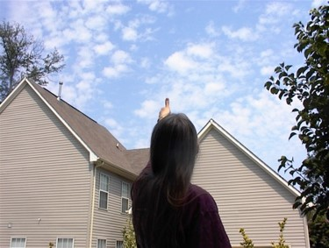
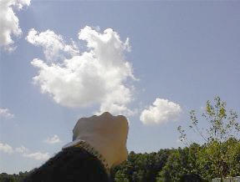
How to Observe: Determining Level of Cumulus Clouds
Tip:
For Cumulus (puffy) clouds, use fist/thumb/pinky finger strategy to estimate cloud height.
High clouds (cirrocumulus) appear comparable in size to pinky finger held at arm’s length.
Mid-level clouds (altocumulus) appear comparable in size to thumb held at arm’s length.
Low clouds (cumulus) appear comparable in size to fist held at arm’s length.

Slide 36
How to Observe: Determining Level Stratus Clouds
Tip:
For stratus (layered) clouds, look for clues near the Sun.
NEVER look directly at the Sun!
Cirrostratus is the only cloud type which can produce a halo around the sun or moon. The halo will have all the rainbow colors in it.
Altostratus will produce a thinly veiled Sun or moon, and will often be darker in appearance, a medium gray color. The Sun looks dimly lit behind these clouds.
Stratus will usually be very gray and often very low to the ground. They tend to cover a lot of the sky.

Slide 37
How to Observe: Cloud Type Practice and Support
Try the interactive tool found in the e-Training section under “Supporting Material”: Cloud Type Practice.

Slide 38
How to Observe: Surface Conditions and Measurements
Surface Conditions (Required): Define the surface conditions of your observation site.
Tips:
A pond would be an example of standing water.
Leaves on trees refers to the majority of the deciduous trees around your observation site.
Surface Measurements (Optional):
Air Temperature
Barometric Pressure
Relative Humidity
These are all optional. Unless you have been trained in the associated GLOBE Protocol, skip surface measurements.
E-Training for the above Surface Measurements can be found under the Atmosphere E-Training suite.

Slide 39
Report Your Data to GLOBE
There are 4 ways to enter GLOBE data:
Live Data Entry: These pages are for entering environmental data, collected at defined sites, according to protocols, and using approved instrumentation – for entry into the official GLOBE science database.
Email Data Entry: If connectivity is an issue, data can also be entered via email.
Mobile Data App:
Download the GLOBE Data Entry App From the app store.
Download the NASA GLOBE Observer App from the app store.

Slide 40
Set up an Atmosphere Site

Slide 41
Set up an Atmosphere Site: Document with Photos
Taking pictures can help you better document your observation site.
You can see change over time if you routinely take pictures of your site and compare.
Site photos can help with interpretation of satellite imagery over the same ground location.

Slide 42
Set up an Atmosphere Site: Select “No Thermometer”
For clouds, atmosphere site specification is very simple: No thermometer

Slide 43
Begin a New Cloud Report
Click here to start a new report

Slide 44
Enter Date and Time
Note: From this point, the GLOBE Data Entry App for mobile devices follows basically the same steps as the website.
Tip:
Report the date and time you made the observation, not the date and time of data entry.

Slide 45
Select Cloud Condition
The first step is the most important and the easiest: observing “Is the sky clear, cloudy, or obscured”.

Slide 46
Clear Sky Report
Why do I need to enter data if it’s a clear day?
To scientists, the fact that there are no clouds is a measurement itself!
Photos are optional, but useful
For clear days, reporting is easy (and important).

Slide 47
Cloud Sky Report
The data entry system will ask you about clouds at high, mid, and low levels, one level at a time.
Choose cloud types, all that apply on each level. Record cloud cover and opacity.

Slide 48
Enter Contrails if Present
Enter NUMBER of contrails by type

Slide 49
How to Explore Data: Data Counts
Use the GLOBE Visualization System to explore your own data, but also see where data has been entered across the globe.
E-Training is available to explore the full power of the GLOBE Visualization System

Slide 50
How to Explore Data: Measurements
You can also use the GLOBE Visualization System to learn about the actual measurements that were made, one day at a time, with the legend showing what observers reported at their location.
Cloud Cover reports for March 6th, 2015

Slide 51
Explore Data: Sample Student Research Questions - GLOBE Visualization
Do cloud patterns/parameters change during the year?
Explore “All Cloud Types” or “Cloud Cover” layers.
Are contrails often seen in the local area? Why or why not?
Explore various “Contrail coverage” layers.
Do the types of clouds and contrails you observe relate?
Explore various “Cloud Types” and “Contrail coverage”.

Slide 52
Explore Data: Example Student Research Questions - Further Measurements
Does the amount of the cloud cover affect the local temperature?
Add air temperature protocols.
How reliable are local weather forecasts based on the cloud type observations alone? Can they be improved by using other GLOBE Measurements?
Add air temperature, barometric pressure, precipitation, relative humidity, surface temperature, water vapor, or wind protocol(s).
Do cloud conditions and phenomena that block our view of the sky influence the types of vegetation and soil in our areas? If so, how?
Add biometry, land cover or soil protocols.

Slide 53
Explore Data: Example Student Research Questions – Outside Observations
How do the clouds you see relate to nearby mountains, lakes, large rivers, bays, or the ocean?
Add maps or satellite imagery.
How do our cloud observations compare with satellite images of clouds?
Explore NASA or NOAA resources.
If there’s a satellite measurement made at the same time over your location, you’ll receive satellite imagery that you can use to explore this question.

Slide 54
Understand Data: Match Email
Observers will receive a ‘Match’ email when their observation aligns to corresponding satellite data. The ground observation will be on the left side and the satellite observation and images will be on the right.

Slide 55
Understand Data: How to Use Your Match Email
When first participating in the GLOBE Cloud Protocol, reviewing the match email can be a good opportunity to reflect on your observation and consider any difficulties that you had when observing a tricky cloudscape.
Match emails can help understand what may be the difference between ground perspective and satellite views.
Satellite data received in match emails can guide student research investigations and prompt further questions.
Tip:
Corresponding satellite data is not only accessible in your email, but you can also access your match link within the GLOBE Data Visualization System and the Explore Data link on the NASA satellite comparison support webpages.

Slide 56
Understand Data: Context from Satellite
From above, satellite imagery provides information about clouds and characteristics on mid and high levels that may be obscured from the ground.
With satellite imagery, you can see where your local weather fits into global patterns and phenomena.
The NASA Worldview site provides contextual information on cloud cover from the MODIS instrument on the Terra and Aqua satellites. Satellite imagery for March, 6th 2015.

Slide 57
Understand Data: Compare to Satellite Data
Satellite imagery takes some practice to interpret!
Tips:
Define colors.
Identify north.
Identify land cover.
Consider prior knowledge and geography.
Overcast
Clear
March 6th, 2015

Slide 58
Understand Data: YOUR Observations are important!
Orbiting satellites observe the Earth at similar locations and times.
Your ground-based observation can help make sense of what the satellites observe.
GLOBE Cloud observations aligned to satellite data are important because:
You expand the reach of scientists who are limited in time, number, and money.
You are contributing to a database that has been growing for over 2 decades. A long-term data set is crucial for scientists to see patterns and change over time.
You add another layer of perspective helping scientists to better understand the effects of clouds on our Earth.

Slide 59
Quiz Questions
Challenge yourself to answer these questions and check whether you have achieved the learning objectives of this module.
What are the key factors in how clouds form?
What are the 3 characteristics that define cloud type?
What factors determine if and what type of contrail will form?
What are some reasons that studying clouds are important?
If the sky is empty of clouds, should you still submit a cloud observation report?
What feature of clouds makes some days darker?
If it is raining, what two cloud types might it be? What is the difference?
What is the type of cloud you are most likely viewing if you can imagine lots of fun shapes?
What can you use to help determine cloud height?
Should you observe and report clouds all the way to the horizon?
How much of the sky needs to be obscured to report that state?
What’s an example of a question you could explore or investigate based on cloud observations?

Slide 60
GLOBE Learning Activities
Cloud Watch (pdf): Monitor clouds and weather to under the connections.
Estimating Cloud Cover - A Simulation (pdf): Try this fun activity to train your eye.
Or try a new, online version - Cloud Cover Practice.
Observing, Describing, and Identifying Clouds (pdf): Begin to learn cloud types and names.
Try the complementary interactive - Cloud Type Practice.

Slide 61
Elementary GLOBE Resources
The Cloud Protocol is easy for kids and adults of all ages! If you are working with younger students, the elementary GLOBE resources may be especially helpful.
Try the GLOBE Clouds Storybook and related learning activities:
Cloud Fun
Cloudscape
To Spread or Not to Spread
Try the GLOBE Aerosols Storybook and related learning activities:
Sky Observers
Why (not) So Blue?
See the Light
Up in the Air

Slide 62
NASA Resources
NASA Earth Observatory feature article on clouds
NASA Fact Sheet: The Importance of Understanding Clouds
Imagery from Space: Explore NASA Worldview or Visible Earth, great resources for interpreting satellite imagery.

Slide 63
You have completed the Cloud Protocol training module, featuring satellite comparisons!
If you are ready to take the Assessment Test, sign on and take the quiz corresponding to the Clouds Protocol.
You are ready to take Cloud Protocol observations and interpret satellite data! Welcome to the GLOBE Atmosphere community!
Please provide us with feedback about this module. This is a community project and we welcome your comments, suggestions and edits. Comment here: e-Training Feedback
Questions about this module? Contact GLOBE: help@globe.gov

Slide 64
Credits
Slides:
Dr. Lin Chambers, NASA Langley Research Center, USA
Sarah McCrea, NASA Langley Research Center, USA
Jessica Taylor, NASA Langley Research Center, USA
Russanne Low, Ph.D., University of Nebraska-Lincoln, USA
Images:
NASA Langley Research Center
More Information:
The GLOBE Program
NASA Satellite Comparison Website on GLOBE.gov
NASA Wavelength : NASA’s Digital Library of Earth and Space Education Resources
NASA Global Climate Change: Vital Signs of the Planet
Version 3/1/2017. If you edit and modify this slides set for use for educational purposes, please note “modified by (and your name and date)” on this page. Thank you.

