Slide 1
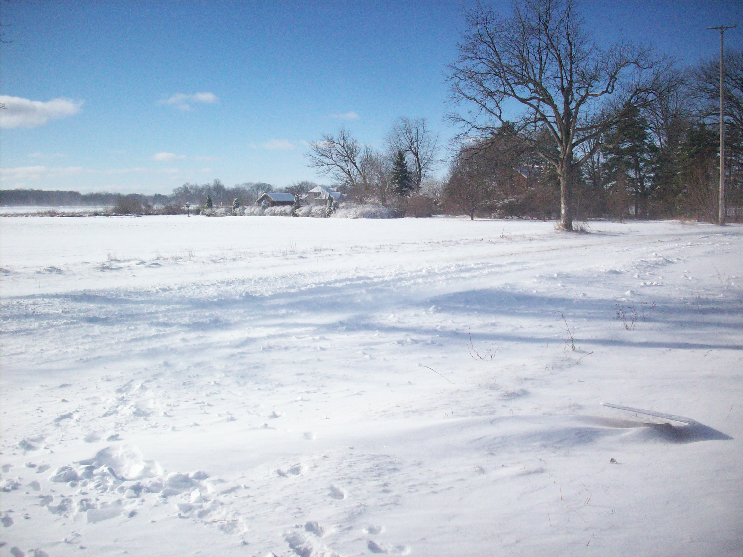
Protocol Training Slides
Precipitation-Snow
Picture by Kevin Czajkowski

Slide 2
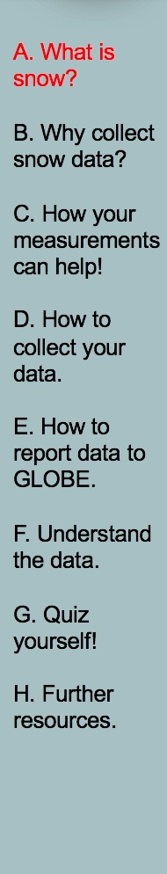
Overview and Learning Objectives
Overview
This module:
Describes the different types of precipitation
Provides step-by-step protocol instructions for collecting snow depth, water equivalent and pH
Learning Objectives
After completing this module, you will be able to:
Describe why snow observations are important
Describe how, where, and when to collect snow observations
Upload data to GLOBE website
Visualize data using the GLOBE Visualization System and formulate your own questions about weather
Estimated time to complete module: 1 hour

Slide 3
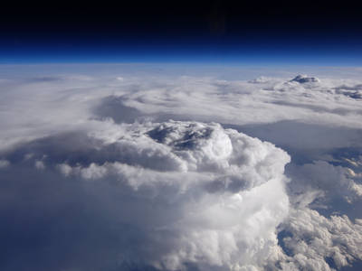
The Atmosphere
Extremely thin sheet of air extending about 300 miles from Earth’s surface to edge of space.
Its composition has changed over time.
The water in the atmosphere plays an essential role in determining the weather.
Temperature and precipitation in a given region vary over time when studying climate change.
When we study the history of Earth’s climate, we notice that temperature and precipitation in any given region vary over time and that the composition of the atmosphere has changed.
Storm Cell
Atmosphere Protocol

Slide 4
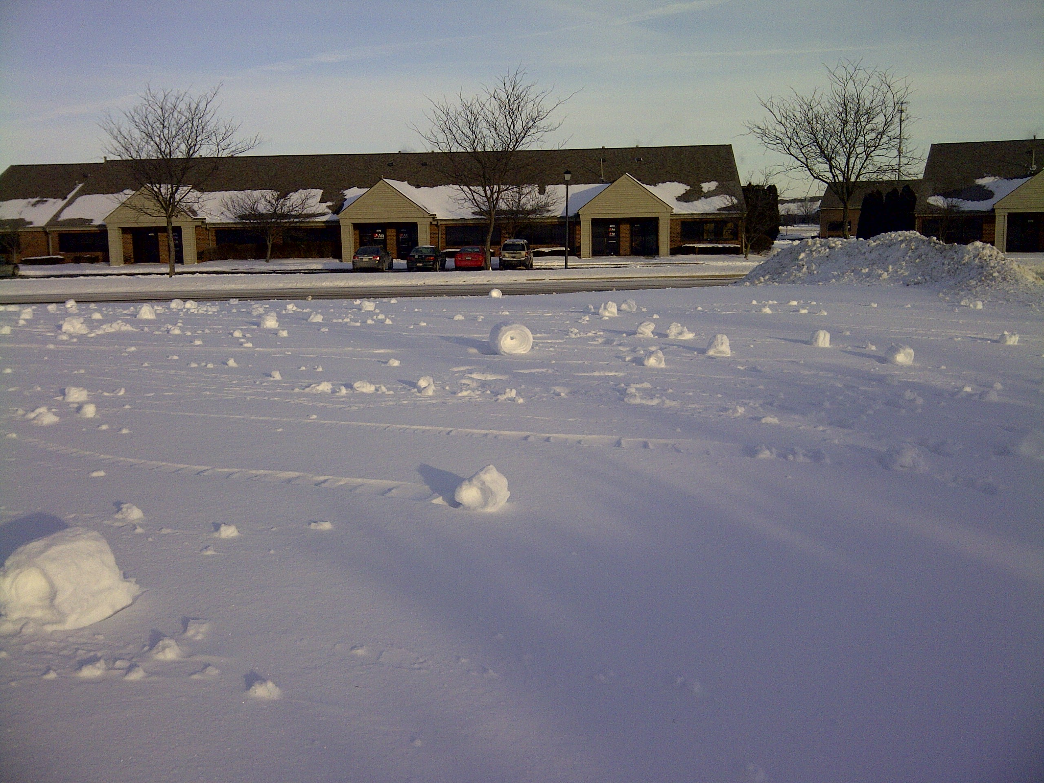
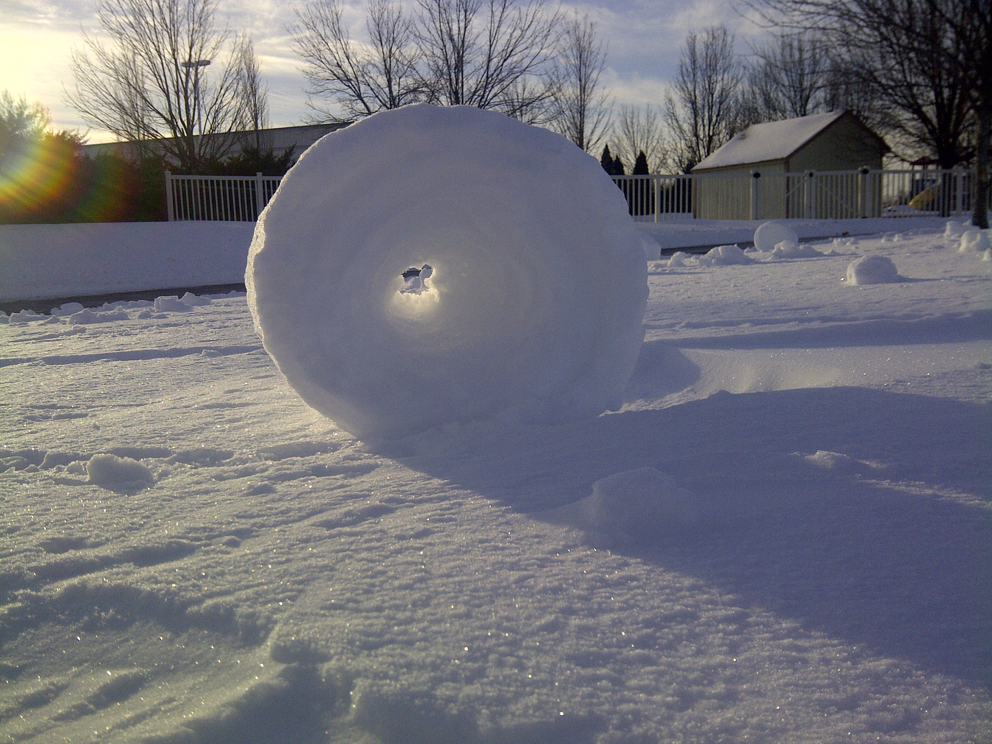
Snow Rollers: form when warm temperatures and very strong winds roll the snow
Pictures by Kevin Czajkowski

Slide 5
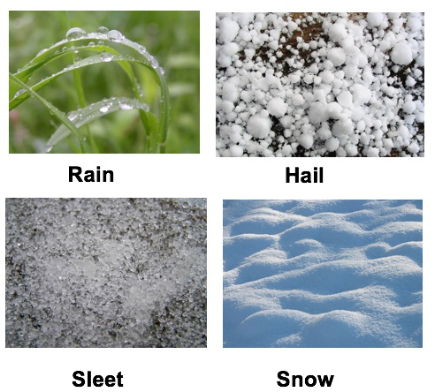
Precipitation Types
Aerosols
Air Temperature
Albedo
Barometric Pressure
Clouds
Precipitation
Relative Humidity
Surface Ozone
Surface Temperature
Water Vapor
Wind
Image: Wikipedia Commons

Slide 6
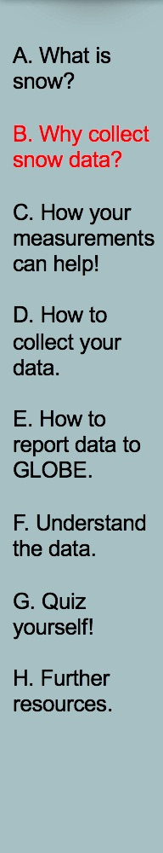
The importance of recording snow observations
In the Western United States, snow melt is an important source of water.
Snow is an important source of water for springtime growth of some agricultural crops.
Image courtesy of National Drought Mitigation Center, UNL

Slide 7
NASA uses many satellites to observe snow cover
Advanced Very High Resolution Radiometer (AVHRR)
Geostationary Operational Environmental Satellite (GOES)
Moderate Resolution Imaging Spectroradiometer (MODIS)
Modis Image. Source: Nasa.

Slide 8
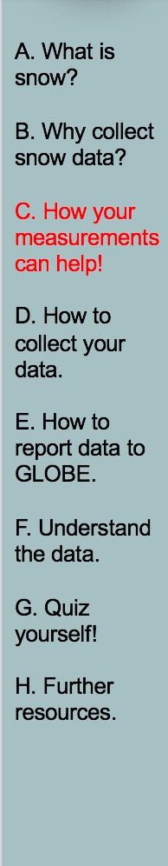
YOUR observations can help NASA scientists to understand and predict
the year to year variation in snow cover.
water available from snow melt.
whether a year will be particularly wet or dry for our location.
the pH of precipitation and how it varies.

Slide 9
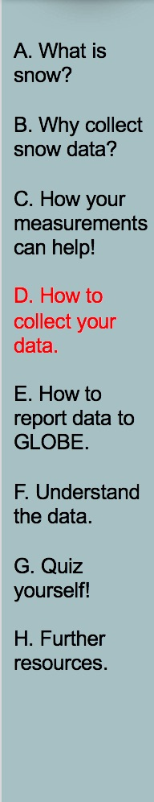
What I Need to Collect Snow Data
Materials | Snow Board*, meter stick, straight sided container, overflow tube from your rain gauge, 2 clean sampling jars with covers, a container for the snowpack rain equivalent sample, something flat and clean to slide under inverted containers, labels for snow sample
Data Sheet | Atmosphere Investigation Integrated 1-Day Data Sheet
When | Preferably within one hour of local solar noon; OK at other times
Where | Where the wind won’t drift the snow (See Documenting your atmosphere study site)
Other | Log book for data collection; computer with internet connection to enter data
*Click here for Snow Board Directions

Slide 10
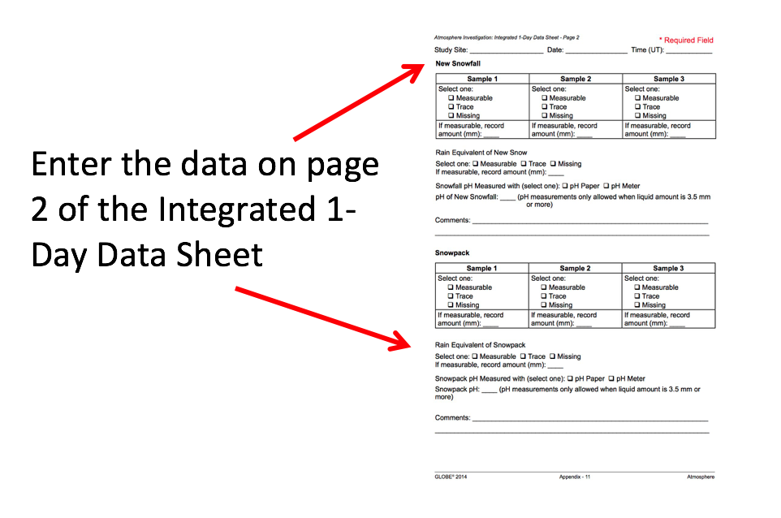
Data Sheet
Atmosphere Integrated 1-Day Data Sheet

Slide 11
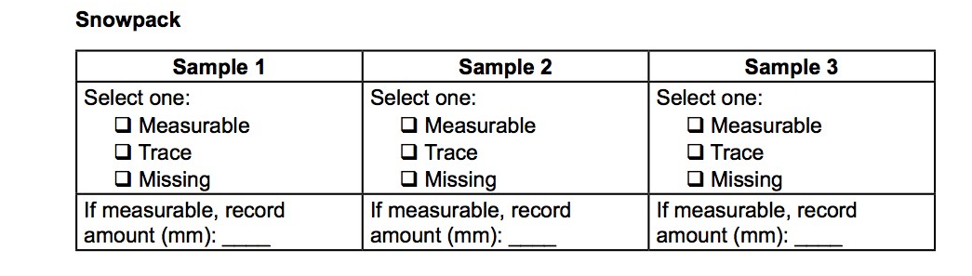
Collecting Data-Snowpack
Insert the measuring stick vertically into the snow until it rests on the ground. Be careful not to mistake an ice layer or crusted snow for the ground. Read and record the depth of the snowpack to the nearest millimeter. If not measurable but there is some snow, pick Trace.
Repeat at least 2 more times in areas with little drifting snow.
Report the observations on the data sheet.

Slide 12
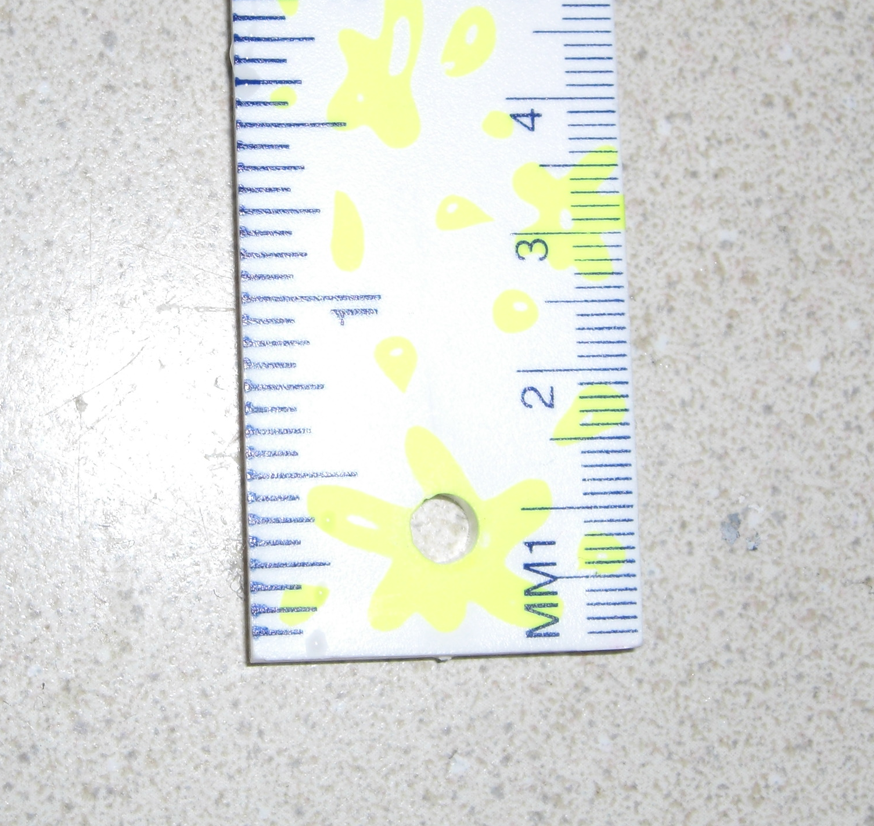
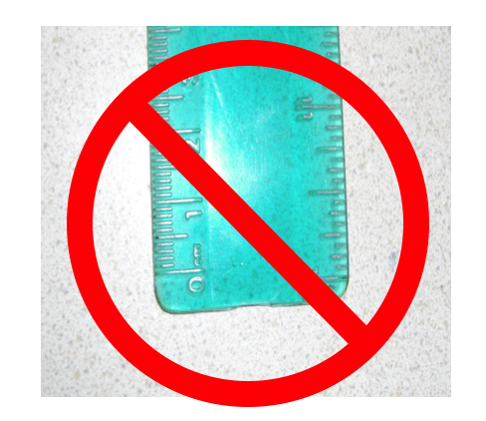
Measuring Snow Depth
Use a measurement device such as a ruler that starts at 0 at the edge and read to the nearest millimeter.
Use this type
Not this type
Photos by Kevin Czajkowski

Slide 13
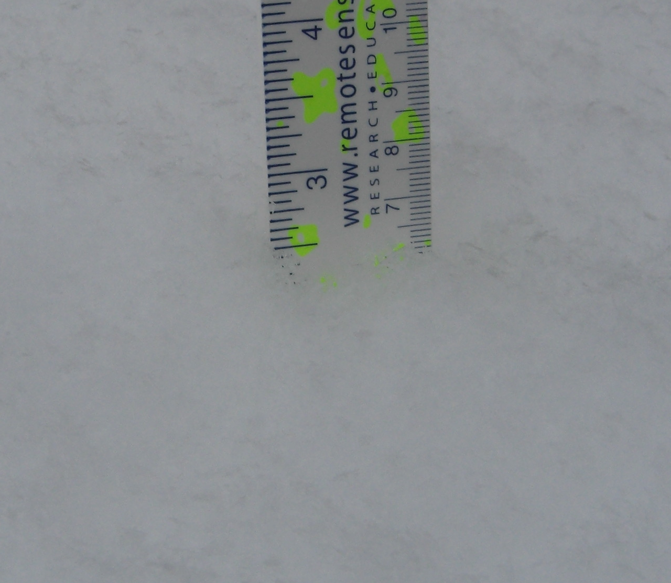
Reading the Ruler
Read the ruler to the nearest millimeter.
What depth is this?
61 mm
Picture by Kevin Czajkowski

Slide 14
Collecting Data: New Snowfall
After a new snowfall, gently insert the measuring stick vertically into the snow until it touches the snowboard. Read and record the depth of new snow to the nearest millimeter. If no new snow has fallen, record 0 as the depth of new snow.
If there is new snow, take at least two more measurements at different spots on the snowboard.
Report these numbers as the depth of new snow. If the snowfall is so small that a depth can’t be read, record the letter “T” (for trace) for new snow. If the snow on the snowboard has been disturbed before you can take an accurate measurement, report “M” for missing.
Record the number of days since the last reading of snow on the snowboard.

Slide 15
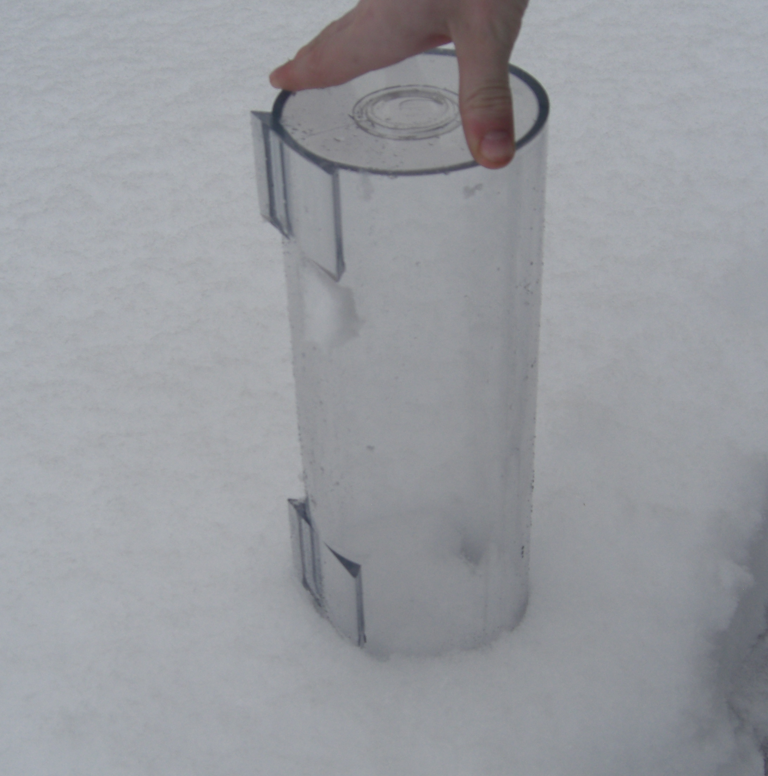
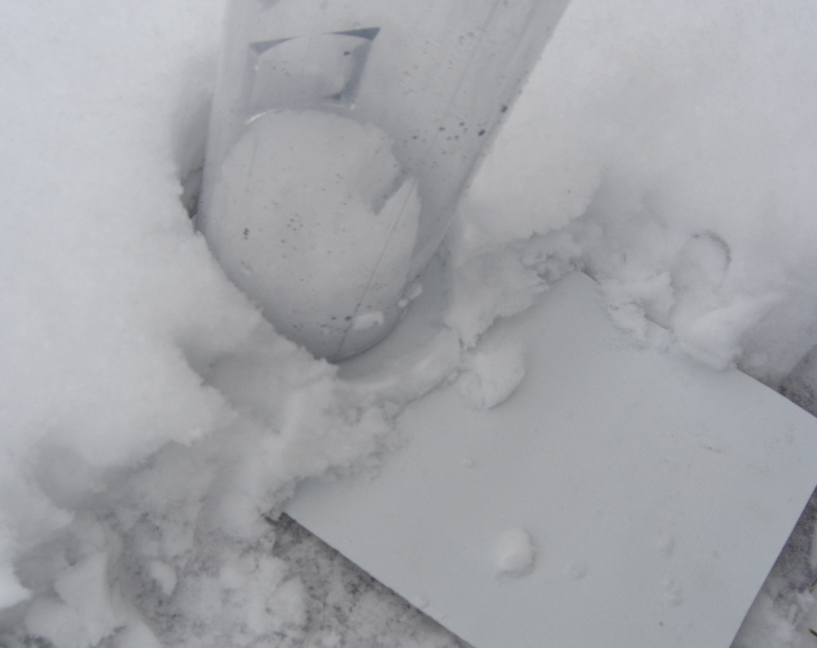
Collecting Data- New Snow and Snowpack Water Equivalent
Take the overflow tube from the rain gauge. Choose a place where the snow has not been disturbed away from the snowboard for snowpack and on the snowboard for new snow. Push the tube into the snow with the opening facing down until it touches the ground. Use a flat object placed under the tube opening to trap the snow in the tube.
Save this sample in your tube or another container, cover it, and label.
Pictures by Kevin Czajkowski

Slide 16
Clear the Snowboard
Once you have taken all of your samples, clear off the snowboard. Place a flag or other marker nearby to help you locate the snowboard after the next snowfall.
Take your labeled samples inside to melt and measure.

Slide 17
Testing For Snow Water Equivalent
Once your snow samples are indoors, allow them to melt. Be sure they are covered to prevent evaporation.
Pour the melt water from the “new snow” sample into the measuring tube of the rain gauge (you may want to use the rain gauge funnel to help).
Repeat and record the rain equivalent in millimeters to the nearest 10th of a meter.
If there is more water that can fit into the measuring tube, empty the tube, repeat steps 2 and 3 and add the amounts.
Record this and the rain equivalent on your Data Sheet and log book.
Pour melted snow water back into the sample jar.
Repeat steps 2-6 for the “snowpack” sample.
Save the liquid samples to do the pH tests.

Slide 18
What I Need to Collect pH Data
Materials | Finely ground “table” salt, salt card with 4mm and 5mm circles, stirring rod or spoon, pH paper or meter, 3 clean 100 ml beakers or cups, covered sample jar with at least 30ml of rain or melted snow, latex gloves, distilled water in wash bottle
Data Sheet | Atmosphere Integrated 1-Day Data Sheet
When | After observing snow or rain
Where | A good observation site (See Documenting your atmosphere study site)
Other | Log book for data collection; computer with internet connection to enter data

Slide 19
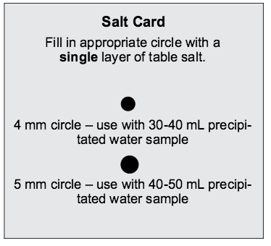
Testing for pH-1
Put on latex gloves.
Sprinkle salt onto the appropriate circle on your salt card. If your rain or snow sample is 40-50 ml, use the 5 mm circle on the salt circle. If your rain or melted snow sample is 30-40 ml, use the 4mm circle.
Fill the appropriate circle with a single layer of salt. Remove any excess salt from the salt card.
Pour the salt covering the circle on your salt card into the beaker.
Stir the beaker’s contents thoroughly with the stirring rod or spoon until the salt is dissolved.

Slide 20
Testing for pH-2
6) Follow the instructions that came with the pH paper to measure the pH of the sample. Record the pH value on your Data Sheet and in your log book.
7) If you have at least 30 ml of rain or snow left in your sample jar then repeat steps 1-7. Otherwise, repeat step 7. Continue until you have collected a total of 3 pH measurements.
8) Calculate the average of the 3 pH measurements and record on your Data Sheet.
9) Check to make sure that each measurement is within 1.0 pH unit of the average. If they are not, then repeat the measurements. If your measurements are still not within 1.0 pH unit of the average, discuss possible problems.
10) Discard used pH paper in a waste container and rinse the beakers and sample jar three times with distilled water.

Slide 21
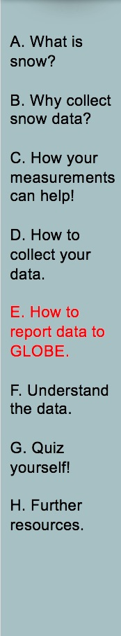

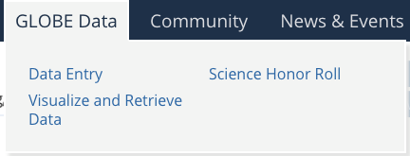
Entering Precipitation Data
You have 3 options:
Download the Data Entry app from the App Store.
Live Data Entry: These pages are for entering environmental data – collected at defined sites, according to protocol, and using approved instrumentation – for entry into the official GLOBE science database.
Email Data Entry : If connectivity is an issue, data can also be entered via email.

Slide 22
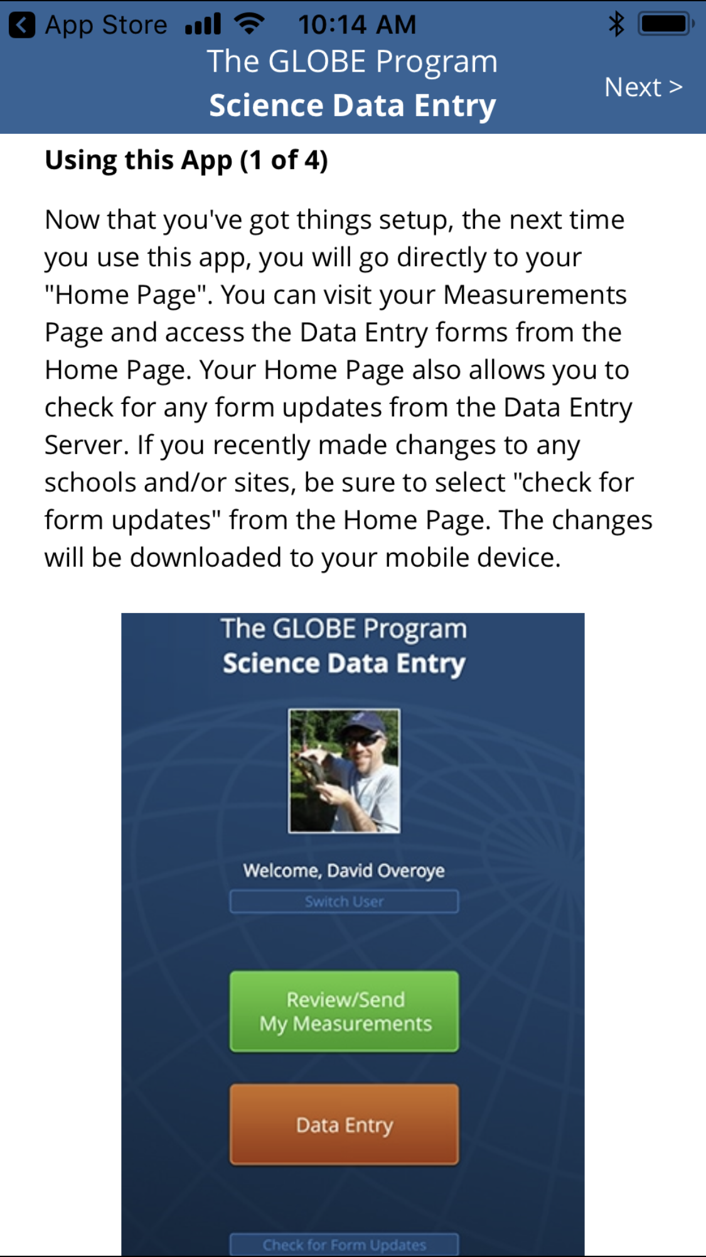
Data Entry App
After downloading the GLOBE Data Entry App, you will need to sign in with your GLOBE account.
Then, your screen will display a series of steps to use the App.

Slide 23
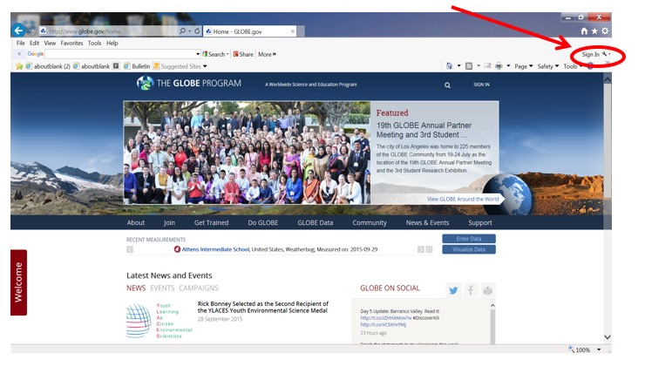
Live Data Entry-1
1) Go to the GLOBE website and press enter data

Slide 24
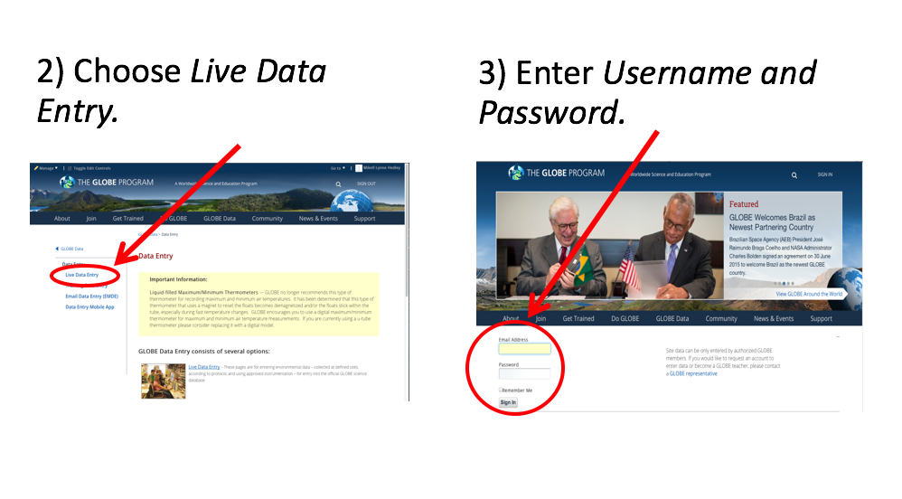
Live Data Entry - Steps 2 and 3

Slide 25
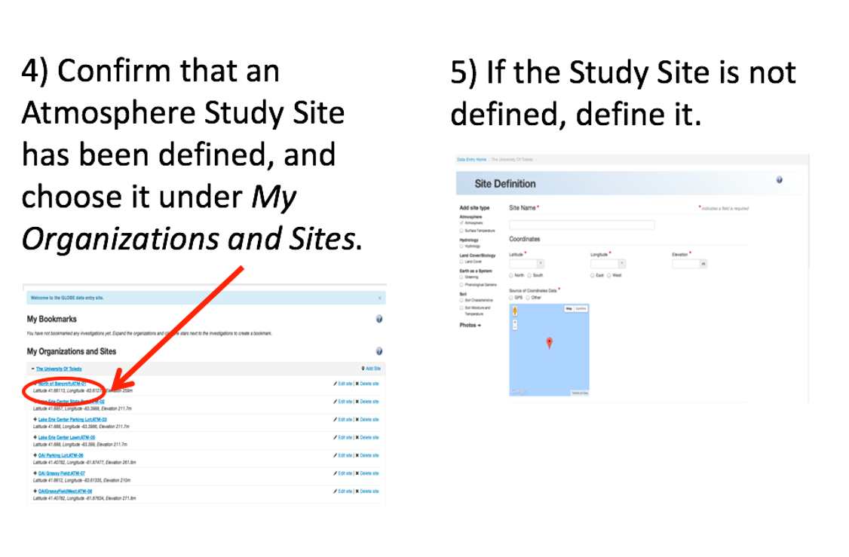
Live Data Entry - Steps 4 and 5

Slide 26
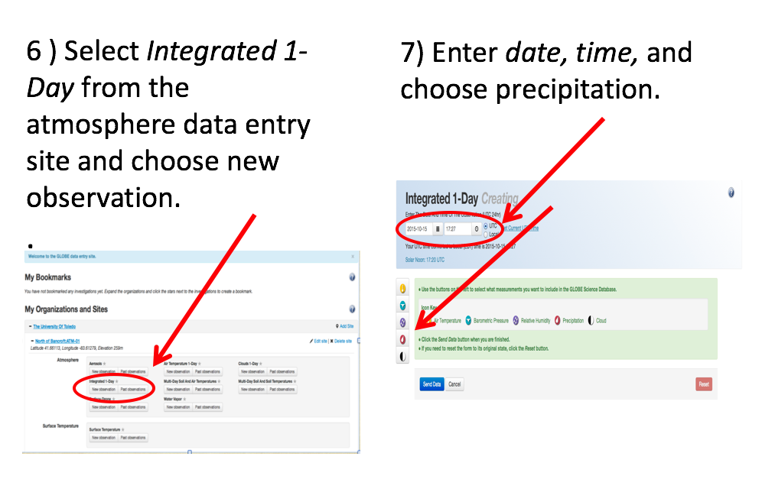
Live Data Entry - Steps 6 and 7

Slide 27
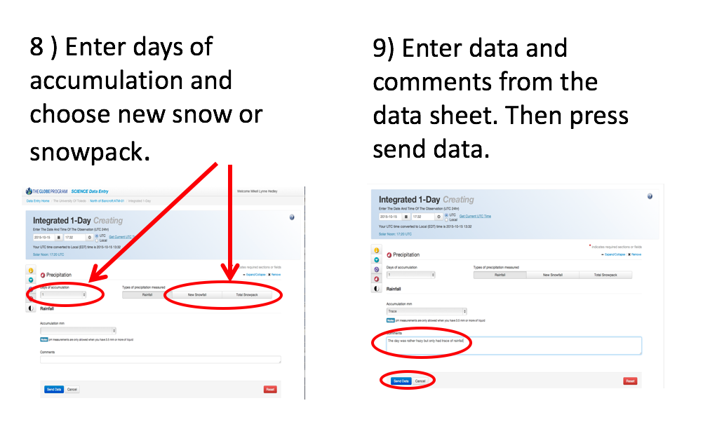
Live Data Entry - Steps 8 and 9

Slide 28
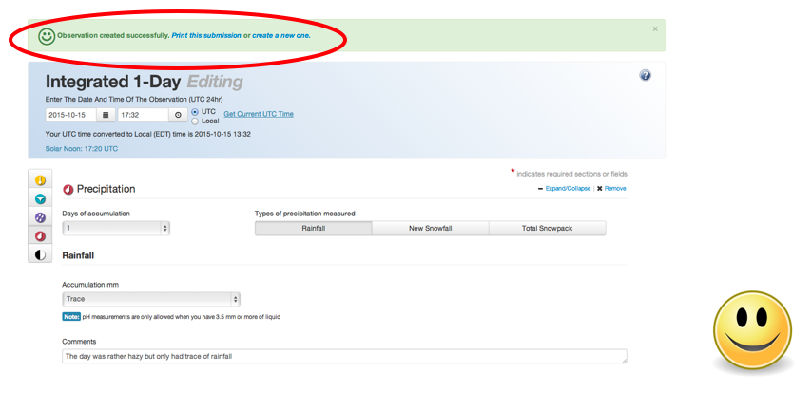
Live Data Entry - Step 10
10) If you have entered data correctly, you will get a smiley face.
.

Slide 29
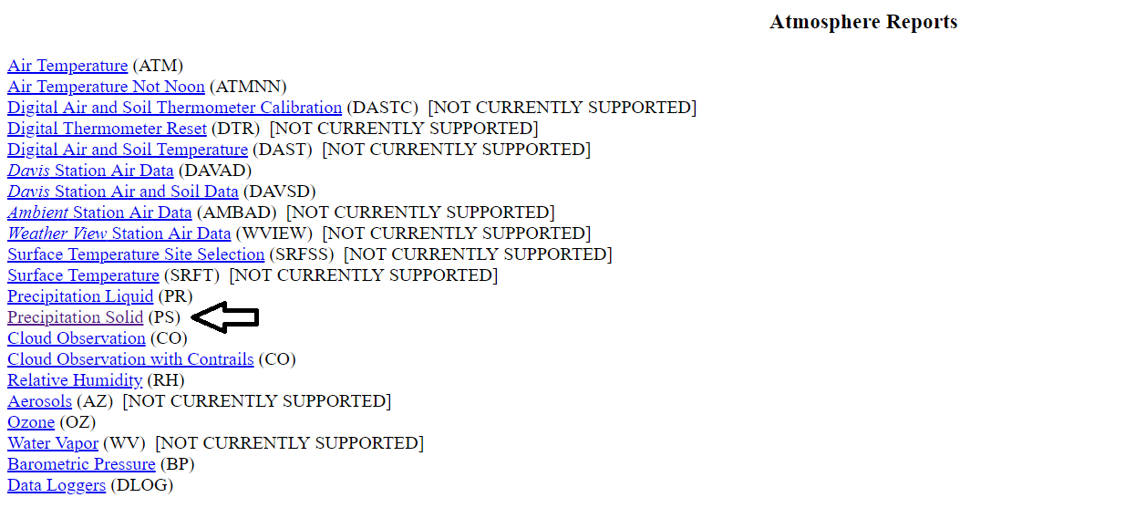
Email Data Entry
If you need to submit your data by email, select the “Precipitation Solid (PS)” data entry format, under “Atmosphere Reports”:

Slide 30
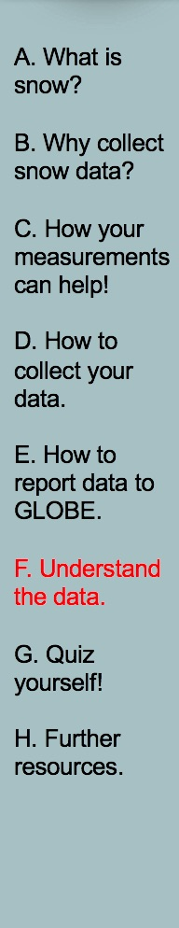
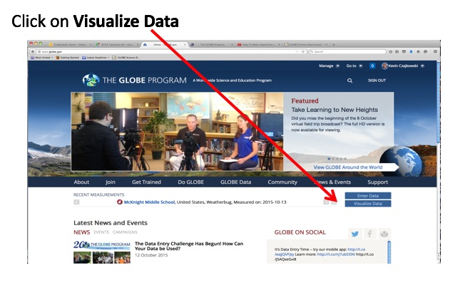
Retrieving Data from the GLOBE Visualization System-Step 1
E-training is available to explore the full power of the visualization system.

Slide 31
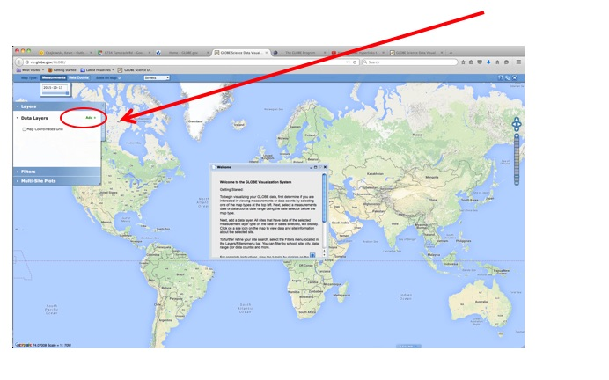
Retrieving Data from the GLOBE Visualization System- Step 2
Close the Welcome box and click on Add + to add a layer

Slide 32
Questions for YOU to Investigate
When does your area get precipitation? Why?
What would happen if you got only half the normal amount of precipitation in a given year? How would the effects vary depending on when within the year there was less precipitation?
Is the amount of precipitation you get at your school the same or different from the amount measured at the five nearest GLOBE schools? What causes these differences or similarities?
Does precipitation pH vary from storm to storm? Why?
How do the amount and timing of precipitation relate to budburst and other phenology measurements?
How do the amount and timing of precipitation in your area relate to land cover?
How does the pH of precipitation relate to soil pH and the pH of nearby water bodies?

Slide 33
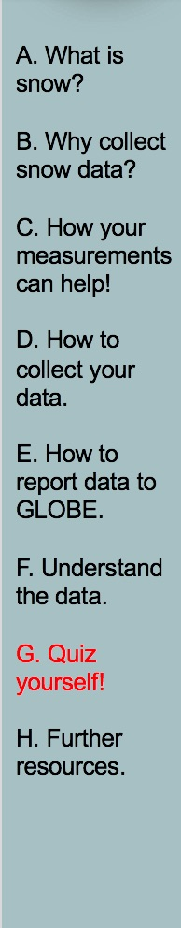
What Have Your Learned?
Name the four types of precipitation.
Why is it important to collect rain and/or snow data?
Where should you place your rain gauge?
Describe the procedure in collecting rain data.
Where should you place your snow board?
Describe the procedure to collect snow depth with your snow board.

Slide 34
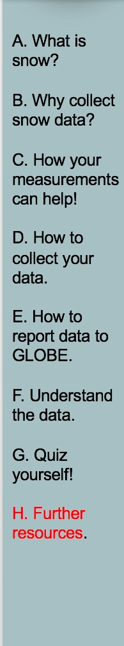
Frequently Asked Questions (FAQs) 1
Why do we have to check the rain gauge every day, even if we know it hasn’t rained?
The problem with containers like a rain gauge is that they tend to collect more than just rain. Leaves, dirt, and other debris can quickly spoil the rain gauge as a scientific instrument. This debris can block the funnel, causing rainwater to flow out of the gauge. Even if the debris isn’t large enough to block the funnel, it may become mixed in with the rainwater and affect the level of precipitation you read or the pH reading. Therefore, it is important that you check the gauge daily to make sure it is free of dust and debris.
2. What is solar noon, and how do we figure out when it is in our area?
Local solar noon is a term used by scientists to indicate the time of day when the sun has reached its highest point in the sky in your particular location. The easiest way to determine local solar noon is to find out the exact times of sunrise and sunset in your area, calculate the total number of hours of daylight between those times, divide the number of daylight hours by two, and add that number to the time of sunrise. See the examples in Solar Noon in the section on Measurement Logistics.

Slide 35
Frequently Asked Questions (FAQs) 2
3. Can we leave the overflow tube of our rain gauge out as a snow catcher?
Unfortunately, this won’t work. Snow blows around too much to get an accurate measure of its depth using a rain gauge. Plus, we need to get several measurements of snow depth and average them to get a more accurate measure of the depth of snow in a region. However, on days where the temperature will be both above and below freezing, leave the overflow tube out to catch both rain and snow. The snow on these days is usually wet and heavy and doesn’t blow as much and melts before local solar noon. You can measure the water in the overflow tube to get the rain equivalent of the snow plus any rainfall.

Slide 36
Frequently Asked Questions (FAQs) 3
4. What should we do if we are likely to get both rain and snow during certain times of year?
There are many places where transition times (from Autumn to Winter, and then from Winter to Spring) mean that temperature can fluctuate above and below freezing over relatively short times. Once there is a chance that overnight temperatures will be below freezing, bring the funnel top and measuring tube of the rain gauge indoors. Leave the overflow tube in place at your Atmosphere Study Site. The narrow measuring tube is much more likely to crack if ice forms in it after a rainfall than is the larger overflow tube. The overflow tube will be able to catch any rain or snow that falls.
In some cases, you may get a snowfall that melts before your usual measurement time. If this happens, you can’t report a new snow depth, but you can report as metadata that there was snow on the ground but it melted before a measurement was made.
Bring the measuring tube outside with you and use it to measure the amount of rain plus melted snow present in your overflow tube. If the water in your overflow tube all fell as rain, report it as rain. If the water in your overflow tube is all from snow which has melted, report it as the water equivalent of new snow, and report the new snow depth as “M” for missing and the snowpack depth on the ground as whatever value you measure (including 0.0 in many cases). If the water in your overflow tube is a mix of rain and melted snow or you don’t know which it is, report it as rain and include in your comments that the sample included or may have included melted snow.

Slide 37
Further Resources
  GLOBE Learning Activities
  My NASA Data Weather and Climate Activities
  NASA Wavelength NASA’s Digital Library of K-16 Earth and Space Education Resource
  Information on purchasing GLOBE supplies

Slide 38


Please provide us with feedback about this module. This is a community project and we welcome your comments, suggestions and edits!
Comment here: eTraining Feedback
Questions about this module? Contact GLOBE: help@globe.gov
Credits
Slide Developers:
Kevin Czajkowski
Janet Struble
Mikell Lynne Hedley
Sara Mierzwiak
Photos unless otherwise identified:
Kevin Czajkowski
Funding Provided by NASA
Version 12/1/16. If you edit and modify this slide set for use for educational purposes, please note “modified by (and your name and date) “ on this page. Thank you.

