Slide 1
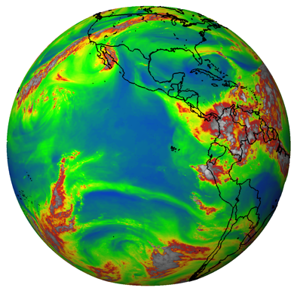
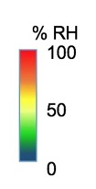
Protocol Training Slides:
Relative Humidity
Relative humidity found in our atmosphere,
as observed by satellites of the GOES project.
The gray and white regions are clouds. Image: NOAA

Slide 2
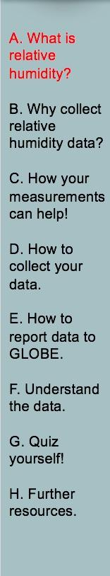
Overview and Learning Objectives
Overview
This module:
Describes relative humidity
Provides step-by-step protocol instructions for collecting relative humidity
Learning Objectives
After completing this module, you will be able to:
List some reasons to collect relative humidity
Describe how, where, and when to collect relative humidity
Upload data to the GLOBE website
Visualize data using the GLOBE Visualization Site and formulate your own questions about weather
Estimated time needed to complete this module: 1.5 hours

Slide 3

The Atmosphere
Extremely thin blanket of air extending about 300 miles from Earth’s surface to edge of space
Contains water vapor, an important part of hydrologic cycle
Image: NASA
Link to the GLOBE Atmosphere Protocols

Slide 4
Relative Humidity
Measures the amount of water vapor in the atmosphere (humidity) relative to the maximum amount of water vapor that the atmosphere could hold at the same temperature
Affects the heating and cooling of air
Warm air can hold more water vapor and the saturation point of the air is higher than for cold air
Water vapor has the strongest impact as a greenhouse gas
Specific humidity refers to the actual amount of water vapor in the air
Aerosols
Air Temperature
Albedo
Barometric Pressure
Clouds
Precipitation
Relative Humidity
Surface Ozone
Surface Temperature
Water Vapor
Wind

Slide 5
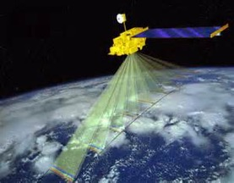
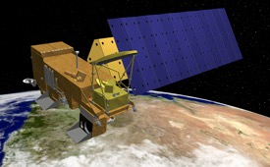
Measuring Relative Humidity
MODIS (or Moderate Resolution Imaging Spectroradiometer)
Key instrument on the Terra and Aqua Satellites
Views the entire Earth’s surface every 1 or 2 days
Helps in understanding the global dynamics and processes of the lower atmosphere over land and water
Check out the MODIS Image of the Day
NASA’s Terra satellite
NASA’s Aqua satellite

Slide 6
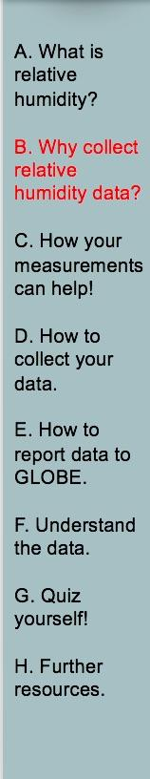
Recording Relative Humidity (RH) is important for many reasons:
Taking RH measurements helps us understand how quickly water will move from the surface of the Earth to the atmosphere and then back to Earth.
RH measurements are important in classifying an area as arid (dry), or humid (moist).
RH influences when clouds will form and when precipitation will fall.
The amount of water in the atmosphere is one of the determining factors in the weather and climate in an area.
RH affects the heating and cooling of the air.
Because of its high heat capacity, water vapor can greatly change the rate that air masses change temperature.

Slide 7
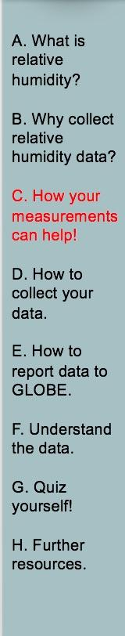
Your observations are valuable contributions to the scientific community and may be used by educators, students, researchers, and the general public to increase environmental awareness and STEM literacy, as well as advance Earth system science.

Slide 8
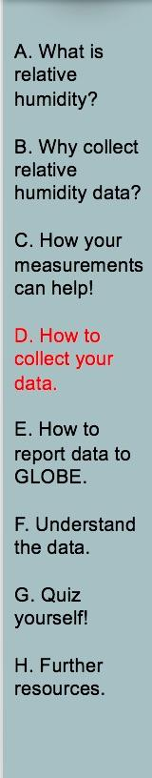
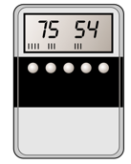
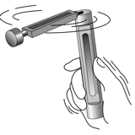
What I Need to Collect RH Data
Instruments | Digital Hygrometer or Sling Psychrometer (with chart), Calibrated Thermometer, Watch or Timer
Data Sheet | Atmosphere Investigation Data Sheet
When | Preferably within one hour of local solar noon; OK at other times
Where | A good observation site (See Documenting your atmosphere study site) at your Instrument Shelter
Other | Log book for data collection; Computer with internet connection to enter data
Digital Hygrometer
Sling Psychrometer

Slide 9
Which Instrument do I Use?
You can use either a Digital Hygrometer or a Sling Psychrometer
If the students have only a short period of time to take the measurements, use the digital hygrometer.
If you have the time, the students will probably enjoy using the sling psychrometer.
It is important to note that either instrument will give data that is equally useful to scientists, teachers and student researchers. It is the choice of the teacher and students to choose the instrument they want to use.
Digital Hygrometer
Sling Psychrometer

Slide 10
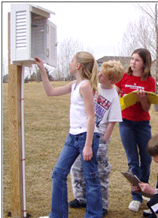
Instrument Shelter
Your hygrometer is placed in the instrument shelter for 30 minutes.
Your shelter should be located in an open area without obstructions such as trees and other buildings, and within walking distance.
Your instrument shelter should be clean both inside and out.
Installed Instrument Shelter

Slide 11
Collecting Data: Hygrometer
Preferably within an hour of local solar noon, open the instrument shelter and place the hygrometer in the instrument shelter.
After 30 minutes, record the time and date on your Atmosphere data sheet in both local and UT time. Note: GLOBE Website entry should be UT time.
Read the relative humidity to the nearest 1% and note the instrument used.
Read the current temperature (if your reading is not being taken at the same time as the daily reading of maximum, minimum, and current temperature).
Return the hygrometer to the classroom, and store it in a dry place.

Slide 12
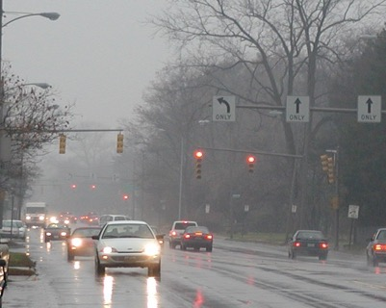
When Not to Collect Data: Hygrometer
If precipitation is occurring outside or fog is present, do not take the digital hygrometer outside. Record 100% and put “condensation occurring” in comments

Slide 13
Collecting Data: Sling Psychrometer- Steps 1-5
Stand far enough away from other people and the instrument shelter so you will not hit them with the psychrometer. Stand in the shade if possible with your back to the sun. If there is no shade near the shelter, move to a shady spot nearby, but not too close to trees or buildings.
Keep the sling psychrometer as far away as possible from your body to prevent body heat from changing the temperature readings. This is very important in cold weather. Do not touch or breathe on the temperature-sensing parts of the thermometer as this, too, may affect the reading.
Open the sling psychrometer case by pulling out the slider, which contains the two thermometers.
Wait three minutes to allow the thermometer to read the current air temperature and then read the current dry bulb temperature to 0.5 ̊ C using the thermometer with no wick attached. Make sure your eyes are level with the instrument.
Record the dry bulb temperature.

Slide 14
Collecting Data: Sling Psychrometer- Steps 6-12
Check to be sure that there is still distilled water in the reservoir, and that the wick is wet. If it is dry, add distilled water to the reservoir.
Sling the psychrometer for 3 minutes.
Let the psychrometer stop whirling on its own! Do not stop it with your hand or other object.
Read the wet bulb temperature to 0.5 ̊ C (from the thermometer with the wick attached).
Record the wet bulb temperature.
Determine the relative humidity using a psychrometric chart or the sliding scale found on the cases of some psychrometers. You may also leave this blank as GLOBE can calculate relative humidity from your wet and dry bulb temperatures.
When you are done with the instrument, close it up and return it to the shelter properly.

Slide 15
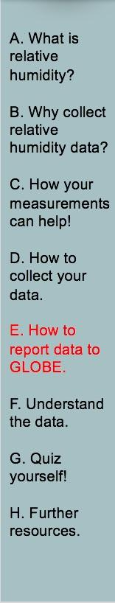

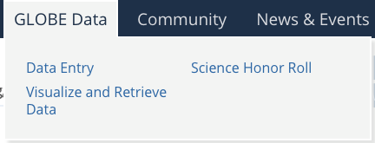
GLOBE Program Science Data Entry
You have 3 options:
Download the Data Entry app from the App Store.
Live Data Entry: These pages are for entering environmental data – collected at defined sites, according to protocol, and using approved instrumentation – for entry into the official GLOBE science database.
Email Data Entry – If connectivity is an issue, data can also be entered via email.

Slide 16
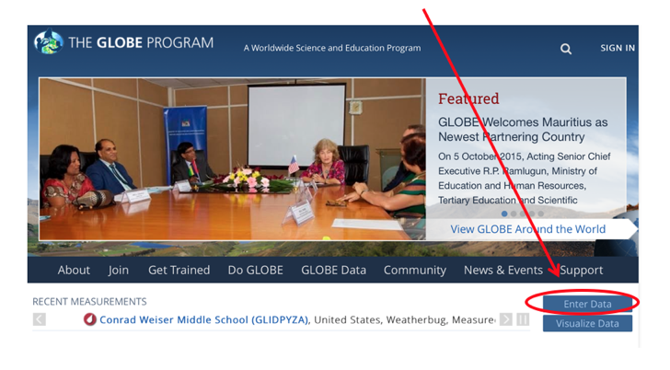
Entering Relative Humidity Data- Step 1
1) Go to GLOBE.gov and press enter data.

Slide 17
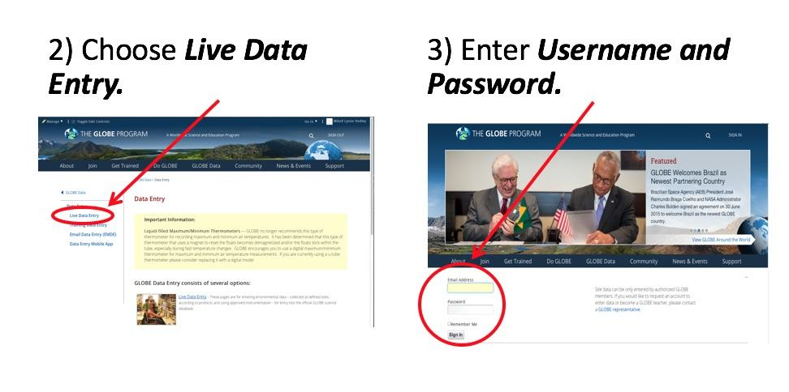
Entering Relative Humidity Data- Steps 2 & 3

Slide 18
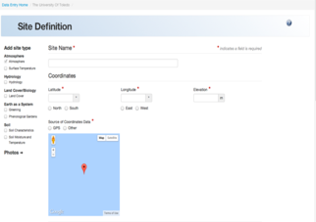
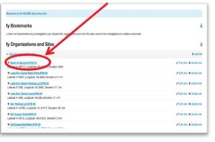
Entering Relative Humidity Data- Steps 4 & 5
4) Confirm that an Atmosphere Study Site has been defined, and choose it under My Organizations and Sites list.
5) If the Study Site is not defined, define it.

Slide 19
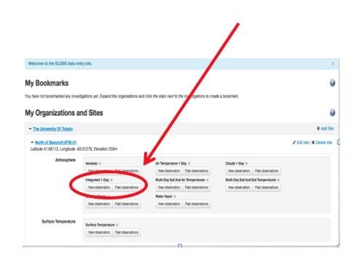
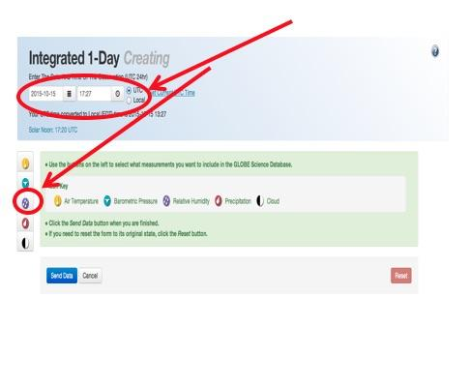
Entering Relative Humidity Data- Steps 6 & 7
6 ) Select Integrated 1-Day from the atmosphere data entry site and choose new observation.
7) Enter Date, local or UTC time, and choose relative humidity.

Slide 20
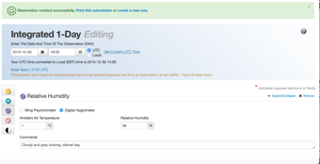
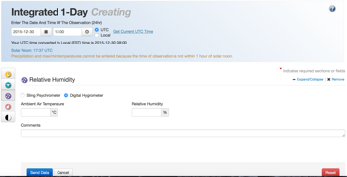

Entering Relative Humidity Data- Steps 8 & 9
8) Choose the method of observation (sling psychrometer or digital hydrometer) – enter dry bulb and wet bulb for sling psychrometer and ambient air temperature and RH% for digital hydrometer.
9) If you have entered data correctly, you will get a smiley face.

Slide 21
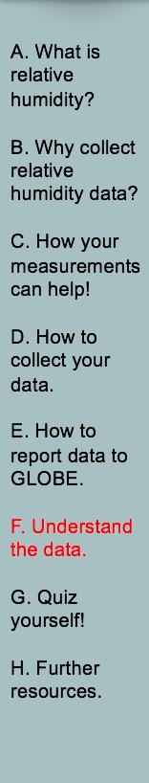
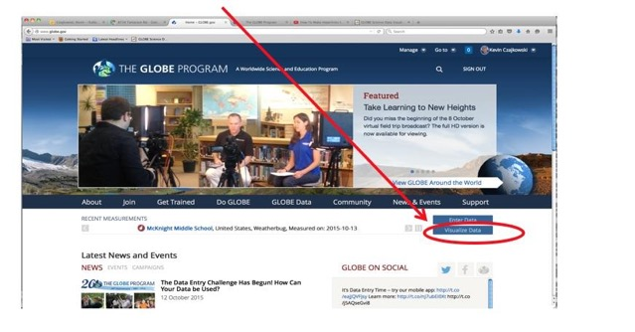
Retrieving Data from the GLOBE Visualization System
Click on Visualize Data
E-training is available to explore the full power of the visualization system.

Slide 22
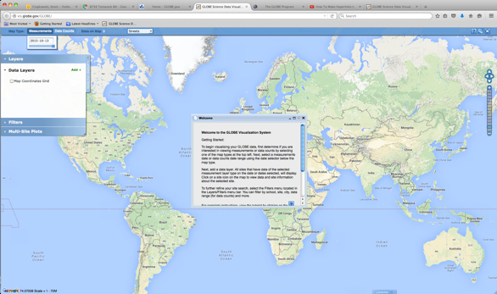
Viewing data on the map on the GLOBE Visualization System
Close the Welcome box and click on
Add + to add a layer

Slide 23
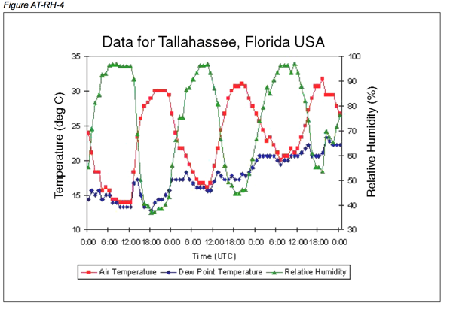
Understanding the Data
This graphic from the GLOBE database shows the relationship between air temperature and relative humidity for Tallahassee, FL. Note that as air temperature goes up throughout the day, relative humidity goes down and the opposite occurs in the evening.

Slide 24
Questions for YOU to Investigate
How are your relative humidity observations related to air temperature?
Can you find other GLOBE sites at your latitude which are closer to or further from large bodies of water? Do you see any systematic differences in relative humidity between your location and the others?
Does relative humidity affect any non-atmosphere parts of your local environment? How?
At what time of day will relative humidity normally be at a maximum? minimum?
Are your relative humidity and phenology measurements related?

Slide 25
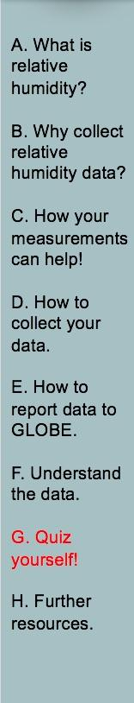
What have you learned?
What is relative humidity?
Why is it important to collect relative humidity data?
What instruments can you use to collect relative humidity?
Where should you place your instrument?
When should you take your measurements?
What data sheet will you use?
Describe the procedure in collecting relative humidity.
How do you enter data on the GLOBE website?
What are some questions you could use to investigate relative humidity in the visualization part of GLOBE?
What data layer would you need to add?

Slide 26
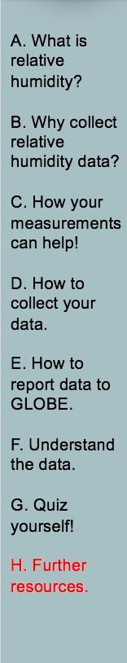
Frequently Asked Questions (FAQs) 1
1. Why do you have two different methods of measuring relative humidity?
Two methods are used to try to provide an incentive for the teacher and student to make a determination about how much time is desired taking the observations. One is more complex (and fun) than the other. Observations from either method are equally valuable to the GLOBE program and scientists, in general.
2. Why do we need to take the hygrometer inside each day, and bring
it out to the weather shelter 30 minutes before we make our local solar noon observations?
The sensitive electronics inside the hygrometer cannot be exposed to condensation for long periods of time, so it is best to avoid all situations when condensation may be expected. If fog or persistent rainfall is occurring at the time of observation, it is best not to take the hygrometer outside; rather, the observer should report a relative humidity of 100%, but also should make a comment in the metadata that the observation was inferred based on visible condensation in the air (rain or fog).

Slide 27
Frequently Asked Questions (FAQs) 2
3. I see the definitions for wet-bulb and dry-bulb temperature; what is the dew point temperature?
The dew point temperature is the temperature to which air must be cooled to achieve saturation (relative humidity = 100%) given its current water content. Dew point is a measure of the actual water vapor content. On calm clear days followed by calm clear nights, the temperature will fall rapidly towards the dew point. Unless dew forms, if the air temperature reaches the dew point temperature, fog may form. Once dew or fog forms, the dew point temperature will fall, because there is less water vapor in the air.
4. Why can’t we use the sling psychrometer below freezing?
The relationship between evaporation rate and temperature is more complicated below freezing than above freezing, so the sling psychrometer will not be as practical. More expensive models that have greater ranges are available, but are beyond the reach of the expected school budgets for instruments. We recommend the use of a hygrometer for locations that have frequent temperatures below freezing.

Slide 28
Frequently Asked Questions (FAQs) 3
5. How accurate are these relative humidity readings, compared to those that might be taken with more expensive instruments?
The hygrometer will report relative humidity with an accuracy range of 2-4%, within the desired 5% figure. The sling psychrometer reports temperature to within an accuracy of approximately 0.5 ̊ C; provided the calibration on the thermometers is maintained, this also ensures accuracy better than 5% over the most common range of values of relative humidity, between 20-95%.
6. The reservoir on the left side of the instrument (holding the wick) is either broken or cracked (nearly broken); is there a way to still use it?
Yes. The plastic reservoir end cap that holds the wick inside can become weak. The instrument is still useable; however some simple repairs or precautionary effort must be done. Taping a piece of cardboard on the end will usually hold the wick inside and not affect the readings.
7. Is there a special way that we should store our sling psychrometer?
In order to prevent the liquid separating in the thermometers, it is suggested that you store the sling psychrometer in a jar or other receptacle so that the thermometers are resting with the lower temperatures at the bottom.

Slide 29
Further Resources
  Video: How to use a sling psychrometer
  Sling Psychrometer Chart
  GLOBE Learning Activities
  My NASA Data
  NASA Wavelength NASA’s Digital Library of K-16 Earth and Space Education Resources
  For information on purchasing GLOBE supplies go to:
  Equipment suppliers

Slide 30


We want your Feedback!
Please provide us with feedback about this module. This is a community project and we welcome your comments, suggestions and edits!
Comment here: eTraining Feedback
Questions about module? Contact GLOBE: help@nasaglobe.org
Credits
Power point Developers:
Kevin Czajkowski
Janet Struble
Mikell Lynne Hedley
Sara Mierzwiak
Photos unless otherwise identified:
Kevin Czajkowski
Funding Provided by NASA
Version 5-13-20. If you edit and modify this slide set for use for educational purposes, please note “modified by (and your name and date)“ on this page. Thank you.

