Slide 1
Protocol Training Slides for Surface Temperature
Photo credit: Kevin Czajkowski

Slide 2
Overview and Learning Objectives
Overview
This module:
Describes how to take surface temperature measurements
Provides instructions on how to enter your data on the GLOBE website
Learning Objectives
After completing this module, you will be able to:
Describe and define surface temperature
List reasons why it is important to collect surface temperature data
Determine the correct locations to take surface temperature readings
Upload data to the GLOBE website
Visualize data using GLOBE and formulate your own questions about weather
Estimated time needed for completion of this module: 1.5 hours

Slide 3
The Atmosphere
Extremely thin blanket of air extending about 300 miles from Earth’s surface to edge of space
Protects us from the blasts of heat and radiation coming from the Sun
Image: NASA
Link to GLOBE Teacher’s Guide Atmosphere Protocol

Slide 4
Surface Temperature
Is the radiating temperature emitted as electromagnetic energy of the Earth’s surface including vegetation, paved surfaces, and the ground, etc.
Varies depending on the ground cover and the time of day
Affects all aspects of the Earth’s Energy Budget
Aerosols
Air Temperature
Albedo
Barometric Pressure
Clouds
Precipitation
Relative Humidity
Surface Ozone
Surface Temperature
Water Vapor
Wind

Slide 5
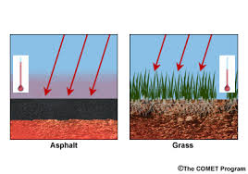
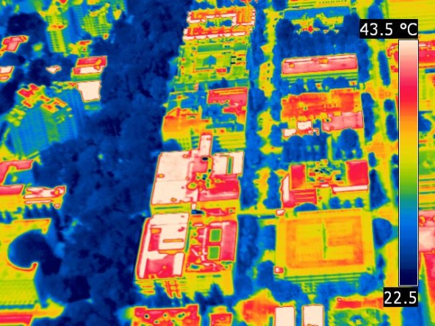
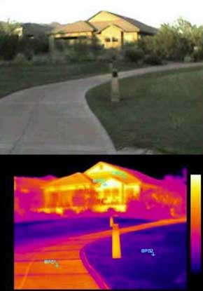
Surface temperature is the temperature at the Earth’s surface, including the land, water and structures
Not all surfaces have the same temperature!

Slide 6
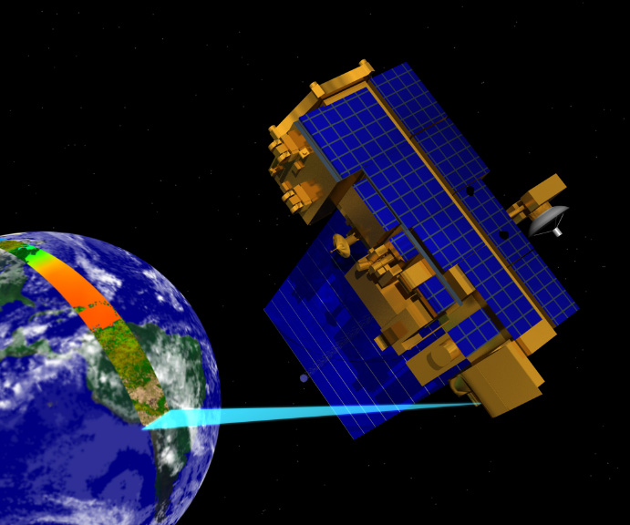
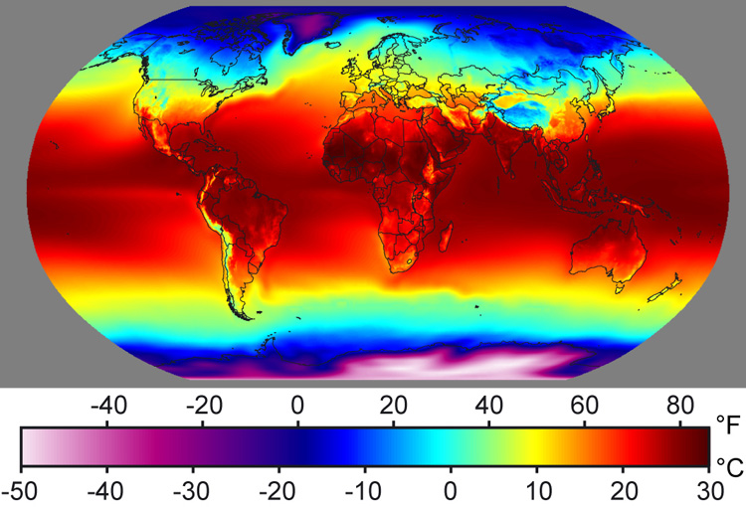
Recording surface temperature is important-1
1. To help verify surface temperature readings collected by NASA satellites.
Image: Windows to the Universe
Image: NASA
Find out more about NASA’s MODIS Imagery
Image: Kevn Czajkowski

Slide 7
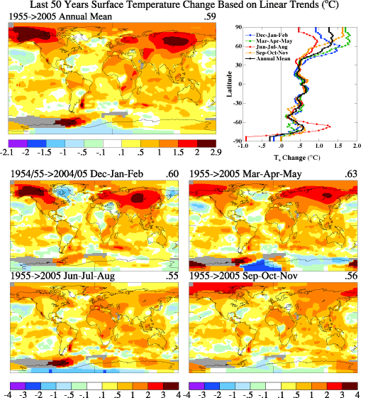
Recording surface temperature is important-2
2. To help understand seasonal changes in Earth’s surface.
Image: NASA GISS

Slide 8
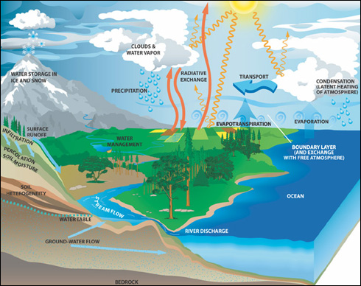
Recording surface temperature is important-3
3. To help understand the rate of heat and moisture exchange between the atmosphere and Earth.
Image: NASA

Slide 9
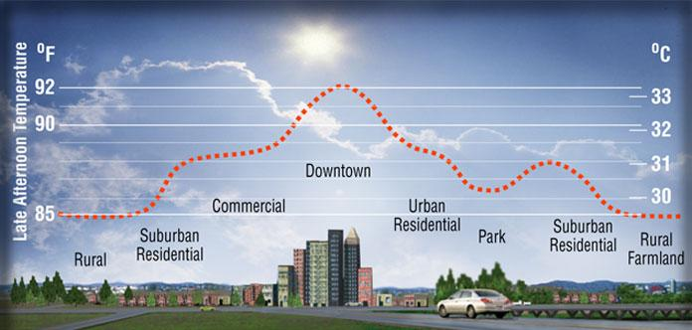
Recording surface temperature is important-4
4. To assist in urban planning and to help understand the Urban Heat Island Effect.

Slide 10
YOUR measurements can help NASA scientists to understand and predict
How do urban areas affect the temperature around them?
What is the contribution of changing land use and land cover on local energy budgets?
How are land surface temperatures changing over the long-term?
How accurate are data from NASA satellites?

Slide 11
What you need to collect data:
Instruments | Your eyes, GPS unit, Infrared Thermometer, Meter Stick
References | GLOBE cloud chart
When | Good: Any time Better: Within one hour of local solar noon Best: Within +/- 15 minutes of a satellite overpass
Where | A good observation site (See Documenting your atmosphere study site)
Form | Surface Temperature Data Sheet

Slide 12
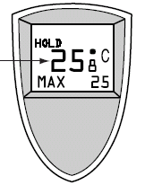
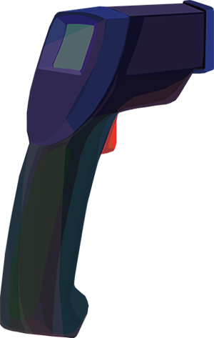
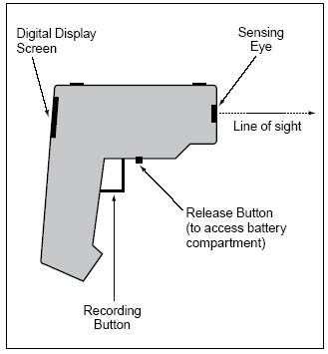
Instrument: Infrared Thermometer
Measures infrared (heat) radiation emanating from a surface and converts it to temperature.
Surface temperature can be observed by sensing the infrared part of the electromagnetic spectrum.

Slide 13
Infrared Thermometer Specifications
Accuracy: ±2 °C
Range: make sure that the instrument’s temperature range is large enough to capture the variations in your area.
Where do I get one?
Handheld infrared thermometers can be purchased from a number of stores and online retailers. Prices range from $25-$300 USD
Maintenance of instrument:
-proper cleaning of lenses is important since accumulated particles on the lens can reduce the accuracy
-do not use solvents to clean the lens

Slide 14
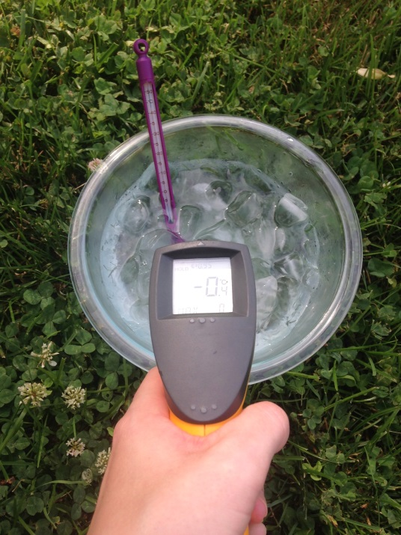
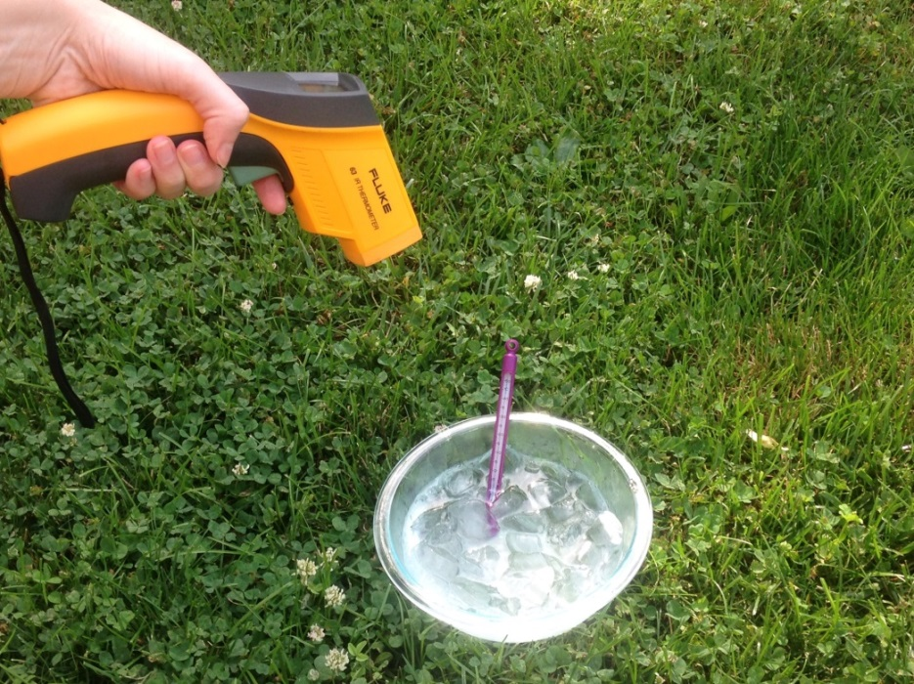
Calibrate your Infrared Thermometer
Calibrate once per year to ensure proper performance!
Calibrate with an ice water bath. Wait until the water reaches 0° C, then see if the infrared thermometer shows a similar reading.
If the temperature observed is more than +2° C or less than -2° C, try changing the battery. If the calibration still is off, the IRT needs to be replaced.
Photo credit: Sara Mierzwiak
Photo credit: Sara Mierzwiak
Notes:
Calibrate with bucket of ice water
-point IRT perpendicular to water surface about 5 cm away
-reading should be within –2° C to +2° C
The IRT sensor is susceptible to large differences in air temperature. If you enclose the IRT in the adapted oven mitt (thermal glove), this will ensure the IRT stays insulated and will provide accurate readings.
Some IRT units are equipped with a laser that will shine from the front of the thermometer along the approximate line of sight, causing a red dot to appear where the surface temperature is measured. Make sure students do not aim this laser beam directly at eyes or off surfaces that could reflect in someone’s eyes.
Wrap your IRT in the Thermal Glove when the air temperature at your study site varies more than 5 degrees Celsius from the air temperature of where the IRT has been stored. The IRT with the thermal glove has been tested to work for 30 minutes. The thermal glove is made from a standard oven mitt. The oven mitt used to make the thermal glove MUST be constructed of 100% terry cloth; inside and outside. An actual-size pattern of the thermal glove with hole designations for the IRT’s sensing eye and digital display screen is shown in the Surface Temperature Protocol section of the 2003 Teacher’s Guide.

Slide 15
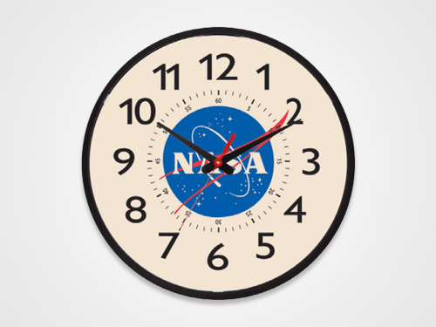
Collecting Data using an Infrared Thermometer
HOW?
Hold your arm at arms length and point the instrument at the ground. After you pull the trigger then read the value including the tenths of a degree Celsius.
WHEN?
Surface temperature measurements can be taken any time during the day.
Photo credit: Kevin Czajkowski
Notes:
Calibrate with bucket of ice water
-point IRT perpendicular to water surface about 5 cm away
-reading should be within –2° C to +2° C
The IRT sensor is susceptible to large differences in air temperature. If you enclose the IRT in the adapted oven mitt (thermal glove), this will ensure the IRT stays insulated and will provide accurate readings.
Some IRT units are equipped with a laser that will shine from the front of the thermometer along the approximate line of sight, causing a red dot to appear where the surface temperature is measured. Make sure students do not aim this laser beam directly at eyes or off surfaces that could reflect in someone’s eyes.
Wrap your IRT in the Thermal Glove when the air temperature at your study site varies more than 5 degrees Celsius from the air temperature of where the IRT has been stored. The IRT with the thermal glove has been tested to work for 30 minutes. The thermal glove is made from a standard oven mitt. The oven mitt used to make the thermal glove MUST be constructed of 100% terry cloth; inside and outside. An actual-size pattern of the thermal glove with hole designations for the IRT’s sensing eye and digital display screen is shown in the Surface Temperature Protocol section of the 2003 Teacher’s Guide.

Slide 16
Data Collection: Overview
Choose a site that is homogenous at least 30 meters square (if possible). Can be grass, asphalt, etc.
Collect GPS data for the center of the site (latitude, longitude and elevation).
Pick nine random observation spots in the study site:
Read and record surface temperature
Record the time
Measure and record snow depth (if present)
Use the Cloud Protocol to record cloud observations.
Record your data on the Surface Temperature Data sheet.
Log into the GLOBE website .
Create a Surface Temperature site.
Go back to Data Entry, select the new Surface Temperature site you just created, and enter your data.
Notes:
Calibrate with bucket of ice water
-point IRT perpendicular to water surface about 5 cm away
-reading should be within –2° C to +2° C
The IRT sensor is susceptible to large differences in air temperature. If you enclose the IRT in the adapted oven mitt (thermal glove), this will ensure the IRT stays insulated and will provide accurate readings.
Some IRT units are equipped with a laser that will shine from the front of the thermometer along the approximate line of sight, causing a red dot to appear where the surface temperature is measured. Make sure students do not aim this laser beam directly at eyes or off surfaces that could reflect in someone’s eyes.
Wrap your IRT in the Thermal Glove when the air temperature at your study site varies more than 5 degrees Celsius from the air temperature of where the IRT has been stored. The IRT with the thermal glove has been tested to work for 30 minutes. The thermal glove is made from a standard oven mitt. The oven mitt used to make the thermal glove MUST be constructed of 100% terry cloth; inside and outside. An actual-size pattern of the thermal glove with hole designations for the IRT’s sensing eye and digital display screen is shown in the Surface Temperature Protocol section of the 2003 Teacher’s Guide.

Slide 17
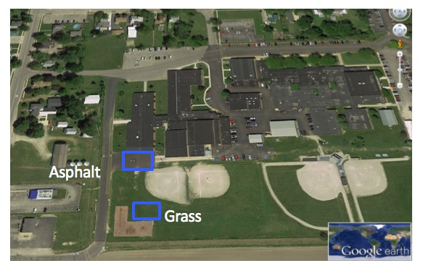
1. Choose homogenous study areas.
Choose study areas that are as large as possible and that have homogeneous cover. If the only area you have is smaller, take observations there and measure the size of the area. At this school, students took surface temperature observations on the asphalt and the nearby grassy outfield of a softball field.
Notes:
Calibrate with bucket of ice water
-point IRT perpendicular to water surface about 5 cm away
-reading should be within –2° C to +2° C
The IRT sensor is susceptible to large differences in air temperature. If you enclose the IRT in the adapted oven mitt (thermal glove), this will ensure the IRT stays insulated and will provide accurate readings.
Some IRT units are equipped with a laser that will shine from the front of the thermometer along the approximate line of sight, causing a red dot to appear where the surface temperature is measured. Make sure students do not aim this laser beam directly at eyes or off surfaces that could reflect in someone’s eyes.
Wrap your IRT in the Thermal Glove when the air temperature at your study site varies more than 5 degrees Celsius from the air temperature of where the IRT has been stored. The IRT with the thermal glove has been tested to work for 30 minutes. The thermal glove is made from a standard oven mitt. The oven mitt used to make the thermal glove MUST be constructed of 100% terry cloth; inside and outside. An actual-size pattern of the thermal glove with hole designations for the IRT’s sensing eye and digital display screen is shown in the Surface Temperature Protocol section of the 2003 Teacher’s Guide.

Slide 18
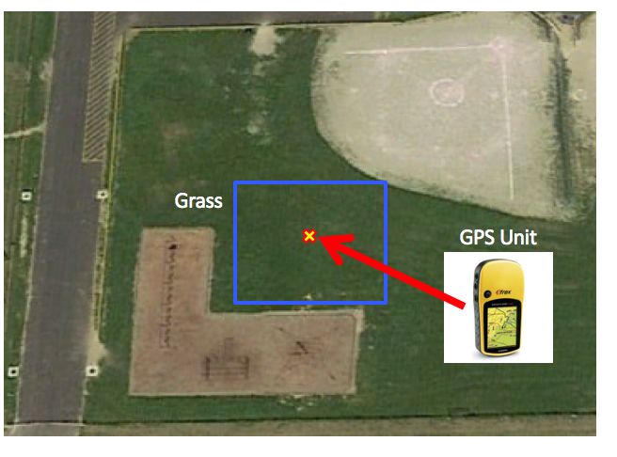
2. Collect GPS data of the center of each study area.
Record latitude, longitude and elevation.
GPS Protocol
Notes:
Calibrate with bucket of ice water
-point IRT perpendicular to water surface about 5 cm away
-reading should be within –2° C to +2° C
The IRT sensor is susceptible to large differences in air temperature. If you enclose the IRT in the adapted oven mitt (thermal glove), this will ensure the IRT stays insulated and will provide accurate readings.
Some IRT units are equipped with a laser that will shine from the front of the thermometer along the approximate line of sight, causing a red dot to appear where the surface temperature is measured. Make sure students do not aim this laser beam directly at eyes or off surfaces that could reflect in someone’s eyes.
Wrap your IRT in the Thermal Glove when the air temperature at your study site varies more than 5 degrees Celsius from the air temperature of where the IRT has been stored. The IRT with the thermal glove has been tested to work for 30 minutes. The thermal glove is made from a standard oven mitt. The oven mitt used to make the thermal glove MUST be constructed of 100% terry cloth; inside and outside. An actual-size pattern of the thermal glove with hole designations for the IRT’s sensing eye and digital display screen is shown in the Surface Temperature Protocol section of the 2003 Teacher’s Guide.

Slide 19
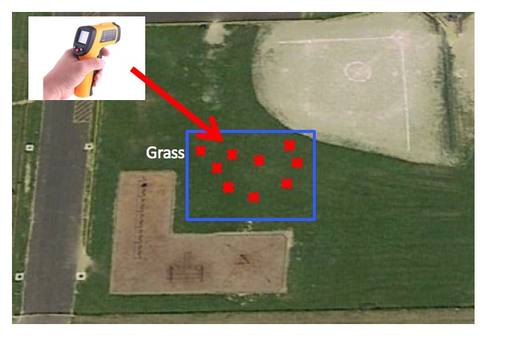
3. Take 9 random surface temperature readings
Take 9 random surface temperature readings within each study area. The 9 random observations ensure a good average for the site is observed.
Notes:
Calibrate with bucket of ice water
-point IRT perpendicular to water surface about 5 cm away
-reading should be within –2° C to +2° C
The IRT sensor is susceptible to large differences in air temperature. If you enclose the IRT in the adapted oven mitt (thermal glove), this will ensure the IRT stays insulated and will provide accurate readings.
Some IRT units are equipped with a laser that will shine from the front of the thermometer along the approximate line of sight, causing a red dot to appear where the surface temperature is measured. Make sure students do not aim this laser beam directly at eyes or off surfaces that could reflect in someone’s eyes.
Wrap your IRT in the Thermal Glove when the air temperature at your study site varies more than 5 degrees Celsius from the air temperature of where the IRT has been stored. The IRT with the thermal glove has been tested to work for 30 minutes. The thermal glove is made from a standard oven mitt. The oven mitt used to make the thermal glove MUST be constructed of 100% terry cloth; inside and outside. An actual-size pattern of the thermal glove with hole designations for the IRT’s sensing eye and digital display screen is shown in the Surface Temperature Protocol section of the 2003 Teacher’s Guide.

Slide 20
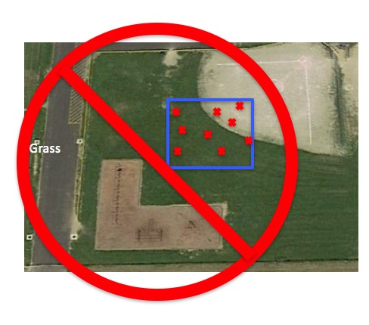
Caution!
Do not mix cover types in one study area.
In this case, the study area mistakenly has grass and bare ground.
.
Notes:
Calibrate with bucket of ice water
-point IRT perpendicular to water surface about 5 cm away
-reading should be within –2° C to +2° C
The IRT sensor is susceptible to large differences in air temperature. If you enclose the IRT in the adapted oven mitt (thermal glove), this will ensure the IRT stays insulated and will provide accurate readings.
Some IRT units are equipped with a laser that will shine from the front of the thermometer along the approximate line of sight, causing a red dot to appear where the surface temperature is measured. Make sure students do not aim this laser beam directly at eyes or off surfaces that could reflect in someone’s eyes.
Wrap your IRT in the Thermal Glove when the air temperature at your study site varies more than 5 degrees Celsius from the air temperature of where the IRT has been stored. The IRT with the thermal glove has been tested to work for 30 minutes. The thermal glove is made from a standard oven mitt. The oven mitt used to make the thermal glove MUST be constructed of 100% terry cloth; inside and outside. An actual-size pattern of the thermal glove with hole designations for the IRT’s sensing eye and digital display screen is shown in the Surface Temperature Protocol section of the 2003 Teacher’s Guide.

Slide 21
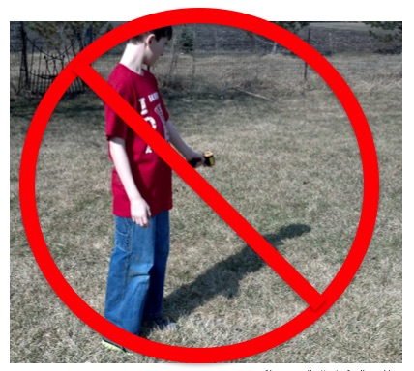
Caution! 1
Do not take the temperature of shadowed areas including the shadow that your body may cast.
Notes:
Calibrate with bucket of ice water
-point IRT perpendicular to water surface about 5 cm away
-reading should be within –2° C to +2° C
The IRT sensor is susceptible to large differences in air temperature. If you enclose the IRT in the adapted oven mitt (thermal glove), this will ensure the IRT stays insulated and will provide accurate readings.
Some IRT units are equipped with a laser that will shine from the front of the thermometer along the approximate line of sight, causing a red dot to appear where the surface temperature is measured. Make sure students do not aim this laser beam directly at eyes or off surfaces that could reflect in someone’s eyes.
Wrap your IRT in the Thermal Glove when the air temperature at your study site varies more than 5 degrees Celsius from the air temperature of where the IRT has been stored. The IRT with the thermal glove has been tested to work for 30 minutes. The thermal glove is made from a standard oven mitt. The oven mitt used to make the thermal glove MUST be constructed of 100% terry cloth; inside and outside. An actual-size pattern of the thermal glove with hole designations for the IRT’s sensing eye and digital display screen is shown in the Surface Temperature Protocol section of the 2003 Teacher’s Guide.

Slide 22
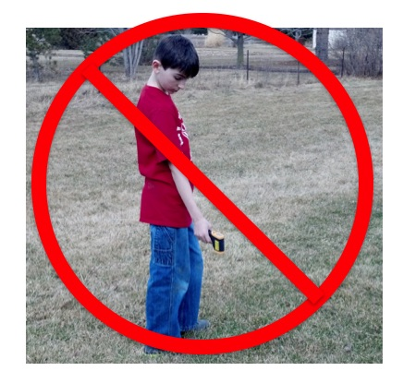
Caution! 2
Extend your arm in front of you to take the observations. You don’t want to measure the temperature of your feet.
.
Notes:
Calibrate with bucket of ice water
-point IRT perpendicular to water surface about 5 cm away
-reading should be within –2° C to +2° C
The IRT sensor is susceptible to large differences in air temperature. If you enclose the IRT in the adapted oven mitt (thermal glove), this will ensure the IRT stays insulated and will provide accurate readings.
Some IRT units are equipped with a laser that will shine from the front of the thermometer along the approximate line of sight, causing a red dot to appear where the surface temperature is measured. Make sure students do not aim this laser beam directly at eyes or off surfaces that could reflect in someone’s eyes.
Wrap your IRT in the Thermal Glove when the air temperature at your study site varies more than 5 degrees Celsius from the air temperature of where the IRT has been stored. The IRT with the thermal glove has been tested to work for 30 minutes. The thermal glove is made from a standard oven mitt. The oven mitt used to make the thermal glove MUST be constructed of 100% terry cloth; inside and outside. An actual-size pattern of the thermal glove with hole designations for the IRT’s sensing eye and digital display screen is shown in the Surface Temperature Protocol section of the 2003 Teacher’s Guide.

Slide 23
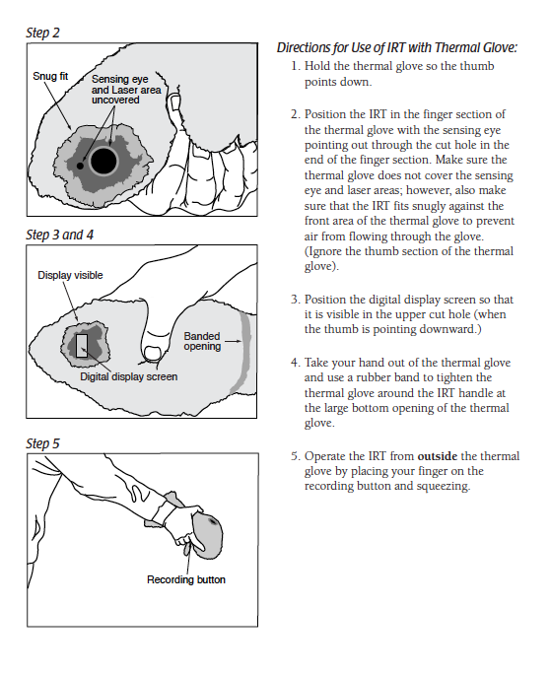
Caution! Thermal Shock
When the air temperature at your study site varies more than 5° C from the air temperature of the storage location of the IRT, place the IRT outdoors for at least 60 minutes prior to data collection.
Or, you can make a thermal glove using a terry cloth oven mitt.
Notes:
Calibrate with bucket of ice water
-point IRT perpendicular to water surface about 5 cm away
-reading should be within –2° C to +2° C
The IRT sensor is susceptible to large differences in air temperature. If you enclose the IRT in the adapted oven mitt (thermal glove), this will ensure the IRT stays insulated and will provide accurate readings.
Some IRT units are equipped with a laser that will shine from the front of the thermometer along the approximate line of sight, causing a red dot to appear where the surface temperature is measured. Make sure students do not aim this laser beam directly at eyes or off surfaces that could reflect in someone’s eyes.
Wrap your IRT in the Thermal Glove when the air temperature at your study site varies more than 5 degrees Celsius from the air temperature of where the IRT has been stored. The IRT with the thermal glove has been tested to work for 30 minutes. The thermal glove is made from a standard oven mitt. The oven mitt used to make the thermal glove MUST be constructed of 100% terry cloth; inside and outside. An actual-size pattern of the thermal glove with hole designations for the IRT’s sensing eye and digital display screen is shown in the Surface Temperature Protocol section of the 2003 Teacher’s Guide.

Slide 24
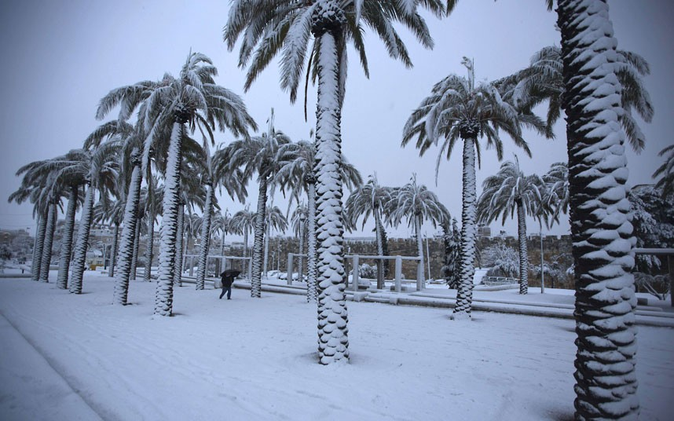
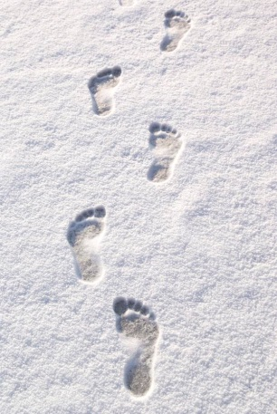
Measuring Surface Temperature in Snow
What if there is snow? Just measure the snow depth for each of the 9 observation locations, and then collect your surface temperature readings.
Your footprints will affect the snow but that is ok.
.
Notes:
Calibrate with bucket of ice water
-point IRT perpendicular to water surface about 5 cm away
-reading should be within –2° C to +2° C
The IRT sensor is susceptible to large differences in air temperature. If you enclose the IRT in the adapted oven mitt (thermal glove), this will ensure the IRT stays insulated and will provide accurate readings.
Some IRT units are equipped with a laser that will shine from the front of the thermometer along the approximate line of sight, causing a red dot to appear where the surface temperature is measured. Make sure students do not aim this laser beam directly at eyes or off surfaces that could reflect in someone’s eyes.
Wrap your IRT in the Thermal Glove when the air temperature at your study site varies more than 5 degrees Celsius from the air temperature of where the IRT has been stored. The IRT with the thermal glove has been tested to work for 30 minutes. The thermal glove is made from a standard oven mitt. The oven mitt used to make the thermal glove MUST be constructed of 100% terry cloth; inside and outside. An actual-size pattern of the thermal glove with hole designations for the IRT’s sensing eye and digital display screen is shown in the Surface Temperature Protocol section of the 2003 Teacher’s Guide.

Slide 25
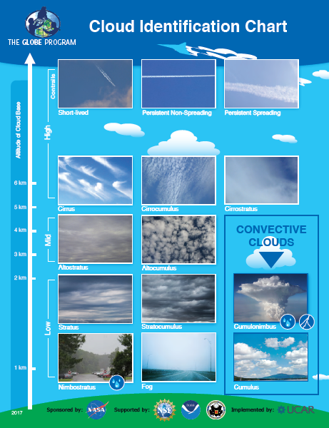
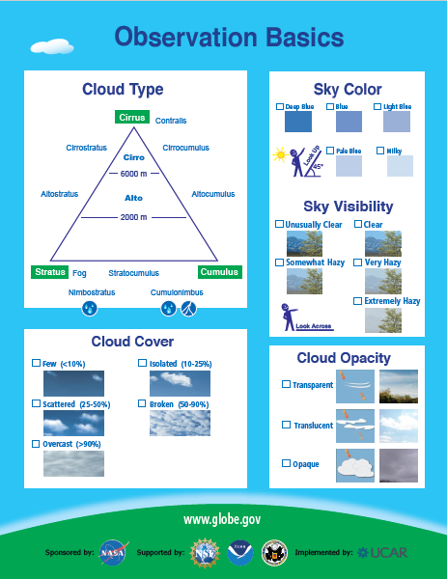
4. Record cloud and contrail data using the GLOBE Cloud Protocol
The GLOBE Cloud Chart can help you identify the clouds.
.
Notes:
Calibrate with bucket of ice water
-point IRT perpendicular to water surface about 5 cm away
-reading should be within –2° C to +2° C
The IRT sensor is susceptible to large differences in air temperature. If you enclose the IRT in the adapted oven mitt (thermal glove), this will ensure the IRT stays insulated and will provide accurate readings.
Some IRT units are equipped with a laser that will shine from the front of the thermometer along the approximate line of sight, causing a red dot to appear where the surface temperature is measured. Make sure students do not aim this laser beam directly at eyes or off surfaces that could reflect in someone’s eyes.
Wrap your IRT in the Thermal Glove when the air temperature at your study site varies more than 5 degrees Celsius from the air temperature of where the IRT has been stored. The IRT with the thermal glove has been tested to work for 30 minutes. The thermal glove is made from a standard oven mitt. The oven mitt used to make the thermal glove MUST be constructed of 100% terry cloth; inside and outside. An actual-size pattern of the thermal glove with hole designations for the IRT’s sensing eye and digital display screen is shown in the Surface Temperature Protocol section of the 2003 Teacher’s Guide.

Slide 26
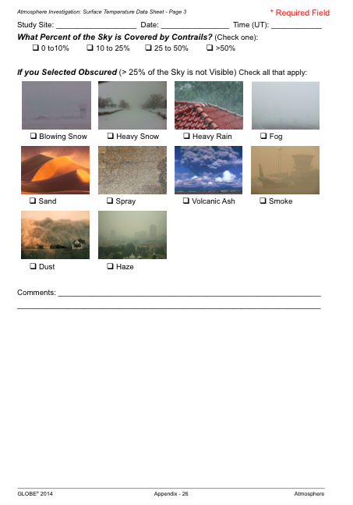
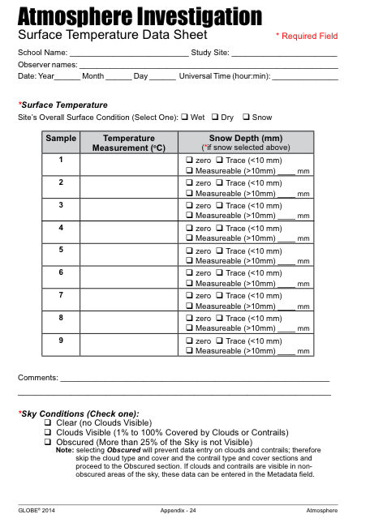
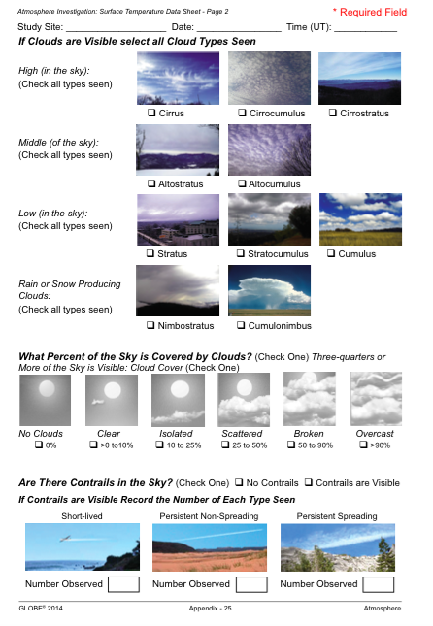
5. Record your data on the Surface Temperature Data Sheet
Notes:
Calibrate with bucket of ice water
-point IRT perpendicular to water surface about 5 cm away
-reading should be within –2° C to +2° C
The IRT sensor is susceptible to large differences in air temperature. If you enclose the IRT in the adapted oven mitt (thermal glove), this will ensure the IRT stays insulated and will provide accurate readings.
Some IRT units are equipped with a laser that will shine from the front of the thermometer along the approximate line of sight, causing a red dot to appear where the surface temperature is measured. Make sure students do not aim this laser beam directly at eyes or off surfaces that could reflect in someone’s eyes.
Wrap your IRT in the Thermal Glove when the air temperature at your study site varies more than 5 degrees Celsius from the air temperature of where the IRT has been stored. The IRT with the thermal glove has been tested to work for 30 minutes. The thermal glove is made from a standard oven mitt. The oven mitt used to make the thermal glove MUST be constructed of 100% terry cloth; inside and outside. An actual-size pattern of the thermal glove with hole designations for the IRT’s sensing eye and digital display screen is shown in the Surface Temperature Protocol section of the 2003 Teacher’s Guide.

Slide 27
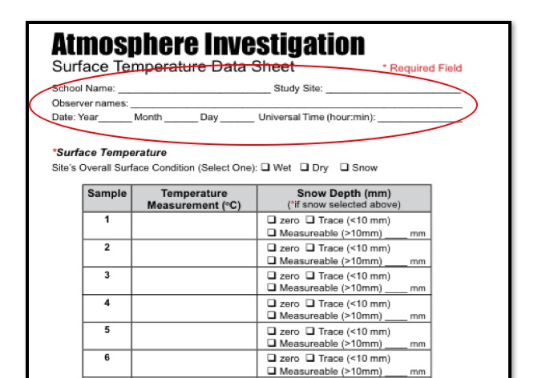
Be sure to enter your school, study site, observer names, date and time (local or UTC)
Notes:
Calibrate with bucket of ice water
-point IRT perpendicular to water surface about 5 cm away
-reading should be within –2° C to +2° C
The IRT sensor is susceptible to large differences in air temperature. If you enclose the IRT in the adapted oven mitt (thermal glove), this will ensure the IRT stays insulated and will provide accurate readings.
Some IRT units are equipped with a laser that will shine from the front of the thermometer along the approximate line of sight, causing a red dot to appear where the surface temperature is measured. Make sure students do not aim this laser beam directly at eyes or off surfaces that could reflect in someone’s eyes.
Wrap your IRT in the Thermal Glove when the air temperature at your study site varies more than 5 degrees Celsius from the air temperature of where the IRT has been stored. The IRT with the thermal glove has been tested to work for 30 minutes. The thermal glove is made from a standard oven mitt. The oven mitt used to make the thermal glove MUST be constructed of 100% terry cloth; inside and outside. An actual-size pattern of the thermal glove with hole designations for the IRT’s sensing eye and digital display screen is shown in the Surface Temperature Protocol section of the 2003 Teacher’s Guide.

Slide 28
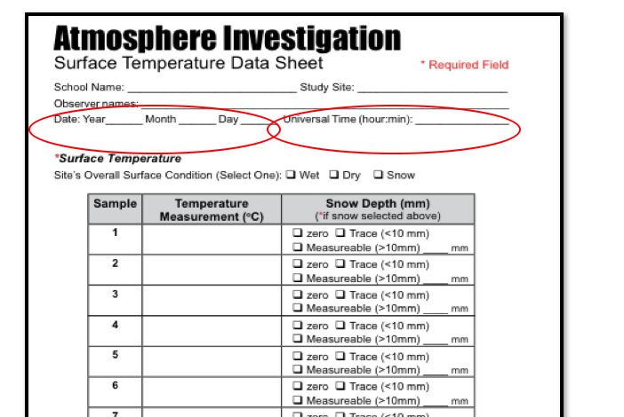
CAUTION – An observation without a date or time is worthless
Notes:
Calibrate with bucket of ice water
-point IRT perpendicular to water surface about 5 cm away
-reading should be within –2° C to +2° C
The IRT sensor is susceptible to large differences in air temperature. If you enclose the IRT in the adapted oven mitt (thermal glove), this will ensure the IRT stays insulated and will provide accurate readings.
Some IRT units are equipped with a laser that will shine from the front of the thermometer along the approximate line of sight, causing a red dot to appear where the surface temperature is measured. Make sure students do not aim this laser beam directly at eyes or off surfaces that could reflect in someone’s eyes.
Wrap your IRT in the Thermal Glove when the air temperature at your study site varies more than 5 degrees Celsius from the air temperature of where the IRT has been stored. The IRT with the thermal glove has been tested to work for 30 minutes. The thermal glove is made from a standard oven mitt. The oven mitt used to make the thermal glove MUST be constructed of 100% terry cloth; inside and outside. An actual-size pattern of the thermal glove with hole designations for the IRT’s sensing eye and digital display screen is shown in the Surface Temperature Protocol section of the 2003 Teacher’s Guide.

Slide 29
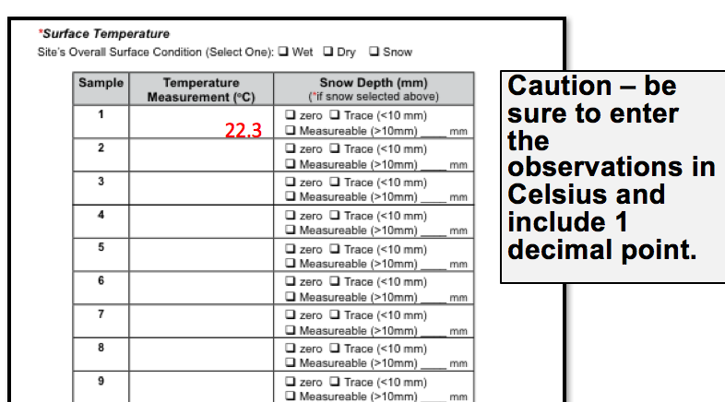
Enter the 9 surface temperature observations and snow depth, add comments of anything interesting about the observation.
Notes:
Calibrate with bucket of ice water
-point IRT perpendicular to water surface about 5 cm away
-reading should be within –2° C to +2° C
The IRT sensor is susceptible to large differences in air temperature. If you enclose the IRT in the adapted oven mitt (thermal glove), this will ensure the IRT stays insulated and will provide accurate readings.
Some IRT units are equipped with a laser that will shine from the front of the thermometer along the approximate line of sight, causing a red dot to appear where the surface temperature is measured. Make sure students do not aim this laser beam directly at eyes or off surfaces that could reflect in someone’s eyes.
Wrap your IRT in the Thermal Glove when the air temperature at your study site varies more than 5 degrees Celsius from the air temperature of where the IRT has been stored. The IRT with the thermal glove has been tested to work for 30 minutes. The thermal glove is made from a standard oven mitt. The oven mitt used to make the thermal glove MUST be constructed of 100% terry cloth; inside and outside. An actual-size pattern of the thermal glove with hole designations for the IRT’s sensing eye and digital display screen is shown in the Surface Temperature Protocol section of the 2003 Teacher’s Guide.

Slide 30
Do the cloud and contrail protocols.
Notes:
Calibrate with bucket of ice water
-point IRT perpendicular to water surface about 5 cm away
-reading should be within –2° C to +2° C
The IRT sensor is susceptible to large differences in air temperature. If you enclose the IRT in the adapted oven mitt (thermal glove), this will ensure the IRT stays insulated and will provide accurate readings.
Some IRT units are equipped with a laser that will shine from the front of the thermometer along the approximate line of sight, causing a red dot to appear where the surface temperature is measured. Make sure students do not aim this laser beam directly at eyes or off surfaces that could reflect in someone’s eyes.
Wrap your IRT in the Thermal Glove when the air temperature at your study site varies more than 5 degrees Celsius from the air temperature of where the IRT has been stored. The IRT with the thermal glove has been tested to work for 30 minutes. The thermal glove is made from a standard oven mitt. The oven mitt used to make the thermal glove MUST be constructed of 100% terry cloth; inside and outside. An actual-size pattern of the thermal glove with hole designations for the IRT’s sensing eye and digital display screen is shown in the Surface Temperature Protocol section of the 2003 Teacher’s Guide.

Slide 31
Record the sky condition.
If you can’t see the sky, check the reason.
Caution – If you click obscured, clouds cannot be entered.
Notes:
Calibrate with bucket of ice water
-point IRT perpendicular to water surface about 5 cm away
-reading should be within –2° C to +2° C
The IRT sensor is susceptible to large differences in air temperature. If you enclose the IRT in the adapted oven mitt (thermal glove), this will ensure the IRT stays insulated and will provide accurate readings.
Some IRT units are equipped with a laser that will shine from the front of the thermometer along the approximate line of sight, causing a red dot to appear where the surface temperature is measured. Make sure students do not aim this laser beam directly at eyes or off surfaces that could reflect in someone’s eyes.
Wrap your IRT in the Thermal Glove when the air temperature at your study site varies more than 5 degrees Celsius from the air temperature of where the IRT has been stored. The IRT with the thermal glove has been tested to work for 30 minutes. The thermal glove is made from a standard oven mitt. The oven mitt used to make the thermal glove MUST be constructed of 100% terry cloth; inside and outside. An actual-size pattern of the thermal glove with hole designations for the IRT’s sensing eye and digital display screen is shown in the Surface Temperature Protocol section of the 2003 Teacher’s Guide.

Slide 32
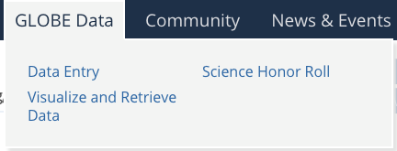
Entering Data
You have 3 options:
Download the Data Entry app from the App Store.
Live Data Entry: These pages are for entering environmental data – collected at defined sites, according to protocol, and using approved instrumentation – for entry into the official GLOBE science database.
Email Data Entry : If connectivity is an issue, data can also be entered via email.

Slide 33
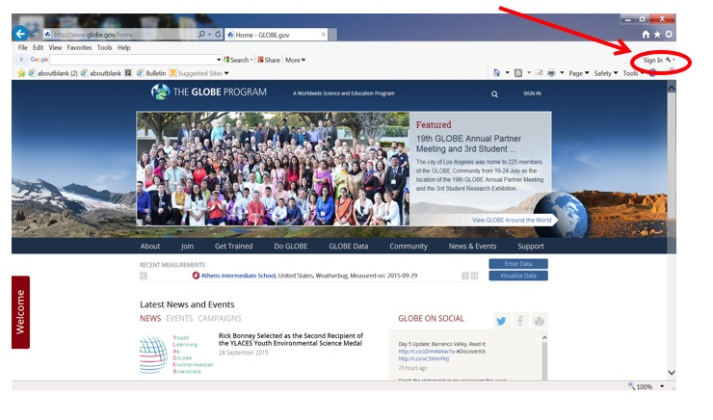
Entering Data-Step 1
Go to the GLOBE website and click sign in.

Slide 34
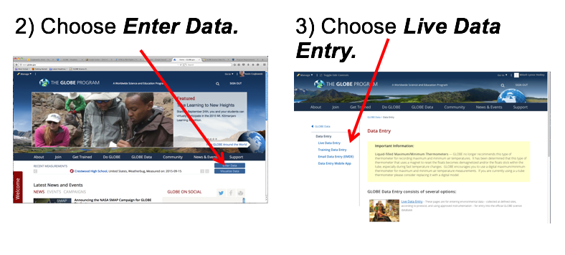
Entering Data-Step 2 and 3

Slide 35
Set up a new surface temperature site.
If you have already done this step, skip to the next step. If you have not, set up a surface temperature site. You must first create one by following the steps below.
Select “Surface Temperature Site Selection” from the atmosphere data entry menu.
Select site and initial, correcting, or updating information option.
Enter date & supplemental site definition data from the surface temperature data sheet.
Confirm data entries on verification page.

Slide 36
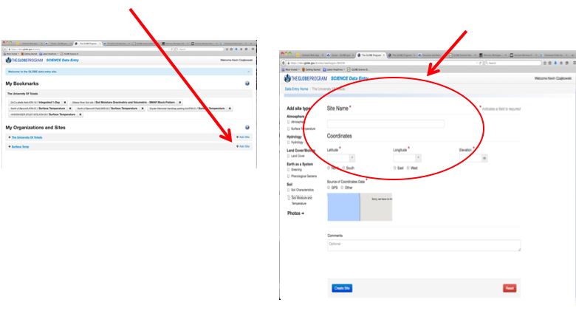
Create a New Surface Temperature Site-1
6) Add a surface temperature site.
7) Enter a site name, latitude and longitude for the center of your site, and click on Create Site.

Slide 37
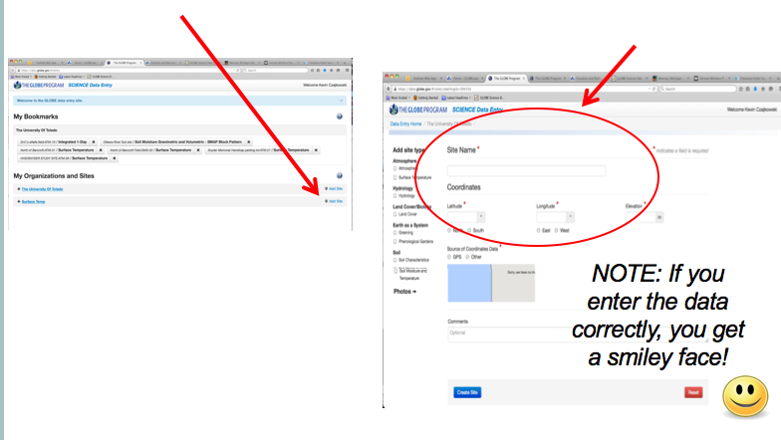
Create a New Surface Temperature Site-2
7) Enter a site name, latitude and longitude for the center of your site, and click on Create Site.
6) Add a surface temperature site.

Slide 38
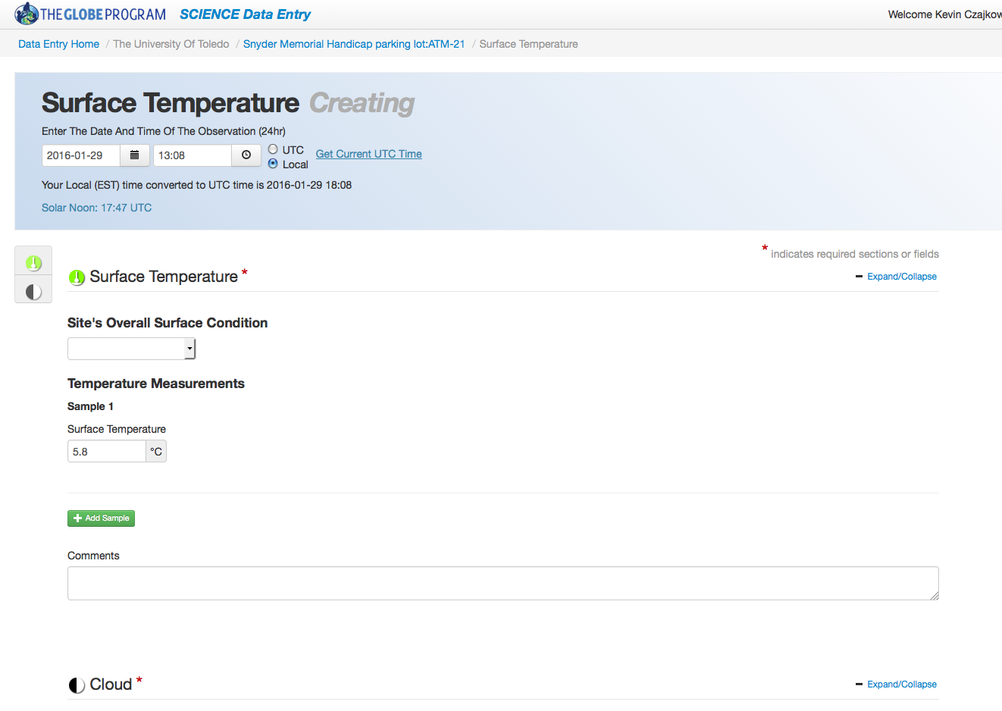
Continue to enter your data
Once you’ve created the Surface Temperature site, go back to Data Entry, select the site you just created, and enter your data.

Slide 39
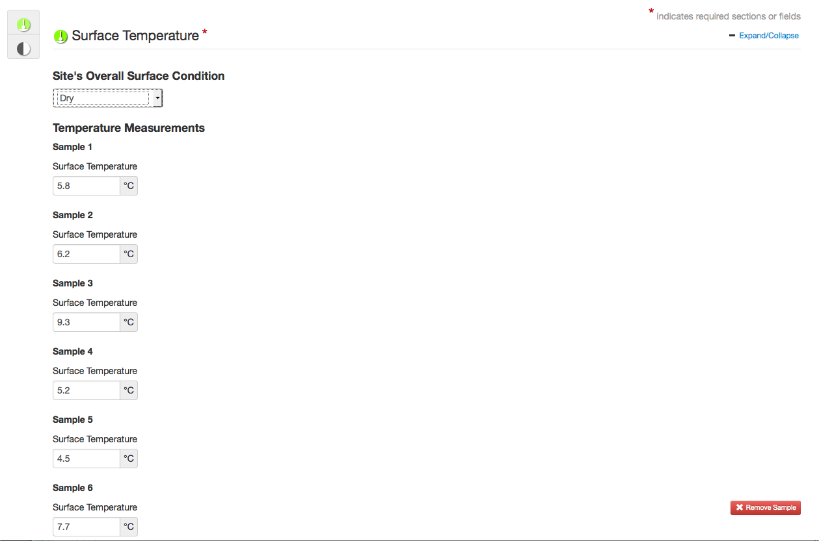
Continue to enter all 9 of the random observations you collected within your Surface Temperature study area.

Slide 40
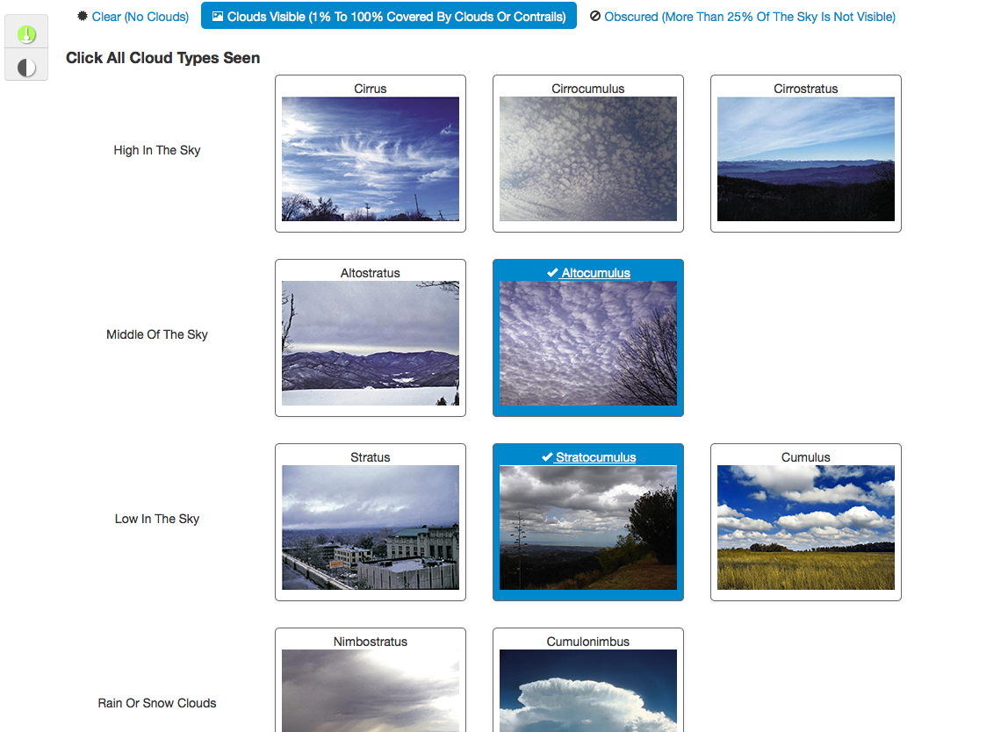
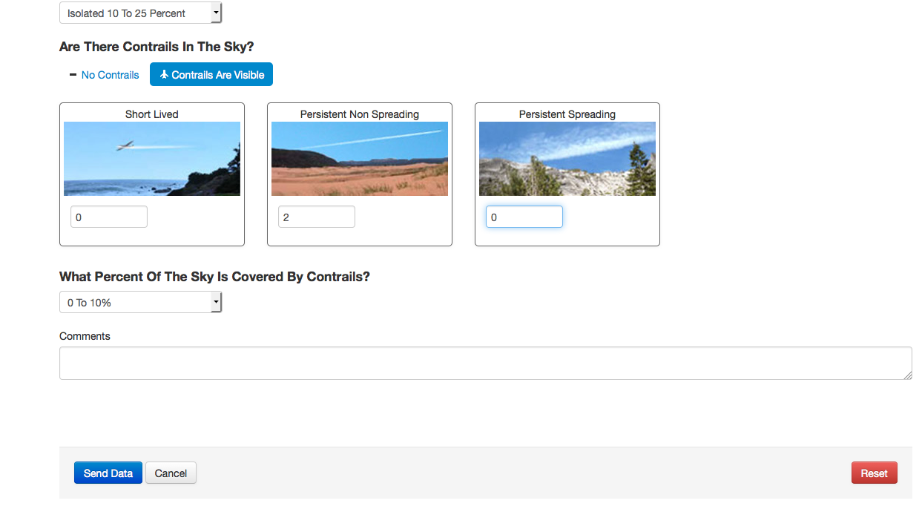
Then enter your Clouds and Contrails Observations.

Slide 41
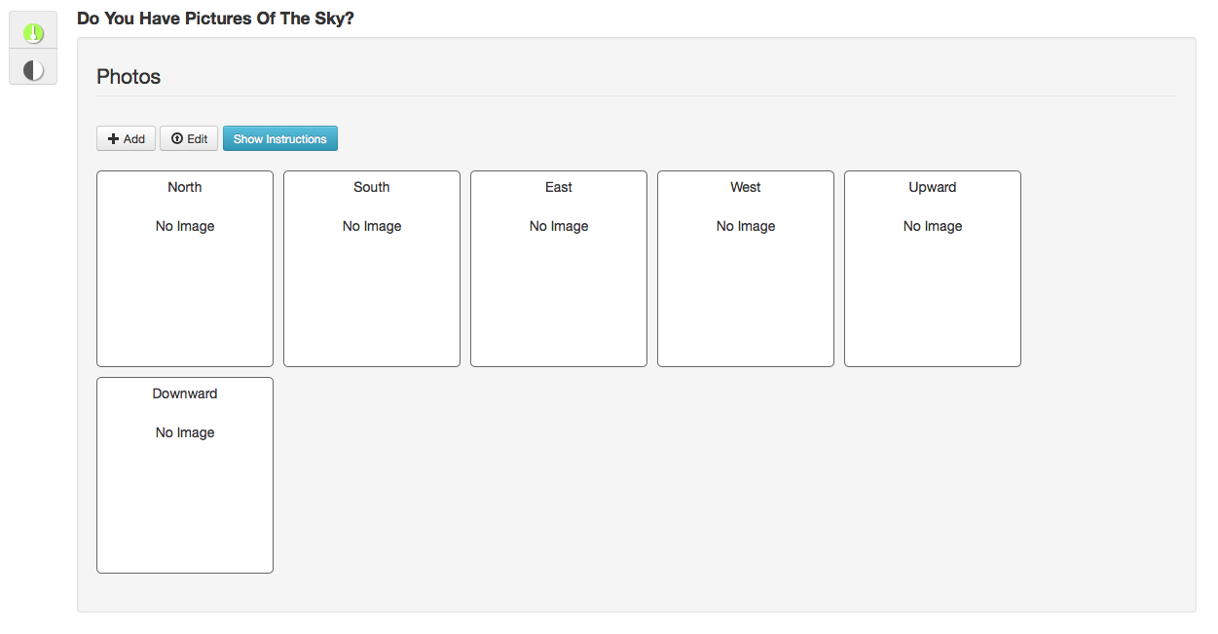
Once you’ve successfully entered your data, you can upload any photos you took of the sky.
Adding photos to your site is a fun way to get others (students, family members, etc.) involved, AND it helps NASA scientists corroborate your data!

Slide 42
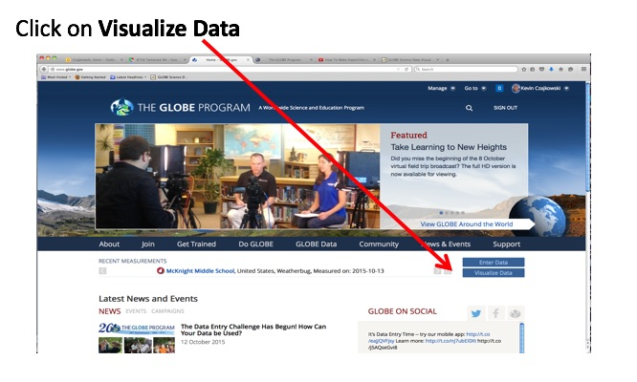
Retrieving Data from the GLOBE Visualization System
E-training is available to explore the full power of the visualization system.

Slide 43
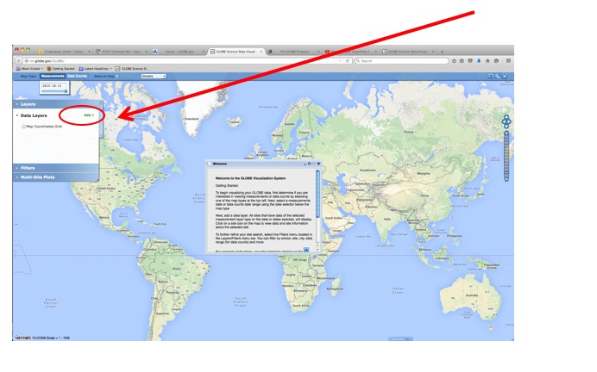
View data on a map in the GLOBE Visualization System
Close the Welcome box and click on Add + to add a layer

Slide 44
Once the data is entered, you can view it.
Comparison of Asphalt versus concrete temperature,
Ida Elementary School, Michigan
GLOBE allows you to analyze your data. For example, surface temperatures of different surface materials can be very different!

Slide 45
Questions for you to investigate:
How does surface temperature compare with current air temperature? How does surface temperature compare with soil temperature at 5 cm and 10 cm?
How does surface temperature vary with land cover (e.g., bare soil, short grass, tall grass, concrete, asphalt, sand, forest litter)?
How does surface temperature vary with surface soil color?
How does the surface temperature of the ground, near the outside of the atmosphere shelter, compare with the current air temperature measured inside the shelter?
How does surface temperature change for different cover types (grass vs. asphalt for instance) on a cloudy day?
How does the time of year affect the surface temperature?
How does the surface temperature change for different cover types when it is wet versus when it is dry?

Slide 46
What have you learned?
What does surface temperature mean?
Why it is it important to collect surface temperature data?
What instruments are needed to collect surface temperature data?
Where can I purchase the instruments?
Where should I take my surface temperature measurements?
What data is collected?
How do I submit data to GLOBE?
What can I do with the data submitted to GLOBE?

Slide 47
Frequently Asked Questions (FAQs)
Should I turn on the red laser on the IRT to do my measurement?
Some IRT units are equipped with a laser and backlight. You can choose whether or not to activate these. If you choose to put them on, a red laser will shine from the sensing eye area along the approximate line of sight of the instrument when the recording button is pressed. This will cause a red dot to appear where the surface temperature is being measured. A backlight for the digital display screen will remain lit for seven seconds after the recording button is pressed and released.
Using the laser can help you more accurately locate the point where you are measuring the surface temperature. However, it will also reduce battery life and could possibly be a distraction to students. It is imperative that the laser beam NOT be aimed directly at eyes or off surfaces where it could reflect into anyone’s eyes. The laser and backlight option is controlled by a switch located above the battery in the battery compartment.

Slide 48
Further Resources
For information on purchasing GLOBE supplies
For information on infrared thermometers and how they work
For information about the NASA MODIS Satellite Mission
For information about GLOBE
NASA Wavelength: NASA’s Digital Library for Earth and Space Education

Slide 49
Please provide us with feedback about this module. This is a community project and we welcome your comments, suggestions and edits! Comment here: eTraining Feedback Questions about Module? Contact GLOBE: help@globe.gov
Power point Developers:
Kevin Czajkowski
Janet Struble
Mikell Lynne Hedley
Sara Mierzwiak
Photos unless otherwise identified:
Kevin Czajkowski
Funding Provided by NASA
Version 12/1/16. If you edit and modify this slide set for use for educational purposes, please note “modified by (and your name and date) “ on this page. Thank you.

