Slide 1


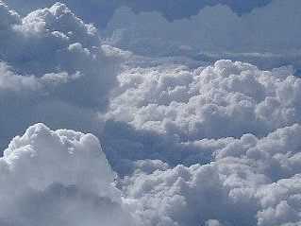
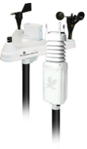
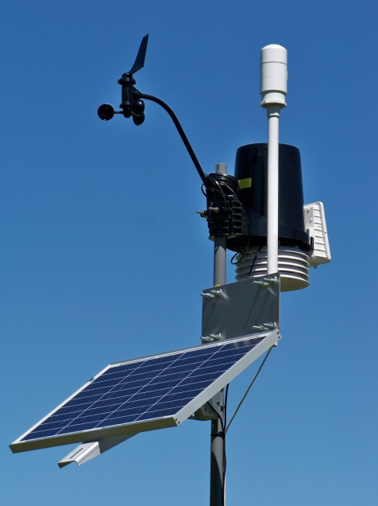
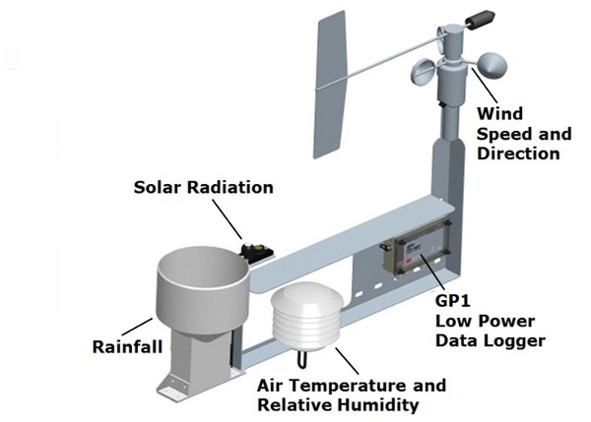
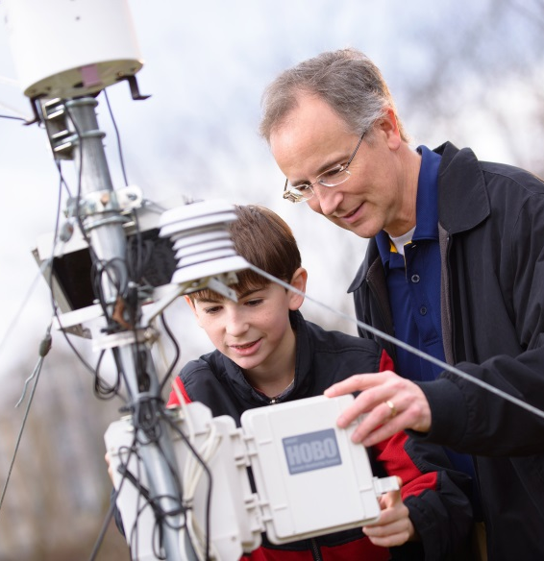
Protocol Training Slides for:
Automated Weather Stations (AWS)
Atmosphere Automated Weather Stations
Photo credit: Daniel Miller
Automated Weather Stations (AWSs) can collect a variety of data for upload to GLOBE. They are also known as Personal Weather Stations (PWSs).

Slide 2
The Weather
Atmosphere Automated Weather Stations
Describes the state of the atmosphere at a given point in time and geographic location
Caused by the interactions of solar radiation, Earth's large ocean, diverse landscapes and motion in space
Is crucial in gaining an understanding of the Earth system
Atmosphere Protocol

Slide 3
Automated Weather Stations
Atmosphere Automated Weather Stations
Overview
Learning Objectives
This module
Describes the different types of automated weather stations
Provides an introduction to collecting and entering your data on the GLOBE website
After completing this module, you will be able to do
Describe the different automated weather stations (AWS)
List the instruments contained in AWS and the data each collects
Determine the correct location of AWS
Upload data to GLOBE website
Visualize data using GLOBE Visualization Site and formulate your own questions about weather

Slide 4

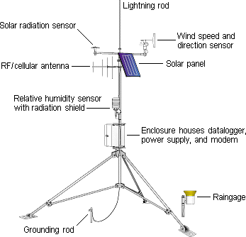
What is an Automated Weather Station (AWS)?
An AWS can collect meteorological data from multiple instruments.
Atmosphere Automated Weather Stations
A. What is AWS?
B. Why collect data using AWS?
C. How your measurements can help!
D. How to collect your data
E. Entering your data
F. Understanding the data
G. Quiz Yourself
H. Frequently Asked Questions
I. Further Resources
Parameter | Instrument
Temperature | Thermometer
Precipitation | Rain Gauge
Humidity | Hygrometer
Atmospheric Pressure | Barometer
Wind Speed | Anemometer
Wind Direction | Wind Vane
Solar Radiation | Pyranometer
Soil Moisture | Soil Hygrometer
Soil Temperature | Soil Thermometer

Slide 5
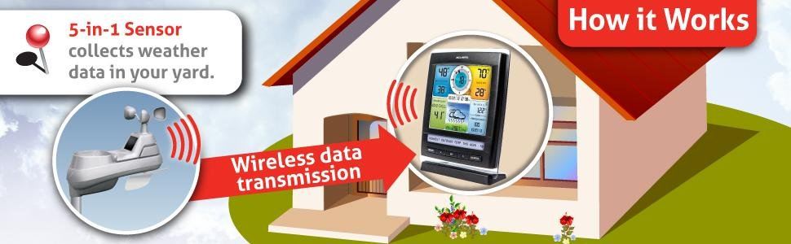
How does an AWS work?
Atmosphere Automated Weather Stations
A. What is AWS?
B. Why collect data using AWS?
C. How your measurements can help!
D. How to collect your data
E. Entering your data
F. Understanding the data
G. Quiz Yourself
H. Frequently Asked Questions
I. Further Resources
Data collected by the AWS is contained in a data logger and can be emailed directly to GLOBE. AWSs are often powered by solar panels and accessible via mobile phone.

Slide 6
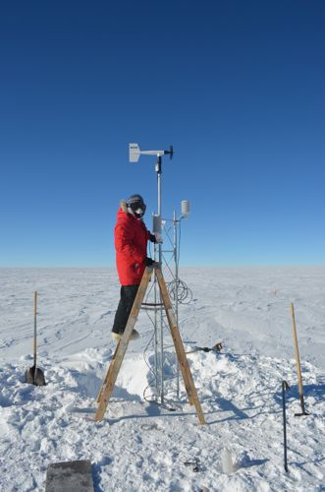
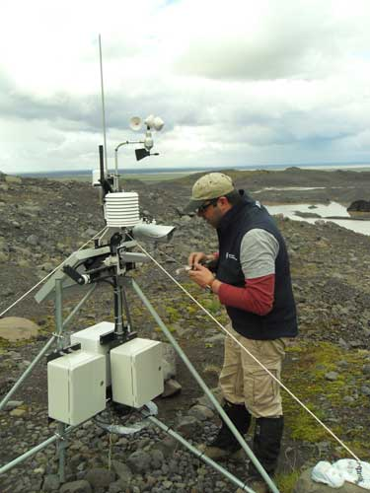
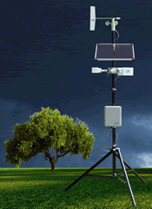
Where are AWSs used?
Atmosphere Automated Weather Stations
A. What is AWS?
B. Why collect data using AWS?
C. How your measurements can help!
D. How to collect your data
E. Entering your data
F. Understanding the data
G. Quiz Yourself
H. Frequently Asked Questions
I. Further Resources
Scientists use AWSs around the world, in all types of environments!

Slide 7
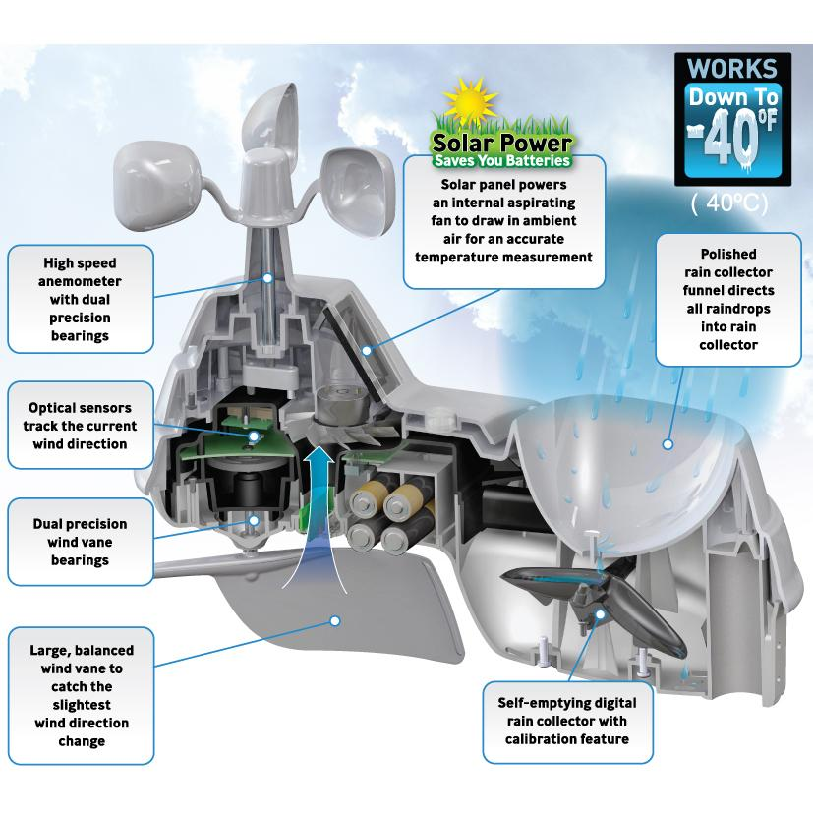
What’s inside of the AWS?
Atmosphere Automated Weather Stations
A. What is AWS?
B. Why collect data using AWS?
C. How your measurements can help!
D. How to collect your data
E. Entering your data
F. Understanding the data
G. Quiz Yourself
H. Frequently Asked Questions
I. Further Resources
Inside the AWS are some delicate instruments that are protected from the elements by a protective casing.
Batteries are also stored inside. Many AWS have solar panels for power in addition to batteries.
Notes:
Image – instruments in a weather station
Solar panels
High speed anemometer
Optical sensors to track wind direction
Wind vane
Fan draws in air for an accurate reading
Rain collector
Self emptying digital rain collector with calibration feature

Slide 8
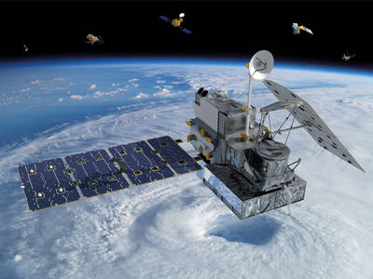
Your data can also assist with NASA and NOAA weather observations
Atmosphere Automated Weather Stations
A. What is AWS?
B. Why collect data using AWS?
C. How your measurements can help!
D. How to collect your data
E. Entering your data
F. Understanding the data
G. Quiz Yourself
H. Frequently Asked Questions
I. Further Resources
Earth based measurements of precipitation can assist the Global Precipitation Measurement Mission (GPM) by providing in situ data.
GPM aids in understanding water-borne diseases and freshwater availability.
Knowing how much precipitation falls and where it falls helps to understand weather and climate impacts.
GLOBE students have taken precipitation observations for a GPM field campaign.
GLOBE weather data is provided to NOAA Meteorological Data Assimilation System (MADIS)
NASA’S GLOBAL PRECIPITATION MEASUREMENT MISSION (GPM)
Slide updated 11/14/2025

Slide 9
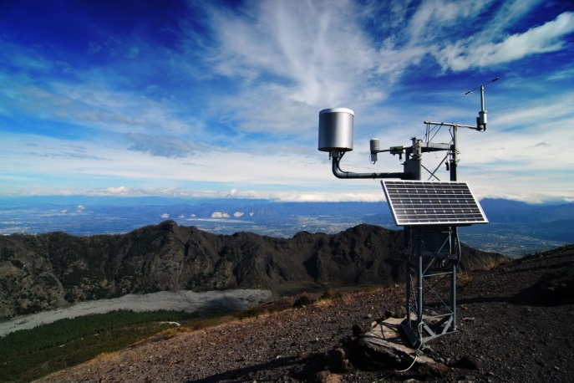
YOUR measurements can help scientists answer questions
Atmosphere Automated Weather Stations
A. What is AWS?
B. Why collect data using AWS?
C. How your measurements can help!
D. How to collect your data
E. Entering your data
F. Understanding the data
G. Quiz Yourself
H. Frequently Asked Questions
I. Further Resources
How do urban areas affect the temperature around them?
How does daily weather change seasonal and yearly averages?
How do local factors such as elevation and water bodies affect the weather?
How does El Nino affect your weather?

Slide 10
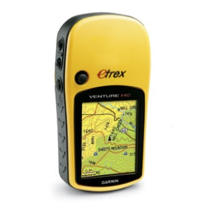
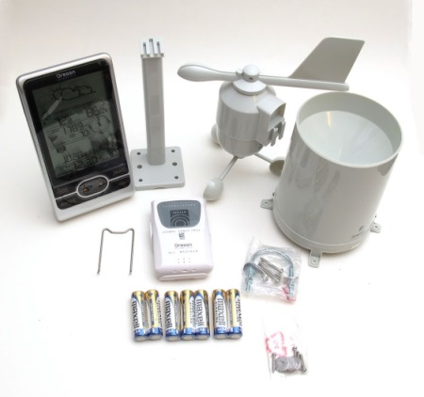
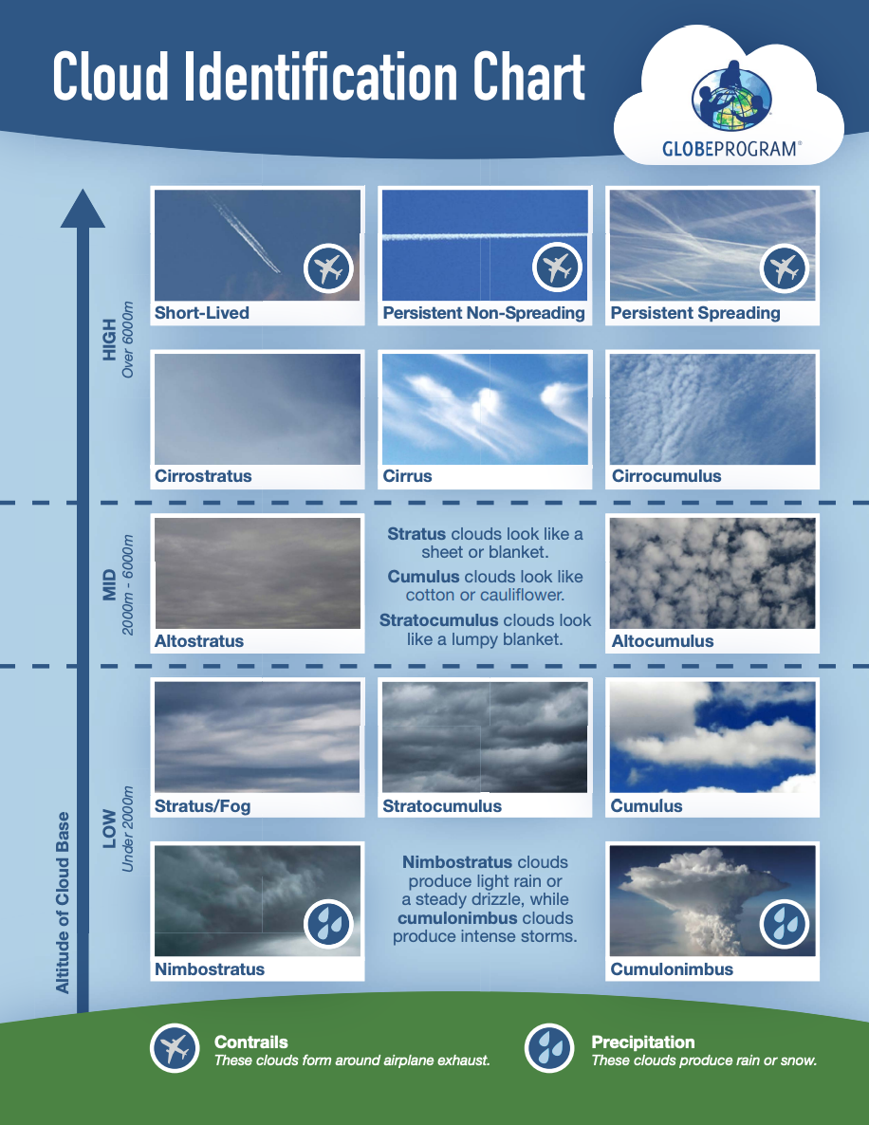
What I Need to Collect Data
Atmosphere Automated Weather Stations
A. What is AWS?
B. Why collect data using AWS?
C. How your measurements can help!
D. How to collect your data
E. Entering your data
F. Understanding the data
G. Quiz Yourself
H. Frequently Asked Questions
I. Further Resources
Instruments | Your eyes, GPS unit, Automated Weather Station
References | GLOBE cloud chart
When | AWS take weather observations continuously (typically every 15 minutes)
Where | A good observation site (See Documenting your atmosphere study site)
Form | Atmosphere Investigation Data Sheet
Slide updated 11/14/2025

Slide 11
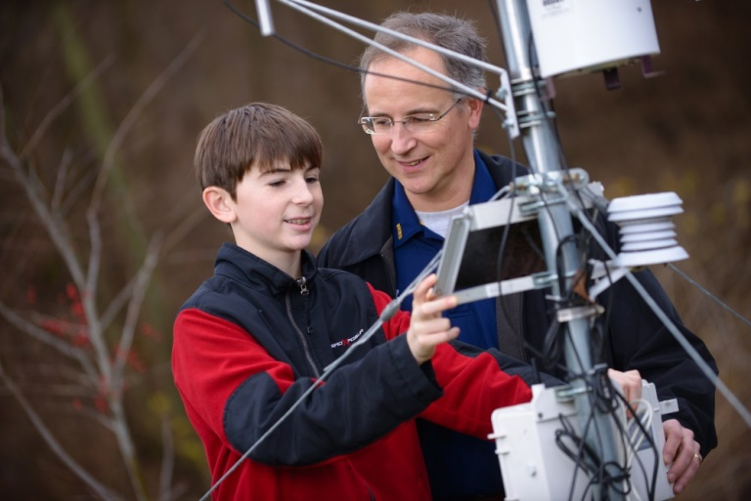
What Type of AWS Should I Get?
Atmosphere Automated Weather Stations
A. What is AWS?
B. Why collect data using AWS?
C. How your measurements can help!
D. How to collect your data
E. Entering your data
F. Understanding the data
G. Quiz Yourself
H. Frequently Asked Questions
I. Further Resources
There are many different types of AWSs:
$ Very simple ones with only two or three instruments
$$$ Very expensive ones with lots of instruments
Which one you get depends on your interests and budget
An AWS can be permanently installed or set up temporarily
Photo Credit: Daniel Miller

Slide 12
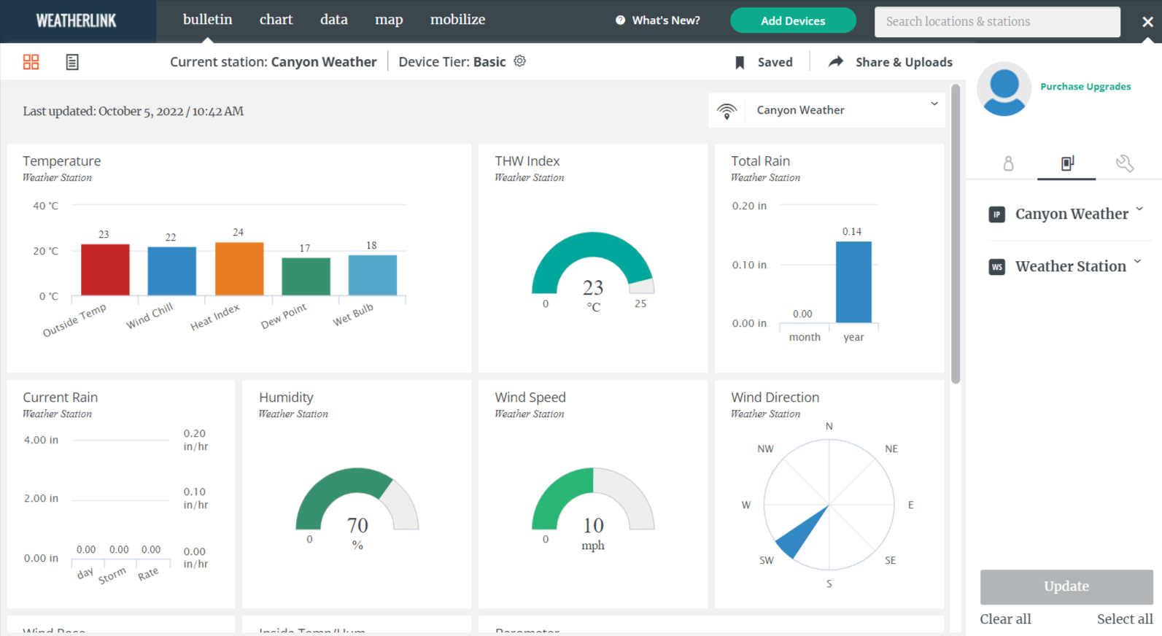

Where can I get an AWS?
Atmosphere Automated Weather Stations
A. What is AWS?
B. Why collect data using AWS?
C. How your measurements can help!
D. How to collect your data
E. Entering your data
F. Understanding the data
G. Quiz Yourself
H. Frequently Asked Questions
I. Further Resources
You can purchase an AWS from many different vendors
Davis Weather Stations are easy to set up to send data to GLOBE and its Weatherlink site
You can use this link to comparison shop: at the Weather Underground.com
Davis operates a weatherlink.com site to view your data. This is where you set up your data to automatically send to GLOBE
You can start with a simple version and then add sensors and instruments as you like!
Slide updated 11/14/2025

Slide 13
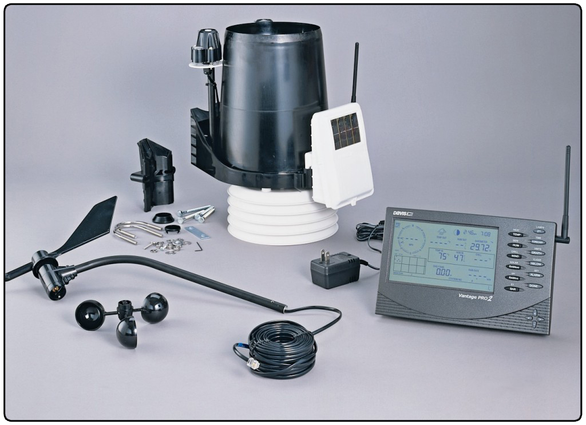
Assembling your AWS
Atmosphere Automated Weather Stations
A. What is AWS?
B. Why collect data using AWS?
C. How your measurements can help!
D. How to collect your data
E. Entering your data
F. Understanding the data
G. Quiz Yourself
H. Frequently Asked Questions
I. Further Resources
Once you receive your AWS, it will take approximately one hour to assemble using the manufacturer’s instructions.

Slide 14

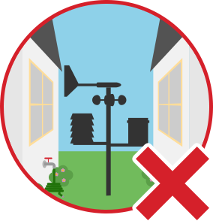
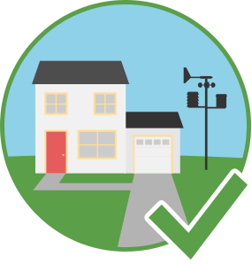
Where should I install my AWS?
Atmosphere Automated Weather Stations
A. What is AWS?
B. Why collect data using AWS?
C. How your measurements can help!
D. How to collect your data
E. Entering your data
F. Understanding the data
G. Quiz Yourself
H. Frequently Asked Questions
I. Further Resources
You should install your AWS in a place that is easily accessible to you.
However, it should not be installed between buildings or under trees.
A location near your home or school in an open area that is grassy is best.
Go here for a good installation guide: http://www.wunderground.com/weatherstation/installationguide.asp

Slide 15
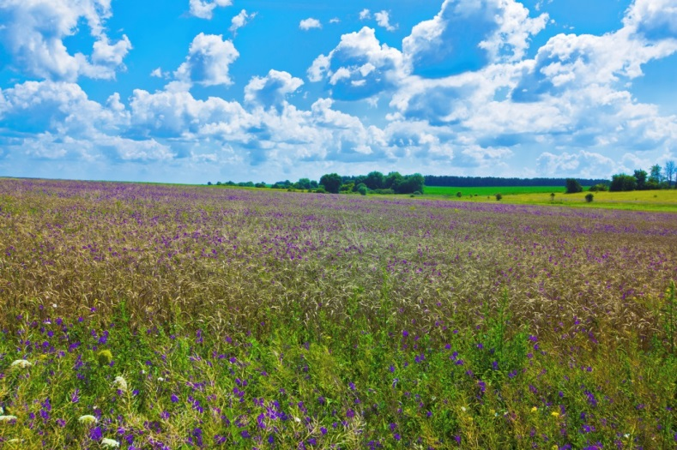
What are some things that can interfere with the AWS?
Atmosphere Automated Weather Stations
A. What is AWS?
B. Why collect data using AWS?
C. How your measurements can help!
D. How to collect your data
E. Entering your data
F. Understanding the data
G. Quiz Yourself
H. Frequently Asked Questions
I. Further Resources
Obstructions to wind (ex. buildings)
Things that give off humidity (ex. trees)
Things that give off heat (ex. pavement and rooftops)
Therefore, place your AWS in an area that is away from trees, pavement and rooftops and that has open access to wind flow.

Slide 16
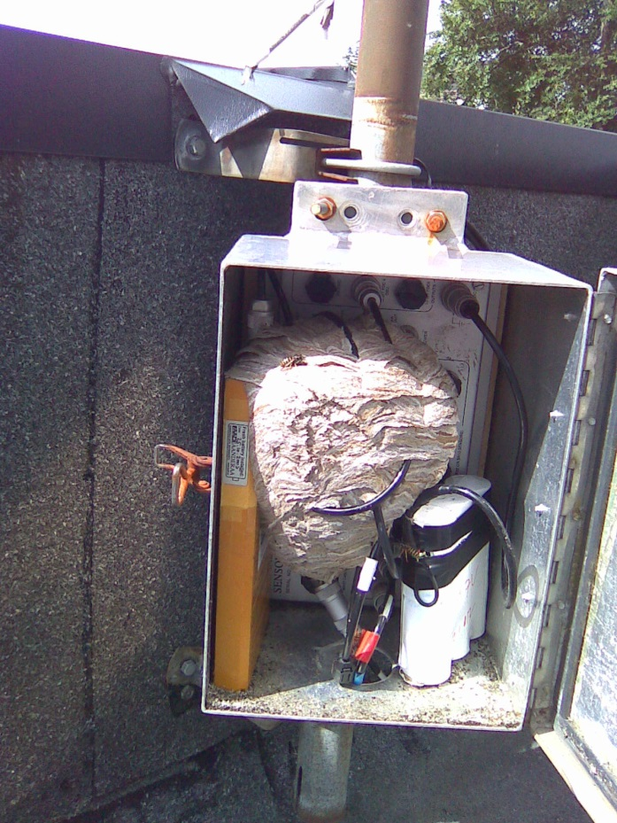

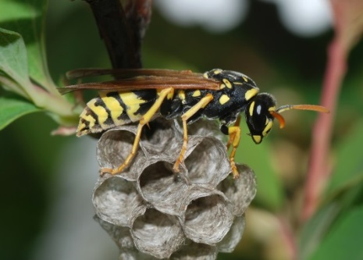
CAUTIONS!
Atmosphere Automated Weather Stations
A. What is AWS?
B. Why collect data using AWS?
C. How your measurements can help!
D. How to collect your data
E. Entering your data
F. Understanding the data
G. Quiz Yourself
H. Frequently Asked Questions
I. Further Resources
Wasps or spiders may try to set up a home inside of the protective casing of your AWS!

Slide 17
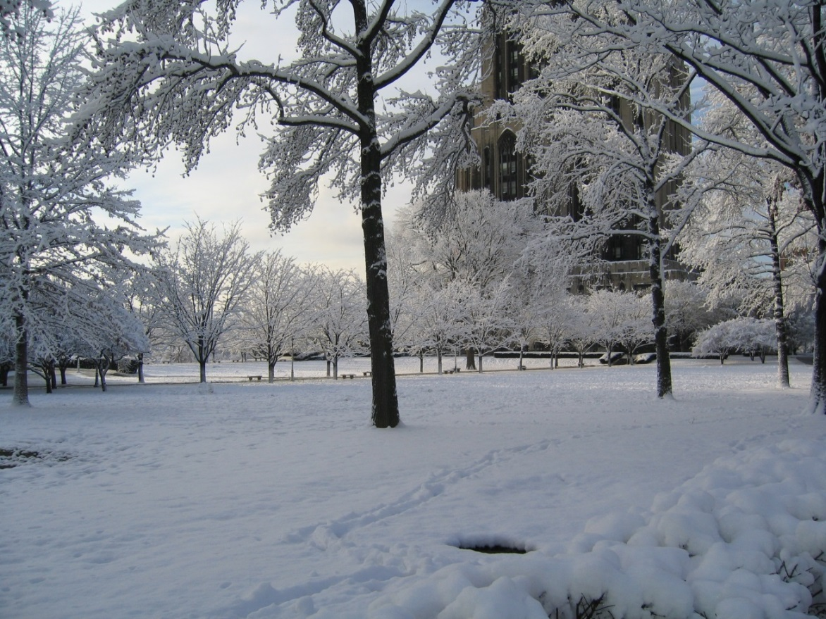
CAUTIONS!
Atmosphere Automated Weather Stations
A. What is AWS?
B. Why collect data using AWS?
C. How your measurements can help!
D. How to collect your data
E. Entering your data
F. Understanding the data
G. Quiz Yourself
H. Frequently Asked Questions
I. Further Resources
Check the operating temperatures of your AWS in the manufacturer’s instructions. Some AWS will not operate in extremely cold environments!

Slide 18
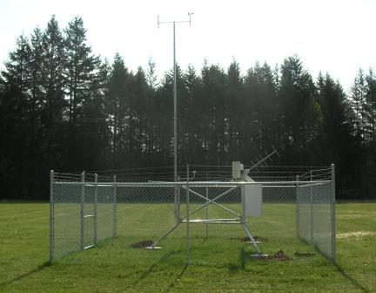
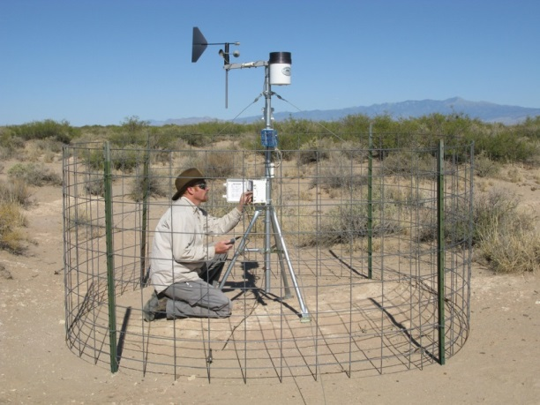
Protecting Your AWS
Atmosphere Automated Weather Stations
A. What is AWS?
B. Why collect data using AWS?
C. How your measurements can help!
D. How to collect your data
E. Entering your data
F. Understanding the data
G. Quiz Yourself
H. Frequently Asked Questions
I. Further Resources
You can protect your AWS from people and animals by placing fencing around it.

Slide 19
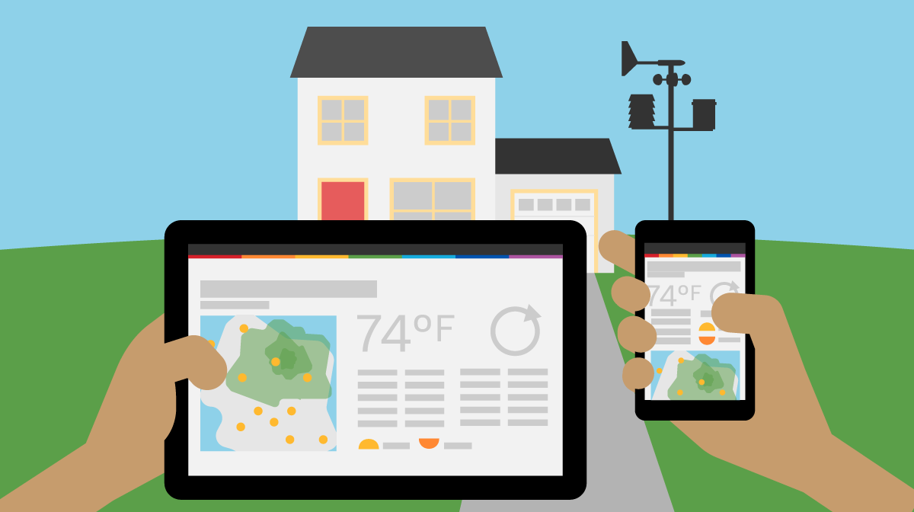
Data from your AWS
Atmosphere Automated Weather Stations
A. What is AWS?
B. Why collect data using AWS?
C. How your measurements can help!
D. How to collect your data
E. Entering your data
F. Understanding the data
G. Quiz Yourself
H. Frequently Asked Questions
I. Further Resources
You can view data from your AWS directly on your smart phone or tablet; however, you should also share it with the GLOBE community.
For your AWS data to be available to teachers and students around the world, you will need to upload your data to the GLOBE website or use the email approach to send the data to the GLOBE database.

Slide 20
Entering Data
Atmosphere Automated Weather Stations
A. What is AWS?
B. Why collect data using AWS?
C. How your measurements can help!
D. How to collect your data
E. Entering your data
F. Understanding the data
G. Quiz Yourself
H. Frequently Asked Questions
I. Further Resources
Click on the AWS name below to go to the GLOBE Guide for each type.
Davis | WeatherBug
Slide updated 11/14/2025

Slide 21
Collecting Data
Atmosphere Automated Weather Stations
A. What is AWS?
B. Why collect data using AWS?
C. How your measurements can help!
D. How to collect your data
E. Entering your data
F. Understanding the data
G. Quiz Yourself
H. Frequently Asked Questions
I. Further Resources
Choose and purchase an AWS according to your budget and predicted use.
Set up your AWS in an open area following the manufacturer’s instructions. Install each of the sensors you purchased.
Collect GPS data for the center of the site (latitude, longitude and elevation).
Record your site data on an Atmosphere Investigation data sheet and in the GLOBE Observer app or web data entry.
Use the Cloud Protocol to record cloud observations.
Set up your AWS to log readings in 15-minute intervals. Transfer the data to your computer using the directions included with the AWS data software.
Slide updated 11/14/2025

Slide 22
Entering Data
Atmosphere Automated Weather Stations
A. What is AWS?
B. Why collect data using AWS?
C. How your measurements can help!
D. How to collect your data
E. Entering your data
F. Understanding the data
G. Quiz Yourself
H. Frequently Asked Questions
I. Further Resources
Log into the GLOBE website.
Set up an Atmosphere Site
Under *Thermometer Type choose the type of AWS you have: Davis or AWS WeatherBug Station.
For Davis, set up through the Sharing your Davis Weather Station Data with GLOBE instructions.
For WeatherBug, set up and connect your AWS through https://www.weatherbug.com/
  Get a WeatherBug ID
  Enter the Station ID that you got from WeatherBug.
Add other descriptions of your site including pictures.
Everything should be ready for GLOBE to pull your data from your AWS to the GLOBE website.
Slide updated 11/14/2025

Slide 23
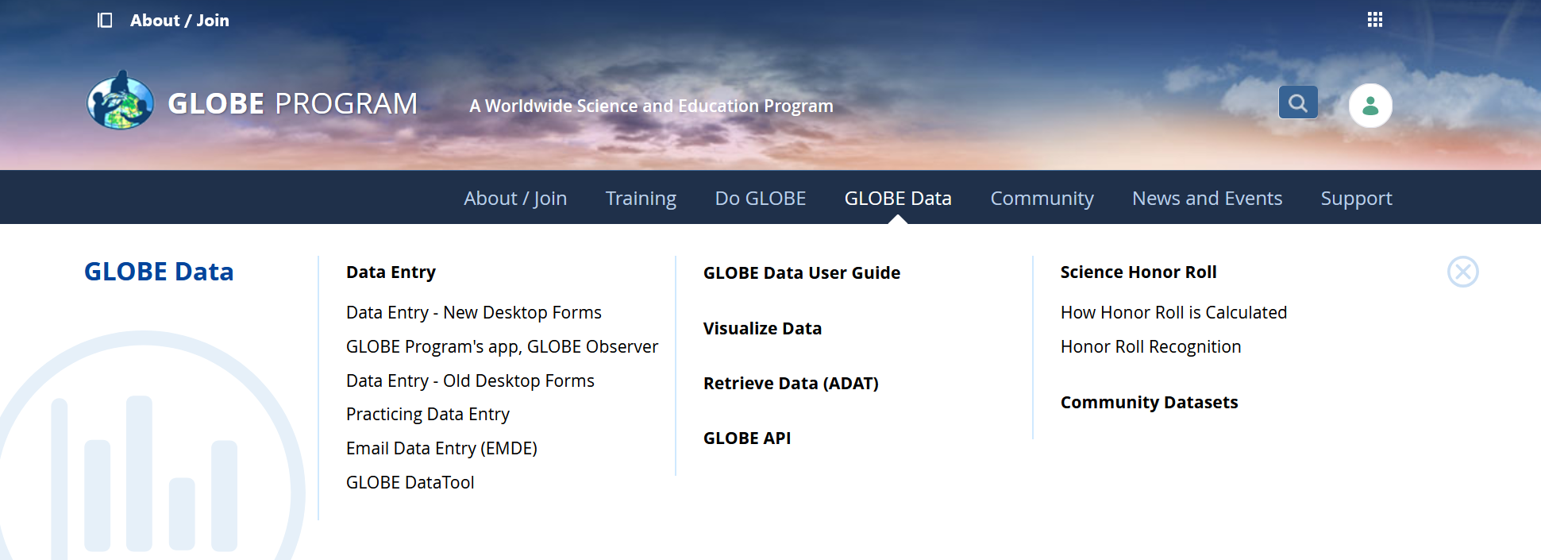

Entering Data
Atmosphere Automated Weather Stations
A. What is AWS?
B. Why collect data using AWS?
C. How your measurements can help!
D. How to collect your data
E. Entering your data
F. Understanding the data
G. Quiz Yourself
H. Frequently Asked Questions
I. Further Resources
Two Options for Uploading Data:
1b) Website Data Entry: Visit globe.gov, sign in, then click on the “GLOBE Data” tab, then underneath “Data Entry” click on “Data Entry – New Desktop Forms”.
1a) App Data Entry: Download the GLOBE Observer app from the App Store. Sign in and go to “Data Entry” at the top.
Slide updated 11/14/2025

Slide 24
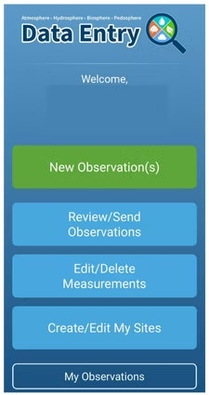

Atmosphere Automated Weather Stations
A. What is AWS?
B. Why collect data using AWS?
C. How your measurements can help!
D. How to collect your data
E. Entering your data
F. Understanding the data
G. Quiz Yourself
H. Frequently Asked Questions
I. Further Resources
Entering Atmosphere Study Site Information in the GLOBE Observer Data Entry System
The steps below will walk you through entering your Atmosphere Study Site Information in the GLOBE Observer App, which you can access using your GLOBE or GLOBE Observer login.
1. Click “Data Entry”
2. Click "Create/Edit My Sites"
Slide updated 11/14/2025

Slide 25
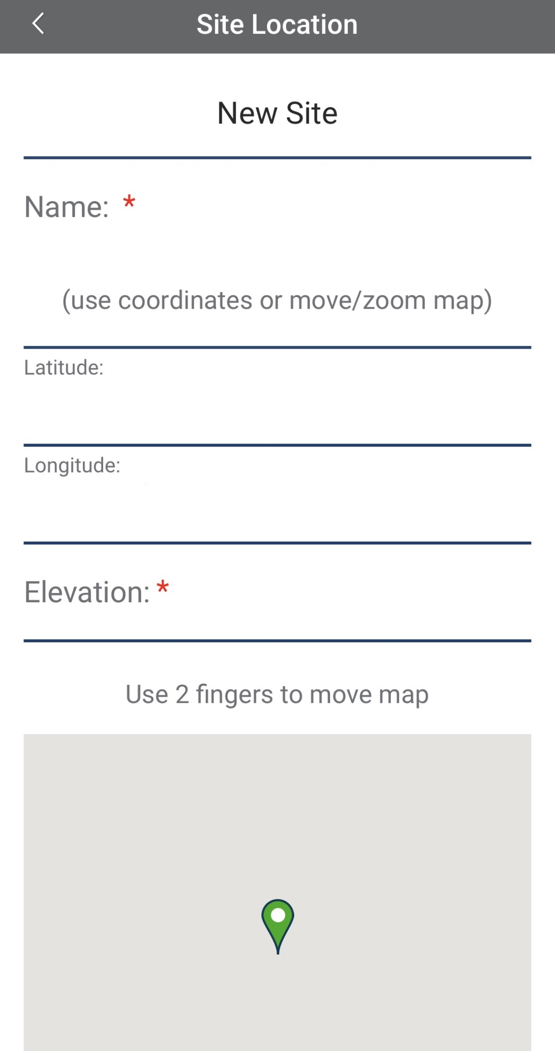
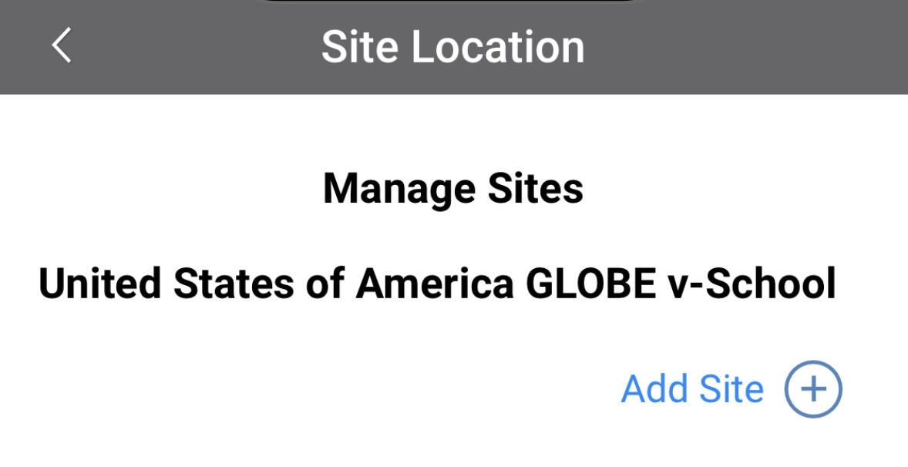
Atmosphere Automated Weather Stations
A. What is AWS?
B. Why collect data using AWS?
C. How your measurements can help!
D. How to collect your data
E. Entering your data
F. Understanding the data
G. Quiz Yourself
H. Frequently Asked Questions
I. Further Resources
Entering Atmosphere Study Site Information in the GLOBE Observer Data Entry System
3. Choose a site from your list of existing sites or click "Add Site +" to enter a New Site name.
4. Enter any Site Specific Comments in the space below the map.
Slide updated 11/14/2025

Slide 26
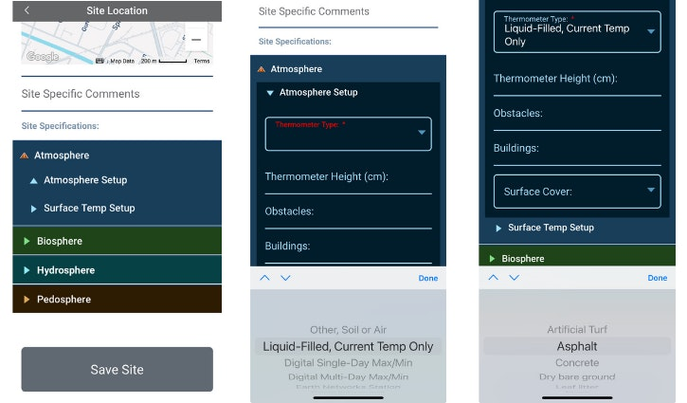
Atmosphere Automated Weather Stations
A. What is AWS?
B. Why collect data using AWS?
C. How your measurements can help!
D. How to collect your data
E. Entering your data
F. Understanding the data
G. Quiz Yourself
H. Frequently Asked Questions
I. Further Resources
Entering Atmosphere Study Site Information in the GLOBE Observer Data Entry System
5. Click on the arrow next to "Atmosphere" and select "Atmosphere Setup."
Slide updated 11/14/2025

Slide 27
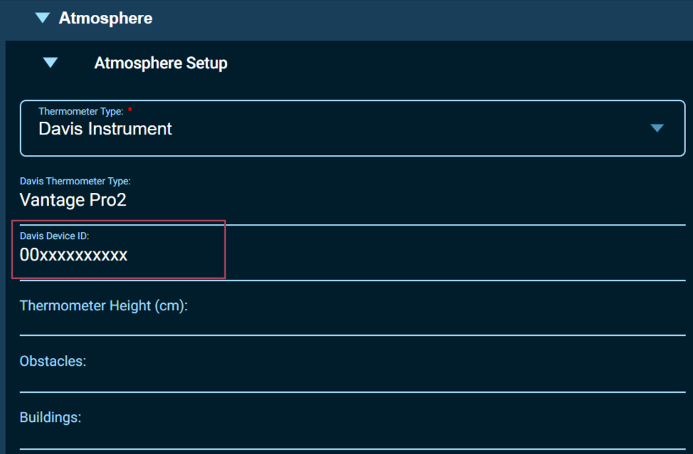
Atmosphere Automated Weather Stations
A. What is AWS?
B. Why collect data using AWS?
C. How your measurements can help!
D. How to collect your data
E. Entering your data
F. Understanding the data
G. Quiz Yourself
H. Frequently Asked Questions
I. Further Resources
Entering Atmosphere Study Site Information in the GLOBE Observer Data Entry System
6. Select the Davis or Weatherbug option from the Thermometer Types and enter your DeviceID in the appropriate field.
For Davis AWS, make sure this is entered exactly as shown on the WeatherLink site. Save the new site.
Slide updated 11/14/2025

Slide 28
Atmosphere Automated Weather Stations
A. What is AWS?
B. Why collect data using AWS?
C. How your measurements can help!
D. How to collect your data
E. Entering your data
F. Understanding the data
G. Quiz Yourself
H. Frequently Asked Questions
I. Further Resources
Entering Atmosphere Study Site Information in the GLOBE Observer Data Entry System
7. Select the Surface Cover type from the dropdown list. Click "Save Site" at the bottom of the screen.
Slide updated 11/14/2025

Slide 29
Entering Data
Atmosphere Automated Weather Stations
A. What is AWS?
B. Why collect data using AWS?
C. How your measurements can help!
D. How to collect your data
E. Entering your data
F. Understanding the data
G. Quiz Yourself
H. Frequently Asked Questions
I. Further Resources
The next step is to hook up a Davis or Weather Bug AWS through WeatherBug to the GLOBE website. It can take 24 hours for data to appear.
For Davis, set up through the Sharing your Davis Weather Station Data with GLOBE instructions. If the DeviceID entered into the form matches the DeviceID shown in your Davis WeatherLink Console, and if you are sharing your data with the GLOBE-Davis Data collection account, then your data will begin to appear on the GLOBE website.
For WeatherBug, set up and connect your AWS through https://www.weatherbug.com/
Slide updated 11/14/2025

Slide 30
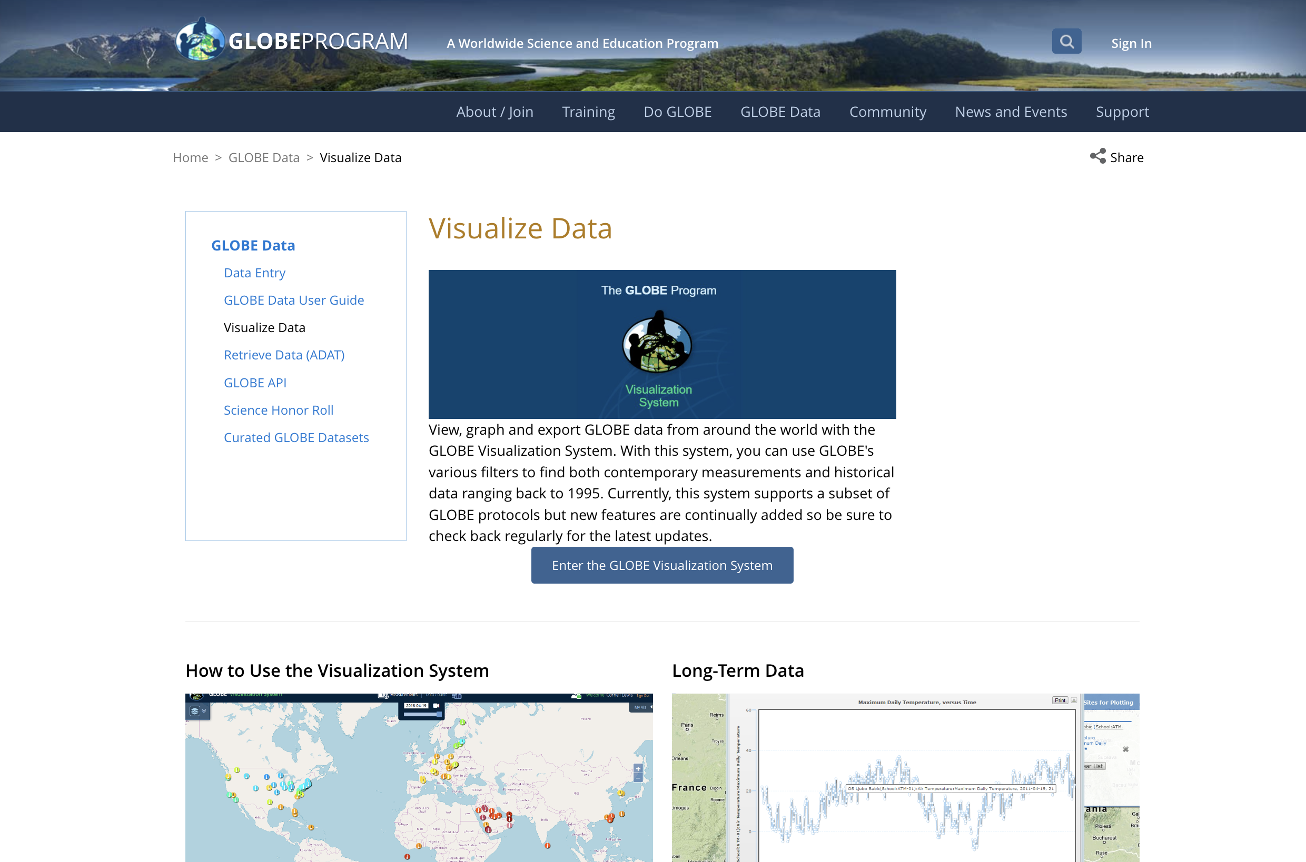
Retrieving Data from the
GLOBE Visualization
Atmosphere Automated Weather Stations
A. What is AWS?
B. Why collect data using AWS?
C. How your measurements can help!
D. How to collect your data
E. Entering your data
F. Understanding the data
G. Quiz Yourself
H. Frequently Asked Questions
I. Further Resources
Click on Enter the GLOBE Visualization System
The Tutorial Center is available to explore the full power of the visualization system.
Slide updated 11/14/2025

Slide 31
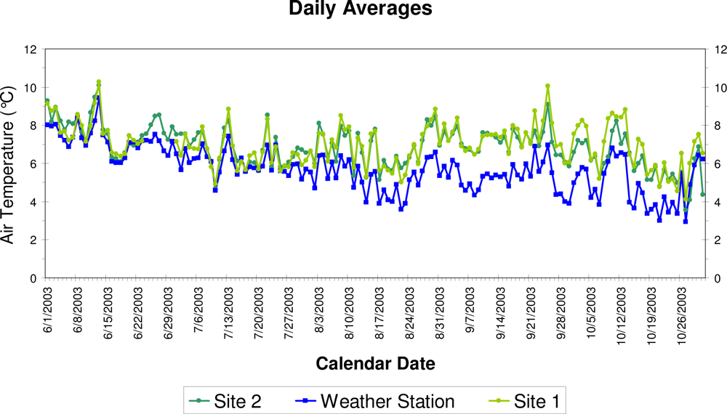
Once you’ve entered your data, you can view it.
Atmosphere Automated Weather Stations
A. What is AWS?
B. Why collect data using AWS?
C. How your measurements can help!
D. How to collect your data
E. Entering your data
F. Understanding the data
G. Quiz Yourself
H. Frequently Asked Questions
I. Further Resources
GLOBE allows you to analyze your data.

Slide 32
What Have I Learned?
Atmosphere Automated Weather Stations
A. What is AWS?
B. Why collect data using AWS?
C. How your measurements can help!
D. How to collect your data
E. Entering your data
F. Understanding the data
G. Quiz Yourself
H. Frequently Asked Questions
I. Further Resources
What is an automated weather station (AWS)?
What instruments does an AWS contain?
What data is collected by each instrument in AWS?
Why it is it important to collect weather data?
Where can I purchase an AWS?
Where should I place my AWS?
What do I need to collect data?
How do I submit data to GLOBE?
What can I do with the data submitted to GLOBE?

Slide 33
FAQs
Atmosphere Automated Weather Stations
A. What is AWS?
B. Why collect data using AWS?
C. How your measurements can help!
D. How to collect your data
E. Entering your data
F. Understanding the data
G. Quiz Yourself
H. Frequently Asked Questions
I. Further Resources
Can I submit data to GLOBE from my AWS WeatherBug weather station?
If you are a GLOBE Certified Teacher/School: If your weather station meets GLOBE specifications (see below), and you have the appropriate logging ability, all you need to do is define a site and indicate the thermometer type as "AWS". This generates an email to our systems support team that tells us that a school wants their AWS WeatherBug data sent to GLOBE. The GLOBE systems team looks up your information in the AWS WeatherBug list of schools and verifies your status. They define that to the GLOBE database, indicating you want your data sent to GLOBE and that's it!
Is there additional help on the GLOBE website on how to set up a Davis automated weather station?
Yes. Read the step-by-step instructions in Sharing your Davis Weather Station Data with GLOBE
Slide updated 11/14/2025

Slide 34
Further Resources
Atmosphere Automated Weather Stations
A. What is AWS?
B. Why collect data using AWS?
C. How your measurements can help!
D. How to collect your data
E. Entering your data
F. Understanding the data
G. Quiz Yourself
H. Frequently Asked Questions
I. Further Resources
For GLOBE E-training go to: https://www.globe.gov/get-trained/protocol-etraining/protocol-etraining-modules
Video: Alaska National Park Service Automated Weather Stations by Kenai Fjords National Park Service https://youtu.be/TFvoFvGHpPc?si=MD3JFNwVqgYQxNuX
What is a Personal Weather Station? http://www.wunderground.com/weatherstation/whatispws.asp
Hydrometeorlogical Networks in the U.S.: http://www.eol.ucar.edu/projects/hydrometnet/
Davis Weather Stations videos: https://www.youtube.com/user/davisinstruments/videos
Simple Homemade Weather Station for Kids: http://celebrating200years.noaa.gov/edufun/book/BuildyourownWeatherStation.pdf

Slide 35

Thank you to GLOBE Mission Earth, Sara Mierzwiak for producing these slides in 2016 and for David Overoye for producing the updated instructions for sharing Davis weather station data with GLOBE.
Please provide us with feedback. This is a community project and we welcome your comments, suggestions and edits! Questions? Contact help@nasaglobe.org
Atmosphere Automated Weather Stations
A. What is AWS?
B. Why collect data using AWS?
C. How your measurements can help!
D. How to collect your data
E. Entering your data
F. Understanding the data
G. Quiz Yourself
H. Frequently Asked Questions
I. Further Resources
The GLOBE Program is sponsored by these organizations:
Version 11/14/25. If you edit and modify this slide set for use for educational purposes, please note “modified by (and your name and date)“ on this page. Thank you.
Modified by GLOBE Implementation Office – Science, Training, Education and Public Engagement

