Slide 1
Elementary GLOBE Workshop
Insert Organization and Trainer Name
Notes:
This slide set was created by NASA Langley Research Center. GLOBE Facilitators can use and edit these slides as needed to conduct Elementary GLOBE Training.

Slide 2
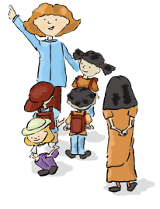
Agenda

Slide 3
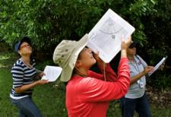
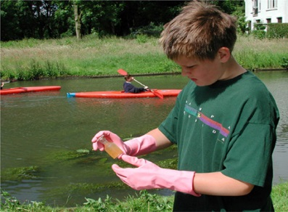
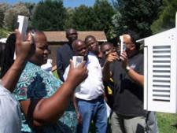
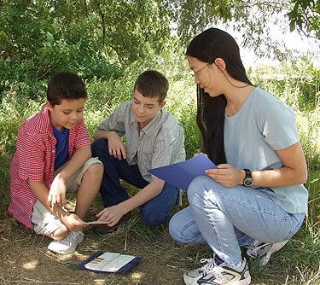
Global Learning and Observations to Benefit the Environment
Vision:
  A worldwide community of students, teachers, scientists, and citizens working together to better understand, sustain, and improve Earth's environment at local, regional, and global scales.
Mission:
  To promote the teaching and learning of science, enhance environmental literacy and stewardship, and promote scientific discovery.
Notes:
The international GLOBE network has grown to include representatives from over 110 participating countries and over 100 U.S. Partners coordinating GLOBE activities that are integrated into their local and regional communities. Due to their efforts, there are tens of thousands of GLOBE-trained teachers representing schools around the world. GLOBE students have contributed over 100 million measurements to the GLOBE database for use in their inquiry-based science projects.
Scientific protocols are developed by scientists, tested by teachers in classrooms around the world and executed by students
Produces meaningful, standardized research-quality data that can be used in support of student and professional scientific research
Global data sets; students across the world are conducting consistent, common inquiry-based science projects and uploading their measurements to the GLOBE database

Slide 4
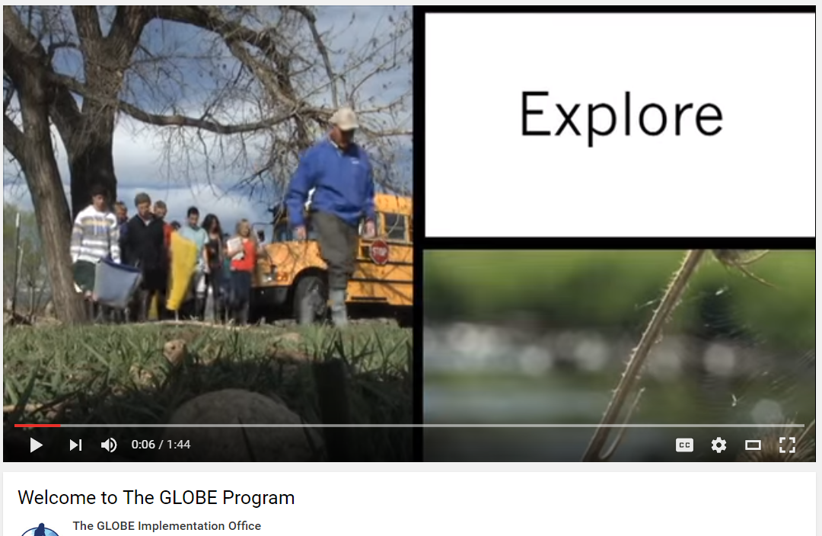
Introduction to GLOBE
https://www.youtube.com/watch?v=bEzdkvwSDn8
Notes:
The GLOBE Program has a YouTube channel with various videos that you can show during training, or provide the links for teachers to access after the training.
The GLOBE Implementation Office channel: https://www.youtube.com/c/theglobeimplementationofficegio

Slide 5
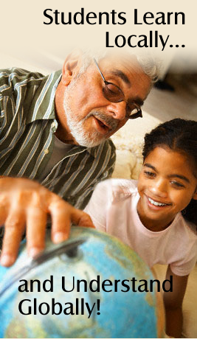
Do GLOBE
  Students:
  Observe their environment and ask questions
  Collect environmental data and report their observations to the GLOBE data base
  Create maps and graphs on the GLOBE Web site
  Analyze data and conduct research with scientists and other students
  Publish research results and share their data & findings with others via the Internet
  Collaborate with other students and scientists around the world

Slide 6
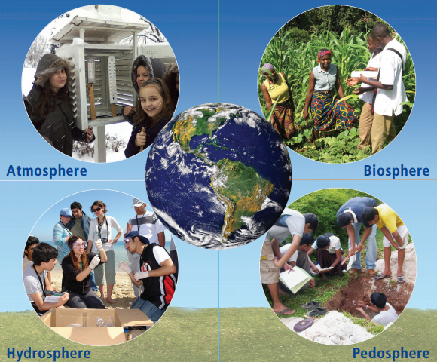
GLOBE Science Investigation Protocols

Slide 7
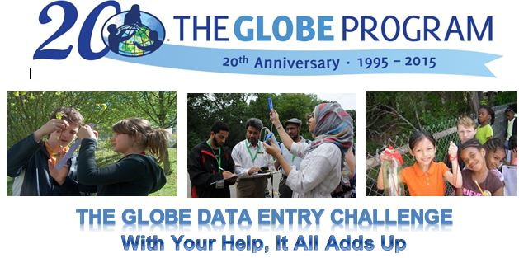
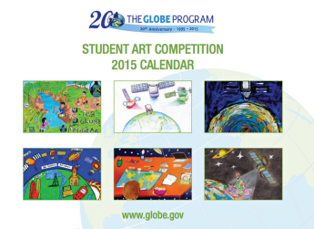
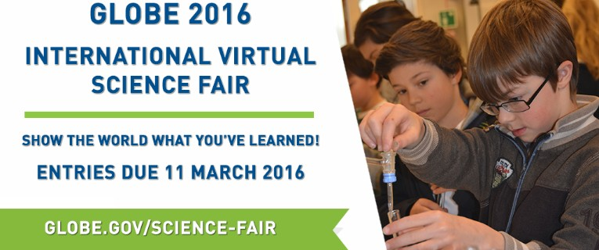
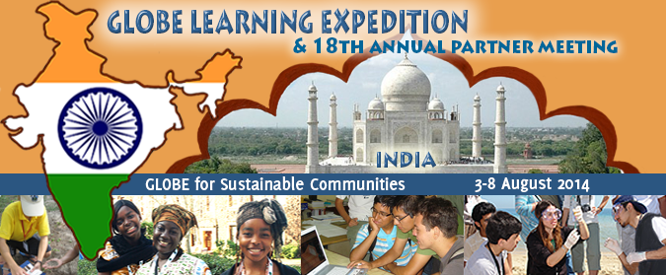
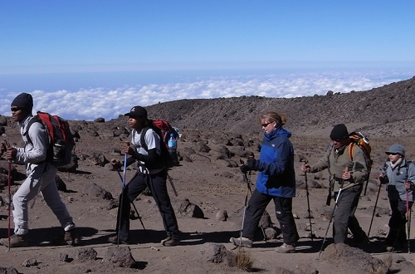
GLOBE Engagement Events
Mt. Kilimanjaro Student Expedition
Notes:
GLOBE Sponsors a number of events throughout the year to encourage active participation in the program.
Data Challenges
Virtual and Local Science fairs
Mt Kilamanjaro Expedition
Field campaigns (by any scientist but NASA sponsors some)
Student field research and research presentation at the GLOBE Annual Meeting

Slide 8
NASA Resources in Elementary
NASA Education Website http://www.nasa.gov/audience/foreducators/k-4/index.html
NASA Science Education Lessons: http://nasawavelength.org/
The Space Place: http://spaceplace.nasa.gov/
Climate Kids: http://climatekids.nasa.gov/
NASA e-Clips, Our World: http://nasaeclips.arc.nasa.gov/playlists/ourworld
Elementary GLOBE: http://www.globe.gov/web/elementary-globe

Slide 9
Elementary GLOBE
Elementary GLOBE offers storybooks and lessons that enhance literacy skills while encouraging scientific exploration.

Slide 10
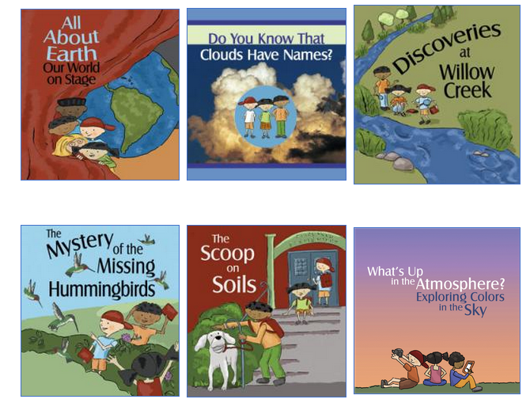
Exploring Earth Science through GLOBE Elementary Story Books
Join the GLOBE Kids as they explore and investigate the natural world!

Slide 11
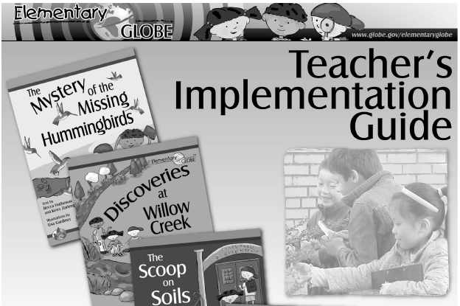
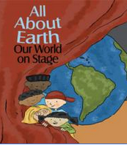
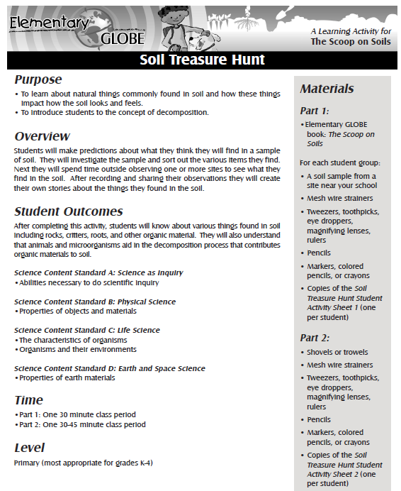
Elementary GLOBE Resources
Teacher Implementation Guide
Storybooks
Learning Activities
* All are FREE online – View or Print
http://www.globe.gov/web/elementary-globe

Slide 12
Available Languages
Elementary GLOBE Books, Activities, and the Teacher’s Guide available in:
Arabic
English
French
German
Spanish

Slide 13

Science and Engineering Practice Skills
Asking Questions
Developing and using models
Planning and carrying out investigations
Analyzing and interpreting data
Using mathematics and computational thinking
Constructing explanations
Engaging in argument from evidence
Obtaining, evaluating and communicating information
Notes:
NGSS (Next Generation Science Standards): http://www.nextgenscience.org/
Full appendix of NGSS Practices: http://www.nextgenscience.org/sites/default/files/Appendix%20F%20%20Science%20and%20Engineering%20Practices%20in%20the%20NGSS%20-%20FINAL%20060513.pdf

Slide 14

Building Science Inquiry & Literacy Skills
Overlapping skills and behaviors:
  note details
  compare and contrast
  predict
  sequence events
  link cause and effect
  distinguish fact from opinions
  link words with precise meanings
  make inferences
  draw conclusions

Slide 15
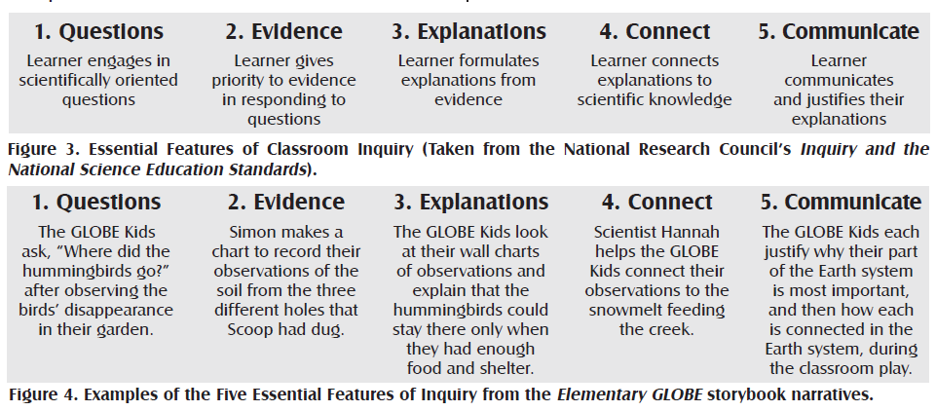
Storybooks & Inquiry

Slide 16
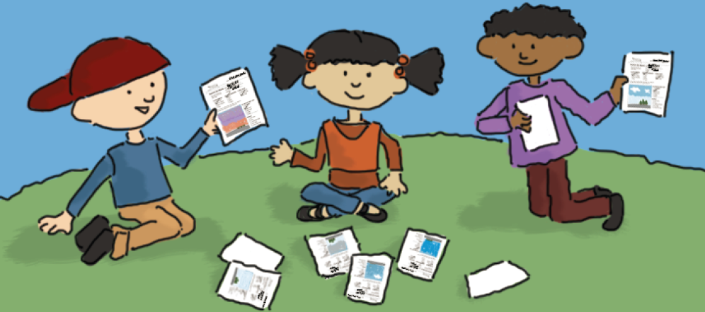
Implementation Strategies

Slide 17
Elementary Strategies
Picture Walk
Word Wall
5 Finger Retell
Inquiry Skills Checklist
Journals

Slide 18
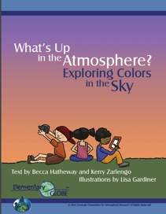
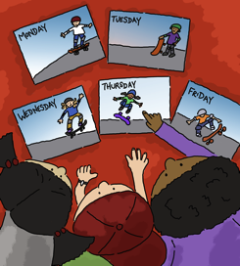
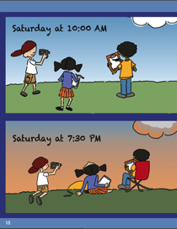
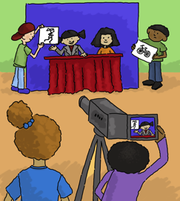
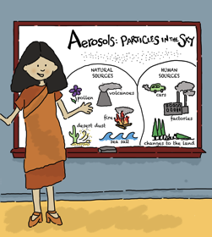
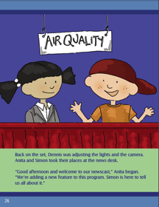
Aerosols Storybook – Picture Walk
Notes:
Picture Walk: The illustrations in the Elementary GLOBE storybooks were meant to engage young learners. In many instances, the illustrations provide information to enhance and enrich the science content of the storybooks and also to introduce new words. For example, on page 19 of the Discoveries at Willow Creek storybook, Simon’s journal includes a water strider, a whirligig beetle, and a water boatman. On page 2 of The Scoop on Soils storybook, the GLOBE Kids’ journals provide useful information on “soil profiles” and also includes centimeters and inches as ways to record measurement. When reading the storybooks, pause periodically and ask your students to discuss what is going on in the storybook illustration. Ask your students to use vocabulary words from the word wall to describe what they see in the storybook illustrations.

Slide 19
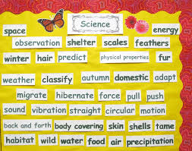
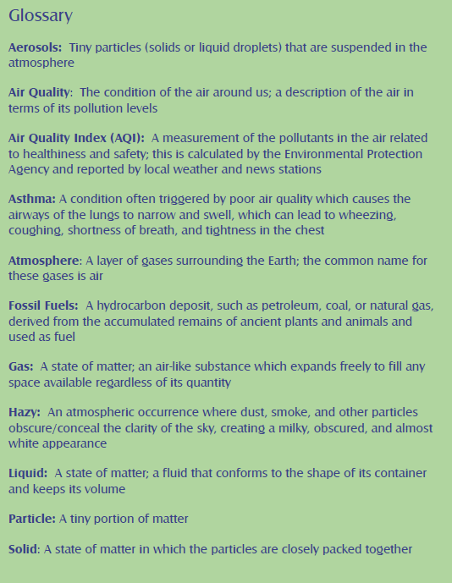
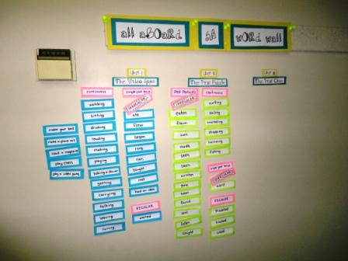
Vocabulary Development - Word Wall
Notes:
Word Wall: Before reading the Elementary GLOBE storybooks or working through one of the learning activities with your students, list key vocabulary words on the board or on a piece of chart paper. Introduce these words to your students before you read the storybooks or work on the learning activities. As you read the storybooks or learning activities, continue to add to the word wall as you and your students encounter new and relevant vocabulary words. Encourage your students to refer to the word wall when they read the storybooks, write in their journals, or record information on the Student Activity Sheets.

Slide 20
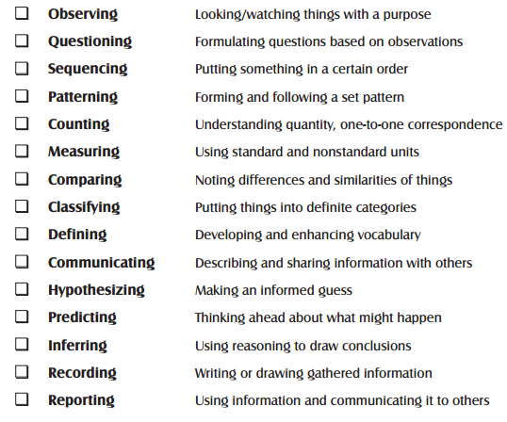
Inquiry Skills Checklist

Slide 21
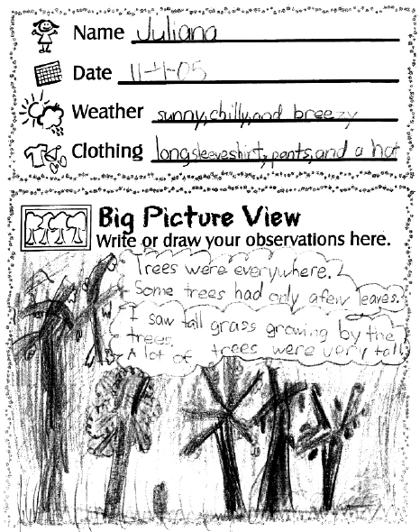
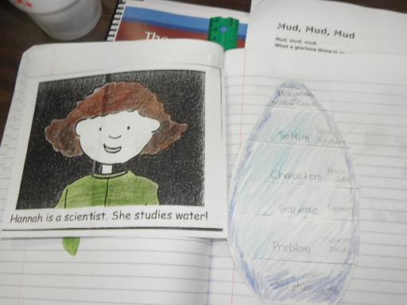
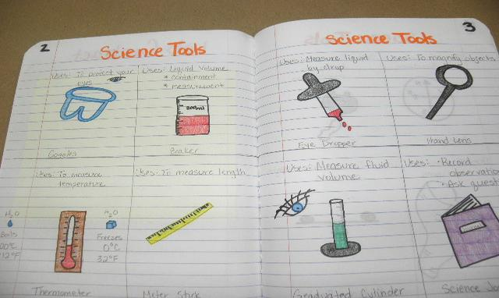
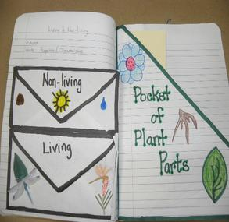
Journaling
Notes:
Journaling - The GLOBE Kids make frequent use of their science journals. They write and draw in their journals as they investigate the world around them. In The Mystery of the Missing Hummingbirds, the students use their journals to record observations in their school garden. Simon, Dennis, and Anita record information about the soil profiles they find in The Scoop on Soils. And in Discoveries at Willow Creek, the GLOBE Kids compare information in their journals from visits during two different seasons to the creek to learn how that environment has changed.
Keeping a science journal provides a place for students to record information and helps them focus their observations. Student journals allow for literacy connections in your science curriculum by encouraging students to write and communicate their thoughts.
The Elementary GLOBE Student Activity Sheets found in the learning activities can be used individually or made into a notebook or journal. These notebooks can also include blank pages where students have space for recording information in freeform style. You can also use composition books as journals and insert the Student Activity Sheets into the composition book once they are complete.

Slide 22
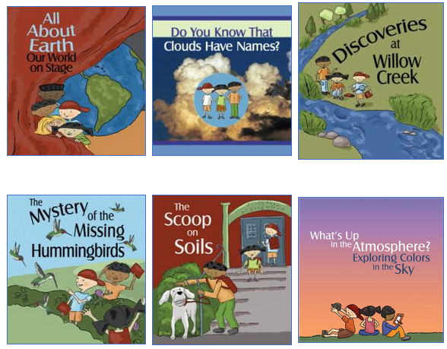
Storybooks
Main Characters: GLOBE Kids and Teacher
Teacher’s Notes & Glossary
  Aerosols
  Seasons
  Water
  Soil
  Clouds
  Earth as a System

Slide 23
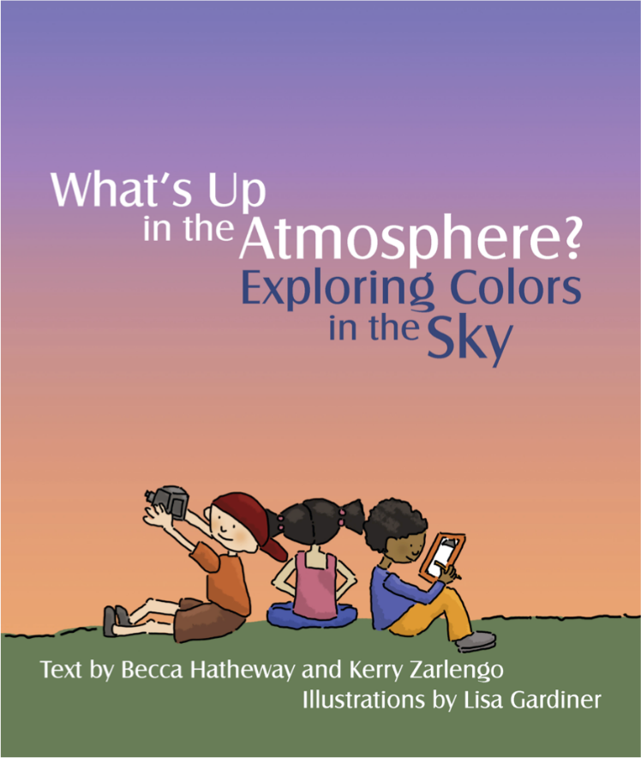
Aerosols Storybook
What color is the sky today? Anita, Simon, and Dennis want to know why the sky isn't always blue. They learn that there's a lot more than air in the atmosphere, which can affect the colors we see in the sky.

Slide 24
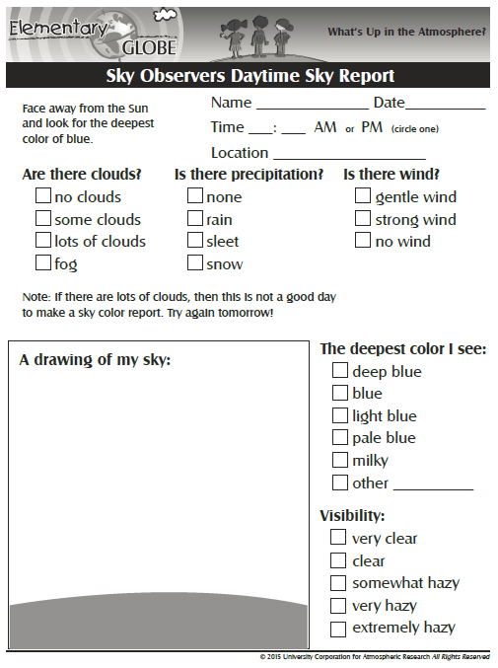
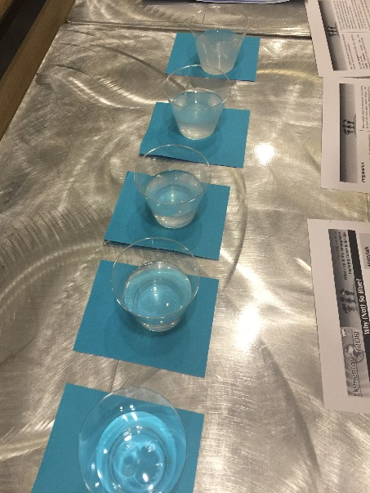
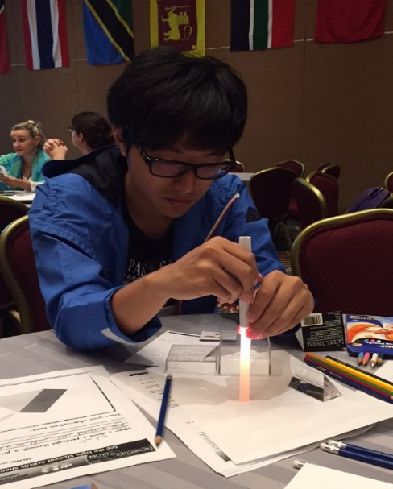
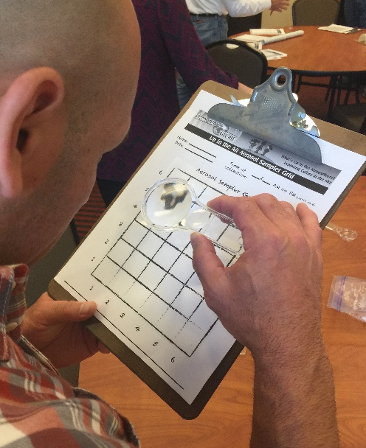
Aerosols – Learning Activities
Sky Observers
Why (Not) So Blue?
See the Light
Up in the Air
Notes:
Sky Observers. Students will make observations of the sky, record their findings and share their observation reports with their peers. View webstory, Become an Atmosphere Observer: http://science-edu.larc.nasa.gov/skycolor/
Why (Not) So Blue? Students will conduct an experiment to see how drops of milk will affect color and visibility in cups of water representing the atmosphere.
See the Light. Students will use prisms and glue sticks to explore the properties of light.
Up in the Air. Students will work in groups to make an aerosol sampler, a simple adhesive tool that allows students to collect data and estimate the extent of aerosols present at their school.

Slide 25
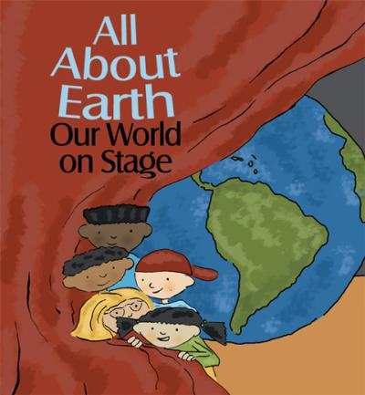
Earth System - Storybook
The GLOBE Kids are excited to perform a play demonstrating what they have learned about the Earth and its parts. A problem comes up when the Kids start to argue about which component of the Earth system is most important and should have the lead role in the play. As the Kids work through the components, they come to understand the importance and interconnectedness of the sun, water, air, soil, and living things.

Slide 26
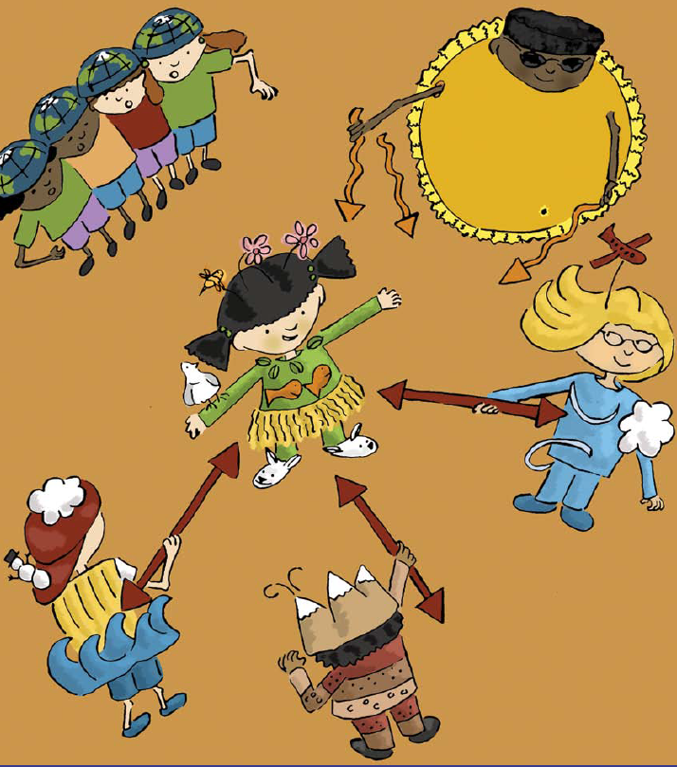
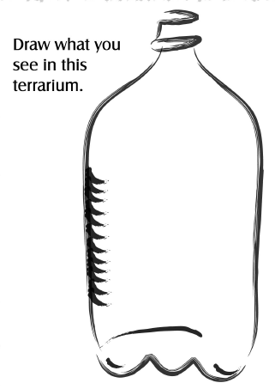
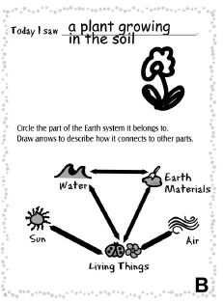
Earth System – Learning Activities
Earth System in a Bottle
We’re All Connected
Earth System Play
Notes:
Activity 1: Earth System in a Bottle. Students will be able to conduct an experiment designed to test a plant’s need for water, sunlight, and soil.
Activity 2: We’re All Connected. Students will be able to explain how the Earth’s processes and components are interconnected.
Activity 3: Earth System Play. Students will be able to demonstrate their knowledge of how water, air, soil, and living things interact in the Earth system.

Slide 27
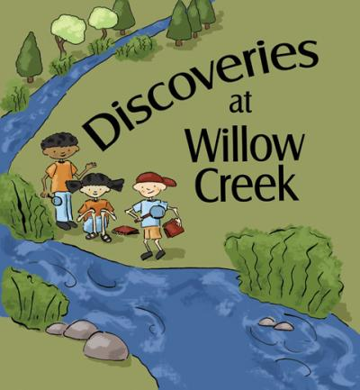
Water - Storybook
On their second visit to Willow Creek, the GLOBE Kids discover why the creek looks different from their previous visit. They make observations, take measurements, and look for critters in the water.

Slide 28
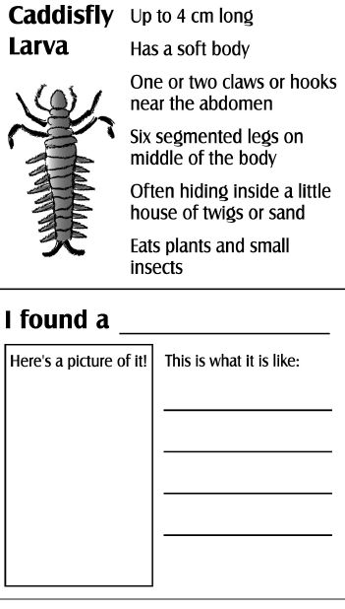
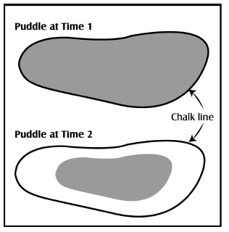
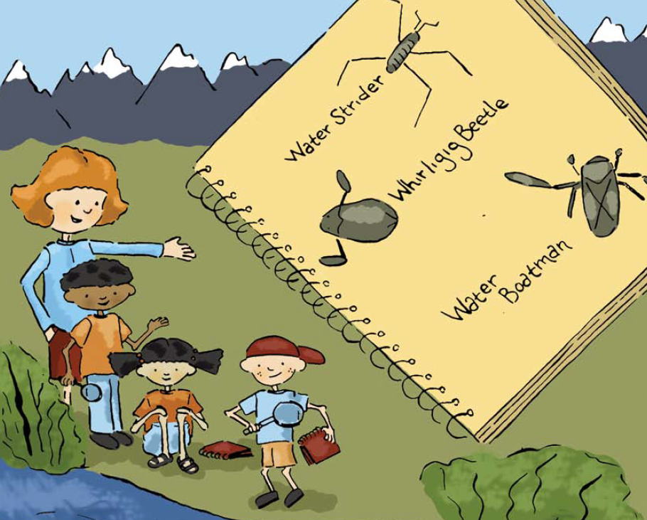
Water – Learning Activities
Magnify That
Measure Up
Water Wonders
Notes:
Activity 1: Magnify That. Students will be able to identify a magnifying lens and explain its purpose. They will be able to explain why an object looks different.
Activity 2: Measure Up. Students will be able to make nonstandard and standard linear measurements.
Activity 3: Water Wonders. Students will be able to describe adaptive features of aquatic macroinvertebrates and their importance in the scientific study of waterbodies.

Slide 29
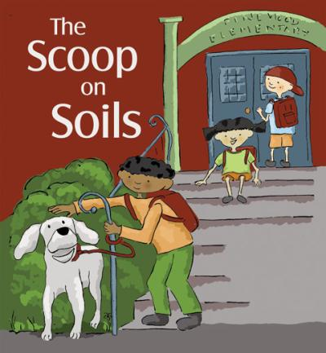
Soils - Storybook
The GLOBE Kids are on the trail of Scoop, an eager dog who loves to dig holes in the soil. At each hole Scoop has dug, the Kids use their journals to record the soil color, texture, and structure.

Slide 30
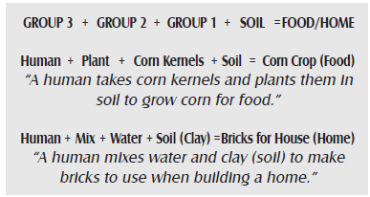
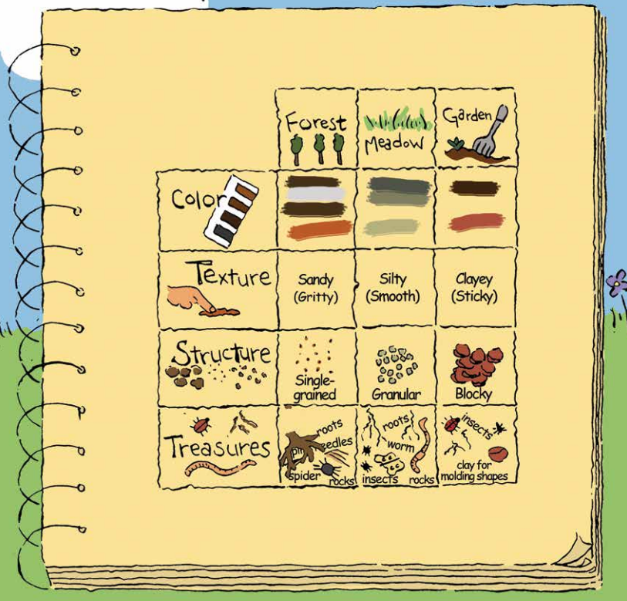


Soils – Learning Activities
Getting to Know Soil
Soil Treasure Hunt
We All Need Soil!
Notes:
Activity 1: Getting to Know Soil. Students will be able to describe a soil profile and will be able to explain the different properties of soil, including texture, color, and size.
Activity 2: Soil Treasure Hunt. Students will be able to list things found in soil such as rocks, roots, critters, and organic materials.
Activity 3: We All Need Soil! Students will be able to explain soil’s function for plants and animals and the overall importance of soil science.

Slide 31

Clouds - Storybook
The GLOBE Kids share information about the different cloud types by acting out analogies related to cloud shapes.

Slide 32



Clouds – Learning Activities
Cloud Fun
Cloudscape
To Spread or Not to Spread
Notes:
Activity 1: Cloud Fun. Students will be able to describe the shape and appearance of cumulus clouds. They will be able to explain what kind of weather is to be expected when cumulus clouds are present.
Activity 2: Cloudscape. Students will be able to identify cloud types using cloud classification names.
Activity 3: To Spread or Not to Spread. Students will be able to identify the three types of contrails.

Slide 33

Seasons - Storybook
The GLOBE Kids wonder why the ruby-throated hummingbirds have stopped visiting the school garden. The Kids conduct an investigation, learning more about the needs of the ruby-throated hummingbirds and the seasonal changes where they live. During their investigation, they learn about the natural environment in Costa Rica, where the hummingbirds spend the winter.

Slide 34





Seasons – Learning Activities
All Year Long
The Colors of the Seasons
Honing in on Hummingbirds
Notes:
Activity 1: All Year Long. Students will be able to describe the seasonal changes in a local habitat by making detailed observations, recording their results, making comparisons, and sharing information with others.
Activity 2: The Colors of the Seasons. Students will be able to explain how colors in nature relate to their local environment and to seasonal changes within that environment.
Activity 3: Honing in on Hummingbirds. Students will be able to conduct a research project related to ruby-throated hummingbirds and will be able to communicate their results using different formats.

Slide 35







Elementary GLOBE Progression Example
Book -> Activities -> GLOBE Data Collection
Green-Up/Green Down Protocol

Slide 36

Become GLOBE Certified through eTraining

Slide 37

Notes:
Share Elementary GLOBE Resources with the Community. Must be signed-in to view.

Slide 38
Contact Information

