Slide 1
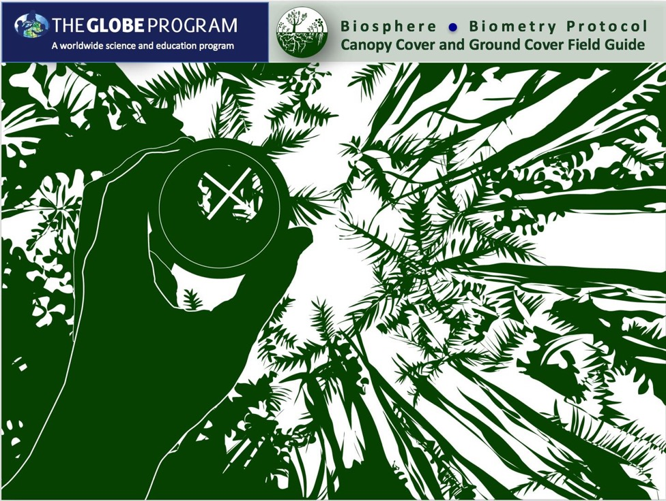

Slide 2

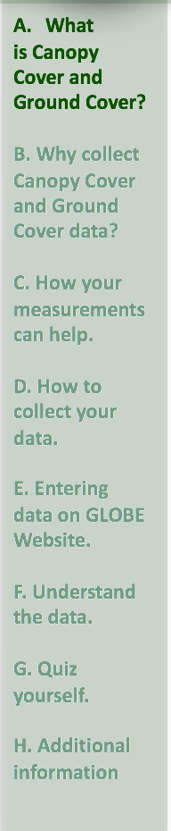
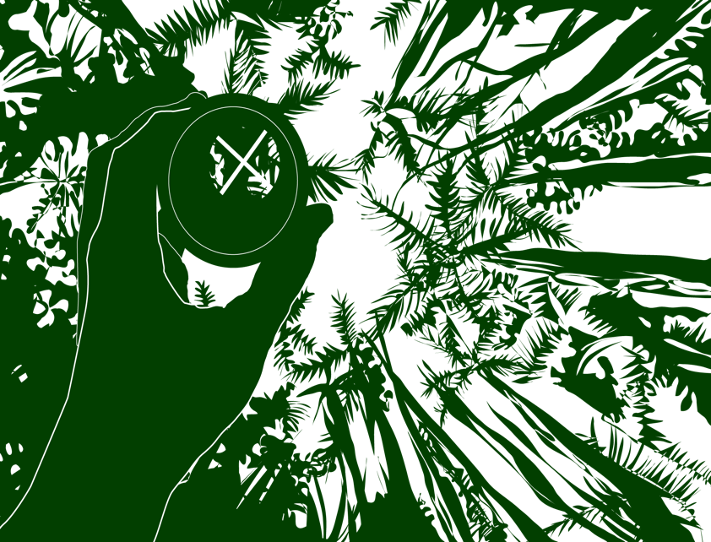
Overview
This module:
Reviews the selection of a GLOBE land cover study site
Reviews the procedure for locating your site using a GPS receiver
Provides a step by step introduction of the protocol method
Learning Objectives
After completing this module, you will be able to:
Define canopy cover and ground cover and explain how these measurements can support understanding of satellite images
Understand the importance of quality control steps in the collection of accurate data
Explain how canopy cover and ground cover measurements are used to determine a site’s MUC Classification
Conduct canopy cover and ground cover measurements in the field
Upload data to the GLOBE database
Visualize data using GLOBE’s Visualization System
Estimated time to complete module: 1.5 hours

Slide 3
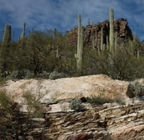
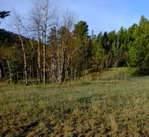
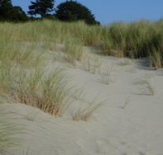
The Biosphere
The Biosphere is Earth’s zone of life. Every organism on Earth belongs to the biosphere. GLOBE has several ways to explore and measure components of the Biosphere through investigations in land cover, phenology, and carbon storage. Some GLOBE Hydrosphere investigations also include measurements of organisms: the macroinvertebrate and mosquito larvae protocols.
Like all parts of the Earth system, the Biosphere is subject to change. We can quantify these changes by taking measurements over time, and compare what we saw in the past to what we see in the present.
Canopy Cover and Ground Cover measurements are part of GLOBE’s Biosphere protocols.
Photo Credit: Shelley E. Olds

Slide 4
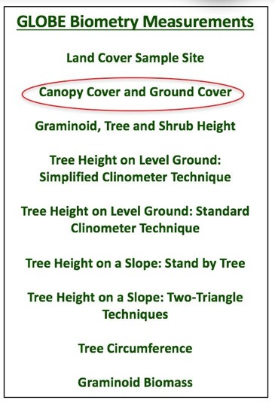
What is Biometry?
Biometry is the measuring of living things. A scientist is interested not only in the characteristics of vegetation at a study site, but also how it is distributed. How dense is the forest? Does sunlight penetrate to the forest floor? Is the landscape dominated by grasses? Has there been a recent disturbance, such as a forest fire or flood? These are questions that are answered by taking biometric measurement of land cover.
In this protocol, you will be measuring canopy cover and ground cover. Land cover is a general term for the differences in vegetation we see on the land. Canopy cover and ground cover are two land cover measurements.
The GLOBE Biometry Protocols (list, right) will assist you in determining the MUC classification of your study site.

Slide 5
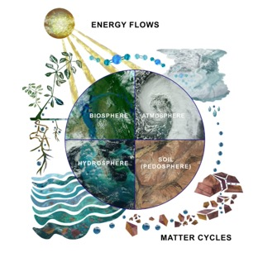
Why Study Land Cover?
Land cover includes both developed and natural areas. All living things depend on their habitat, or land cover, for survival. They find shelter, food, and protection there. Land cover has a direct effect on the kinds of animals that will likely inhabit an area. Therefore, land cover is of great interest to ecologists, who study how plants and animals relate to their environment.
The Earth System: Energy flows and matter cycles.
Land cover can influence weather, soil properties, and water chemistry. Different land cover types are all distinct in their effects on the flow of energy, water and various chemicals between the air and surface soil. Knowing what types of land cover occur is important for a variety of Earth system science investigations.

Slide 6
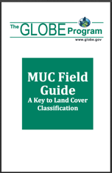
GLOBE Land Cover Investigations
Land cover is a general term used to describe what is on the ground covering the land. Different land cover terms are used to describe the differences we see when we look at the land. Scientists classify land cover based on established criteria. This is done so that there is a consistent use of terms among people. For instance, what one person may call a forest living in the tropical Amazon may be quite different from a person living in northern Canada. Different species of trees live in these places, trees may be of different heights and the amount of ground and canopy cover may be quite different. For this reason, we need a standardized way to describe land cover.
GLOBE uses a land cover classification scheme called Modified UNESCO Classification (MUC). There are many different types of classification schemes used. These are often designed for specific places or regions. MUC can be used around the world and allows people to contribute to a global database.

Slide 7
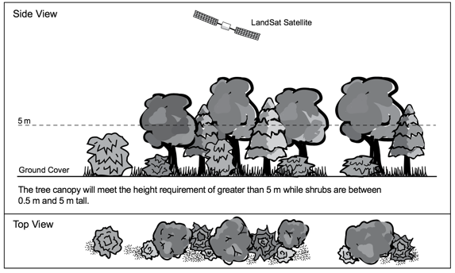
What is Canopy Cover?
Canopy cover describes the proportion of land area covered by either tree crowns or shrub crowns, as viewed from the air. It is a measurement used to describe the density of trees in a forest or tree stand, and the cover of shrubs in a shrubland. It helps to correctly choose the correct MUC land cover type.
Canopy
Cover

Slide 8
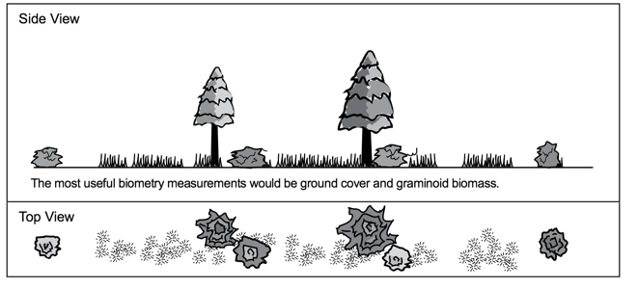
What is Ground Cover?
Ground Cover refers to the proportion of land that is covered by vegetation. This measurement is useful for calculating standing biomass, as well as understanding erosion and other geological processes taking place on the landscape. As with canopy cover, it helps to correctly choose the correct MUC land cover type.
Ground Cover

Slide 9
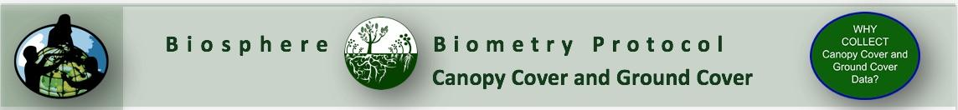
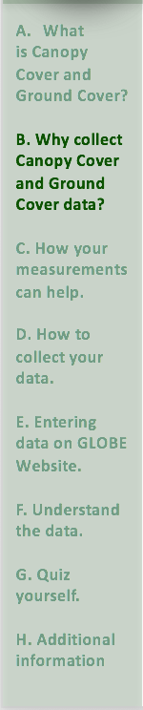
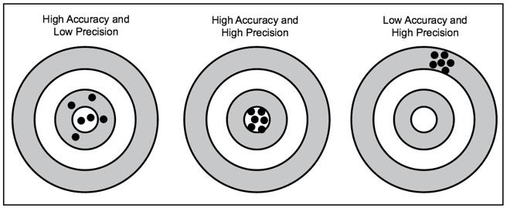
Accuracy vs. Precision
Accuracy is a measure of how well the data describe a phenomenon. Precision is demonstrated when repeated measurements yield the same outcome. In most GLOBE protocols, you are asked to take a measurement 3 times – allowing for you – as well as others – to determine the precision of your data.

Slide 10
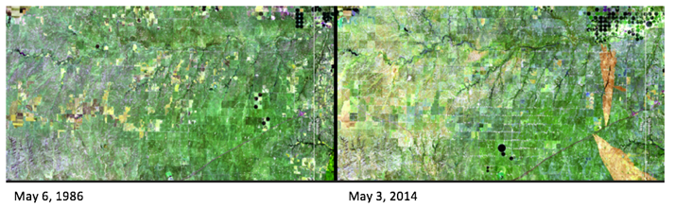
Why Collect Canopy Cover and Ground Cover Data?
Measuring canopy cover and ground cover is a class of biometric measurements that allows us to understand the movement of materials through the Earth system, as well as interpret remotely sensed images of vegetation cover from satellites. By making quantitative measurements, it is possible to document vegetation changes that take place on the landscape over time.
These images show a portion of the Texas Panhandle, bordering Oklahoma. The area contains more than 3,600 oil and natural-gas wells, seen here as white spots. The reduced vegetation (green) in the 2014 image was caused by several recent years of drought. Other visible changes include additional center-pivot irrigation systems (dark circles) and several new burn scars from wildfires in March 2014. Source: NASA Images of Change.

Slide 11
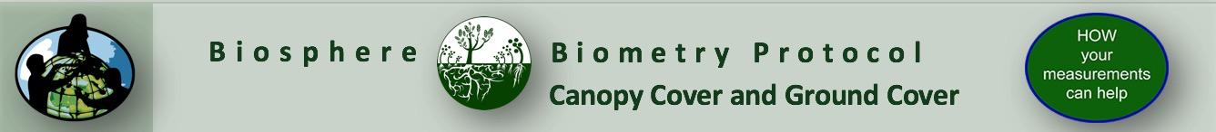

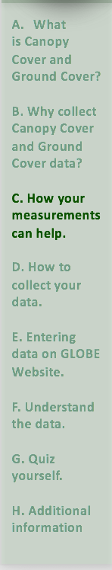
Let’s do a quick review before moving onto data collection! Question 1
1. What part of the Earth system is known as the zone of life?
A. Atmosphere
B. Biosphere
C. Lithosphere
D. Hydrosphere
Do you know the answer?

Slide 12
Let’s do a quick review before moving onto data collection! Answer to Question 1
1. What part of the Earth system is known as the zone of life?
A. Atmosphere
B. Biosphere- ☺ correct!
C. Lithosphere
D. Hydrosphere
Were you correct?

Slide 13
Let’s do a quick review before moving onto data collection! Question 2
2. If you wanted to investigate a question such as, “How dense is the forest?” or “Is the landscape dominated by grasses?”, you would do this kind of measurement:
A. Biometry
B. Phenology
C. Lithosphere
    D. Hydrosphere
Do you know the answer?

Slide 14
Let’s do a quick review before moving onto data collection! Answer to Question 2
2. If you wanted to investigate a question such as, “How dense is the forest?” or “Is the landscape dominated by grasses?”, you would do this kind of measurement:
A. Biometry ☺ correct!
B. Phenology
C. Lithosphere
    D. Hydrosphere
Were you correct?

Slide 15
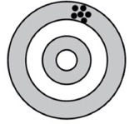
Let’s do a quick review before moving onto data collection! Question 3
3. Look at this image. Is this an example of:
A. High accuracy, low precision
B. High accuracy, high precision
C. Low Accuracy, high precision
What is your answer?

Slide 16
Let’s do a quick review before moving onto data collection! Answer to Question 3
4. Look at this image. Is this an example of:
A. High accuracy, low precision
B. High accuracy, high precision
C. Low Accuracy, high precision ☺ correct!
Were you correct? Let’s now look at how to collect your data!

Slide 17
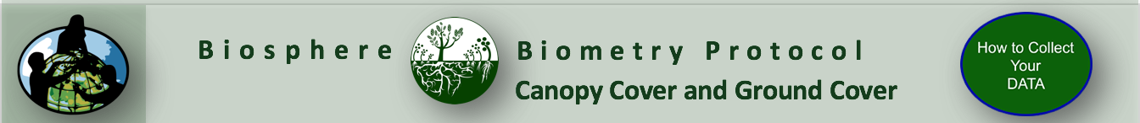
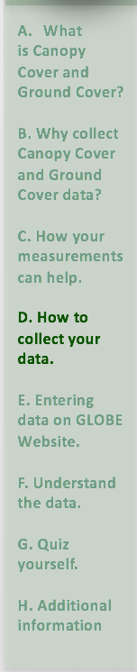
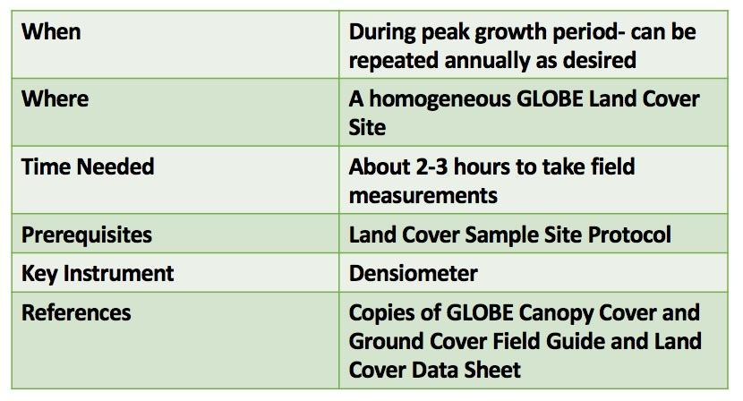
How to Collect Data: What do you need to start?

Slide 18
Time and Frequency of Data Collection
The protocol requires measurements of canopy cover. For this reason, the best time to complete this measurement is when the leaves are open, that is, during the growing season. The measurements will take between 1-3 hours.
The frequency of the measurements you decide to take will depend on your research questions and goals. For instance:
You can take biometry measurements only once in a site during peak growth. You use the data to determine the correct MUC choice.
You can take measurements twice a year, during peak growth and dormancy periods (winter or drought), to measure seasonal change.
You can return to the same study site year after year and repeat the biometry measurements to track changes in site biomass over time.

Slide 19
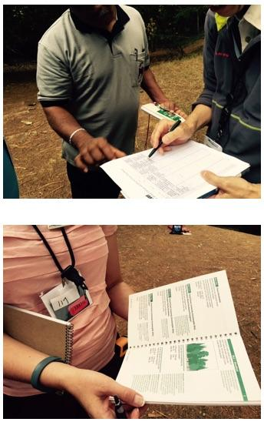
Before you Begin: Prerequisite Measurements
Before you begin taking Canopy Cover and Ground Cover measurements, you will need to have already identified your Land Cover Sample Site. Measurements taken using the Canopy Cover and Ground Cover Field Guide will support completion of the Land Cover Sample Site Protocol. Ultimately, you will be able to identify the scientific classification of the plant community observed using the MUC Guide.
This tutorial provides the directions for completing measurements in the Canopy Cover and Ground Cover Field Guide. If you are ready to begin documentation of Canopy Cover and Ground Cover, start with the next slide.

Slide 20
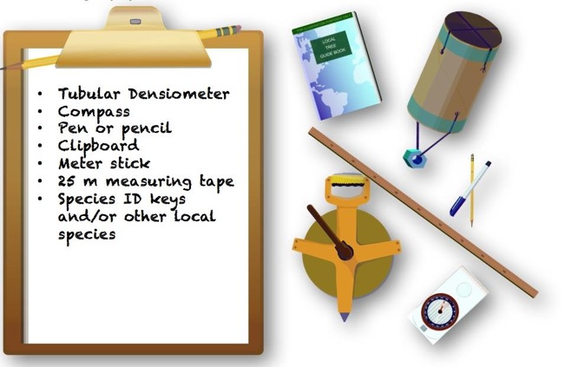
To Describe Canopy Cover and Ground Cover, You Will Need the Following Equipment:

Slide 21
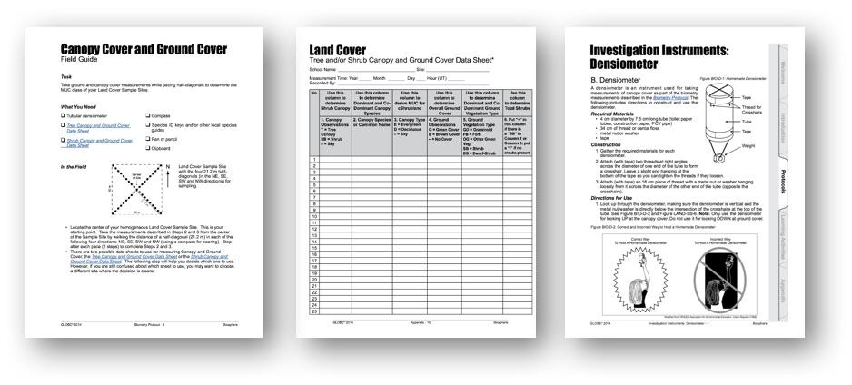
To Describe Canopy Cover and Ground Cover, You Will Need the Following Documents:
Canopy Cover and Ground Cover Field Guide
Tree and/or Shrub Canopy and Ground Cover Data Sheet
Biosphere Investigation Instruments: Denisometer
Biometry Protocol

Slide 22
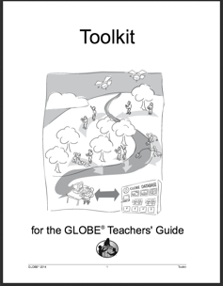
Sources for Equipment You Need:
Instructions for making a homemade densiometer follow on the next slide.
For Other Equipment:
The following resources summarize the measurements associated with each protocol, associated skill level, scientific specifications for the instruments, and how to access the equipment you need (purchase, build, or download).
Where to find specifications for instruments used in GLOBE investigations
Where to find scientific instruments used in GLOBE investigations

Slide 23
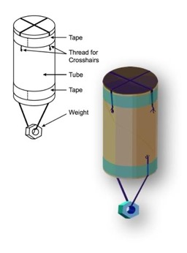
Build Investigation Instrument- Densiometer
A densiometer is an instrument used for taking measurements of canopy cover. The following includes directions to construct and use the densiometer.
Required Materials
4 cm by 7.5 cm long tube (toilet paper tube, construction paper, PCV pipe)
34 cm of thread or dental floss
Metal nut or washer, tape
Construction
Gather the required materials.
Attach with tape two threads across the diameter of one end of the tube to form a crosshair. Leave a short end that you can pull to tighten the thread if necessary.
Attach with tape an 18 cm piece of thread with a metal nut or washer hanging loosely from it across the diameter of the other end of the tube, across from the crosshairs.

Slide 24
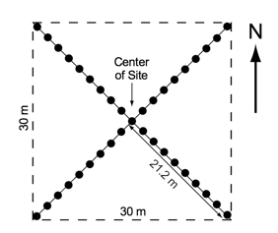
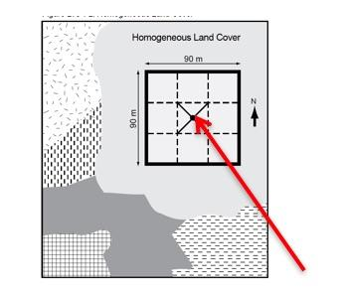
Identify Your Sample Area in the Field
Before you take canopy and ground cover measurements, you need to have defined your Land Cover Study Site. You will be returning to the location of your Land Cover Sampling Site that you identified in a previous field excursion.
Land Cover Sample Site with the four 21.2 m half-diagonals In the NE, SE, SW and NW directions for sampling.
Locate the center of your homogeneous Land Cover Sample Site. This is your starting point.

Slide 25
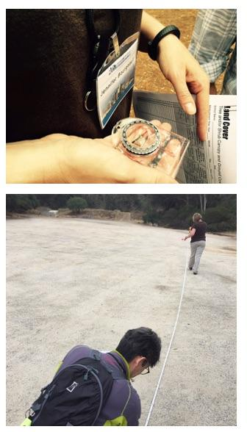
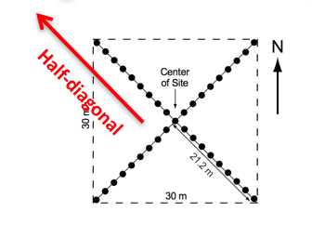

Define your Half Diagonal Transects
You will make your measurements by walking the distance of a half-diagonal (21.2 m) in each of the following four directions: NE, SE, SW and NW (use a compass to determine the directions.) For instructions how to use the compass, see
Biosphere Investigation Instrument: Compass
You will stop after each pace (2 steps) to make each measurement.
Before you begin you will need to “pace yourself”- calculate how many paces you make in 21.2 meters. Do this by stretching a meter tape 21.2 meters, and walk the tape, counting your steps. A pace is two steps.

Slide 26
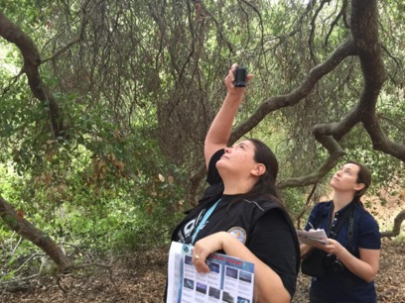
Canopy Cover and Ground Cover Protocol Steps
After you identify your sampling area, continue to follow the Canopy Cover and Ground Cover Field Guide, beginning with step 2 in the guide. You will be able to determine the dominant canopy cover through calculations at the end of the protocol.

Slide 27
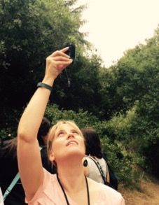
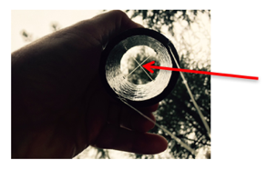
Begin at Step 2. Canopy Cover Measurements
You will take a measurement each pace as you walk your half diagonal transect.
Look up through your densiometer at the canopy, making sure it is vertical and that the metal nut/washer is directly below the intersection of the crosshairs at the top of the tube. Look at the highest canopy in your spot.
a. If you see vegetation, twigs or branches at the crosshairs, record a (+) on the data sheet. If you see sky at the cross, record a (-).
Here, the sighting threads crossover on vegetation= + reading will be recorded on the data table.
When using densiometer, be sure you are looking straight up, perpendicular to the ground.

Slide 28
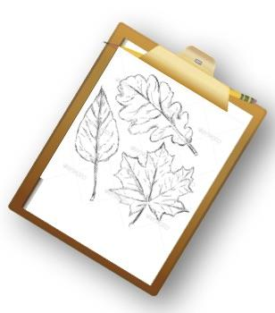
Decide Whether the Canopy is Dominated by Trees or by Shrubs
Identify whether the plant you see through the densiometer is a tree (T) or a Shrub (Sh).
If you record a (+), identify the species name. If you do not know the genus and species but know the common name, record the common name. If you do not know the common name, collect a leaf or describe or sketch it for identification later in the classroom.
Remember that trees are over 5 m. If the
plant is 50 cm-5 m, it is categorized as a shrub.

Slide 29
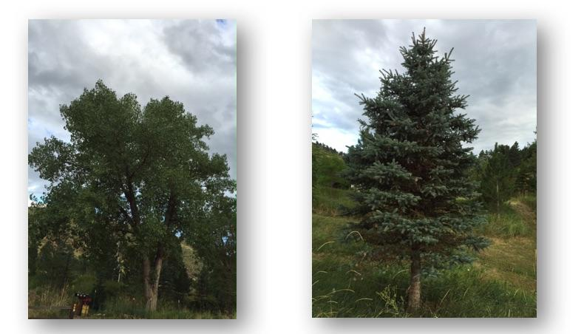
Canopy Cover Measurements
Record the canopy type as Evergreen (E) or Deciduous (D) on the data table.
Deciduous trees and shrubs have flat, broad leaves and shed their leaves at the end of the growing season, usually fall in temperate climates, or the onset of the dry season in tropical climates.
Evergreen trees and shrubs retain their needles or scales throughout the year.

Slide 30
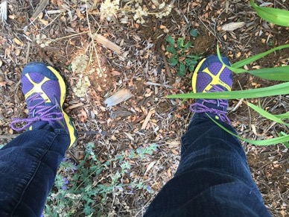
3. Describing Ground Cover
At each pace, you will describe both the canopy and the ground cover. After you describe the canopy, look down. To describe ground cover, stand with your feet shoulder-width apart and look down and observe any vegetation that is touching your foot or touching below the knee. Do not pick up your foot, only describe the vegetation touching you without moving.
Common fieldwork error: do not measure ground cover by looking down using the densiometer! Use the densiometer for canopy cover only!

Slide 31

Measuring Ground Cover
(3) If the vegetation is green (alive), record a (G) on the data sheet.
If the vegetation is green, record if it is graminoid (grasslike) (GD), other green vegetation (OG), Shrub (SB) or Dwarf Shrub (DS).
If the vegetation is brown but still attached, record a (B).
If there is no vegetation, record a (-) on the data sheet.
In this photo, the field scientist recorded Graminoid (GD) (on leg) and Other Green vegetation (OG) by big toe on left foot.

Slide 32
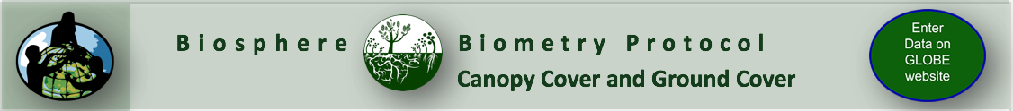
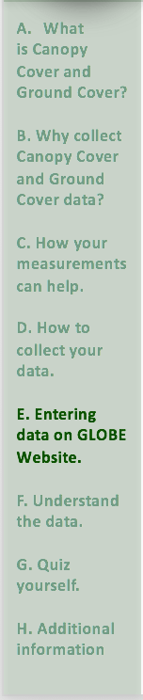
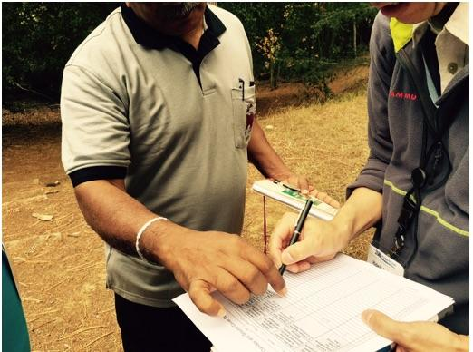
Calculate the Percentages for Each Column of the Data Sheet
4. After you have completed your measurements, fill out the summary tables on the Tree/Shrub Canopy and Ground Cover Data Sheet and calculate percentages.

Slide 33
Let’s do a quick review before moving onto data entry. Question 4
4. When should you take canopy cover and ground cover measurements?
A. All times of year are fine
B. During the peak growth period, usually summer or the wet season
C. Repeat the measurements every two weeks
Do you know the answer?

Slide 34
Let’s do a quick review before moving onto data entry.
Answer to Question 4
4. When should you take canopy cover and ground cover measurements?
A. All times of year are fine
B. During the peak growth period, usually summer or the wet season ☺ correct!
C. Repeat the measurements every two weeks
Were you correct?

Slide 35
Let’s do a quick review before moving onto data entry. Question 5
5. What protocol do you need to complete before taking your canopy cover and ground cover measurements?
A. All the hydrology protocols
B. Land Cover Sample Site Definition
C. The MUC guide Classification
Do you know the answer?

Slide 36
Let’s do a quick review before moving onto data entry.
Answer to Question 5
5. What protocol do you need to complete before taking your canopy cover and ground cover measurements?
A. All the hydrology protocols
B. Land Cover Sample Site Definition ☺ correct!
C. The MUC guide Classification
Were you correct?

Slide 37
Let’s do a quick review before moving onto data entry.
Question 6
6. How do you use your densiometer?
A. Hold perpendicular to the ground, looking up at the canopy, and record what you see in the crosshairs
B. Hold perpendicular to the ground, look down at the groundcover, and record what you see in the cross hairs
C. Both A and B
D. None of the above
Do you know the answer?

Slide 38
Let’s do a quick review before moving onto data entry.
Answer to Question 6
6. How do you use your densiometer?
A. Hold perpendicular to the ground, looking up at the canopy, and record what you see in the crosshairs ☺ correct!
B. Hold perpendicular to the ground, look down at the groundcover, and record what you see in the cross hairs
C. Both A and B
D. None of the above
Were you correct?

Slide 39
Let’s do a quick review before moving onto data entry.
Question 7
7. When you measure ground cover, you should record:
A. All the vegetation in the 50 cm quadrant around your feet
B. The vegetation that touches your foot or your leg under your knee
C. Both A and B
D None of the above
Do you know the answer?

Slide 40
Let’s do a quick review before moving onto data entry.
Answer to Question 7
7. When you measure ground cover, you should record:
A. All the vegetation in the 50 cm quadrant around your feet ☺ correct!
B. The vegetation that touches your foot or your leg under your knee
C. Both A and B
D None of the above
Were you correct? Let’s now look at how to collect your data!

Slide 41
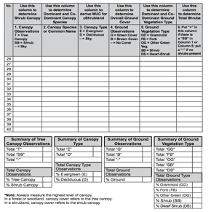
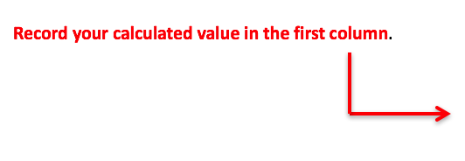
Prepare your Data for Data Entry. Calculate the Percentages for Each Column of the Data Sheet and Enter on the Form- Step 1
Determining the Percentage of Tree or Shrub Canopy Cover (Column 1).
Calculate the percent of tree canopy and shrub canopy and shrub canopy, using the following equation as a model:
% Tree Canopy Cover= # of +’s (Tree Canopy) x 100
# of Total Observations
% Shrub Canopy Cover= # of +’s (Shrub Canopy) x 100
# of Total Observations

Slide 42
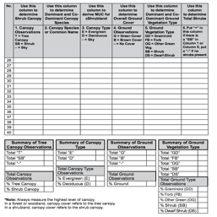
Calculate the Percentages for Each Column of the Data Sheet and Enter on the Form- Step 2
Determining the Percentage of Evergreen or Deciduous Canopy Cover (Column 2).
Calculate the percent Evergreen or Deciduous Canopy Cover, using the following equation as a model:
% Evergreen= # of E’s(Evergreen Observations) x 100
# of E’s + D’s (Total Canopy Type Observations)
% Deciduous= # of D’s (Deciduous Observations) x 100
# of E’s + D’s (Total Canopy Type)
Record your calculated value in the second column.

Slide 43
Calculate the Percentages for Each Column of the Data Sheet and Enter on the Form- Step 3
Determining the Percentage of Ground Cover (Column 3).
Calculate the percent Ground Cover, using the data collected. Use the following equation as a model:
% Ground Cover= # of G’s(Green) + # of B’s (Brown) x 100
# of G’s + B’s + (-) (total observations)
Record your calculated value in the third column.

Slide 44
Prepare Data for Sharing on the GLOBE Website: Calculate the Percentages for Each Column of the Data Sheet
Determining the Composition of Herbaceous Coverage (Column 4). Calculate the percent of the ground that is graminoid, forb or other green vegetation using the data and the following equation as a model:
% Graminoid= # of GD’s (Graminoid Observations) x 100
# of GD’s + # of FB’s + # of OG’s + # of SB’s + # of DS’s
(total Herbaceous Ground Observations)
% Forbs= # of FB’s (Forbs Observations) x 100
# of GD’s + # of FB’s + # of OG’s + # of SB’s + # of DS’s
(total Herbaceous Ground Observations)
% Other Green Vegetation = # of OG’s (Other Green Observations) x 100
# of GD’s + # of FB’s + # of OG’s + # of SB’s + # of DS’s
(total Herbaceous Ground Observations)
% Shrub Vegetation = # of SB’s (Shrub Observations) x 100
# of GD’s + # of FB’s + # of OG’s + # of SB’s + # of DS’s
(total Herbaceous Ground Observations)
% Dwarf Shrub Vegetation = # of DS’s (Dwarf Shrub Observations) x 100
# of GD’s + # of FB’s + # of OG’s + # of SB’s + # of DS’s
(total Herbaceous Ground Observations)
Record your calculated values in the fourth column.

Slide 45
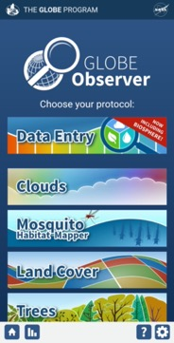
Submit your Data to GLOBE
1.Desktop Data Entry: Log environmental data directly on the GLOBE website.
2.Email Data Entry: If connectivity is an issue, data can also be entered via email.
3.GLOBE Observer App: The app allows users to enter data directly from an iOS or Android device for any GLOBE protocol.

Slide 46
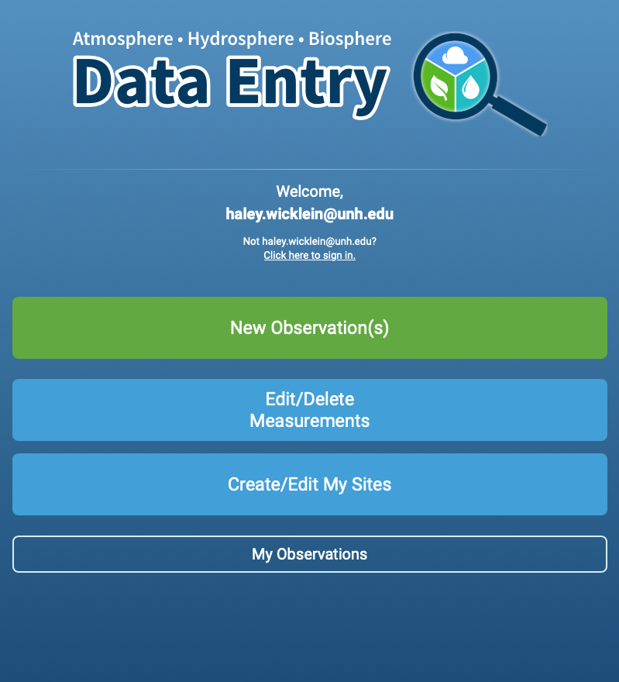
Entering your data via the GLOBE website or GLOBE Observer App
Click “New Observation(s)”

Slide 47
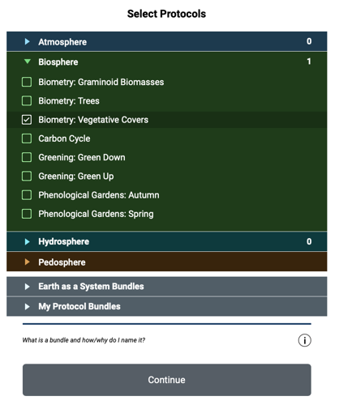
Entering your data via the GLOBE website or GLOBE Observer App
Select “Biometry: Vegetative Covers”
Click Continue
46

Slide 48
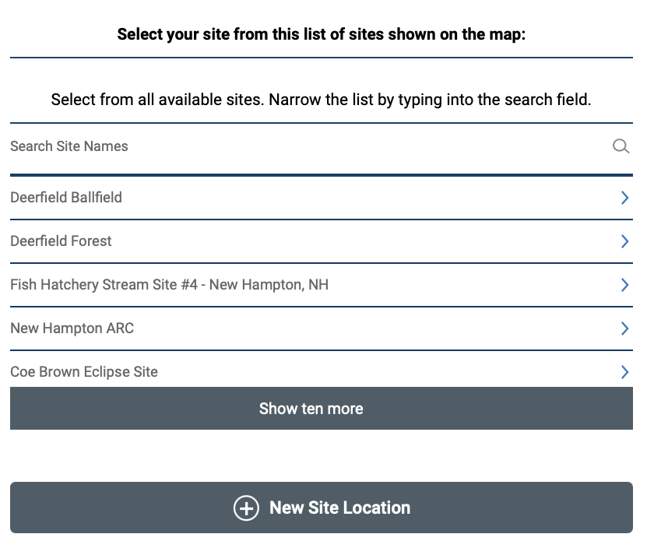
Entering your data via the GLOBE website or GLOBE Observer App
On the location page, scroll down to select your site OR choose “New Site Location” to add a new site.
Tutorials are available on how to add a new site.

Slide 49
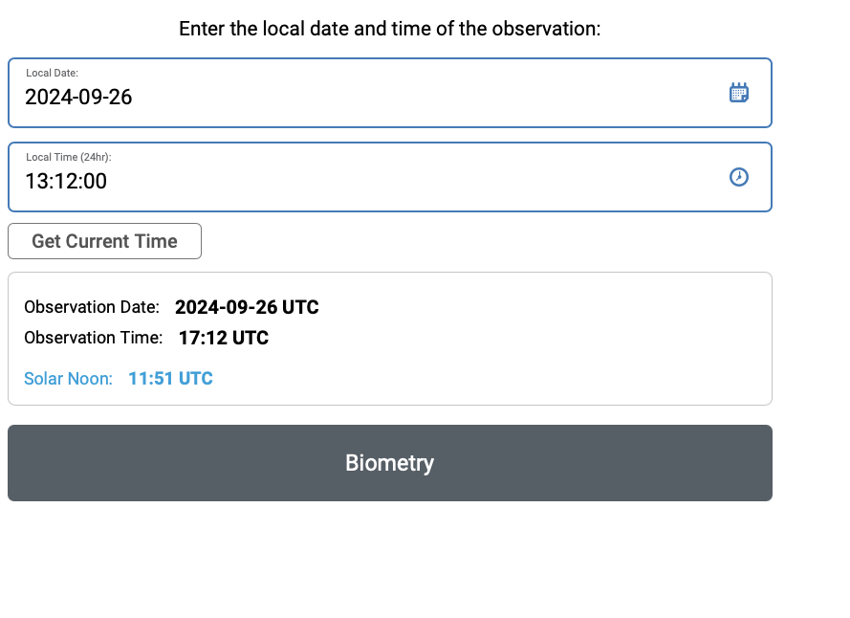
Entering your data via the GLOBE website or GLOBE Observer App
Add the time and date that you collected your data
Click Biometry

Slide 50
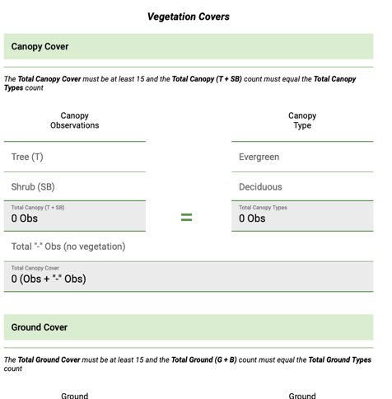
Entering your data via the GLOBE website or GLOBE Observer App
Enter the data from your datasheet into the form.
Be sure that each reporting category you identified totals 100%!

Slide 51
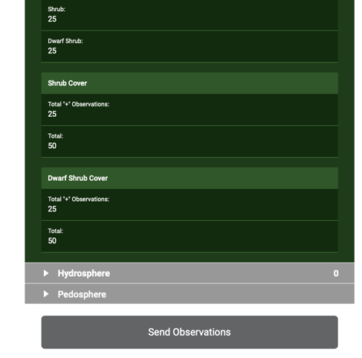
Entering your data via the GLOBE website or GLOBE Observer App
Review the data you entered
Click send observation and wait for the message that your observation was successfully sent!
50

Slide 52
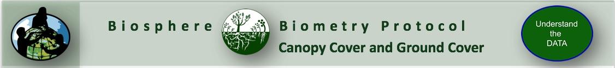


Visualize and Retrieve Data: Select Land Cover
GLOBE provides the ability to view and interact with data measured across the world. Use the visualization tool to map, graph, filter and export Land Cover Classification data that have been measured across GLOBE protocols since 1995.
Click the layers icon.
Click Submit.
Select Land Cover Classification under the Biosphere drop down
See video tutorials on using the GLOBE Visualization system.

Slide 53

Visualize and Retrieve Data: Select Range of Dates
Select the date for which you need Land Cover Classification data.

Slide 54

Visualize and Retrieve Data: Accessing Data
Select the sampling site for which you need Land Cover Classification Data, and a box will open with a data summary for that site.
Click on the table icon to view the data in a table and download it as a .csv for analysis.
Clicking on a location will open to a map note providing data for that location and time.

Slide 55

Understand the DATA You Collect:
The Canopy Cover and Ground Cover Field Guide Protocol gets us one step further toward being able to determine the correct MUC Class of the sampling site.
The MUC Field Guide: A Key to Land Cover Classification is available for download on mobile devices- consult your app store.

Slide 56



Review questions to help you prepare for the Canopy Cover and Ground Cover Quiz:
Canopy Cover and Ground Cover are part of what set of GLOBE Biosphere Protocols?
What environmental factors influence canopy cover?
Why is documenting Canopy Cover important?
What land cover classification scheme does GLOBE use, in order to ensure comparisons between sample sites around the globe?
Canopy cover can be best understood as the view of vegetation from what perspective?
When is the best time to conduct canopy cover and ground cover measurements?
What instrument will you use to conduct canopy cover measurements?
How do you determine where to sample your data in the field- how do you set up half transects?
How do you determine the length of your pace?

Slide 57



Frequently Asked Questions:
What should we do if there is a multi-storied canopy?
If there is a multi-story canopy, try to identify the highest level of the canopy without changing your position. If the vegetation touches the intersection of the crosshairs, mark a (+).
What if the entire circle I see through the densiometer is full of vegetation, but there is no vegetation at the crosshairs? This is a sampling question. The Land Cover/Biology Team has chosen the intersection of the crosshairs as the sample. Therefore, this would be a (–).
What if we can’t get to our site during peak vegetation (full leaf-on) conditions?
If you cannot get to your site during peak growth (leaf-on), measure your site during the leaf-off period and try your best to get the peak growth (leaf-on) data, when you can.

Slide 58
Question for Research Investigations
Once you have used this data to determine the MUC class, there are a number of questions that you can explore:
What natural changes could alter the MUC class of these sites?
Is this MUC class typical for its latitude, longitude and elevation?
If someone only had photos of your site, what MUC class would he/she think this site is?
What other MUC classes are most similar to your site?
How will the land cover of your site affect local climate?
How will the land cover at your site affect your local watershed?
If you compared a Landsat image from ten years ago to one from today how do you think they would differ?
Does the nearest water body affect the vegetation of this site?
What types of animals do you think live here?
How are the land cover and soil characteristics of this site related?
How are the land cover and soil characteristics related?

Slide 59
Questions about content in the module? Contact GLOBE: training@nasaglobe.org
Credits
Slides:
Russanne Low, Ph.D., University of Nebraska-Lincoln
Rebecca Boger, Ph.D., Brooklyn College
Cover Art:
Jenn Glaser, ScribeArts
More Information:
The GLOBE Program
NASA Wavelength NASA’s Digital Library of Earth and Space Education Resources
NASA Global Climate Change: Vital Signs of the Planet
Version 9/26/24. If you edit and modify this slide set for use for educational purposes, please note “modified by (and your name and date “ on this page. Thank you.

