Slide 1
Measuring Tree Height on Level Ground:
Standard Clinometer Technique

Slide 2
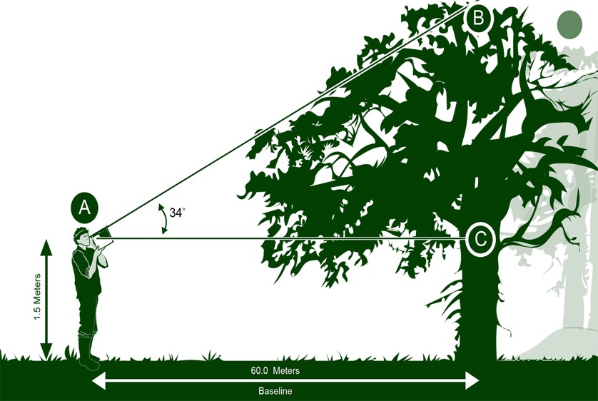
Overview
This module:
Describes how to build a clinometer, the scientific instrument used to obtain tree and shrub height
Provides a step by step introduction of how to measure the height of grass-like plants
Provides a step by step introduction of a protocol method that can be used when measuring tree or shrub height when measuring tree height on level ground
Learning Objectives
After completing this module, you will be able to:
Define graminoid tree and shrub height
Describe the importance of quality control steps in the the collection of accurate data
Explain the difference between accuracy and precision
Conduct graminoid tree and shrub height measurements in the field
Upload data to the GLOBE database
Visualize data using GLOBE’s Visualization System

Slide 3
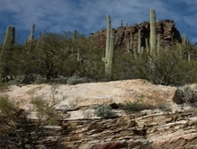
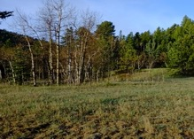
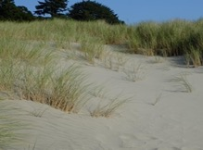
The Biosphere
The Biosphere is Earth’s zone of life. Every organism on Earth belongs to the biosphere. GLOBE has several ways to explore and measure components of the Biosphere through investigations in land cover, phenology, and carbon storage. Some GLOBE Hydrosphere investigations also include measurements of organisms: the macroinvertebrate and mosquito larvae protocols
The protocols for graminoid, tree and shrub height are part of the land cover investigation.
You can find more information in:
Biosphere Introduction
Hydrosphere Introduction
Photo Credit: Shelley E. Olds

Slide 4
What is Biometry?
Biometry is the measuring of living things. A scientist is interested not only in the characteristics of vegetation at a study site, but also how it is distributed. How dense is the forest? Does sunlight penetrate to the forest floor? Is the landscape dominated by grasses? Has there been a recent disturbance, such as a forest fire or flood? These are questions that are answered by taking biometric measurements.
In this protocol, you will be measuring the height of trees, shrubs, and grass-like plants using the Standard Clinometer Technique on Level Ground. These measurements will assist you in determining the MUC classification of your study site.
GLOBE Biometry Measurements
Land Cover Sample Site
Canopy Cover and Ground Cover
Graminoid, Tree and Shrub Height
Tree Height on Level Ground:
Simplified Clinometer Technique
Tree Height on Level Ground: Standard
Clinometer Technique
Tree Height on a Slope: Stand by Tree
Tree Height on a Slope: Two-Triangle Techniques
Tree Circumference
Graminoid Biomass

Slide 5
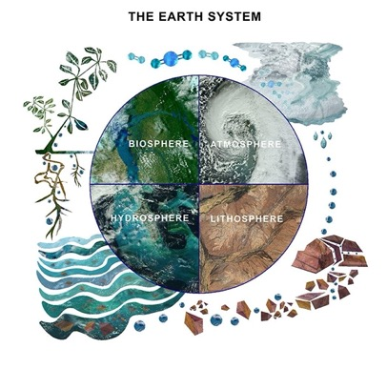
Why Study Land Cover?
Land cover includes both developed and natural areas. All living things depend on their habitat, or land cover, for survival. They find shelter, food, and protection there. Land cover has a direct effect on the kinds of animals that will likely inhabit an area. Therefore, land cover is of great interest to ecologists, who study how plants and animals relate to their environment.
Land cover can influence weather, soil properties, and water chemistry. Different land cover types are all distinct in their effects on the flow of energy, water and various chemicals between the air and surface soil. So, knowing what types of land cover occur is important for a variety of Earth system science investigations.

Slide 6
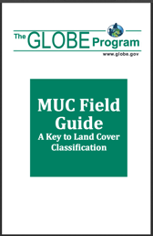
GLOBE Land Cover Investigations
Land cover is a general term used to describe what is on the ground covering the land. Different land cover terms are used to describe the differences we see when we look at the land. Scientist classify land cover based on established criteria. This is done so that there is a consistent use of terms among people. For instance, what one person may call a forest living in the tropical Amazon may be quite different from a person living in northern Canada. Different species of trees live in these places, trees may be of different heights and the amount of ground and canopy cover may be quite different. For this reason, we need a standardized way to describe land cover.
GLOBE uses a land cover classification scheme called Modified UNESCO Classification (MUC). There are many different types of classification schemes used. These are often designed for specific places or regions. MUC can be used around the world and allows people to contribute to a global data base.

Slide 7
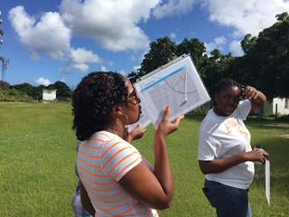
What is Graminoid, Tree and Shrub Height?
To describe your Land Cover Sample Site and identify the MUC code, you may need to measure the average height of the vegetation. For low-lying vegetation, such as grasses, and medium height vegetation, such as shrubs, you will take a random sample of plants, measure them, and calculate the average plant height.
To measure tree height, you will need to use a Clinometer to make the measurements. You will find instructions for building a clinometer in this tutorial.

Slide 8
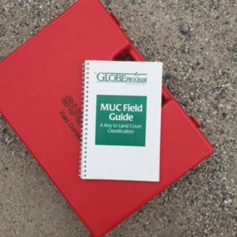
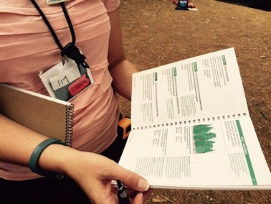
Why Do We Collect Graminoid, Tree and Shrub Height?
You will need to measure the height of graminoid (grasslike) vegetation, shrubs and /or trees to help determine the MUC class of your Land Cover Sample Site. MUC stands for Modified UNESCO Classification system, an international standard for describing vegetation. Because the MUC system is widely used, it will allow you to compare your study site to others around the globe.

Slide 9
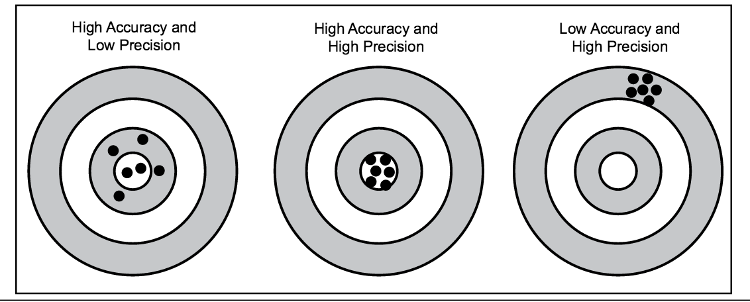
Accuracy vs. Precision
Accuracy is a measure of how well the data describe a phenomenon. Precision is demonstrated when repeated measurements yield the same outcome. In most GLOBE protocols, you are asked to take a measurement 3 times – allowing for you – as well as others – to determine the precision of your data.

Slide 10
Timing and Frequency of Data Collection
The frequency of the measurements you decide to take will depend on your research goals:
You can take biometry measurements only once in a site during peak growth. This will help with the MUC classification.
You can take measurements twice a year, during peak growth and dormancy periods (winter or drought), to measure seasonal change
You can return to the same study site year after year and repeat the biometry measurements to track changes in site biomass over time

Slide 11
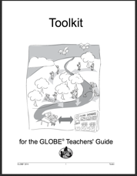
Sources for Equipment You Need
Instructions for making a homemade clinometer follows in this tutorial.
For Other Equipment:
The following resources summarize the measurements associated with each protocol, associated skill level, scientific specifications for the instruments, and how to access the equipment you need (purchase, build, or download).
Where to find specifications for instruments used in GLOBE investigations
Where to find scientific instruments used in GLOBE investigations

Slide 12
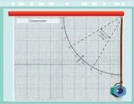


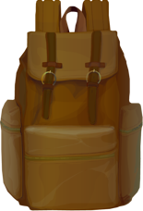
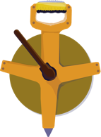



To Measure Graminoid, Tree and Shrub Height, You Will Need the Following Equipment:
Flexible measuring tape
50 m measuring tape
Pen or pencil
Clinometer
Permanent tree markers or flagging (optional, if you plan to return to the site)
Blindfold
Small bean bag

Slide 13
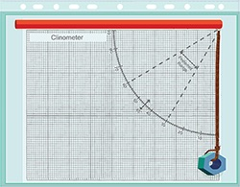
Instructions to Build a Clinometer
A clinometer measures angles to determine the heights of objects without directly measuring them. It is a simplified version of the quadrant (a medieval measuring instrument), and the sextant (an instrument used to locate the positions of ships). Like these instruments, the clinometer has an arc with graduated degree markings that go from 0 to 90 degrees.
Required Material:
Clinometer Sheet and Table of Tangents (located in Biosphere Appendix)
Pieces of stiff cardboard at least the size
of the sheets referenced above
Drinking straw
Metal nut or washer
15 cm of thread or dental floss
Glue
Scissors
Something to punch one small hole
Tape

Slide 14
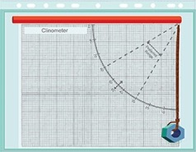
Instructions to Build a Clinometer
Gather the materials.
Glue a copy of the Clinometer Sheet onto one side of a piece of cardboard of the same size.
Glue a copy of the Table of Tangents to the other side of the cardboard.
Punch a hole through the marked circle on the Clinometer Sheet.
Push one end of the thread or dental floss through the hole and tie or tape it on the Table of Tangents side of the cardboard. Colored thread or floss will allow it to be seen more easily.
Tie a metal nut or washer to the other end of the thread so that it hangs in front of the Clinometer Sheet.
Tape a drinking straw along the designated line on the Clinometer Sheet, to use as a sighting device.
The cardboard and both the clinometer and table of tangents sheets can be placed in a sheet
protector or laminated to ensure longer life. The straw would then be placed on the outside of
the plastic and the hole for the thread with the washer would be punched through the entire
instrument (plastic cover, cardboard and sheets).

Slide 15
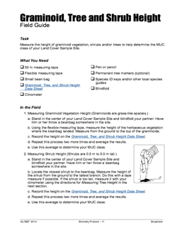
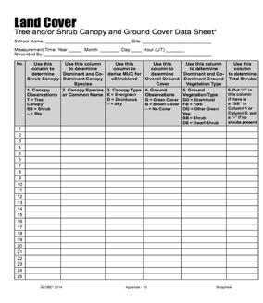
To Measure Graminoid, Tree and Shrub Height, You Will Need the Following Documents:
To be prepared, bring the following documents with you in the Field:
Graminoid, Tree and Shrub Height Field Guide
Graminoid, Tree and Shrub Height Data Sheet

Slide 16
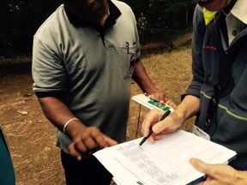
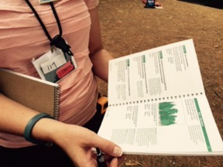
Before You Begin: Prerequisite Measurements
Before you begin taking Graminoid, Tree and Shrub Height measurements, you will need to have already identified your Land Cover Sample Site.. Ultimately, you will be able to identify the scientific classification of the plant community observed using the MUC Guide.
This tutorial provides the directions for completing measurements in the Graminoid Tree and Shrub Height Field Guide.

Slide 17
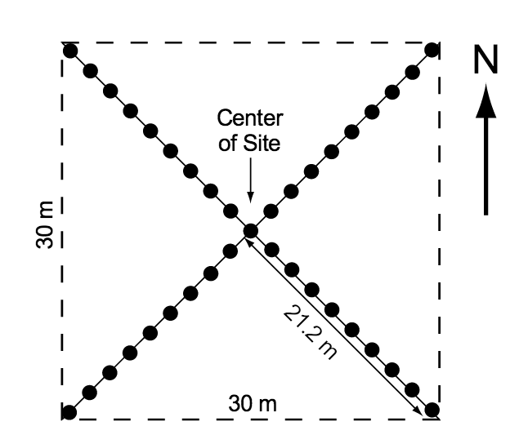
Identifying the Center of the Land Cover Sample Site
Locate the center of your homogeneous Land Cover Sample Site. This is your starting point.
Land Cover Sample Site with the four 21.2 m half-diagonals In the NE, SE, SW and NW directions for sampling.

Slide 18
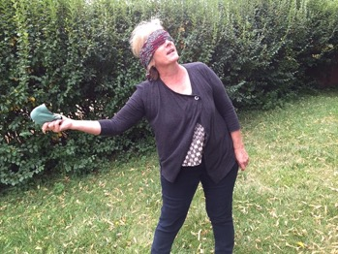
1 a. Measuring Graminoid Vegetation Height
Stand in the center of your Land Cover Sample Site and blindfold your partner. Have them throw the beanbag somewhere in the site.
Using a flexible measuring tape, measure the height of the herbaceous vegetation where the beanbag landed. Measure from the ground to the top of the graminoids.
Record the height on the Graminoid, Tree and Shrub Height Data Sheet.
Repeat this process two more times and average the results.
You have now completed the Graminoid Height measurement.

Slide 19

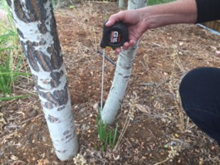
1b. Measuring Shrub Vegetation Height (0.5 m-5 m tall)
Stand in the center of your Land Cover Sample Site and blindfold your partner. Have him or her throw a beanbag somewhere on the site.
Locate the shrub closest to the beanbag. Measure the height of the shrub from the ground to the tallest branch. Do this with a tape measure if possible. (If the shrub is too tall, measure it with your clinometer, using the directions for measuring Tree height).
Record the height on the Graminoid, Tree and Shrub Height Data Sheet.
Repeat this process two more times and average the results
Use this average to determine your MUC class.
You have now completed the steps for Shrub Height

Slide 20
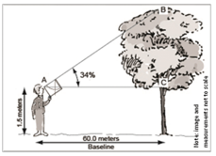
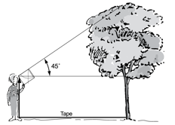
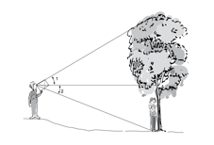
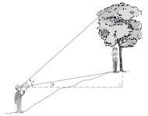
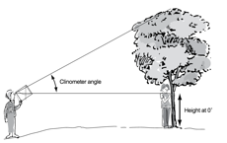
2. Measuring Tree Height Using Standard Clinometer Technique
There are different techniques to measure tree and shrub height. You need to select the one that best suits your situation and follow that field guide. There is a slide stack for each of the methods below.
1. If your feet are level with the tree base, use one of these two protocols
This slide stack
I. Standard Clinometer Technique
II. Simplified Clinometer Technique
2. If you are measuring tree height on a slope, choose one of these options
III. Two Triangles with Eyes Higher
Than Tree Base
IV. Two Triangles with Eyes
Lower than Tree Base
V. Stand by Tree Technique

Slide 21
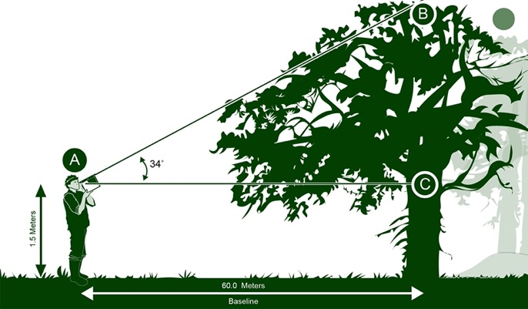
2. Measuring Tree Height
The method you use will depend on the topography of your site. This is the Standard Clinometer Technique with Feet Level with Tree Base.
No slope: Standard Clinometer Method 1

Slide 22
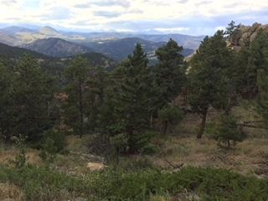
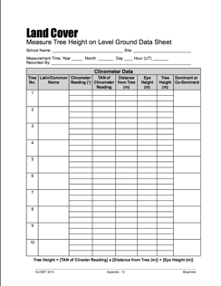
Measuring Tree Height
Determine your dominant (most common and co-dominant (second-most common) tree species by counting the number of times each tree species was recorded on the Canopy and Ground Cover Data Sheet. Record the names of the species on the Graminoid, Tree and Shrub Height Data Sheet.
Dominant tree species in this photo is Ponderosa Pine (Colorado, USA).

Slide 23

Measuring Tree Height
2. Select 5 trees to sample, including:
  The tallest tree of the dominant species
  The shortest tree of the dominant species that still reaches the canopy.
  Three trees that have heights in between the tallest and shortest of the dominant species.
Permanently mark number and label the trees if you plan to return to this site to take measurements over time.
Adjust your distance from the tree so that you are at least as far away from the tree
as the tree is tall. For the most accurate measurement, adjust your distance so that the
angle of the clinometer is as close to 30 degrees as possible.
Be sure to be on level ground so that your feet are at the same elevation as the
base of the tree. If you are standing on a slope, you need to use an Alternative
technique to measure tree height

Slide 24
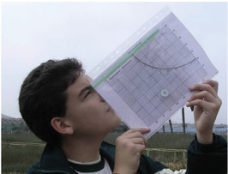

I. Measuring Tree Height when the Ground is Level: Standard Clinometer Technique
Move away from the base of the tree until you can see the top of the tree through the drinking straw of the clinometer.
For the best results, adjust your distance from the base of the tree so that the clinometer reads as close to 30 ̊ as possible and you are at least as far from the tree as it is tall.
Be sure to be on level ground so that your feet are at the same elevation as the base of the tree. Remember, if you are not on the same level with the tree, you need to use one of the alternative methods for measuring tree height.
Have your partner read and record the number of degrees of the angle.

Slide 25
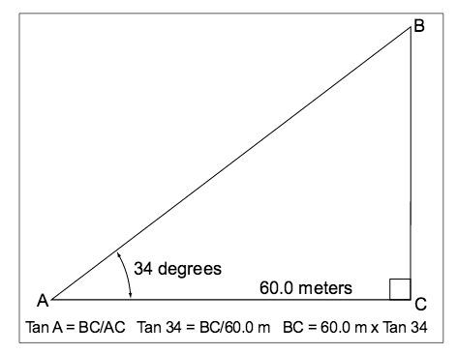
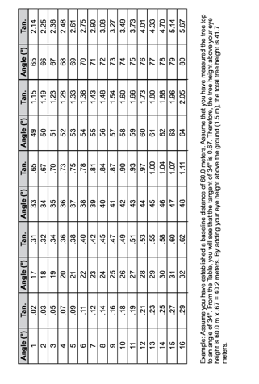
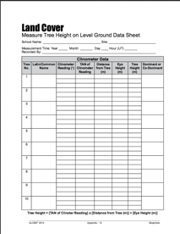
I. Measuring Tree Height when the Ground is Level: Standard Clinometer Technique
Using the Table of Tangents, record the TAN of the angle on the Data Sheet
Table of Tangents

Slide 26

I. Measuring Tree Height when the Ground is Level: Standard Clinometer Technique.
Measure the distance between you and the tree. Have your partner help you using the 50 m tape. Record this in the table on your Data Sheet
Measure the height from the ground to your eye level. (You only need to do this step once!) Record this in the table.

Slide 27
I. Measuring Tree Height when the Ground is Level: Standard Clinometer Technique.
• Calculate the tree height using the following formula:
Tree height=[TAN (Angle of Clinometer) x (Distance to Tree)] + (Height to 0 degree on tree)
Record on your Data Sheet.
Measure the height of each tree three times and calculate the average of the three heights. If they are within one meter, record the average on your Data Sheet. If not, repeat the measurements until they are within one meter
Repeat the step above for the other four trees and you are done!
If your co-dominant species is a tree, repeat steps b-e for the co-dominant tree
species. If you do not have five co-dominant species trees on your site, include other
tree species to make a total of five. Note that you are using other species in the
Metadata

Slide 28
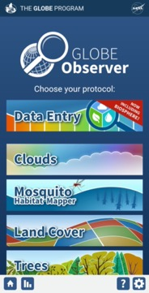
Report your Data to GLOBE
1.Desktop Data Entry: Log environmental data directly on the GLOBE website.
2.Email Data Entry: If connectivity is an issue, data can also be entered via email.
3.GLOBE Observer App: The app allows users to enter data directly from an iOS or Android device for any GLOBE protocol.

Slide 29
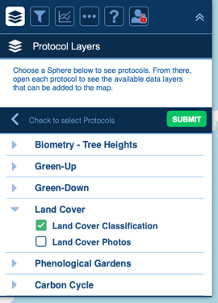
Visualize and Retrieve Data
GLOBE provides the ability to view and interact with data measured across the world. Use the visualization tool to map, graph, filter and export Land Cover Classification data that have been measured across GLOBE protocols since 1995.
Click the layers icon.
Click Submit.
Select Land Cover Classification under the Biosphere drop down
See video tutorials on using the GLOBE Visualization system.
29

Slide 30
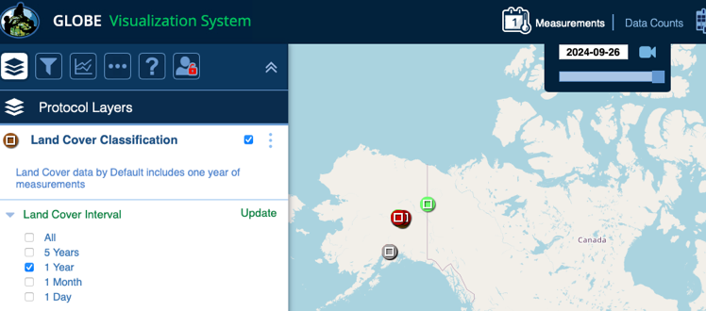
Visualize and Retrieve Data: Select Range of Dates
Select the date for which you need Land Cover Classification data.

Slide 31
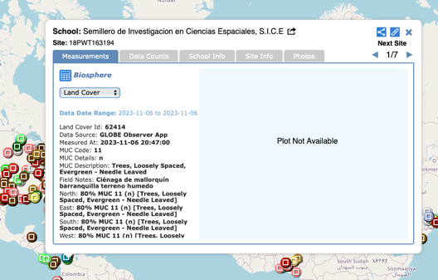
Visualize and Retrieve Data: Accessing Data
Select the sampling site for which you need Land Cover Classification Data, and a box will open with a data summary for that site.
Click on the table icon to view the data in a table and download it as a .csv for analysis.
Clicking on a location will open to a map note providing data for that location and time.
31

Slide 32
Review questions to help you prepare for the Graminoid, Tree and Shrub Height Quiz:
Graminoid, Tree and Shrub Height are part of what set of GLOBE Biosphere Protocols?
What is a graminoid plant?
Why is documenting Graminoid, Tree and Shrub Height important?
What land cover classification scheme does GLOBE use, in order to ensure comparisons between sample sites around the globe?
What specialized instrument will you use to determine tree and tall shrub height?
What is the difference between the terms accuracy and precision?
How are trees defined in the MUC classification?
What geometric shape will you be identifying to help you calculate tree height using a clinometer?
How many trees do you need to measure for your sample in the Tree and Shrub Height part of the Biometry Protocol?
In determining which of the 5 different tree height measurement techniques to use, what is the most important environmental characteristic to consider?

Slide 33
You have now completed the slide stack. If you are ready to take the assessment, sign on and take the assessment corresponding to Graminoid Tree and Shrub Height Protocol.
When you pass the assessment, you are ready to take Graminoid Tree and Shrub Height Protocol measurements!
Welcome to the GLOBE Biometry Community!

Slide 34
Frequently Asked Questions-FAQ’s
What if my students are too young to understand the math used to determine tree height?
Use the Simplified Technique for Measuring Tree Height on Level Ground
What if I want to measure the heights of trees on a slope?
There are additional guides for these situations that provide different methods to measure the heights of trees on slopes. The one you choose depends on the topography of your site.
What if the tree is leaning?
If the tree is leaning, just measure to the top of the tree as usual. Measure the baseline distance to a point directly below the highest point of the canopy, which may not be where the trunk of the tree meets the ground
What if the canopy cover is thick and I cannot clearly see the top of individual trees?
A very thick canopy often occurs in areas where many of the trees are very close in height. You may have to move around your area to find a good sight-line to the tops of your trees.

Slide 35
Frequently Asked Questions-FAQ’s
How accurate is measuring tree heights?
Like any other measurement, accuracy and precision increase with practice and the use
of care in the measurement. Three groups measuring the same tree should get results
within +/- 1 meter of each other.
What do I do if I do not have a single co-dominant tree or shrub species?
If the co-dominant species is mixed at your site, measure the heights and circumferences
for 5 trees or shrubs of different species. Note the species you are using in the Metadata.
What do I do if there are not 5 trees or shrubs of the dominant species at my site?
Should I measure any heights and circumferences?
If there are less than five, measure all the trees or shrubs at your site and make a note
in the metadata

Slide 36
Questions about content in the module? Contact GLOBE: training@nasaglobe.org

