Slide 1
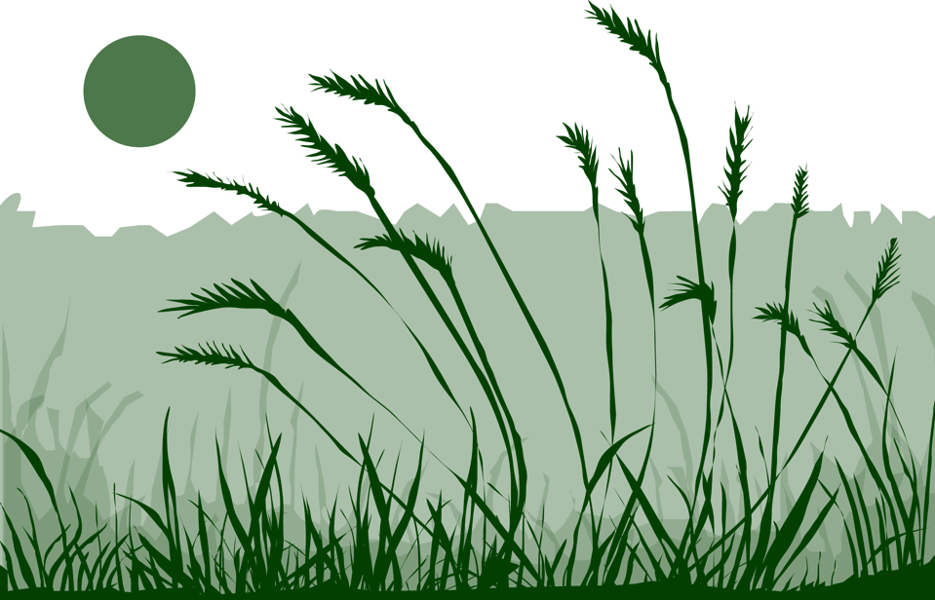
Slide One

Slide 2

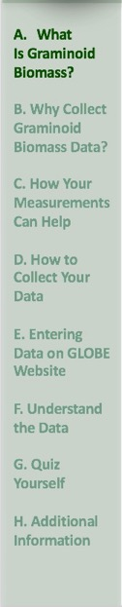
Overview
This module:
Provides a step by step introduction of the protocol method
Discusses the importance of obtaining graminoid (grass-like plant) data
Learning Objectives
After completing this module, you will be able to:
Define graminoid biomass and give an example of how graminoid biomass can be used by scientists
Describe the importance of quality control steps in the the collection of accurate data
Explain the difference between accuracy and precision
Conduct sampling procedures in the field and complete measurement procedures in the lab
Upload data to the GLOBE database
Visualize data using GLOBE’s Visualization System
Estimated time to complete module: 1.5 hours

Slide 3
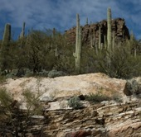
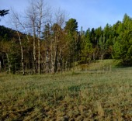
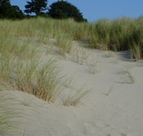
What is the Biosphere?
The Biosphere is Earth’s zone of life. Every organism on Earth belongs to the biosphere. GLOBE has several ways to explore and measure components of the Biosphere through investigations in land cover, phenology, and carbon storage. Some GLOBE Hydrosphere investigations also include measurements of organisms: the macroinvertebrate and mosquito larvae protocols.
Like all parts of the Earth system, the Biosphere is subject to change. We can quantify these changes by taking measurements over time and comparing what we saw in the past to what we see in the present.
The Graminoid Biomass Measurements are part of GLOBE’s biometry observations.
Find more information in:
Biosphere Introduction
Photo Credit: Shelley E. Olds

Slide 4
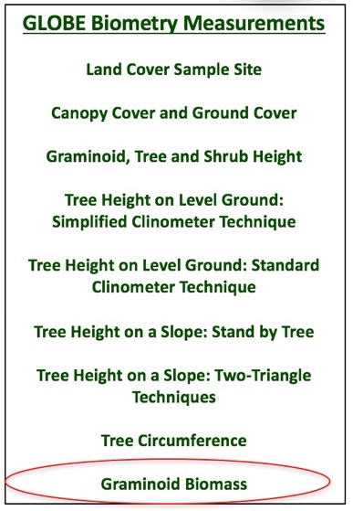
What is Biometry?
Biometry is the measuring of living things. A scientist is interested not only in the characteristics of vegetation at a study site, but also how it is distributed. How dense is the forest? Does sunlight penetrate to the forest floor? Is the landscape dominated by grasses? Has there been a recent disturbance, such as a forest fire or flood? These are questions that are answered by taking biometric measurement of land cover.
In this protocol, you will be measuring graminoid biomass- the total weight of grass-like plant material in a given volume or area.

Slide 5
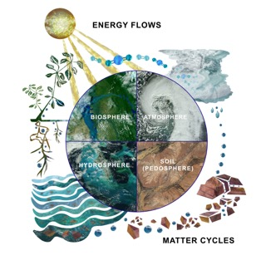
Why Study Land Cover?
Land cover includes both developed and natural areas. All living things depend on their habitat, or land cover, for survival. They find shelter, food, and protection there. Land cover has a direct effect on the kinds of animals that will likely inhabit an area. Therefore, land cover is of great interest to ecologists, who study how plants and animals relate to their environment.
Land cover can influence weather, soil properties, and water chemistry. Different land cover types are all distinct in their effects on the flow of energy, water and various chemicals between the air and surface soil. So, knowing what types of land cover occur is important for a variety of Earth system science investigations.
.

Slide 6
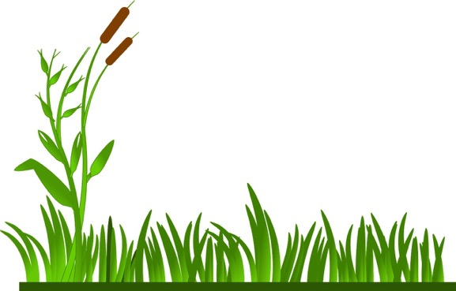
What is Biomass?
Biomass is organic material which has stored sunlight in the form of chemical energy. In plants this includes both the above ground part of the plant, as well as the roots found underground. Biomass can be quantified by determining the weight or mass of plant tissue found in a given area or volume. In this protocol, we are measuring above-ground biomass of grass-like plants.
ClkerFreeVectorImages:
Creative Commons CCO License

Slide 7
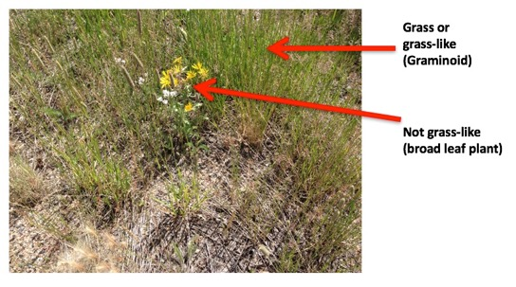
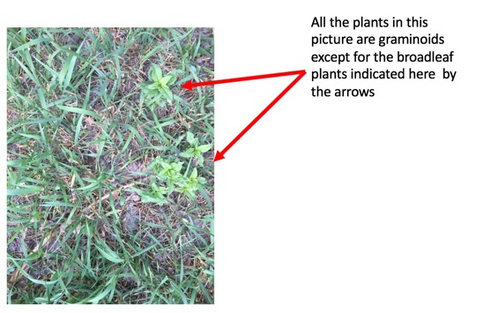
What is Graminoid Biomass?
Graminoid is another word for grasses and grass-like, narrow leafed plants.
Graminoid Biomass is a measure of the total mass of grass-like plants in a given area or volume. For this protocol, you will be measuring the above ground biomass of grasses only and not the biomass of other plants such as broad-leaf or woody plants, mosses, and lichens.

Slide 8
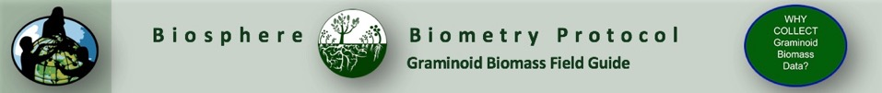
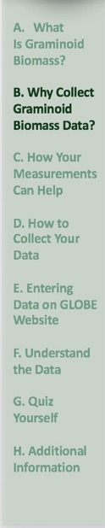
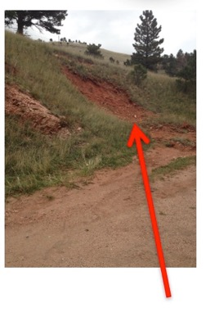
Why Collect Graminoid Biomass Data?
Biomass measurements are useful in a variety of applications.
Measurement of biomass is an indicator of the amount of energy stored in vegetation. This information can be used to calculate primary productivity of an ecological site, and can also be used to calculate the amount of carbon that is sequestered (stored) in grasses and similar plants.
Estimates of biomass are also useful because vegetation cover plays a role in the hydrological properties of a site, such as infiltration, runoff and erosion.
Controlled burning is used by managers to promote growth of grasses that can be foraged by livestock.
Many ecologists find plant biomass a good indicator of a species’ role in the ecosystem, because the measurement reflects the nutrients, water and sunlight that is procured by that species.
Flood erosion: Slope is intact where there is grass. Where there was a path, the slope was subject to mass wasting and erosion during the 2013 flood in Boulder, Colorado USA.

Slide 9
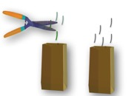
Why Collect Green and Brown Biomass?
You will be collecting both standing green above ground biomass and standing brown biomass. Grasses regenerate at the beginning of the growing season from below ground tissue. There is ongoing turnover from green to brown leaves during the growing season, and when growth ceases at the end of the growing season, the standing biomass rapidly turns from green to brown.
Why weigh green and brown graminoid biomass separately?
Green and brown (living and dead) tissue enter different food webs and their contribution to various parts of the carbon cycle can be modeled.
Knowing the green/brown composition of a grassland is also important information when determining fire risk.
An accurate estimate of above-ground dry weight biomass is necessary for grassland and prairie management. Biomass measurements can inform us about available forage for animals and determine the risk of erosion related to loss of grass cover. Knowing the amount of green vs. brown biomass can be important in modeling seasonal dynamics when the grass is grazed by animals.

Slide 10
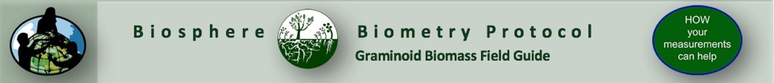
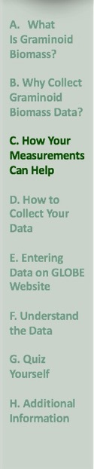
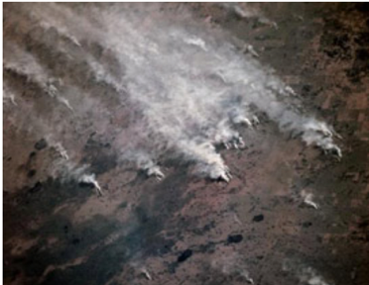
Biomass Burning
Scientists use satellite data to monitor fires and smoke associated with wildfires, prescribed burns, deforestation and other agricultural applications, collectively referred to as biomass burning. Biomass burning plays a major role in the global carbon cycle impacting both regional and global climate change. Biomass burning releases significant amounts of CO₂, trace gases and particulates into the atmosphere. Knowing the amount of biomass in an area can assist in preparing for wildfires.
Detailed measurements from Tropospheric Emission Spectrometer on the Aura satellite of the global tropospheric distributions of co-located O3, CO, water vapor, and nitrogen oxides are being used to investigate the impacts of biomass burning on air quality and climate. Image: NASA.

Slide 11

Let’s do a quick review before moving onto data collection! Question 1
What is a “graminoid?”
A grass-like plant, with thin leaves, such as rushes, sedges and grasses
A broad-leaf plant, like an oak tree or a rose.
What is your answer?

Slide 12
Let’s do a quick review before moving onto data collection! Answer to Question 1
What is a “graminoid?”
A grass-like plant, with thin leaves, such as rushes, sedges and grasses- ☺ Correct!
A broad-leaf plant, like an oak tree or a rose.
Were you correct?

Slide 13
Let’s do a quick review before moving onto data collection! Question 2
Of what scientific use is graminoid biomass data?
We can use it to understand energy use, storage and transfer in ecosystems
It can be used to calculate the amount of carbon stored in grass-like plants
It can be used to estimate risk of erosion related to loss of grass cover
It can be used to determine the available food for livestock
All of the above
A and B only
What is the answer?

Slide 14
Let’s do a quick review before moving onto data collection! Answer to Question 2
Of what scientific use is graminoid biomass data?
We can use it to understand energy use, storage and transfer in ecosystems
It can be used to calculate the amount of carbon stored in grass-like plants
It can be used to estimate risk of erosion related to loss of grass cover
It can be used to determine the available food for livestock
All of the above ☺ Correct
A and B only
Were you correct? Let’s move on to the data collection procedure.

Slide 15
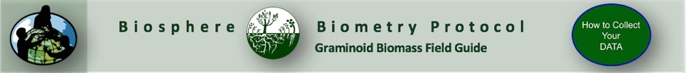
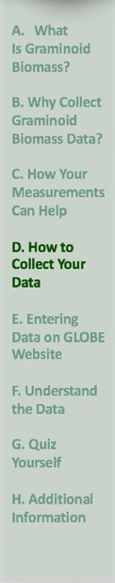
Protocol at a Glance
Where | Biosphere Study site
When | Variable, depending on your research goals
Frequency | As necessary to determine MUC at most sites, or, frequently as an enrichment study
Skill Level | All
Equipment | For Field: Bean bag, blindfold, grass clippers, small brown paper bags, balance, pen or pencil. For Lab: balance and drying oven.
Necessary Documents | Graminoid Biomass Field and Lab Guide Graminoid Biomass Data Sheet

Slide 16
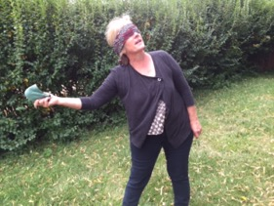
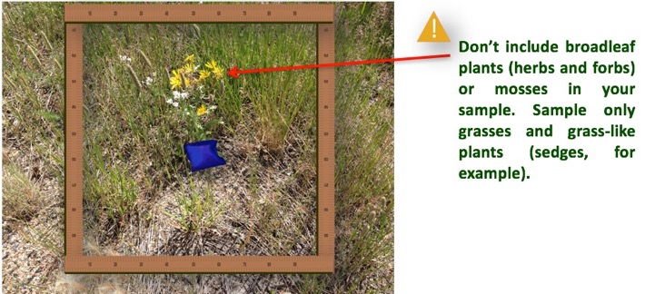
How to Collect Your Data
Blindfold your partner and have him or her throw a beanbag somewhere in the site.
a. Mark a one-meter square around the beanbag to take a random sample.

Slide 17

Collect your graminoid samples
b. Using the garden clippers, clip all the vegetation close to the ground within the square (m2). Do not collect any unattached leaves or litter.
c. Sort the clippings into green and brown portions. Any clipping with even a little green is considered green.
d. Place the green and brown portions into separate brown paper bags. Label the bags.
Repeat this procedure two more times.

Slide 18
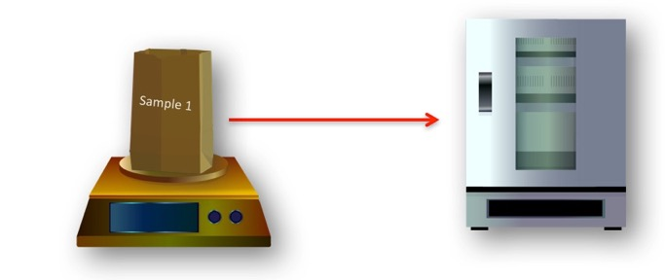
The next steps take place in your laboratory space
Calculating Graminoid Biomass:
a. Check the temperature of the drying oven, it should read between 50 and 70 degrees Celsius.
b. Put the labeled bags in the drying oven.
c. Use a balance to measure the mass (g) of each bag once a day.

Slide 19
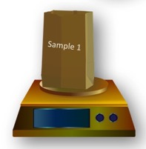
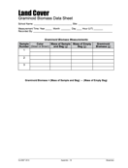
Measure your dry weight
d. When the mass is the same two days in a row, the samples are completely dry.
e. Record the mass of each bag and its contents on the Graminoid Biomass Data Sheet.
f. Shake out the contents of one bag and weigh the empty bag. Record this mass. Repeat this step for each bag.
g. Calculate the mass of the graminoid vegetation (graminoid biomass) using the following formula:
h. Record the graminoid biomass of each sample on the Graminoid Biomass Data Sheet.
Graminoid Biomass = Mass of Sample and Bag – Mass of Empty Bag

Slide 20

Helpful Hints
Do not use a conventional oven to dry the graminoid vegetation. This is dangerous because the oven may have to be left on continuously for several days!
Make sure to use several small brown drying bags for proper drying of graminoid samples.
In warm, dry climates, graminoid biomass samples can be dried in mesh bags outside.

Slide 21
Let’s do a quick review before moving onto data entry! Question 3
In this protocol, how do you determine the random sample where you will take clippings for analysis in the lab?
Lay out a grid and sample at intervals
Throw a bean bag
What is the answer?

Slide 22
Let’s do a quick review before moving onto data entry! Answer to Question 3
In this protocol, how do you determine the random sample where you will take clippings for analysis in the lab?
Lay out a grid and sample at intervals
Throw a bean bag ☺ correct!
Were you correct?

Slide 23
Let’s do a quick review before moving onto data entry! Question 4
If the clipping is almost all brown with just a little bit of green on one end, you would put the clipping in the:
Green sampling bag
Brown sampling bag
Mixed brown and green sampling bag
What is your answer?

Slide 24
Let’s do a quick review before moving onto data entry! Answer to Question 4
If the clipping is almost all brown with just a little bit of green on one end, you would put the clipping in the:
Green sampling bag- ☺ Correct!
Brown sampling bag
Mixed brown and green sampling bag
Were you correct?

Slide 25
Let’s do a quick review before moving onto data entry! Question 5
When the oven-dried mass of the sample is the same for at least ___ in a row, it is considered completely dry.
24 hours
Two days
Three days
One week
What is your answer?

Slide 26
Let’s do a quick review before moving onto data entry! Answer to Question 5
When the oven-dried mass of the sample is the same for at least ___ in a row, it is considered completely dry.
24 hours
Two days ☺ Correct!
Three days
One week
Were you correct? Let’s move on to GLOBE data entry and visualization!

Slide 27

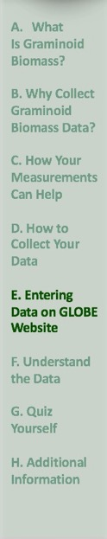
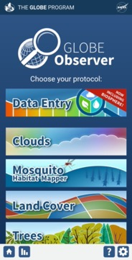
Submit your Data to GLOBE
1.Desktop Data Entry: Log environmental data directly on the GLOBE website.
2.Email Data Entry: If connectivity is an issue, data can also be entered via email.
3.GLOBE Observer App: The app allows users to enter data directly from an iOS or Android device for any GLOBE protocol.

Slide 28
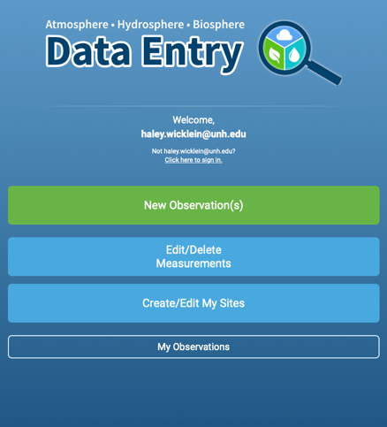
Entering your data via the GLOBE website or GLOBE Observer App
Click “New Observation(s)”

Slide 29
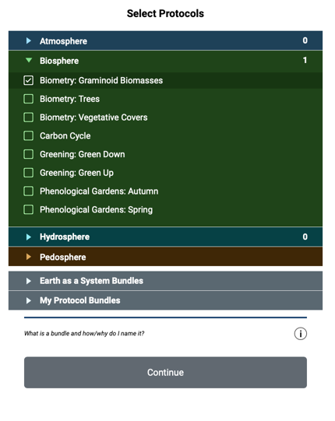
Entering your data via the GLOBE website or GLOBE Observer App
Select “Biometry: Graminoid Biomasses”
Click Continue
29
29

Slide 30
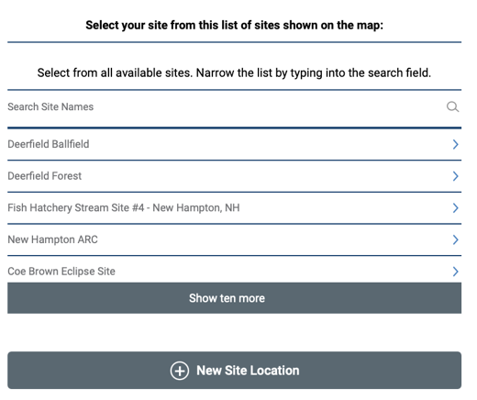
Entering your data via the GLOBE website or GLOBE Observer App
On the location page, scroll down to select your site OR choose “New Site Location” to add a new site.
Tutorials are available on how to add a new site.
30
30

Slide 31
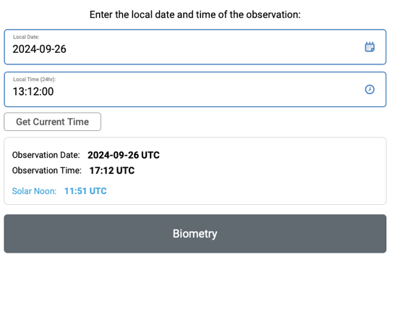
Entering your data via the GLOBE website or GLOBE Observer App
Add the time and date that you collected your data
Click Biometry
31
31

Slide 32
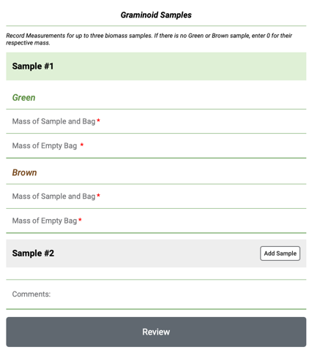
Entering your data via the GLOBE website or GLOBE Observer App
Enter the data from your datasheet into the form.
Click Review
32
32

Slide 33
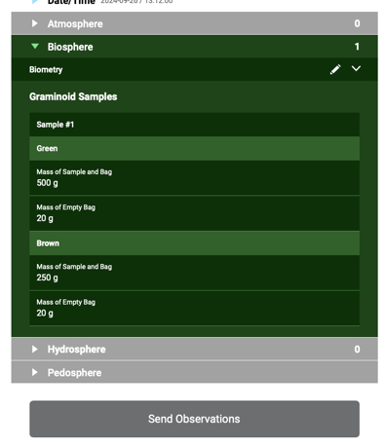
Entering your data via the GLOBE website or GLOBE Observer App
Review the data you entered
Click send observation and wait for the message that your observation was successfully sent!
33
33

Slide 34
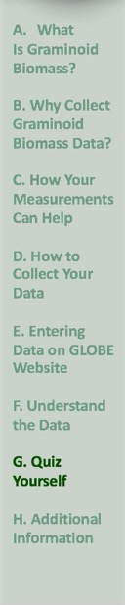
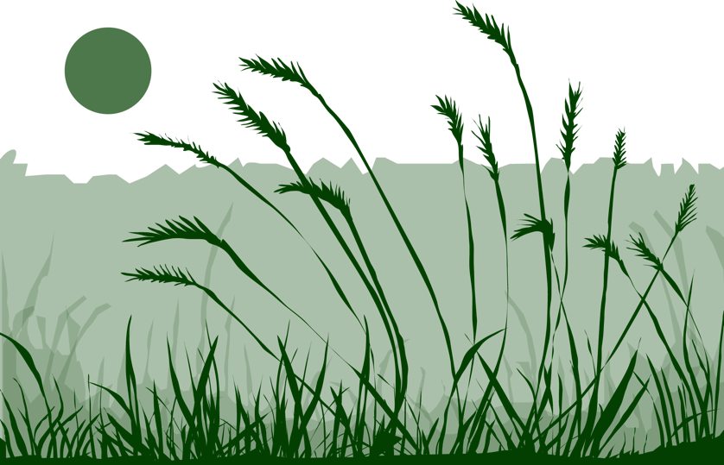
Next Steps
You have now completed the slide stack. If you are ready to take the assessment, sign on and take the assessment corresponding to Graminoid Biomass Protocol.
When you pass the assessment, you are ready to take Graminoid Biomass Protocol measurements!
Welcome to the GLOBE Biometry Community!

Slide 35
Review questions to help you prepare to do the Graminoid Biomass measurements associated with the GLOBE Biometry Protocol
Graminoid biomass measurements are part of what GLOBE Protocol area or Earth system sphere?
Graminoid biomass measurements are part of which specific protocol?
What environmental factors influence the amount and kind of graminoid biomass landscape?
What is another term for graminoid?
Are mosses, lichens, forbs and small showy flowering plants considered graminoids?
Name three reasons why a region’s graminoid biomass is important for scientists and land managers to know.
How does graminoid biomass data help us to quantify changes in atmospheric gases and CO₂?
When is the best time during the year to measure graminoid biomass?
Why is it not allowed to use a home oven to dry your graminoid biomass samples?
How do you know when your samples are completely dry?

Slide 36
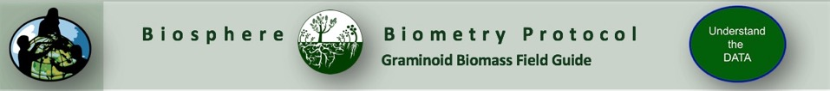
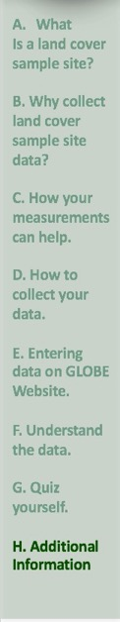
Frequently Asked Questions
What if we can’t get to our site during peak vegetation (full leaf-on) conditions?
If you cannot get to your site during peak growth (leaf-on), measure your site during the leaf-off period and try your best to get the peak growth (leaf-on) data, when you can.
When I am measuring grass biomass, what do I do with mosses or lichens?
Moss and lichens are considered “Other Green” and have their own designation on the Canopy and Ground Cover Data Sheet. Do not include mosses or lichens in your dried samples. Record in metadata if these species comprise a large part of your green ground cover.
My school does not have a drying oven. Can we dry the grass another way?
First, check to see if you can use a drying oven at a community college, university, government agency or some other business or organization in your community. In warm, dry climates, graminoid biomass samples can be dried in mesh bags outside. Do not use a conventional oven to dry the graminoid vegetation. This is dangerous!

Slide 37

Questions about content in the module? Contact GLOBE: training@nasaglobe.org
Credits
Slides:
Russanne Low, Ph.D., University of Nebraska-Lincoln
Rebecca Boger, Ph.D., Brooklyn College
Cover Art:
Jenn Glaser, ScribeArts
More Information:
The GLOBE Program
NASA Wavelength NASA’s Digital Library of Earth and Space Science
NASA Global Climate Change: Vital Signs of the Planet
Version 9/26/24. If you edit and modify this slide set for use for educational purposes, please note “modified by and your name and date “ on this page. Thank you.

