Slide 1
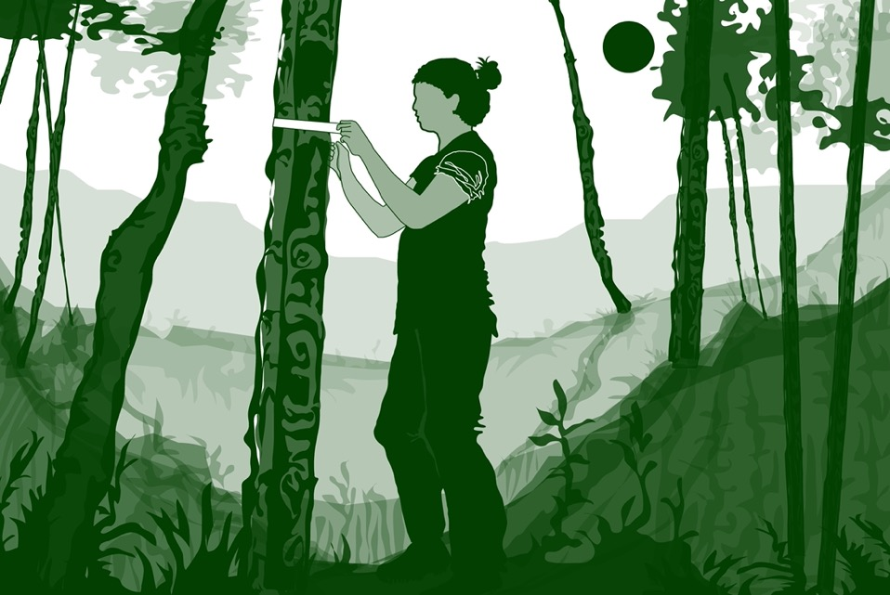

Slide 2
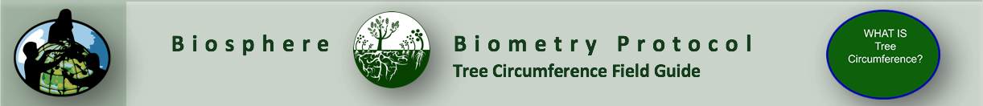
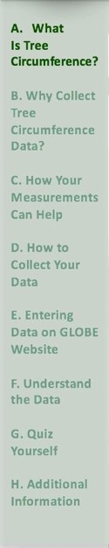

Overview
This module:
Provides a step by step introduction of the protocol method
Discusses the importance of tree circumference data for understanding changes in the Earth system
Learning Objectives
After completing this module, you will be able to:
Define tree circumference and give an example of how tree circumference data could be used to understand changes in forest structure and climate
Describe the importance of quality control steps in the the collection of accurate data
Conduct tree circumference measurements in the field
Upload data to the GLOBE portal
Visualize data using GLOBE’s Visualization Site
Estimated time to complete module: 1.5 hours

Slide 3
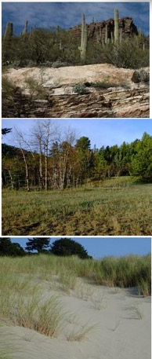
The Biosphere
The Biosphere is Earth’s zone of life. Every organism on Earth belongs to the biosphere. GLOBE has several ways to explore and measure components of the Biosphere through investigations in land cover, phenology, and carbon storage. Some GLOBE Hydrosphere investigations also include measurements of organisms: the macroinvertebrate and mosquito larvae protocols.
Like all parts of the Earth system, the Biosphere is subject to change. We can quantify these changes by taking measurements over time, and compare what we saw in the past to what we see in the present.
You can find more information in:
Biosphere Introduction

Slide 4
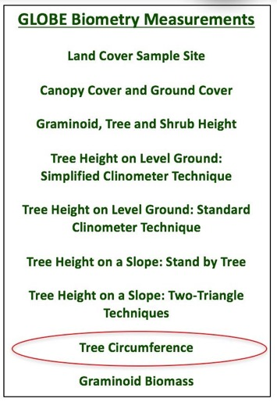
What is Biometry?
Biometry is the measuring of living things. A scientist is interested not only in the characteristics of vegetation at a study site, but also how it is distributed. How dense is the forest? Does sunlight penetrate to the forest floor? Is the landscape dominated by grasses? Has there been a recent disturbance, such as a forest fire or flood? These are questions that are answered by taking biometric measurements.
This slide set introduces you to the Tree Circumference Measurement Protocol.

Slide 5
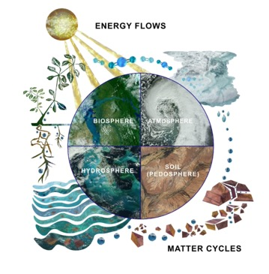
Why Study Land Cover?
Land cover includes both developed and natural areas. All living things depend on their habitat, or land cover, for survival. They find shelter, food, and protection there. Land cover has a direct effect on the kinds of animals that will likely inhabit an area. Therefore, land cover is of great interest to ecologists, who study how plants and animals relate to their environment.
Land cover can influence weather, soil properties, and water chemistry. Different land cover types are all distinct in their effects on the flow of energy, water and various chemicals between the air and surface soil. So, knowing what types of land cover occur is important for a variety of Earth system science investigations.
The Earth System: Energy flows and matter cycles.

Slide 6
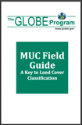
GLOBE Land Cover Investigations
Land cover is a general term used to describe what is on the ground covering the land. Different land cover terms are used to describe the differences we see when we look at the land. Scientists classify land cover based on established criteria. This is done so that there is a consistent use of terms among people. For instance, what one person may call a forest living in the tropical Amazon may be quite different from a person living in northern Canada. Different species of trees live in these places, trees may be of different heights and the amount of ground and canopy cover may be quite different. For this reason, we need a standardized way to describe land cover.
GLOBE uses a land cover classification scheme called Modified UNESCO Classification (MUC). There are many different types of classification schemes used. These are often designed for specific places or regions. MUC can be used around the world and allows people to contribute to a global database.

Slide 7
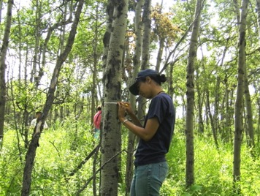
What is Tree Circumference?
Tree circumference is a common measurement used by ecologists. It is the measurement around the trunk of the tree, taken at Diameter Breast Height (DBH). DBH is a standard measure 1.35 m from the ground surface and used by foresters and ecologists used to ensure consistency of measurement over time and between collectors.
Tree circumference is one of the several vegetation measurements in the Biometry Protocol. In combination with other measurements in the protocol, tree circumference data are useful for describing the vegetation landscape and answering many scientific questions related to forest stability and change. DBH measurements can be used to estimate the volume, biomass, and carbon storage of trees and are critical to understanding biomass and carbon storage in local ecosystems.

Slide 8
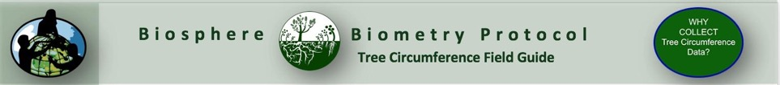
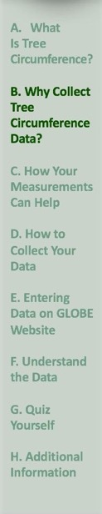
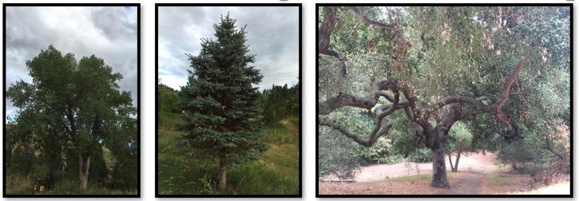
Why Collect Tree Circumference Data?
From circumference measurements, it is possible to calculate tree diameter and cross-sectional area and estimate the volume and above ground biomass of trees. These measurements are used by foresters and managers to calculate the approximate age of the tree. The measurements are also used to estimate the amount of standing timber in a forest.
Carbon dioxide is a greenhouse gas contributing to climate change. Plants play an important role in the climate system by sequestering, or “fixing” carbon that they take in during the process of photosynthesis and turning it into plant biomass. Understanding the amount of carbon stored in vegetation is important for communities making land management decisions related to climate change mitigation. Standing carbon biomass can be calculated using measurements collected in the Carbon Cycle Protocol. Read about Above Ground Carbon Density in the next slide.

Slide 9
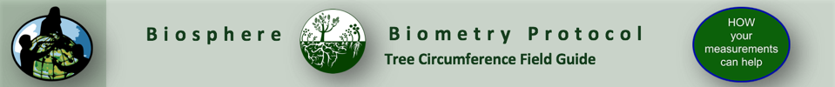
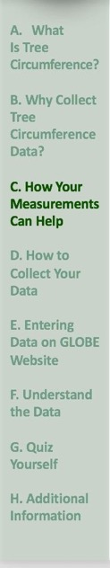
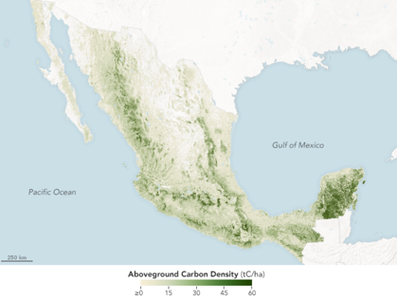
Above Ground Carbon Density
To assess the forest cover of Mexico, the research team pulled together a combination of ground-based and satellite measurements. Broad measures of forest density, height, and structure were derived from observations by the Landsat series of satellites, NASA’s Shuttle Radar Topography Mission, and the PALSAR radar backscatter instrument on Japan’s ALOS satellite. Those space-based measurements were then melded with data from ground-based inventories of trees on more than 26,000 plots across Mexico.
The maps above depict the concentration of biomass—a measure of the amount of organic carbon stored in the trunks, limbs, and leaves of trees in Mexico. The darkest greens reveal the areas with the densest, tallest, and most robust forest growth Text and Image: NASA Earth Observatory.

Slide 10
How Your Measurements Can Help
Tree ranges are already changing as a result of changes in climate. Scientists and forest managers are concerned about the effect that changes temperature and precipitation will have on forests and their species composition.
Trees respond to stress by producing more seeds. These seeds are dispersed by wind and animals. Those that are transported to a suitable environment for germination will grow. As climate warms and precipitation regimes change regionally, the most suitable sites for germination may be different than they are today, and that may mean that higher elevations and upper latitudes provide better conditions for seedlings than the present location of their parent tree. This is the way that a species’ range can migrate. See next slide for the changes that we are anticipating to happen with respect to tree range in the boreal forest.
How can we track tree migration? The first indications of a changing tree range can be ascertained by counting and monitoring the size of trees found in a given area and comparing these data with nearby regions.
Your observations are valuable contributions to the scientific community and may be used by educators, students, researchers, and the general public to increase environmental awareness and STEM literacy, as well as advance Earth system science.

Slide 11
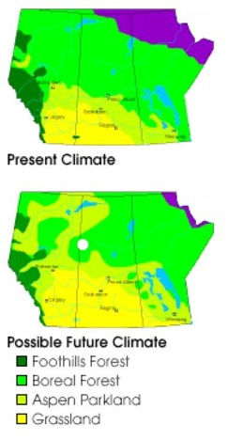
Example of Changing Tree Range: Projected Changes in the Boreal Forest resulting from Climate Change
The distribution of grasslands and boreal forests is highly dependent on moisture availability. These maps of central Canada show the present location of grasslands, aspen parkland, and boreal and foothills forests.
In Western Canada, some scientists are already concerned that the expected warming and drying of the climate will drastically reduce the abundance of aspen, the primary commercial hardwood species in the southern boreal forest. Insufficient moisture could produce an open aspen parkland, where stunted aspen cluster along water courses, with grasslands in between.
Model simulations by Canadian Forest Service scientists indicate that under doubled atmospheric carbon dioxide levels, boreal forests will retreat and grasslands will expand.
Text: NASA Observatory, Image: courtesy Ted Hogg, Northern Forestry Division of the Canadian Forest Service

Slide 12
Research Questions
Here are some questions that monitoring of vegetation using the Tree Circumference Field Guide as part of the Biometry Protocol could address:
What happens to specific tree species as temperatures increase?
What will happen when a tree’s optimum environment moves northward?
Are we seeing changes in the composition and size of trees in our forests?
How much carbon is sequestered: by a tree and within a forest?
Is there evidence of altitudinal migration of trees in your region in response to a changing climate?
Can you think of others?

Slide 13

Let’s do a quick review before moving onto data collection! Question 1
Tree Circumference is part of what GLOBE protocol?
A. Biometry
B. Earth system
C. Phenology
D. Lithosphere
What is the answer?

Slide 14
Let’s do a quick review before moving onto data collection! Answer to Question 1
Tree Circumference is part of what GLOBE protocol?
A. Biometry ☺ Correct!
B. Earth system
C. Phenology
D. Lithosphere
Were you correct?

Slide 15
Let’s do a quick review before moving onto data collection! Question 2
Why does GLOBE report land cover classifications using the Modified UNESCO Classification (MUC Guide)?
A. To standardize the terms and definitions used by GLOBE participants when describing the vegetation they are studying
B. To enable comparable data to be available for analysis on the GLOBE website
C. It is the only land cover classification scheme used worldwide
D. None of the above
E. A and B only
What is the answer?

Slide 16
Let’s do a quick review before moving onto data collection! Answer to Question 2
Why does GLOBE report land cover classifications using the Modified UNESCO Classification (MUC Guide)?
A. To standardize the terms and definitions used by GLOBE participants when describing the vegetation they are studying
B. To enable comparable data to be available for analysis on the GLOBE website
C. It is the only land cover classification scheme used worldwide
D. None of the above
E. A and B only ☺ Correct!
Were you correct?

Slide 17
Let’s do a quick review before moving onto data collection! Question 3
Which is a reason to collect tree circumference data? It allows us to:
A. Track tree migration over the years
B. Estimate standing tree biomass
C. learn about the role of trees in carbon sequestration (storage) in forests
D. All of the above
E. A and B only
What is the answer?

Slide 18
Let’s do a quick review before moving onto data collection! Answer to Question 3
Which is a reason to collect tree circumference data? It allows us to:
A. Track tree migration over the years
B. Estimate standing tree biomass
C. Learn about the role of trees in carbon sequestration (storage) in forests
D. All of the above ☺ Correct!
E. A and B only
Were you correct?
Let’s move on to data collection!

Slide 19
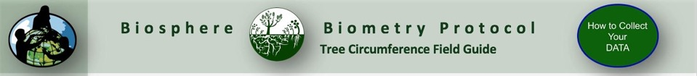
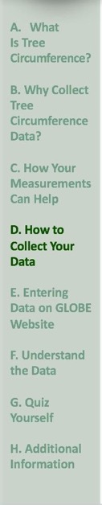
Protocol at a Glance: Tree Circumference
When | Anytime during the year, annually.
Where | A homogeneous GLOBE Land Cover Study Site
Prerequisite Work | Defined GLOBE Land Cover Study Site Graminoid, Tree and Shrub Height Protocol
Key Instrument | Tape measure
References | Tree Circumference Field Guide

Slide 20
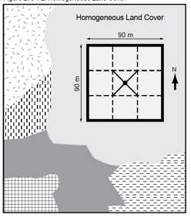
How to Collect Your Data in the Field: Prerequisite Steps
You will make tree circumference measurements for the dominant and co-dominant trees you identified when completing the measurements in the Graminoid, Tree and Shrub Height Field Guide.
You will have defined your Land Cover Sampling Site and will need to complete the measurements in the Graminoid, Tree and Shrub Height. Field Guide before you complete the tasks in the Tree Circumference Field Guide.
Land Cover Sampling Site
Graminoid, Tree and Shrub Height Field Guide

Slide 21
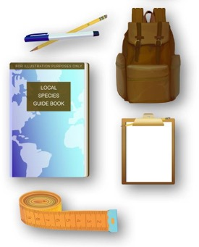
Assemble Equipment
Flexible Measuring Tape
Tree Circumference Data Sheet
Pen or Pencil
Species ID keys and/or other local species guides
Bring the following documents with you in the field:
Tree Circumference Data Sheet
Tree Circumference Field Guide

Slide 22
How to Collect your Data in the Field
Select your dominant and co-dominant species
You will be taking your tree circumference measurements on the same 5 trees you selected for tree height.
a. Determine your dominant (most common) and co-dominant (second-most common) tree species by counting the number of times each tree species was recorded on the Canopy and Ground Cover Data Sheet. Record the names of the species on your Graminoid, Tree and Shrub Height Data Sheet
b. Choose:
The tallest tree of the dominant species
The shortest tree of the dominant species that still reaches the canopy
Three trees that have heights in between the tallest and the shortest of the dominant species
c. Permanently mark and number/label the trees if you will be returning to this site to take measurements over time

Slide 23
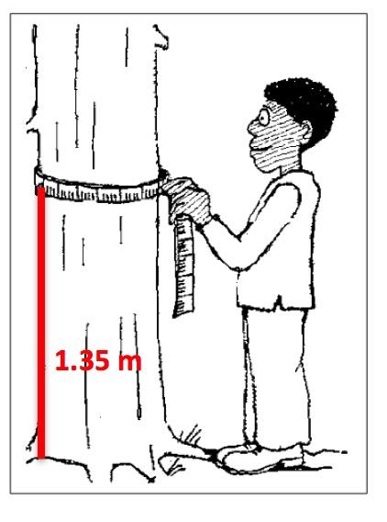
Measuring Tree Circumference
With the flexible tape measure, measure from the ground at the base of the tree to a height of 1.35 m up on the tree (this is called DBH - Diameter Breast Height*).
Measure the circumference in centimeters at Diameter Breast Height.

Slide 24
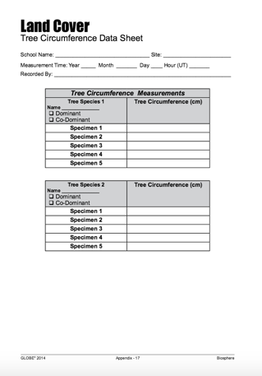
Recording your measurements
3. Record your measurement on the Tree Circumference Data Sheet.
4. Repeat this for each of the trees you measured for height, using the Graminoid, Tree and Shrub Height Field Guide.

Slide 25
Let’s do a quick review before moving onto data entry. Question 4
Which trees do you use to take the tree circumference measurements?
The same 5 trees used for tree height
Any 5 trees that are dominant or the second-most common tree species
The 5 tallest trees
All of the above
A and C only
What is the answer?

Slide 26
Let’s do a quick review before moving onto data entry. Answer to Question 4
Which trees do you use to take the tree circumference measurements?
The same 5 trees used for tree height- Correct! ☺
Any 5 trees that are dominant or the second-most common tree species
The 5 tallest trees
All of the above
A and C only
Were you correct?

Slide 27
Let’s do a quick review before moving onto data entry. Question 5
At what height should you measure tree circumference?
At the thickest part of the trunk
At 1.35 m from the base of the tree
Roughly at your chest height.
What is your answer?

Slide 28
Let’s do a quick review before moving onto data entry. Answer to Question 5
At what height should you measure tree circumference?
At the thickest part of the trunk
At 1.35 m from the base of the tree ☺ Correct!
Roughly at your chest height.
Were you correct?
Let’s now explore GLOBE Data Entry and Visualization!

Slide 29
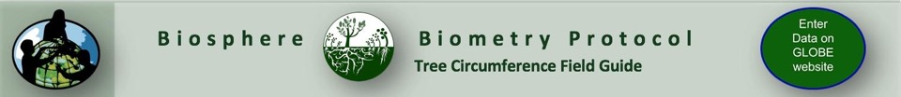
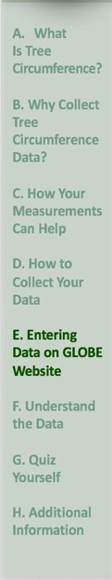
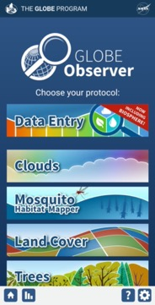
Report Data to the GLOBE Database
1.Desktop Data Entry: Log environmental data directly on the GLOBE website.
2.Email Data Entry: If connectivity is an issue, data can also be entered via email.
3.GLOBE Observer App: The app allows users to enter data directly from an iOS or Android device for any GLOBE protocol.

Slide 30
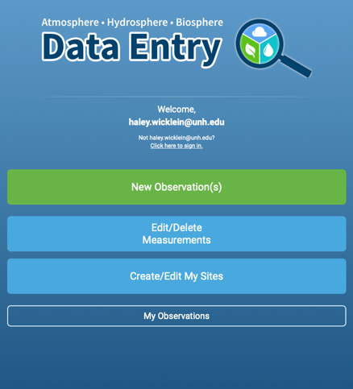
Entering your data via the GLOBE website or GLOBE Observer App
Click “New Observation(s)”

Slide 31
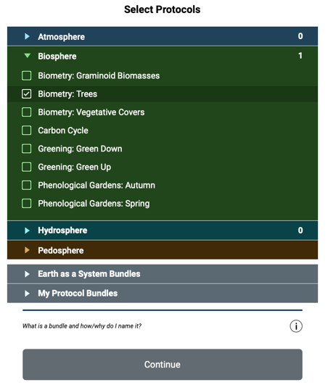
Entering your data via the GLOBE website or GLOBE Observer App
Select “Biometry: Trees”
Click Continue

Slide 32
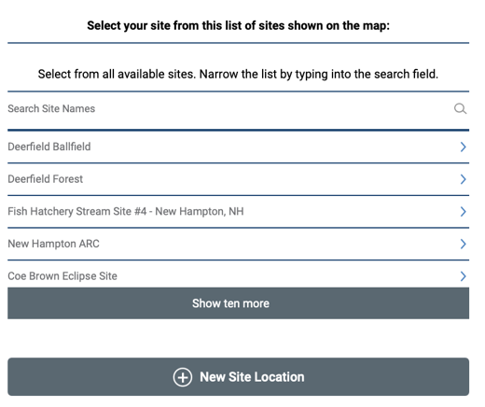
Entering your data via the GLOBE website or GLOBE Observer App
On the location page, scroll down to select your site OR choose “New Site Location” to add a new site.
Tutorials are available on how to add a new site.

Slide 33
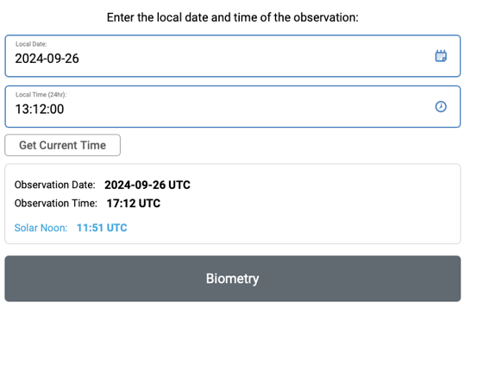
Entering your data via the GLOBE website or GLOBE Observer App
Add the time and date that you collected your data
Click Biometry

Slide 34
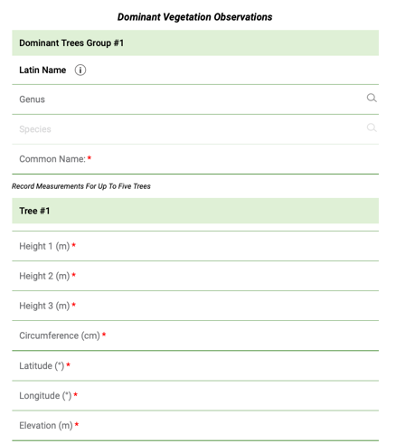
Entering your data via the GLOBE website or GLOBE Observer App
Enter the data from your datasheet into the form.

Slide 35
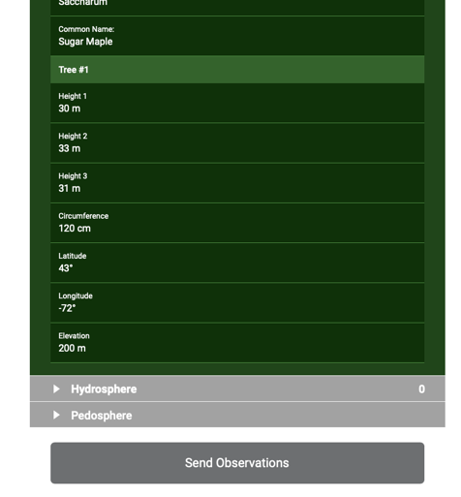
Entering your data via the GLOBE website or GLOBE Observer App
Review the data you entered
Click send observation and wait for the message that your observation was successfully sent!

Slide 36
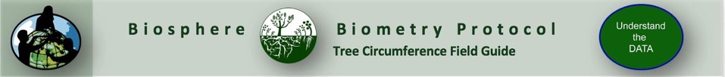
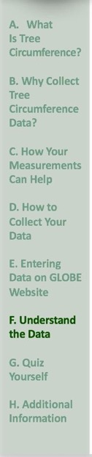
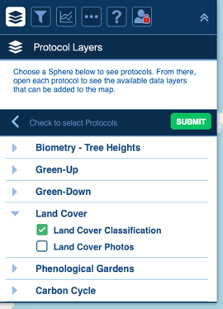
Visualize and Retrieve Data: Select Land Cover
GLOBE provides the ability to view and interact with data measured across the world. Use the visualization tool to map, graph, filter and export Land Cover Classification data that have been measured across GLOBE protocols since 1995.
Click the layers icon.
Click Submit.
Select Land Cover Classification under the Biosphere drop down
See video tutorials on using the GLOBE Visualization system.

Slide 37
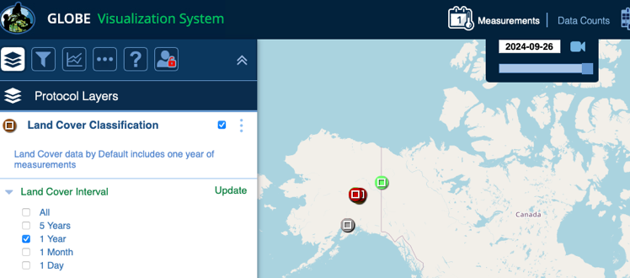
Visualize and Retrieve Data: Select Range of Dates
Select the date for which you need Land Cover Classification data.

Slide 38
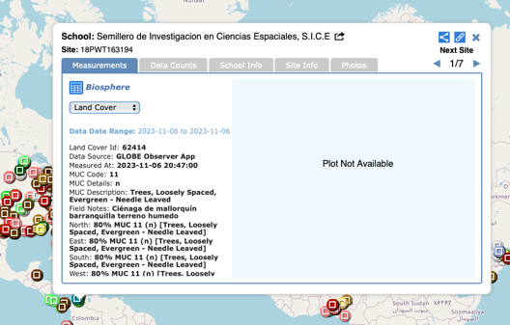
Visualize and Retrieve Data: Accessing Data
Select the sampling site for which you need Land Cover Classification Data, and a box will open with a data summary for that site.
Click on the table icon to view the data in a table and download it as a .csv for analysis.
Clicking on a location will open to a map note providing data for that location and time.

Slide 39
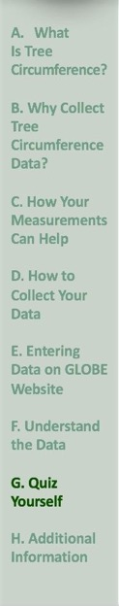
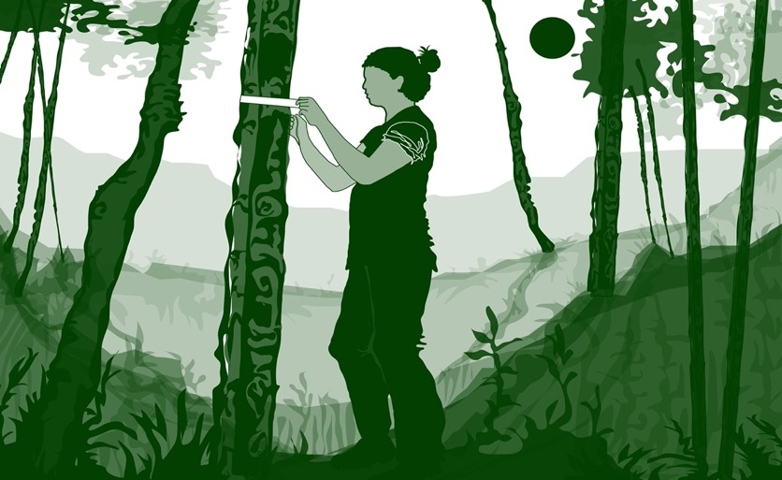
Review questions to help you prepare to do the Tree Circumference measurements associated with the GLOBE Biometry Protocol
Tree circumference measurements are part of what GLOBE Protocol area or Earth system sphere?
Tree Circumference measurements are part of which specific protocol?
What environmental factors influence the average circumference of a tree stand that you might be sampling?
Diameter Breast Height is a standard height used by ecologists and foresters to collect tree circumference data. How high is this measurement taken on the trunk of the tree, measuring from the ground?
Tree circumference data are used to quantify the amount of carbon stored on a landscape. Name one reason this data is important to scientists?
Explain how tree circumference data can be used to track tree migration and range spread related to a change in climate.
Where will you take your tree circumference measurements- on what GLOBE sampling site type?
You will need some data about your study area to choose the correct trees to measure: which other biometry measurement will you need to complete before completing the Tree Circumference measurements?
How do trees respond to stress?
How might a scientist use tree circumference to estimate the volume of biomass of above ground trees? What other data might be useful?

Slide 40

Are You Ready for the Quiz?
You have now completed the slide stack. If you are ready to take the assessment, sign on and take the assessment corresponding to Tree Circumference.
When you pass the assessment, you are ready to take Tree Circumference measurements!
Welcome to the GLOBE Biometry Community!

Slide 41
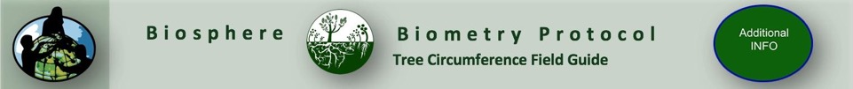
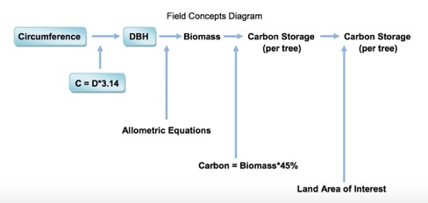
Useful Teaching Resource
The GLOBE Carbon Cycle Learning Activities have activities for introducing carbon cycling, systems thinking, and how to measure trees!

Slide 42
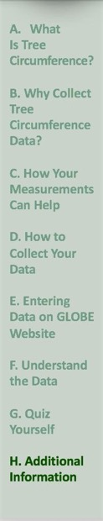
Frequently Asked Questions (FAQs)
Why do we measure at DBH (Diameter Breast Height) when we are measuring the circumference, not the diameter of the tree?
The answer is that many ecologists use the diameter measurement in their analyses, but it is not possible to measure the diameter of a tree directly without specialized equipment. Tree diameter measurements only require a tape measure. To calculate diameter from circumference, the formula is
Diameter = Circumference/ π where π is 3.14.
What do I do if I do not have a single co-dominant tree or shrub species?
If the co-dominant species is mixed at your site, measure the heights and circumferences for 5 trees or shrubs of different species. Note the species you are using in the Metadata.
What do I do if there are not 5 trees or shrubs of the dominant species at my site? Should I measure any heights and circumferences?
If there are less than five, measure all the trees or shrubs at your site and make a note in the Metadata.

Slide 43

Questions about content in the module? Contact GLOBE: training@nasaglobe.org
Credits
Slides:
Russanne Low, Ph.D., University of Nebraska-Lincoln
Rebecca Boger, Ph.D., Brooklyn College
Cover Art:
Jenn Glaser, ScribeArts
More Information:
The GLOBE Program
NASA Wavelength NASA’s Digital Library for Earth and Space Science Education Resources
NASA Global Climate Change: Vital Signs of the Planet
Version 9/26/24. If you edit and modify this slide set for use for educational purposes, please note “modified by and your name and date“ on this page. Thank you.

