Slide 1
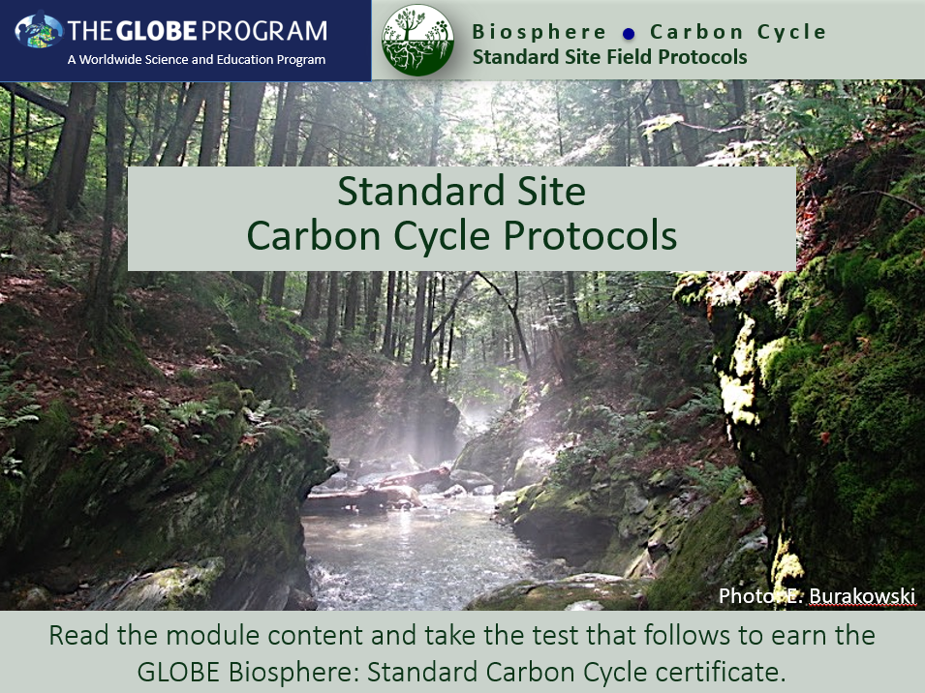
Slide One

Slide 2
Part 1 :
Introduction to
Carbon Cycle

Slide 3
Overview
This section…
teaches why carbon is an important element in ecosystems and how it cycles through ecosystems.
demonstrates how carbon is stored in and transferred between the biosphere, geosphere, atmosphere, and hydrosphere.
explains how humans have disrupted the natural carbon cycle, including rates of transfer between spheres.
explains how increases in atmospheric CO₂ impact climate.
highlights four introductory Learning Activities.

Slide 4
Learning Objectives
After completing this section, you will be able to:
Provide examples of the role of humans in the global carbon cycle.
Explain how carbon is stored in and passed between living & non-living things in terrestrial ecosystems.
Describe two ways in which environmental conditions impact carbon flows through ecosystems.
Estimated time to complete module: 2 hours

Slide 5
The Biosphere
The Biosphere is comprised of all living things on Earth. GLOBE has several ways to explore and measure components of the biosphere through investigations about one of the most fundamental elements for life on Earth – carbon. Carbon also plays a critical role in regulating the Earth's climate system.
Through the burning of fossil fuels and land use change, humans have disrupted the carbon cycle and are now the dominant cause of global climate change.
The GLOBE Carbon Cycle Project consists of four major categories:
(1) Introductory Learning Activities
(2) Classroom experiments (Plant-A-Plant)
(3) Field Measurements (Protocols)
(4) Modeling

Slide 6
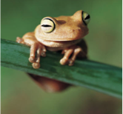
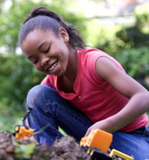
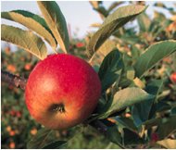
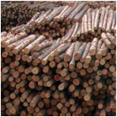
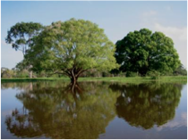
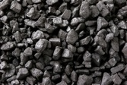
Carbon: A building block of life
The most abundant element in living things
Accounts for 45-50% of the total mass of the biosphere
Also present in the Earth’s atmosphere, soil, oceans, and crust

Slide 7
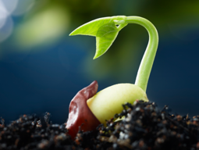
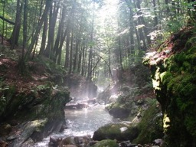
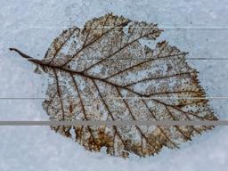
Review: What is the Carbon Cycle?
Carbon is the most abundant element in living things. It is also present in the Earth’s atmosphere, soil, oceans, and crust. The Global Carbon Cycle is the movement of carbon between the atmosphere, land, and oceans.
The global carbon cycle is a key regulator of Earth’s climate system and is central to ecosystem function. Rising CO₂ is the dominant contributor to climate change. Understanding how ecosystems cycle and store carbon is key to understanding solutions to climate change.

Slide 8
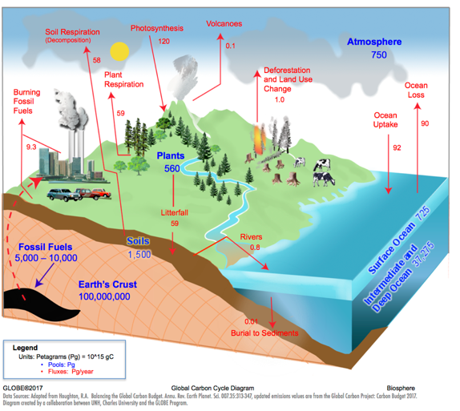
Review: The Carbon Cycle
Carbon Pools:
A place where carbon resides, measured in Petagrams (Pg)
Carbon Fluxes:
Movement of carbon between pools, measured in Petagrams/year
(Pg/year)

Slide 9
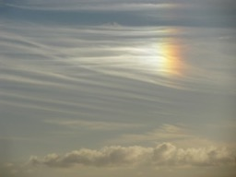
How does the biosphere affect atmospheric carbon dioxide (CO₂) concentrations?
Photosynthesis
CO₂ + H₂O → C₆H₁₂O₆ + O₂
Biosphere
Atmosphere
Respiration
C₆H₁₂O₆ + O₂ → CO₂ + H₂O

Slide 10
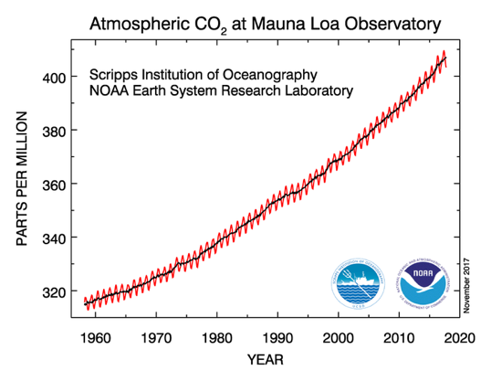
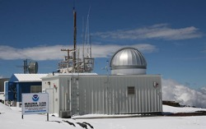
Monthly records of atmospheric CO₂ have been collected at Mauna Loa, Hawaii since 1958.
red – monthly CO₂ showing seasonal cycle
black – long-term trend, adjusted for seasonal cycle
Image: ersl.noaa.gov

Slide 11
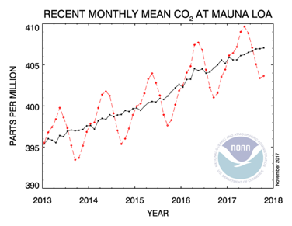
A closer look at several years of CO₂ concentrations reveals a zig-zag pattern, a seasonal cycle.
Image: ersl.noaa.gov

Slide 12

The “falling arm” of the zig-zag coincides with periods when photosynthesis exceeds respiration, in other words, the biosphere is taking up more CO₂ from the atmosphere than it is releasing.
Photosynthesis
CO₂ + H₂O → C₆H₁₂O₆ + O₂
May
September
Image: ersl.noaa.gov

Slide 13
The “rising arm” of the zig-zag coincides with periods when respiration exceeds photosynthesis, in other words, the biosphere is releasing more CO₂ to the atmosphere than it is absorbing.
Respiration
C₆H₁₂O₆ + O₂→ CO₂ + H₂O
May
September
Image: ersl.noaa.gov

Slide 14
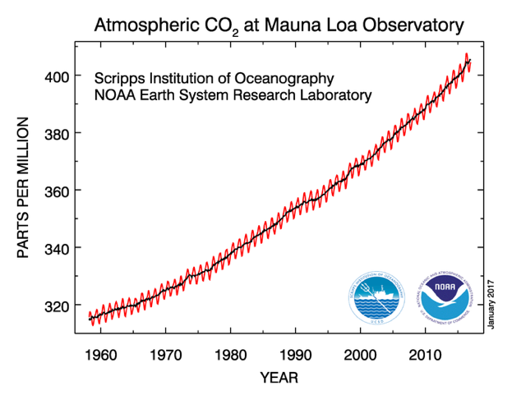
The long-term trend shows an increase in CO₂ of 1-3 parts per million per year since 1958.
increasing trend
Image: ersl.noaa.gov

Slide 15
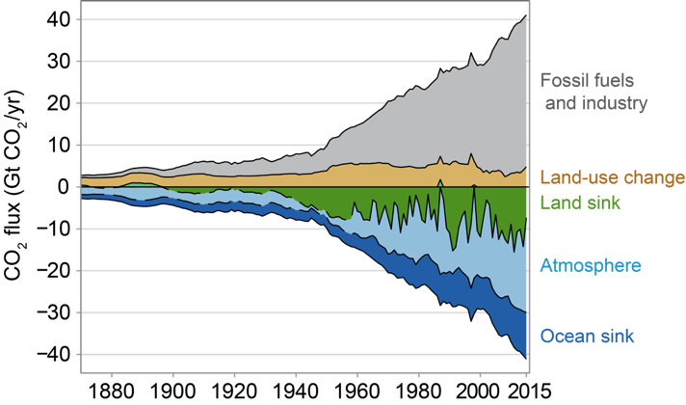
Increases in atmospheric CO₂ are primarily from the burning of fossil fuels.
Image: La Quere et al. 2016, Figure 3

Slide 16
Fossil fuels come from organic material that was buried and deposited millions of years ago.
Play the Earth Operators Manual Video
https://www.youtube.com/watch?v=_8VqWKZIPrM

Slide 17
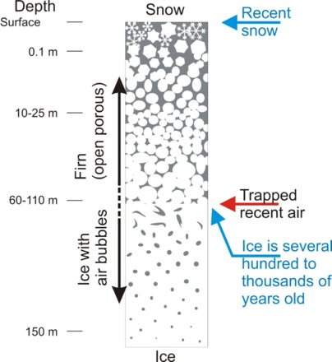
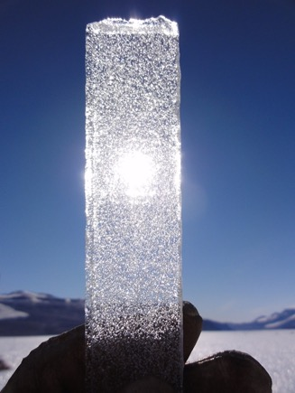
Ice cores trap ancient atmosphere in tiny bubbles.
Image: Bernhard Bereiter
Image: Niels Bohr Institute

Slide 18
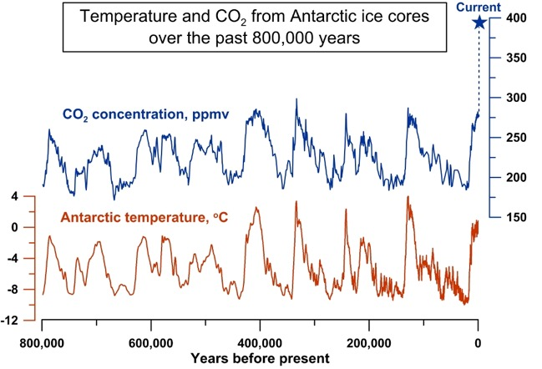
From ice cores, we know atmospheric CO₂ is higher today than it has been in the past 800,000 years.
Image: Jeremy Shakun/Harvard University

Slide 19
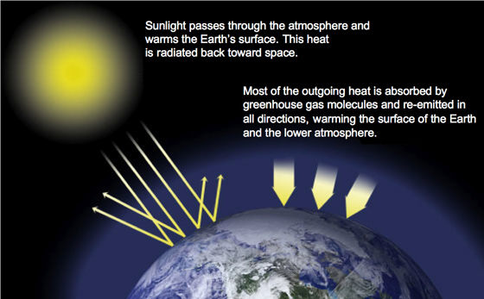
Carbon dioxide is a greenhouse gas. It traps heat in the atmosphere and warms the Earth.
Image: NASA

Slide 20
Increases in atmospheric CO₂ have contributed to a rise in Earth’s temperature.
The term
temperature anomaly
means a departure from a reference value or long-term average, in this case 1951-1980. A positive
anomaly
indicates that the observed
temperature
was warmer than the reference value.

Slide 21
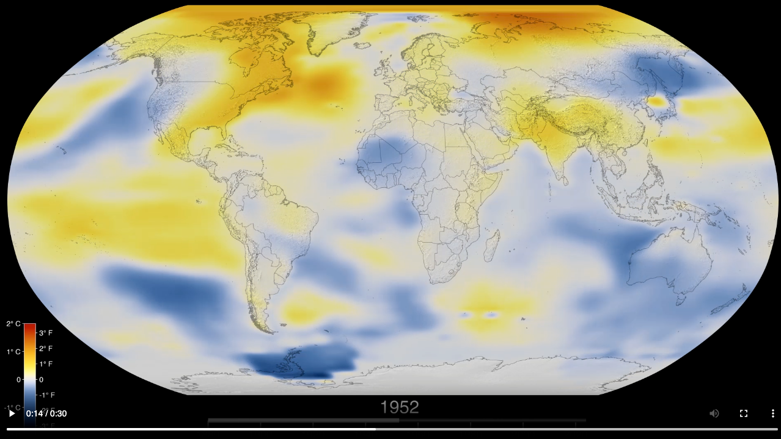
Increases in atmospheric CO₂ have contributed to a rise in Earth’s temperature.
Play Global Temperature Anomalies from 1880 to 2023
Movie: NASA Scientific Visualization Studio

Slide 22
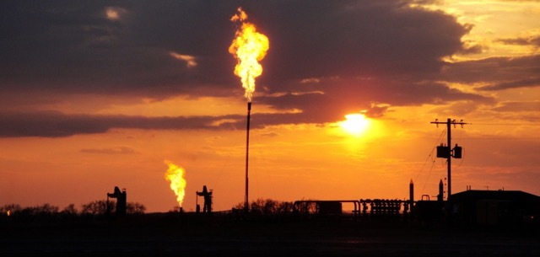
Why Collect Carbon Cycle Data?
The carbon cycle is no longer in balance due to human activities, specifically burning fossil fuels and land use change. CO₂ concentrations in the atmosphere are over 40% higher than the natural range over the past 800,000 years.

Slide 23
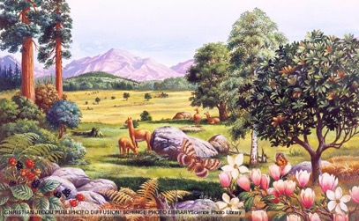
Why Collect Carbon Cycle Data?
The last time in Earth’s history CO₂ levels were this high was over
3 million years ago, during the mid-Pliocene Warm Period. The increase in atmospheric CO₂ occurred over thousands of years. Sea level was
5-20 m higher, global air temperatures were 4ºC warmer, and global sea surface temperatures were 2ºC warmer. Today, we are increasing atmospheric CO₂ at a rate faster than we’ve ever seen in the geologic record.

Slide 24
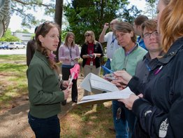
Why Collect Carbon Cycle Data?
Scientists collect carbon cycle data to understand how terrestrial ecosystems will respond to warmer temperatures and higher CO₂.
Your observations are valuable contributions to the scientific community and may be used by educators, students, researchers, and the general public to increase environmental awareness and STEM literacy, as well as advance Earth system science.

Slide 25
Introductory Activities
The GLOBE Carbon Cycle materials include learning activities that introduce students to systems thinking, carbon, and the carbon cycle.
If these concepts are new to your students, they are highly recommended prior to conducting field protocols or modeling activities. The activities include:
Paperclip Simulation: introduction to systems thinking and using the '1-box model'
Carbon Cycle Adventure Story: follow a carbon atom through the carbon cycle
Carbon Travels Game: follow a carbon atom as it travels through the Earth's carbon pools
Getting To Know Global Carbon: learn the basics of the carbon cycle through diagrams

Slide 26
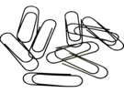
Introductory Activities
Paperclip Simulation - Introduction to Systems Thinking
(60 minutes + 30 math extension).
Student Outcomes:
Simulate a basic system
Collect, record, and analyze data
Create a 1-box model to learn modeling and system terms
Manipulate variables to obtain an expected outcome
Materials:
Simulation materials: paperclips, bell, signs, and roles
Class Data Table (paper OR .xls) and Projector AND/OR Whiteboard/large paper with markers
Student Worksheets & Paper Clip Simulation Data Table

Slide 27
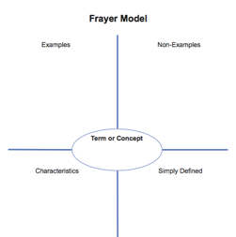
What is a System?
Definition: A collection of interconnected parts that function as a complex whole, through which matter cycles and energy flows.
Why does GLOBE use a ‘systems thinking’ approach to understand the Carbon Cycle?
1. Systems are an important unifying concept across the K-12 curriculum.
2. The actual carbon cycle is extremely complicated. Simplifying it as a system that focuses on the most important elements can help us understand why the atmosphere is changing and what it might look like in the future.
**Use the Frayer Model template to help students define the word ‘system’

Slide 28
Modeling Systems with the 1-Box Model
The 1-box model represents an individual component of a system. It introduces concepts like inputs, outputs and residence time and shows how these can produce particular patterns of change over time.
In the GLOBE Carbon Cycle Learning Activities, students use the 1-box model to diagram and manipulate movement of matter through systems.
Input Flux
(per unit time)
Pool
Output Flux
(per unit time)
*A pool can also be referred to as a stock or reservoir, a flux can also be referred to as a flow.

Slide 29
Modeling Systems with the 1-Box Model
The 1-box model can be used to represent many different systems.
In the paperclip factory simulation to understand the components of a system:
Production
Store Inventory
Purchases
Or to model parts of the Global Carbon Cycle:
Photosynthesis
Plant Pool
Respiration

Slide 30
Putting many '1-Box Models' together makes a box and arrow model that shows how individual components of an entire system are connected.
Putting together many boxes (pools) and arrows (fluxes) allows you to model the movement of matter through more complex systems. For example, the model below shows the movement of carbon through the Atmosphere, Soil and Plant Pools of the Carbon Cycle:
Atmosphere Pool
Soil Respiration
Plant Respiration
Photosynthesis
Litterfall
Soil Pool
Plant Pool

Slide 31
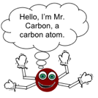
Introductory Activities
Carbon Cycle Adventure Story – Follow a carbon atom through the carbon cycle in a self-guided adventure story (60-90 minutes).
Student Outcomes:
List major pools and fluxes of the carbon cycle
Diagram the carbon cycle using box and arrow models
Describe what components of the carbon cycle make it a system
Materials:
Carbon Cycle Adventure Story booklets (one per student or pair)
Carbon Story Journey Table (one per student or pair)
White board, chalk board, large paper, or overhead projector & markers/chalk

Slide 32
Introductory Activities
Carbon Travels Game – roll the dice to determine the fate of a carbon atom as it travels through Earth’s carbon pools (60-120 min)
Student Outcomes:
Research a specific carbon pool and present to peers
List all major pools and fluxes in global carbon cycle
Define residence time
Compare and contrast the carbon cycle pre- and post-1700
Materials:
Resources about carbon cycle
Large sheets of paper
Carbon Cycle Station Instructions and Signs
Journey Table (1 per student)
1 six-sided die per student or station

Slide 33
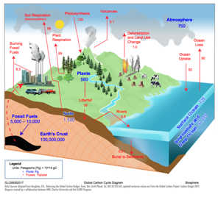
Introductory Activities
Getting to Know Global Carbon – learn the basics of the carbon cycle through diagrams (70-100 min)
Student Outcomes:
Create diagrams of complex systems
Conceptualize 1 Pg of carbon
Describe why the carbon cycle is not in equilibrium
Materials:
White board, chalk board, large paper or overhead projector & markers/chalk
Materials for students to draw their own carbon cycle diagram
Global Carbon Cycle Diagram – student copies or projected image

Slide 34
Quiz Questions
Challenge yourself to answer these questions and check whether you have achieved the learning objectives of this module.
What is the carbon cycle?
What is the difference between pools and fluxes?
What are the major pools of carbon in the Earth System? Which contain the most carbon? The least?
Why is studying the carbon cycle important?
When atmospheric carbon dioxide concentrations increase, what happens to Earth’s temperature?
Does photosynthesis add or remove carbon from the atmosphere? Does respiration add or remove carbon from the atmosphere?
What process has caused the most recent (past 150 years) increase in atmospheric carbon dioxide?
What activity could you use to introduce students to systems thinking?
What is a system?
What is a 1-box model? What are two examples of a 1-box model?

Slide 35
Part 2 :
Standard Site Field Protocols

Slide 36
Overview
This section…
Shows how to determine if you have a standard or non-standard site.
Demonstrates how to set up a standard sample site
Provides step-by-step instructions for protocols
Describes how to enter data on the GLOBE website
Helps you understand your data

Slide 37
Learning Objectives
After completing this module, you will be able to:
Perform field measurements to assess carbon storage and plant growth at a local field site and upload data to the GLOBE database
Understand resources available to help you analyze and interpret your data
Estimated time to complete module: 1.5 hours

Slide 38
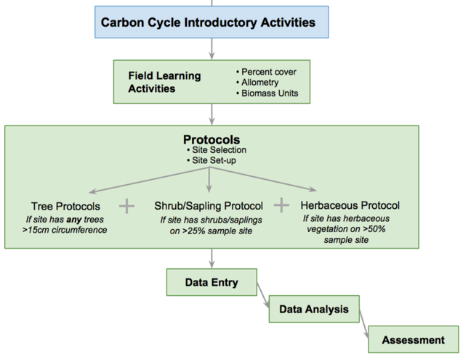
Field Protocols Flowchart

Slide 39
Example Research Questions
There are many research questions that can be explored through carbon field measurements. Below are some examples:
How much carbon is stored in the vegetation near my school?
Do different vegetation types store different amounts of carbon?
How does the uptake of carbon by schoolyard vegetation compare to the emissions of carbon by the school (carbon footprint)?
Is there more carbon stored in the global human population or trees in [MY STATE]?
What is the pattern in which biomass and carbon storage change over time in my sample site? *Multiple years of data needed*

Slide 40
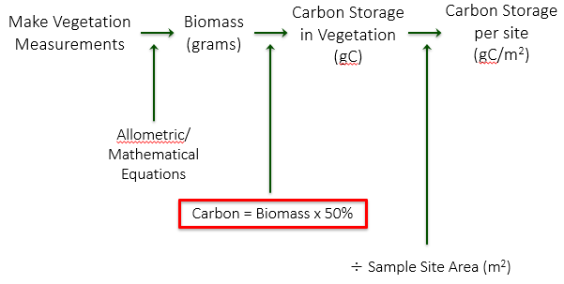
How Will You Calculate Carbon?

Slide 41
Standard Site Carbon Field Protocols
For All Sites Complete:
Field Learning Activities
Site Selection
  - Choose your field site location
Site Set-up
  - Set up your site
  - Determine which vegetation you will measure based on tree size and % cover estimates
Complete some or all of the following, depending on vegetation present:
How to Measure Trees Supporting Protocol
Tree Protocols
Shrub/Sapling Protocol
Herbaceous Protocol

Slide 42
Field Learning Activities
These activities teach important concepts and skills for understanding and conducting Carbon Protocols.
Biomass Units
Percent Cover
Allometry

Slide 43
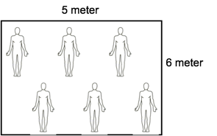
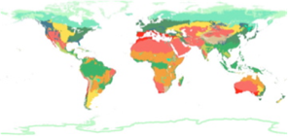
Biomass Units
Students calculate the biomass of the classroom in g/m².
Students assess how biomass would change if size or mass of a sample area were different.
Students rank global biomes from greatest to least biomass and compare their guess to available data.
Students estimate how much carbon is stored in their schoolyard (g C/m²) based on their biome classification and what they see.

Slide 44
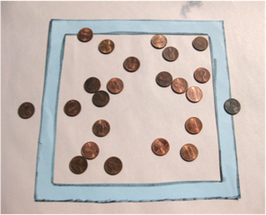
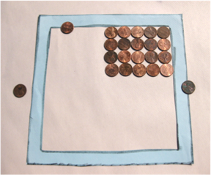
Percent Cover
Students practice estimating percent cover
Students use these to determine if shrubs/saplings and/or herbaceous vegetation should be measured in the sample site.

Slide 45
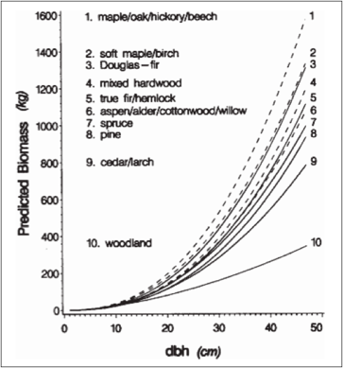
Allometry
Students measure their height, arm span, and foot length to show how living organism’s parts are related to the whole (allometry)
Students use this concept to understand how circumference/DBH of trees can be used to estimate biomass
Students view allometric relationships of tree species groups
Jenkins et al. 2003

Slide 46
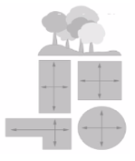
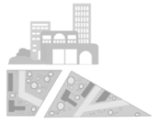
Site Selection
Site selection can be completed with or without student involvement
Determine if your site is a “Standard” or ”Non-standard” site:
Standard Site - an accessible area of at least 225 m² (15m x 15m) of contiguous vegetation (forest, shrubland, grassland). Aim for 30 m x 30 m (900 m²). A smaller or different shaped area will work; modify Tree Mapping protocol to suit your site & students.
Non-standard Site – an accessible area of 225 m² (15m x 15m) with some vegetation and some human interference (i.e. a local park, city block, or the school area itself). *Please complete Carbon Cycle Non-Standard Site Field Protocols eTraining*
.

Slide 47
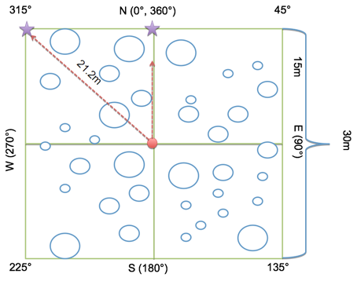
Standard Site Set-Up
Before going out in the field, students learn necessary skills for Site Set-up: pacing, compass, (and optional GPS).
Students then work in teams to set up a Carbon Cycle sample site:
1. Perimeter Team
2. Corner Team
3. Center Team

Slide 48
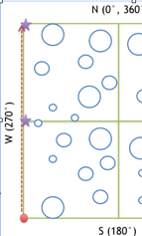
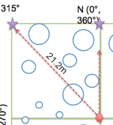

Standard Site Set-up (Cont’d)
Corner teams
Use compass to pace from plot center to each corner. Place a temporary flag. Repeat for corresponding sides.
Perimeter Team
Start at first corner completed by a Corner Team. Pace along perimeter to check flags placed by Corner Teams.
Center Team
Record the appropriate site location information on the Sample Site Data Sheet. Conduct vegetation analysis by estimating percent cover of shrubs/saplings and herbaceous cover. Take site photos.

Slide 49
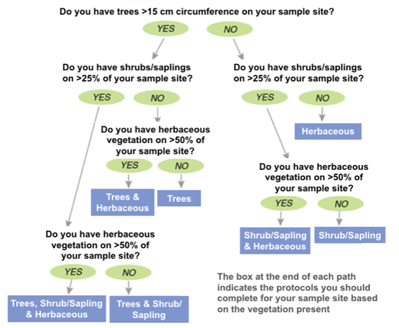
Protocol Decision Tree
Determine which vegetation you will measure.
*Not sure how big the trees are? See Supporting Protocol 'How To Measure Trees' for instructions on accurate circumference measurements

Slide 50
Trees: Protocol Overview
How to Measure Trees (Supporting Protocol) | Time: 60 minutes Instruments: tree cookies, small flexible measuring tape, calculator Prerequisites: None
Tree Mapping *This can be done simultaneously with tree circumference, shrub/sapling & herbaceous measurements (if applicable). Complete once per site. | Time: 70 minutes (only needs to be completed once per site) Instruments: 50 m flexible measuring tape, local tree ID guide, compass Prerequisites: Site Set-up, How to Measure Trees, Field Learning Activities (Biomass Units, Allometry)
Tree Circumference *This can be done simultaneously with shrub/sapling & herbaceous measurements (if applicable).Complete each year. | Time: 60 minutes Instruments: Measuring tapes (150-300 cm) Prerequisites: Site Set-up, How to Measure Trees, Tree Mapping, Field Learning Activities (Biomass Units, Allometry)

Slide 51
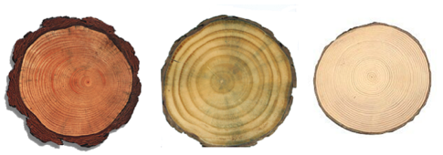
How to Measure Trees
Students measure tree cookies to understand the relationship between circumference and diameter
Students learn that circumference is measured at 1.35 meters from the tree base
Students gain understanding of concepts precision and accuracy

Slide 52
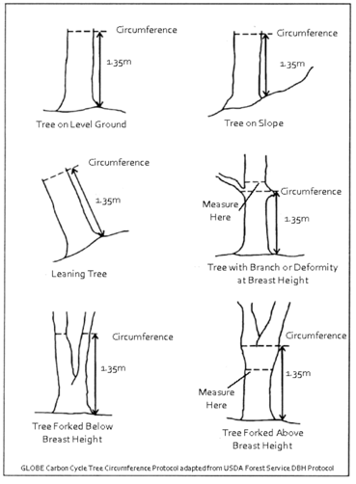
How to Measure Trees (Cont’d)
Use the 'Badly Behaving Trees Guide' at right to accurately measure trees in the field plot:
  Measure up 1.35m from the highest point around the base of the tree - this is “breast height”
  Measure around the tree at the given height in cm to find tree circumference at breast height
  This can later be converted to diameter at breast height (DBH)

Slide 53
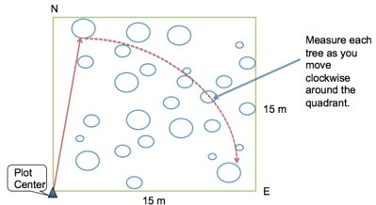
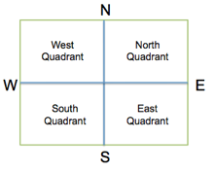
Tree Mapping
*only needs to be completed once per site*
Students divide into 4 quadrant teams and use a compass and measuring tape or pacing to map the location of each tree in the quadrant so the biomass and growth of each tree can be tracked over time.

Slide 54
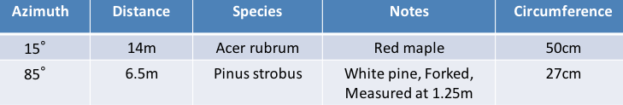
Tree Mapping (Cont’d)
*only needs to be completed once per site*
Measure and record azimuth and distance of each tree from center, and identify the genus and species.
If completing in conjunction with the Tree Circumference protocol, you will also measure circumference at this time.

Slide 55
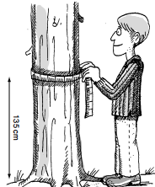
Tree Circumference
*Complete each year*
Measure circumference at breast height (CBH, 1.35m) for all mapped trees, currently living & greater than 15cm CBH on your site.
Measure CBH to the nearest tenth centimeter, e.g. 16.6cm.
In the 'notes' section of the data sheet, include:
  If the tree has died since the previous year
  The common name of the tree
  If circumference was not measured at breast height (due to tree branching or bulging- See the 'Badly Behaving Tree Guide' for more information)

Slide 56
Shrubs/Saplings: Protocol Overview
Shrub/Sapling Protocol *This can be done simultaneously with tree & herbaceous measurements (if applicable). Complete each year. | Time: 40 minutes Instruments: Compass, 2-3 m stick marked in centimeters Prerequisites: Site Set-up

Slide 57
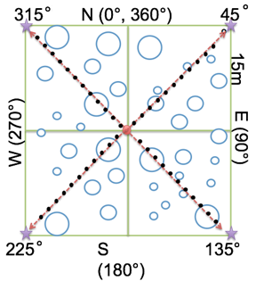
Shrub/Sapling Protocol
*Complete each year*
For each plot corner:
Pace from the center towards a corner. At each pace (two steps), place the measuring stick straight down.
Record ‘H’ (hit) if the stick is touching a shrub or sapling.
  Mark ‘E’ if the species is evergreen and measure the height of the shrub or sapling.
  Mark ‘D’ if the species is deciduous and measure the height of the shrub or sapling.
Use the measuring stick to measure a representative height of the whole shrub/sapling.
Record ‘M’ (miss) if the stick is not touching a shrub or sapling.
Repeat these steps until you reach the corner.
Repeat for each corner.
Standard Shrub/Sapling Measurements - Student Field Guide

Slide 58
Herbaceous Vegetation: Protocol Overview
Herbaceous Vegetation Protocol *This can be done simultaneously with tree & shrub/sapling measurements (if applicable). Complete each year. | Time: 40 minutes Instruments: OUTSIDE: beanbag, blindfold, measuring tape, clippers, small brown paper bags, INSIDE: balance, drying oven (optional) Prerequisites: Site Set-up

Slide 59
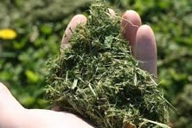
Herbaceous Protocol
*Complete each year*
Collect samples of herbaceous vegetation from the site.
Blindfold a member of the team and have him/her/them throw a beanbag somewhere in the sample site.
Mark a one-meter square around the bean bag to take a random sample.
Using grass clippers, clip all the vegetation close to the ground within the square. Do NOT collect any leaves or litter that are already dead or unattached from the ground.
Place clippings into brown paper bags and label with the site name, date, and sample number (e.g., Field Site Name, Herb Sample #1, bag 1 of 2).
Repeat steps 1-5 two more times.

Slide 60


Herbaceous Protocol (Cont’d)
*Complete each year*
Dry the herbaceous samples by either:
(a) Drying oven: Set oven temp to 50-70ºF, put labeled bags in drying oven. Weigh the bag once per day after day one until sample weights the same two days in a row. Record the mass (g) of the sample + bag and the mass of the empty bag.
(b) Air drying: Select a dry, secluded area large enough for all sample bags. Open the tops of the bags for maximum airflow. Weigh once per day after day five, until sample weighs the same two days in a row. Record the mass (g) of the sample + bag, and the mass of the empty bag.
Image: censam.mit.edu
Image: iowalearningfarms

Slide 61
Data Entry at Globe.gov (1/3)
After students have returned from the field with their paper data sheets, data can be shared with the GLOBE and scientific community by entering it into the GLOBE online science database (https://data.globe.gov).
When you submit your data through GLOBE, the calculations to convert your raw data to biomass and carbon storage values will be completed for you.
*Before you enter data, review it as a class, checking for data quality including precision and typos. See the Carbon Cycle Data Entry Teachers Guide for notes and suggestions .

Slide 62
For years 2+ Data Review - Compare Data To Previous Years
Did any trees increase in circumference? Is it what you expected? Any possible errors? Compare large trees to small trees.
Any decreases in tree circumference? Have trees died? Difficult bark (wavy, bumpy)? Measured at same height?
Differences in species?
Any new trees? Factors that affected current year (ie: ice storms, insects, hurricanes).

Slide 63
Data Entry at Globe.gov (2/3)
Data can be entered to the GLOBE website in three ways:
Desktop Data Entry: Log environmental data directly on the GLOBE website.
Email Data Entry: If connectivity is an issue, data can also be entered via email.
GLOBE Observer App: The app allows users to enter data directly from an iOS or Android device for any GLOBE protocol.

Slide 64
Data Entry at Globe.gov (3/3)
To add your Carbon Cycle data to the GLOBE website, create a new site if you do not already have one.
If you already have a Carbon Cycle site, you can skip ahead to add your Carbon Cycle data.

Slide 65
Add new site at Globe.gov or on the GLOBE Observer App
Create a new site
Add site coordinates
Describe site, indicate standard or non-standard, and vegetation measured
Submit
Optional: add site photos

Slide 66


1. Create a new site
Log in to the GLOBE Data Entry webpage and click “Create/Edit My Sites”.
Then click “Add site”.

Slide 67

2. Add site coordinates
Choose a name for your site
Type in coordinates or move the map to add your latitude and longitude

Slide 68

3. Describe site; indicate standard or non-standard, and vegetation types measured
Check the vegetation types you will measure
Select Standard or Non-Standard*
Add the area of the site in m²
*This will determine the data entry form you see!

Slide 69


4. Submit!
At the bottom of the screen, click the ”Save Site” button.
Your site will now appear in the list of GLOBE data collection sites under your school/organization.
To return to the data entry home page, use the home icon at the bottom of the screen.

Slide 70

5. Optional: Add site photos
After your site is created, you can add site photos by going to “Create/Edit My Sites” from the data entry home page and clicking on your carbon site name. Scroll down to the photo section:
Click on the camera icon to upload a photo.
Optional: add a caption
Click “Update Site”
Make sure that your photos do not contain people!

Slide 71

Add Carbon Cycle data
Once your site has been established in the database, you or your students are ready to upload carbon data. Learn how to manage student accounts.
From the data entry homepage. Click “New Observation”

Slide 72

Add Carbon Cycle data (Cont’d)
Under Biosphere, select Carbon Cycle
Click Continue

Slide 73

Add Carbon Cycle data (Cont’d)*
Scroll down the page and choose the Carbon site you created

Slide 74

Add Carbon Cycle data (Cont’d)*
Update the date and time to when you collected your carbon data
Click “Carbon Cycle”

Slide 75

Add carbon cycle tree* data
Enter data from your data sheet for each tree.
Click “Add Tree” to enter data for each subsequent tree you measured.
* not all sites will have trees. Skip if not applicable to your site.

Slide 76

Enter shrub and sapling* data
Add shrub and sapling data from your data sheet.
Click “Add Sample” for additional shrubs or saplings as necessary.
* not all sites will have shrubs and saplings. Skip if not applicable to your site.

Slide 77

Enter herbaceous* data
Add data from your three herbaceous samples.
Biomass is automatically calculated.
Click “Add Bag” if you had multiple bags per sample.
* not all sites will have herbaceous vegetation. Skip if not applicable to your site.

Slide 78

Send Data to GLOBE
Click the “Review” button at the bottom of the screen.
Open the Biosphere drop down and review the data you entered.
If it is correct, click “Send Observations”.
Wait to receive the message that your observations were successfully sent!

Slide 79
Understanding Your Data: Data Analysis
Use the Biomass & Carbon Analysis Teacher Guides (separate documents for Trees, Shrubs/Saplings, and Herbaceous vegetation) to assist students with observing and understanding patterns and trends in their field measurement data.
Requires:
Data spreadsheet downloaded from GLOBE (see instructions on following page)
Microsoft Excel (or similar spreadsheet program)
Biomass Analysis Questions

Slide 80


Download Data From GLOBE (1/3)
*complete with carbon and biomass estimates
Go to GLOBE’s Data Access Tool
Read through the instructions to familiarize yourself with this tool.
Under Data Filters, click ‘Select Protocols’
Scroll down to find the Biosphere section, click ‘Carbon Cycle’, and click Add to Filter.
Select a data range that includes the date in which you collected data. Click Add to Filter.

Slide 81


Download Data From GLOBE (2/3)
Under Site Filters, click ‘School/Teacher/Partner/Team’, and select your school.
If you have multiple Carbon Cycle field sites, select the individual site in which you are interested under ‘Site Name’.
Click the green ‘Apply Filter’ button in the top left.

Slide 82


Download Data From GLOBE (3/3)
Click ‘Obtain Measurement Data’ (Note, data will be downloaded for the whole list you see, if your school is not the only one listed, redefine your filters).
The button will update, and you can click Download Measurement Data to download a .csv, which can be opened in a spreadsheet tool such as Excel. (See an example Carbon Cycle spreadsheet on the Data Analysis section of the Carbon Cycle webpage).
* Note, you can also use the GLOBE Visualization System to view your and other school’s Carbon Cycle data on a map.

Slide 83
Understanding Your Data: Data Interpretation
Use the GLOBE Carbon Cycle data interpretation teacher guides and activities to give students context for understanding their data.
Human carbon storage vs. tree carbon storage
Schoolyard area (scaling)
Net Primary Production (NPP)

Slide 84

Human Carbon vs. Tree Carbon
Use a back-of-the-envelope calculation to determine whether more carbon is stored in humans or trees.
Example research question that can be answered through this activity: Is there more carbon stored in the global human population or the trees in [MY STATE]?
** This activity can help students understand why there is not a ‘human’ pool on the Global Carbon Cycle Diagram.

Slide 85

Schoolyard area scaling
The Determining Scale & Calculating Area Teacher Guide describes how to use an aerial photo/map to scale your sample site carbon measurements to larger areas of similar vegetation.
Example research question that can be answered through this activity: How much carbon is stored in the vegetation near my school?
*Note the teacher will need Google Earth Pro (a free application) to create the map image.

Slide 86
Calculating Net Primary Productivity
Use the Calculating Net Primary Productivity Teacher Guide to understand the change in carbon storage over time. *Needs multiple years of carbon data*
Example research question that can be answered through this activity: What is the pattern in which biomass and carbon storage change over time in my sample site?
Net Primary Productivity (NPP), or the production of plant biomass, is equal to all of the carbon taken up by the vegetation through photosynthesis minus the carbon that is lost to respiration. NPP can be calculated with this equation:
$$NPP=Carbon stored for Year 2 −Carbon Stored for Year 1$$

Slide 87
Quiz Questions
Challenge yourself to answer these questions and check whether you have achieved the learning objectives of this module.
Name two carbon cycle field learning activities.
What are some research questions you could ask using GLOBE carbon cycle data at your site?
What is the minimum area for a Standard site?
If your site has trees, what data will you record for each tree?
At what height do you measure tree circumference?
If a tree is on a steep slope, what guide could you use to accurately measure tree circumference?
What is the percent cover needed to take herbaceous vegetation measurements? Shrub/sapling measurements?
How are tree measurements converted to biomass? To carbon storage?
If you measure shrub/saplings, what data will you record?
How might someone calculate carbon storage of vegetation over the entire town based on your field measurements?

Slide 88
Additional Information
Additional Resources:
NASA’s A Breathing Planet, Off Balance Article and Video:
https://www.nasa.gov/feature/goddard/carbon-climate
NASA Global Climate Change Website:
https://climate.nasa.gov/
NASA Scientific Visualization Studio
https://svs.gsfc.nasa.gov
Global Carbon Project
http://www.globalcarbonproject.org
  Global Carbon Atlas
  http://www.globalcarbonatlas.org

Slide 89
Additional Information
Questions about this module?
Contact GLOBE: training@nasaglobe.org
eTraining Authors:
Dr. Elizabeth Burakowski, University of New Hampshire
Haley Wicklein, University of New Hampshire
Jennifer Bourgeault, University of New Hampshire
This work was supported by NASA (Grant no. 80NSSC18K0135). Any opinion, findings and conclusions or recommendations expressed in this material are those of the authors(s) and do not necessarily reflect the views of NASA.

