Slide 1
Non-Standard Site Carbon Cycle Protocols
Photo: E. Burakowski

Slide 2
Overview
This module…
Reviews why carbon is an important element in ecosystems and how it cycles through ecosystems
Shows how to determine if you have a standard or non-standard site.
Demonstrates how to set up a standard sample site
Provides step-by-step instructions for protocols
Describes how to enter data on the GLOBE website
Helps you understand your data

Slide 3
Learning Objectives
After completing this module, you will be able to:
Describe the major pools and fluxes of the carbon cycle
Perform field measurements to assess carbon storage and plant growth at a local field site and upload data to the GLOBE database
Understand resources available to help you analyze and interpret your data
Estimated time to complete module: 2 hours

Slide 4
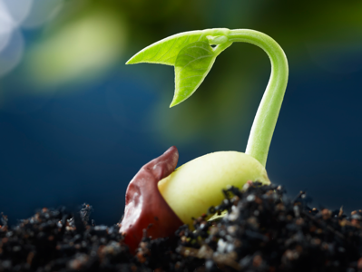
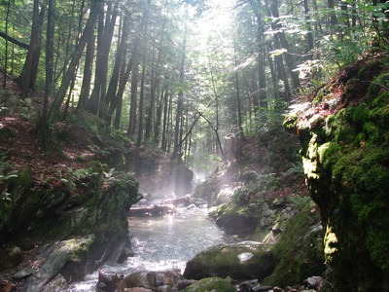
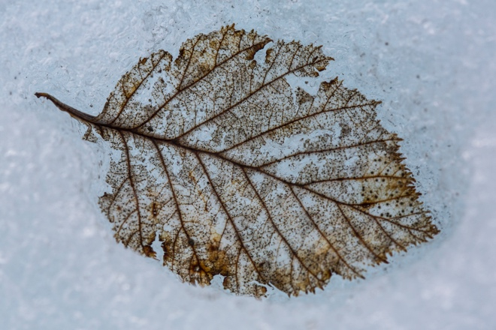
Review: What is the Carbon Cycle?
Carbon is the most abundant element in living things. It is also present in the Earth’s atmosphere, soil, oceans, and crust. The Global Carbon Cycle is the movement of carbon between the atmosphere, land, and oceans.
The global carbon cycle is a key regulator of Earth’s climate system and is central to ecosystem function. Rising CO2 is the dominant contributor to climate change. Understanding how ecosystems cycle and store carbon is key to understanding solutions to climate change.

Slide 5
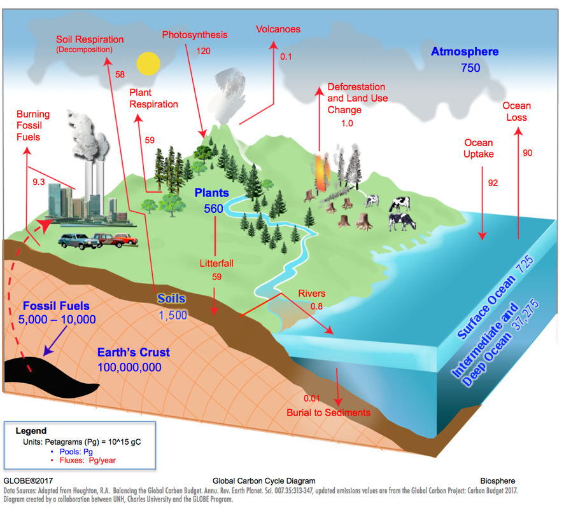
Review: The Carbon Cycle
Carbon Pools:
A place where carbon resides, measured in Petagrams (Pg)
Carbon Fluxes:
Movement of carbon between pools, measured in Petagrams/year
(Pg/year)

Slide 6
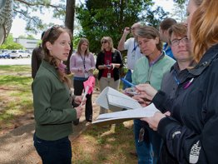
Review: Why Collect Carbon Data?
Scientists collect carbon cycle data to understand how terrestrial ecosystems will respond to warmer temperatures and higher CO2.
Carbon cycle data collected with GLOBE will contribute to a better understanding of the relationship between carbon storage in plants and surface climate.

Slide 7
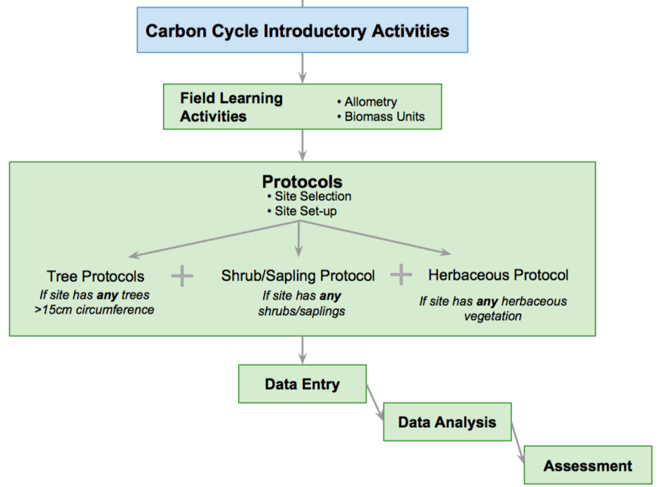
Field Protocols Flowchart

Slide 8
Example Research Questions
There are many research questions that can be explored through carbon field measurements. Below are some examples:
How much carbon is stored in the vegetation near my school?
Do different vegetation types store different amounts of carbon?
How does the uptake of carbon by schoolyard vegetation compare to the emissions of carbon by the school (carbon footprint)?
Is there more carbon stored in the global human population or trees in [MY STATE]?
What is the pattern in which biomass and carbon storage change over time in my sample site? *Multiple years of data needed*

Slide 9
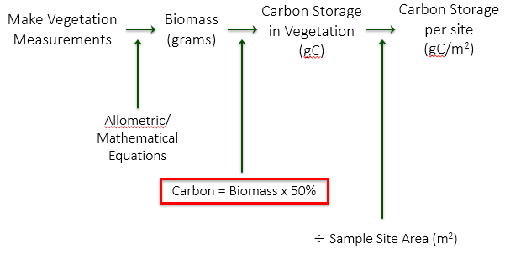
How Will You Calculate Carbon?

Slide 10
Non-Standard Site Carbon Field Protocols
For All Sites Complete:
Field Learning Activities
Site Selection
- Choose your field site location
Site Set-up
- Set up your site
- Determine which vegetation you will measure based on tree size and % cover estimates
Complete some or all of the following, depending on vegetation present:
How to Measure Trees Supporting Protocol
Tree Protocols
Shrub/Sapling Protocol
Herbaceous Protocol

Slide 11
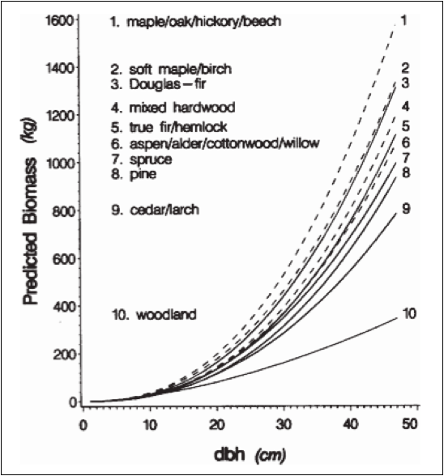
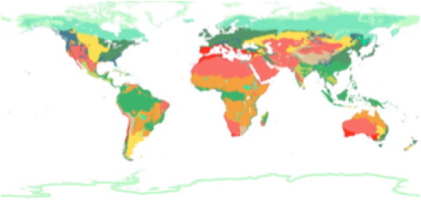
Field Learning Activities
These activities teach important concepts and skills for understanding and conducting Carbon Protocols.
Biomass Units
Allometry

Slide 12
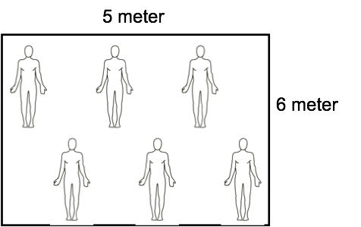
Biomass Units
Students calculate the biomass of the classroom in g/m2.
Students assess how biomass would change if size or mass of a sample area were different.
Students rank global biomes from greatest to least biomass and compare their guess to available data.
Students estimate how much carbon is stored in their in schoolyard (g C/m2) based on their biome classification and what they see.

Slide 13
Allometry
Students measure their height, arm span, and foot length to show how living organism’s parts are related to the whole (allometry).
Students use this concept to understand how circumference/DBH of trees can be used to estimate biomass.
Students view allometric relationships of tree species groups.
Jenkins et al. 2003

Slide 14
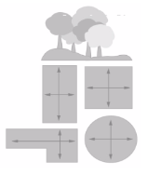
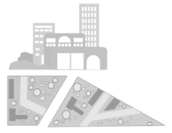
Site Selection
Site selection can be completed with or without student involvement
Determine if your site is a “Standard” or ”Non-standard” site:
Standard Site - an accessible area of at least 225 m² (15m x 15m) of contiguous vegetation (forest, shrubland, grassland). Aim for 30 m x 30 m (900 m²). A smaller or different shaped area will work; modify Tree Mapping protocol to suit your site & students. *Please use Standard Site Carbon Cycle Protocols eTraining*
Non-standard Site – an accessible area of 225 m² (15m x 15m) with some vegetation and some human interference (i.e. a local park, city block, or the school area itself).

Slide 15
Site Selection (Cont’d)
Site selection can be completed with or without student involvement
For a Non-Standard site:
Use aerial maps to make a rough count of the number of trees in the schoolyard, park, or neighborhood of interest.
a) If the number of trees is < 150, your sample site size will be the entire area (i.e. A city block).
b) If the number of trees is ≥ 150, select 1-2 smaller areas in which to perform all field measurements for carbon.

Slide 16
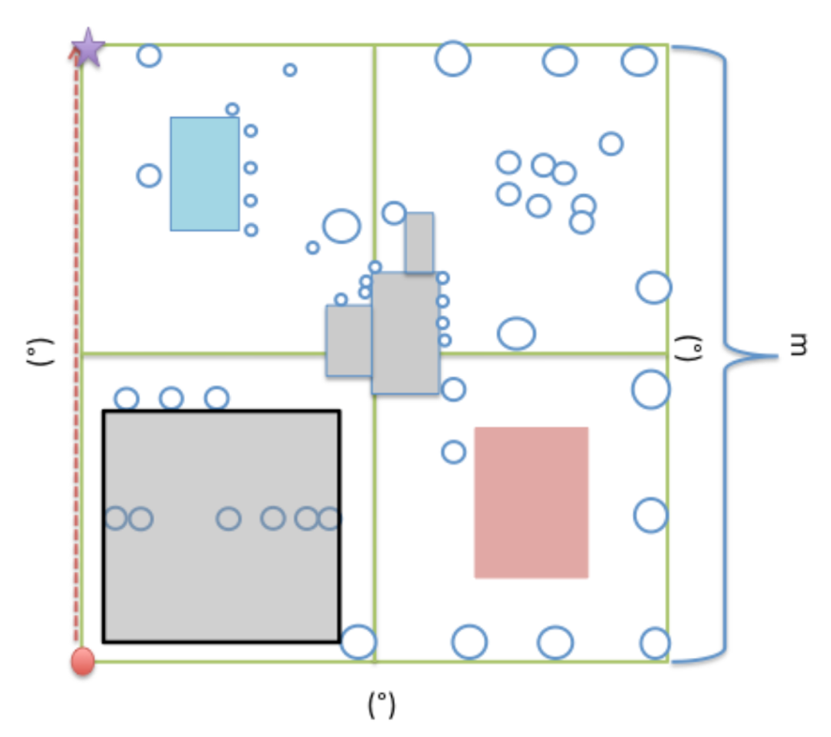
Non-Standard Site Set-Up
Before going out in the field, students learn necessary skills for Site Set-up: pacing, compass, (and optional GPS).
Students then work in teams to set up a Carbon Cycle
sample site:
1. Perimeter Team
2. Photography Team
3. Data recording Team
4. GPS Team if using GPS unit*.
*If using phone for GPS, data recording team collects coordinates

Slide 17
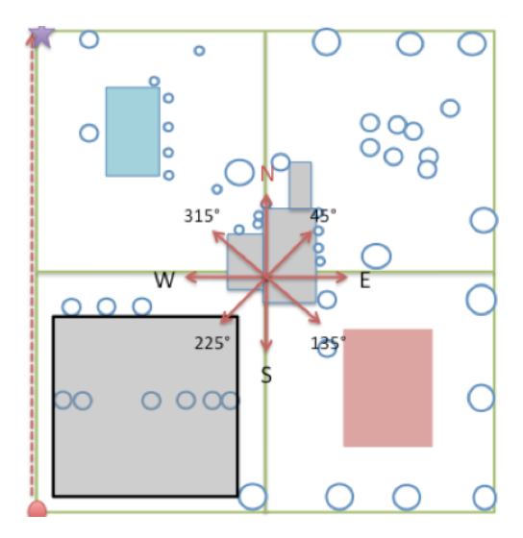
Non-Standard Site Set-up (Cont’d)
Perimeter Team
Start at one corner of the site and rotate clockwise until facing nearest corner. Record bearing and paces to nearest corner. Repeat for each corner.
Photography Team
Select a spot in middle of site to take photos. Use compass to take one photo in nine directions below and work with data recording team to enter photo numbers or photo time-stamp on site set-up sheet.
Data recording Team
Each team member independently estimates percent cover of shrubs & saplings and herbaceous cover.
Work with photography team to record the photo numbers. Use the time stamp of the photo if using a smart phone.
Provide additional info to metadata section (ie: MUC classification, dominant species, water, etc.)

Slide 18
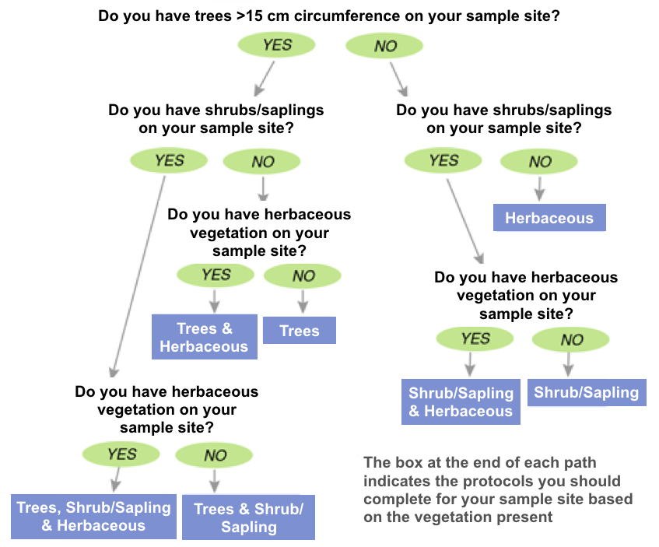
Protocol Decision Tree
Determine which vegetation you will measure.
*Not sure how big the trees are? See Supporting Protocol 'How To Measure Trees' for instructions on accurate circumference measurements

Slide 19
Trees: Protocol Overview
How to Measure Trees (Supporting Protocol) | Time: 60 minutes Instruments: tree cookies, small flexible measuring tape, calculator Prerequisites: None
Tree Mapping *This can be done simultaneously with tree circumference, shrub/sapling & herbaceous measurements (if applicable). | Time: 70 minutes (only needs to be completed once per site) Instruments: 50 m flexible measuring tape, local tree ID guide, compass Prerequisites: Site Set-up, How to Measure Trees, Field Learning Activities (Biomass Units, Allometry)
Tree Circumference *This can be done simultaneously with shrub/sapling & herbaceous measurements (if applicable). | Time: 60 minutes Instruments: Measuring tapes (150-300 cm) Prerequisites: Site Set-up, How to Measure Trees, Tree Mapping, Field Learning Activities (Biomass Units, Allometry)

Slide 20
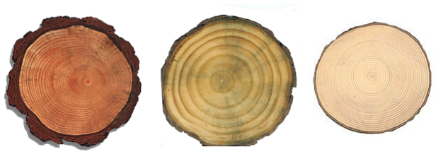
How to Measure Trees
Students measure tree cookies to understand the relationship between circumference and diameter
Students learn that circumference is measured at 1.35 meters from the tree base
Students gain understanding of concepts precision and accuracy

Slide 21
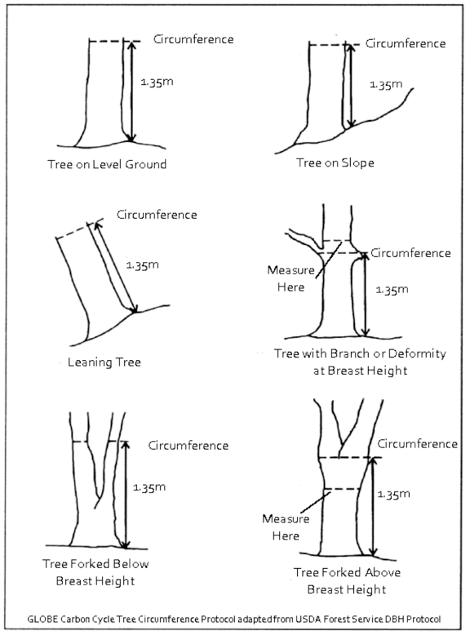
How to Measure Trees (Cont’d)
Use the 'Badly Behaving Trees Guide' at right to accurately measure trees in the field plot:
Measure up 1.35m from the highest point around the base of the tree - this is “breast height”.
Measure around the tree at the given height in cm to find tree circumference at breast height.
This can later be converted to diameter at breast height (DBH).

Slide 22
Tree Mapping
Aerial image mapping – students draw circles around trees and shrubs visible on a Google Earth aerial image. Devise a naming/numbering system for your trees.
Divide class into four quadrant teams. Sub-divide quadrant team into Data Recorder, Tree Verification, and Species ID teams.
N
West
Quadrant
North
Quadrant
W
E
South
Quadrant
East
Quadrant
S

Slide 23
Tree Mapping (Cont’d)
Verify trees from aerial image and identify the genus and species.
If completing in conjunction with the Tree Circumference protocol, you will also measure circumference at this time.

Slide 24
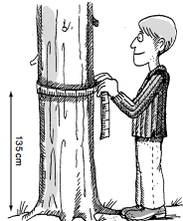
Tree Circumference
Measure circumference at breast height (CBH, 1.35m) for all mapped trees, currently living & greater than 15cm CBH on your site.
Measure CBH to the nearest tenth centimeter, e.g. 16.6cm.
In the 'notes' section of the data sheet, include:
If the tree has died since the previous year
The common name of the tree
If circumference was not measured at breast height (due to tree branching or bulging- See the 'Badly Behaving Tree Guide' for more information)

Slide 25
Shrubs/Saplings:
Protocol Overview
Shrub/Sapling Protocol *This can be done simultaneously with tree & herbaceous measurements (if applicable). *Complete each year | Time: 40 minutes Instruments: Compass, 2-3 m stick marked in centimeters Prerequisites: Site Set-up

Slide 26
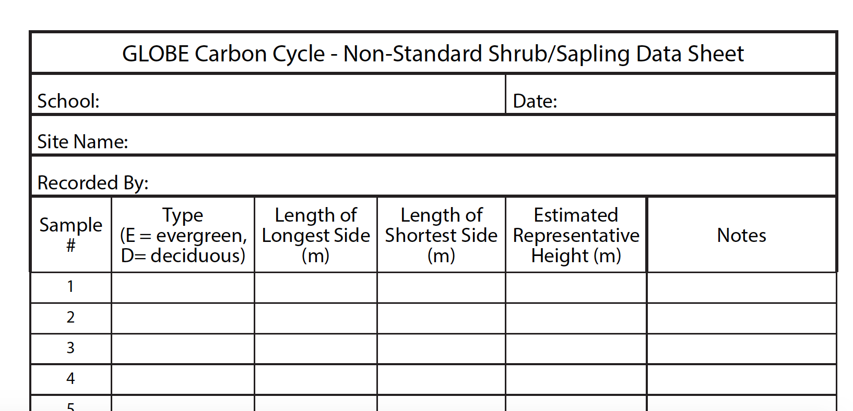
Shrub/Sapling Protocol
For each plot corner:
Start at one edge of the site. Measure each shrub on the entire site.
Mark ‘E’ if the species is evergreen and measure the height of the shrub or sapling
Mark ‘D’ if the species is deciduous and measure the height of the shrub or sapling.
Record the length in meters of the longest and shortest sides of the shrub. Also measure the height of the shrub if < 2-3 m tall. If > 2-3 m tall, use a clinometer or estimate height of shrub.
Repeat for all shrubs and saplings on your site.
Non-Standard Shrub/Sapling Measurements - Student Field Guide
Datasheet

Slide 27
Herbaceous Vegetation:
Protocol Overview
Herbaceous Vegetation Protocol *This can be done simultaneously with tree & shrub/sapling measurements (if applicable). *Complete each year | Time: 40 minutes Instruments: OUTSIDE: beanbag, blindfold, measuring tape, clippers, small brown paper bags, INSIDE: balance, drying oven (optional) Prerequisites: Site Set-up

Slide 28
Herbaceous Protocol
Herbaceous Measurements - Student Field Guide
Collect samples of herbaceous vegetation from the site.
Blindfold a member of the team and have him/her/them throw a beanbag somewhere in the sample site.
Mark a one-meter square around the bean bag to take a random sample.
Using grass clippers, clip all the vegetation close to the ground within the square. Do NOT collect any leaves or litter that are already dead or unattached from the ground.
Place clippings into brown paper bags and label with the site name, date, and sample number (e.g., Field Site Name, Herb Sample #1, bag 1 of 2).
Repeat steps 1-5 two more times.

Slide 29
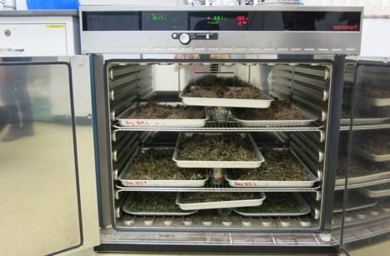
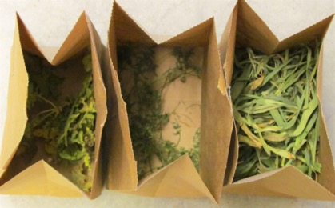
Herbaceous Protocol (Cont’d)
Dry the herbaceous samples by either:
(a) Drying oven: Set oven temp to 50-70ºF, put labeled bags in drying oven. Weigh the bag once per day after day one until sample weights the same two days in a row. Record the mass (g) of the sample + bag and the mass of the empty bag.
(b) Air drying: Select a dry, secluded area large enough for all sample bags. Open the tops of the bags for maximum airflow. Weigh once per day after day five, until sample weighs the same two days in a row. Record the mass (g) of the sample + bag, and the mass of the empty bag.
Herbaceous Measurements - Student Field Guide
Image: censam.mit.edu
Image: iowalearningfarms

Slide 30
Data Entry at Globe.gov (1/3)
After students have returned from the field with their paper data sheets, data can be shared with the GLOBE and scientific community by entering it into the GLOBE online science database (https://data.globe.gov).
When you submit your data through GLOBE, the calculations to convert your raw data to biomass and carbon storage values will be completed for you.
*Before you enter data, review it as a class, checking for data quality including precision and typos. See the Carbon Cycle Data Entry Teachers Guide for notes and suggestions .

Slide 31
As Part of your data review - Compare Data To Previous Years if applicable
Did any trees increase in circumference? Is it what you expected? Any possible errors? Compare large trees to small trees.
Any decreases in tree circumference? Have trees died? Difficult bark (wavy, bumpy)? Measured at same height?
Differences in species?
Any new trees? Factors that affected current year (i.e.: ice storms, insects, hurricanes).

Slide 32
Data Entry at Globe.gov (2/3)
Data can be entered to the GLOBE website in three ways:
Live Data Entry: These pages are for entering environmental data, collected at defined sites, according to protocols, and using approved instrumentation – for entry into the official GLOBE science database.
Email Data Entry: If connectivity is an issue, data can also be entered via email.
Mobile Data App: The app allows users to enter data directly from an iOS or Android device for any GLOBE protocol.

Slide 33
Data Entry at Globe.gov (3/3)
To add your Carbon Cycle data to the GLOBE website, create a new site if you do not already have one.
If you already have a Carbon Cycle site, you can skip ahead to add your Carbon Cycle data.

Slide 34
Add new site at Globe.gov
Add new site
Add site coordinates by map
Describe site, and indicate if standard or non-standard
Land Cover type (see Land Cover eTraining)
Add MUC description
Add site photos
Submit

Slide 35
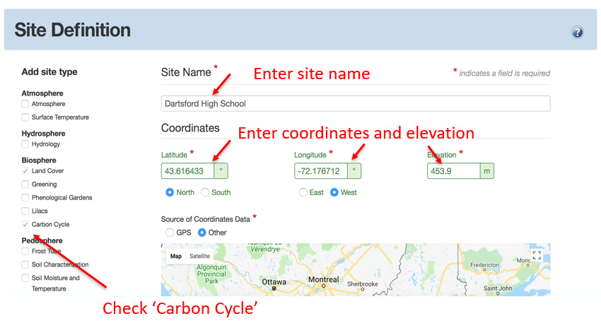
1. Add new site

Slide 36
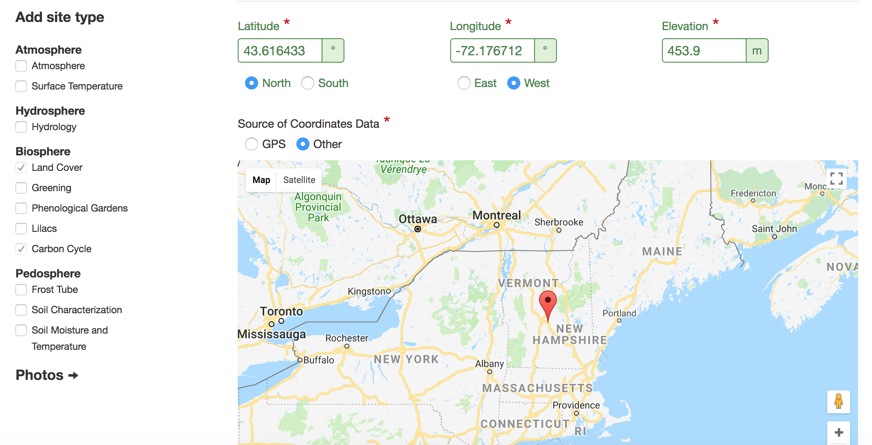
2. Add site coordinates via map
Select ‘GPS’ if you used a GPS.
Select ‘other’ if you use the map below or smartphone.
Zoom into your region on the map and move the map until the red pin is on your site.

Slide 37
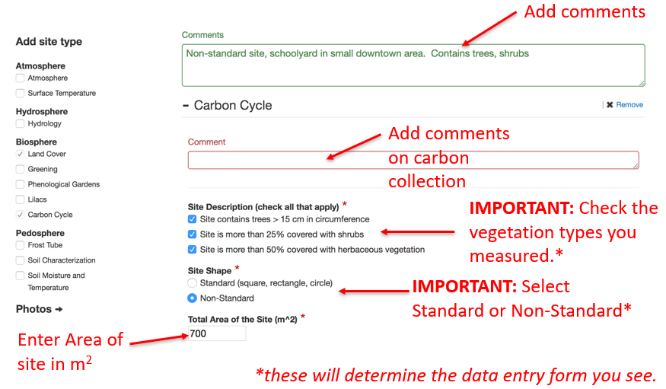
3. Describe site; indicate if standard or non-standard

Slide 38
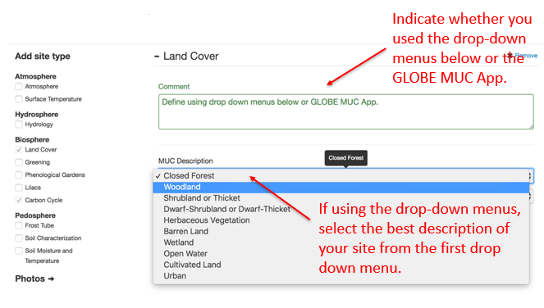
4. Describe Land Cover

Slide 39
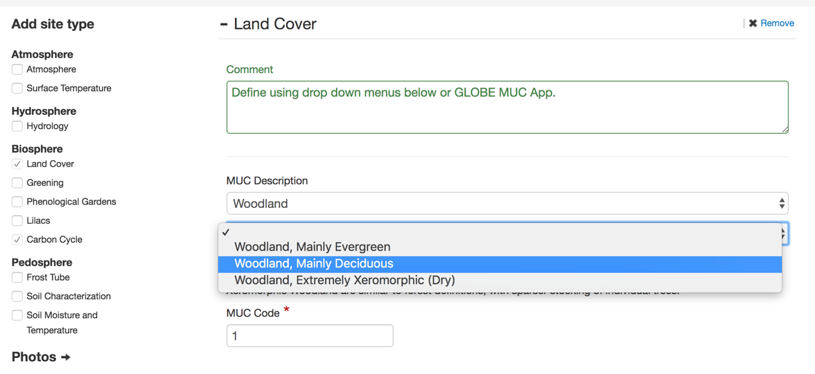
5. Add Modified UNESCO Classification (MUC) Land Cover (1/4)
A second drop-down menu appears after you selected from the first drop-down menu. Continue down the menus until MUC code is completed.

Slide 40
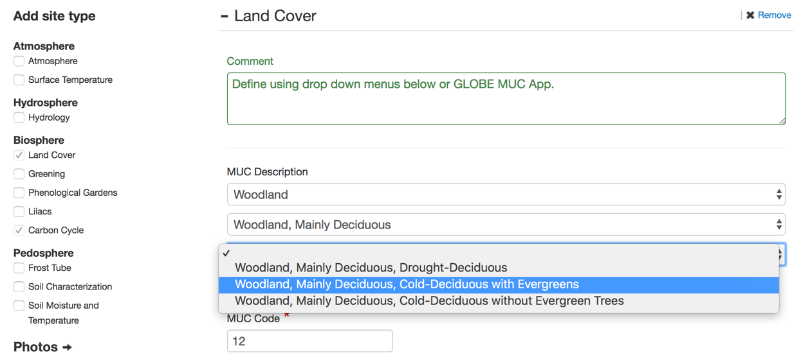
5. Add MUC Land Cover (2/4)
Continue down the menus.
MUC code will update automatically in this box. You do not need to enter numbers here if you are using the menus.

Slide 41
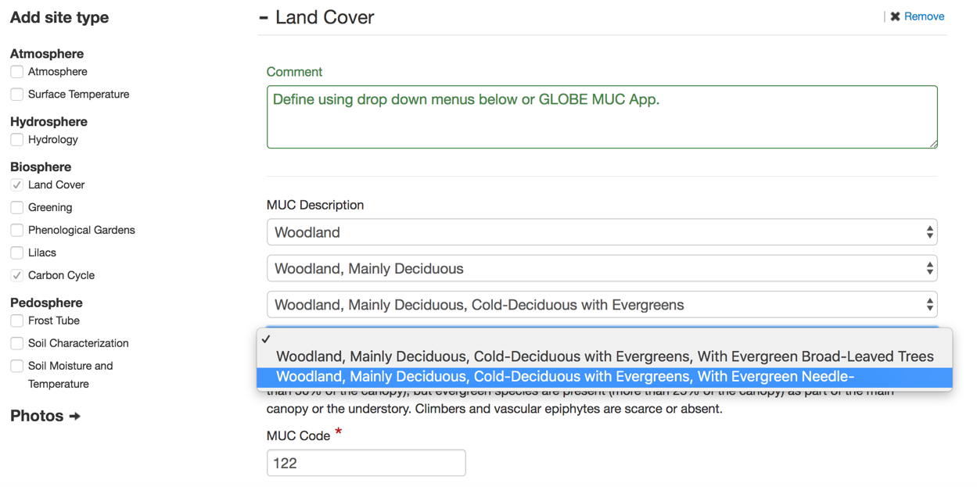
5. Add MUC Land Cover (3/4)
Fourth drop down menu.
Note how the MUC code updated automatically.

Slide 42
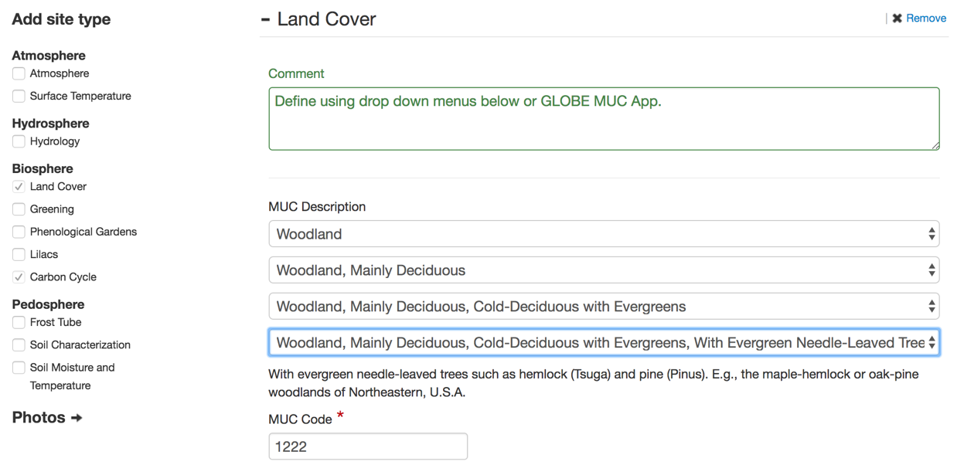
5. Add MUC Land Cover (4/4)
Completed MUC code. Alternatively, you can skip the drop-down menus and enter the 4-digit MUC code directly from the GLOBE MUC App.

Slide 43
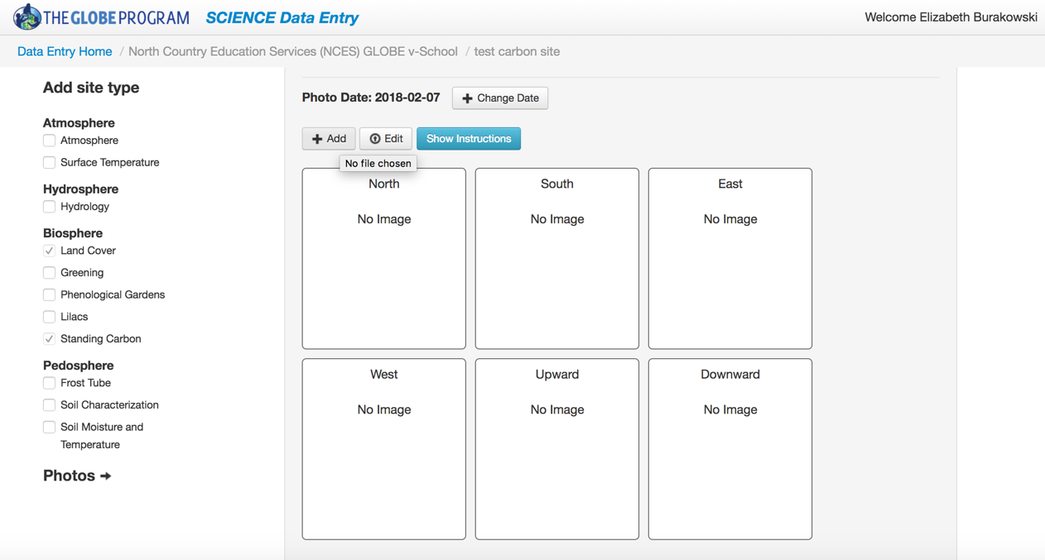
6. Add site photos (1/3)
Enter the date the photos were taken.
Click ‘+Add’, and navigate to your photos on you computer. Add photos for North, South, East, West, Upward, and Downward
Completed MUC code. Alternatively, you can skip the drop-down menus and enter the MUC code from the GLOBE MUC App.

Slide 44
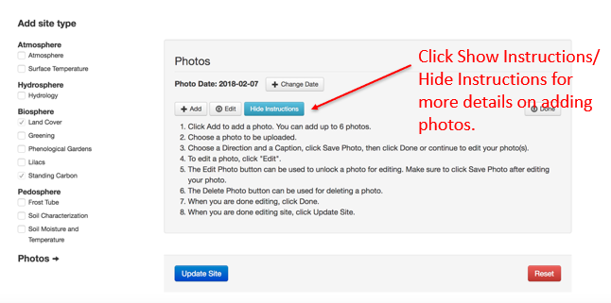
6. Add site photos (2/3)

Slide 45
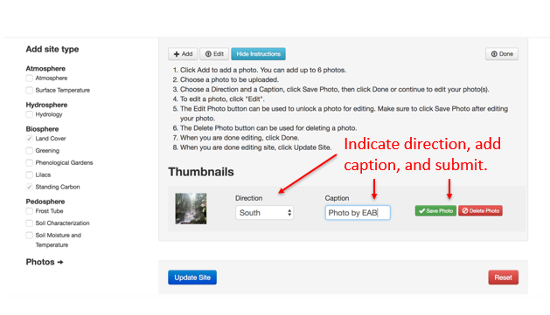
6. Add site photos (3/3)

Slide 46
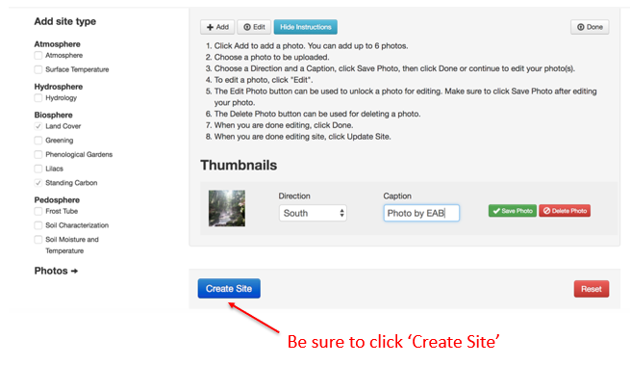
7. Submit site

Slide 47
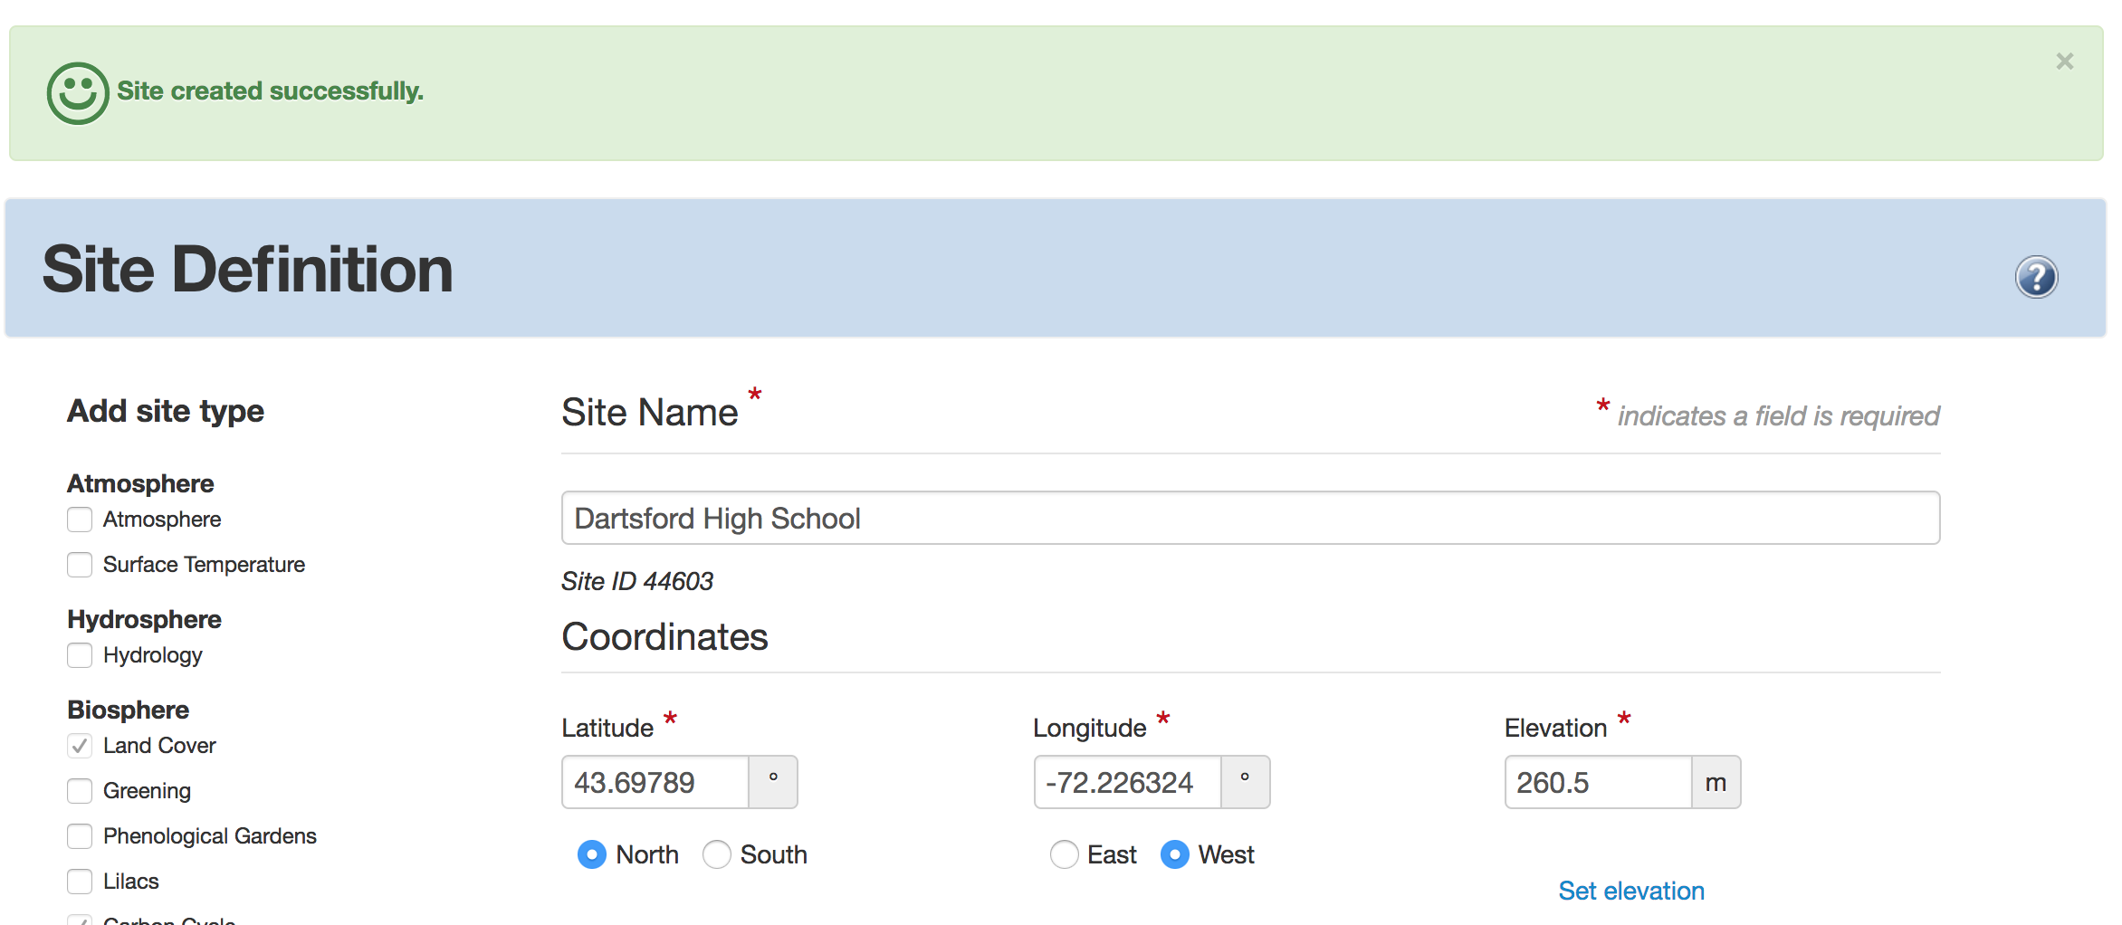
8. Confirm site submission/update
Look for the ‘Site Created or Updated Successfully’ message
If you don’t see “Site Created or Updated successfully, follow the red error messages to complete the form”.

Slide 48
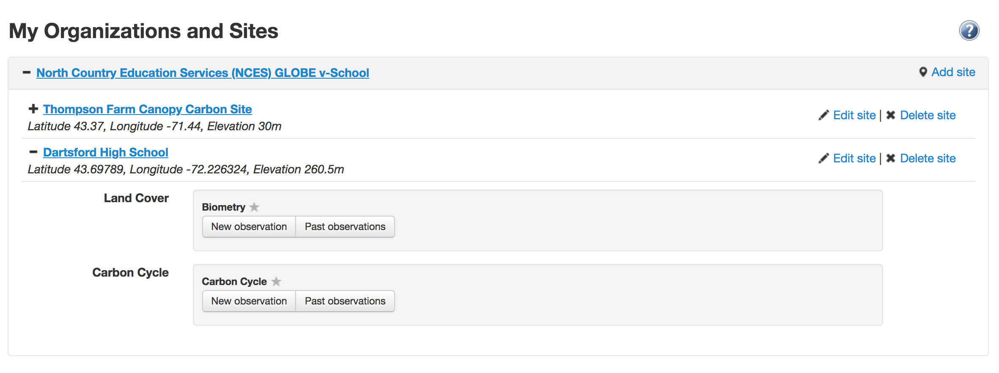
Add Carbon Cycle data
Once your site has been established in the database, navigate to data entry home.
Select your site by clicking on it. This will expand a menu below.
Menu will expand with options below.
Select new observation for carbon cycle.

Slide 49
Add carbon data*
Select or enter the date of your data collection
*Data entry on the GLOBE website is very similar to the GLOBE App.
Only web data entry is shown here.

Slide 50
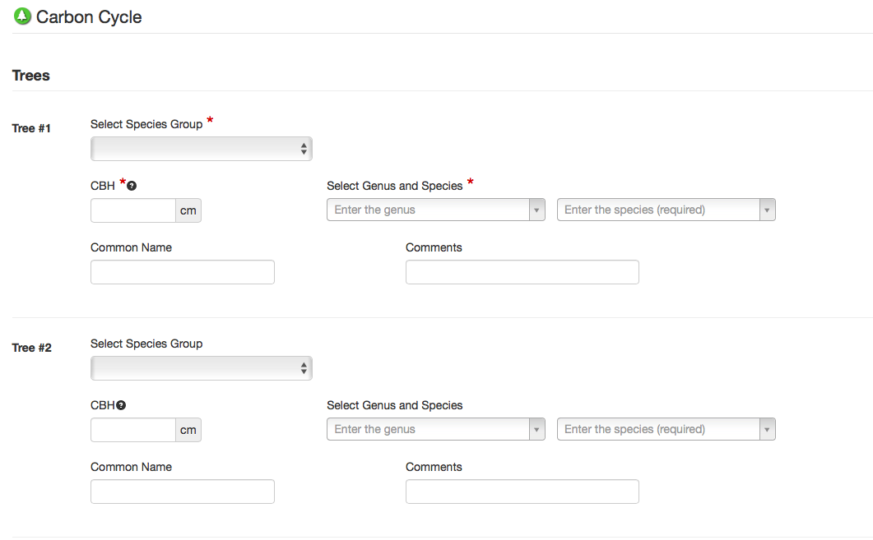
Add carbon cycle tree* data
Enter data from your data sheet for each tree
Record the tree name/number from your data sheet in the Comments section
* not all sites will have trees. Skip if not applicable to your site.

Slide 51
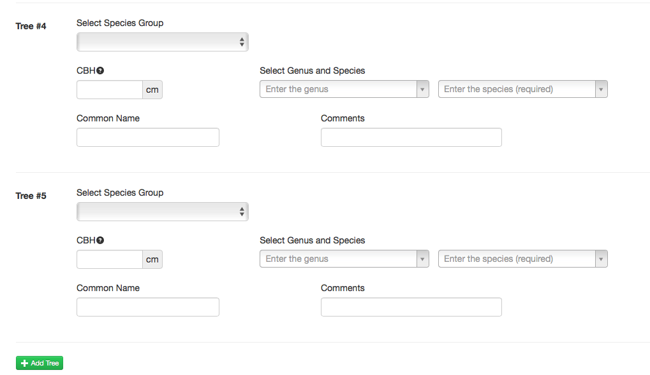
Add additional trees if necessary
Add additional trees, if necessary.

Slide 52
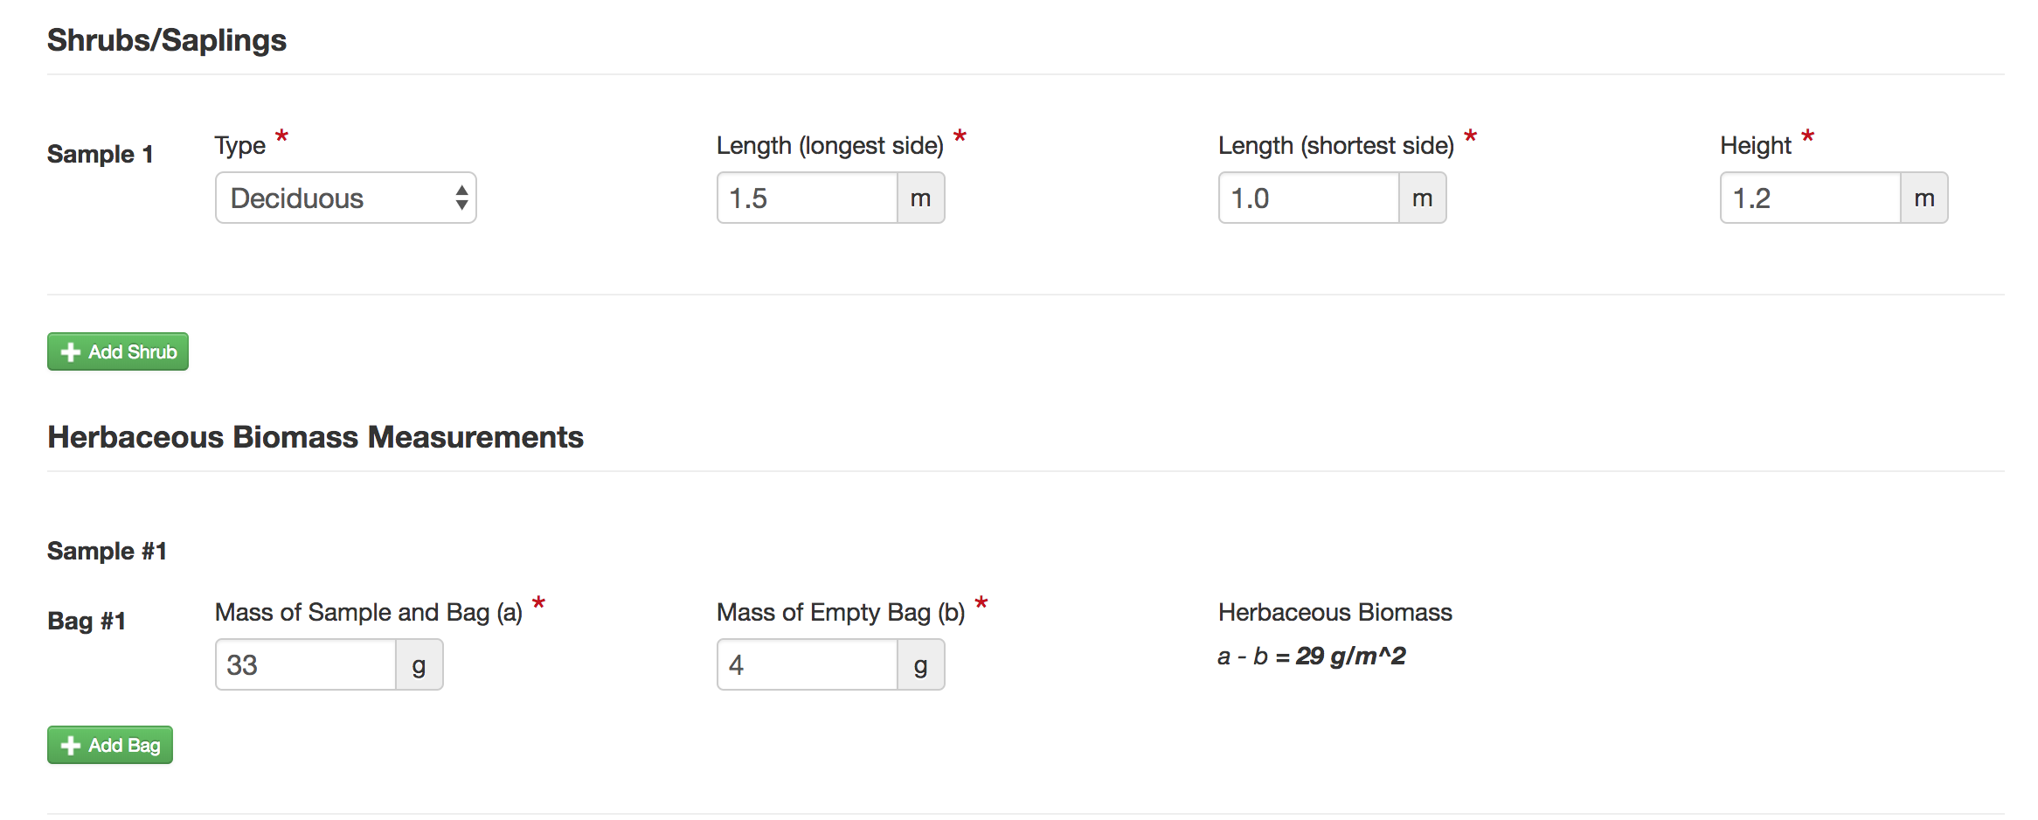
Enter shrub, sapling* and herbaceous data.
Add shrub, sapling data from worksheet.
Add additional shrubs or saplings, if necessary.
Add herbaceous data from worksheet.
Add additional herbaceous, if necessary.
* not all sites will have shrubs/saplings or herbaceous. Skip if not applicable.

Slide 53
Send Data to GLOBE
Click ‘Send Data’ when data entry is complete.

Slide 54
Confirm Data Submission
Look for the ‘Observation created successfully message’.

Slide 55
Understanding Your Data: Data Analysis
Use the Biomass & Carbon Data Analysis Teacher Guide (separate documents for Trees, Shrubs/Saplings, and Herbaceous vegetation) to assist students with observing and understanding patterns and trends in their tree field measurement data.
Requires:
Data spreadsheet downloaded from GLOBE (see instructions on following page)
Microsoft Excel (or similar spreadsheet program)
Biomass Analysis Questions

Slide 56
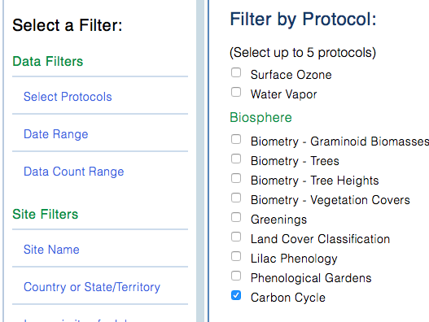
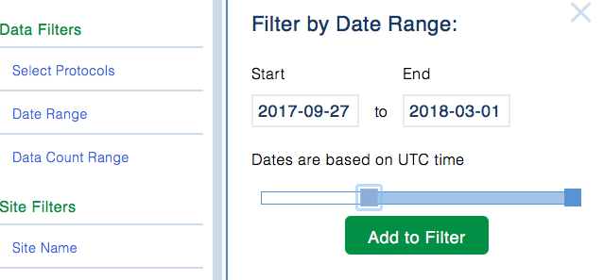
Download Data from GLOBE (1/3)
*complete with carbon and biomass estimates
Go to GLOBE’s Data Access Tool
Read through the instructions to familiarize yourself with this tool.
Under Data Filters, click ‘Select Protocols’
Scroll down to find the Biosphere section, click ‘Carbon Cycle’, and click on Add Protocols.
Select a data range that includes the date in which you collected data. Click on Add to Filter.

Slide 57
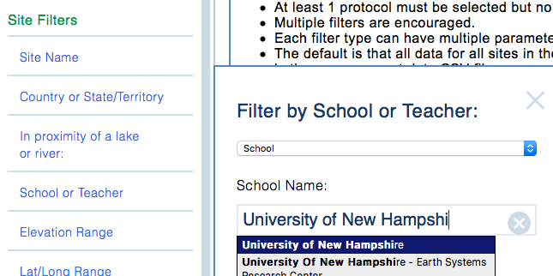
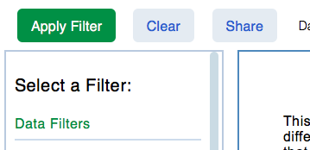
Download Data from GLOBE (2/3)
Under Site Filters, click ‘School or Teacher’, and select your school.
If you have multiple Carbon Cycle field sites, select the individual site which you are interested in under ‘Site Name’.
Click the green ‘Apply Filter’ button in the top left.

Slide 58
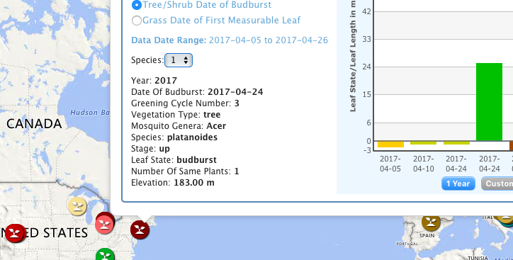
Download Data from GLOBE (3/3)
Click ‘Obtain Measurement Data’ (Note, data will be downloaded for the whole list you see, if your school is not the only one listed, redefine your filters).
The button will update, and you can click to download a .csv, which can be opened in a spreadsheet tool such as Excel. (See an example Carbon Cycle spreadsheet on the Data Analysis section of the Carbon Cycle webpage).
* Note, you can also use the GLOBE Visualization System to view your and other school’s Carbon Cycle data on a map.

Slide 59
Understanding Your Data: Data Interpretation
Human carbon storage vs. tree carbon storage
Schoolyard area (scaling)
Net Primary Production (NPP)

Slide 60
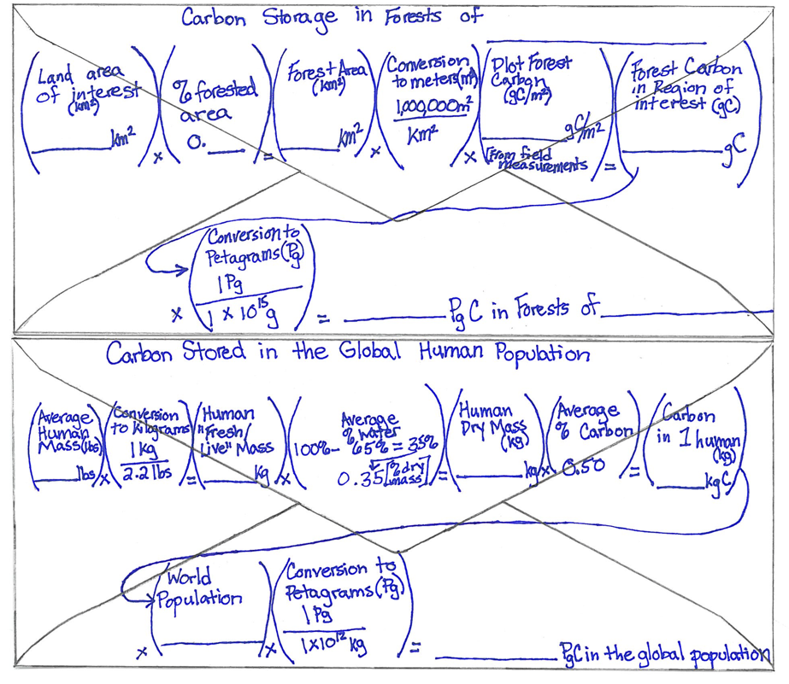
Human Carbon vs. Tree Carbon
Use a back-of-the-envelope calculation to determine whether more carbon is stored in humans or trees.
Example research question that can be answered through this activity: Is there more carbon stored in the global human population or the trees in [MY STATE]?
** This activity can help students understand why there is not a ‘human’ pool on the Global Carbon Cycle Diagram.

Slide 61
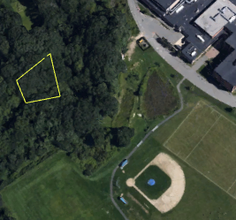
Schoolyard area scaling
*Very helpful activity for Non-Standard Sites!*
The Determining Scale & Calculating Area Teacher Guide describes how to use an aerial photo/map to scale your sample site carbon measurements to larger areas of similar vegetation.
Example research question that can be answered through this activity: How much carbon is stored in the vegetation near my school?
*Note the teacher will need Google Earth Pro (a free application) to create the map image.

Slide 62
Calculating Net Primary Productivity
Use the Calculating Net Primary Productivity Teacher Guide to understand the change in carbon storage over time. *Needs multiple years of carbon data*
Example research question that can be answered through this activity: What is the pattern in which biomass and carbon storage change over time in my sample site?
Net Primary Productivity (NPP), or the production of plant biomass, is equal to all of the carbon taken up by the vegetation through photosynthesis minus the carbon that is lost to respiration. NPP can be calculated with this equation:
$$NPP=Carbon stored for Year 2 −Carbon Stored for Year 1$$

Slide 63
Quiz Questions
Challenge yourself to answer these questions and check whether you have achieved the learning objectives of this module.
Name two carbon cycle field learning activities.
What are some research questions you could ask using GLOBE carbon cycle data at your site?
What is the minimum area for a Non-Standard site?
If your site has trees, what data will you record for each tree?
At what height do you measure tree circumference?
If a tree is on a steep slope, what guide could you use to accurately measure tree circumference?
How are tree measurements converted to biomass?
What data will you record if your site has shrubs or saplings?
How is biomass converted to carbon storage?
How might someone calculate carbon storage of vegetation over the entire town based on your field measurements?

Slide 64
Additional Information
Questions about this module? Contact GLOBE: help@globe.gov Additional Links:
NASA’s A Breathing Planet, Off Balance Article and Video:
https://www.nasa.gov/feature/goddard/carbon-climate
NASA Global Climate Change Website:
https://climate.nasa.gov/
NASA Scientific Visualization Studio
(https://svs.gsfc.nasa.gov)
Global Carbon Project
(http://www.globalcarbonproject.org)
Global Carbon Atlas
(http://www.globalcarbonatlas.org)

