Slide 1
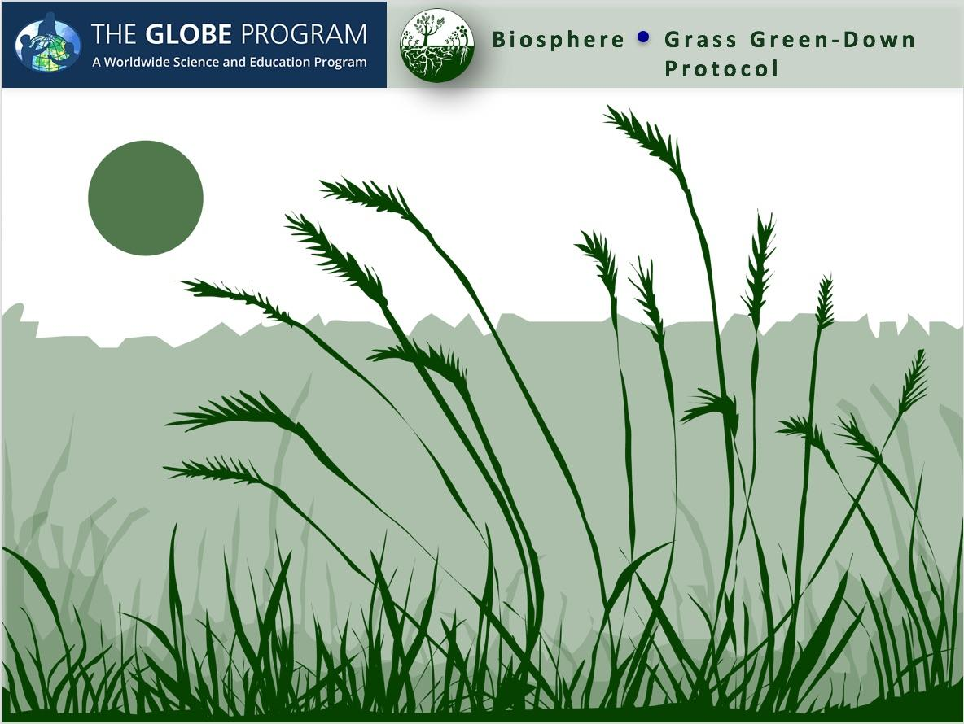

Slide 2
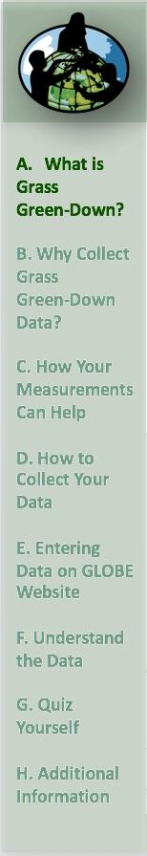
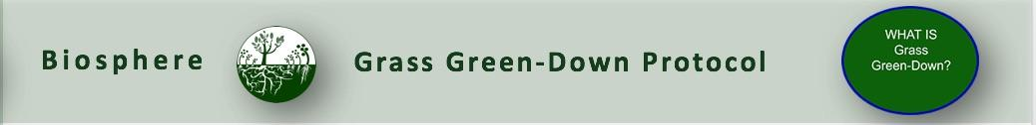
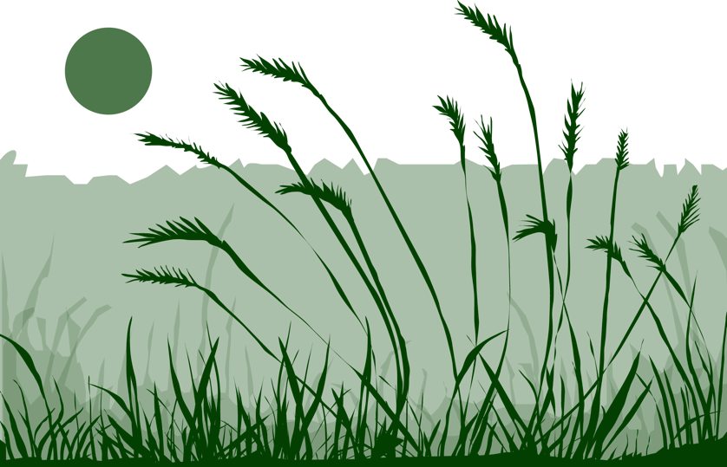
Overview
This module:
Describes how to select and define a GLOBE Phenology Protocol Study Site
Provides a step-by-step introduction of the protocol method
Learning Objectives
After completing this module, you will be able to:
Define phenology and what is meant by grass green-down
Describe the importance of quality control steps in the collection of accurate data
Describe why green-down data is important for understanding our changing Earth system
Identify a grass green-down study site and conduct measurements in the field
Upload data to the GLOBE database
Visualize data using GLOBE’s Visualization System
Estimated time to complete module; 1.5 hours

Slide 3
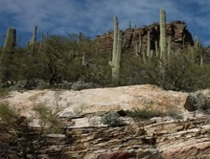
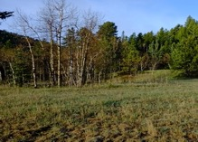
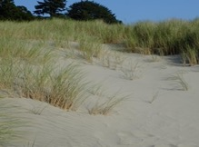
The Biosphere
The Biosphere is Earth’s zone of life. Every organism on Earth belongs to the biosphere. GLOBE has several ways to explore and measure components of the Biosphere through investigations in land cover, phenology, and carbon storage. Some GLOBE Hydrosphere investigations also include measurements of organisms: the macroinvertebrate and mosquito larvae protocols.
Grass Green-Down is one of the GLOBE phenology protocols.
More information can be found in the:
Biosphere Introduction
Hydrosphere Introduction
Photo Credit: Shelley E. Olds

Slide 4
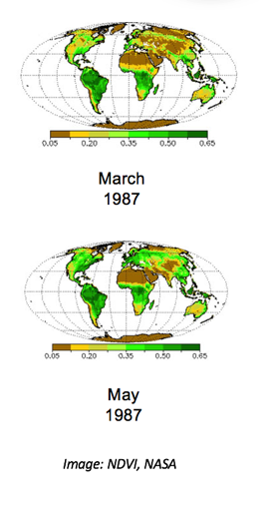
What is Phenology, and how is it related to Green-Down?
Phenology is the study of living organisms’ response to seasonal and climatic changes in the environment in which they live. You can study the phenology of both plants and animals.
The plant growing season is the period between green-up and green-down.
Plant green-up is initiated when dormancy (a state of suspended growth and metabolism) is broken by environmental conditions such as longer hours of sunlight and higher temperatures in temperate regions, or rains and cooler temperatures in desert areas.
Green-down marks the end of the growing season for many plants. A color change is generally associated with green-down of leaves. The color will vary by species.

Slide 5
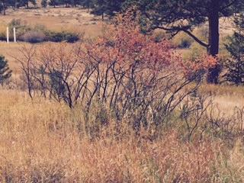
What is Grass Green- Down?
Plant green-down is also called senescence. It is initiated when environmental conditions change:
  Fewer hours of sunlight and lower temperatures in temperate regions.
  Drier and warmer temperatures in desert areas.
Green-down starts dormancy (a state of suspended growth and metabolism).
For many places around the world, there is one green-up and green-down cycle, e.g., one warm and cold season.
There are places where multiple wet and dry seasons can occur in a single year, resulting in multiple green-up and green-down cycles.
Most are familiar with green-down of trees, but color change also marks dormancy of grasses

Slide 6
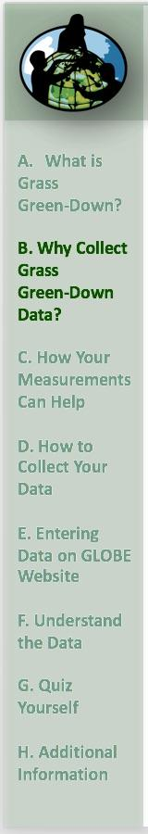
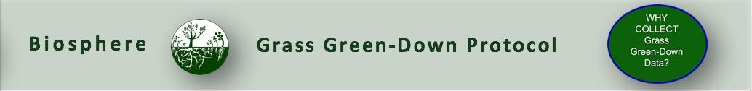
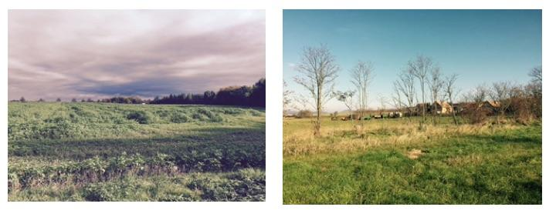
Why Collect Green-Down Data?
Scientists are very interested in knowing when leaves appear in spring and how quickly they expand. The timing and rate of fall leaf changes, such as color changes and leaf drop, are also important. These plant phenological events are directly related to global carbon fixation and the amount of carbon dioxide in the atmosphere. Also, they affect and are affected by air temperature and humidity, as well as soil moisture.

Slide 7
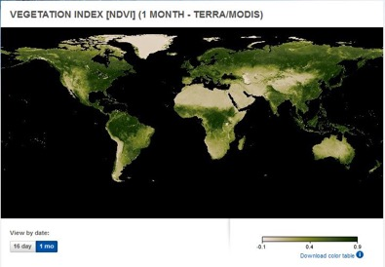
Satellite Measurements of Phenology
Many scientists use data from a NASA sensor, the Moderate Resolution Imaging Spectrometer (MODIS), to monitor the seasonal dynamics of vegetation.
Scientists also use a metric called the Normalized Difference Vegetation Index (or NDVI) to quantify the Earth’s greenness. NDVI is calculated from satellite data of red and near-infrared light, and can help monitor vegetation health, ecosystem disturbances, and changes in vegetation density over time. Learn more about NDVI in this My NASA Data Mini-lesson.
Watch an animation of NDVI from the NASA Visualization Studio to see changes in greenness over time!

Slide 8
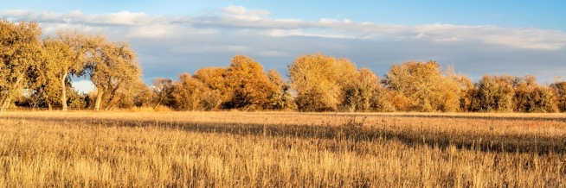
Why Collect Green-Down Data?
Your observations are valuable contributions to the scientific community and may be used by educators, students, researchers, and the general public to increase environmental awareness and STEM literacy, as well as advance Earth system science.
Monitoring the length of the growing season is important for society so that it can better adapt to variations in the length of the growing season and to other impacts of climate change, which may affect food production, economic growth, and human health.

Slide 9

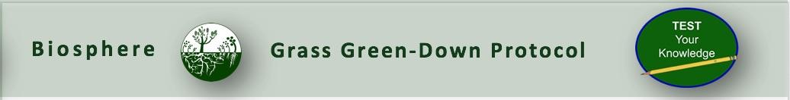
Let’s do a quick review before moving onto data collection! Question 1
1. What part of the Earth system is known as the zone of life?
A. Atmosphere
B. Biosphere
C. Lithosphere
D. Hydrosphere
Do you know the answer?

Slide 10
Let’s do a quick review before moving onto data collection! Answer to question 1.
1. What part of the Earth system is known as the zone of life?
A. Atmosphere
B. Biosphere- correct ☺
C. Lithosphere
D. Hydrosphere
Were you correct?

Slide 11
Let’s do a quick review before moving onto data collection! Question 2
True or False: In every part of the world, there is one green-up and green-down cycle.
Do you know the answer?

Slide 12
Let’s do a quick review before moving onto data collection! Answer to question 2
True or False: In every part of the world, there is one green-up and green-down cycle. False ☺
Were you correct?

Slide 13
Let’s do a quick review before moving onto data collection! Question 3
Why are scientists interested in green-up data? The data can be used to:
help interpret satellite observations of greenness, such as imagery of the Normalized Difference Vegetation Index (NDVI)
determine how environmental conditions affect plant growth
calculate changes in growing season length and onset over years
monitor the nature and extent of climate change and its effects on plants and animals
all of the above
only A and B
Do you know the answer?

Slide 14
Let’s do a quick review before moving onto data collection! Answer to question 3
Why are scientists interested in green-up data? The data can be used to:
help interpret satellite observations of greenness, such as imagery of the Normalized Difference Vegetation Index (NDVI)
determine how environmental conditions affect plant growth
calculate changes in growing season length and onset over years
monitor the nature and extent of climate change and its effects on plants and animals
all of the above –correct ☺
only A and B
Were you correct? Let’s now look at data collection.

Slide 15
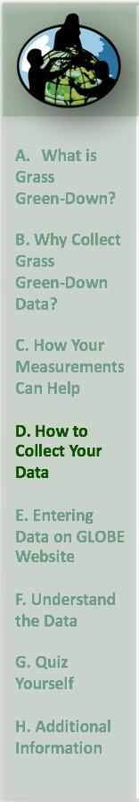
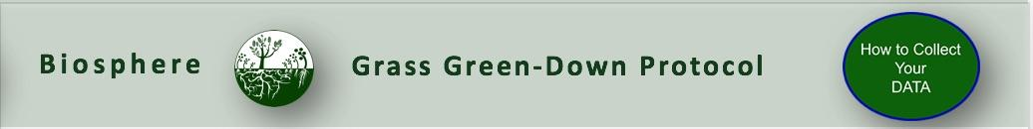
Overview of the Grass Green-Down Protocol
When | At least twice a week beginning two weeks prior to the anticipated start of green down, continuing until plant color change has ended, or leaves have dropped off.
Where | Grass Green-Up, Green-Down site: ideally, your observations in a one-meter square that is dominated by grass plants.
Time Needed | 10-15 minutes per measurement. Frequency of observations: Ideally, visit your site at least two times a week.
Prerequisites | None
Primary Instrument | GLOBE Plant Color Guide
Skill level | All
References | Tree, Shrub, and Grass Green-Down Data Sheet Grass Green-Up and Green-Down Site Selection Field Guide Site Definition Sheet

Slide 16

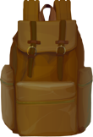


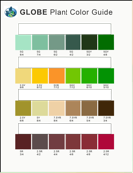
Needed Equipment and Documents
First Visit
Pencil or pen
Camera
Compass
Fine-Tip Permanent Marker
GLOBE Plant Color Guide
Every Visit
GLOBE Plant Color Guide
Pencil or pen
Documents Needed Each Visit
Grass Green-Down Protocol Field Guide
Green Down Tree, Shrub and Grass Green-Down Data Sheet
Site Definition Sheet
Grass Green-Up and Green-Down Site Selection Field Guide

Slide 17

Site Selection
Site selection is important. Chose a site that contains plants indicative of the surrounding climate. You will need to make your observations in a one-meter square that is dominated by grass plants.
  Native species
  Not watered or fertilized
  Away from buildings
  Choose a site that is accessible and can be visited repeatedly.
    NOTE: To determine if the plant is too close to a building, stand at the plant and sight the top of the building through your clinometer. If the angle is greater than 45˚, the building is too close. You do not want the plant to be closer to the building than it is tall.

Slide 18
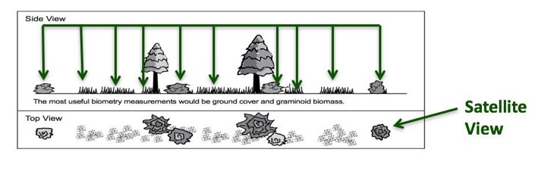
Other Site Selection Considerations
Select one or more species that is common in your area. Think from the perspective of a satellite – what is the satellite “seeing”?
If you are also doing atmospheric or soil moisture protocols, select a site less than 2 km from your atmosphere or soil moisture site, and an elevation difference less than 100 meters. This is important because local topography affects weather significantly.

Slide 19
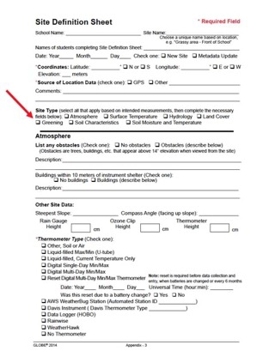
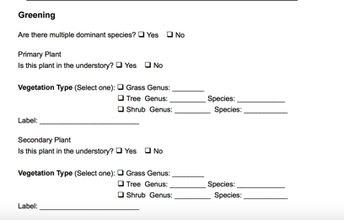
Grass Green-Down Site Definition-1
-
1. Complete the Greening portion of the Site Definition Sheet.
2. Identify genus using field guides or help of plant specialists. Record the genus on the Site Definition Sheet.

Slide 20
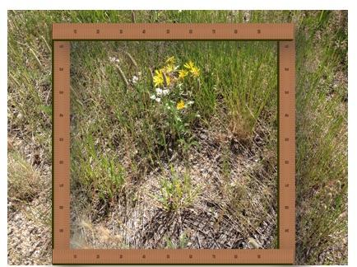
Grass Green-Down Site Definition-2
3. Select a one-meter square area dominated by grass plants. Mark your one-meter square plot with nails or stakes or other durable identifiers.
4. Locate coordinates using your phone or the GPS Protocol.

Slide 21
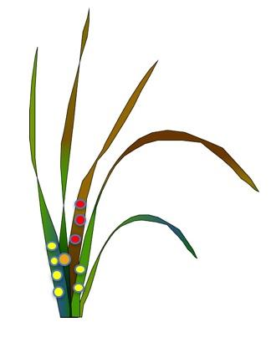
First Visit: Green-Down Grasses
First visit only/getting started
Fill in the top of your Data Sheet.
Determine whether there are more than one green down cycles; if yes, during which cycle are you currently collecting data (1, 2, or 3)?
Look for the four longest green grass shoots.
Mark the base of the longest grass shoot with a single dot, using a permanent felt marker. Mark the second longest shoot with two dots, the third with three dots and the fourth shoot with four dots.

Slide 22

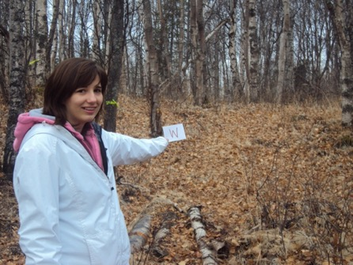
First Visit: Green-Down Grasses- Site Documentation
First visit only/getting started
5. Take a photograph from the center of the site looking in the north, south, east, and west directions.

Slide 23
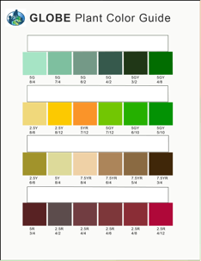

Every Visit: Green-Down Grasses
Examine each of your four grass shoots. For each shoot, use the GLOBE Plant Color Guide to estimate the dominant color percentage of each shoot. For example, if shoot #1 appears colored at 60 percent 5G 7/12 and 40 percent 2.5 Y8/10, record the shoot color as 5G 7/12 for that observation date.
Record your observations for each shoot on the Tree, Shrub, and Grass Green-Down Data Sheet.
  If leaf is snow covered, report “snow covered”;
  If leaf has fallen, report “fallen” and stop reporting after that;
  Otherwise, continue to report the color until the color stops changing.
  You are done!

Slide 24
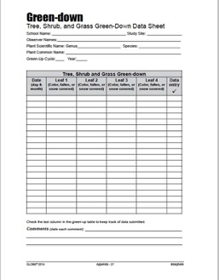
Grass Green-Down Data Sheet r
Fill in the top portion of the data sheet.
Because of the possibility of multiple growing seasons in a year, report which cycle you are observing. If there is only one cycle, then you report green-up cycle 1. The onset of the first green-down after 1 January is considered cycle 1.

Slide 25
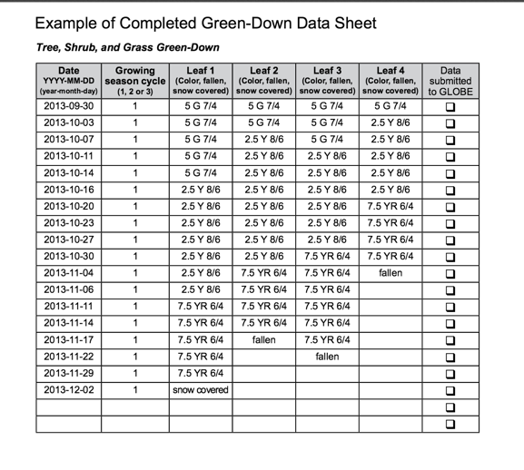

Example of Completed Data Sheet

Slide 26
Let’s review so far! Question 4
When selecting a phenology site, you want to be sure it is accessible and easy to visit, and that you collect data that can be examined in the context of other GLOBE data you might collect. GLOBE recommends that you place your site as close to your other study sites as possible, and no further than:
2 km from your Atmosphere or Soil (Pedosphere) investigation sites
100 m difference in elevation from your Atmosphere or Soil study sites
Both A and B
Neither A nor B: you must collect your data at your Biosphere Land Cover study site.
What is the answer?

Slide 27
Let’s review so far! Answer to question 4
When selecting a phenology site, you want to be sure it is accessible and easy to visit, and that you collect data that can be examined in the context of other GLOBE data you might collect. GLOBE recommends that you place your site as close to your other study sites as possible, and no further than:
2 km from your Atmosphere or Soil (Pedosphere) investigation sites
100 m difference in elevation from your Atmosphere or Soil study sites
Both A and B- correct ☺
Neither A nor B: you must collect your data at your Biosphere Land Cover study site.
Were you correct?

Slide 28
Let’s review so far! Question 5
How do you ensure that you look at the same blades of grass as you monitor green-down?
Take a GPS reading of the grass blade.
Mark the blades with small dots, with the longest blade marked with one dot, the second longest with two dots, and so on.
What is the answer?

Slide 29
Let’s review so far! Answer to Question 5
How do you ensure that you look at the same blades of grass as you monitor green-down?
Take a GPS reading of the grass blade.
Mark the blades with small dots, with the longest blade marked with one dot, the second longest with two dots, and so on.- correct ☺
Were you correct? Now let’s look at GLOBE Data Entry and Visualization

Slide 30
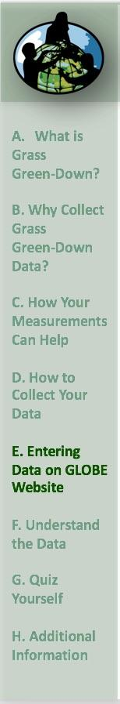
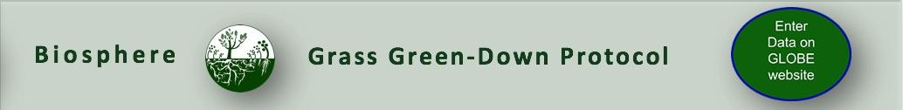
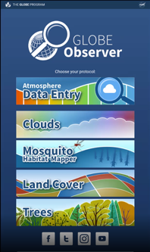
Report Your Data to GLOBE
Desktop Data Entry: Log environmental data directly on the GLOBE website.
Email Data Entry: If connectivity is an issue, data can also be entered via email.
GLOBE Observer App: The app allows users to enter data directly from an iOS or Android device for any GLOBE protocol.

Slide 31

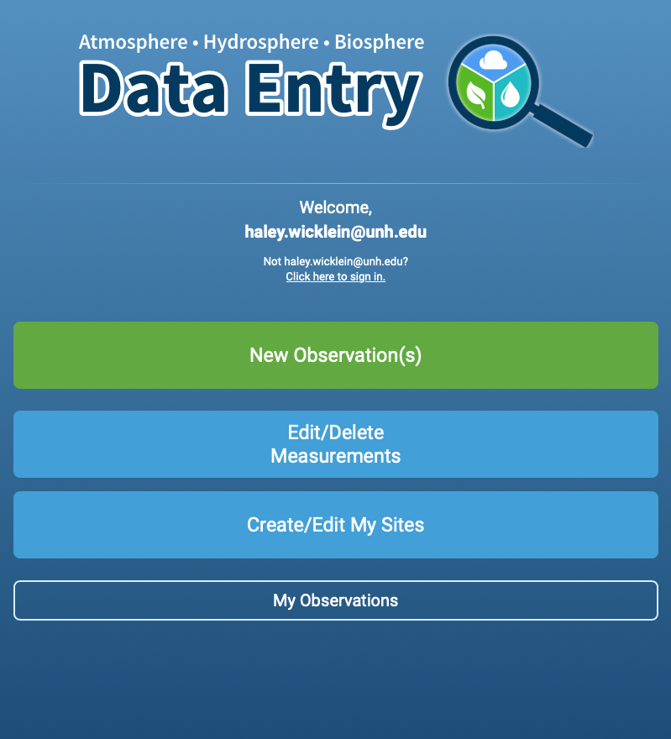
Entering your data via the GLOBE website or GLOBE Observer App
Click “New Observation(s)”

Slide 32
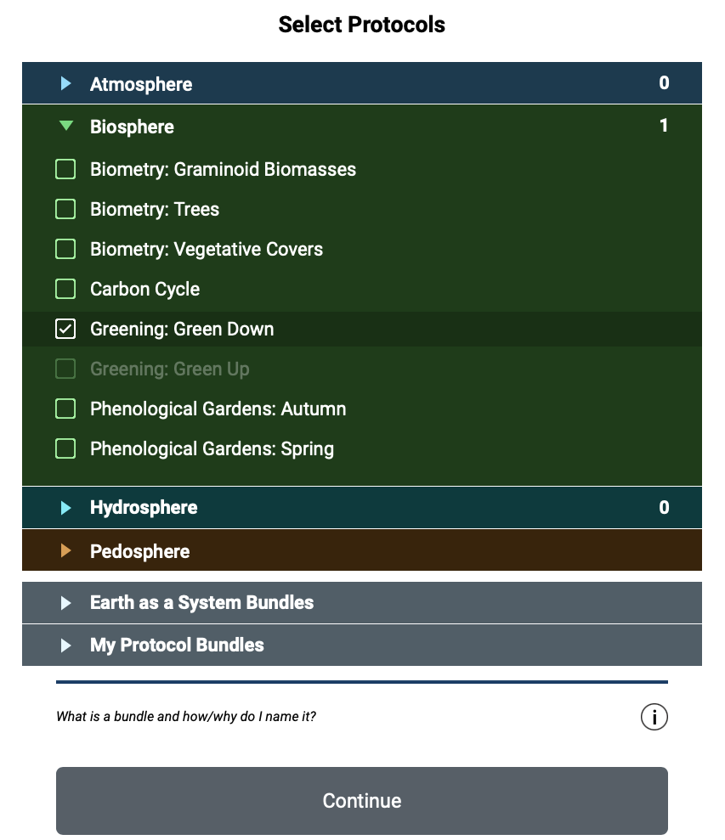
Entering your data via the GLOBE website or GLOBE Observer App
Select “Greening: Green Down”
Click Continue

Slide 33
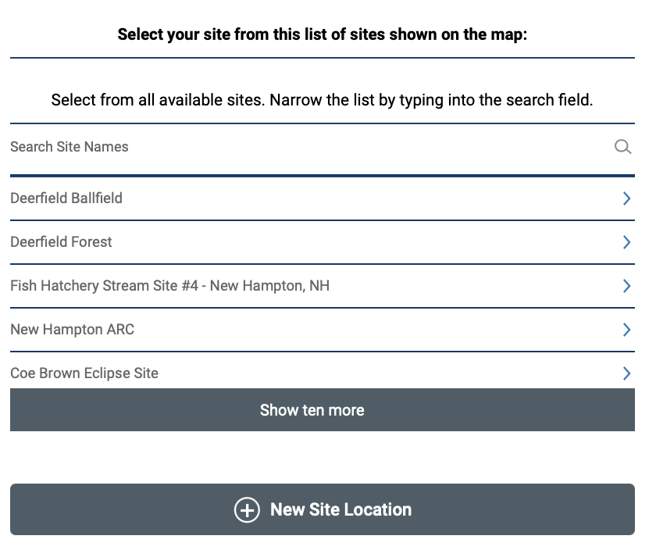
Entering your data via the GLOBE website or GLOBE Observer App
On the location page, scroll down to select your site OR choose “New Site Location” to add a new site.
Tutorials are available on how to add a new site.

Slide 34
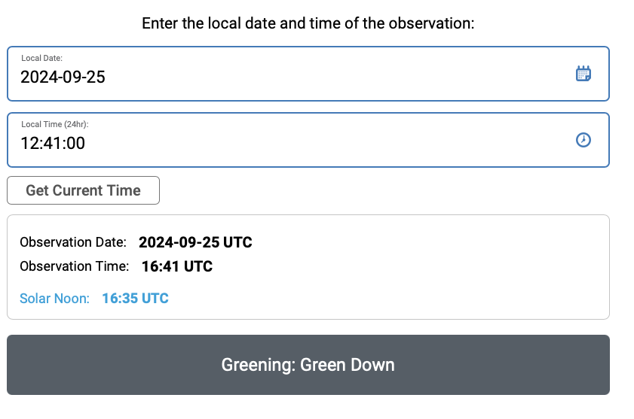
Entering your data via the GLOBE website or GLOBE Observer App
Add the time and date that you collected your data
Click Greening: Green Down

Slide 35
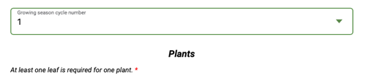
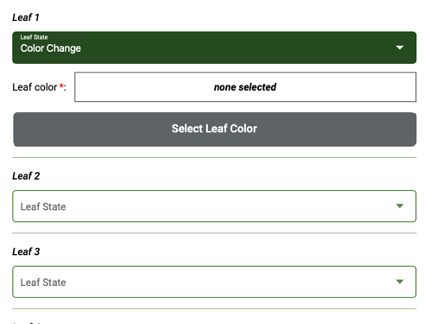
Entering your data via the GLOBE website or GLOBE Observer App
Choose your growing season cycle number
Add your leaf color codes for each grass leaf by selecting “color change” and clicking “Select Leaf Color”

Slide 36
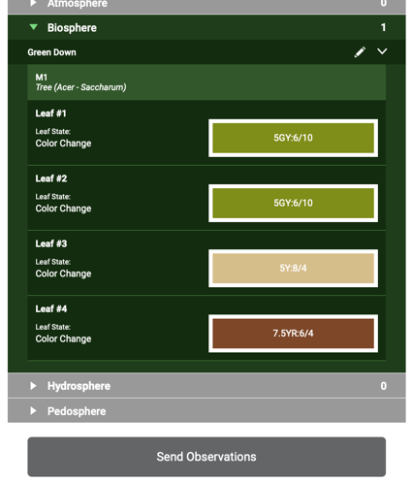
Review and sent data via the GLOBE website or GLOBE Observer App
Review the data you entered
Click send observation and wait for the message that your observation was successfully sent!

Slide 37
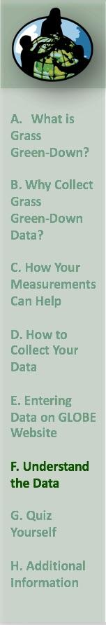
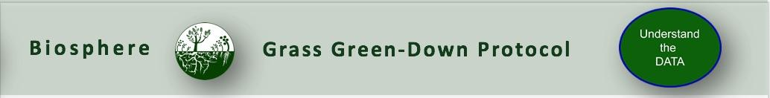
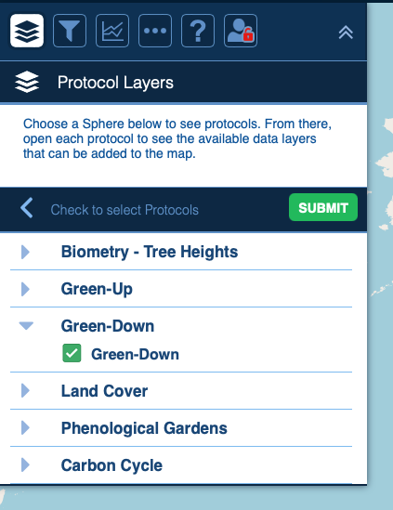
Visualize and Retrieve Data
GLOBE provides the ability to view and interact with data measured across the world. Use the visualization tool to map, graph, filter and export Green-Down data that have been measured across GLOBE protocols since 1995.
Click the layers icon.
Click Submit.
Select Green-down under the Biosphere drop down
See video tutorials on using the GLOBE Visualization system.

Slide 38
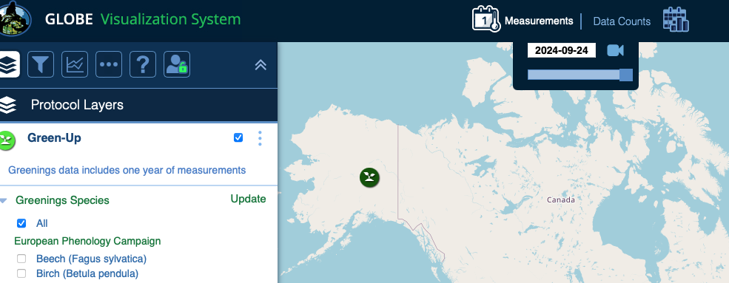
Visualize and Retrieve Data
Select the date for which you need Green-Down data.
38

Slide 39
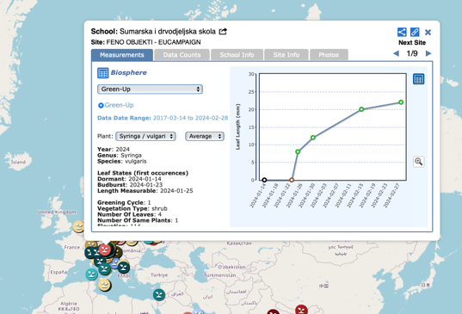
Visualize and Retrieve Data
Select the sampling site for which you need Green-Down Data, and a box will open with a data summary for that site.
Click on the table icon to view the data in a table and download it as a .csv for analysis.
Clicking on a location will open to a map note providing data for that location and time.
39

Slide 40
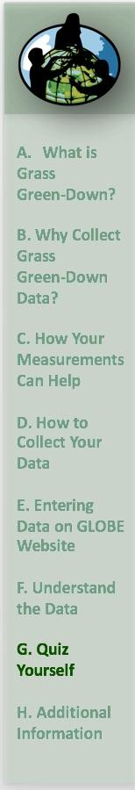
Review questions to help you prepare to do the Grass Green-Down Measurements associated with the GLOBE Biometry Protocols
Grass Green-Down measurements are part of what GLOBE Protocol area or Earth system sphere?
What is phenology?
Why is it important for scientists to know when green-down takes place in a location, year by year?
With respect to Green-Up and Green-Down, when is the plant growing season?
Green-down is a metabolic response to what changes in a plant’s environment?
Why is green-down data useful for scientists and what does it tell us about changes in the Earth system?
Why do we use the GLOBE plant color guide when monitoring Green-Down?
When do you start and stop your grass green-down measurements?
How do you identify the grass leaves you are monitoring, so you can return to the same leaves throughout the green-down phase of the plant growth cycle?
Why is it important to measure green-down of grasses in a natural habitat, rather than in a lawn or a crop field?

Slide 41
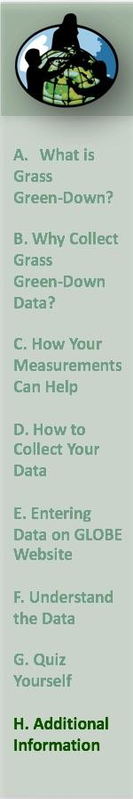

Congratulations!
You have now completed the slide stack. Sign on to the GLOBE website and take the assessment corresponding to Grass Green-Down Protocol.
When you pass the assessment, you are ready to take Grass Green-Down measurements!
Welcome to the Green-Down GLOBE community!

Slide 42


Research Questions for Investigation:
What other animals (butterflies, waterfowl, songbirds) migrate after plants green-down? When? Why?
Does the timing of green-down occur earlier or later at higher elevations in your region? Why?
Does the timing of green-down occur earlier or later inland or near the coast in your region? Why?
How do fallen plant leaves affect soil properties such as soil color, water-holding capacity, and soil nutrients? How could you find out? Why is this important?

Slide 43
FAQ: Frequently Asked Questions
Should I use the same leaves I used for green-up?
If possible, use the same grass plot. If you use other plants, try to select plants of the same species. If the plants you use for green-down are at a different location than the ones you used for green-up, then define a new site.
Do you have any tips how to locate the same grass blade and make measurements throughout the observation period?
The best way to locate the grass blades is by providing small dots on the leaves you are monitoring, according to the protocol. Next to the grass blade, mark this area with some flagging tape on a wire or other way so that the area can be located easily throughout the observation period.

Slide 44
Questions about the content of this module? Contact GLOBE: training@nasaglobe.org.
Credits
Slides:
Russanne Low, Ph.D., University of Nebraska-Lincoln, USA
Rebecca Boger, Ph.D., Brooklyn College, NYC, USA
Cover Art: Jenn Glaser, ScribeArts
More Information:
The GLOBE Program
NASA Wavelength NASA’s Digital Library of Earth and Space Education Resources
NASA Global Climate Change: Vital Signs of the Planet
Version 9/25/24. If you edit and modify this slide set for use for educational purposes, please note “modified by (and your name and date)“ on this page.

