Slide 1
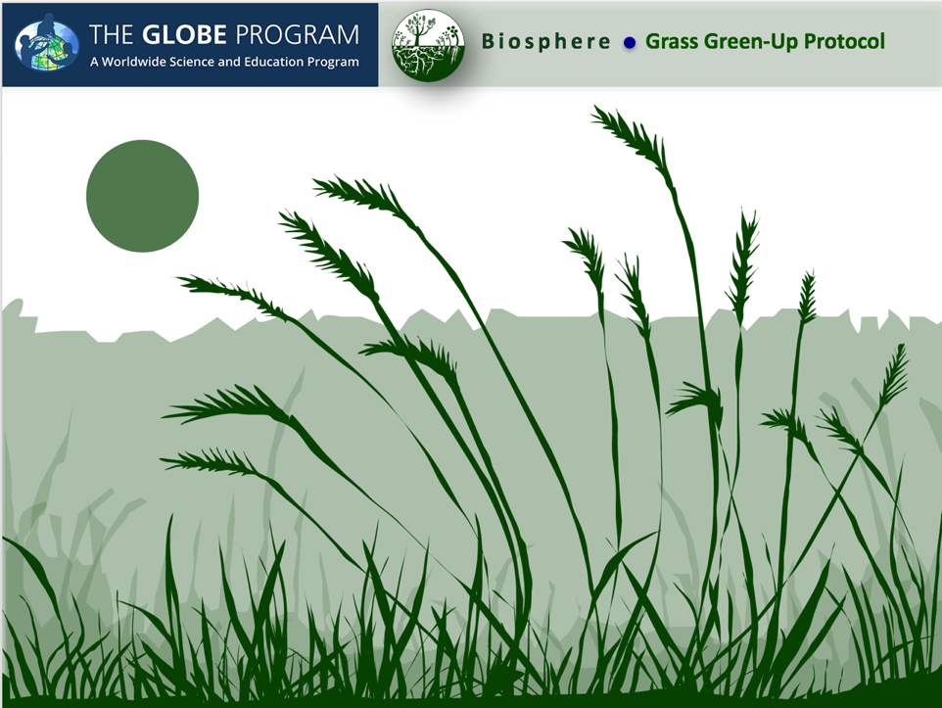

Slide 2


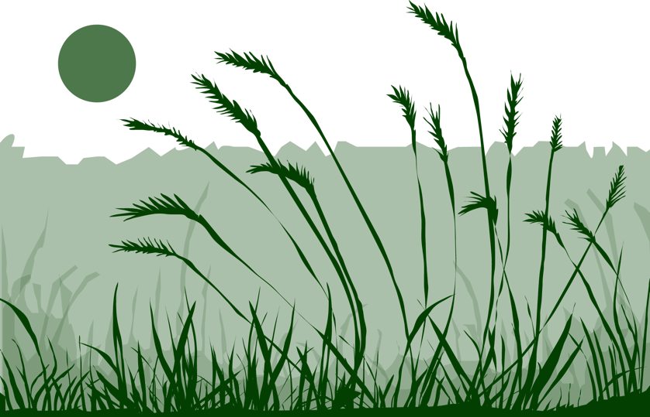
Overview
This module:
Describes how to select and define a GLOBE Phenology Protocol Study Site
Provides a step-by-step introduction of the protocol method
Learning Objectives
After completing this module, you will be able to:
Define phenology and what is meant by grass green-up
Describe the importance of quality control steps in the collection of accurate data
Describe why green-up data is important for understanding our changing Earth system
Identify a grass green-up study site and conduct measurements in the field
Upload data to the GLOBE database
Visualize data using GLOBE’s Visualization System
Estimated time to complete module 1.5 hours

Slide 3
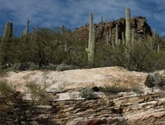
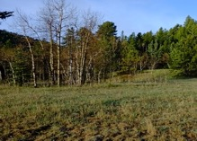
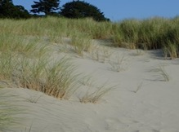
The Biosphere
The Biosphere is Earth’s zone of life. Every organism on Earth belongs to the biosphere. GLOBE has several ways to explore and measure components of the Biosphere through investigations in land cover, phenology, and carbon storage. Some GLOBE Hydrosphere investigations also include measurements of organisms: the macroinvertebrate and mosquito larvae protocols.
Grass Green-Up is one of the GLOBE phenology protocols.
More information can be found in the:
Biosphere Introduction
Hydrosphere Introduction
Photo Credit: Shelley E. Olds

Slide 4
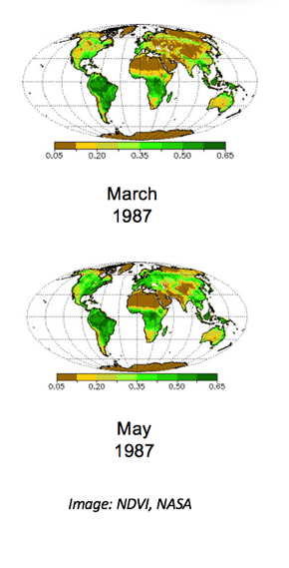
What is Green- Up?
Phenology is the study of living organisms’ response to seasonal and climatic changes in the environment in which they live. You can study the phenology of plants or animals.
The plant growing season is the period between green-up and green-down.
Plant green-up is initiated when dormancy (a state of suspended growth and metabolism) is broken by environmental conditions such as longer hours of sunlight and higher temperatures in temperate regions, or rains and cooler temperatures in desert areas.

Slide 5
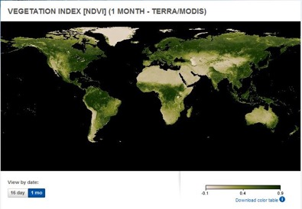
Satellite Measurements of Phenology
Many scientists use data from a NASA sensor, the Moderate Resolution Imaging Spectrometer (MODIS), to monitor the seasonal dynamics of vegetation.
Scientists also use a metric called the Normalized Difference Vegetation Index (or NDVI) to quantify the Earth’s greenness. NDVI is calculated from satellite data of red and near-infrared light, and can help monitor vegetation health, ecosystem disturbances, and changes in vegetation density over time. Learn more about NDVI in this My NASA Data Mini-lesson.
Watch an animation of NDVI from the NASA Visualization Studio to see the changes in greenness over time!
5

Slide 6

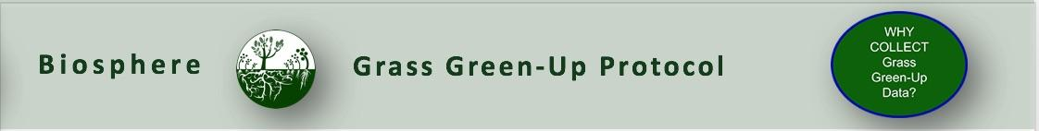
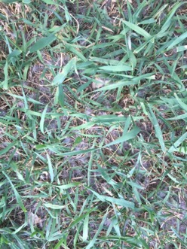
Why Collect Green-Up Data?
Scientists are very interested the timing of spring green-up and fall green-down. These plant phenological events are directly related to global carbon fixation and the amount of carbon dioxide in the atmosphere. They also affect and are affected by air temperature and humidity and soil moisture. Green- Up data are used by scientists to:
  calculate growing season length
  determine how environmental conditions such as air and soil temperature, precipitation, soil moisture, and day length affect plant growth
  monitor the effect of climate change on plants and animals
  help interpret satellite observations of greenness
  use in climate and ecological models
  predict forested or grassland area susceptibility to fire.

Slide 7
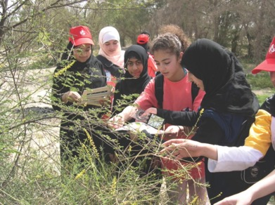
Why Collect Green-Up Data?
Your observations are valuable contributions to the scientific community and may be used by educators, students, researchers, and the general public to increase environmental awareness and STEM literacy, as well as advance Earth system science.

Slide 8

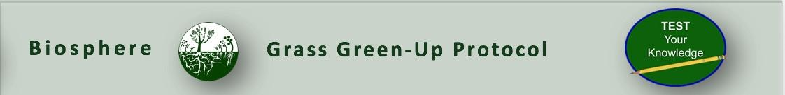
Let’s do a quick review before moving onto data collection! Question 1
1. What part of the Earth system is known as the zone of life?
A. Atmosphere
B. Biosphere
C. Lithosphere
D. Hydrosphere
Do you know the answer?

Slide 9
Let’s do a quick review before moving onto data collection! Answer to Question 1
1. What part of the Earth system is known as the zone of life?
A. Atmosphere
B. Biosphere- correct ☺
C. Lithosphere
D. Hydrosphere
Were you correct?

Slide 10
Let’s do a quick review before moving onto data collection! Question 2
True or False: In every part of the world, there is one green-up and green-down cycle.
Do you know the answer?

Slide 11
Let’s do a quick review before moving onto data collection! Answer to Question 2
True or False: In every part of the world, there is one green-up and green-down cycle. False
Were you correct?

Slide 12
Let’s do a quick review before moving onto data collection! Question 3
Why are scientists interested in green-up data? The data can be used:
to help interpret satellite observations of greenness, such as imagery of the Normalized Difference Vegetation Index (NDVI)
to determine how environmental conditions affect plant growth
to calculate changes in growing season length and onset over years
to monitor the nature and extent of climate change and its effects on plants and animals
all of the above
only A and B
Do you know the answer?

Slide 13
Let’s do a quick review before moving onto data collection! Answer to Question 3
Why are scientists interested in green-up data? The data can be used:
to help interpret satellite observations of greenness, such as imagery of the Normalized Difference Vegetation Index (NDVI)
to determine how environmental conditions affect plant growth
to calculate changes in growing season length and onset over years
to monitor the nature and extent of climate change and its effects on plants and animals
all of the above –correct ☺
only A and B
Were you correct? Let’s now look at data collection.

Slide 14

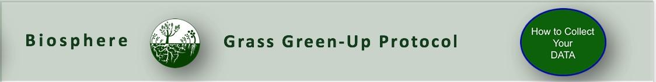
Overview of the Grass Green-Up Protocol
When | Select your site at least 2 weeks before green-up begins. For grasses, the start of Green-Up occurs when any initial green grass shoot is first observed.
Where | You will need to make your observations in a one-meter square that is dominated by grass plants.
Time Needed | 10-15 minutes per measurement. Frequency of observations: Ideally, visit plant at least two times a week to check for the start of green-up and continue observing until leaf growth plateaus.
Prerequisites | None
Primary Instrument | Metric ruler
Skill level | All
References | Site Definition Sheet Grass Green-Up Protocol Field Guide Green-up data sheet
* Because of the possibility of multiple growing seasons in a year, we are asking you to report which cycle you are observing. If there is only one cycle, then you report green-up cycle 1. The onset of the first green-down after 1 January is considered green-up cycle 1.

Slide 15
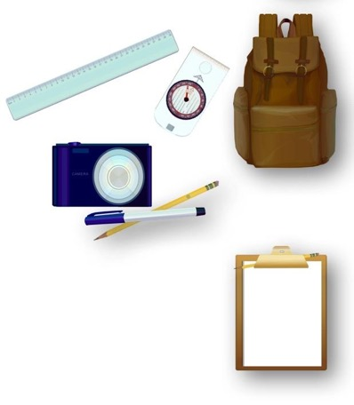
Equipment and Documents Needed
First Visit Only
Fine tip permanent marker
Camera
Compass
Every Visit
Pencil or pen
Ruler with mm units
Documents Needed in the Field
Site Definition Sheet
Tree and Shrub Green-Up and Green-Down Site Selection
Grass Green-up Protocol Field Guide
Green-up data sheet

Slide 16

Site Selection
Site selection is important. Choose a site that contains plants indicative of the surrounding climate. You will need to make your observations in a one-meter square that is dominated by grass plants.
  Native species
  Not watered or fertilized
  Away from buildings
  Choose a site that is accessible and can be visited repeatedly.
    NOTE:. To determine if the plant is too close to a building, stand at the plant and sight the top of the building through your clinometer. If the angle is greater than 45˚, the building is too close. You do not want the plant to be closer to the building than it is tall.

Slide 17
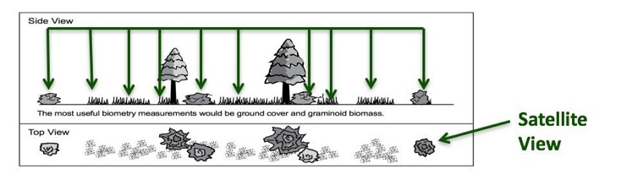
Other Site Selection Considerations
Select one or more species that is common in your area. Think from the perspective of a satellite – what is the satellite “seeing”?
If you are also doing atmospheric or soil moisture protocols, select a site less than 2 km from your atmosphere or soil moisture site, and an elevation difference less than 100 meters. This is important because local topography affects weather significantly.
17

Slide 18
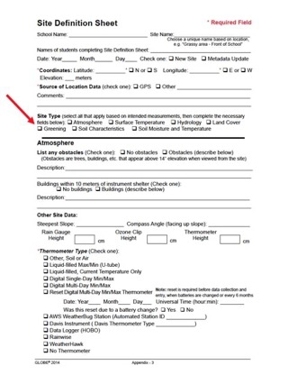
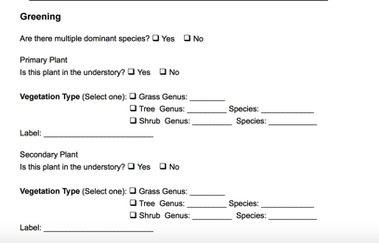
Grass Green-Up Site Selection-1
In the Field
Complete the Greening portion of the Site Definition Sheet.
Identify genus using field guides or help of plant specialists. Record the genus on the Site Definition Sheet.

Slide 19
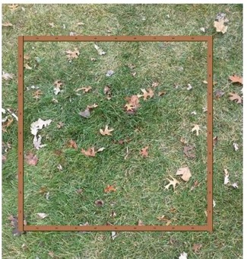
Grass Green-Up Site Selection-2
In the Field
Select a one-meter square area dominated by grass plants. Mark your one-meter square plot with nails or stakes or other durable identifiers.
Locate coordinates using your phone or the GPS Protocol.

Slide 20
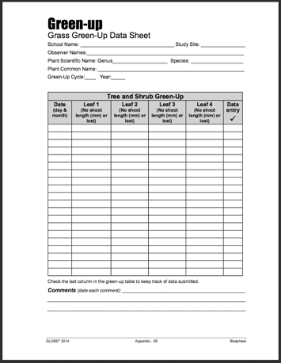
Grass Green-Up Data Sheet
Fill in the top portion of the data sheet

Slide 21
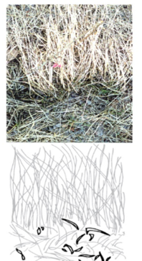
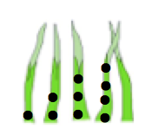
Grass Green-Up: Every Visit-1
Here are the steps:
Look for new green grass shoots.
Mark the base of the first grass shoot with a single dot, using a permanent felt marker.
Mark the second shoot with two dots, the third with three dots and the fourth shoot with four dots.
Use the ruler to measure the length of the shoots to the nearest millimeter.
Measure the leaves at regular intervals until the leaf length stops increasing.

Slide 22
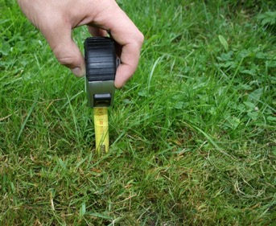
Grass Green-Up Every Visit-2
Options for state of leaf:
Report “no shoot” before the leaves of grass can be seen.
Measure the length in millimeters after the shoot appears.
Report “lost” if something happens to the marked leaves.

Slide 23
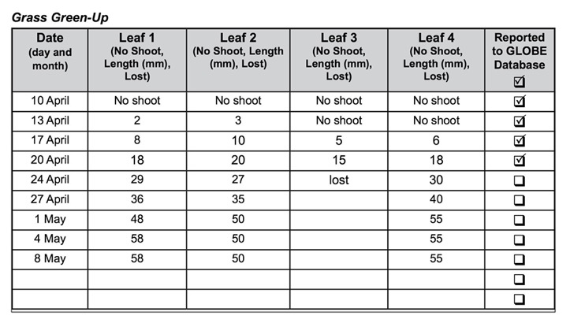
Example of Completed Data Sheet

Slide 24

Let’s review so far! Question 4
When selecting a phenology site, you want to be sure it is accessible and easy to visit, and that you collect data that can be examined in the context of other GLOBE data you might collect. GLOBE recommends you place your site as close to your other study sites as possible, and no further than:
2 km from your Atmosphere or Soil (Pedosphere) investigation sites
100 m difference in elevation from your Atmosphere or Soil study sites
Both A and B
Neither A nor B: you must collect your data at your Biosphere Land Cover study site.
What is the answer?

Slide 25
Let’s review so far! Answer to Question 4
When selecting a phenology site, you want to be sure it is accessible and easy to visit, and that you collect data that can be examined in the context of other GLOBE data you might collect. GLOBE recommends you place your site as close to your other study sites as possible, and no further than:
2 km from your Atmosphere or Soil (Pedosphere) investigation sites
100 m difference in elevation from your Atmosphere or Soil study sites
Both A and B- correct ☺
Neither A nor B: you must collect your data at your Biosphere Land Cover study site.
Were you correct?

Slide 26
Let’s review so far before – Question 5
How many grass blades do you need to observe when applying the Grass Green-up Protocol?
All the blades in a 1 m sample grid
10 blades of grass within the sample grid
4 blades of grass within the sample grid
1 blade of grass within the sample grid
What is the answer?

Slide 27
Let’s review so far before- Answer to Question 5
How many grass blades do you need to observe when applying the Grass Green-up Protocol?
All the blades in a 1 m sample grid
10 blades of grass within the sample grid
4 blades of grass within the sample grid – correct ☺
1 blade of grass within the sample grid
Were you correct?

Slide 28

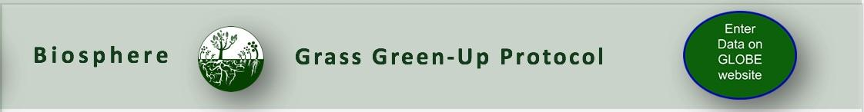
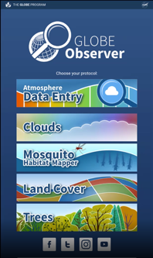
Report Your Data to GLOBE
Desktop Data Entry: Log environmental data directly on the GLOBE website.
Email Data Entry: If connectivity is an issue, data can also be entered via email.
GLOBE Observer App: The app allows users to enter data directly from an iOS or Android device for any GLOBE protocol.

Slide 29
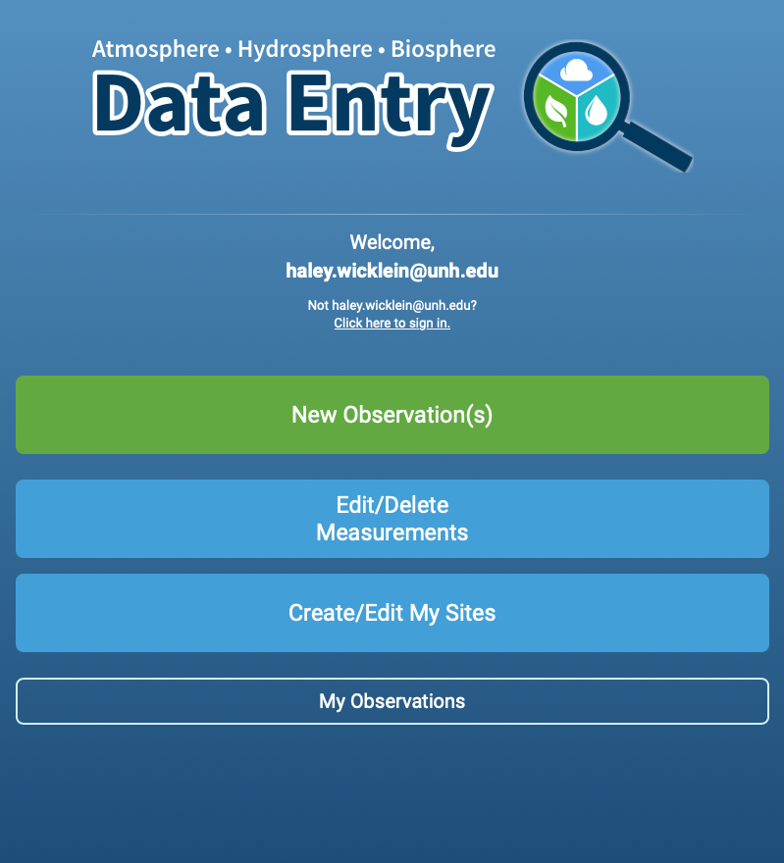
Entering your data via the GLOBE website or GLOBE Observer App
Click “New Observation(s)”

Slide 30
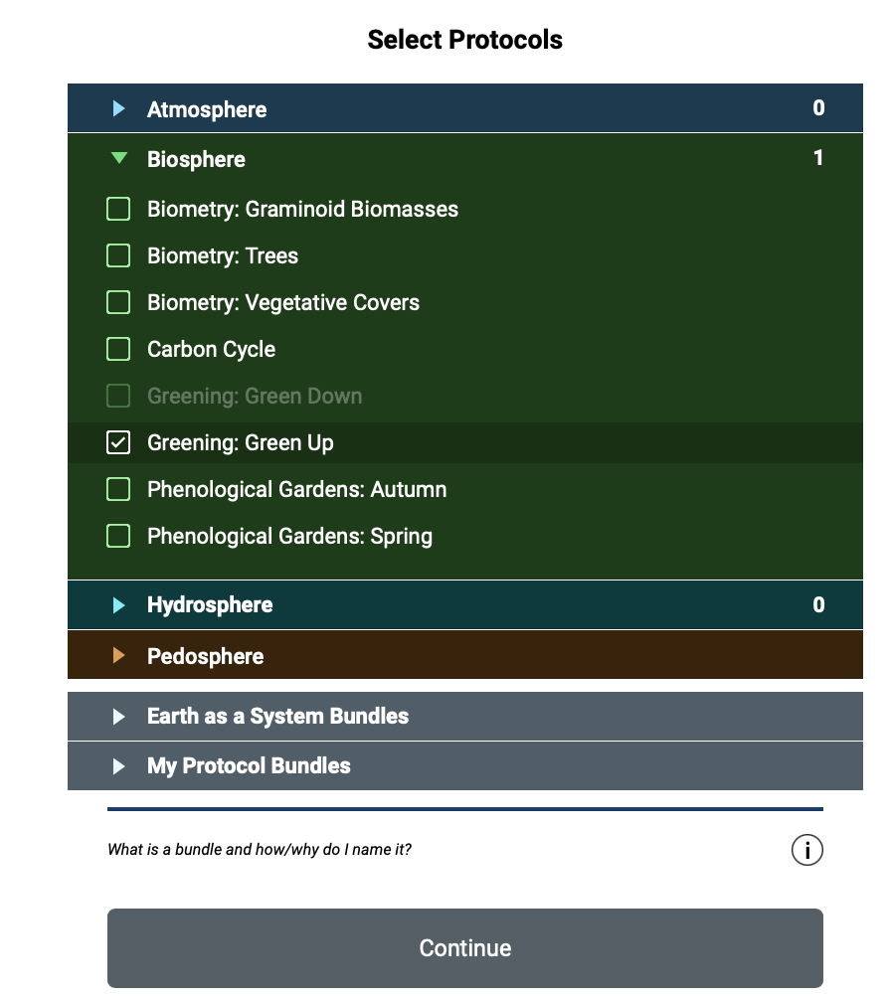
Entering your data via the GLOBE website or GLOBE Observer App
Select “Greening: Green Up”
Click Continue
30

Slide 31
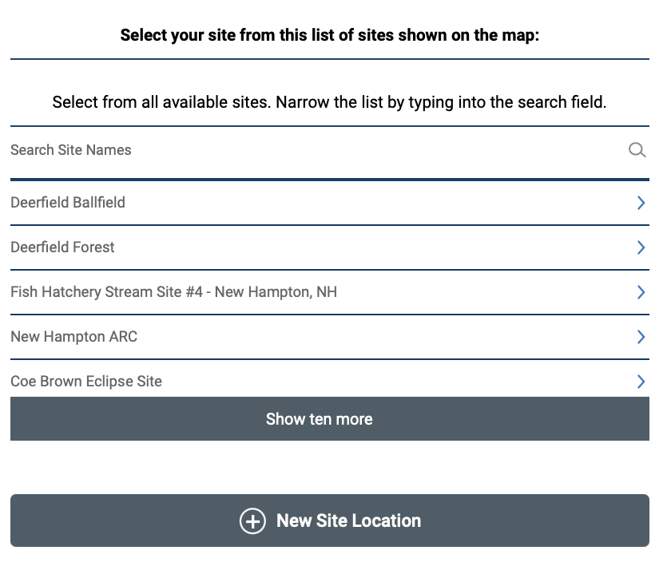
Entering your data via the GLOBE website or GLOBE Observer App
On the location page, scroll down to select your site OR choose “New Site Location” to add a new site.
Tutorials are available on how to add a new site.
31
31

Slide 32
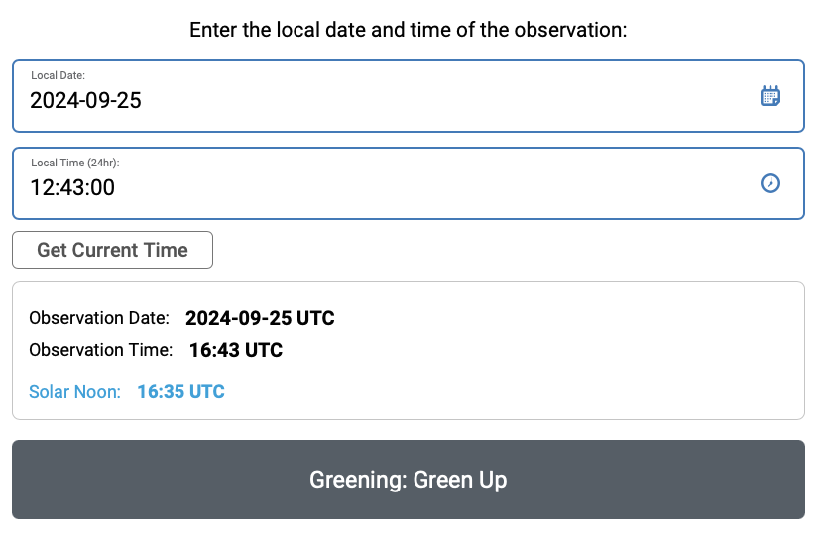
Entering your data via the GLOBE website or GLOBE Observer App
Add the time and date that you collected your data
Click Greening: Green Up
32
32

Slide 33
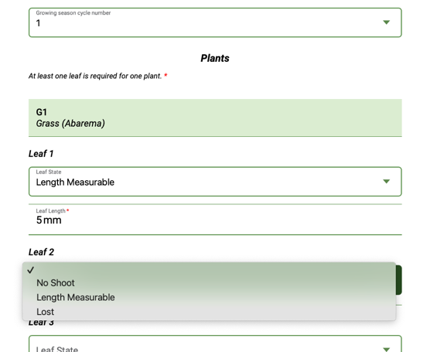
Entering your data via the GLOBE website or GLOBE Observer App
Choose your growing season cycle number.
If you can measure the length of the grass leaf, enter the length in mm.
If the grass leaves have not appeared yet, enter “No Shoot”.
33
33

Slide 34
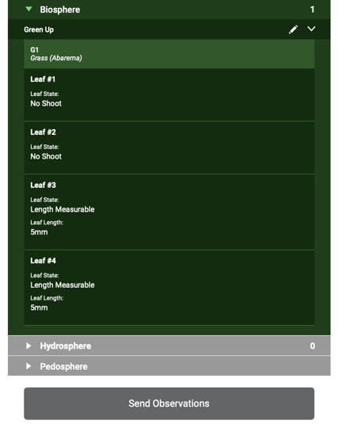
Entering your data via the GLOBE website or GLOBE Observer App
Review the data you entered
Click send observation and wait for the message that your observation was successfully sent!
34
34
34

Slide 35

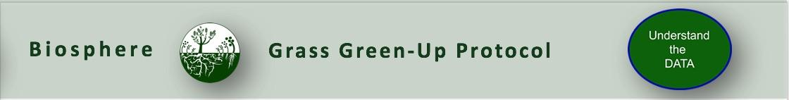
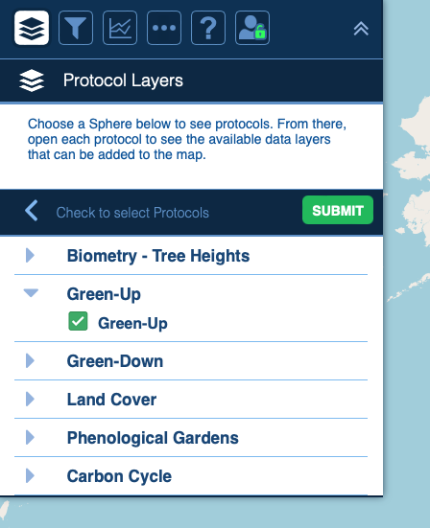
Visualize and Retrieve Data
GLOBE provides the ability to view and interact with data measured across the world. Use the visualization tool to map, graph, filter and export Green-Up data that have been measured across GLOBE protocols since 1995.
Click the layers icon.
Select Green-up under the Biosphere drop down
See video tutorials on using the GLOBE Visualization system.
35

Slide 36
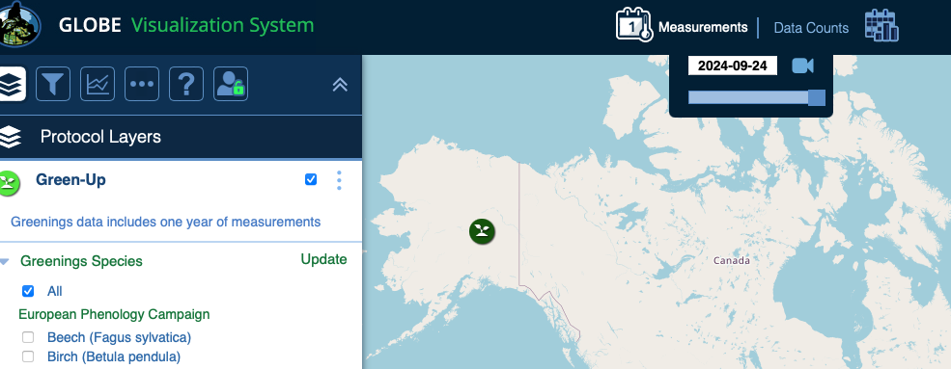
Visualize and Retrieve Data
Select the date for which you need Green-up data.
36

Slide 37
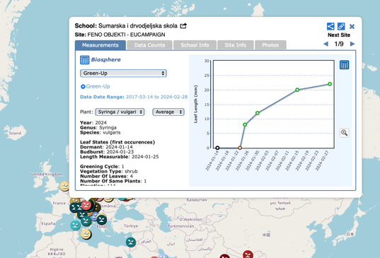
Visualize and Retrieve Data
Select the sampling site for which you need Green-Up Data, and a box will open with a data summary for that site.
Click on the table icon to view the data in a table and download it as a .csv for analysis.
Clicking on a location will open to a map note providing data for that location and time.
37

Slide 38

Review questions to help you prepare to do the Grass Green-Up Measurements associated with the GLOBE Biometry Protocols
Grass Green-Up measurements are part of what GLOBE Protocol area or Earth system sphere?
What is phenology?
Why is it important for scientists to know when Green-Up takes place in a location, year by year?
With respect to Green-Up and Green-Down, when is the plant growing season?
If there is more than one Green-Up season during the year in your region, how do you decide when to measure Green-Up?
How soon before green-up should you identify and prepare your study site?
How often should you monitor your grass shoots during green up?
When do you stop monitoring your grass shoots?
How do you mark the grass leaves so you know to measure the same leaves throughout the green-up season?

Slide 39


Congratulations!
You have now completed the slide stack. Sign on to the GLOBE website and take the assessment corresponding to Grass Green-Up Protocol.
When you pass the assessment, you are ready to take Grass Green-Up measurements!
Welcome to the Green-Up GLOBE community!

Slide 40
Research Questions for Investigation:
How long does green-up take for a given species?
How does green-up differ among different species within a forested study area?
How does green-up relate to precipitation? To soil moisture?
Does temperature influence the rate of green-up?

Slide 41
FAQ: Frequently Asked Questions
How do I mark the grass shoots if they start on the same day?
Mark the base of the four longest grass shoots that appear at the earliest date.
What do I do if on the first day I see shoots, I see more than four? How do I select the shoots to study?
Mark the base of the four longest grass shoots that appear on the first day.
What if there are grass shoots the first day when I go to take a picture of the site?
Mark the base of the four longest grass shoots that are present on this day.

Slide 42
Questions about the content of this module? Contact GLOBE: training@nasaglobe.org.
Credits
Slides:
Russanne Low, Ph.D., University of Nebraska-Lincoln, USA
Rebecca Boger, Ph.D., Brooklyn College, NYC, USA
Cover Art:
Jenn Glaser, ScribeArts
More Information:
The GLOBE Program
NASA Wavelength NASA’s Digital Library of Earth and Space Education Resources
NASA Global Climate Change: Vital Signs of the Planet
Version 9/25/24. If you edit and modify this slide set for use for educational purposes, please note “modified by (and your name and date )“ on this page. Thank you.

