Slide 2
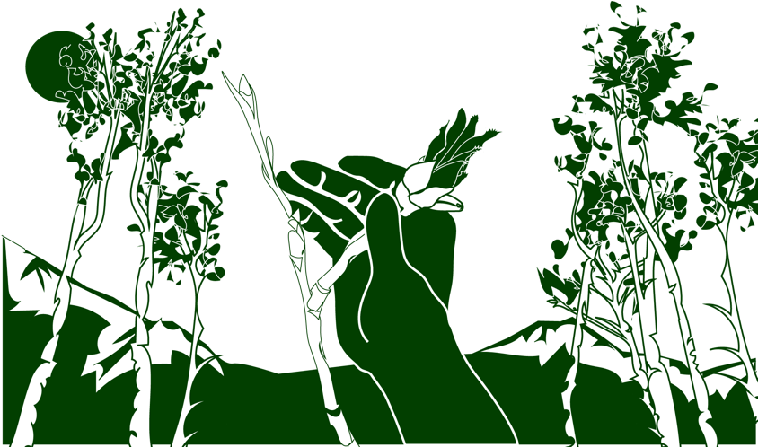
Overview
This module:
Describes how to select and define a GLOBE Phenology Protocol Study Site
Provides a step-by-step introduction of the protocol method
Learning Objectives
After completing this module, you will be able to:
Define phenology and what is meant by tree and shrub green-down
Describe the importance of quality control steps in the the collection of accurate data
Describe why green-down data is important for understanding our changing Earth system
Explain the difference between accuracy and precision
Identify a tree and shrub green-down study site and take measurements in the field
Upload data to the GLOBE database
Visualize data using GLOBE’s Visualization System

Slide 3
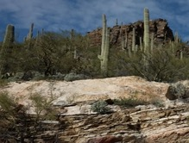
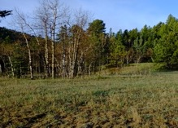
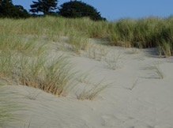
The Biosphere
The Biosphere is Earth’s zone of life. Every organism on Earth belongs to the biosphere. GLOBE has several ways to explore and measure components of the Biosphere through investigations in land cover, phenology, and carbon storage. Some GLOBE Hydrosphere investigations also include measurements of organisms: the macroinvertebrate and mosquito larvae protocols.
Tree and Shrub Green-Down is one of the GLOBE phenology protocols.
More information can be found in the:
Biosphere Introduction
Hydrosphere Introduction
Photo Credit: Shelley E. Olds

Slide 4
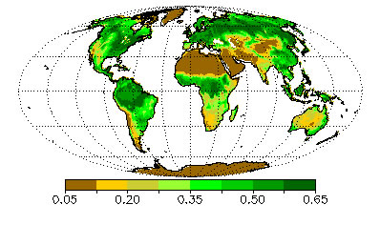
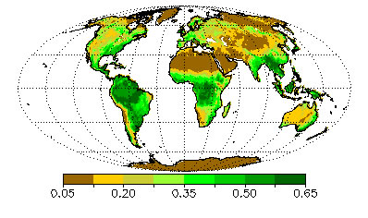
What is Green-Down?
Green-down marks the end of the growing season for many plants. A color change is generally associated with green-down of leaves. The color will vary by species.
July
1987
November
1987
Image: Normalized Difference Vegetation Index (NDVI). NASA

Slide 5
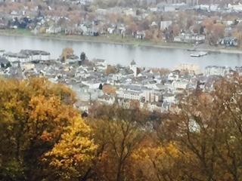
What is Green- Down?
Phenology is the study of living organisms’ response to seasonal and climatic changes in the environment in which they live.
The plant growing season is the period between green-up and green-down.
Plant green-down is also called senescence. It is initiated when environmental conditions change
Fewer hours of sunlight and lower temperatures in temperate regions, or drier and warmer temperatures in desert areas.
Most are familiar with green-down of trees, but
Color change also marks dormancy of grasses
Green-down starts dormancy (a state of suspended growth and metabolism)
For many places around the world, there is one green-up and green-down cycle, e.g., one warm and cold season.
There are places where multiple wet and dry seasons can occur in a single year, resulting in multiple green-up and green-down cycles

Slide 6
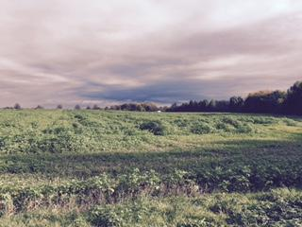
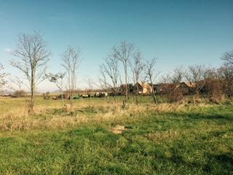
Why Collect Green-Down Data?
Scientists are very interested the timing and rate of fall green-down and spring green-up. These plant phenological events are directly related to global carbon fixation and the amount of carbon dioxide in the atmosphere. They also affect and are affected by air temperature and humidity and soil moisture.

Slide 7
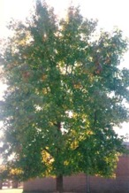
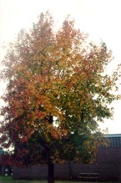
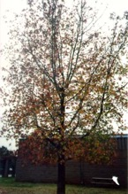
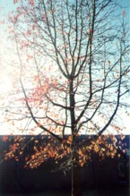
Why Collect Green-Down Data?
Your observations are valuable contributions to the scientific community and may be used by educators, students, researchers, and the general public to increase environmental awareness and STEM literacy, as well as advance Earth system science.
Monitoring the length of the growing season is important for society so that it can better adapt to variations in the length of the growing season and to other impacts of climate change, which may affect food production, economic growth, and human health.

Slide 8
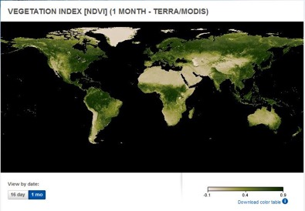
Satellite Measurements of Phenology
Many scientists use data from a NASA sensor, the Moderate Resolution Imaging Spectrometer (MODIS), to monitor the seasonal dynamics of vegetation.
Scientists also use a metric called the Normalized Difference Vegetation Index (or NDVI) to quantify the Earth’s greenness. NDVI is calculated from satellite data of red and near-infrared light, and can help monitor vegetation health, ecosystem disturbances, and changes in vegetation density over time. Learn more about NDVI in this My NASA Data Mini-lesson.
Watch an animation of NDVI from the NASA Visualization Studio to see changes in greenness over time!

Slide 9
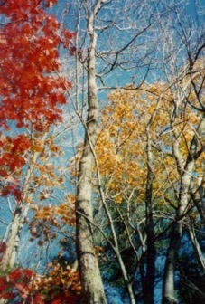
Time Requirements
Frequency of observations: At least twice a week beginning two weeks prior to the anticipated start of green down, continuing until plant color change has ended or leaves have dropped off.
Reporting the number of growing seasons: Some locations have multiple growing seasons in a year.
On your data sheet, report which cycle you are observing.
In a location where there is only one growing cycle, report green-down cycle 1.
The onset of the first green-down after 1 January is considered green-down cycle 1.

Slide 10
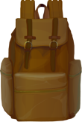
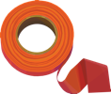
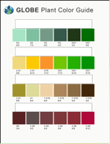
Assemble Equipment for the Green-Down Protocol
What You Need the first visit
Pencil or pen.
Camera
Compass
Fine-Tip Permanent Marker
GLOBE Plant Color Guide
Every Visit
GLOBE Plant Color Guide
Pencil or pen
Documents to Bring to the Field
Site Definition Sheet
Tree and Shrub Green-Up and Green-Down Site Selection
Tree, Shrub and Grass Green-Down Data Sheet
Tree and Shrube GreenDown Protocol Field Guide
Notes:
Links need to be added

Slide 11
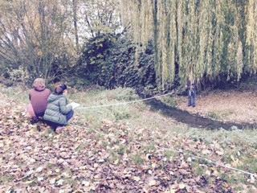
Site Definition and Site Selection
Site selection is important!
Choose plants that are indicative of the surrounding climate:
Native species
Not watered or fertilized
Away from buildings
Choose a site that is accessible and can be visited repeatedly.
If possible, choose the same plant/s each year.
Plants should not be closer to a building that the height of that building. To determine if the plant is too close to a building, stand at the plant and sight the top of the building through our clinometer. If the angle is greater than 45˚, the building is too close.

Slide 12
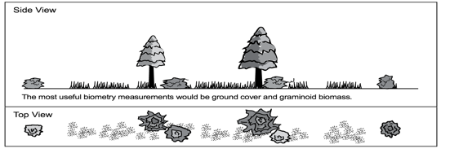
Other Site Considerations
Select one or more species that is common in your area. Think from the perspective of a satellite – what is the satellite “seeing”?
If you are also doing atmospheric or soil moisture protocols, select a site less than 2 km from your atmosphere or soil moisture site, and an elevation difference less than 100 meters. This is important because local topography affects weather significantly.
Satellite View

Slide 13
Site preparation: Trees and shrubs
Before collecting data, set up site, using the Tree and Shrub Green- Up and Green-Down Site Selection Field Guide
Complete sections of Site Definition Sheet.
Select shrub or tree- It should be a dominant native species, deciduous and easily accessible.
Select large and healthy branch. If a lower branch is chosen, it should
be on the edge of the stand of trees or shrubs since branches inside a stand may experience a different microclimate due to shading.
North side of plant if living in Southern Hemisphere
South side of plant if living in Northern Hemisphere
Identify genus and species.
Mark selected tree and branch with flagging tape.
Locate coordinates using your phone or the GPS Protocol.
Site preparation is done only once. Can be done before or during first green down visit. You are done with this step!

Slide 14
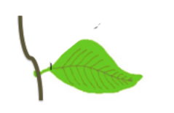
First Visit Green-Down Observations: Trees and Shrubs
First time only: getting started
Complete the upper portion of your data sheet.
Determine whether there are more than one green down cycles; if yes, during which cycle are you currently collecting data (1, 2, or 3)?
Locate the leaf at the end of the branch. Label this leaf by marking one dot on the branch next to the leaf stem or petiole. Locate the three other leaves on this branch closest to this terminal leaf.
Label these leaves by marking two, three, or four dots next to their stems on the branch.

Slide 15
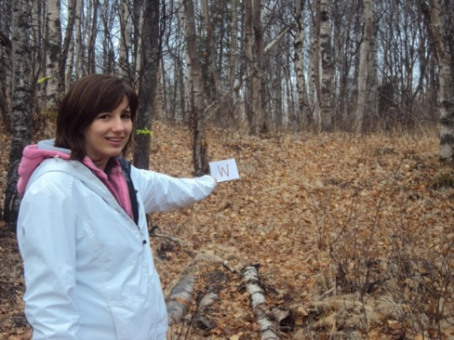
First Visit Green-Down Observations: Trees and Shrubs
First time only: getting started
5. Take a photograph from the center of your site looking in the north, south, east, and west directions.

Slide 16
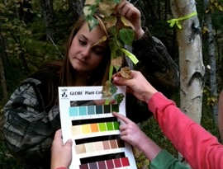
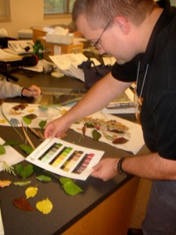
Every visit: Trees and Shrubs
Examine each of your four leaves. For each leaf, use the GLOBE Plant Color Guide to estimate the dominant color of each leaf. For example, if leaf 1 appears colored at 60 percent 5G 7/12 and 40 percent 2.5 Y8/10, record the leaf color as 5G 7/12 for that observation date.
Record your observations on the Tree, Shrub, and Grass Green-Down Data Sheet.
Common Problems If leaf is snow covered, report “snow covered”, If leaf has fallen, report “fallen” and stop reporting after that, Otherwise, continue to report the color until the color stops changing.

Slide 17
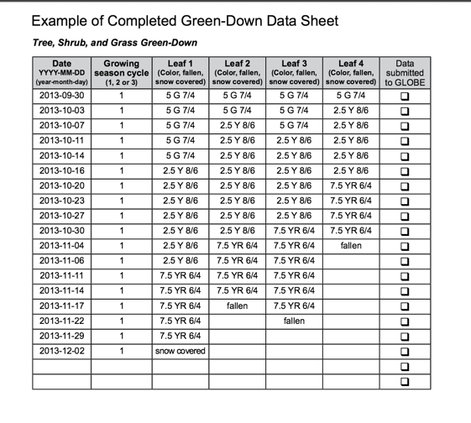
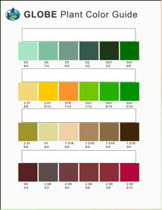
Example of Completed Data Sheet

Slide 18
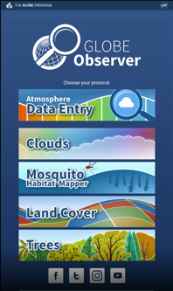
Report Your Data to GLOBE
Desktop Data Entry: Log environmental data directly on the GLOBE website.
Email Data Entry: If connectivity is an issue, data can also be entered via email.
GLOBE Observer App: The app allows users to enter data directly from an iOS or Android device for any GLOBE protocol.
Step 1: Confirm that a Green-Down Study Site has been defined
Step 2: Select “Green-Down” from the Phenology data entry menu
Step 3: Select your Study Site, enter the date and growing season cycle
Step 4: Enter data for the grass/ leaves/buds from each line of the data sheet, one at a time
Step 5: Confirm data entries on verification page

Slide 19
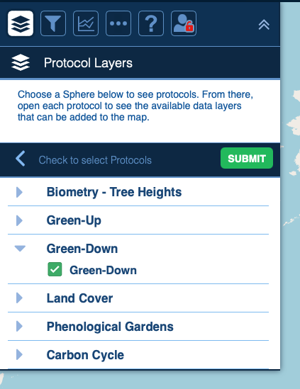
Visualize and Retrieve Data
GLOBE provides the ability to view and interact with data measured across the world. Use the visualization tool to map, graph, filter and export Green-Down data that have been measured across GLOBE protocols since 1995.
Click the layers icon.
Click Submit.
Select Green-down under the Biosphere drop down
See video tutorials on using the GLOBE Visualization system.

Slide 20
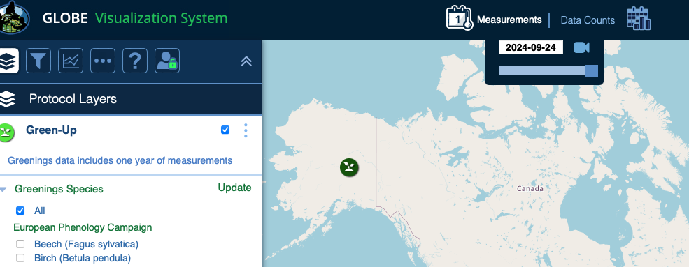
Visualize and Retrieve Data
Select the date for which you need Green-Down data..

Slide 21
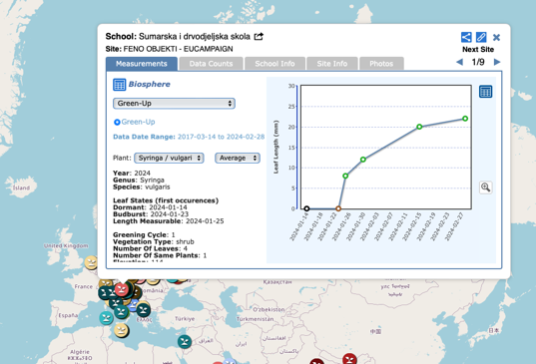
Visualize and Retrieve Data
Select the sampling site for which you need Green-Down Data, and a box will open with a data summary for that site.
Click on the table icon to view the data in a table and download it as a .csv for analysis.
Clicking on a location will open to a map note providing data for that location and time.

Slide 22
Review questions to help you prepare to do the Tree and Shrub Green-Down Measurements associated with the GLOBE Biometry Protocol
Tree and Shrub Green-Down measurements are part of what GLOBE Protocol area or Earth system sphere?
What is phenology?
Why is it important for scientists to know when green-down takes place in a location, year by year?
With respect to Green-Up and Green-Down, when is the plant growing season?
Green-down is a metabolic response to what changes in a plant’s environment?
Why is green-down data useful for scientists and what does it tell us about changes in the Earth system?
Why do we use the GLOBE plant color guide when monitoring Green-Down?
When do you start and stop your Tree and Shrub green-down measurements?
How do you identify the leaves you are monitoring, so you can return to the same leaves throughout the green-down phase of the plant growth cycle?
Why is it important to measure green-down of trees in a natural habitat, away from buildings and other built structures?

Slide 23
You have now completed the slide stack. Sign on to the GLOBE website and take the assessment corresponding to Tree and Shrub Green-Down Protocol.
When you pass the assessment, you are ready to take Tree and Shrub Green-Down measurements!
Welcome to the Green-Down GLOBE community!

Slide 24
Frequently Asked Questions
What do you mean by a relatively large branch?
Use your judgment. Each branch should be healthy and large relative to the other branches on the tree or shrub. You want the branch to still be there next year. Be careful not to damage the branch during the labeling and measurements.
What if a branch breaks during the study?
Continue your observations by teaming up with other students and observing their branch.
Should I look at the same branch from year to year?
You should observe the same branch, which will typically have new terminal buds each year.
What if needle-leaved trees are the abundant vegetation?
Usually there are understory deciduous shrubs that can be used instead. For example, Snowberry in Douglas Fir, Gamel Oak in Ponderosa Pine. Typically these deciduous plants are what the satellites are detecting as Green-up. The Green-up of conifers is a subtle process and not easily observed.

Slide 25
For More Information visit www.globe.gov or contact training@nasaglobe.org.

