Slide 1
Intro Slide

Slide 2
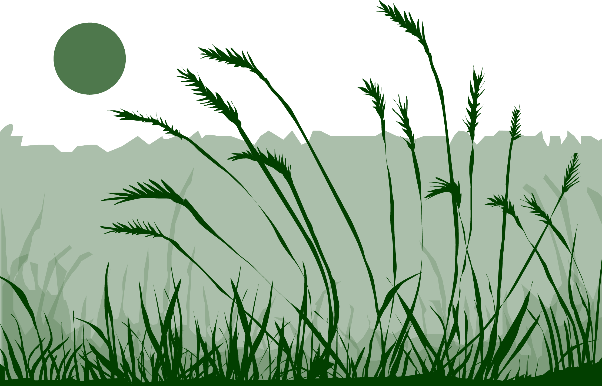
Overview
This module:
Describes how to select and define a GLOBE Phenology Protocol Study Site
Provides a step by step introduction of the protocol method
Learning Objectives
After completing this module, you will be able to:
Define phenology and what is meant by grass green-down
Describe the importance of quality control steps in the collection of accurate data
Describe why green-down data is important for understanding our changing Earth system
Identify a grass green-down study site and conduct measurements in the field
Upload data to the GLOBE portal
Visualize data using GLOBE’s Visualization Site
Estimated time to complete module; 1.5 hours

Slide 3
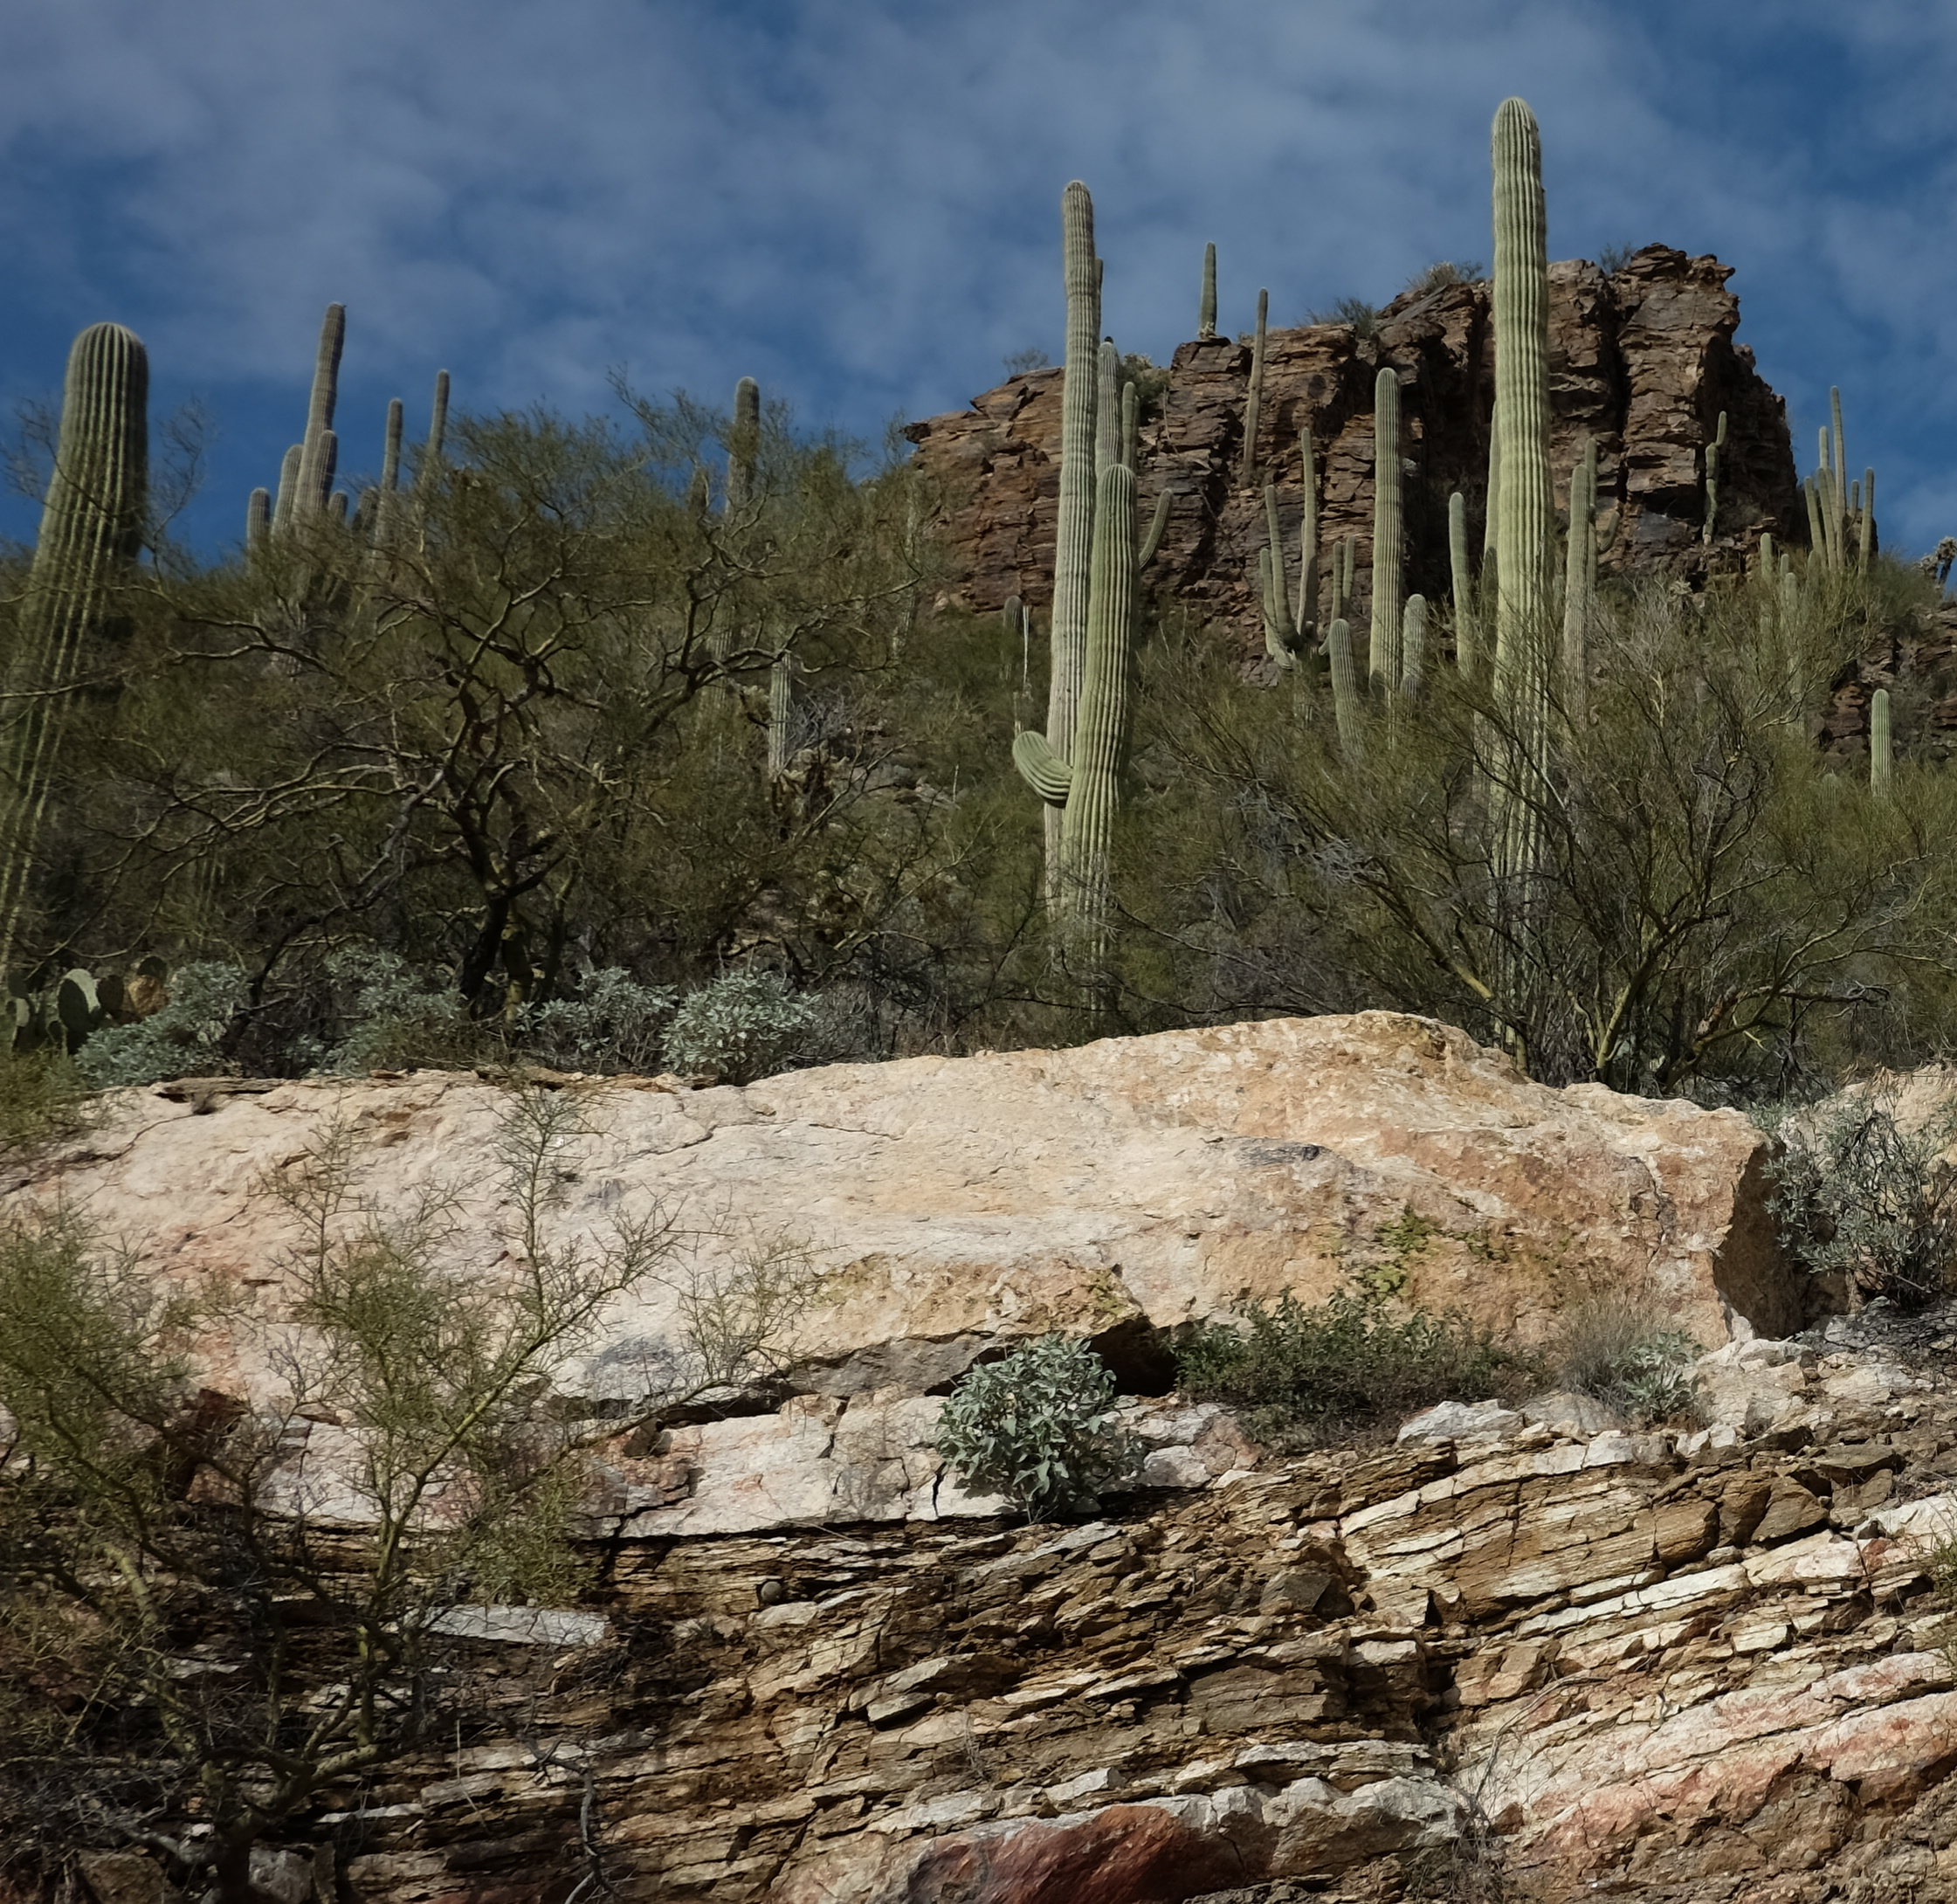
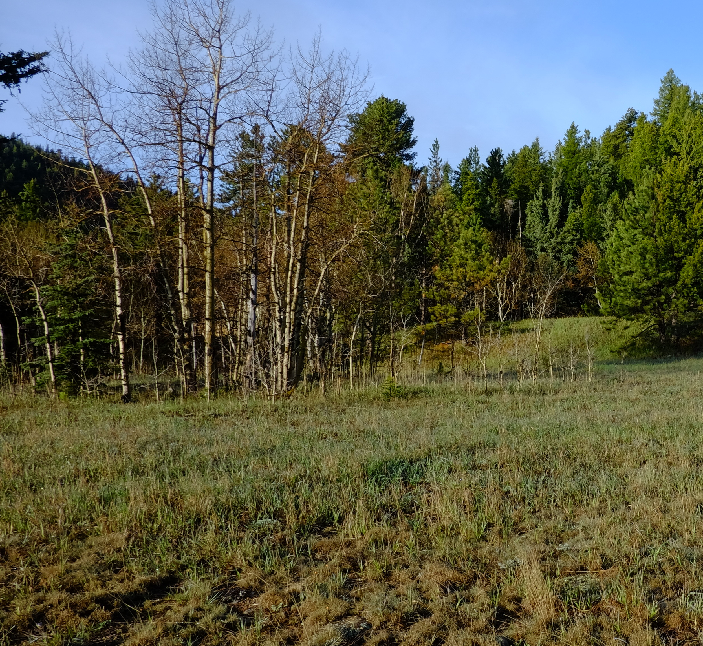
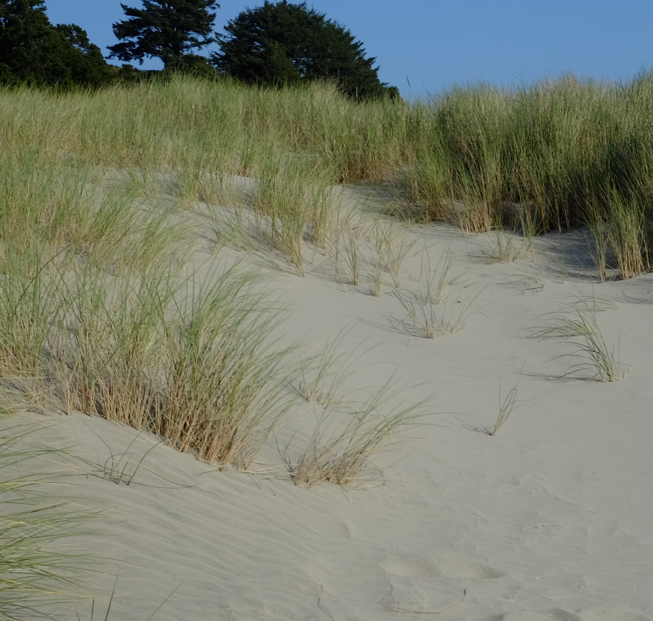
The Biosphere
The Biosphere is Earth’s zone of life. Every organism on Earth belongs to the biosphere. GLOBE has several ways to explore and measure components of the Biosphere through investigations in land cover and phenology. As well, the Hydrosphere investigations include the macroinvertebrates and mosquito larvae protocols.
Grass Green-Down is one of the GLOBE phenology protocols.
You can find more information in:
Biosphere Introduction
Photo Credit: Shelley E. Olds

Slide 4
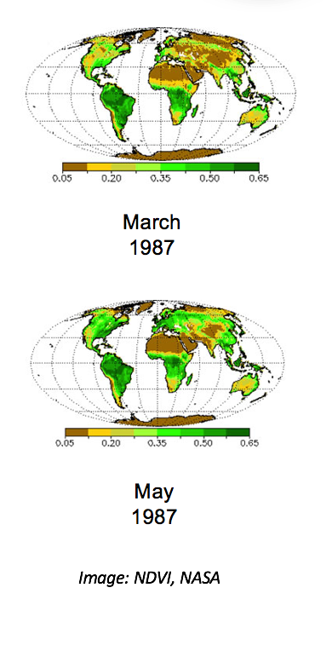
What is Phenology, and how is it related to Green-Down?
Phenology is the study of living organisms’ response to seasonal and climatic changes in the environment in which they live. You can study the phenology of both plants and animals.
The plant growing season is the period between green-up and green-down.
Plant green-up is initiated when dormancy (a state of suspended growth and metabolism) is broken by environmental conditions such as longer hours of sunlight and higher temperatures in temperate regions, or rains and cooler temperatures in desert areas.
Green-down marks the end of the growing season for many plants. A color change is generally associated with green-down of leaves. The color will vary by species.

Slide 5
What is Grass Green- Down?
Plant green-down is also called senescence. It is initiated when environmental conditions change:
Fewer hours of sunlight and lower temperatures in temperate regions.
Drier and warmer temperatures in desert areas.
Green-down starts dormancy (a state of suspended growth and metabolism).
For many places around the world, there is one green-up and green-down cycle, e.g., one warm and cold season.
There are places where multiple wet and dry seasons can occur in a single year, resulting in multiple green-up and green-down cycles.
Most are familiar with green-down of trees, but color change also marks dormancy of grasses

Slide 6
Why Collect Green-Down Data?
Scientists are very interested in knowing when leaves appear in spring and how quickly they expand. The timing and rate of fall leaf changes, such as color changes and leaf drop, are also important. These plant phenological events are directly related to global carbon fixation and the amount of carbon dioxide in the atmosphere. Also, they affect and are affected by air temperature and humidity, as well as soil moisture.

Slide 7
Green-Down from Space?
Scientists use data from a NASA sensor, the Moderate Resolution Imaging Spectrometer (MODIS), to monitor the seasonal dynamics of vegetation. Green-up/green-down data gathered by GLOBE students, using consistent methods all over the world, are one of the best tools with which to verify the accuracy of these satellite products.
The Normalized Difference Vegetation Index is the analysis of the greenness of Earth viewed from space through the examination of two different spectral wavelengths of light (near infrared and red). Scientists can use these data to track major changes in the density of Earth’s vegetation; they can also use these data to study changes in plant growth as a result of climate and environmental changes, as well as human activity.
See where green-down begins in your area here. Page through the monthly changes in net primary production to see where green gives way to brown and identify the time frame you will want to begin your observations.
Image:
NASA Earth Observatory

Slide 8
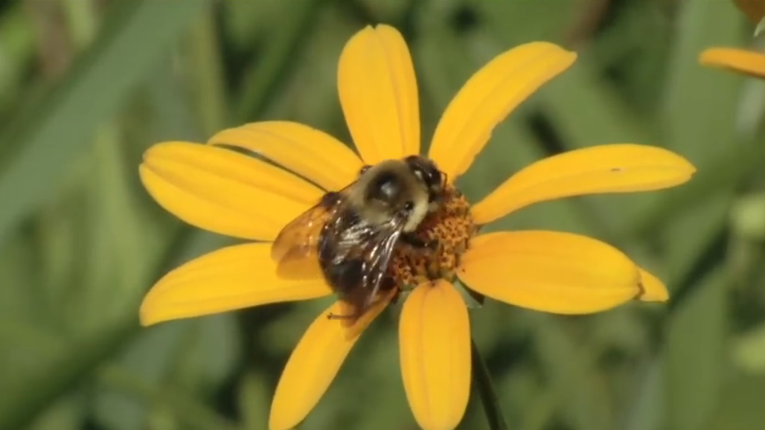
How Your Measurements Can Help
Estimates of changes in the growing season are often done using satellite data.
Ground observations are critical to improve the interpretation of satellite data.
Monitoring the length of the growing season is important for society so that it can better adapt to variations in the length of the growing season and to other impacts of climate change, which may affect food production, economic growth, and human health.

Slide 9
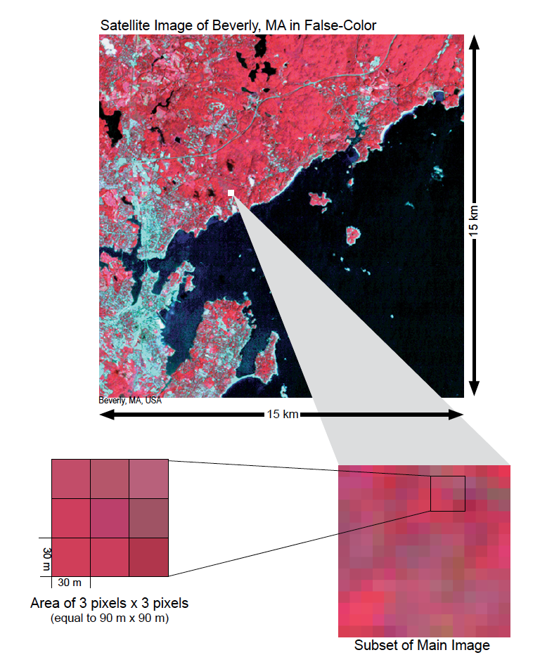
Scientific Importance of Green-Up and Green-Down
Remote sensing from space has the great advantage of being able to cover very large areas quickly and to revisit the same area frequently. However, some of the detail that can be seen at ground level may not be detected by a remote sensing system.
Scientists need the data collected at sample sites on the ground to interpret remotely sensed data about an area. It is not possible to effectively visit every place on Earth to map the land cover. Instead, we rely on samples – actual ground visits – and relate these samples to what we can see using various remote sensing systems.
As you zoom in on a 15 km x 15 km satellite image, the pixels (which are 30 m x 30 m in size) become visible. You will be taking field measurements at sites that are 90 m x 90 m (equal to 3 pixels x 3 pixels).

Slide 10
Let’s do a quick review before moving onto data collection! Question 1
1. What part of the Earth system is known as the zone of life?
A. Atmosphere
B. Biosphere
C. Lithosphere
D. Hydrosphere
Do you know the answer?

Slide 11
Let’s do a quick review before moving onto data collection! Answer to question 1.
1. What part of the Earth system is known as the zone of life?
A. Atmosphere
B. Biosphere- correct ☺
C. Lithosphere
D. Hydrosphere
Were you correct?

Slide 12
Let’s do a quick review before moving onto data collection! Question 2
True or False: In every part of the world, there is one green-up and green-down cycle.
Do you know the answer?

Slide 13
Let’s do a quick review before moving onto data collection! Answer to question 2
True or False: In every part of the world, there is one green-up and green-down cycle. False is correct ☺
Were you correct?

Slide 14
Let’s do a quick review before moving onto data collection! Question 3
Why are scientists interested in green-up data? The data can be used to:
help interpret satellite observations of greenness, such as imagery of the Normalized Difference Vegetation Index (NDVI)
determine how environmental conditions affect plant growth
calculate changes in growing season length and onset over years
monitor the nature and extent of climate change and its effects on plants and animals
all of the above
only A and B
Do you know the answer?

Slide 15
Let’s do a quick review before moving onto data collection! Answer to question 3
Why are scientists interested in green-up data? The data can be used to:
help interpret satellite observations of greenness, such as imagery of the Normalized Difference Vegetation Index (NDVI)
determine how environmental conditions affect plant growth
calculate changes in growing season length and onset over years
monitor the nature and extent of climate change and its effects on plants and animals
all of the above –correct ☺
only A and B
Were you correct? Let’s now look at data collection.

Slide 16
Overview of the Grass Green-Down Protocol
When | At least twice a week beginning two weeks prior to the anticipated start of green down, continuing until plant color change has ended, or leaves have dropped off.
Where | Grass Green-Up, Green-Down site: ideally, your observations in a one-meter square that is dominated by grass plants.
Time Needed | 10-15 minutes per measurement. Frequency of observations: Ideally, visit plant at least two times a week to check for the start of green-up and continue observing until leaf growth plateaus.
Prerequisites | None
Primary Instrument | Metric ruler, GLOBE Plant Color Guide
Skill level | All
References | Tree, Shrub, and Grass Green-Down Data Sheet Grass Green-Up and Green-Down Site Selection Field Guide Site Definition Sheet

Slide 17
Needed Equipment and Documents
First Visit
Pencil or pen
Camera
Compass
Fine-Tip Permanent Marker
GLOBE Plant Color Guide
Every Visit
GLOBE Plant Color Guide
Pencil or pen
Documents Needed Each Visit
Grass Green-Down Protocol Field Guide
Green Down Tree, Shrub and Grass Green-Down Data Sheet
Site Definition Sheet
Grass Green-Up and Green-Down Site Selection Field Guide

Slide 18
Site Selection
Site selection is important. Chose a site that contains plants indicative of the surrounding climate. You will need to make your observations in a one-meter square that is dominated by grass plants.
Native species
Not watered or fertilized
Away from buildings
NOTE: To determine if the plant is too close to a building, stand at the plant and sight the top of the building through your clinometer. If the angle is greater than 45˚, the building is too close. You do not want the plant to be closer to the building than it is tall.

Slide 19
Other Site Selection Considerations
Deciduous trees or shrubs, or grasses. Select one or more species that are common in your area. Think from the perspective of a satellite – what is the satellite “seeing”?
Select a site close to an atmosphere or soil moisture site, if possible. Ideally, it should be less than 2 km from your atmosphere or soil moisture site, and have an elevation difference less than 100 meters. Why is this important?
Local topography affects weather significantly.
Accessibility: Choose a site that can be easily visited repeatedly.
Consistency: If possible, choose the same plant/s each year.

Slide 20
Grass Green-Down Site Definition-1 -
1. Complete the Greening portion of the Site Definition Sheet.
2. Identify genus using field guides or help of plant specialists. Record the genus on the Site Definition Sheet.

Slide 21
Grass Green-Down Site Definition-2
3. Select a one-meter square area dominated by grass plants. Mark your one-meter square plot with nails or stakes or other durable identifiers.
4. Locate coordinates using the GPS Protocol.

Slide 22
First Visit: Green-Down Grasses
First visit only/getting started
Fill in the top of your Data Sheet.
Determine whether there are more than one green down cycles; if yes, during which cycle are you currently collecting data (1, 2, or 3)?
Look for the four longest green grass shoots.
Mark the base of the longest grass shoot with a single dot, using a permanent felt marker. Mark the second longest shoot with two dots, the third with three dots and the fourth shoot with four dots.

Slide 23
First Visit: Green-Down Grasses- Site Documentation
First visit only/getting started
5. Take a photograph from the center of the site looking in the north, south, east, and west directions.

Slide 24
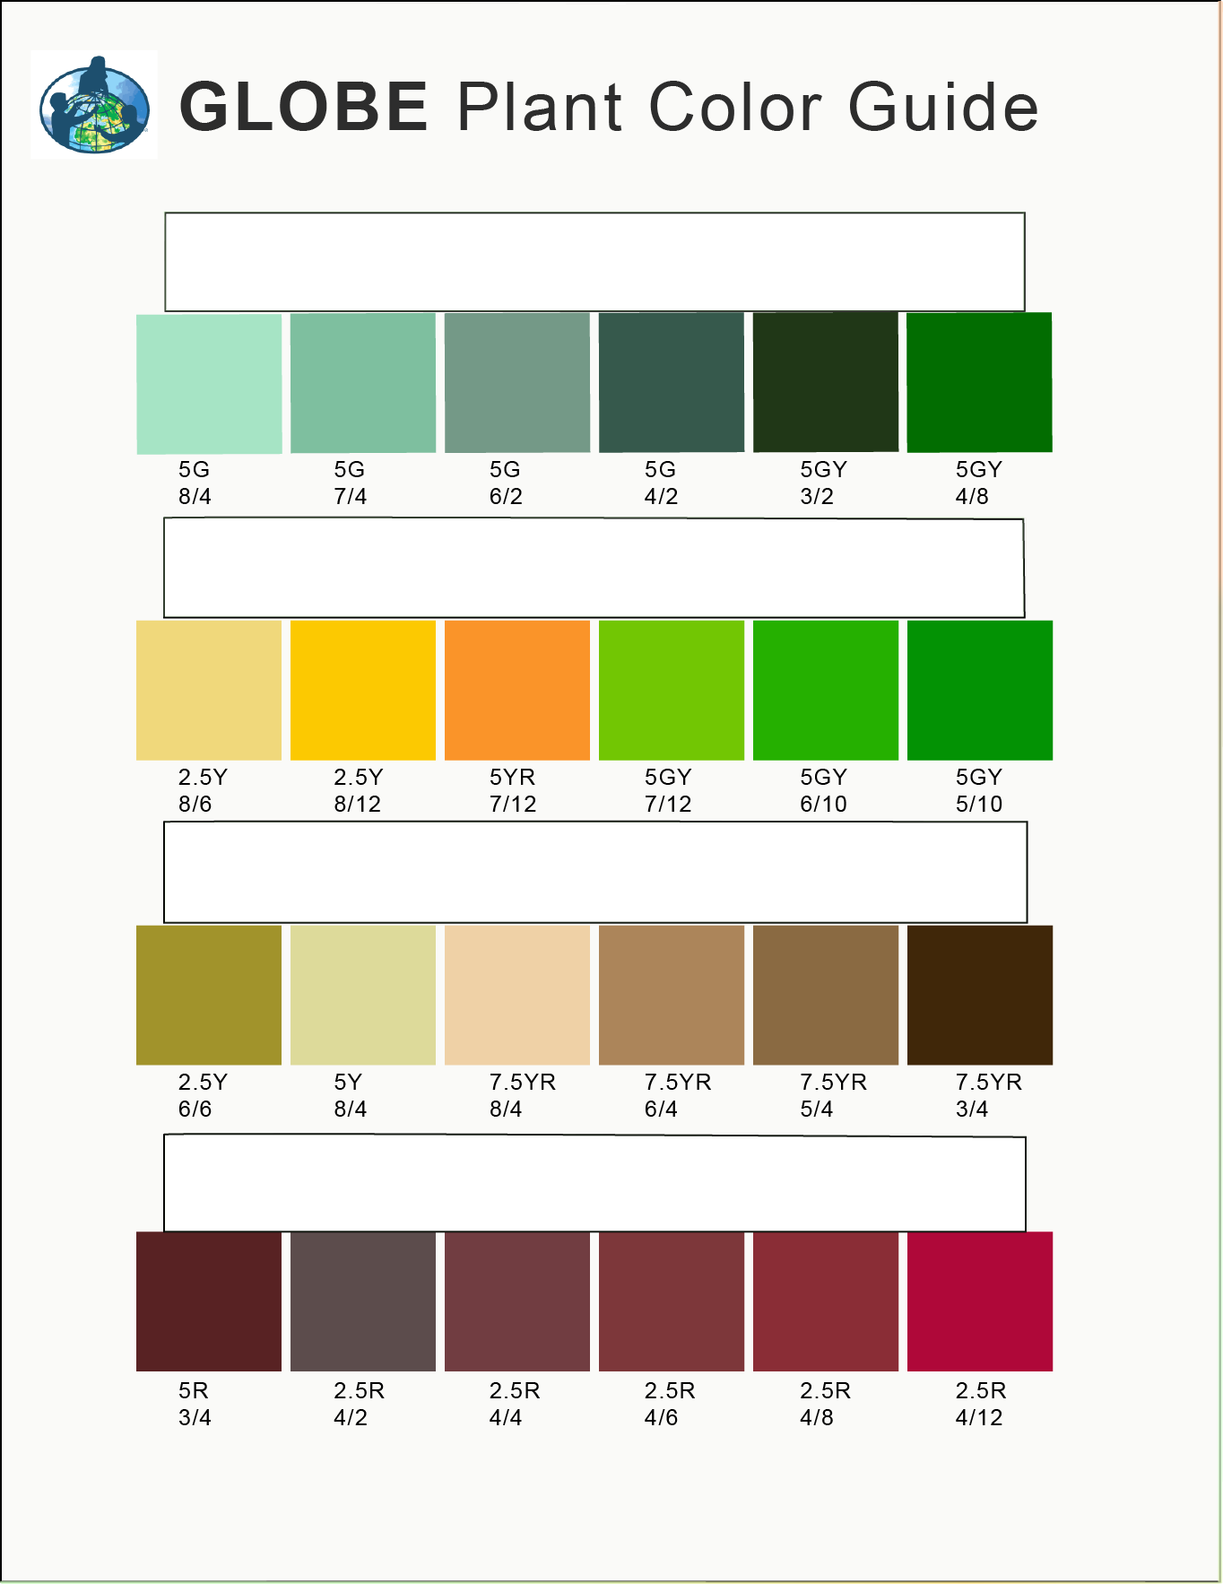
Every Visit: Green-Down Grasses
Examine each of your four grass shoots. For each shoot, use the GLOBE Plant Color Guide to estimate the dominant color percentage of each shoot. For example, if shoot #1 appears colored at 60 percent 5G 7/12 and 40 percent 2.5 Y8/10, record the shoot color as 5G 7/12 for that observation date.
Record your observations for each shoot on the Tree, Shrub, and Grass Green-Down Data Sheet.
If leaf is snow covered, report “snow covered”;
If leaf has fallen, report “fallen” and stop reporting after that;
Otherwise, continue to report the color until the color stops changing.
You are done!

Slide 25
Grass Green-Down Data Sheet r
Fill in the top portion of the data sheet.
Because of the possibility of multiple growing seasons in a year, we are asking you to report which cycle you are observing. If thee is only one cycle, then you report green-up cycle 1. The onset of the first green-down after 1 January is considered green-up cycle 1.

Slide 26
Example of Completed Data Sheet

Slide 27
Let’s review so far! Question 4
When selecting a phenology site, you want to be sure it is accessible and easy to visit, and that you collect data that can be examined in the context of other GLOBE data you might collect. GLOBE recommends that you place your site as close to your other study sites as possible, and no further than:
2 km from your Atmosphere or Soil (Pedosphere) investigation sites
100 m difference in elevation from your Atmosphere or Soil study sites
Both A and B
Neither A nor B: you must collect your data at your Biosphere Land Cover study site.
What is the answer?

Slide 28
Let’s review so far! Answer to question 4
When selecting a phenology site, you want to be sure it is accessible and easy to visit, and that you collect data that can be examined in the context of other GLOBE data you might collect. GLOBE recommends that you place your site as close to your other study sites as possible, and no further than:
2 km from your Atmosphere or Soil (Pedosphere) investigation sites
100 m difference in elevation from your Atmosphere or Soil study sites
Both A and B- correct ☺
Neither A nor B: you must collect your data at your Biosphere Land Cover study site.
Were you correct?

Slide 29
Let’s review so far! Question 5
How do you ensure that you look at the same blades of grass as you monitor green-down?
Take a GPS reading of the grass blade.
Mark the blades with small dots, with the longest blade marked with one dot, the second longest with two dots, and so on.
What is the answer?

Slide 30
Let’s review so far! Answer to Question 5
How do you ensure that you look at the same blades of grass as you monitor green-down?
Take a GPS reading of the grass blade.
Mark the blades with small dots, with the longest blade marked with one dot, the second longest with two dots, and so on.- correct ☺
Were you correct? Now let’s look at GLOBE Data Entry and Visualization

Slide 31
Report Your Data to GLOBE
Live Data Entry: Upload your data to the official GLOBE science database.
Email Data Entry: Send data in the body of your email (not as an attachment) to DATA@GLOBE.GOV.
Mobile Data App: Download the GLOBE Science Data Entry app to your mobile device and select the right option.
For Android via Google Play
For IOS via the App Store

Slide 32
Entering your data via Live Data Entry or Data Entry Mobile App- Screen 1

Slide 33
Entering your data via Live Data Entry or Data Entry Mobile App- Screen 2

Slide 34
Visualize and Retrieve Data- Step 1
GLOBE provides the ability to view and interact with data measured across the world. Select our visualization tool to map, graph, filter and export Green-Up data that have been measured across GLOBE protocols since 1995.
Click “Add” and dropdown menu will appear. Select green-down.
Link to step-by-step tutorials on Using the Visualization System will assist you in finding and analyzing GLOBE data: PDF version

Slide 35
Visualize and Retrieve Data- Step 2
Select the date for which you need Green-Down data, add layer, and you can see locations where data is available.

Slide 36
Visualize and Retrieve Data- Step 3
Clicking on a location will open to a map note providing Green-Down data for that location and time. Follow instructions in the tutorial to download data as a .csv file for analysis.

Slide 37
Review questions to help you prepare to do the Grass Green-Down Measurements associated with the GLOBE Biometry Protocols
Grass Green-Down measurements are part of what GLOBE Protocol area or Earth system sphere?
What is phenology?
Why is it important for scientists to know when green-down takes place in a location, year by year?
With respect to Green-Up and Green-Down, when is the plant growing season?
Green-down is a metabolic response to what changes in a plant’s environment?
Why is green-down data useful for scientists and what does it tell us about changes in the Earth system?
Why do we use the GLOBE plant color guide when monitoring Green-Down?
When do you start and stop your grass green-down measurements?
How do you identify the grass leaves you are monitoring, so you can return to the same leaves throughout the green-down phase of the plant growth cycle?
Why is it important to measure green-down of grasses in a natural habitat, rather than in a lawn or a crop field?

Slide 38
Congratulations!
You have now completed the slide stack. If you are ready to take the quiz, sign on and take the quiz corresponding to the Grass Green-Down Protocol.
You can also review the slide stack, post questions on the discussion board, or look at the FAQs on the next page.
When you pass the quiz, you are ready to take Grass Green-Down Protocol measurements! Welcome to the GLOBE phenology community!

Slide 39
Research Questions for Investigation:
What other animals (butterflies, waterfowl, songbirds) migrate after plants green-down? When? Why?
Does the timing of green-down occur earlier or later at higher elevations in your region? Why?
Does the timing of green-down occur earlier or later inland or near the coast in your region? Why?
How do fallen plant leaves affect soil properties such as soil color, water-holding capacity, and soil nutrients? How could you find out? Why is this important?

Slide 40
FAQ: Frequently Asked Questions
Should I use the same leaves I used for green-up?
If possible, use the same grass plot. If you use other plants, try to select plants of the same species. If the plants you use for green-down are at a different location than the ones you used for green-up, then define a new site.
Do you have any tips how to locate the same grass blade and make measurements throughout the observation period?
The best way to locate the grass blades is by providing small dots on the leaves you are monitoring, according to the protocol. Next to the grass blade, mark this area with some flagging tape on a wire or other way so that the area can be located easily throughout the observation period.

Slide 41
Please provide us with feedback about this module. This is a community project and we need and welcome your comments, suggestions and edits! Comment here: eTraining Feedback Questions about the content of this module? Contact GLOBE: help@globe.gov
Credits
Slides:
Russanne Low, Ph.D., University of Nebraska-Lincoln, USA
Rebecca Boger, Ph.D., Brooklyn College, NYC, USA
Cover Art: Jenn Glaser, ScribeArts
More Information:
The GLOBE Program
NASA Wavelength NASA’s Digital Library of Earth and Space Education Resources
NASA Global Climate Change: Vital Signs of the Planet
The GLOBE Program is sponsored by these organizations:
Version 2/21/20. If you edit and modify this slide set for use for educational purposes, please note “modified by (and your name and date “ on this page.

