Slide 1
Slide One

Slide 2
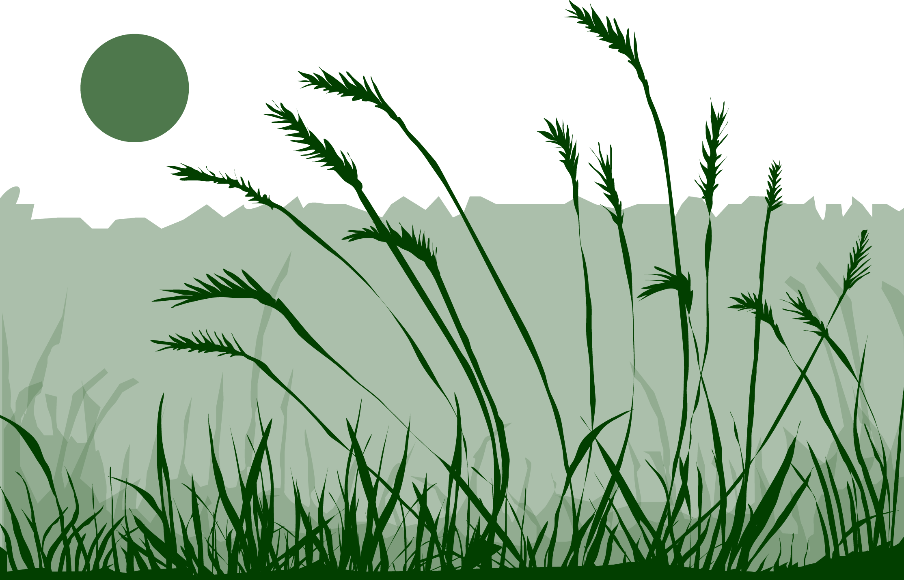
Overview
This module:
Describes how to select and define a GLOBE Phenology Protocol Study Site
Provides a step by step introduction of the protocol method
Learning Objectives
After completing this module, you will be able to:
Define phenology and what is meant by grass green-up
Describe the importance of quality control steps in the collection of accurate data
Describe why green-up data is important for understanding our changing Earth system
Identify a grass green-up study site and conduct measurements in the field
Upload data to the GLOBE portal
Visualize data using GLOBE’s Visualization Site
Estimated time to complete module 1.5 hours

Slide 3
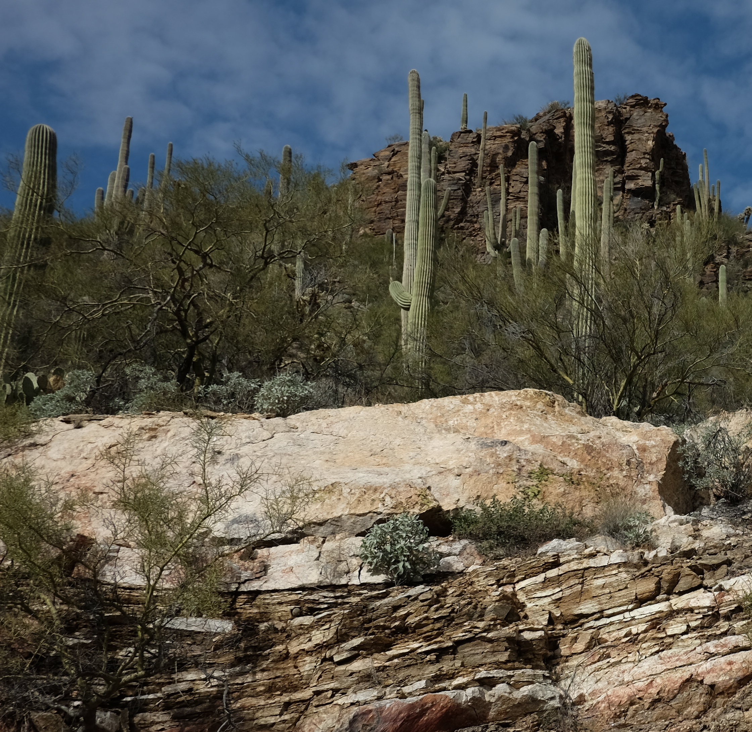
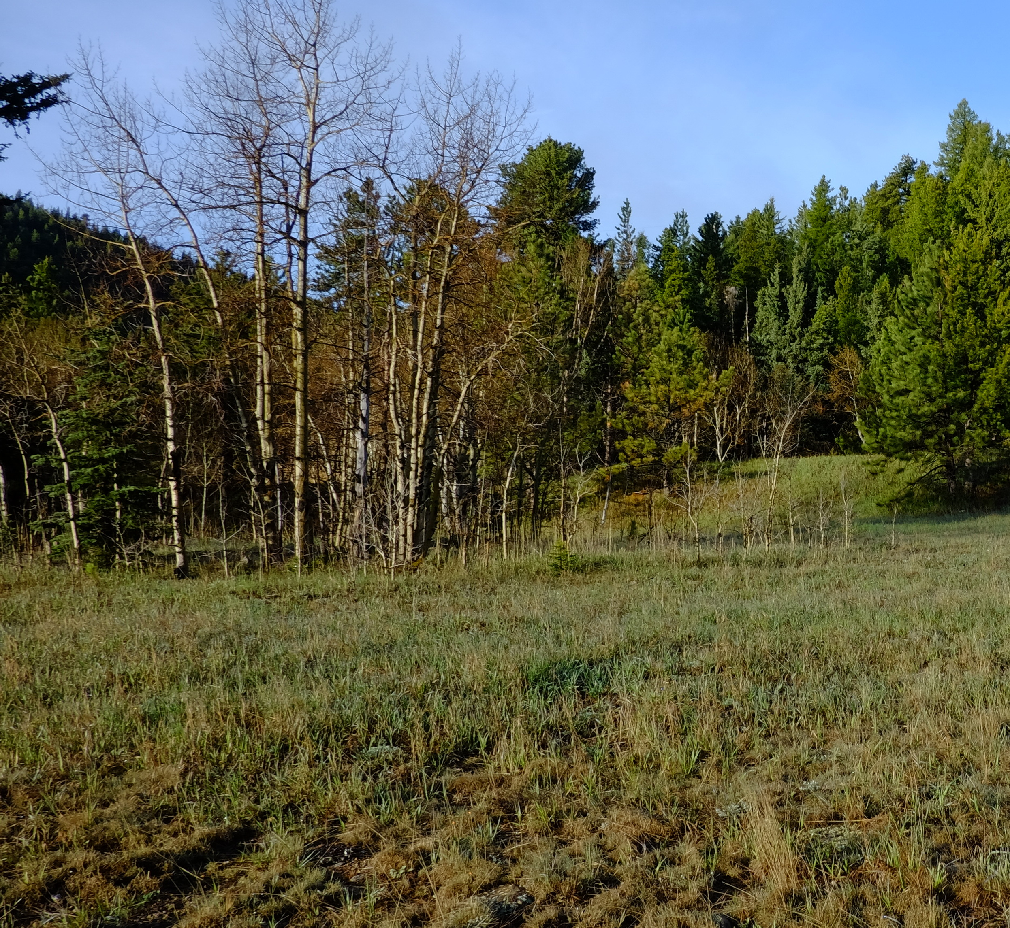
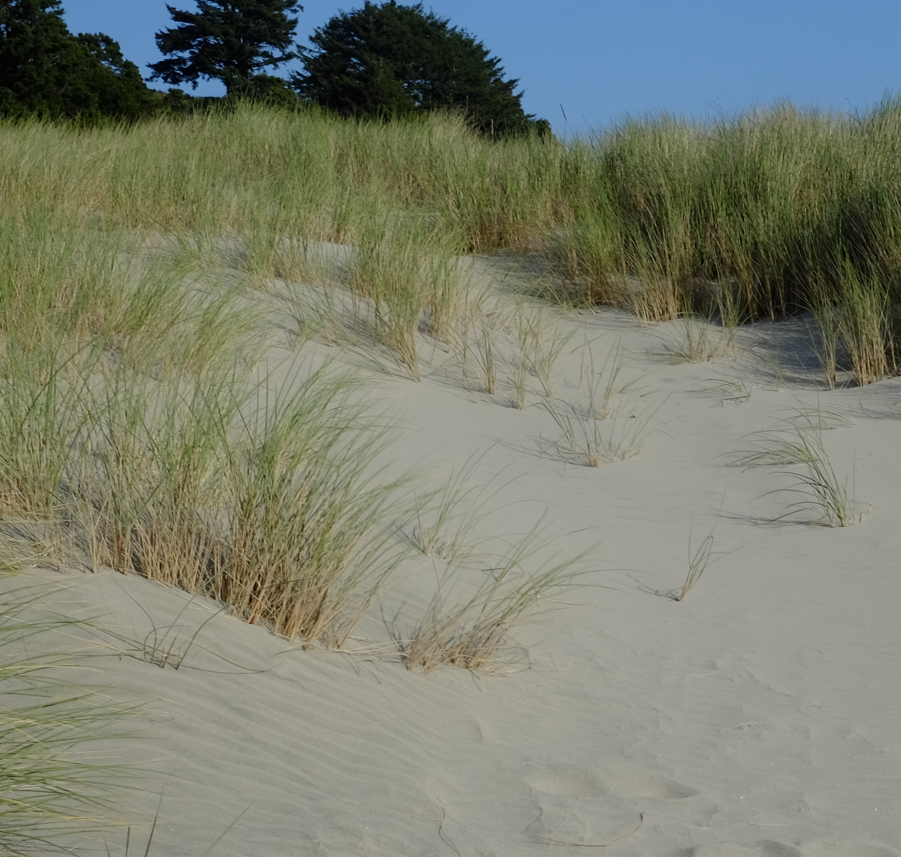
The Biosphere
The Biosphere is Earth’s zone of life. Every organism on Earth belongs to the biosphere. GLOBE has several ways to explore and measure components of the Biosphere through investigations in land cover and phenology. As well, the Hydrosphere investigations include the macroinvertebrates and mosquito larvae protocols.
Tree and Shrub Green-Up is one of the GLOBE phenology protocols.
You can found more information in:
Biosphere Introduction
Photo Credit: Shelley E. Olds

Slide 4
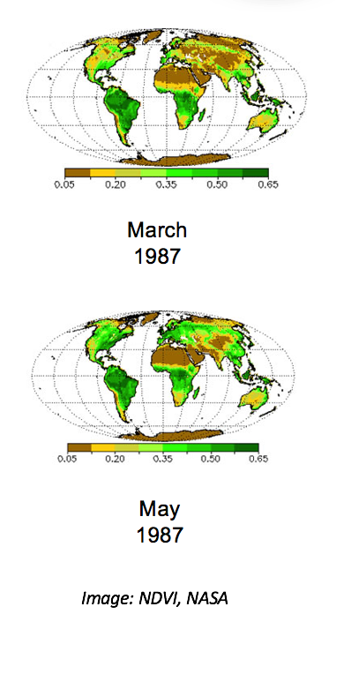
What is Green- Up?
Phenology is the study of living organisms’ response to seasonal and climatic changes in the environment in which they live. You can study the phenology of plants or animals.
The plant growing season is the period between green-up and green-down.
Plant green-up is initiated when dormancy (a state of suspended growth and metabolism) is broken by environmental conditions such as longer hours of sunlight and higher temperatures in temperate regions, or rains and cooler temperatures in desert areas.

Slide 5
Why Collect Green-Up Data?
Scientists are very interested in knowing when leaves appear in spring and how quickly they expand. The timing and rate of fall leaf changes, such as color changes and leaf drop, are also important. These plant phenological events are directly related to global carbon fixation and the amount of carbon dioxide in the atmosphere. Also, they affect and are affected by air temperature and humidity, as well as soil moisture. Green-up data are used by scientists:
To calculate growing season length and monitor interannual changes in growing season duration.
To determine how environmental conditions such as air and soil temperature, precipitation, soil moisture, and day length affect plant growth.
To monitor the nature and extent of climate change and its effects on plants and animals.
To help interpret satellite observations of greenness.
In climate and ecological models, and to predict forested or grassland area susceptibility to fire.

Slide 6
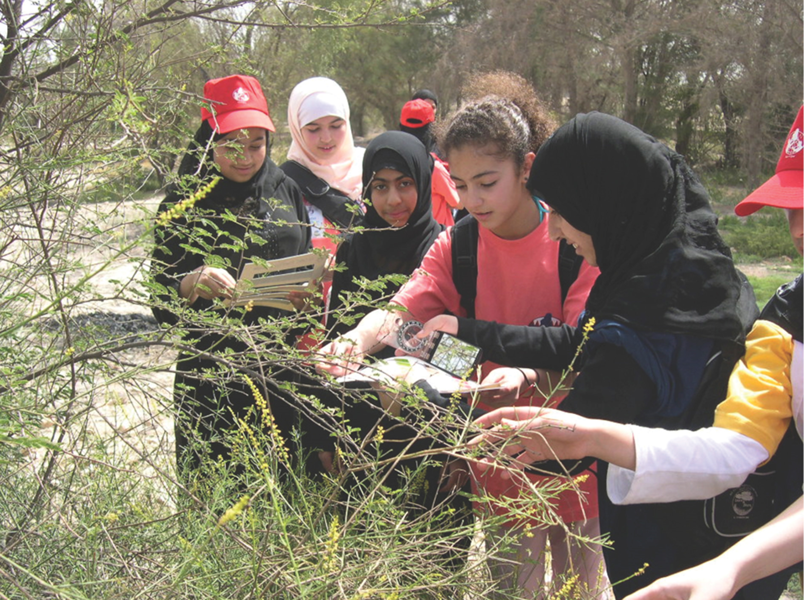
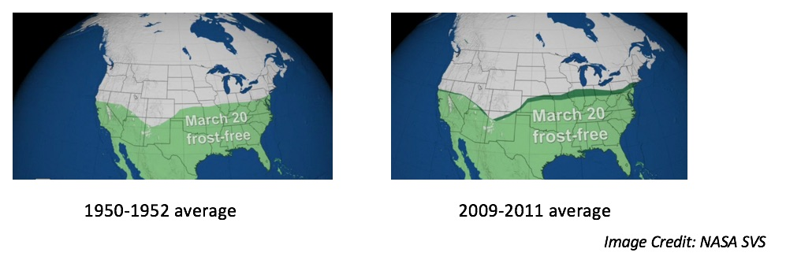
How Your Measurements Can Help
Monitoring the length of the growing season is important for society so that it can better adapt to variations in the length of the growing season and to other impacts of climate change, which may affect food production, economic growth, and human health.
Here is a link to a scientific visualization that shows changes in early spring frost-free regions, comparing average values in the early 1950s with the late 2000s:

Slide 7
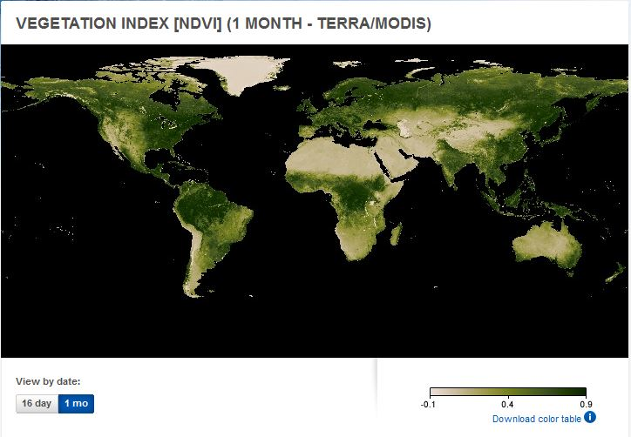
Green-Up data help scientists to interpret satellite images
Many scientists use data from a NASA sensor, the Moderate Resolution Imaging Spectrometer (MODIS), to monitor the seasonal dynamics of vegetation. Green-up/green-down data gathered by GLOBE students, using consistent methods all over the world, are one of the best tools with which to verify the accuracy of these satellite products.
The Normalized Difference Vegetation Index is the analysis of the greenness of Earth viewed from space through the examination of two different spectral wavelengths of light (near infrared and red). Scientists can use these data to track major changes in the density of Earth’s vegetation; they can also use these data to study changes in plant growth as a result of climate and environmental changes, as well as human activity.
See where green-down begins in your area here. Page through the monthly changes in net primary production to see where green gives way to brown, and identify the time frame you will want to begin your observations.

Slide 8
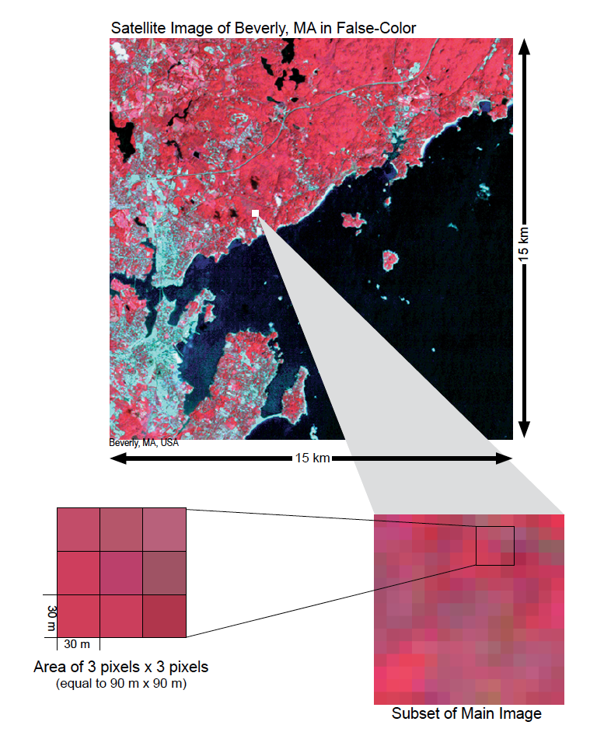
Scientific Importance of Green-Up and Green-Down
Remote sensing from space has the great advantage of being able to cover very large areas quickly and to revisit the same area frequently. However, some of the detail that can be seen at ground level may not be detected by a remote sensing system.
Scientists need the data collected at sample sites on the ground to interpret remotely sensed data about an area. It is not possible to effectively visit every place on Earth to map the land cover. Instead, we rely on samples – actual ground visits – and relate these samples to what we can see using various remote sensing systems.
As you zoom in on a 15 km x 15 km satellite image, the pixels (which are 30 m x 30 m in size) become visible. You will be taking field measurements at sites that are 90 m x 90 m (equal to 3 pixels x 3 pixels).

Slide 9
Let’s do a quick review before moving onto data collection! Question 1
1. What part of the Earth system is known as the zone of life?
A. Atmosphere
B. Biosphere
C. Lithosphere
D. Hydrosphere
Do you know the answer?

Slide 10
Let’s do a quick review before moving onto data collection! Answer to Question 1
1. What part of the Earth system is known as the zone of life?
A. Atmosphere
B. Biosphere- correct ☺
C. Lithosphere
D. Hydrosphere
Were you correct?

Slide 11
Let’s do a quick review before moving onto data collection! Question 2
True or False: In every part of the world, there is one green-up and green-down cycle.
Do you know the answer?

Slide 12
Let’s do a quick review before moving onto data collection! Answer to Question 2
True or False: In every part of the world, there is one green-up and green-down cycle. False
Were you correct?

Slide 13
Let’s do a quick review before moving onto data collection! Question 3
Why are scientists interested in green-up data? The data can be used:
to help interpret satellite observations of greenness, such as imagery of the Normalized Difference Vegetation Index (NDVI)
to determine how environmental conditions affect plant growth
to calculate changes in growing season length and onset over years
to monitor the nature and extent of climate change and its effects on plants and animals
all of the above
only A and B
Do you know the answer?

Slide 14
Let’s do a quick review before moving onto data collection! Answer to Question 3
Why are scientists interested in green-up data? The data can be used:
to help interpret satellite observations of greenness, such as imagery of the Normalized Difference Vegetation Index (NDVI)
to determine how environmental conditions affect plant growth
to calculate changes in growing season length and onset over years
to monitor the nature and extent of climate change and its effects on plants and animals
all of the above –correct ☺
only A and B
Were you correct? Let’s now look at data collection.

Slide 15
Overview of the Grass Green-Up Protocol
When | Select your site at least 2 weeks before green-up begins. For grasses, the start of Green-Up occurs when any initial green grass shoot is first observed.
Where | You will need to make your observations in a one-meter square that is dominated by grass plants.
Time Needed | 10-15 minutes per measurement. Frequency of observations: Ideally, visit plant at least two times a week to check for the start of green-up and continue observing until leaf growth plateaus.
Prerequisites | None
Primary Instrument | Metric ruler
Skill level | All
References | Site Definition Sheet Grass Green-Up Protocol Field Guide Green-up data sheet
* Because of the possibility of multiple growing seasons in a year, we are asking you to report which cycle you are observing. If there is only one cycle, then you report green-up cycle 1. The onset of the first green-down after 1 January is considered green-up cycle 1.

Slide 16
Equipment and Documents Needed
First Visit Only
Fine tip permanent marker
Camera
Compass
Every Visit
Pencil or pen
Fine tip permanent marker
Ruler with mm units
Documents Needed in the Field
Site Definition Sheet
Tree and Shrub Green-Up and Green-Down Site Selection
Grass Green-up Protocol Field Guide
Green-up data sheet

Slide 17
Site Selection
Site selection is important. Choose a site that contains plants indicative of the surrounding climate. You will need to make your observations in a one-meter square that is dominated by grass plants.
Native species
Not watered or fertilized
Away from buildings
NOTE:. To determine if the plant is too close to a building, stand at the plant and sight the top of the building through your clinometer. If the angle is greater than 45˚, the building is too close. You do not want the plant to be closer to the building than it is tall.

Slide 18
Other Site Selection Considerations
Deciduous trees or shrubs, or grasses. Select one or more species that are common in your area. Think from the perspective of a satellite – what is the satellite “seeing”?
Select a site close to an atmosphere or soil moisture site, if possible. Ideally, it should be less than 2 km from your atmosphere or soil moisture site, and have an elevation difference less than 100 meters. Why is this important?
Local topography affects weather significantly.
Accessibility. Choose a site that can be easily visited repeatedly.
Consistency. If possible choose the same plant/s each year.

Slide 19
Grass Green-Up Site Selection-1
In the Field
Complete the Greening portion of the Site Definition Sheet.
Identify genus using field guides or help of plant specialists. Record the genus on the Site Definition Sheet.

Slide 20
Grass Green-Up Site Selection-2
In the Field
Select a one-meter square area dominated by grass plants. Mark your one-meter square plot with nails or stakes or other durable identifiers.
Locate coordinates using the GPS Protocol.

Slide 21
Grass Green-Up Data Sheet
Fill in the top portion of the data sheet

Slide 22
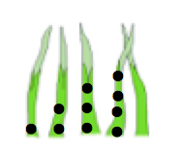
Grass Green-Up: Every Visit-1
Here are the steps:
Look for new green grass shoots.
Mark the base of the first grass shoot with a single dot, using a permanent felt marker.
Mark the second shoot with two dots, the third with three dots and the fourth shoot with four dots.
Use the ruler to measure the length of the shoots to the nearest millimeter.
Measure the leaves at regular intervals until the leaf length stops increasing.

Slide 23
Grass Green-Up Every Visit-2
Options for state of leaf:
Report “no shoot” before the leaves of grass can be seen.
Measure the length in millimeters after the shoot appears.
Report “lost” if something happens to the marked leaves.

Slide 24
Example of Completed Data Sheet

Slide 25
Let’s review so far! Question 4
When selecting a phenology site, you want to be sure it is accessible and easy to visit, and that you collect data that can be examined in the context of other GLOBE data you might collect. GLOBE recommends you place your site as close to your other study sites as possible, and no further than:
2 km from your Atmosphere or Soil (Pedosphere) investigation sites
100 m difference in elevation from your Atmosphere or Soil study sites
Both A and B
Neither A nor B: you must collect your data at your Biosphere Land Cover study site.
What is the answer?

Slide 26
Let’s review so far! Answer to Question 4
When selecting a phenology site, you want to be sure it is accessible and easy to visit, and that you collect data that can be examined in the context of other GLOBE data you might collect. GLOBE recommends you place your site as close to your other study sites as possible, and no further than:
2 km from your Atmosphere or Soil (Pedosphere) investigation sites
100 m difference in elevation from your Atmosphere or Soil study sites
Both A and B- correct ☺
Neither A nor B: you must collect your data at your Biosphere Land Cover study site.
Were you correct?

Slide 27
Let’s review so far before – Question 5
How many grass blades do you need to observe when applying the Grass Green-up Protocol?
All the blades in a 1 m sample grid
10 blades of grass within the sample grid
4 blades of grass within the sample grid
1 blade of grass within the sample grid
What is the answer?

Slide 28
Let’s review so far before- Answer to Question 5
How many grass blades do you need to observe when applying the Grass Green-up Protocol?
All the blades in a 1 m sample grid
10 blades of grass within the sample grid
4 blades of grass within the sample grid – correct ☺
1 blade of grass within the sample grid
Were you correct?

Slide 29
Report Your Data to GLOBE
Live Data Entry: Upload your data to the official GLOBE science database
Email Data Entry: Send data in the body of your email (not as an attachment) to DATA@GLOBE.GOV
Mobile Data App: Download the GLOBE Science Data Entry app to your mobile device and select the right option.
For Android via Google Play
For IOS via the App Store

Slide 30
Entering your data via Live Data Entry or Data Entry Mobile App-1

Slide 31
Entering your data via Live Data Entry or Data Entry Mobile App-2

Slide 32
Visualize and Retrieve Data-1
GLOBE provides the ability to view and interact with data measured across the world. Select our visualization tool to map, graph, filter and export Green-Up data that have been measured across GLOBE protocols since 1995.
Link to step-by-step tutorials on Using the Visualization System will assist you in finding and analyzing GLOBE data: PDF version

Slide 33
Visualize and Retrieve Data-2
Select the date for which you need Green-Up data, add layer and icons will appear where data for that location is available.

Slide 34
Visualize and Retrieve Data-3
Clicking on a location will open to a map note providing Green-Up data for that location and time. Follow instructions in the tutorial to download data as a .csv file for analysis

Slide 35
Review questions to help you prepare to do the Grass Green-Up Measurements associated with the GLOBE Biometry Protocols
Grass Green-Up measurements are part of what GLOBE Protocol area or Earth system sphere?
What is phenology?
Why is it important for scientists to know when Green-Up takes place in a location, year by year?
Has Green-Up dates changed in North America over the past 70 years?
With respect to Green-Up and Green-Down, when is the plant growing season?
If there is more than one Green-Up season during the year in your region, how do you decide when to measure Green-Up?
How soon before green-up should you identify and prepare your study site?
How often should you monitor your grass shoots during green up?
When do you stop monitoring your grass shoots?
How do you mark the buds so you know to measure the same buds throughout the green-up season?

Slide 36
Congratulations!
You have now completed the slide stack. If you are ready to take the quiz, sign on and take the quiz corresponding to the Grass Green-Up Protocol.
You can also review the slide stack, post questions on the discussion board, or look at the FAQs on the next page.
When you pass the quiz, you are ready to take Grass Green-Up Protocol measurements! Welcome to the GLOBE phenology community!

Slide 37
Research Questions for Investigation:
How long does green-up take for a given species?
How does green-up differ among different species within a forested study area?
How does green-up relate to precipitation? To soil moisture?
Does temperature influence the rate of green-up?

Slide 38
FAQ: Frequently Asked Questions
How do I mark the grass shoots if they start on the same day?
Mark the base of the four longest grass shoots that appear at the earliest date.
What do I do if on the first day I see shoots, I see more than four? How do I select the shoots to study?
Mark the base of the four longest grass shoots that appear on the first day.
What if there are grass shoots the first day when I go to take a picture of the site?
Mark the base of the four longest grass shoots that are present on this day.

Slide 39
Please provide us with feedback about this module. This is a community project and we need and welcome your comments, suggestions and edits! Comment here: eTraining Feedback Questions about the content of this module? Contact GLOBE: help@globe.gov
Credits
Slides:
Russanne Low, Ph.D., University of Nebraska-Lincoln, USA
Rebecca Boger, Ph.D., Brooklyn College, NYC, USA
Cover Art:
Jenn Glaser, ScribeArts
More Information:
The GLOBE Program
NASA Wavelength NASA’s Digital Library of Earth and Space Education Resources
NASA Global Climate Change: Vital Signs of the Planet
The GLOBE Program is sponsored by these organizations:
Version 2/18/20. If you edit and modify this slide set for use for educational purposes, please note “modified by (and your name and date )“ on this page. Thank you.

