Slide 1
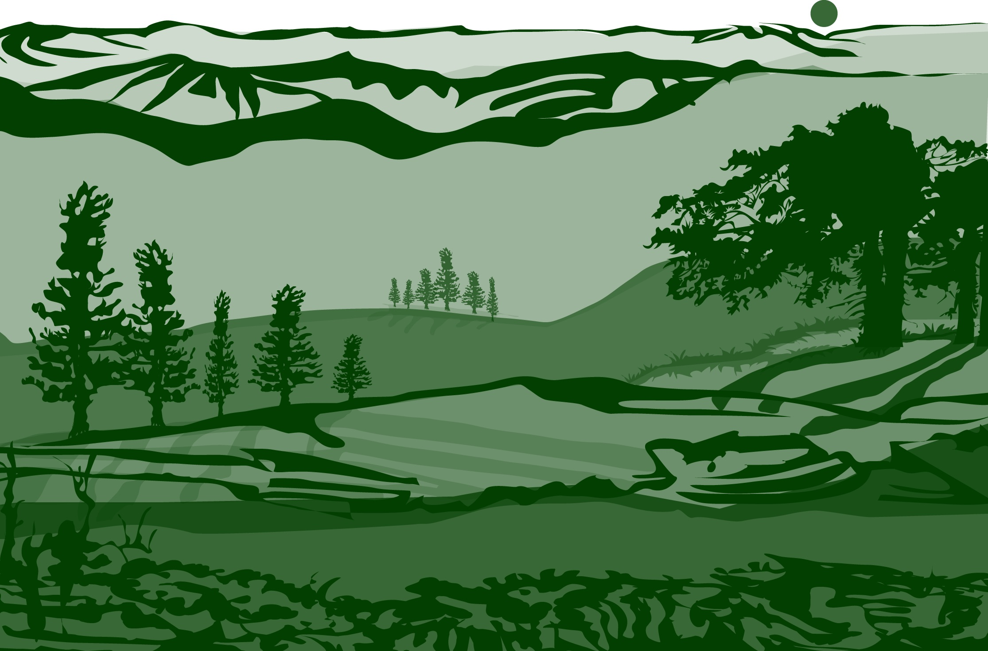
Introduction to Biosphere

Slide 2
Overview and Learning Objectives
This module:
Reviews the GLOBE Biosphere Protocol Area
Introduces the investigations associated with the Biosphere
After completing this module, you will be able to:
Compare and contrast biometry and phenology measurements
Describe how biosphere protocols can support understanding of satellite images
Describe the importance of quality control steps in the collection of accurate data
Explain why the MUC Classification system is used to classify land cover at your study site
Upload data to the GLOBE portal
Visualize data using GLOBE’s Visualization System
Estimated time to complete this module: 1.5 hours

Slide 3
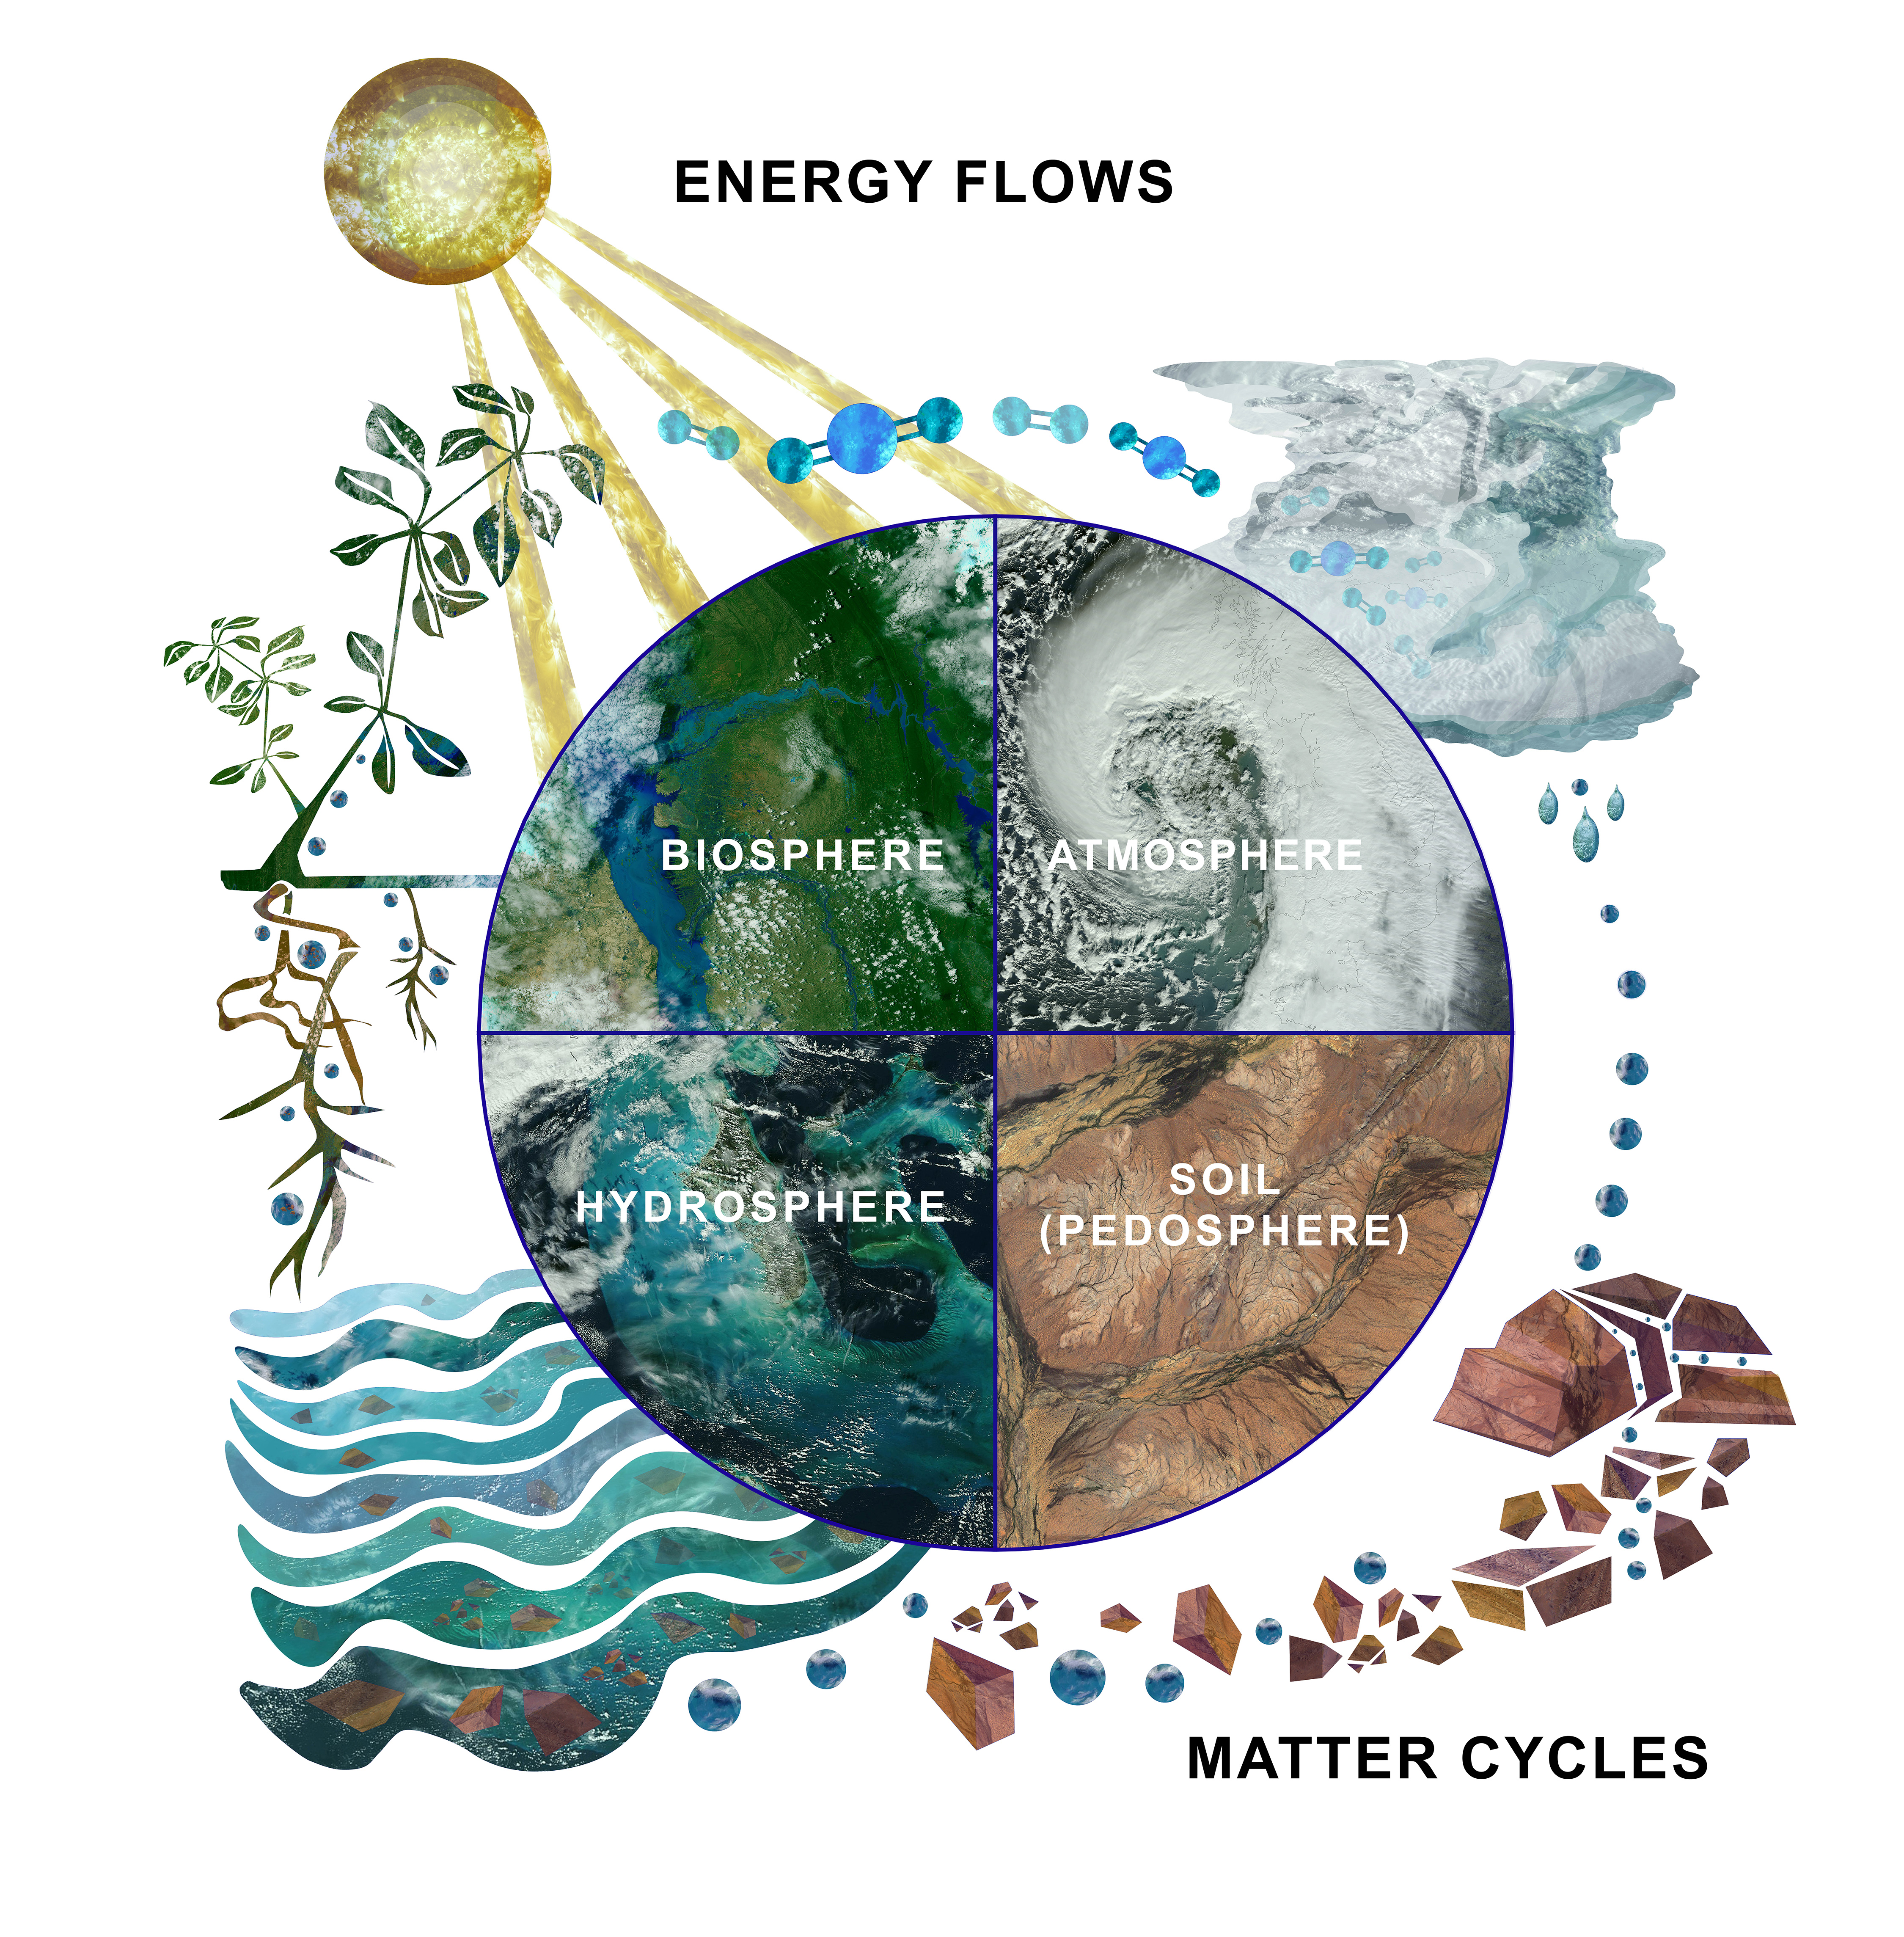
1. Introduction: The Biosphere is Part of the Earth System
The Earth system refers to Earth´s interacting physical, chemical, and biological processes. The system consists of the atmosphere (air), hydrosphere (water), lithosphere (land) and biosphere (life). The biosphere is constantly responding to changes in the Earth system including the biological processes such as ecological succession, the impact of extreme weather and geological events, and community growth responses resulting from a warming global climate. We can quantify these changes by taking measurements over time, and by comparing what we saw in the past to what we see in the present by examining changes in land cover.
Through the GLOBE biosphere protocols, you will describe the land cover at your sampling site, take biometric measurements (biometry), observe responses of common plants and animals to seasonal changes in weather and climate (phenology), and measure carbon storage and plant growth (carbon cycle).
The Earth System: Energy flows and matter cycles.
In the Earth system, everything is connected to everything else.

Slide 4
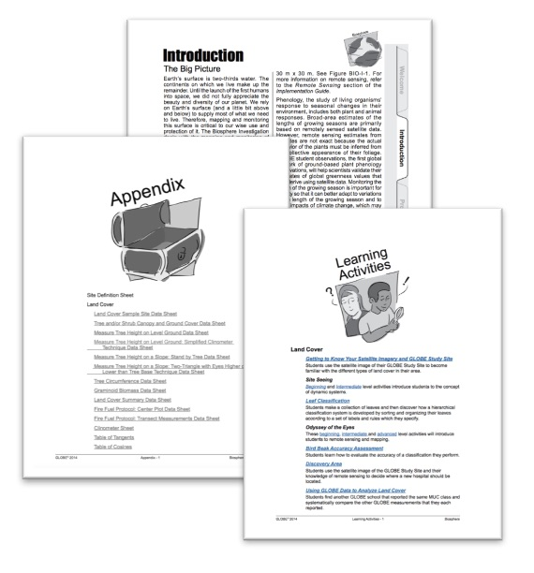
GLOBE’s Biosphere Investigations
Students, volunteers and scientists investigate Earth’s zone of life through GLOBE Biosphere investigations. You will define your study site and collect data using GLOBE protocols. These instructions ensure that you will use the right instruments and procedures so that the data you collect will be comparable to data collected by others around the world.
You also have access to Learning Activities, which aid in the understanding of important scientific concepts, data collection methodologies, and procedures for analysis. The Biosphere Investigation area of the GLOBE Teacher’s Guide has links to all the biosphere protocols covered in this module. There is a separate document with classroom learning activities supporting the biosphere investigations. The Appendix contains data sheets for all the biosphere protocols.
GLOBE Biosphere Teacher’s Guide
Biosphere Learning Activities

Slide 5
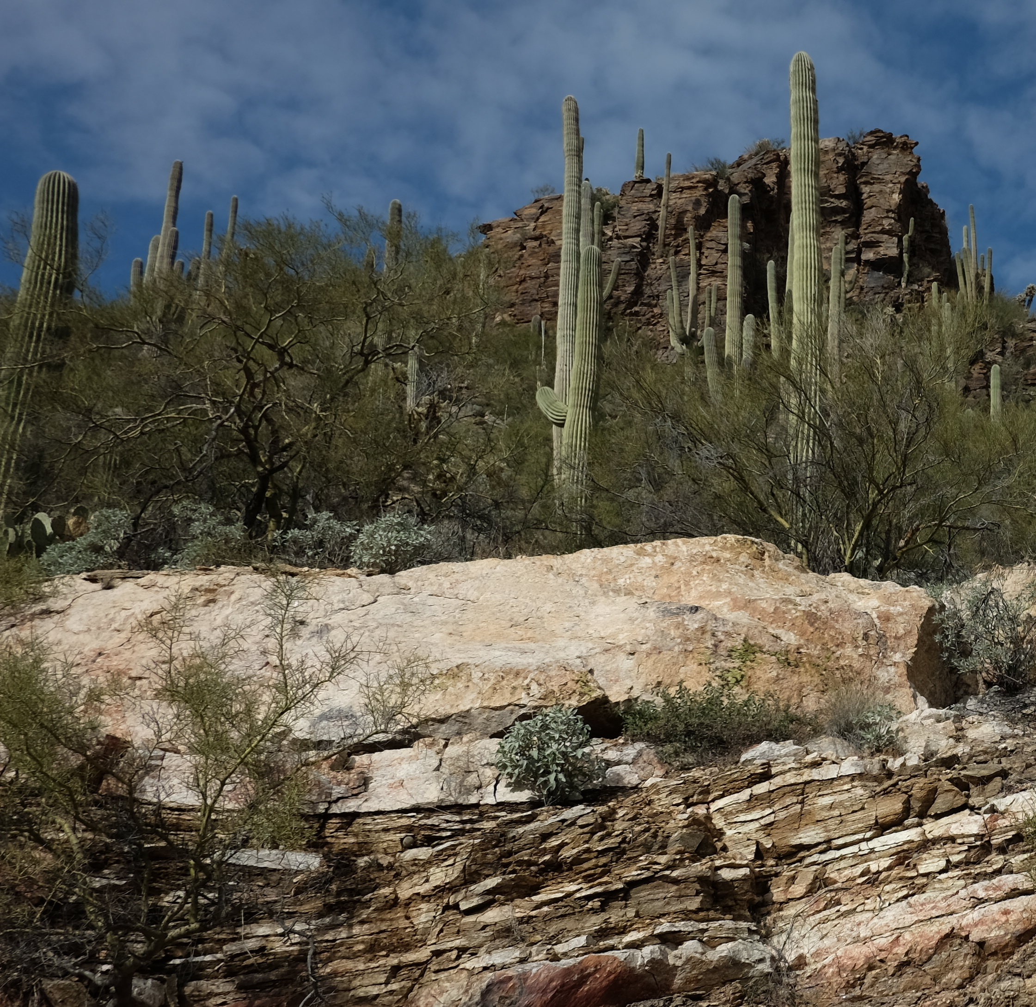
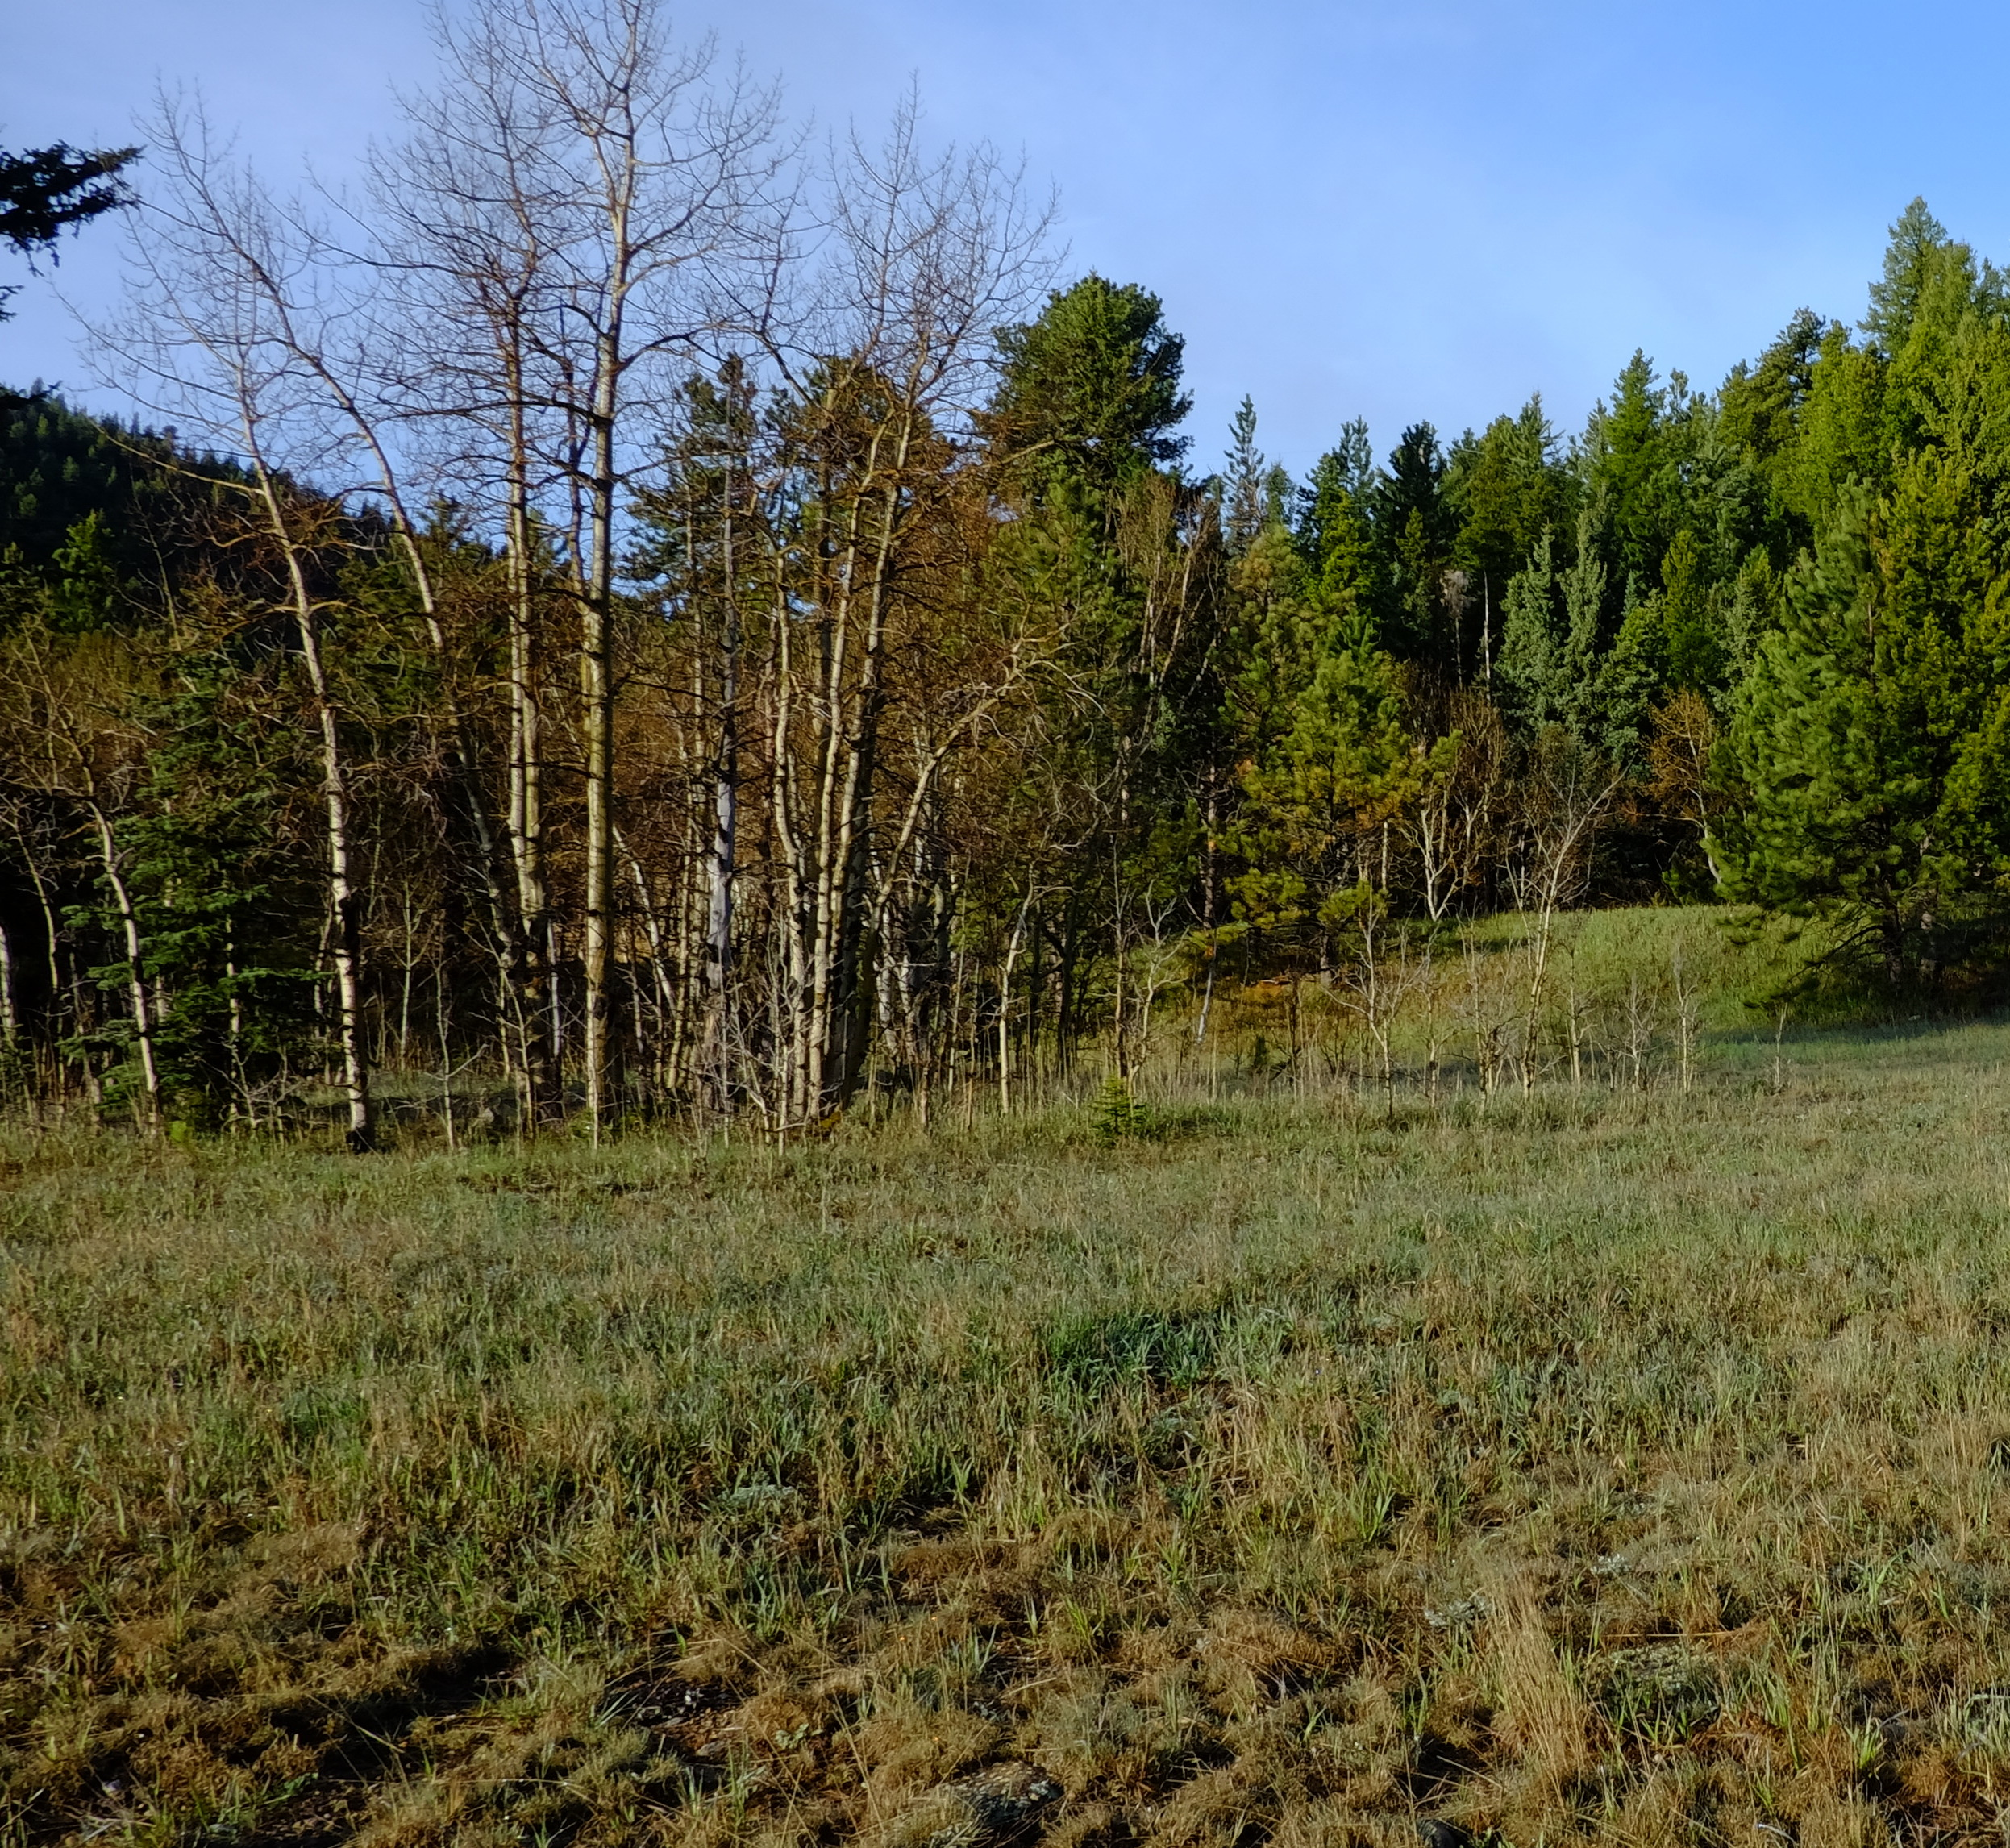
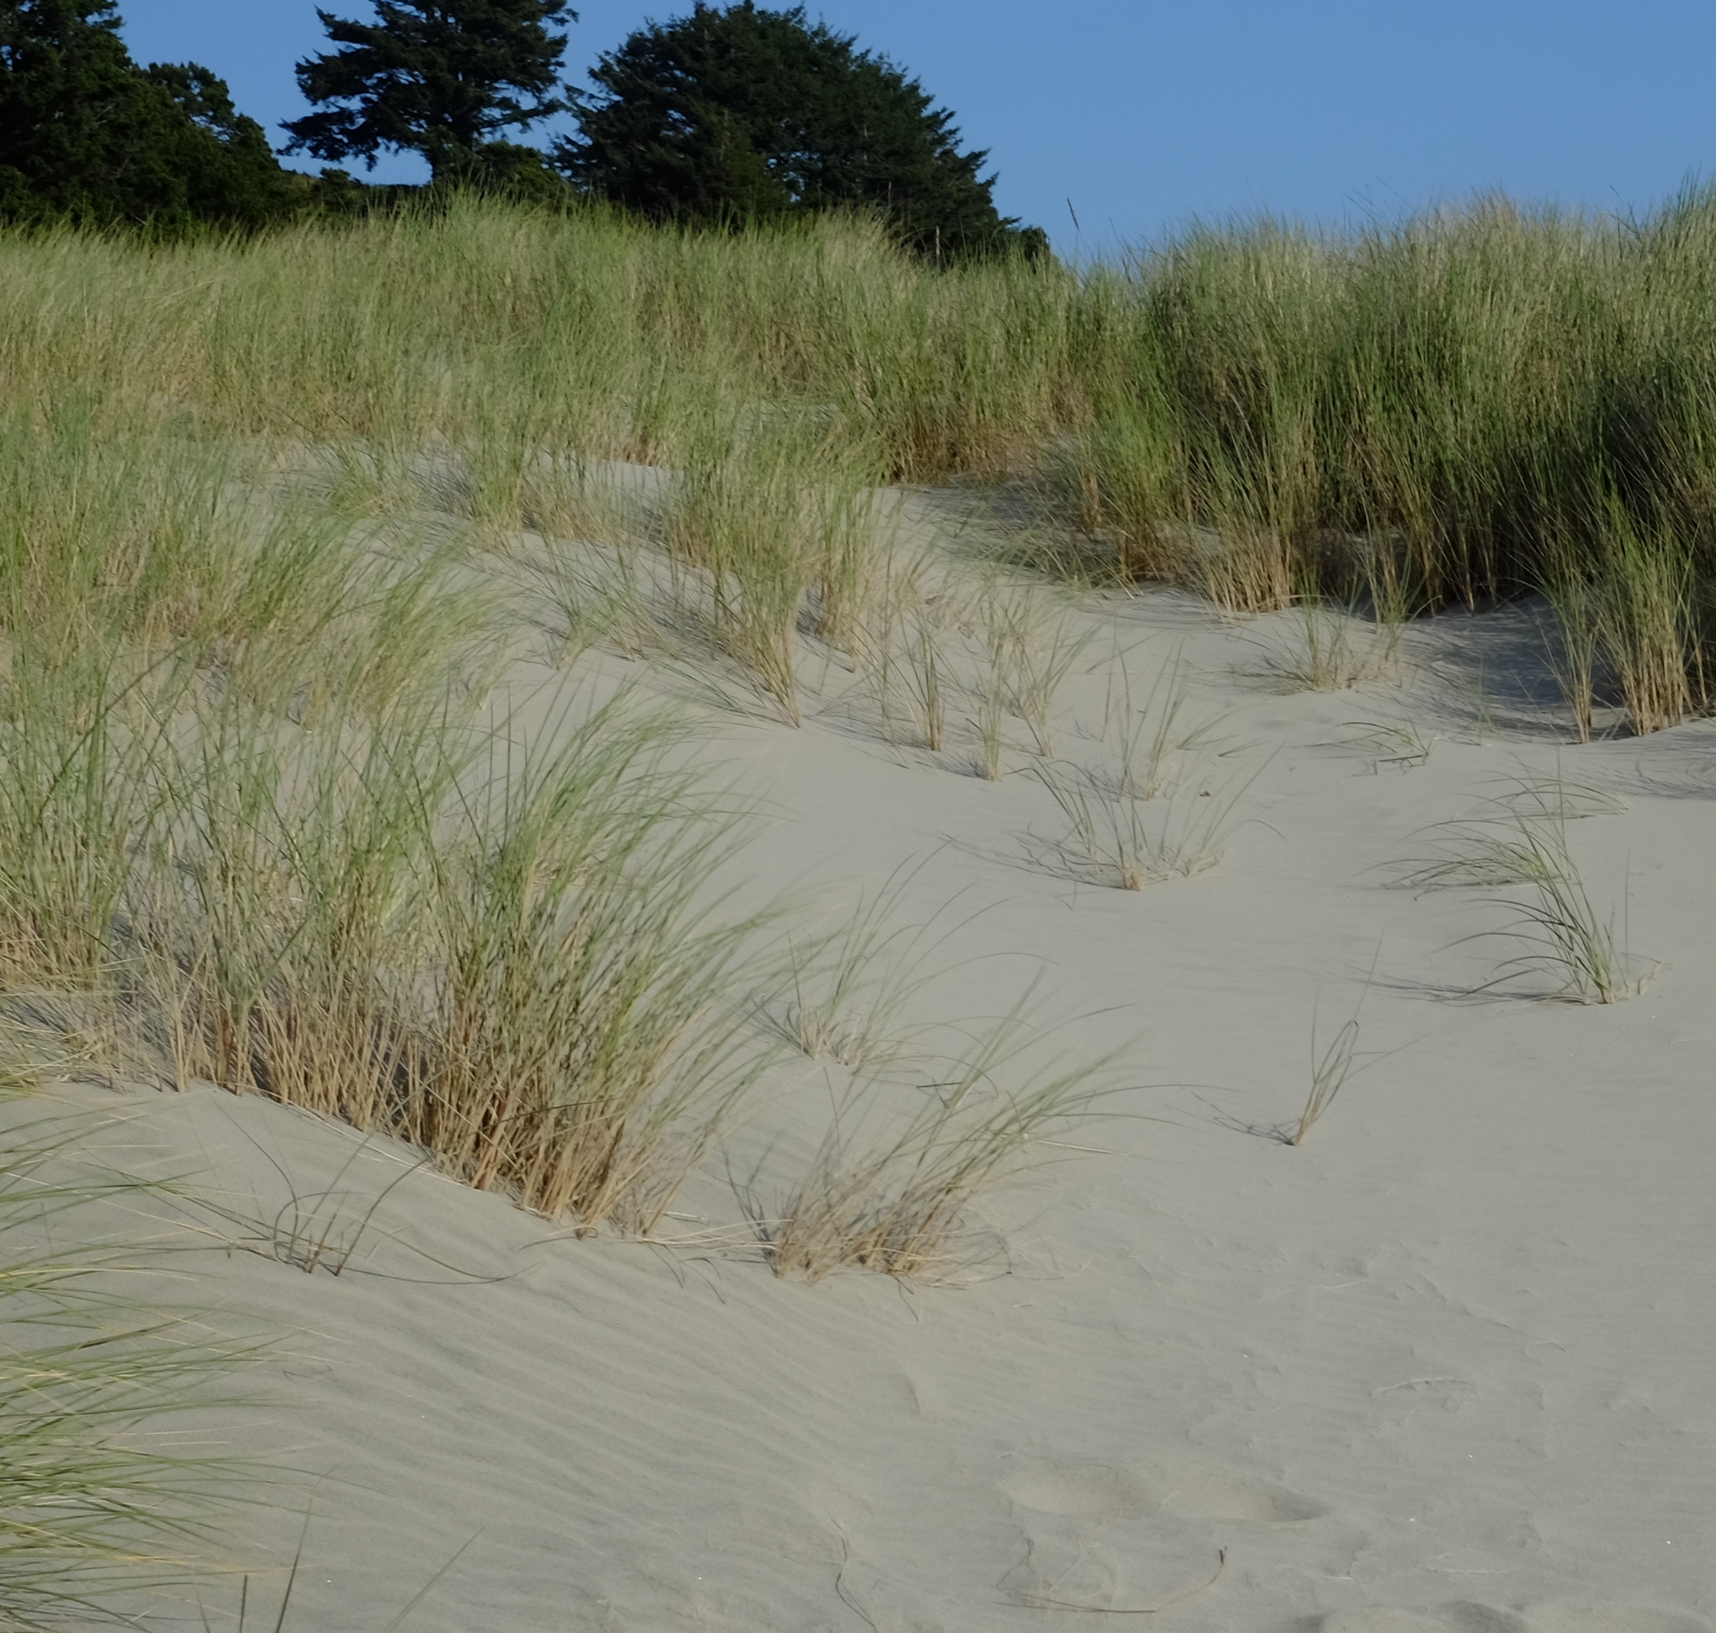
What is the Biosphere?
The Biosphere is Earth’s zone of life. Every organism on Earth belongs to the biosphere.
Some GLOBE Biosphere protocols are directed at describing the land cover at your Biosphere Sample Site. These are the Biometry Protocols. Biometry is the term used to describe the measurement and analysis of biological phenomena.
Other biosphere protocols address the phenology of common organisms. Phenology is is the study of life cycle events in organisms and how these are influenced by seasonal and interannual variations in climate.
Some biosphere protocols assess the plant growth and carbon storage in a Sample Site. These Carbon Cycle protocols allow you to monitor changes in vegetation over time.
* You will find a few other investigations examining life forms in the Hydrosphere protocol area. These include the examination of freshwater invertebrates and mosquito larvae.

Slide 6
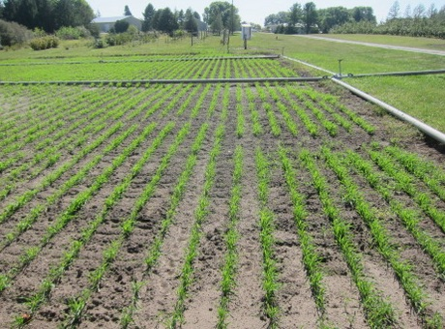
Why are GLOBE Biosphere investigations important?
NASA research is advancing Earth system science to meet the challenges of climate and environmental change. One of their overarching science goals is to detect and predict changes in Earth’s ecosystems and biogeochemical cycles, including land cover, biodiversity, and the global carbon cycle.
Current environmental changes in the Earth system are unprecedented, in both timing and geographical extent. These changes will have profound implications for future climate, food production, biodiversity and sustainable resource use.
Frost-free and growing seasons are getting longer. Source: NASA.

Slide 7
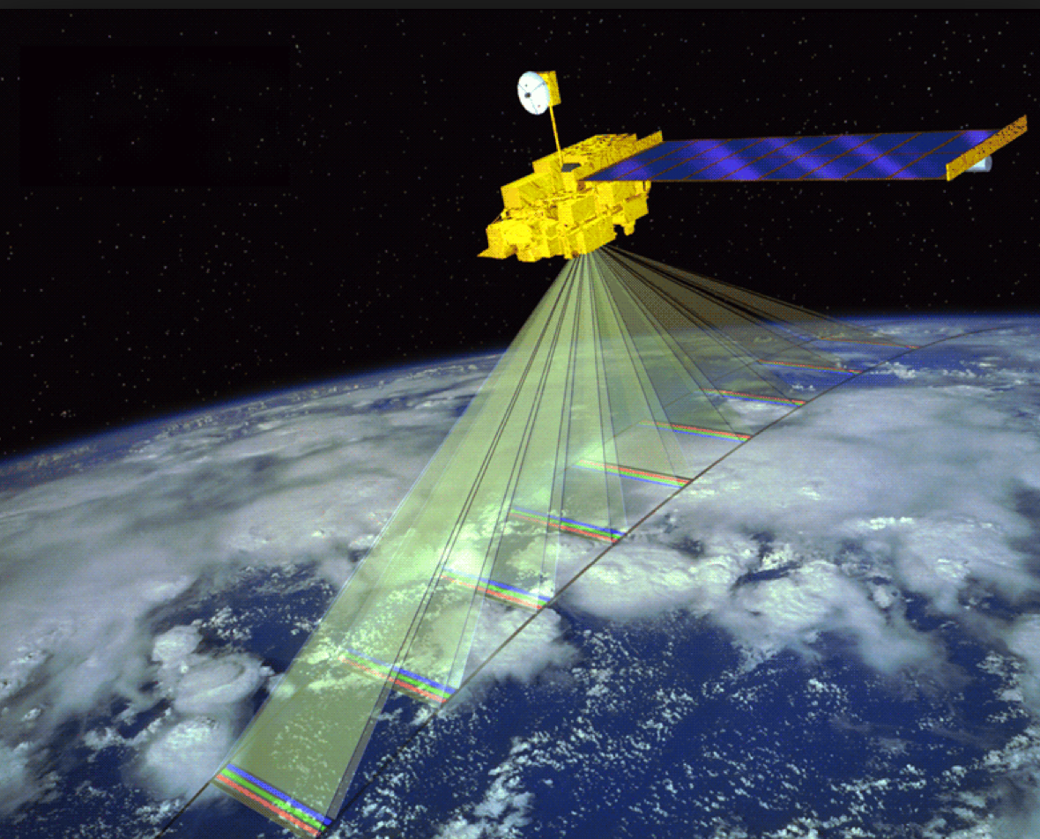
GLOBE Biosphere investigations are our “eyes” on the ground
NASA satellite missions remotely sense data about the Earth system that documents the changes taking place. They are our “eyes” in the sky or orbit. However, there is a need for actual ground observations to accompany these data.
Ground observations- measurements and observations that are part of GLOBE Biosphere protocols- can help verify the accuracy of satellite data and improve the accuracy of our remote sensing systems.
Terra’s five instruments provide measurements of plant (vegetation) composition, structure, extent, and change. Image: NASA.

Slide 8
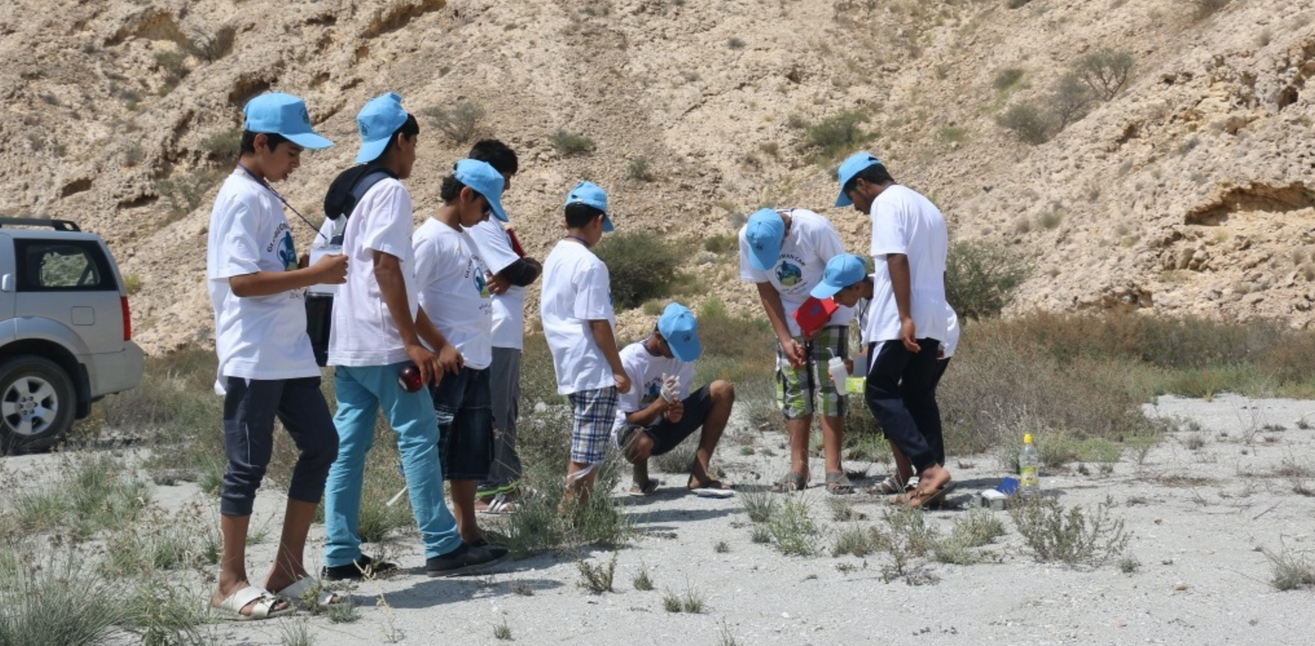
Using GLOBE data in place-based investigations in your classroom
GLOBE Biosphere investigations support the understanding of satellite data about the extent of vegetation as well as changes in seasonality. But its important to remember that the data you collect on site will have much greater resolution than any satellite data set, and can be employed in your own place-based investigations of the Earth system.
GLOBE students conducting investigations at their field camp.
Source: GLOBE Oman (2016)

Slide 9
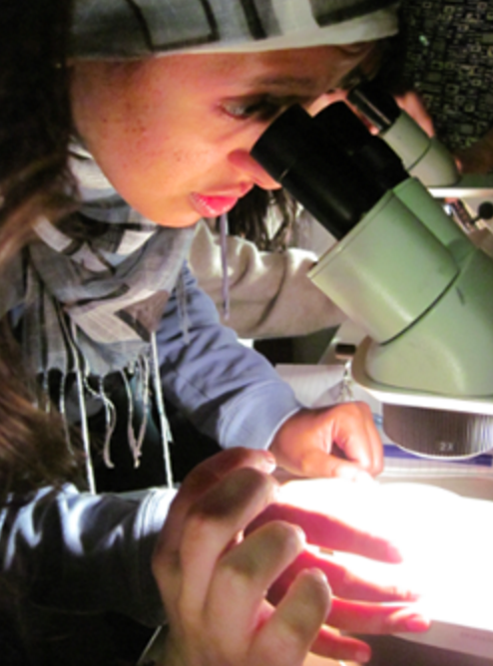
GLOBE students are scientists
Students or citizen scientists following the GLOBE protocols are scientists, investigating questions about the changing world. Not only are they asking their own questions and designing their own investigations, they are also contributing data that can be used by scientists around the world who are advancing our understanding of global change.
Let’s review what we have learned so far.

Slide 10
Review your Understanding! Question 1
The Biosphere is:
a. Part of the Earth system
b. The zone of life
c. One of the GLOBE protocol areas
d. b and c only
e. All of the above
What is the answer?

Slide 11
Review your Understanding! Answer to Question 1
The Biosphere is:
a. Part of the Earth system
b. The zone of life
c. One of the GLOBE protocol areas
d. b and c only
e. All of the above ☺ Correct!
Were you Correct? Go onto the next question!

Slide 12
Review your Understanding! Question 2
What is the most important use of GLOBE data?
a. It can be used by scientists to improve the interpretation of satellite data
b. Students and volunteers can use GLOBE data to conduct their own original investigations
c. Both are important outcomes of the GLOBE program
What is your answer?

Slide 13
Review your Understanding! Answer to Question 2
What is the most important use of GLOBE data?
a. It can be used by scientists to improve the interpretation of satellite data
b. Students and volunteers can use GLOBE data to conduct their own original investigations
c. Both are important outcomes of the GLOBE program ☺ correct!
Were you correct? Let’s move to the next question.

Slide 14
Review your Understanding! Question 3
What is true about GLOBE protocols ?
a. It is recommended to always use them when collecting data, unless you or the teacher wants to use a more scientific procedure learned in college
b. They ensure that the data collected by GLOBE schools and volunteers around the world can be compared because the data collection procedures are the same
c. GLOBE protocols are only a suggestion how to collect data. As long as you report the data to the GLOBE database, it is up to you how you want to collect it
d. A and B
e. All of the above
What is your answer?

Slide 15
Review your Understanding! Answer to Question 3
What is true about GLOBE protocols ?
a. It is recommended to always use them when collecting data, unless you or the teacher wants to use a more scientific procedure learned in college
b. They ensure that the data collected by GLOBE schools and volunteers around the world can be compared because the data collection procedures are the same
☺ Correct!
c. GLOBE protocols are only a suggestion how to collect data. As long as you report the data to the GLOBE database, it is up to you how you want to collect it
d. A and B
e. All of the above
Were you correct? Let’s proceed to the next section, where you will learn about GLOBE’s Land Cover Protocols.

Slide 16
2. Introduction to Land Cover
Land cover includes both developed and natural areas. All living things depend on their habitat, or land cover, for survival. They find shelter, food, and protection there. Land cover has a direct effect on the kinds of animals that will likely inhabit an area. Therefore, land cover is of great interest to ecologists, who study how plants and animals relate to their environment.
Land cover exerts influence on weather, soil properties, and water chemistry. Different land cover types are all distinct in their effects on the flow of energy, water and various chemicals between the air and surface soil. As you can see, knowing what types of land cover occur is important for a variety of Earth system science investigations. Your GLOBE Land Cover Sample Site description will allow you to classify your vegetation so it can be compared with land cover in other regions. Your biometry measurements support definition of your GLOBE Land Cover Sample Site.

Slide 17
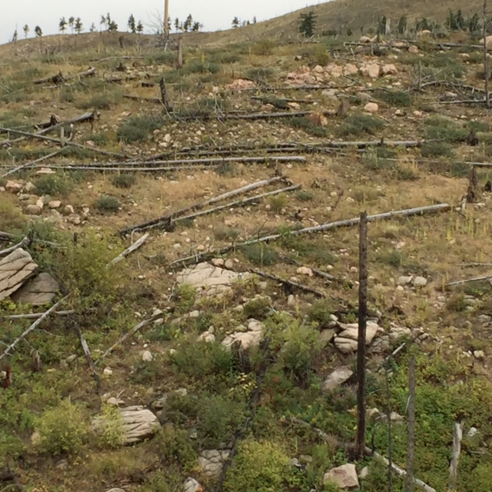
2. Land Cover
The Land Cover protocols provide instructions how to describe the vegetation at your Land Cover Sample Site. Ideally, you will describe the vegetation at the height of the growing season. No matter what climate zone a GLOBE school is located, whether desert, temperate or tropical rainforest, the same classification scheme is used, allowing for scientific comparison of data sets around the globe.
The Biometry Protocols enhance your land cover description with quantitative data. These data are necessary to determine the scientific classification of your Land Cover Sample Site, and are important for our understanding of the Earth’s carbon cycle.
The Fire Fuel Protocols enable you to describe the availability and kind of fire fuel at your sample site, which is important information for mitigating wildfire danger. While climate change causes wildfires to occur at a greater frequency, your work describing fire fuel at GLOBE study sites is expected to become more important with every year.

Slide 18
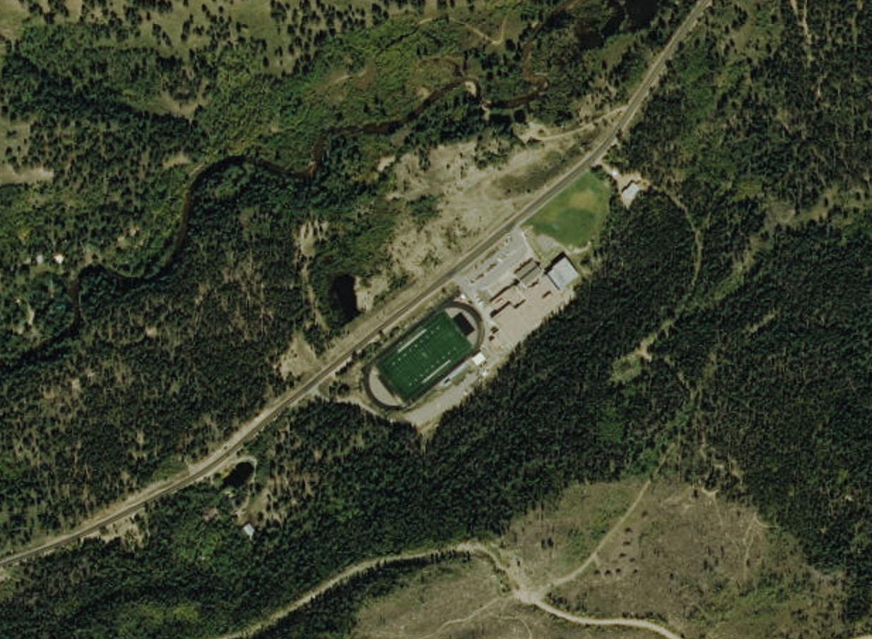
How should we start our GLOBE Land Cover Investigations?
A good place to begin is by observing your surrounding area in an aerial photograph. After you locate easily identifiable locations in an aerial photograph, view the same location in a satellite image. Can you recognize some of the same locations as you did in the aerial photograph?
Aerial photographs are available for many locations using Google Earth.
Landsat satellite images can be found easily at the USGS Landsat Mission site.
Aerial photograph of Nederland Middle and High School, Colorado USA.

Slide 19
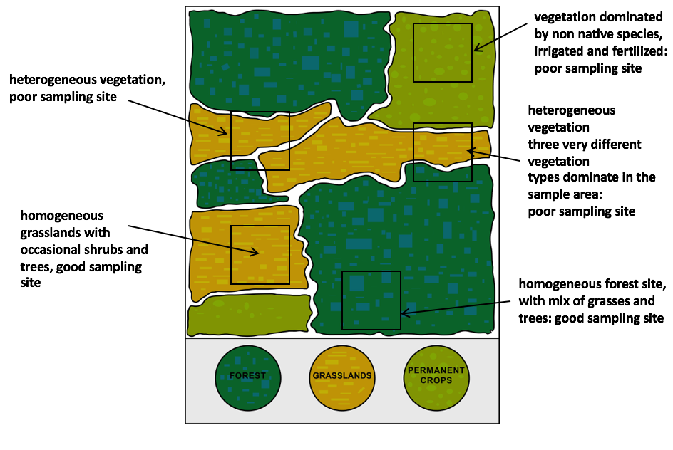
First, select a homogeneous sampling site near your school
Land Cover measurements can be taken anywhere that consists of a large homogeneous land cover type.
What makes a site homogenous? A homogeneous sampling site can contain many different species and growth forms (trees, grasses, and shrubs) but the sampling site should exhibit the same species and density of plants over the whole sampling area.
Often you will be able to determine whether or not your study site is homogenous by eye: see figure.

Slide 20
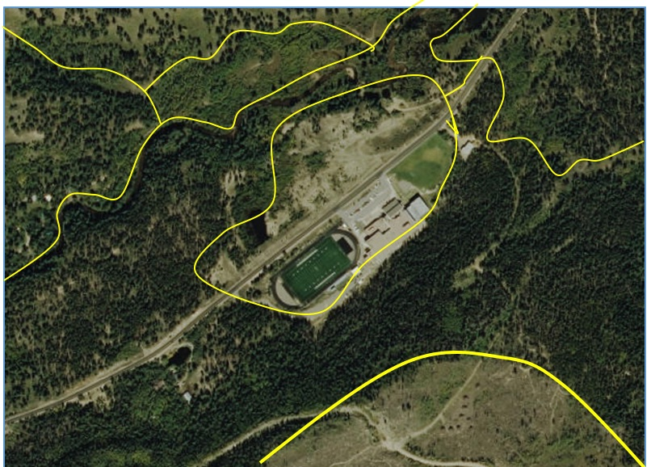
Identify Likely Homogeneous Land Cover Sample Sites on your Aerial Photograph or Satellite Image
You can see that there are several areas with distinctive vegetation around this school. There are GLOBE Learning Activities in the GLOBE Teacher’s Guide to assist in identifying different land cover types in your image, either by eye or using a digital analysis tool (Multispec).
You can’t tell from the aerial photographs or satellite images the species composition of trees or the dominant grasses and shrubs. For this, it is necessary to do on-the-ground observations to interpret this image.
Aerial photograph of Nederland Middle and High School, Colorado USA, with different vegetation types identified.

Slide 21
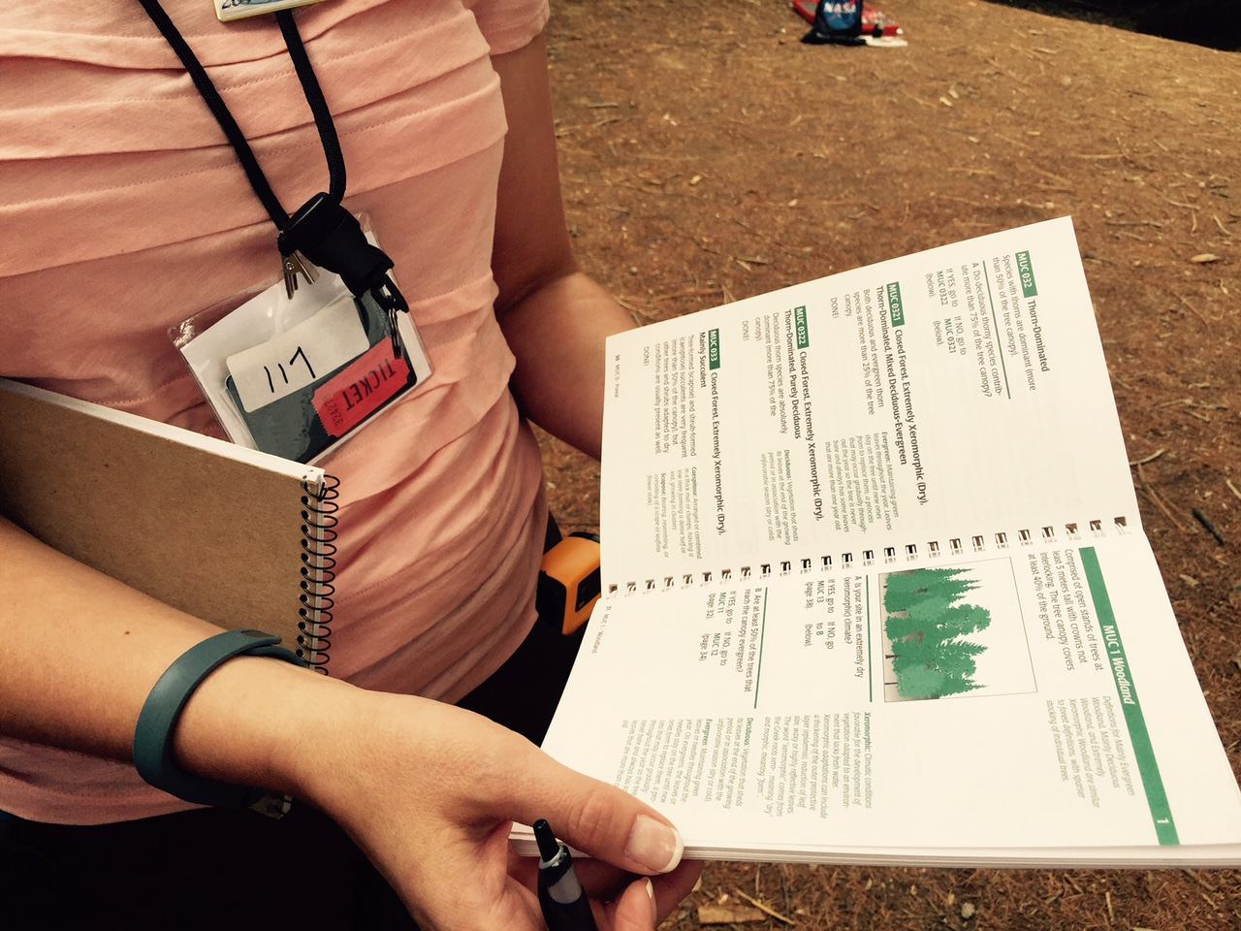
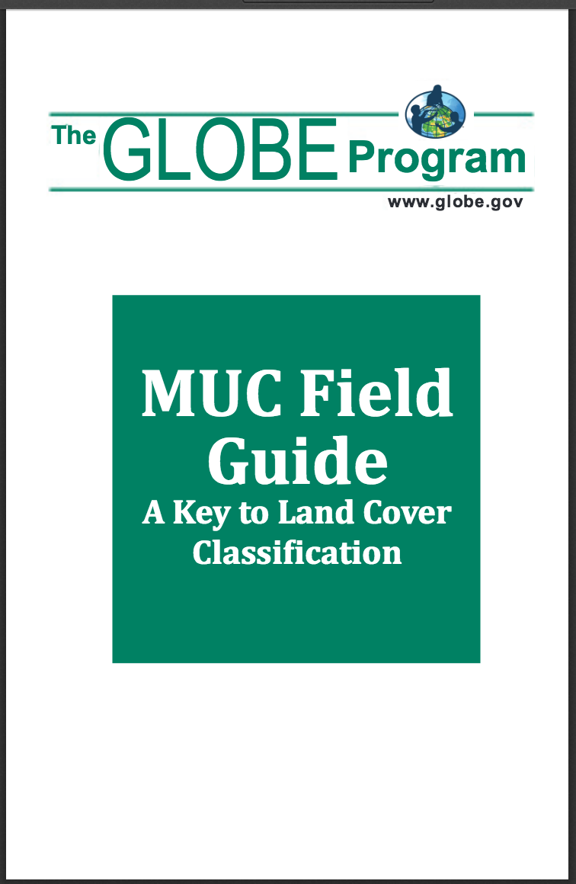
Classifying Land Cover: MUC Guide
Once you have defined your Land Cover Sample Site, there are several different protocols that are used to quantify different aspects of vegetation in a study area. You will use these measurements to classify your sample site, using the Modified UNESCO Classification Guide, also called the MUC Field Guide.
This land cover classification system is used so that there is a consistent use of terms around the world. For instance, what one person may call a forest living in the tropical Amazon may be quite different from a person living in northern Canada. Different species of trees live in these places, trees may be of different heights and the amount of ground and canopy cover may be quite different. UNESCO Classification (MUC).

Slide 22
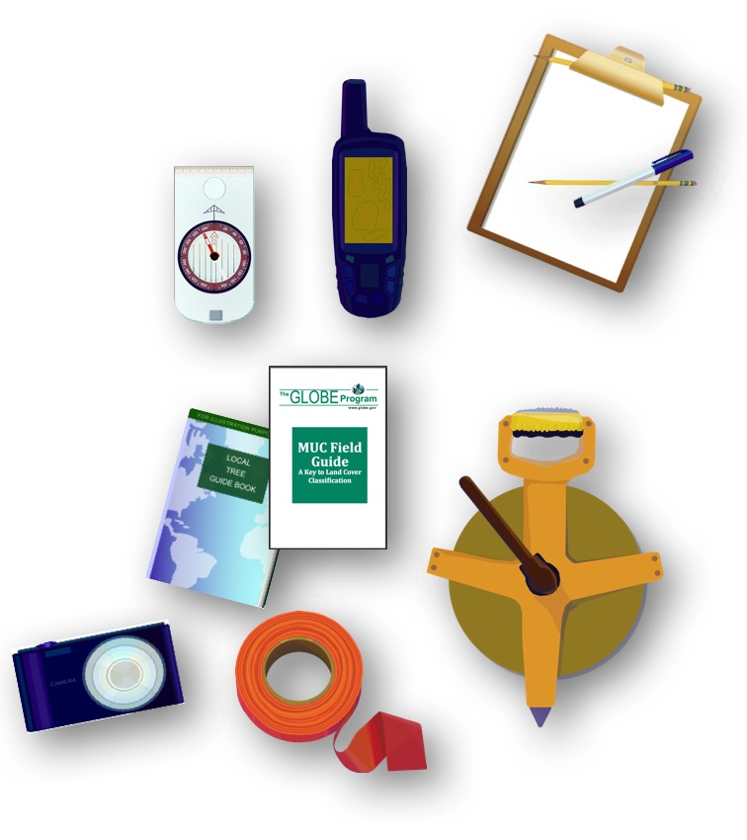
On the Ground: Describing the Land Cover Sampling Site
Where: a 90 x 90 m homogeneous vegetation
When: once for every new site during peak growing season, or more frequently in sites of your choosing, especially after extreme weather events (flooding or drought) or wildfire
Equipment you will need: GPS, compass, metric tape measure and equipment for specific biometry protocols, local plant key, MUC Guide

Slide 23
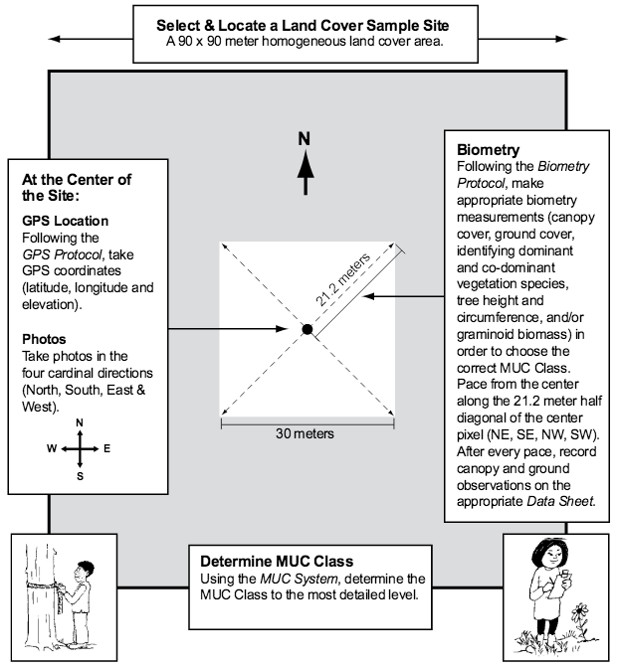
Define your Land Cover Sample Site
It is not expected that you or your students will return to these sites as with other GLOBE protocols. The exception is when the cover has changed due to fire, flood or man-made modification.
Land cover sample sites must be 90 m X 90 m in size and homogeneous (contain the same land cover type throughout). A sample site area of 90 m x 90 m is necessary in order to accurately locate the site on the ground and on the satellite image.

Slide 24
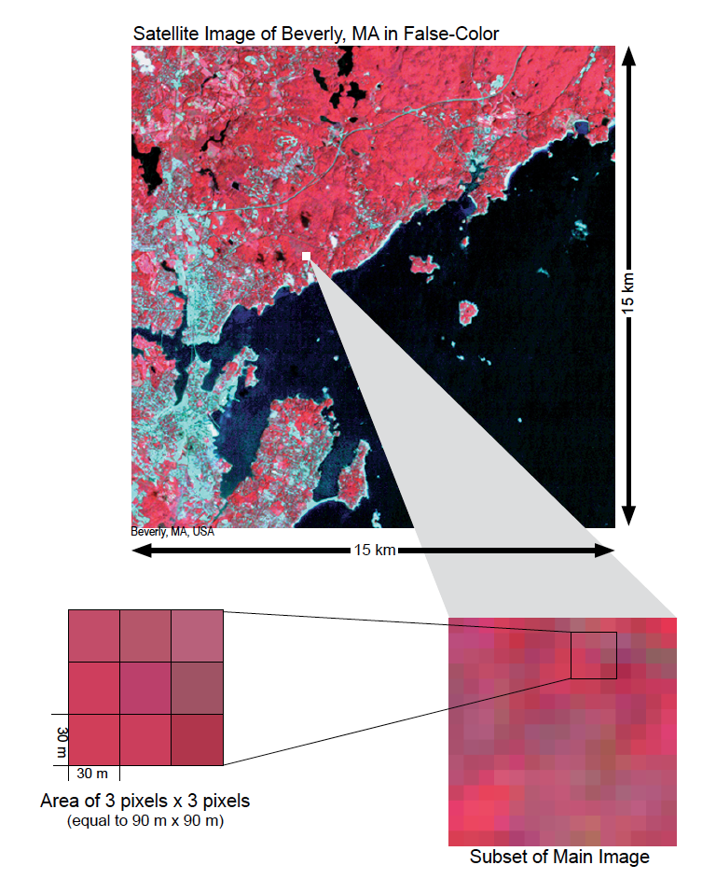
Size of a GLOBE Land Cover Sampling Site
Do you wonder why GLOBE uses a 90 x 90 m Land Cover Sampling Site?
As you zoom in on a 15 km x 15 km satellite image, the pixels (which are 30 m x 30m in size) become visible. In the Land Cover/Biology Investigation, students take field measurements at sites that are 90 m x 90 m (equal to 3 pixels x 3 pixels).
This area is equivalent to nine Landsat pixels (a square of 3 pixels by 3 pixels). A sample site area of 90 m x 90 m is necessary in order to accurately locate the site on the ground and on the satellite image.

Slide 25
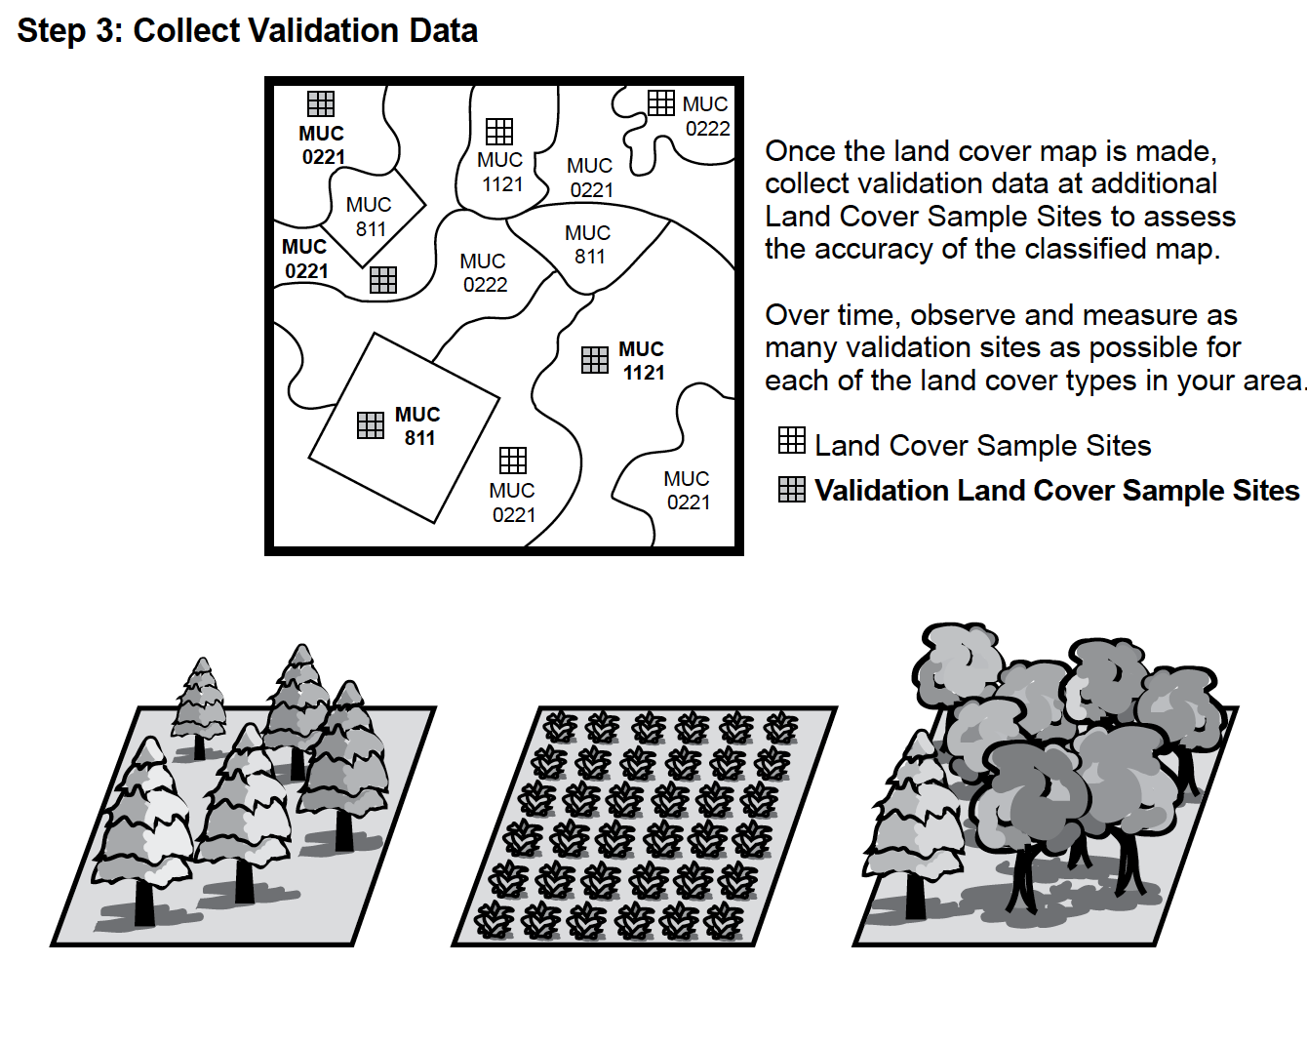
Use your Satellite Map to Guide your Field Investigations
Once you create your map, you are ready to travel to the different vegetation zones you identified in your satellite imagery and describe them using GLOBE Biometry Protocols. After following the measurements, you will be able to classify the vegetation areas in your Land Cover Sampling Site using the MUC Guide.
To describe the different vegetation types in the study site may take several field excursions, and can be completed over months or years. You can do fieldwork as many areas as you need to create an accurate description of your study site.

Slide 26
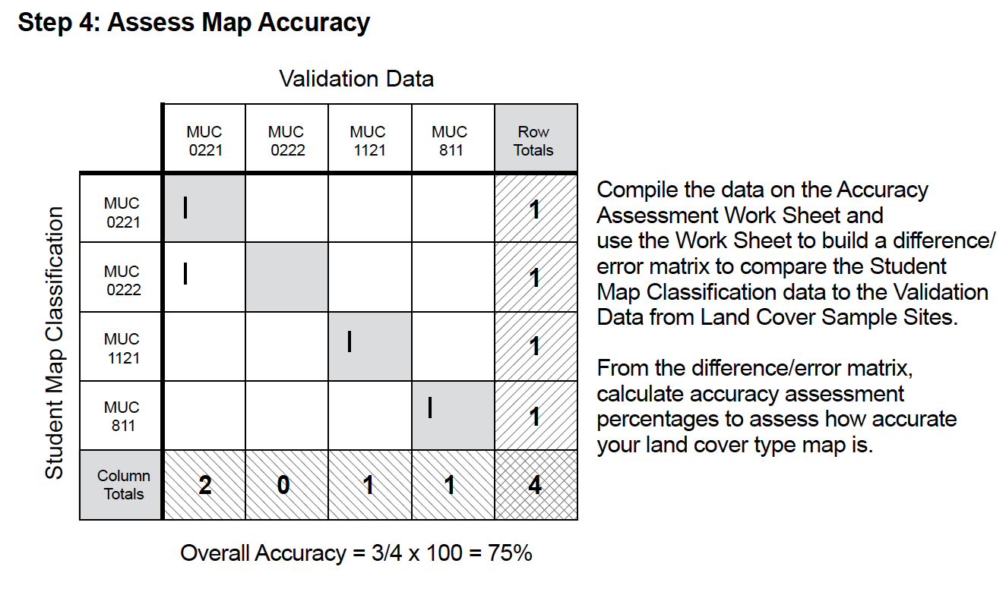
Use your Satellite Map to Guide your Field Investigations-2
The Introduction to Biosphere section of the GLOBE Teacher’s Guide includes learning activities that you or students can use to calculate the overall accuracy of their classification of study sites by comparing their classification of satellite images with ground observation data.
See also NASA’s Landsat Education Portal for lesson ideas.
In the next section, we will survey the different GLOBE Biometry Protocols that you will use to classify your vegetation.

Slide 27
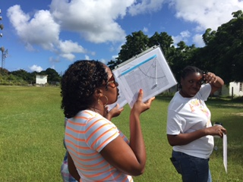
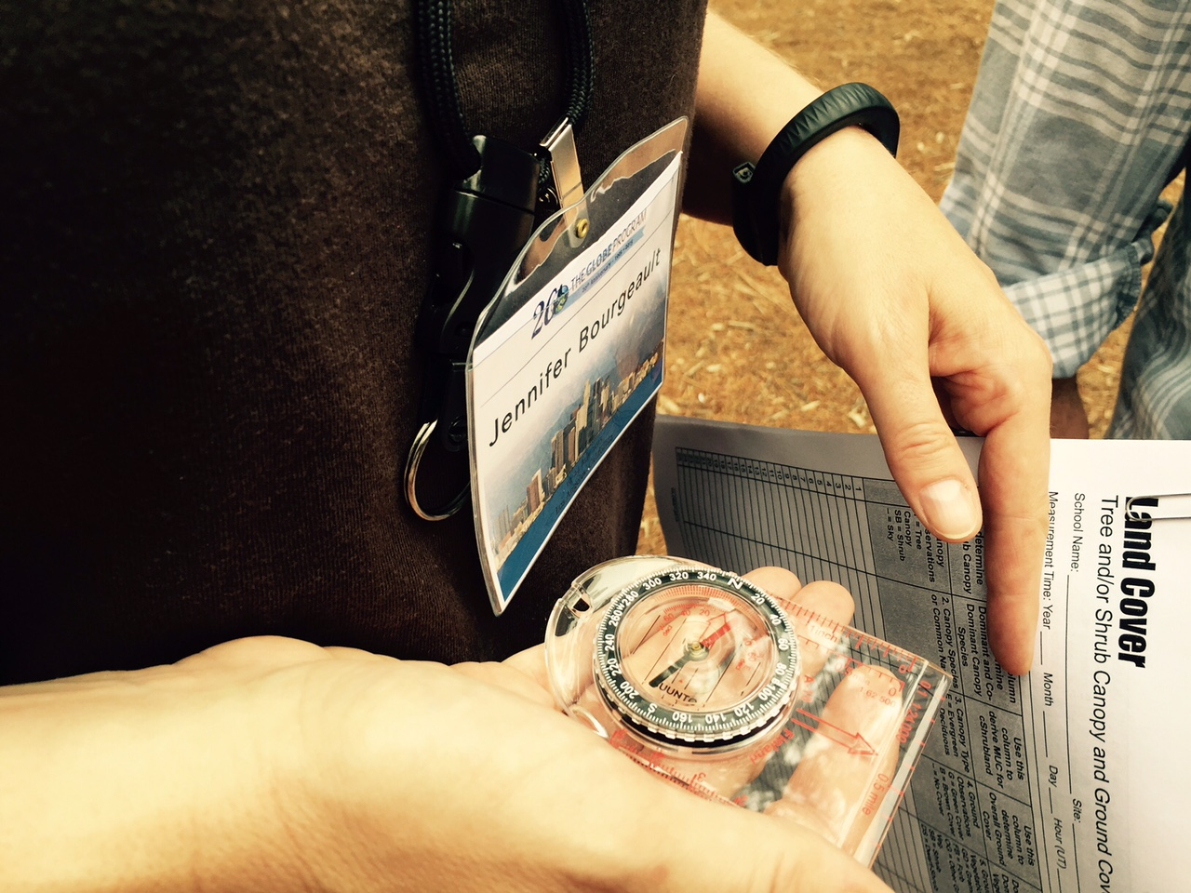
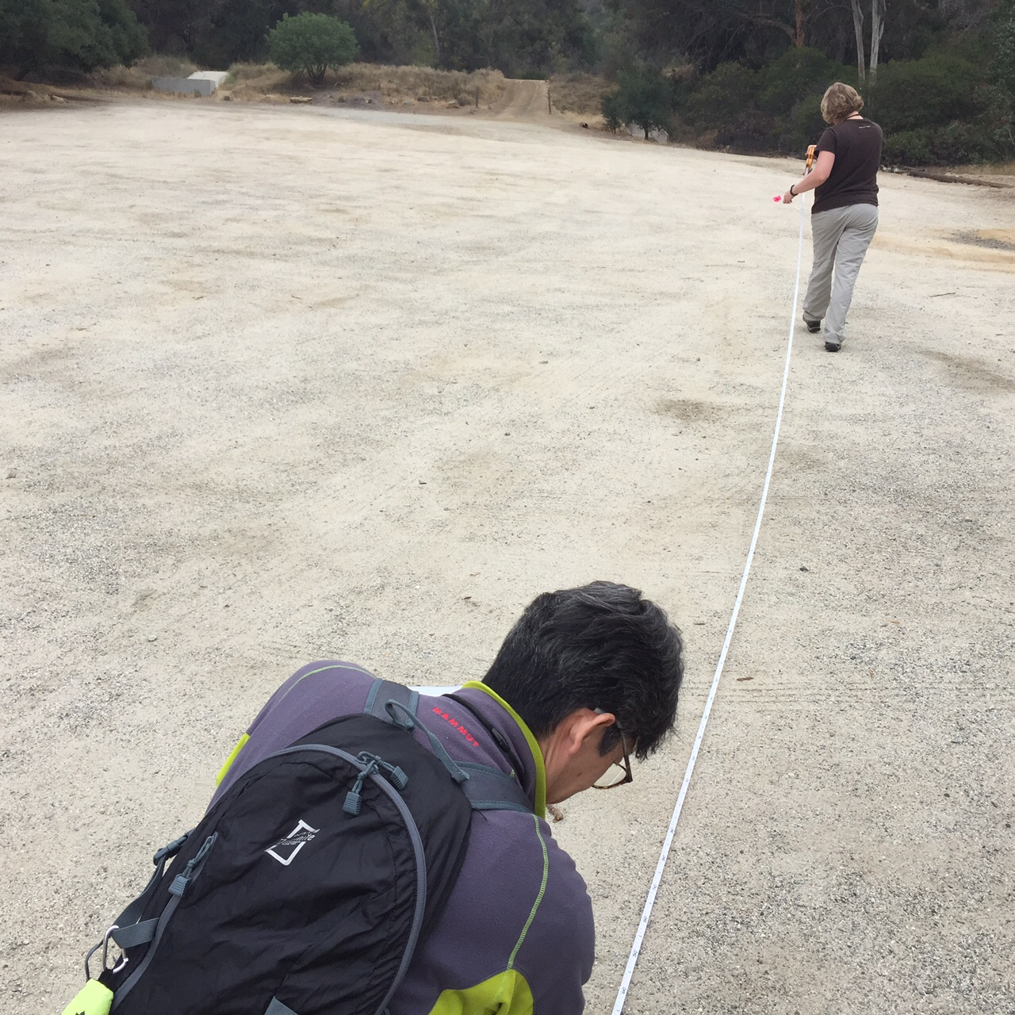
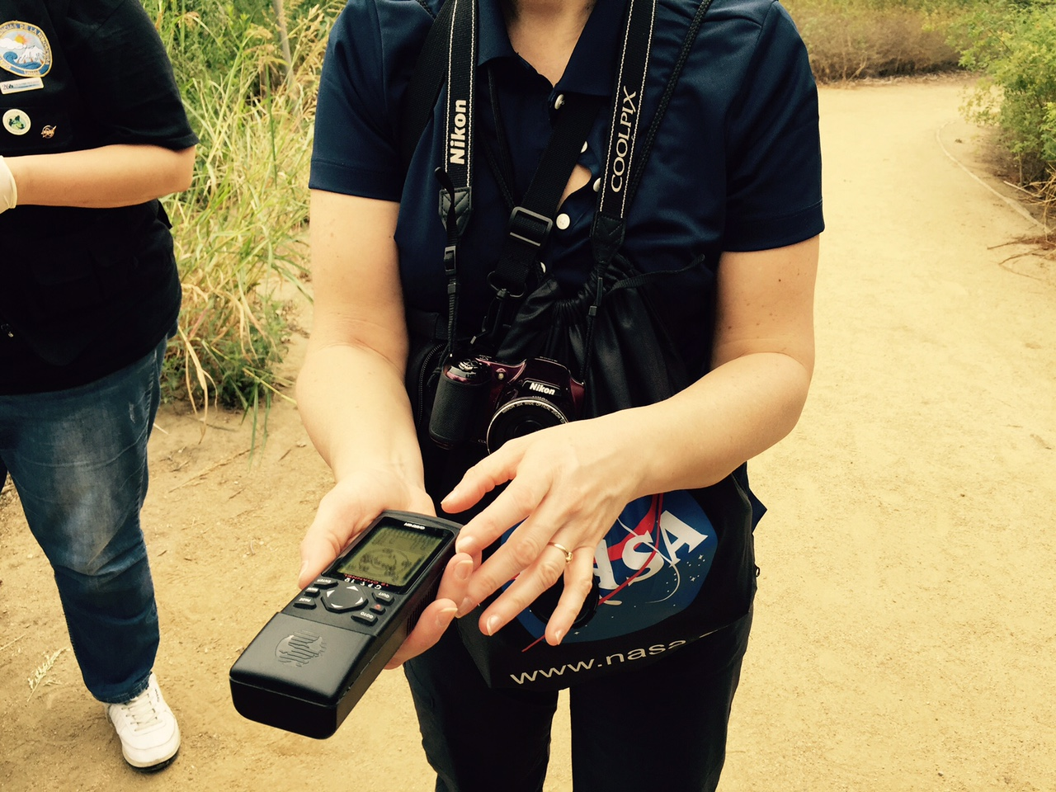
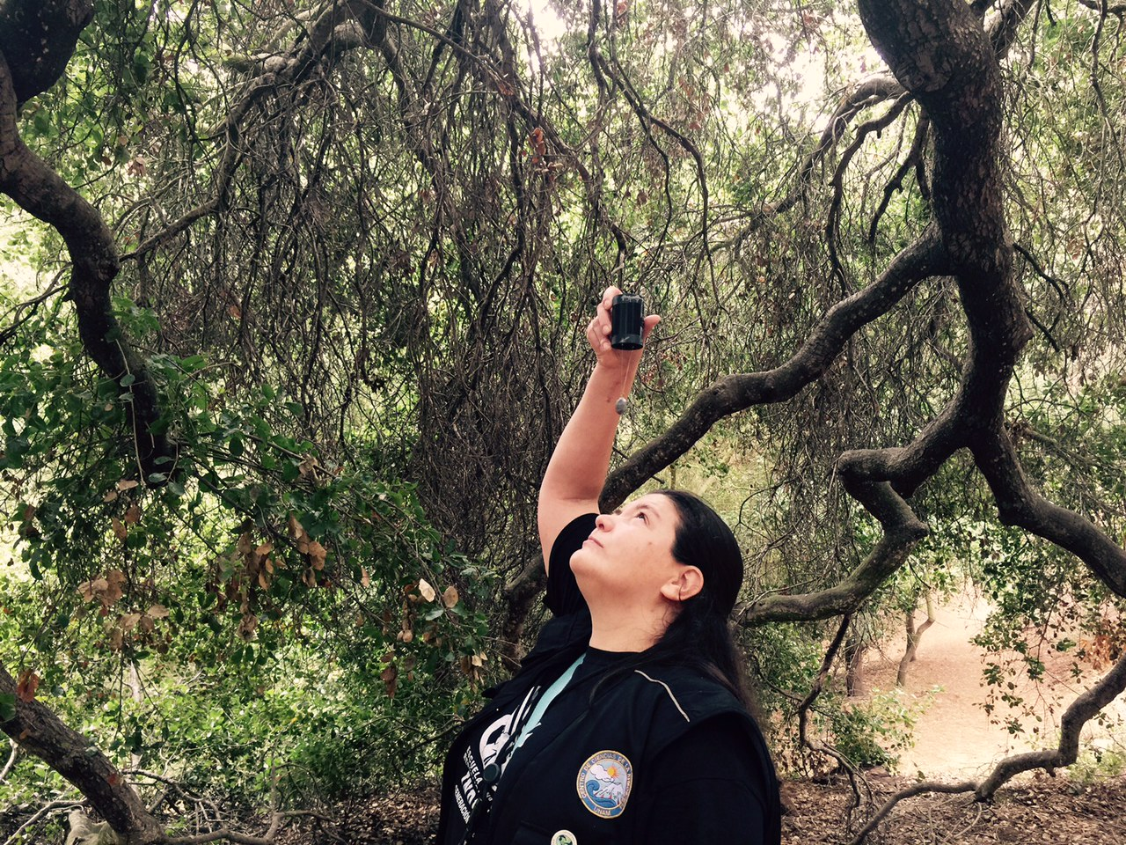
Sequencing, Interconnections, and Interdependence of Learning Activities and Protocols
In order to report data for the main protocol, the Land Cover Sample Site Protocol, you must be able to carry out the Biometry Protocol and accurately record the location of sites (latitude, longitude and elevation) using a GPS receiver. In addition, you must be able to use MUC to classify land cover, pace accurately, use a compass, and make and know how to use a densiometer and clinometer correctly. Teachers will find classroom learning activities to prepare students to conduct the investigations correctly in the GLOBE Teacher’s Guide.

Slide 28
Review your Understanding! Question 4
How big is a GLOBE land cover sampling site?
a. 15 x 15 km
b. 90 x 90 m
c. 30 x 30 m
d. 3 x 3 m
What is your answer?

Slide 29
Review your Understanding! Answer to Question 4
How big is a GLOBE land cover sampling site?
a. 15 x 15 km
b. 90 x 90 m ☺ correct!
c. 30 x 30 m
d. 3 x 3 m
Were you correct?

Slide 30
Review your Understanding! Question 5
What do we use to classify a GLOBE Land Cover Study Site?
a. The MUC Guide
b. A land cover classification system that can be applied in all parts of the world
c. The Modified UNESCO Classification Guide
d. A and C only
e. All of the above
What is your answer?

Slide 31
Review your Understanding! Answer to Question 5
What do we use to classify a GLOBE Land Cover Study Site?
a. The MUC Guide
b. A land cover classification system that can be applied in all parts of the world
c. The Modified UNESCO Classification Guide
d. A and C
e. All of the above ☺ correct!
Were you correct?

Slide 32
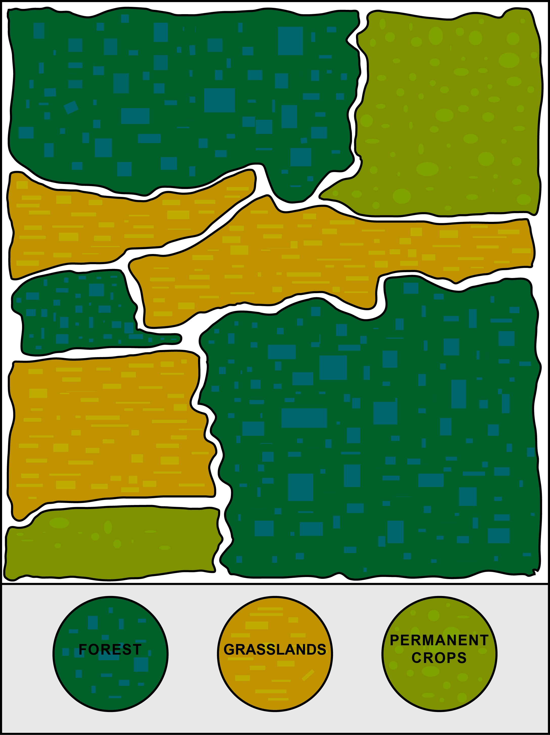
Review your Understanding Question 6
What characteristic is important when selecting a sampling site?
a. All the plants need to be of the same species
b. The sampling site can have many different species, but the density and composition of species should be similar over the sampling area
c. The site must be heterogeneous
d. The site should be composed of well adapted, non-native species
What is your answer?

Slide 33
Review your understanding. Answer to Question 6.
What characteristic is important when selecting a sampling site?
a. All the plants need to be of the same species
b. The sampling site can have many different species, but the density and composition of species should be similar over the sampling area ☺ correct!
c. The site must be heterogeneous
d. The site should be composed of well adapted, non-native species
Were you correct? We now are ready to move onto an overview of the GLOBE biometry and phenology protocols!

Slide 34
3. GLOBE Biometry Protocols
Biometry is the measuring of living things. A scientist is interested not only in the characteristics of vegetation at a study site, but also how it is distributed. How dense is the forest? Does sunlight penetrate to the forest floor? Is the landscape dominated by grasses? Has there been a recent disturbance, such as a forest fire or flood? These are questions that are answered by taking biometric measurements of land cover.
Let’s take a look at the GLOBE biometry protocols.
Student measuring tree circumference

Slide 35
Biometry Protocols: Graminoid, Tree and Shrub Height
To describe your Land Cover Sample Site and identify the MUC code, you may need to measure the average height of the vegetation. For low-lying vegetation, such as grasses, and medium height vegetation, such as shrubs, you will take a random sample of plants, measure them, and calculate the average plant height.
To measure tree height, you will need to use a Clinometer to measure the angle from your eye to the top of the tree, and calculate the tree height using some basic trigonometry. You will find instructions for building a clinometer in the Teacher’s Guide.

Slide 36
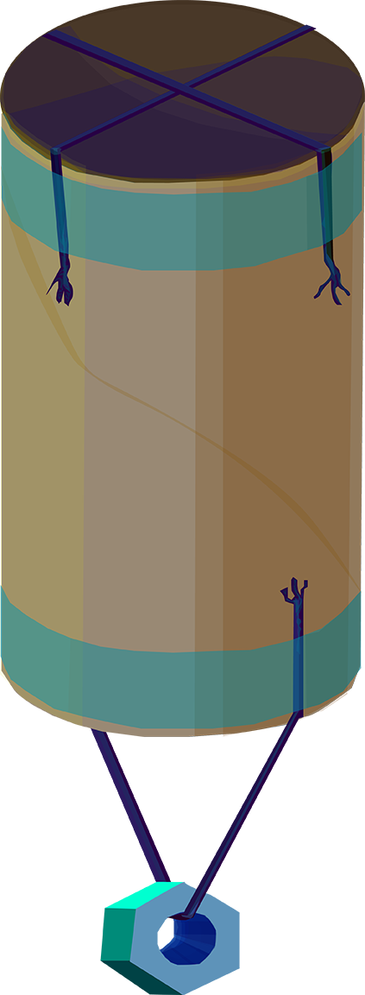
Biometry Protocols: Canopy Cover and Ground Cover
Canopy cover describes the proportion of land area covered by either tree crowns or shrub crowns, as viewed from the air. It is a measurement used to describe the density of trees in a forest or tree stand, and the cover of shrubs in a shrub land. It helps to correctly choose the correct MUC land cover type.
Canopy cover is estimated using a scientific instrument known as a densiometer. You can make this instrument using common household materials: instructions are located in the GLOBE Teacher’s Guide.

Slide 37
Biometry Protocols: Tree Circumference
Tree circumference is a common measurement used by ecologists. It is the measurement around the trunk of the tree, taken at a Diameter Breast Height (DBH) (1.35 m).
Tree circumference is one of the several vegetation measurements in the Biometry Protocol. In combination with other measurements in the protocol, tree circumference data is useful for describing the vegetation landscape and answering many scientific questions related to forest stability and change.

Slide 38
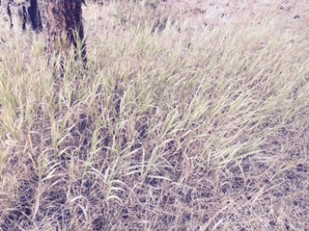
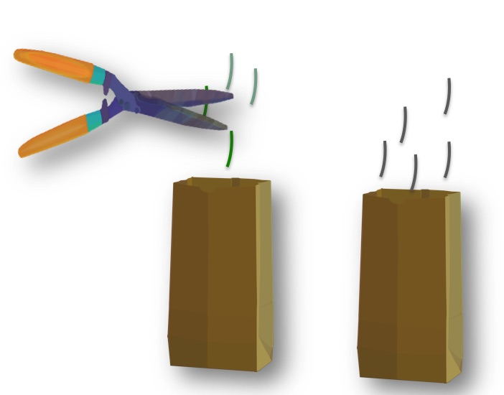
Biometry Protocols: Graminoid Biomass
Graminoid is another word for grasses and grass-like plants. Graminoid Biomass is a measure of the total mass of grass-like plants in a given area or volume.
Measurement of biomass is an indicator of the amount of energy stored in vegetation. This information can be used to calculate primary productivity of an ecological site, and can also be used to calculate the amount of carbon that is sequestered (stored) in grasses and similar plants.
Students will collect green and brown graminoid samples from a given area, and take them to their lab where they will dry and weigh their samples.
Estimates of biomass are also useful because vegetation cover plays a role in the hydrological properties of a site, such as infiltration, runoff and erosion.

Slide 39
Land Cover: Fire Fuel Protocol
Scientists project that changes in climate will be accompanied by increasing frequency of wildfires. Data collected using the GLOBE Fire Fuel Protocol will become increasingly important as communities adapt to and mitigate the negative consequences of climate change.
The Fire Fuel Protocol measures the amount of different types of fuels found on your Land Cover Sample Site. Fire fuels are the above ground organic biomass that can contribute to a wild land fire, and include dead branches, logs, live shrubs and trees.
The data you collect can be used for other types of research and management. For instance, the estimates of live and dead biomass made from your measurements are extremely important for understanding carbon, water and nutrient cycles. Potential smoke and carbon inputs to the atmosphere can be calculated from the loadings of fuels computed from your data.
Dead standing fire fuel and surface fire fuel, at site of 2012 Flagstaff Fire, Colorado, USA.

Slide 40
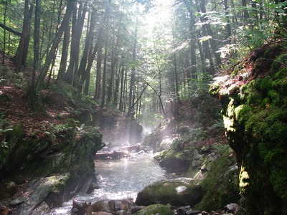
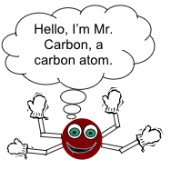
Carbon Cycle
Carbon is the most abundant element in living things. It is also present in the Earth’s atmosphere, soil, oceans, and crust. The Global Carbon Cycle is the movement of carbon between the atmosphere, land, and oceans. Carbon Cycle materials use a systems-thinking approach to gain a foundation in the carbon cycle and its relation to climate and energy. These include:
Introductory Learning Activities: Hands-on activities that use a systems thinking approach to understanding the global carbon cycle.
Plant-A-Plant Experiments: Hands-on cultivation experiments for the classroom, with options for structured, guided, or open levels of inquiry.
Protocols and Field Learning Activities: Skills designed to help you collect and analyze data to determine the biomass and carbon storage in the vegetation near you.
Modeling: Computer models (at varying levels of complexity) to help you predict the change in biomass and carbon storage over time.
Teacher Support: NGSS-correlated materials; ready-to-use assessment materials; and background information on carbon, systems, models, and inquiry teaching.

Slide 41
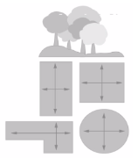
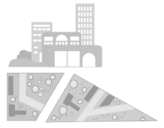
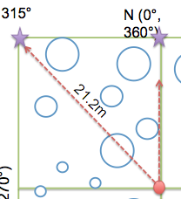
Carbon Cycle Protocols
Site Selection: Determine if your site is a “Standard” or ”Non-standard” site.
Standard Site - an accessible area of at least 225 m² (15m x 15m) of contiguous vegetation (forest, shrubland, grassland). Aim for 30 m x 30 m (900 m²), although a smaller or different shaped area will work.
Non-standard Site – an accessible area of 225 m² (15m x 15m) with some vegetation and some human interference (i.e. a local park, city block, or the school area itself).
Site Set-up:
Use a compass and pacing to set up the site.
Record appropriate site information.
Can be done from center of Land Cover Site.

Slide 42
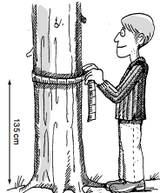
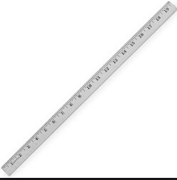
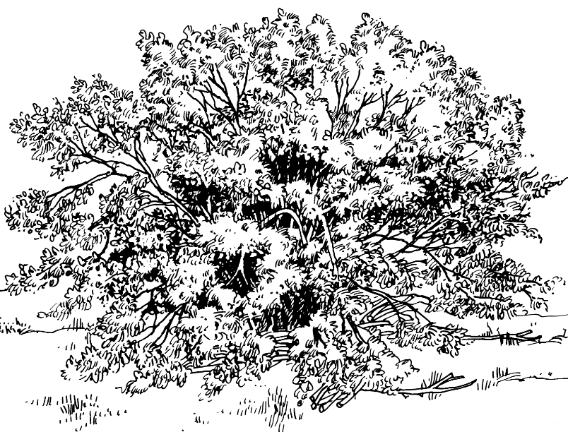
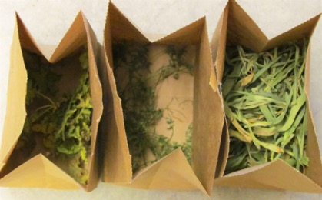
Carbon Cycle Protocols
Depending on vegetation present, you will measure:
Image: iowalearningfarms
All TREES present:
Tree Mapping Protocol
Tree Circumference Protocol
SHRUBS/SAPLINGS: Measured if $≥$25% cover
HERBACEAOUS
VEGETATION: Measured if $≥$50% cover

Slide 43
Carbon Cycle: How Will You Calculate Carbon?
Make Vegetation Measurements
Carbon Storage
in Vegetation
(gC)
Carbon Storage
per site
(gC/m²)
Biomass
(grams)
Allometric/
Mathematical
Equations
Carbon = Biomass x 50%
$$÷$$
Sample Site Area (m²)
When you submit your data through the GLOBE website, the calculations to convert your raw data to biomass and carbon storage values will be completed for you!

Slide 44
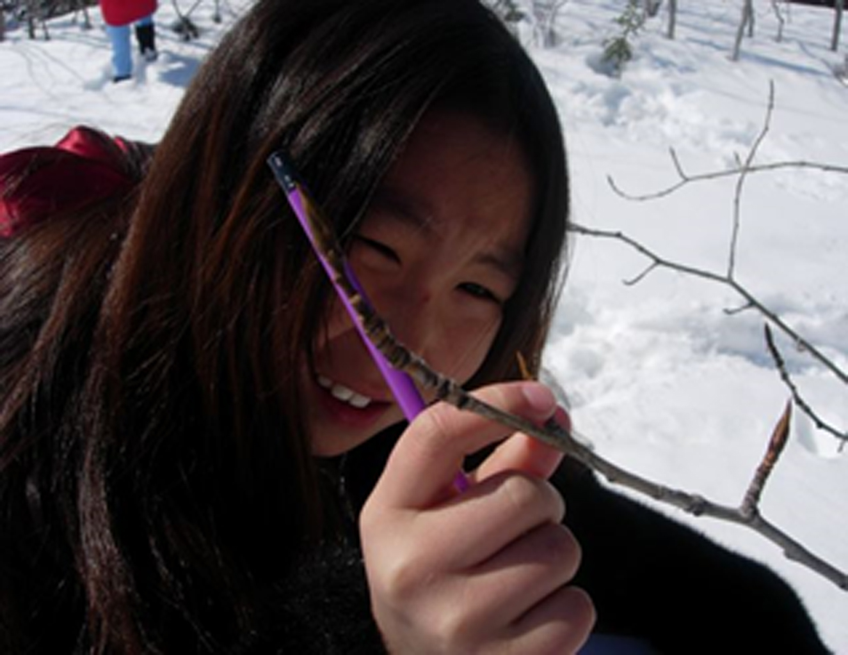
Phenology
Phenology is the study of living organisms’ response to seasonal and climatic changes in the environment in which they live. Using the phenology protocols, you will observe the seasonal changes observed in plant growth and animal behavior. These data are critical to better understand the response of our ecosystems to a warming climate.
Student monitoring green-up in a shrub

Slide 45
Conducting Phenology Protocols
Where: At your Phenology Study Site
When: Takes place at specific times of the year
Examples of Frequency for some of the Protocols:
Green-Up and Green-Down: Twice a week beginning two weeks prior to anticipated color change
Ruby-throated Hummingbird: Spring daily until first sighting, Fall, daily until last sighting
Seaweed Reproductive Phenology: Once a month for four months in a row during low tides
Student monitoring green-up in a shrub

Slide 46
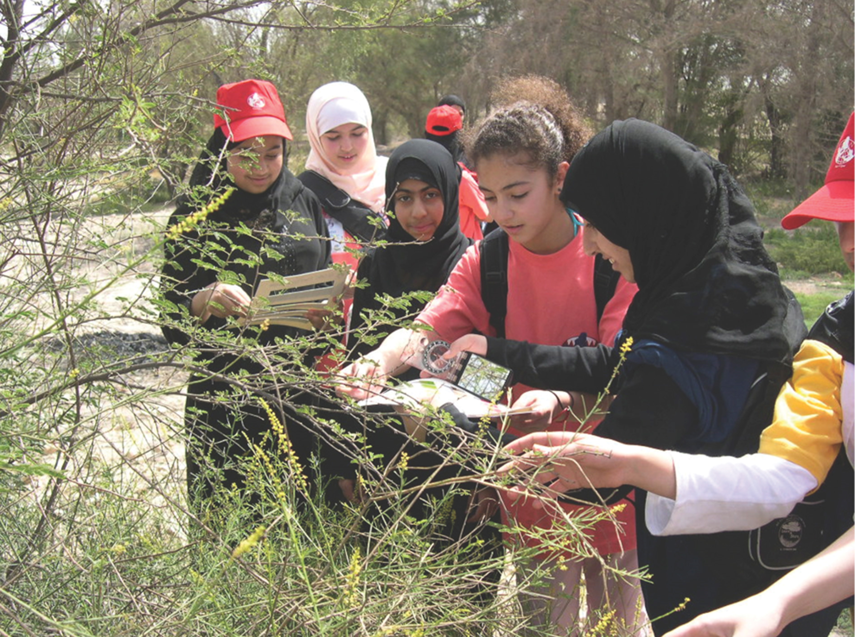
Phenology: Tree and Shrub Green-Up
Tree and Shrub Green-Up starts when dormancy (a state of suspended growth and metabolism) is broken by environmental conditions such as longer hours of sunlight and higher temperatures in temperate regions, or rains and cooler temperatures in desert areas.
Students monitoring green-up
Frequency of Observations: Twice a week beginning two weeks prior to the anticipated start of budburst. By using a permanent marker, students can mark the buds they are examining during green up with dots.

Slide 47
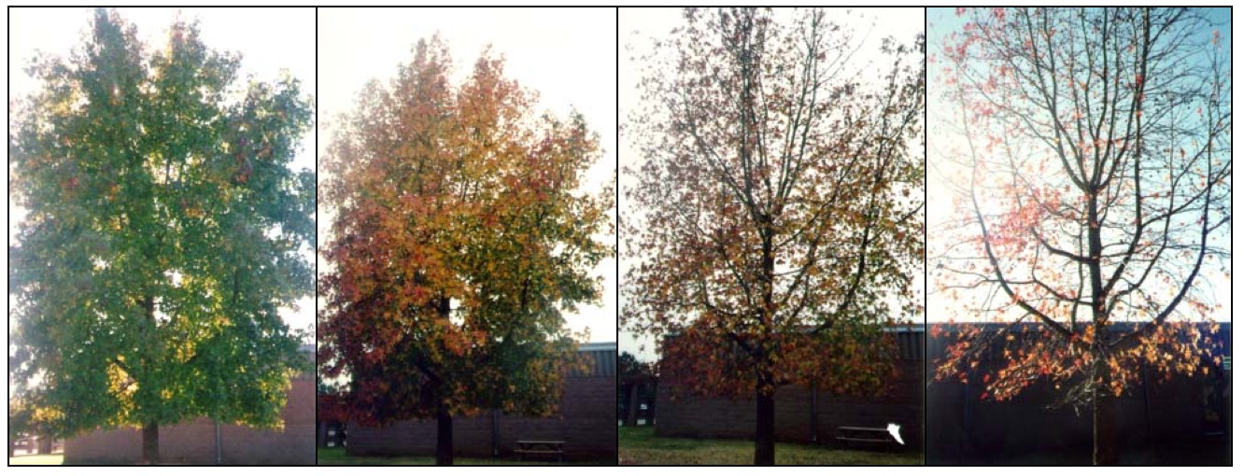
Phenology: Tree and Shrub Green-Down
Green-down marks the end of the growing season for many plants. A color change is generally associated with green-down of leaves. The color will vary by species.
These plant phenological events are directly related to global carbon fixation and the amount of carbon dioxide in the atmosphere. Green-down events are also affected by air temperature and humidity and soil moisture.
Frequency of Observations: Twice a week beginning two weeks prior to anticipated color change.

Slide 48
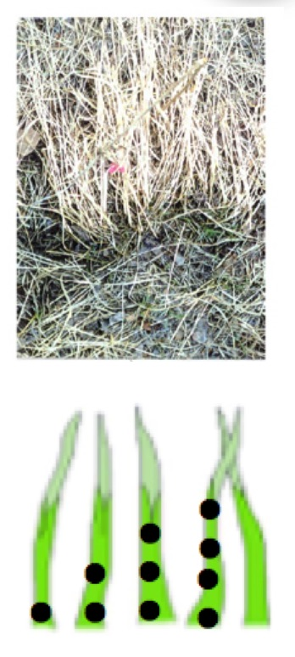
Phenology: Grass Green-Up
Grass Green-Up is another phenological measurement that is used to identify the beginning of the growing season. Monitoring the length of the growing season is important. Knowing the onset and length of the growing season is critical for society, because it is a measure that allows us to monitor the impacts of climate change, which has implications for food production, economic growth, and human health.
Frequency of Observations: Twice a week beginning two weeks prior to the anticipated start of budburst. Mark each shoot with dots using a permanent marker so you can conduct measurements on the same shoots throughout green-up.

Slide 49
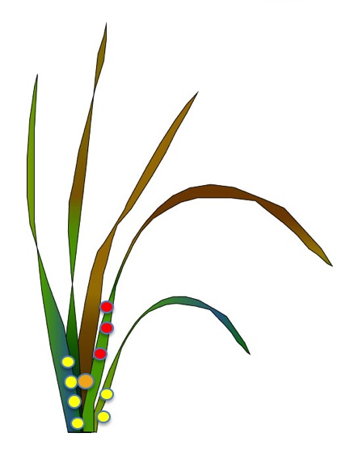
Phenology: Grass Green-Down
Green-down marks the end of the growing season for many plants. A color change is generally associated with green-down of leaves. The color will vary by species.
At least twice a week beginning two weeks prior to the anticipated start of green down, continuing until plant color change has ended or leaves have dropped off.
Frequency of Observations: Twice a week beginning two weeks prior to anticipated color change
Grass in green-down, with shoots marked so they can be measured every few days by students

Slide 50
Phenology: Lilac Phenology
In places where lilacs grow, you can observe the budding and blooming of common lilac plants. Plants of the same species respond similarly to environmental changes, such as changes in temperature and moisture, even if they are located in different regions in the world. By having a network of lilac plants around the world (where this plant species is capable of growing), scientists can then examine regional and global patterns in phenology. Cloned plants respond identically to environmental changes. Variations observed in the dates of growth stage events in cloned plants can be clearly linked to climate rather than variations between individual plants.
Observations are made daily beginning in spring, to the end of bloom.

Slide 51
Phenology: Phenological Gardens
A GLOBE phenological garden contains a variety of plants that bloom at different times during the year. This allows you and scientists to learn how the growing season is changing from year to year as well as see if there is an overall change in the growing season over a longer length of time. The collection of atmosphere data (such as temperature and precipitation) and soil moisture and temperature data will greatly help you and scientists interpret the phenological garden data. You can find the field guides for these measurements in the Atmosphere and Soil (Pedosphere) Protocols.
The plants need to come from selected nurseries to make sure that the plants are clones. A cloned plant shares identical DNA with the other clones. Cloned plants are needed to make large-scale comparison among the dates of the different developmental phases of the plant.
Frequency of Observations: Daily for each plant variety before leaf growth and blooming starts and during the blooming stages. Two or three times a week in between blooms.

Slide 52
Phenology: Arctic Bird Migration
Ornithologists believe climate to be a primary factor influencing bird distribution. Many bird species that breed in the Arctic and near Arctic zones migrate in autumn to wintering areas.
Students need to gather information about birds in your area. What are common birds in your area? Which species breed in your area? Which species stay the whole year? Which species are migratory and only stay for part of the year?
You may want to select a bird species that arrives in the early spring so that student observations can fit into the school calendar.
Gathering data in many different locations will increase knowledge, not only about bird migration patterns and its connection to climate changes, but also on changes in species abundance and distribution.
Frequency of observations: Every other day beginning 2 weeks prior to expected arrival time until few or none of the selected species are seen.

Slide 53
Phenology: Ruby Throated Hummingbird
The Ruby-throated Hummingbird is an ideal species for a cross disciplinary science study involving students from Canada, Mexico, the United States, and all seven Central American countries (Belize, Costa Rica, El Salvador, Guatemala, Honduras, Nicaragua, and Panama).
Scientists want to learn about their migration patterns as well as their eating and nesting behavior. What flowers do they prefer to visit for sweet nectar? Will they come to a hummingbird feeder in your yard? How do adult hummingbirds care for their eggs and young hummingbirds after they hatch?
Students will learn how to identify and age male and female Ruby-throated Hummingbirds and to observe migration and feeding behavior. Students will learn how to make connections among hummingbird behavior and weather, climate, food availability, seasonality, photoperiod (day length), and other environmental factors.
Frequency of Observations:
Spring: daily until first sighting
Autumn: daily until last siting
Feeder/Flower Visits: twice a week
Nesting behavior: Daily if possible

Slide 54
Phenology: Seaweed Reproductive Phenology
To conduct this protocol, it is best to be located near the ocean in an area where at least one of the selected seaweed species is found. The seaweed species used in this study are: Ascophyllum nodosum, Fucus distichus, Fucus spiralis, Fucus vesiculosus, Pelvetia canaliculata, and Fucus serratus.
The object of the study is to learn connections between the seaweed phenology and climate factors. Sampling should be done once a month for four consecutive months.
Frequency of Observations: Once a month for four months in a row during low tides.

Slide 55
Review your Understanding! Question 7
What is the goal of phenology?
a. To observe an organism’s growth and behavior to study changes in seasons and climate
b. To measure the different growth parameters of plants and describe the land cover, so it can be identified in Landsat images
c. To determine how fast Arctic terns fly
d. a and b
e. All of the above
What is your answer?

Slide 56
Review your Understanding! Answer to Question 7
What is the goal of phenology?
a. To observe an organism’s growth and behavior to study changes in seasons and climate ☺ correct!
b. To measure the different growth parameters of plants and describe the land cover, so it can be identified in Landsat images
c. To determine how fast Arctic terns fly
d. a and b
e. All of the above
Were you correct? Onto the next question!

Slide 57
Review your Understanding! Question 8
What is biometry?
a. The measurement of living things
b. The study of the response of living organisms to seasonal and climate changes in the environment
c. The study of life on Earth and the Earth system
What is your answer?

Slide 58
Review your Understanding! Answer to Question 8
What is biometry?
a. The measurement of living things ☺ correct!
b. The study of the response of living organisms to seasonal and climate changes in the environment
c. The study of life on Earth and the Earth system
Were you correct? Onto the next question!

Slide 59
9. Review your Understanding! Question 9
Which of the following is a a GLOBE phenology protocol?
a. Fire Fuel
b. Land Cover
c. Canopy Cover and Ground Cover
d. Arctic Bird Migration
What is your answer?

Slide 60
9. Review your Understanding! Answer to Question 9
Which of the following is a a GLOBE phenology protocol?
a. Fire Fuel
b. Land Cover
c. Canopy Cover and Ground Cover
d. Arctic Bird Migration ☺ Correct!
Were you correct? Onto the next question!

Slide 61
Review your Understanding! Question 10
What vegetation might you measure in the Carbon Cycle Protocols?
a. Trees
b. Shrubs
c. Grass
d. All of the above
What is your answer?

Slide 62
Review your Understanding! Answer to Question 10
What vegetation might you measure in the Carbon Cycle Protocols?
a. Trees
b. Shrubs
c. Grass
d. All of the above
Were you correct? You will measure all trees present, and shrubs and herbaceous vegetation depending on percent cover. On to the next question…

Slide 63
Review your Understanding! Answer to Question 10
How often are Green-Up measurements made?
a. Once for each new site
b. Once a month for four months in a row during low tides
c. Twice a week beginning two weeks prior to the anticipated start of budburst
d. Daily beginning in Spring, until the end of the blooming season
What is your answer?

Slide 64
Review your Understanding! Question 10
How often are Green-Up measurements made?
a. Once for each new site
b. Once a month for four months in a row during low tides
c. Twice a week beginning two weeks prior to the anticipated start of budburst ☺ correct!
d. Daily beginning in Spring, until the end of the blooming season
Were you correct? If so, you are ready to learn about GLOBE data entry and visualization.

Slide 65
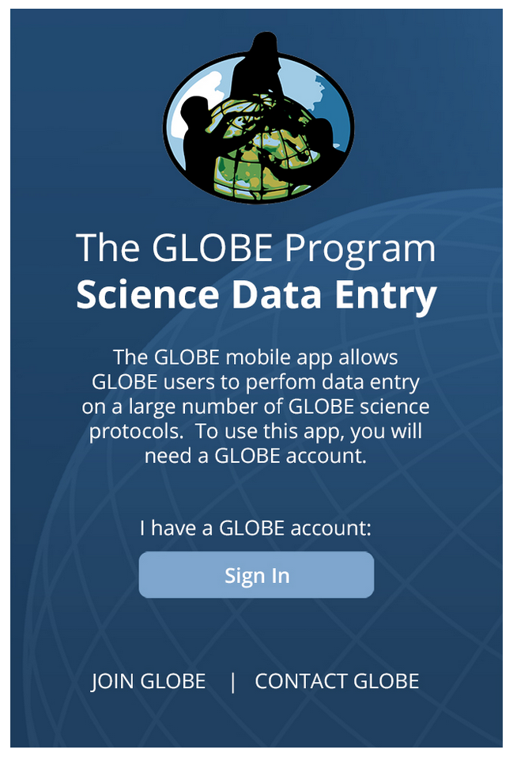
Report your Data to GLOBE
Its easy to report your data to GLOBE- its easiest with the Mobile Data App.
Mobile Data App: Download the GLOBE Science Data Entry app to your mobile device and select the right option.
For Android via Google Play
For IOS via the App Store
You can also enter data from a computer using the Internet, or email your data:
Data Entry from a computer: Upload your data to the official GLOBE science database
Email Data Entry: Send data in the body of your email (not as an attachment) to DATA@GLOBE.GOV

Slide 66
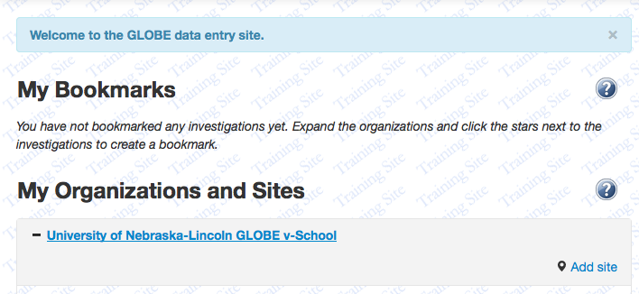
Entering your Data: Add a New Study Site
See how you can enter data about a new Land Cover site. Sign in, and you will see this field:
Add your site by
Clicking here

Slide 67
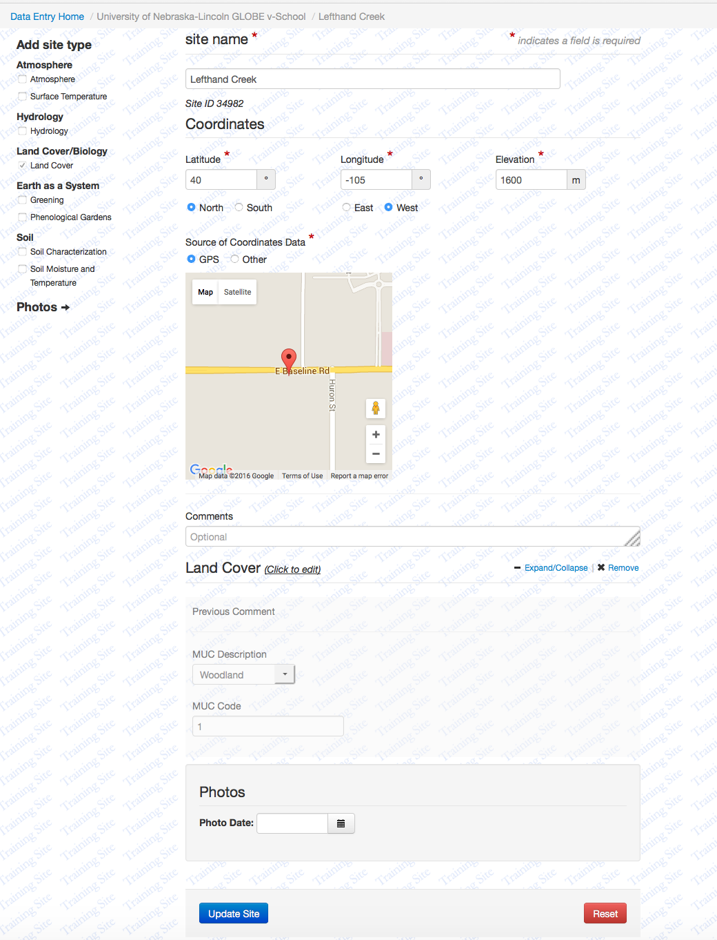
Entering your Data: Add Site Descriptors and Submit
Add your site name
Protocol area
GPS location
Add MUC description
Upload photos
Submit data

Slide 68
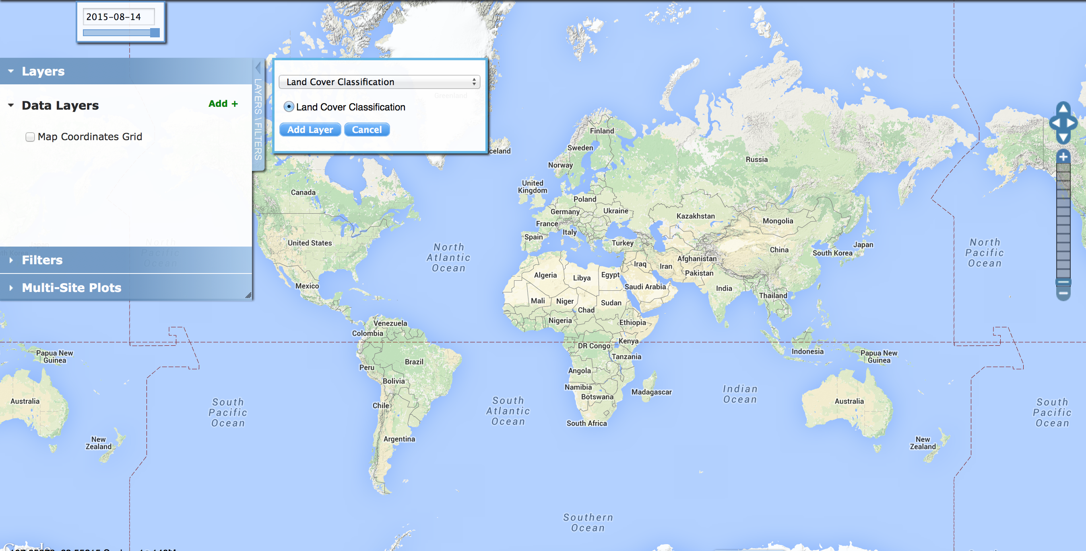
Visualize and Retrieve Data
GLOBE provides the ability to view and interact with data measured across the world. Once you have determined the MUC class of your study site, select the GLOBE Visualization System to map, graph, filter and export Land Cover Classification data that have been measured across GLOBE protocols since 1995.
Link to step-by-step tutorials on Using the Visualization System will assist you in finding and analyzing GLOBE data:
PDF version
Select Land Cover Classification data from drop down menu

Slide 69
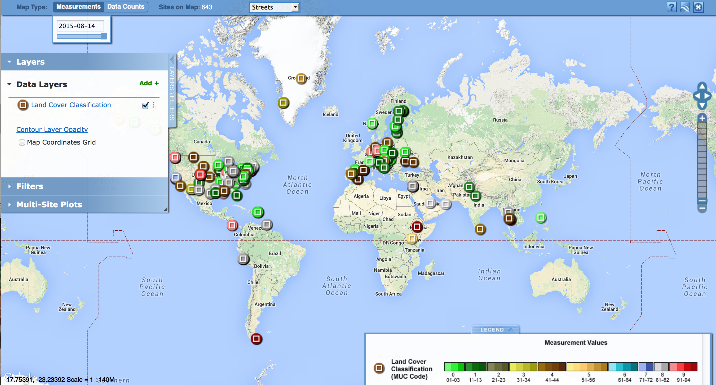
See where Land Cover Data has been reported by others
Select the date for which you need Land Cover Classification data, add layer and you can see where data is available.
Locations where Land Cover Classification data is available for the week you selected

Slide 70
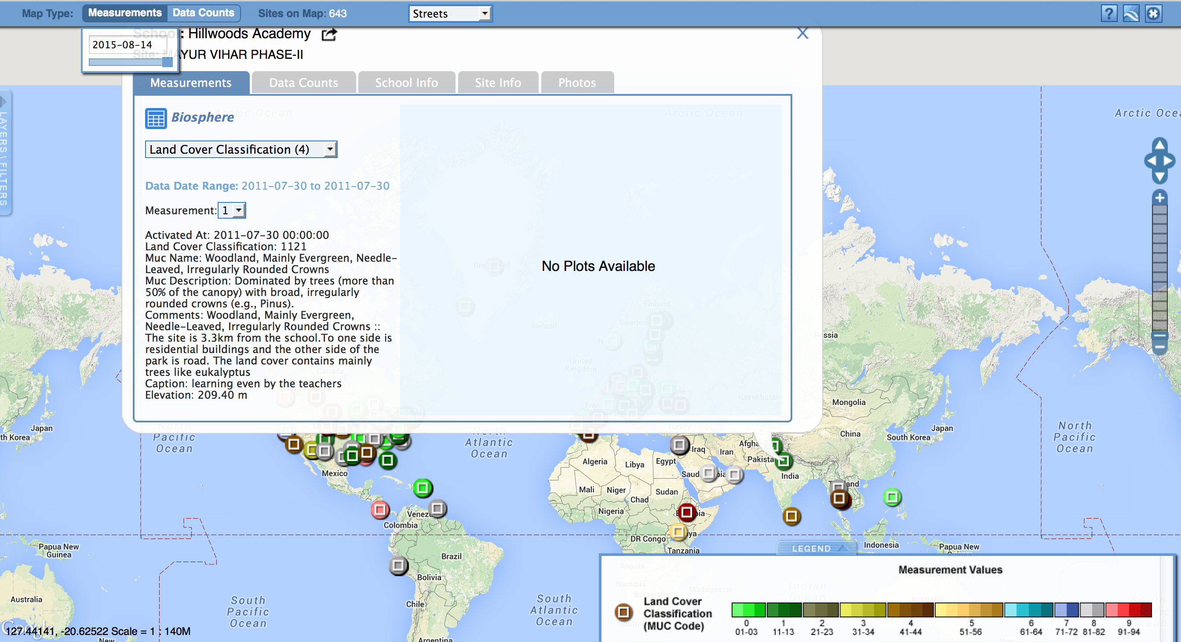
You can download data from any Land Cover Sampling Site in the GLOBE database
Clicking on a location will open to a map note providing Land Cover Classification data for that location and time. Follow instructions in the tutorial to download data as a .csv file for analysis.
Select the sampling site for which you need Land Cover Classification Data, and a box will open with a data summary for that site.

Slide 71
For Teachers: Ideas for Student Research Using Biosphere Data
What natural changes could alter the MUC class of these sites?
Is this MUC class typical for its latitude, longitude and elevation?
If someone only had photos of your site, what MUC class would he/she think this site is?
What other MUC classes are most similar to your site?
How will the land cover of your site affect local climate?
How will the land cover at your site affect your local watershed?
If you compared a Landsat image from ten years ago to one from today how do you think they would differ?
Does the nearest water body affect the vegetation of this site?
How are the land cover and soil characteristics of this site related?
Does the phenological data about your organism differ significantly from past years?
Are there trends in phenological data for your organism in different regions or latitudes?
How much carbon is stored in the vegetation near my school? Do different vegetation types store different amounts of carbon?

Slide 72
We are now at the end of the module. Before you take the quiz about the Introduction to the Biosphere Investigations, stop and think about these questions!
Land Cover measurements are part of what GLOBE Protocol area or Earth system sphere?
What is the difference between the biometry and the phenology protocols?
What is the difference between homogenous and heterogeneous sampling sites?
Can a sampling site be classified as homogenous if it has evenly dispersed trees, grasses and shrubs in the same vegetation? How big should your sampling site be, at minimum, in meters?
What vegetation classification scheme is used by GLOBE to ensure that land cover data is comparable from one site to another?
What protocols will you need to do in order to determine the MUC class of your land cover sampling site?
What are some examples of phenology investigations supported by GLOBE protocols?
Can you conduct Carbon Cycle protocols in your school yard or city park? What types of vegetation will you measure?
If you are unsure of any of the answers to these questions, you can find them by reviewing the slide set. Other questions? Take a look at the Frequently Asked Questions, next slide.

Slide 73
FAQs: Frequently Asked Questions
What if I don’t have enough time to complete the Land Cover protocols during the academic year?
Answer: It is recognized that it will take time, perhaps several successive years, to accumulate a set of Land Cover Sample Sites representative of each important type of land cover within your GLOBE Study Site. You may want to assign a land cover type to each of several student teams, so that no two teams are working in the same type of land cover and as many data are collected as possible.
How often should I collect biosphere data?
Answer: Some choose one site which they visit every year at the same time of year to record changes in biometry over time. Others choose to visit a single site twice a year in order to track seasonal changes. Often, their visits will correspond to the times of peak foliage and minimum foliage (drought or winter season).

Slide 74
You are done!
You have now completed the module. If you are ready to take the quiz, sign on and take the quiz corresponding to Introduction to Biosphere.
Welcome to the GLOBE Biosphere Investigation!
For More Information Contact
The GLOBE Program

Slide 75
Please provide us with feedback about this module. This is a community project and we welcome your comments, suggestions and edits! Comment here: eTraining Feedback Questions about the content of this module? Contact GLOBE: help@globe.gov
Credits
Slides:
Russanne Low, Ph.D., University of Nebraska-Lincoln, USA
Cover Art:
Jenn Glaser, ScribeArts
More Information:
The GLOBE Program
NASA Wavelength NASA’s Digital Library for Earth and Space Education Resources
NASA Global Climate Change: Vital Signs of the Planet
The GLOBE Program is sponsored by these organizations:
Version 6/24/20. If you edit and modify this slide set for use for educational purposes, please note “modified by (and your name and date)” on this page. Thank you.

Slide 76
Appendix 1

Slide 77
Appendix 2

Slide 78
Appendix 3
Site Set-up | Latitude, longitude, elevation, pacing | Carbon Cycle Sample Site | Once per Sample Site | Compass, flags, camera, GPS/phone
Carbon Cycle Tree Mapping | Tree location and ID | Carbon Cycle Sample Site | Once per Sample Site | 50 m flexible measuring tape, local tree ID guide, compass
Carbon Cycle Tree Circumference | Tree circumference | Carbon Cycle Sample Site | Once per year | Measuring tapes (150-300 cm)
Carbon Cycle Shrubs | Shrub type, shrub height | Carbon Cycle Sample Site | Once per year | Compass, 2-3 m stick marked in centimeters
Carbon Cycle Herbaceous | Herbaceous biomass | Carbon Cycle Sample Site | Once per year | OUTSIDE: beanbag, blindfold, measuring tape, clippers, small brown paper bags, INSIDE: balance, drying oven (optional)

