Slide 1
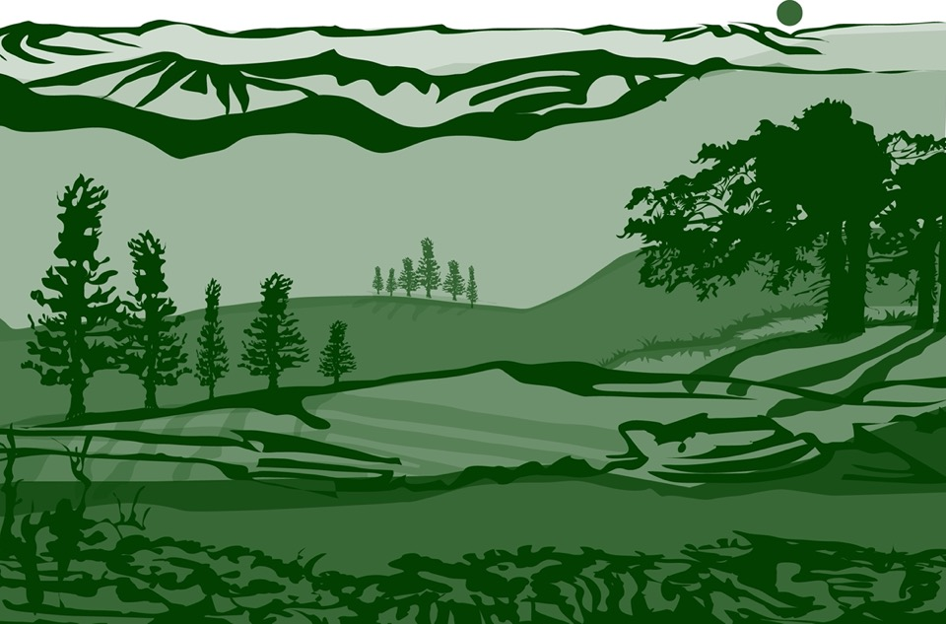

Slide 2



Overview
This module:
Reviews the selection of a GLOBE biometry site
Reviews the procedure for locating your site using a GPS receiver
Provides a step-by-step introduction of the protocol method
Learning Objectives
After completing this module, you will be able to:
Define land cover and explain how these measurements can support understanding of satellite images
Describe the importance of quality control steps in the the collection of accurate data
Explain why the MUC Classification system is used to classify your study site
Identify and document a Land Cover Sampling Site for use in GLOBE investigations
Upload data to the GLOBE database
Visualize data using GLOBE’s Visualization System

Slide 3
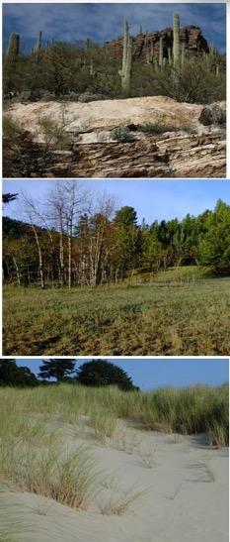
The Biosphere
The Biosphere is Earth’s zone of life. Every organism on Earth belongs to the biosphere. GLOBE has several ways to explore and measure components of the Biosphere through investigations in land cover, phenology, and carbon storage. Some GLOBE Hydrosphere investigations also include measurements of organisms: the macroinvertebrate and mosquito larvae protocols.
Like all parts of the Earth system, the Biosphere is subject to change. We can quantify these changes by taking measurements over time and compare what we saw in the past to what we see in the present.
You can find more information in:
Biosphere Introduction

Slide 4
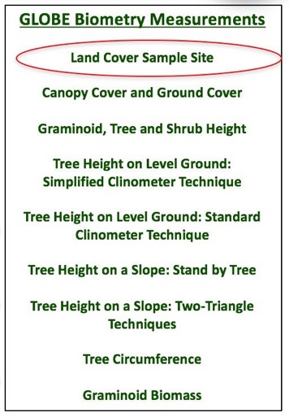
What is Biometry?
Biometry is the measuring of living things. A scientist is interested not only in the characteristics of vegetation at a study site, but also how it is distributed. How dense is the forest? Does sunlight penetrate to the forest floor? Is the landscape dominated by grasses? Has there been a recent disturbance, such as a forest fire or flood? These are questions that are answered by taking biometric measurements.
In this protocol, you will be describing your land cover study site. Land cover is a general term for the differences in vegetation we see on the land. Your land cover measurements will assist you in determining the MUC classification of your study site.

Slide 5
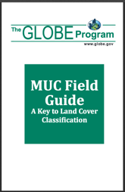
GLOBE Land Cover Investigations
Land cover is a general term used to describe what is on the ground covering the land. Different land cover terms are used to describe the differences we see when we look at the land. Scientists classify land cover based on established criteria. This is done so that there is a consistent use of terms among people. For instance, what one person may call a forest living in the tropical Amazon may be quite different from a person living in northern Canada. Different species of trees live in these places, trees may be of different heights and the amount of ground and canopy cover may be quite different. For this reason, we need a standardized way to describe land cover.
GLOBE uses a land cover classification scheme called Modified UNESCO Classification (MUC). There are many different types of classification schemes used. These are often designed for specific places or regions. MUC can be used around the world and allows people to contribute to a global database. When you complete your biometry measurements, you will have the data you need to identify the land cover classification of your study site.
.

Slide 6


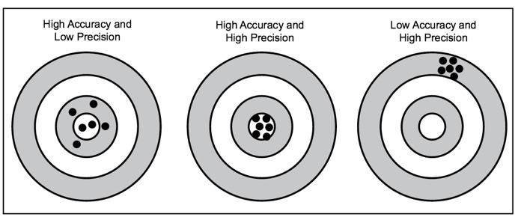
Accuracy vs. Precision
Accuracy is a measure of how well the data describe a phenomenon. Precision is demonstrated when repeated measurements yield the same outcome. In most GLOBE protocols, you are asked to take a measurement 3 times – allowing for you – as well as others – to determine the precision of your data.

Slide 7


Protocol at a Glance
When Anytime. Determining some of the biometry measurements are best done during the growing season
Where Homogeneous 90 m x 90 m vegetation patch
Time Needed 1-2 hours for initial description, plus subsequent visits to conduct the biometry measurements
Prerequisites None
Key Instruments 50 m measuring tape, GPS receiver or phone, compass
References:
Land Cover Sample Site protocol Field Guide (pdf)
Land Cover Sample Site Data Sheet
GPS Field Guide and GPS Data Sheet
MUC Field Guide or MUC System Table and MUC Glossary of Terms

Slide 8
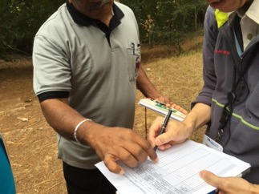
Timing and Frequency of Data Collection
To lay out your MUC, you only need to visit the site once.
Time required for initial set up and description: estimated 1-2 hours.

Slide 9
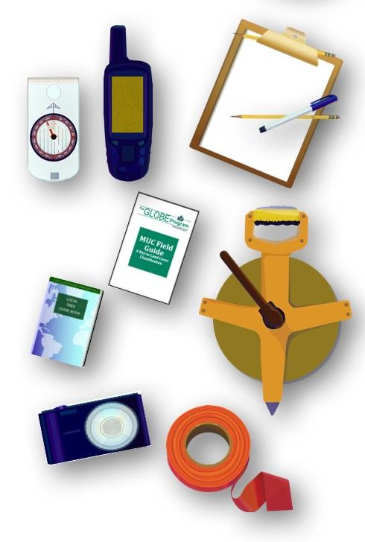
Describe your Land Cover Sampling Site
Needed Equipment:
GPS Receiver or phone
Compass
Clipboard
Pen or Pencil
Camera
Permanent tree markers (optional, if you plan to return to the site)
50 m tape measure
Local vegetation field guides
Needed Documents:
Land Cover Sample Site protocol Field Guide (pdf)
Land Cover Sample Site Data Sheet
GPS Field Guide and GPS Data Sheet
MUC Field Guide or MUC System Table and MUC Glossary of Terms

Slide 10
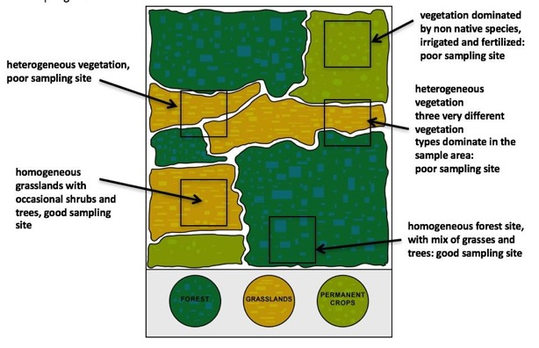
Homogeneous vs. Heterogeneous Sampling Site Diagram
A homogenous site can contain many different species and growth forms (trees, grasses, and shrubs) but the sampling site should exhibit the same species and density of plants over the whole sampling area:

Slide 11
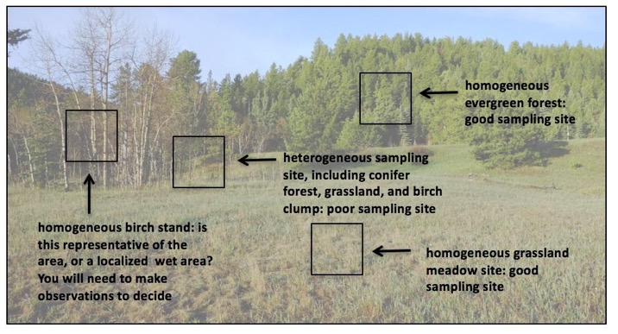
Site Selection in the Field:
Locate the approximate center of the 90 m x 90 m homogeneous site.
Note: The site can be much larger than 90 m x 90 m as long as it is homogeneous.

Slide 12
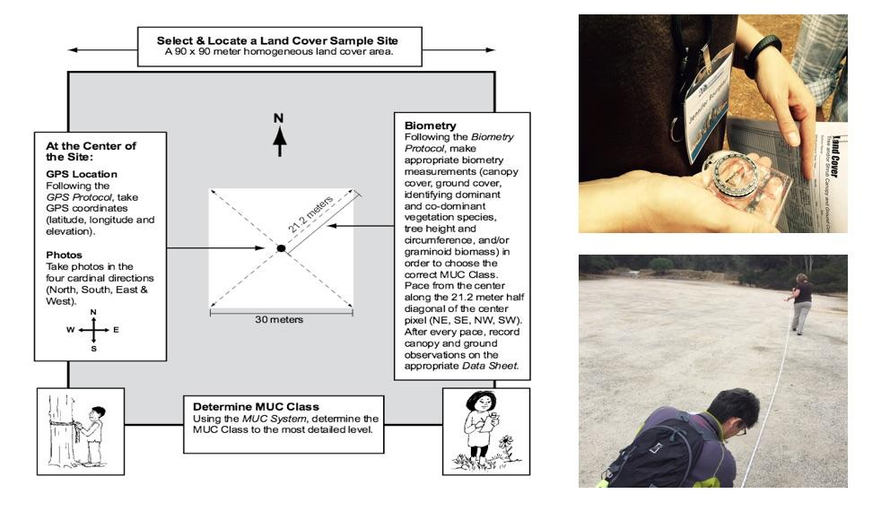
Diagram of Sample Site Considerations

Slide 13
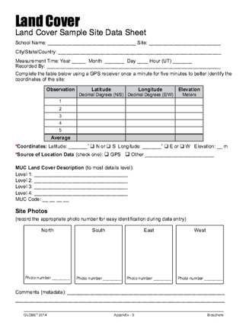
In the Field
1. Fill in the top portion of the data sheet
If you do not have a phone available, follow GPS Protocol, reproduced here:
2. Collect positional data using a GPS receiver.
Identify the latitude, longitude and elevation of the center following instructions from the GPS field guide, below:
Turn on the receiver, making sure that you are holding it vertical and you are not blocking the antenna’s view of the sky. In most receivers the antenna is internal and is located at the top of the receiver.
After an introduction message, the receiver will start to search for satellites. Some receivers may display the previous latitude, longitude, and elevation values while it is locking onto satellite signals.

Slide 14
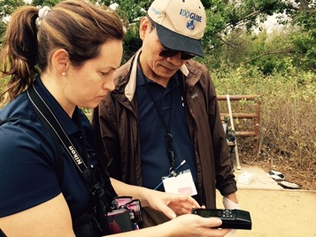
Using a GPS Receiver
Wait for the receiver to indicate that at least four satellites have been acquired and that a good measurement is available. In most receivers, this is indicated by the appearance of a “3-D” message.
At one minute intervals and without moving the receiver more than one meter, make five recordings on a copy of the GPS Investigation Data Sheet
Record all of the following displayed values:
a. Latitude
b. Longitude
c. Elevation
d. Time
e. Number of satellites
f. “2-D’ or “3-D” status icons

Slide 15
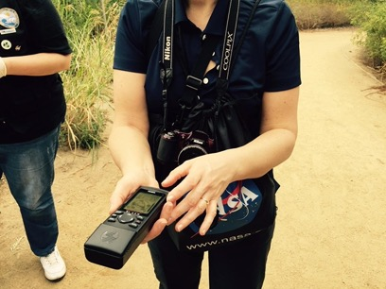
Calculate your average reading and verify.
Turn off the receiver.
Average all five latitudes, longitudes, and elevations.
Confirm for yourself that your results make sense.
You should be able to get a rough estimate of your latitude and longitude by looking at a globe or local map.
Copy and submit all GPS readings as your site location to the GLOBE data portal.

Slide 16
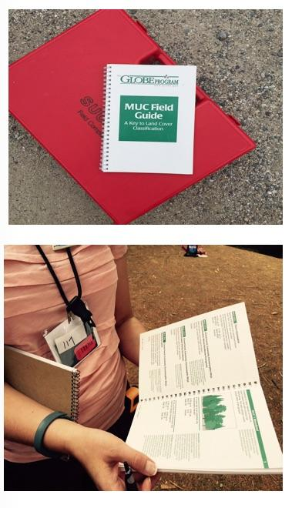
Determine MUC Class of Sample Site
3. Determine MUC class to the most detailed level using either the MUC Field Guide. You will likely need to make measurements following the Biometry Protocol Field Guides to help determine the class.
Note: This step may take several visits as you collect necessary biometry data.
For most sites, it will be necessary to measure Canopy Cover and Ground Cover and Graminoid, Tree and Shrub Height before you can complete your Land Cover Sample Site Description.

Slide 17
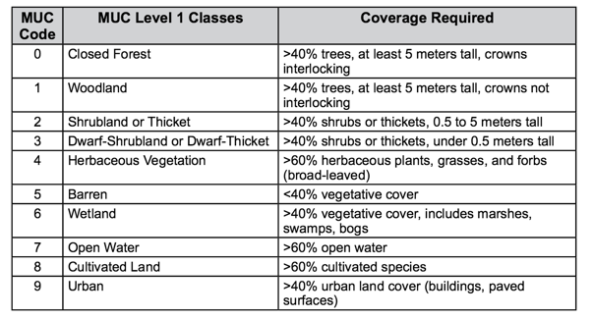
MUC Guide has a dichotomous key structure
.
When classifying land cover using the MUC System, always begin with the most general classes (Level 1) and proceed sequentially to the more detailed (higher level) classes. For example, the Level 2 classes within Closed Forest are Mainly Evergreen, Mainly Deciduous, and Extremely Xeromorphic (Dry). These Level 2 classes contain more detail than the Level 1 class, Closed Forest, and they may all be collapsed into the Closed Forest class. In other words, any member of one of these three Level 2 classes is always a member of the Closed Forest Level 1 class. See table below. This is a condensed version of MUC, showing only the Level 1 and Level 2 classes, and how your biometry measurements are needed to determine the appropriate MUC class. Conduct the appropriate biometry protocols to determine the MUC class of your sample site. You will likely be able to determine Level 3 or Level 4 classes once you have collected sufficient data.

Slide 18
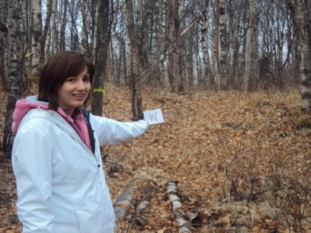
Make Notes and Photograph the Site
4. Note any unusual or helpful metadata. Record this in the appropriate place on your Land Cover Sample Site Data Sheet.
5. Using the camera, take a photo in each cardinal direction – north, south, east and west. Use your compass to determine the directions. Record each photo number in the correct arrow on Your Data Sheet.
You are done!

Slide 19


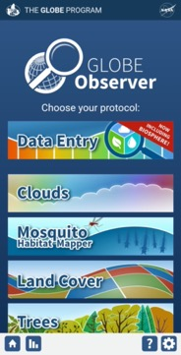
Report Data to the GLOBE Database
1.Desktop Data Entry: Log environmental data directly on the GLOBE website.
2.Email Data Entry: If connectivity is an issue, data can also be entered via email.
3.GLOBE Observer App: The app allows users to enter data directly from an iOS or Android device for any GLOBE protocol.

Slide 20
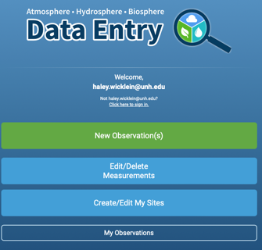

Entering your data via the GLOBE website or GLOBE Observer App
Log in to the GLOBE Data Entry webpage and click “Create/Edit My Sites”.
Then click “Add site”.

Slide 21
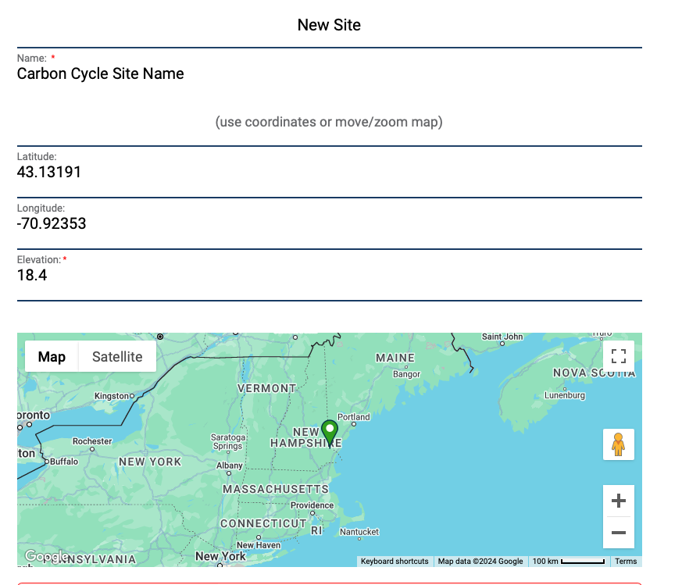
Site Name and Coordinates
Choose a name for your site
Type in coordinates or move the map to add your latitude and longitude

Slide 22
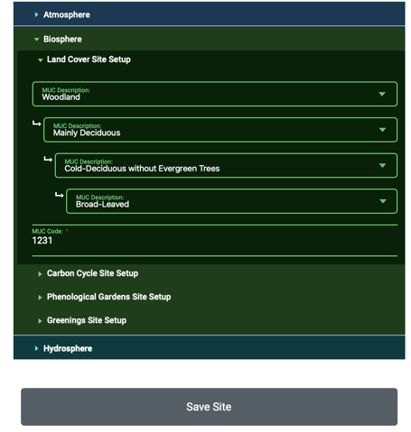
Site Name and Coordinates
Use the dropdown menus to enter your MUC classification
Click Save Site

Slide 23

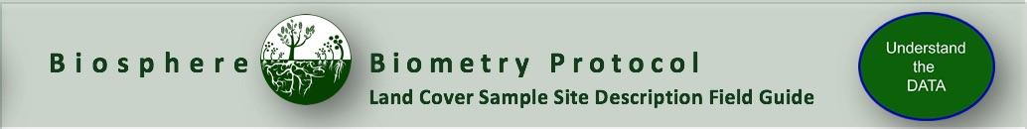
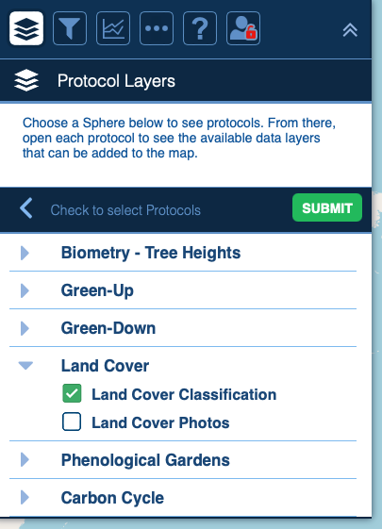
Visualize and Retrieve Data
GLOBE provides the ability to view and interact with data measured across the world. Use the visualization tool to map, graph, filter and export Land Cover Classification data that have been measured across GLOBE protocols since 1995.
Click the layers icon.
Click Submit.
Select Land Cover Classification under the Biosphere drop down
See video tutorials on using the GLOBE Visualization system.

Slide 24
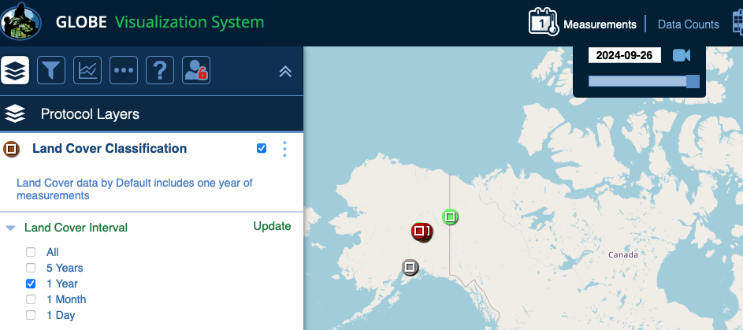
Visualize and Retrieve Data
Select the date for which you need Land Cover Classification data.

Slide 25
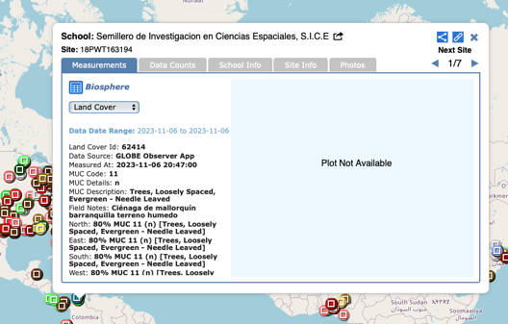
Visualize and Retrieve Data
Select the sampling site for which you need Land Cover Classification Data, and a box will open with a data summary for that site.
Click on the table icon to view the data in a table and download it as a .csv for analysis.
Clicking on a location will open to a map note providing data for that location and time.

Slide 26
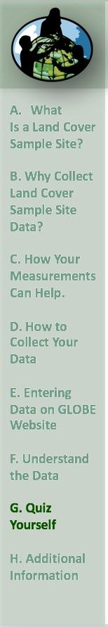

Review questions to help you prepare to do the Land Cover Sampling Site Description associated with the GLOBE Biometry Protocol
Land Cover measurements are part of what GLOBE Protocol area or Earth system sphere?
What GLOBE protocols require you to establish your Land Cover Sampling Site?
What is the difference between homogenous and heterogeneous sampling sites?
Can a sampling site be classified as homogenous if it has evenly dispersed trees, grasses and shrubs in the same vegetation?
How big should your sampling site be, at minimum, in meters?
What instrument do you use to determine the latitude and longitude of your sampling site?
What vegetation classification scheme is used by GLOBE to ensure that land cover data is comparable from one site to another?
What protocols will you need to do in order to determine the MUC class of your land cover sampling site?
Define these terms: accuracy and precision. Why do GLOBE protocols usually specify that measurements be taken at least 3 times?

Slide 27
Are you ready to take the quiz?
You have now completed the slide stack. If you are ready to take the assessment, sign on and take the assessment corresponding to Land Cover Sample Site Description Field Guide Protocol.
When you pass the assessment, you are ready to establish your Land Cover Sample Site!

Slide 28


Some Questions for Future Research using your Land Cover Data:
What natural changes could alter the MUC class of these sites?
Is this MUC class typical for its latitude, longitude and elevation?
If someone only had photos of your site, what MUC class would he/she think this site is?
What other MUC classes are most similar to your site?
How will the land cover of your site affect local climate?
How will the land cover at your site affect your local watershed?
If you compared a Landsat image from ten years ago to one from today how do you think they would differ?
Does the nearest water body affect the vegetation of this site?
What types of animals do you think live here?
How are the land cover and soil characteristics of this site related?

Slide 29
Credits:
Slides:
Russanne Low, Ph.D., University of Nebraska-Lincoln, USA
Rebecca Boger, Ph.D., Brooklyn College, NYC, USA
Cover Art:
Jenn Glaser, ScribeArts
More Information:
The GLOBE Program
NASA Earth Science
NASA Global Climate Change: Vital Signs of the Planet
Questions about content in the module? Contact GLOBE: training@nasaglobe.org

