Slide 2
Overview
This module…
Teaches why carbon is an important element in ecosystems and how it cycles through ecosystems.
Introduces:
  systems and systems terminology
  modeling and modeling terminology
Describes a simple modeling activity using the Paperclip Factory simulation and more complex Biomass Accumulation Modeling activity
Provides a brief overview of Global Carbon Cycle models

Slide 3
Learning Objectives
After completing this module, you will be able to:
Provide definitions of a system and a model
Use a diagram to describe a system.
Explain why models are useful tools for predicting system responses
Use the Paperclip Factory, Biomass Accumulation Model, and Global Carbon Cycle Models to teach students about systems modeling.
Estimated time to complete module: 2 hours

Slide 4
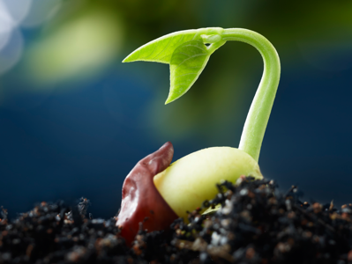
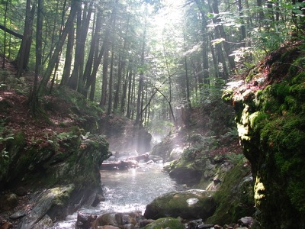

Review: What is the Carbon Cycle?
Carbon is the most abundant element in living things. It is also present in the Earth’s atmosphere, soil, oceans, and crust. The Global Carbon Cycle is the movement of carbon between the atmosphere, land, and oceans.
The global carbon cycle is a key regulator of Earth’s climate system and is central to ecosystem function. Rising CO2 is the dominant contributor to climate change. Understanding how ecosystems cycle and store carbon is key to understanding solutions to climate change.

Slide 5
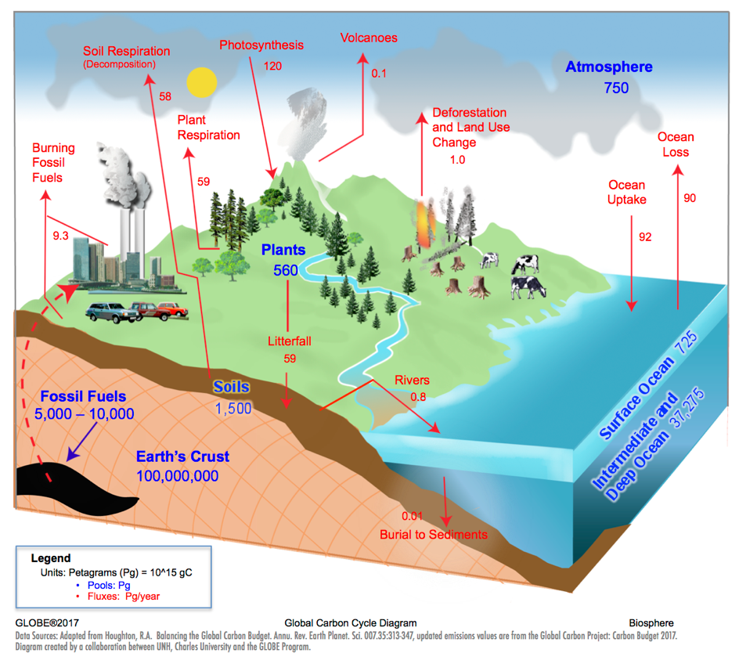
The Carbon Cycle
Carbon Pools:
A place where carbon resides, measured in Petagrams (Pg)
Carbon Fluxes:
Movement of carbon between pools, measured in Petagrams/year
(Pg/year)

Slide 6
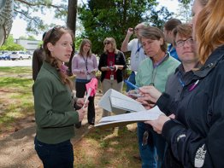
Review: Why Collect Carbon Data?
Scientists collect carbon cycle data to understand how terrestrial ecosystems will respond to warmer temperatures and higher CO2.
Carbon cycle data collected with GLOBE will contribute to a better understanding of the relationship between carbon storage in plants and surface climate.

Slide 7
What is a System?
Definition: A collection of interconnected parts that function as a complex whole, through which matter cycles and energy flows.
Why does GLOBE use a ‘systems thinking’ approach to understand the Carbon Cycle?
Systems are an important unifying concept across the K-12 curriculum.
The actual carbon cycle is extremely complicated. Simplifying it as a system that focuses on the most important elements can help us understand why the atmosphere is changing and what it might look like in the future.
Frayer Model
Examples
Non-
Examples
Term or
Concept
Characteristics
Simply Defined
Use the Frayer Model template to help students define a ‘system’

Slide 8
System Characteristics
Systems can be made up of systems
The whole is greater than the sum of its parts
A system will change if one or more of its parts are removed
A system has qualities that could not be achieved simply by adding up its individual parts
Systems can be closed or open.
Systems can have feedbacks.

Slide 9

STOP!
Can you think of an example of a system?
Can you think of a non-example (something that is not a system?)

Slide 10
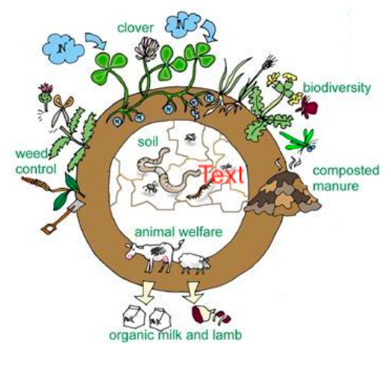

System Examples and Non-Examples
Examples of Systems:
  Bicycle
  Farm
  Factory
Non-Examples:
  Rock
  Shoe
  Jug of milk

Slide 11
Systems Vocabulary
Open System – a system that continuously interacts with its environment. Transfer of information, matter, or energy across the system boundary. Implies inexhaustible supply of energy available to the system.
Closed System – a system that is self-contained in regard to transfer of matter. No matter crosses the system boundary, but energy does. The universe is the only truly closed system.

Slide 12
Systems Vocabulary (continued)
Positive feedback– a system response that keeps the system moving in the same direction, amplifying the initial perturbation, or forcing, to the system. Example: when snow melts, the darker ground beneath absorbs more of the sun’s energy, leading to more snowmelt.
Negative feedback – a system response that balances or reverses an initial perturbation to the system. Example: the thermostat in your house turns the furnace on when it is too cold. Once the house warms up, the thermostat turns the furnace off, maintaining a steady temperature.

Slide 13
Systems Vocabulary (continued)
Pool (or stock, reservoir) – the storehouse of material in a portion of the system environment.
Flux (or flow) – the movement of material from one pool to another, per unit time.
Input (or flux in) – the flow of material entering a pool.
Output (or flux out) – the flow of material leaving a pool.
Steady State (or dynamic equilibrium) – a condition in which the input equals the output, resulting in a steady pool size.

Slide 14
Systems Diagram
A 1-box stock and flow diagram visualizes the basic system components.
Input Flow (Flux In)
Pool
(stock, reservoir)
Output Flow (Flux Out)
Per unit time
Per unit time
Once a basic system has been represented in a diagram, modelers can add feedbacks and define relationships using mathematical equations so that the system can be tested and observed over time and under varying conditions.

Slide 15
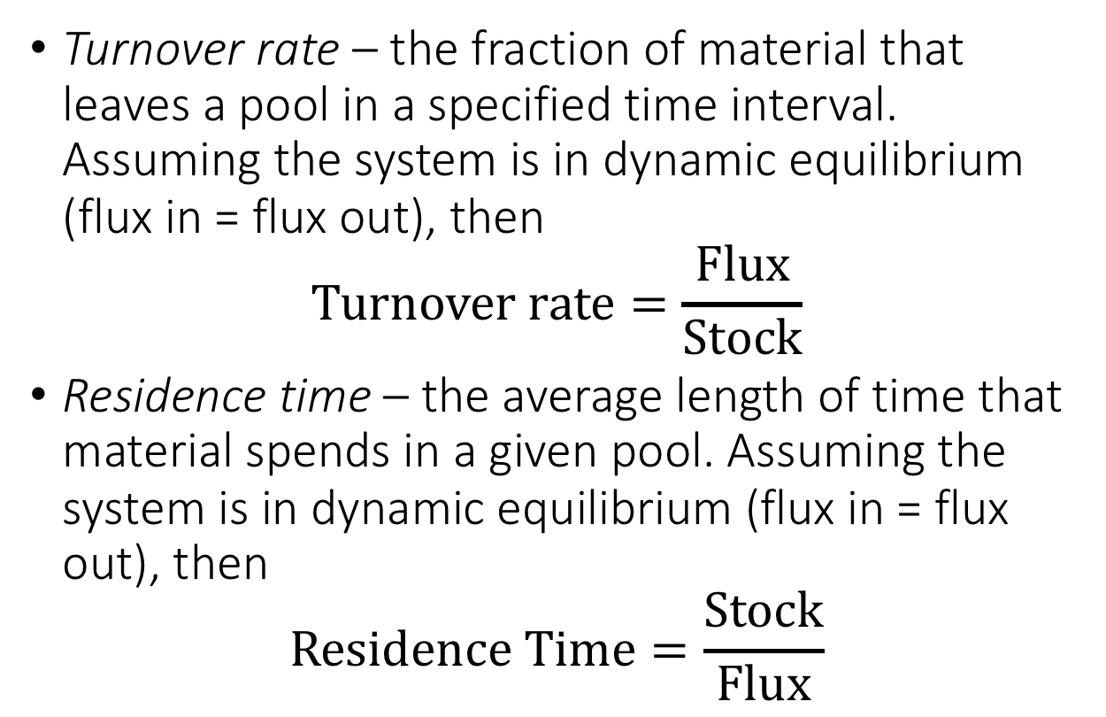
Systems Vocabulary (continued)
Turnover rate – the fraction of material that leaves a pool in a specified time interval. Assuming the system is in dynamic equilibrium (flux in = flux out), then
$$Turnover rate=\frac{Flux}{Stock}$$
Residence time – the average length of time that material spends in a given pool. Assuming the system is in dynamic equilibrium (flux in = flux out), then
$$Residence Time=\frac{Stock}{Flux}$$

Slide 16
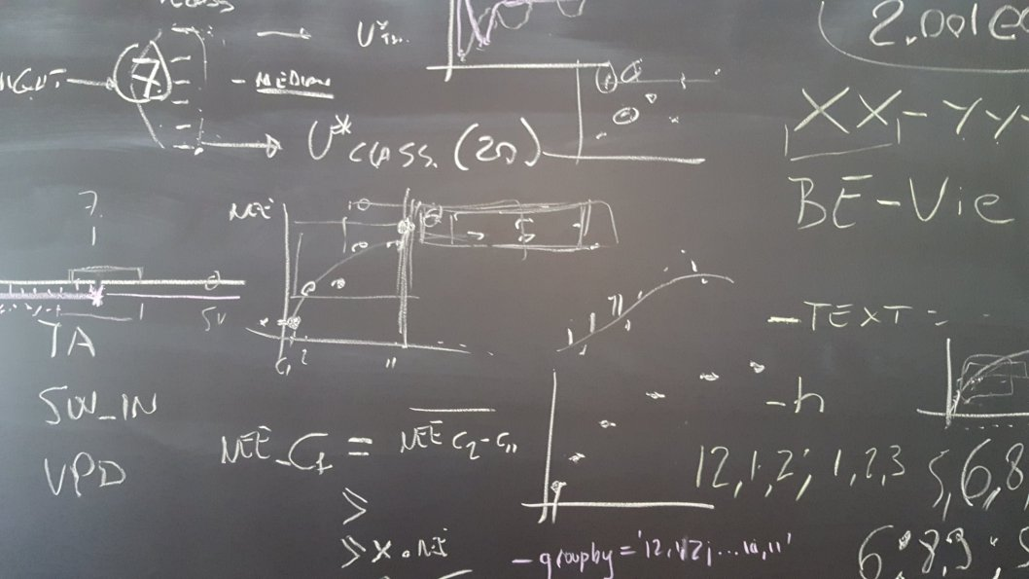
What is a Model?
Models are tools that help us understand and explain systems that are too complex or difficult to observe or comprehend on our own.
Some models have complex mathematical equations, but we can still learn a great deal from models with basic math functions like addition, subtraction, multiplication, and division.
Photo credit: Elizabeth Burakowski, 2016
A complex set of model equations for friction velocity. Not all models are this complex. Simple models with basic math are equally useful.

Slide 17
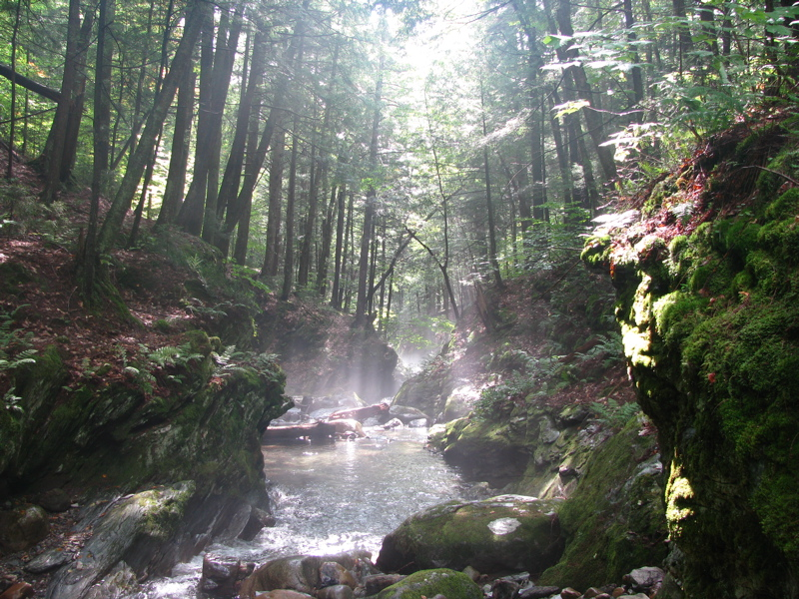
Why use models?
Scientists use models to examine the fundamental behavior of a system, such as how carbon is stored and cycled through a forest.

Slide 18
Modeling Systems with the 1-Box Model
The 1-box model represents an individual component of a system. Using these models introduce concepts like inputs, outputs and residence time and show how these can produce particular patterns of change over time.
Input Flow (Flux In)
Pool
(stock, reservoir)
Output Flow (Flux Out)
Per unit time
Per unit time
*A pool can also be referred to as a stock or reservoir, a flux can also be referred to as a flow.

Slide 19
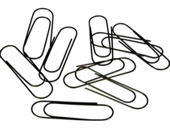
Paperclip Simulation and Model
Paperclip Simulation - Introduction to Systems Thinking
(60 minutes + 30 math extension).
Student Outcomes:
Simulate a basic system
Collect, record, and analyze data
Create a 1-box model to learn modeling and system terms
Manipulate variables to obtain an expected outcome
Materials:
Simulation materials: paperclips, bell, signs, and roles
Class Data Table (paper OR .xls) and Projector AND/OR Whiteboard/large paper with markers
Student Worksheets & Paper Clip Simulation Data Table

Slide 20
The Paperclip Simulation
In the paperclip factory simulation, students identify the components of a system in a 1-box model:
Production
Store Inventory
Purchases
Components of the paperclip factory model include:
Production (inputs),
Store Inventory (pool), and
Purchases (outputs)
When production = purchases, inventory is at “steady state” or equilibrium.

Slide 21
The Computer Based Model Paperclip Simulation
The interactive, online computer simulation version of the model is available at:
https://exchange.iseesystems.com/public/globeprogam/paperclip-tutorial-model
Follow the prompts and instructions on the web tool to help familiarize students with the isee modeling tool. Using the Paperclip tutorial will prepare student for using other GLOBE Carbon Cycle Models such as the Biomass Accumulation Model and the Global Carbon Cycle Models.

Slide 22
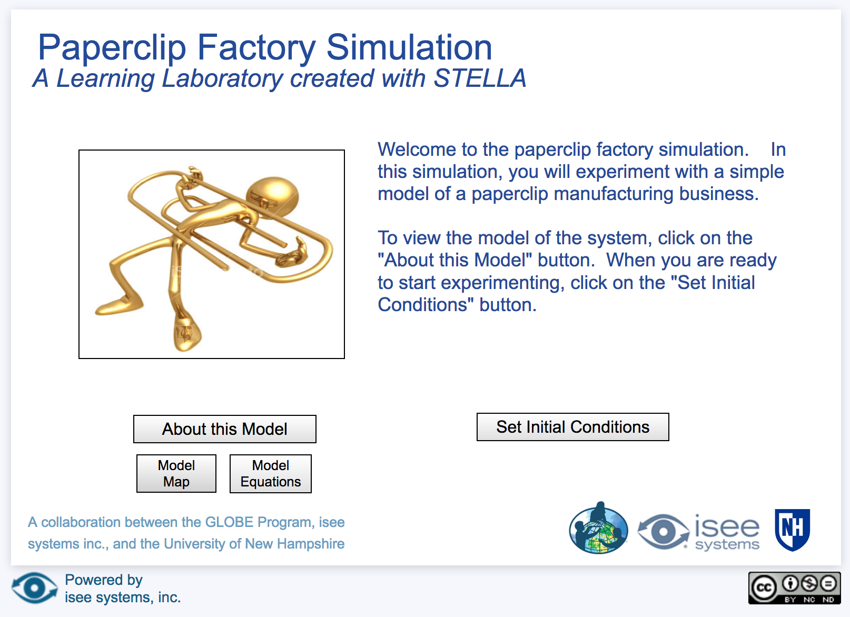
The Computer Based Model Paperclip Simulation
Homepage of the Paperclip Factory Simulation. Click on ‘About this Model’ to guide students through the construction of the model step-by-step.

Slide 23
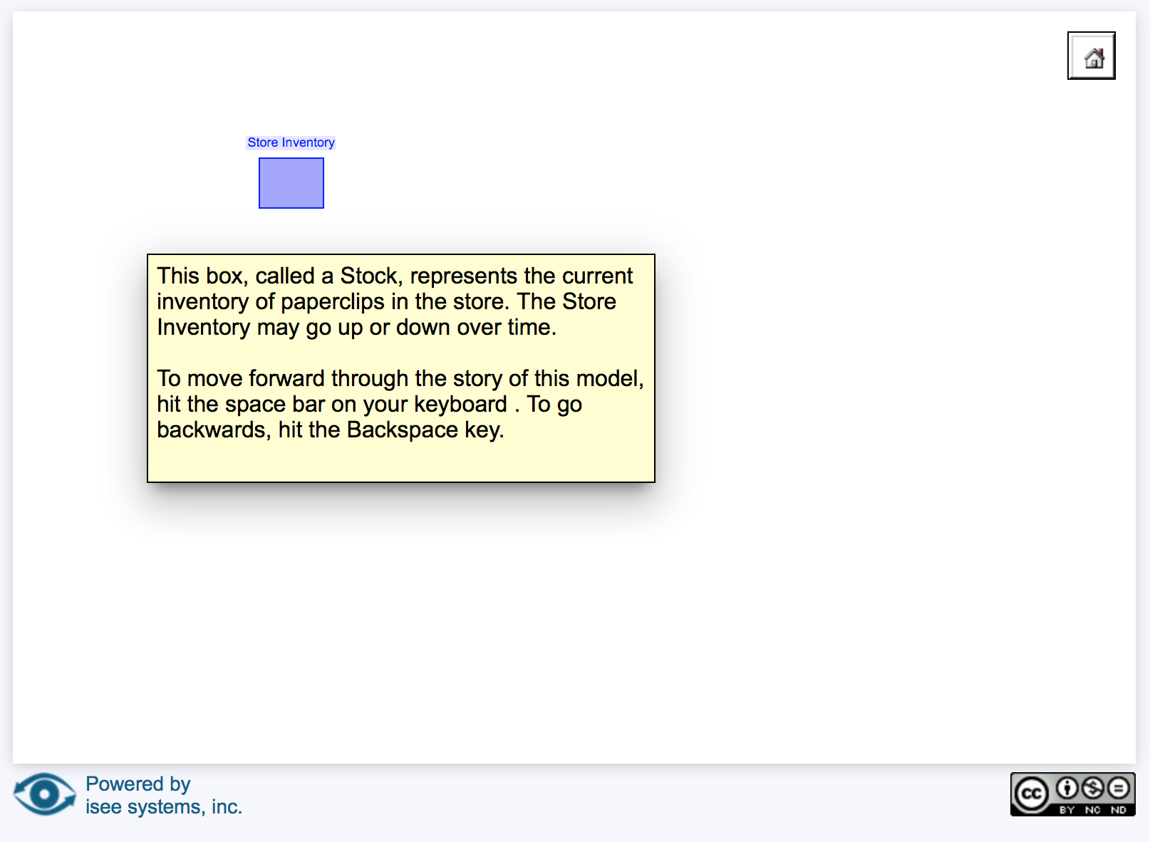
Paperclip Model Story
This module shows how the model is constructed step-by-step, explaining each component of the paperclip model. Follow the instructions in the yellow box to advance through the model story online.
Boxes in the isee system represent stocks, or pools
Hit the home button in the upper right to return to the homepage.

Slide 24
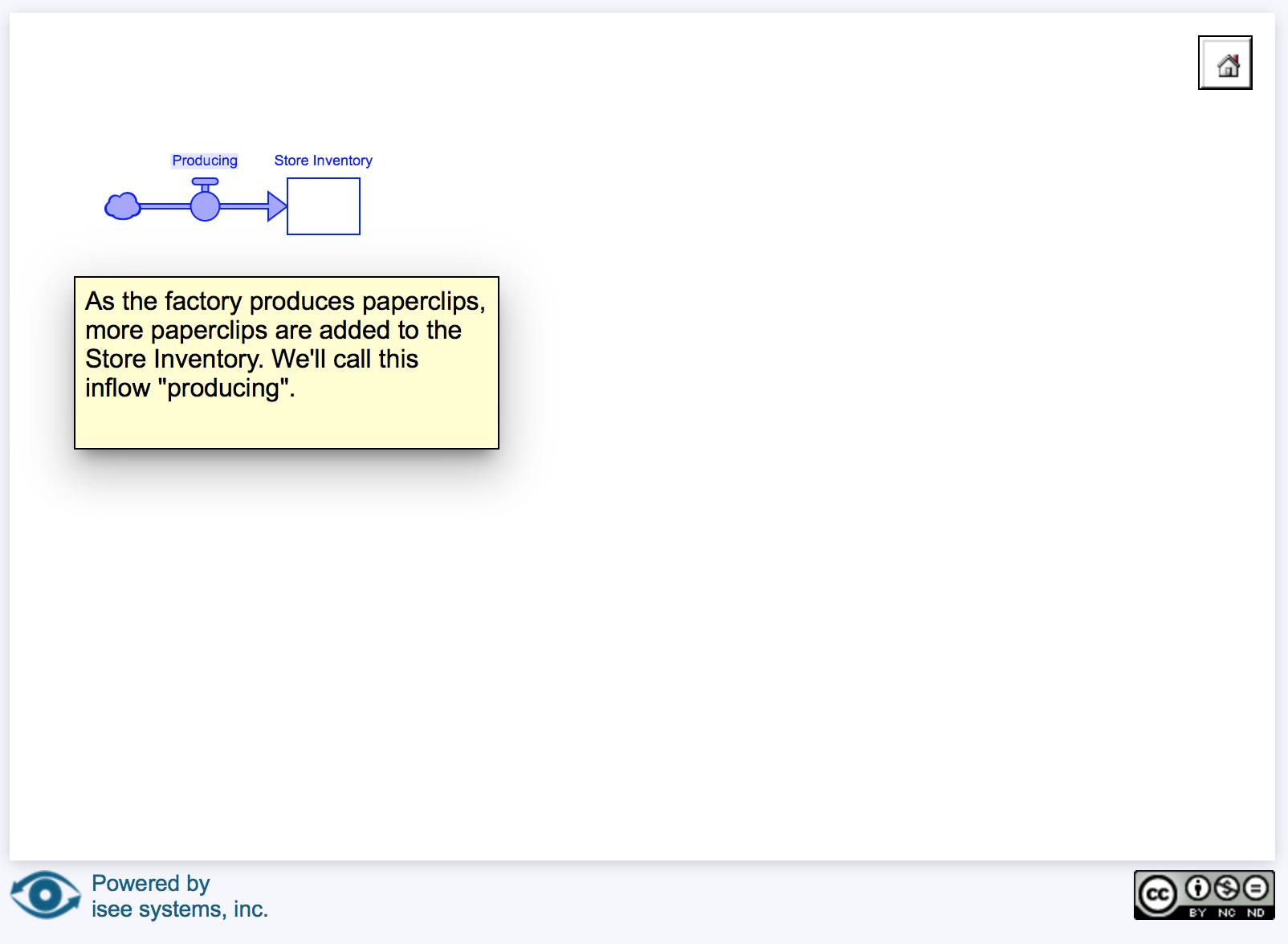
Paperclip Model Story
Each component of the model is highlighted in blue one by one, with a brief description of the component in the yellow box.
Valves in the isee system represent fluxes, or flows

Slide 25
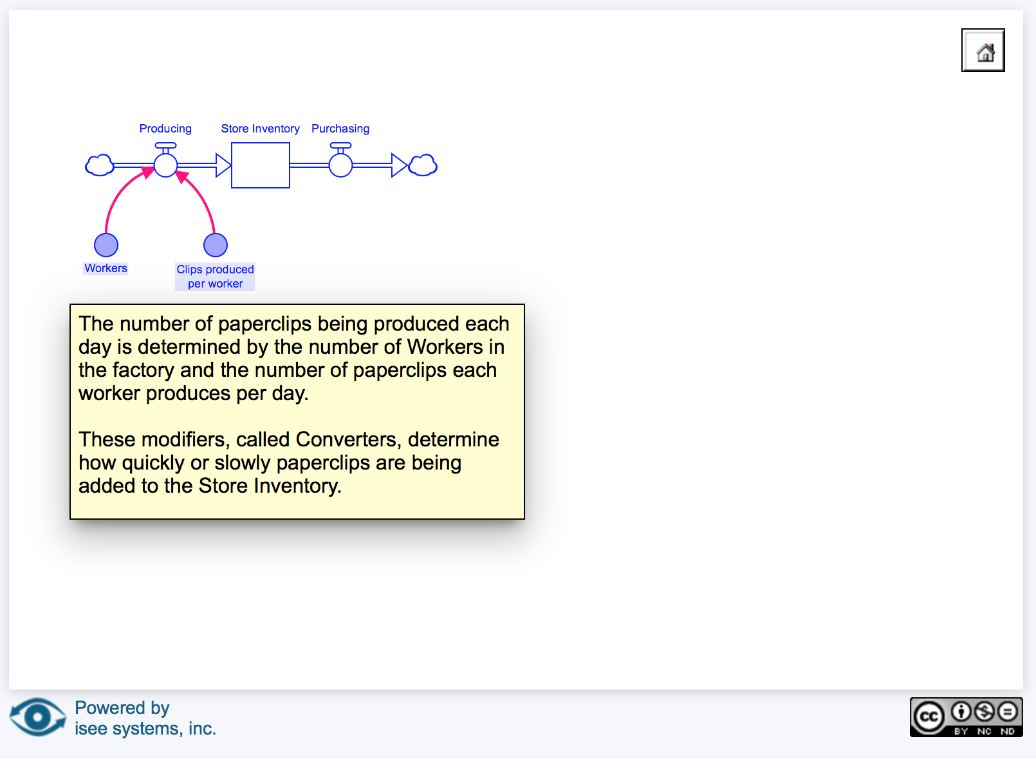
Paperclip Computer Model: Converters
The paperclip computer model introduces a new modelling term- converters. Converters modify flows. In the diagram below, paperclip production is modified by the number of workers and the number of clips produced by each worker.
Circles with pink arrows are called converters. They can modify the flow in and out of the stocks.

Slide 26
Paperclip Model Map
Click on Model Map from the homepage to see the entire model and it’s individual components.

Slide 27
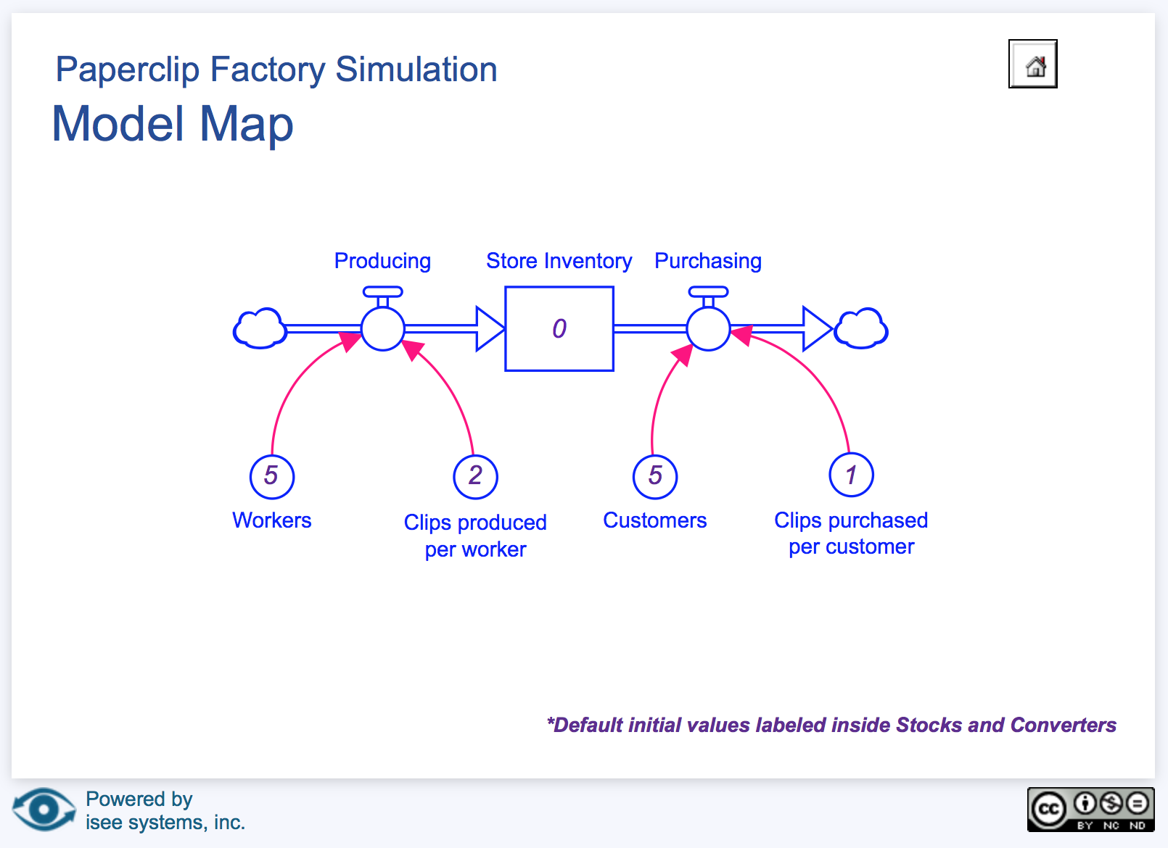
Paperclip Model Map
In addition to the model story, students can view the entire model by clicking on the Model Map on the home page. Below is the complete model map for the Paperclip Factory Simulation. Default initial values are show in each component. .

Slide 28
Set Initial Conditions to get started
Press the ‘Set Initial Conditions’ button on the homepage to start using the model.

Slide 29
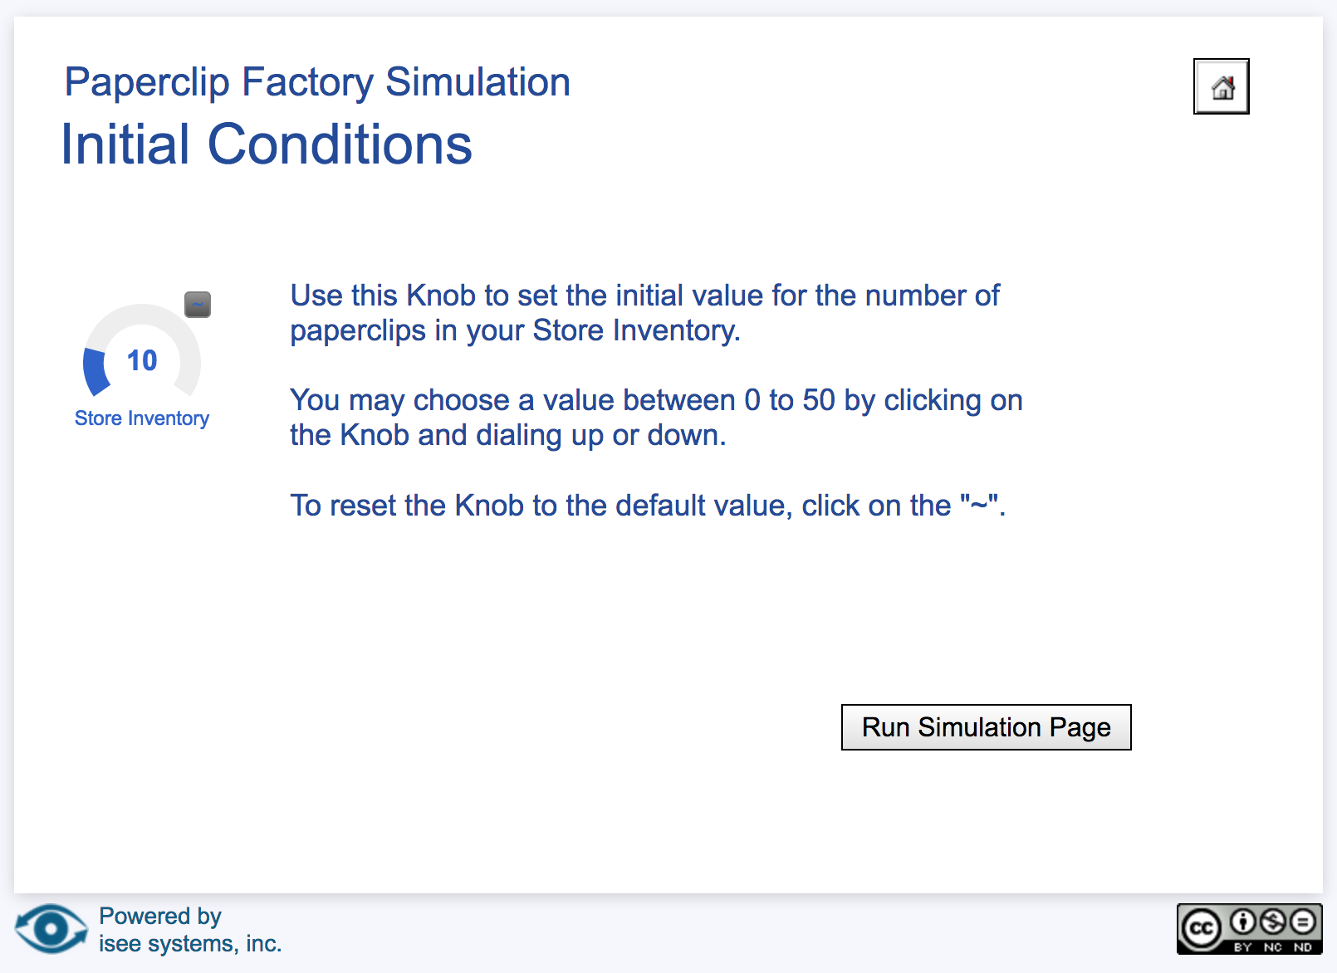
Set initial conditions for the paperclip Store Inventory.
After you’ve set the initial inventory using the knob on the left, click on ‘Run simulation page’ to set the converters.
Drag and click cursor on the knob to set the initial inventory. This is your pool, or stock.

Slide 30
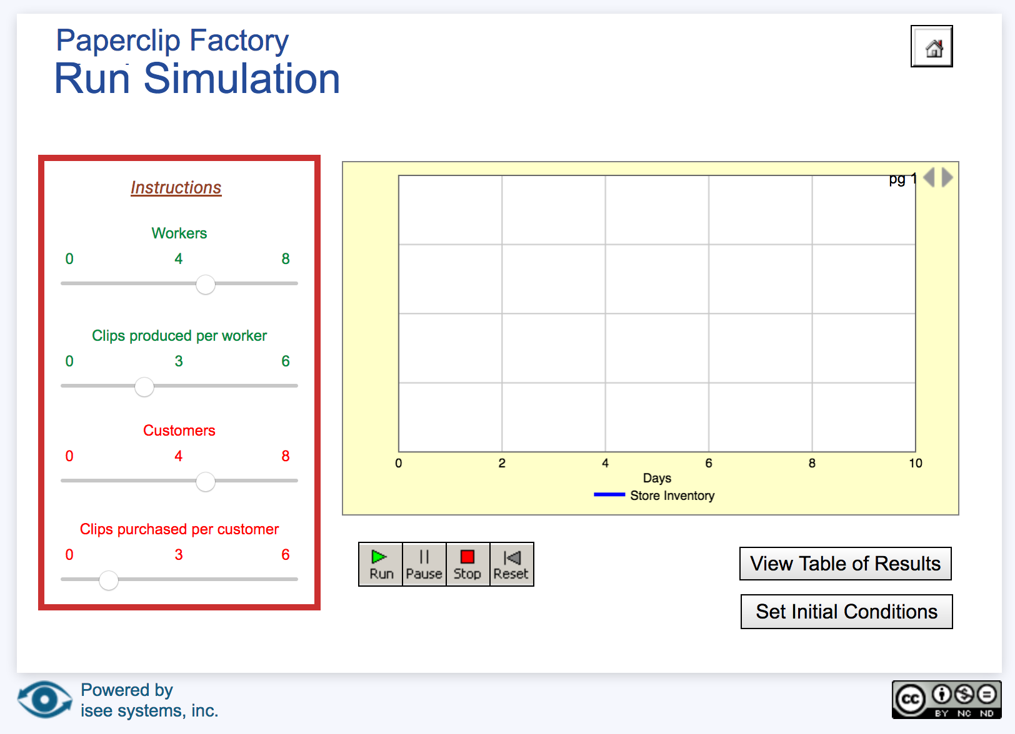
Set converters to modify flows, and run the simulation.
The Run Simulation page for the paperclip factory.
Set the following from the left menu:
# of workers
Clips produced per worker
Customers
Clips purchased per customer
Press the green ‘Run’ button to start the simulation.

Slide 31
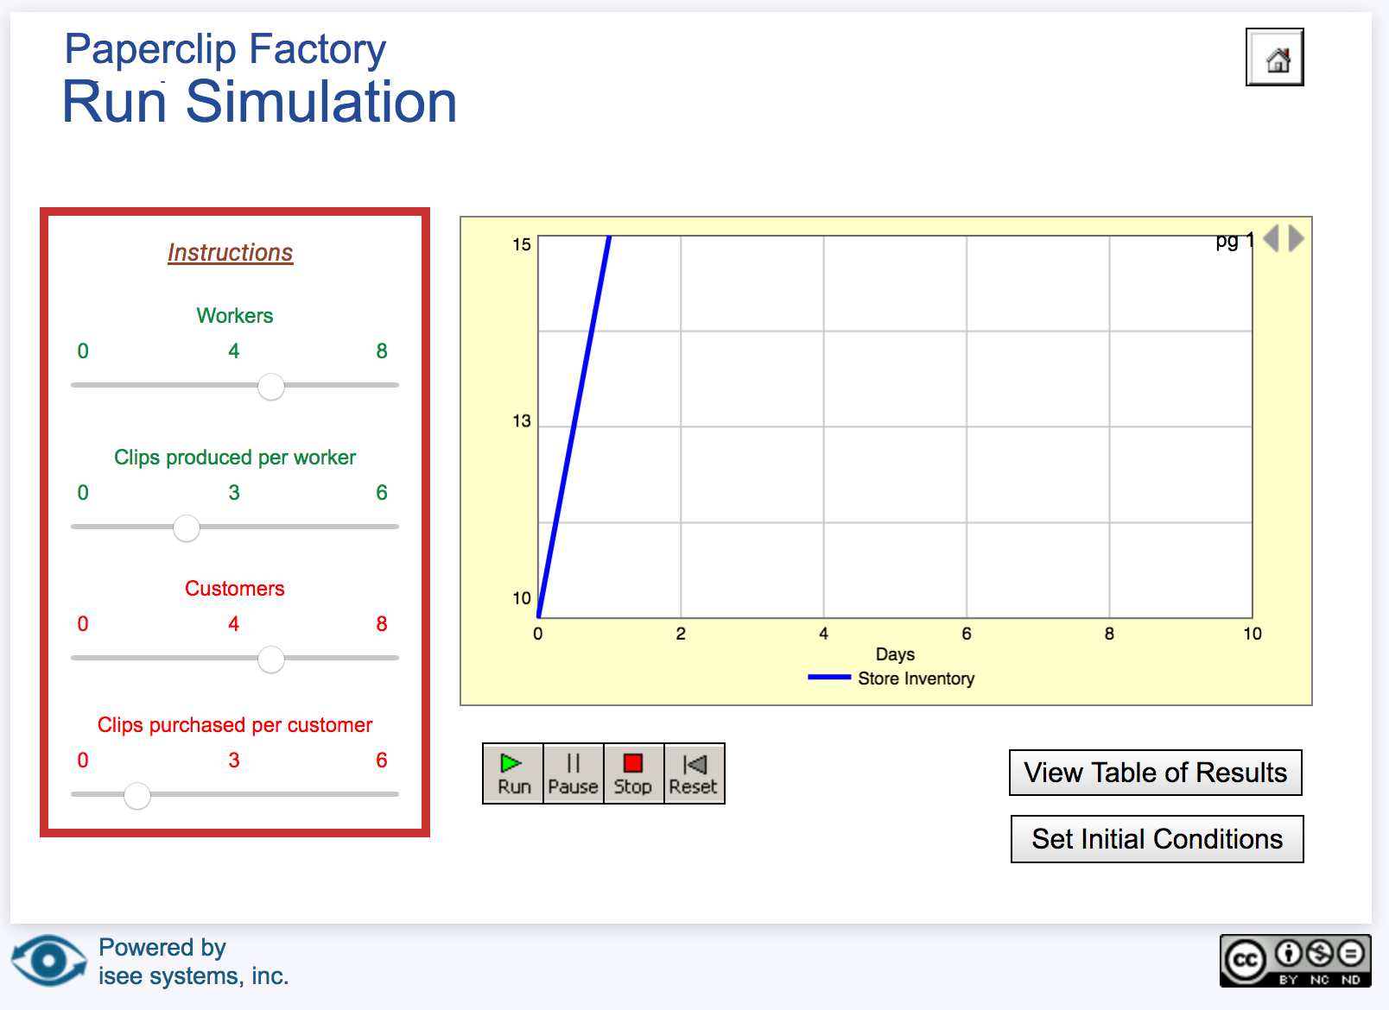
Run the paperclip simulation
Let the simulation run for one day. Have the students calculate the inventory based on the initial store inventory and the options they selected on the left menu. Compare their calculated value with the graph.
Press the pause button to temporarily stop the simulation. We’ve paused on day 1.
The graph shows the number of days on the x-axis (horizontal) and store inventory on the y-axis (vertical).

Slide 32
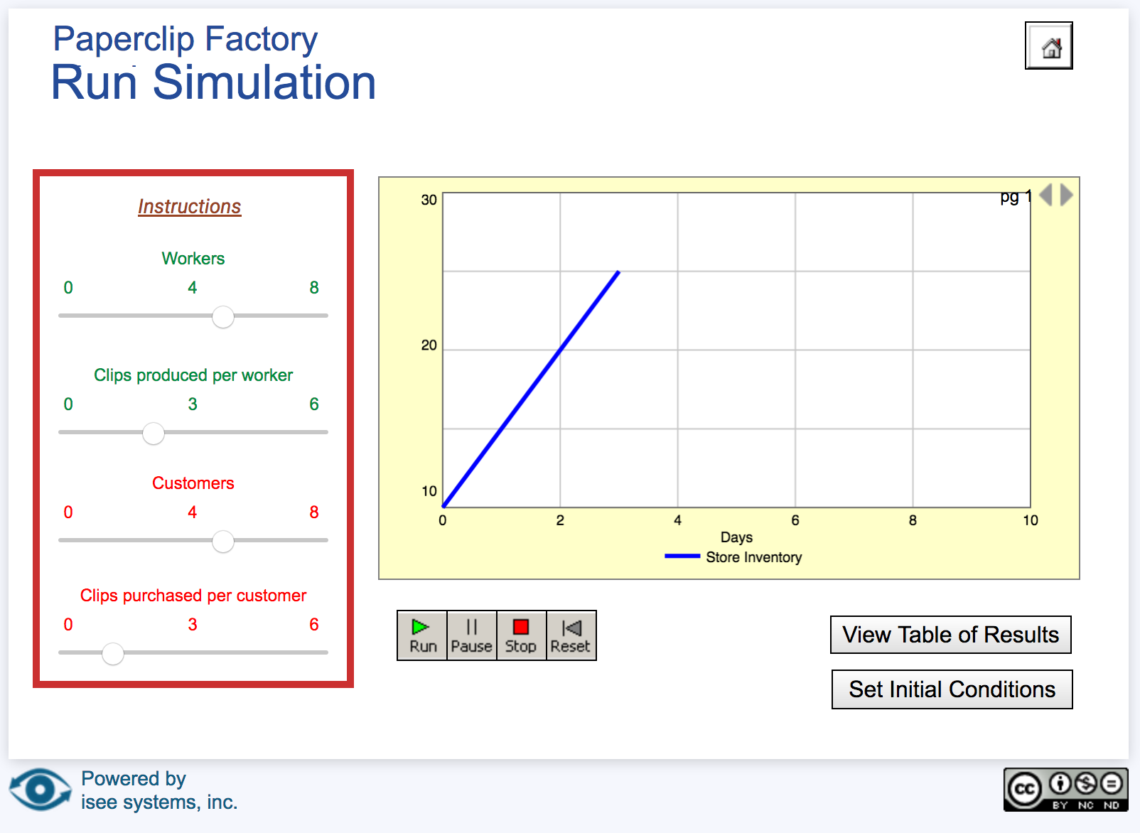
Run the paperclip simulation
Let the simulation run for several more days and watch the store inventory increase. Prompt students using systems terminology. Why is the inventory increasing? Because the flux in (worker production) is greater than the flux out (customer purchases).
After three days of simulation, the store inventory is now 25 paperclips.
Students can also click on ‘View Table of Results” to examine the model calculations.

Slide 33
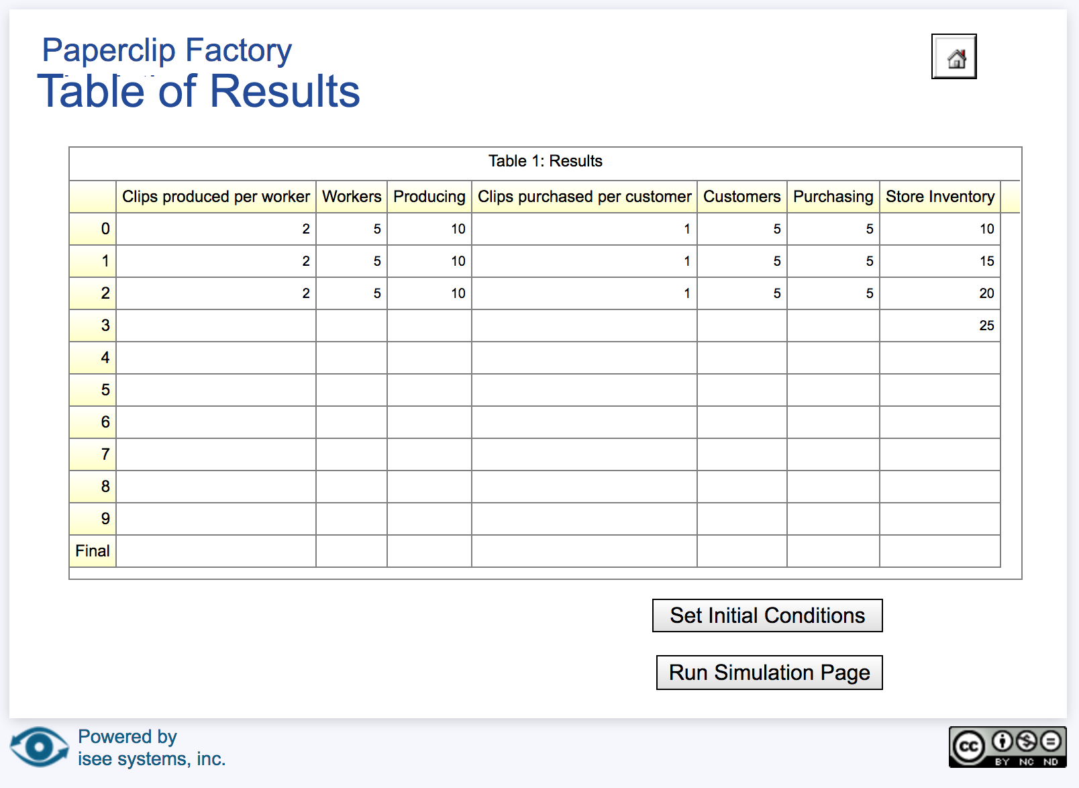
Examine the table of results
In addition to the graph display of results, students can compare pencil and paper calculations to the results table. The graph in the previous slide is plotting the store inventory (y-axis) over time (x-axis; number of days in column 1 in the table below).
After three days of simulation, the store inventory is now 25 paperclips.

Slide 34
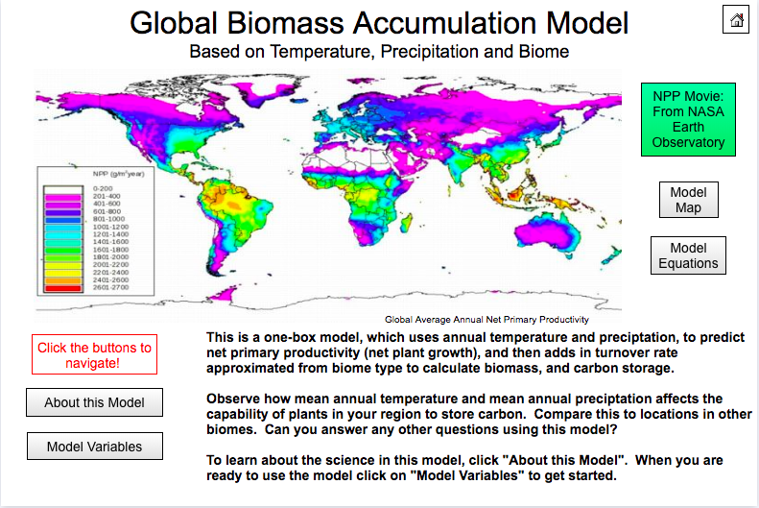
Biomass Accumulation Model
The Biomass Accumulation Model uses temperature and precipitation to predict net primary productivity (NPP, net plant growth), and then adds turnover rate approximated from biome type to calculate biomass and carbon storage.
Explore the Biomass Accumulation Model: https://exchange.iseesystems.com/public/globeprogram/biomass-accumulation-model
Like the Paperclip Model, you can explore the Model Story by clicking the ’About This Model’ button.

Slide 35
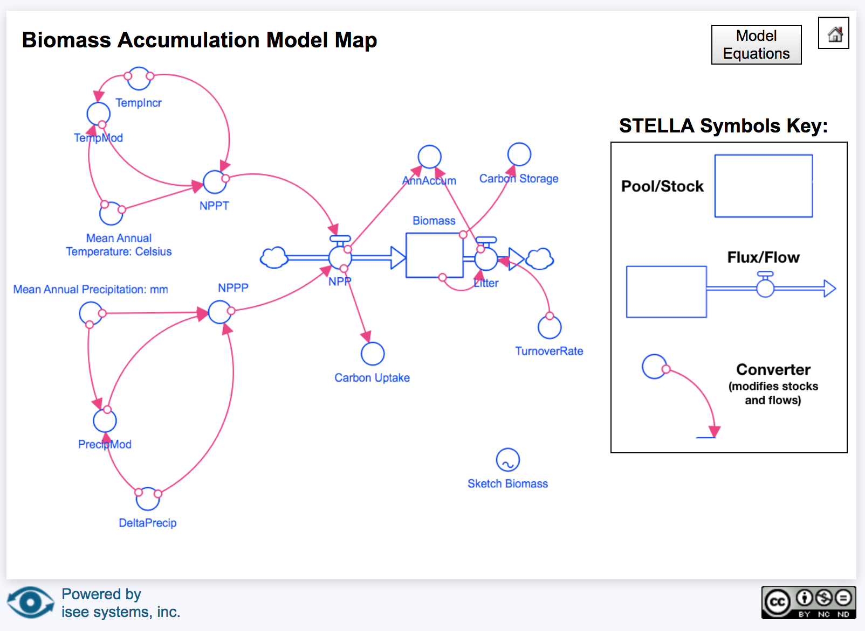
Biomass Accumulation Model Map
At first glance, it can be difficult for students to see where the box and arrows are. We have highlighted the box and arrows in red below. The small blue circles and pink arrows pointing toward the blue flux arrows are converters that modify the flows into the box, or stock. The Teacher Guide introduces students to the simple computer model and allows them to identify and describe the effects of different model variables through isolation testing.
Model Map of the Biomass Accumulation Map. The cloud symbols represent places where other pools could connect in a more complex model.

Slide 36
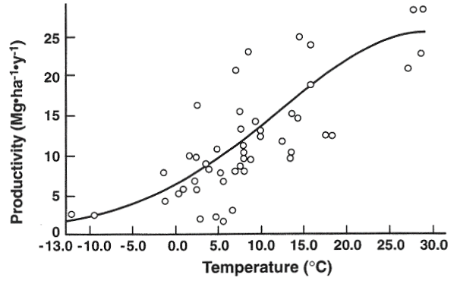
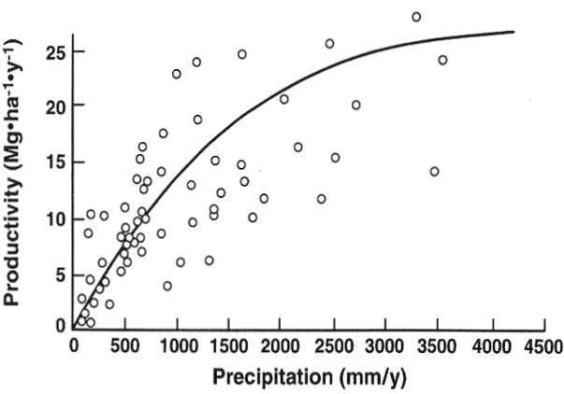
Biomass Accumulation Model
Two converters in the model modify net primary production (NPP, biomass accumulated in the plant pool), driven by temperature and precipitation using the equations illustrated below. For more information on how the model works, open the online model and click 'Model Story'.
Figure 1. Leith equation relating NPP and temperature.
Figure 2. Leith equation relating NPP and precipitation.

Slide 37
Biomass Accumulation Model
To get started with the Biomass Accumulation Model, click on the Model Variables button and follow the instructions to guide you through initial conditions.

Slide 38
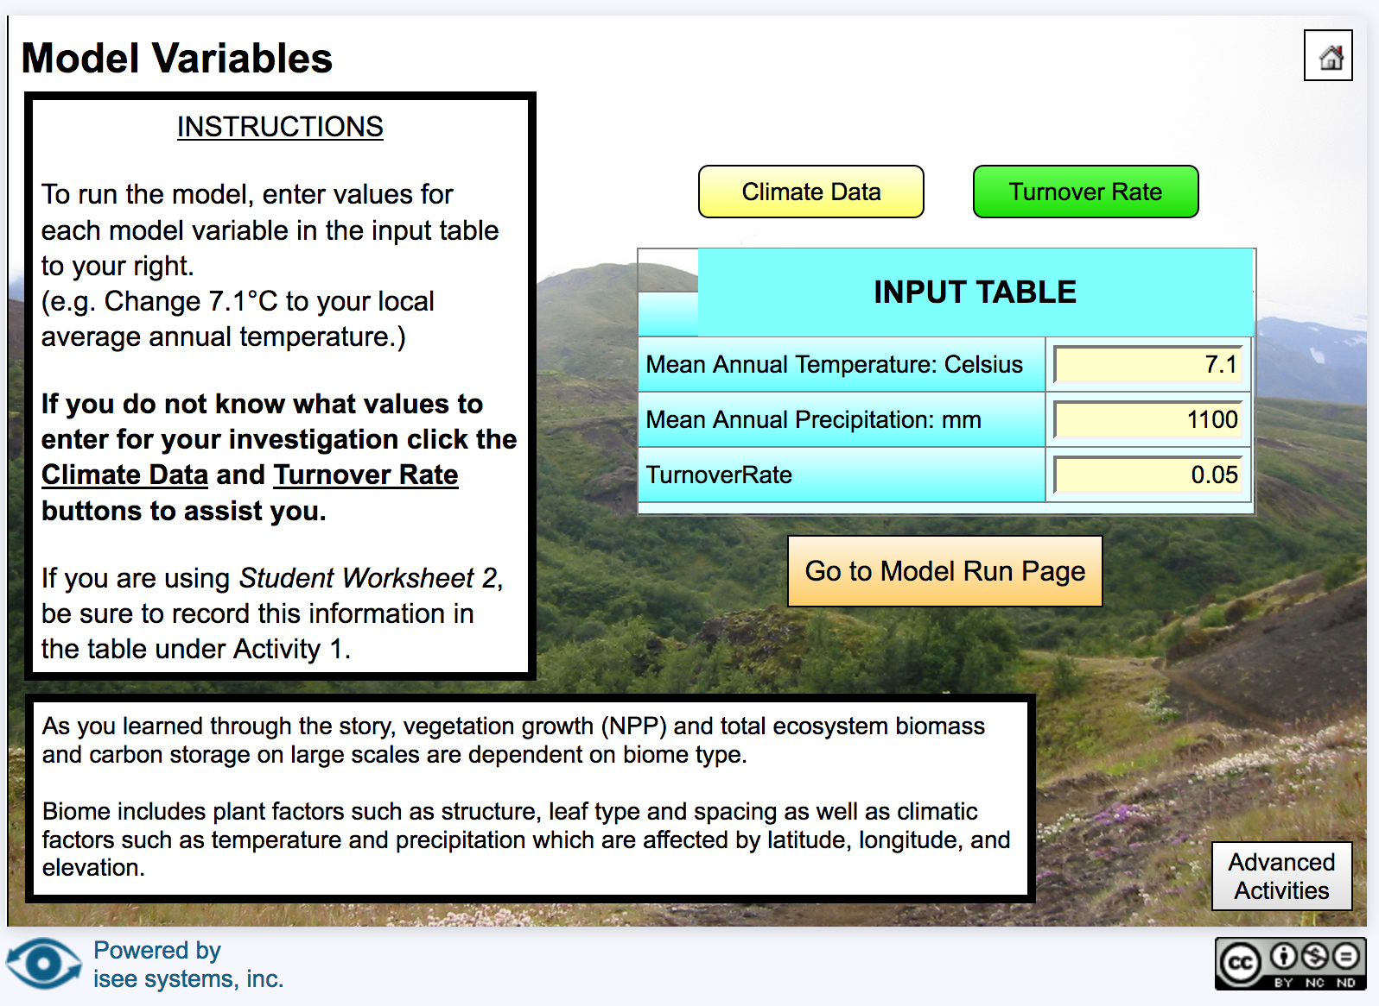
BAM: Model Variables
Follow the instructions on the left menu to change the model inputs: Mean Annual Temperature, Mean Annual Precipitation, and Turnover Rate.
Use the Teacher Guide and associated Student Worksheets to understand how biomass changes with temperature and precipitation. ​

Slide 39

Biomass Accumulation Model Tutorial
This 5 minute video tutorial introduces the Biomass Accumulation Model and describes how to change model variables and complete a model run.
Video requires the free PowerPoint Add-In “Web Video Player”. Go to Insert → Add-Ins → Store → Search for “Web Video Player”.
Alternatively, navigate to video link: https://www.youtube.com/watch?v=K8vQvYOprVU&feature=youtu.be
Notes:
Placeholder for now.

Slide 40
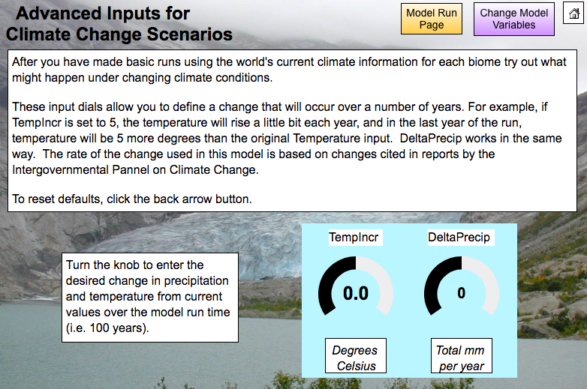
Biomass Accumulation Model- Advanced Activities
Students can also explore the effect of future temperature and precipitation projections on biomass accumulation. For more information and student directions, see Student Worksheet 3 in the Teacher Guide.

Slide 41
Box-and-Arrow Models
Putting together many boxes (pools) and arrows (fluxes) makes a “box and arrow” model. This type of model allows you to simulate the movement of matter through more complex systems. For example, the model below shows the movement of carbon through the Atmosphere, Soil and Plant Pools of the Carbon Cycle:
Atmosphere Pool
Soil Respiration
Plant Respiration
Photosynthesis
Litterfall
Soil Pool
Plant Pool

Slide 42
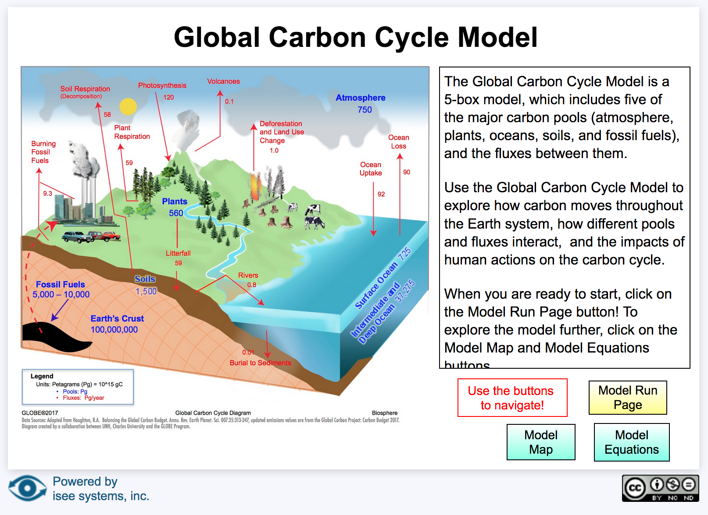
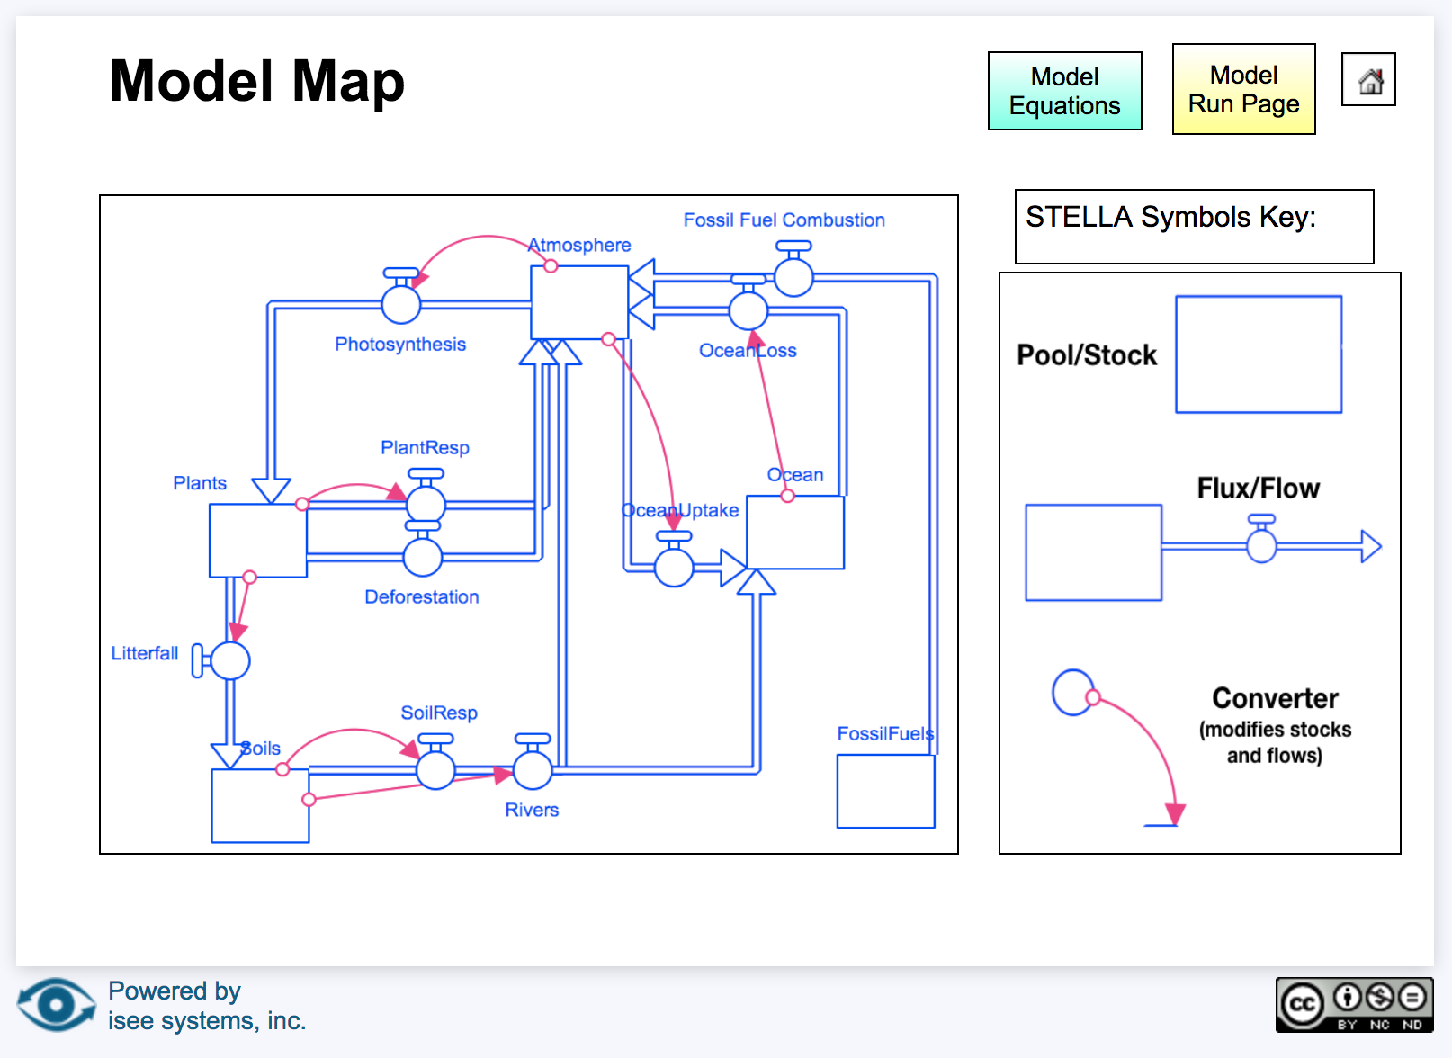
Simple Global Carbon Cycle Model
The online Global Carbon Cycle model connects the three boxes (stocks) in the previous slide using arrows (fluxes). Note the addition of the fossil fuel pool that adds carbon to the atmosphere through fossil fuel combustion, and the ocean pool that moves carbon to/from the atmosphere and soils. In activities outlined in the Global Carbon Cycle Modeling Teacher Guide, students will compare the pre- and post-industrial revolution effects of fossil fuels on the global carbon cycle.

Slide 43
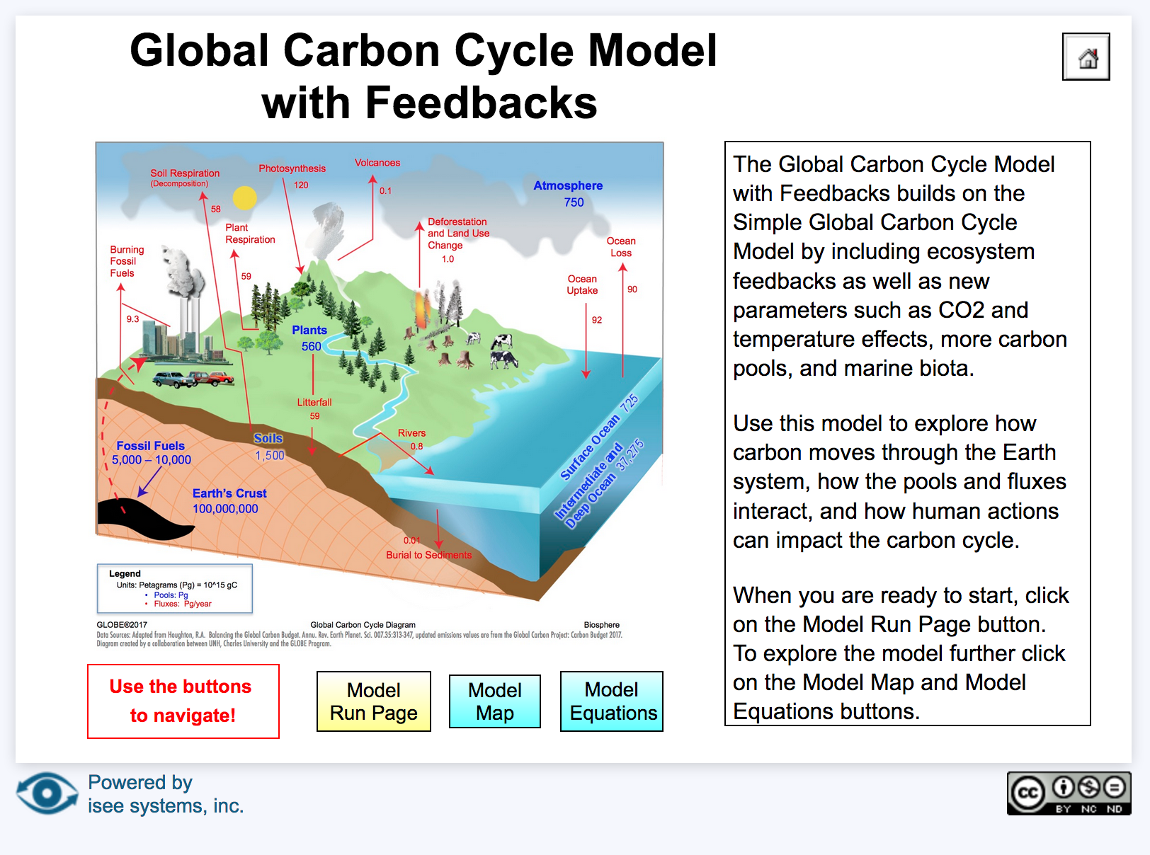
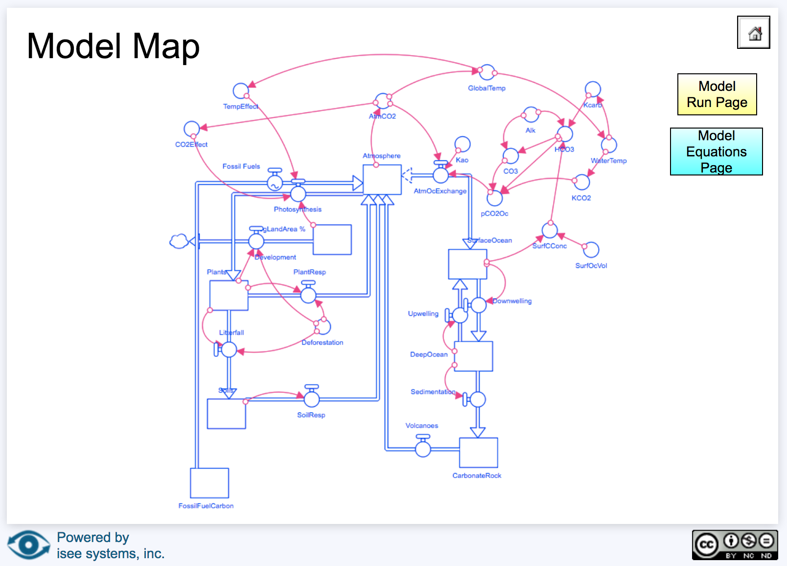
Advanced Global Carbon Cycle Model with Feedbacks
In the Advanced Global Carbon Cycle Model, students can explore the effect of positive and negative feedbacks on the Earth System. Note the addition of several converters (blue circles with pink arrows) in the model map. Two of the feedbacks include the CO₂ feedback and temperature feedback, which the students will explore in Activity 3: Complex Model, outlined in the Teacher Guide.

Slide 44
Quiz Questions
Challenge yourself to answer these questions and check whether you have achieved the learning objectives of this model.
What is a system?
What are three characteristics of a system?
What is a model?
Why do scientists use models?
What are the components of a 1-box model?
Can you define equilibrium using Earth Systems terminology?
In the Paperclip and Biomass models, what button can you click to learn more about how the model works and the science behind it?
What are the three inputs to the Biomass Accumulation Model?
Which of the GLOBE models includes system feedbacks?

Slide 45
NASA’s A Breathing Planet, Off Balance Article and Video:
https://www.nasa.gov/feature/goddard/carbon-climate
NASA Global Climate Change Website:
https://climate.nasa.gov/
Global Carbon Project
(http://www.globalcarbonproject.org)
  GLOBE Carbon Cycle Systems and Modeling Intro:
  (Click to Open PDF)
  isee systems exchange (online computer models):
  (http://exchange.iseesystems.com)

