Slide 1
Setting up your GLOBE account
David Overoye

Slide 2
Introduction
Process –
Detail step by step instruction
Opportunity for you to try it on your own “Your Turn”
“Test” to see if you’ve learned what you need to know

Slide 3
Topics - People
Setting up your GLOBE account and MyPage
Make sure everything is ready to go and you know the basics of getting around in GLOBE
References
Setting up your GLOBE account – video
http://www.globe.gov/teaching-and-learning/web-tutorials/account-setup-tutorial
Setting up your GLOBE account - presentation

Slide 4
Step 1 Login and review your account information
Login and click on your name on the top right to access your account information
Details – name, email, picture – upload your picture
Password
Organization – which organization you belong to
Communities – which communities you’ve joined
GLOBE User Groups – your roles in GLOBE. Includes Organization Manager and notification preferences.
GLOBE Info – preferences and information
GLOBE Training – your training records
Other areas are optional and self explanatory
Review these sections for accuracy. Update if needed.
Remember to click “Save” on the bottom if you make any change

Slide 5
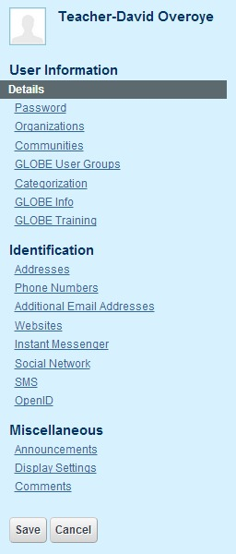
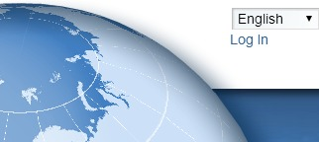
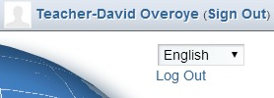
Your Turn
Try this…
Add your picture and check your job title
Look at your GLOBE User groups and make sure your information is correct
Check your GLOBE info is correct.
Check your address and phone number
Add your social usernames (if you want)

Slide 6
Step 2 – Update my “MyPage”
Select the first option from the drop down on the top right – Go to \/ - “My Public Pages”
Use the pencil icon in the middle to change or add content about yourself
Edit the student count
Update the Protocols and Activities Used
Review the Data Entry and Collaboration tabs – more on those later.

Slide 7
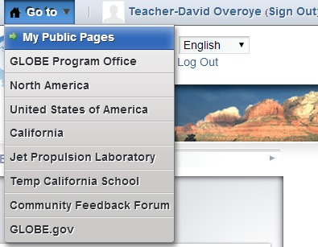
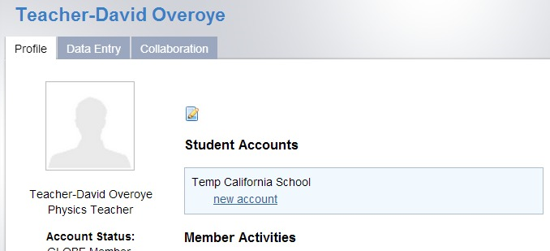
Your Turn – MyPage changes
Try this…
Go to your “Mypage” and add some content in the middle area. (pencil icon).
Use “Edit” to update the number of students you are involved with.
Select Protocols and Recognition and update the protocols and Learning Activities you use.

Slide 8
Test
I want to change my email address. Where do I go?
I noticed my school/partner/country page says there’s a different number of students than there really is..How do I change that?
My Mypage says NONE under protocols and activities used. Why is it none, and how can I change that?

