Slide 1
Country Coordinators and Partners
David Overoye

Slide 2
Introduction
Process –
Detail step by step instruction
Opportunity for you to try it on your own – “Your turn”
“Test” to see if you’ve learned what you need to know

Slide 3
Topics - People
What can a country coordinator, partner and their assistants do?
Managing schools, users
Managing the Country or partner page
Adding News and Events
Workshops
Metrics/reporting

Slide 4
Country Coordinator/Partner Managing Users
Select Manage->Control Panel to get to the administration area.
From the left side select Users
Lists all users in your Country/Partnership
Click on a name to Edit the user’s information
Update password or other information
Click on Actions to see other options
Deactivate – “Turns off” the account (can be activated later)
Impersonate User – Logs you in as them so you can see what they can see and do
Select “Add” to add a new user
A Password will be sent to them automatically
Be sure to verify their “GLOBE Groups” information – are they a teacher/trainer…are they trained? Should they be allowed to modify their school’s webpage?

Slide 5
Country Coordinator/Partner Managing Schools
From the left side Select Organizations
Lists all schools in your Country/Partnership
Click on a name to Edit the School’s information
Actions provide other options – generally not used
Select “Add” to Add a new school
Input name, type (School_organization), status (GLOBE School) and verify the “Parent organization” is your country/Partnership. Next input the address and save.
Select GLOBE info and input the information

Slide 6
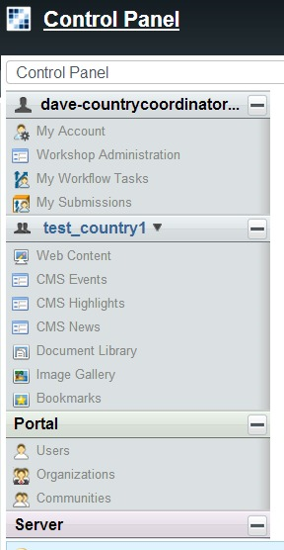
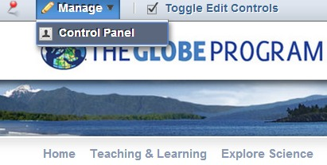
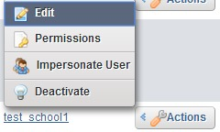
Your Turn
Try this…
Go to the control panel and create a temporary school – write down the name – we’ll need it shortly!
How many teachers are in your region?
How many schools are in your region?

Slide 7
GLOBE User Groups
GLOBE User Groups help provide information to the system on who the people are, and what permissions they have
For all users who signup for a workshop, this process happens automatically..but if you need to, you can change or correct these settings yourself.
Everything is under the Control Panel

Slide 8
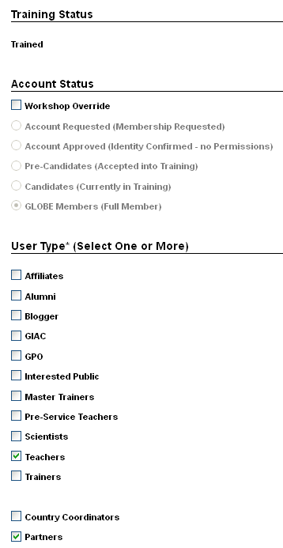
Control Panel Functions
Managing Users - GLOBE User Groups:
Click on ‘GLOBE User Groups’ for the selected
user in their profile (on right column)
Users have certain characteristics:
Training Status
Account Status
User Type
The system will automatically put new members into the correct user groups as they proceed through workshop process.
Admin/Help Desk/Partners and CCs have the ability to override workshop process to assign account status

Slide 9
Control Panel Functions
Managing Users - GLOBE User Groups:
Account Status – defines the person’s GLOBE status and permissions on the site.
Training Status – defines where the person is in the training process (untrained, in-training, trained).
User Type – defines the person’s job (teacher, scientists, pre-service, interested public, etc.). These user groups are not associated with site permissions

Slide 10
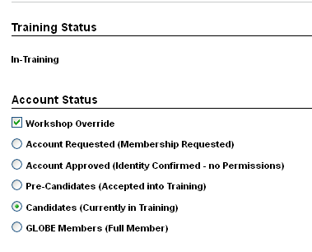
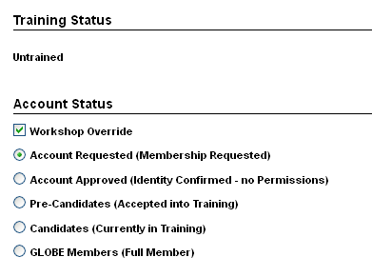
Control Panel Functions
Managing Users - GLOBE User Groups:
To ensure members have the correct permissions on the site, account and training statuses are synced
Account Requested/Approved, Pre-Candidates can only have the ‘Untrained’ training status
Candidates can only have the ‘In-Training’ status
GLOBE Members are Trained

Slide 11
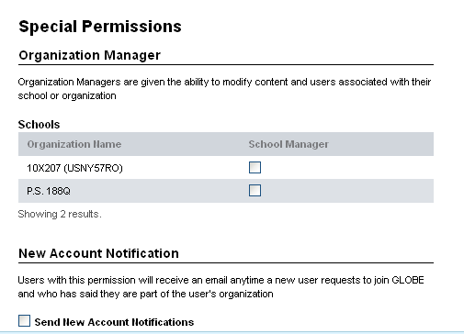
Control Panel Functions
Managing Users Continue - GLOBE User Groups
As a Partners or CC, you can assign member to:
Organization Manager Role
Allows people with this role to change their organization page
New Account Notification Role
- Allows user with this role to receive an email anytime anyone joins GLOBE who is in their organization

Slide 12
Q&A

Slide 13
Managing your country/partner page
Select Goto -> and select your country/Partnership page
Review members, schools, organization map…Does everything look okay?
Select the pencil icon from your country/partner page and write something about your country/partner and GLOBE
Select the “Contact Info” tab and review
You can click the pencil icon to add information
You can select the “wrench” icon on the GLOBE Member Info to select people who will be your points of contact.
This is the only page which includes an “Add” option on the top left which will allow you to add additional contacts and additional content.
Select the “Resources” tab
You can click the pencil icon to add information about resources that may be useful to your schools or teachers.
Go to the Control Panel (manage->control panel)
Select CMS News and “Add News”
The filename, News Title, “Short Blurb”, “Long Blurb” and “News Full Text” are required. Everything else is optional.
Click “Publish” when complete
Go Back to your Country/Partner page and see your news article listed.
You can also add Events
Document Library and Image Gallery can be used, but are not visible at this time on the country pages.

Slide 14
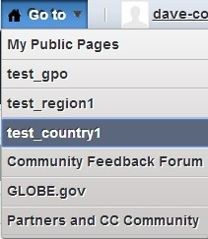
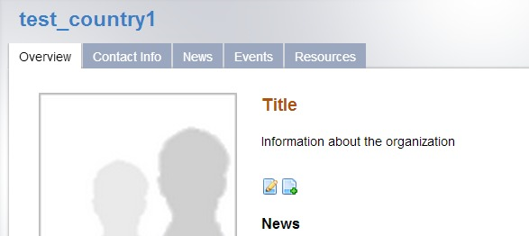
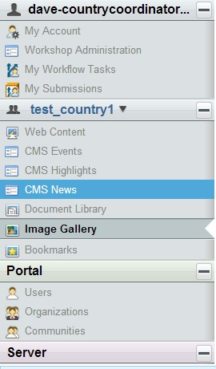
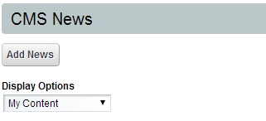
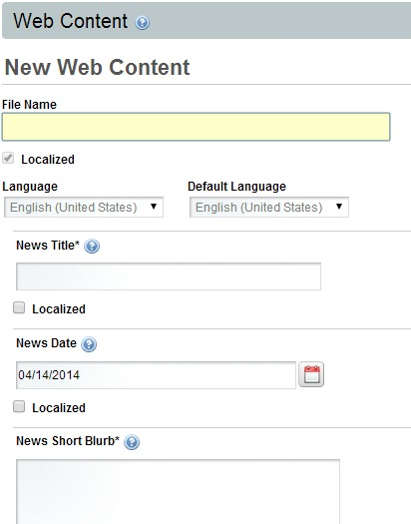
Your Turn

Slide 15
Your Turn
Try This…
Add content to your country/partner page
Add a News article about this conference
Edit your country’s/partner’s contact page. Just a basic edit of the content is good enough.
Check that you could add more content if you wanted to.

Slide 16
Test
A teacher calls you and says they can’t change any of their school information on their school page..Why?
A teacher calls and says they’re not able to enter data – the system says they don’t have permission…Why?
People are requesting to join GLOBE in your country/partnership, but you have never received an email letting you know…Why?
You just added a Teacher using the Control Panel, but they don’t show up on the school page…Why?
You just added a new school, but when you go to the school’s page, the map shows it’s location is in the wrong place…Why?
You know a school’s been added, but they don’t show up on the website…Why?

Slide 17
Q&A

Slide 18
Workshops
Setting up a workshop and marking people as completing a workshop is an essential part of a country coordinator’s/partner’s role in GLOBE
Workshops are the gateway to GLOBE
We’ll review the tools to search workshop information
We’ll review the process of setting up a workshop:
1) Create the Workshop
2) Assign the trainers for the workshop
3) Make the workshop Active
4) Accept people into the workshop
5) Change people’s status as they complete the workshop
We’ll review the signup process for a workshop
We’ll review the completion and archiving of a workshop

Slide 19
Workshops – Searching
Go to the Control Panel and select Workshop administration and Launch Admin Workshop. There are 4 options:
Create a Workshop
People Trained at Workshop – find people trained in your organization and send emails
Workshop Search – Find current and past workshops. Edit and complete workshop activities
Schools with People Trained – find schools you’ve trained
Select People Trained at Workshop
Try Export to File to get a list of all people ever trained
Try Advanced Filter to narrow down the list by time or protocols
Select “Send email to those listed” to see how you can send an email to groups of users
Select Workshop Search
Try Export to File to get a list of all workshops ever recorded
Try Advanced Filter to narrow down the list by time or protocols

Slide 20
Workshops – Creating (1)
Select Create a Workshop
Fill out all fields with an asterisk * - these are required
For now, do NOT click the box which says “Creator is workshop trainer”.
For Location title use something like this: “Dave’s Test Workshop” (only use your name instead of mine)
Use your office/school address for workshop location. “Validate Address” insures we have the location correct.
Select Teachers for the audience, and choose a Grade Level
Choose today’s date for the workshop date
Select “Potential Restricted Attendance”
Add some Details which indicate this is a test workshop
Create a workshop for the Clouds protocol
Click Submit and you will see a preview of what the workshop will look like when it “goes live”. You can click “Edit” to change anything.
The workshop will be “Pending” initially. A Trainer must be assigned before you can “go-live”

Slide 21
Workshops – Creating (2)
From this point, you can change and track your workshop under the workshop search tool
Use the breadcrumb as a shortcut to navigate…click “Manage Workshop” in the top breadcrumb.
There are Pre-workshop Actions, and Post-Workshop Actions
Pre-workshop – edit information, add trainers, view rosters and accept people into your workshop, add new people to the workshop, contact attendees
Post Workshop – View Roster and give attendees credit, fill out post workshop forms, print letters and certificates
Change status from Pending to “Active” will push your workshop to be “live” on the main GLOBE.gov website.
The workshop URL is a link which will go directly to the workshop. You can give this URL out to people to signup for your workshop.
Assign a trainer using the “Add Trainer to Workshop link”.
Use the advanced filter to find someone from one of the countries here to do the training
You must have all topics covered by a trainer before the workshop can be made “Active”. Once you make it “Active” anyone can see it.

Slide 22
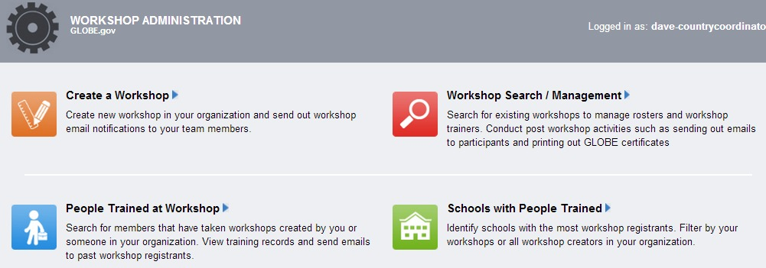
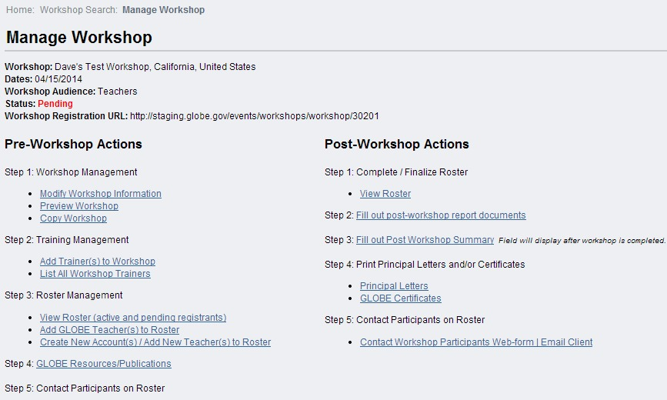

Slide 23
Your Turn – Create a Workshop
Find the Workshop Administration area
Try searching for workshops which have occurred in the past
Try searching for people who have attended workshops in the past – can you email them?
Create a workshop using the Create Workshop option
Assign trainers use the Add Trainer to Workshop under Workshop Management
Edit the workshop and make it “Active”
Find the Workshop Registration URL and go to it to make sure your workshop appears

Slide 24
Q&A

Slide 25
Signup for a Workshop as a Teacher
Click the Signout button so you are no longer logged in as yourself
Go to Events -> Workshops & Training
http://www.globe.gov/events/workshops
Use the map, or the list to find the workshop you just created. Or use the registration URL
Click the Title of the workshop and then select Register for Workshop.
Since we’re signing up for the workshop as a new teacher, select “Sign up for GLOBE account”
Enter test data for first and last name. For email, use something like this dave-teacher@rws.com (ie norah-teacher@rws.com). This will become your test teacher account, so write down the email and the password you want to use.
For the school – use the school you created previously
Select Create Account
The account is created, and you are asked to login with the new account. Enter your password and sign in. Accept the Privacy Policy and Confirm you want to attend the workshop. You have now signed up for the workshop, and have an account with GLOBE…but…
If you click on the account name on the top right, you will see this user can’t do much, and their status is untrained
If you click on Goto, you will see there is no MyPage.
If you go to a forum, you will see this user can read the forums, but can not post anything
If you go to the school page (try using the Search), you will see this user is not listed.
Click the Signout button so you are no longer logged in as the teacher.

Slide 26
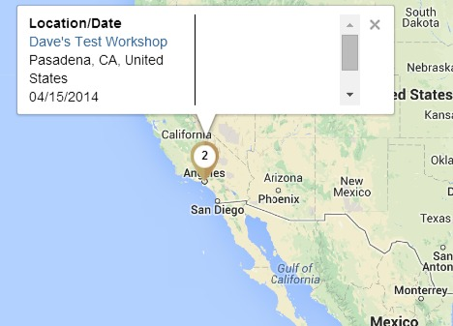
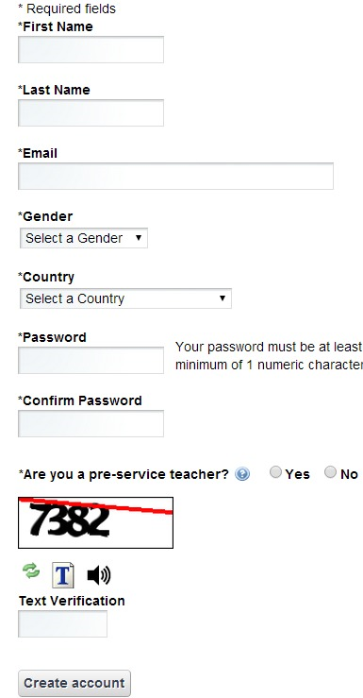
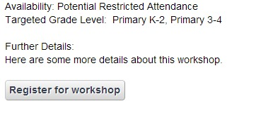
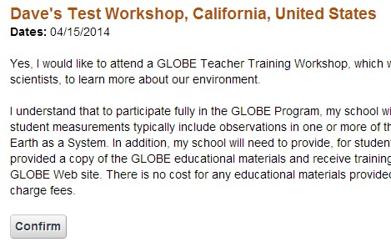

Slide 27
Your Turn
Go to the workshops page (under events)
Find the workshop you created and signup
Use the temporary school you created earlier, and the email of the form yourname-teacher@rws.com to sign up
Once you have your account, login and confirm your registration
While logged in as the teacher, look at the admin areas, your school page and verify you can’t really do much with this account.
Make sure you wrote down your teacher account login and password – we’ll use it again later.
Signout of the Teacher Account

Slide 28
Q&A

Slide 29
Managing and Completing the Workshop
Login as yourself and navigate to the workshop administration area, find and select the workshop you created (Hint – control panel)
Select View Roster and you will see the teacher account you created is signed up. They are “Account Requested” and “Pending”.
Click the check box, and “Update Registration Status to” – “Registered”
This will send an email telling the person they have been accepted into the workshop. They will become a “Pre-Candidate” and “Registered”
Note you can select existing users, or Create New users and add them to your workshop manually.
Note you can use step 5 to send an email to all participants
Once people show up for your workshop, change their status to “In Session”
This will give them a “MyPage” and allow them to enter Test Data.
Post Workshop Actions
View Roster and mark your teacher as “Complete” and submit
This will allow them to enter “real data”
Select principal letter to print
Select Certificates to Print
Select Fill out Post Workshop Summary - type in any Post Workshop Summary information into the workshop form, and change Status to Closed.

Slide 30
Your Turn
Log in and navigate to the workshop management area for your workshop.
Select View Roster, and change the teacher’s status to Registered.
Explore – add a new user, and select an existing user.
Explore – send an email to workshop participants
Select View Roster, and change the teacher’s status to “In Session”
Complete the workshop
View the Roster and mark participants as Complete
View principal letter and certificates
Fill out post workshop summary form and change workshop status to “closed”

Slide 31
Test
You used the workshop tool and entered all the information, but the workshop doesn’t show up on the GLOBE Workshop page…Why?
Teachers are at your workshop. They can log in, but they don’t have a MyPage and they can’t enter data…Why?
Teachers have finished your workshop, but they can’t enter data in the production database….Why?
A teacher is at your workshop, but can’t login…What should you check?

Slide 32
Metrics and Reporting
Country/Partner Page – Organization Measurements and Accomplishments
Number of teachers, schools, measurements, GLOBE stars, honor rolls etc
Control Panel
Count number of users and organizations of various types
Changes over time – number of people, trainers, schools, workshops etc
http://www.globe.gov/about-globe/metrics/impact

Slide 33
Test
How many teachers do you have in your country/Partnership now?
How many new schools were added during the last year?
How many workshops were held during the last year?
How many Honor Awards does a given school in your country/Partnership have?

