Slide 1
How to get New Users
Into GLOBE
David Overoye

Slide 2
Introduction
Process –
Detailed step by step directions
Opportunity for you to try it on your own “Your Turn”
“Test” to see if you understand

Slide 3
Topics - People
How do new people join GLOBE?
Signup for workshop
Click “Join GLOBE”
You use the Control Panel->Users and click “Add” option
How to find new GLOBE members?

Slide 4
Best Way to join GLOBE - Workshops
User finds a workshop, clicks on it and decides they want to attend. The steps:
User finds a workshop
User submits their request to join the workshop by creating an account and clicking the submit button
The workshop coordinator reviews the list of people and decides who they will let attend
The workshop coordinator marks the people who show up for the training as “in-training”
The workshop coordinator marks the people who complete training as “completed”
At each step, the user and their school changes status, and they get increased capability in GLOBE

Slide 5
Transition from new user to GLOBE Teacher
User Status | Filled out GLOBE account request form/signed up for workshop | Accepted into a training | Training Begins | Completed Training
Account Status | Account requested | Pre-candidate | Candidate | GLOBE member
Training Status | Untrained | Untrained | In-training | Trained
School status | Requested Organization | Pre-candidate school | Candidate school | GLOBE school

Slide 6
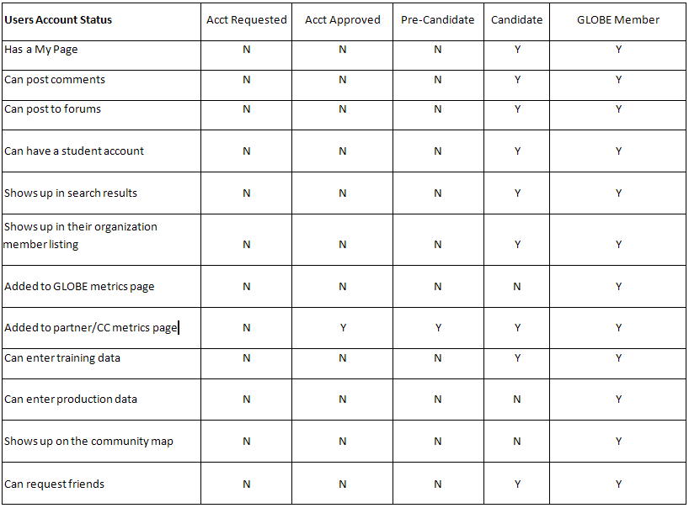
Roles / Permission for Users

Slide 7
Roles / Permissions for Organizations
Organizations | Account Requested | Account Approved | Pre-Candidate | Candidate | GLOBE School | Inactive Partners
Organization Page | N | N | N | Y | Y | Y
Shows up in Search | N | N | N | N | Y | Y
Shows up in parent list of sub-organizations | N | N | N | N | Y | N
Shows up on Community Map | N | N | N | N | Y | N
Added to GLOBE Metrics page | N | N | N | N | Y | N
Added to partner/country rewards and recognition metrics | N | Y | Y | Y | Y | N

Slide 8
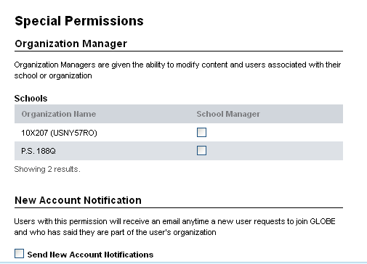
Second Option – click “Join GLOBE”
Users may click the “Join GLOBE” button. The steps:
User clicks Join GLOBE and submits the form
An email is sent to the helpdesk stating “New Account Requested”
An email is also sent to the partner/country coordinator and anyone at the school associated with the new user IF they have the “New Account Notification” box checked (in the GLOBE User Groups area).
*Note – we will be changing that so it is automatically checked for all country coordinators and partners
2) The helpdesk (or potentially the partner or country coordinator) reviews the request, verifies the user is a real person at a real email address and switches their status to “Account Approved” and changes their UserGroup appropriately (teacher, pre-service, interested public)
The user is now in the system, and can login, but they can’t do much until they get training. They should NOT be marked as trained, or GLOBE member unless they have completed training.

Slide 9
Third way – Country Coordinator/Partner Add
At any time, you can go to the control panel, select Users, select “Add”
Note – it is ALWAYS easier if you add their school (organization) first
When creating the account
Input their email and name on the first page
Select their school under the organization page then click Save.
The user will receive an email (example follows) with their account info and password.
The user will be “Account Approved”, but will not be assigned to anything else. You should go to GLOBE Groups and assign them as a teacher or whatever may be appropriate
3) You can change their password if you like, in which case the user will get the second email (next page).
4) You can add any additional information

Slide 10
Dear Dave Overoye, Welcome to The GLOBE Program!
Your GLOBE user account has been created at www.globe.gov.
You are joining GLOBE at a time of great growth and meaningful transition to a new website portal. In addition, the website is dynamic, meaning you will always find new and engaging content (that is largely powered by you, the GLOBE community) as well as a rapidly growing network of users to connect with.
Here is your account information: Your GLOBE login is your email address: nightdave@aol.com Your password is 9C8MLAJ8Ez
Should you forget your password at any time, you can select the Forgot Password link on the GLOBE website login page and a new temporary password will be emailed to you.
If you have any questions about your account, contact us, at help@globe.gov or at 1-800-858-9947.
This is an automatically generated email. Please do not respond to this email.
Sincerely,
GLOBE Community Support Team help@globe.gov http://www.globe.gov

Slide 11
Dear Dave Overoye, Your new password for http://www.globe.gov is SGLOBE12! The request for a new password was made from 10.238.191.124 / 10.238.191.124 with the browser Mozilla/5.0 (Windows NT 6.1; WOW64) AppleWebKit/537.36 (KHTML, like Gecko) Chrome/34.0.1847.116 Safari/537.36. Sincerely, GLOBE Help Desk help@globe.gov http://www.globe.gov

Slide 12
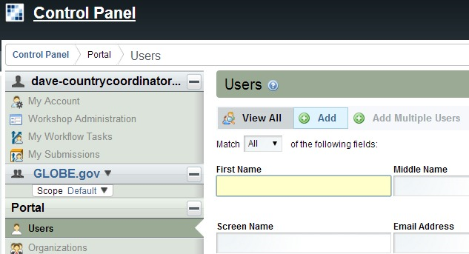

Slide 13
Your Turn
Go to the control panel and create a temporary new school (Organizations)
Go to the control panel and create a new teacher account
Choose the new school for the teacher to belong to
Change the password for the teacher account
Save the new teacher account
Go to the control panel and list all users whose accounts are “Account Approved”
Is the teacher account you created listed?
Are there other accounts listed? If so, what does that mean?
If you wanted to give this new user full teacher permissions, how would you do it?
Use the “Actions” button to “Deactivate” the user (this removes the account, but does not delete the account).
Go to the control panel and select Organizations
Use “Actions” to Delete the temporary school you just created

Slide 14
Virtual Schools
Every user in GLOBE “belongs” to an organization
Country Coordinators -> Countries
US Partners -> Partner organization
Teachers -> Schools
Where do users “go” when they don’t have a school?
Teachers in training
People interested in GLOBE but not teachers
A teacher who is not currently working
Virtual Schools
Created as a place to put people who are not currently in an organization
Every country and partner has a “Virtual School”
Virtual Schools do not have an address, but anyone in a virtual school can create a data site and enter data

Slide 15
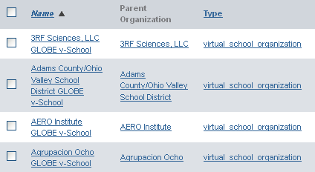
Virtual Schools
Naming Convention:
Japan (country)
Japan GLOBE v- School
California (state)
California GLOBE v-School
AERO Institute (partner)
AERO Institute GLOBE v-School

Slide 16
Q&A

