Slide 1
NSF GLOBE Workshop
UNC @ Charlotte
Website Training
Session 1

Slide 2
Update your MyPage
Update information about yourself
Update the number of students you teach
Update which protocols you use

Slide 3
Update Your MyPage
Cheat sheet help
Change the content on their MyPage | Click on the first link on the drop down arrow on the top right of the page (Goto->MyPage). Look for and click on the small pencil icon in the middle column of the page. You will see a form which you can input information into.
Input the number of students they directly support (for GLOBE metrics) | Click on “Go to” and select “MyPage”. On the right side of the page, select the “Edit” button next to “Number of my students using GLOBE this year”.
Input which protocols and learning activities they use (for GLOBE metrics, and to let other teachers know what is useful) | Click on Your Name and select “MPage”. On the right side of the page, select the Tab “Protocols and Activities Used”. Click on “Edit” to select which you use.

Slide 4
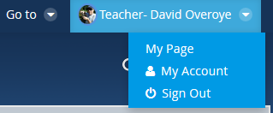
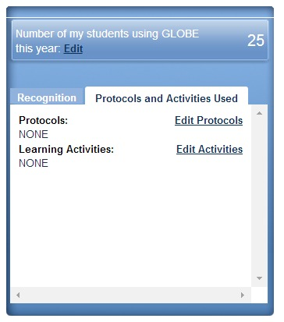
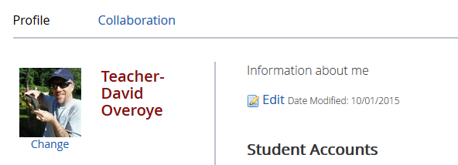
Updating your MyPage

Slide 5
Adding News/Events
Go to your partner page and add a news article about your being here

Slide 6
Add News/Events to your partner/country page
Cheat sheet help
Post a News or Event Article on their page | Select Goto>Partner page name. Select Manage->Site Administration->Content from the drop down menu on the top right. Select CMS News or CMS Events from the left hand navigation. Click Add News or Add Events. Enter required fields and click “Publish”.

Slide 7
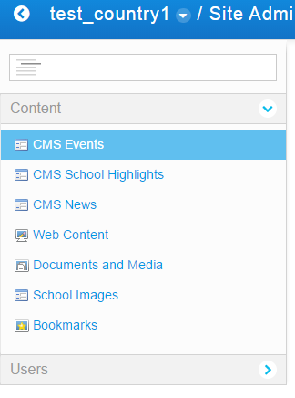
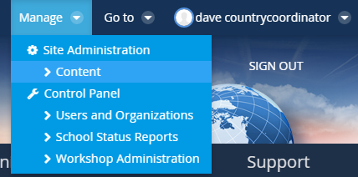
Adding News and Events
From your country/partner page, select Manage and go to Content
  This is only available when you are on your country (or school) pages
On the left menu you will see options to Add News (CMS News), Add Events, (CMS Events) and upload Documents and Media
  Documents and Media can be linked to from your web content, news or event

Slide 8
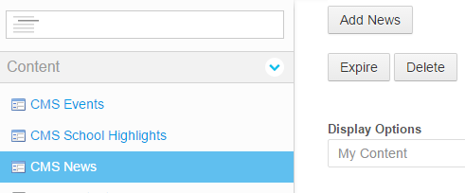
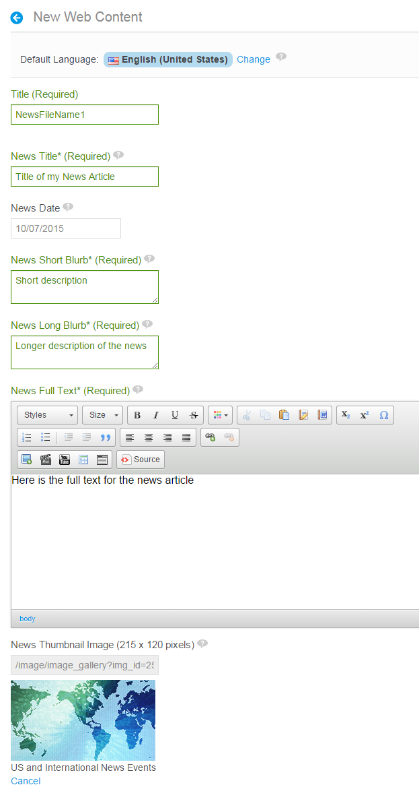
Example – Add News
Select CMS News, and “Add News”
Fill in required fields
  Filename (Title)
  News Title
  Short and Long descriptions
  Full text (Content)
  Optional metadata
  Upload images/videos
Click Save and Publish, or schedule the article to be live on specific dates
News will appear on your country/partner page
You can go back and edit or add translations

Slide 9
Navigation Challenge
How many GLOBE Schools in India?
What is the URL a teacher goes to to join GLOBE?
What is the URL for where I post bugs and questions about the site?
How many workshops are currently scheduled in Argentina?
How many Learning Activities are associated with the Aerosol protocol
Who posted to the scientists blog on 1/23/16?
How many schools received the Atmosphere Science Honor Roll in 12/2015?

Slide 10
Navigation Challenge - Hints
Community Map
  1390
Join
  http://www.globe.gov/join/become-a-globe-teacher/create-a-globe-teacher-account
Support
  http://www.globe.gov/support/feedback-forum
Get Trained
  1
Teacher’s Guide
  6
Scientists Network
  Mullica Jaroensutasinee
GLOBE Data
  62

Slide 11
Uploading a Document
Find the “Train the Trainer-Nashville” folder in the Trainers Community and upload a document
  Delete it after if needed

Slide 12
Uploading a Document
Cheat sheet help
Upload a Document to a community | Go to the community you’d like to upload the document to. (Community->GLOBE Communities lists all communities). Most Communities have a Documents page – click on it in the left hand nav. Most communities have a “Member Documents” Folder – click on it. Select “Add” from the menu and create a folder, or add a document. Select Browse to find the document, add meta data an “Publish”. There is a document link created which you can link to if desired.
Upload a Document to your MyPage | Select Your Name->MyPage. Select Manage->Content. Select Documents and Media from the left side menu. This is your personal library. Click Add to add documents/images. Once you upload the document, select Details and Get URL to find the URL to the image you just uploaded.

Slide 13
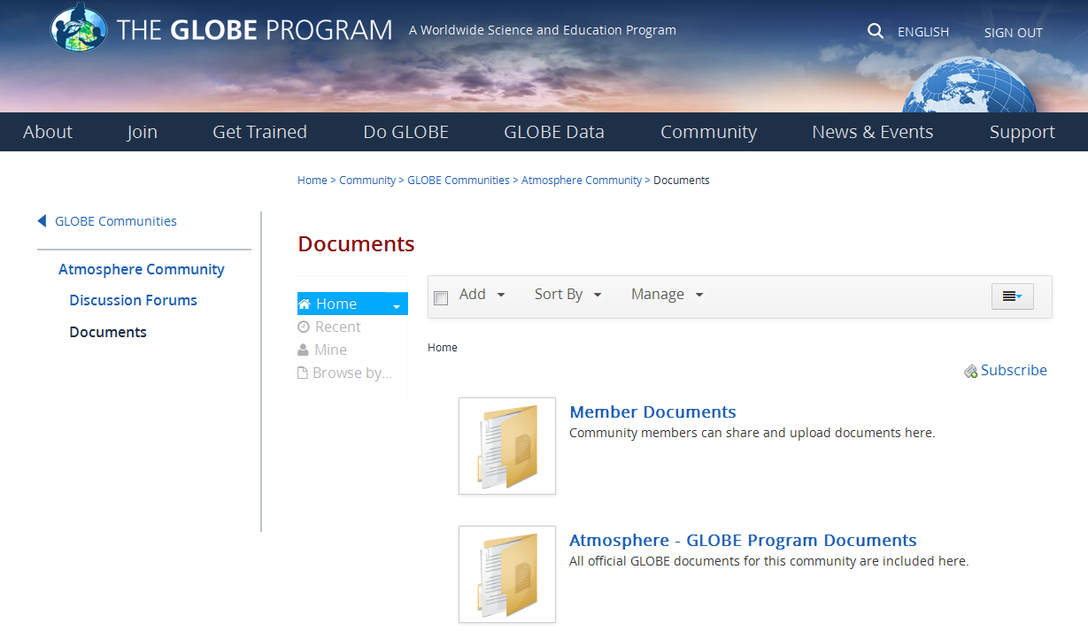
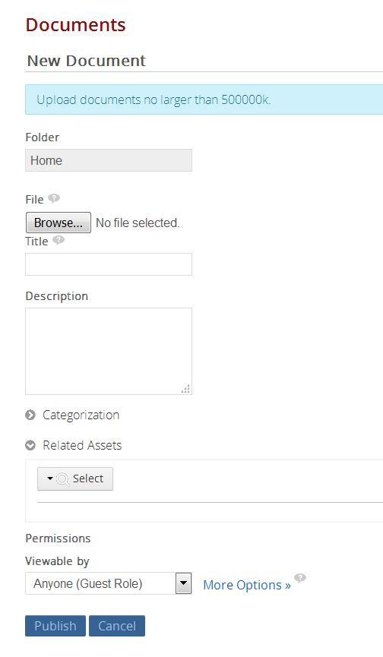
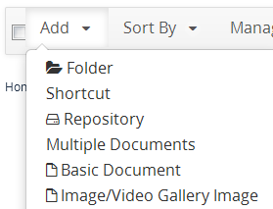

Slide 14
Visualization Retrieval

Slide 15
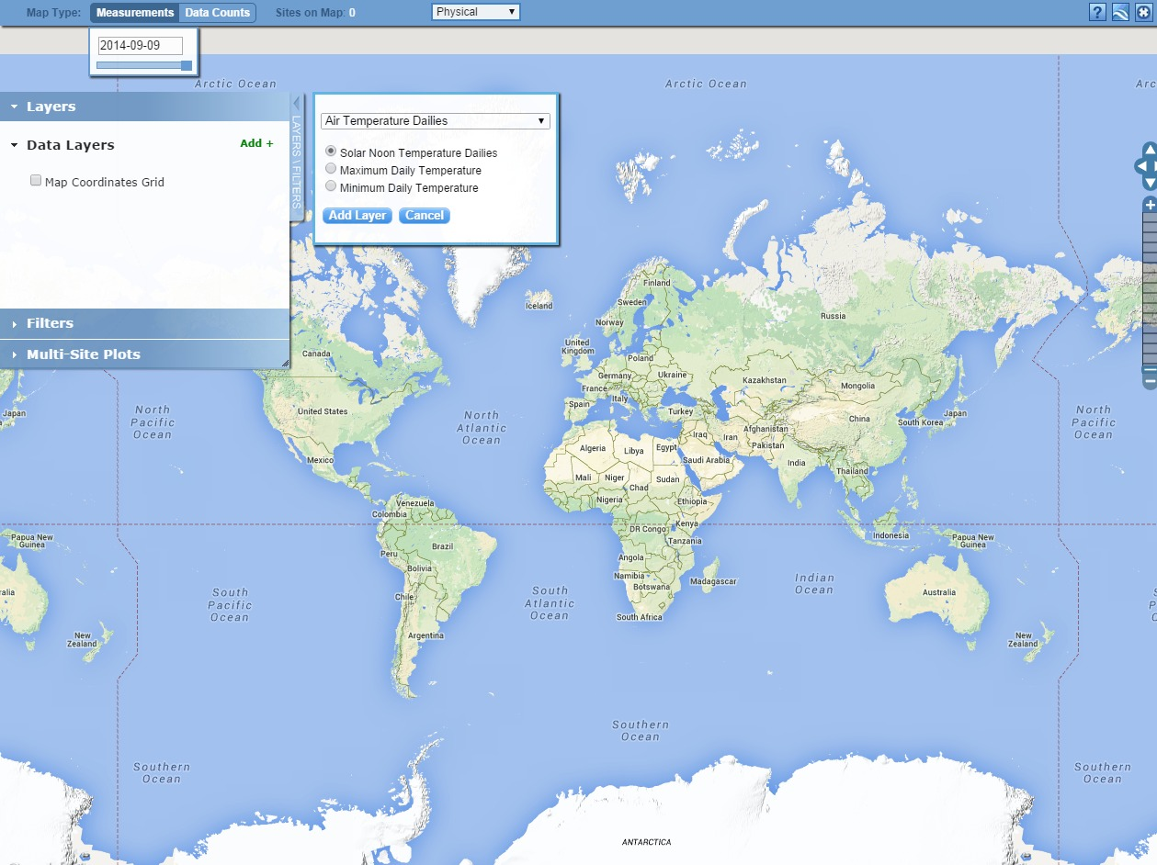
Step 1 – Add Data Layers

Slide 16
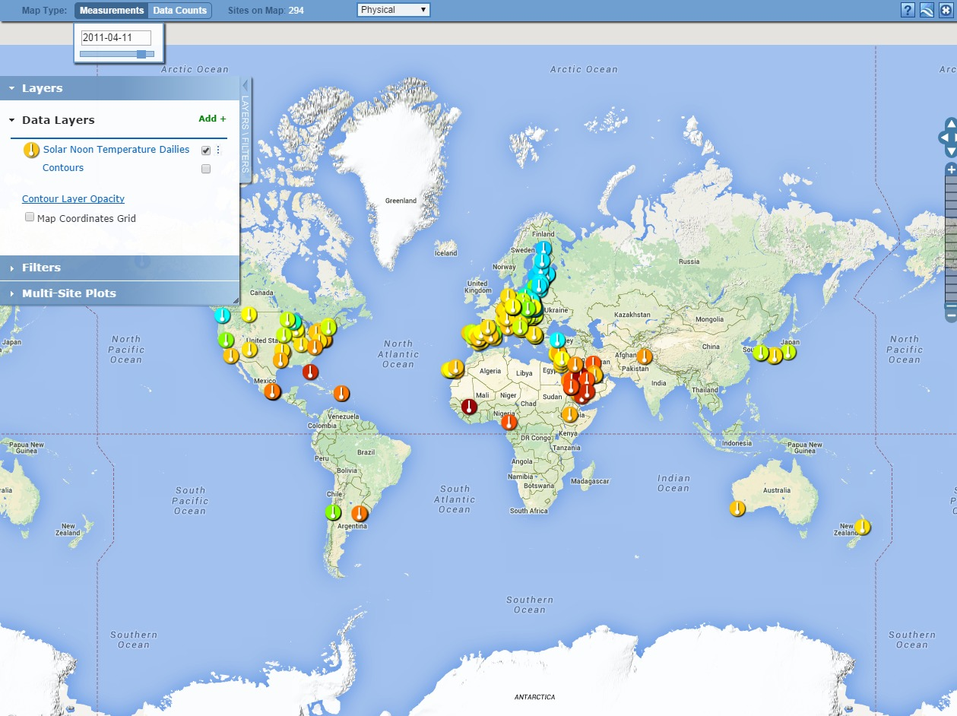
Step 2 – Select the Date

Slide 17
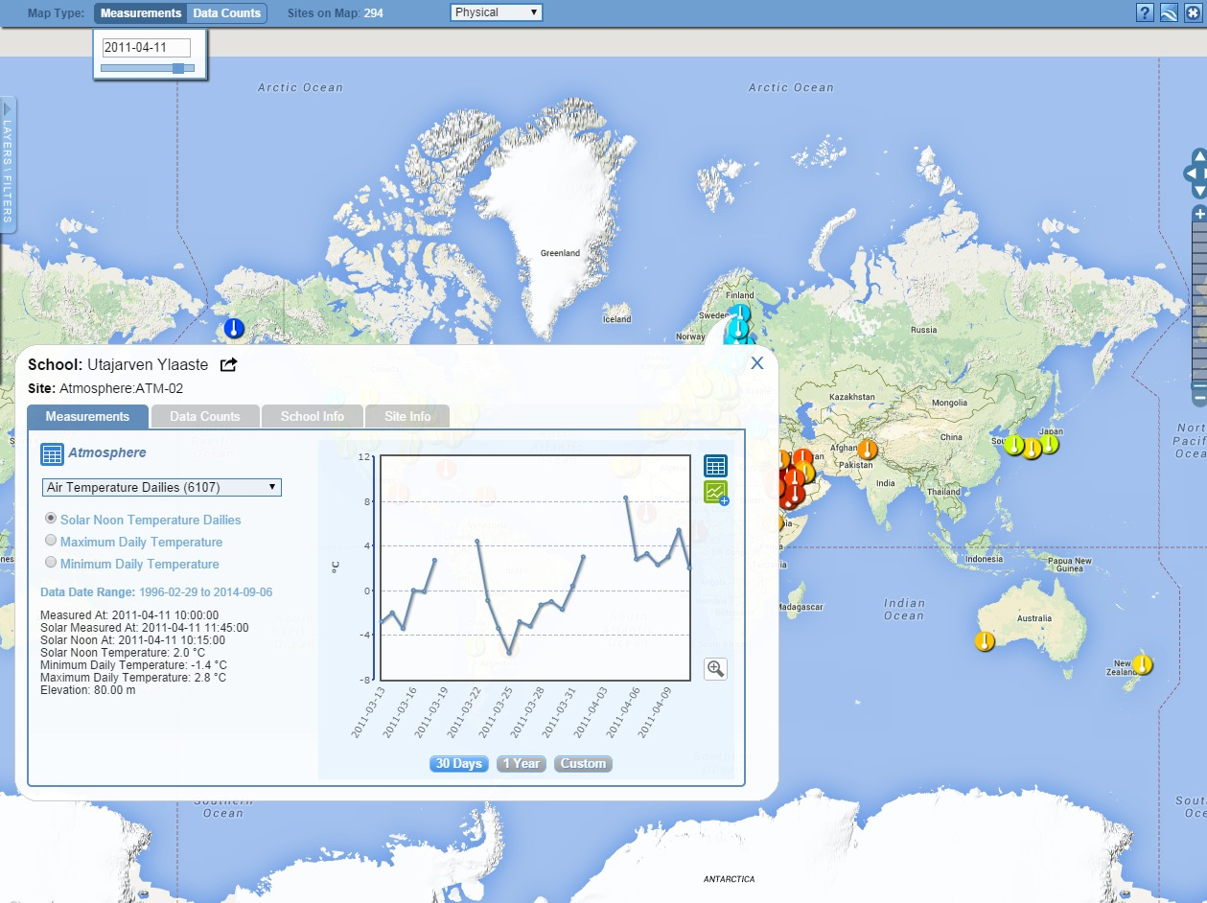
Step 3 – Select the Data Point

Slide 18
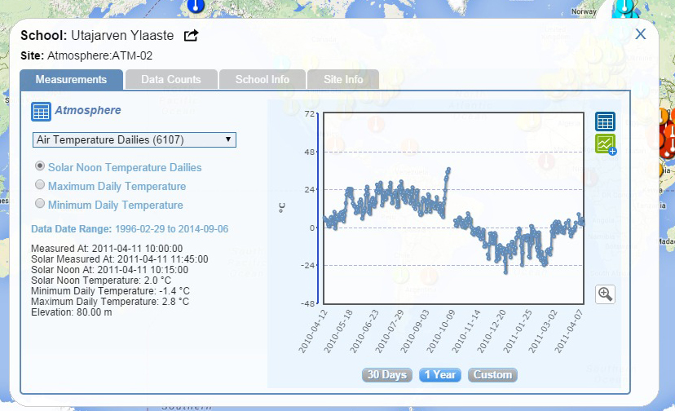
Vis system popup window
See all Atmosphere Data
Go to this school’s page
See Plot Data in a Table
Add this Data to a multi-site Plot
Change the X axis Timeline

Slide 19
Visualization Retrieval
What school reported the coldest solar noon temperature in Poland on
2/16/2014? What was the temperature?
What was the temperature for the one school which reported data in Argentina on that date?
Make a chart showing the Solar Noon Temperature Dailies for 1 year with data from the school in Poland and the school in Argentina.
  What do you see happening?
  Why does it happen
  Try checking and un-checking the “Auto Y-Axis” button to see what happens
Find someone in another country that is doing the clouds protocol this year (or a protocol of your choice) and request to be a friend

Slide 20
Answers
What school reported the coldest temperature in Poland on 2/16/2014? What was the temperature?
  If you did solar noon dailies - Gymnasium No 1, daily average -1C, minimum daily, -5C
  If you did minimum - Gimnazium por. J.Czumy in Celestynów -6C
What was the average temperature for the one school which reported data in Argentina on that date?
--- 21.7 C
Make a chart showing the Solar Noon Temperature Dailies for 1 year with data from the school in Poland and the school in Argentina.
  What do you see happening?
  Why does it happen
  Try checking and un-checking the “Auto Y-Axis” button to see what happens
--- The temperature cycles are shifted relative to each other…because they are in the north/south latitudes
Find someone in another country that is doing the clouds protocol this year (or a protocol of your choice) and request to be a friend

Slide 21
Posting to a Forum
Go to the Atmosphere forum, join the community and post a comment about doing the Aerosol protocol

Slide 22
Posting to a Forum
Cheat sheet help
Post to a Forum | Go to the forum you are interested in and click “Post a new Thread”, or click “Reply” to an existing thread. You can also “subscribe” to the forum to receive email anytime someone posts to the forum. . Communities are listed under Community->GLOBE Communities

Slide 23
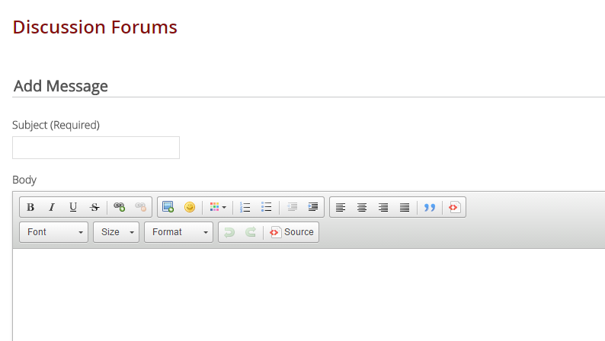
Posting to a Forum

Slide 24
Collaboration Search
Find someone in another country who has done a protocol you are interested in within the last year.
  Find their MyPage
  Request to be their friend

Slide 25
Project Collaborator
Cheat sheet help
Find Someone to Collaborate With | Select Community->Find a Project Collaborator from the top Menu. Use the form to find someone who is in a particular country and using the same protocols as you. Select “Add as Friend” and they will receive an email from you.

Slide 26
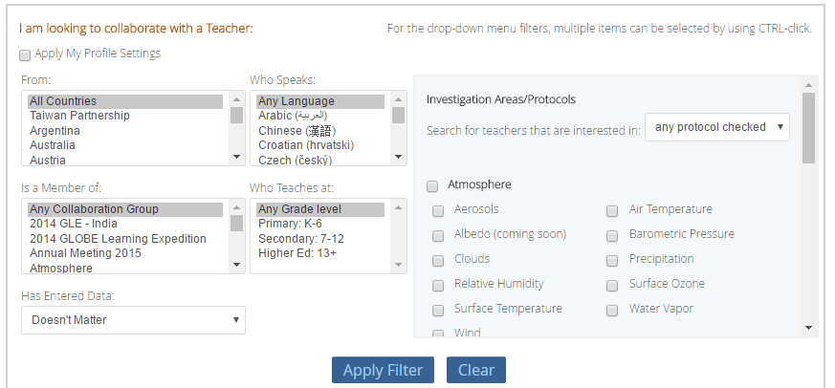
Project Collaborator

Slide 27
Create a Workshop
Setup a workshop with your choice of protocols in your choice of location. Do not set it to “active”
  Find the friendly URL for the workshop
  Make sure you know where to “View Roster” and how to change user’s status

Slide 28
Create a Workshop
Cheat sheet help
Create Workshops | Go to Manage-> Workshop Administration. Select “Create New Workshop”
If you follow these steps – your teachers will be able to interact with GLOBE flawlessly!
  1) Create the Workshop
  2) Assign the trainers for the workshop
  3) Make the workshop Active
  4) Accept people into the workshop
  5) Change people’s status as they complete the workshop

Slide 29
