Slide 1
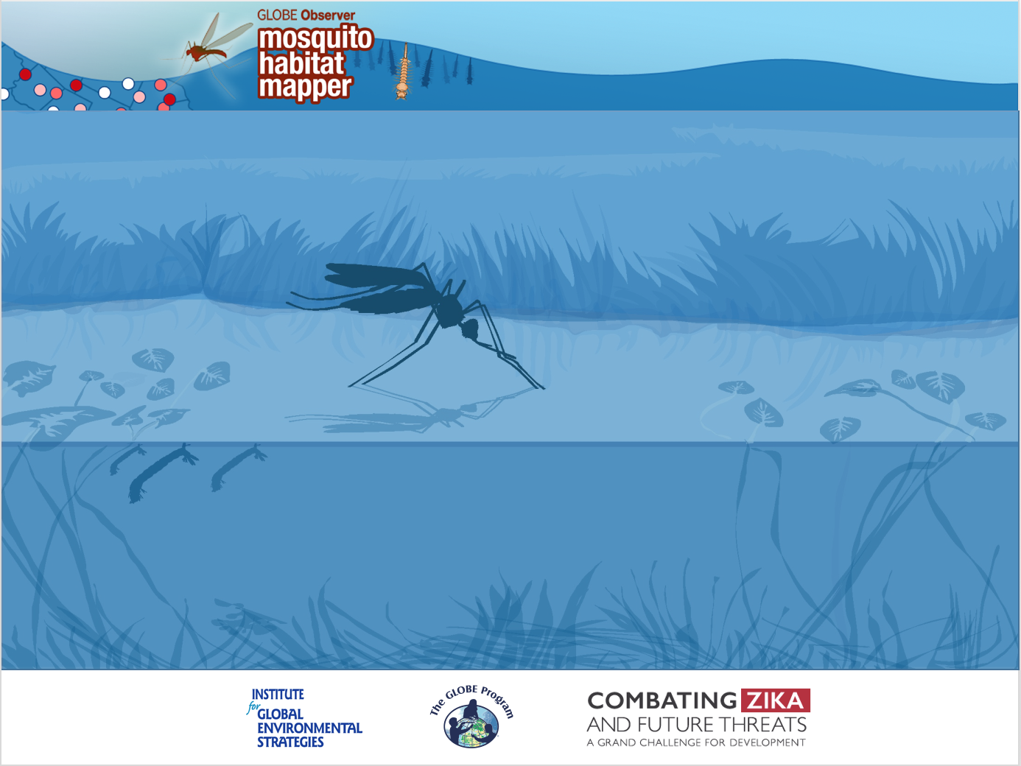
GO
Mosquito
ID Mosquito Larvae
Know Your Mosquito Larvae

Slide 2

Knowing your mosquito larvae involves…
recognizing the gross morphological characteristics of mosquito larvae.
learning the morphological features used in identifying a larva specimen.
You will investigate and identify the larvae of three genera of mosquitoes:
    Anopheles
    Aedes
    Culex
These three genera are of interest because they contain species that can transmit pathogens to humans and cause disease.
To know the larvae of these three genera, you will examine morphological features on the terminal abdominal segments (8-10).

Slide 3
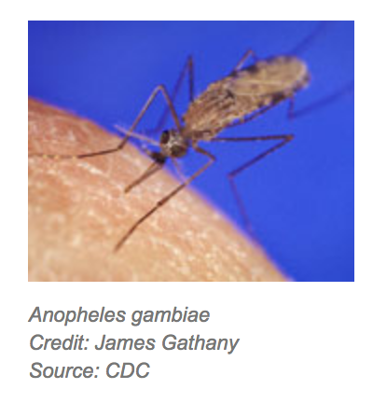
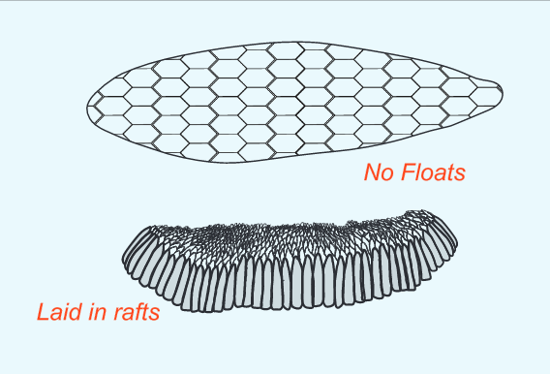
Anopheles
Anopheles mosquito larvae are found in a wide variety of habitats. Many species of Anopheles prefer open-water pools with little vegetation, but others have adapted to other habitats.
Anopheles species lay individual eggs supported by floats on the water surface or on moist soil immediately adjacent to fluctuating water bodies.
Notes:
Eggs image: Jenn Glaser, for the GLOBE Program

Slide 4
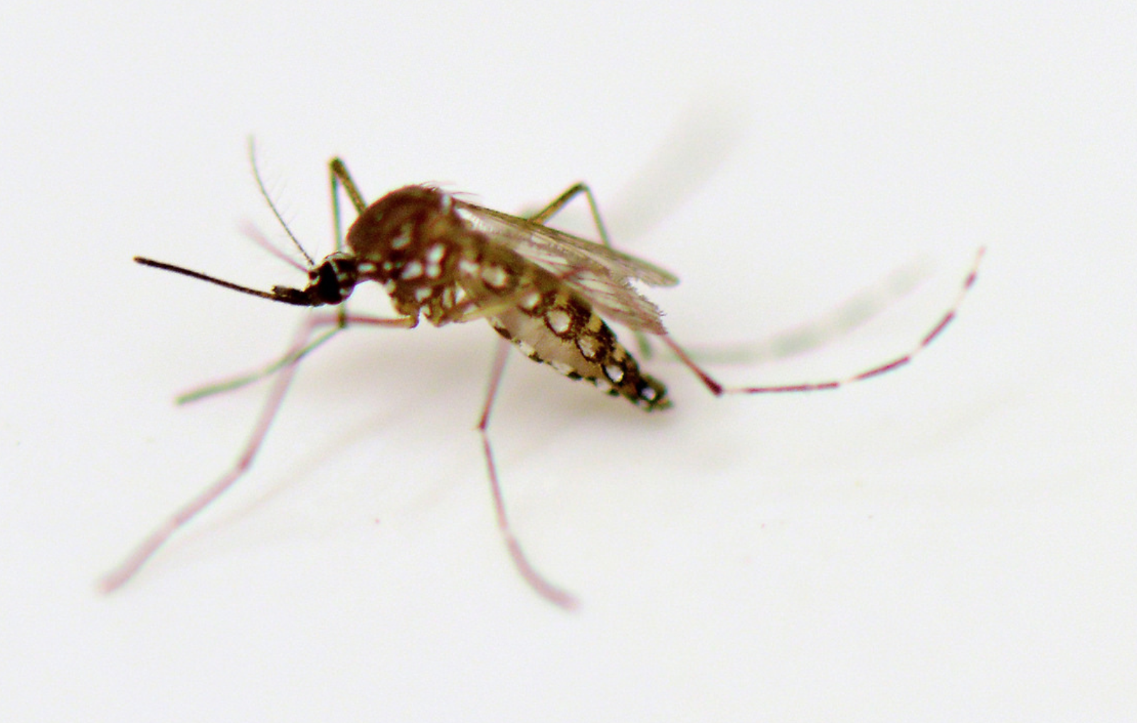
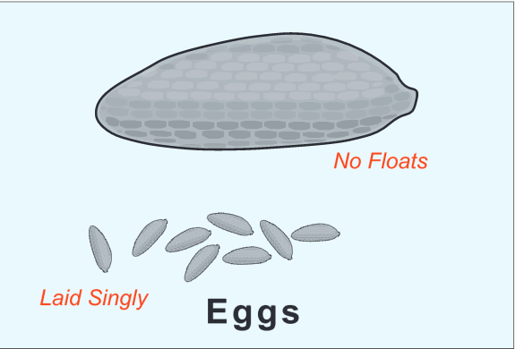
Aedes
Aedes aegypti and Aedes albopictus are container breeding mosquitoes.
Aedes aegypti lay their eggs in water found in artificial containers- such as flowerpots and water jugs. The females lay the eggs along the edge, just above the water level. When the water level rises, it moistens the eggs and they then begin to develop.
Aedes albopictus also lay their eggs in artificial containers but, in addition, will use natural containers such as a tree hole or a coconut shell.
Other species of Aedes mosquitoes breed in floodplains after rain events, in irrigation ditches, in woodland pools, brackish swamps and salt marshes.
Notes:
Adult Mosquito Photo Credit: Dean Calma / IAEA
Eggs: Jenn Glaser for GLOBE

Slide 5
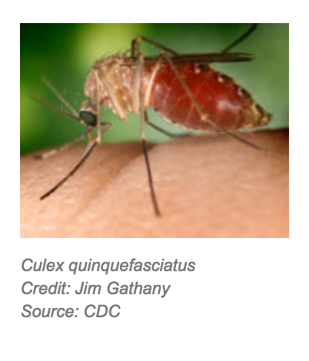
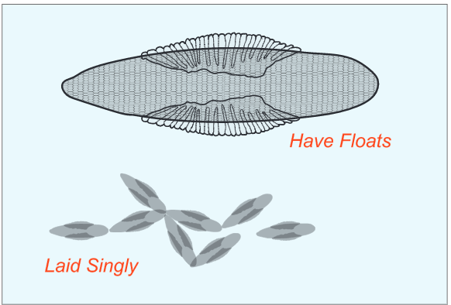
Culex
Culex mosquitoes breed in stagnant water found in:
Sewage systems
Drainage systems
Septic tanks
Containers: tires, buckets and rain barrels
Open surface water habitats: swamps, marshes, bogs, rice fields, pastures
They prefer to lay eggs in rainwater barrels, storm drains, and septic tanks. Eggs are laid in rafts that float on the water surface.
Notes:
Egg image: Jenn Glaser, for GLOBE

Slide 6
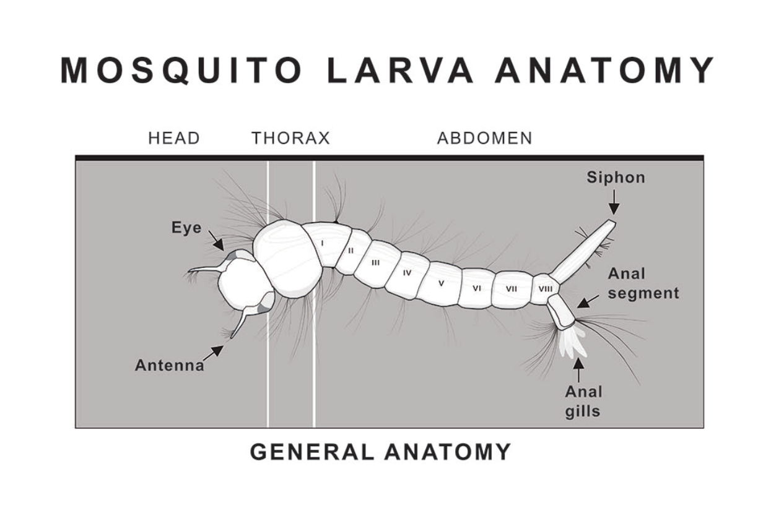

Slide 7
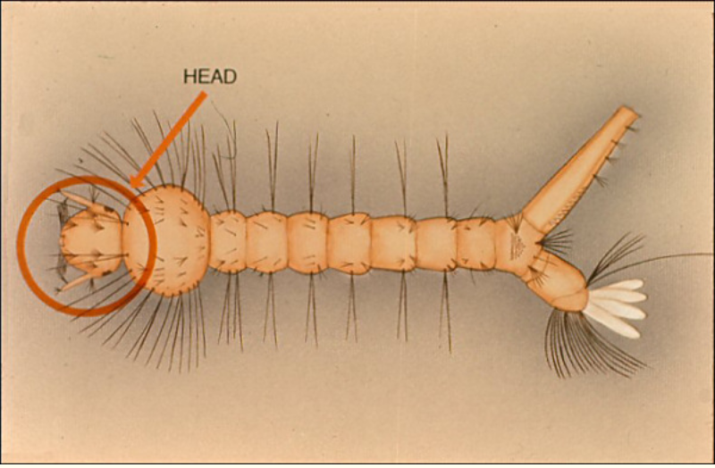
Head: the head is round or slightly oblong and slightly flattened
Reproduced with permission from CDC, UTEP Biodiversity Collection
http://www.utep.edu/leb/mosquito/

Slide 8
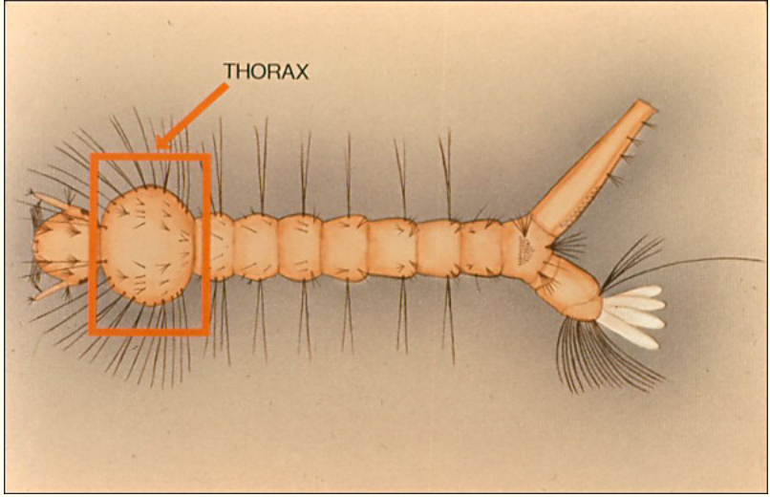
Thorax: appears distinct from the head, separated by a very narrow neck
Reproduced with permission from CDC, UTEP Biodiversity Collection
http://www.utep.edu/leb/mosquito/

Slide 9
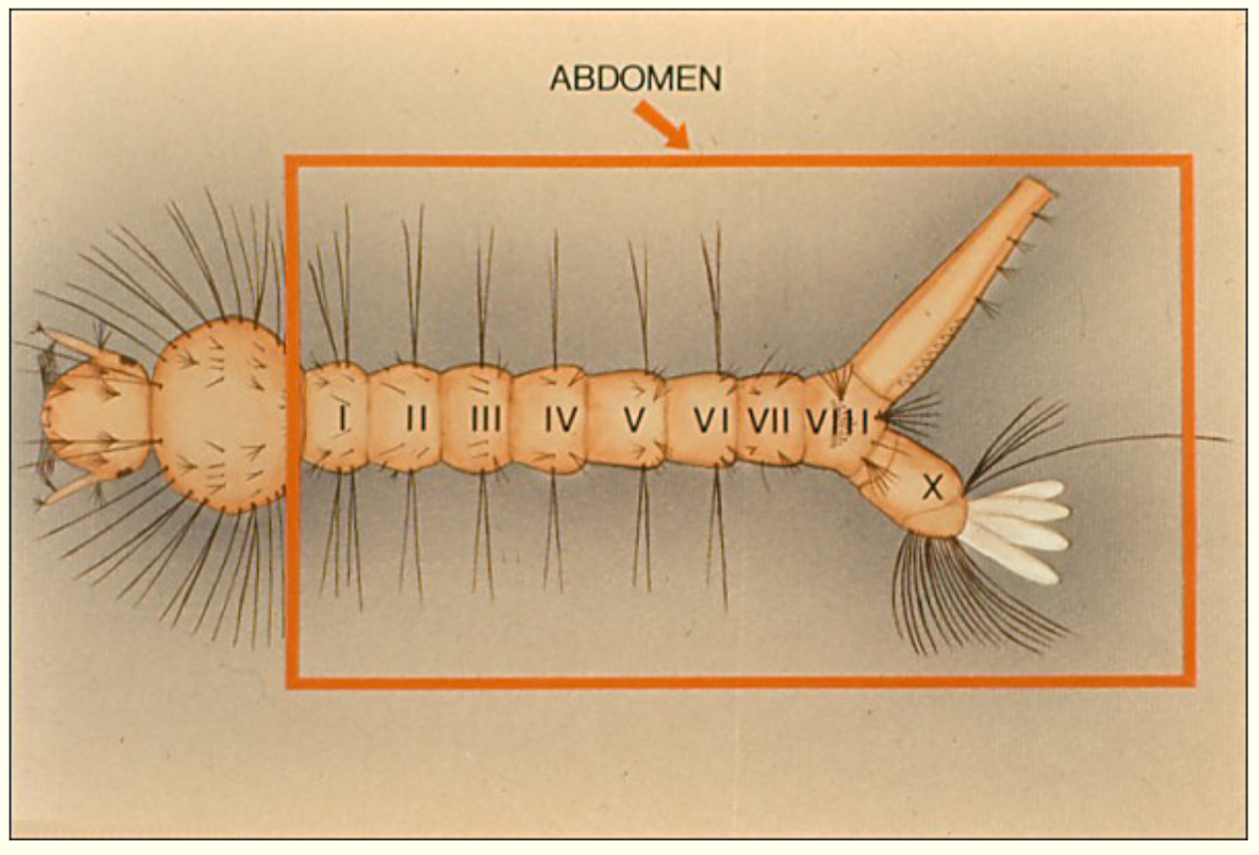
Abdomen: segmented section behind thorax
The abdomen has 10 segments, but not all are distinct. In Aedes and Culex, the ninth segment is not distinct; in Anopheles, the tenth.
The four white protrusions on the anal segment are anal papillae which perform osmotic regulation of the organism.
Reproduced with permission from CDC, UTEP Biodiversity Collection
http://www.utep.edu/leb/mosquito/

Slide 10
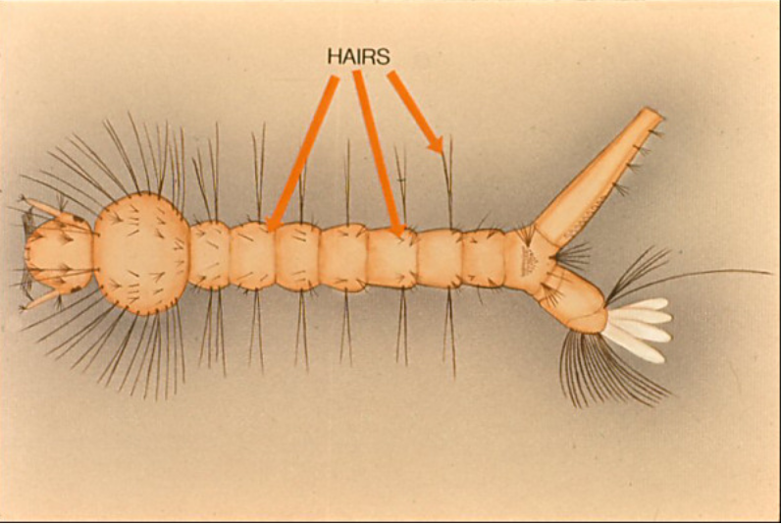
Hairs: the number, position and arrangement of hairs on the larva can be diagnostic.
TUFTS
ANAL
BRUSH
Reproduced with permission from CDC, UTEP Biodiversity Collection
http://www.utep.edu/leb/mosquito/

Slide 11
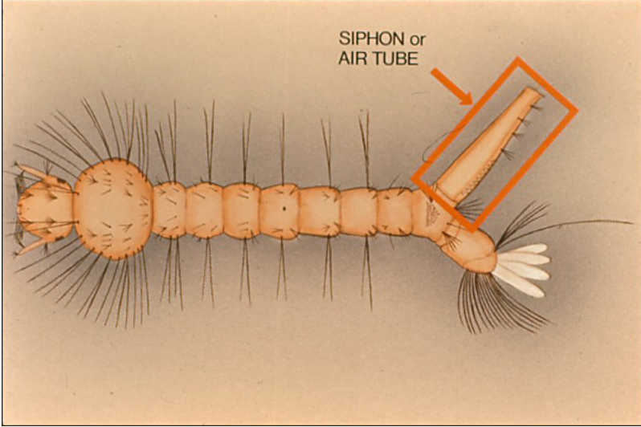
Siphon: an air tube on the 8th abdominal segment.
All genera – except one- have a siphon.
Reproduced with permission from CDC, UTEP Biodiversity Collection
http://www.utep.edu/leb/mosquito/

Slide 12
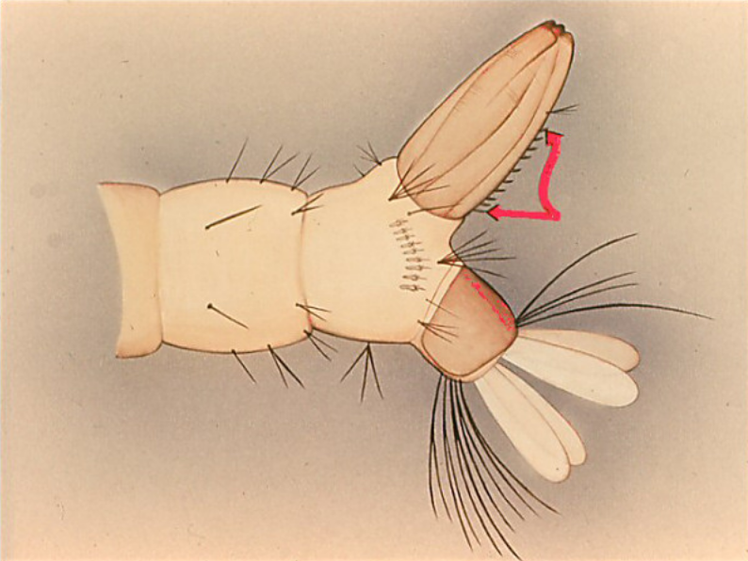
Pecten: a row of closely set teeth or spines on each side of the siphon.
Reproduced with permission from CDC, UTEP Biodiversity Collection
http://www.utep.edu/leb/mosquito/

Slide 13
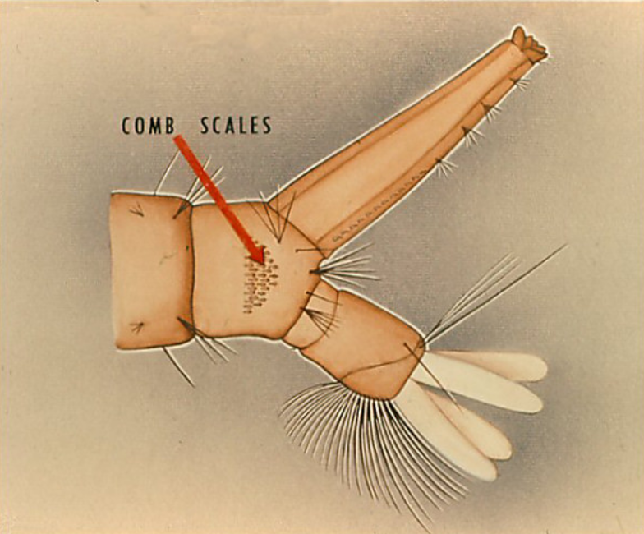
Comb scales: a line or patch of scales found on the 8th abdominal segment in most genera.
Reproduced with permission from CDC, UTEP Biodiversity Collection
http://www.utep.edu/leb/mosquito/

Slide 14
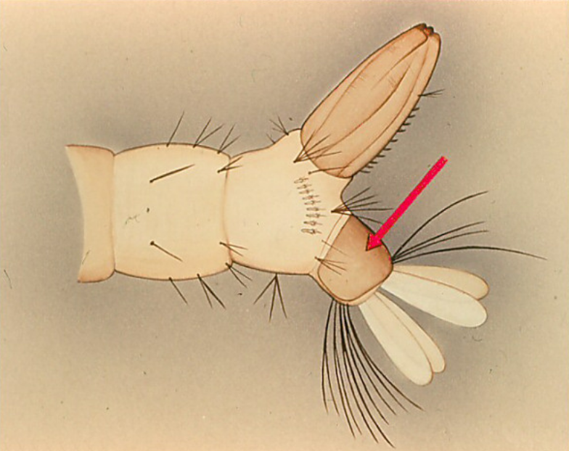
Saddle: a thickened and dark plate that encircles or partially encircles the 10th abdominal segment. It looks like a saddle, hence its name.
Reproduced with permission from CDC, UTEP Biodiversity Collection
http://www.utep.edu/leb/mosquito/

Slide 15
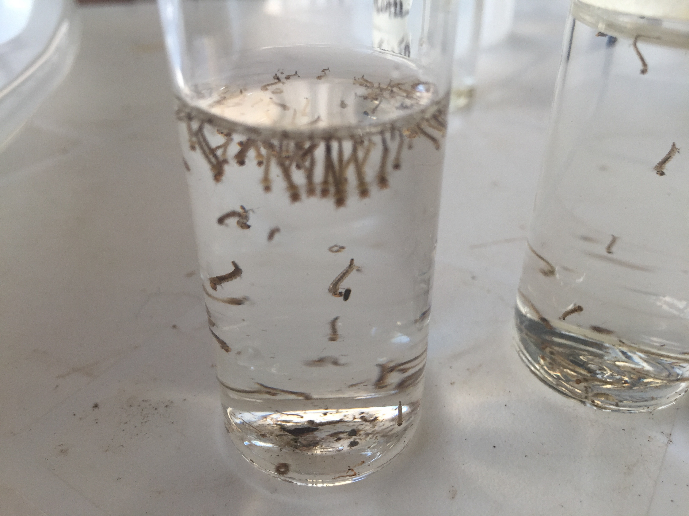
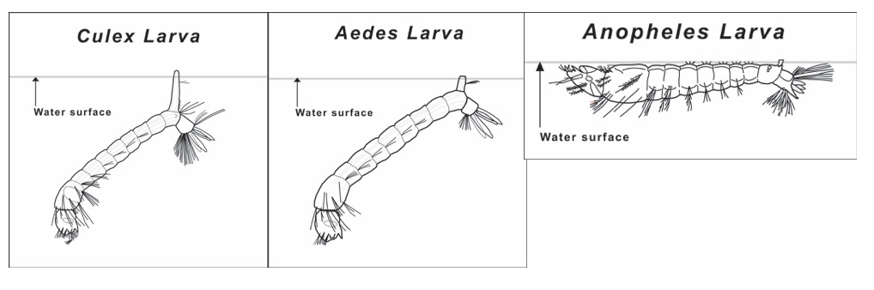
First step in mosquito larvae identification
Place the larvae in cups, vials or plastic bags. Observe them to see how they suspend from the surface of the water. If the larvae are lying flat on the surface, they are from the genus Anopheles. This is the only genus of mosquito that lies flat on the surface; all others are suspended from the surface at an angle.

Slide 16
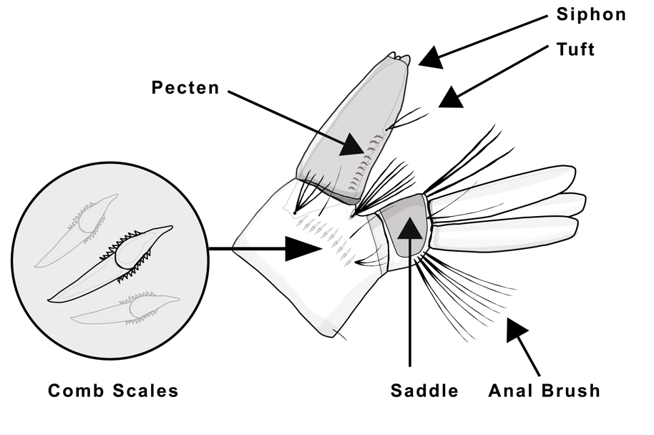
Details of abdominal morphology
*Key features are often found on the anal segment and the siphon.
Siphon: the air tube used by some species of mosquito to breathe. (more on next slide)
Saddle: a dark, thickened band on the anal segment. It can ring the segment, be in two pieces, or appear like it does here, as a saddle
Comb scales: scaly or spiny spicules found in rows or a patch on the abdomen.
Pecten: an even row of tiny spines found on the siphon.

Slide 17
Siphon
The siphon is an air tube located on the abdomen of the larva.
Because the larva hatches from the egg and lives in the water, the siphon allows the larva to breathe.
Most species, including those in the genera Culex and Aedes, have a siphon and spend most of their time on the surface breathing.
Anopheles does not have a siphon. Instead, it lays parallel to the surface and breathes through openings on its 8th abdominal segment (spiracles).
Some species have specialized siphons and attach to emergent plants found in water, using the plant tissue to access air to breathe.

Slide 18
Abdominal Hairs
The placement and number of hairs on the abdomen can be diagnostic.
Setae, Brushes, Tufts and Hairs:
Tuft: more than one hair growing together.
Brush: a clump of tufts
Setae: another word for insect “hair”
Anal Brush: the anal brush is is used like a rudder when the larva is swimming

Slide 19
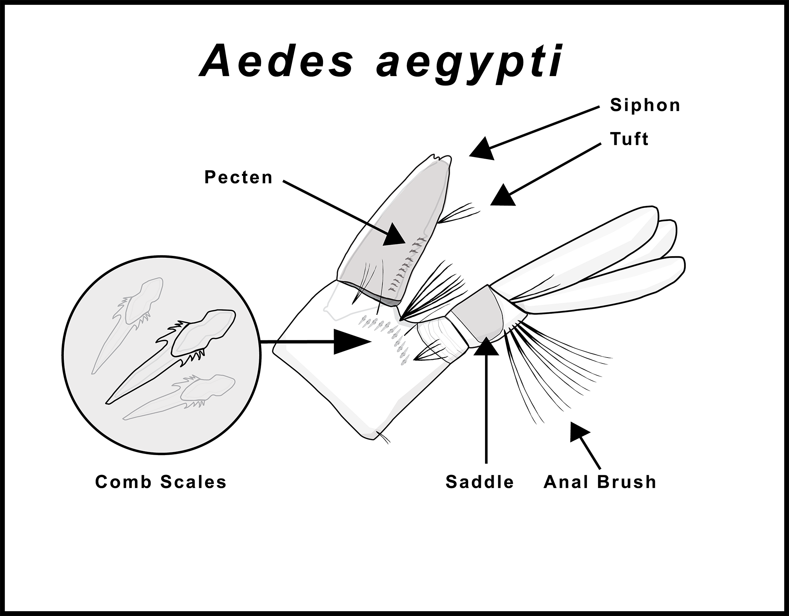
Note: Distinguishing between Aedes albopictus and Aedes aegypti requires at least 35x magnifier.
You will need to look at the comb scales. Note the differences shown in the diagrams above.

Slide 20
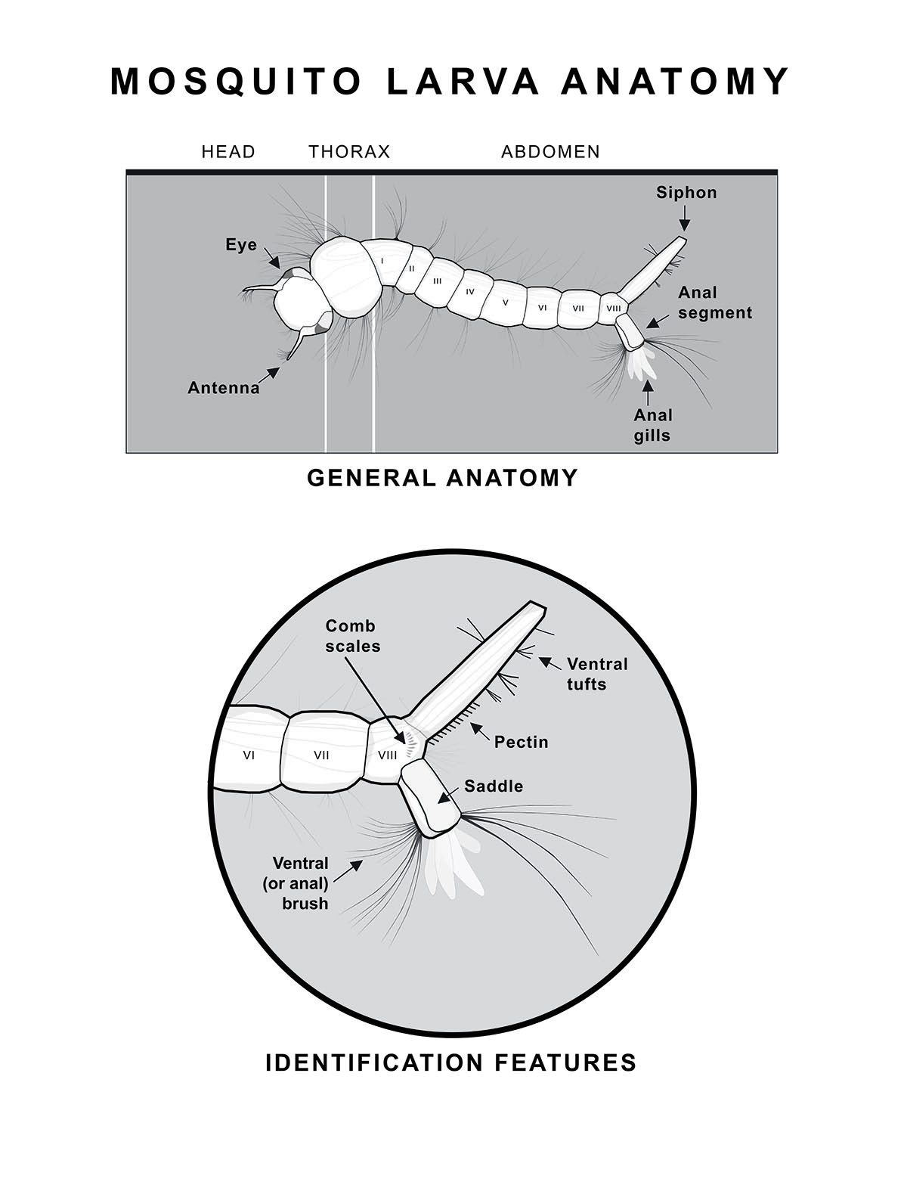
Identifying mosquito genera and species in your area
Familiarize yourself with the general anatomy of the mosquito larvae and the key features that distinguish those genera or species that are found in your locality.
Consult with mosquito experts or mosquito identification keys for your locality to identify important species in your region.

Slide 21


Acknowledgements
The GLOBE Observer Mosquito Habitat Mapper is a NASA-sponsored project that is the result of the combined efforts of an extended team that includes the Institute for Global Environmental Strategies (IGES); NASA Goddard Space Flight Center, Langley Research Center, and Jet Propulsion Laboratory; Space Science Applications, Inc. (SSAI); the GLOBE Implementation Office (GIO), GLOBE DIS and Brooklyn College.
The Mosquito Challenge Community Campaign (MCCC) is focused on demonstrating the usefulness of citizen science data collected using the GO Mosquito Habitat Mapper for combating Zika in Brazil and Peru. MCCC is led by IGES in partnership with the University Corporation for Atmospheric Research (UCAR), and leverages the NASA App, and the GLOBE Program networks of scientists, teachers, students, and citizen scientists. The MCCC project is made possible through the generous support of the Combating Zika and Future Threats Grand Challenge through the United States Agency for International Development (USAID).
This presentation was prepared by the Institute for Global Environmental Strategies (IGES) and does not necessarily reflect the views of the NASA or USAID. For more information, contact the MCCC Principal Investigator, Dr. Russanne Low:
Rusty_low@strategies.org
www.globe.gov
Educators: If you modify this presentation for your own use, please retain this page and add your name and contact information here, thank you!

