Slide 1
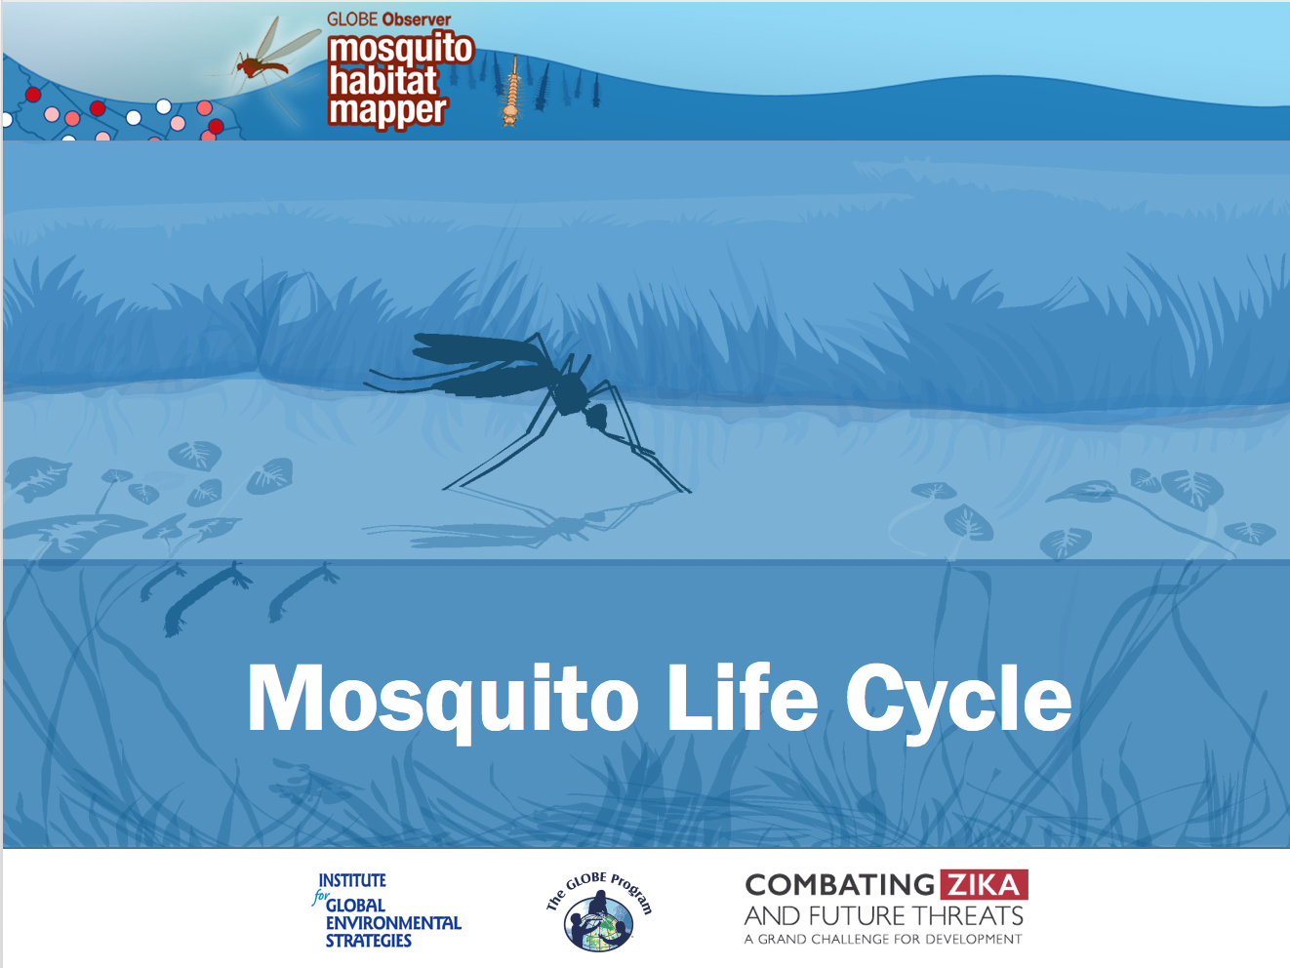
Mosquito Life Cycle

Slide 2

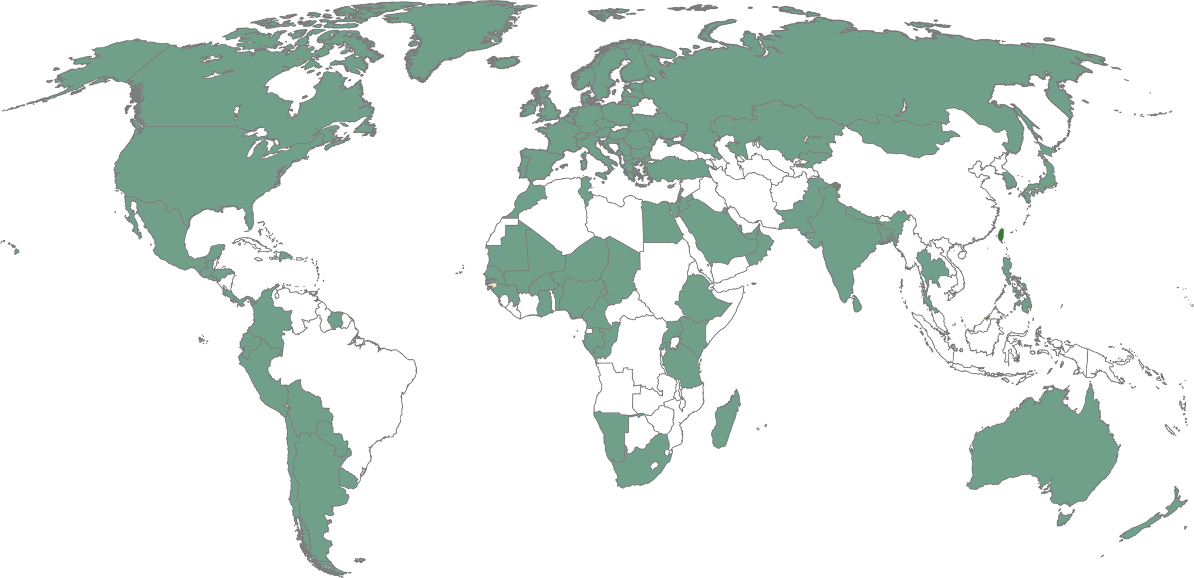
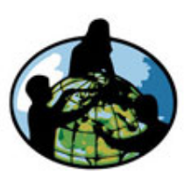
GLOBE is a science and education program that connects a network of students, teachers and scientists from around the world to better understand, sustain and improve Earth’s environment at local, regional and global scales.
To date, more than 130 million measurements have been contributed to the GLOBE database, creating meaningful, standardized, global research-quality data sets that can be used in support of student and professional scientific research.
It’s easy to get started! You are here!

Slide 3
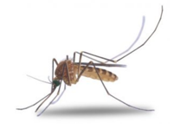
What do you know about the life cycle of mosquitoes?

Slide 4
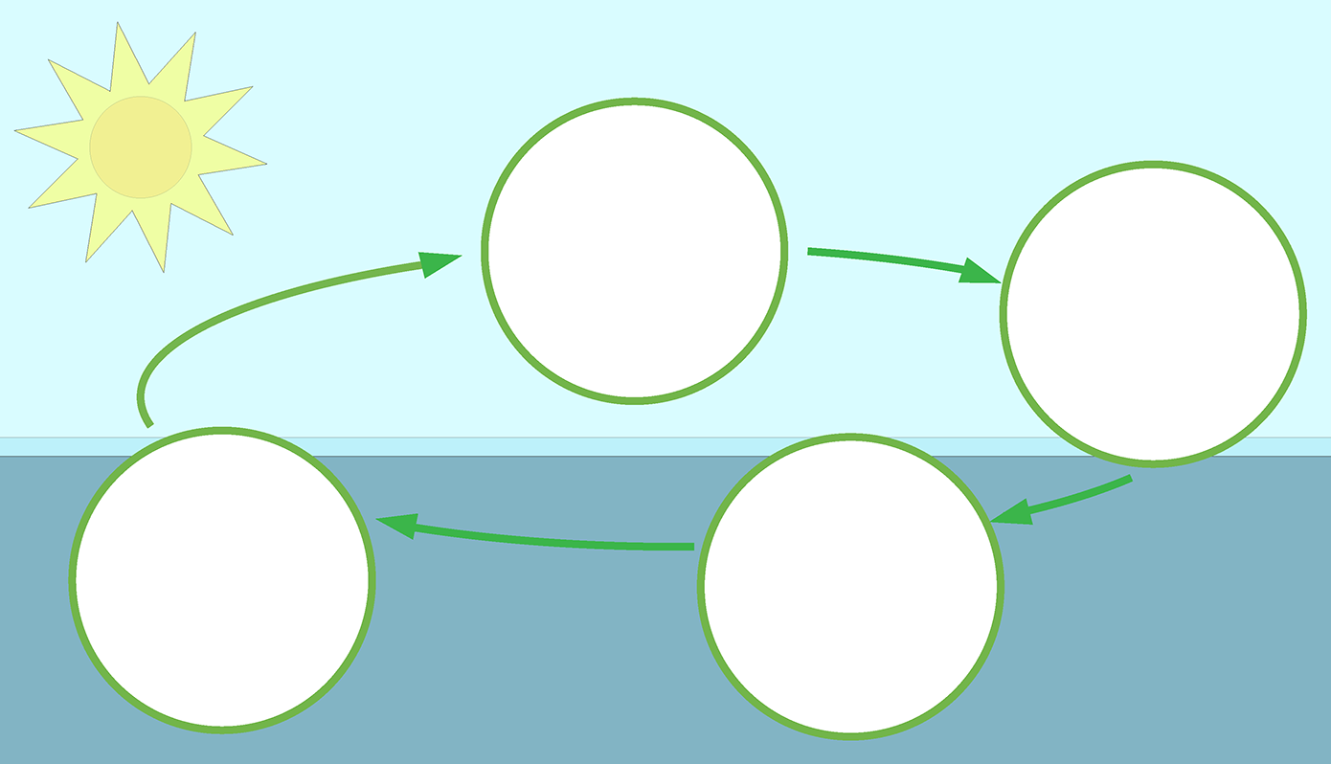
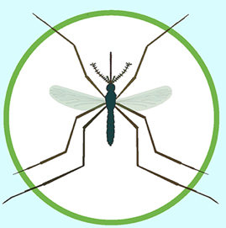

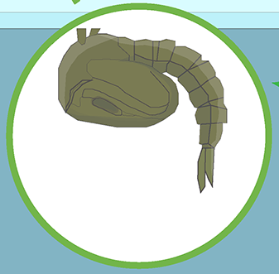
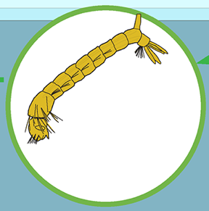
Mosquito Life Cycle
Four stages: Egg, Larva, Pupa, Adult

Slide 5
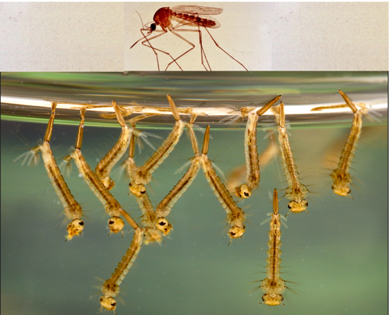
Important Vocabulary
Egg: laid in or near water; hatches to become larva.
Larva: (larvae) immature form that lives in water; breathes at surface; eats microorganisms; molts four times to grow.
Instar: phase between two periods of molting. (We observe the 4th instar- which is also called a “wiggler.”)
Pupa: (pupae) last immature stage before emerging as an adult. Non-feeding stage. Also known as tumblers.
Adult: flying insect
*Length of each stage depends on species and ambient temperatures.

Slide 6
Mosquito Life Cycle
Adult
Egg
The adult female mosquito lays eggs in or near water. The eggs are deposited singly, or attached together to form rafts.
Some mosquitoes, like those that transmit yellow fever mosquito and dengue, prefer to lay their eggs in small containers near humans- like flower pots and
water containers.
Most eggs hatch into larvae within 24-48 hours after becoming moist but some can also persist for weeks or months through dry periods. Others can withstand subzero winters!

Slide 7
Mosquito Life Cycle
Egg
Many mosquitoes lay eggs on the surface of fresh or stagnant water. If they prefer open air, breeding sites they usually choose where the water is sheltered from wind by vegetation. Other mosquitoes prefer a protected habitat, such as a natural container (tree or rock holes) or an artificial container, such as a dish or cup. Eggs can be found in pastures, tree holes, and stream bottoms and hatch when flooded with water.
Culex lay eggs in a “raft” that floats on the surface of the water.
Anopheles lay single eggs on the water surface
Aedes lay eggs in damp soil or on the sides of containers; the eggs begin to develop when the water level rises and floods the eggs.

Slide 8
Mosquito Life Cycle
Larva
The larva hatches from the egg and lives in the water. Some mosquito eggs, however, need to be dried completely before they will hatch.
Most species, such as found in Culex and Aedes genera, have a siphon or air tube and spend most of their time on the surface breathing. Anopheles does not have a siphon. Instead, it lays parallel to the surface and breathes through openings on its 8th abdominal segment (spiracles).
Some species have specialized siphons and attach to emergent plants found in water, using the plant tissue to access air to breathe.

Slide 9
Mosquito Life Cycle
Larva
Larvae eat constantly- feeding on algae, plankton, fungi, bacteria and other aquatic organisms. One genera of mosquito is specifically adapted to eat other mosquito larvae!
The larvae hang on the surface of the water with their mouths open. They have brushes (hairs around their mouth) that filter water- so only particles small enough to be eaten enter the mouth.

Slide 10
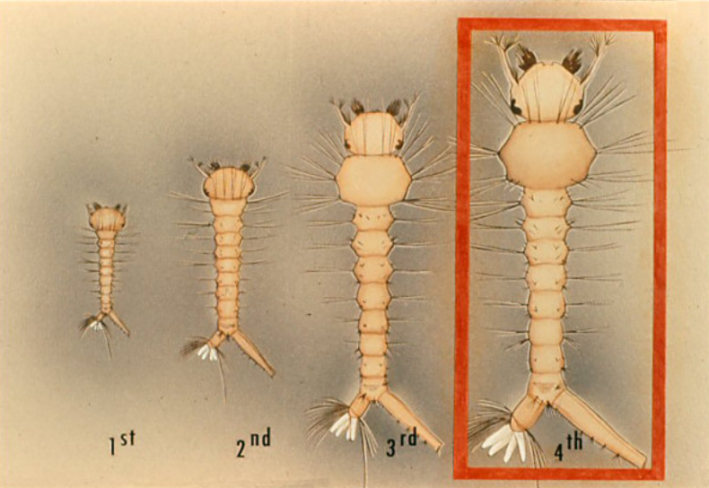
Mosquito Life Cycle
Larva
During growth, the larva molts (sheds its skin) four times. (The fourth molt results in the change from larva to pupa)
The stages between molts are called instars.
At the 4th instar, the larva can a length of almost 10 mm. Toward the end of this instar feeding ceases.

Slide 11
Mosquito Life Cycle
Larva
When the 4th instar larva molts, it becomes a pupa.
When identifying mosquito larvae, look for the largest larvae
in your sample, the 4th instar. The diagnostic features you are looking for are most pronounced in this stage.

Slide 12
Mosquito Life Cycle
Pupa
Mosquito pupae, commonly called "tumblers," live in water from 1 to 4 days, depending upon species and temperature.
The pupa is lighter than water and therefore floats at the surface. It takes oxygen through two breathing tubes called "trumpets."
The pupa does not eat, but it is not an inactive stage. When disturbed, it dives for safety in a jerking, tumbling motion and then floats back to the surface.

Slide 13
Mosquito Life Cycle
Pupa
The metamorphosis of the mosquito into an adult is completed within the pupal case.
The pupal case is like a “factory” where the mosquito larva becomes an adult. The adult mosquito splits the pupal case and emerges to the surface of the water where it rests until its body dries and hardens.

Slide 14
Mosquito Life Cycle
Adult
Adults emerge, and fly away looking for their first meal and to mate.
Adults eat nectar, like many other insects.

Slide 15
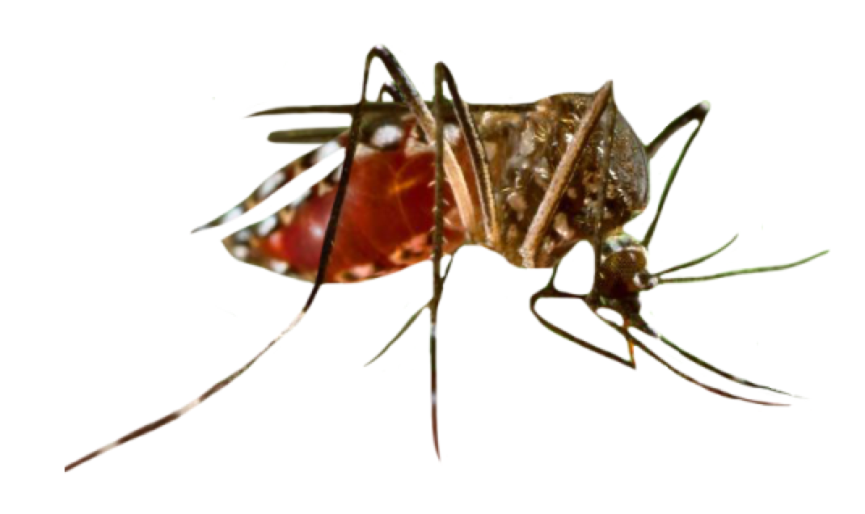
Mosquito Life Cycle
Adult Female
Image: CDC, USA
Only female mosquitoes bite, seeking blood from humans and other animals. Blood provides pre-natal supplements needed for egg development.
After her blood meal, the female lays eggs on or near the water. The eggs can survive dry conditions for a few months.
Not all species of mosquitoes require females to eat a blood meal to make eggs, but those are the mosquitoes you are most familiar with!

Slide 16


Acknowledgements
The GLOBE Observer Mosquito Habitat Mapper is a NASA-sponsored project that is the result of the combined efforts of an extended team that includes the Institute for Global Environmental Strategies (IGES); NASA Goddard Space Flight Center, Langley Research Center, and Jet Propulsion Laboratory; Space Science Applications, Inc. (SSAI); the GLOBE Implementation Office (GIO), GLOBE DIS and Brooklyn College.
The Mosquito Challenge Community Campaign (MCCC) is focused on demonstrating the usefulness of citizen science data collected using the GO Mosquito Habitat Mapper for combating Zika in Brazil and Peru. MCCC is led by IGES in partnership with the University Corporation for Atmospheric Research (UCAR), and leverages the NASA App, and the GLOBE Program networks of scientists, teachers, students, and citizen scientists. The MCCC project is made possible through the generous support of the Combating Zika and Future Threats Grand Challenge through the United States Agency for International Development (USAID).
This presentation was prepared by the Institute for Global Environmental Strategies (IGES) and does not necessarily reflect the views of the NASA or USAID. For more information, contact the Principal Investigator, Dr. Russanne Low, at IGES:
Rusty_low@strategies.org
www.globe.gov
Educators: did you modify this file for your class? Put your name here!

