Slide 1
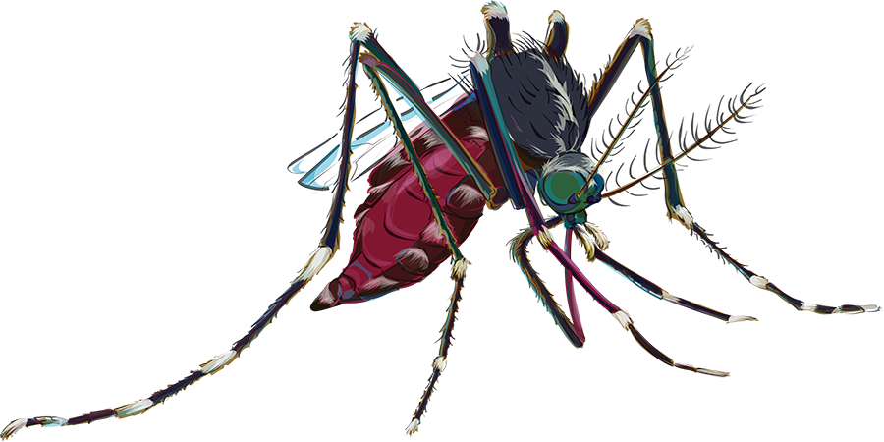
Seeing your Data: GLOBE Viz and ADAT, and Google
Wednesday, April 17, 2019
2 pm ET/6 pm UTC

Slide 2
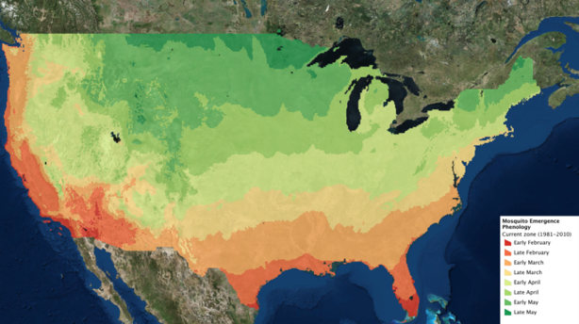
Todays’ Agenda
Quick overview of the Mission Mosquito campaign
Active Mosquito Season-Phenology: Liz Burck
Seeing Your Data: Cassie Soeffing
Upcoming Events

Slide 3
The GLOBE “Mission Mosquito” Campaign
Campaign connecting citizen scientists of all ages to monitor changes in the frequency, range, and distribution of potential disease vector mosquitoes
Conduct research to explore how these vary in response to changes in environmental conditions
Fusion of the GLOBE and the GLOBE Observer programs

Slide 4
Campaign Participants Can …
Can conduct their own research and contribute to the science outcomes for this campaign, which include:
Basic scientific research that refines understanding of mosquito ecology and behavior
Development of an extensive database that can be used by scientists who create and use models to develop early warning systems of potential disease outbreaks

Slide 5
Mosquito Habitat Mapper tool
Four Steps- and you don’t have to do all of them!
Identify potential mosquito breeding habitats
Sample and Count
Photograph and Identify Species of Larvae
Eliminate breeding site

Slide 6
Through this campaign, we strive to:
Identify baseline (2018-2021) for range and distribution of vectors such as Aedes aegypti and Aedes albopictus.
Identify seasonality of local mosquito vectors: first sighting, last sighting, period of greatest number of observations
Quantify change in mosquito frequency and distribution at local, regional, national and global scales with specific reference to prevailing environmental parameters, such as precipitation, land cover, surface temperature, and soil moisture.

Slide 7
Liz Burck
Senior Science Education Specialist
Institute for Global Environmental Strategies

Slide 9
Phenology: the timing of events in the life cycle of an organism (mosquito!)
This mosquito phenology study needs citizen scientists to:
1. determine the onset of mosquito season in your area
2. monitor the duration and intensity of the season
3. determine the end of the mosquito season
Your data is important. It will show:
geographic and yearly trends in seasonality
the impacts of climate change on mosquito seasons
patterns of mosquito-borne diseases
The Phenology Guide for Citizen Scientists will show you how……

Slide 10
Appendix B: Data Table
Investigator’s name(s) _________________________________________________________________________________________
Chosen name for study site: _____________________________ Type of breeding site (pond, container, trap):__________________
City and State: ________________________________________ Latitude and longitude: __________________________________
Date of observation | Time of observation | Current temperature at site (°C) | Adults present? (yes/no/?) | Larvae present? (yes/no/?) | Pupae present? (yes/no/?) | Larvae ID (Genus/species name or “uncertain”) | Comments / Observations

Slide 11
Where have we found mosquitoes using GLOBE Viz

Slide 12
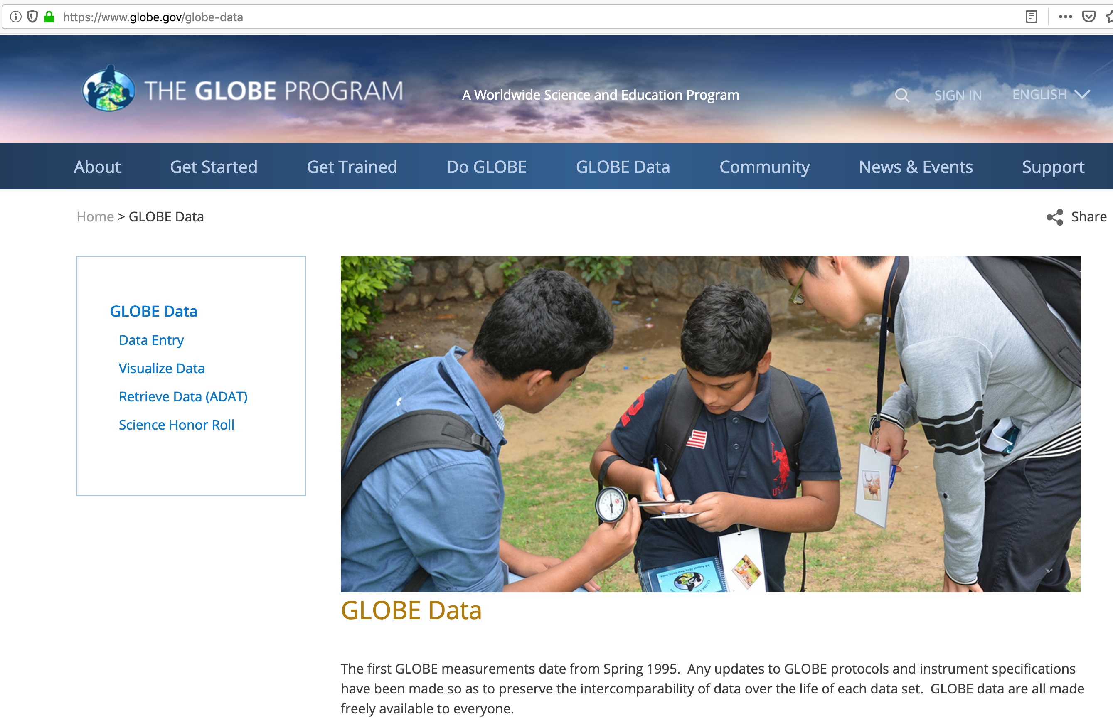

Slide 13
Three Steps to Visualize your Data
1. Select the type of data you want (Add Layers)
2. Select the Date of the data you want to see
3. Click on a data point on the map to view a
a table and the metadata

Slide 14
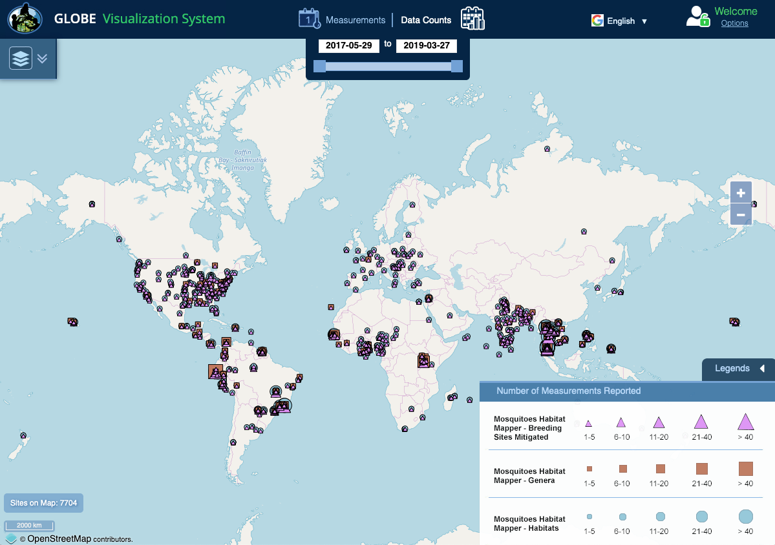
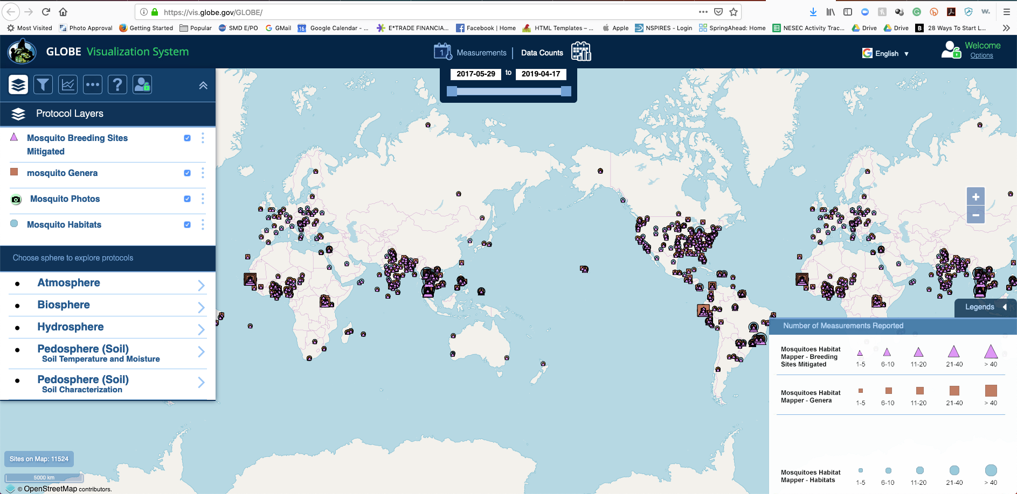

Slide 15
Follow along with me online!
GLOBE ADAT to Google Maps

Slide 16
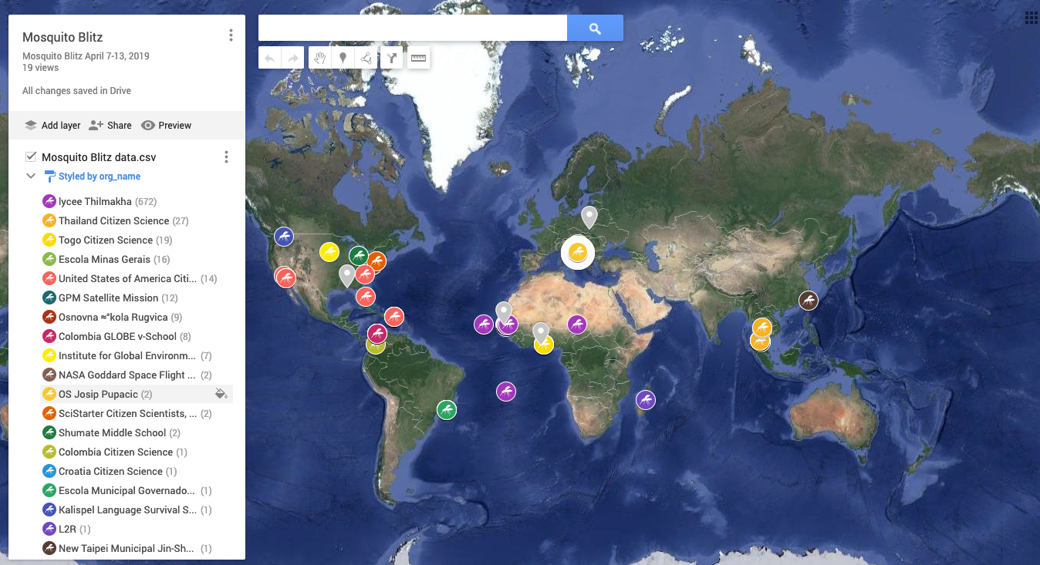
Google Maps

Slide 17
Webinar Challenge
Create a map with your sites/observations
GLOBE Viz – send a screen shot of your map
Google Map – either email the link to the
map or send a screen shot

Slide 18
Upcoming Webinars
May 8th, 2 PM ET Education Webinar
Protection and Prevention Measures
May 29, 2 pm ET Citizen Science
Mosquitoes on the Landscape

Slide 19
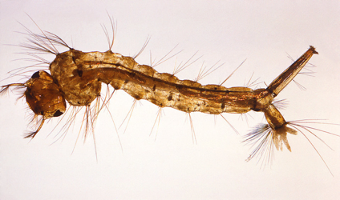
Get Involved!
Get on our newsletter and webinar mailing list
Visit and share our GMM webpage
Check out our archived and upcoming webinars
Be sure to try out the app and submit your data

Slide 20
Rusty_Low@strategies.org
Liz_Burck@strategies.org
Cassie_Soeffing@strategies.org
https://www.globe.gov/web/mission-mosquito/overview

