Slide 1
Education Webinar # 8 Student Research Projects
June 5, 2019
GLOBE Mission Mosquito

Slide 2
Today’s Agenda
Welcome
Using the MHM to do student investigations
Ines Mauad: Brazil
Patchara Pongmanawut: Thailand
Jeff Bouwman: USA
MHM “Honor Roll”
Upcoming Events

Slide 3
The GLOBE “Mission Mosquito” Campaign
D
Campaign connecting citizen scientists of all ages to monitor changes in the frequency, range, and distribution of potential disease vector mosquitoes
Conduct research to explore how these vary in response to changes in environmental conditions
Fusion of the GLOBE and the GLOBE Observer programs

Slide 4
Mosquito Habitat Mapper tool
D
Four Steps- and you don’t have to do all of them!
Identify potential mosquito breeding habitats
Sample and Count
Photograph and Identify Species of Larvae
Eliminate breeding site

Slide 5
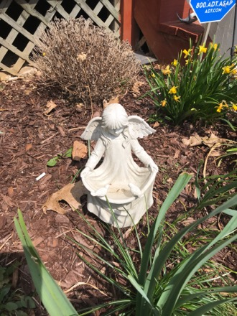
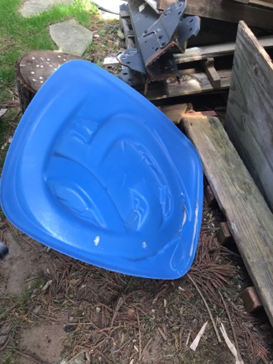
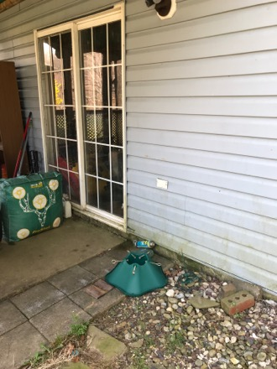
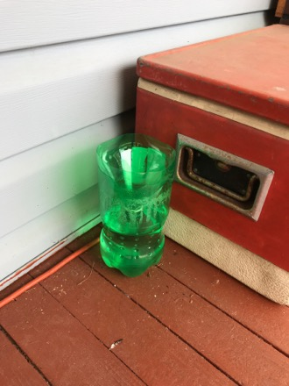
A few tips and tricks:
Be sure to take data even when it is inactive mosquito season!
Image credits: Janney

Slide 6
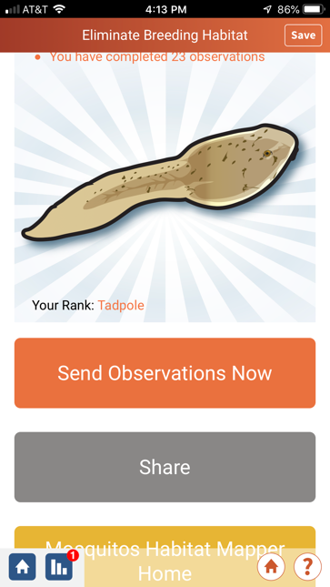
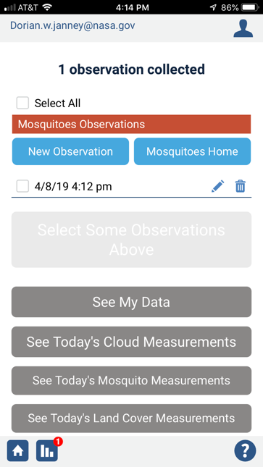
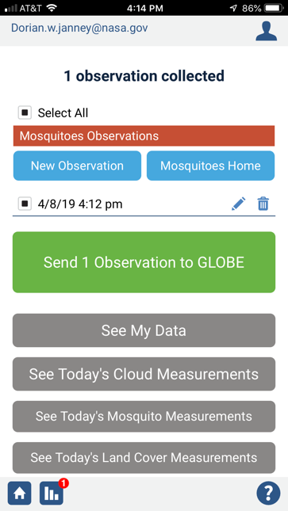
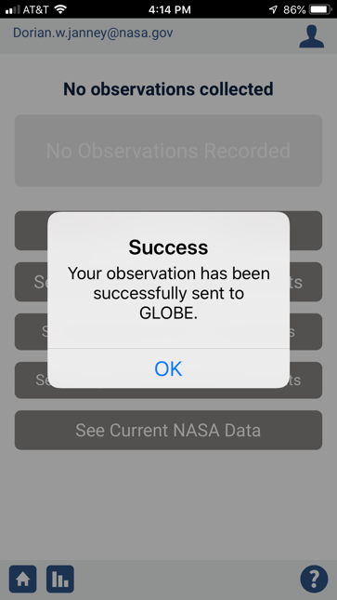
Remember to submit your data!

Slide 7
Rocking with Collecting and Submitting MHM Data!!
Data Counts as of 6/3/2019
Total number of observations: 12,473

Slide 8
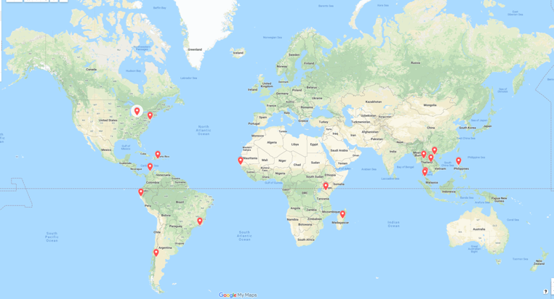
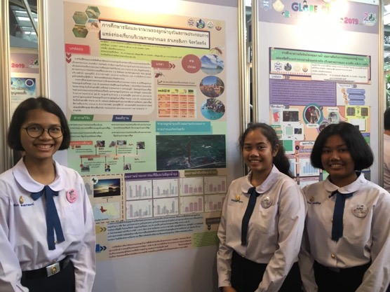
Using the MHM for Student Research
International Virtual Science Symposium
23 IVSS projects used the MHM in their research
15 different countries

Slide 9
IVSS MHM-related project titles
Typology and evolution of the number of mosquito habitats in Matameye (Niger)
A study of mosquito prevalence at St. Scholastica Catholic School and its surroundings (Kenya)
Community Based Mosquito Vector Prevention Model : Conceptual Approach to Mitigating the Risk of Mosquito threats Thru Community Empowerment and Education (Philippines)
Comparative studies of larvae of mosquitoes present in the Gardenia’s urbanization, Barranquilla (Columbia)
Identification of the potential sites of disease vectors at Kaolack level (Senegal)

Slide 10
Dengue situation with different ecological and environmental factors in the sub-district in Chiang Mai (Thailand)
Determine the periods of strong outbreak mosquito and reduce their population (Senegal)
Distribution and abundance of mosquitoes in the world. Preliminary report. (Argentina)
Mosquitos in Piura, abundant rainfall or little prevention? (Peru)
Research on Zika virus presence in Central Kenya (Kenya)
Study of mosquito species and their number in a touristic place in Pak Meng beach, Trang (Thailand)

Slide 11
Temporarily storing water in mined pits in the Ezimbeni area (South Africa)
The effect of climate change on dengue fever and the number of mosquito larvae in Mueang Nakhon Si Thammarat (Thailand)
The hunting efficiency of natural mosquito larvae predators (Thailand)
Initial research on mosquito and mosquito larvae characteristics, comparing mosquitoes in urban and suburban areas of Ha Hoi (Vietnam)
The study of behavioral factors of people in DonChan district community Affecting Dengue fever outbreak (Thailand)

Slide 12
Research on mosquitoes and diseases they transmit (Kenya)
Drones are an Effective Way to Identify Mosquito Breeding Habitats (USA)
Facility or freedom? That is the question! (Brazil)
Mosquito larvae predominant in the Olympic Center (Santo Domingo)
What are the Humidity, Precipitation, and Temperature Conditions Associated with Active Mosquito Season? (USA)
Drones are an accurate and efficient way to identify mosquito breeding grounds in Medford (USA)

Slide 13
IVSS MHM Interactive Map
http://bit.ly/2MsQQxt

Slide 14
Notes:
LiveSlide Site
https://www.google.com/maps/d/u/0/viewer?mid=1UAm6cUL27WAOJ-IH0Gn5XWHaAd-KxXVg&ll=1.420941477612504%2C18.927025949999916&z=3

Slide 15
To see the IVSS projects:
Go to GLOBE
Search for “IVSS Student Reports”
Go to “2019 Virtual Science Symposium”
Click on “Virtual Science Symposium Reports”
Filter by “hydrosphere” and then “Mosquitoes”

Slide 16
Add a Student Research Report anytime!
Students can upload their Student Research Report at any time during the year.
Search on the GLOBE home page for “Student Research Reports”
Upload your research report- be sure to click “Mission Mosquito Report”

Slide 17
“Bundling” GLOBE Protocols/ Tools
Atmosphere: air temperature, precipitation, relative humidity
Hydrosphere: all protocols (alkalinity, dissolved oxygen, etc)
Pedosphere: soil moisture, soil temperature
Biosphere: land cover, Green Up- Green Down

Slide 18
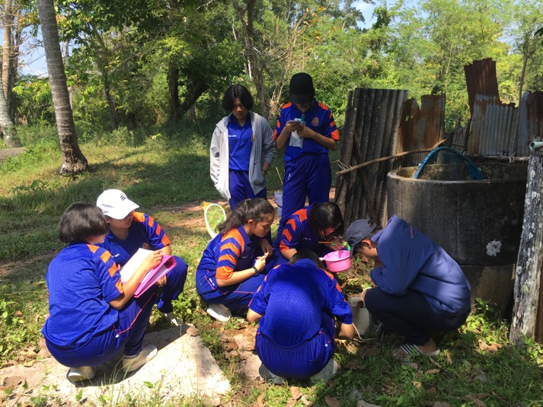
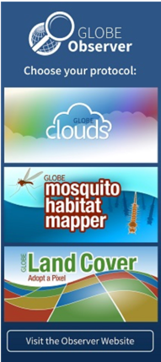
Now we will hear from students/teachers:
Ines Mauad: Brazil
Patchara Pongmanawut: Thailand
Jeff Bouwman: USA

Slide 19
Ines Mauad: Brazil

Slide 20
Patchara Pongmanawut: Thailand

Slide 21
Jeff Bouwman: USA

Slide 22
The GLOBE Mission Mosquito Honor Roll
GLOBE Member School/Institution Country
D. Palacios I.E. Enrique Lopez Albujar- Piura Peru
I. Mauad Escola Minas Gerais Brazil
G. Aikpon University of Abomey Calavi Benin
E. Martinez Columbia GLOBE V-School Columbia
J. Bouwman Shumate Middle School USA
H. Akoffodji CREC Benin
A. Salako CREC Benin
P. Pongmanawut Princess Chulabhorn Science High School- Trang Thailand

Slide 23
Upcoming Events
Wednesday, June 19th at 2 PM (ET)
Citizen Science webinar: “Introduction to data reporting mapping tools”
Tuesday, July 9th at 2 PM (ET)
Education webinar: “Using NASA Earth Observations for Mosquito-borne Disease
Research”
Wednesday, July 24th at 2 PM (ET)
Citizen Science webinar: “How can mosquito citizen science data protect
communities from disease?”
Look for our next newsletter on June 12th!

Slide 24
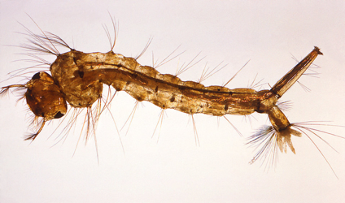
Get Involved!
Get on our newsletter and webinar mailing list
Visit and share our GMM webpage
Check out our archived and upcoming webinars
Be sure to try out the app and submit your data

Slide 25
Thank you
GLOBE Mission Mosquito archived webinars
https://www.globe.gov/web/mission-mosquito/overview/webinars

