Slide 1
Education Webinar # 9 Using NASA Observations for Mosquito-borne Disease Applications
July 9, 2019
GLOBE Mission Mosquito

Slide 2
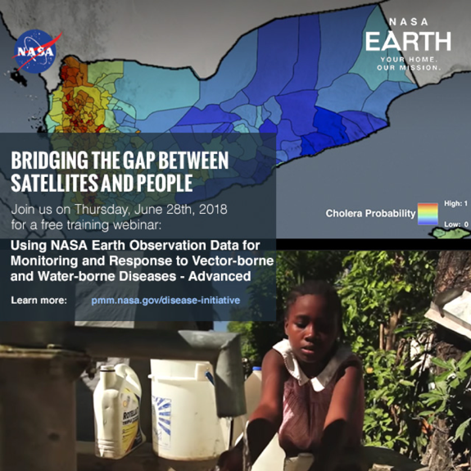
Today’s Agenda
Welcome
The GLOBE Observer MHM tool review
GLOBE MHM observations
Dr. Ben Zaitchik’s presentation
Accessing and layering NASA data sets
MHM “Honor Roll”
Upcoming Events

Slide 3
The GLOBE “Mission Mosquito” Campaign
D
Campaign connecting citizen scientists of all ages to monitor changes in the frequency, range, and distribution of potential disease vector mosquitoes
Conduct research to explore how these vary in response to changes in environmental conditions
Fusion of the GLOBE and the GLOBE Observer programs

Slide 4
Mosquito Habitat Mapper tool
D
Four Steps- and you don’t have to do all of them!
Identify potential mosquito breeding habitats
Sample and Count
Photograph and Identify Species of Larvae
Eliminate breeding site

Slide 5
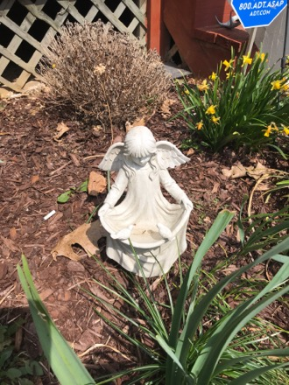
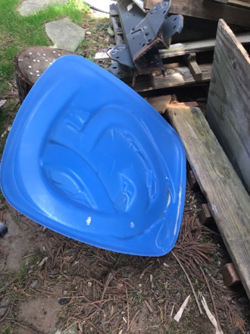
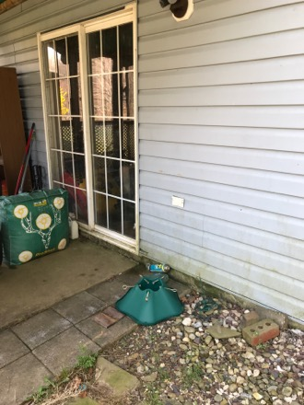
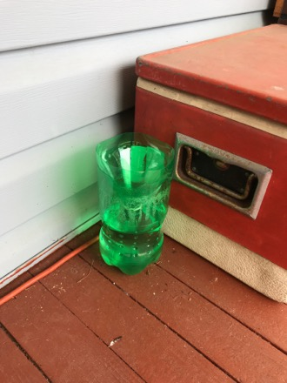
A few tips and tricks:
Be sure to take data even when it is inactive mosquito season!
Image credits: Janney

Slide 6
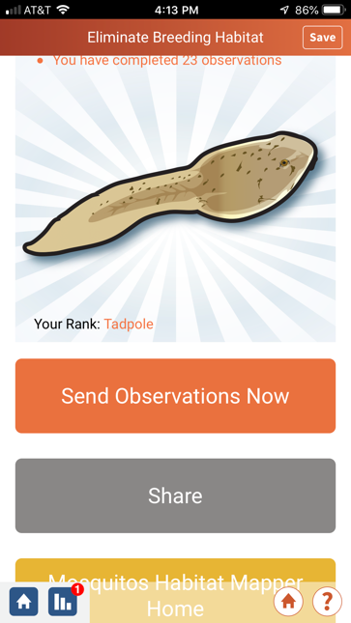
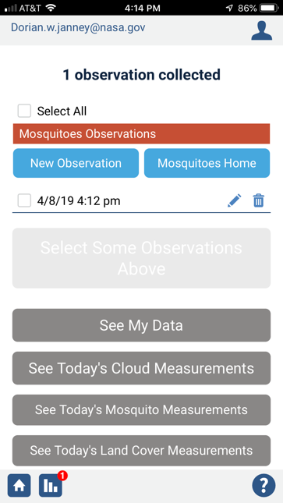
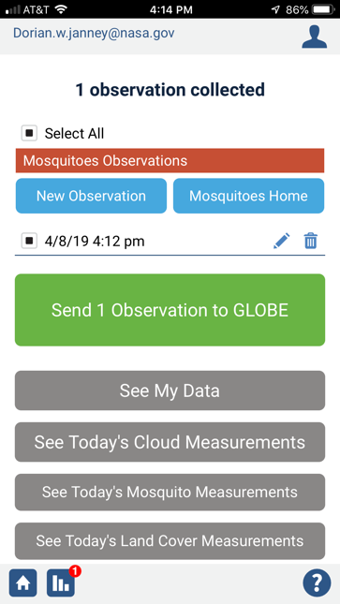
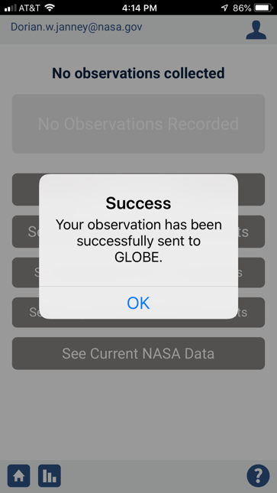
Remember to submit your data!

Slide 7
Rocking with Collecting and Submitting MHM Data!!
Data Counts as of 7/8/2019
Total number of observations: 13,951

Slide 8
NASA Earth observing satellites

Slide 9
Using NASA EOS data for disease applications

Slide 10
Dr. Ben Zaitchik
Associate professor at Johns Hopkins University, Baltimore, MD
Research includes understanding, managing, and coping with climatic and hydrologic variability
Uses a combination of observation: both in situ and remotely sensed and numerical modeling techniques

Slide 11
Case Study: Malaria in Loreto region of Peru
65,000 cases of malaria reported in 2014 and 2015
Key genus: Anopheles darlingi
Environmental parameters of interest include:
Air temperature: 18$° C to 32° C$
Monthly precipitation: > 80 mm/month
Humidity: > 60%
Soil moisture, vegetation cover and ponded areas also impact malaria cases
https://iridl.ldeo.columbia.edu/maproom/Health/Regional/Africa/Malaria/CSMT/index.html
https://www.cdc.gov/malaria/about/distribution.html
Notes:
There were 65,000 reported cases in both 2014 and 2015, most of them being reported from the Loreto region, which is an area in the Amazonian rainforest which we will focus on today. Although malaria has always been a major public health problem in this region, there was an eradication campaign during the 1950s and 60’s which had resulted in a drastic reduction of malaria cases, bringing them down to about 1,500 cases reported in Peru in 1963. The number of cases remained at these low levels until 1997, when the cases began to climb in the Loreto region again. In 2011 there were only 9,306 confirmed cases, whereas in 2013 the number rose to 35,826.

Slide 12
precipitation data
humidity data
temperature data
potential outbreak

Slide 13
NASA Earth observing data sets
Giovanni for monthly precipitation data from GPM mission
https://giovanni.gsfc.nasa.gov/giovanni/
NASA Worldview for other data
https://worldview.earthdata.nasa.gov/

Slide 14
Giovanni

Slide 15
Getting the Monthly Precipitation
1. Keyword: “IMERG Final”- search
Merged satellite gauge precipitation estimate- Final Run
Set units to mm/month
2. Select Plot: Time Series: Seasonal
3. Select Seasonal Dates: click all boxes
4. Set years: 2014 to 2017
5. Select Region: use bounding box to highlight region, helps to know decimal coordinates (-73.25383=long, -3.74912= lat.)

Slide 17
Click green button- “Plot Data”
Launching workflow

Slide 18
Click on “Downloads” on far left
Combined ASCII

Slide 19
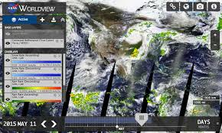
NASA Worldview
Do the tutorial!!
Surface Skin/ Air Temperature:
Aqua/ AIRS
“Surface Skin Temperature (Day, Monthly)”
Relative Humidity: Aqua/ AIRS
(Surface Relative Humidity (Day, Monthly)

Slide 20
Setting Up Worldview
Along bottom: set up date, beginning with 2014, and set up months, set to begin on Jan.1, 2014

Slide 21
Set the location of interest: near Loreto, Peru
Overlays: open (click on the eye icon) “Place Labels”, “Coastlines/ Borders”
Zoom in close to Peru, and use cursor to help you locate region that includes -3.749 and – 73.254

Slide 22
Add Temperature layer
Click on red button- “Add Layers”
Search box” “Surface Skin Temp. (Day, Monthly- Aqua/ AIRS)
Results are in Kelvin, 18$°$= 291$°$/ 32˚= 305$°$
Can change palette, opacity, and threshold to meet needs

Slide 23
Add relative humidity layer
Go to “Add Layers”
Search for “Surface Relative Humidity (Day. Monthly) Aqua/ AIRS)
Set threshold for 50% and above
Select different color palette
Work with opacity to meet your needs

Slide 24
More Training Resources
Beginner level training: "Using NASA Earth Observing Data for Monitoring and Response to Vector-borne and Water-borne Diseases"
Advanced level training: "Using NASA Earth Observation Satellite Data to Predict, Monitor and Respond to Vector-borne and Water-related Disease"

Slide 25
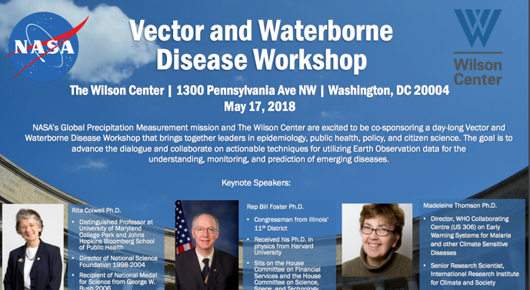
Additional related resources
Predicting Malaria with NASA satellites video
GPM Disease Initiative website
Using GPM and other NASA EOS Data to Understand Vector-borne Disease webquest

Slide 26
GO MHM Top Data Collectors for Past Month
GLOBE Member School/Institution Country
D. Palacios I.E. Enrique Lopez Albujar- Piura Peru
I. Mauad Escola Minas Gerais Brazil
G. Aikpon University of Abomey Calavi Benin
E. Martinez Columbia GLOBE V-School Columbia
A. Kaui St. Scholastica Catholic School Kenya
S. Moreno I.E. Virgen Dolorosa Peru

Slide 27
Upcoming Events
July 14th through 19th: Annual GLOBE meeting in Detroit
Weds., July 24th at 2 PM (ET)
Citizen Science webinar: “How can mosquito citizen science data protect
communities from disease?”
Weds., August 7th, 2019 8 PM (ET)
Education webinar: Around the World with MHM
Look for our next newsletter on July 17th!

Slide 28
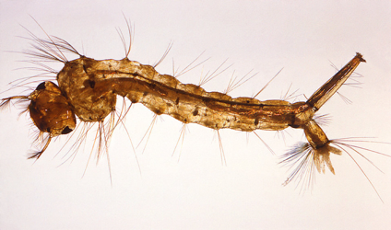
Get Involved!
Get on our newsletter and webinar mailing list
Visit and share our GMM webpage
Check out our archived and upcoming webinars
Be sure to try out the app and submit your data

