Slide 1
GLOBE Mission Mosquito presents a series of mosquito tutorials
Mosquitoes as Vectors of Disease

Slide 2
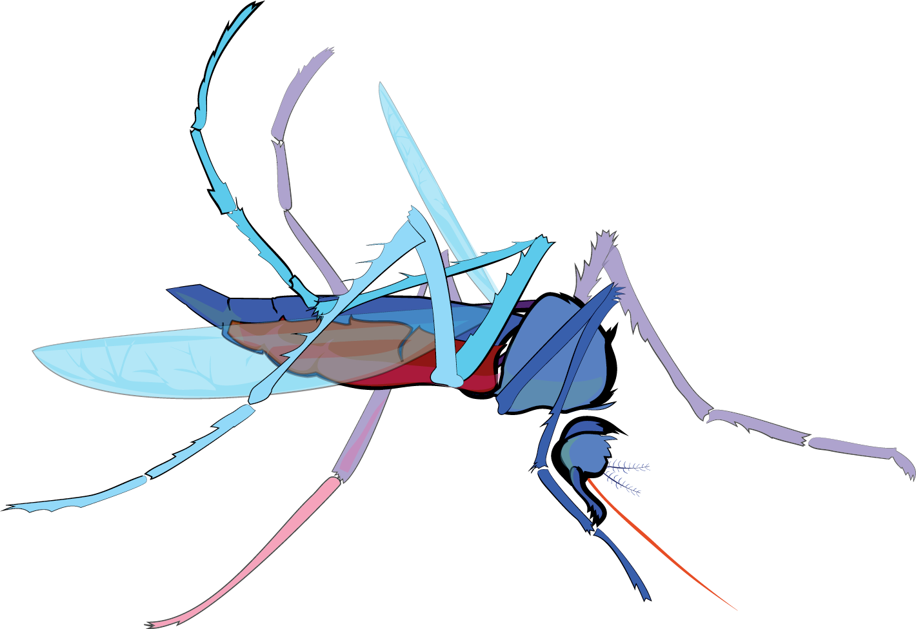
Why Make Observations?
Slide Sets
Why Make Observations?
Mosquito as Vectors of Disease
Satellite Data and NASA Connections
Prior Knowledge Quiz
Describing your mosquito habitat site
Using the app for the first time
Using the macro lens
Identifying specimens

Slide 3
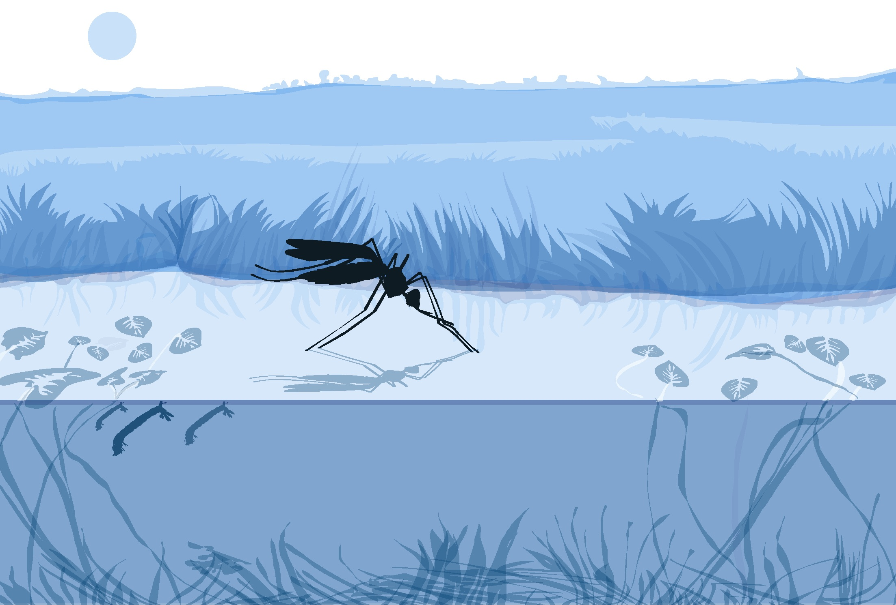
Mosquitoes as Vectors of Disease

Slide 4
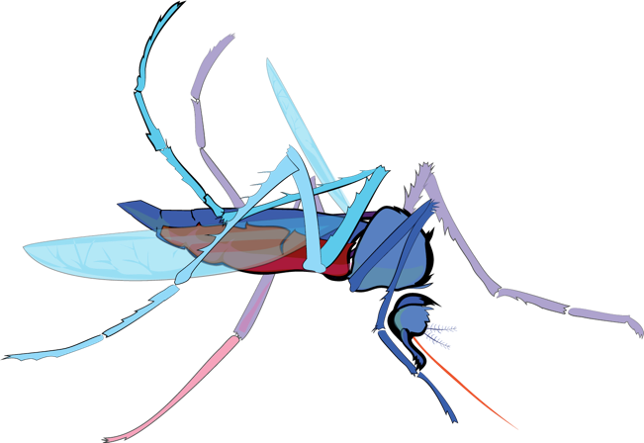
Did you know that ….
Mosquitoes are the world’s most deadly animal in the world!
Notes:
NACCHO Report: Shifting Our Approach to Mosquito Control Capabilities in the U.S.
Established a baseline of the landscape of local vector control

Slide 5
But why?
Every year, more than a billion people worldwide (roughly one in every seven people) become ill.
Estimates are between 500,000-750,000 people die as a result of mosquito bites.

Slide 6
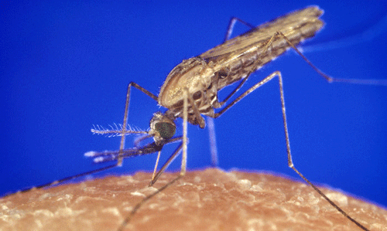
Anopheles
Found in open water pools with little vegetation
Most like clean, clear water, but some breed in eutrophic or polluted water.
Photograph by James Gathany, CDC

Slide 7
Anopheles
Malaria is a disease
caused by parasites that
are transmitted to humans by the Anopheles
mosquito.
Malaria causes more
deaths per year than any
other mosquito-
transmitted disease.
Malaria is preventable
and curable with drugs and medical attention.
Anopheles life cycle

Slide 8
Anopheles
Not all Anopheles mosquitoes transmit malaria. About 10% of approximately 400 species.
You can find out which species are important vectors for disease transmission in your region in the next slide.

Slide 9
Anopheles

Slide 10
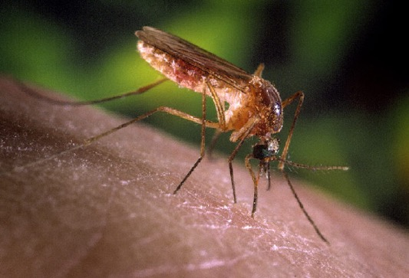
Culex
Culex mosquitoes breed in stagnant water: places such as rainwater barrels, drainage systems, septic tanks, and containers such as tires, buckets and rain barrels).
Photograph by James Gathany, CDC

Slide 11
Culex
Culex prefer open habitats such as surface water that has become stagnant and enriched with organic matter like swamps, marshes, bogs, rice fields, pastures.

Slide 12
Culex
Lymphatic filariasis
Encelphalitis
West Nile Virus
Rift Valley fever (also Aedes vexans)
Culex is a vector of several human and animal diseases
Culex life cycle

Slide 13
Culex
Lymphatic filariasis is a parasitic disease caused by microscopic,thread-like nemotodes. The adult worms only live in the human lymph system. Transmitted by mosquito bites.

Slide 14
Culex
Lymphatic filariasis is found in these
countries:
South America: Culex quinquefasciatus
Asia: Aedes, Mansonia
Africa: Anopheles

Slide 15
Aedes
Aedes aegypti and Aedes albopictus are container breeding mosquitoes.
They lay eggs in artificial
containers that contain water.
The females lay the eggs singly, just above the water level. When the water level rises, it moistens the eggs, which signals them to then begin to develop.
Photograph by James Gathany, CDC

Slide 16
Aedes
Aedes aegypti strongly prefer artificial containers.
Aedes albopictus will lay eggs in both artificial and natural containers.
Both mosquitoes are well adapted to human habitats.
Notes:
https://doi.org/10.7554/eLife.08347.001
Kraemer et al. 2015 eLife 2015;4:e08347

Slide 17
Aedes
Other Aedes mosquitoes breed in floodplains after rain events, in irrigation ditches, in woodland pools, brackish swamps and salt marshes.
Notes:
https://doi.org/10.7554/eLife.08347.001
Kraemer et al. 2015 eLife 2015;4:e08347

Slide 18
Aedes
Aedes aegypti and Aedes albopictus are two species that potentially transmit
pathogens to humans that can cause the following diseases:
yellow fever
dengue fever
chikungunya
Zika virus
lymphatic filariasis
equine encephalitis
Rift valley fever
Notes:
Image credit: Rusty Low, FIOCRUZ
Really a different ball game
Bednets, useful for malaria, doesn’t’ work as they are day time biters. Larvacides are not easily deployed because they preferentially lay their eggs in manufactured containers as small as a bottle cap. Fogging at night doesn’t work well because they are active during the day,

Slide 19
Yellow Fever
Symptoms: fever, headache (mild) to organ failure (severe)
Prevention: Vaccine is available

Slide 20
Dengue
40% of the world’s populations lives in areas where there is a risk of dengue transmission.

Slide 21
Dengue
Number of cases per year: ~400 million (CDC).
Symptoms: fever, headache, joint pain, rash, jaundice, hemmorrhagic dengue… can be fatal
Prevention: vaccine is in phase 3 trials

Slide 22
Chikungunya
Symptoms: fever, headache, joint pain, rash, no vaccine available

Slide 23
Zika
Why high interest? Insufficient surveillance worldwide, heightened interest in using satellite data to predict outbreaks of vector borne disease.
Global map of the predicted distribution of Ae. aegypti. The map depicts the probability of occurrence (from 0 blue to 1 red).

Slide 24
Chikungunya
Can be sexually transmitted through fluids (blood transfusion
Symptoms similar to dengue and chikungunya
Up to 80% of cases are asymptomatic
Can cause birth defects of fetus

Slide 26
Mosquitoes as Vectors of Disease
Authors:
Russanne Low PhD
Science Lead GO Mosquito Habitat Mapper
Institute for Global Environmental Strategies Arlington VA
Rusty_low@strategies.org
Rebecca Boger, PhD
Brooklyn College, NY USA
Renee Codsi
Institute for Global Environmental Strategies
Did you modify this file for your class?
Put your name and the date here!
This work is licensed under https://creativecommons.org/licenses/by-nc-sa/4.0/

