Slide 1
GLOBE Mission Mosquito presents a series of mosquito tutorials
Prior Knowledge Quiz

Slide 2
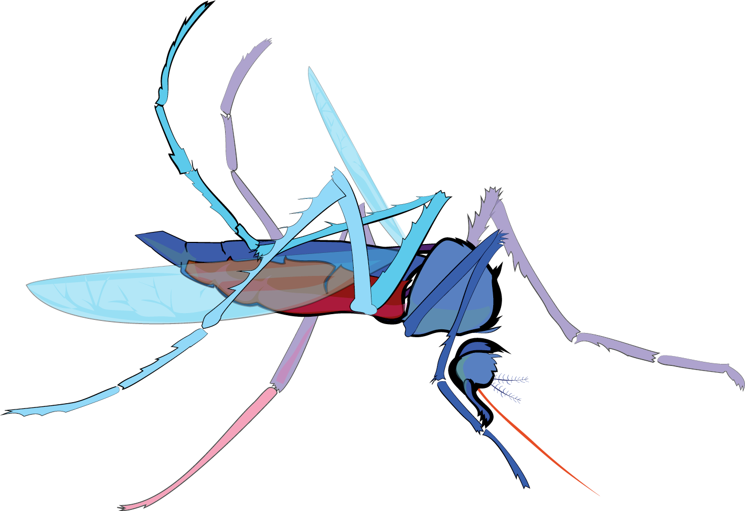
Prior Knowledge Quiz
Slide Sets
Why Make Observations?
Mosquito as Vectors of Disease
Satellite Data and NASA Connections
Prior Knowledge Quiz
Describing your mosquito habitat site
Using the app for the first time
Using the macro lens
Identifying specimens

Slide 3
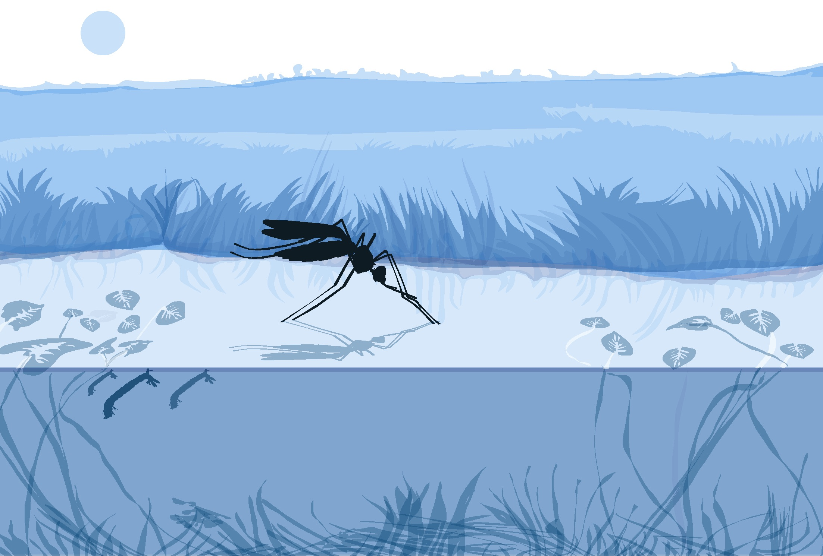
What do you know about Mosquitoes?

Slide 4
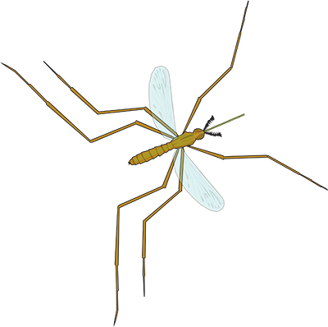
True or False
There are about 3500 species of mosquitoes.
Notes:
Image: NASA

Slide 5
True
There are about 3500 species of mosquitoes.
Notes:
Image: NASA

Slide 6
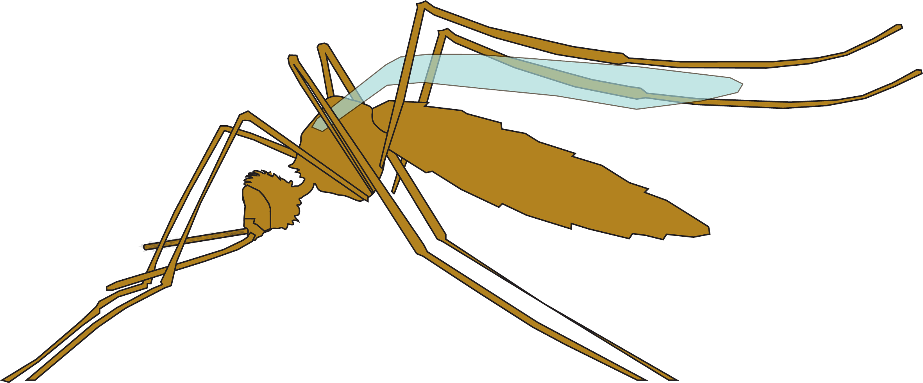
True or False
Both male and female mosquitoes bite humans.
Notes:
Image: NASA

Slide 7
False
Both male and female mosquitoes bite humans.
Notes:
Image: NASA

Slide 8
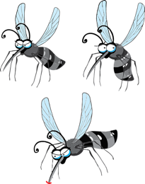
True or False
If you find the yellow fever mosquito (Aedes aegypti) or the Asian tiger mosquito (Aedes albopictus), it means that you have Zika, chikungunya, yellow fever or dengue in the region.

Slide 9
False
The mosquito must bite an infected host for the mosquito to acquire and transmit the pathogen.

Slide 10
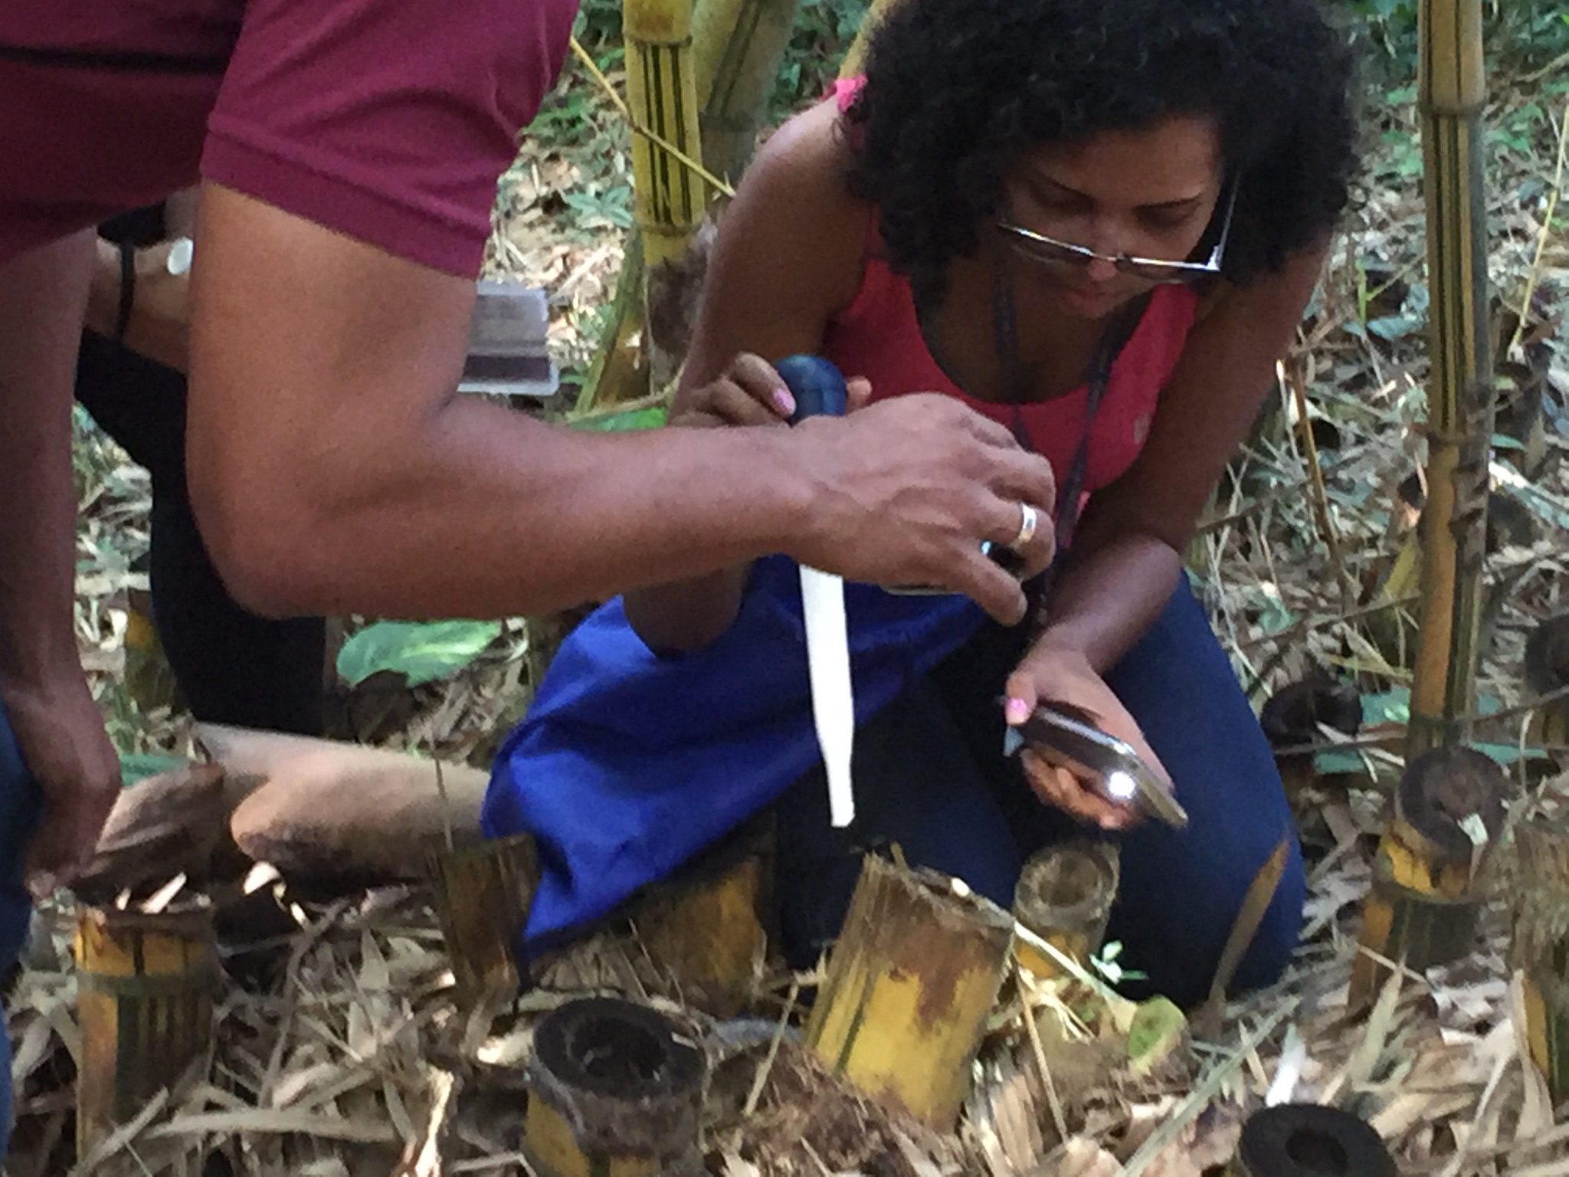
True or False
Mosquitoes don’t have a useful role in the ecosystem. We would be better off without them!

Slide 11
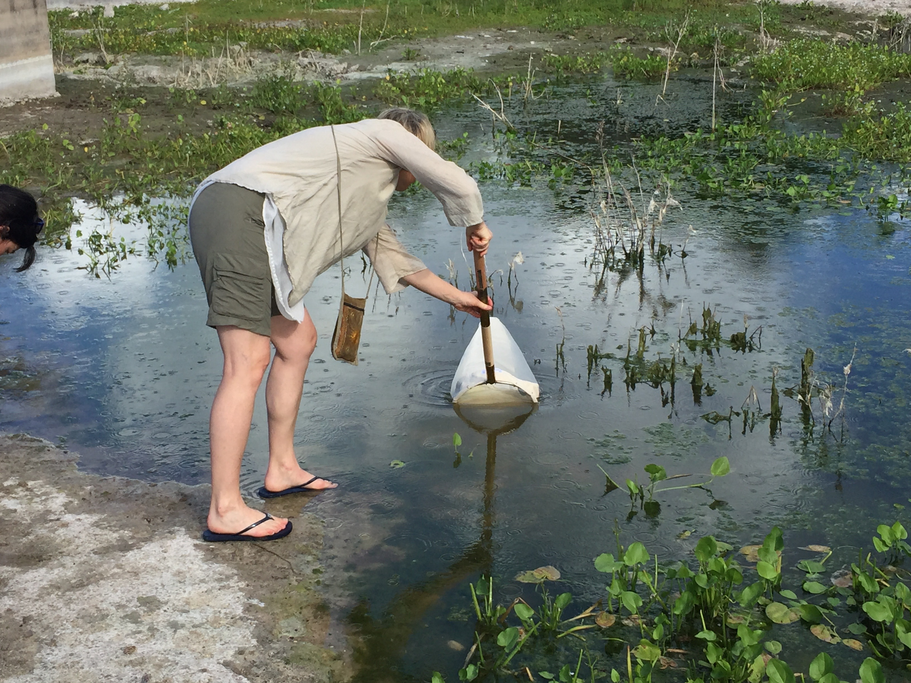
True or False
Mosquitoes tend to prefer clean water sites when they lay their eggs.

Slide 12
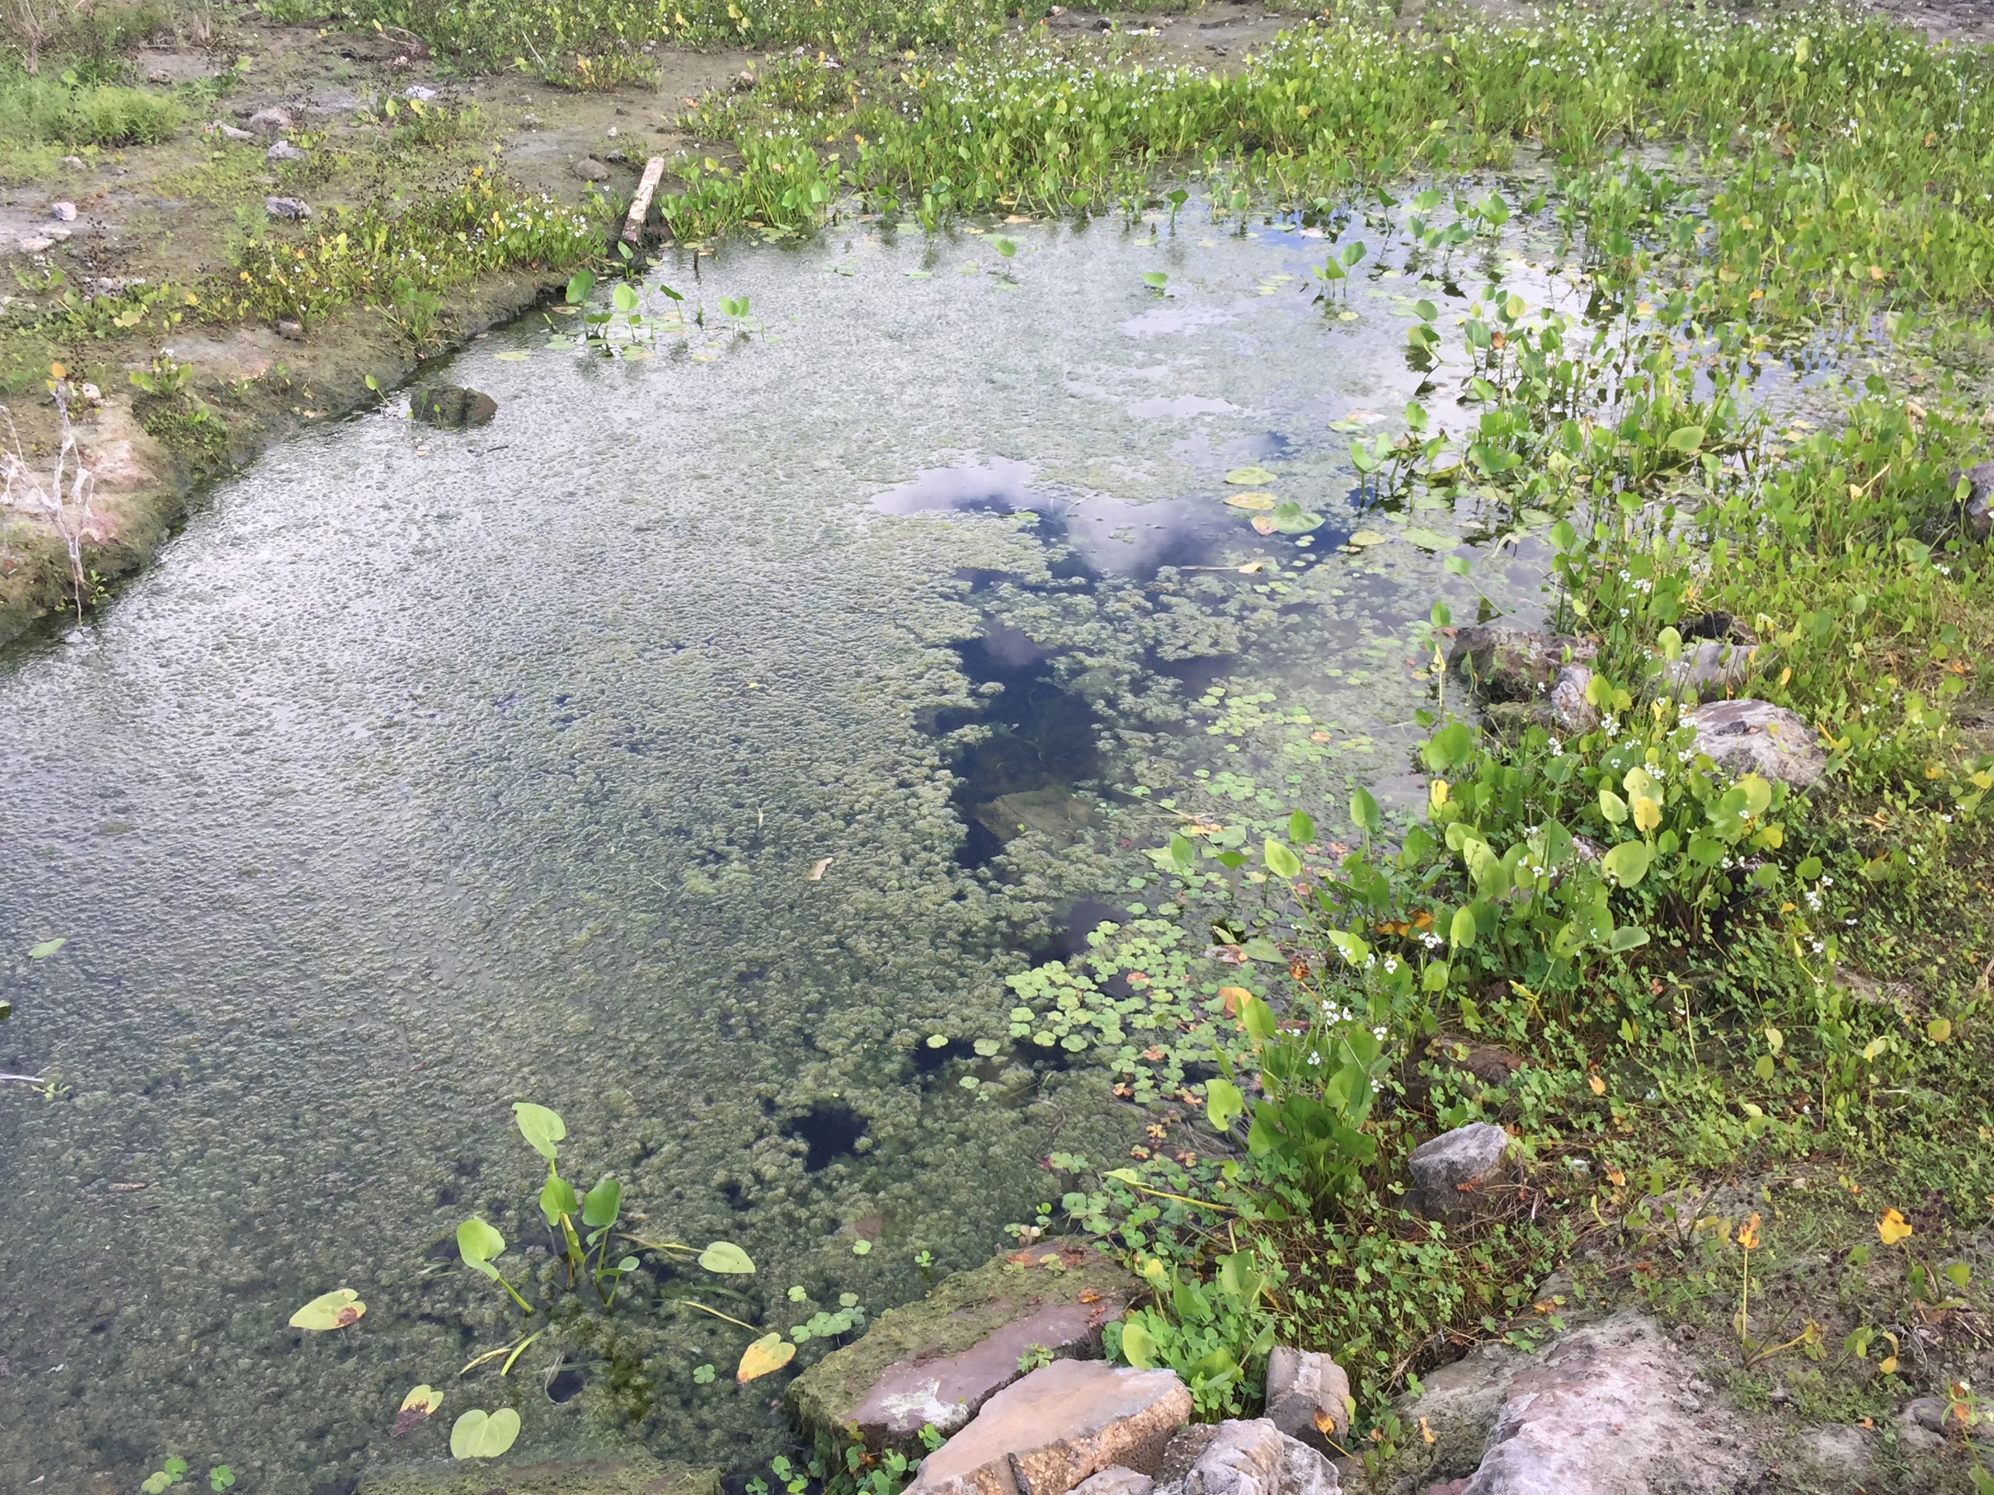
False
Preferences of clear water used to be reported for some vector species but now it is recognized that water of different characteristics; from clear to highly eutrophic are regularly used by many species.

Slide 13
True or False
Mosquito bites, especially those from mosquitoes who are vectors of disease, mostly bite at dusk and in the evening.

Slide 14
False
Mosquito activity depends on the species. Anopheles mosquitoes with the potential to transmit malaria, tend to bite at night, while the yellow fever mosquito and the Asian tiger mosquito are equally active during the day.
Bed nets provide protection from malaria but not Zika virus for this reason.
Notes:
What would you change to make this a True answer?

Slide 15
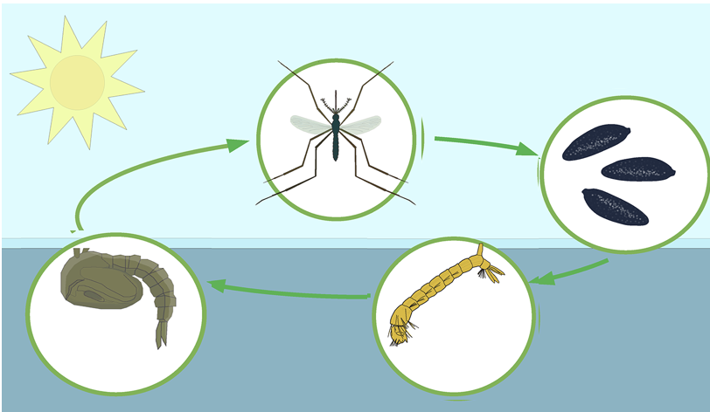
True or False
All stages of the mosquito life cycle pose a disease danger to humans: egg, larva, pupa,
and adult

Slide 16
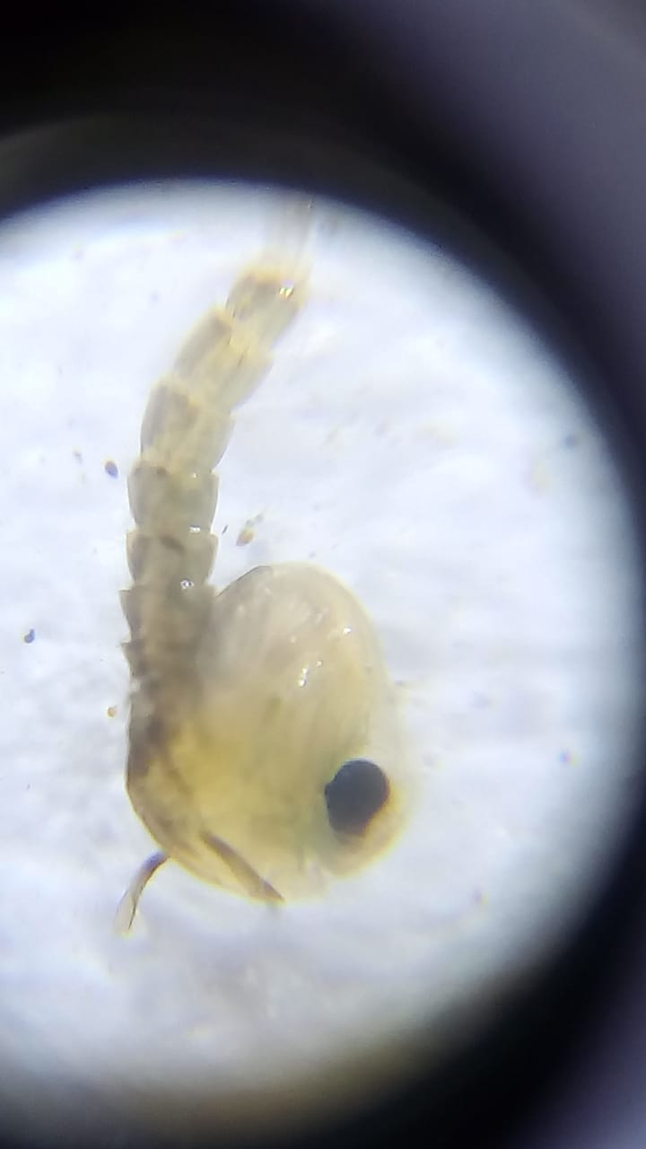
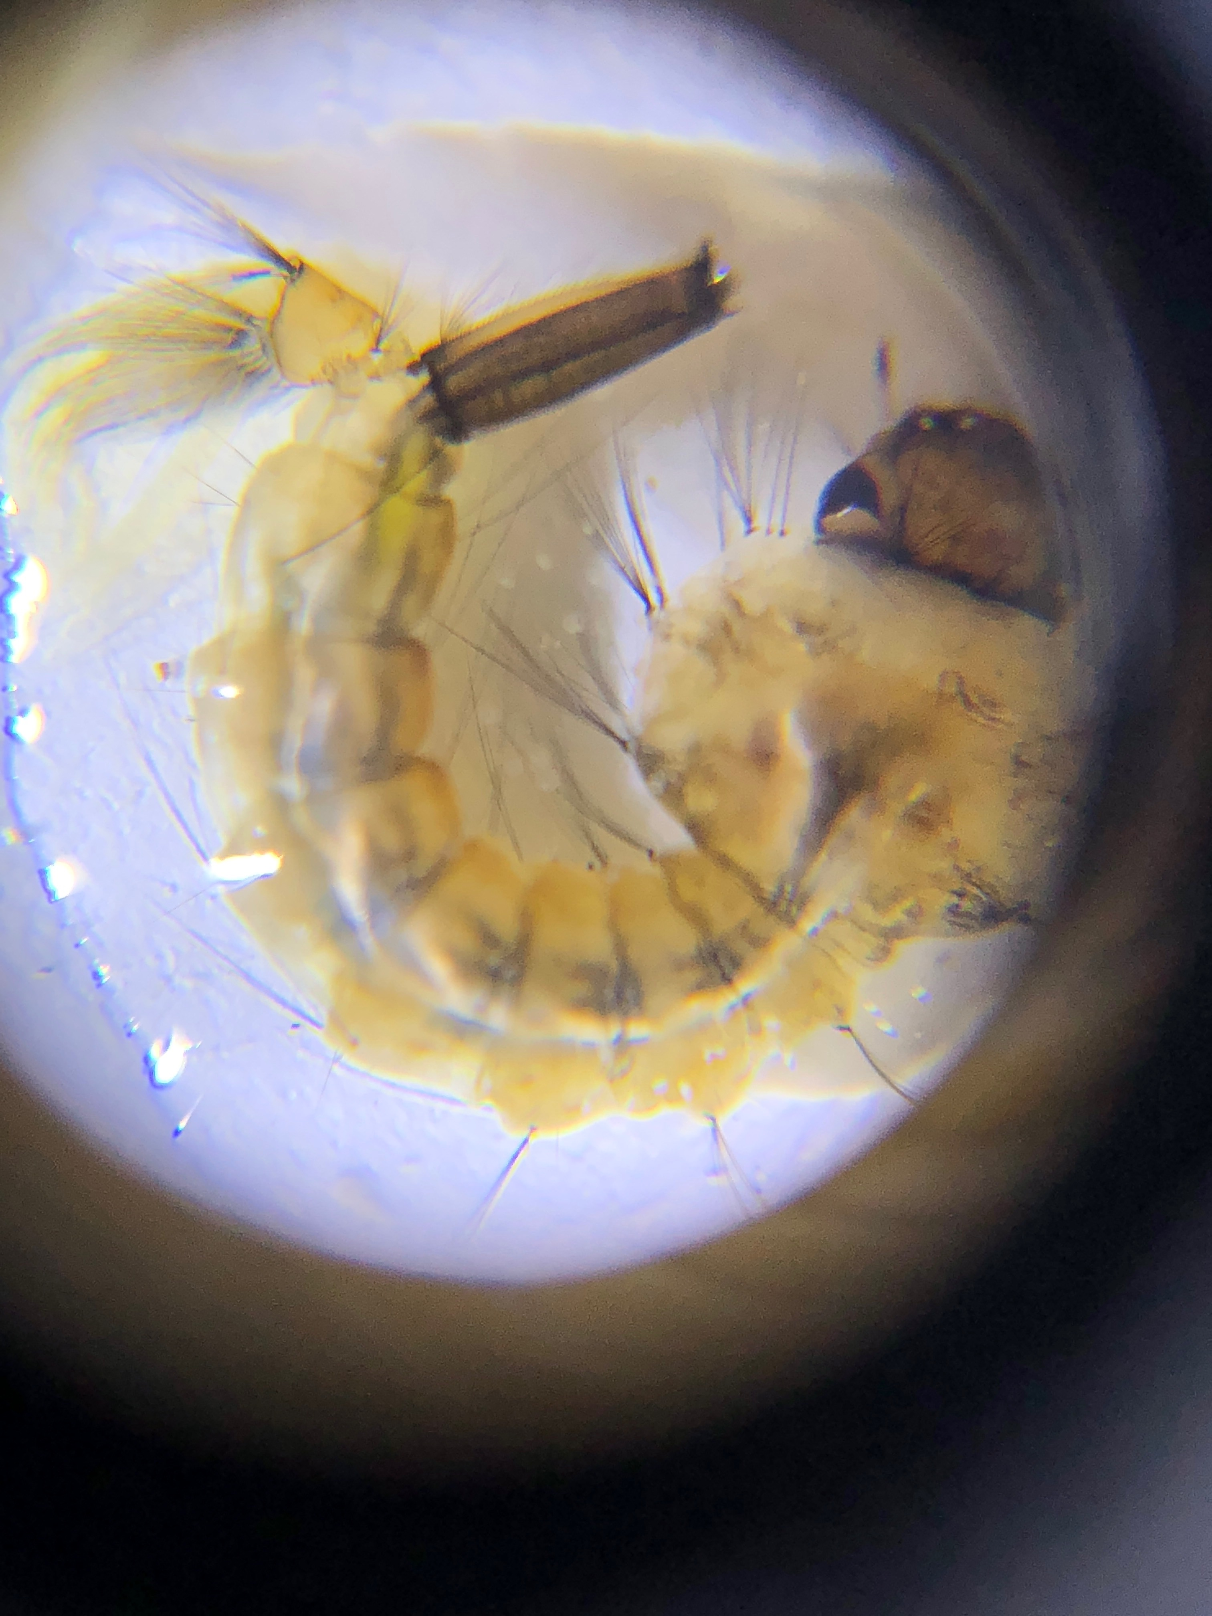
False
Adults become infected by parasites or viruses through biting infected hosts, and then transmit the pathogen when they bite future victims. Only adults pose a disease hazard to humans.

Slide 17
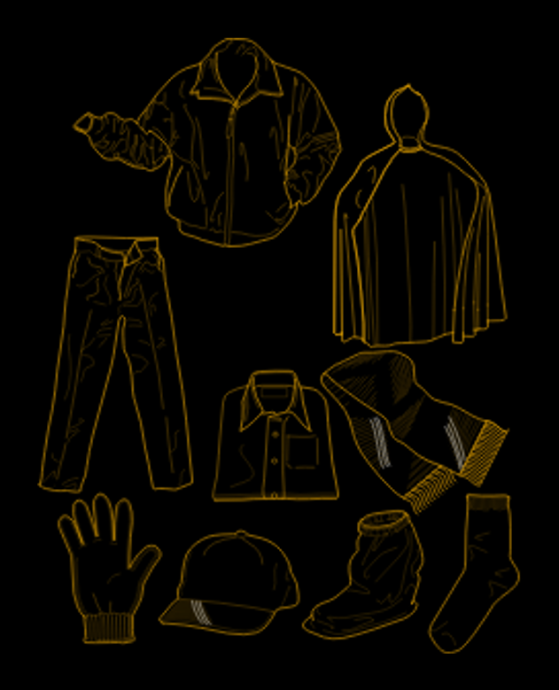
True or False
Dark clothing is more attractive
to many species of mosquitoes

Slide 18
True
Dark clothing has been shown to attract some species of mosquitoes more than light clothing. Wearing lighter colored clothing can provide some added protection from mosquito bites

Slide 19
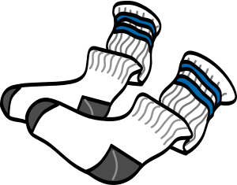
True or False
Smelly feet attract some species of mosquitoes .

Slide 20
True
Smelly feet attract some species of mosquitoes .

Slide 21
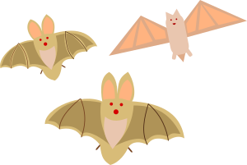
True or False
Mosquitoes locate their hosts by sound and radar, like bats.

Slide 22
False
Mosquitoes find hosts three ways; by sight (detect movement), by detecting infrared radiation emitted by warm bodies, and by chemical signals (carbon dioxide and lactic acid) from a distance of 25-35 meters!
They do not use radar like bats.

Slide 23
True or False
Depending on the species, some mosquitoes fly more than 60 km to obtain a blood meal.

Slide 24
True
Some mosquitoes, such as salt marsh mosquitoes can fly more than 60 km for a blood meal, others, such as Aedes aegypti, the mosquito that can transmit Zika, dengue, yellow fever and chikungunya may fly only a hundred meters in her lifetime.
That is one reason why home and community mosquito surveillance and mitigation are especially effective in reducing risk for these diseases.
.

Slide 25
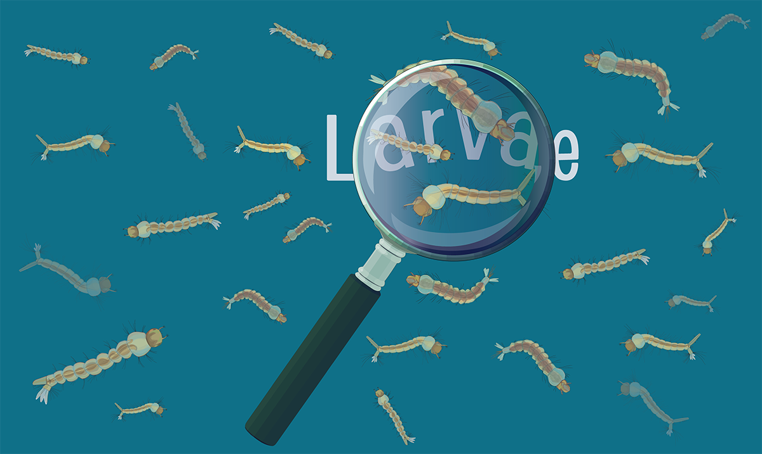
True or False
The only protection we have against mosquito-borne disease are vaccines.

Slide 26
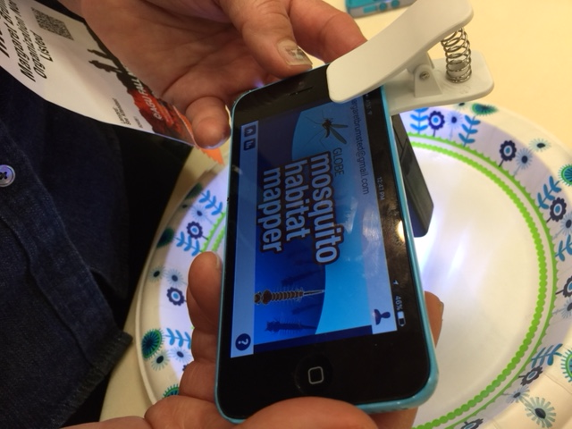
False
It is important to educate yourself about mosquitos and avoiding behaviors you can do to protect yourself from bites. Using an insect repellent with DEET is effective. For night biting mosquitoes, such as Anopheles, bed nets are effective protection.
For vector borne diseases for which there is no vaccine, the only protection we have is surveillance, breeding site mitigation, and public education. The GLOBE Observer Mosquito Habitat Mapper does all three!

Slide 28
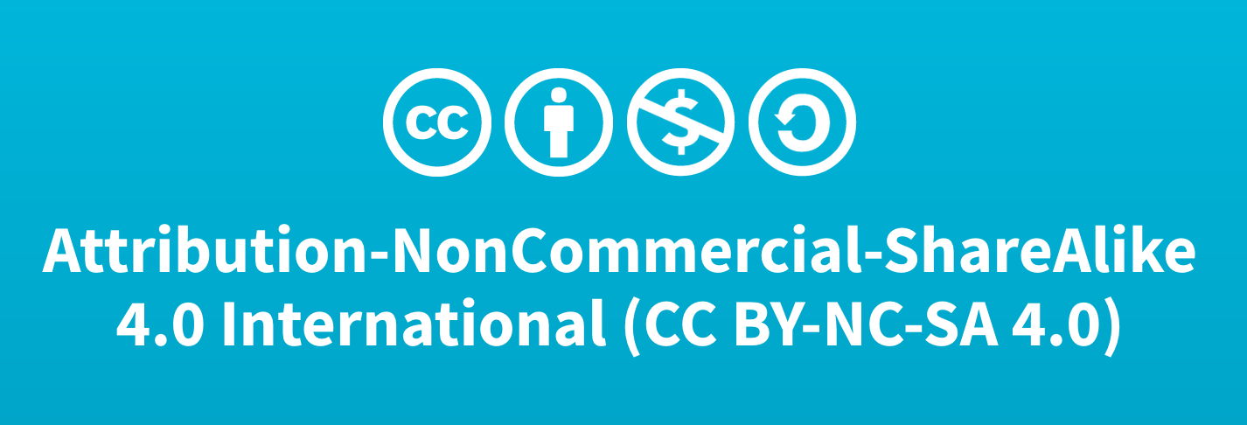
Prior Knowledge Quiz
Author:
Russanne Low PhD
Science Lead GO Mosquito Habitat Mapper
Institute for Global Environmental Strategies Arlington VA
Rusty_low@strategies.org
Did you modify this file for your class?
Put your name and the date here!
This work is licensed under https://creativecommons.org/licenses/by-nc-sa/4.0/

