Slide 1
GLOBE Mission Mosquito presents a series of mosquito tutorials
Using the MHM tool for the first time

Slide 2
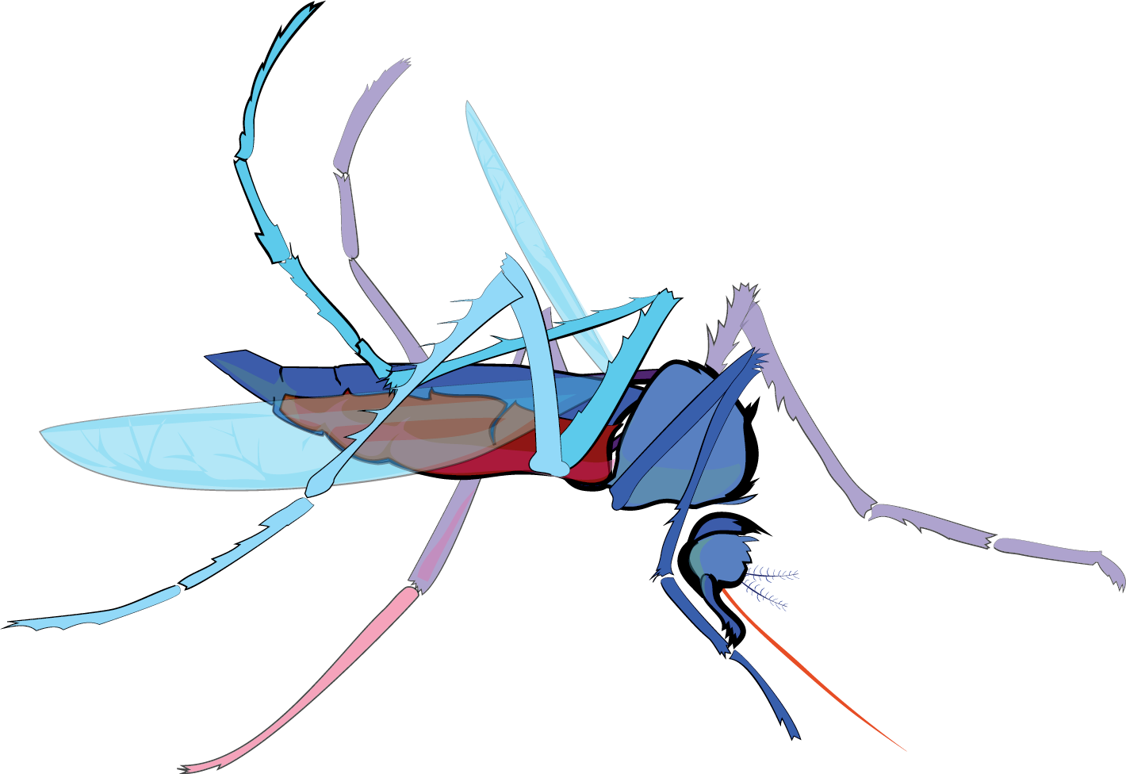
Using the MHM tool for the first time
Slide Sets
Why Make Observations?
Mosquito as Vectors of Disease
Satellite Data and NASA Connections
Prior Knowledge Quiz
Using the MHM tool for the first time
Describing your mosquito habitat site
Using the macro lens
Identifying specimens

Slide 3
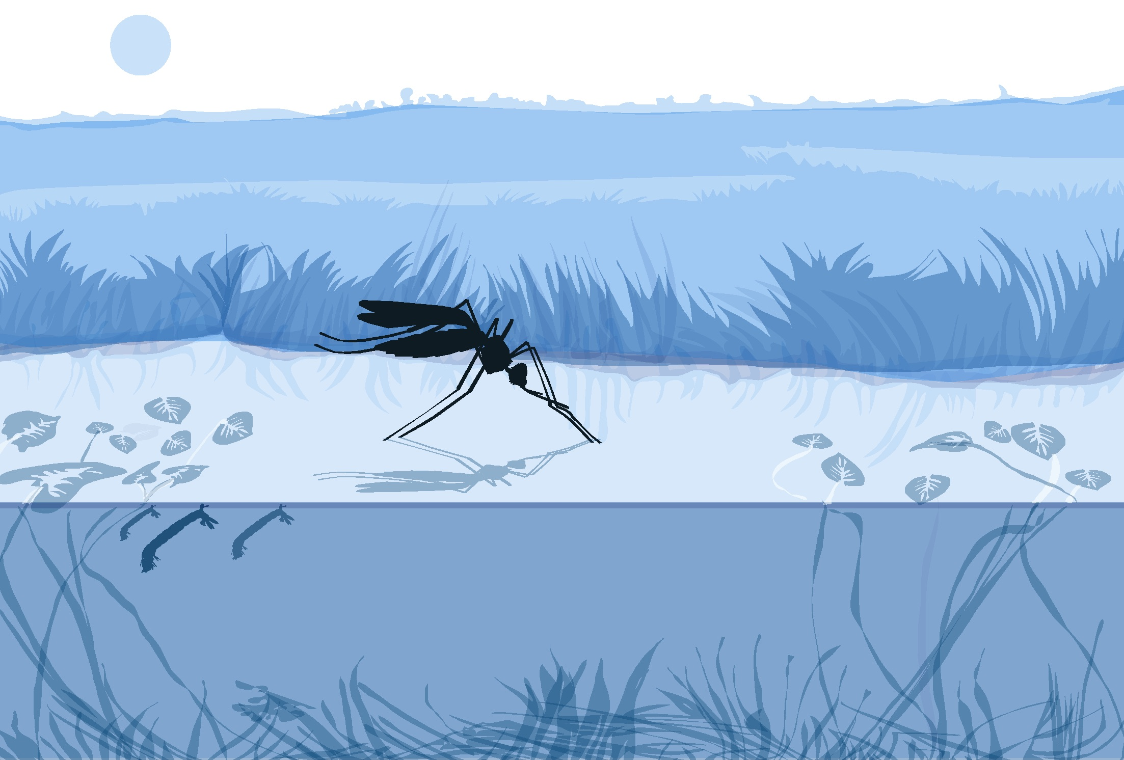
Using the MHM Tool for the first time

Slide 4
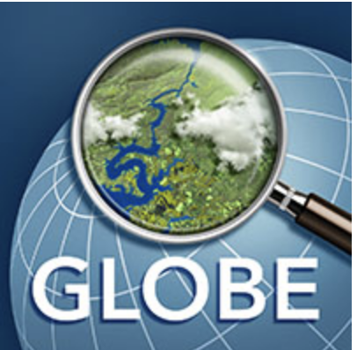
GLOBE Observer invites you to make environmental observations that complement NASA satellite observations to help scientists studying Earth and the global environment.
By using the GLOBE Observer app, you are joining the GLOBE community and contributing important scientific data to NASA, GLOBE, your local community, and students and scientists worldwide.
Get the app from your online app store.
Then open the app. You will need access
to your email to register.
observer.globe.gov
Notes:
Image: NASA

Slide 5
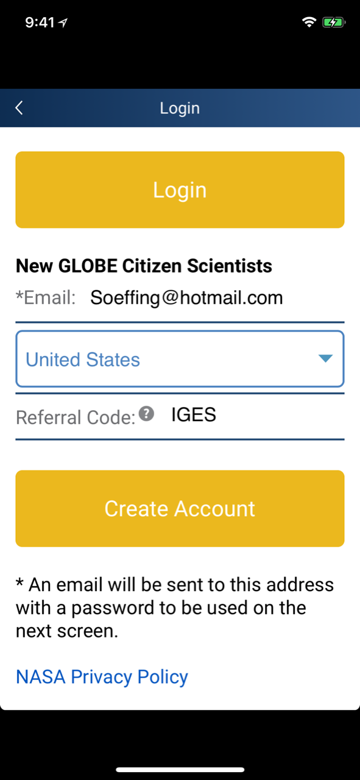
Creating a GLOBE Observer account
When you open your app for the first time, you will get this message asking you to create your account.
Your workshop leader may provide you with a referral code. If so, enter it here.
When you download and install the GLOBE Observer app, if asked, allow access to location services. This part is important for recording your observations.
Notes:
Image: NASA

Slide 6
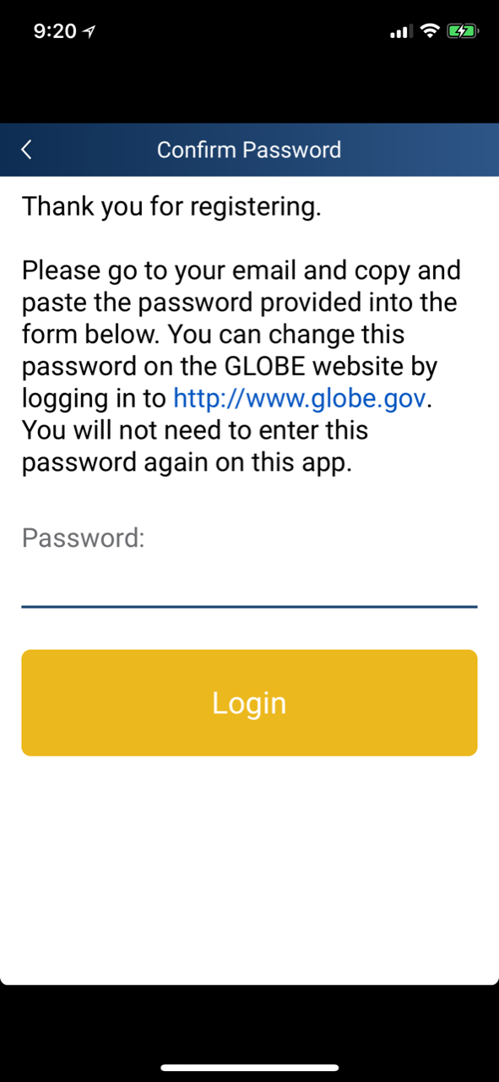
Creating a GLOBE Observer account
You will need to get your password from the email you used to register before you can begin making observations.
Notes:
Image: NASA

Slide 7
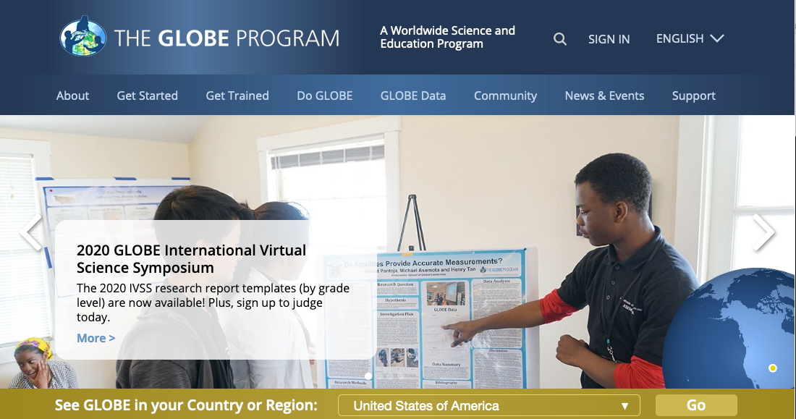
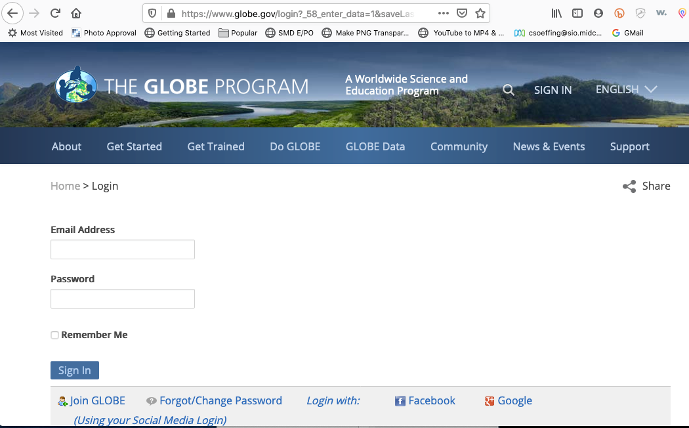
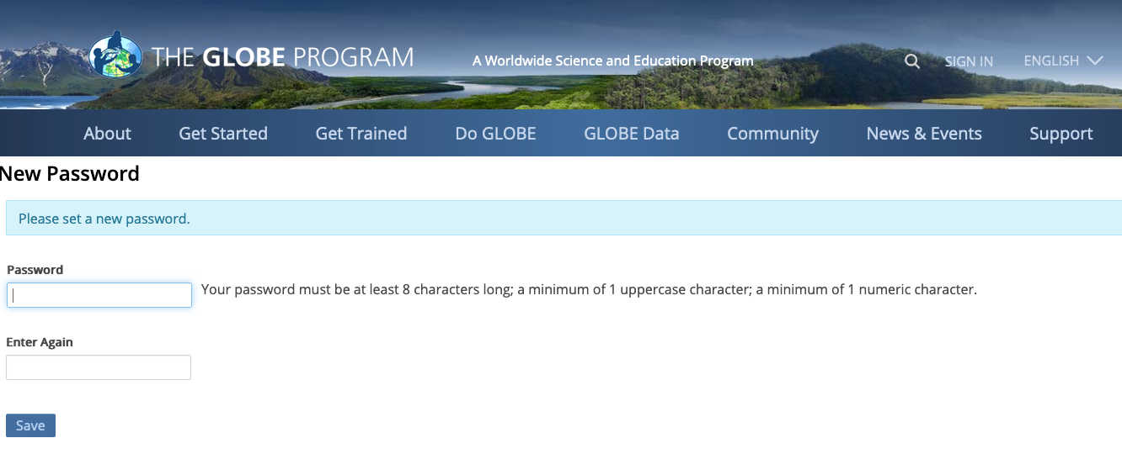
Forgot your password? Change it!
What if you forget your password? Follow these steps to change it.
Go to -- globe.gov
Click sign in
Select Forgot/Change password
Type in your email address, click I am not a robot and Send Password reset link
You’ll be sent a reset link, use it to create your own password.
Notes:
Image: NASA

Slide 8
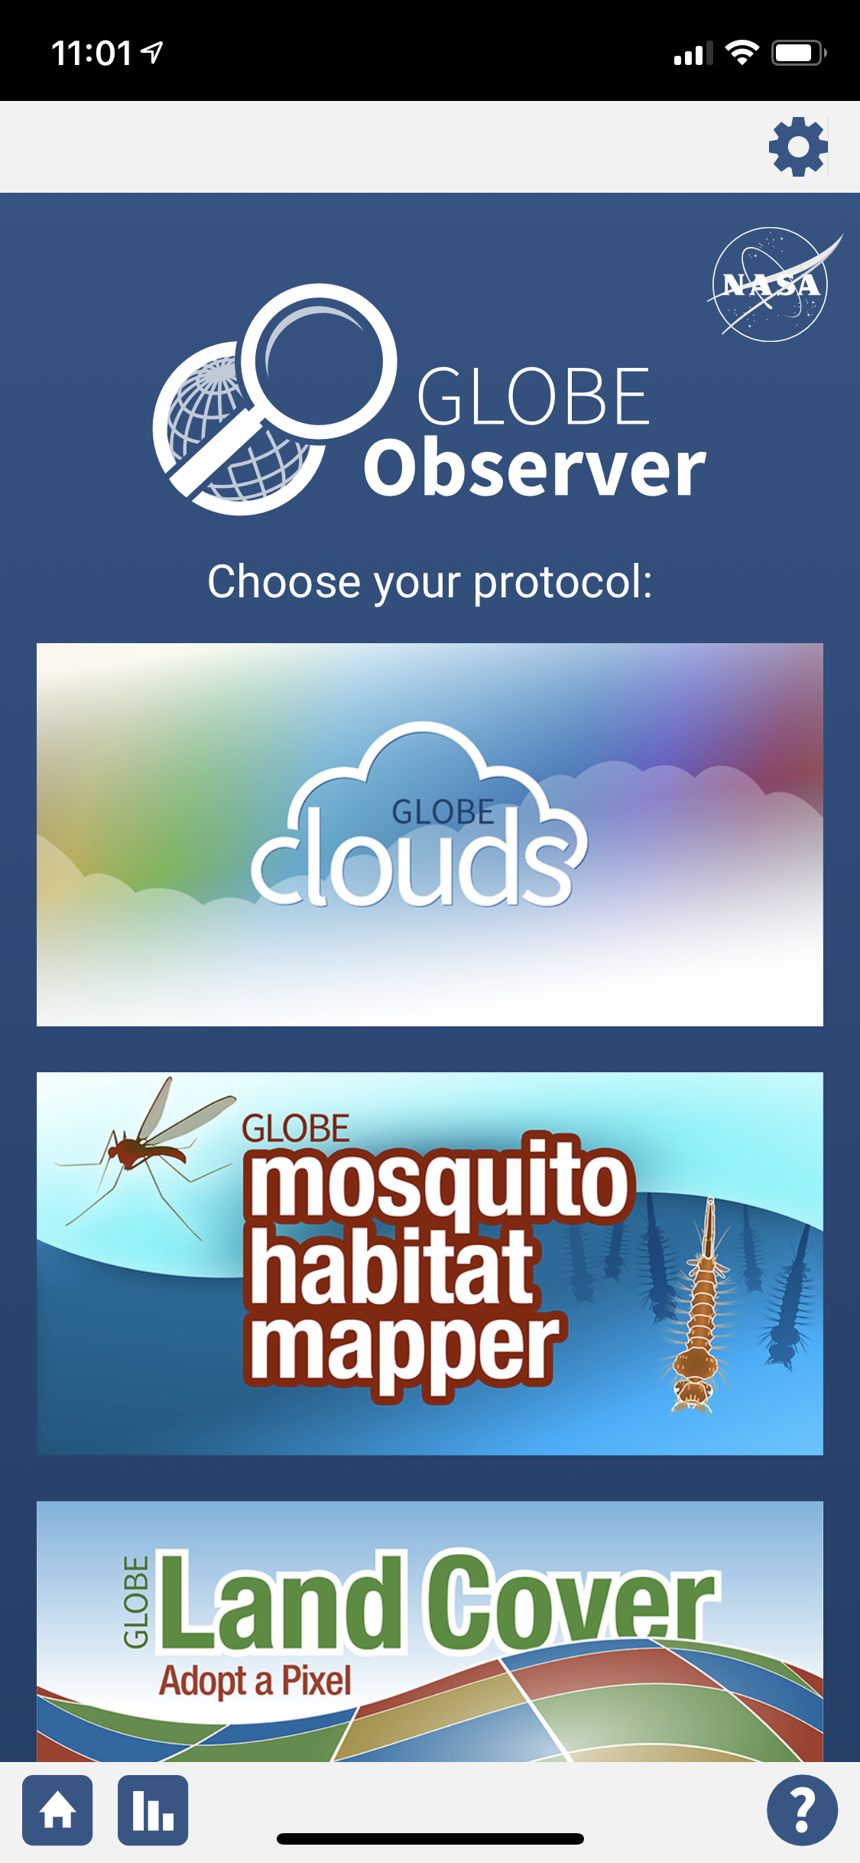
Signing in
Click on the icon for GLOBE Mosquito Habitat Mapper.
Log in with your email address and password.
Notes:
Image: NASA

Slide 9
Signing in
Click on the icon for GLOBE Mosquito Habitat Mapper.
To return to this screen at any time, select the ”home” button.
Notes:
Image: NASA

Slide 10
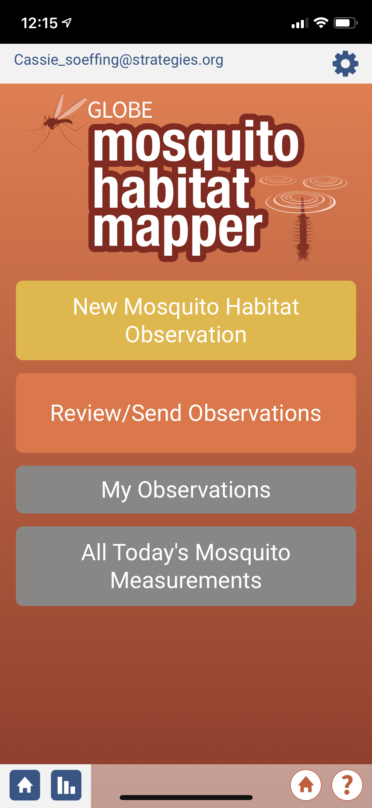
What’s next?
At the top of the first frame you will see your email.
If you are sharing mobile devices, this is where you can have other GLOBE user email addresses stored for quick and easy access.
Notes:
Image: NASA

Slide 11
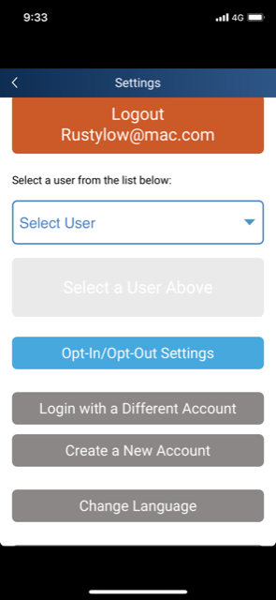
Options
You can choose the language that you want to display by selecting “Change Language.”
Notes:
Image: NASA

Slide 12
Let’s get started!
To begin, click
“New Mosquito Habitat Observation”

Slide 13
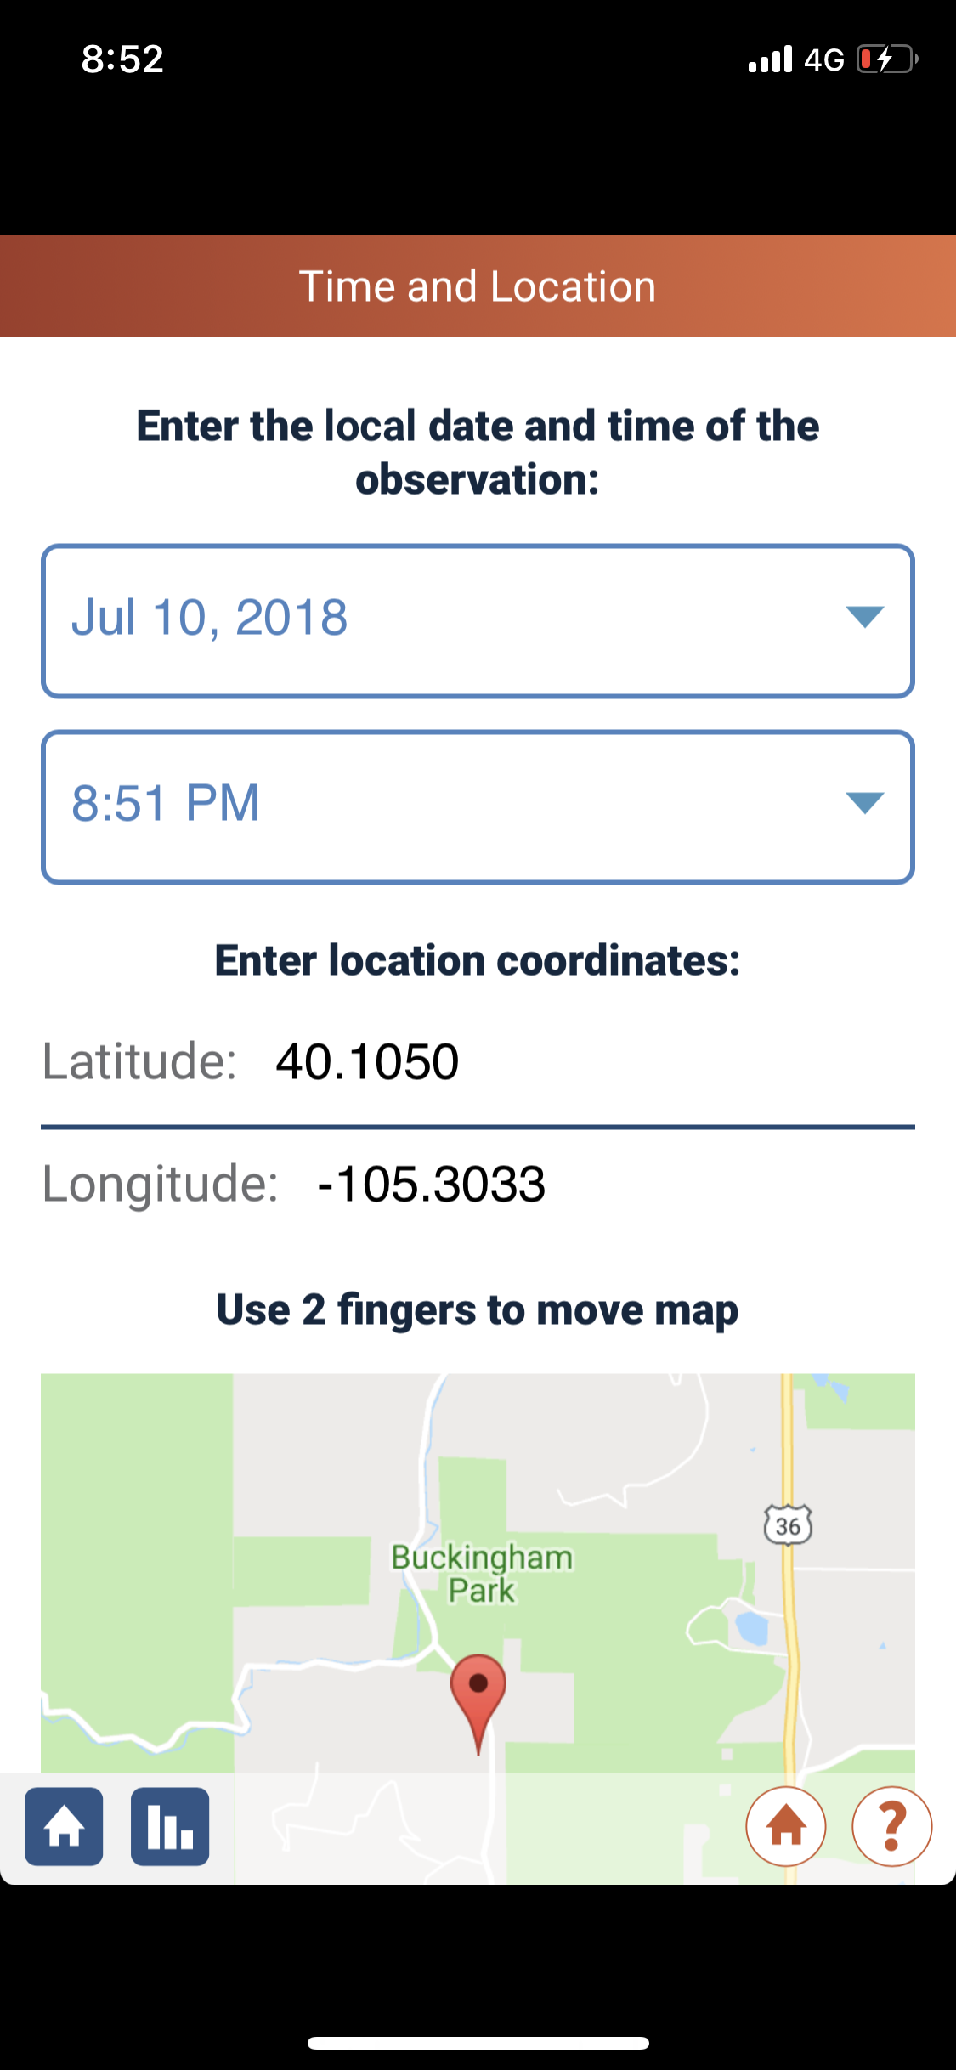
Let’s get started!
The date, time, latitude and longitude will automatically populate these fields.
If you don’t see the location coordinates, check to make sure your phone settings have selected “location” services on.
You can also input these values from a map manually.

Slide 14
Fine tune your location
The date, time, latitude and longitude will automatically populate these fields.
If you don’t see the location coordinates, check to make sure your phone settings have selected “location” services on.
You can also input these values from a map manually.

Slide 15
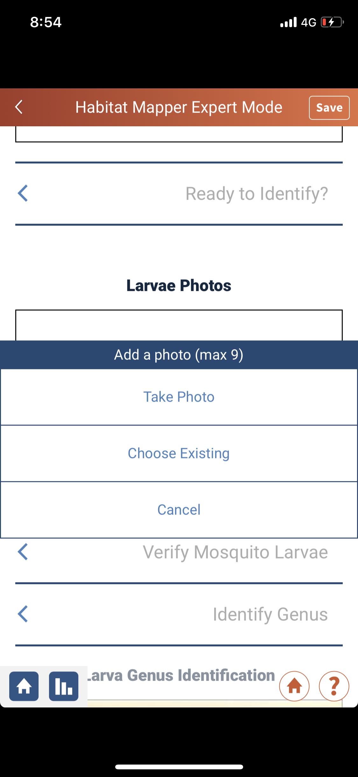
Fine tune your location
You can take photos in app by clicking on “take photo”.
You can also upload a photo from your camera roll by selecting ”choose existing”.

Slide 16
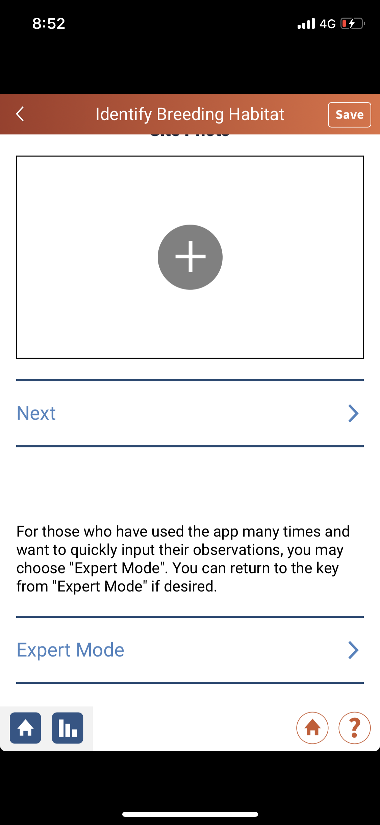
Fine tune your location
The app will ask you if you want to use “expert mode”.
After you have been through the app one or two times, we suggest you use expert mode. It provides a simple, streamlined process- it’s easier!
If at anytime you need to consult the mosquito key, you can access it from expert mode!

Slide 17
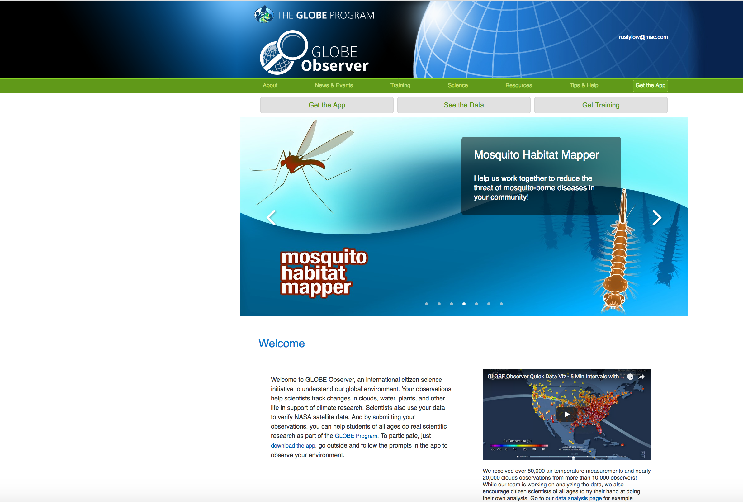
Questions? We are here to help you!
Find more information on the
GLOBE Observer website
www.globe.gov/es/web/globe-observer/
Problems?
Contact help@globe.gov

Slide 19
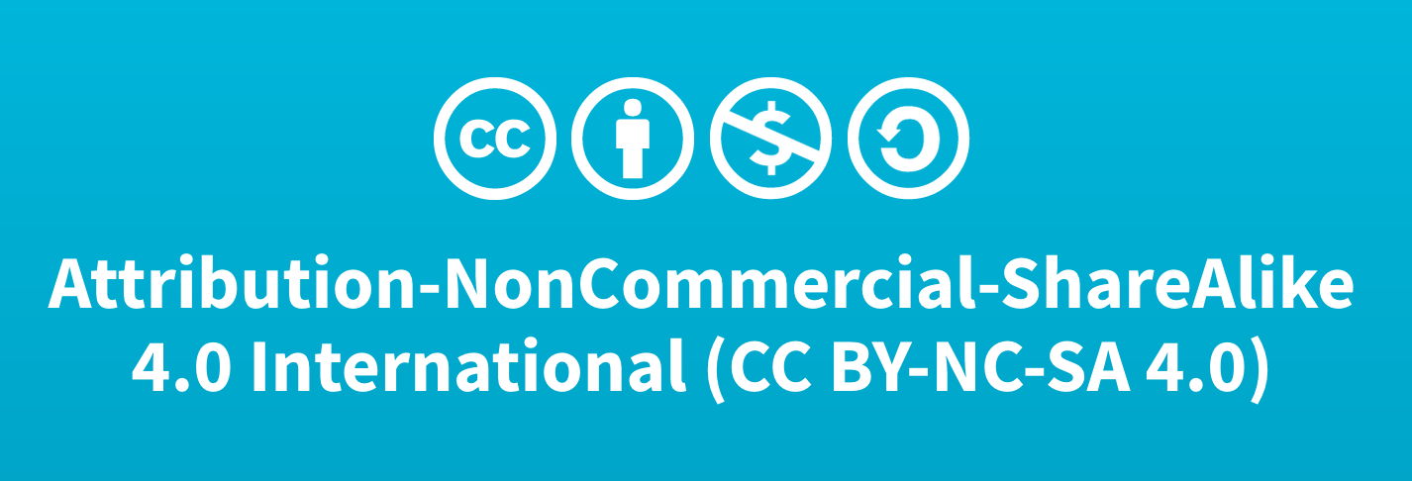
Using the MHM tool for the first time
Author:
Russanne Low PhD
Science Lead GO Mosquito Habitat Mapper
Institute for Global Environmental Strategies Arlington VA
Rusty_low@strategies.org
Did you modify this file for your class?
Put your name and the date here!
This work is licensed under https://creativecommons.org/licenses/by-nc-sa/4.0/

