Slide 1
GLOBE Mission Mosquito presents a series of mosquito tutorials
Using the app to describe your mosquito habitat site

Slide 2
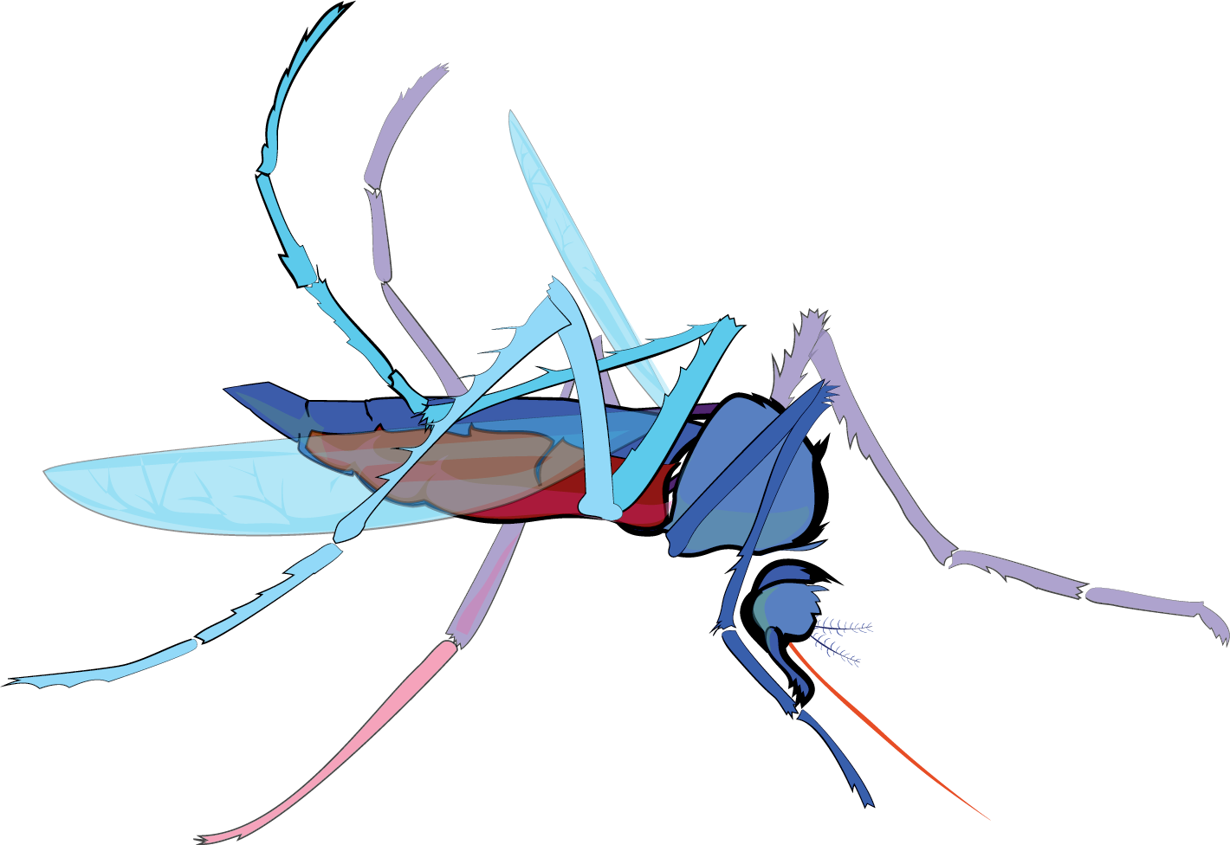
Using the app to describe your mosquito habitat site
Slide Sets
Why Make Observations?
Mosquito as Vectors of Disease
Satellite Data and NASA Connections
Prior Knowledge Quiz
Using the MHM tool for the first time
Using the app to describe your mosquito habitat site
Using the macro lens
Identifying specimens

Slide 3
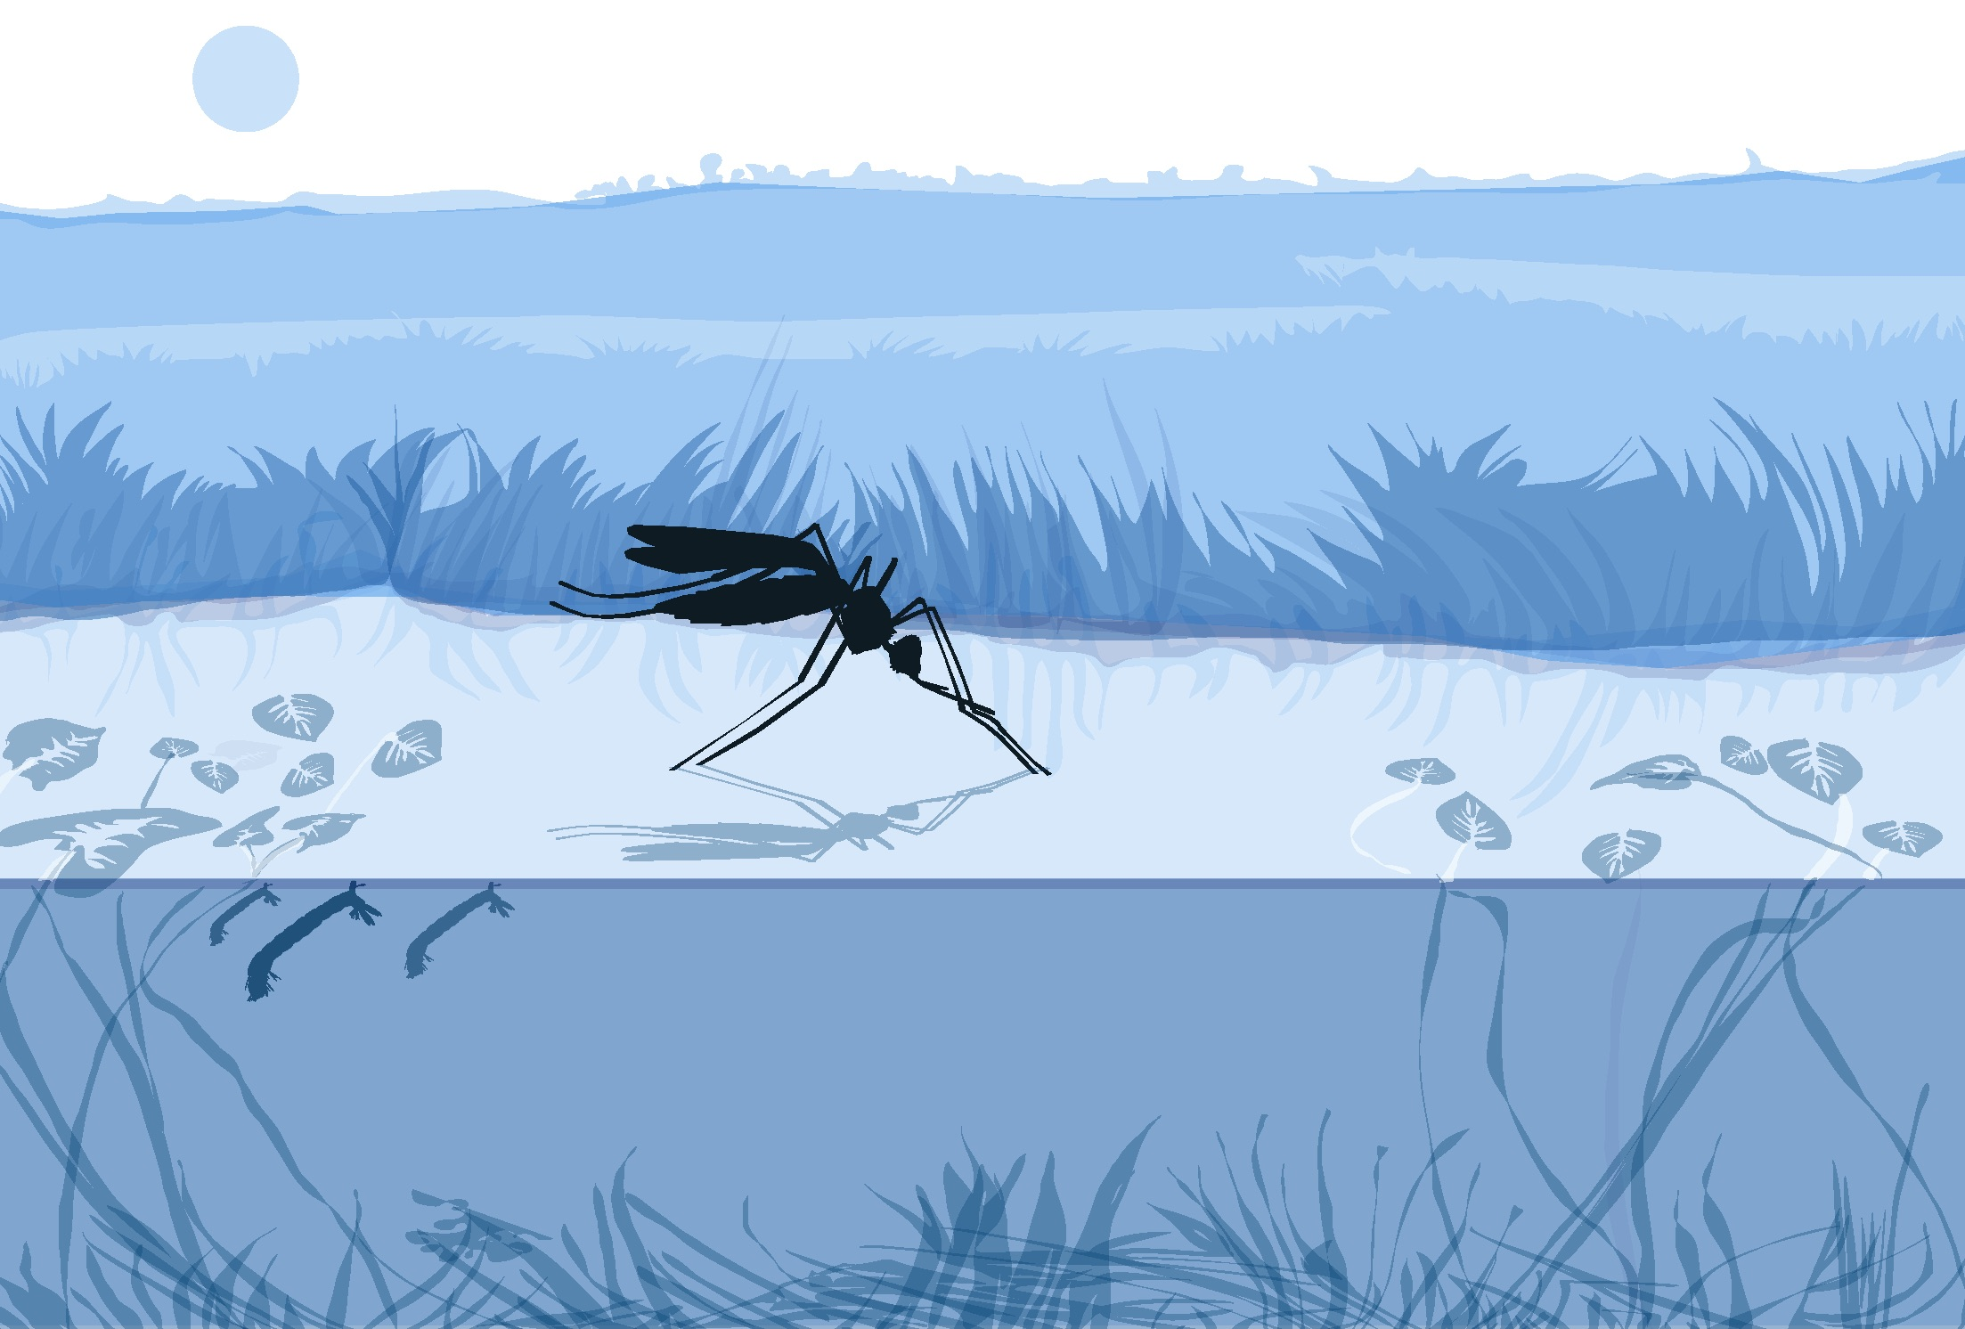
Using the app to describe your mosquito habitat site

Slide 4
GLOBE Observer is an international network of citizen scientists and scientists working together to learn more about our global environment, including our changing climate and its impacts.
Notes:
Image: NASA

Slide 5
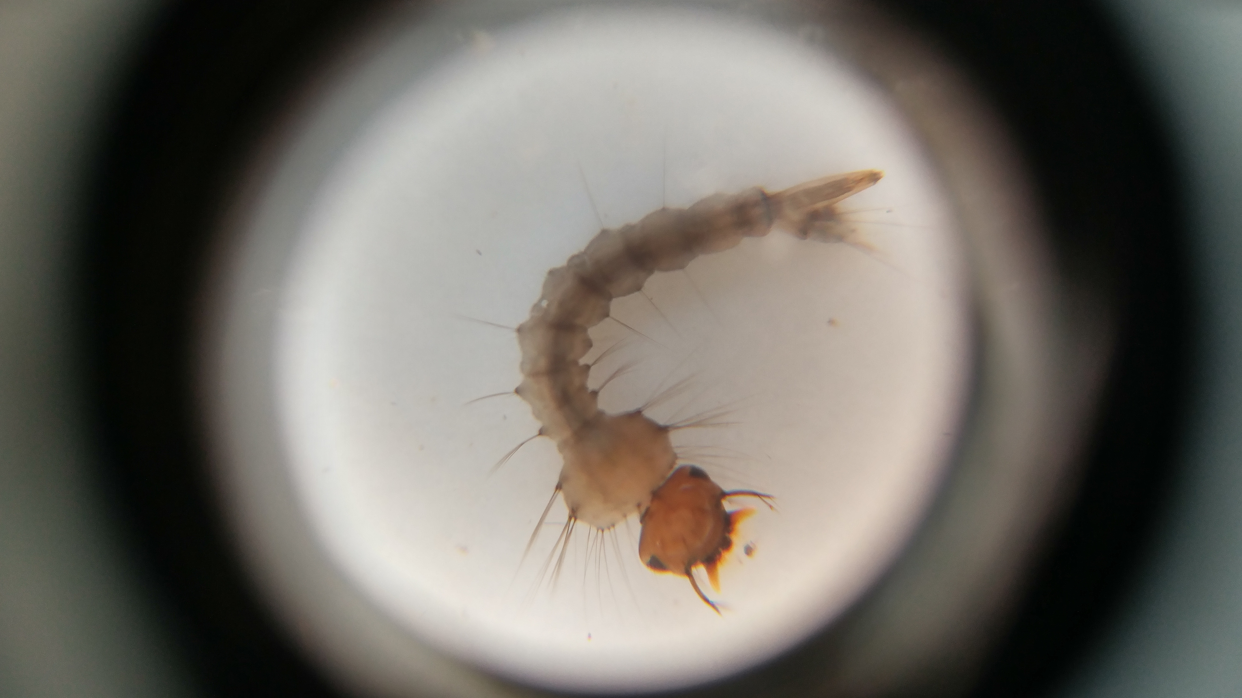
Mosquito larvae
Our investigation focuses on mosquito larvae- the larva is an immature developmental stage that lives in water, doesn’t bite and doesn’t pose a health hazard to humans!
Notes:
Image: NASA

Slide 6
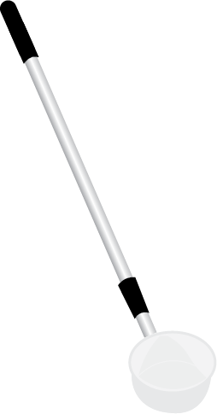
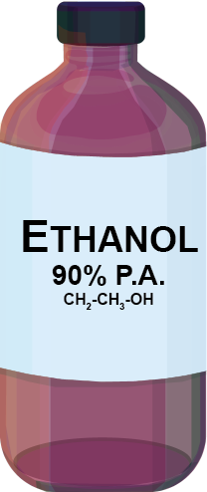
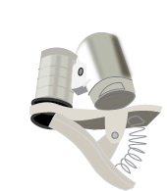
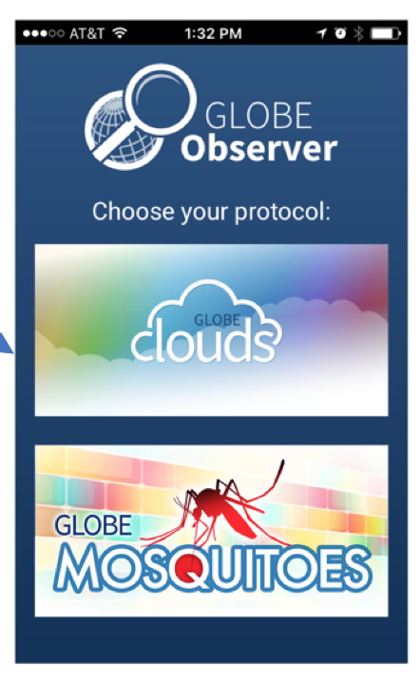
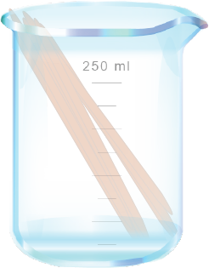
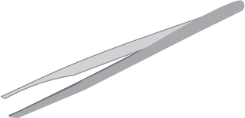
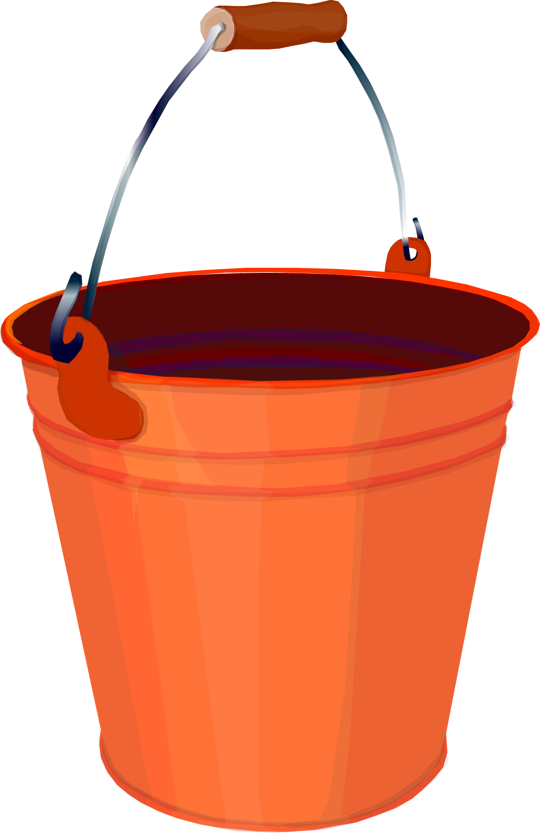
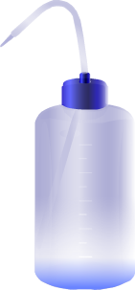
Tools you could use
*minimum tools needed
Notes:
Image: NASA

Slide 7
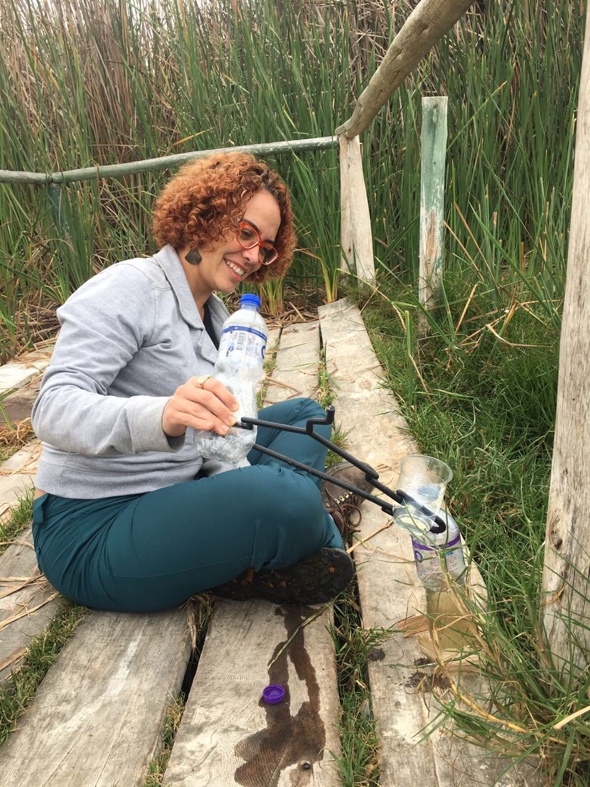
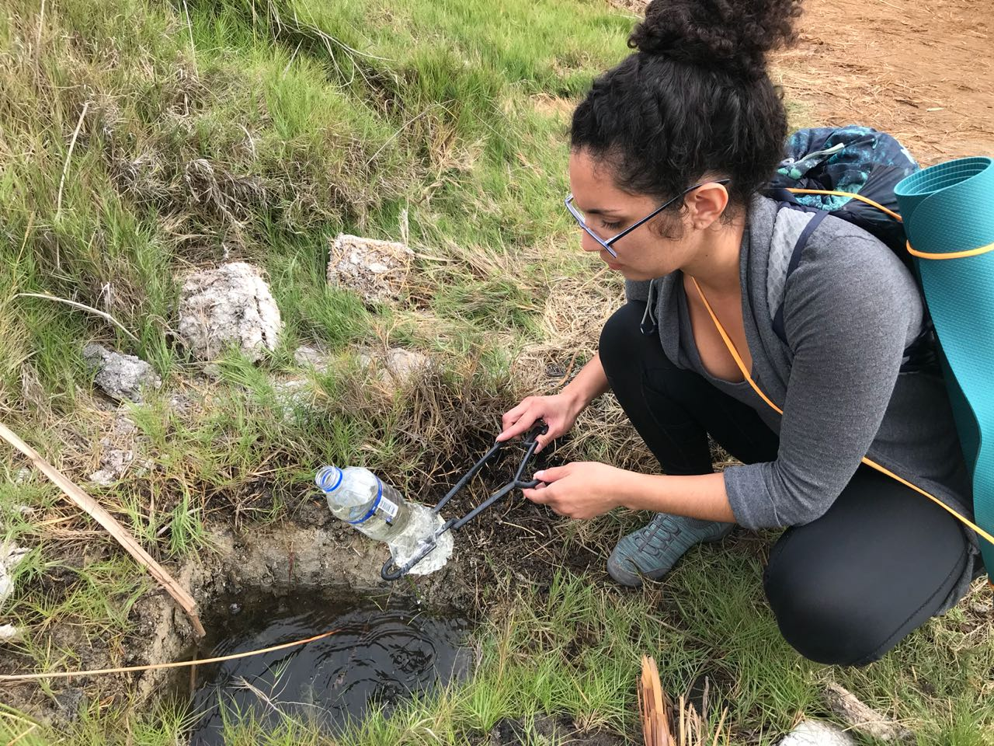
Collecting water samples
You can make your own!
Notes:
Image: NASA

Slide 8
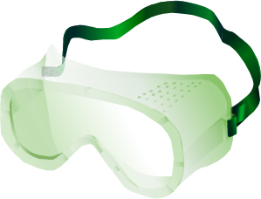
Citizen Science Safety
Wear long sleeves, pants socks and shoes, insect repellent
Wear gloves and/goggles to be protected from contaminated water sources.
Sample in your own yard or in public areas. Do not take samples on private property unless you have obtained permission.
Notes:
Image: NASA

Slide 9
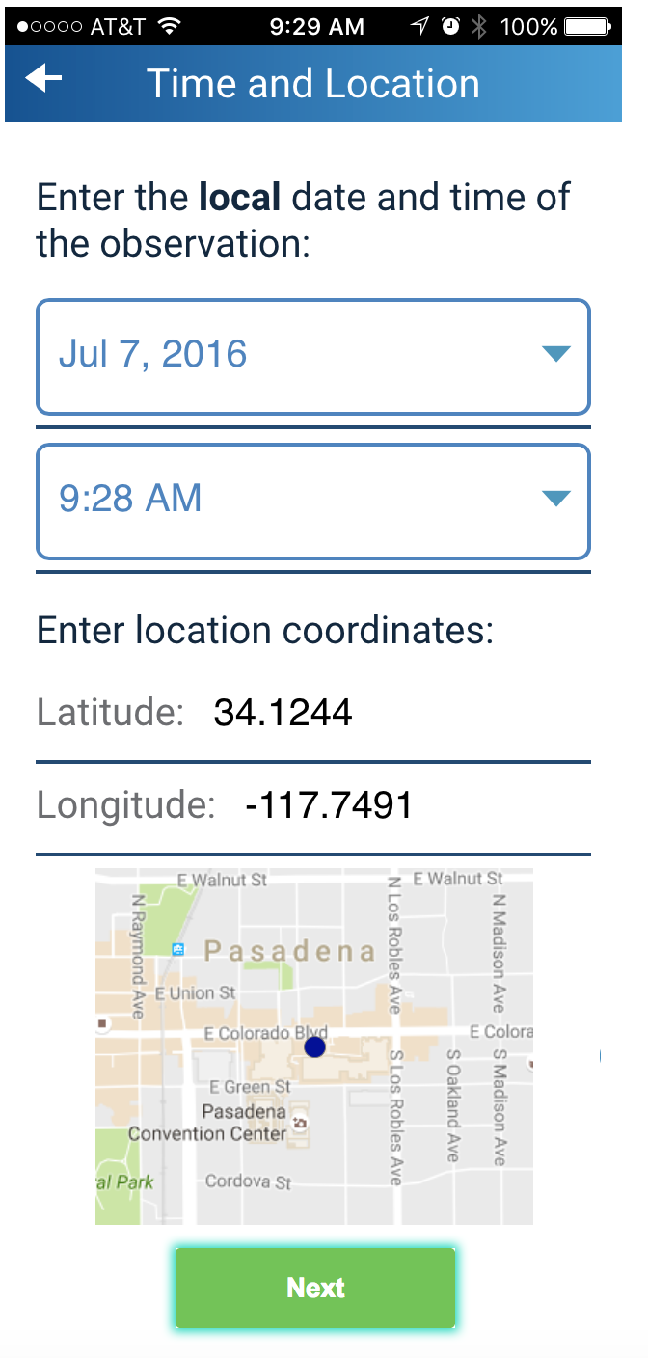
Recording Data Step 1: Locating and recording breeding sites
Open GLOBE Observer Mosquito Habitat Mapper.
The app will automatically download the date, time and the latitude / longitude of your location.
You will be able to verify the location by the map that is provided.
Notes:
Image: NASA

Slide 10
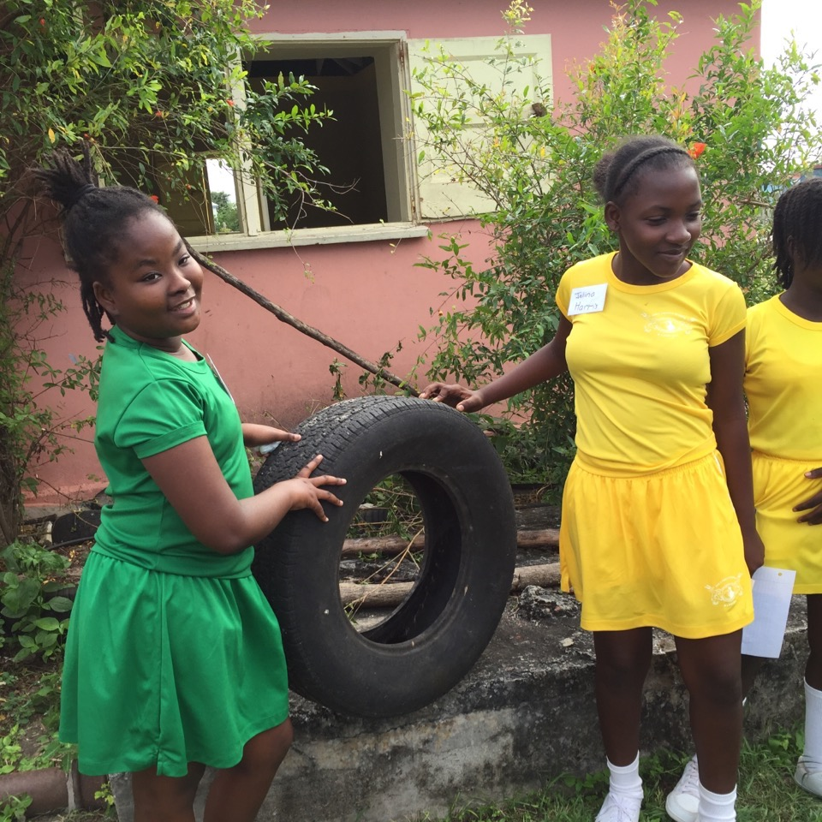
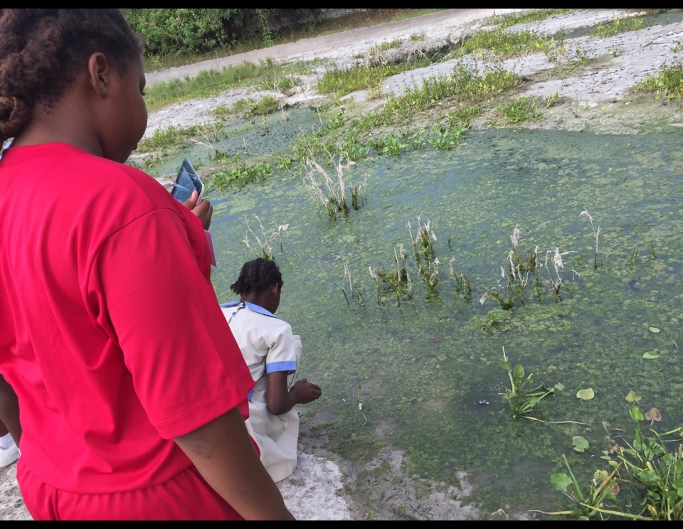
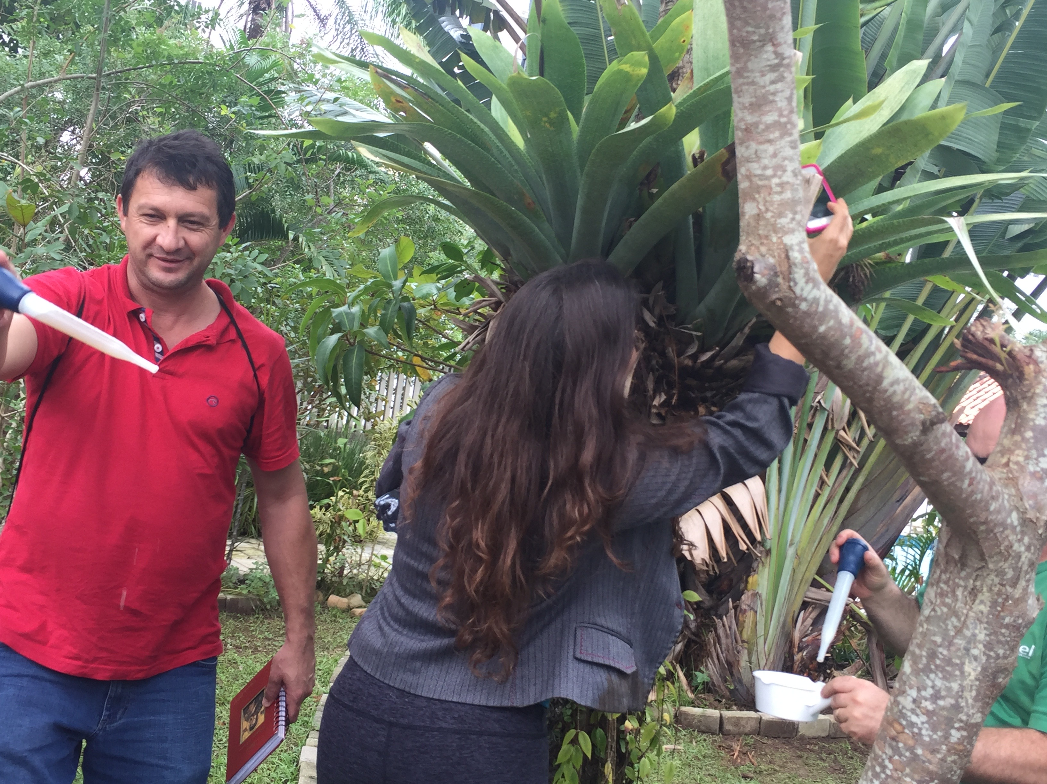
Step 1: Locate
Locate sources of standing water and see if you see mosquito larvae
Notes:
Image: NASA

Slide 11
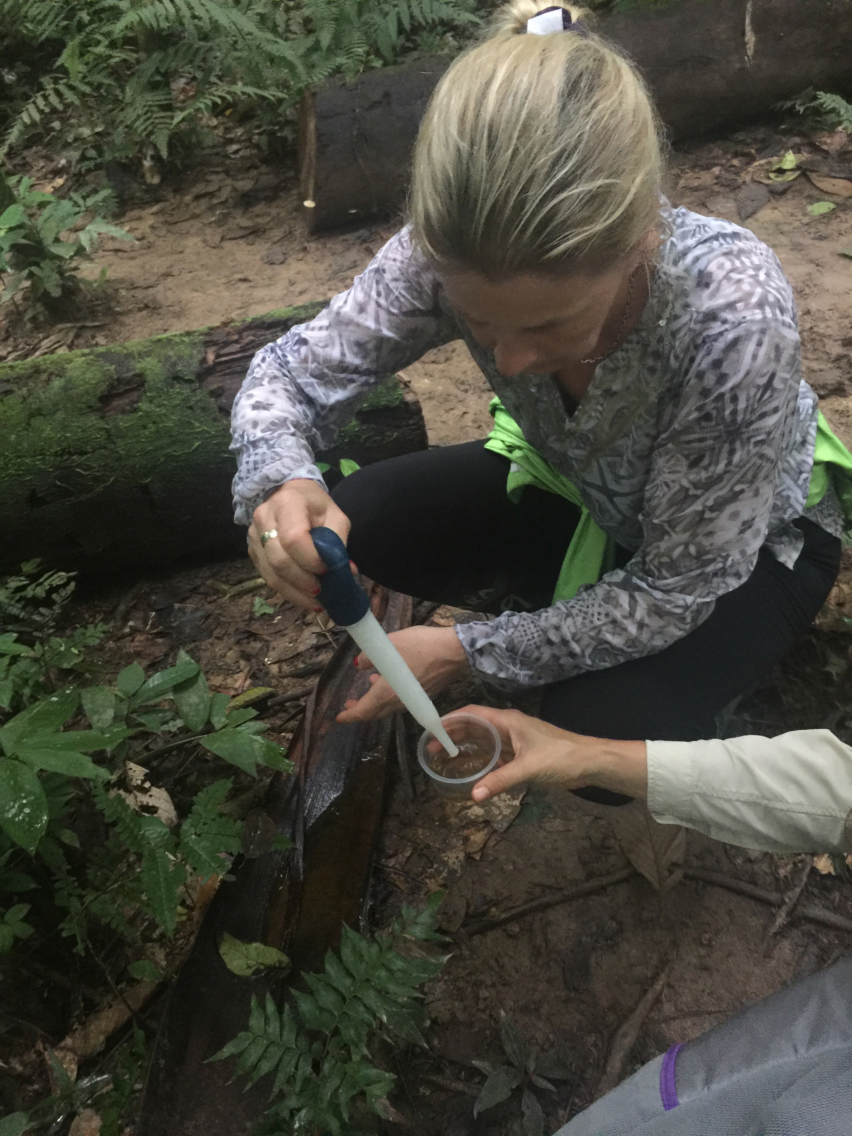
Step 2: Sample and Count
There are several different ways to collect water samples. Use the one that is best for your site:
Bulb syringe,
Mosquito dipper
Net and wash bottle
You can also ask your local mosquito control authority which method they prefer to use.
Notes:
Image: NASA

Slide 12
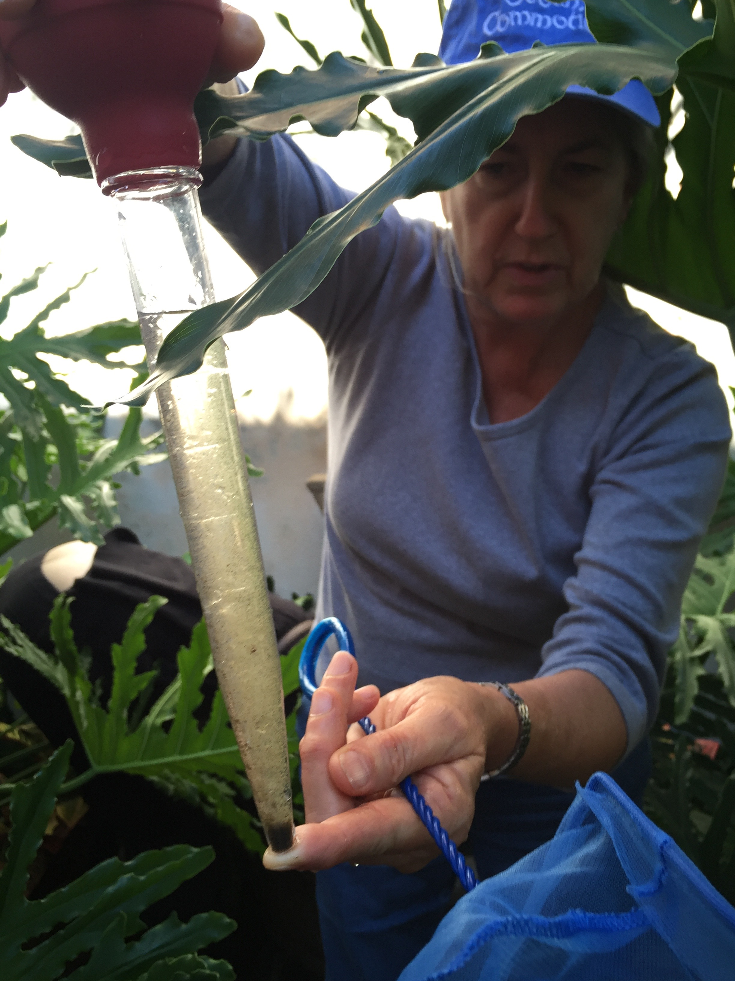
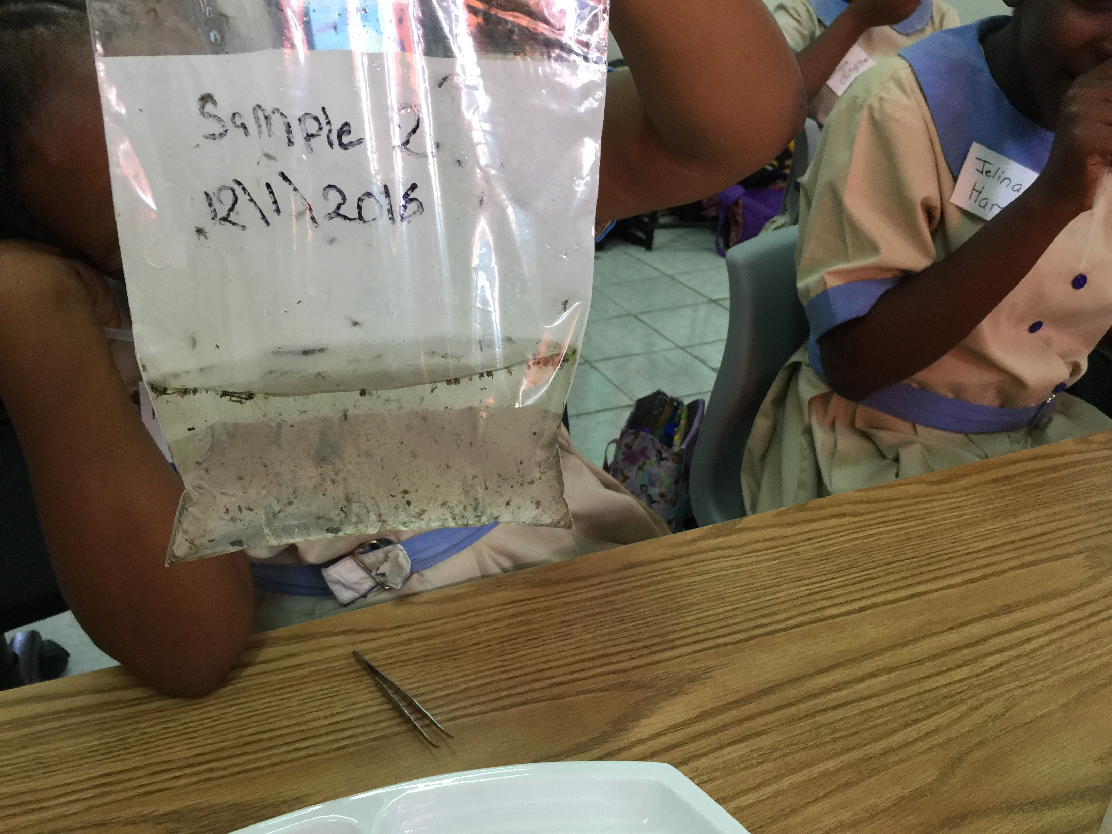
Step 2: Sample and count
This method is appropriate for all environments and sampling sites.
Press and collapse bulb, place syringe tip near the top of the water surface. Release bulb so bulb inflates, and water enters the syringe.
Transfer sample to plastic bag, by holding tip and then releasing the sample into the bag.

Slide 13
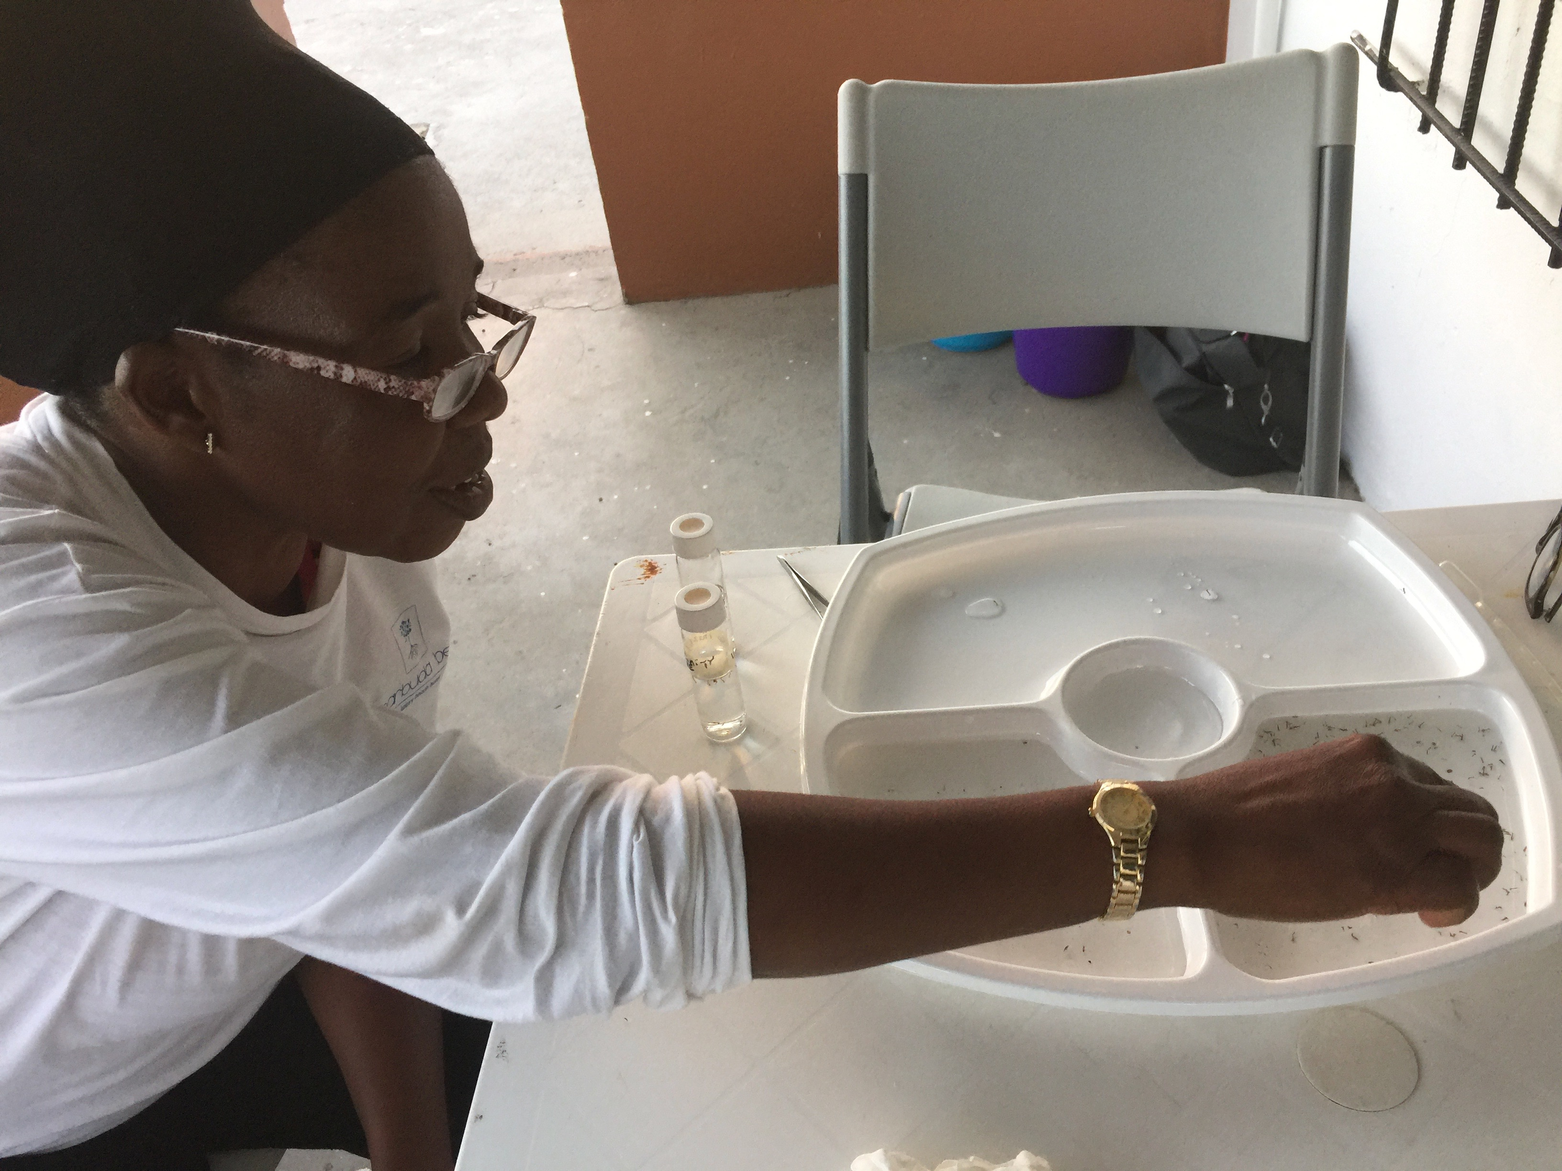
Safe handling of samples
Leave air in bags so that larvae can breathe and keep bags cool and in the shade. If they warm up in the sun, the larvae may die.
Identify the larvae soon after collection. If left overnight, any pupae in the sample may become adult flying mosquitoes.
If you find adult mosquitoes in your sample bag, shake the bag to drown the adult mosquitoes and dispose of the sample by pouring on the ground.

Slide 14
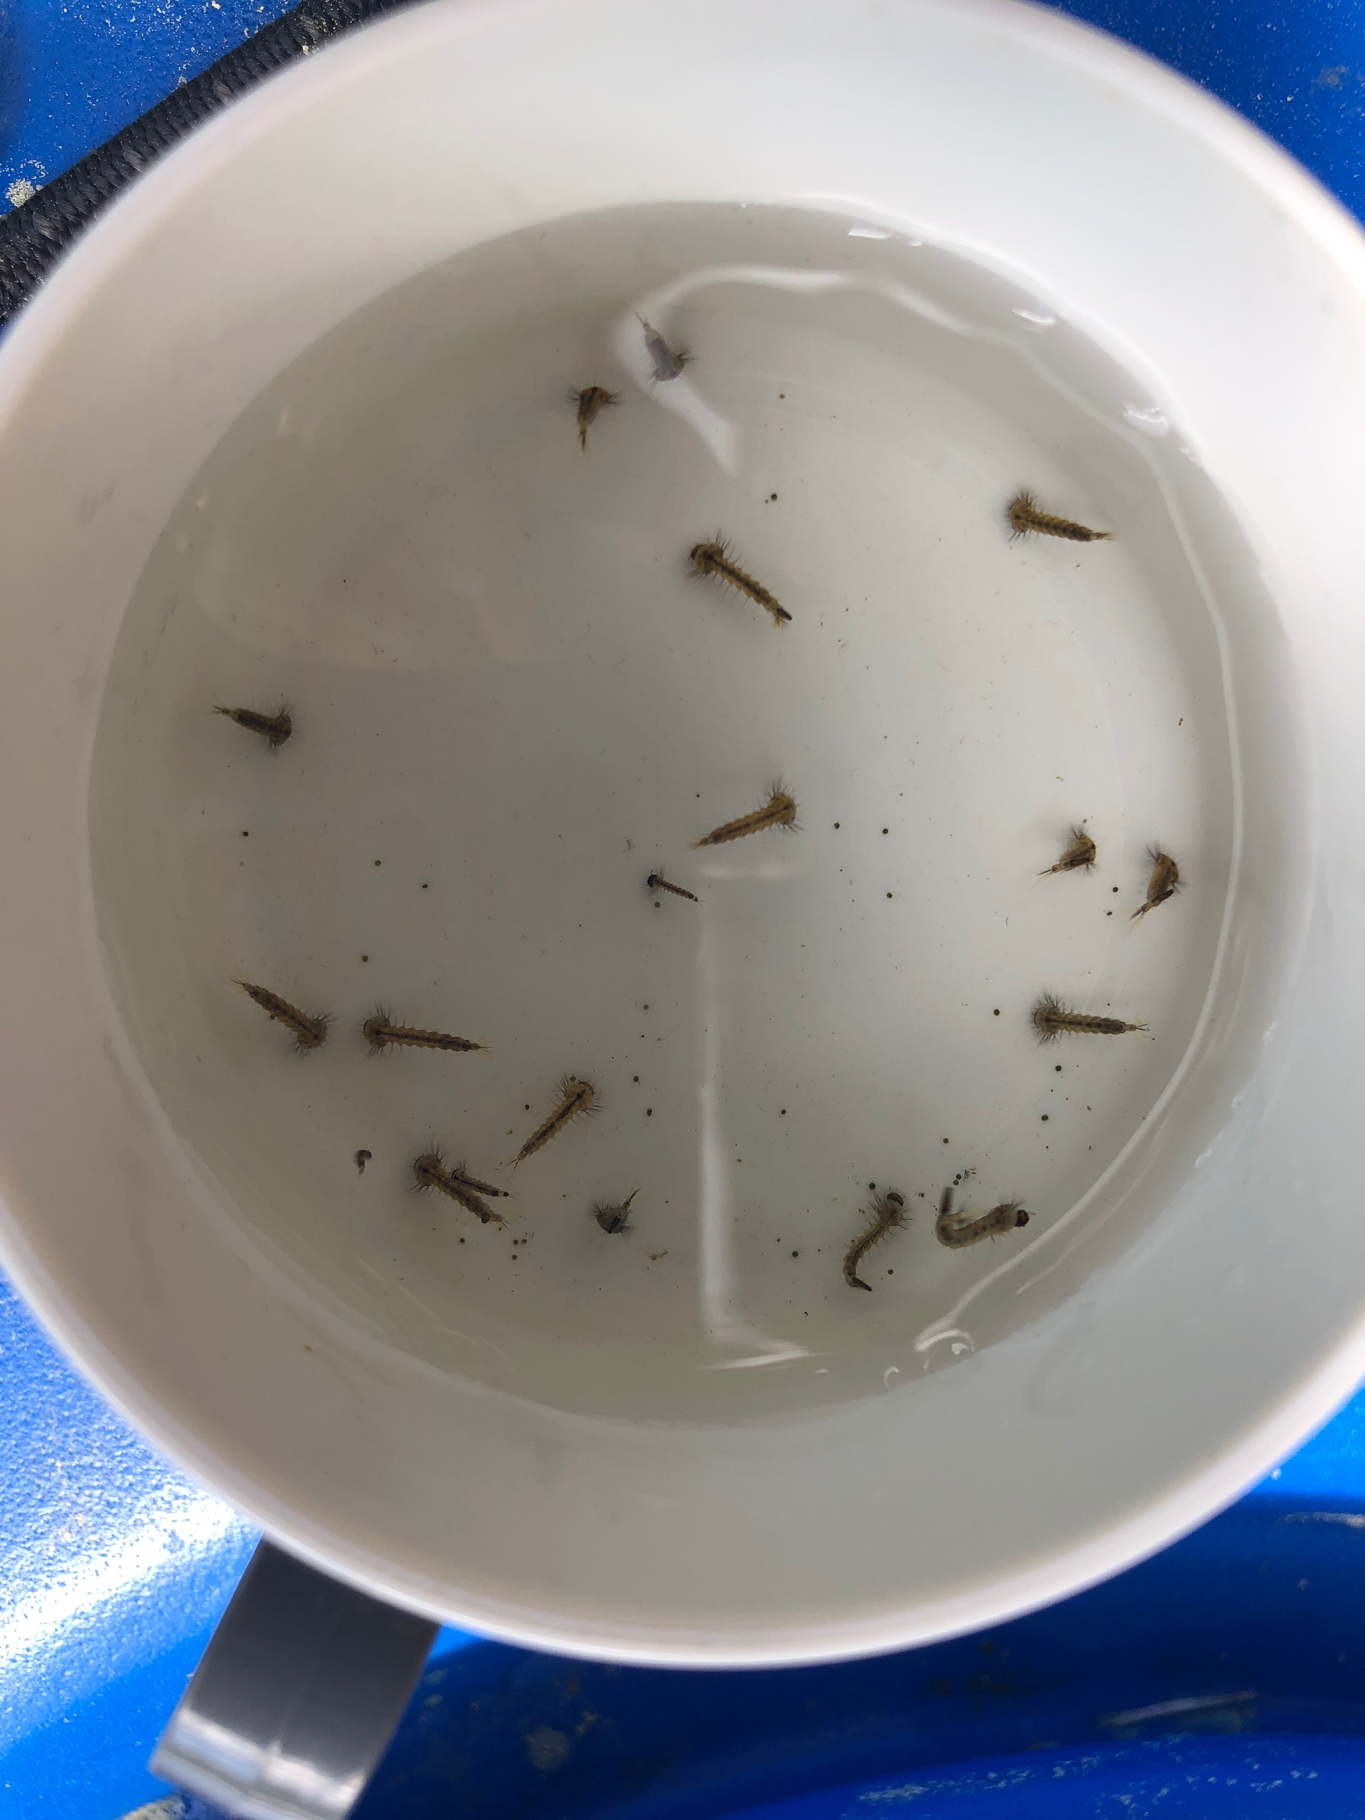
Step 2: Count the larvae
Provide a count of the larvae and pupae in your sample.
Be as precise as you can in your estimate.
Do you see how different they look? Why do you think?

Slide 15
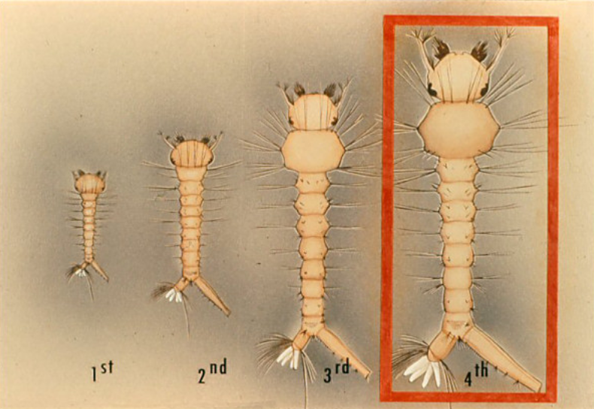
Mosquito larvae not just one size
The features that we use to identify the specimen are seen on the 4th instar larva.
Look for the biggest larvae you have in your sample. If you can’t distinguish the features, its possible that your larvae are still in one of the 1st-3rd instars.
In this case, you can count your larvae, but you will not be able to identify them.

Slide 16
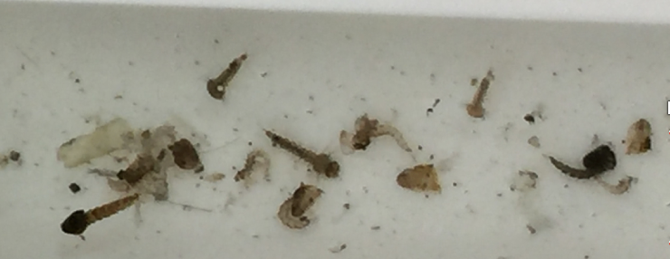
Step 2: Count the pupa you see too
pupa
After the 4th instar, the mosquito larva turns into a pupa, where it metamorphoses into an adult mosquito.
You may find pupae in your sample.

Slide 17
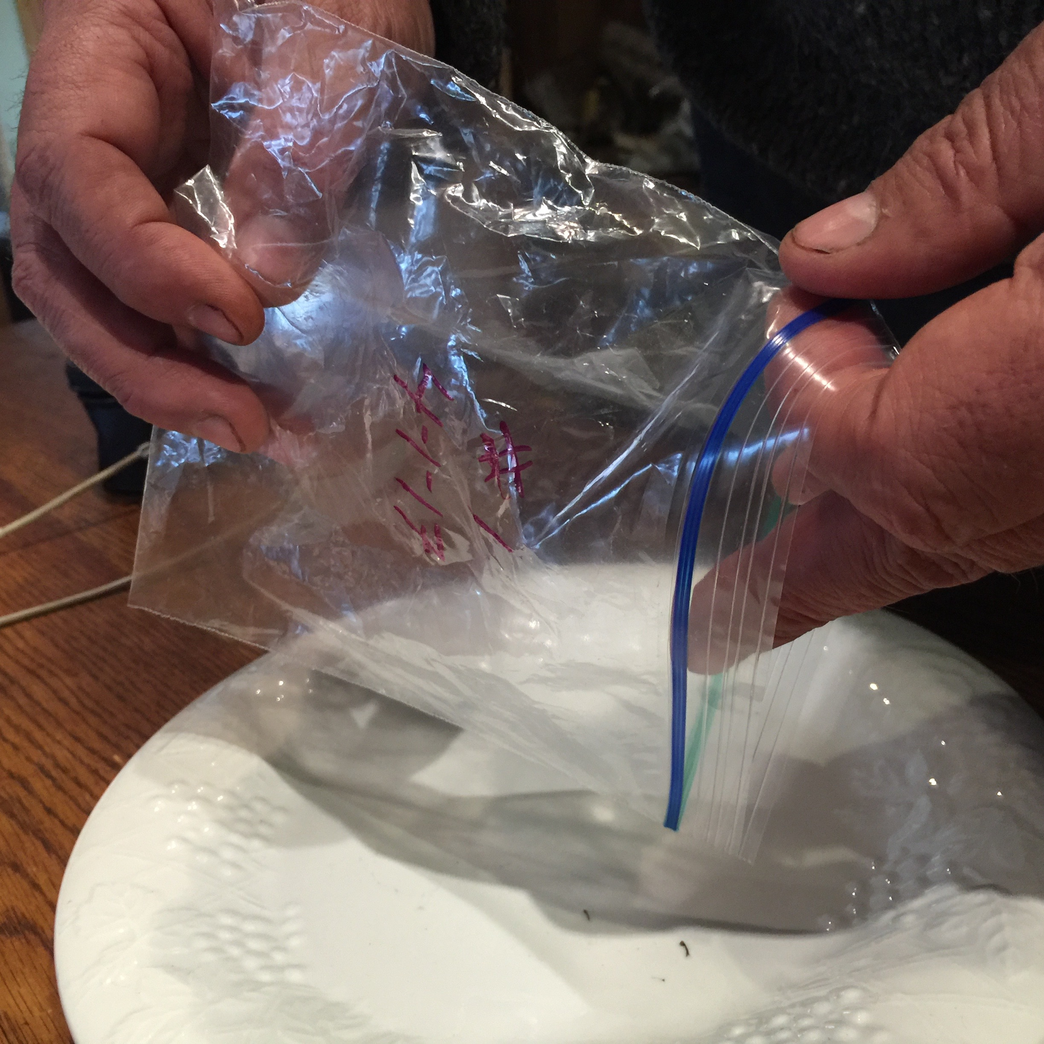
Step 3: Photograph and Identify 1
Pour part of the sample containing larvae on to a white tray or plate.

Slide 18
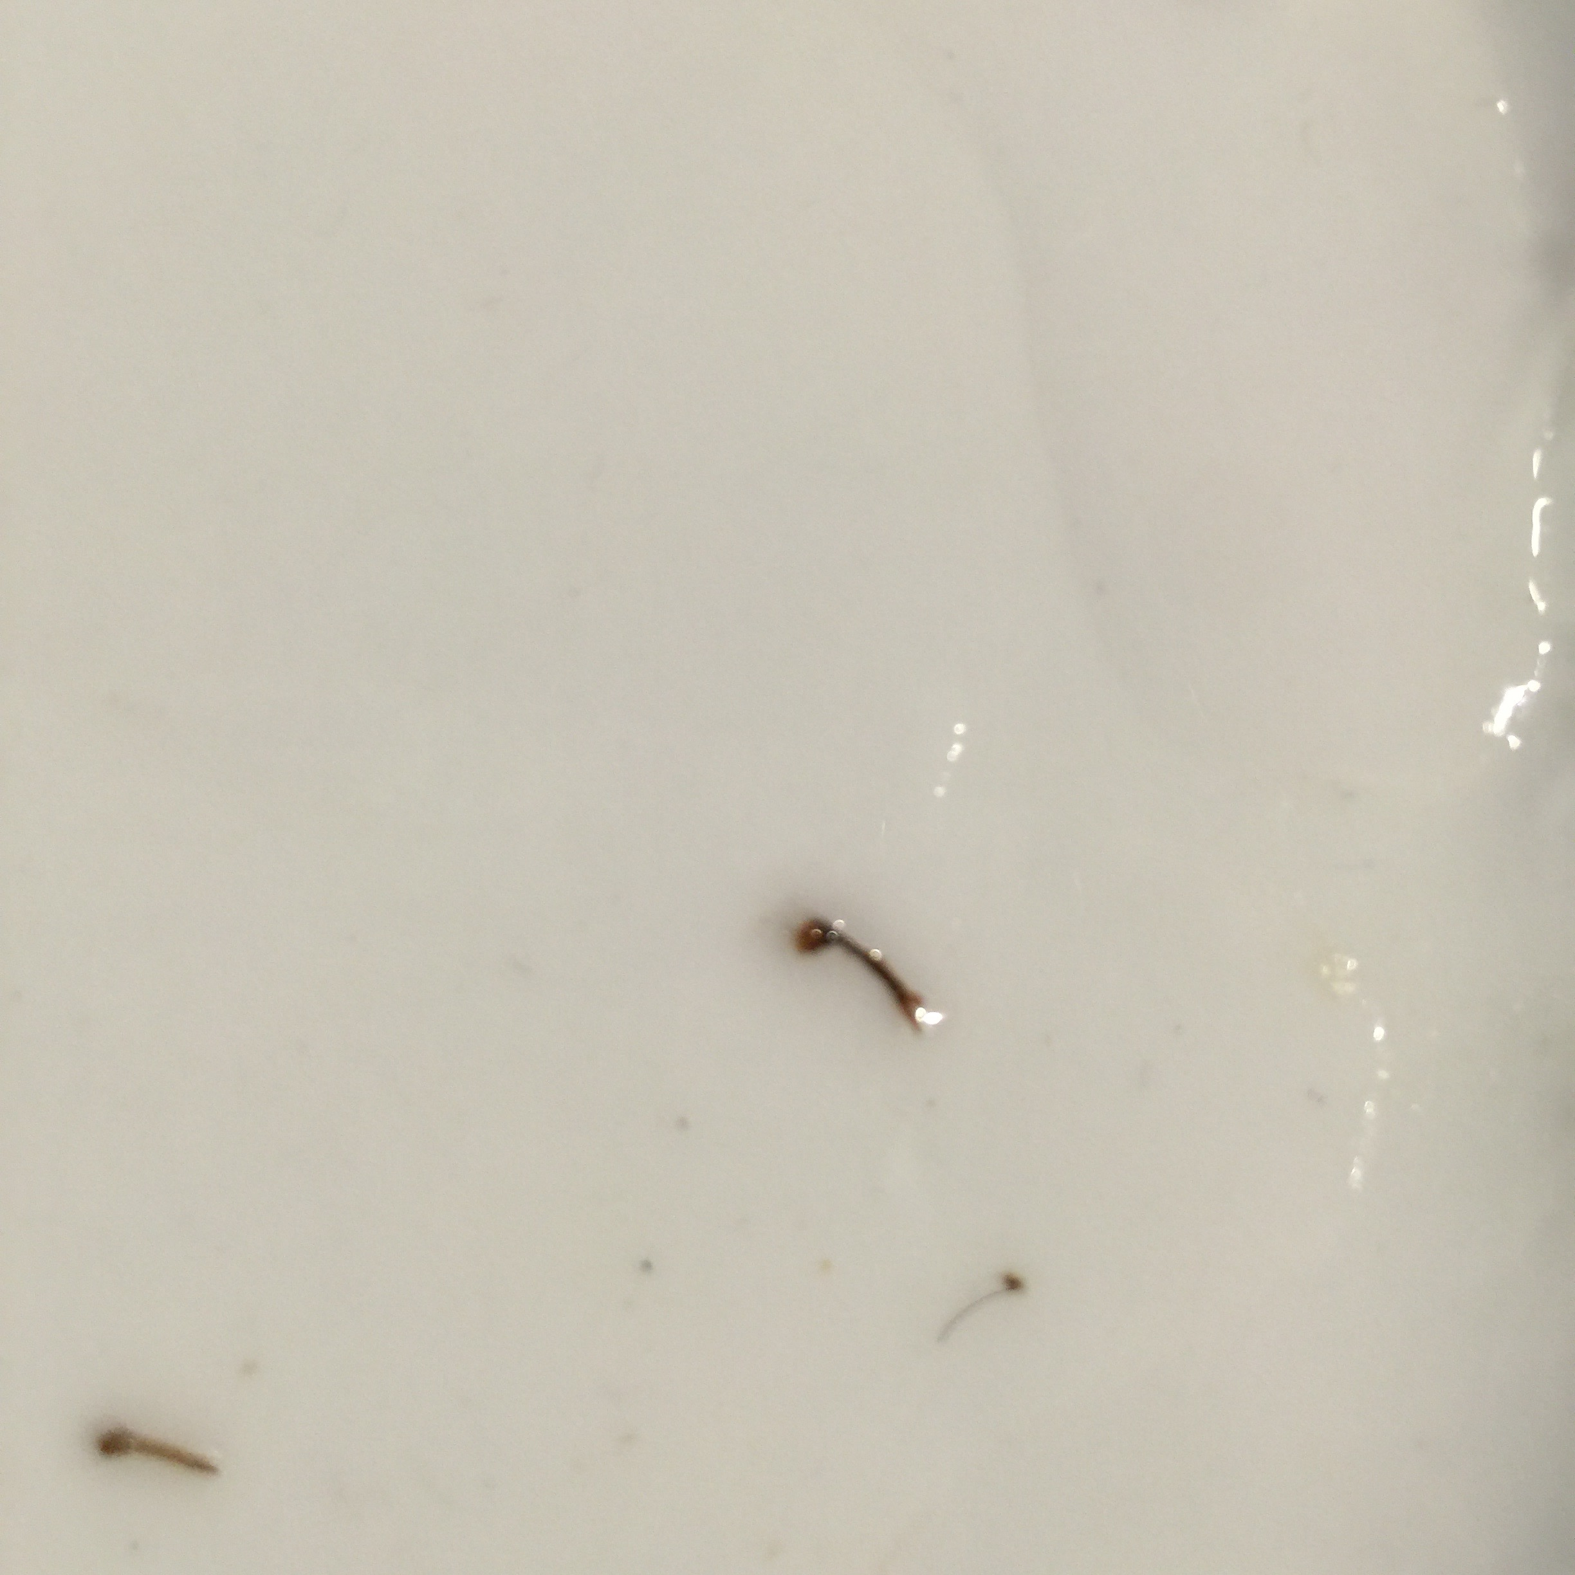
Step 3: Photograph and Identify 2
You can use a dropper or spoon to isolate one larva and put it on a white surface.
Suspend in a small drop of water.
larvae

Slide 19
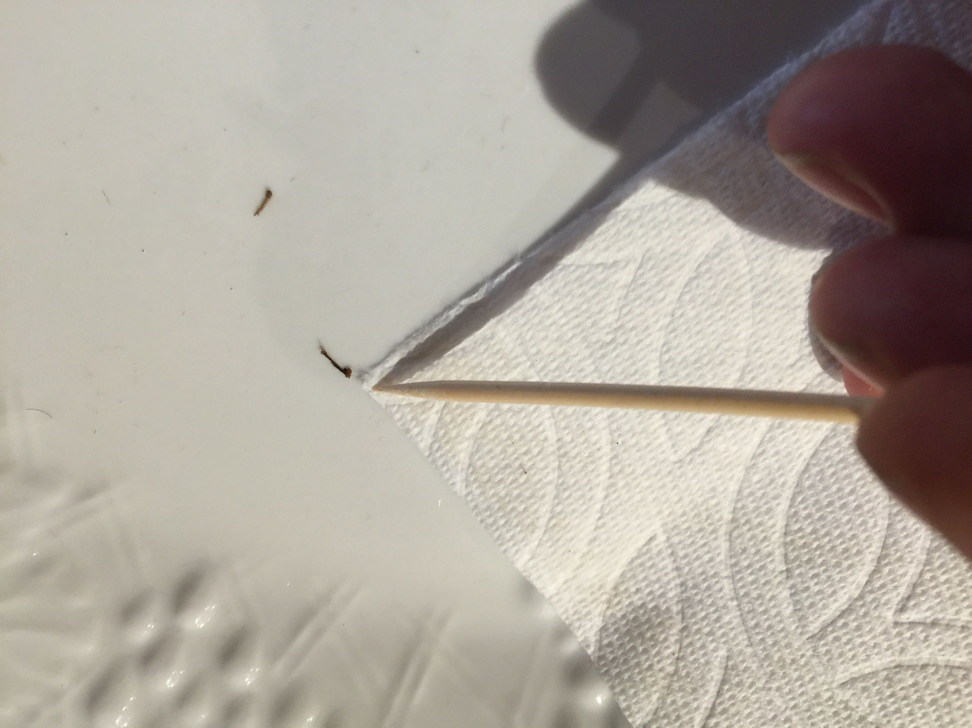
Step 3: Photograph and Identify 3
If there is too much water, the larva can swim and will be hard to keep the lens in focus. You can remove most of the water by blotting it up using the corner of a paper towel.
If the larva is still moving too fast to see, you can euthanize it with a drop of alcohol.
larvae

Slide 20
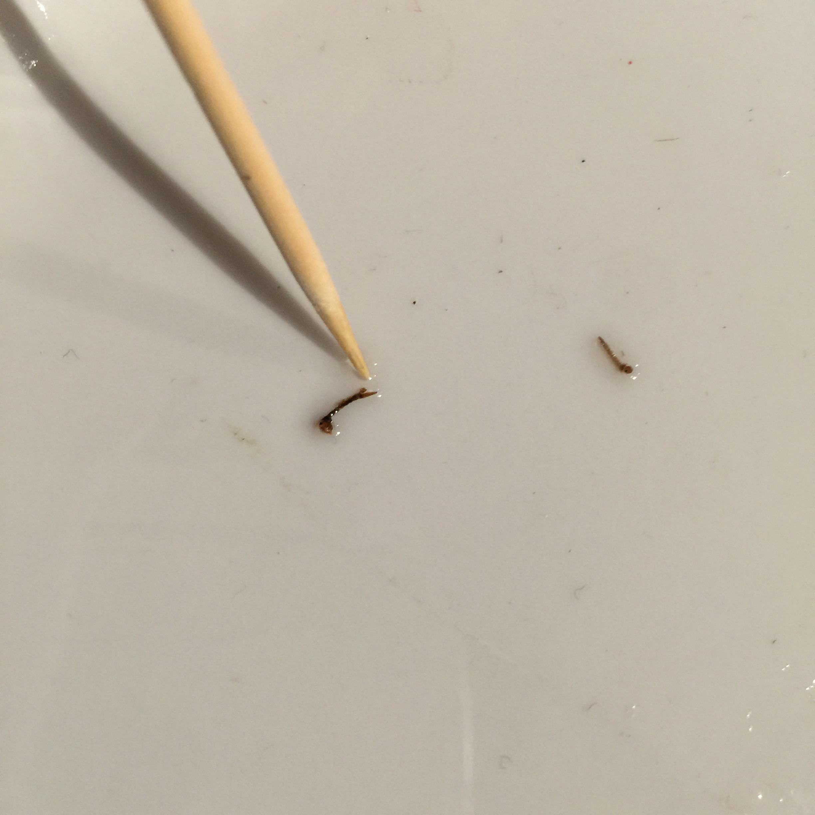
Step 3: Photograph and Identify 4
larvae
Use a probe or toothpick to position the larvae so you can see the diagnostic features.

Slide 21
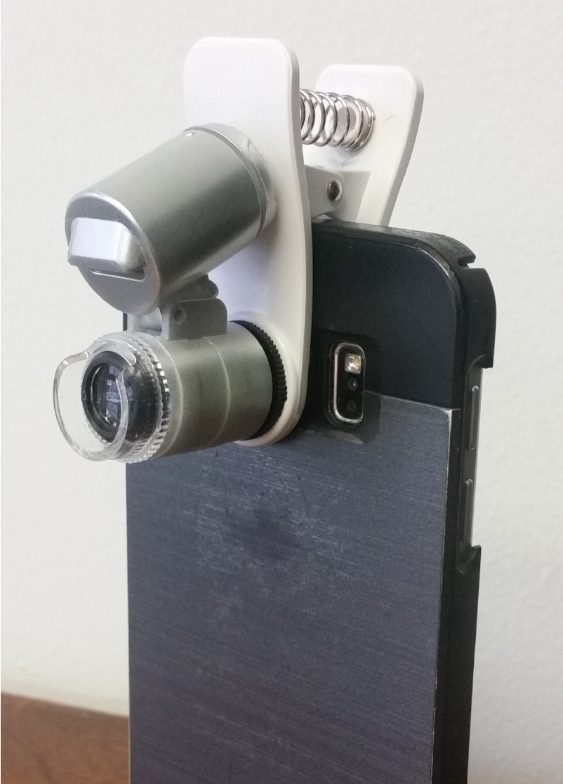
Step 3: Photograph and Identify 5
Attach a macro lens to a mobile device so that you can take a picture and upload it to the cloud.

Slide 22
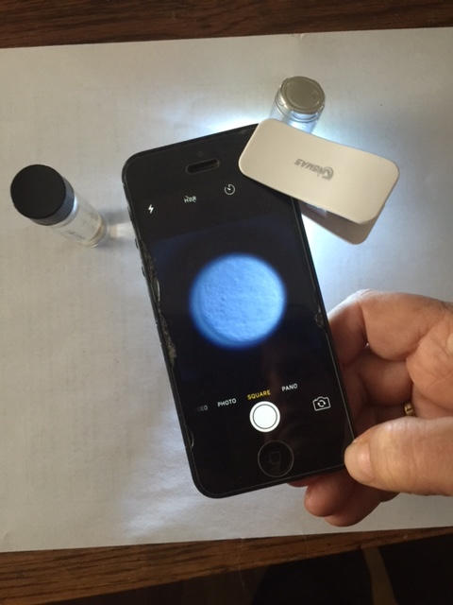
Step 3: Photograph and Identify 6
Clip the macro lens over the lens of the camera and line it up so that you see a perfect circle of light on your phone screen.

Slide 23
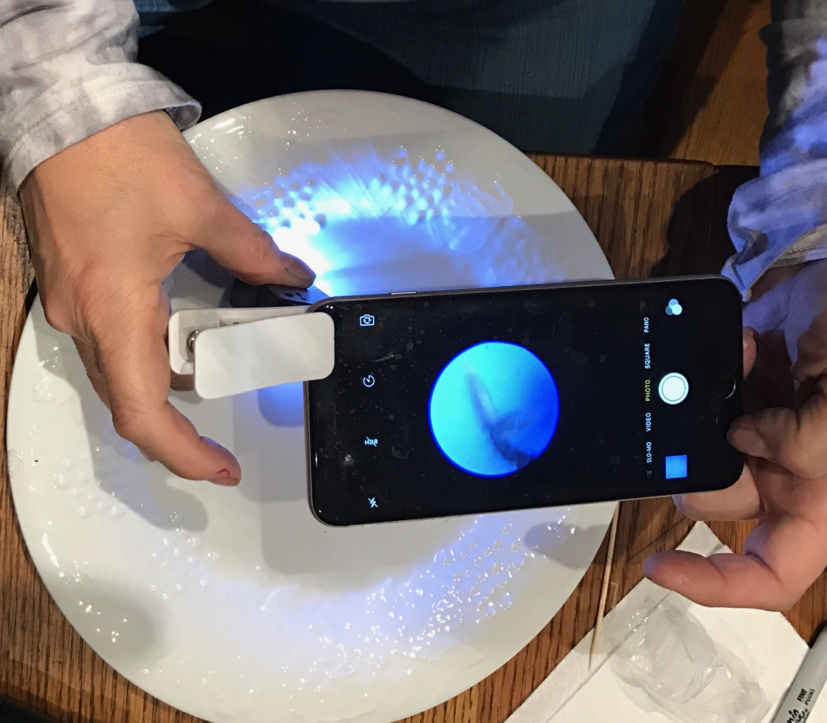
Step 3: Photograph and Identify 7
Line up the lens so that the specimen is in the circle of light on the viewer.

Slide 24
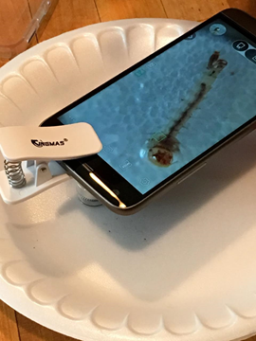
Step 3: Photograph and Identify 8
Many clip-on devices have a clear collar on them at the end of the lens. You can rest the collar of the lens on your plate.
The collar helps to you to find the focal length that is ideal for looking at your specimen.
larvae

Slide 25
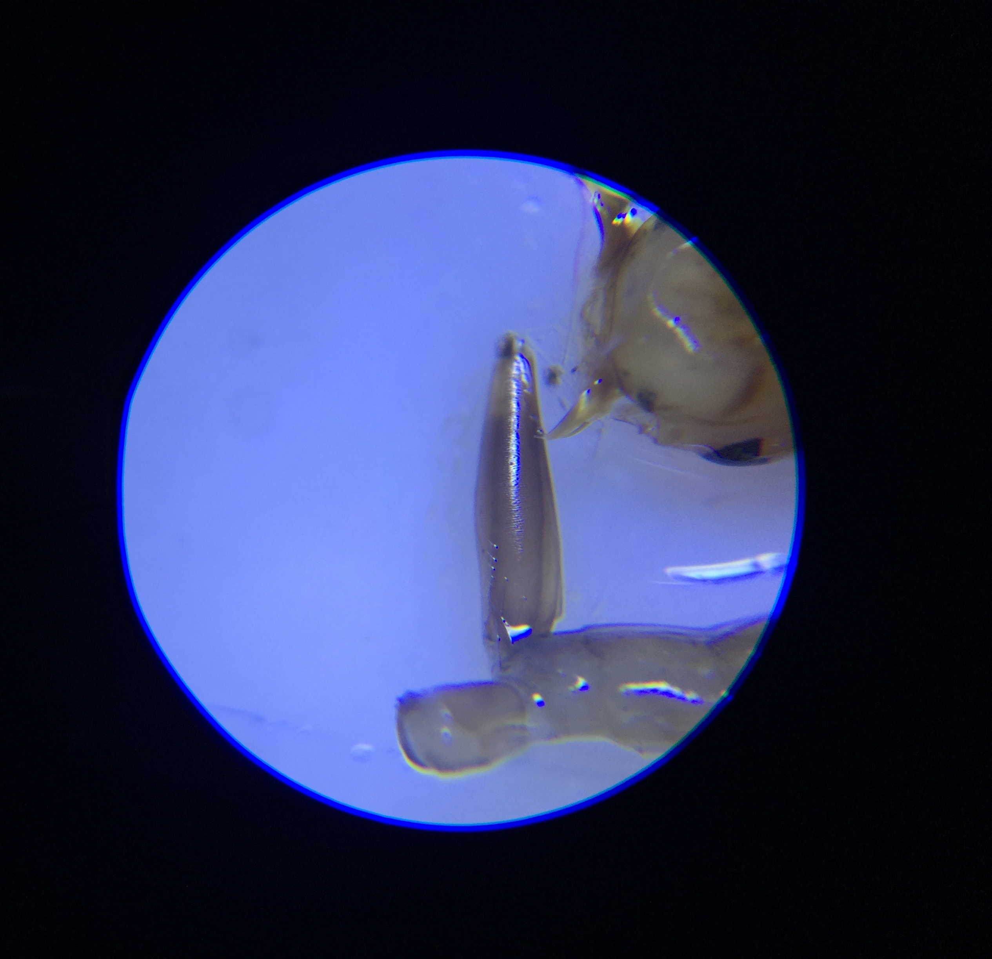
Step 3: Photograph and Identify 9
Once you have determined that you have a mosquito larva, you will want to focus on the diagnostic features.
Now you are ready to identify your specimen using either the app or a local mosquito larva key.
Larvae siphon

Slide 26
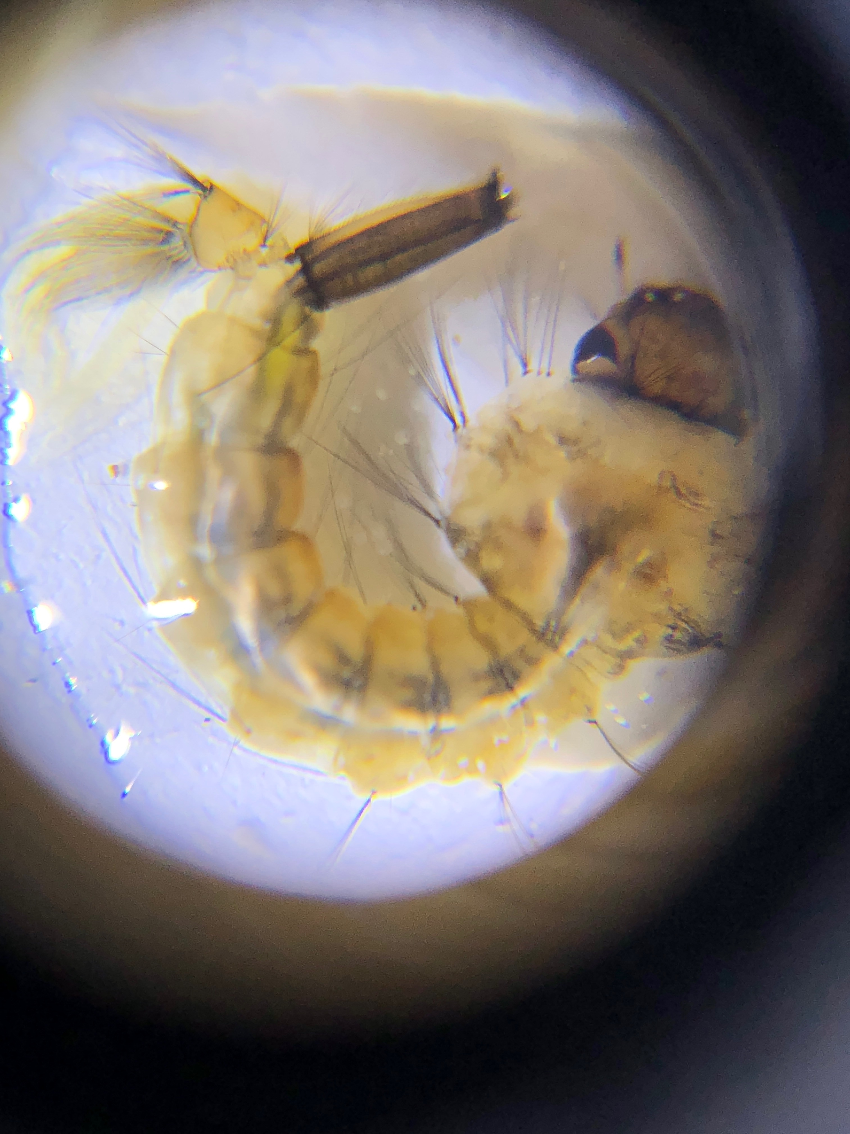
Step 3: Photograph and Identify 8
If the larvae, you found are “other” it is probable you have found one of the many mosquitoes that play an important role in the ecosystem.
These mosquitoes are occasionally referred to as “nuisance” species, with respect to humans, but they also serve as food for other organisms and as pollinators for plants.
Don’t worry about removing a breeding site from use unless it is a container species. Birds, frogs and other living things will thank you!

Slide 27
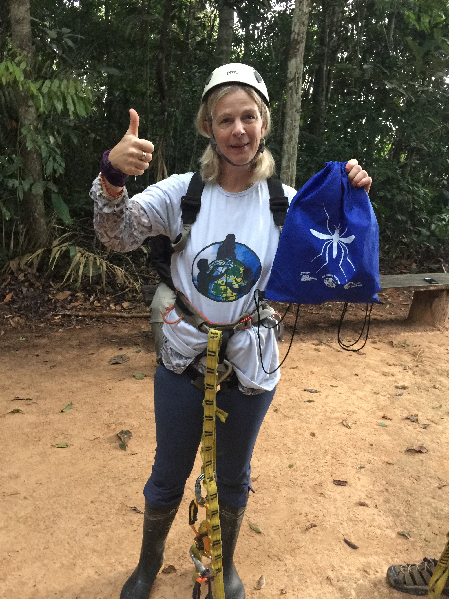
Step 4: Eliminate if possible
Eliminate the breeding site from use by mosquitoes by doing any of the following:
tip and toss water
cover container
contact public health official if you locate a breeding site that you can’t remove from use by yourself
Note: most mosquitoes do not transmit pathogens to humans or cause disease.

Slide 29
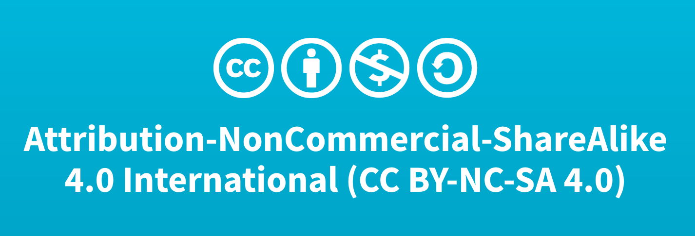
Using the MHM tool for the first time
Author:
Russanne Low PhD
Science Lead GO Mosquito Habitat Mapper
Institute for Global Environmental Strategies Arlington VA
Rusty_low@strategies.org
Did you modify this file for your class?
Put your name and the date here!
This work is licensed under https://creativecommons.org/licenses/by-nc-sa/4.0/

