Slide 1
GLOBE Mission Mosquito presents a series of mosquito tutorials
Using the macro lens

Slide 2
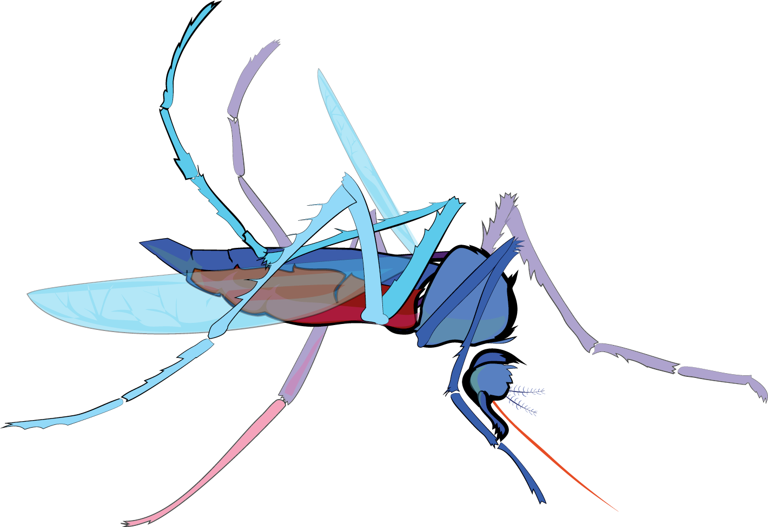
Using the macro lens
Slide Sets
Why Make Observations?
Mosquito as Vectors of Disease
Satellite Data and NASA Connections
Prior Knowledge Quiz
Using the MHM tool for the first time
Describing your mosquito habitat site
Using the macro lens
Identifying specimens

Slide 3
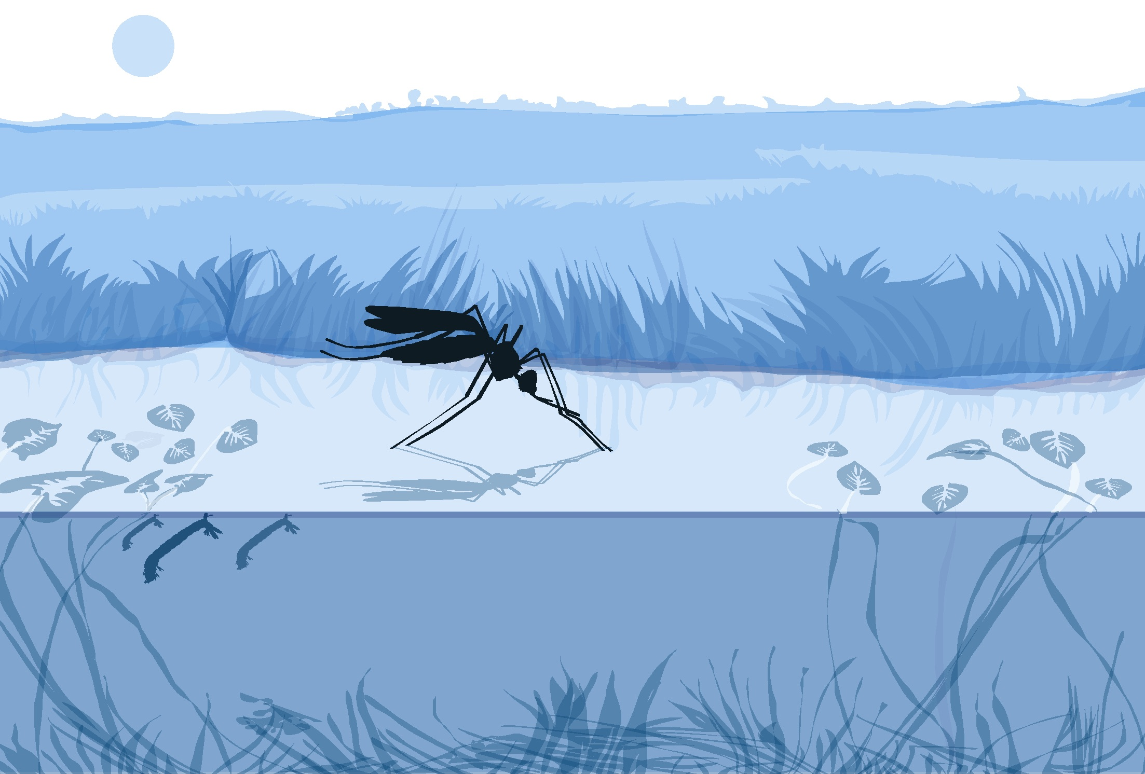
Using the macro lens

Slide 4
Using the macro lens
The following instructions will guide you to view of your specimen clearly.
Use a lens 60x-100x for best results.
Tip: You can also use a hand lens to identify some of the characteristics and identify most specimens to genera. You can take a picture through the lens.
Notes:
Image: NASA

Slide 5
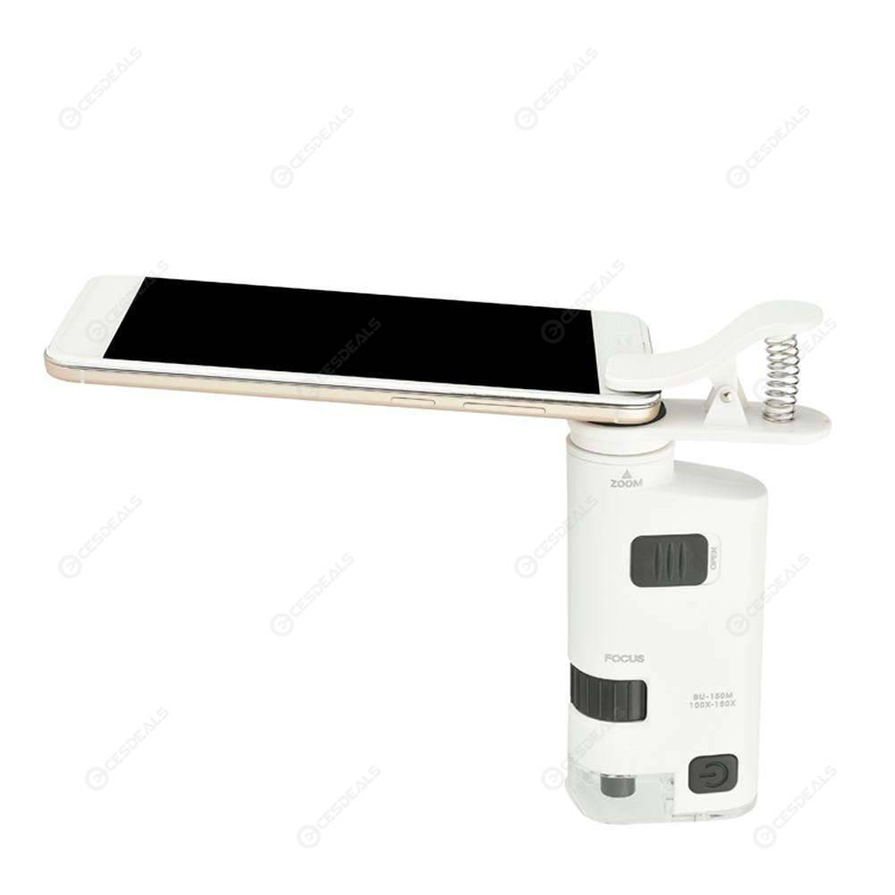
Using the macro lens
A note about lens types:
There are several types of lens available. Each has benefits. All units tested included lights.
The 60x is very easy to use and is recommended, especially working with students. This is because it is a fixed focal length.
The 100x and higher versions provide adequate detail to identify unique species features. These models requires some practice to use.
Select the right tool for your situation.
60x
100x
60x – 150x
Notes:
Image: NASA

Slide 6
Tips on using the 100x macro lens
Remove the plastic tab that is protecting the batteries.
Make sure the batteries are alternated with +, -, + in a line
Use the box to make a bridge to support your mobile device. That will allow you to use your other hand to focus using the knobs
For most models, the clear plastic sleeve rests on the plate. This provides the correct focal length. The specimen is positioned in the circle inside the plastic sleeve.
1
2
3
4
Notes:
Image: NASA

Slide 7
Recording your data using the macro lens
Clip the macro lens over the rear lens of the camera on the mobile device.
Adjust its position until you have a perfect, white circle in the
camera viewfinder.
Notes:
Image: NASA

Slide 9
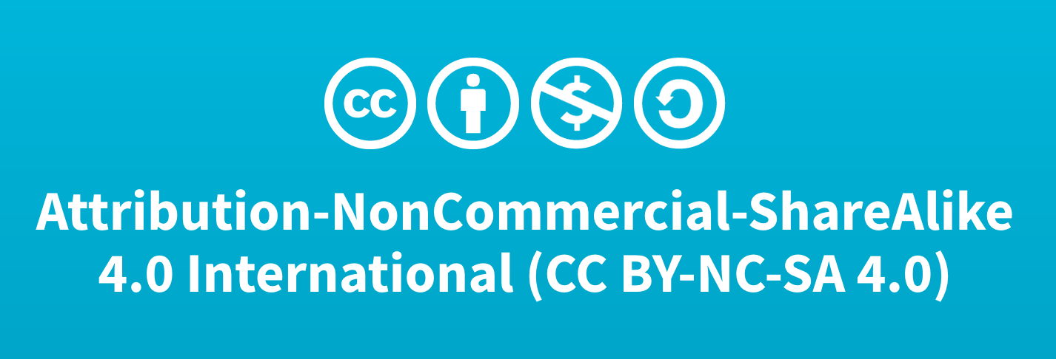
Using the macro lens
Author:
Russanne Low PhD
Science Lead GO Mosquito Habitat Mapper
Institute for Global Environmental Strategies Arlington VA
Rusty_low@strategies.org
Did you modify this file for your class?
Put your name and the date here!
This work is licensed under https://creativecommons.org/licenses/by-nc-sa/4.0/

