Slide 1
23rd GLOBE Annual Meeting Student Data Collection
Amy Barfield

Slide 2
Data Collection
During the student experience at Howell Nature Center, you will be asked to work in groups of 4-5 to come up with a research question, collect data, and create a presentation to share with the community members about your experience and what you learned.
We are asking that you use at least one of the following protocols:
Water Temperature (probe)*
Water Electrical Conductivity (probe)*
Water Dissolved Oxygen (probe)*
Water pH (probe)*
Tree Height (GLOBE Observer)
Land Cover (GLOBE Observer)
*Use of kayaks and canoes may be used to collect water quality measurements. Probes will be supplied by Vernier and PASCO.

Slide 3
Prep
We will only be providing BRIEF demos to prepare for data collection so please familiarize yourself with the protocols prior to arriving in Detroit and come ready with questions!
You may find the eTraining to be a valuable source to help you prepare in addition to reading through the following slides.

Slide 4
GLOBE Observer
You may use the GLOBE Observer app to help with data collection.
The focus at this meeting will be on the Land Cover and Tree Height tools to align with the current international campaigns.
Please download the GLOBE Observer app today and start practicing!

Slide 5
Getting and Using the App
Download the free app from the App Store or Google Play
2. Register with an email address (or web form)
3. Go outside and follow the prompts in the app to observe your environment!

Slide 6
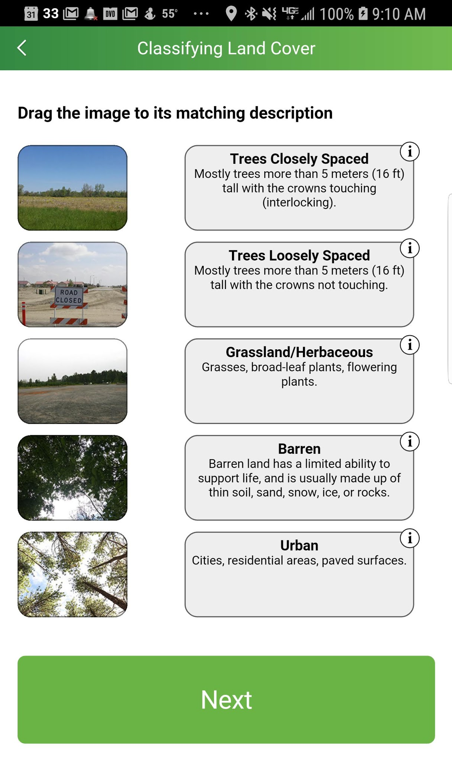
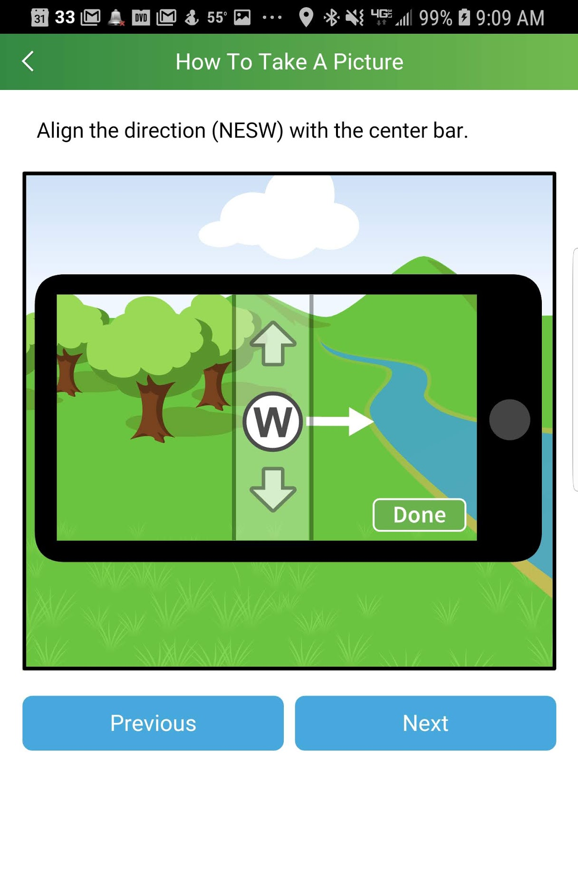
Land Cover
App Tool
Photograph and classify land cover over an area the size of a soccer field
Pro users: Quantify own values with MUC guide
Benefits
Collaboration between app users, between NASA scientists and citizen scientists
Assist scientists working to enhance global maps of land cover use
Observations will contribute to new maps with a finer spatial resolution than is possible with satellites alone

Slide 7
Using the App: What it looks like

Slide 8
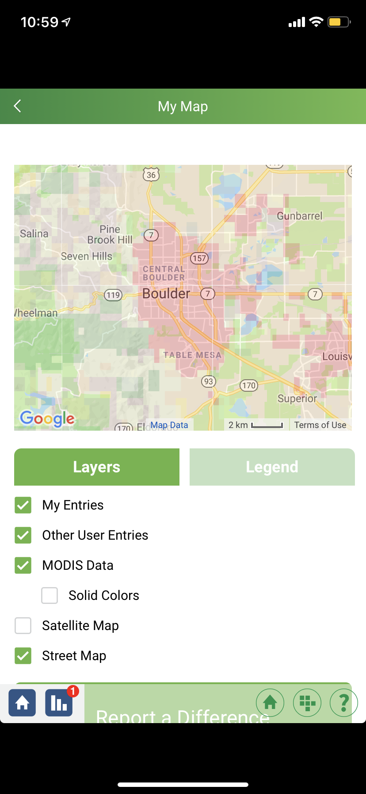
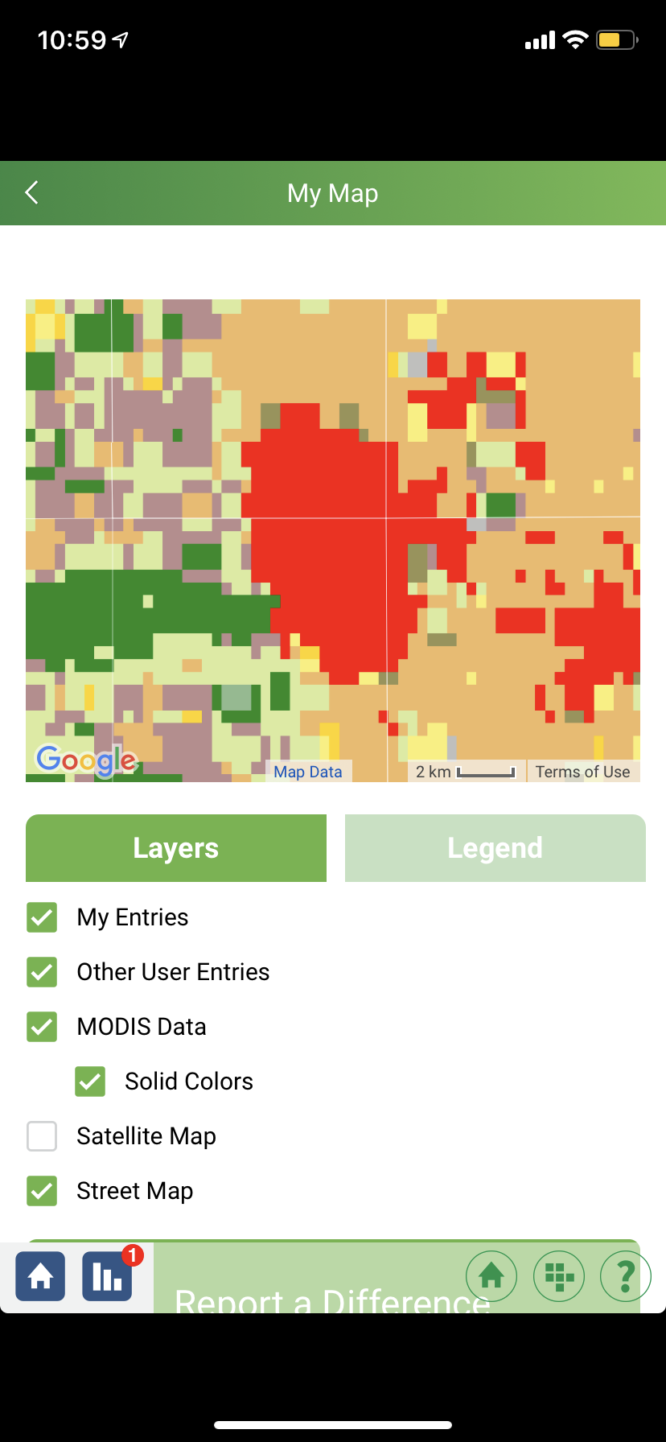
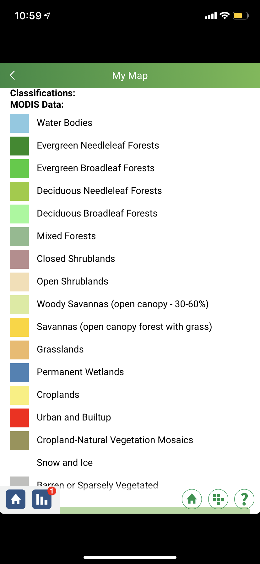
The app helps classify the types of land cover to help make sure NASA satellite data is correct.

Slide 9
Trees
App Tool
Measure tree height
Optional: Measure tree circumference
Benefits
Track growth of trees over time
Allows NASA scientists to understand the +/- of biomass which can inform calculations of the carbon that trees and forests take in and release into the atmosphere
Use a mobile device as the measurement tool (no need for additional instrumentation)
Compare NASA ICESat-2 measurements
Ice, Cloud, and land Elevation Satellite-2

Slide 10
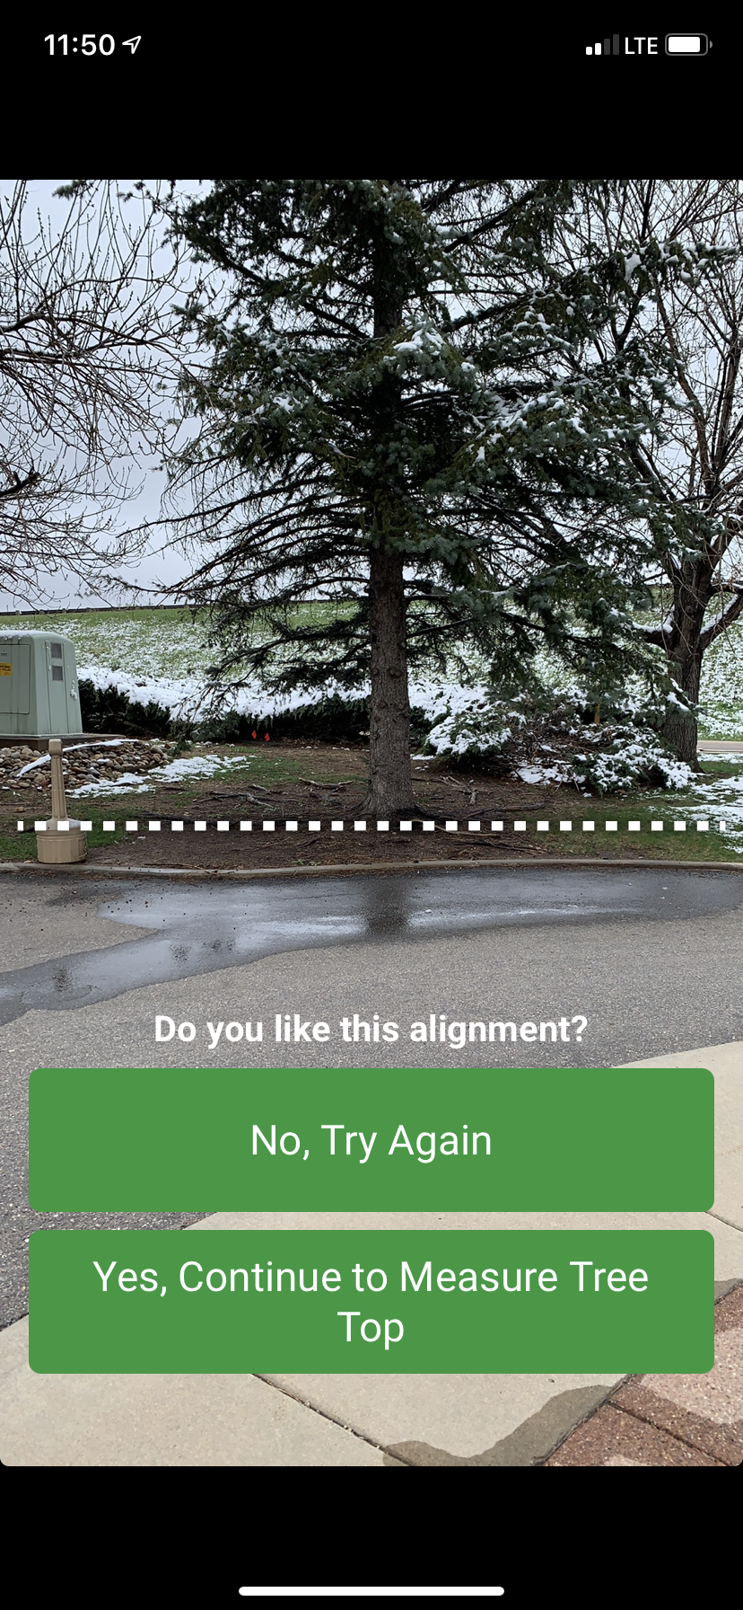
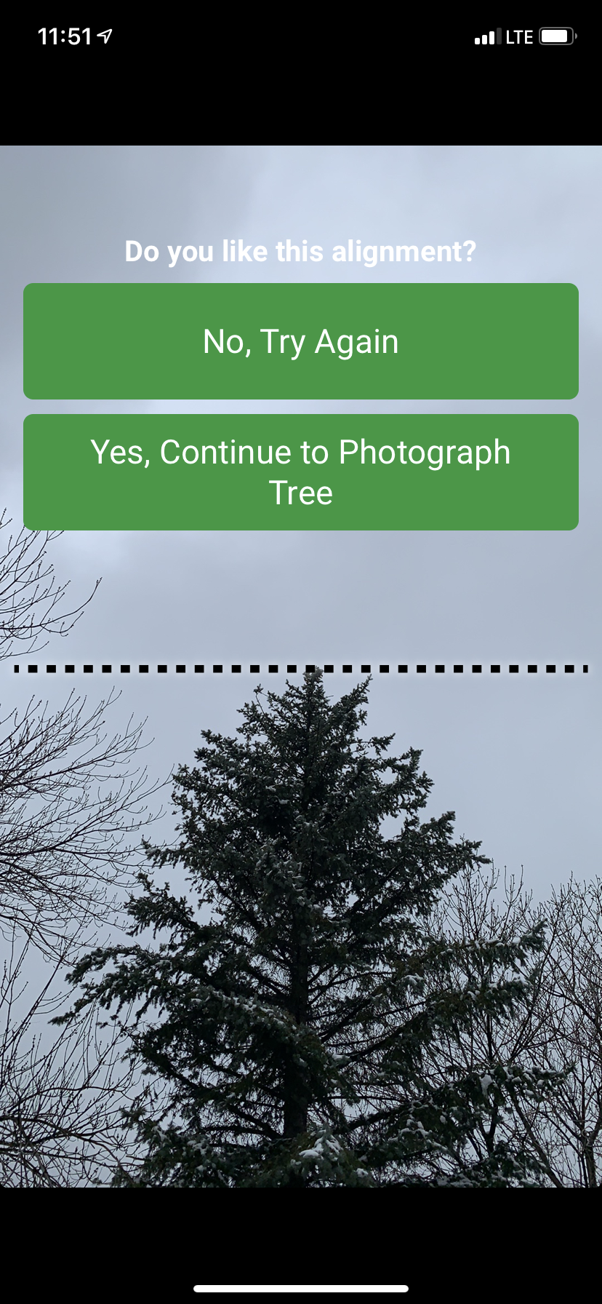
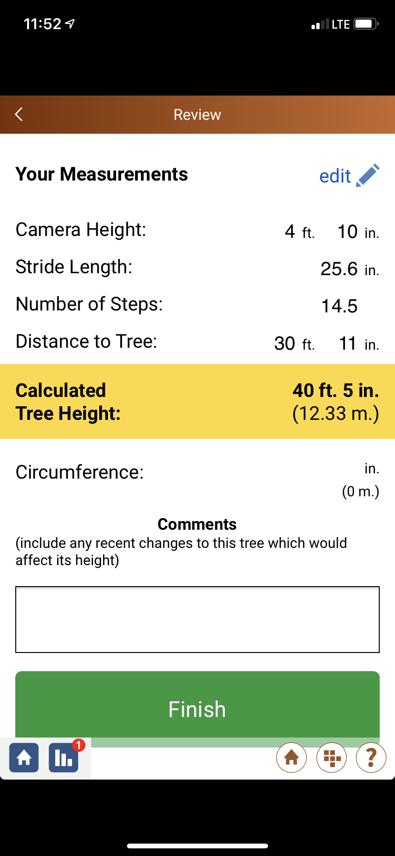
Screenshots from using the app

Slide 11
Water Health
Hydrology Protocols:
In this investigation we will run various tests on the water to gauge the health of the water. We will also explore how these various variables relate to each other.

Slide 12
Water Temperature
Temperature- Using a Temperature Probe
Please refer to the user manual that comes with the probes for more complete and probe specific directions.
General Directions:
1. Put the metal end of the probe (not the plastic handle) into the sample water and keep it submerged until the reading stabilizes (stops changing).
2. Read the temperature on the meter without removing the probe from the water.
3. Record the temperature in your student journal.
4. Have two other students repeat the measurement with new water samples.
5. Calculate the average of the three measurements.
6. All temperatures should be within 1.0˚C of the average. If they are not, repeat the measurement.
8. Rinse the electrode with distilled water and blot dry.

Slide 13
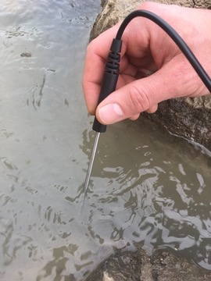
Temperature
Using a temperature probe
Fish temperature tolerances

Slide 14
Dissolved Oxygen
Dissolved Oxygen (DO)- Using a Probe
Please refer to the user manual that comes with the probes for more complete and probe specific directions.
General Directions:
1. Lower the tip of the probe into the sampling water and slowly move it back and forth. If you are measuring flowing water, you can just hold the probe in place.
2. When reading has stabilized, record the dissolved oxygen value in your journal.
3. Repeat the readings two more times and record the dissolved oxygen.
4. Check to make sure that the three readings are within 0.2mg/L of one another. If they are not, continue taking readings until the last three are within 0.2mg/L of one another.
5. Calculate the average of the three measurements.
6. Rinse the electrode with distilled water and blot dry.

Slide 15
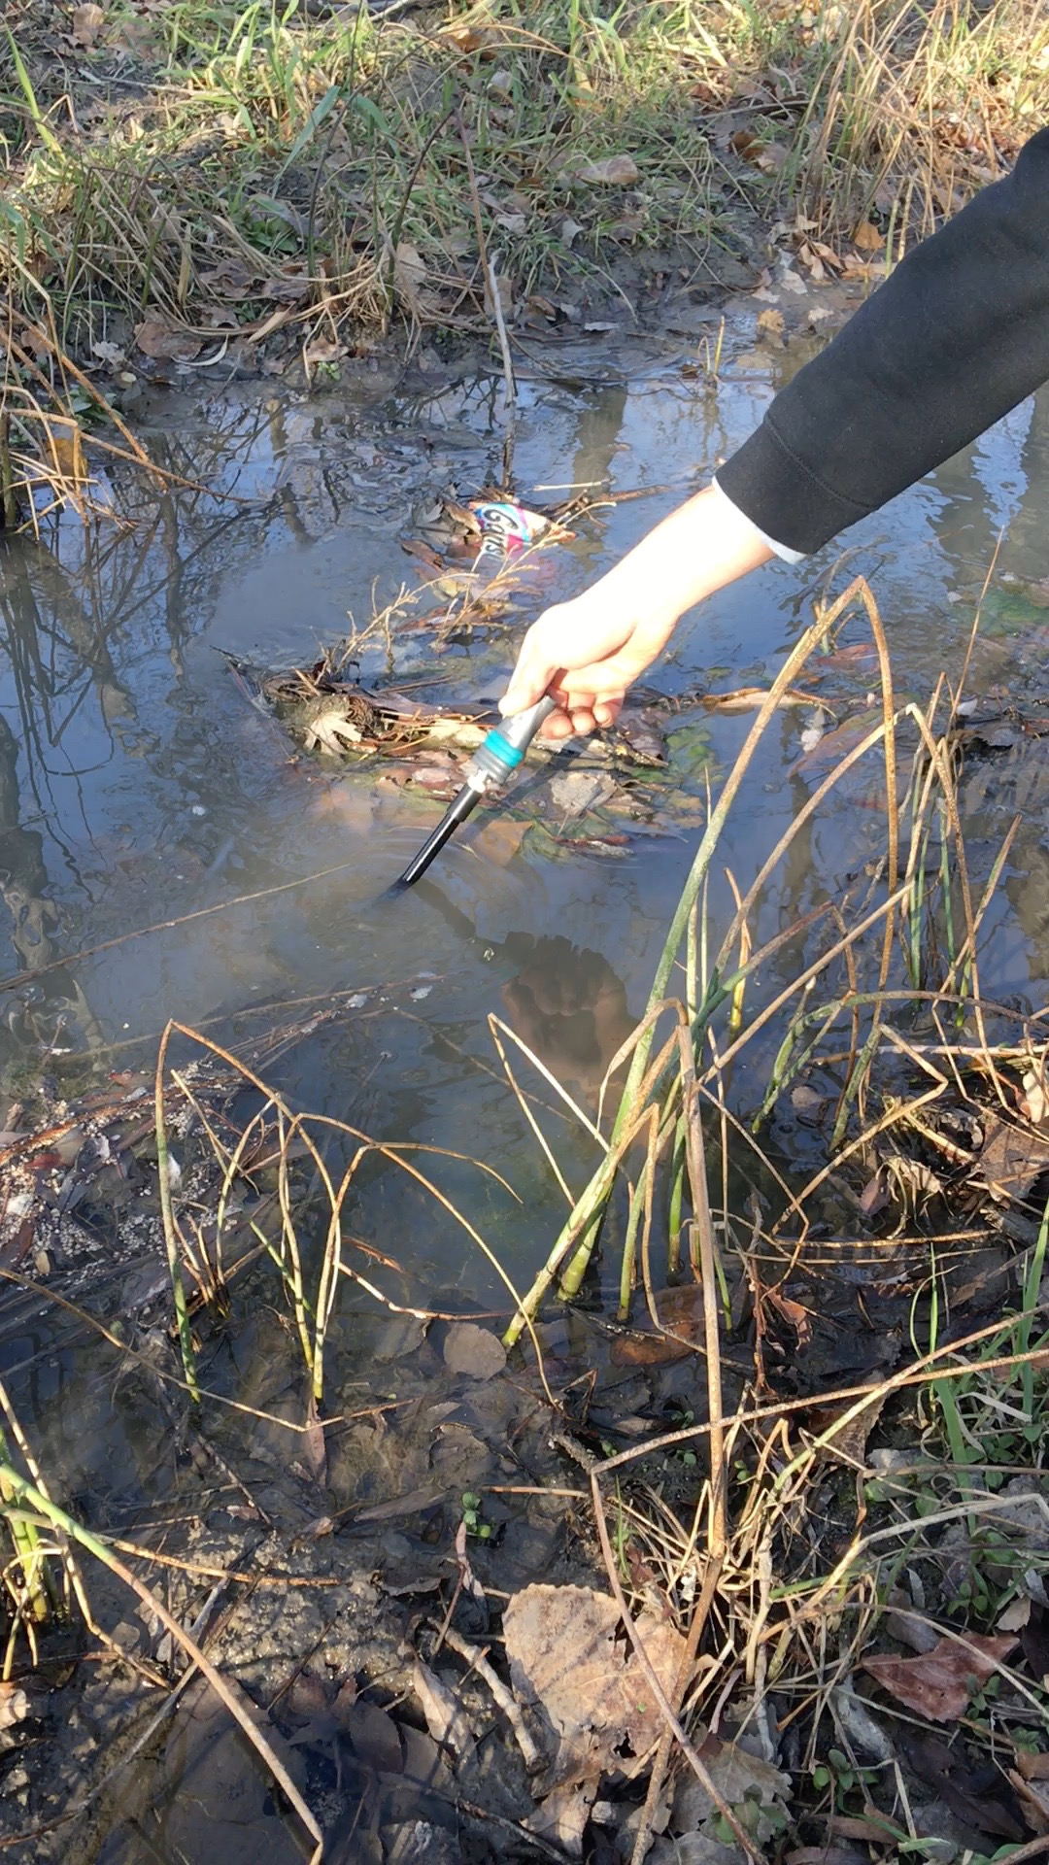
DO
Fish tolerances for DO
Using a wireless probe

Slide 16
Electrical Conductivity
Electrical Conductivity-Using a Probe
Please refer to the user manual that comes with the probes for more complete and probe specific directions.
General Directions:
1. Lower the tip of the probe into the sampling water and slowly move it back and forth. If you are measuring flowing water, you can just hold the probe in place.
2. When reading has stabilized, record the conductivity value in your journal.
3. Repeat the readings two more times and record the conductivity.
4. Calculate the average of the three measurements.
5. Check to make sure that the three readings are within 40mS/cm of one another. If they are not, continue taking readings until the last three are within 40 mS/cm of one another.
6. Rinse the electrode with distilled water and blot dry.

Slide 17
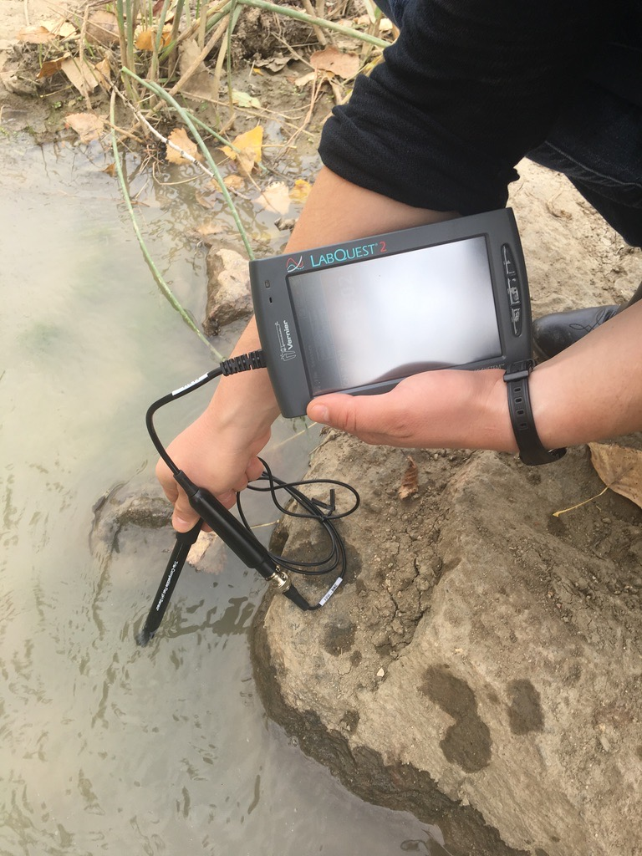
Conductivity
Conductivity Averages (source: fondriest)
Using a conductivity probe

Slide 18
pH
pH- Using a Probe
Please refer to the user manual that comes with the probes for more complete and probe specific directions.
General Directions:
1. Lower the tip of the probe into the sample water and keep it submerged until the reading stabilizes (stops changing).
2. Read the pH on the meter without removing the probe from the water.
3. Record the pH in your student journal.
4. Have two other students repeat the measurement with new water samples.
5. Calculate the average of the three measurements.
6. All temperatures should be within 1.0˚C of the average. If they are not, repeat the measurement.
7. Rinse the electrode with distilled water and blot dry. BE SURE TO PLACE PROBE TIP BACK IN STORAGE SOLUTION!

Slide 19
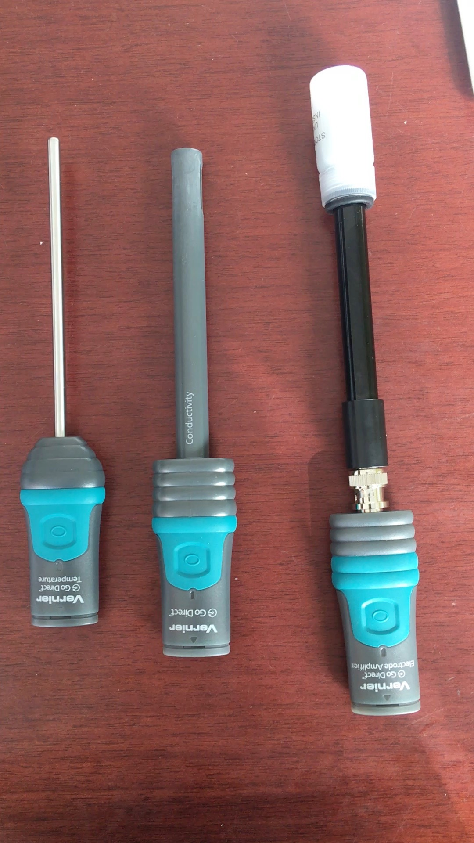
pH
3 of the GoDirect probes
pH scale

Slide 20
Downloading the apps
PASCO and Vernier both use graphical apps to help with data collection and visualization. The following slides were prepared for a project which used iPads and Vernier probes.
I have included these slides to help with downloading the app to your tablet or smartphone device and familiarizing yourself with the Vernier software, but keep in mind these are limited because they only show one type of product.
Both Apple and Android devices work with both the Vernier and PASCO apps. And you may use either or both PASCO and Vernier probes! You can use a smartphone or tablet for data collection as well!

Slide 21
Preparing your Tablet or Smartphone
The process outlined below will be very similar if using another brand of tablet or a smartphone.
Similar steps will also be taken for downloading and using the PASCO SPARKvue app.
Please prepare to use both the Vernier and SPARKvue apps. Some older models of tablets and smartphones may not support the Vernier app, if this applies to you, please still download the SPARKvue app

Slide 22
iPad and Probes (Temperature, pH, Conductivity, DO)
*This picture does not include the Dissolved Oxygen probe (DO) but we will be using it at Howell. The process for the DO probe is the same as the other probes.
Temperature
pH*
Conductivity
For more information on the probes, go to www.vernier.com
*Keep pH probe in storage solution when not in use. Go to the Vernier website for more information about replacing the solution.

Slide 23
iPad and Probes (Temperature, pH, Conductivity, DO)
1) Set up iPad
You will need to connect to Wi-Fi and create or sign into an Apple ID account.
2) Download Graphical Analysis App (https://www.vernier.com/products/software/graphical-analysis/)
Apple Users: Open App Store:
Android users can download the app from Google Play
Using the search bar in the upper left-hand corner, search for “Vernier Graphical Analysis” (it might pop up in the options menu as you type)
Select the Vernier Graphical Analysis 4 application. The icon for this app looks like this:
The app is free. There are other Vernier apps that you will see, but you will only need the Graphical Analysis 4. To download, click on this button:
The app should start downloading immediately.
Watch a video tutorial for downloading the app here: https://youtu.be/s1-XoBb_Oe0

Slide 24
iPad and Probes (Temperature, pH, Conductivity, DO)
3) Connect probes
Make sure to read the directions that come with the probes.
You will need to fully charge the probes before use. To do this, use the charging cord that comes with your probe. The small USB port plugs into the probe and the large USB port will need to be plugged into a power source. You can use the block that comes with your iPad and plug it into the wall. The probe will display a blue light while the probe is charging and the light will turn off when it is fully charged.
Turn on the probe by pressing on the large green button. Hold the button until you see a flashing red light.
Open the Graphical Analysis App on your iPad.
Select “New Experiment”. A pop-up window will prompt you to choose how you want to collect data, select “Wireless Devices” then another pop-up window will display the probe by its name and serial number. For example, the temperature probe will have GDX-TMP in front of a number. Select the desired probe by its name and the probe and iPad will connect via Bluetooth. When the devices are connected, the flashing red light on the probe will turn green.

Slide 25
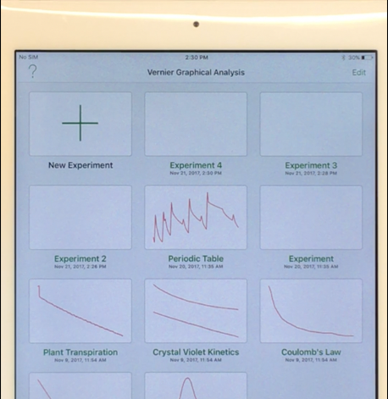
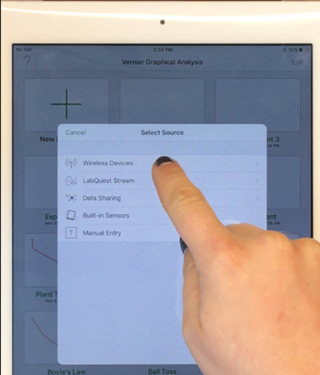
iPad and Probes (Temperature, pH, Conductivity, DO)
Select New Experiment → → Then Wireless Devices → → Then select your probe

Slide 26
iPad and Probes (Temperature, pH, Conductivity, DO)
3) Connect probes continued
If you are having any problems connecting, make sure your Bluetooth is turned on on your iPad. To check, open the Settings on your iPad and you will see the Bluetooth settings on the left-hand panel.
Make sure it says “on” next to “Bluetooth.” If it does not say “on,” press the word “Bluetooth” to switch it on. You will see a little Bluetooth icon in the upper right corner of your iPad screen.
Once the probe is connected a graph or a graph and table will appear on the screen.

Slide 27
iPad and Probes (Temperature, pH, Conductivity, DO)
4) Collecting data
To begin collecting data, press “Collect” at the top of the screen.
The application automatically begins creating a graph of what you are measuring over time, but you can change the appearance of this any time before or during data collection.
To change how you view your data select this icon in the top right corner:
You can view your data as a graph, table, graph and table, or just see an output of what the probe is reading (Meter).

Slide 28
iPad and Probes (Temperature, pH, Conductivity, DO)
4) Collecting data continued
To change how your data is collected, you can press “Mode” at the bottom left corner of your screen. You cannot change the mode of collection while the data is being collected.
You have two options: “Time Based” and “Event Based.”
Either option is acceptable. When to use wither will depend on what you are trying to achieve with your data collection.
You should experiment with the different Modes and decide which option works best for you and for whichever protocol you are using.

Slide 29
iPad and Probes (Temperature, pH, Conductivity, DO)
4) Collecting data continued
Time Based means the app will continuously collect data for a certain period of time and present a data table and graph of your data over time. You can adjust how frequently the data is collected (X# of data points per second (rate) OR X amount of time for each data point (interval)).
Event Based requires you to manually add the data to your graph/table. With this option, you will have to prompt the app to plot each data “event” by pressing “Keep” at the top of the screen (next to “Collect”).
This option may be better for your GLOBE data as GLOBE usually just asks for specific numbers instead of data over time. With “Events” you can create a data table with only a certain number of measurements which you can average to give your final result.
Events With Entry will prompt you to name each data point while Selected Events will not.
Event based options have an “Average over 10 seconds” mode which will take measurements continuously for 10 seconds and give a single value of the average readings for those 10 seconds.

Slide 30
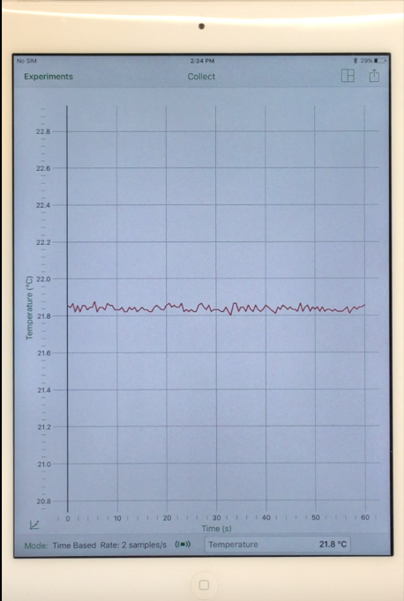
iPad and Probes (Temperature, pH, Conductivity, DO)
Press here to view your data as a graph, table, or meter
Press here to share your data with classmates
4) Collecting data continued
You can also customize the graph by selecting the little graph icon above “Mode”. You can add lines to the graph, as well as other options.
You can share your data with classmates or others by pressing the box with arrow icon in the top right corner.
Airdrop is an easy way to share data between iPads but you will need to change the view to a table before sharing. Emailing is also a convenient way to share.
Watch a video tutorial of collecting data here: https://youtu.be/3f1PkboT5PM
Press Collect to begin your data collection and Stop to end it. You may also need to select ”Keep,” which will also appear up here, in order to collect event based data points.
Press here to customize your graph
Press here to change how you collect the data (time or event based)

Slide 31
PASCO
We will also have the pleasure of using PASCO probes for data collection.
Familiarize yourself with the app and probes here: https://www.pasco.com/sparkvue/

Slide 32
If you have any questions about the instruments or protocols, please email me at barfield@ucar.edu.

