Slide 1

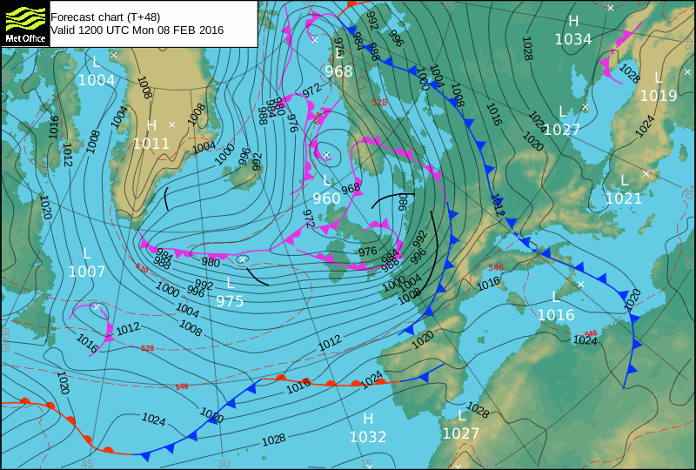
Protocol Training Slides for:
Barometric Pressure

Slide 2
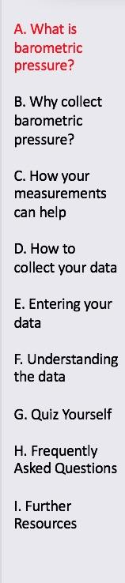
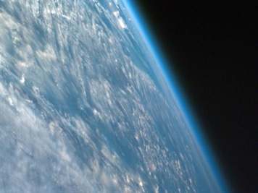
The Atmosphere
Extremely thin blanket of air extending about 300 miles from Earth’s surface to edge of space
Composition of molecules of nitrogen, oxygen, argon, water vapor, carbon dioxide, and other gases
Protection from the blasts of radiation emanating from the Sun
Image: NASA

Slide 3
This Module
Overview
This module
Describes how to take barometric pressure observations
Provides instructions on how to enter your data on the GLOBE website
Learning Objectives
After completing this module, you will be able to
Describe what barometric pressure is
List reasons why it is important to collect barometric pressure data
Determine the correct locations to take barometric pressure readings
Upload data to GLOBE website
Visualize data using GLOBE Visualization Site and formulate your own questions about weather
Estimated time to complete module: 1 hour

Slide 4
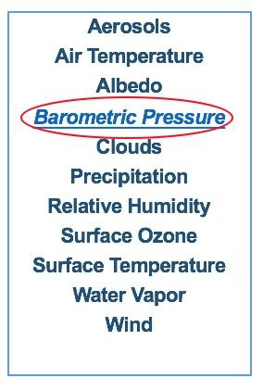
Barometric Pressure
Measures the weight of the atmosphere per unit area
Is the weight (force) of the air pushing on each unit of surface area on the ground
Increase or decrease indicates upcoming weather change
High pressure generally brings fair weather, and low pressure is associated with “bad weather”
Link to Barometric Pressure Protocol here

Slide 5
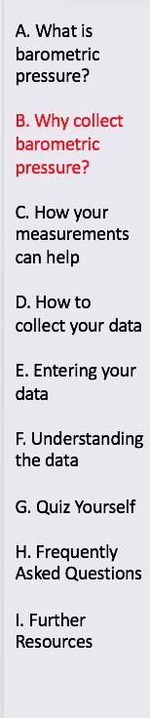
Recording barometric pressure is important for many reasons:
Used to predict the weather
Used to interpret measurements of aerosols, ozone, and water vapor

Slide 6
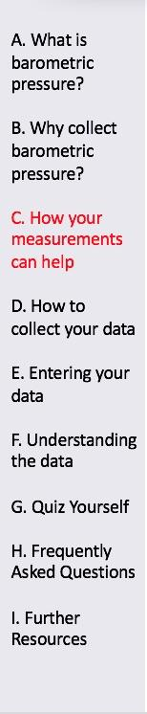
Your observations are valuable contributions to the scientific community and may be used by educators, students, researchers, and the general public to increase environmental awareness and STEM literacy, as well as advance Earth system science. Specifically, they can help the scientific community
Understand and predict the weather (air temperature, rain, relative humidity, cloud conditions, atmospheric pressure)
Understand Atmospheric Composition (trace gases and particles in the air)
Interpret aerosols, ozone, and water vapor measurements

Slide 7
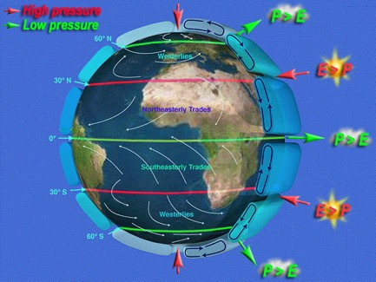
How Precipitation and Evaporation Relate to Barometric Pressure
Studying the relationship of ocean salinity and atmospheric pressures which vary on Earth.
Image illustrates the pattern of atmospheric pressures on Earth. Atmospheric pressure highs are at the poles, 30°N and 30°S. Atmospheric lows are along the equator, 60°N and 60°S.
Cloudiness and precipitation (P) dominate bands of low pressure. At these latitudes, world's rainforests are located. Dryness and evaporation (E) dominate bands of high pressure. At these latitudes, deserts are located.
E – Evaporation; P – Precipitation
Image: University of Maine, Aquarius

Slide 8
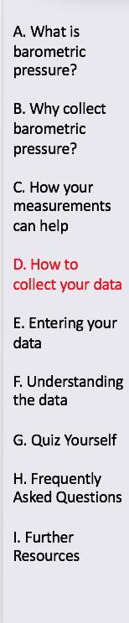
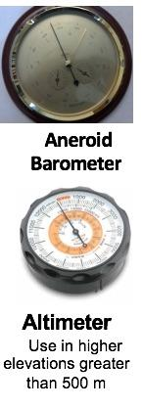
Protocol at a Glance
Instruments | Aneroid Barometer or Altimeter
Barometric Pressure Data Sheet | or Atmosphere All Protocols Data Sheet
When | Preferably, within one hour of local solar noon
Where | Classroom Wall at eye level
Other | Log book for data collection; Computer with internet connection to enter data

Slide 9
Calibrating your Instrument: Aneroid Barometer
Calibration of Aneroid Barometer
Inspect your barometer; it will most likely have two different scales, one in millibars (or hectopascals) and one in millimeters (or centimeters) of mercury. All of your measurements for GLOBE should be taken in millibars or hectopascals (remember, these are equivalent).
Find a local reliable weather information source, which provides measurements of pressure. Compare to see if the readings are the same. Once you have obtained an accurate sea level pressure reading in millibars or hectopascals, reset your barometer to this pressure reading using a small set screw on the back of the barometer (this should only be done by the teacher!).
There is a needle that can be set to the current reading each day – you should do this each day after you take your pressure reading.
When you take tomorrow’s reading, your barometer’s set needle will read yesterday’s value, and you can instantly compare to see whether pressure is higher or lower now than the day before!
Calibrate every 6 months.

Slide 10
Calibrating your Instrument: Altimeter
Calibrating the Altimeter
Most likely already calibrated by the factory.
Pick a location where you know the altitude from a reliable source and check the setting. If different, set the altitude.

Slide 11
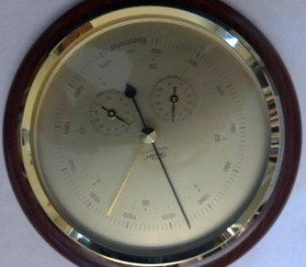
Collecting Data-1
Read the barometer to the 0.1 millibar using the black arm. This barometer reads 1006.2 mb.
For this location, the pressure has dropped over the last 24 hours.

Slide 12

Collecting Data-2
Collect data daily, preferably within one hour of local solar noon. Record the time (local or UTC) and date on the Barometric Pressure Data Sheet.
Tap gently on the glass cover of the aneroid barometer to stabilize the needle.
Read the barometer to the nearest 0.1 millibar (or hectopascal).
Record this reading as the current pressure.
Set the “set needle” to the current pressure.

Slide 13
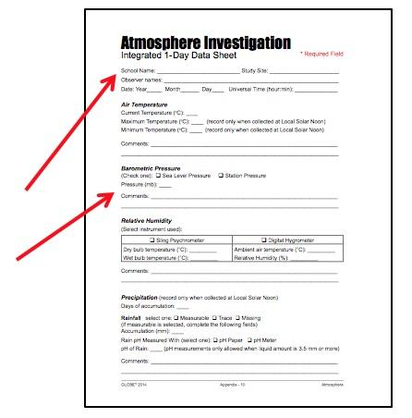
Data Sheet
Enter the data on the Barometric Pressure Data Sheet or Atmosphere All Protocols Data Sheet.
Be sure to fill out the top: School Name, Study Site, Observer Names, Date and Time (local or UTC)
Barometric Pressure Data Sheet
Atmosphere All Protocols Data Sheet

Slide 14
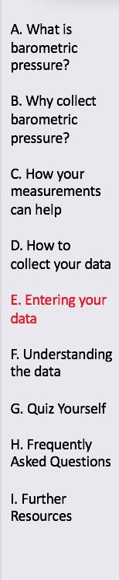

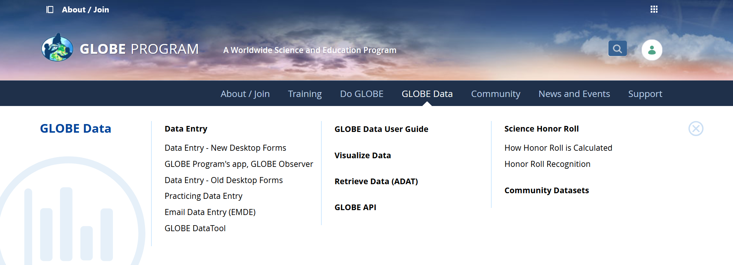
Entering Barometric Pressure in the GLOBE Observer Data Entry System
Two Options for Uploading Data:
These methods all allow users to submit environmental data – collected at defined sites, according to protocol, and using approved instrumentation – for entry into the official GLOBE science database.
Download the GLOBE Observer mobile app from the App Store.
Data Entry: Visit globe.gov, click on the “GLOBE Data” tab, then underneath “Data Entry” click on “Data Entry – New Desktop Forms”.
Note 1: You will need a GLOBE teacher, trainer, or scientist account to submit GLOBE data.
Note 2: It may take some time after you enter your data for it to appear in the GLOBE data visualization system.

Slide 15

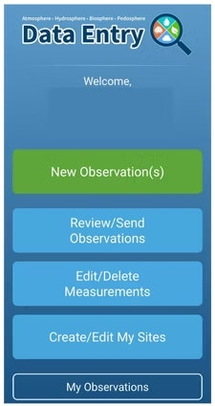
The steps below will walk you through entering your Atmosphere Study Site Information in the GLOBE Observer App, which you can access using your GLOBE or GLOBE Observer login.
2. Click "Create/Edit My Sites"
1. Click “Data Entry”

Slide 16
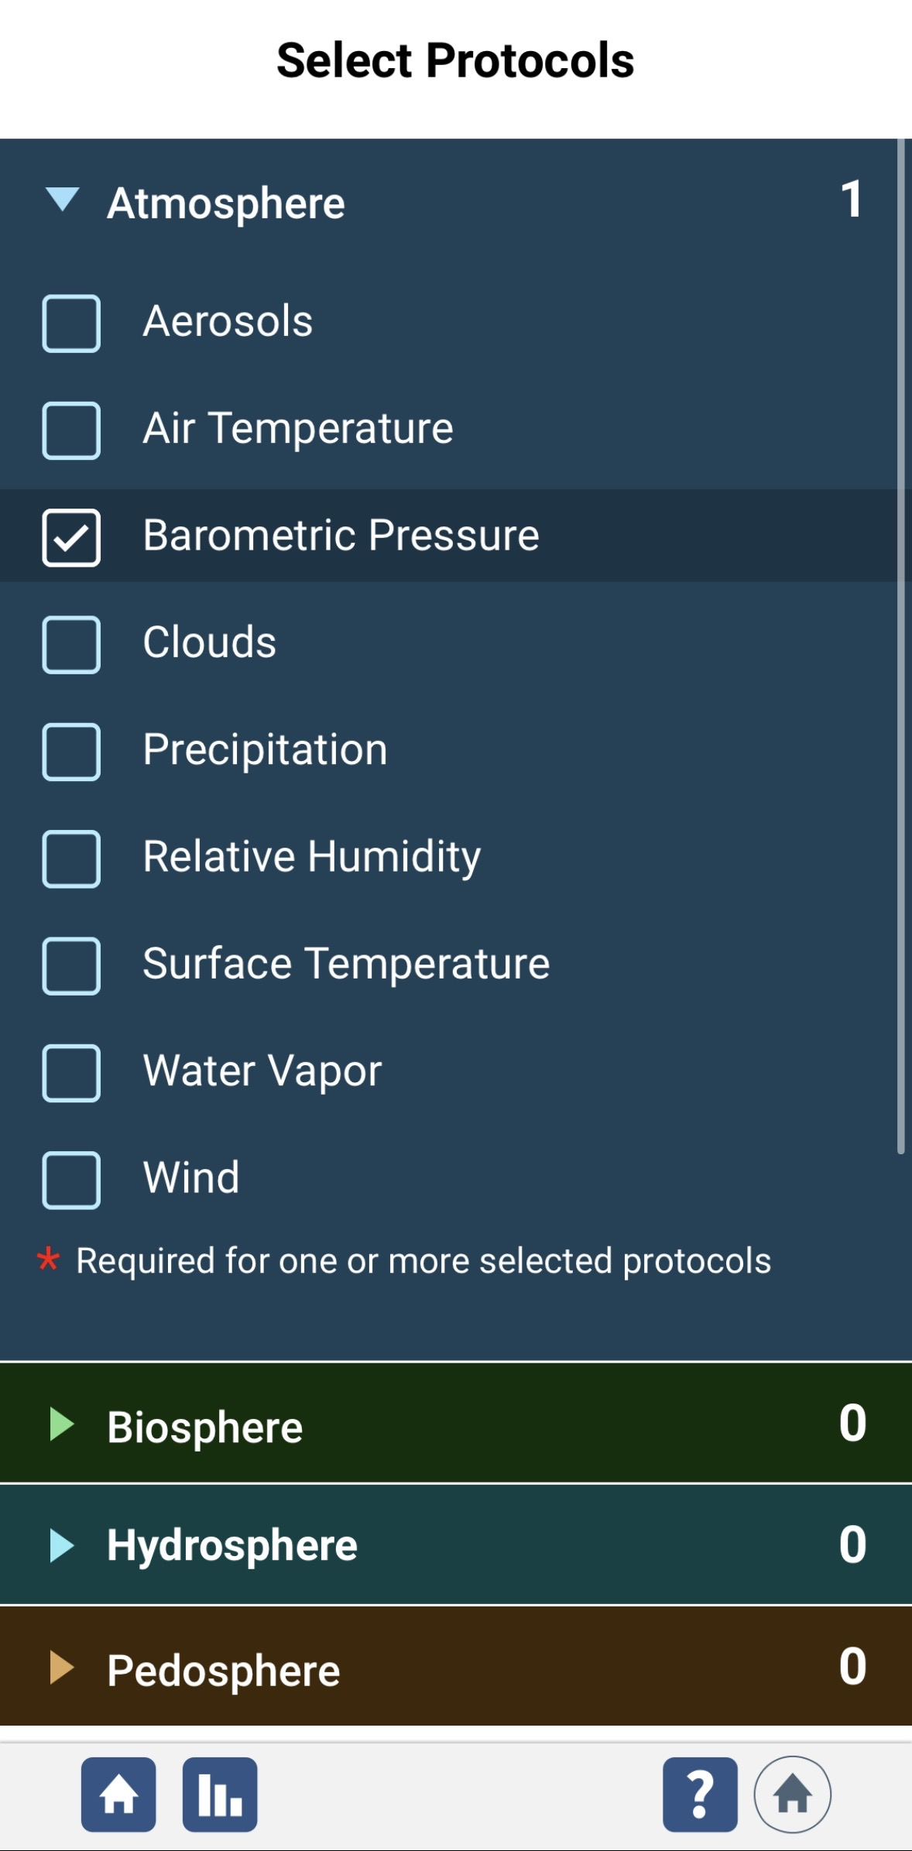
3. Click on the arrow next to "Atmosphere" and select “Barometric Pressure“. The other necessary protocols will be automatically selected.

Slide 17
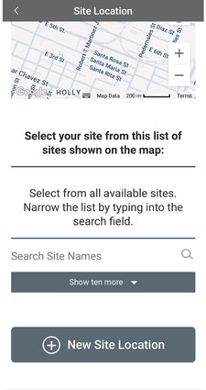
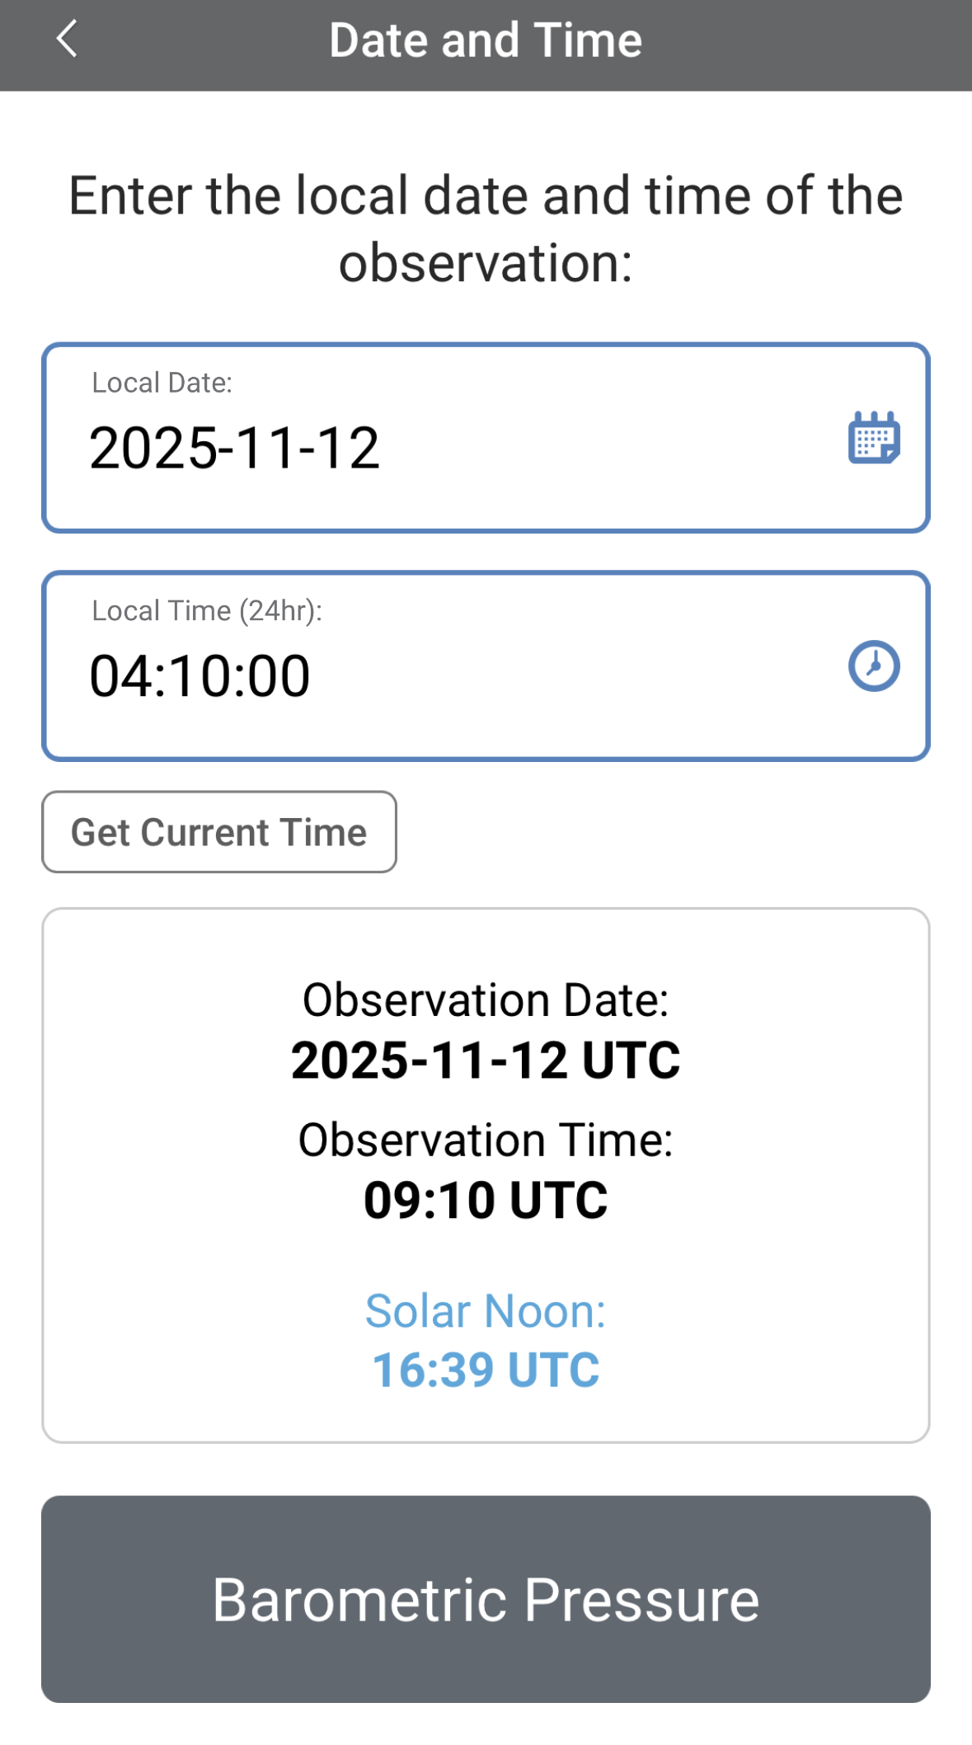
4. At the bottom of the screen, click “Continue”. When prompted, enter site location details (latitude, longitude, and elevation). Choose an existing site or identify a new site by clicking “+ New Site Location”
5. Check to see if the “Date and Time” are correct, if it is not, click
“Get Current Time” to update it. Then click “Barometric Pressure” to move on

Slide 18
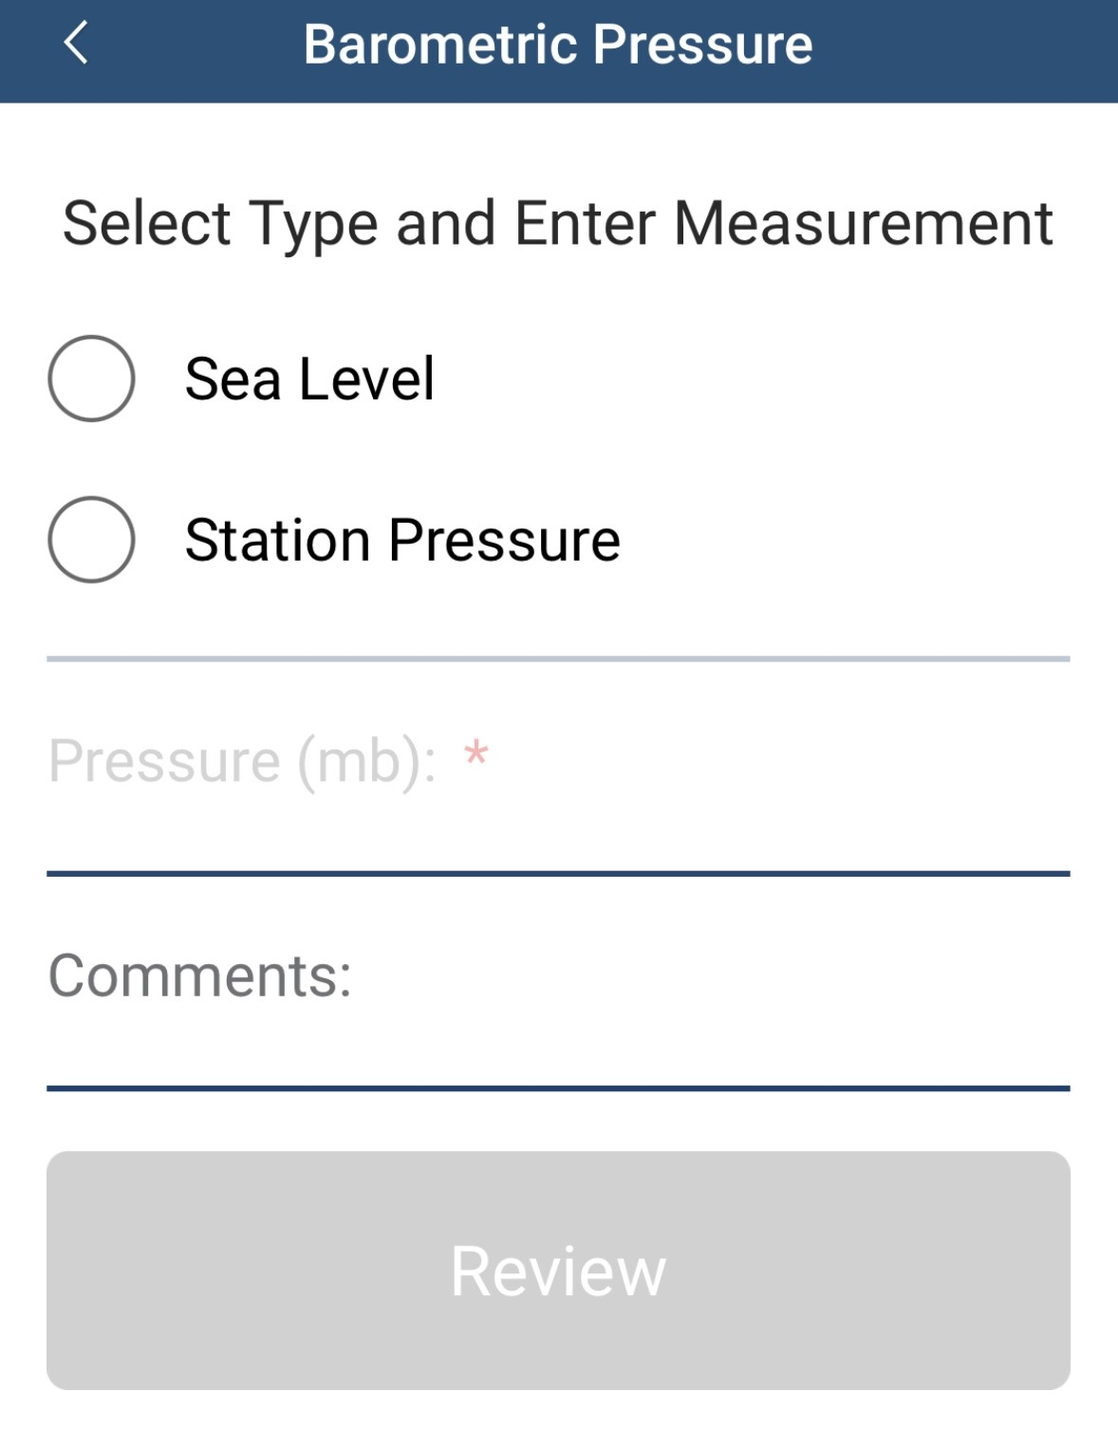
12) Enter Barometric Pressure type and measurement details. Then click “Review” to view your observation summary, and then click “Finish” to submit the observation

Slide 19
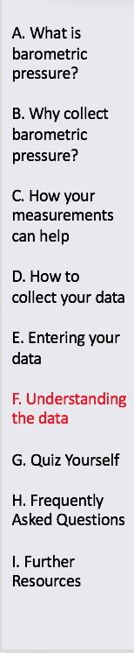
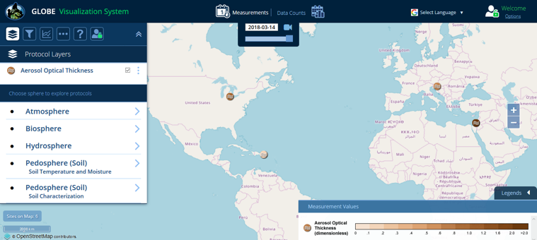
Visualize and Retrieve Data
GLOBE provides the ability to view and interact with data measured across the world. Select our visualization tool to map, graph, filter and export data that have been measured across GLOBE protocols since 1995.
These step-by-step tutorials on using the visualization system will assist you in finding and analyzing data: PDF version PowerPoint version
http://vis.globe.gov/GLOBE/

Slide 20
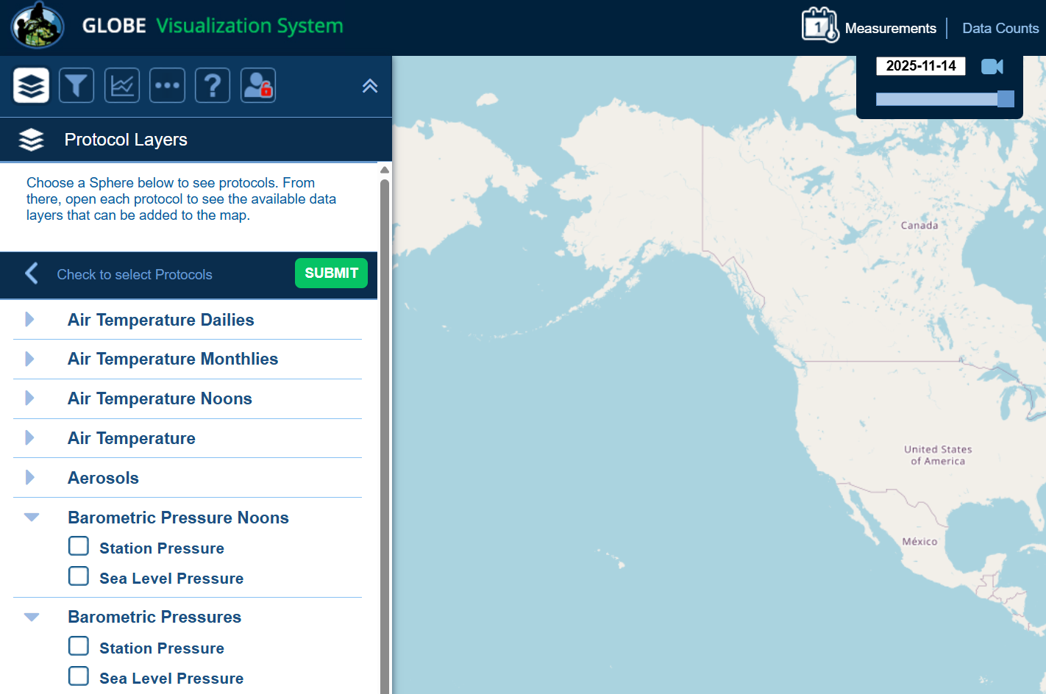
Visualize and Retrieve Data
Select the date for which you need data, add the protocol layers, and you can see where data is available.

Slide 21
Questions for YOU to Investigate
After recording your pressure readings for a month, make a graph of your pressure observations and also plot the daily precipitation. Do you see a relationship between these observations?
Is there any relationship between your data from the Cloud Protocols and barometric pressure?
Use pressure data from several GLOBE schools adjusted to sea level pressure to see if you can locate where high and low pressure areas are for a given day. How well do your findings compare with weather maps from your local newspaper or any other source?

Slide 22
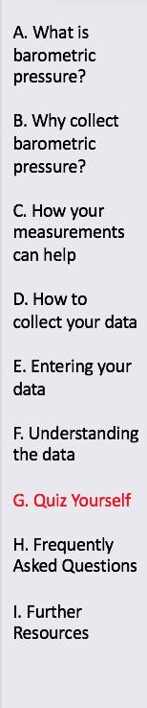
What have YOU learned?
What is barometric pressure?
Why is it important to collect barometric pressure data?
What instrument(s) is/are needed to collect barometric pressure data?
Where can I purchase the instrument(s)?
Where should I take my barometric pressure measurements?
What data do I need to collect?
How do I submit my data to GLOBE?
What can I do with the data submitted to GLOBE?

Slide 23
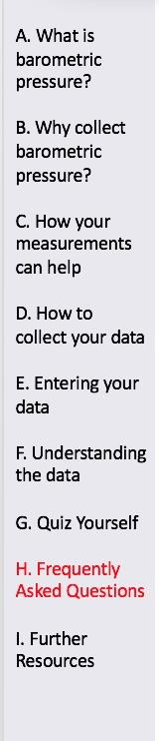
FAQs 1
If we missed reading the barometric pressure for a day or more (over the weekend, holiday, vacation, etc.), can we still report the pressure today? Yes, you are only reporting today’s pressure, so please report it as often as possible.
2. I really don’t understand the difference between barometric station pressure and sea level pressure.
Since weather stations are spread all over the world at many elevations, and since pressure decreases rapidly with elevation, meteorologists need a way to map horizontal pressure patterns using a constant reference altitude. The easiest way to do this is to convert all observed pressure values to sea level pressure. In GLOBE, barometric pressures are reported as sea level pressures but can be accessed and visualized as either sea level or station pressures, as the database is capable of making corrections to compensate for elevation changes.
3. Why do we have to reset the “set needle” each day?
The set needle is used to identify the previous pressure reading. Using it, you can instantly compare the current pressure reading to the previous one. For example, if the pressure is lower today than yesterday, you might ask yourself if the weather is stormier?

Slide 24
FAQs 2
  6. How accurate are these pressure readings, compared to those that might be taken with mercury barometers? Today’s aneroid barometers are not as accurate, in general, as well-made mercury barometers. There are some electronic barometers that have very accurate measurements, but the relatively inexpensive instruments that meet GLOBE specifications have all the necessary accuracy for our pressure measurements (about 3 to 4 mbar).
  7. Why does pressure always decrease with height in the atmosphere? Because pressure is a measure of the mass of the atmosphere above you (air does have mass!), as your elevation increases, there is less air above you, so pressure is less.
  8. Why do high altitude GLOBE schools have to use an altimeter?
  Most aneroid barometers are designed to be used near sea level. Altimeters are special aneroid barometers designed to be used at higher altitudes (including aircraft). At an altitude of 500 m above sea level, we would expect atmospheric pressure to be no greater than 1000 mbar and down to as low as 900 mbar for intense storms. Most aneroid barometers, however, have 950 mbar as the lowest possible measurement.

Slide 25
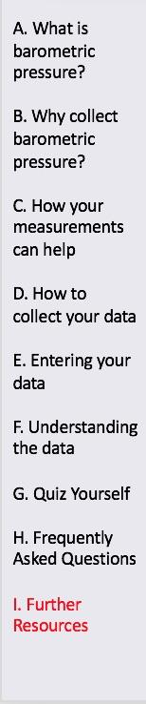
Further Resources
  GLOBE Learning Activities
  My NASA Data
  Information on purchasing GLOBE supplies

Slide 26


We want your feedback!
Please provide us with feedback about this module. This is a community project and we welcome your comments, suggestions and edits!
Do you have questions? help@nasaglobe.org
Credits:
Power point Developers:
Kevin Czajkowski
Janet Struble
Mikell Lynne Hedley
Sara Mierzwiak
Photos unless otherwise identified:
Kevin Czajkowski
Funding Provided by NASA
Version 04/10/26. If you edit and modify this slide set for use for educational purposes, please note “modified by (and your name and date)“ on this page. Thank you
Modified by GLOBE Implementation Office – Science, Training, Education and Public Engagement

