Slide 1


Clouds Protocol
Featuring Satellite Comparison
Read the module content and take the test that follows to earn the GLOBE Atmosphere: Clouds certificate.

Slide 2
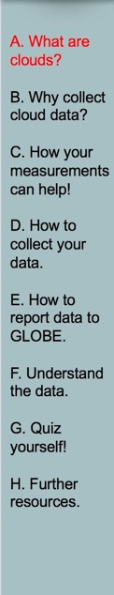
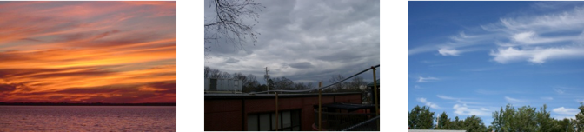
Clouds and Satellite Comparison
“We seek to remind people that clouds are expressions of the atmosphere’s moods, and can be read like those of a person’s countenance.”
Manifesto of the Cloud Appreciation Society
https://cloudappreciationsociety.org/manifesto/

Slide 3
Overview
This module…
Provides a step by step introduction to the protocol method
Reviews the selection of a GLOBE Atmosphere site
Explains how to make a cloud observation and report it to GLOBE
Introduces satellite comparison data

Slide 4
Learning Objectives
After completing this module, you will be able to:
Explain what clouds are and how they form
Explain why clouds are an important element of the Earth system
Explain why cloud observations are important for understanding our changing Earth System
Identify a clouds study site and take observations of the sky
Upload data to the GLOBE database
Compare corresponding satellite data to ground cloud reports
Visualize data using GLOBE’s Visualization System
Develop ideas for questions and investigations you can address using cloud observations and incorporate satellite data when applicable
Estimated time to complete module: 2 hours

Slide 5
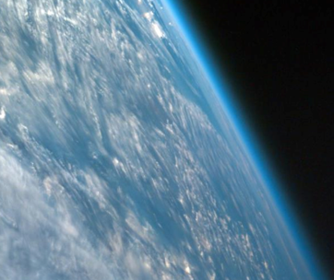
The Atmosphere
The Earth's atmosphere is an extremely thin sheet of air extending from the surface of the Earth to the edge of space. The Earth is a sphere with a roughly 13,000 km diameter; the thickness of the atmosphere is about 100 km.
In this picture, taken from a spacecraft orbiting at 300 km above the surface, we can see the atmosphere as the thin blue band between the surface and the blackness of space. If the Earth were the size of a basketball, the thickness of the atmosphere could be modeled by a thin sheet of plastic wrapped around the ball!

Slide 6
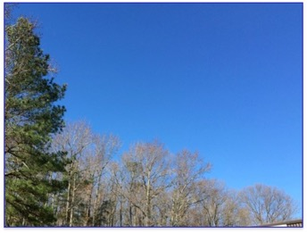
Where Do Clouds Come From?
Water in the atmosphere exists in three main phases (solid, liquid, and gas). It changes phase depending on temperature and pressure. Like most other gases that make up the atmosphere, water vapor is invisible to the human eye.
Unlike most other gases in our atmosphere, under the right conditions water vapor can change from a gas into solid particles or liquid drops.
Though we cannot see it, there is still water (vapor) present in a clear blue sky.

Slide 7
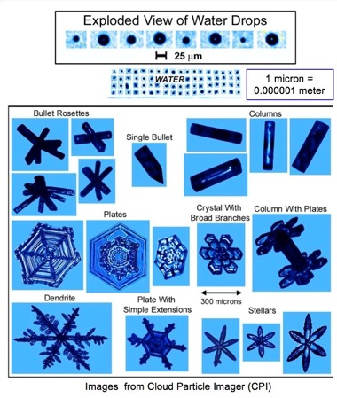
How do Clouds Form?
If temperatures are above freezing, water vapor will condense onto small particles (dust, smoke, salt, etc.) in our atmosphere, as water droplets. The small particles are known as cloud condensation nuclei (CNN). Without them clouds would not form above -40°C.
If temperatures are below freezing, as they are at high altitudes, tiny ice crystals will mostly form instead.

Slide 8
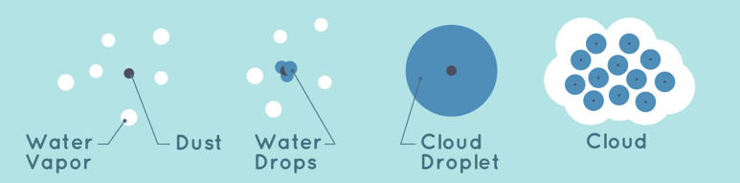
Key Factors for Cloud Formation
Clouds form from water in the sky. Water vapor is always in the sky in some amount but is invisible. Clouds form when an area of air becomes cooler until the water vapor there condenses to liquid form. At that point, the air is said to be "saturated" with water vapor. The air where the cloud forms must be cool enough for the water vapor to condense. The water will condense around things like dust, ice or sea salt - all known as condensation nuclei. The temperature, wind and other conditions where a cloud forms determine what type of cloud it will be.

Slide 9
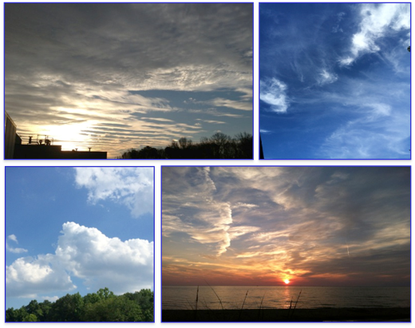
What are Clouds?
When a large number of water drops or ice crystals are present, and they scatter enough light for us to see them, they form visible clouds.
At any given time, over half of Earth’s surface is covered by clouds.

Slide 10
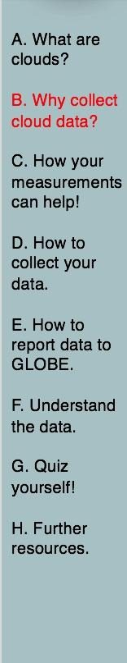
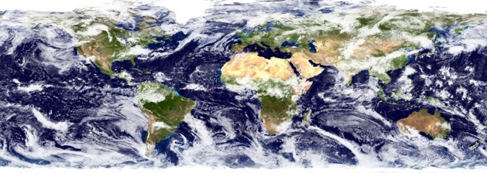
Why Collect Cloud Data?
One of the most interesting features of Earth, as seen from space, is the ever-changing distribution of clouds. They are as natural as anything we encounter in our daily lives. As they float above us, we hardly give their presence a second thought. And yet, clouds have an enormous influence on Earth’s energy balance, climate, and weather.
Even small changes in the abundance, location, or cloud type can impact Earth’s climate and weather. This is why collecting data on clouds is important.

Slide 11
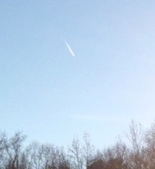
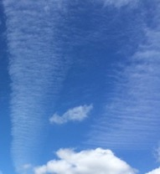
Clouds and Weather
Clouds can help us predict weather. Clouds can also tell us something about air temperature, water, and wind up in the sky. During the day a cloudy sky will make the temperature cooler. At night a clear sky will make temperatures cooler. Clouds also bring us rain.
Dry air aloft
Moist air aloft, wind perpendicular to contrail

Slide 12
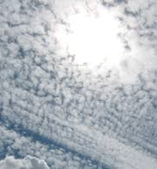
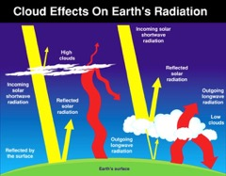
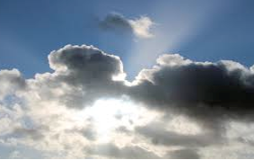
Clouds and Earth’s Energy Budget
Clouds also affect how much sunlight is reaching the ground and how much heat is escaping back to space. Understanding the clouds helps us better understand climate.
Clouds are the key regulator of the planet’s average temperature. Some clouds contribute to cooling because they reflect some of the Sun’s energy – called solar energy or shortwave radiation – back to space. Other clouds contribute to warming because they trap some of the energy emitted by Earth’s surface and lower atmosphere – called thermal energy or longwave radiation.

Slide 13

Clouds and Earth’s Energy Budget (2)
The color of the arrows represent the type of radiation. Yellow represents radiation from The Sun (solar shortwave). Red represents heat (outgoing longwave) radiation leaving the Earth. The thickness of the arrows represent amount.
For example, for low clouds (right side of the diagram), the yellow arrow is thicker on the top of the cloud than at the bottom. A larger fraction of the sunlight gets reflected and a small amount makes it to the ground. We see this as shadows casted by low clouds.

Slide 14
Clouds and Earth’s Energy Budget (3)
Different types of clouds have varying impacts on Earth’s energy budget. For example, low, thick clouds (e.g., stratocumulus clouds) are opaque and do not let as much solar energy reach the Earth’s surface, which tends to have a net cooling effect on the Earth. High, thin clouds (e.g., cirrus clouds) are transparent and allow shortwave radiation through to the surface of Earth to produce a net warming effect.
The thickness, altitude, and cover of clouds can affect how bright or dark days will appear.

Slide 15
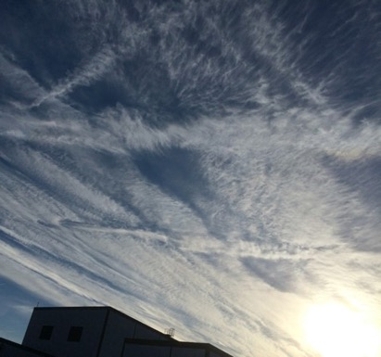
Importance of Contrail Data
Contrails, or condensation trails, are the linear clouds formed when a jet aircraft passes through a portion of the atmosphere having the right moisture (humidity) and temperature conditions. The relationship between contrails and clouds is a current investigation area for scientists.

Slide 16
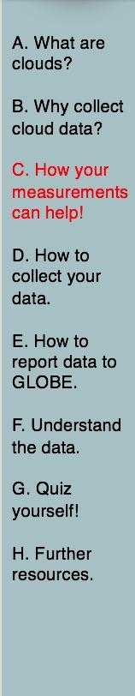
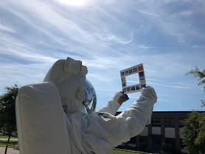
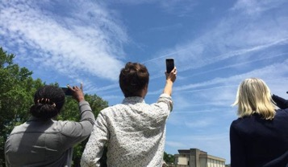
Your Measurements Contribute to Science
Your observations are valuable contributions to the scientific community and may be used by educators, students, researchers, and the general public to increase environmental awareness and STEM literacy, as well as advance Earth system science.

Slide 17
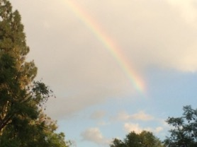
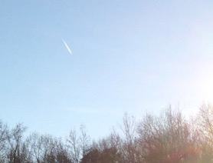
Your Measurements Can
Help Scientists
Understand how cloud climatology may be changing
  Human observers can identify qualitative aspects (e.g. cloud type clues) that automated sensors cannot.
Provide ground-based data on contrails
  Human observers can see small features (e.g. short-lived contrails) that are not visible from satellites.

Slide 18
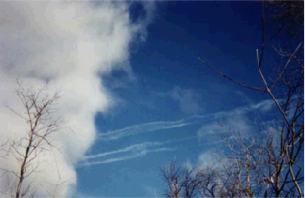
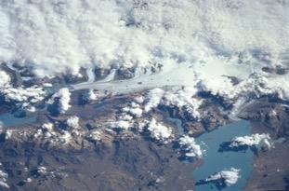
Your Measurements Can
Help Scientists
Verify and improve automated remote sensing.
Improve interpretation of satellite observations of Earth’s energy balance.
From the bottom: Blue sky provides great contrast
From the top: Varied surface confounds detection
Hint: Observations timed to coincide with satellite imagery provide useful comparisons, for scientists, and for you!

Slide 19
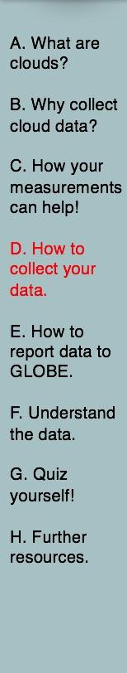
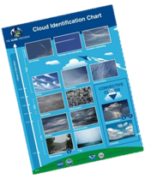
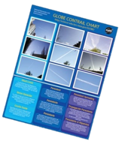
Equipment and Documents Needed 1
Instrument | You are the instrument (eyes)
References | GLOBE cloud chart and contrail ID chart (English/French/Spanish) (Russian/Chinese/Arabic)
When | Good: Any time Better: Within one hour of local solar noon Best: Corresponding to satellite observation (within +/- 15 minutes of orbiting satellites)
Where | A good observation site (See the Documenting Your Atmosphere Study Site Field Guide)

Slide 20
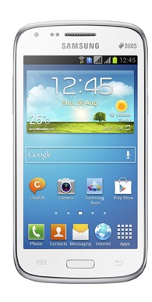
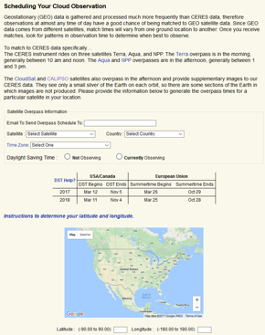
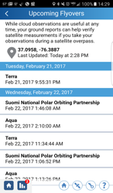
Equipment and Documents Needed 2
Align your ground report to corresponding satellite data by accessing satellite overpass times on the NASA Cloud Satellite Portal or the free NASA GLOBE Observer App.
The GLOBE Cloud protocol includes satellite comparison support. Access satellite overpass times for your observation site by entering your credentials. An overpass schedule will be available on the website and emailed to your inbox.
From the home screen of the GLOBE Clouds app, select the orange button titled “Check Satellite Flyovers”.
Note: Geostationary (GEO) satellites are focused over one section of the Earth’s surface, scanning a designated area, and GEO data is processed more frequently than CERES. That is why observations at almost any time of day have a good chance of being matched. For those reasons, GEO satellites are not included on overpass schedules.

Slide 21
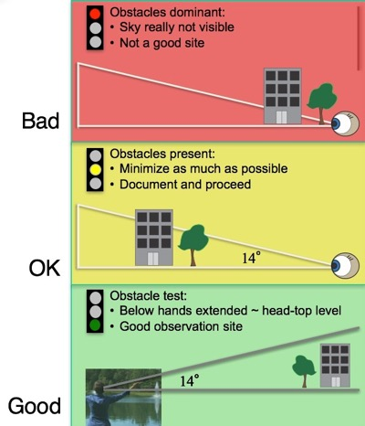
Site Selection
What Makes a Good Site?
Observe from location that provides the most unobstructed view of the sky.
Best to observe from a consistent location each time.
Reminder: Define a new site within your GLOBE profile (online or on the mobile apps) if you are in a different location.

Slide 22


How to Observe: Introduction
Look at the sky in every direction above 14°.
This is a good observation to do with a small group (each can take a quarter of the sky) although individuals can do it also.
Cloud identification is an art; you will get better with practice.
The most important step is the first and easiest: observing “What is in Your Sky”
  No Observable Clouds
  Observable Clouds
  Or the view of your sky and clouds is obscured
NEVER look at directly at the Sun!
This photo shows observers estimating 14 degrees above the horizon by placing their hands in a “V” at about head height. The area between their hands, above them, is their observation area. Any clouds below this angle, found in the horizon, should not be reported.

Slide 23
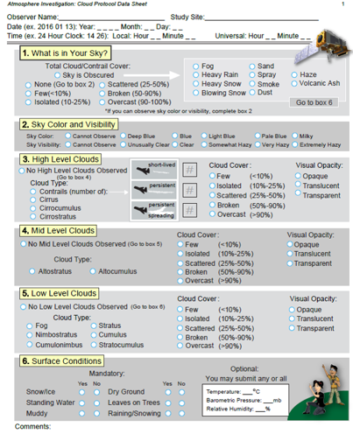
How to Observe: The Data Sheet
Walk through the GLOBE Cloud Data Sheet:
Record date, time, and location.
Observe total sky conditions, if applicable.
On high, mid, and low levels define cloud type, cloud cover, and cloud visual opacity.
Conclude your report with surface condition observations.
Cloud Data Sheet

Slide 24
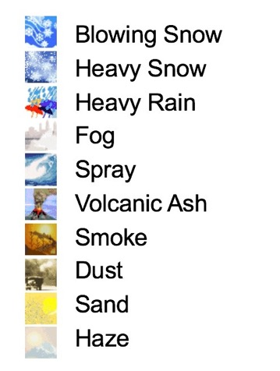
How to Observe: Obscuration
Identify an obscuration if you can not see the sky.
If more than 1/4th of the sky is obscured by one of these options, record and report the reason on the data sheet.
Note: If your sky is blocked by buildings or trees, do not record it as an obscuration, please look for a more open observation site.

Slide 25
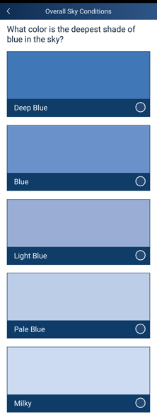
How to Observe: Sky Color
Sky color is an indication of the amount of aerosols in the atmosphere. Aerosols tend to scatter all wavelengths of light, making the sky look more white. Deep blue suggests very few aerosols. A milky sky suggests there are lots of aerosols.
Goal: to observe the bluest part of the sky.
Note: Sky color can only be observed from a clear section of sky, with no clouds in view.
Tips:
Turn your back to the Sun.
Look at the sky halfway between the horizon and straight up (45°).
Pick the shade that most closely matches your sky.
You want to match the color of the sky, not the clouds, so if it’s too cloudy you may not to be able to observe sky color.

Slide 26
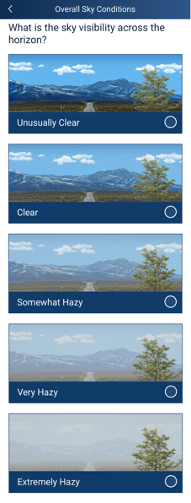
How to Observe: Sky Visibility
Sky visibility is an indication of the amount of the aerosols close to the surface of the ground. The more aerosols there are, the hazier it will appear.
Look at a landmark in the distance.
Try to use the same landmark every time.
Tip:
It can be helpful to take a picture of your sky day-to-day to notice the difference between visibility observations. In addition, the clearest sky for your area will be seen just after a front or a storm moves through your area.

Slide 27
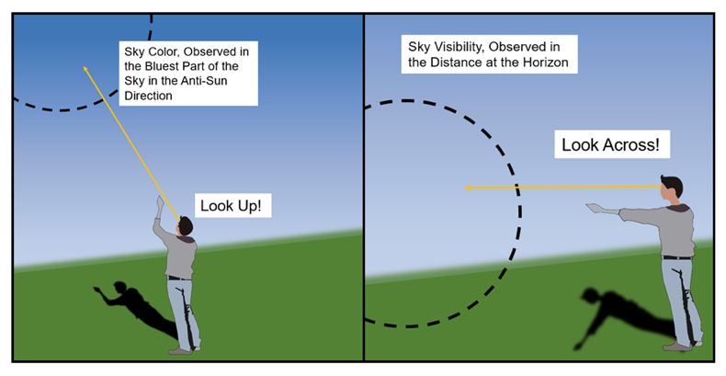
How to Observe: Sky Conditions
Tip:
Here’s a good reminder for the difference between observing sky color and sky visibility, and where to look as you observe each.

Slide 28
How to Observe: Cloud Details at Each Height
At each level (high, mid, and low) observers will identify the following:
Cloud Type(s)
Cloud Cover
Cloud Visual Opacity
Contrails are reported in the high cloud section.
Factors such as where the cloud is with respect to the Sun, it’s altitude and thickness, and total cloud cover impacts can make some days seem darker.

Slide 29
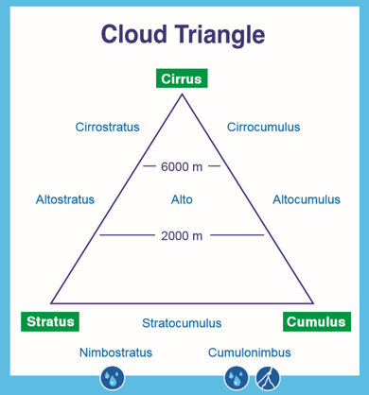
How to Observe: Cloud Type
Clouds can be defined according to:
Their shape
The cloud base altitude
Whether they are producing precipitation
The Cloud Triangle is a useful memory device.

Slide 30
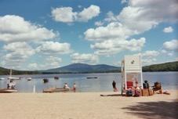
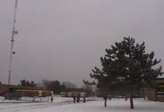
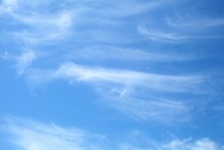
How to Observe: Cloud Type by Shape
3 main cloud shapes are:
Cumulus (Puffy): Made of water, cumulus clouds can be associated with fair weather. They are usually not very tall and they are separated from each other with lots of blue sky in between.
Stratus (Layered): Made of water. These clouds can be found from Earth’s surface to 2,000 m high. When you see the Sun’s disk through them, the edges look sharp.
Cirrus (Wispy): Made of ice crystals and are considered “high clouds”, forming above 6,000m. They generally indicate fair to pleasant weather. The reason for the long tail is primarily due to high speed winds at high altitudes.

Slide 31






How to Observe: Cloud Cover
You will estimate the total cloud cover of the whole sky and at each level (high, mid, and low levels).
It may be helpful to divide the sky in 4 quadrants (North, South, East, and West) and estimate cloud cover in each, then take the average to get the whole sky value.
Tip:
Observe the sky overhead, excluding the horizon. This can be done by:
observing above 14°,
or holding your arms out in a “V”, hands even with the height of the top of your head, and observing between your hands,
or holding your fist out at arm’s length, even with the horizon; putting your second fist on top of the other; observing the sky from above the top of your second fist.
No Clouds (0%)
Few
(0-10%)
Isolated
(10-25%)
Scattered
(25-50%)
Broken
(50-90%)
Overcast
(>90%)

Slide 32



How to Observe: Visual Opacity
Tip:
If your shadow is well defined, a lot of sunlight is getting through the cloud above you, so the cloud’s visual opacity would be transparent. As your shadow becomes more fuzzy, the cloud would be considered more opaque.
Transparent: Thin clouds through which light passes easily, and through which you can even see blue sky. Note the milky bluish-whitish appearance.
Translucent: Medium-thickness clouds that let some sunlight through. There may be some milky bluish-white near the edges, and a very little bit of gray; but these clouds are mostly a bright white.
Opaque: Thick clouds which do not allow light to pass directly, although light can diffuse through them. Clouds look gray. When these clouds are in from of the Sun, it is impossible to tell where the Sun is.
Transparent
Translucent
Opaque

Slide 33
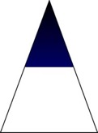
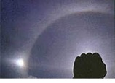
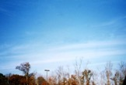
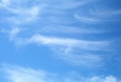
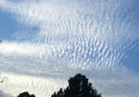
How to Observe: High Level Clouds
NEVER look directly at the Sun!
High Clouds are those whose base are at 6,000m or above. Types include cirrus, cirrocumulus, and cirrostratus. The clouds can be either ice or water droplets, but are more often ice crystals. Water clouds tend to have definite edges, while ice clouds are more wispy. Contrails (airplane trails of moisture) are high clouds as well.
Cirrostratus with Halo
Cirrostratus
Cirrus
Cirrocumulus

Slide 34
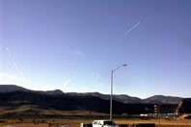
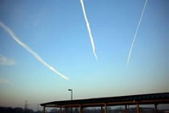
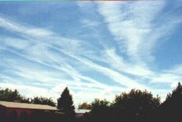

How to Observe: Contrails
Count the number of each type; remember to report 0 if no clouds are present
Short-Lived:
Contrails that form short line segments that fade out as the distance from the airplane that created them increases.
Persistent Non-Spreading: Remain long after the airplane has left the area. They form long, generally straight lines of constant width across the sky. These contrails are no wider than your index finger, held at arm’s length.
Persistent Spreading: Remain long after the airplane has left the area. They form long streaks that have widened with time since the plane passed. These contrails are wider than your index finger held at arm’s length.

Slide 35
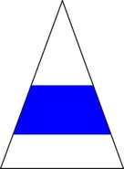
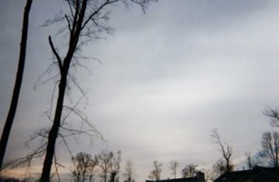
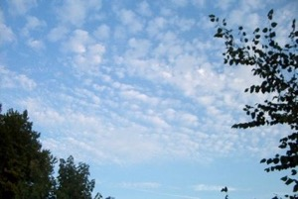
How to Observe: Mid-Level Clouds
Altostratus
Altocumulus
These are generally clouds whose base is between 2,000 and 6,000m altitude. Cloud types are altostratus or altocumulus, and are generally but not always water clouds, depending on the atmosphere’s temperature and other conditions at the cloud altitude.

Slide 36
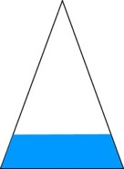



How to Observe: Low Level Clouds
Stratus
Stratocumulus
Cumulus
These are generally clouds made of water droplets whose base is below 2,000m altitude. Low cloud types include stratocumulus, cumulus, stratus, cumulonimbus, and nimbostratus. Fog can also be put in this class because it is a ground-level stratus cloud. The tops of cumulonimbus clouds can be high enough to form ice crystals.

Slide 37




How to Observe: Low Level Precipitating Clouds
From afar
From below
Nimbostratus
Cumulonimbus
Clouds that precipitate have names with nimbo prefix/suffix. Precipitation can be in any form such as rain, snow, hail, etc. Cumulonimbus clouds are known as thunderstorm clouds and are sometimes called anvil clouds because of their shape. Nimbostratus clouds often bring steady, ongoing precipitation.

Slide 38



How to Observe: Determining Level of Cumulus Clouds
Tip:
For Cumulus (puffy) clouds, use fist/thumb/pinky finger strategy to estimate cloud height.
High clouds (cirrocumulus) appear comparable in size to pinky finger held at arm’s length.
Mid-level clouds (altocumulus) appear comparable in size to thumb held at arm’s length.
Low clouds (cumulus) appear comparable in size to fist held at arm’s length. You can image fun shapes looking at these.

Slide 39



How to Observe: Determining Level Stratus Clouds
Tip:
For stratus (layered) clouds, look for clues near the Sun.
NEVER look directly at the Sun!
Cirrostratus is the only cloud type which can produce a halo around the sun or moon. The halo will have all the rainbow colors in it.
Altostratus will produce a thinly veiled Sun or moon, and will often be darker in appearance, a medium gray color. The Sun looks dimly lit behind these clouds.
Stratus will usually be very gray and often very low to the ground. They tend to cover a lot of the sky.

Slide 40

How to Observe: Cloud Type Practice and Support
Try the interactive tool found in the e-Training section under “Supporting Material”: Cloud Type Practice.

Slide 41

How to Observe: Surface Conditions and Measurements
Surface Conditions (Required): Define the surface conditions of your observation site.
Tips:
A pond would be an example of standing water.
Leaves on trees refers to the majority of the deciduous trees around your observation site.

Slide 42



Entering Clouds Data in the GLOBE Observer Data Entry System
Two Options for Uploading Data:
These methods all allow users to submit environmental data – collected at defined sites, according to protocol, and using approved instrumentation – for entry into the official GLOBE science database.
Download the GLOBE Observer mobile app from the App Store.
Data Entry: Visit globe.gov, click on the “GLOBE Data” tab, then underneath “Data Entry” click on “Data Entry – New Desktop Forms”.
Note 1: You will need a GLOBE teacher, trainer, or scientist account to submit GLOBE data.
Note 2: It may take some time after you enter your data for it to appear in the GLOBE data visualization system.

Slide 43


Entering Clouds Data
The steps below will walk you through entering your Atmosphere Study Site Information in the GLOBE Observer App, which you can access using your GLOBE or GLOBE Observer login.
2. Click "Create/Edit My Sites"
1. Click “Data Entry”

Slide 44

3. Click on the arrow next to "Atmosphere" and select “Clouds”

Slide 45


4. At the bottom of the screen, click “Continue”. When prompted, enter site location details (latitude, longitude, and elevation). Choose an existing site or identify a new site by clicking “+ New Site Location”
5. Check to see if the “Date and Time” are correct, if it is not, click
“Get Current Time” to update it. Then click “Clouds” to move on

Slide 46

6. Click the “Cloud Coverage” level that best describes your current observation

Slide 47






7a. Click on the “Overall Sky Conditions” options that best describe your current “Cloud Coverage”. There will be multiple sections to scroll through and select choices in. Below are the options that appear if you selected “Clouds or Contrails” before

Slide 48

7a.i “Clouds or Contrails” continued: After selecting “Overall Sky Conditions” you will see a screen asking you identify the cloud types. If you already know how to identify clouds, you may proceed to “Manual Cloud Identification”, otherwise, click on “Guided Cloud Identification Wizard” for a briefing on cloud identification

Slide 49



7a.i “Clouds or Contrails” continued: The Guided Cloud Identification Wizard will remind you identify all the different cloud types before showing you the “Cloud Triangle that you will reference to determine cloud height. It also shows the types of clouds likely to appear at certain altitudes.

Slide 50



7a.i “Clouds or Contrails” continued: The Guided Cloud Identification Wizard will list the way to identify clouds based on how they look. You can select multiple cloud shapes. Afterwards, you will be given the option to identify cloud coverage and opacity for each of the different levels of the Cloud Triangle by pressing “Observe”. This is not necessary to move forward with submitting the observation

Slide 51


7a.i “Clouds or Contrails” continued: To identify cloud coverage and opacity percentage, you must press and move the arrows to change the percentages. The images will give you a visual sense of what the percentage ranges represent. When you’re done, send your data to GLOBE!

Slide 52


7a.ii “Clouds or Contrails” continued: After completing the Guided Cloud Identification Wizard, you will have to select the number and type of contrails you observe.

Slide 53


7a.ii “Clouds or Contrails” continued: Please select either “No” or “Yes” depending on if the cloud’s appearance matches the one being described for rain clouds.

Slide 54



7a.ii “Clouds or Contrails” continued: Please select either “No” or “Yes” depending on if the cloud’s appearance matches the one being described for puffy clouds.

Slide 55



7a.ii “Clouds or Contrails” continued: Please select either “No” or “Yes” depending on if the cloud’s appearance matches the one being described for layered clouds.

Slide 56


7a.ii “Clouds or Contrails” continued: Please select either “No” or “Yes” depending on if the cloud’s appearance matches the one being described for wispy clouds. After this, you will have completed the cloud identification and will be taken to a review of your identified clouds.

Slide 57




7a.ii “Clouds or Contrails” continued: After completing the visual identification, you will be asked to observe Cloud Cover and Visual Opacity. After learning how to observe both, you will be instructed to make observations for the clouds that you identified previously.

Slide 58
7b. Click on the “Overall Sky Conditions” options that best describe your current “Cloud Coverage”. There will be multiple sections to scroll through and select choices in. Below are the options that appear if you selected “Clear Sky” before

Slide 59




7c. Click on the “Overall Sky Conditions” options that best describe your current “Cloud Coverage”. There will one section with multiple sections. Below are the options that appear if you selected “Obscured” before

Slide 60


8. After completing your observations of clouds, select “Yes” or “No” on the various available surface conditions that appear during your observation. At the bottom, click the “Next” button to move on

Slide 61


Visualize and Retrieve Data
GLOBE provides the ability to view and interact with data measured across the world. Select our visualization tool to map, graph, filter and export data that have been measured across GLOBE protocols since 1995.
These step-by-step tutorials on using the visualization system will assist you in finding and analyzing data: PDF version PowerPoint version
http://vis.globe.gov/GLOBE/

Slide 62

Visualize and Retrieve Data
Select the date for which you need data, add the protocol layers, and you can see where data is available.

Slide 63
Explore Data: Sample Student Research Questions - GLOBE Visualization
Do cloud patterns/parameters change during the year?
  Explore “All Cloud Types” or “Cloud Cover” layers.
Are contrails often seen in the local area? Why or why not?
  Explore various “Contrail coverage” layers.
Do the types of clouds and contrails you observe relate?
  Explore various “Cloud Types” and “Contrail coverage”.
  For further support visit the GLOBE Clouds Student Project Support webpage.

Slide 64
Explore Data: Example Student Research Questions - Further Measurements
Does the amount of the cloud cover affect the local temperature?
  Add air temperature protocols.
How reliable are local weather forecasts based on the cloud type observations alone? Can they be improved by using other GLOBE Measurements?
  Add air temperature, barometric pressure, precipitation, relative humidity, surface temperature, water vapor, or wind protocol(s).
For further support visit the GLOBE Clouds Student Project Support webpage.

Slide 65
Explore Data: Example Student Research Questions - Further Measurements (2)
Do cloud conditions and phenomena that block our view of the sky influence the types of vegetation and soil in our areas? If so, how?
  Add biometry, land cover or soil protocols.
  For further support visit the GLOBE Clouds Student Project Support webpage.

Slide 66
Explore Data: Example Student Research Questions – Outside Observations
How do the clouds you see relate to nearby mountains, lakes, large rivers, bays, or the ocean?
  Add maps or satellite imagery.
How do our cloud observations compare with satellite images of clouds?
  Explore NASA or NOAA resources.
  If there’s a satellite measurement made at the same time over your location, you’ll receive satellite imagery that you can use to explore this question.
For further support visit the GLOBE Clouds Student Project Support webpage.

Slide 67

Understand Data: Satellite Match Table
Observers will receive a satellite match email when their observation aligns to corresponding satellite data. Detailed description on how to read the satellite comparison table are found on the GLOBE Clouds website.

Slide 68

Understand Data: How to Use Your Satellite Match
When first participating in the GLOBE Cloud Protocol, reviewing the satellite comparison can be a good opportunity to reflect on your observation and consider any difficulties that you had when observing a tricky cloudscape.
Satellite comparisons can show you the difference between ground perspective and satellite views.
Satellite data received in the satellite match table can guide student research investigations and prompt further questions.
Tip: Matched satellite data is not only accessible in your email, but you can also access your comparison link within the GLOBE Data Visualization System.

Slide 69

Understand Data: Context from Satellite
From above, satellite imagery provides information about clouds and characteristics on mid and high levels that may be obscured from the ground.
With satellite imagery, you can see where your local weather fits into global patterns and phenomena.
The NASA Worldview site provides contextual information on cloud cover from the MODIS instrument on the Terra and Aqua satellites. Satellite imagery for March, 6th 2015.

Slide 70




Understand Data: Compare to Satellite Data
Satellite imagery takes some practice to interpret!
Tips:
Define colors.
Identify north.
Identify land cover.
Consider prior knowledge and geography.
Overcast
Clear
March 6th, 2015

Slide 71


Understand Data: YOUR Observations are important!
Orbiting satellites observe the Earth at similar locations and times.
Your ground-based observation can help make sense of what the satellites observe.
GLOBE Cloud observations aligned to satellite data are important because:
You expand the reach of scientists who are limited in time, number, and money.
You are contributing to a database that has been growing for over 2 decades. A long-term data set is crucial for scientists to see patterns and change over time.
You add another layer of perspective helping scientists to better understand the effects of clouds on our Earth.

Slide 72

Quiz Questions
Challenge yourself to answer these questions and check whether you have achieved the learning objectives of this module.
What are the key factors in how clouds form?
What are the 3 characteristics that define cloud type?
What factors determine if and what type of contrail will form?
What are some reasons that studying clouds are important?
If the sky is empty of clouds, should you still submit a cloud observation report?
What feature of clouds makes some days darker?
If it is raining, what two cloud types might it be? What is the difference?
What is the type of cloud you are most likely viewing if you can imagine lots of fun shapes?
What can you use to help determine cloud height?
Should you observe and report clouds all the way to the horizon?
How much of the sky needs to be obscured to report that state?
What’s an example of a question you could explore or investigate based on cloud observations?

Slide 73


GLOBE Learning Activities
Cloud Watch (pdf): Monitor clouds and weather to under the connections.
Estimating Cloud Cover - A Simulation (pdf): Try this fun activity to train your eye.
Or try a new, online version - Cloud Cover Practice.
Observing, Describing, and Identifying Clouds (pdf): Begin to learn cloud types and names.
Try the complementary interactive - Cloud Type Practice.

Slide 74


Elementary GLOBE Resources
The Cloud Protocol is easy for kids and adults of all ages! If you are working with younger students, the elementary GLOBE resources may be especially helpful.
Try the GLOBE Clouds Storybook and related learning activities:
Cloud Fun
Cloudscape
To Spread or Not to Spread
Try the GLOBE Aerosols Storybook and related learning activities:
Sky Observers
Why (not) So Blue?
See the Light
Up in the Air

Slide 75
NASA Resources
NASA Earth Observatory feature article on clouds
NASA Fact Sheet: The Importance of Understanding Clouds
Imagery from Space: Explore NASA Worldview or Visible Earth, great resources for interpreting satellite imagery.

Slide 76
You have completed the Cloud Protocol training module, featuring satellite comparisons!
If you are ready to take the Assessment Test, sign on and take the quiz corresponding to the Clouds Protocol.
You are ready to take Cloud Protocol observations and interpret satellite data! Welcome to the GLOBE Atmosphere community!
Please provide us with feedback about this module. This is a community project and we welcome your comments, suggestions and edits.
Questions about this module? Contact GLOBE: help@nasaglobe.org

Slide 77

Credits
Slides:
Dr. Lin Chambers, NASA Langley Research Center, USA
Sarah McCrea, NASA Langley Research Center, USA
Jessica Taylor, NASA Langley Research Center, USA
Russanne Low, Ph.D., University of Nebraska-Lincoln, USA
Images:
NASA Langley Research Center
More Information:
GLOBE Program
NASA Satellite Comparison Website on GLOBE.gov
NASA Global Climate Change: Vital Signs of the Planet
Version 11/12/2025. If you edit and modify this slides set for use for educational purposes, please note “modified by (and your name and date)” on this page. Thank you.
Modified by GLOBE Implementation Office – Science, Education, Training and Public Engagement

